Slide 1
HEC-FDA 2.0 – New Features
Jordan Lucas
Richard Nugent
April 2024
Notes:
Hit record

Slide 2
Objectives
Impact Areas
Hydraulic Model Direct-Import
Tabular Copy-Pasting
New Distributional Assumptions
Exporting from 1.4.3 to 2.0
Notes:
Not exhaustive
Resources at end

Slide 3
Objectives
Impact Areas
Hydraulic Model Direct-Import
Tabular Copy-Pasting
New Distributional Assumptions
Exporting from 1.4.3 to 2.0

Slide 4
Impact Areas
What is it?
  Geospatial boundary around study area
  Formerly known as a Damage Reach
What’s different?
  1.4.3 – referenced by river stations, text inputs
  2.0 – geospatial data inputs
Generated in geospatial software (e.g. ArcGIS Pro)
Delineated by common H&H and/or economic characteristics

Slide 5
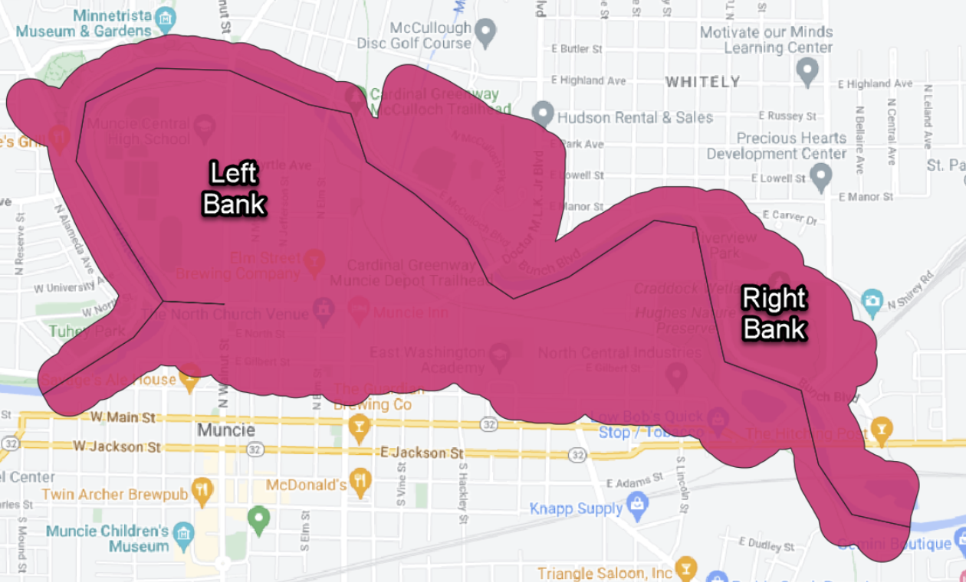
Impact Areas

Slide 6
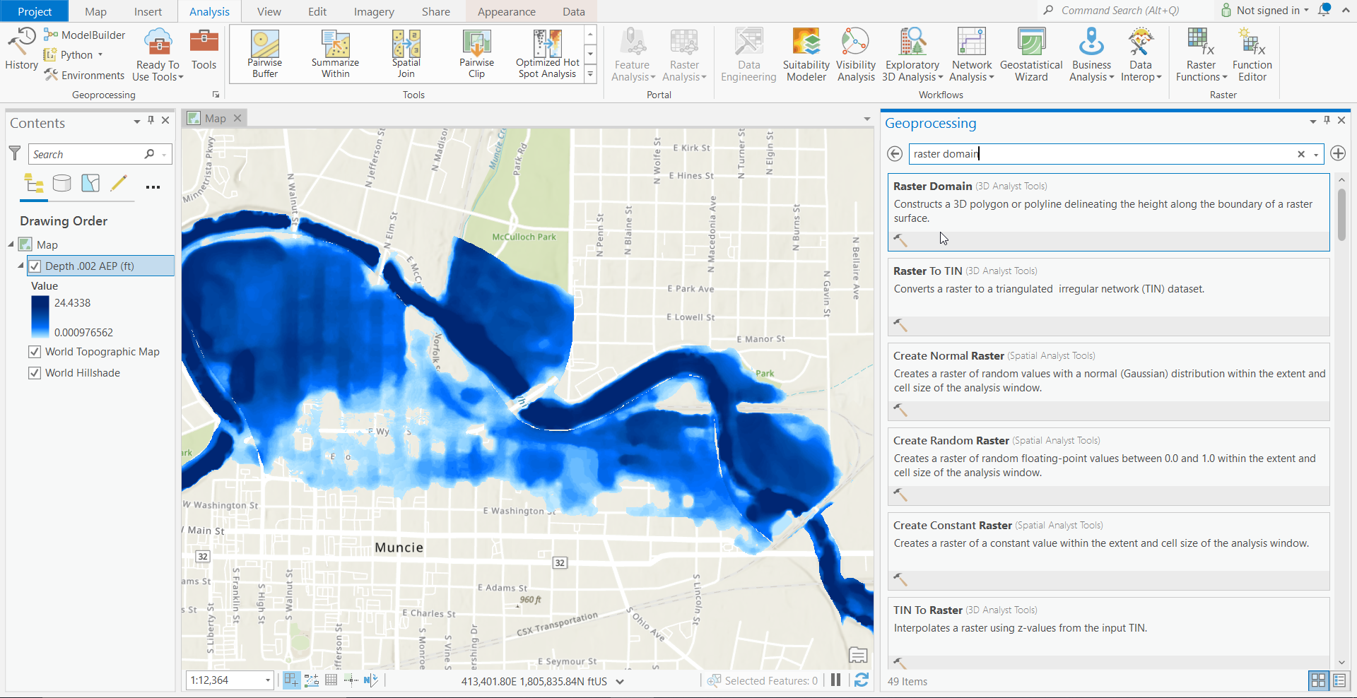
Impact Areas

Slide 7
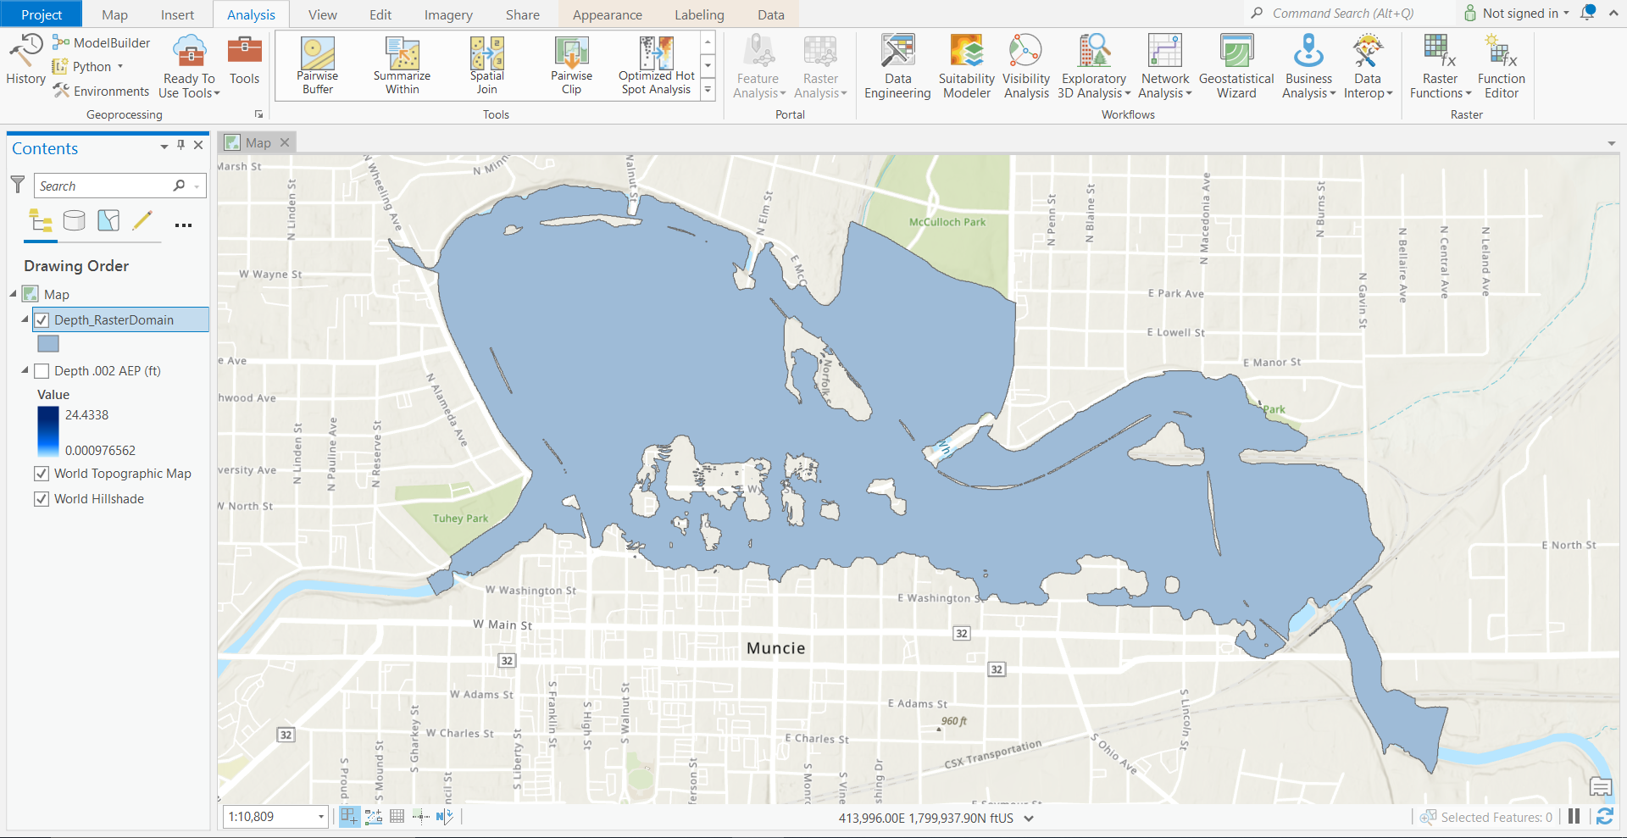
Impact Areas

Slide 8
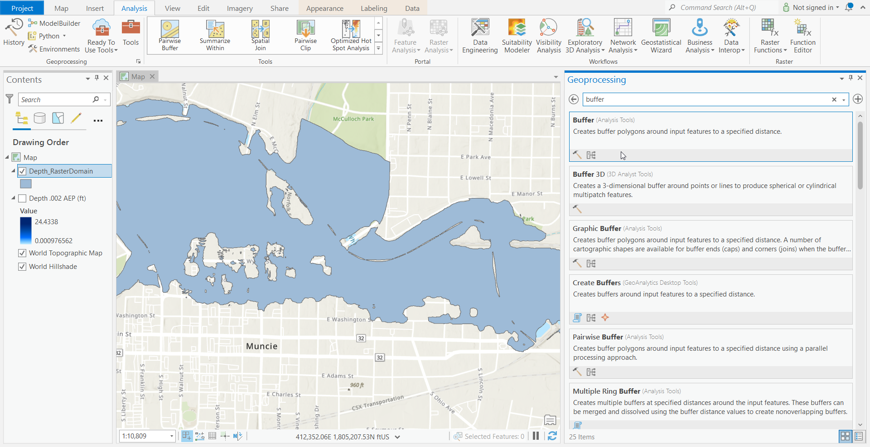
Impact Areas

Slide 9
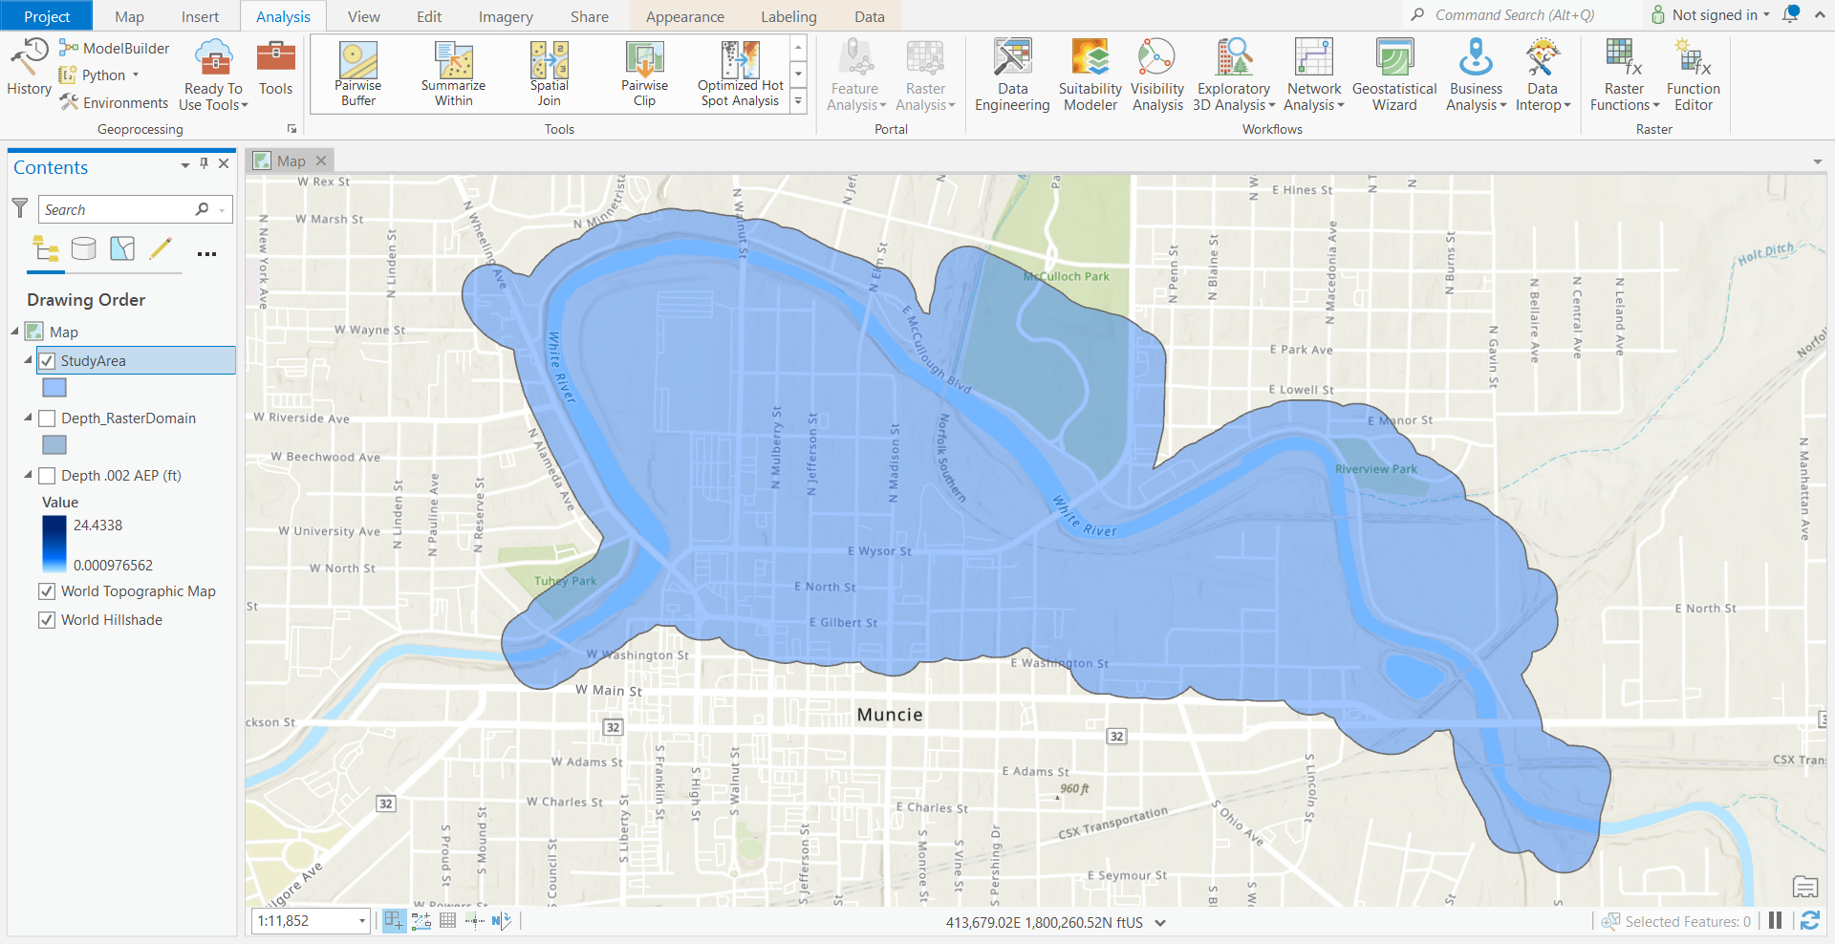
Impact Areas

Slide 10
Impact Areas

Slide 11
Objectives
Impact Areas
Hydraulic Model Direct-Import
Tabular Copy-Pasting
New Distributional Assumptions
Exporting from 1.4.3 to 2.0

Slide 12
Hydraulic Model Direct-Import
What is it?
  Contains geospatial stage-frequency data
What’s different?
  1.4.3 – lots of pre-processing, text inputs
  2.0 – geospatial data inputs
Generated in HEC-RAS
Multiple input options
  Unsteady HDF
  Steady HDF
  Gridded Data

Slide 13
Hydraulic Model Direct-Import
Unsteady HDF
  Eight or more HDF files
  One HDF for each AEP
Steady HDF
  One HDF file
  Should include eight or more AEP events
Gridded Data
  Several TIFF files
  One TIFF file for each AEP event
  Must be imported in several sub-folders
Must update the Return Interval or AEP upon importing

Slide 14
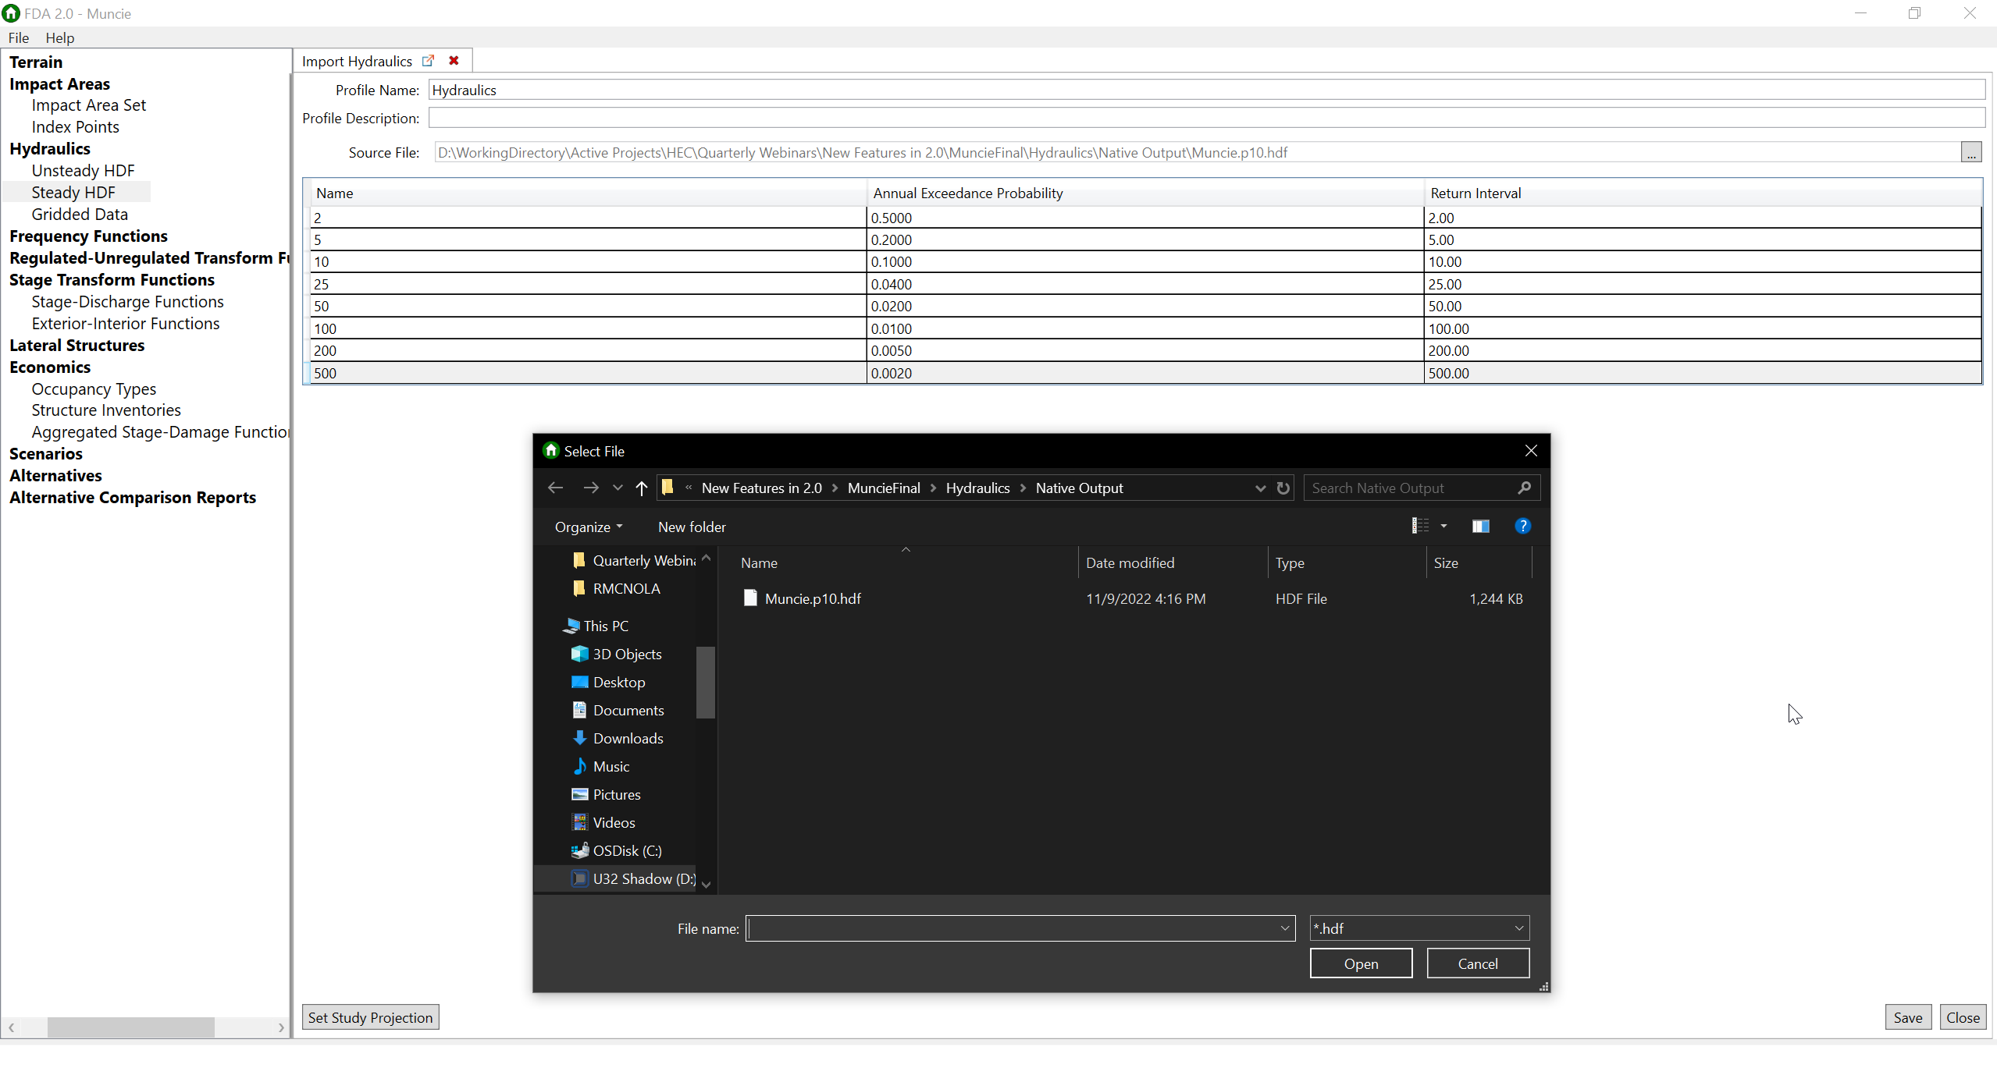
Steady HDF Import

Slide 15
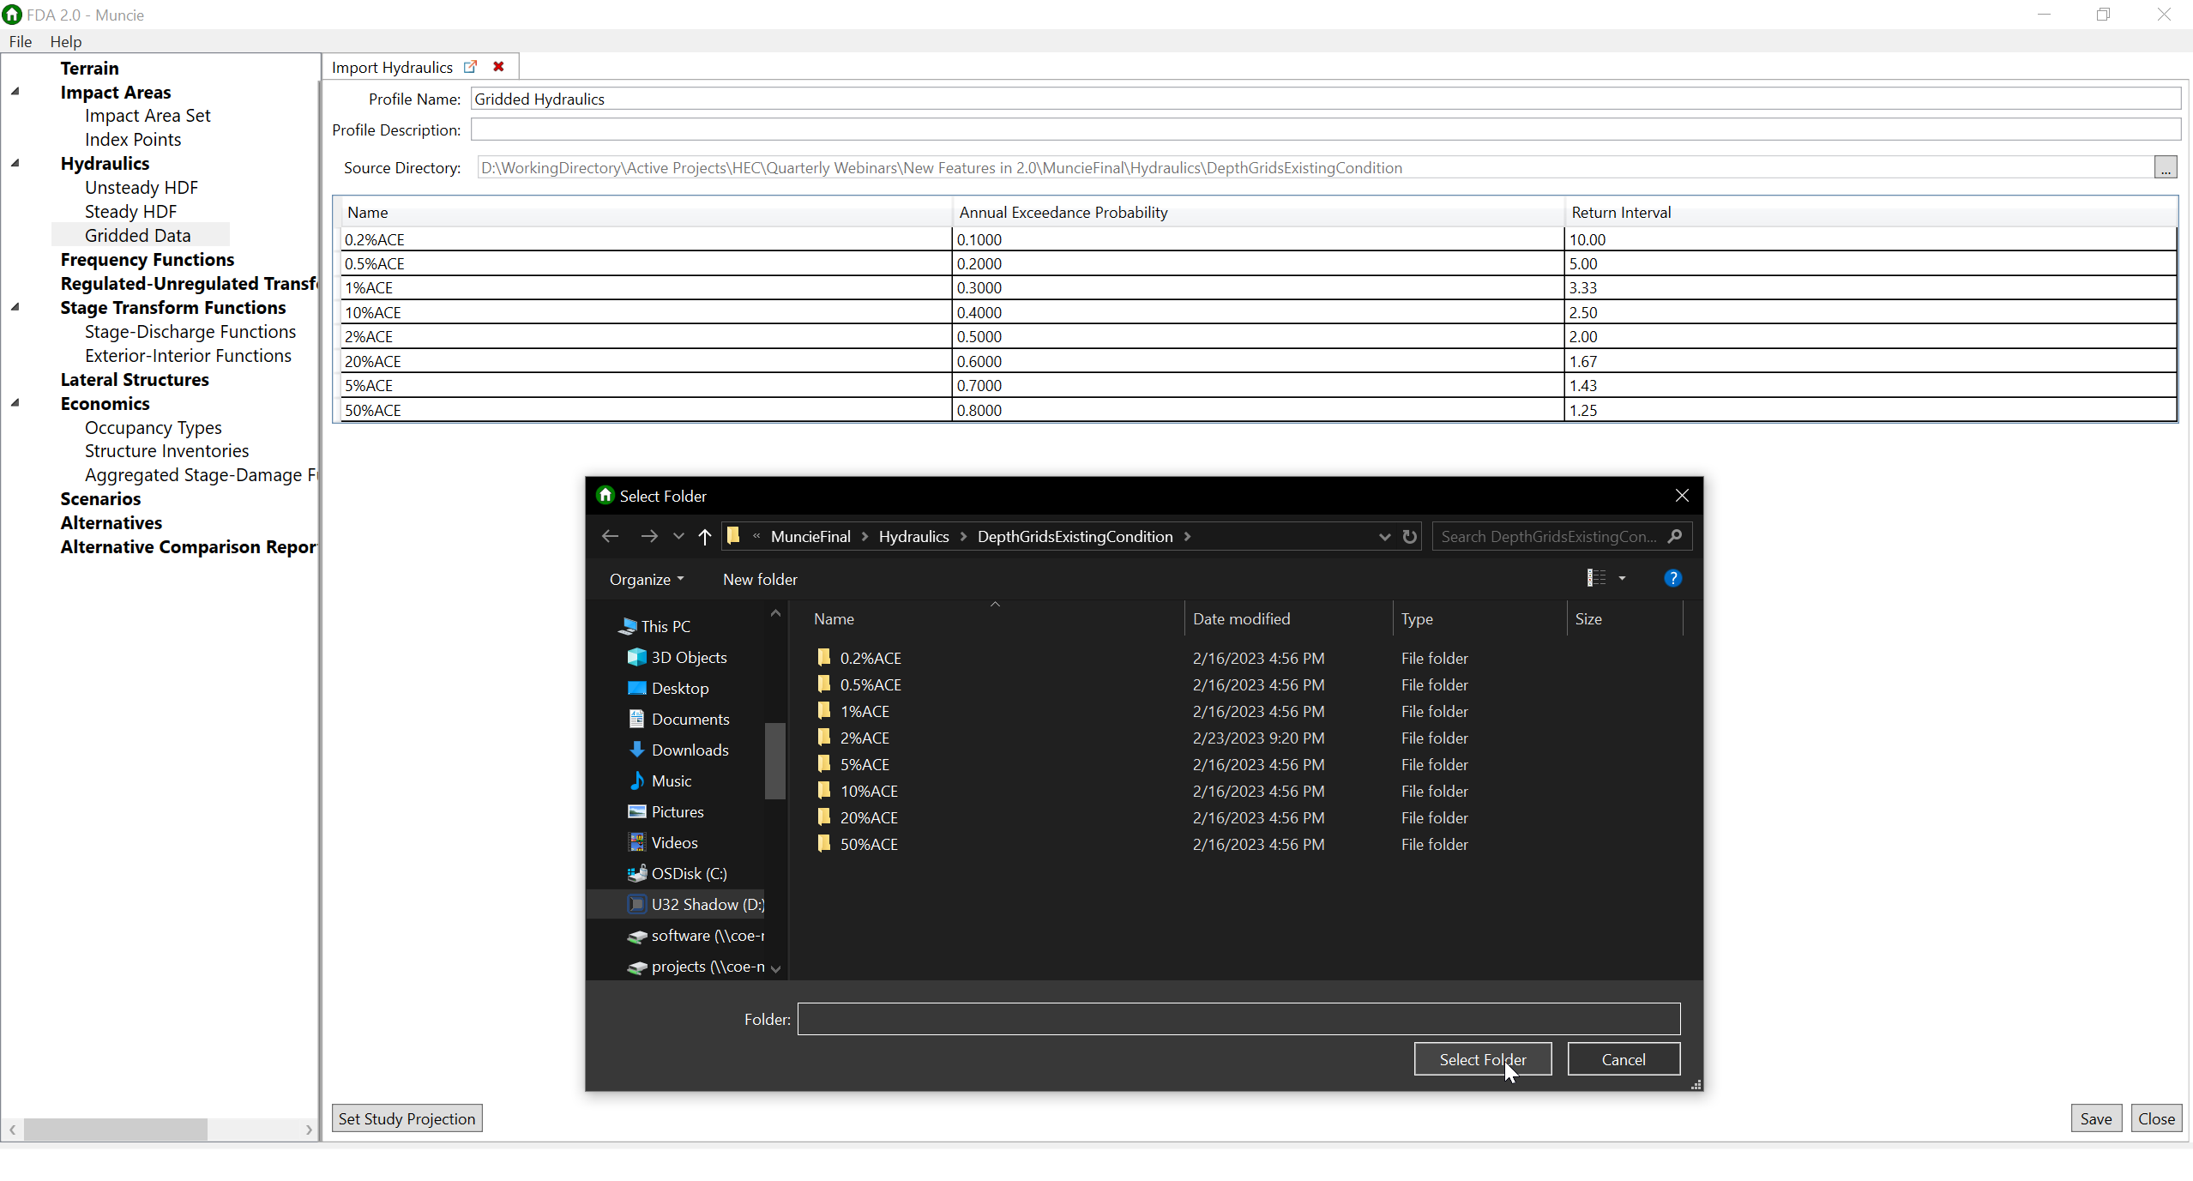
Steady HDF Import

Slide 16
Objectives
Impact Areas
Hydraulic Model Direct-Import
Tabular Copy-Pasting
New Distributional Assumptions
Exporting from 1.4.3 to 2.0

Slide 17
Tabular Copy-Pasting
My favorite new feature!!!
What’s different?
  1.4.3 – no….
  2.0 – YES!!!
Where?
  Frequency Function
  Regulated-Unregulated Transform Function
  Stage Transform Functions
  And more!

Slide 18
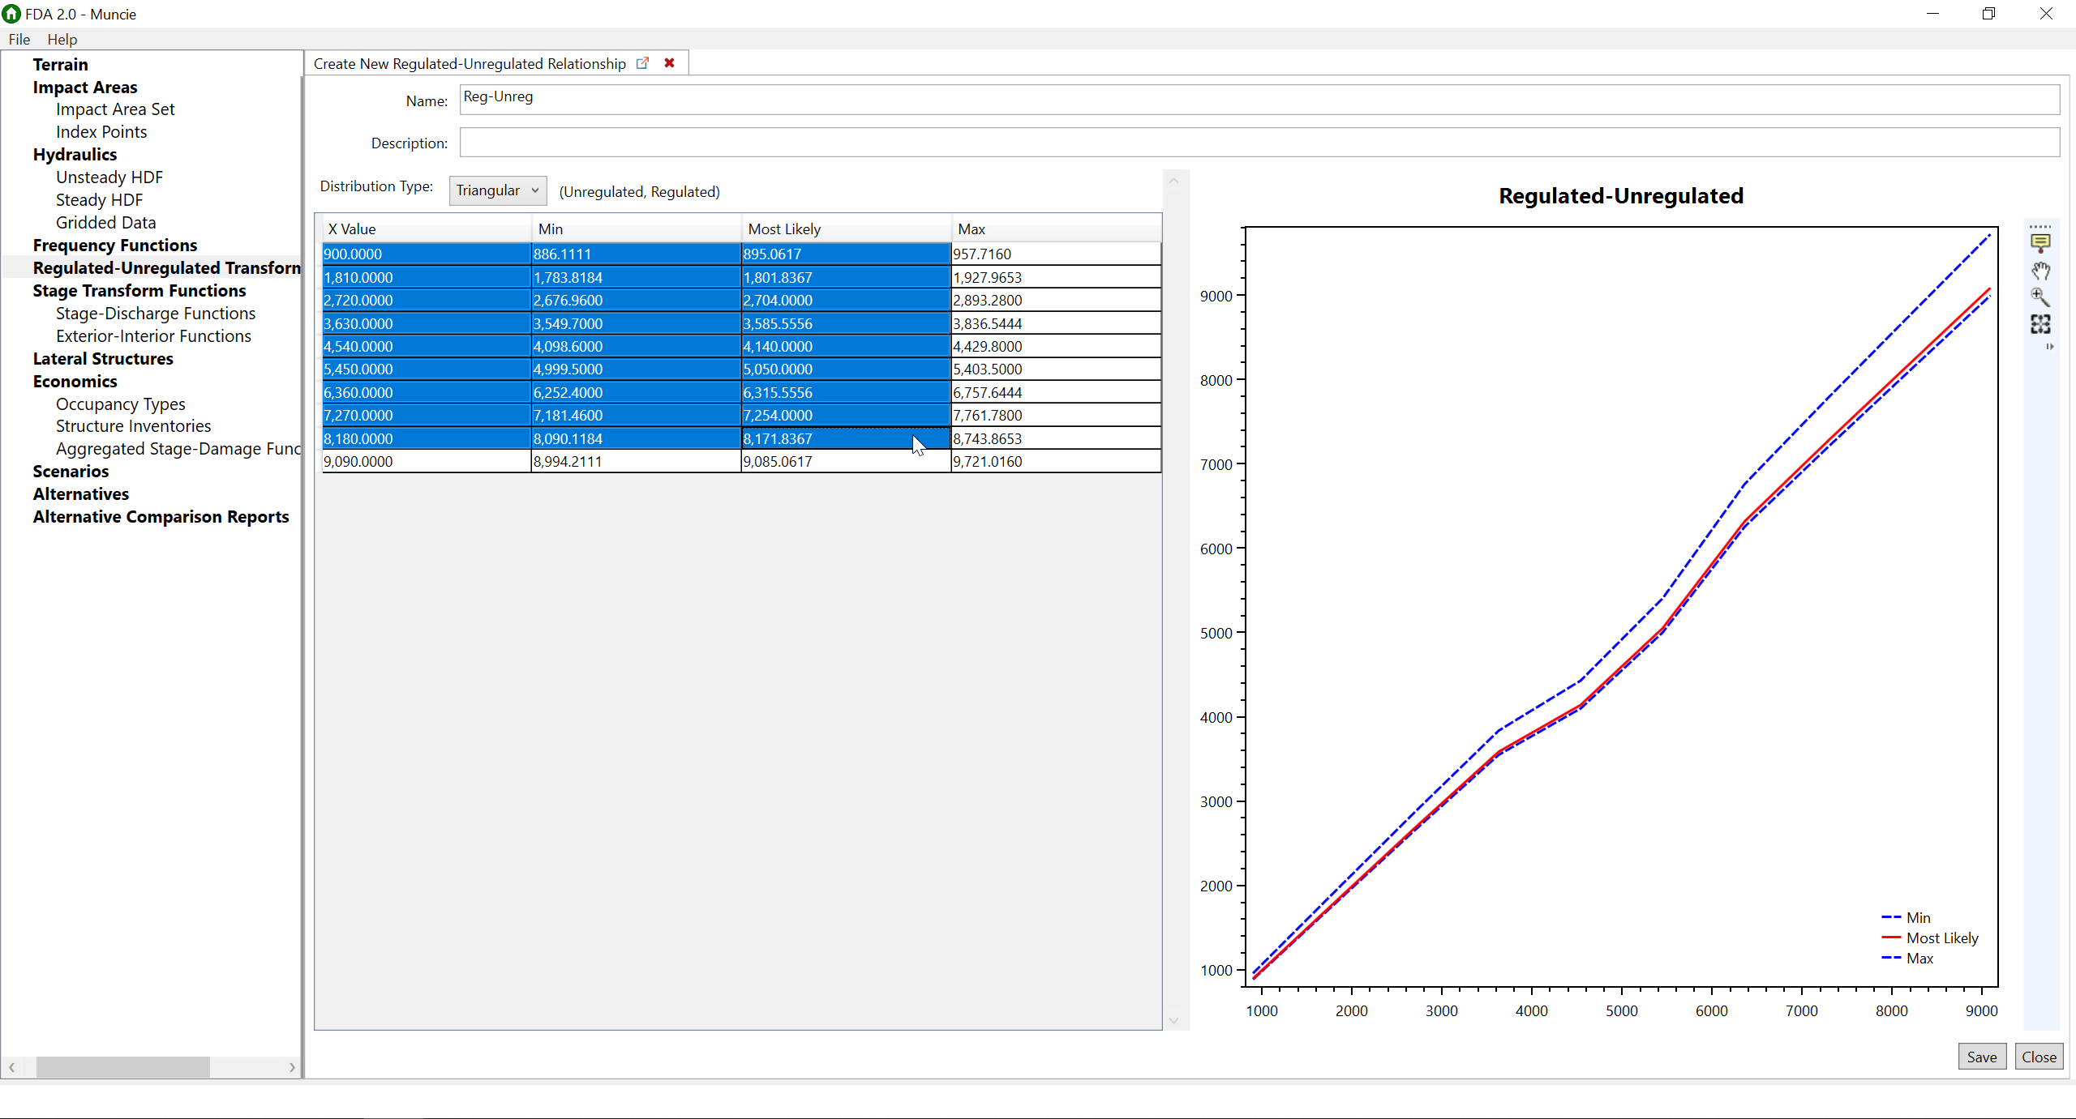
Regulated-Unregulated Transform

Slide 19
Objectives
Impact Areas
Hydraulic Model Direct-Import
Tabular Copy-Pasting
New Distributional Assumptions
Exporting from 1.4.3 to 2.0

Slide 20
New Distributional Assumptions
What is it?
  Empirical distribution of stage-damage
What’s different?
  1.4.3 – Assumed normal distribution of damage for a given stage
  2.0 – Empirical distribution

Slide 21
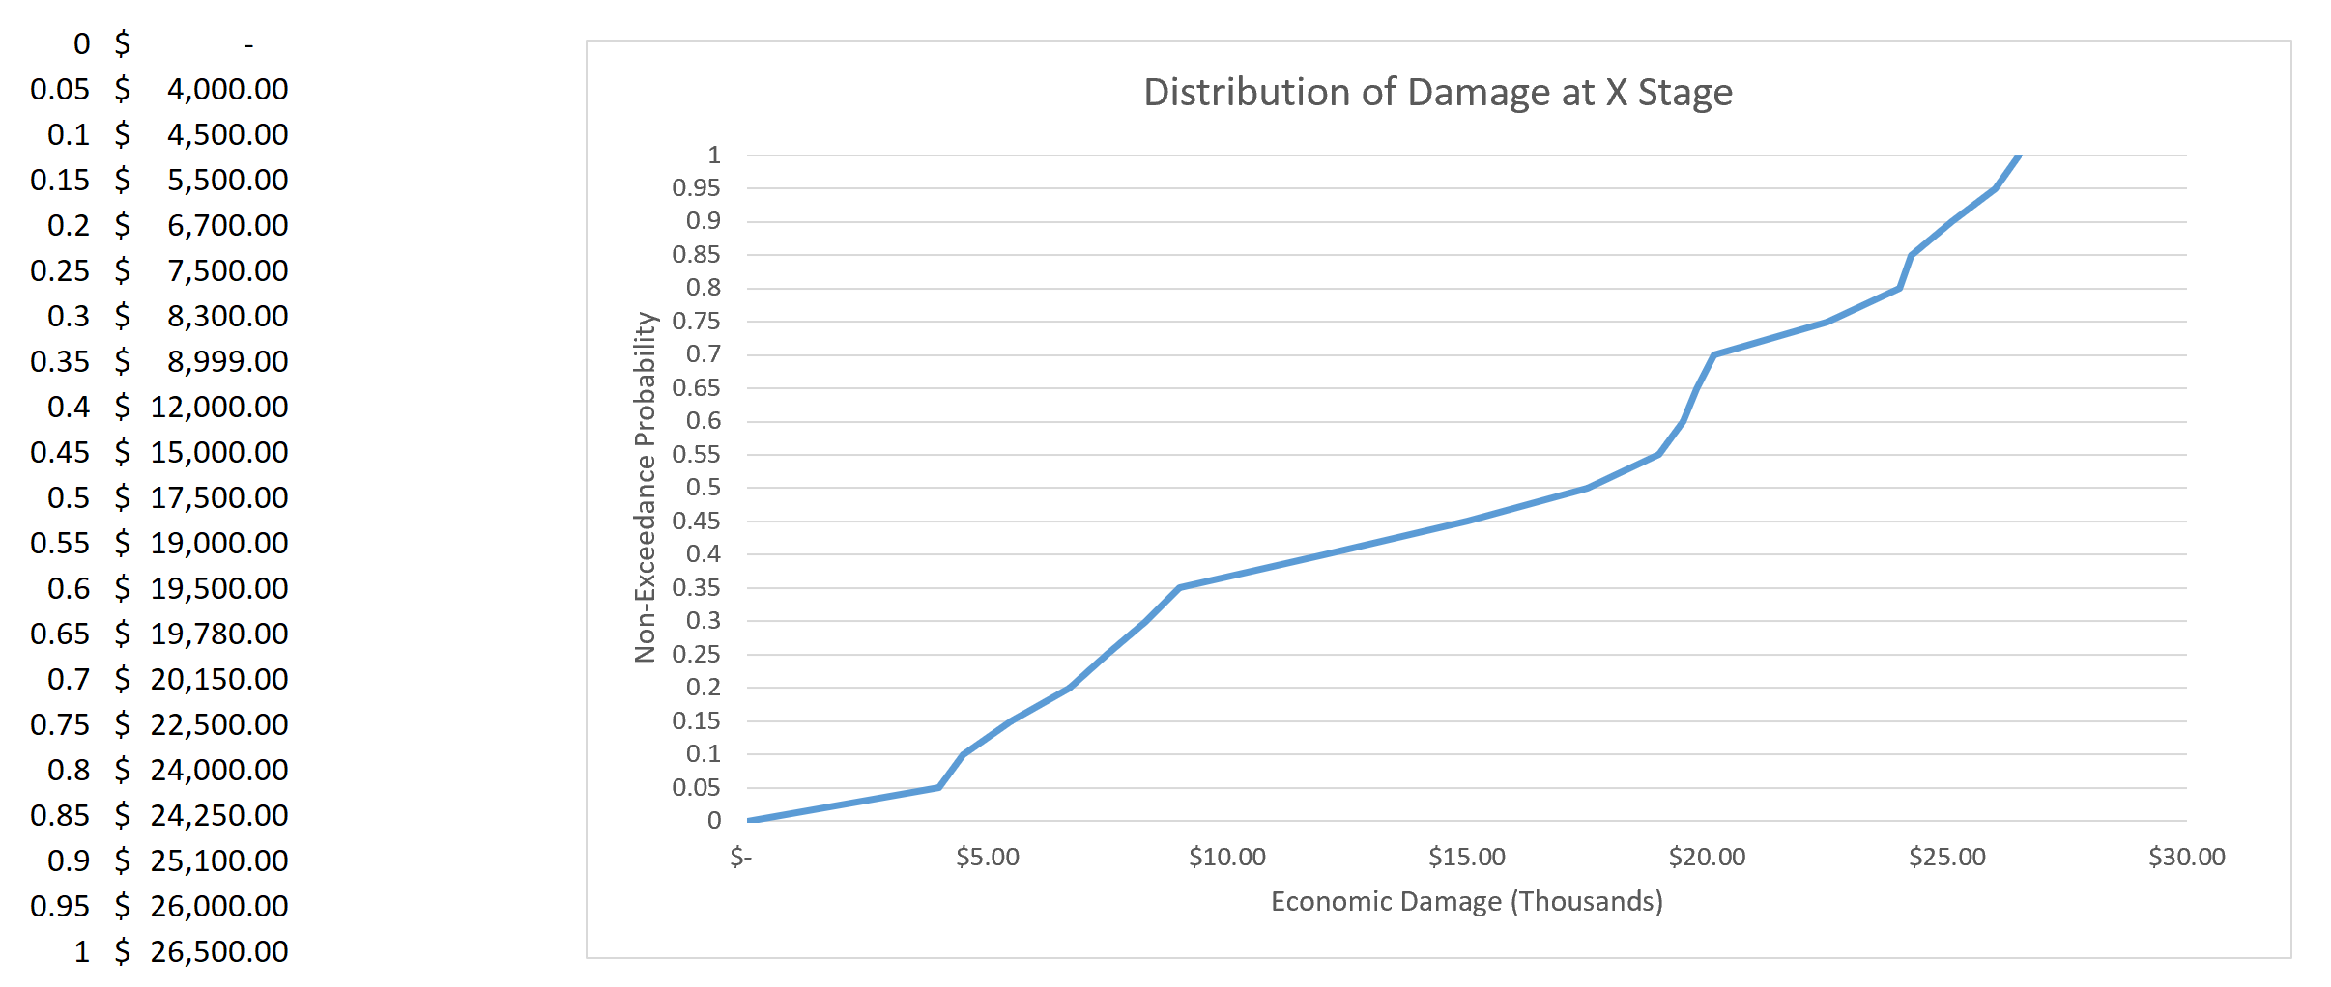
Empirical Relationship for a single stage
Notes:
If we look at a single stage, this is what we’ll see
Right column shows sampled damage values for this stage
4k at 5th percentile, 710k at 95th percentile
No longer assume the PDF is symmetrical around the mean
Let’s look at histogram

Slide 22
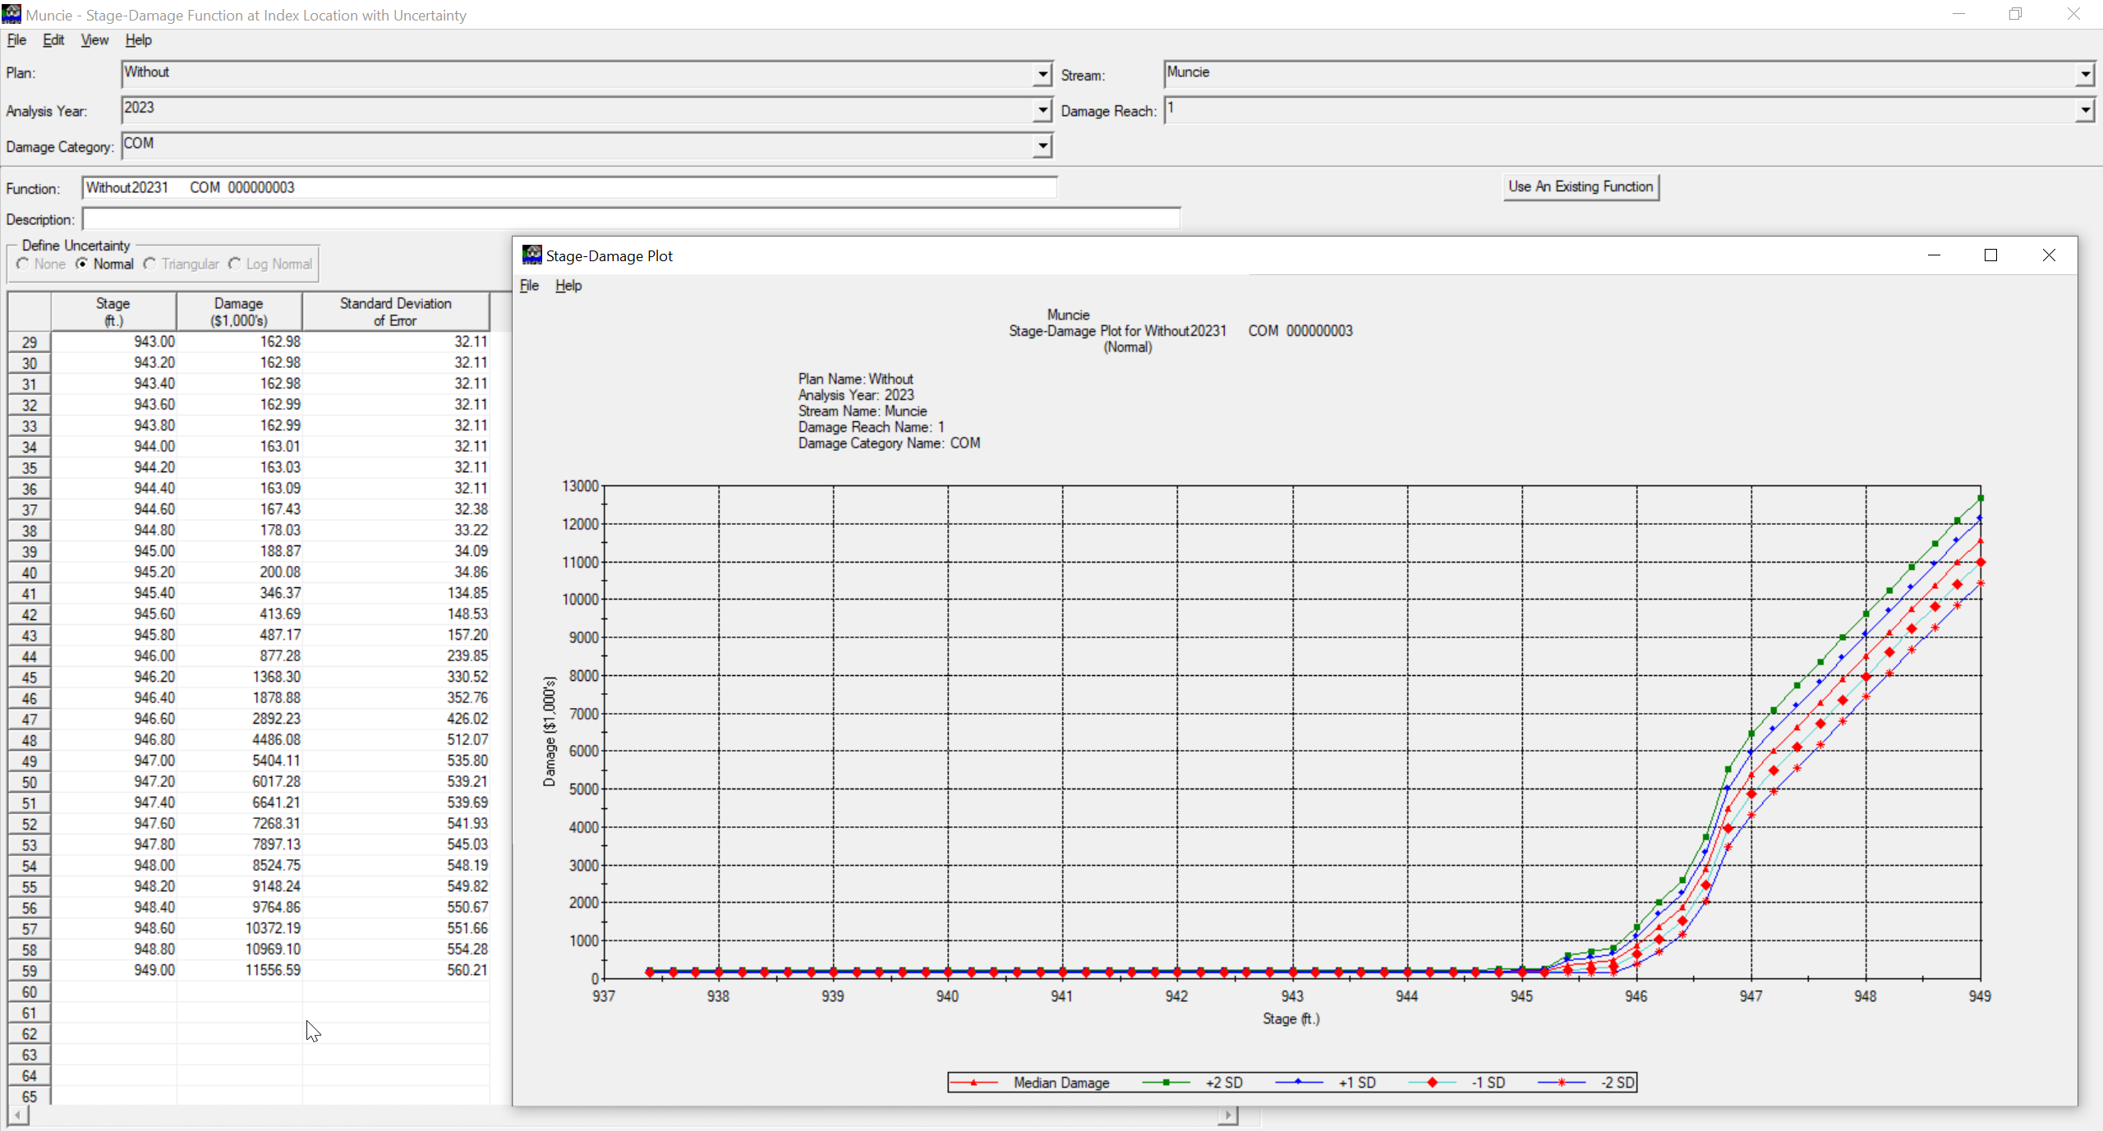
New Distributional Assumptions

Slide 23
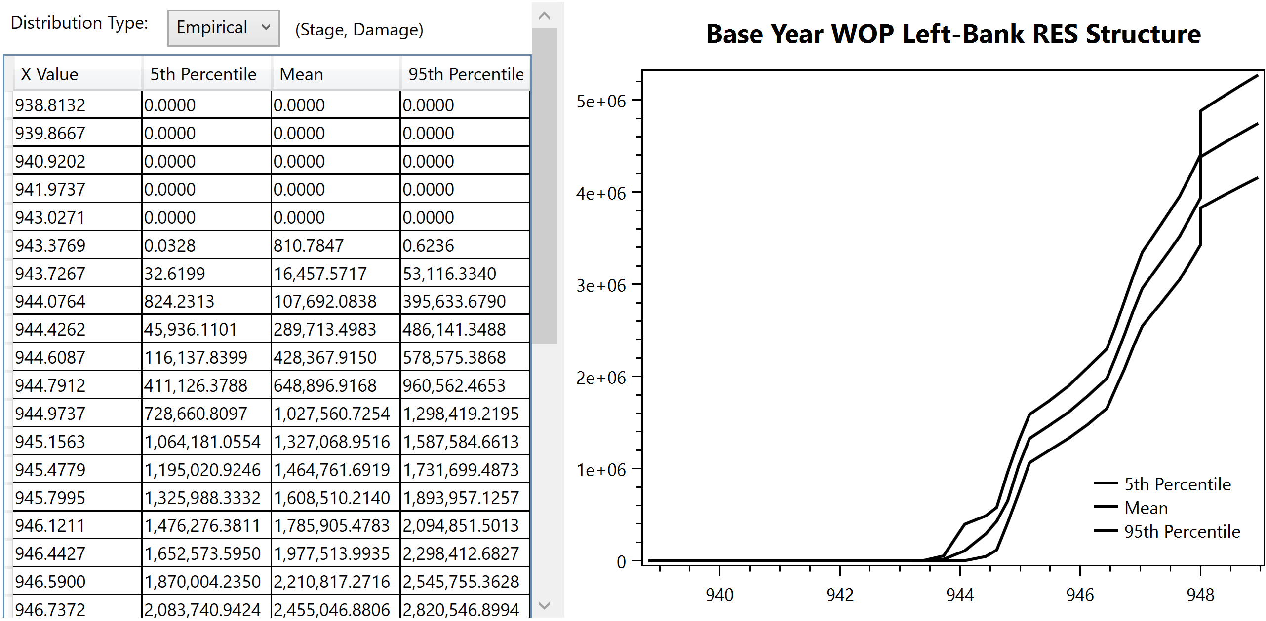
Example Stage-Damage Function
Notes:
Back to this
At a given stage, empirical distribution of dollar damage
1.4.3 forces a normal distribution
2.0 doesn’t; empirical distribution
Focus in on the distribution of damage at a single stage

Slide 24
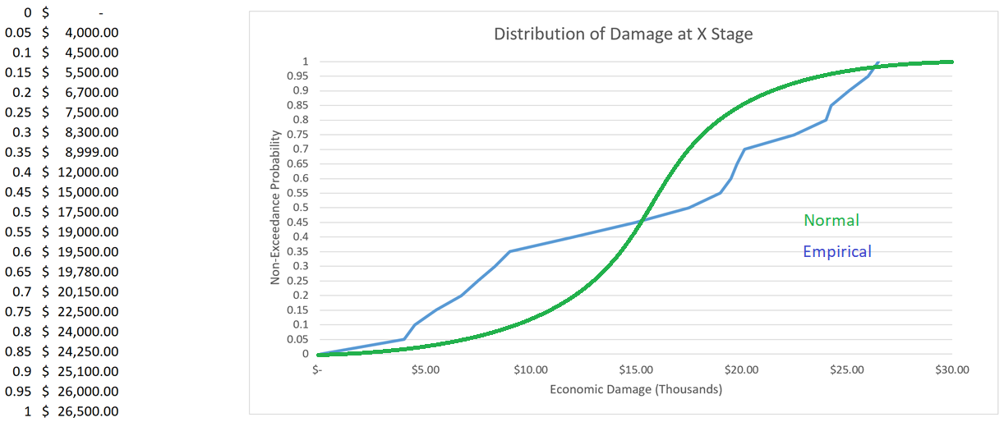
Empirical Relationship for a single stage
Notes:
If we look at a single stage, this is what we’ll see
Right column shows sampled damage values for this stage
4k at 5th percentile, 710k at 95th percentile
No longer assume the PDF is symmetrical around the mean
Let’s look at histogram

Slide 25
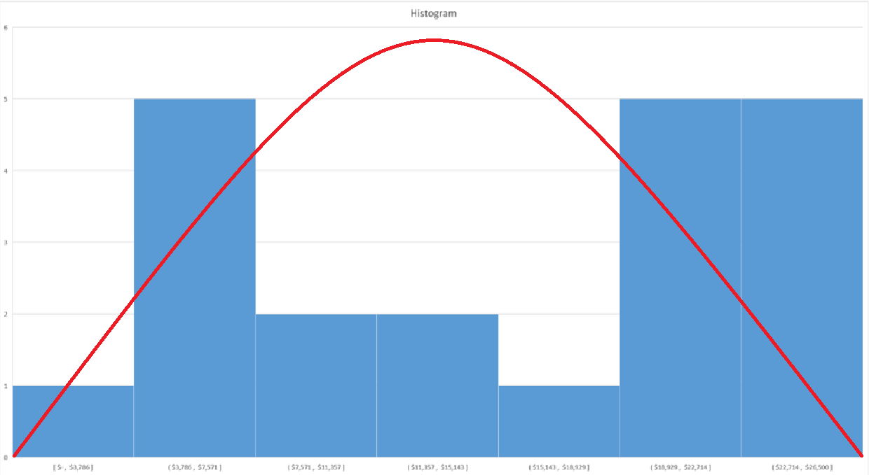
Not a normal Distribution
Notes:
Normal would show bell-shape
Our monte carlo process shows this is definitely not a normal dist
Big implications
This is the last hangup for certification

Slide 26
Objectives
Impact Areas
Hydraulic Model Direct-Import
Tabular Copy-Pasting
New Distributional Assumptions
Exporting from 1.4.3 to 2.0

Slide 27
Exporting from 1.4.3 to 2.0
What is it?
  Can export a finished 1.4.3 model to 2.0
Requires GIS software to edit 1.4.3 study files
Requires Impact Areas

Slide 28
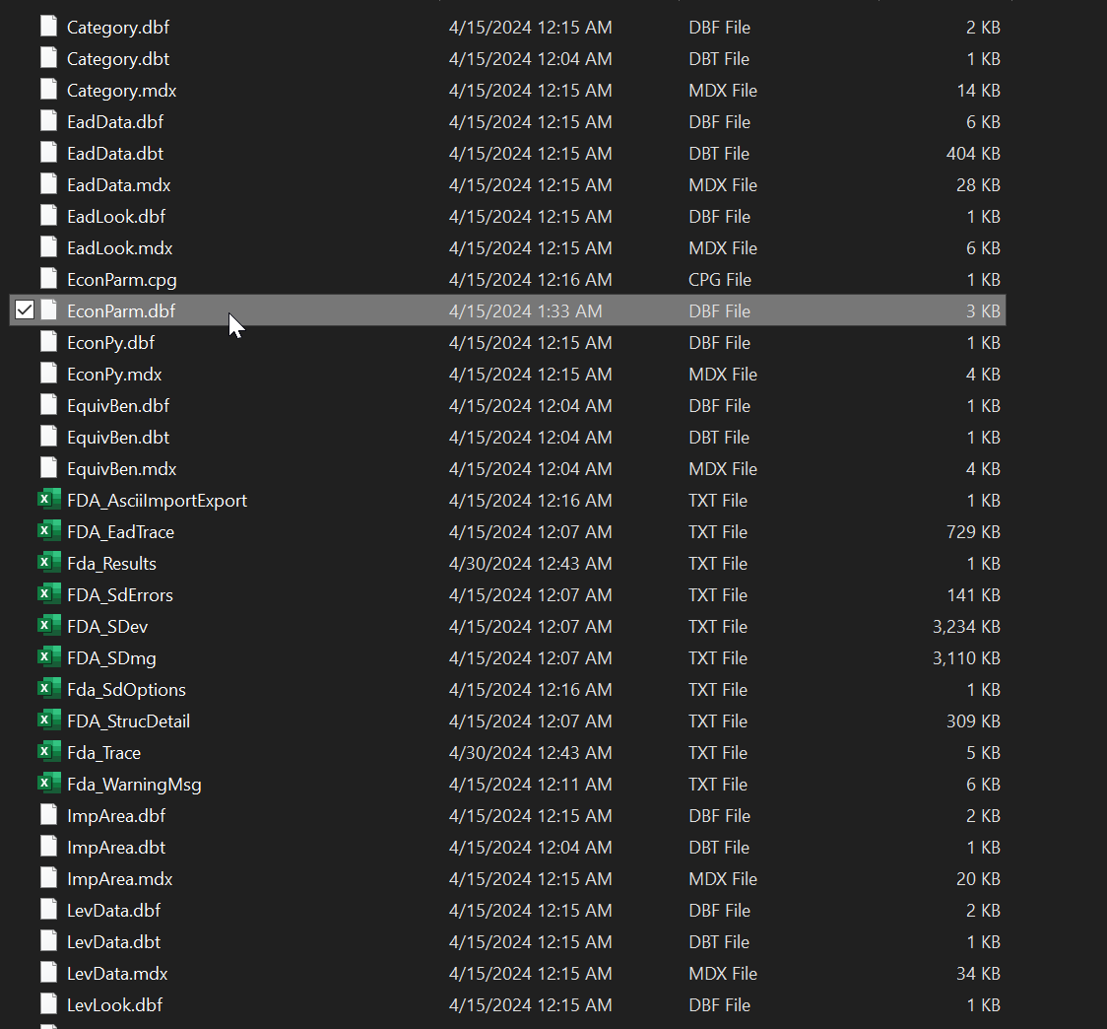
Exporting from 1.4.3 to 2.0

Slide 29
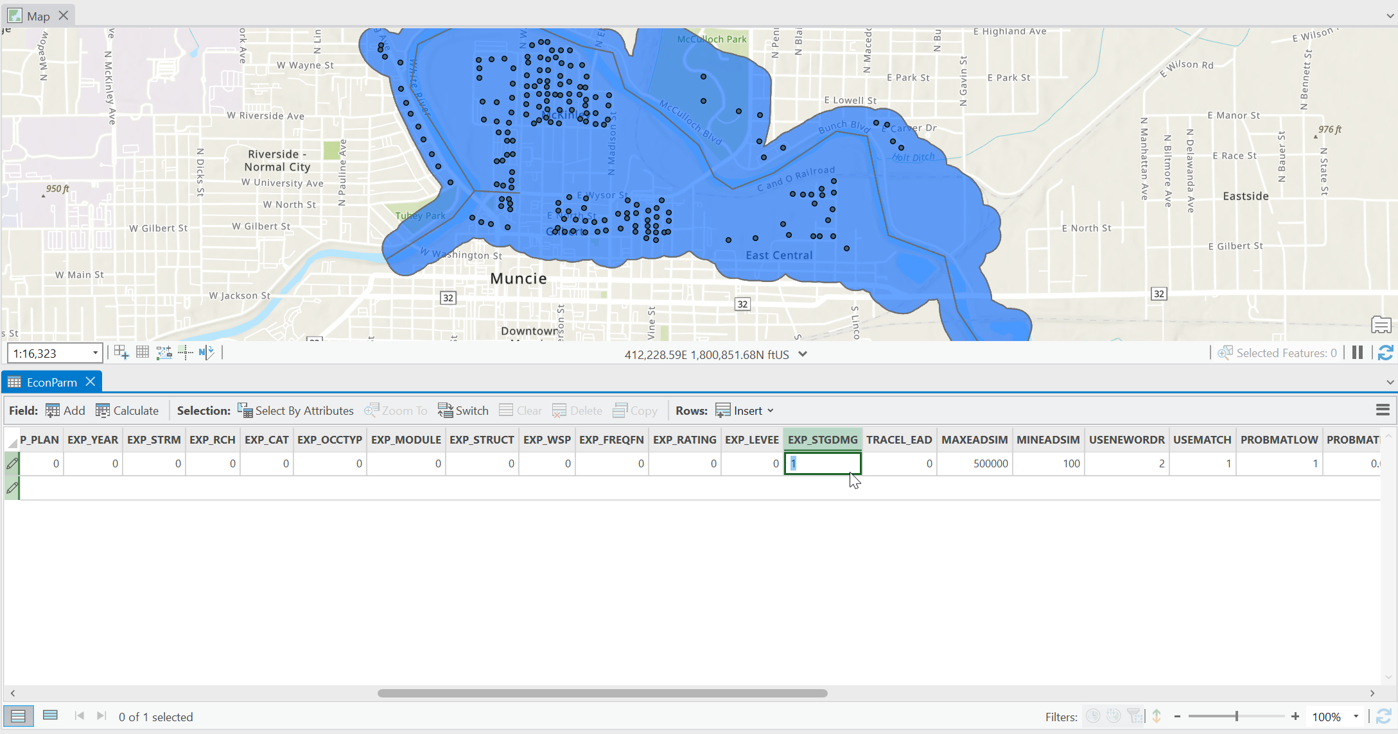
Exporting from 1.4.3 to 2.0

Slide 30
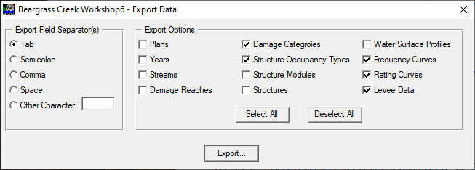
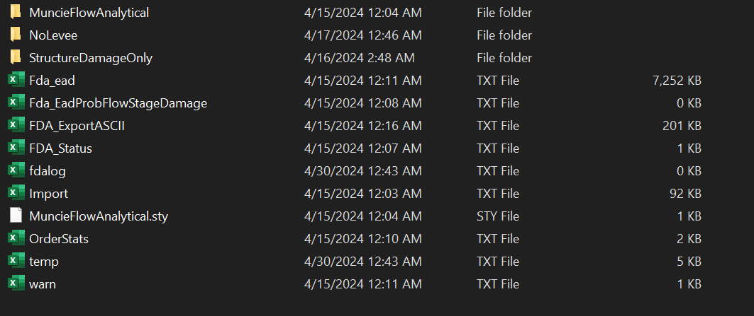
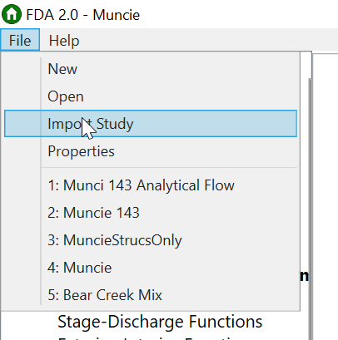
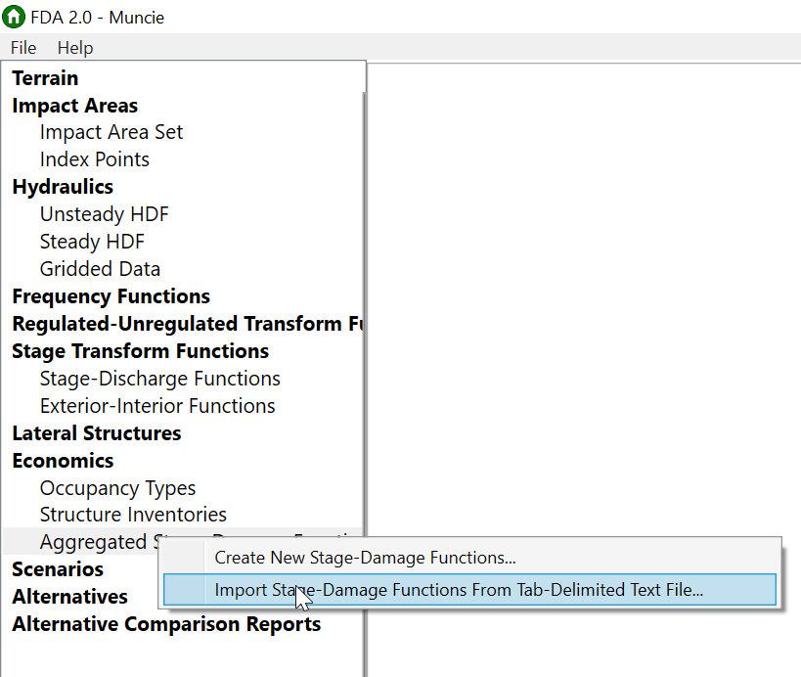
Exporting from 1.4.3 to 2.0
1. Export
2. Import
3. Impact Area
4. Import Again

Slide 31
Objectives - Recap
Impact Areas
Hydraulic Model Direct-Import
Tabular Copy-Pasting
New Distributional Assumptions
Exporting from 1.4.3 to 2.0

Slide 32
Other New features
Index points optional, implicit
Structure inventory direct-import
  No more modules
Faster compute

Slide 33
Resources
Differences between Version 1.4.3 and Version 2.0
  https://www.hec.usace.army.mil/confluence/fdadocs/fdaqsg/differences-between-version-1-4-3-and-version-2-0-134000921.html
Recommended GIS Skills
  https://www.hec.usace.army.mil/confluence/fdadocs/fdaqsg/recommended-gis-skills-167252682.html
Version 1.4.3 to Version 2.0 Study Conversion
  https://www.hec.usace.army.mil/confluence/fdadocs/fdatutorials/tutorials/version-1-4-3-to-version-2-0-study-conversion
Exporting Aggregated Stage-Damage Functions from 1.4.3
  https://discourse.hecdev.net/t/how-can-i-export-aggregated-stage-damage-functions/2049
FDA 2.0 Workshops
  https://www.hec.usace.army.mil/confluence/fdadocs/fdatutorials/course-materials/prospect-209-flood-damage-assessment/using-hec-fda-version-2-0-software/fy24-209-introduction-to-economic-risk-assessment-for-frm-studies/fy24-hec-fda-workshop-1

