Slide 1
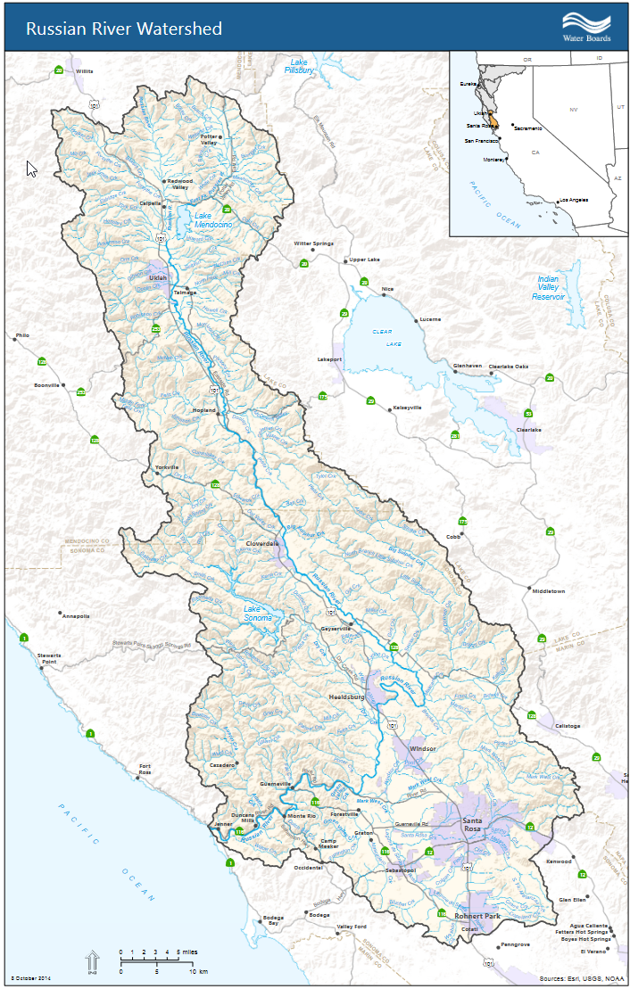
Introduction to
HEC-WAT
Lea Adams
Chief, Water Resources Division
USACE Hydrologic Engineering Center

Slide 2
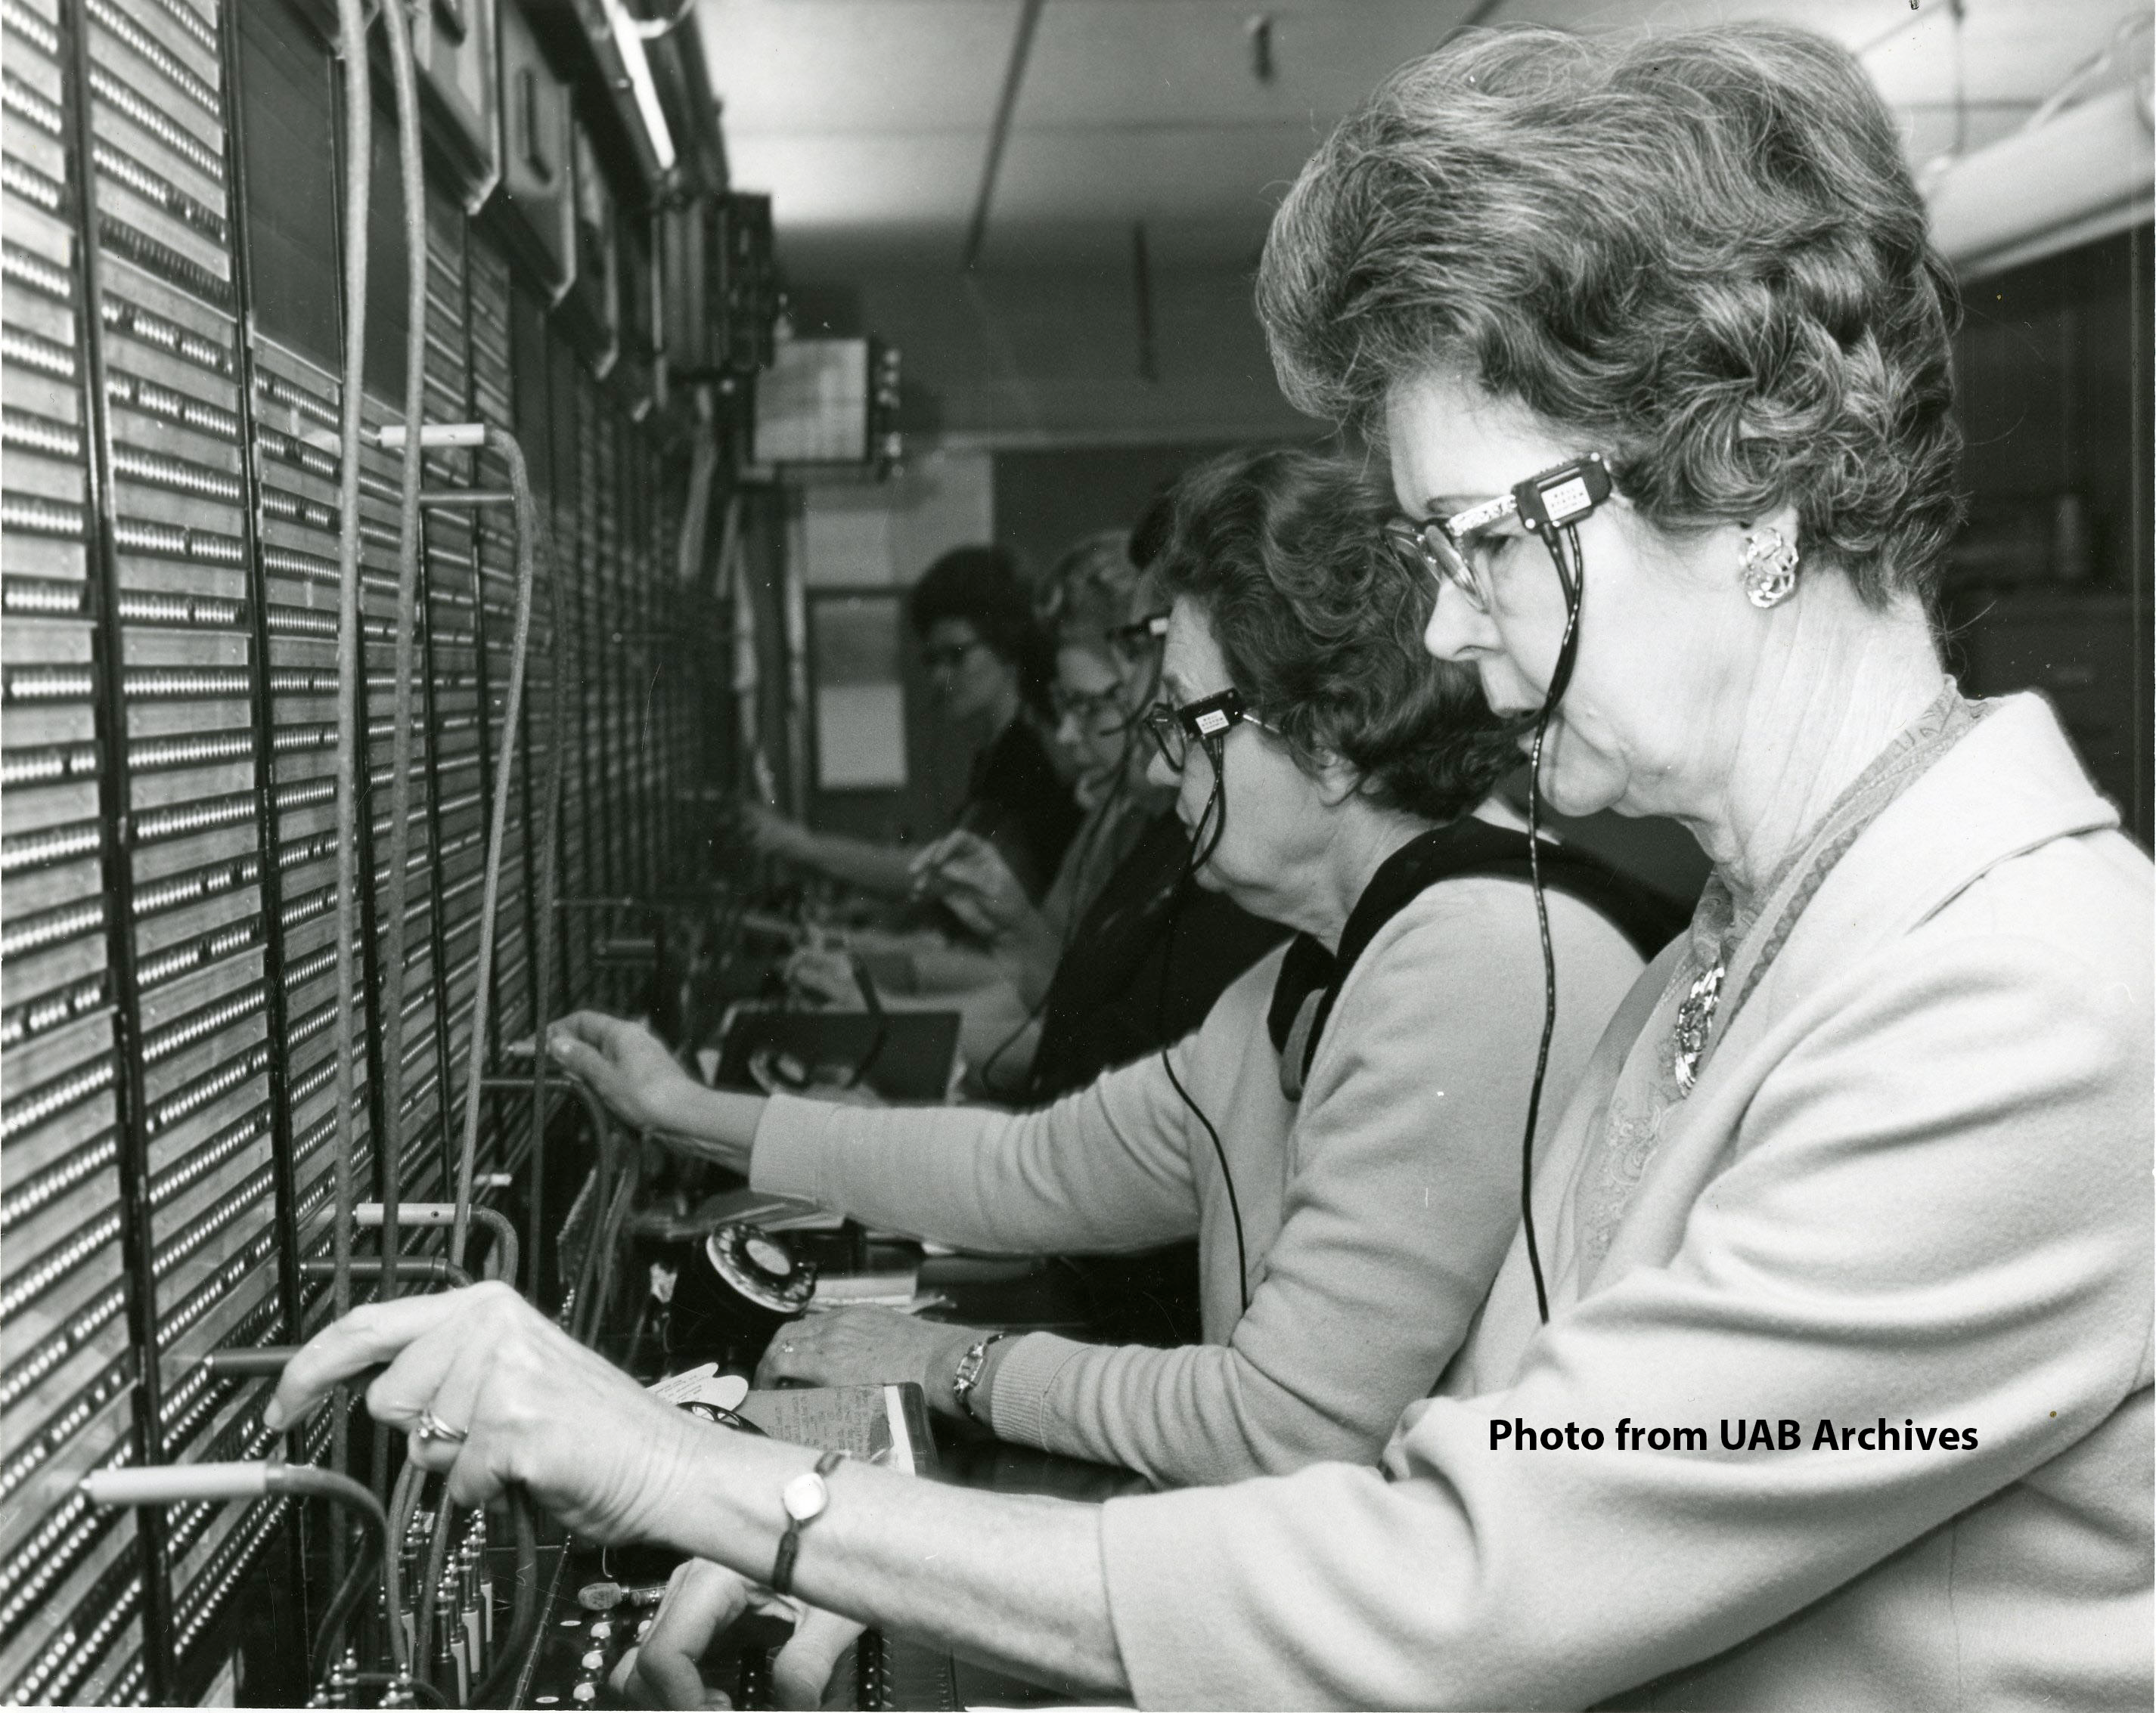
HEC-WAT – the basics
  What the heck is HEC-WAT?
    Fundamentally, HEC-WAT is a switch board operator
    Seamlessly facilitates phone calls (i.e. data transfer between software tools)
    In other words, the WAT integrates a suite of water resources software
    Supports full functionality of component software – no simplifications needed, unless the user wants them.
Actual photo of HEC-WAT in operation.

Slide 3
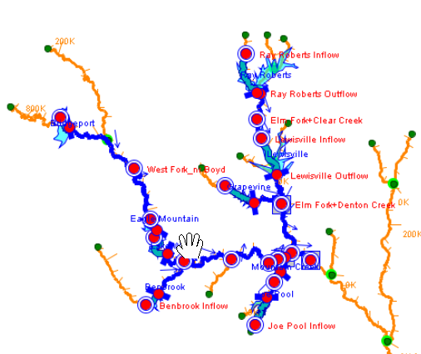
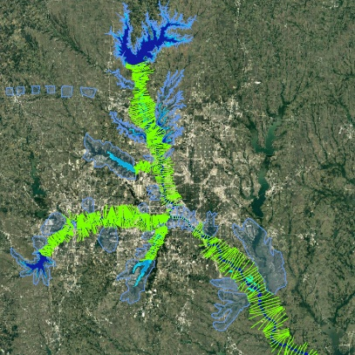
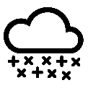
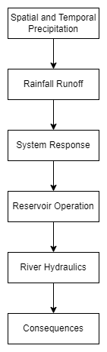

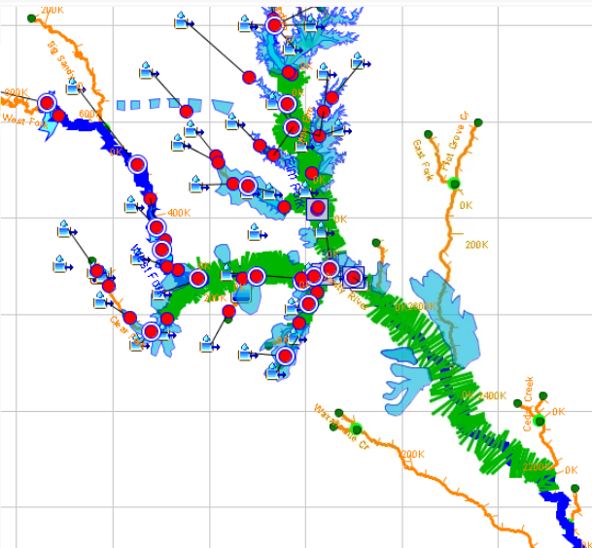

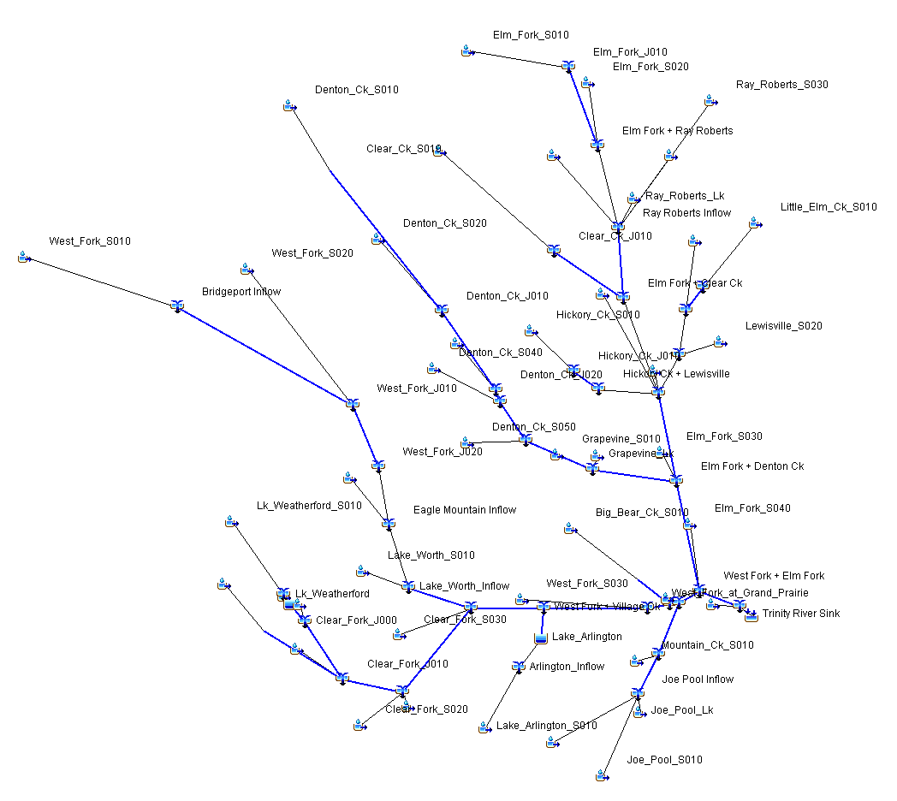




Watershed Systems are explicitly modeled in HEC-WAT
SWG Plugin
HS Plugin
HMS Plugin
Fragility Curve
Plugin
ResSim
Plugin
RAS Plugin
FIA Plugin
go-consequences Plugin

Slide 4
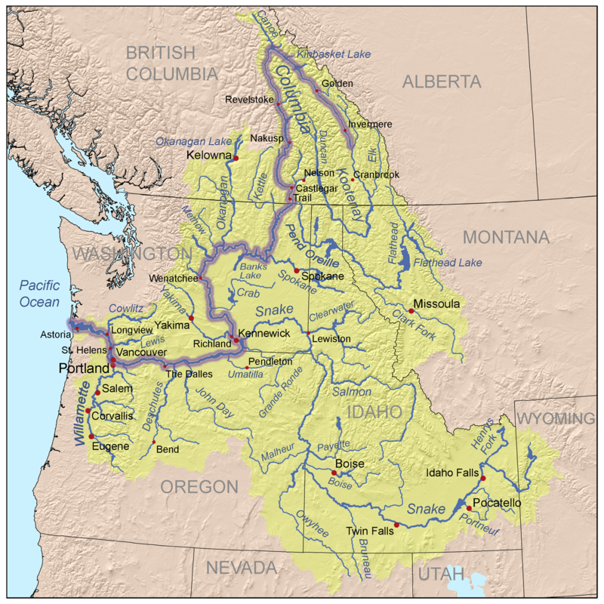
HEC-WAT – the basics
  When should you use HEC-WAT?
    When your study area requires a system-wide approach
      a study area with numerous combinations of flood sources and dam or levee breach locations
      a study area where upstream flood infrastructure performance affects downstream conditions; i.e. a flood risk management system
    When you need to evaluate a large number of hydrologic scenarios

Slide 5
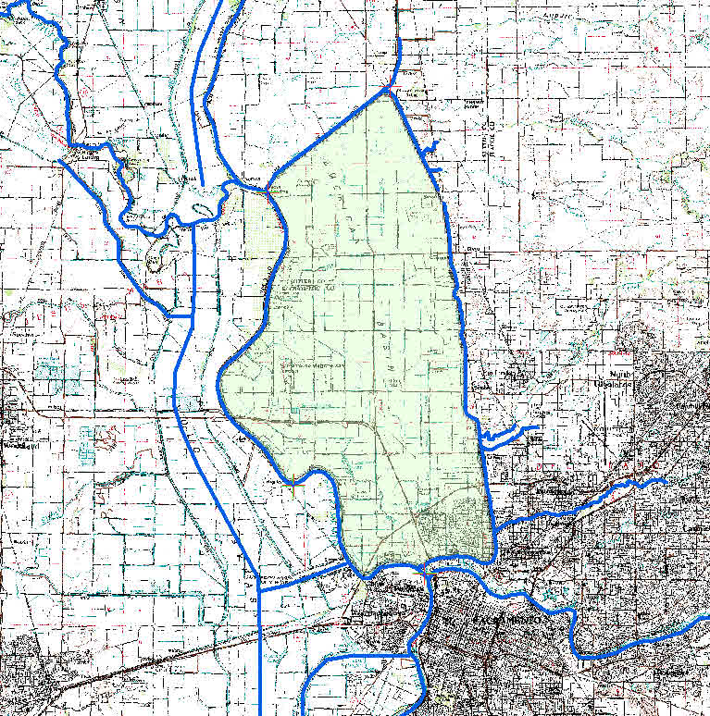
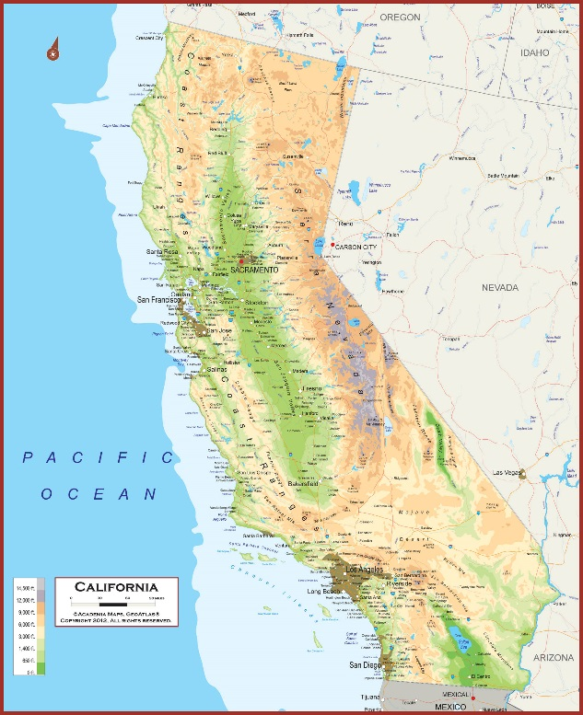
Demonstration study location
Feather R
N
Sacramento R
East Side Tribs
Natomas Basin
Yolo Bypass
American R
Sacramento
Notes:
Surrounded on all sides by water
The basin is shaped like slightly tipped bathtub, with greater flood depths at southern end.

Slide 6
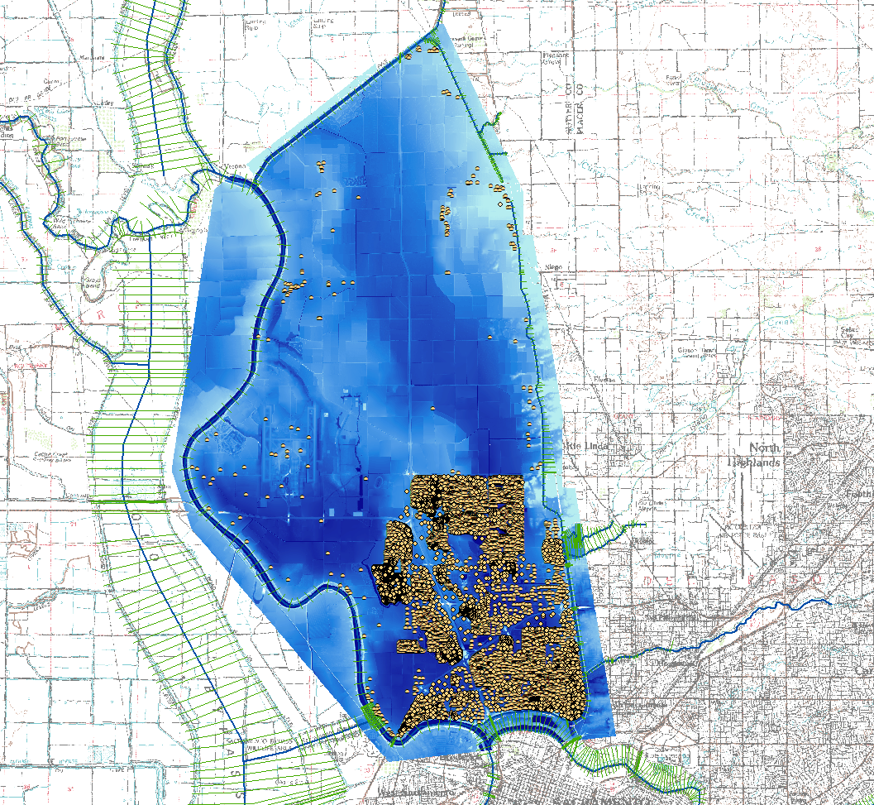
Natomas flood hazard
Max Depths: 28-32 feet
Notes:
Max depths in an extreme flood event as shown here are 28-32 feet, if the levees were to breach

Slide 7
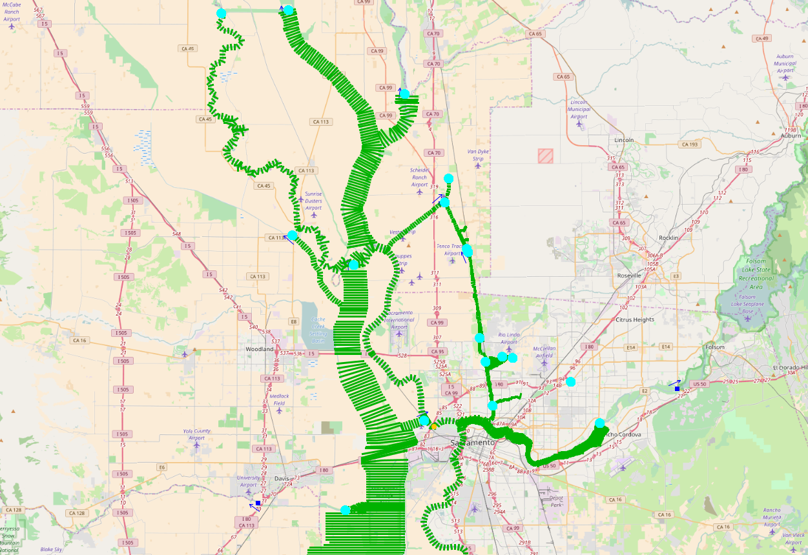
Multiple sources of flooding
Feather R
Hydrologic Sampling
Sacramento R
East Side Tribs
American R
Notes:
Flows sampled from flow-frequency curves based on the large state-funded Central Valley Hydrology Study, so best available hydrology for the area

Slide 8
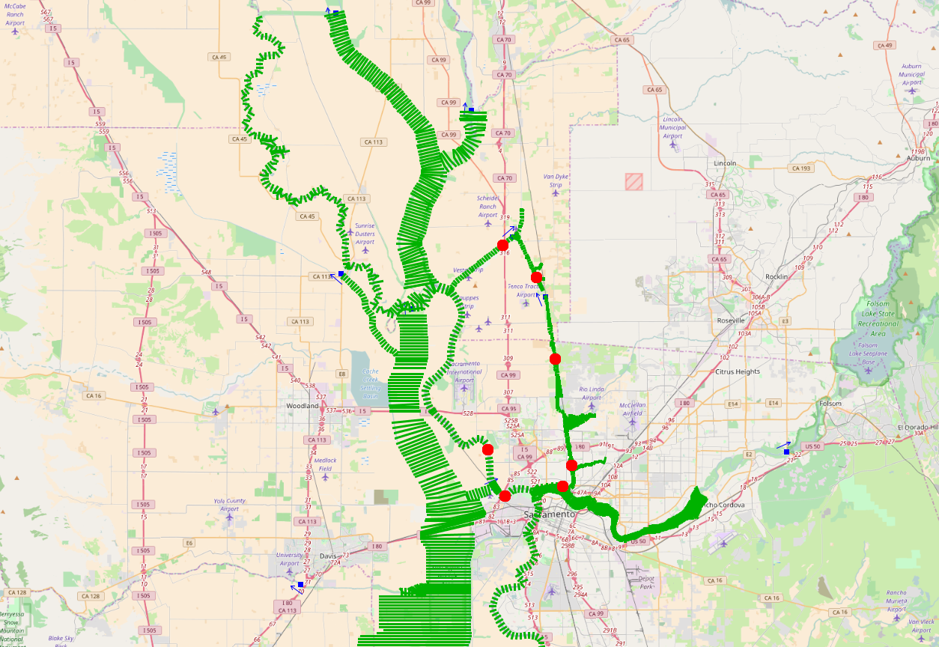
Potential breach locations
Feather R
Fragility Curve Sampling
Sacramento R
East Side Tribs
American R
Notes:
Information about potential breach locations came from an analysis by the Risk Management Center, a part of the Corps.

Slide 9
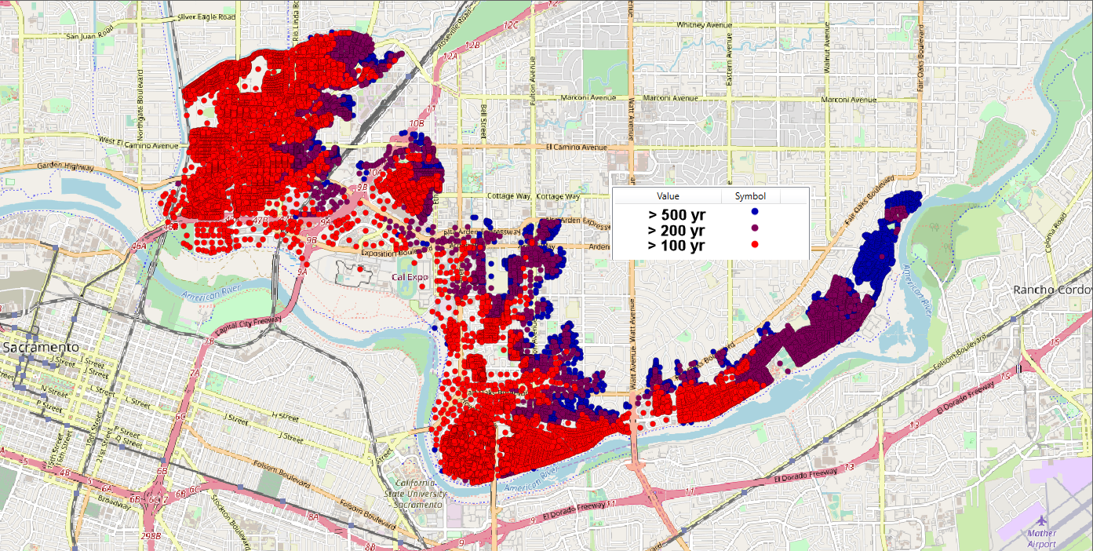
Flood risk analysis results - combined
Notes:
Reflects all the possible flows and breach conditions

Slide 10
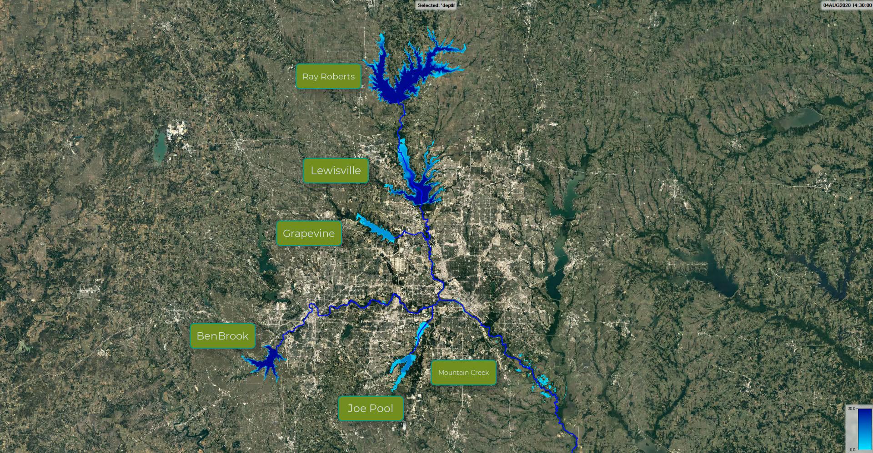
Nuclear Regulatory Commission Demonstration Study
Notes:
Trinity River system, which is upstream of the Dallas-Fort Worth Metropolitan area.
NRC demo study, looking at flood risk for a hypothetical nuclear power plant from multiple dam failures

Slide 11
Data Flow Animation
Precipitation
Inflow
Dam Failure Elevation
Pool Elevation
Computed Outflow With Breaches
Notes:
WAT gives the full shape of the hydrograph, not just the annual maximum

Slide 12
Precipitation to Hazard Frequency
Uncertainties:
Basin wetness
Reservoir Operations
Precipitation
Precipitation
Flow
Probability
Uncertainties:
Breaches
Manning’s N
Stage
Stage
Flow
Probability
Notes:
****Disclaimer*** the other relationships only show knowldege uncertainties, no natural variabilities – which is only a partial truth.
First realization level uncertainties are sampled then event level estimates are created and computed across each program in the program order.
The event level uncertainties would also be sampled within each event for each program in the program order (hard to animate that though)
The objective is to create an estimate of Damage probability based on sampling all of the other events – this image represents one realization of a simulation.
Notice that the majority of the events did not contribute to the output metric, damages typically do not occur more frequently than every year, as a result, skipping the process of computing each of those events can be very beneficial.

Slide 13
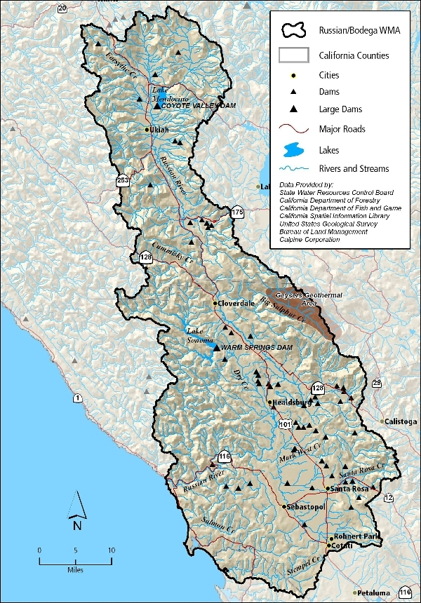
Russian River FIRO
HEC-HMS, HEC-ResSim, HEC-RAS, HEC-FIA
Utilized existing models
1,485 sq. miles
110 miles, 36,000 structures, 2 reservoirs
How would changing operations at upper reservoir affect downstream risk?

Slide 14
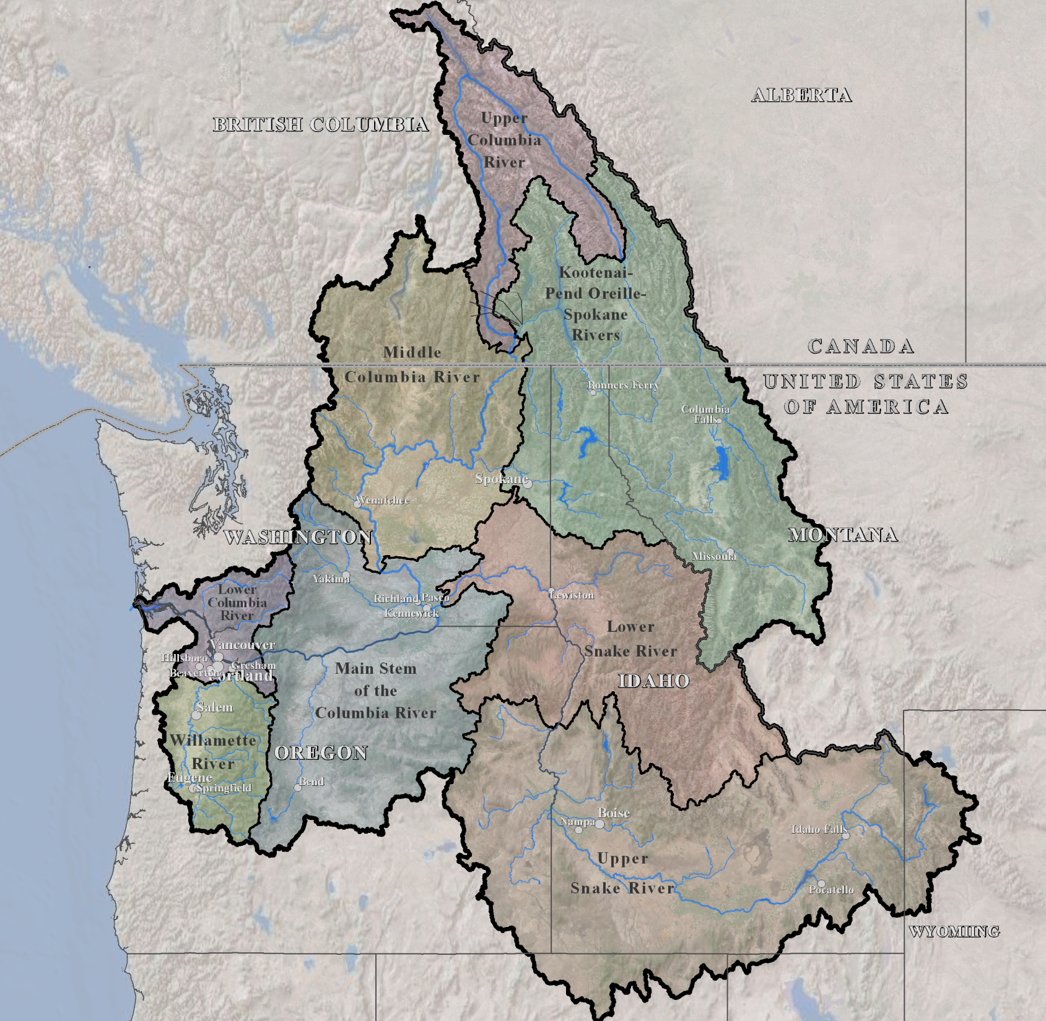
Columbia river treaty
HEC-ResSim, HEC-RAS and HEC-FIA
258,000 sq. miles
2 countries, 7 states
Approximately 176,000 structures
51 projects, 100 fragility curve locations
Evaluate US-Canada Treaty reservoir management alternatives
Notes:
Evaluated United States-Canada Treaty reservoir management alternatives
Treaty can be terminated by either country starting in 2024, with 10 years’ notice
Reduced runtimes per event from 90 minutes to 25 minutes
14

Slide 15
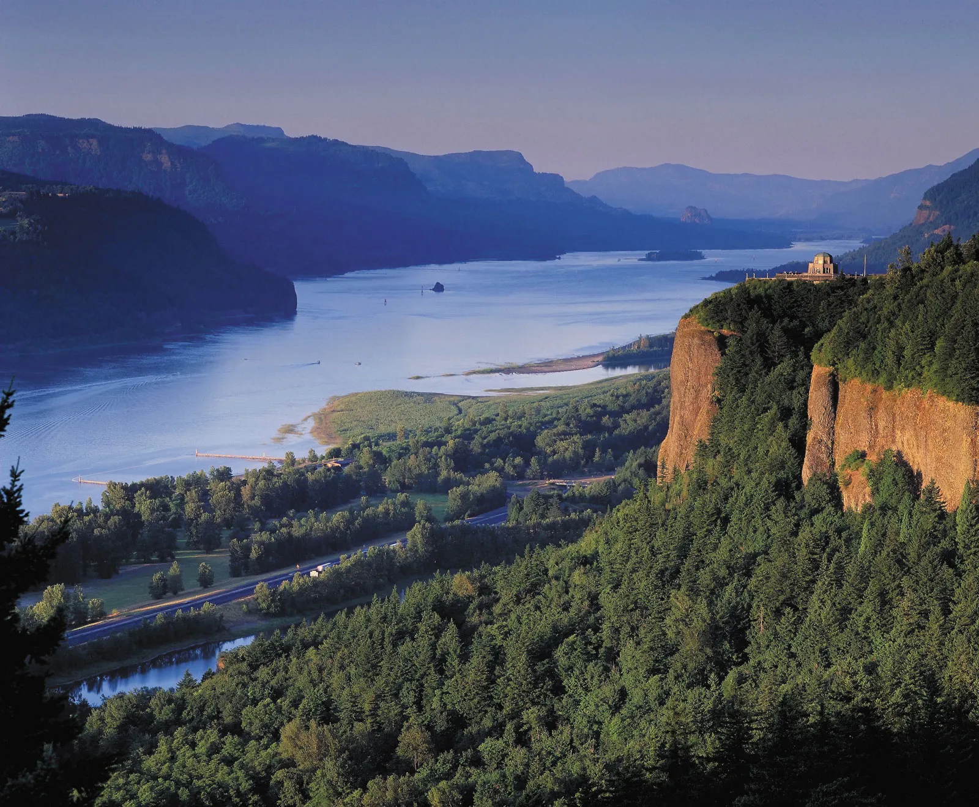
Questions?
Notes:
15

