Slide 1


Introduction to water resources economics
Richard J. Nugent III, Ph.D.
Economist, HEC-FDA Lead
Hydrologic Engineering Center (HEC)

Slide 2
Outline
Introduction to Economics
Public Economics Perspective
Flood Control Act of 1936
1983 Principles and Guidelines
Role of Economics Summary
Cost-Benefit Analysis
Optimization

Slide 3
Introduction to economics
Economics is the science of decision-making: the study of the allocation of scarce resources.
  How do people make decisions?
  What are the optimal decisions?
  Why do (1) and (2) not match?

Slide 4
Introduction to economics
Economics helps individuals, households, organizations, and governments make better decisions.
Perspective of consumer: unlimited wants, but not unlimited funds!
    Economics: what combination of goods and services, spending and saving (debt), work and leisure makes us the best off?
Perspective of government: unlimited interests, but not an unlimited budget!
    Economics: what combination of programs and infrastructure, spending and debt (saving) makes the country the best off?

Slide 5

Public Economics Perspective
Why is the federal government in the business of flood risk management?
Market Failure
Due to:
Economies of Scale
Excludability
Notes:
Economies of scale represent the reduction in per unit (marginal) cost as output increases. There are tremendous economies of scale for large-scale capital investment projects.
In the case of water resources engineering capital investments, the marginal cost is the cost to provide to an additional household flood risk reduction. Output is the risk reduction.
Excludability is the ability to limit services to only paying customers. Specific structures behind a levee are not excludable from flood risk reduction.

Slide 6

Flood control act of 1936
Flood control on navigable waters and their tributaries is in the interest of the general public welfare
Federal government may participate in flood control “if the benefits to whomsoever they may accrue are in excess of the estimated costs, and if the lives and social security of people are otherwise adversely affected.”
…thanks for the job security!!

Slide 7
p&g 1983 + ER 100
Federal Objective: Contribute to national economic development consistent with protecting the Nation’s environment
NED Benefits: Increases in net value of the national output of goods and services
NED Plan: A plan that reasonably maximizes net national economic development benefits, consistent with the Federal Objective

Slide 8
WRDA 2007 + ER 103
Federal Objective: Maximize sustainable economic development, avoid unwise use of floodplains, and protect and restore the functions of natural systems
NED Benefits: Increases in net value of the national output of goods and services
NED Plan: A plan that reasonably maximizes net national economic development benefits, consistent with the Federal Objective
Total Net Benefits Plan: The plan that reasonably maximizes net benefits across all four P&G accounts in comparison to costs

Slide 9
Role of economics: summary
The role of economics in FRM involves:
  Assess (potential reductions in) flood risk
  Weigh the trade-offs: reduction in flood risk against the cost of reducing flood risk
  Maximize increases in net national economic value while protecting the nation’s environment
National economic value is measured in terms of national economic development (NED) benefits:
  Flood risk reduction
  Emergency and clean-up cost savings
  Advanced bridge replacement (cost savings)
Flood risk reduction is identified through counterfactual analysis. Benefits are identified as difference in damages between two states of the future: with- and without-project conditions

Slide 10

NED Benefits
Without-project flood damage
-- With-project flood damage
Notes:
Once we have modeled flood risk for different states of the future: with- and without-project, we can identify the difference in flood risk between those different states of the future. The reduction in flood risk in the with-project condition from the without-project condition is the estimate of the benefits of the flood risk management measures in the with-project condition.
National Economic Development (NED), is defined in the P&G (1983) as “Increases in the net value of the national output of goods and services, expressed in monetary units. Contributions to NED are the direct net benefits that accrue in the planning area and the rest of the Nation. Contributions to NED include increases in the net value of those goods and services that are marketable, and also of those that may not be marketable.”
Note that we are discussing increases in the NET value of the national output of goods in services, that is, benefits NET costs. So we need to take a look at costs before we have identified the NED plan.

Slide 11

NED Costs
Project first cost
Interest during construction
Operations and maintenance
Notes:
The construction costs for each fiscal year are obtained from engineering division. Interest during construction is included as part of the implementation costs because costs are being incurred before the project becomes operational and benefits can be provided. The Federal discount rate is used to calculate the opportunity cost of the funds, or the interest during construction. Conceptually, interest during construction represents the cost of tying funds up in construction while not obtaining any benefits – and the cost represents the next best possible use for the funds, which is taken to be attainable interest from long-term investment in treasuries.

Slide 12
Transform costs and benefits into average annual equivalent (AAEQ) terms
Amortize over 50-year Period of Analysis
Construction Period
Period of Analysis
2020
2025
(Base Year)
2075
Costs Compounded Forward to Base Year
Costs and Benefits Discounted Back to Base Year
Notes:
Now that we have a benefit estimate and a cost estimate, we need a way to compare benefits and costs on equal terms. That is, we need to take into account the time value of money. We place a higher value on the near-term than the long-term. That is, we care less about $100k in damage that occurs in 100 years than $100k in damage that would occur next year. Because of the time value of money, benefits that occur in the year 2075 cannot be directly compared to costs that were incurred in 2020. We need to be able to compare the costs that occur in 2020 as they would be valued in 2025 to the benefits that occur in 2075 as they would be valued in 2025. This logic is used for the entire stream of costs and stream of benefits.
We do this by amortizing over the period of analysis. The base year is the year in which the project alternative becomes operational. The period of analysis is 50 years. The costs that occur before the base year are compounded forward to the base year. The costs that occur after the base year are discounted back to the base year. The net present value of the total costs are amortized over the 50-year period of analysis to get the average annual equivalent cost. The term “equivalent” is the signal that we are taking into account the time value of money.
We carry out the same procedure for benefits – that is discount the stream of benefits over the period of analysis back to the base year.
Once costs and benefits have been amortized, we have costs and benefits as they are worth in the base year, which is 2025 in this example, and can compare costs to benefits.

Slide 13
NED Net Benefits
AAEQ Benefits
-- AAEQ Costs
AAEQ Benefits
÷ AAEQ Costs
AAEQ Net Benefits
Benefit-to-Cost Ratio
The plan with the highest net benefits is the NED plan
The NED plan should have a BCR above 1 to be considered economically justified
Notes:
We have benefits, we have costs, they are on equal terms, and now we are ready to identify the NED plan. . This is what we did at the beginning of the presentation when we looked for the plan P* that maximized net benefits. The difference of AAEQ benefits less AAEQ costs gives us net benefits. The plan with the highest net benefits is the NED plan. We don’t really care to compare BCR across alternatives, because the BCR is not the statistic by which plan selection is made. All we care is that the BCR is above one so that the plan is economically justified (this is a little different from what happens at OMB)

Slide 14
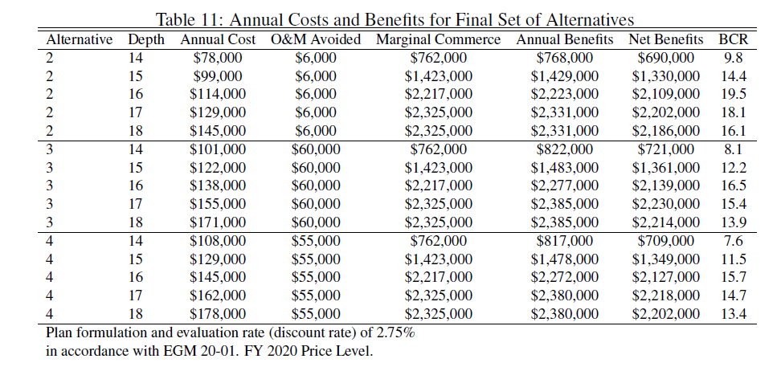
In practice: identify ned plan
Notes:
Take a look at the information in this table to identify the NED plan. While this is an example from a navigation study, the NED plan here has an interesting outcome worth discussing. There are three alternatives, each of which may be implemented at 5 different depths – these combinations are in the first two columns. Annual cost is in the third column, annual benefits in the 6th column, net benefits in the 7th column, and the BCR is in the 8th column. Using this information, please identify the NED plan.
(then, click)
Note that the NED plan need not have the highest BCR. The NED plan is the plan with the highest net benefits. It is possible that plans other than the NED plan have higher BCRs. How could this be?
…….
Take a simple two-plan example. Plan A has benefits of $2 and costs $1, with net benefits of $1 and a BCR of 2. Plan B has benefits of $8 and costs $5, with net benefits of $3 and a BCR of 1.6. Which plan adds more value to the nation? Plan B with net benefits of $3 but the lower BCR of 1.6.

Slide 15
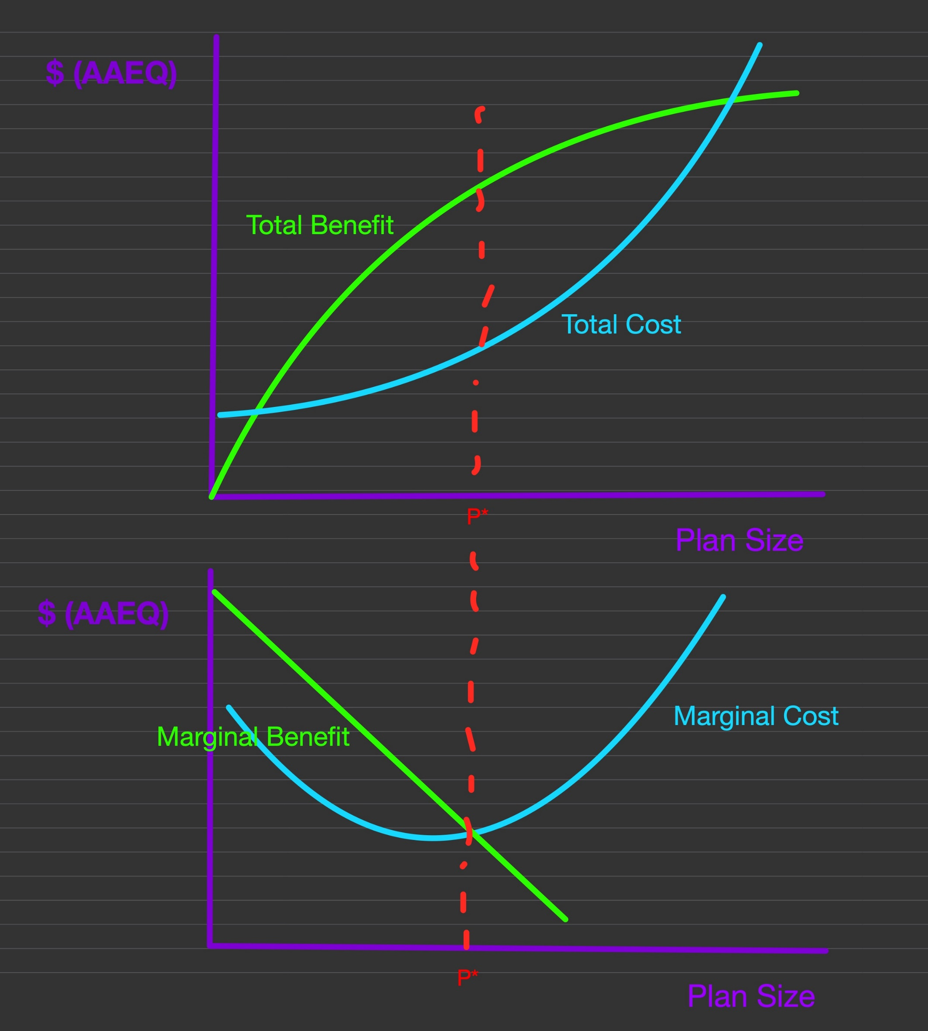
Final note: optimization
Notes:
Once we have a tentatively selected plan, we optimize (find the appropriate scale for) the tsp. Using the discrete process that we follow (i.e. a countable number of optimization alternatives), the optimal plan should almost always occur in the middle, with other smaller and larger alternatives. Why? Because costs will always increase while benefits may not (or may increase very slowly) as plan size increases, there will be a point when net benefits go down. Likewise, because of the nature of spreading fixed costs over the scale of the levee, there will be a point where total costs are greater than total benefits, hence net benefits must decrease at some point at levee size gets smaller.
The lesson to take from this is that if your optimized alternative is either the largest or the smallest plan, you do not know if you have actually optimized the tentatively selected plan. It is possible that a larger or smaller plan, respectively, yields higher net benefits.

