Slide 1
3.2. Estimation of Economic Uncertainty
Jordan Lucas

Slide 2
Sources of Uncertainty
First Floor Elevation
Asset Values
Structure Value
Contents Value
Vehicle Value
Other Value
Depth-Percent Damage Relationships
Structure Damage
Contents Damage
Vehicle Damage
Other Damage
Notes:
Three sources
FFE is approximately where damages begin
Asset values tell us what can be damaged
DDFs tell us at what rate damages increase as stages increase

Slide 3
Sources of Uncertainty
First Floor Elevation
Asset Values
Structure Value
Contents Value
Vehicle Value
Other Value
Depth-Percent Damage Relationships
Structure Damage
Contents Damage
Vehicle Damage
Other Damage
Notes:
Let’s talk a bit more about FFE

Slide 4
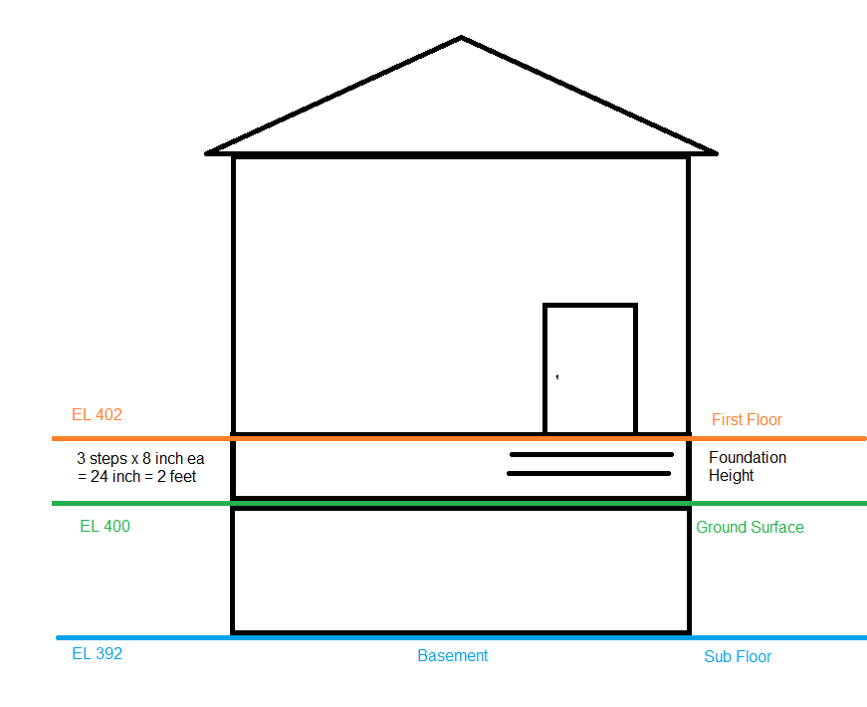
First Floor Elevation
First Floor Elevation = Ground Surface Elevation + Foundation Height
Notes:
FFE=GSE+FH
Damages generally begin when water surface is above the first floor
Some distance between the ground and the first floor
We want to know that, foundation height

Slide 5
First Floor Elevation
Uncertainty
Ground Surface Elevation
LIDAR
Foundation Height
Windshield Survey
Google Maps Street View
Site Visit
Distribution Types in FDA 2.0
Deterministic
Normal
Triangular
Uniform
Notes:
Two sources of uncertainty: GSE and Foundation Height
Lidar and eyeballs
Different types allowed in FDA
So, understanding where damages begin on a given structure helps inform the stage-damage relationship

Slide 6
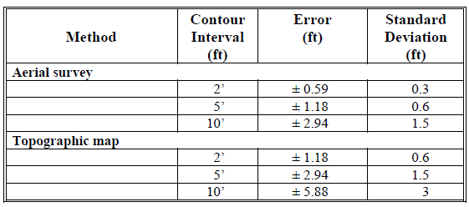
Ground Surface Uncertainty
May be provided by the source
Can reference FDA Manual (Table 9.1)
Can reference EM 1110-2-1619 (Table 6-5)
Both FDA manual and EM represent uncertainty distributions ~40 years old
FDA Manual (Table 9.1)
Notes:
We’re mostly using aerial survey in the form of LIDAR
Table from manual and EM
Very old
Could be updated

Slide 7
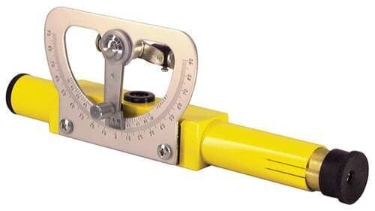

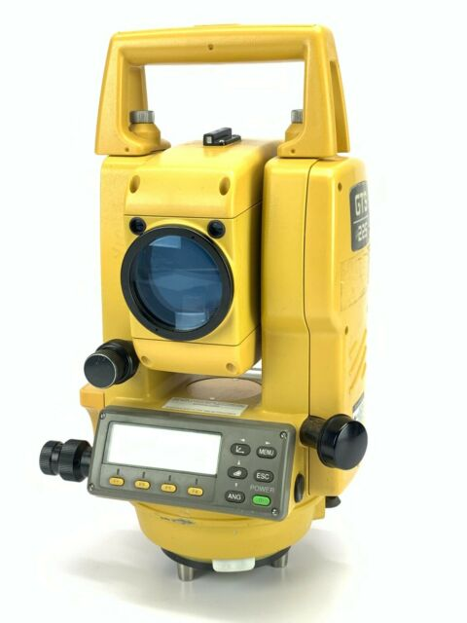
Methods of Survey
Site Visit – uses human eyeballs to count steps from a vehicle approximately 50 feet away
Google Maps Street View Survey – uses human eyeballs to count steps from street view imagery approximately 50 feet away
Slightly more uncertainty than site visit due to potentially low res imagery
Hand Level/Stadia – compares multiple points against a reference to find a horizontal distance.
Conventional/Auto Level – uses GPS and reference systems with a stable tripod to triangulate horizontal distance.
Notes:
How do we measure foundation height?

Slide 8
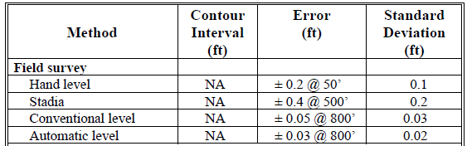
Foundation Height Uncertainty
Google Maps Street View ?? ??????? ??????
FDA Manual (Table 9.1)
Notes:
Also very old
Nothing about naked eye or Google Maps Street View
I usually call it .3 or .4
More uncertainty than Stadia

Slide 9
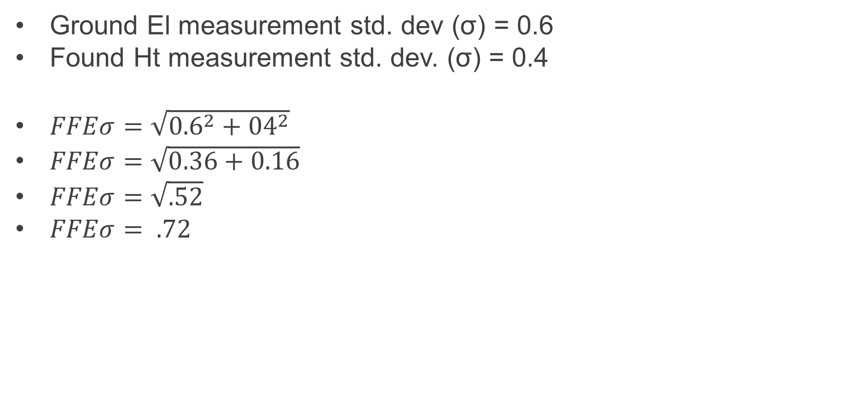
How to combine multiple Uncertainties?
Ground El measurement std. dev (σ) = 0.6
Found Ht measurement std. dev. (σ) = 0.4
$FFEσ=\sqrt{{0.6}^{2}+{04}^{2}}$
$FFEσ=\sqrt{0.36+0.16}$
$FFEσ=\sqrt{.52}$
$FFEσ= .72$
Notes:
Beth showed you this
This is the value you’d enter in FDA

Slide 10
EM 1110-2-1619
“Alternatively, professional judgment can be used to determine the most-likely, minimum, and maximum values, and a triangular distribution can be fitted.”

Slide 11

Statistically Significant Sample Size
$n={(\frac{Z∗S}{E}\text{)}}^{2}$, where
n = Sample size
Z = Z-Value (1.96)
$$S= \frac{{Foundation Height}_{High}−{Foundation Height}_{Low}}{6}$$
E = Allowable error (0.20)
Notes:
Now we need to determine survey sample
Not one way to do this, this is what we use in MVD
Z is for 95% confidence
S is a proxy of KU based on NV
E is allowable error, or desired level of precision (very sensitive to this)

Slide 12
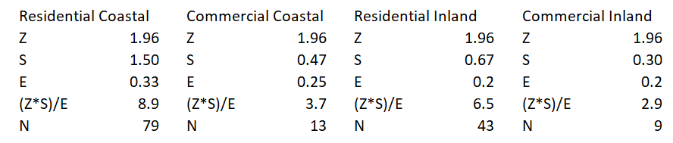
Developing a Stratified Sample
Sample Size Source Calculations
Notes:
Some examples of stratified samples
Best to split by occ type
Can also split by foundation type
Generally want to stratify by attributes that may impact foundation height
I typically round up to the nearest hundred or 500 depending on the size of the study area
May do separate stratification by floodplain

Slide 13
Sources of Uncertainty
First Floor Elevation
Asset Values
Structure Value
Contents Value
Vehicle Value
Other Value
Depth-Percent Damage Relationships
Structure Damage
Contents Damage
Vehicle Damage
Other Damage
Notes:
We know damages begin approx. at FFE
Let’s talk asset value
Helps us understand what can be damaged

Slide 14
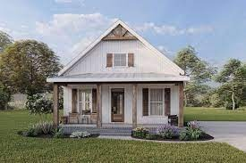
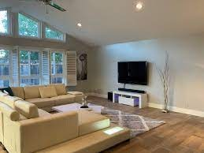
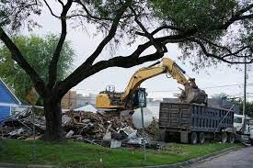
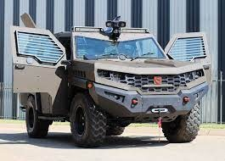
Asset Values
Structure Value
RS Means
Marshall & Swift
Parcel Data
Contents Value
EGMs (RES)
Regional Studies
Vehicle Value
Edmunds or KBB
Other Value
Regional Studies
Pretty open-ended
Same distribution types
Notes:
Look at the pics
RS Means/M&S
Parcel data (no uncertainty, maybe professional judgment or some other source; DOCUMENT IT)
Regional studies
Edmunds/KBB (no uncertainty)
Other: open-ended
Same distro types

Slide 15
Asset Value Entry
Structure Value
Entered directly in structure inventory
Contents Value
May be entered directly in structure inventory
May use CSVR
Vehicle Value
Entered directly in structure inventory
Other Value
May be entered directly in structure inventory
May use OSVR

Slide 16
RS Means
Inputs Convert NSI occupancy types to match RS Means
Select location factor
Select level of depreciation
Estimated age in years
Poor, Average, Good condition
Estimated sq ft (assumes we know with certainty)
Outputs
Used as inputs in FDA
Depreciated replacement dollar value per sq ft
Min
Most Likely
Max

Slide 17
Sources of Uncertainty
First Floor Elevation
Asset Values
Structure Value
Contents Value
Vehicle Value
Other Value
Depth-Percent Damage Relationships
Structure Damage
Contents Damage
Vehicle Damage
Other Damage
Notes:
Last source of uncertainty
We know approx. where damages begin
We know what will be damaged
We need to know at what rate damages occur as stages increase

Slide 18
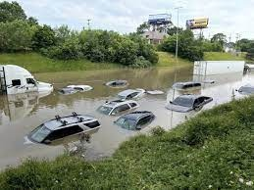
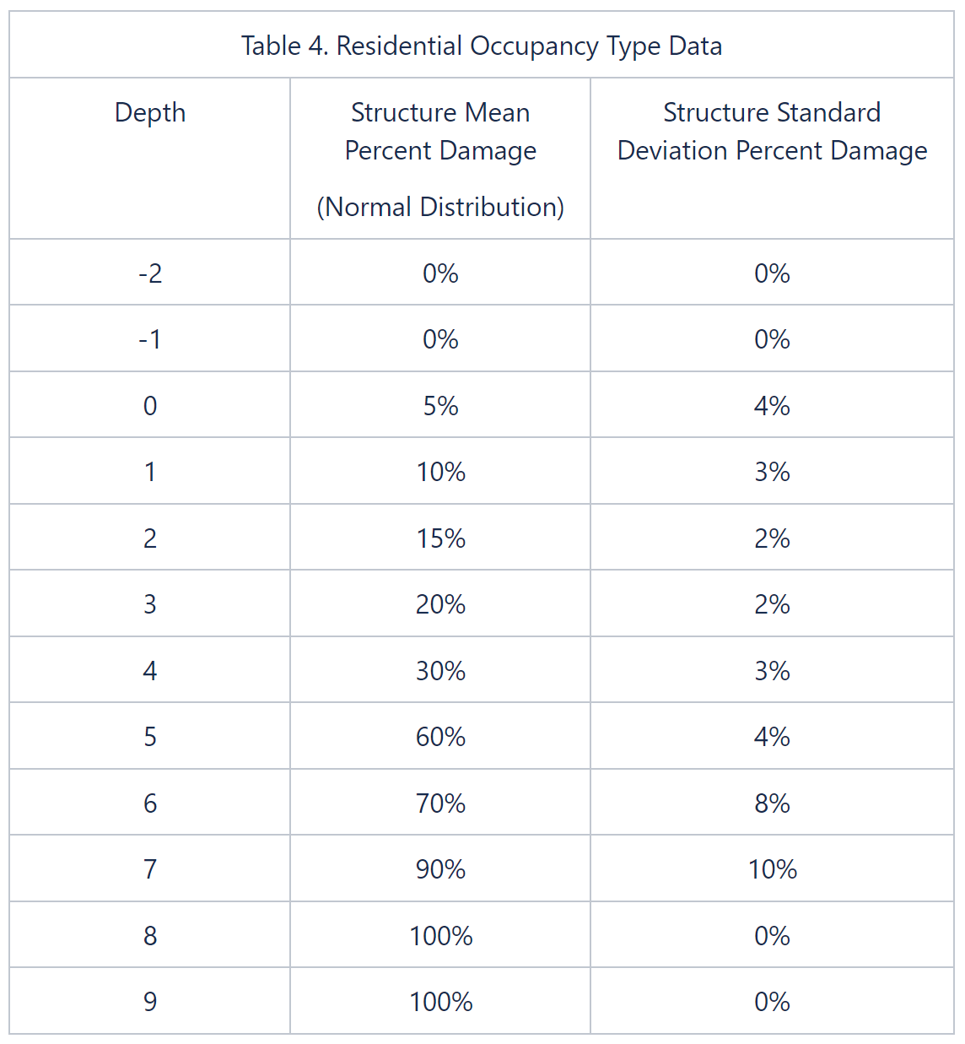
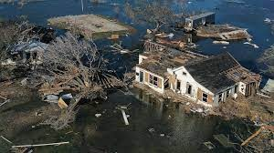
Asset Depth Percent-Damage
Structure Damage
EGMs
Regional Studies
Contents Damage
EGMs
Regional Studies
Vehicle Damage
EGMs
Other Damage
Regional Studies
Other studies or reports
Notes:
There’s uncertainty around the asset values, but also the percent-damage for a given depths
The table shows an example of a depth percent-damage relationship
Normal dist, 5 ft, 60% mean, 4% st dev
EGMs
Regional studies
Vehicle damages come from the EGM
Regional studies fill in the rest of the blanks
Other: open-ended

Slide 19
EGMs
EGM 01-03: Generic Depth-Damage Relationships for Residential Structures (no basements)
Structure and Content Depth-Percent Damage
One Story
Two+ Story
Split Level
AMAZINGLY, allows for negative values
Mean 2.5%, st dev 2.7%
EGM 09-04: Generic Depth-Damage Relationships for Vehicles
Sedan
Pickup
SUV
Sport
Mini Vans
EGM 04-01: Generic Depth-Damage Relationships for Residential Structures (with basements)
Same as EGM 01-03, but with basements
https://planning.erdc.dren.mil/toolbox/library.cfm?Option=Listing&Type=EGM&Search=Policy&Sort=YearDesc

Slide 20
Regional Studies
Not commonly conducted today
Expensive
Sometimes short vs long duration and salt vs fresh water
Will provide example studies for workshop
Expert Elicitation
Consultants
Contractors
Insurance Appraiser/Adjusters
Construction Executives
Restoration Construction Experts
USACE Advisors
Structure Surveys
Structure Owner Interviews

