Slide 2
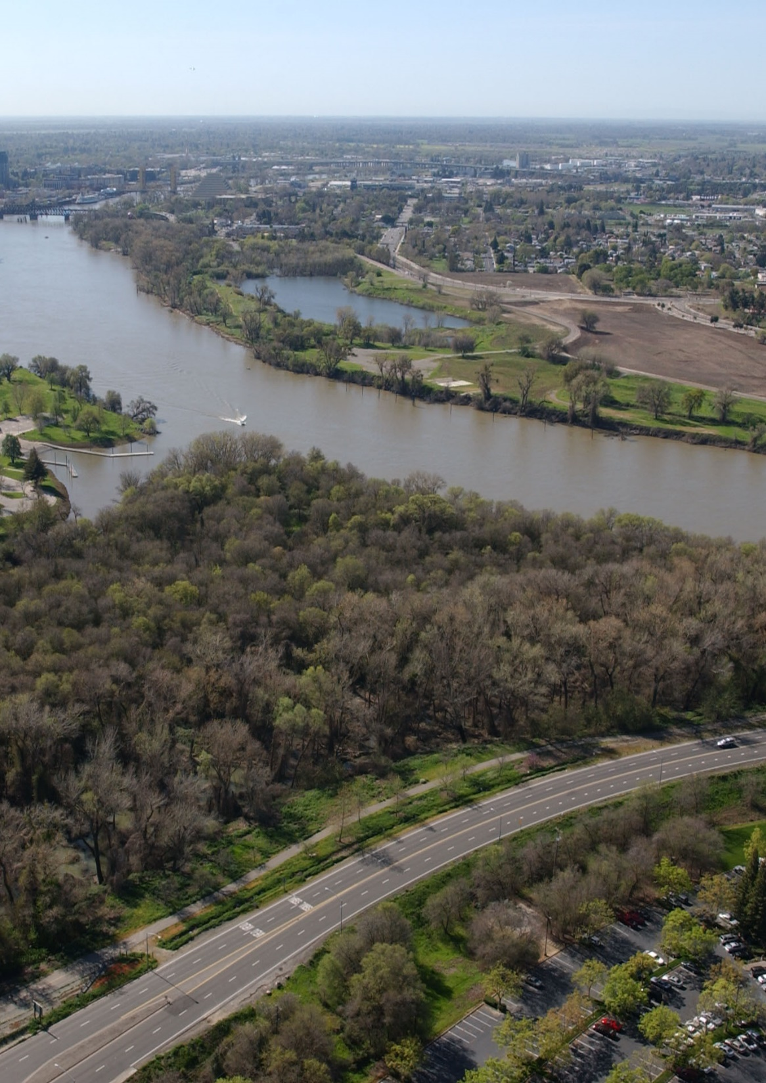
Risk Analyses in a Complex Interconnected System: Sacramento River
David Ford, PE, PhD Nathan Pingel, PE Steve Cowdin, CFM
February 2024

Slide 3
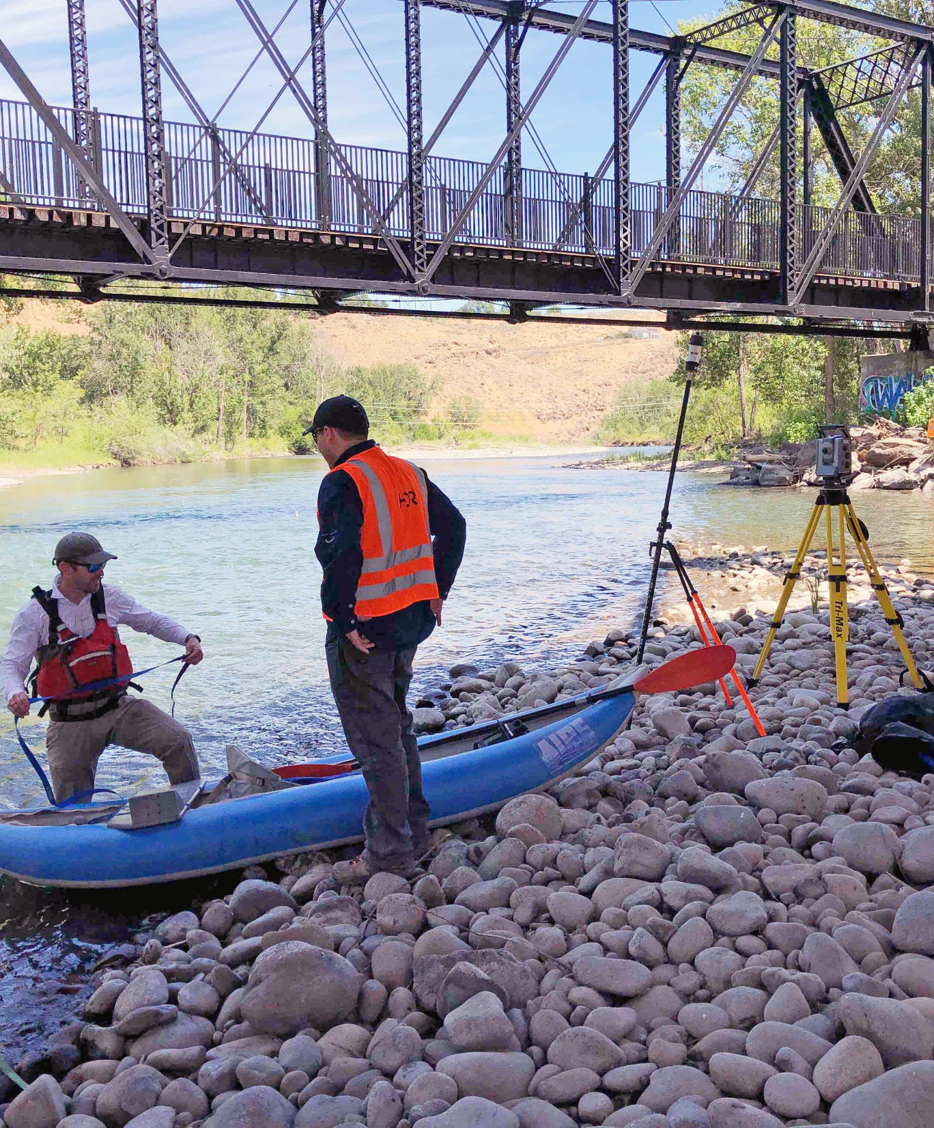
Questions that I will address:
01
What’s the flooding situation in the lower Sacramento River system?
02
Who has assessed risk there and why?
03
How was risk assessed for the system?
04
What makes that assessment difficult?
05
What can you learn from our analyses?
06
What about equity benefits?

Slide 4
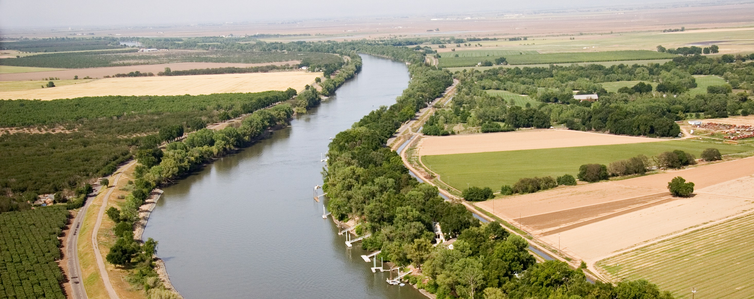
01
What’s the flooding situation in the lower Sacramento River system?

Slide 5
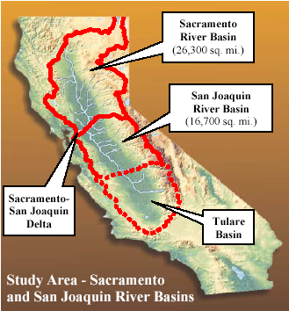

Slide 6
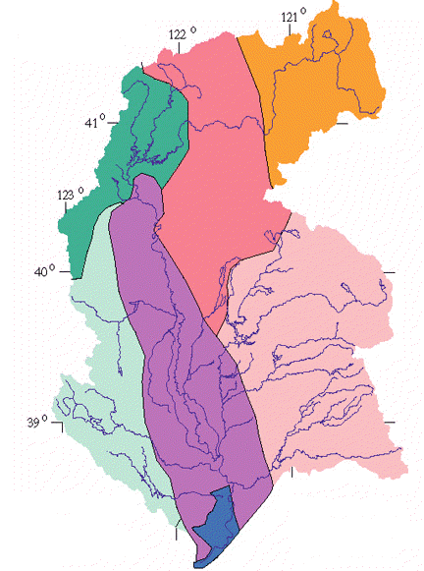
High desert. Snowy winters. MAP=12”
Sierra Nevada. Heavy winter snowfall. Elevations to 7000.
Coastal mountain range. Rainy, but little snow.
Sac Valley. Rain Oct-May. MAP=18” Elevations to 0.

Slide 7
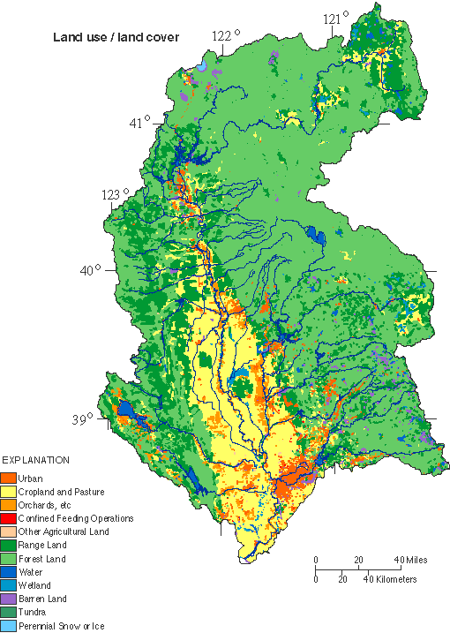

Slide 8
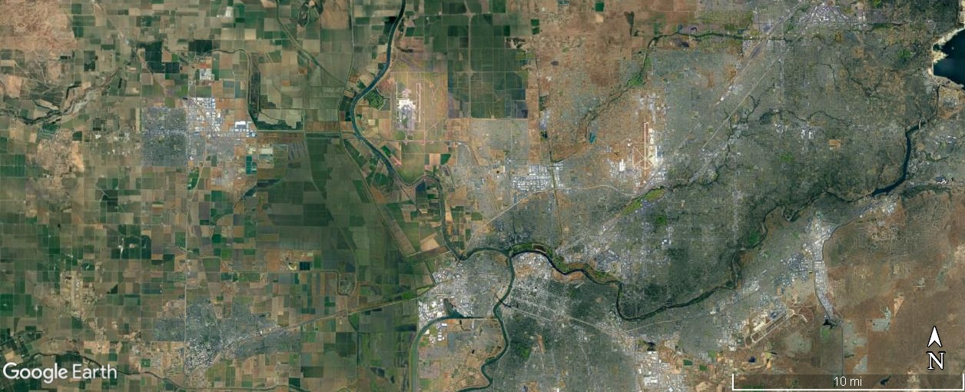
Sacramento River Near Airport
Notes:
Sacramento International Airport

Slide 9
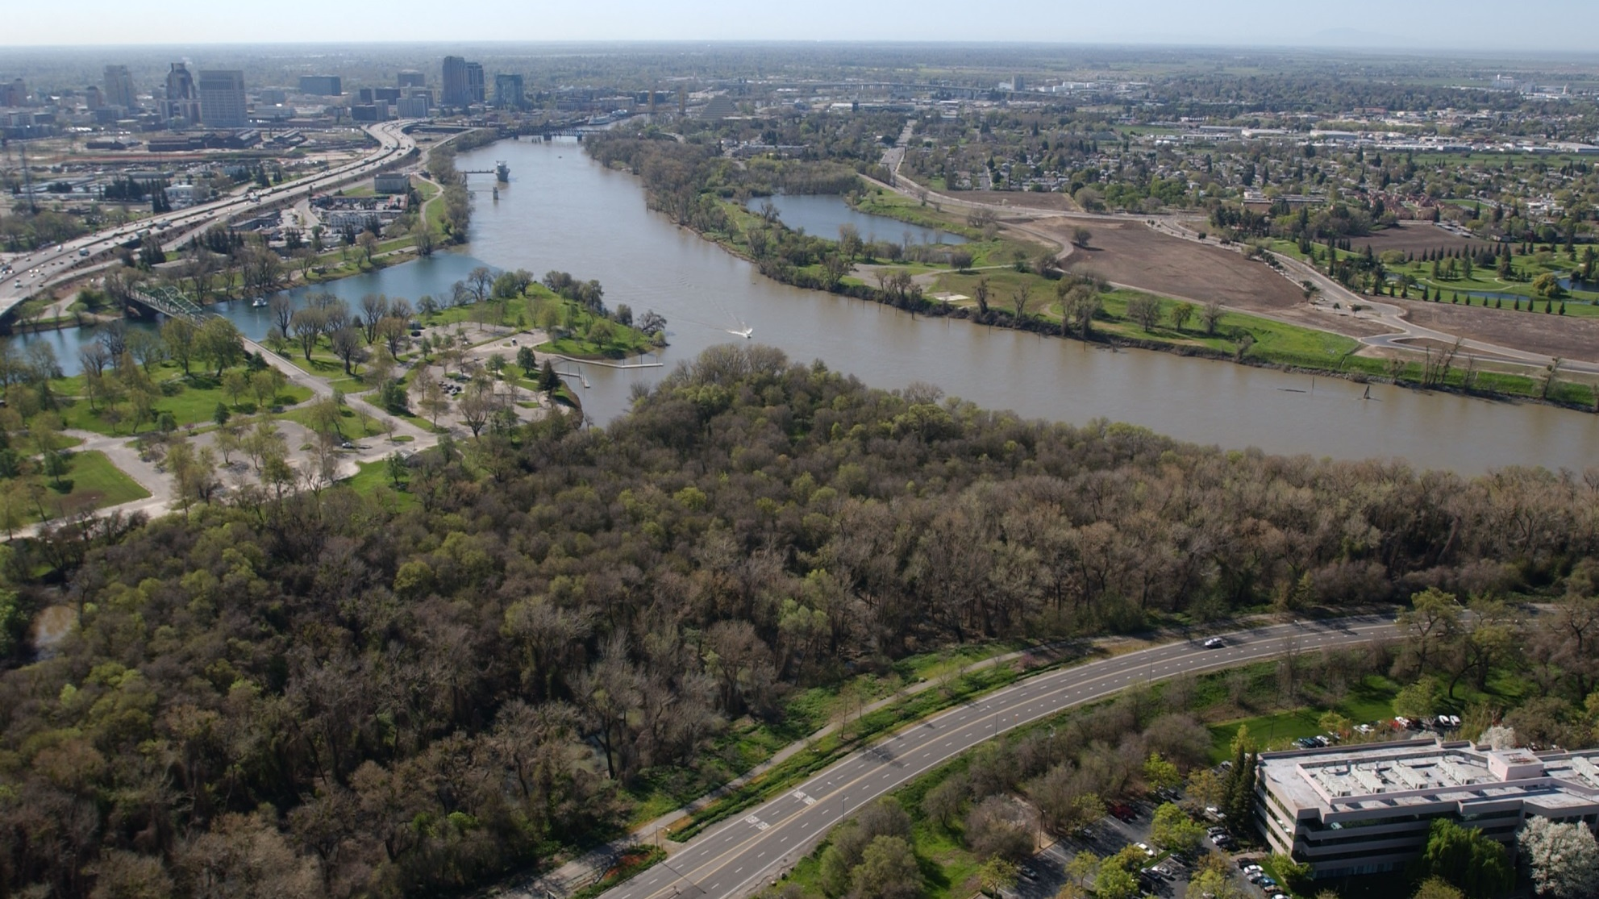
Sacramento River Near Downtown

Slide 10
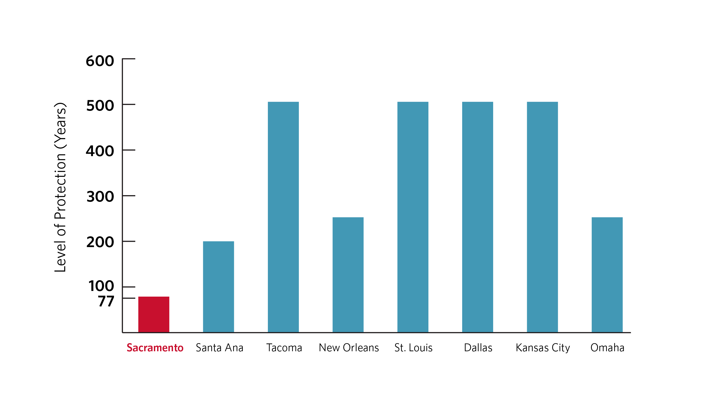
“Level of Protection” and Damage
Low level of protection (high AEP) for city of Sacramento. (See graph below)
Recent major floods in 1986 and 1997.
Estimated damages = $187 million in 1986 and $524 million in 1997.

Slide 11
02
Who assessed the risk there and why?

Slide 12
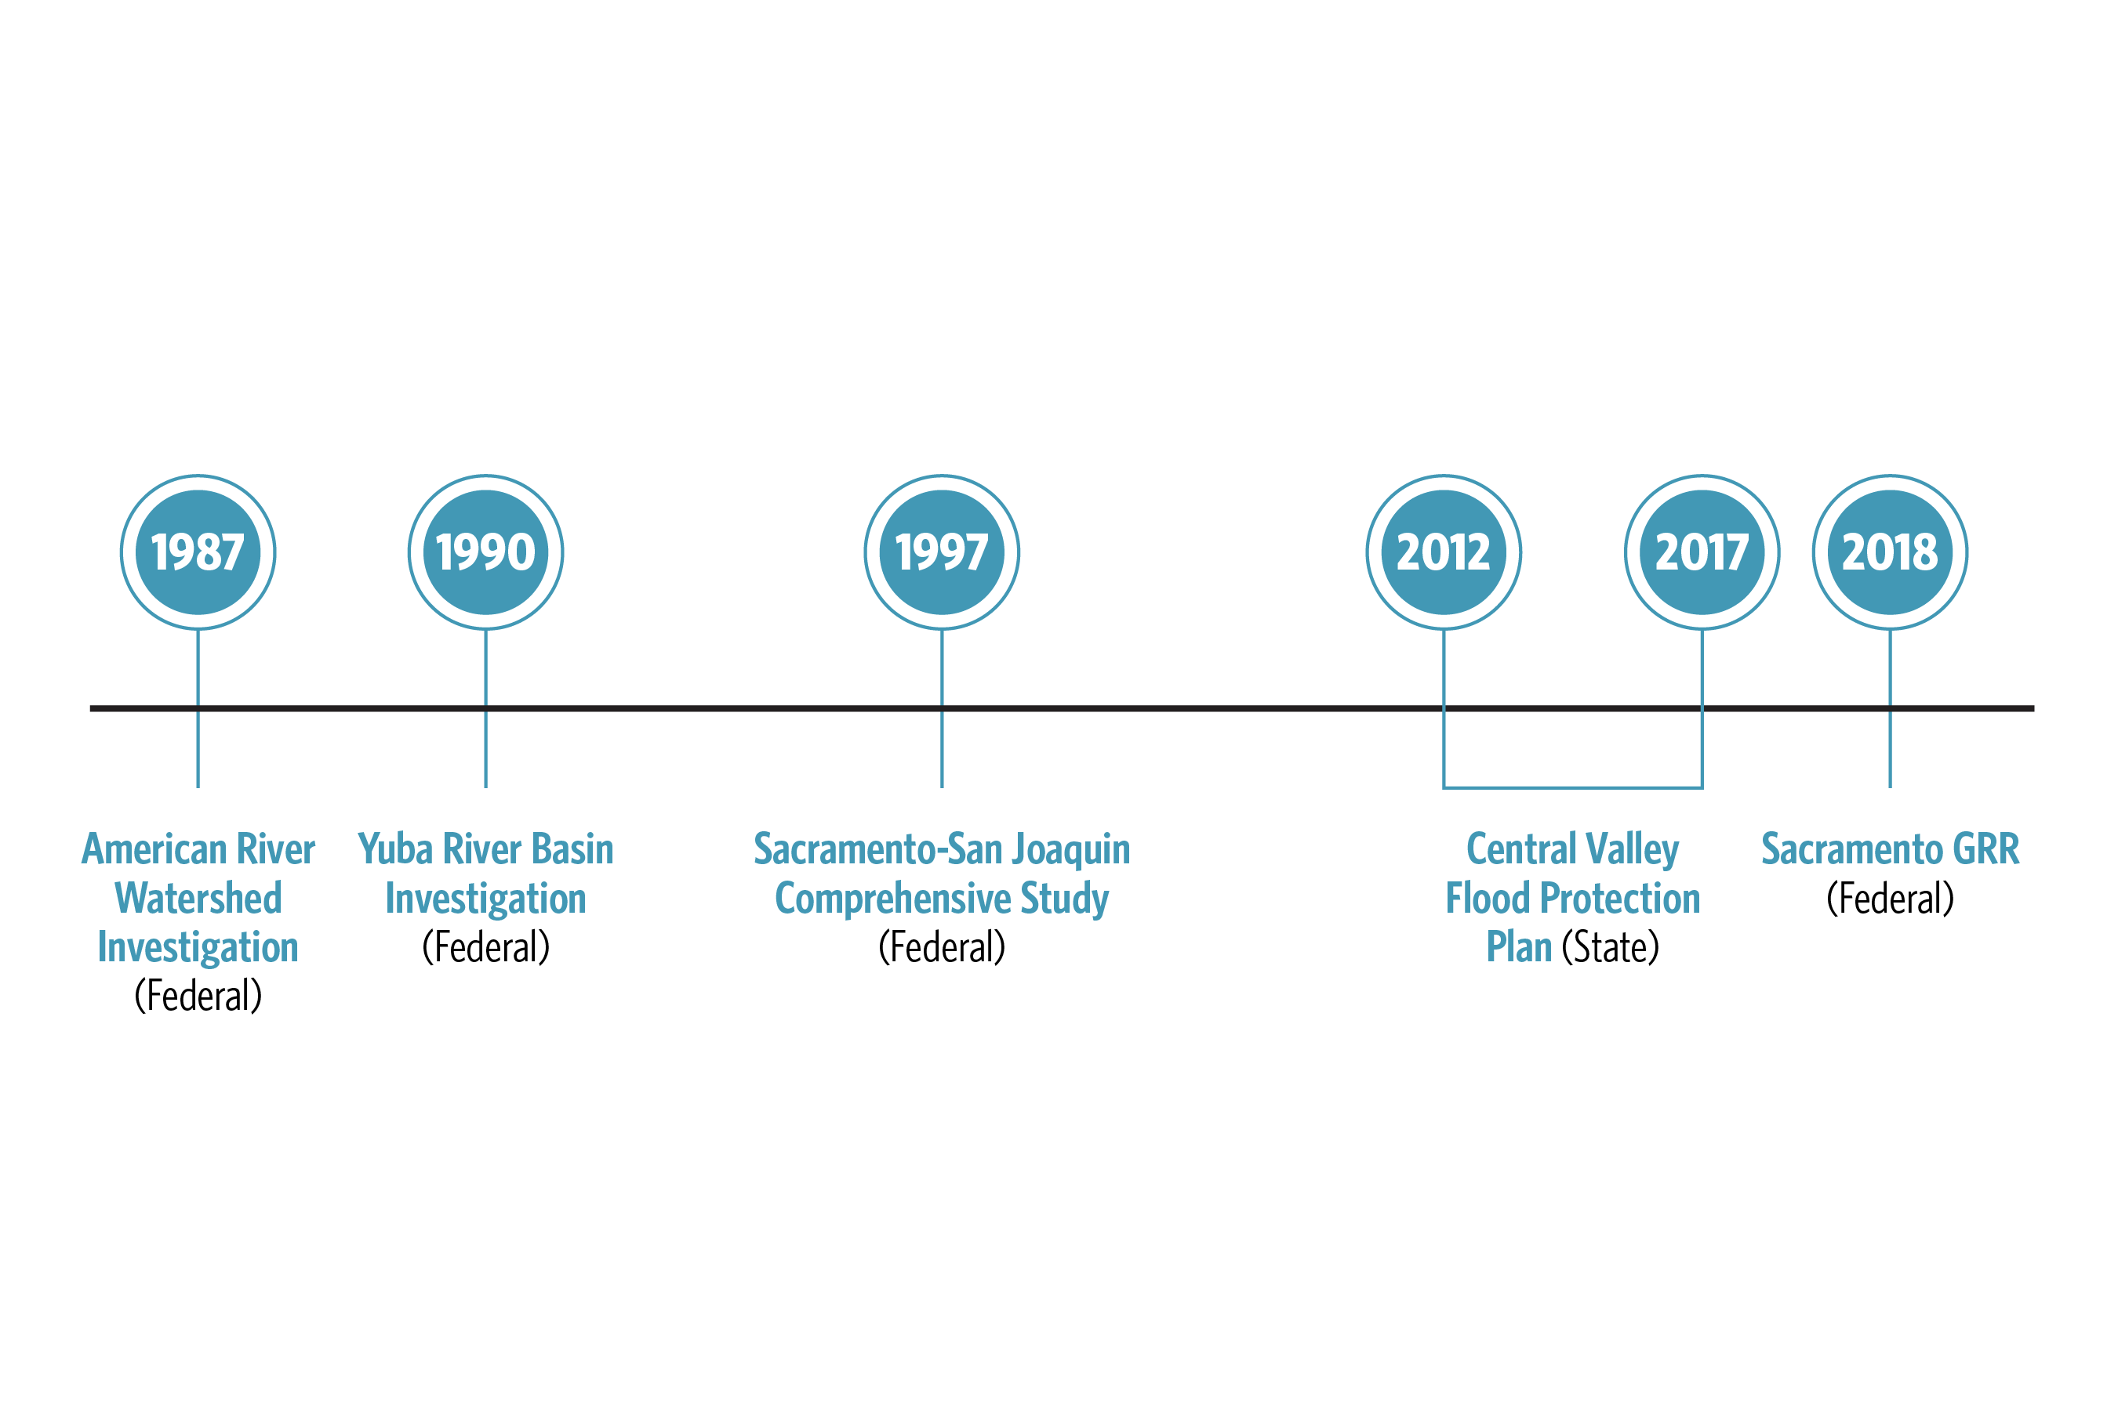
Who assessed risk there and why?
Recent studies include 2022 CVFPP and 2024 Yolo Bypass Comprehensive Study
Notes:
1987 American River Watershed Investigation (Federal). Study flooding in Sacramento area due to Sacramento and American Rivers.
1990 Yuba River Basin Investigation (Federal). Yuba and Feather River watershed.
1997 Sacramento-San Joaquin Comprehensive (Comp) Study (Federal). “…comprehensive assessment of the Central Valley’s flood management system to reduce flood damages and restore the ecosystem.”
2012 and 2017 Central Valley Flood Protection Plan (State).
2018 Sacramento GRR (Federal).
2022 CVFPP
2024 Yolo Bypass Comprehensive study

Slide 13
Who assessed risk there and why?
Other related studies included:
Risk reduction planning studies.
Sacramento Area Flood Control Agency (SAFCA)
City of West Sacramento
Three Rivers Levee Improvement Authority
Permitting studies. For Section 408 and State permits.
Notes:
Risk reduction planning studies. By Sacramento Area Flood Control Agency (SAFCA), City of West Sacramento, Three Rivers Levee Improvement Authority. Use Corps’ analysis programs. Objective to reduce risk, get reimbursement in cost sharing agreement, get permits to alter system.
Permitting studies. For Section 408 and State permits.

Slide 14
03
How was risk assessed for the system?

Slide 15
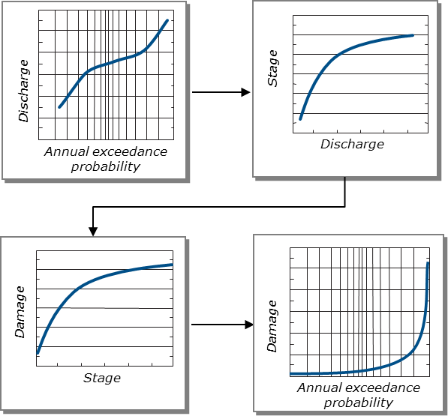
How We Assessed Risk

Slide 16
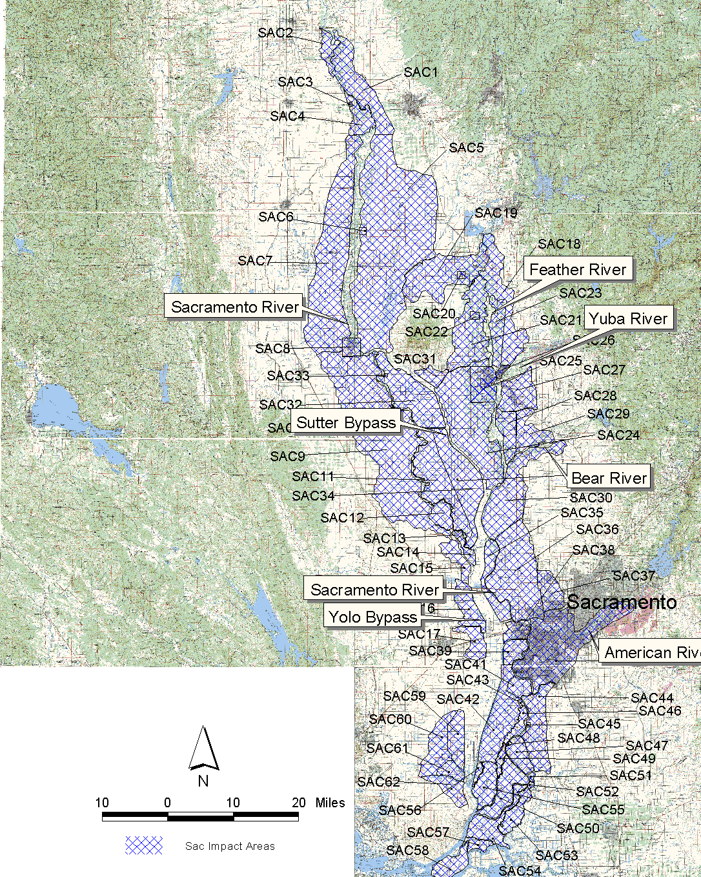
Model Configuration
About 60 impact areas.
Consequence related to stage on adjacent/predominate stream.
Stage-consequence and H&H models from Comp.
Notes:
~60 impact areas
Consequence related to stage on adjacent/predominate stream. 1 stream per impact area, with exceptions.
Stage-consequence models from Comp. Study, enhanced through CVFPP.
H&H models from Comp. Study, enhanced through CVHS and CVFED.

Slide 17
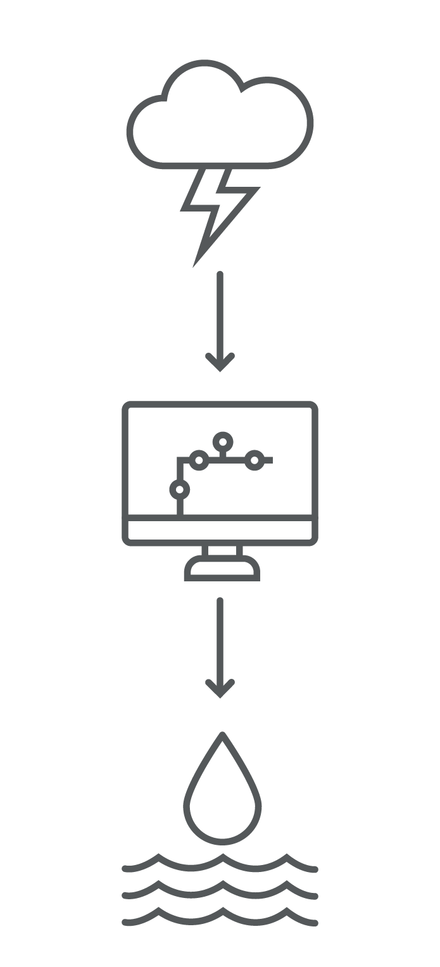
Hydrologic Analyses
Design Storm of Specified Probability
Highly regulated stream
Frequency model not appropriate.
Common design storm approach wouldn’t work.
Alternative approach by SPK relies on:
Gaged flows
Historical patterns
Composite floodplain concept
Update underway.
Calibrated Rainfall-Runoff-Routing Model
Runoff peak of known probability
Notes:
Highly regulated stream;
fitting frequency model to gaged data not appropriate.
Common design storm approach wouldn’t work.
Alternative approach by SPK relies on gaged flows, historical patterns, composite floodplain concept.
Update underway.

Slide 18

Hydraulic Analyses
Hydraulic analyses now use HEC-RAS.
Geometric data collected.
100+ routing reaches and 3,000 cross sections.
Extensive use of advanced modeling features.
Notes:
Hydraulic analyses use unsteady network model—mother of all UNET models initially, now HEC-RAS.
Geometric data collected using digital terrain models and bathymetric surveys (2-ft contours.)
100+ routing reaches and 3,000 cross sections.
Extensive use of advanced modeling features, including hydraulic storage areas, lateral weirs, flow diversions, levees, and bridges.

Slide 19
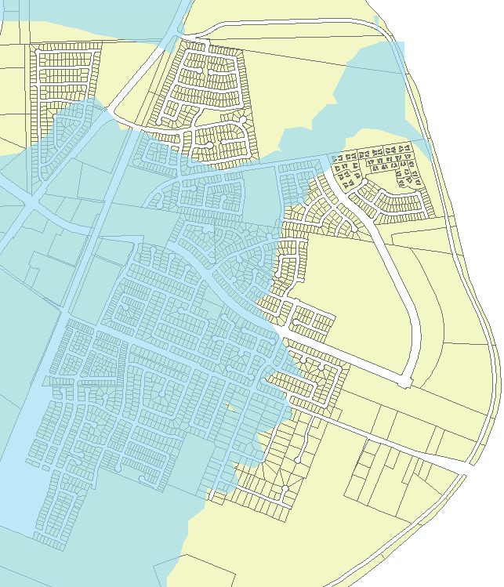
Exposure for Consequence Analysis
Parcel ID (1) | Value of Property ($1,000) (2)
046-491-005-000 | 165.83
046-491-004-000 | 150.97
046-492-008-000 | 217.21
046-503-001-000 | 239.81
046-492-002-000 | 192.66
046-521-005-000 | 219.72
046-491-002-000 | 195.40

Slide 20
04
What makes analysis difficult?

Slide 21
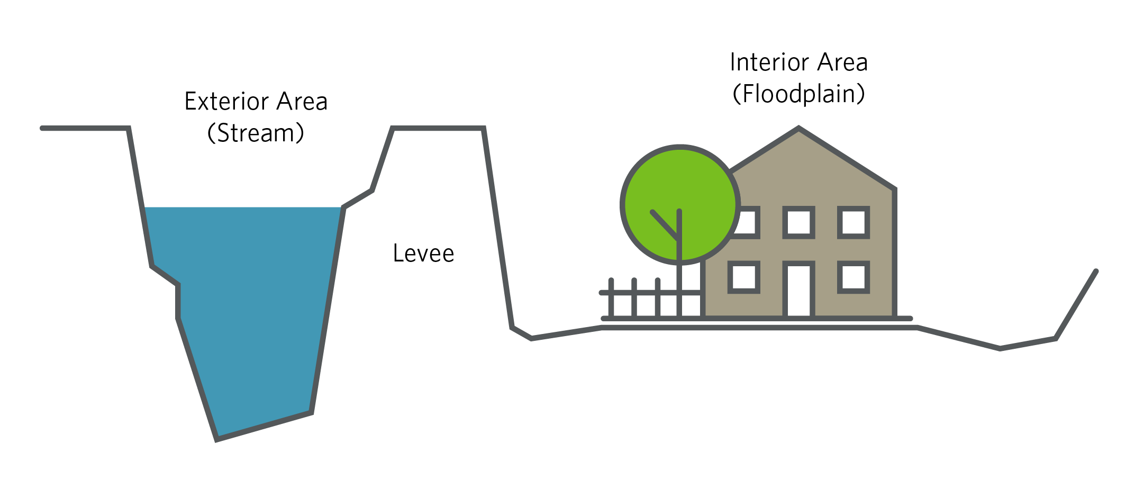
Part 1: What makes analysis difficult?
Notes:
Much of what matters to people in region protected by levees.
Exterior stage-frequency function does not represent interior flooding, so cannot be used for risk and damage computations.

Slide 22
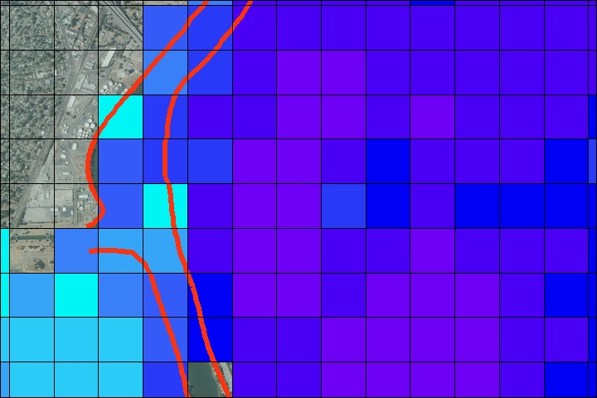
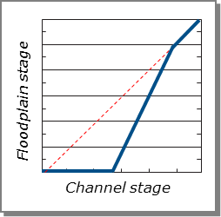
How We Deal With That

Slide 23
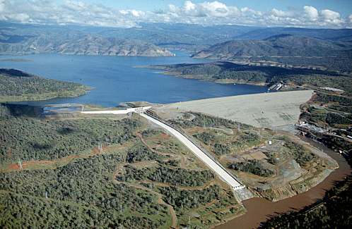
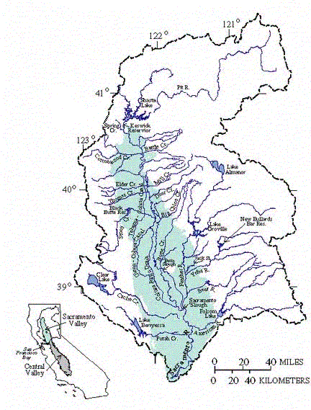
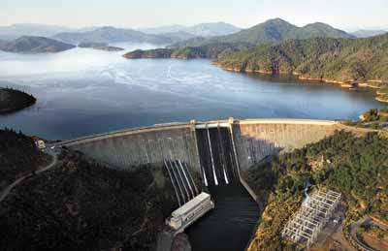
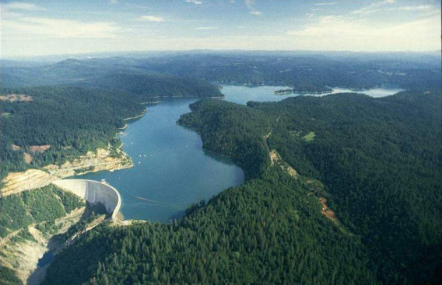
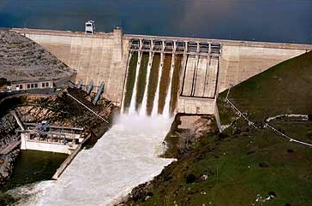
Part 2: What makes analysis difficult?
Notes:
Folsom 1M,
NBB 2M,
Oroville 4.5M,
Shasta 4.5M

Slide 24
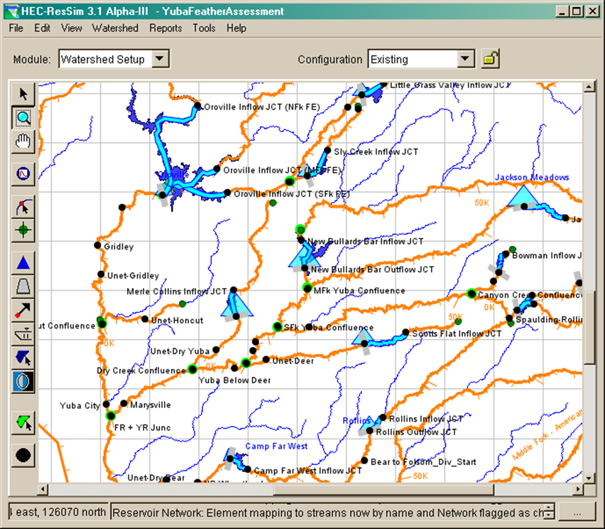
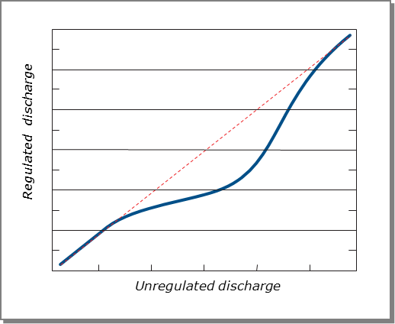
How We Deal With That

Slide 25
Part 3: What makes analysis difficult?

Slide 26
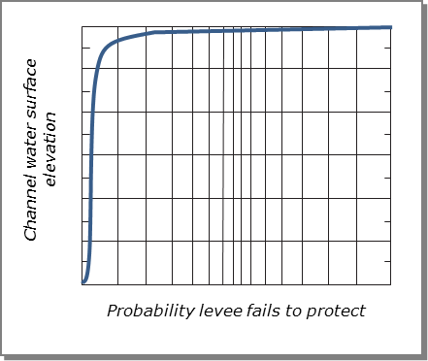
How We Deal With That
Notes:
Develop levee performance functions at index points
Different studies had varying degrees of “rigor”.
For CVFPP, much exploration, drilling, etc. + expert elicitation

Slide 27
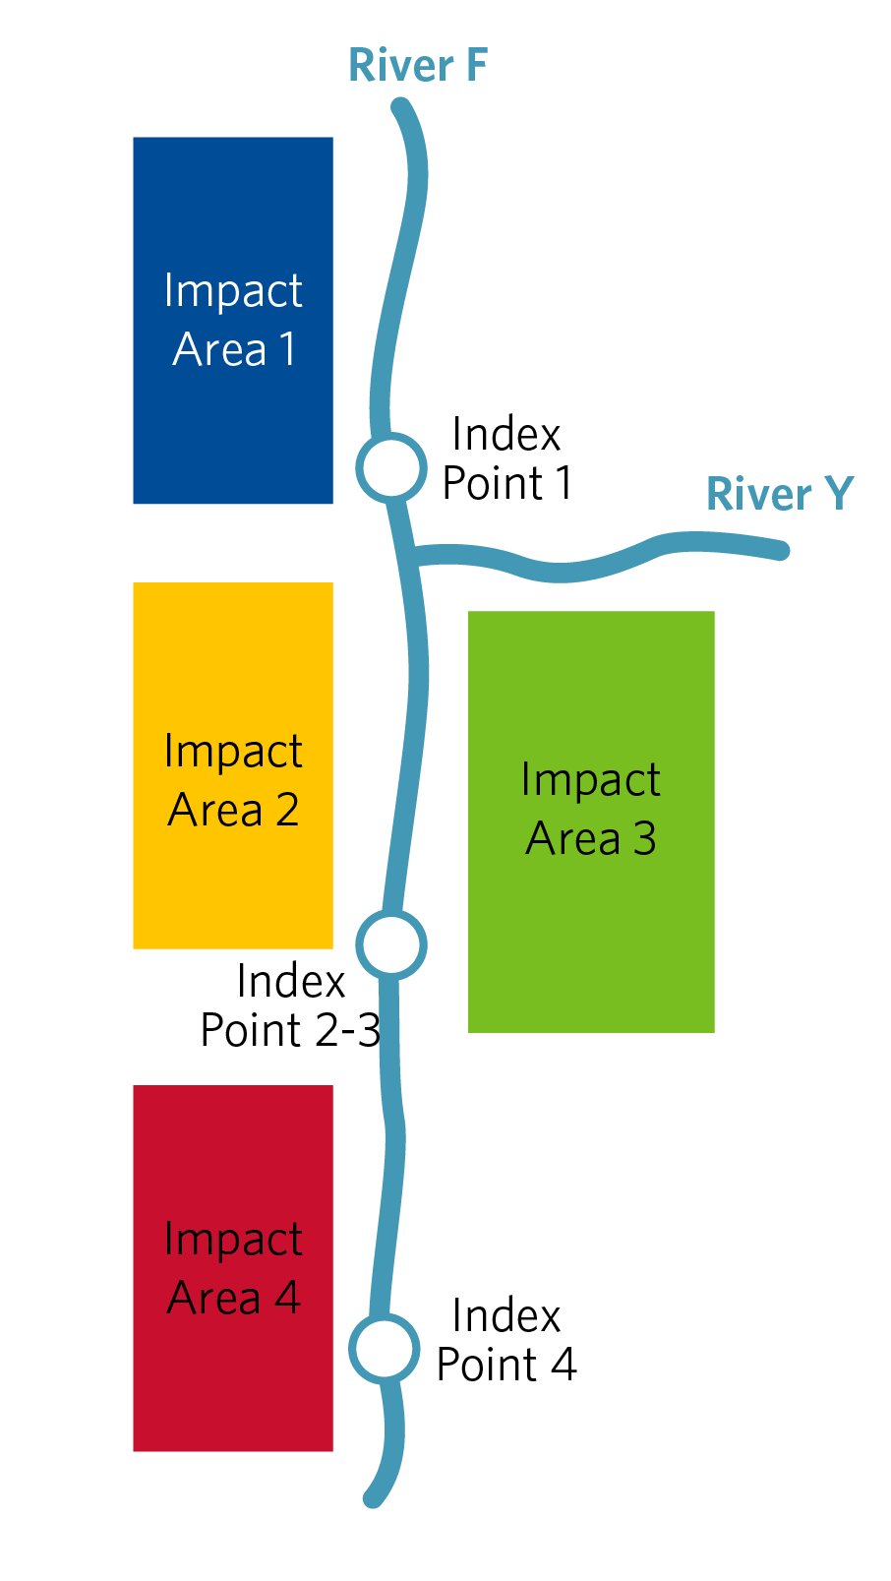
Part 4. What makes analysis difficult?
What is p=0.01 stage at index point 1?
What is p=0.01 stage at index point 4?
Notes:
What is p=0.01 stage at index point 1?
What is p=0.01 stage at index point 4?
Q: Given set of frequency-based design storms, appropriate watershed and channel models, and descriptions of uncertainty about system behavior and performance, how can we define stage-frequency function at any index point in a leveed system?

Slide 28
What would you do?
?

Slide 29
Possible solutions
Ignore it and hope that it goes away or that no one else notices. (Good luck.)
Use the worst case, like FEMA does. (Defeats the purpose of risk analysis, doesn’t it?)
Use frequency-based storm analysis with complete enumeration.
Use frequency-based storm analysis with selective enumeration.
Use frequency-based storm analysis with integrated sampling.
Use period-of-record analysis.

Slide 30
Frequency-Based Storm Analysis with Complete Enumeration
Notes:
For 20 impact areas, 8 storms, 2 centerings – 16 million runs.
If they take 5 min – 160 yrs for analysis

Slide 31

Frequency-Based Storm Analysis with Selective Enumeration
Ask experts to identify more-likely failure scenarios.
Evaluate only those.

Slide 32



Steps in our solution
Found experts.
Provided information.
Opinions on failure for p=0.50 to p=0.002 events.
Configured and ran HEC-FDA.
Statistically analyzed computed EAD and other measures of performance.
Notes:
Found experts who understand the system, know the history, etc.
Provided info. such as profiles for overtopping only, infinitely-high levees, etc.
Asked experts for opinions on failure for p=0.50 to p=0.002 events.
Configured and ran HEC-FDA separately and independently for each expert’s stage-frequency function.
Statistically analyzed computed EAD and other measures of performance.

Slide 33
Stage-Frequency Functions for Expert Scenarios for SAC36

Slide 34
Results of Analysis for SAC36

Slide 35

Why it is so hard to keep your eye on the ball…
Paterno v. State of California.
3000 plaintiffs sued for damages when Linda levee collapsed in 1986.
State’s potential liability $800M to $1.5B.
Most-likely future without project condition now?
Maybe fix levees to design profile. But when?
Notes:
Paterno v. State of California. 3000 plaintiffs sued for damages when Linda levee collapsed in 1986. State assumed responsibility for levee in 1953. Plaintiffs argued that State owed for property lost in flooding.
3rd District Court of Appeals found State should have known fragility, had “ample opportunity” to monitor & make necessary improvements. State Supreme Court refused to hear on appeal. State’s potential liability $800M to $1.5B.
Most-likely future without project condition now? Maybe fix levees to design profile. But when?

Slide 36
Part 5. What makes analysis difficult?
Configured UNET.
Created “sub-impact areas.”
Computed EAD, AEP, CNP.
Now, channel elevation to floodplain surfaces.
Notes:
Configured UNET w/ storage areas to account for spatial variations of stage. Water flows between.
Created “sub-impact areas” with interior-exterior relationship for each.
Computed EAD, AEP, CNP, for each, as before, with multiple scenarios.
Now, channel elevation to floodplain surfaces.

Slide 37
Part 6. What makes analysis difficult?
Development continues.
Forecasted future damage.
Future, without-project = conditions expected in absence of project.
Must consider NFIP participation.
Used population projections.
Scaled or recomputed EAD.
Notes:
Development continues.
Forecasted future damage, without & with project.
Future, without-project = conditions expected in absence of project. Gotta consider NFIP participation.
Used population projections, authorized plans, to develop growth rate.
Scaled or recomputed EAD.

Slide 38
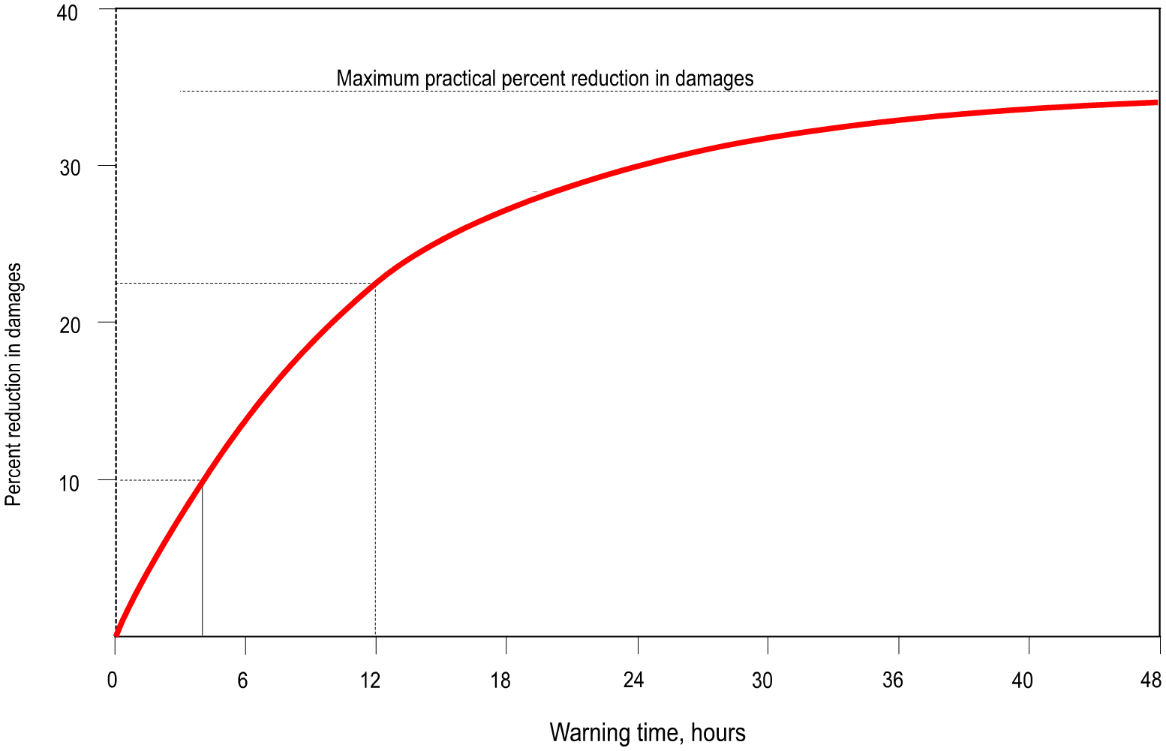
Part 7: What makes analysis difficult?
Sacramento River system has outstanding flood forecasting/ response system in place.
Notes:
Sacramento River system has outstanding flood forecasting / response system in place.
Advanced warning offers damage reduction.
Plans include enhancing that system.
All earlier Corps’ flood warning studies use Day curve to evaluate. HQUSACE said NO here.

Slide 39
Depth-damage-warning time
Notes:
Started with Corps’ depth-damage function for residential content.
Surveyed experts for opinion re: damage reduction possible with varying mitigation time.
Produced and used new method that accounts for lead time, system efficiency.
Technical paper on procedure in ASCE journal. Also accepted by NWS and USGS.

Slide 40
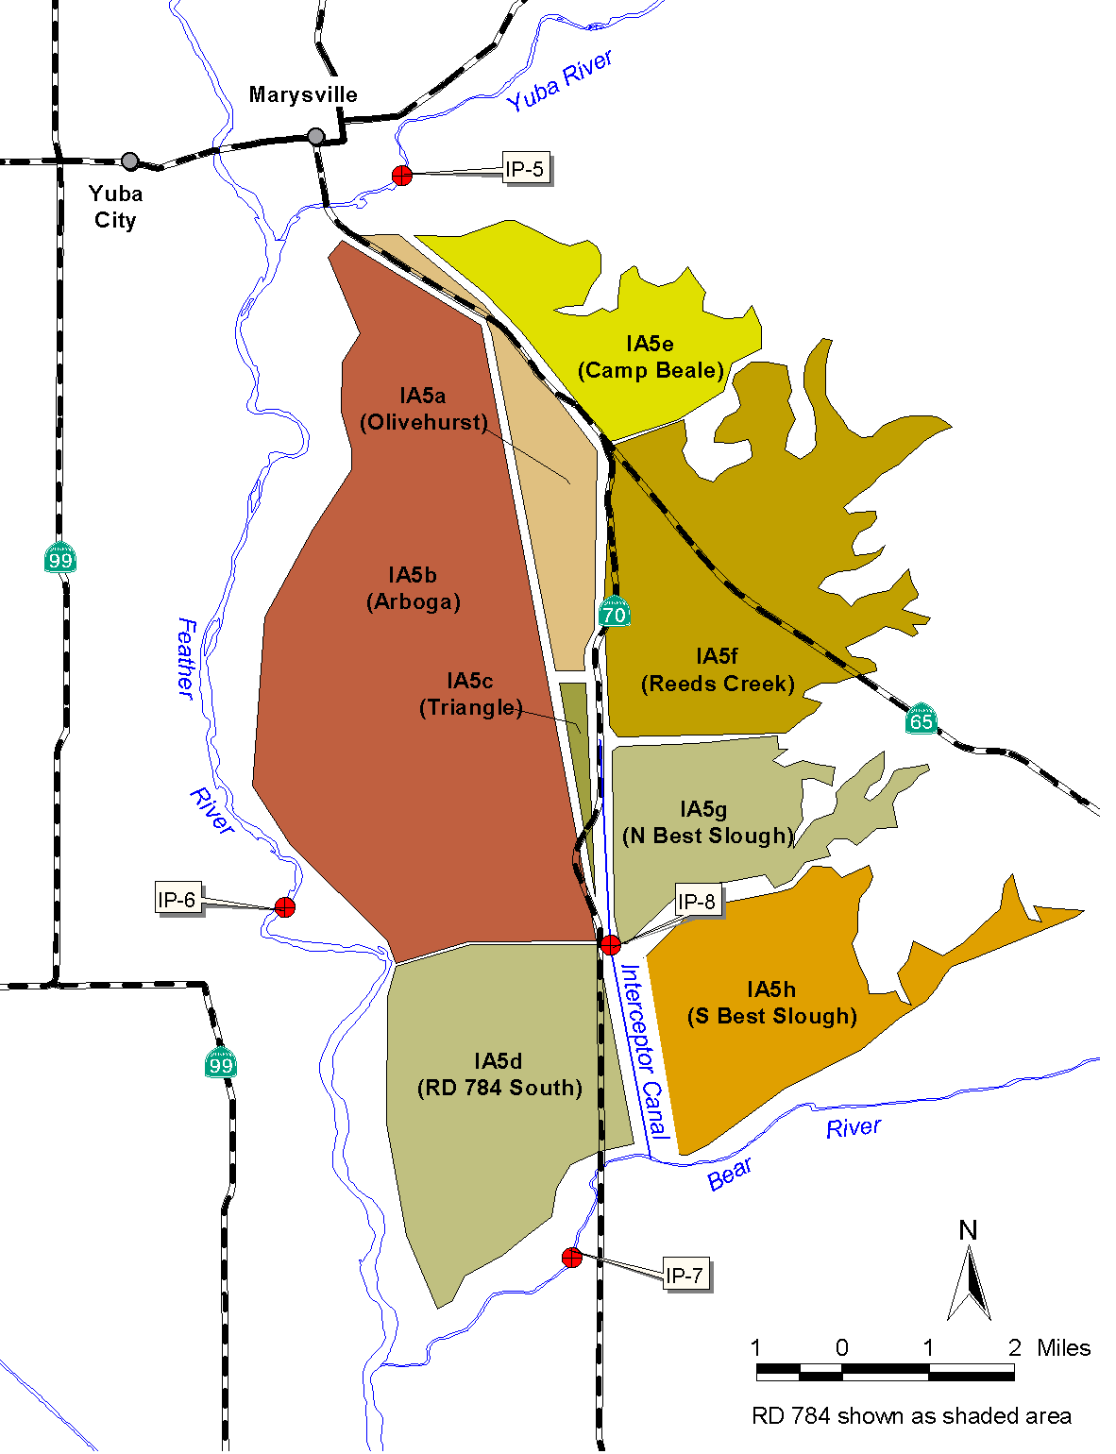
Part 8: What makes analysis difficult?
Flooding from multiple sources with levees to protect.
For example, RD 784 (see right).
How do we characterize risk and potential damage in a case such as this?
Notes:
In some locations, flooding from multiple sources--with levees to protect.
For example, RD 784 (at right) subject to flooding from Yuba, Feather (trib to Sacramento), Bear, and WP Interceptor Canal.
How do we characterize risk and potential damage in a case such as this?

Slide 41
What would you do?
?

Slide 42
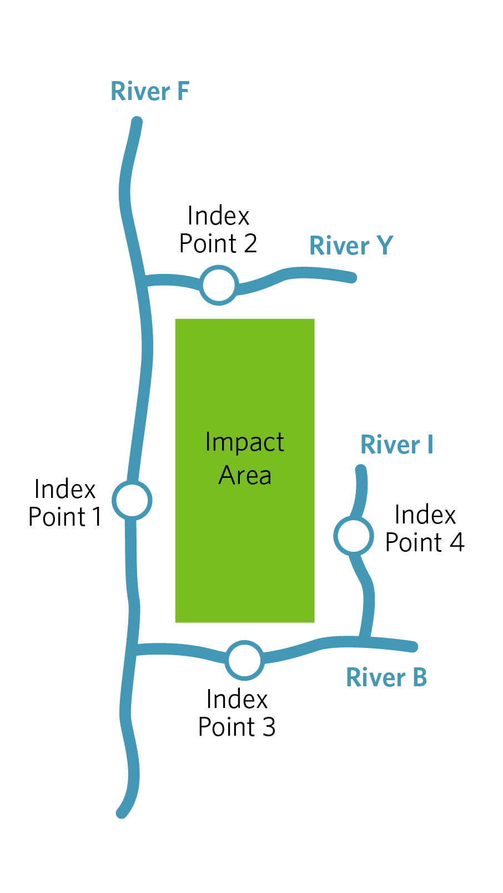
Our Previous Approach
Identified index point (IP) on each stream.
Computed weighted EAD, with weights assigned as:
AEP = min (AEP_{IP})
Notes:
Identified index point (IP) on each stream.
Developed stage-freq for IP.
Defined interior-exterior relationship for impact area (IA) with that IP.
Computed AEP and EAD for IA with selected IP.
Repeated for each IP.
Computed weighted EAD, with weights assigned as (equation pictured)
AEP = min (AEP_{IP})

Slide 43
Our Current Approach
Assess independence of IPs
Assess degrees of correlations
Use appropriate methods based on findings.
Compute EAD with that.
Determine AEP with that.
Notes:
Assess independence of IPs.
Assess degree of correlation between dependent IPs. (Watch consistency in correlation assumptions with hydrology and hydraulics)
Use appropriate method based on findings of correlation analysis.
Compute EAD with that.
Determine AEP with that.

Slide 44
Notes:
ASCE Journal of Water Resources (May/June 2010)

Slide 45

Part 9: What makes analysis difficult?

Slide 46
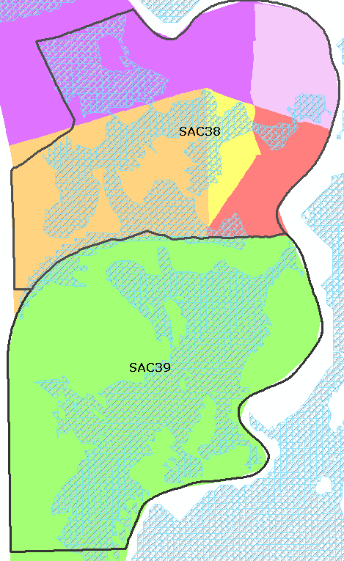
Exposure for Life Risk Analysis
Impact area (1) | Population in floodplain (2)
SAC38 | 91644
SAC39 | 789797
SAC40 | 7217
SJ99 | 12565

Slide 47
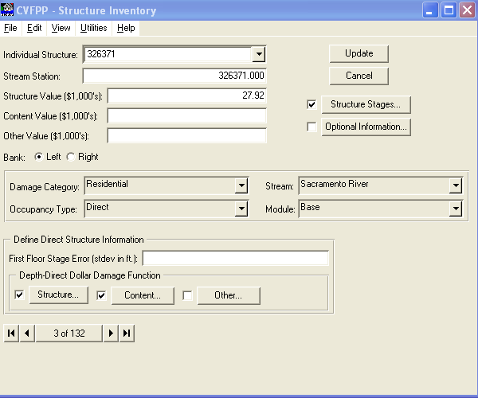

2.1

Slide 48
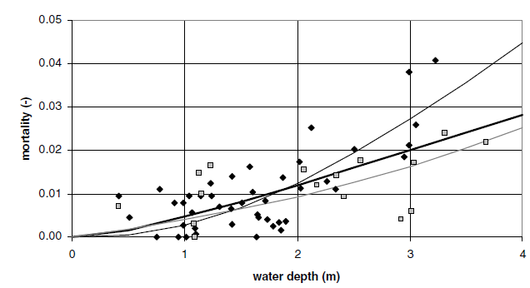
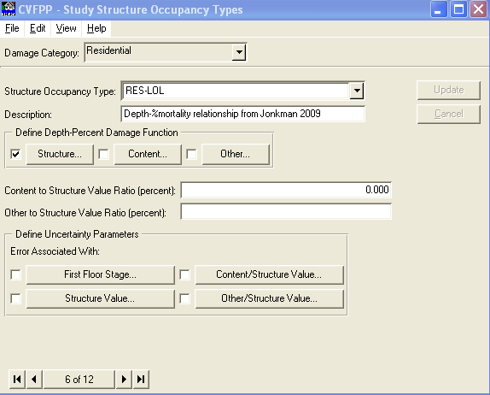
Vulnerability

Slide 49
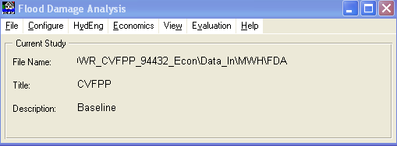
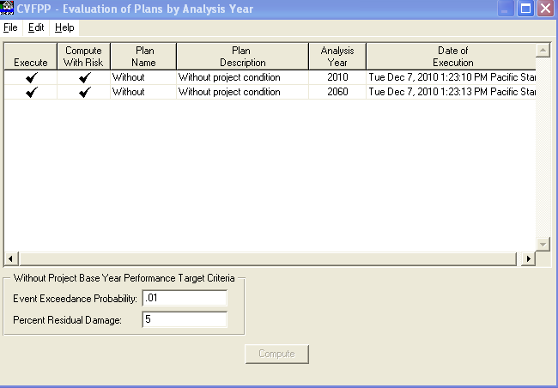
Consequence-Likelihood Computed with HEC-FDA

Slide 50
05
What can you learn from our analyses?

Slide 51




Maintain maximum flexibility in developing depth-damage model.
Work cooperatively with other analysts.
Account for future conditions but be sure to follow the regulations closely.
Answer the questions that are relevant.
Notes:
Maintain maximum flexibility in developing depth-damage model. For example, don’t build in a levee-breech assumption; use the interior-exterior relationship for that.
Work cooperatively with other analysts.
Make sure that the geotechs understand how critical performance curves are (and how difficult it is for you to redo the risk analysis).
Same with H&H analysts. You will bridge any knowledge gap.
Remember it’s a systems analysis.
Account for future conditions but be sure to follow the regulations closely.
ER 1105-2-100 is clear about what to do, but you need to read it a few times to see what is between the lines.
Potential shift in policy re: future development.
Answer the questions that are relevant. For some, you won’t need EAD, just AEP and CNP.

Slide 52




Look hard at the results.
Account for the impacts of flood warning in your watershed.
Don’t oversimplify cases with multiple sources of flooding.
Don’t forget life risk analysis.
Notes:
Look hard at the results. Make sure the risk analysis is complex, but if the results seem wrong, they probably are.
Account for the impacts of flood warning in your watershed.
Don’t oversimplify cases with multiple sources of flooding. Account for risk associated with each area, and remember that for any one area, only 1 value of EAD exists,1 value of the p=0.01 stage exists, etc.
Don’t forget life risk analysis.

Slide 53
06
What about equity benefits?

Slide 54

Equity in Valuation of Water Resource Investments
Recognition of Equity Impacts
Traditional evaluation methods based on protection of high valued structures drive a benefit-cost ratio
Historically, annual losses from flood damage disproportionately impact low-income communities
Project Evaluation with Economics
Benefit-Cost Analysis (BCA): Standard approach but no input on equity
Weighted BCA: supplemental approach accounts for incomes of beneficiaries and provides additional information on benefiting community
Image: US Water Alliance
Notes:
Refer to property value exposure data on slide 19

Slide 55
Weighted BCA Using Income
Value of project benefits and costs based on beneficiaries’ income
Higher-income people gain less value from an additional dollar compared to a lower-income person
Incomes of beneficiaries can affect how they value the monetized benefits and costs
In a flood risk reduction context, lower-income persons would benefit proportionally more from reduced flood risk than those with higher incomes
$$$
$$
Study Area
$

Slide 56
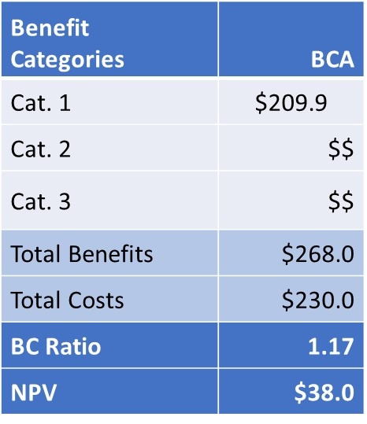
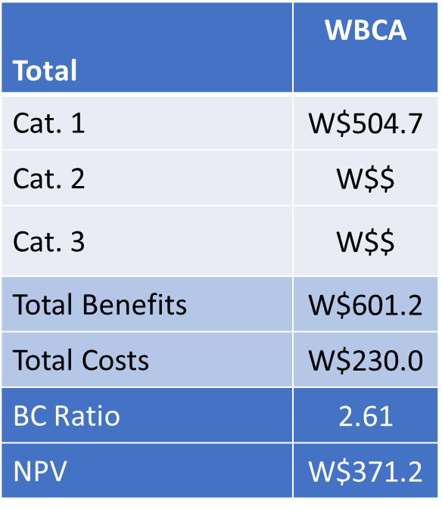
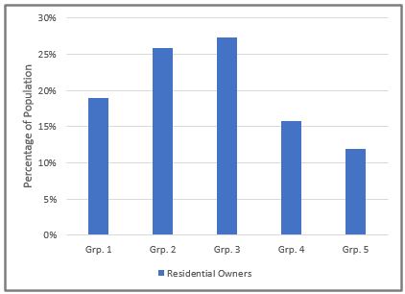
Analytical Outline
2
Regional Income Distribution
3
Estimated Weights
Standard BCA
Weighted BCA
1
6
Distribution of Benefits, per Benefit Category
4
5
Incomes of Beneficiaries
Notes:
Standard BCA:
Present value benefits and costs are computed normally.
Results sub-totaled for each benefit category with identifiable beneficiaries.
Simplified example only shows one benefit category
Regional Income Analysis
Determine equal-sized income groups, such as quintiles.
Compute incomes after tax- and transfer adjustments to gross income
Estimate Weights
Compute weights relative to regional average income and income elasticity
Incomes of beneficiaries
Using various data sources, estimate %’s of beneficiaries
Differentiate %’s of beneficiaries, per benefit category
Distribution of Benefits
Estimate distribution of benefits per income group using %’s of beneficiaries
Estimate distribution of benefits for each benefit category
Apply similar approach to cost burden
Weighted BCA
Combine weights in step (3) with distributions in step (5)
Compare and contrast weighted and standard BCA

Slide 57
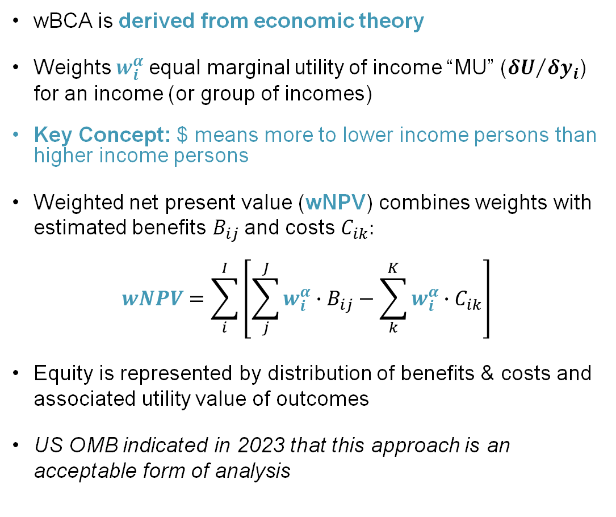
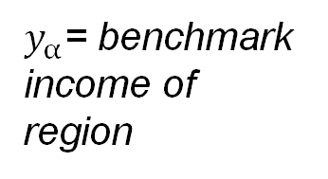
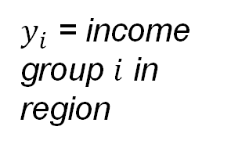
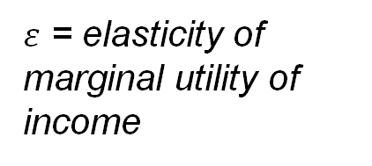
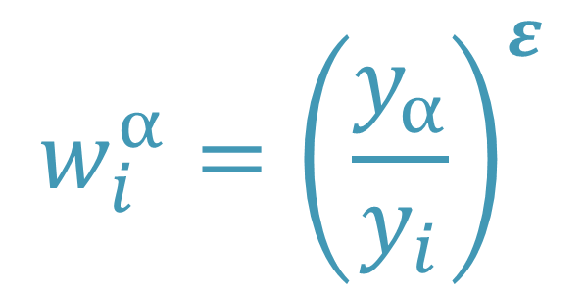
Weighted BCA (wBCA): Analysis of Distributional Effects
$ε$ = elasticity of marginal utility of income
wBCA is derived from economic theory
Weights $w_{i}^{α}$equal marginal utility of income “MU” (${δU}/{δy_{i}}$) for an income (or group of incomes)
Key Concept: $ means more to lower income persons than higher income persons
Weighted net present value (wNPV) combines weights with estimated benefits $B_{ij}$and costs $C_{ik}:$
$$wNPV=\sum_{i}^{I}{\left[\sum_{j}^{J}{w_{i}^{α}∙B_{ij}−\sum_{k}^{K}{w_{i}^{α}∙C_{ik}}}\right]}$$
Equity is represented by distribution of benefits & costs and associated utility value of outcomes
US OMB indicated in 2023 that this approach is an acceptable form of analysis
$y_{α}$= benchmark income of region
$$w_{i}^{α}={\left(\frac{y_{α}}{y_{i}}\right)}^{ε}$$
$y_{i}$ = income group $i$ in region

Slide 58
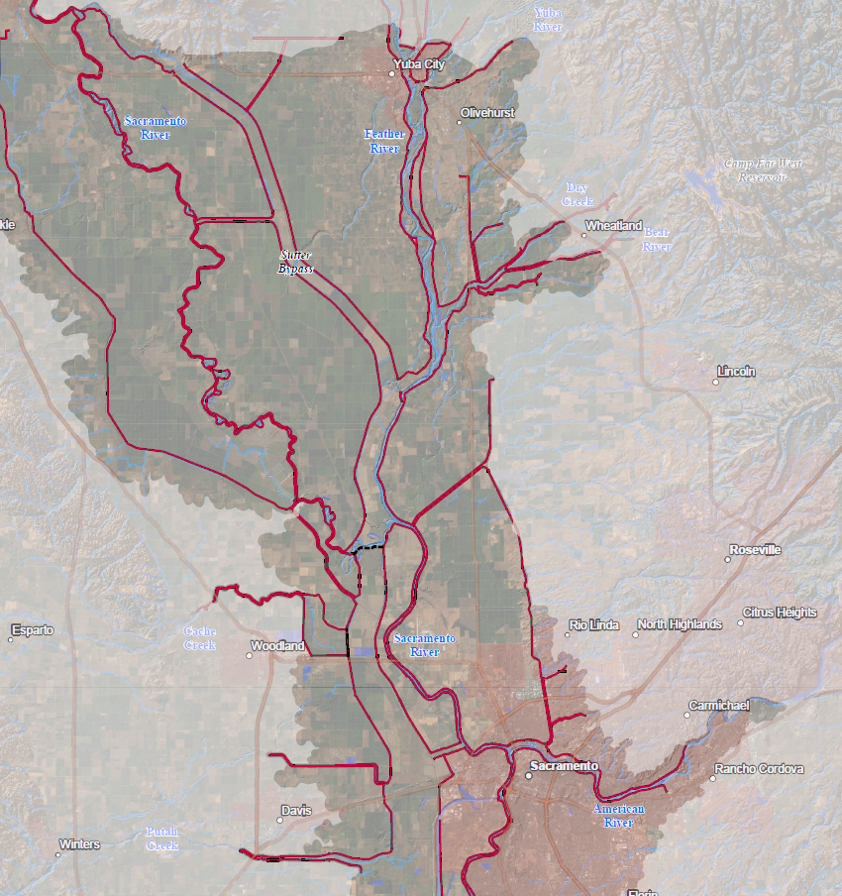
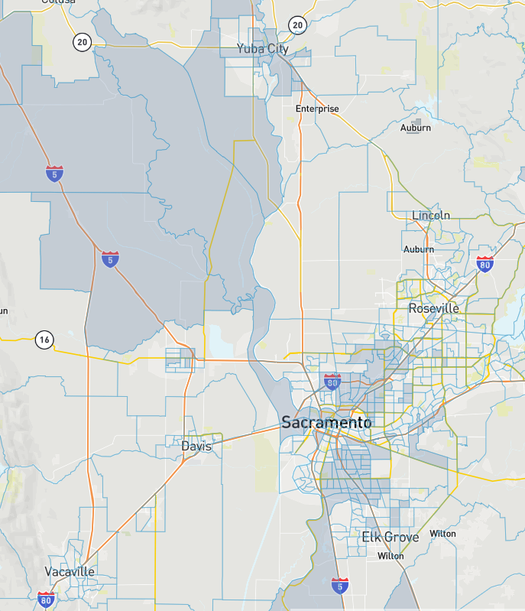
Areas with potential stage reduction
Areas identified as disadvantaged using CEQ Tool
Notes:
Disadvantaged communities shown in gray based on Council on Environmental Quality’s mapping tool.

Slide 59
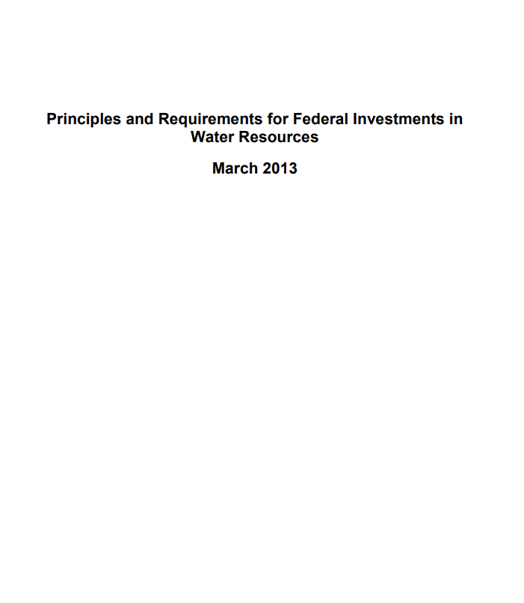
Guidance for Distributional Analyses for Flood Risk Mitigation Projects
2013 Principles, Requirements, and Guidelines (PR&G)
PR&G establish importance of distributional impacts.
No specific guidance provided but federal agencies to develop Agency Specific Procedures (ASP) how to do this.
USACE ASP Pre-Publication (February 1, 2024)
“…the Corps would decide how best to weigh the different kinds of benefits (rather than automatically giving each of the benefit categories “equal” weight).
Notes:
Weighting benefits and costs also consistent with OMB Circular A-4 (BCA)

Slide 60
