Slide 1
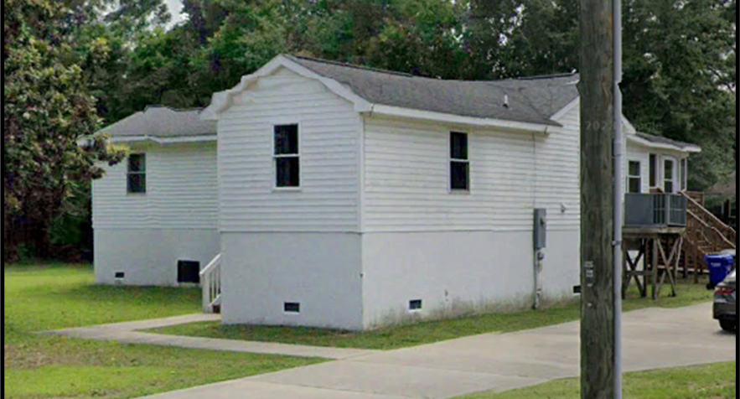
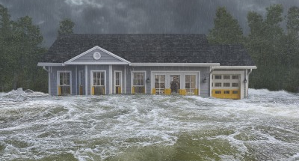
Nonstructural Economics In FDA 2.0
Taylor Bolt
Economist
Omaha District 05 March 2025

Slide 2
Outline
Nonstructural Guidance and Formulation
Workflow
Summary of Economic Inputs for Nonstructural
Nonstructural Measures Overview
How Do I Determine the Best Nonstructural Measure for a Structure?
Modeling Nonstructural Alternatives
Omaha Nonstructural Workbook Example
Considerations
Example of Nonstructural Study
Questions

Slide 3
Why is it Important
Policy and Guidance
WRDA 1974, Section 73: requires consideration of nonstructural measures to reduce flood damages
Principles & Guidelines (1983): nonstructural measures are complete or partial alternatives to traditional structural measures
WRDA 1996, Section 402: identifying impediments that may exist to justifying nonstructural flood control measures as alternatives to structural measures
WRDA 1999, Section 219: nonstructural benefits shall be evaluated using methods similar to structural projects
ER 1105-2-100, Exhibit G-1 (2004): requires consideration of nonstructural measures to reduce flood damages
WRDA 2007, Section 2033: ensuring structural and nonstructural alternatives are evaluated in an equitable manner
WRDA 2016, Section 1184: requires consideration of nonstructural measures when studying feasibility of FRM and CSRM projects
Director of Civil Works Memorandum - Comprehensive Documentation of Benefits in Decision Documents (2021): requires consideration of nonstructural measures
Notes:
Nonstructural measures were required previous to 2021, but since the implementation of the Comprehensive Benefits, there have been significantly more studies doing a more comprehensive look at NS measures.

Slide 4
Takeaways
Structural and nonstructural measures / alternatives should be considered equally and concurrently, when a project is initiated. The Recommended Plan may include one or the other type of measure, or a combination.
The USACE planning process is the same for structural and nonstructural. The difference is in the details.
For FRM studies, PDTs are required to include a stand-alone, nonstructural-only alternative plan in the final array of alternatives per the ASA(CW) Comprehensive Documentation of Benefits in Decision Documents (2021).
Appropriate level of incremental analysis (PB 2019-03)
May use a sample of structures to estimate costs and benefits
Consider project performance under:
Voluntary vs. involuntary (PB 2019-03)
Different relative sea level change (RSLC) scenarios
Different inland hydrology/non-stationarity
Consider benefits of alternative use of land (ER 1105-2-100 and PB 2016-01)
Recreation benefits not limited for justification (ER 1105-2-100, Appendix E)
Ecosystem restoration benefits must be quantified (supports project justification)
Nonstructural measures can also be considered for areas of induced flooding
Participation rates sensitivity analysis
100% participation rate for purposes of plan evaluation and economic justification

Slide 5
Nonstructural Economics Workflow
Evaluate Existing and Future Without Project Conditions
Formulate Nonstructural Alternatives
Conduct Benefits-Cost Analysis
Perform Optimization and Sensitivity Analyses
Mitigate Risk and Uncertainty

Slide 6
The Golden Triangle
Structure Inventory Data
(Economics)
Nonstructural Economic
Analysis
Water Surface and Ground Elevations
(H&H Engineering)
Costs

Slide 7
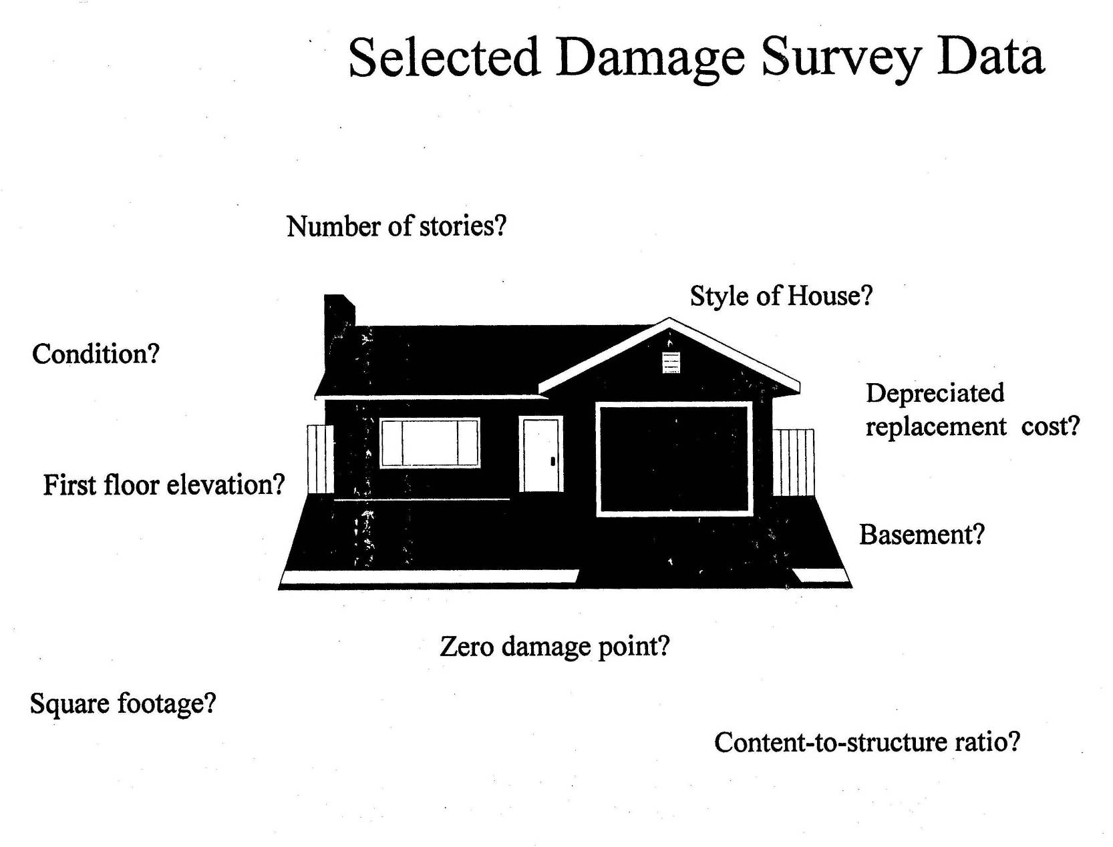
Structure Inventory Data
Obtain GIS parcel or structure footprints to serve as a starting point.
County assessor parcel data, NSI2, Microsoft building footprints, etc.
Detail should be consistent with type of study and planning iteration
Refine economic attributes
Depreciated replacement value
Content-to-structure value ratios
Foundation heights, foundation types, square footage, occupancy type, etc.
Level of sampling/confidence should be consistent with type of study and inventory size

Slide 8
nonstructural Solutions
Physical Measures:
Elevation
Wet Floodproofing
Dry Floodproofing
Basement Removal
Relocation (Mandatory)
Acquisition (Mandatory)
Nonphysical Measures:
Floodplain Mapping
Flood Insurance
Land Use Zoning
Operational Changes
Emergency Preparedness Plans
Flood Warning
Evacuation Plans

Slide 9
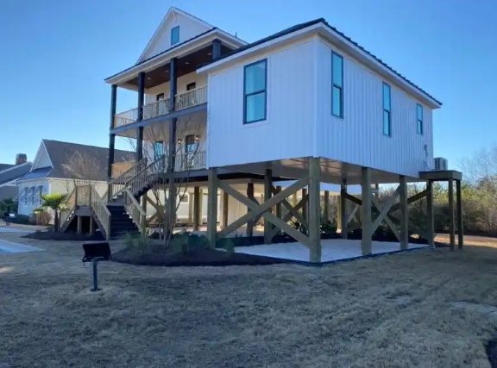
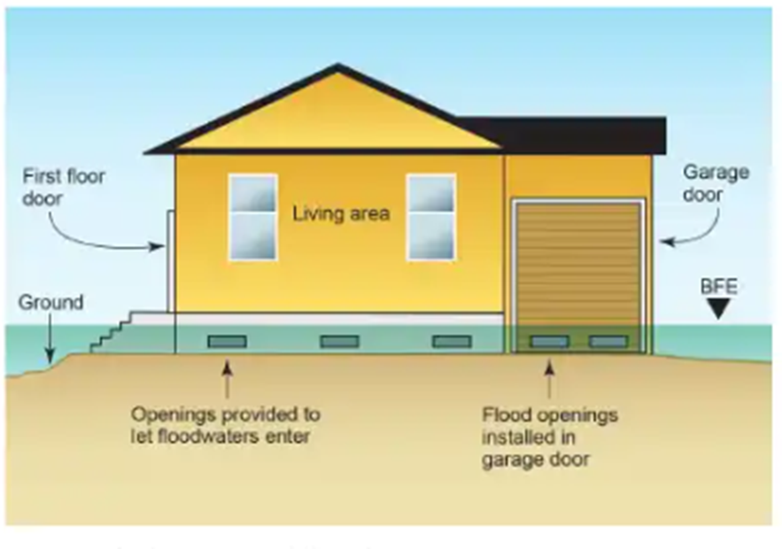
Residential Floodproofing methods
Elevation
Flood Vent
Note: If a house is elevated on walls instead of piers, generally flood vents are needed to equalize pressure.

Slide 10
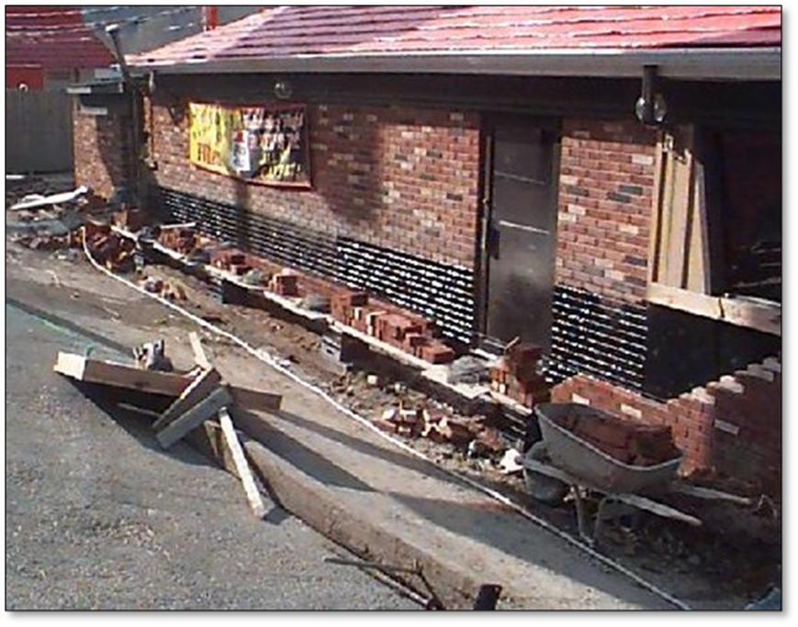
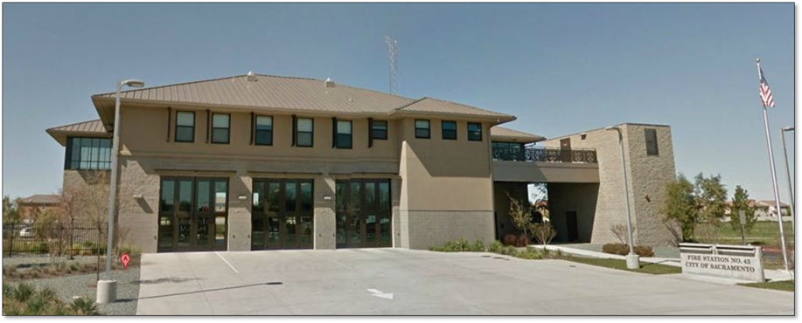
Commercial Floodproofing Methods
Dry Floodproofing
Wet Floodproofing

Slide 11
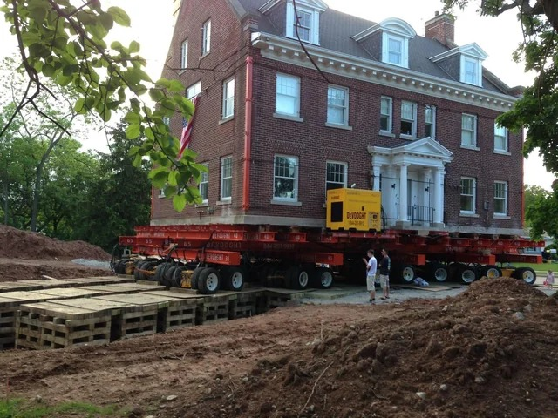
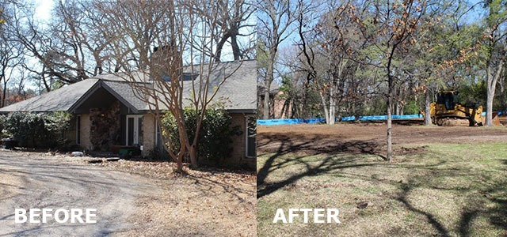
Mandatory Nonstructural Measures
Buyouts/Acquisition
Relocate

Slide 12
Assessing the situation
Flood Characteristics
Flood depth, Flood velocity, Flood duration, Rate of rise, Debris/Ice flows, Wave action, Floodway, Other(?)
Site Characteristics
Location, Soil type, Topography, Site size, Urban/Rural, Other(?)
Building/Structure Characteristics
Type of construction, Foundation, Condition of the building, Lower levels (Basement), Historical Significance, Other(?)
Other Considerations
Building Occupancy, Building Codes, Zoning Ordinances and Local Restrictions, Other Agencies (Local / State / Federal), Aesthetics, Public Health/Safety/Welfare, Other(?)
Notes:
Flood Riak Management Matrix
Quick screening tool, available on National Nonstructural Committee website
PDTs can use to identify site-appropriate nonstructural measures for individual structures

Slide 13
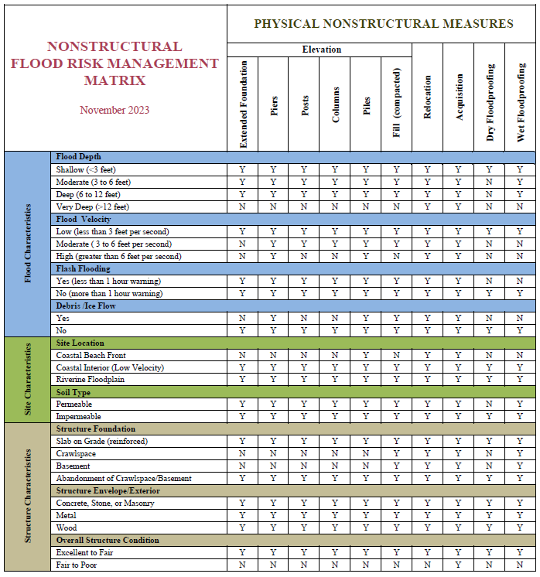

Slide 14
Modeling Nonstructural in FDA 2.0
Elevation
12 feet is the maximum floodproofing height and methods depend on the characteristics of historical flooding.
Change the structures first floor input to the desired elevation. For example, you the individual structure to the base floor elevation of the 0.01 AEP plus two feet.
Join in GIS using the unique identifier for the structure inventory and input structure inventory into FDA 2.0.
Flood Vent and Basement Removal
Generally, if a beginning damage is given for structures, it is the inverse of the first floor or considering a basement. Utilizing flood vents would set the starting damage to 0 or the height of the first floor.
Join in GIS using the unique identifier for the structure inventory and input structure inventory into FDA 2.0

Slide 15
Modeling Nonstructural in FDA 2.0
Dry Floodproofing
Generally, if a beginning damage is given for structures it is the inverse of the first floor or taking into account a basement. Utilizing dry floodproofing would set the starting damage to a maximum of 4 feet.
Join in GIS using the unique identifier for the structure inventory and input structure inventory into FDA 2.0.
Wet Floodproofing
Limited to certain types of buildings. Generally, conveyance structures are added to the structure and it is assumed contents are protected. Modeling wet floodproofing can be done by changing the beginning damage.
Join in GIS using the unique identifier for the structure inventory and input structure inventory into FDA 2.0
Notes:
Wet flood proofing: Ag Buildings, garages, parking garages, warehouses/storage.

Slide 16
Omaha Nonstructural Workbook Example
In 2021 there were several projects that were formulating nonstructural alternatives, so Omaha District built a workbook to easily identify what measures could be implemented.
In addition, the workbook allows users to aggregates structures based on AEP events and adjust the floodproofing height.
Inputs needed:
Structure inventory data (there are built in assumptions for data without SQFT)
Reaches
Stage Damage Detail
Occupancy Types
AEP Events
Maximum Measure Height
Minimum Raise and Flood Vent Height
Target Stage AEP to define BFE
Additional Feet Above Target Stage
- FDA2.0_Omaha_NS_Workbook

Slide 17
Considerations
Structure Type
Surveying Effort
Flow
Stage
Modeling approach
Sensitivity Analysis (Height Optimization, AEP Aggregations, Participation Rate)
Changes in costs(dependent on structure details)
Probability of flooding
Sponsor openness to nonstructural solutions

Slide 18
Tar Pamlico GI Study
Summary
Early on it was clear that any structural alternative was not feasible in the basin after initial model runs.
Realized that a number of nonstructural measures had already been implemented so an extensive survey was conducted.
Used the original hydraulic reaches, then subdivided the hydraulic reaches by Census Tracts based on the number of structures in NS plan.
The table below was the final selected NS plan using comprehensive for the area.
Lessons Learned
Positives
Structure by structure details were captured early on, allowing for less uncertainty after TSP.
All data was significantly refined by TSP.
Coordination with the PDT and vertical team allowed for errors in the H&H to be fixed.
Documentation of why we should do the project.
Negatives
Focusing on the reaches with the most structures instead of which structures are inundated at early AEP’s
Communication with costs happened later instead of early stages of the project.
Nonstructural measures impact on life safety in commercial and residential structures was not measured, instead a semi quantitative analysis was done to explain changes in risk.
Reach | Elevate & Flood Vent | Elevate | Flood Vent | Dry Floodproof | Total
STC1B | 1 | 0 | 0 | 14 | 15
STC1C | 1 | 7 | 4 | 7 | 19
STC1F | 0 | 0 | 0 | 1 | 1
TP10A | 0 | 1 | 1 | 2 | 4
TP10B | 1 | 0 | 0 | 1 | 2
TP10C | 0 | 3 | 1 | 1 | 5
TP10D | 0 | 0 | 0 | 1 | 1
TP3C | 22 | 0 | 0 | 0 | 22
TP3F | 10 | 5 | 0 | 52 | 67
TP8 | 0 | 1 | 0 | 9 | 10
TP9A | 0 | 0 | 2 | 2 | 4
TP9C | 0 | 0 | 0 | 1 | 1
TP9D | 0 | 1 | 0 | 3 | 4
Total | 35 | 18 | 8 | 94 | 155

Slide 19
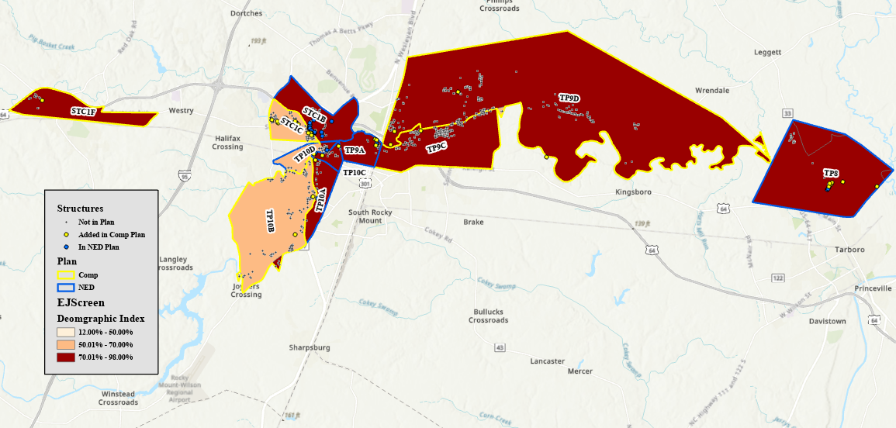
NED and Comprehensive Benefits Plans

Slide 20
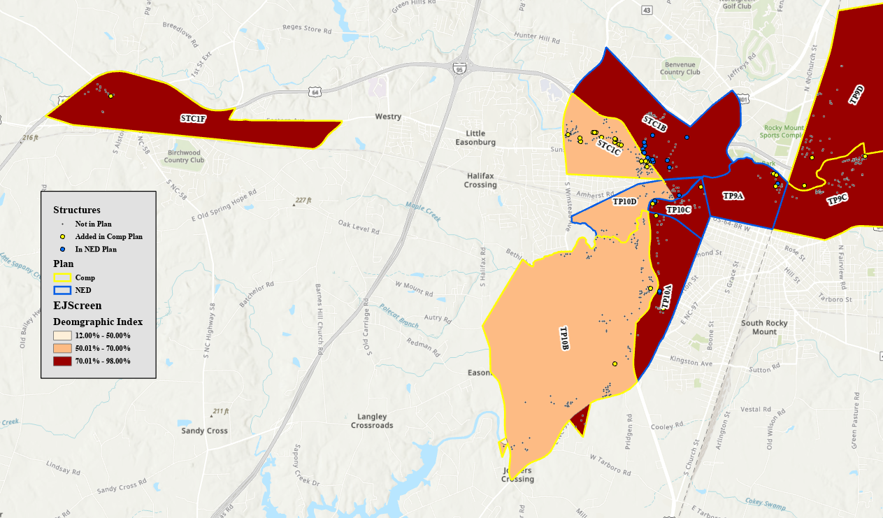
Rocky Mount Area

Slide 21
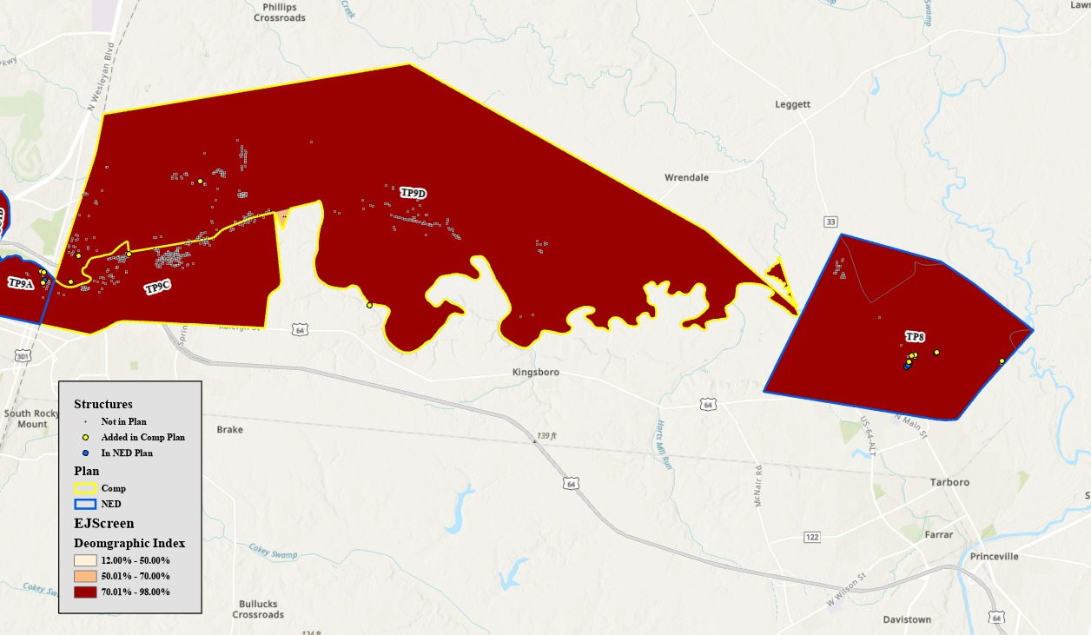
Rocky Mount Area

Slide 22
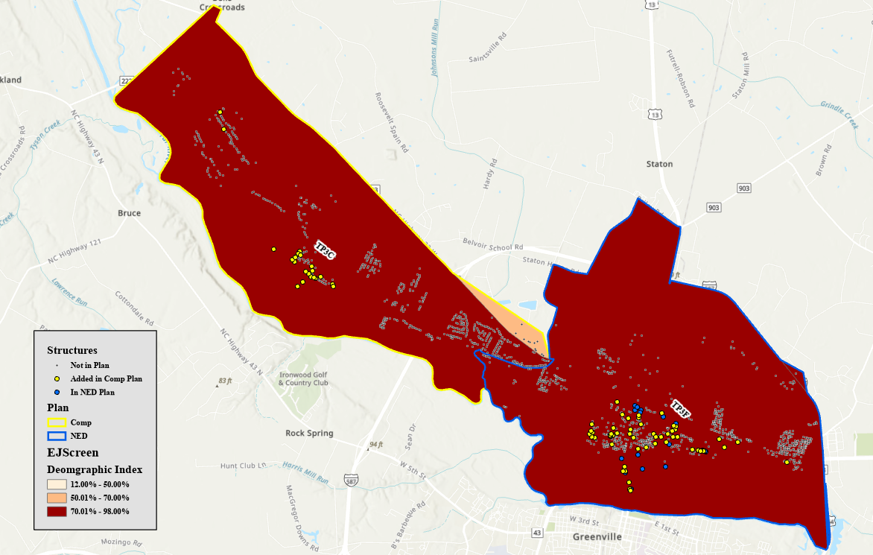
Greenville Area

Slide 23
Tar Pamlico Flood History
Hurricane | Rain Event
Bertha (1996) | Rocky Mount Area (April 25, 2017)
Fran (1996) | Rocky Mount Area (June 16,2020)
Bonnie (1998) | Rocky Mount Area (July 14, 2023)
Dennis (1999) | Greenville Area (June 2019)
Floyd (1999),
Isabel (2003)
Irene (2011)
Matthew (2016)

Slide 24
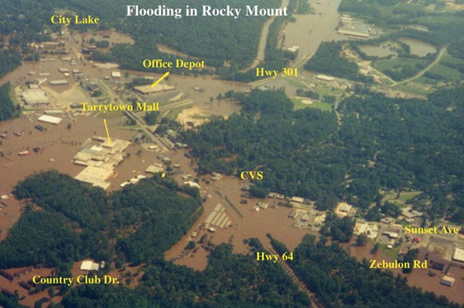
Rocky Mount 1999 Hurricane Floyd

Slide 25
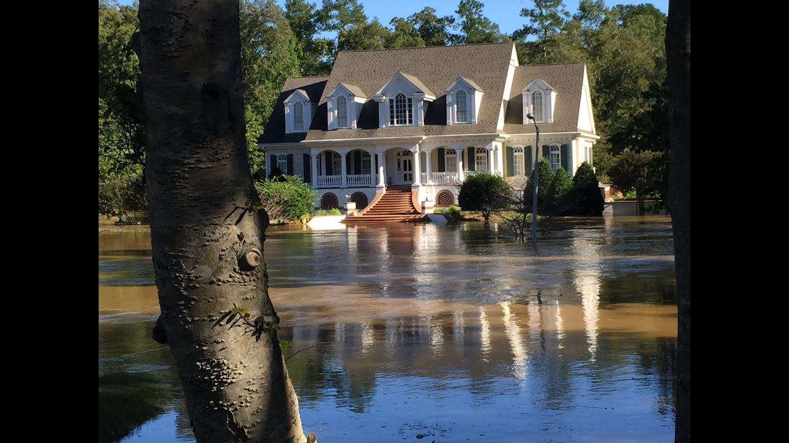
Rocky Mount 2016 Hurricane Matthew

Slide 26
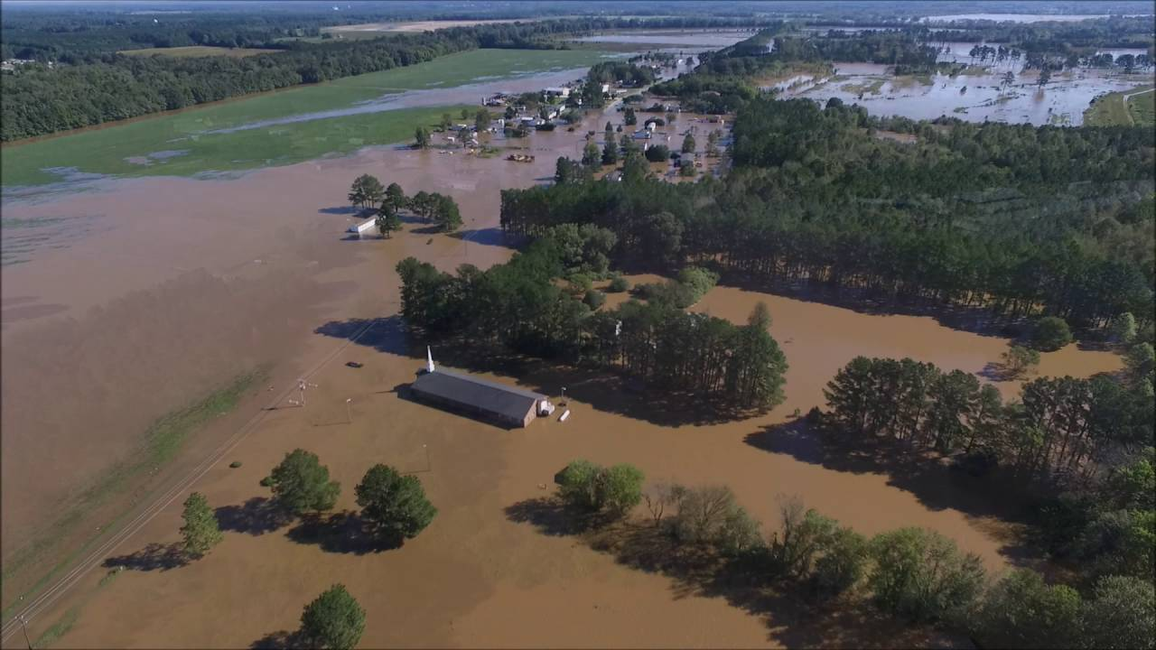
Rocky Mount 2016 Hurricane Matthew

Slide 27
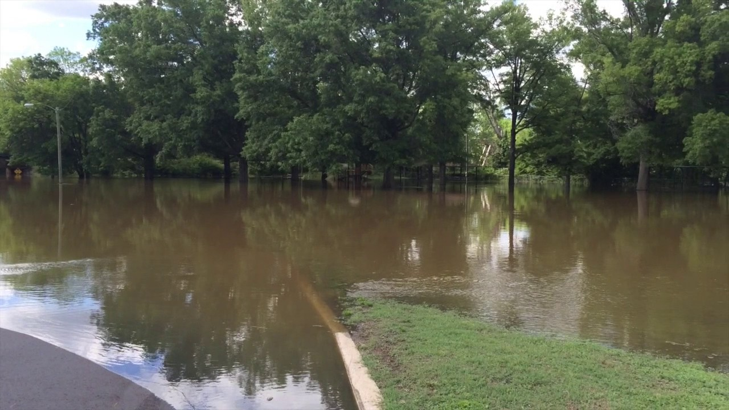
Rocky Mount Flooding April 2017

Slide 28
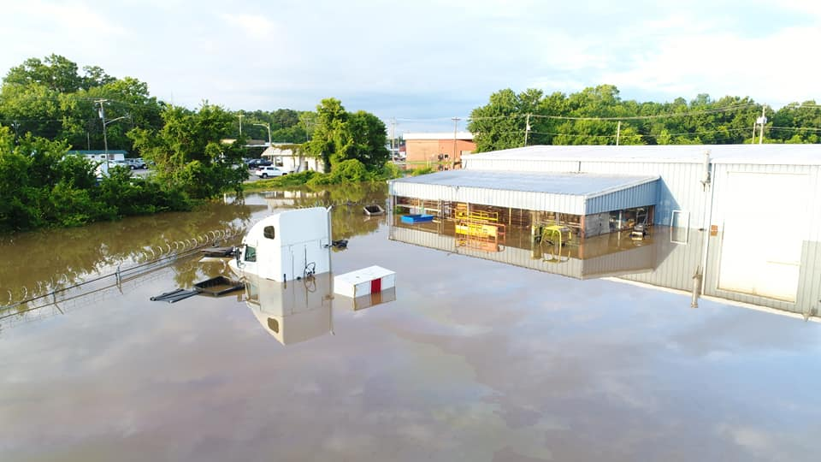
Rocky Mount Flooding June 2020

Slide 29
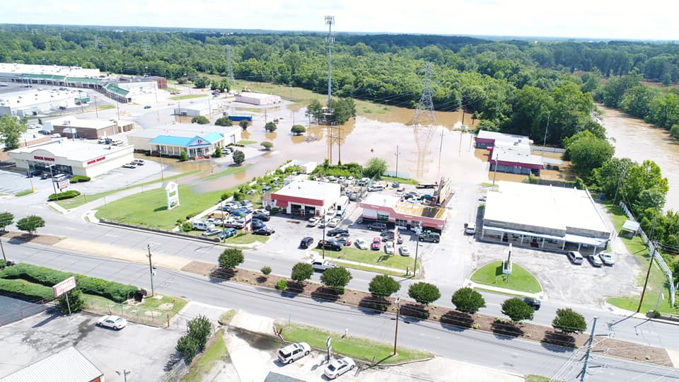
Rocky Mount Flooding June 2020

Slide 30
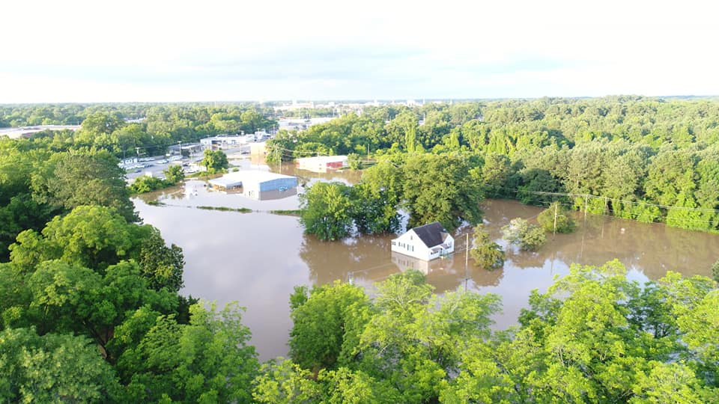
Rocky Mount Flooding June 2020

Slide 31
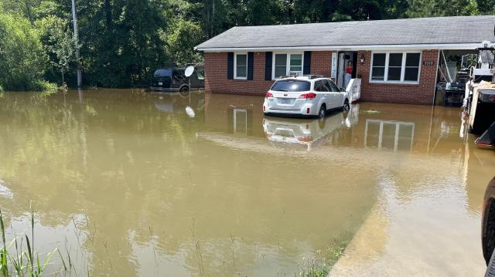
Rocky Mount Flooding July 2023

Slide 32
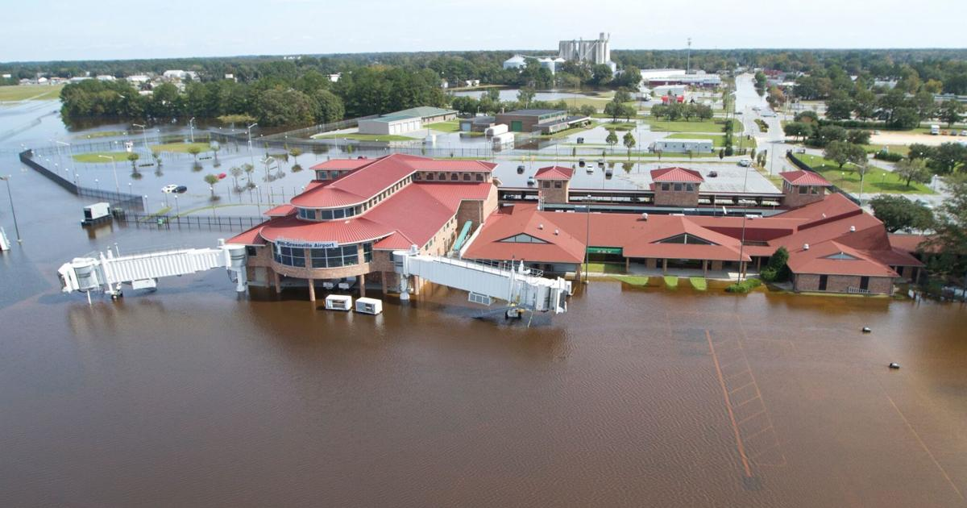
Greenville Airport Flooding 2016 Hurricane Matthew

Slide 33
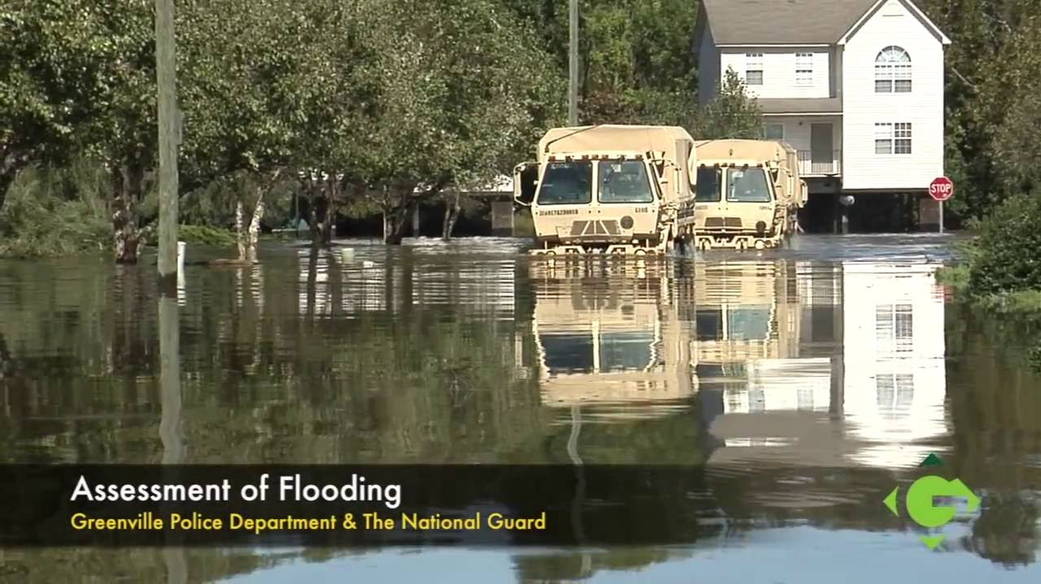
Greenville Flooding 2016 Hurricane Matthew

Slide 34
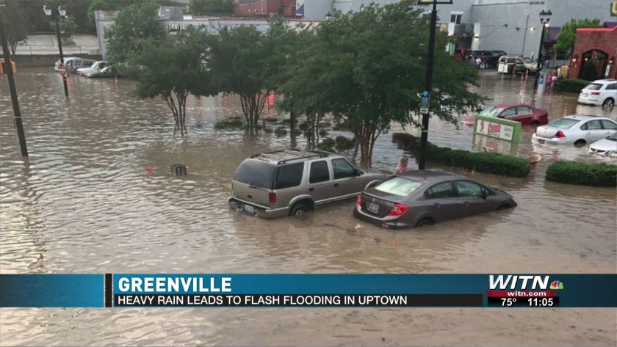
Greenville Flooding June 2019

Slide 35
Questions

