Slide 1
Consequence Estimation with LifeSim DLS-108, Module 2.6
March 2025 / Version 3
Dworshak, ID (source: HDR Engineering)

Slide 2
Learning Objectives
Understand the warning and evacuation process in LifeSim
Describe hazard classification for those exposed to flooding
Describe the use of LifeSim for estimating life loss

Slide 3

What is LifeSim?
Tool to estimate life and economic loss from flooding
Ability to track individual people throughout the warning and evacuation process (agent based)
Traffic simulation engine to estimate the evacuation process
Monte Carlo sampling with uncertainty produces a distribution of life loss results
Notes:
Discuss each bullet

Slide 4
What is LifeSim?
Some Limitations
LifeSim calculates direct life loss, which is may not be the primary consequence life related consequence.
LifeSim is an event-based tool.
For some deterministic scenario (hydraulics) – we calculated an outcome with uncertainty about the other inputs.
Notes:
Discuss each bullet

Slide 5
LifeSim is Scalable
LifeSim can model life-loss broadly, or at remarkable detail depending on the available data.
We can use more information to reduce knowledge uncertainty
Demographics
Handicapped Population
Population over/under 65
Emergency Management
Existing warning systems
Plans and procedures
Roadways
Structure Data for Stability
More

Slide 6
Outline
Evacuation Timeline
Vertical and Horizontal Evacuation
Hazard Zones and Fatality rates
Case Studies

Slide 7
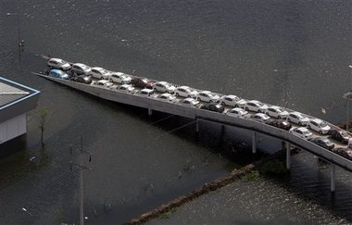
Population Redistribution (Evacuation)
Can people get to safety before water arrives?
What initiated the warning process?
How does the warning spread?
Where do people go when they evacuate?
Notes:
Ask each question

Slide 8
Evacuation Timeline
Threat Detected
Warning Issued
Warning Received
Protective Action Initiated
Safety Reached
Warning Delay Time
Warning Diffusion Time
Protective Action Initiation Time
Evacuation Time
[ Time ]
Objective: Minimize life loss
Notes:
When your objective is to minimize life loss, identifying the parameters driving results is critical to meeting that objective.
LifeSim considers each component with uncertainty from the visualized evacuation timeline. Keep in mind that each of these components can be a risk driver in terms of consequences.

Slide 9
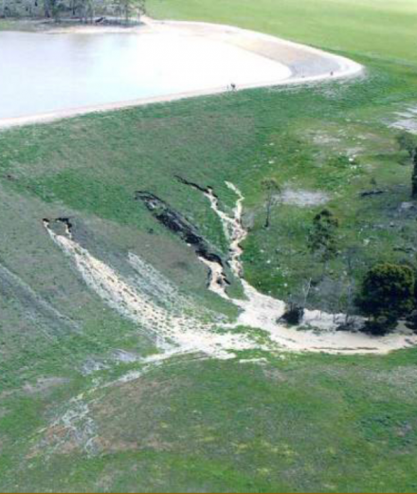


Warning Delay Time
Threat Detected
Warning Issued
Warning Received
Protective Action Initiated
Safety Reached
Warning Delay Time
Warning Diffusion Time
Protective Action Initiation Time
Evacuation Time
[ Time ]
Imminent hazard identification
Hazard communication
Warning issuance
Notes:
Warning Delay Time is the time span between when the threat is detected and the warning is issued and is composed of three parameters. Each parameter can be defined as an uncertainty distribution.
Imminent Hazard Identification is the time when those observing determine there is no stopping the hazard and determine that authorities need to issue an evacuation.
Hazard Communication Delay represents the amount of time that it takes to communicate the imminent threat to those responsible for managing the evacuation.
Warning Issuance Delay is the time from when the agency responsible for evacuating people receives the warning to when they issue an evacuation order to the public.

Slide 10
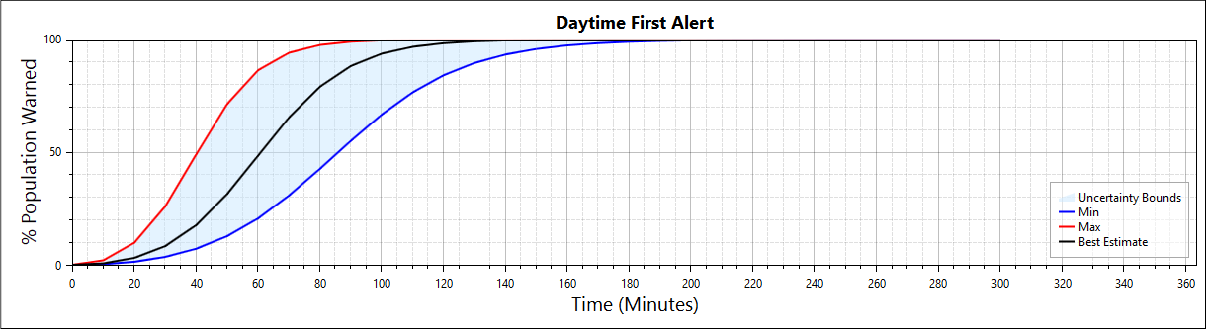
Warning Diffusion Time
Threat Detected
Warning Issued
Warning Received
Protective Action Initiated
Safety Reached
Warning Delay Time
Warning Diffusion Time
Protective Action Initiation Time
Evacuation Time
[ Time ]
Notes:
The Warning Diffusion Time is the time span between when the evacuation order is issued and the warning gets received by the public. This parameter represents a switch from agency sourced information (e.g., issuing evacuation orders to the public) to public receival. In LifeSim the function is represented as a percentage of the population that receives the warning over time. Wide bands of uncertainty can exist around this function and can be reduced with more information such as from an elicitation with local emergency managers.

Slide 11
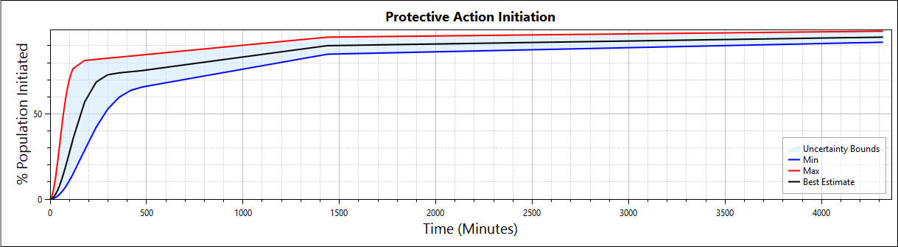
Protective Action Initiation Time
Threat Detected
Warning Issued
Warning Received
Protective Action Initiated
Safety Reached
Warning Delay Time
Warning Diffusion Time
Protective Action Initiation Time
Evacuation Time
[ Time ]
Notes:
The Protective Action Initiation Time is the time span between when warning is received by people to the decision to take protective action (e.g., evacuate). It represents the percentage of population that will take protective action once they have received a first alert over time.

Slide 12



Warning and Mobilization
3 people
2 people
1 Person
Warning received after 78 minutes of issuance
Mobilized 100 minutes after warning received
Vehicle leaves structure carrying two people 178 minutes after warning issuance
Notes:
LifeSim starts by sampling the first alert curves and the protective action initiation functions. It uses a curves sampling method that applies the same percentile for sampling across all ordinates in the function. Curve uncertainty contains both knowledge uncertainty and natural variability. Then, for each evacuating group, it samples a time that the group received the warning and a time that the group takes protective action. By doing this over all evacuating groups, it collectively represents the functions for a simulation.

Slide 13
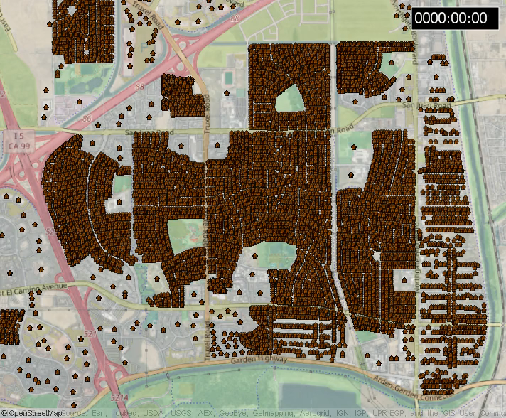
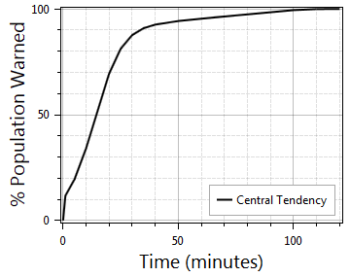



Warning and Mobilization
Not warned
Warned
Mobilized
Notes:
Visual representation Warning and PAI in action.

Slide 14
Evacuation Time
Threat Detected
Warning Issued
Warning Received
Protective Action Initiated
Safety Reached
Warning Delay Time
Warning Diffusion Time
Protective Action Initiation Time
Evacuation Time
[ Time ]
Horizontal
Road network
Destinations
Vertical
Roof
Attic
Multi-story structures
Notes:
Discuss how the next slides will discuss how horizontal and vertical evacuation works in LifeSim.

Slide 15
Outline
Evacuation Timeline
Vertical and Horizontal Evacuation
Hazard Zones and Fatality rates
Case Studies

Slide 16
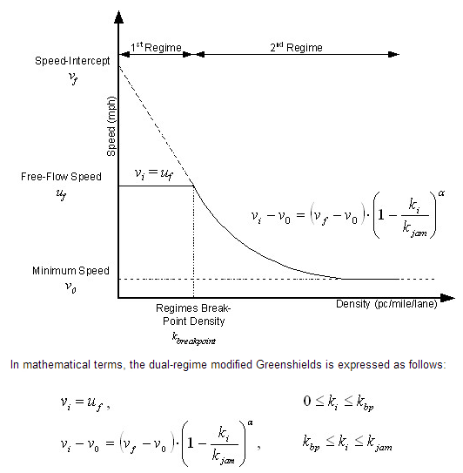
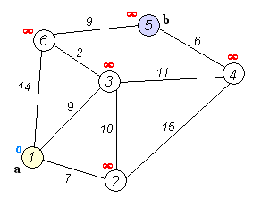
Horizontal Evacuation
Speed is adjusted by vehicle density
Destination is chosen by shortest travel time
Speed
Density

Slide 17
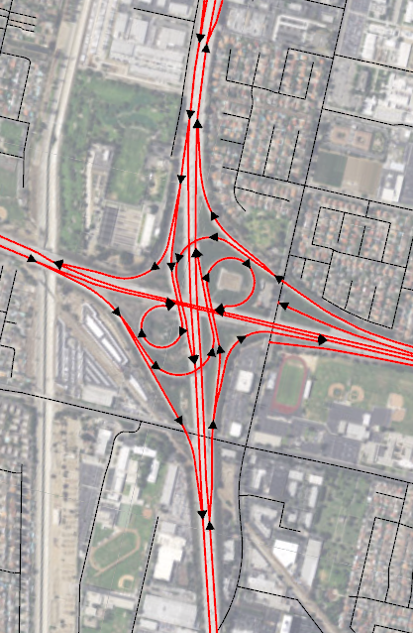
Horizontal Evacuation
One-way roads
Evacuation in vehicles or on foot
Vehicles may turn around if road is flooded
Vehicles can re-route if entering traffic jam
17
Notes:
Agent logic in traffic simulation

Slide 18
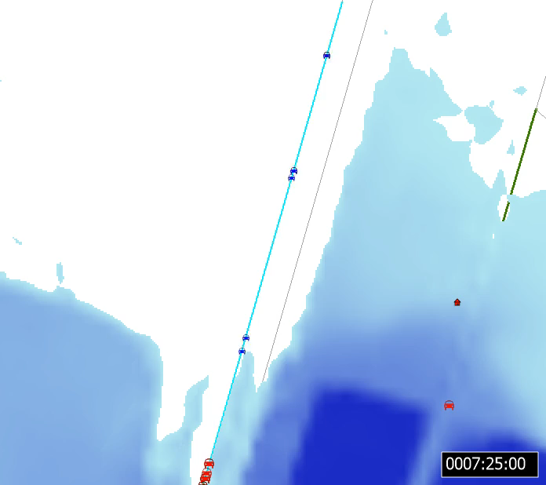
Horizontal Evacuation
Vehicular spillback
Enforces a limited number of vehicles per road segment
Effective vehicle length
Produces accurate spillback
Increased simulation run times ☹

Slide 19
Horizontal Evacuation
Is this road wet?
Is next road wet?
No hazard
No
No
No
Yes
Yes
No, can’t turn around
Does vehicle enter?
Caught, is D_{max} > 0?
Yes
No, turn around
Yes
Stability thresholds
Notes:
Focus on the part where vehicle enters flooded road.

Slide 20
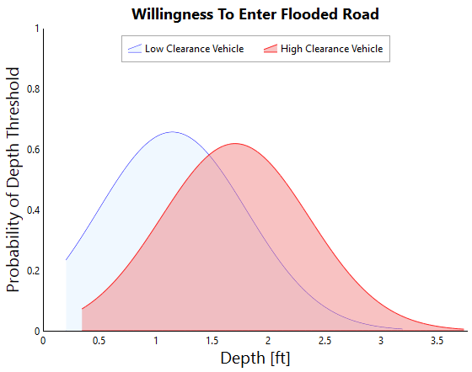
Horizontal Evacuation
Decision to enter a flooded road based on depth
Notes:
Speak to research on people’s perception of risk when en
Motorist Behavior in AUS floods 2016
Gissing, Haynes et al (2016)
Motorist Flash Flood Risk Perception
Ruin et al (2007)
Warning attitudes, age, local knowledge, experience
Drobot et al (2007)
Behavioral analysis questionnaire
Pearson and Hamilton (2016)
tering a flooded road.

Slide 21
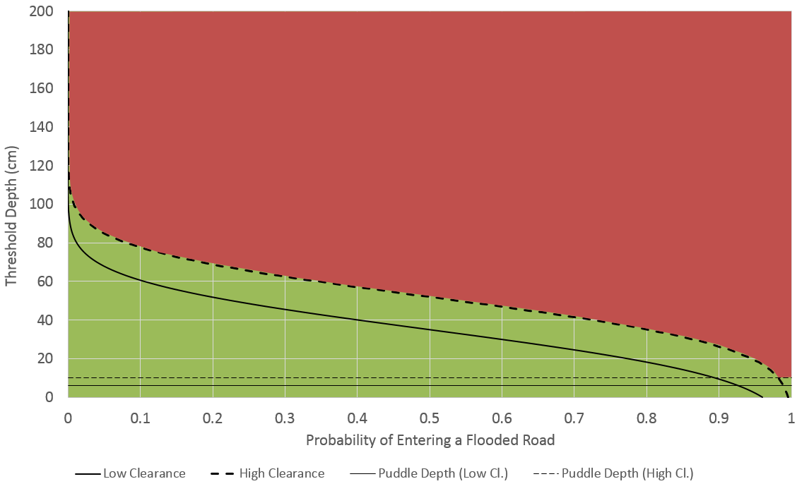
How it Works (High Clearance)
 | Low Clearance | High Clearance
Mean (cm) | 35 | 52
Standard Deviation (cm) | 20 | 20
Puddle Depth (cm) | 6 | 10
Sample high clearance distribution (0.26)
Assign threshold depth to vehicle (63 cm)
Compare to depth on road
Turn around, caught or proceed
No go
Go
Notes:
This plot contains the high and low decision curves and the two puddle depth criteria with axes reversed.

Slide 22
Vertical Evacuation
Is depth > 0 at structure
No hazard
No
Yes
Limited mobility
Age is the primary factor in determining limited mobility
Yes
No
In structure submerge exceeded
Able to access attic/roof
In structure submerge exceeded
No
Yes
No
Yes
Yes
No
High
Low
Goes to attic?
High
Low
Yes
No
Attic
submerge exceeded
Roof
submerge exceeded
Yes
No
Yes
No
High
Low
High
Low
Notes:
https://www.cdc.gov/nchs/fastats/disability.htm
CDC data discusses people over and under 65 that have difficulty performing one complex action
Also, discusses people unable to walk a quarter mile, this would mean they’re almost certainly confined to their home without the availability of a vehicle or rescue
https://dhds.cdc.gov/dataviews/view?viewId=1522
At the bottom you’ll see an excel table (see image below), if you open it, it provides statistics for disabilities by state; columns Z – AK show statistics for people with mobility disabilities.
https://www.census.gov/topics/health/disability/guidance/data-collection-cps.html
How the census gathers data for Current Population Survey (cps) for people with disabilities
https://www.census.gov/topics/health/disability/guidance/data-collection-acs.html
How the census gathers data for the ACS
https://factfinder.census.gov/faces/tableservices/jsf/pages/productview.xhtml?pid=ACS_16_5YR_B18105&prodType=table
SEX BY AGE AMBULATORY DIFFICULTY
These are global estimates for the entire US
https://factfinder.census.gov/faces/tableservices/jsf/pages/productview.xhtml?pid=ACS_16_5YR_S1810&prodType=table
Disability characteristics by state
https://www.census.gov/quickfacts/fact/map/US/DIS010216#viewtop
Interactive map showing percentage of people UNDER AGE 65 with a disability as of July 1, 2017

Slide 23
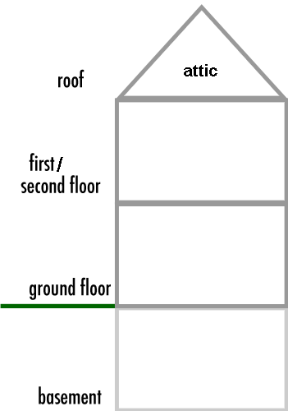



Vertical Evacuation Process
Test to see if person can evacuate above top floor
If they can’t evacuate beyond then they are stuck on the top floor
If they can evacuate beyond the top floor then they will either go to the attic or the roof
Notes:
Step 1 not tested for limited mobility

Slide 24
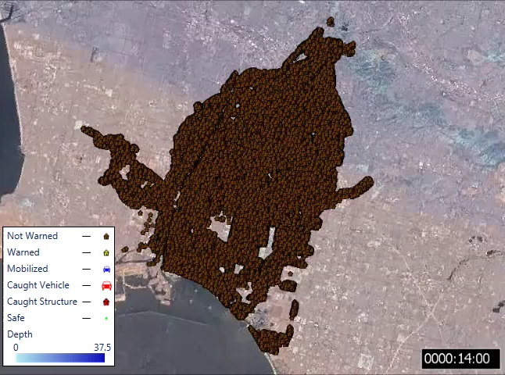
Population Redistribution
Notes:
Shows entire warning and evacuation process animation.

Slide 25
Outline
Evacuation Timeline
Vertical and Horizontal Evacuation
Hazard Zones and Fatality rates
Case Studies

Slide 26

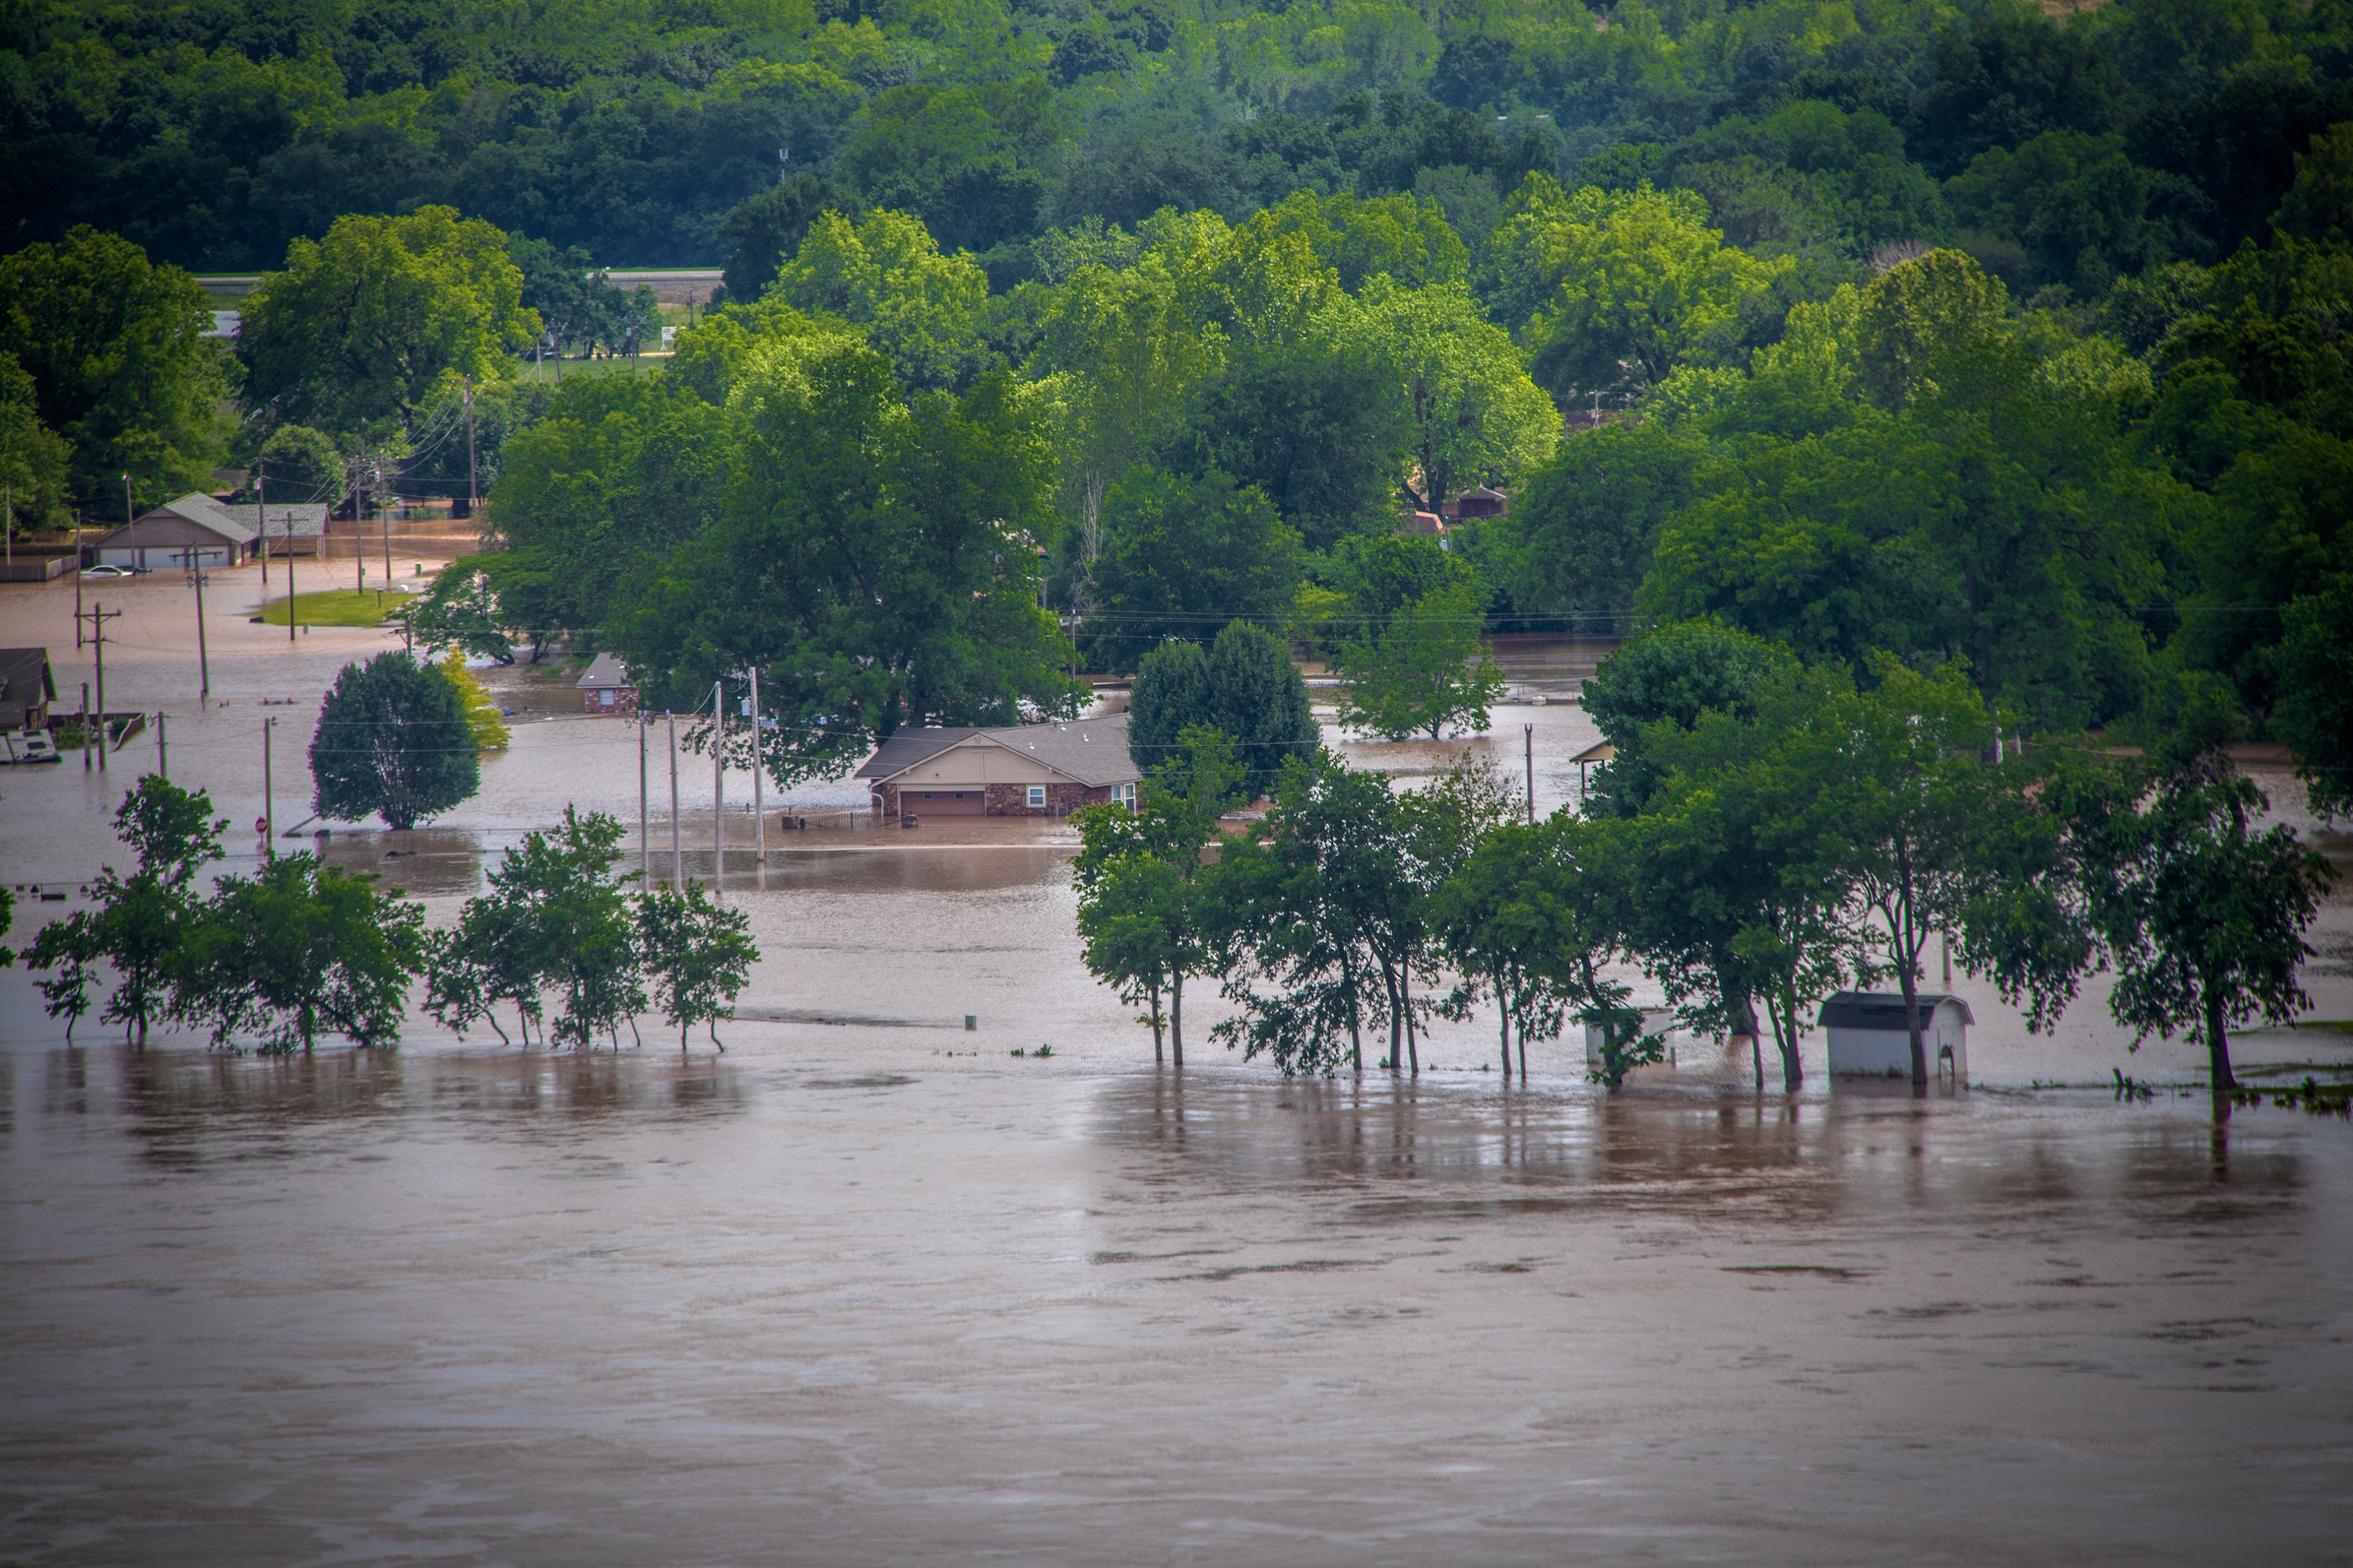
Hazard Zone
Low hazard:
Exposed to relatively calm floodwaters, where the stability of shelters are not at risk, a hazard exists because people are coming in contact with water in locations not meant for such interaction
High hazard:
Stability criteria or submergence criteria of the person (if out in the open), the vehicle (if caught while evacuation), or the structure (if not mobilized) has been exceeded. In that situation, the victims are typically swept downstream, buried in a collapsed building, or trapped underwater
26
Source: stock.adobe.com
Notes:
Speak to hazard zones, not the first time they have seen it.

Slide 27
Structure Submergence
4’
1’
In Structure
High hazard zone most likely around 1 foot below the ceiling, 4 feet from the floor if limited mobility
On Roof
High hazard zone most likely around 4 feet above the top of the roof
1’
Notes:
Discuss submergence criteria used in lifesim.

Slide 28
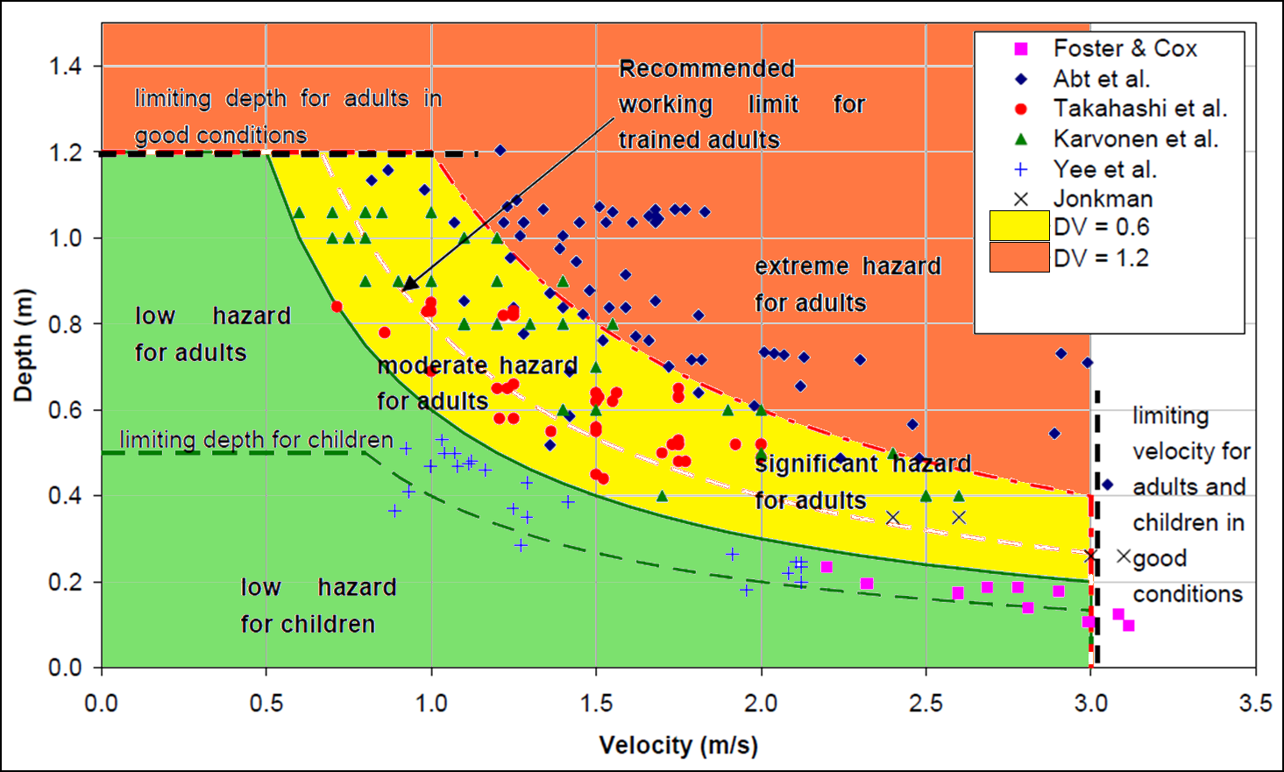
Stability Criteria (Humans)
Source: Shand et al (2011)
Notes:
Discuss research on human stability. Each point is a person.

Slide 29
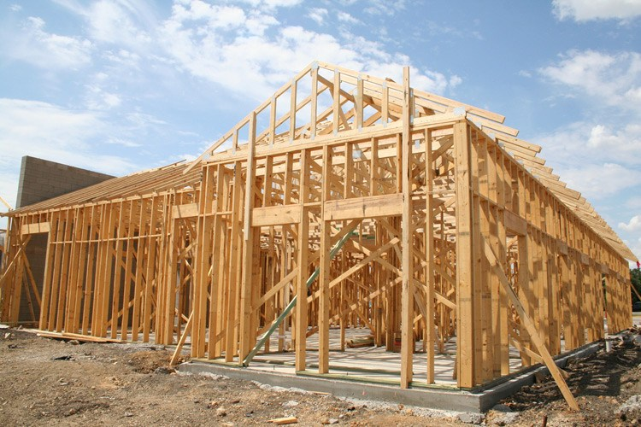

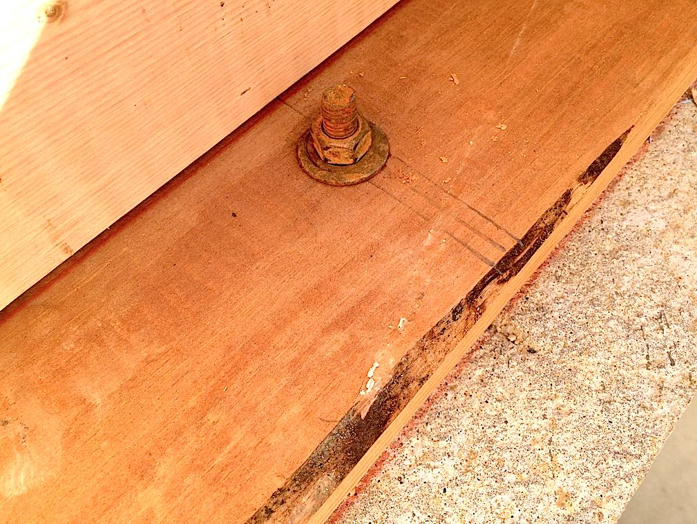
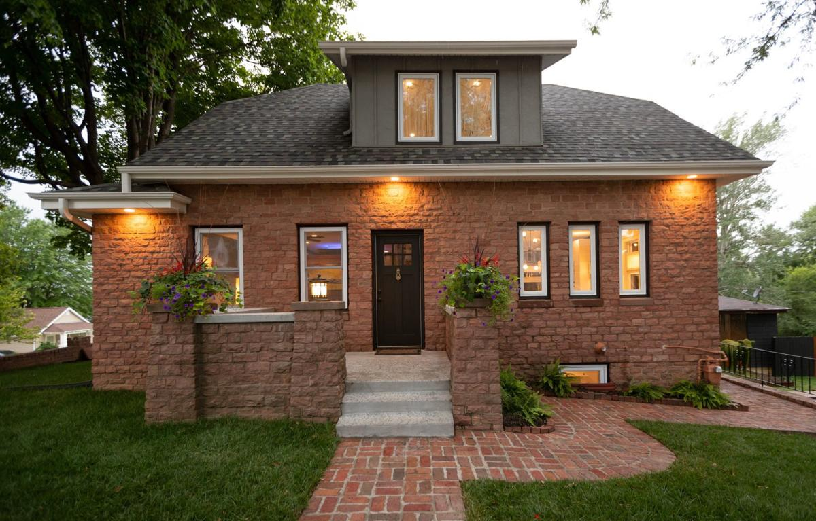
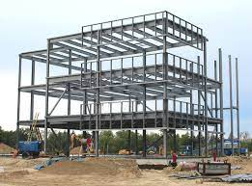
Stability Criteria (Structures)
Manufactured
Wood-buoyant
Wood-anchored
Masonry
Engineered
Notes:
Manufactured
Prefabricated houses that are constructed off-site and then assembled at the building site in sections (e.g., manufactured homes)
Wood-buoyant
Typical wood frame structure with load-bearing walls that is not anchored or bolted to the foundation and is therefore highly susceptible to floating off the foundation
Wood-anchored
Typical wood frame structure with load-bearing walls that is bolted or anchored to the foundation and therefore less susceptible to floating off the foundation. Structures made of heavy materials (such as large timbers), homes with a brick façade and homes with two or more stories are also more likely to resist floating and therefore may also be considered “anchored”
Masonry
Unreinforced stone or block structures
Engineered
Steel and reinforced concrete construction where the walls are non-load bearing and instead the columns and beams carry the load. Walls may be masonry, wood, glass, etc. and are susceptible to collapse separate from the superstructure

Slide 30
Stability Criteria (Structures)
Source: Smith, Davey, and Cox. Flood Hazard Technical Report, 2014.

Slide 31
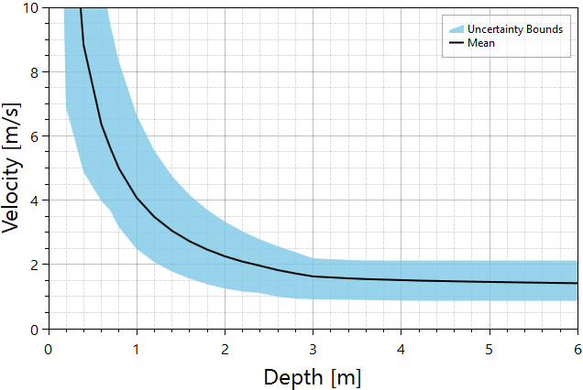
Stability Criteria (Wood-Anchored)
Triangular distribution with
Gallegos et al. (2012) for the most likely
Becker et al. (2011) for minimum and maximum.
More information in the LifeSim Technical Reference Manual.
Notes:
Example of stability criteria with uncertainty

Slide 32
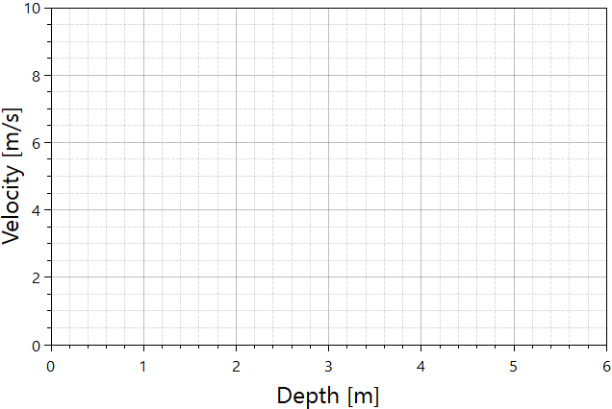
Stability Criteria (How It Works)
Curve sample the function
Assess instantaneous depth and velocity over entire hydraulic event
If depth-velocity pair exceeds threshold, the structure collapses otherwise no collapse
Notes:
Go through how it works in LifeSim to sample stability criteria.

Slide 33
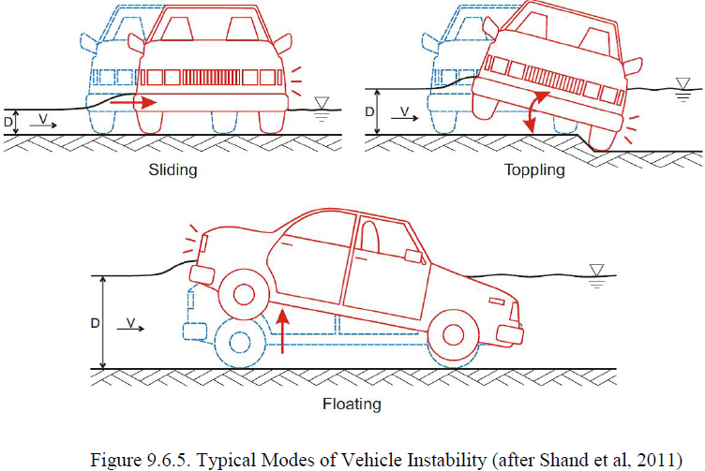
Stability Criteria (Vehicles)
Typical modes of vehicle instability
Source: Shand et al (2011)
Notes:
Discuss vehicular stability

Slide 34
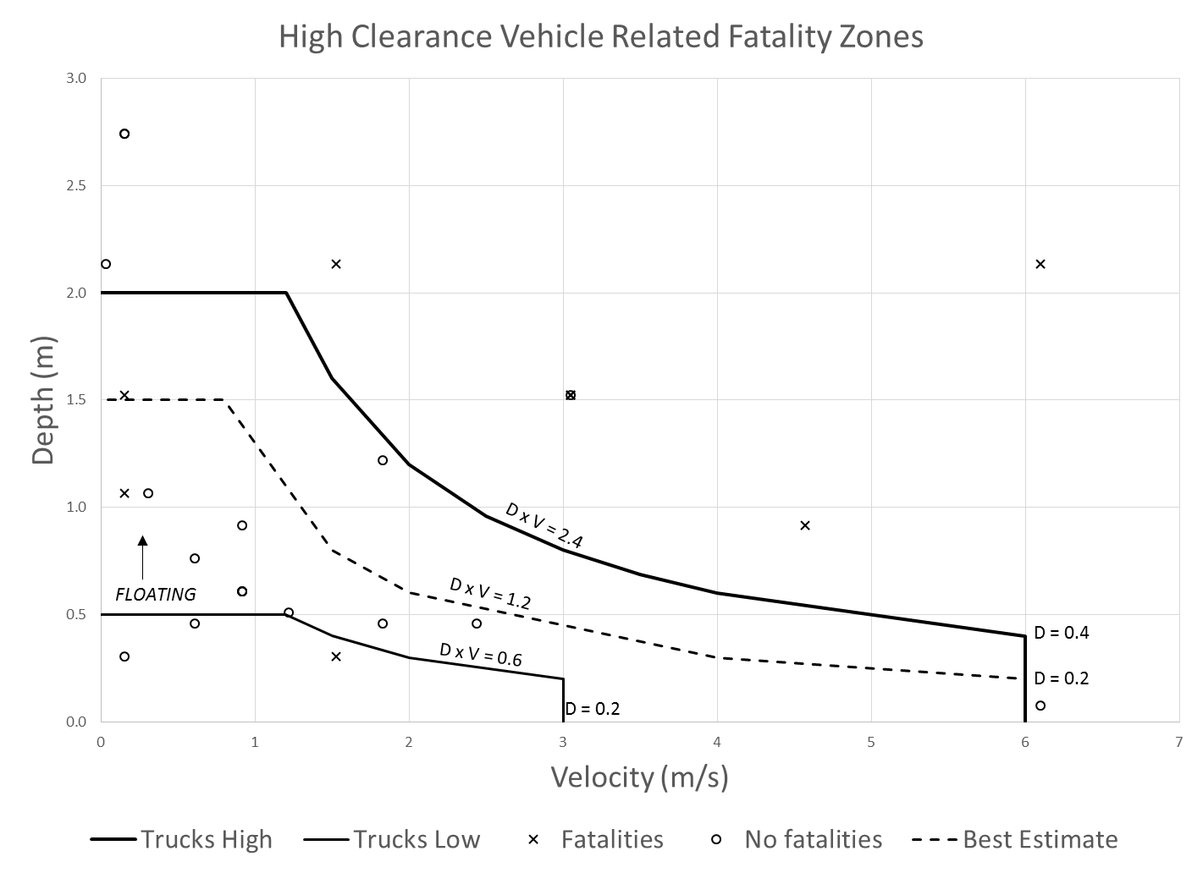
Stability Criteria (Vehicles)
High hazard
Low hazard
Uncertainty
Notes:
Empirical data on stability.

Slide 35
Outline
Evacuation Timeline
Vertical and Horizontal Evacuation
Hazard Zones and Fatality rates
Case Studies

Slide 36
Stability Criteria (Vehicles)
Low clearance vehicles
Cars, minivans, etc.
High clearance vehicles
Trucks, SUVs, vans, etc.
 | High | Low | Best
Depth (m) | 1.5 | 0.3 | 1.2
Velocity (m/s) | 6 | 3 | 4.5
D*V (m²/s) | 1.3 | 0.3 | 0.8
 | High | Low | Best
Depth (m) | 2 | 0.5 | 1.5
Velocity (m/s) | 6 | 3 | 6
D*V (m²/s) | 2.4 | 0.6 | 1.2

Slide 37
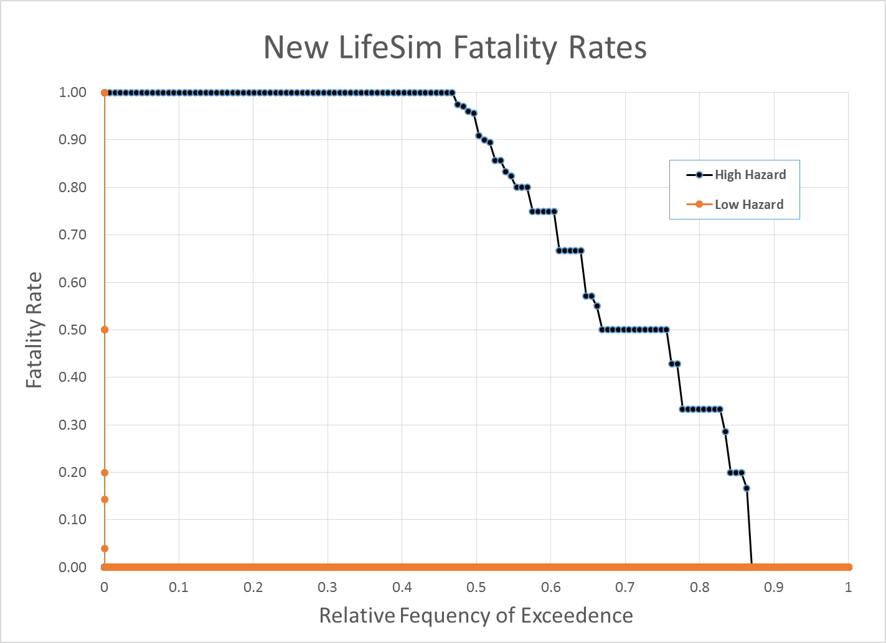
Fatality rates
St. Mary’s Orphanage, Galveston Hurricane, 1900. Building on the beach completely destroyed by waves reaching the second story. Almost nothing remained. Several nuns tied 6-8 children to themselves, they were found still tied together. 100 died, 3 survivors were single children.
Fort Hood, TX, 2016. 2.5 ton Light Medium Tactical Truck overturned and swept into deeper water. 9 of 12 soldiers died.
Taum Sauk Dam Failure. Home completely wiped from foundation. Park superintendent, wife, and 3 children swept away. All survived.

Slide 38
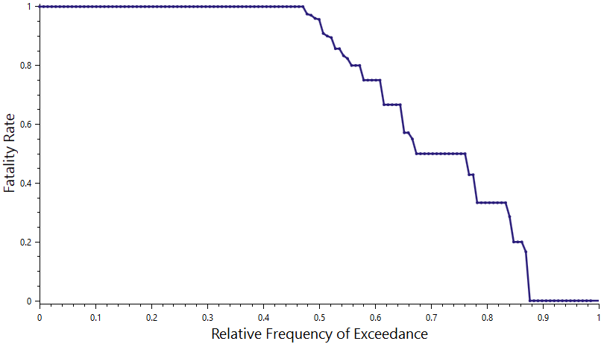
Fatality Rates in LifeSim
Randomly sample x-axis for a group fatality rate
Randomly sample for each person in the group against the fatality rate to determine life loss or survived.
0.75
Notes:
Go through how fatality rates are sampled in LifeSim.

Slide 39
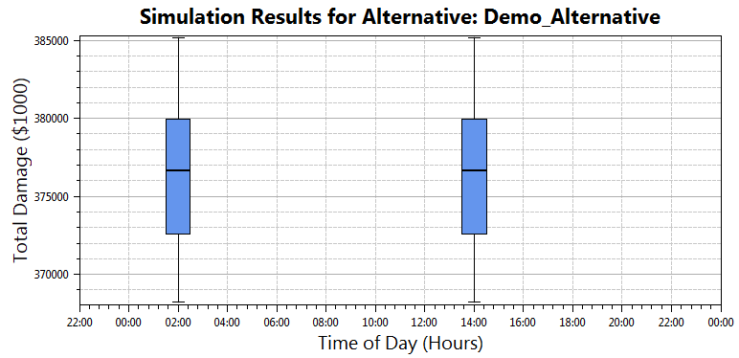
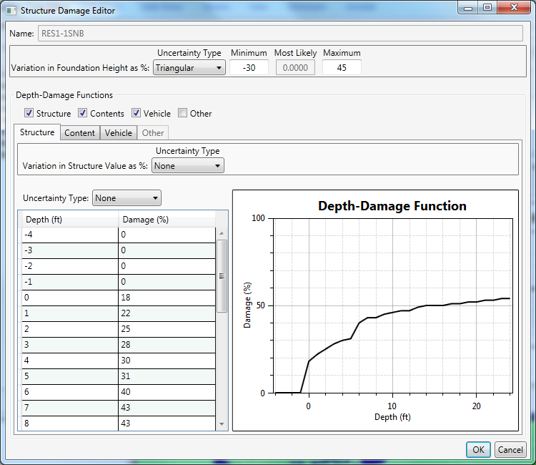
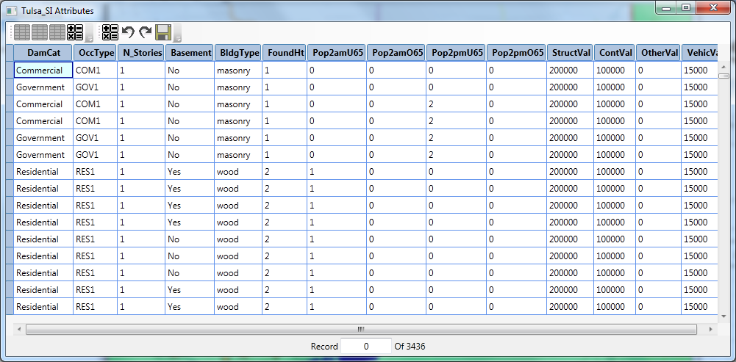
Direct Economic Damages
Notes:
Discuss direct economic damages

Slide 40
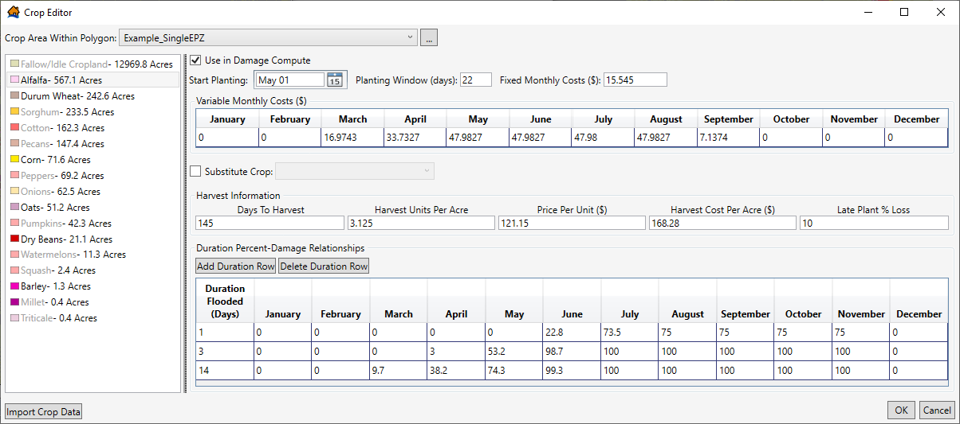
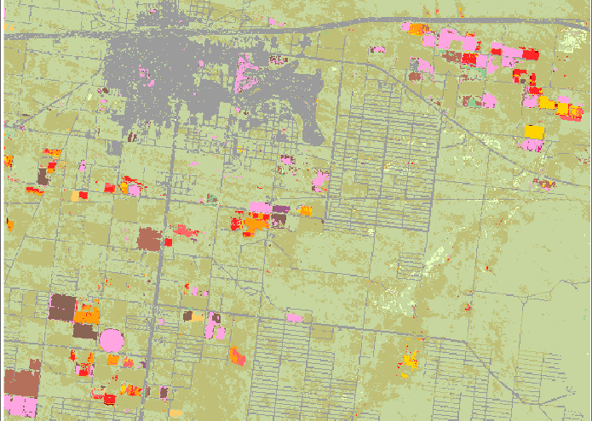
Direct Agricultural Damages
Notes:
Discuss ag damages

Slide 41
Outline
Evacuation Timeline
Vertical and Horizontal Evacuation
Hazard Zones and Fatality rates
Case Studies

Slide 42

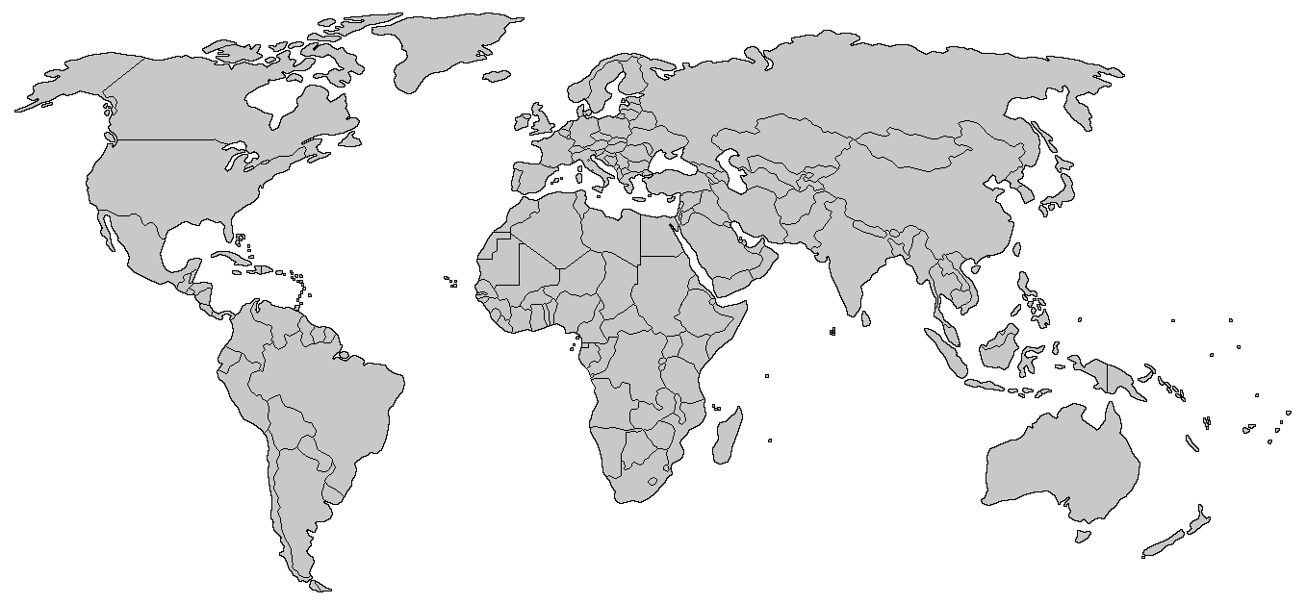
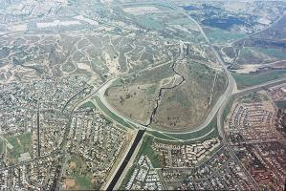
Notes:
Whittier Narrows Dam Safety Modification Study
Downstream of Whittier Narrows is dense urban terrain where significant traffic congestion can occur. LifeSim provides a means of estimating life loss on roads through its traffic simulation system. No other model can reliably provide traffic fatality estimates.
It was shown that sheltering in place actually reduces life loss on roads due to reduced congestion.
Mosul Dam
LifeSim allowed us to have a much better understanding of the range of potential life loss and the factors that drive it. Being able to pinpoint where the focus should be when it comes to either reducing uncertainty or reducing risk is a significant benefit.
There is no other defendable method available for estimating life loss for a Mosul scenario. The empirical record only has a couple data points that would even be close to representative for this situation, so an empirical approach won't work. No other simulation models can handle the extents and PAR this large.
Texas City (maybe)
Asdfasdf
American River (maybe)
Dam and Levee Safety USACE
Australian and Canadian Risk Assessments

Slide 43
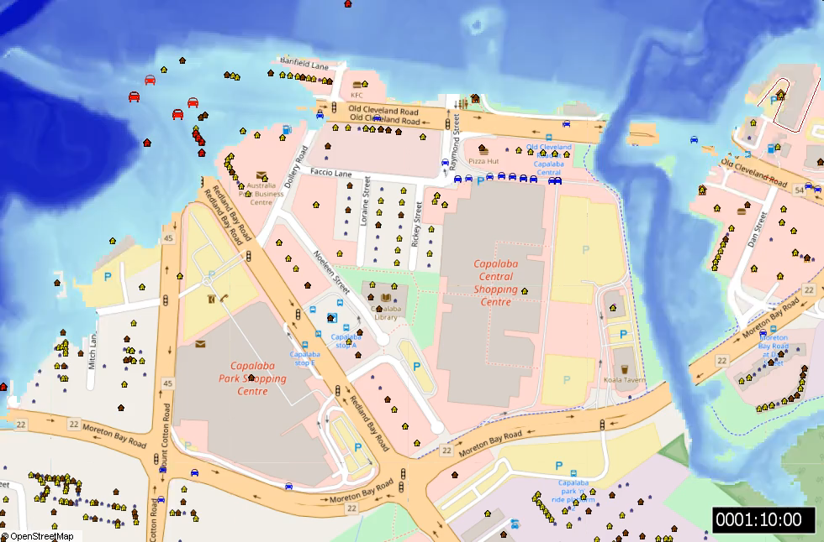
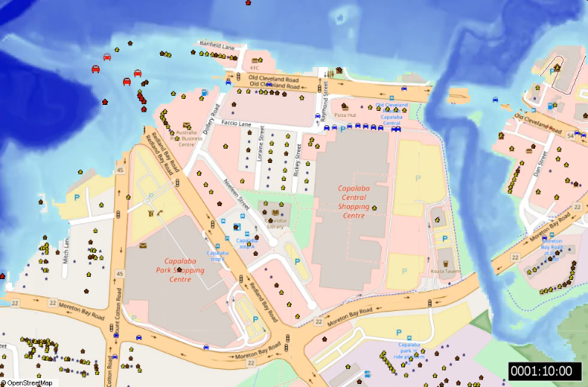
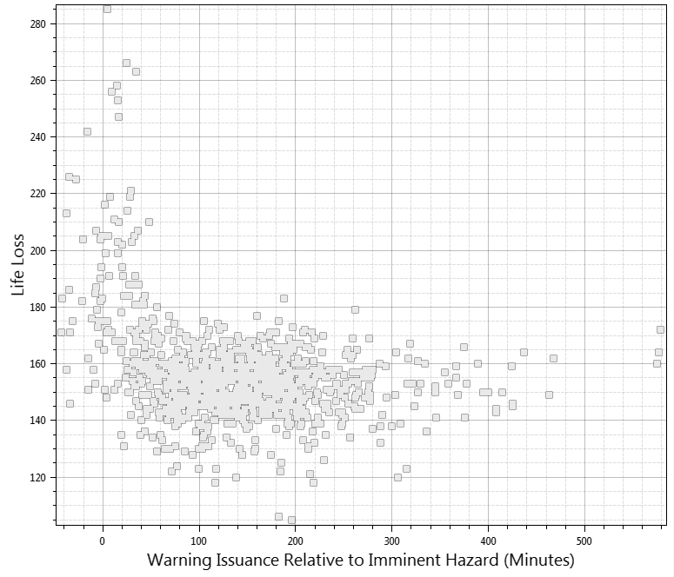

Application - Northern Australia
Life Loss
Warning Issuance
Not warned
Warned
Caught structure
Mobilized
Caught vehicle
Notes:
Explain why life loss is decreasing with less warning time. Tell story of people evacuating north out of the shopping center into the flood.

Slide 44
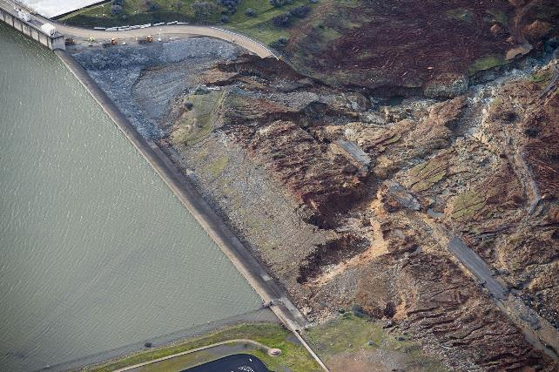
Application - Oroville
Goal: Create a LifeSim model calibrated to the Oroville Dam emergency spillway evacuation February 12, 2017
Notes:
Validation of traffic simulation model using the Oroville evacuation.

Slide 45
Oroville – Warning Delay Time
Threat Detected
Warning Issued
Warning Received
Protective Action Initiated
Safety Reached
Warning Delay Time
Warning Diffusion Time
Protective Action Initiation Time
Evacuation Time
[ Time ]
3:30 p.m. Hazard notification
4:21 p.m. First evacuation warning sent
3:51 p.m. Decision to evacuate
Notes:
Specific times in the warning and evacuation timeline from Oroville

Slide 46
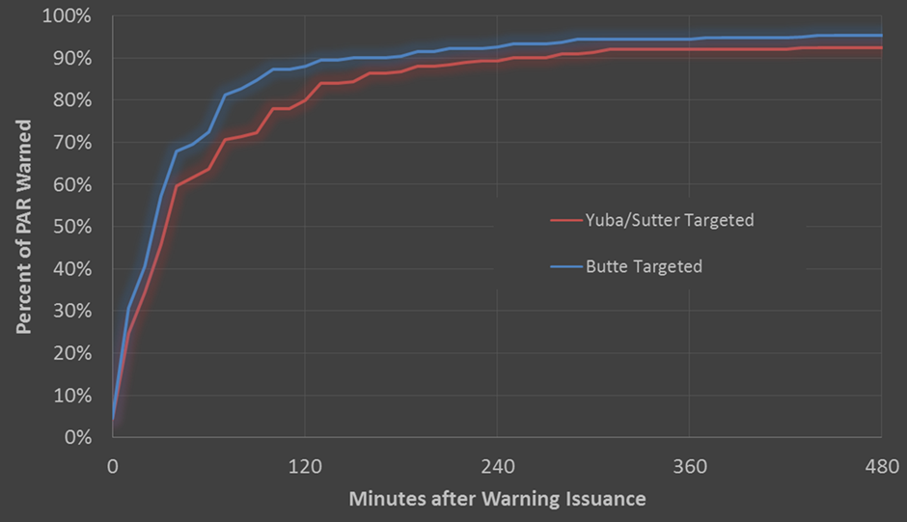
Oroville Warning Diffusion (Survey)
Threat Detected
Warning Issued
Warning Received
Protective Action Initiated
Safety Reached
Warning Delay Time
Warning Diffusion Time
Protective Action Initiation Time
Evacuation Time
[ Time ]
46
Notes:
[click to show graph] data based on survey

Slide 47
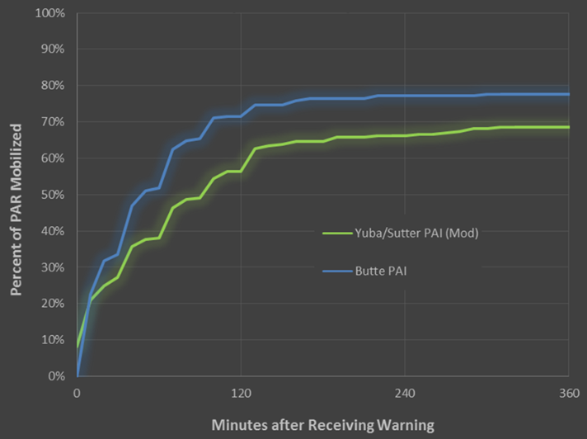
Oroville Protective Action Initiation (Survey)
Threat Detected
Warning Issued
Warning Received
Protective Action Initiated
Safety Reached
Warning Delay Time
Warning Diffusion Time
Protective Action Initiation Time
Evacuation Time
[ Time ]
47
Notes:
[click to show graph] data based on survey

Slide 48
Oroville Evacuation Timeline
Threat Detected
Warning Issued
Warning Received
Protective Action Initiated
Safety Reached
Warning Delay Time
Warning Diffusion Time
Protective Action Initiation Time
Evacuation Time
[ Time ]
Observed:
Mean: 3.04 hours
Range: 7 minutes to 50 hours
Median: 2 hours
Simulated:
Mean: 2.6 hours
Range: 5 minutes to 9 hours
Median: 2.4 hours
Notes:
Overall data looked good.

Slide 49
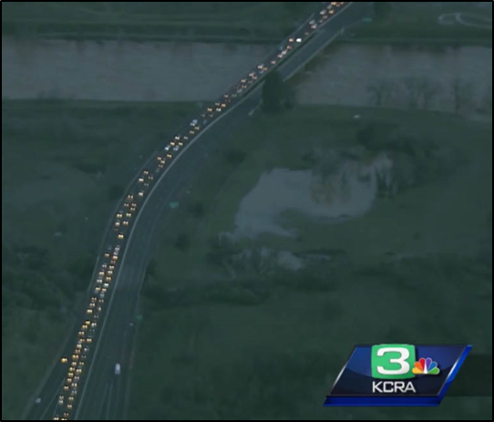
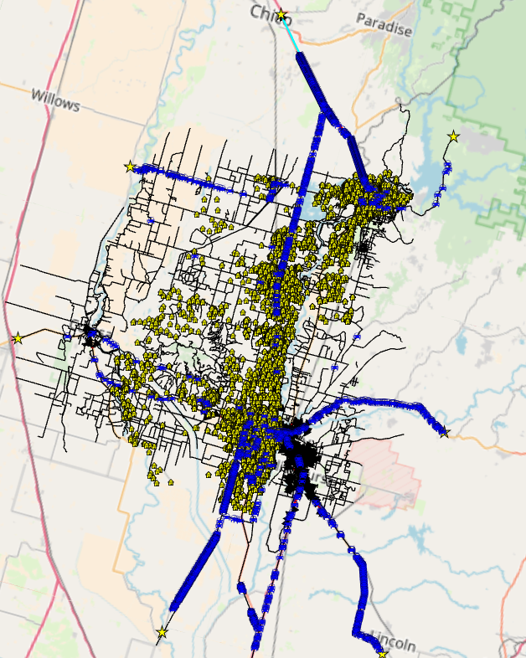
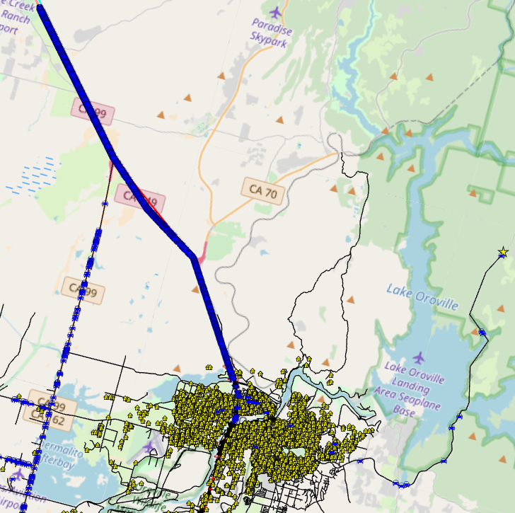

Oroville Traffic Comparison
Oroville
Yuba City
Oroville
Notes:
Traffic congestion in model matches news reports

Slide 50
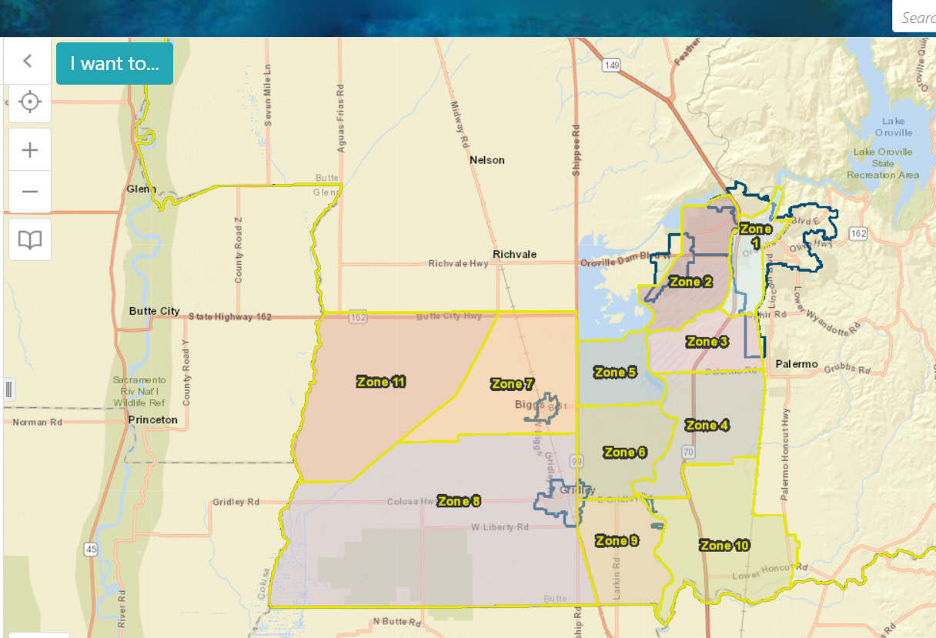
Calibrated LifeSim Oroville Model
Model current evacuation plan
Quantify current plan
Identify alternatives plans
Notes:
Explain how model can be used to test alternative evacuation plans.

Slide 51
LifeSim Model Checklist
Hydraulic data | Responses / Comments
Are the hydraulic output intervals sufficient in capturing the dynamic flood wave behavior? [USACE recommend an interval no greater than 30 minutes with 10 to 15 being generally sufficient]
Is the input terrain data in the hydraulic model detailed enough to capture the major hydraulic features within the floodplain?
Is the hydraulic model resolution (mesh size) suitable to capture key hydraulic features within the downstream floodplain?
Does the hydraulic data pass the peak flow at the end of the model?
If overtopping is involved, is the imminent hazard time set at the start of overtopping as opposed to the breach initiation?
Do imminent hazard times match breach times in the hydraulic model?
Structure inventory
Have the structure material types been defined correctly as well as the number of floors and the foundation height (in feet)?
Does the structure inventory capture the entirety of the maximum inundation extents?
Have you considered the possibility of the population in the structure taking protective action at different times?
Have the 2AM, 2PM and over and under 65 (high and low mobility) population been distributed correctly?
Emergency planning zones
Have the emergency planning zones been defined from information provided by emergency management agencies or dam owners?
For scenarios where there is high flow (e.g., spillway flow) prior to breach do the non-breach flooded areas have their own EPZ?
Are the warning issuance, diffusion and protective action initiation curves based on the questionnaires developed by Sorenson and Mileti (2015a, 2015b, 2015c)?

Slide 52
LifeSim Model Checklist
Road networks | Responses / Comments
Are there enough segments along the key roads to adequately sample the hydraulic data?
Are the vertical offsets (in feet) modelled for bridges in the road network?
Is the representation of one-way roads consistent with the expected traffic behavior?
Destinations
Have destination zones been setup in the correct locations (i.e., major disaster relief shelters, areas of higher terrain etc.)?
Alternatives
Have the destination zone assignments been allocated correctly?
Is the imminent hazard identification time and communication delay defined correctly for each emergency planning zone?
Do the evacuation parameters, life loss parameters and stability criteria seem appropriate?
Simulations
Does the simulation have an adequate number of iterations?
Do the summary output polygon sets provide ample coverage and granularity to analyze results?
Do the animations make intuitive sense or are there problems with the traffic routing in the animation?
Evacuation only: Is there an abnormal amount of life loss on roads (e.g., greater than 25% of the total), and if so, is this reasonable?
Evacuation only: Check map of life loss by road segment and the evacuation/destination graph for anomalies.
Verify destination outflow rates on major arteries with publicly available traffic flow data. In the US, each state has a department of transportation with data on peak flow rates for major roads at various locations.
Do the relative warning issuance plots look sensible based on the length of warning provided to the population?
Other notes
Have the coincident inflows been derived using a valid method (Stephens et al., 2012) or have they been considered in more detail?

Slide 53

Questions
53

Slide 54
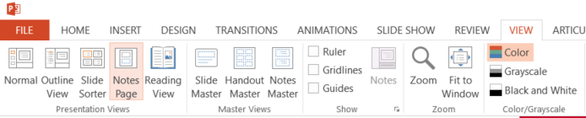
*** DO NOT DELETE THIS SLIDE***
This slide serves as a placeholder for the Facilitator and Producer Guide. To view the Guide, select View from the menu, and then select Notes Page.
❶
❷
Notes:
DLS-###
Title of Course
Presenter Guide
M#: Module Title

Slide 55
*** DO NOT DELETE THIS SLIDE***
Notes:
Module Overview
Purpose
Goals & Objectives
Module Information
Roles and Responsibilities
Provide a brief summary of the training, how it fits into the other USACE courses and key information about the content.
Identify the overall goal of the training.

Slide 56
*** DO NOT DELETE THIS SLIDE***
Notes:
Prepare to Present
Review the Materials
Review the Glossary
Practice and Personalize
Specific instructions may be used throughout the presenter guide to help you and the producer effectively share information and run the session. Be sure to review the various types of instructions below.
SAY: (spoken out loud, spoken verbatim, read this out loud)
DO: (take an action such as, post a link, handout job aid, turn on annotation) 1-step, one-off actions, simple
RUN: (multi-step action, like run an activity that involves audience, send to breakout room, explain instructions, etc.)
PAUSE: (stop and wait for response, provide / allow participants to process and respond)
ASK: (asking a question, ask for a response)
DISCUSS: (open-ended discussion with group)
EXPLAIN: (a list of bulleted points that facilitator puts in their own words)
Review both the slides and the presenter guide to familiarize yourself with the content and the presentation strategy. The slides and presenter guide are contained in the same PowerPoint document. On the menu bar, go to View > Normal to view the slides and View > Notes Pages to view and modify the presenter guide. Review the presenter guide to identify your speaking points, the module activities, and producer instructions.
❶
❷
Producer: a person assigned to each webinar session that runs activities and supports the training.
❸
It’s critical you keep within allotted time limits for your sections. Practice timing yourself and clearly identify what you plan to say using bullet points or a script. Ensure your presentation sounds as natural and personal as possible by modifying the key points and putting them in your own words. Practice your sections multiple times before the live session and attend any preparation and train-the-trainer meetings.

Slide 57
*** DO NOT DELETE THIS SLIDE***
Notes:
Prepare to Present
Review Course Timeline/Outline
❹

