Slide 1
Basic Probability and Statistics
Hydrologic Engineering Center
Brennan Beam, PE
November 2025
Notes:
Modified from Beth’s presentation
Making sure we all have a baseline
Video if you want more detail

Slide 2
Goal
Probability theory is a backbone of risk analysis
Because students’ backgrounds differ, as does their current use of these topics….
….we’ll revisit concepts in probability and statistics, to bring us to a common jump-off point for upcoming material
Notes:
Some recurring themes throughout the course from this lecture
Common understanding

Slide 3
Topics
Vocabulary and Definitions
Dice Rolling and PMFs
CDFs and PDFs
Histograms
Typical Distributions
Sample Moments
LTEP

Slide 4
Definitions
Probability, Frequency
Random
Random Variable
Probability Distribution
Natural Variability
Knowledge Uncertainty
Population and Sample
Parameters and Statistics
Notes:
We’ll define these

Slide 5
Probability
A measure of likelihood, or the chance of an outcome or event
Magnitude: 0 ≤ probability ≤ 1
0% ≤ probability ≤ 100%
Sum of probabilities of all possible outcomes = 1 or 100%
won’t /can’t happen
will happen
Notes:
Read the slide

Slide 6
Frequency
The rate at which something random happens, or how often it happens
  generally based on a given data set or sample
Used to estimate probability
In the Corps, “frequency” is often used interchangeably with “probability”
Notes:
Paraphrase slide
How likely something is to happen is closely tied with how often it happens.

Slide 7
Random
Lacks a clear purpose, intention or method.
Has no predictable pattern
  …but frequency of outcome might be predictable
Happens by chance rather than by plan
Outcome is uncertain
Has a probability of occurrence
Notes:
Many definitions of “Random”
Some outcomes are naturally random
Sometimes describes a process so complex we can’t understand it

Slide 8
Random Variable, RV
A variable that’s subject to chance, and can take on different values with associated probabilities
Use RV to describe something that:
  naturally keeps changing, randomly, or
  we can’t estimate well
We describe a random variable with a probability distribution: outcome vs probability
Notes:
Paraphrase slide
Any value that’s relevant to our analysis, that either hasn’t happened yet or can’t be measured accurately, is a random variable.

Slide 9
Probability Distribution
A relationship between a RV’s value and probability
A function that describes all possible values of a random variable, and their likelihoods
We use probability distributions to describe what is random, and what is unknown
natural variability
knowledge uncertainty
Notes:
Must distinguish randomness from what is unknown
SEE NEXT PAGES

Slide 10
Natural Variability
Aleatory Uncertainty
Some variables are naturally random in that they change or vary unpredictably through time or space.
Examples
  market prices
  annual peak streamflow
  channel roughness, which can be affected by a flood event
  soil properties (vary in space, rather than time)
Notes:
Paraphrase slides

Slide 11
Knowledge Uncertainty
Epistemic Uncertainty
The degree to which we are unsure about any parameters and relationships used in computation: economic, hydraulic or statistical
Might be reducible with more information…
Examples
  estimates of probability
  value of structures/contents in flood plain
  a model that is too simple
decision metrics often encompass NV, but KU still adds “spread”
Notes:
Paraphrase slide

Slide 12
Population and Sample
Population - the “universe”
- all possible outcomes of RV, and their likelihoods
- sometimes, a probability distribution
Sample - a subset of the population
- observations (measurements) of the variable
- results of an experiment
- a representative sample will maintain the probabilistic structure of the population (e.g., distr. & parameters)
Population
Sample
important question: is the random sample representative of the population?
Notes:
Venn diagram good illustration
Sample is result of some experiment or data gathering process
Representative? Want to avoid bias in sampling, or acknowledge it

Slide 13
Parameters and Statistics
Parameter
  A descriptive measure of a POPULATION
Statistic
  A descriptive measure of a SAMPLE
A sample statistic is often used to estimate a population parameter
truth (unknowable)
estimate
Notes:
Paraphrase slide

Slide 14
Topics
Vocabulary and Definitions
Dice Rolling and PMFs
CDFs and PDFs
Histograms
Typical Distributions
Sample Moments
LTEP

Slide 15
Central Tendency Parameters (Discrete)
Mode = most likely
Median = 50% of prob above,
50% of prob below
Mean μ = prob weighted sum of outcomes (expected value)
For a symmetrical distribution, these are the same.
For an asymmetrical distribution, they are not…

Slide 16
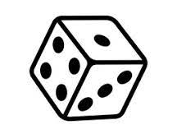


Rolling a 6-sided Die: Physics
probability mass function, PMF
Central Tendency:
expected value, mean
1/6 = 0.167
$$μ=\sum_{iϵI}{p_{i}X_{i}=}$$
= Probability weighted sum of all possible outcomes
= (1/6) * (1 + 2 + 3 + 4 + 5 + 6)
$μ$= 3.5
Notes:
Physics tells us this

Slide 17
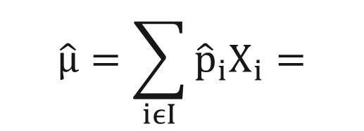
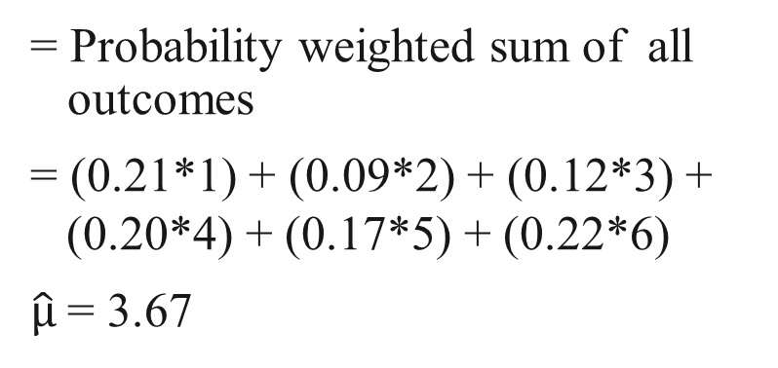
Rolling a 6-sided Die: Experiment
histogram - estimate of PMF
Central Tendency:
expected value, mean
$$\hat{μ}=\sum_{iϵI}{{\hat{p}}_{i}X_{i}=}$$
sample estimate of mean
1/6
= Probability weighted sum of all outcomes
= (0.21*1) + (0.09*2) + (0.12*3) +
(0.20*4) + (0.17*5) + (0.22*6)
$\hat{μ}$= 3.67
Sample size = 100
same number from average of the values
Notes:
This is the result of an experiment

Slide 18
As sample size increases
sample error decreases
Notes:
Paraphrase

Slide 19
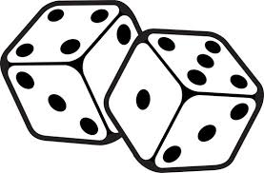
Sum of 2 Dice: Physics & Experiment
36 possible rolls resulting from 2 random numbers, but the function we’re interested in is the SUM of both dice.
Die #2
only 11 possible outcomes of the function “SUM”
1
2
3
4
5
6
Expected Value of the Sum =
2 * ¹/₃₆ + 3 * ²/₃₆ + 4 * ³/₃₆ +
5 * ⁴/₃₆ + 6 * ⁵/₃₆ + 7 * ⁶/₃₆ +
8 * ⁵/₃₆ + 9 * ⁴/₃₆ + 10 * ³/₃₆ +
11 * ²/₃₆ + 12 * ¹/₃₆ = 7
1
2
3
4
5
6
7
2
3
4
5
6
7
8
Die #1
3
4
5
6
7
8
9
4
5
6
7
8
9
10
5
6
7
8
9
10
11
6
7
8
9
10
11
12
these outcomes are mutually exclusive and exhaustive
Notes:
This is a similar system using two dice, and computing the sum. The system is simple enough to estimate probability from the basic understanding. There are 36 possible rolls, as each value on die 1 can be paired with each value on die 2. There are 11 possible sums, between 2 and 12. The likelihood of each possible outcome is simply the number of ways to produce that outcome, divided by the 36 possible outcomes, with 7 the most likely as 6 out of 36.

Slide 20
Rolling 2-dice, PMF from physics
PMF = Probability Mass Function
How would I find my probability or rolling a 3 or less?
What about 4 or less?
Notes:
PMF according to physics, but can conduct an experiment

Slide 21
Topics
Vocabulary and Definitions
Dice Rolling and PMFs
CDFs and PDFs
Histograms
Typical Distributions
Sample Moments
LTEP

Slide 22
Accumulating Probability - CDF
PMF
Cumulative Distribution Function =
probability of being less than or equal to a value
CDF
non-exceedance probability
Notes:
Probability mass function on top, probability of a discrete outcome
Sometimes useful to look at the CDF, bottom, probability of being less than or equal to

Slide 23
Accumulating Probability - CDF
PMF
Cumulative Distribution Function =
probability of being greater than or equal to a value
Can be called Complementary CDF
CDF
exceedance probability
Notes:
OR a complementary CDF, which is greater than some value or exceedance probability
We use this in our H&H modeling

Slide 24
Continuous Random Variables
…the 6-sided dice were DISCRETE random variables
PMF is the prob of a discrete number.
Probability distribution is a continuous function.
Probability of an exact number is zero!
Thus, we are interested in incremental or cumulative probabilities:
P[ 2.5 < X < 3.5 ] = 0.4 (Incremental)
P[ X < 3 ] = 0.7 (Cumulative)
P[x=3] = 0
Relationship: P[ 2.5 < X < 3.5 ] = P[ X < 3.5] – P[ X < 2.5 ]
incremental
cumulative
Notes:
Paraphrase slide
Prob Mass Function is prob of a discrete number, we can’t do that with continuous

Slide 25
Defining a Continuous Distribution
Probability Density Function (PDF), f(x), defines the probability of occurrence for a continuous random variable.
area under curve = probability
Cumulative Distribution Function
(CDF) = ∫ PDF, F(x) = P(X ≤ x), is the probability the random variable is less than some value
curve = probability
P(x₁<X<x₂)
Area = 1
p
PDF
x
x₁
x₂
X
F(x₂)
F(x₁)
CDF
p(x₁<X<x₂) = F(x₂) - F(x₁)
p
=F(x)
x
X
x₁
x₂
Notes:
PDF instead of PMF
These are the basic images and definitions of the Probability Density Function and the Cumulative Distribution function for a continuous random variable.

Slide 26
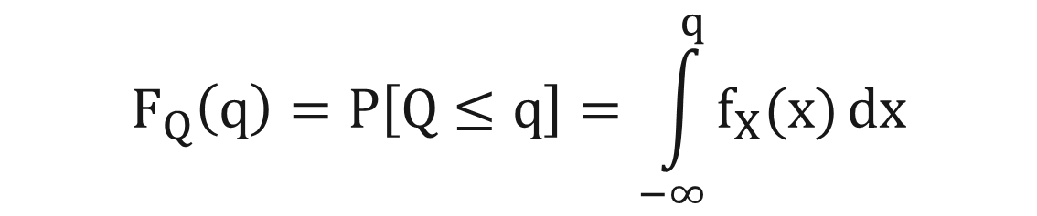
Definition of PDF and CDF
A Probability Density Function (PDF), f(x), describes the probability of occurrence for a random variable.
A Cumulative Distribution Function (CDF), F(x) is the probability of being less than some value:
Equation:
$$F_{Q}\left(q\right)=P\left[Q≤q\right]=\int_{−∞}^{q}{f_{X}(x)}dx$$
f_{X}(x) is the PDF
the integral is the CDF
Notes:
This shows the basic functional form of PDF and CDF for continuous RV
CDF is the integral of the PDF, and a probability for a given value is the integral up to that value.

Slide 27
Topics
Vocabulary and Definitions
Dice Rolling and PMFs
CDFs and PDFs
Histograms
Typical Distributions
Sample Moments
LTEP

Slide 28
Probability Estimates from Data
Estimated Probability = # of Occurrences
# of Independent Trials
= Relative
Frequency
Notes:
Relative Frequency is a very simple but very effective method of estimating probability from observations. Outcomes that are more probable to occur more frequently.

Slide 29
A Key Point
As the number of observations becomes very large, the estimate of probability by relative frequency approaches the true value - population value
Problem: we usually have relatively little data.
Notes:
Paraphrase

Slide 30
Probability Estimates from Data
largest flow of each year
note: this variable is continuous, rather than discrete as the 6-sided die
Notes:
This is an example data set of the annual maximum flow value of each year for an 85 year period of record. Note this is a continuous random variable, because flow can be any value in the range of possibility.

Slide 31
Probability Estimates from Data
histogram
count
histogram approximates the PDF
divide count by 85 to get relative frequency
0
0
Notes:
One way to view the variable probabilistically is to discretize the range and produce a histogram. We see higher bars where there are more occurrences, implying higher probability of those values. The histogram is an estimate of the PDF.

Slide 32
Histogram
Estimating the Probability Density Function, PDF
Histogram or, class interval analysis
Placing observations in intervals (bins) and calculating relative frequency results in a histogram of the observations
As the number of observations becomes very large, and the interval becomes very small, the histogram approaches the true probability density function, PDF, for a continuous random variable
Notes:
Paraphrase

Slide 33
Density function (PDF) vs. histogram
histogram of very large sample
area under the probability density function is probability, and so the area under the entire curve is equal to 1.0
PDF
area = p
q
Notes:
This is intended to show that for a very large sample, the histogram approaches the PDF.

Slide 34
Cumulative Histogram
Cumulative Count
Cumulative Frequency
Cumulative Frequency
0
0
Notes:
Histograms can be accumulated for continuous random variables in the same way they are for discrete random variables, and are an estimate of the CDF. This is the cumulative histogram of the sample of 85 values, as count on the left and as relative frequency on the right.

Slide 35
Cumulative Histogram vs
Cumulative Distribution Function, CDF
But, not always the best way to estimate the CDF for a smaller sample
Cumulative Frequency
Notes:
For a very large sample, the cumulative histogram approaches the CDF.

Slide 36
Assumptions
Treat observations as a random, representative sample of the population of interest
Assume the sample is IID
  random and independent
  identically-distributed – from the same probability distribution, homogeneous, stationary
  estimate of the distribution improves with sample size
  we compute confidence intervals to quantify our error (uncertainty) due to sample NOT being representative
Notes:
*STAR This brings home a lot of the previous concepts
Not so much that they ARE identically distributed as that it is reasonable to fit a single distribution to them.
ID: All value from the same prob distr. OR, all values can be effectively represented by the same probability distribution

Slide 37
Topics
Vocabulary and Definitions
Dice Rolling and PMFs
CDFs and PDFs
Histograms
Typical Distributions
Sample Moments
LTEP

Slide 38
Some Continuous Distributions
Uniform:
Triangular:
Normal:
these are probability density functions (PDFs)
Notes:
In this lecture, we’ll be looking at these four common probability distributions. These are useful for different purposes. Some can be used for describing hydrologic variables, and others are more useful to describe uncertainty distributions.

Slide 39
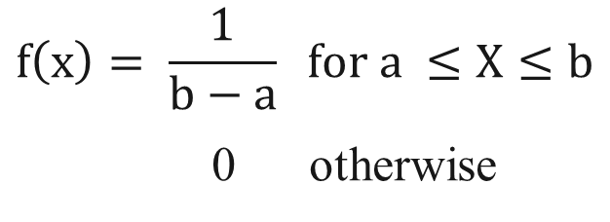
Uniform Distribution
Interpretation:
  All values in range are equally likely
Parameters:
  Range (a, b) (min, max)
What is the mean, median, mode?
What does the CDF look like?
CDF
1
PDF
= f(x)
0
$$f\left(x\right)= \frac{1}{b−a} for a ≤X≤b$$
0 otherwise
Notes:
A common use of the Uniform distribution with min and max of 0 and 1, designated as U[0,1], is for generating values to act as cumulative probabilities to randomly sample from any probability distribution for Monte Carlo simulation, as we did with the dice-rolling spreadsheet.

Slide 40
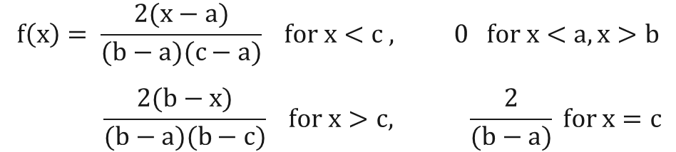
Triangular Distribution
More informative than uniform distribution
Parameters:
  Mode c
  Range (a, b) (min, max)
May be asymmetrical
In this case, Mode < Median < Mean
What does CDF look like?
= f(x)
1
CDF
PDF
0
$$f\left(x\right)= \frac{2(x−a)}{(b−a)(c−a)} for x<c , 0 for x<a, x>b$$
$$\frac{2(b−x)}{(b−a)(b−c)} for x>c, \frac{2}{(b−a)} for x=c$$
Notes:
The triangular distribution can be useful in describing uncertainty around an estimate because it can be either symmetrical or asymmetrical.

Slide 41
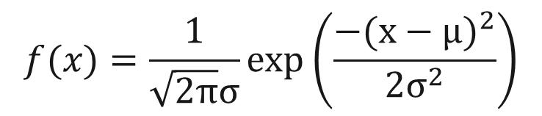
Normal Distribution
Very useful, a common distribution found in nature
Has a defined shape, eqn
Parameters:
  Mean μ
  Variance σ² (standard deviation σ)
Symmetrical
  Mean = Median = Mode
  Skew coefficient = 0
Scalable from Standard Normal
Mean = 0, St.Dev = 1 ~N(0, 1)
What does CDF look like?
1
CDF
PDF
σ
μ
0
$$f(x)=\frac{1}{\sqrt{2π}σ}exp\left(\frac{{−(x−μ)}^{2}}{2σ^{2}}\right)$$
Notes:
The Normal distribution is useful both to describe variables and to describe uncertainty.

Slide 42
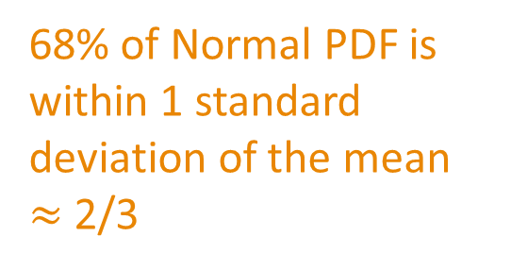
Normal Distribution
68% of Normal PDF is within 1 standard deviation of the mean $≈$2/3
95% of Normal PDF is within 2 standard deviations of the mean
μ = mean
σ = standard
deviation
σ
μ

Slide 43
Topics
Vocabulary and Definitions
Dice Rolling and PMFs
CDFs and PDFs
Histograms
Typical Distributions
Sample Moments
LTEP

Slide 44
Central Tendency Statistics (Continuous)
Mode = most frequently occurring
Median = middle of ranked list
  (50% of data above, 50% of data below)
Mean X (average) = sum of values
expected value number of values
Notes:
These are the statistics of central tendency as estimated from a sample. The earlier mention of the these measures described their definitions for a probability distribution. These sample statistics can be used to estimate the distribution values.

Slide 45

Sample Mean, X average
Central value statistic
Sample mean is an estimate of population mean, μ
where: X_{i} = sample member, i
N = sample size
1st moment about 0
$$\overline{X}=\frac{1}{N}\sum_{i=1}^{N}{X_{i}}$$
X = μ
X_{bar}
mu_{hat}
has same unit as variable
Notes:
Sample mean is also known as expected value, and is noted as X-bar, or whatever variable designation with a bar over it.
A change in the mean moves the PDF left (for lower) or right (for higher).

Slide 46
Dispersion Statistics
Standard Deviation, S = average distance
from mean
Variance, S² = (standard deviation)²

Slide 47
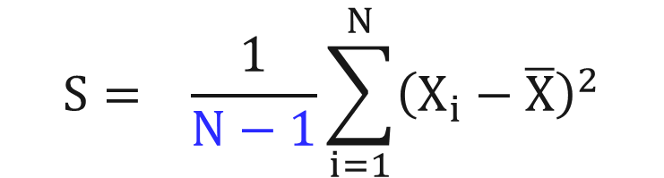
Sample Standard Deviation, S
Dispersion Statistic (average distance from mean)
Sample standard deviation S is an estimate of population standard deviation, σ
where: X_{i} = sample member, i
N = sample size
X = sample mean
2nd moment about mean
$$S= \frac{1}{N−1}\sum_{i=1}^{N}{{\left(X_{i}−\overline{X}\right)}^{2}}$$
S = σ
has same unit as variable
S
Notes:
Standard deviation, noted S, is the average distance from the sample mean. Because the sum of distances from the sample mean is equal to zero, this estimator squares the distances Xi – Xbar to remove the sign and make all values positive. After averaging, the square root it taken to return the metric to the original unit of the variable. The equation divides by N-1 rather than N as a correction for bias, to produce an unbiased estimator.
A change in the standard deviation makes the PDF narrower (for smaller) or wider (for larger).

Slide 48


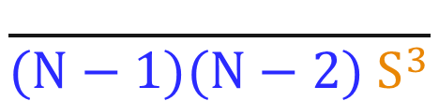
Sample Skew Coefficient, g
Asymmetry statistic
Sample skew is an estimate of population skew, γ, but is volatile for small samples
where: X_{i} = sample member, i
N = sample size
S = sample standard deviation
3rd moment about mean
$$N\sum_{i=1}^{N}{{\left(X_{i}−\overline{X}\right)}^{3}}$$
g = γ
γ = 0
$$g=$$
$$\frac{ }{(N−1)(N−2){ S}^{3}}$$
γ < 0
dimensionless
γ > 0
Normal Distribution
Notes:
The skew coefficient again uses distances from the sample mean, but cubes them, which reestablishes the sign (positive or negative) and exaggerates the value. Values far from the mean, above or below, have more influence on the statistic than values close to the mean. More values far above the mean than far below the mean will produce a positive sum, and more values far below will produce a negative sum.
N-1 and N-2 are again corrections for bias. But with a single N on top and two Ns on the bottom, this is still an average cubed distance from the mean. Finally, it is divided by the standard deviation cubed, both normalizing the value and making it dimensionless (unitless).
A symmetrical sample will have a skew of zero, because the distances above and below the mean are balanced. Values much larger than the mean, producing a positive skew, show as a long upper tail and short lower tail. Values much smaller than the mean, producing a negative skew, show as a long lower tail and short upper tail.

Slide 49
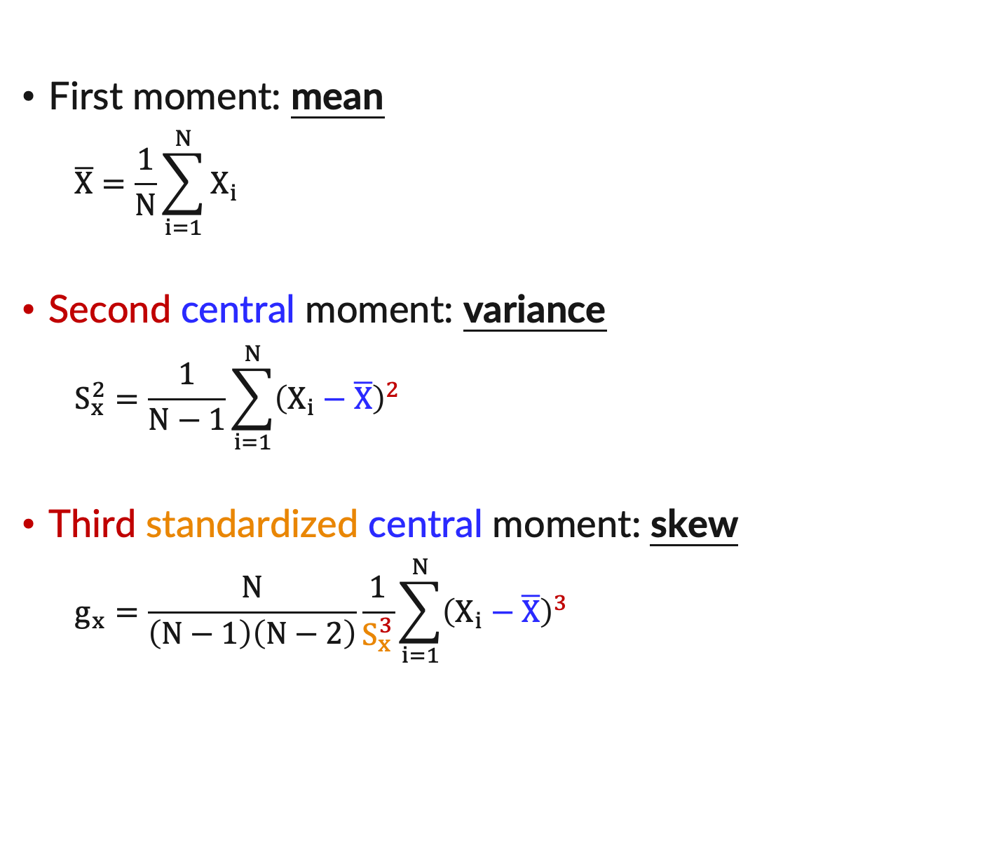
Distribution Moments
First moment: mean
  $$\overline{X}=\frac{1}{N}\sum_{i=1}^{N}{X_{i}}$$
Second central moment: variance
  $$S_{x}^{2}=\frac{1}{N−1}\sum_{i=1}^{N}{{\left(X_{i}−\overline{X}\right)}^{2}}$$
Third standardized central moment: skew
  $$g_{x}=\frac{N}{\left(N−1\right)\left(N−2\right)}\frac{1}{S_{x}^{3}}\sum_{i=1}^{N}{{\left(X_{i}−\overline{X}\right)}^{3}}$$

Slide 50
Topics
Vocabulary and Definitions
Dice Rolling and PMFs
CDFs and PDFs
Histograms
Typical Distributions
Sample Moments
LTEP

Slide 51
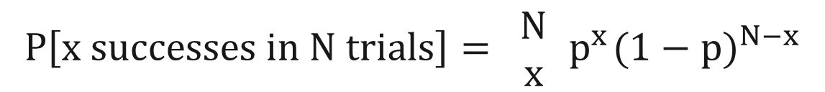

Long-term Exceedance Probability
Probability of occurrence within a longer period of time
What is the probability that a house in the 1% (100-year) floodplain will be flooded at least once in a 30-year period?
Determine the probability of flooding in any one year
Apply the binomial distribution for a 30-year period...
…at the edge of the 1% floodplain
assumes independence of trials
$$P\left[x successes in N trials\right]= \left.\begin{matrix}N \\ x\end{matrix}\right.{ p}^{x}{(1−p)}^{N−x}$$
$$where: \left.\begin{matrix}N \\ x\end{matrix}\right. = \frac{N!}{x!\left(N−x\right)!}$$
= number of ways to get
x successes in N trials
p = probability of success in a single trial
Notes:
Paraphrase

Slide 52
Long-term Exceedance Probability
x=0
Prob of no exceedances in N years is (1 - p) ^{N} (x=0, where p = probability of exceedance)
Prob of one or more exceedances in N years is 1 - (1 - p) ^{N} (complement of none is at least 1)
Prob of one or more “1%” floods in 30 years is 1 - (1 - 0.01) ³⁰ = 0.26 because p = 0.01 and N = 30
x=1, …, x=30
Answer is: 26%
The risk of 1 or more “10-yr” floods in 30 years is 1 - (1-¹/₁₀)³⁰ = 0.96 96%
The risk of 1 or more “100-yr” floods in 30 years is 1 - (1-¹/₁₀₀)³⁰ = 0.26 26%
The risk of 1 or more “500-yr” floods in 30 years is 1 - (1-¹/₅₀₀)³⁰ = 0.06 6%

Slide 53
Goals addressed so far…
revisit probability concepts
estimating probability
  from understanding the system, or from data
using probability distributions to describe what is random, and what is unknown
long-term exceedance probability

Slide 54
Questions
What is the third standardized central moment about the mean?
Can a triangular distribution be symmetrical?
A parameter is a descriptive measure of a sample – T or F?
Epistemic uncertainty is what?

Slide 55
Final Workshop– If time permits
Use Excel to fit different distributions to data
Explore and visualize the impact of different parameterizations
Set the stage for exploring flow frequency later

