Slide 1
Uncertainty in Exceedance Probability Functions (Frequency Curves)
Brennan Beam, PE
Original Slides from:
Beth Faber, PhD, PE
William Scharffenberg, PhD
Gregory Karlovits, P.E., P.H., CFM
Hydrologic Engineering Center
March 2025

Slide 2
Motivation for the Topic

Slide 3
annual maximum flow
Notes:
The next few slides will demonstrate how there is a lot of uncertainty surrounding our frequency quantiles, especially along the tails of the distribution.
When fitting a flood frequency curve to data, the picture we’re accustomed to seeing is the fitted curve and the confidence interval. This lecture explored the uncertainty in this process, both what defines the confidence interval and what exists but does not inform the interval.
56 years

Slide 4
Experiment: 1000 years of data, sampled from LP3 with known parameters
500-yr event
100-yr event
25-yr event
Experiment:
LP3 with known parameters
annual maximum flow
same distribution, linear flow axis
μ = 4
σ = 0.5
γ = 0.4
in experiment, IID assumptions are true, distrib. is correct
Notes:
This is a statistical experiment in which we start with a KNOWN probability distribution, and randomly sample many “years” of data from it. We can perform parameter estimation on that sampled data, and see how well we can predict the true values that in this case are known.
This example samples 1000 “years” of peak annual flows from an LP3 distribution with mean=4, standard dev=0.5, and skew=0.4 Note the occurrence of spans of time that are not representative of the full data set (225 to 425 has mostly very low events, and 650 to 700 has very high events.)

Slide 5
Experiment: 1000 years of data, sampled from LP3 with known parameters
Experiment:
LP3 with known parameters
μ = 4
σ = 0.5
γ = 0.4
Notes:
Motivation:
This is a statistical experiment in which we start with a KNOWN probability distribution, and randomly sample many “years” of data from it. We can perform parameter estimation on that sampled data, and see how well we can predict the true values that in this case are known.
This example samples 1000 “years” of peak annual flows from an LP3 distribution with mean=4, standard dev=0.5, and skew=0.4. Parameters are re-estimated each year, with each additional value. Mean and standard deviation are estimated well with 50 to 100 years of data. However, skew does not stabilize until 300 to 400 years of data are available. The 1% (100-yr) and 4% (25-yr) events are also shown, with the 1% event being much more sensitive to the erratic skew value.
Note how the occurrence of a large flood event impacts the skew estimate. Note how a span of years without large events affect the skew estimate.
Note the occurrence of spans of time that are not representative of the full data set (225 to 425 has mostly very low events, and 650 to 700 has very high events.)
This example is meant to display our uncertainty in our frequency curve estimate, even with 100 years of data available to us. The example actually underestimates our real uncertainty because it creates an ideal case in which the “true” distribution is a LogPearson III. In reality, the choice of LP3 is a simplification that introduces additional error.

Slide 6
Sample Size?
Same data, sliding 100 year window and 50 year window
Notes:
In the previous graphs, the effect of the increasing sample size obscures the effect of individual events on the parameter estimates. In these graphics, a single sample size is maintained, and the “window” is moved across the data set.
Note the increased variability in the estimates using 50 years of record, as compared to using 100 years. Note the still large amount of variability in the 100 year estimates. The impact of individual large events is now clearer, as is the effect of periods without large events. Note the decrease in the skew estimate (and 1% event) between the previously noted low years of 225 to 425, and the rise between 650 and 700, as many large events are included.
The estimated 1% event is rarely correct. What’s the problem here? The data isn’t wrong, and the model isn’t necessarily wrong. But the samples are not representative of the population.

Slide 7
Notes:
When fitting a flood frequency curve to data, the picture we’re accustomed to seeing is the fitted curve and the confidence interval. This lecture explored the uncertainty in this process, both what defines the confidence interval and what exists but does not inform the interval.

Slide 8
Notes:
Another way to view the uncertainty is by the flow estimate. Lets say you decide the 1% flow is 15,000 cfs. Based on the confidence range, the 15,000 cfs flow can fall anywhere from 3% to the 0.2% AEP.
When fitting a flood frequency curve to data, the picture we’re accustomed to seeing is the fitted curve and the confidence interval. This lecture explored the uncertainty in this process, both what defines the confidence interval and what exists but does not inform the interval.

Slide 9
Objectives
Understand the reasons for uncertainty in a flow-frequency curve
Discuss 2 ways to develop a flow-frequency curve, and the sources of uncertainty in each method
Review how to enter this information to FDA

Slide 10
Topics
Where will we get the flow-frequency curve?
Frequency analysis of flow observations
Hydrologic modeling of watershed with frequency-based precipitation
Why is there uncertainty in the curve?
Explore the reasons for uncertainty in the curve, depending on source
How is the uncertainty described in FDA?
Parameter for uncertainty is the Equivalent Record Length
What are situations that challenge those primary methods and typical FDA inputs?

Slide 11
Approaches
We’ll look at two primary approaches to generating the flow-frequency curve
Frequency analysis of gaged flow observations
When we have flow observations at the site of interest
Hydrologic modeling using frequency-based precipitation
When we do not have flow observations at site of interest
When we need to model a complete watershed, multiple sites
When we must capture changing conditions in the watershed
How are these methods related?
both include frequency analysis – for precip, usually regional
Notes:
On the first topic, we will look at two ways to generate flow frequency curves. The first method is frequency analysis at a location with observed flow data. This is the ideal situation where we have a flow gage and can perform Bulletin 17C. The second method is Hydrologic Modeling using frequency based precipitation. Out frequency based precipitation is often from Atlas 14 and potentially 15. We go this route when we
do NOT have a flow gage
When we need to capture multiple locations within the watershed.
If we need to capture changing conditions within the watershed. This would be with project condition that changes the flow

Slide 12
Frequency Analysis Approach

Slide 13
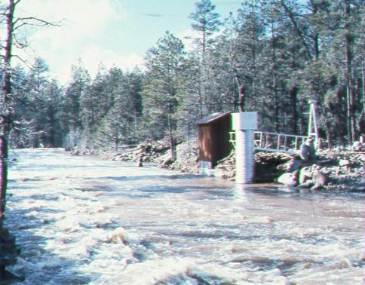
Flow Observation collect data
Observe the flow in a stream by measuring the depth of water
Transform depth to flow using a rating curve
Based on velocity measurements over the range, or on the principles of hydraulics
The USGS operates the National Stream Information Program
29,235 sites with peak streamflow data
the largest collection of flow observations in the United States
Collected data are checked for quality, archived, and available to download.
Can estimate a flow-frequency curve using statistical analysis of the observations from a site
Notes:
The first step to the frequency analysis approach is collecting data. Our data is stream gages which are measured through a rating curve. Brennan had discussed this in the Hydraulics basics class. The USGS maintains and operates the majority of the stream gages in the US though some state agencies will also maintain gages.

Slide 14
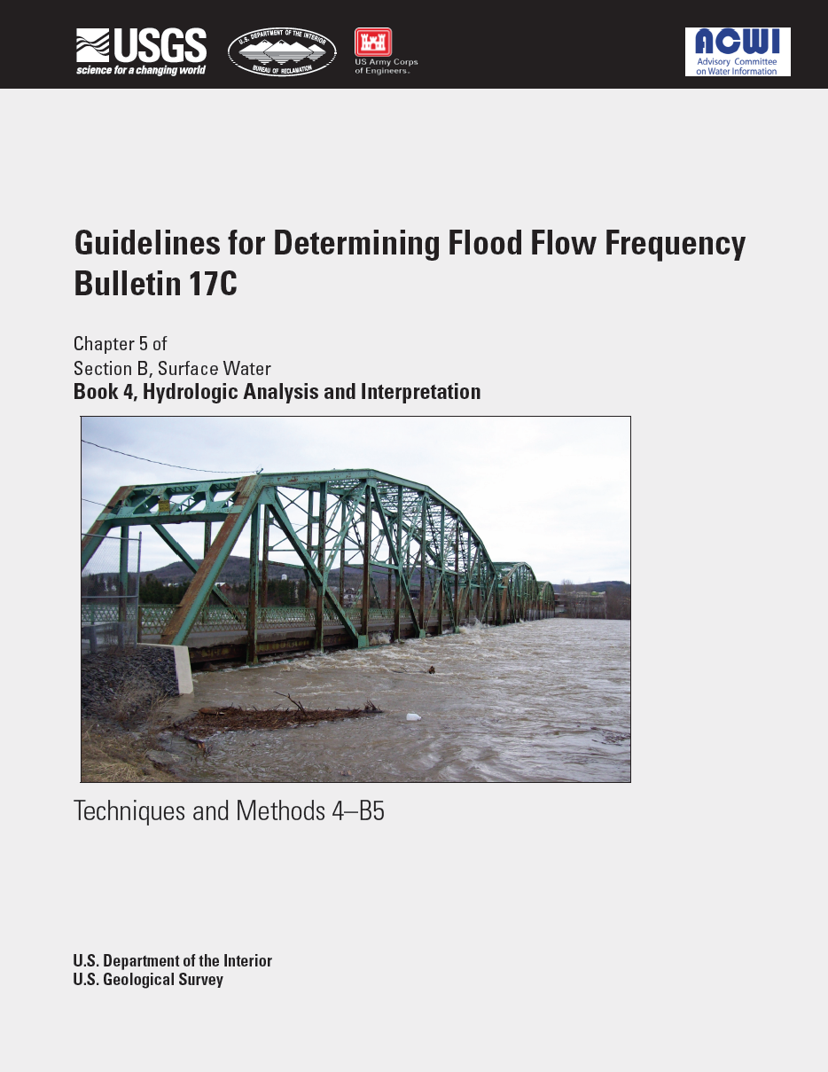
Flow Frequency Analysis Approach
Fit a LogPearson type III (LP3, LP-III) distribution to observed annual-maximum flows
This method works best when there is:
a long record of flow observations,
no regulation, and
flow-frequency curve is needed only for the gage site
Assumptions: IID
Each year’s peak flow is statistically independent
Climate and watershed characteristics affecting flow runoff are unchanged for the entire record - identically distributed
The record length is long enough to describe the "population" of floods (sample is representative)
Bulletin 17C can address:
Potentially low “outliers,” zeros, missing data, thresholds
Historical or paleo information, regionalization of skew
Notes:
Independent in statistics means your data values are not correlated, linear or non-linear, in any way. The data from one year does not affect the data from another year. Identically distributed means the climate and watershed characteristics affecting the flow are unchanged. Then we also assume our record length is long enough to describe the population of the floods. That’s for performing LPIII distribution.
17C does more than just tell us we need to use LPIII. It also provides guidance on handling low outliers and missing data s well as incorporating historical and paleo data.

Slide 15
Sources Uncertainty in Frequency Method
Measurement uncertainty
Inaccurate measurement of the water depth
Transform uncertainty
Poor model for converting water depth to flow rate (often a rating curve)
Model uncertainty
The Log-Pearson III distribution may not represent the data at a particular site very well
The IID assumptions might not be true
Sampling uncertainty
The history of observations may not describe the variability or range well
– record too short, or just not representative
lesser
greater
Notes:
We noted there is uncertainty based on our number of samples. The less samples we have, the greater the uncertainty. There are other types of uncertainty that exist that we do not really incorporate into our flow frequency. There is measurement uncertainty which refers to the actual gage measurement. There is transform uncertainty which refers to converting our stage to your flow. There is model uncertainty which refers to the LPIII distribution being the correct distribution. Maybe another distribution does a better job at fitting the data or maybe the distribution changes for larger flows. Then we have the IID assumptions not holding especially the Identically distributed assumption (i.e. climate change). Lastly, we have our sampling uncertainty where the record could be too short.
You can see there are a lot of places where we can get it wrong. The 17C procedures mainly takes into account the Sampling uncertainty. 17C kind of handles measurement uncertainty and transform uncertainty but fortunately the affect is not that great compared to sampling error.

Slide 16
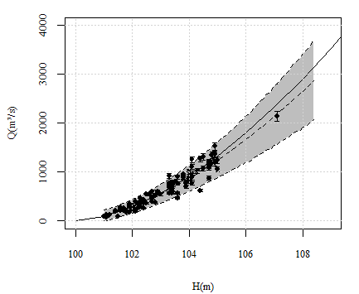
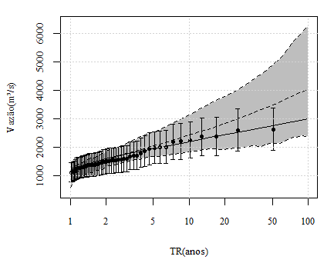
Uncertainty Due to Measurement Error
Real Rating Curve
Real flow-frequency
Estimated Rating Curve
Estimated flow-frequency
Rating Curve +
Uncertainty
Flow-Frequency Curve +
Uncertainty
Complete Bayesian Model for Incorporating Rating Curve Uncertainties and Hydraulic Knowledge in Flood Frequency Analysis
Ana Luisa Nunes de Alencar Osorio Castañon (2017)
16
Notes:
A super duper awesome master’s thesis delving into this topic was performed by a woman from Brazil named Ana Luisa who came to HEC to work with us for a short time a few years ago.
Within this study, she incorporated rating curve uncertainty into estimated flow-frequency curves.
As expected, there is a lot of uncertainty and the uncertainty becomes larger as the stage and/or flow rate increases.

Slide 17
How much difference from distribution choice?
Notes:
I just mentioned we do not incorporate the uncertainty with respect to the distribution choice. Out of full transparency, lets see how sensitive the results can be to distribution choice. We have this dataset with about 100 years of flow record shown on a log and linear scale.

Slide 18
How much difference from distribution choice?
Notes:
Here we have 7 different distributions we plot against the data. We can probability eliminate a few of the distributions. The normal distribution obviously is not a good fit nor is Gumbel distribution. The remaining distributions all seem to do a good job at the 2 year to 20 year but then we start to see divergence in the curve. This is a representation of the distribution uncertainty that exists in the data.

Slide 19
Exploring Sampling Error
Creating a random sample from a known distribution
0.025
0.004
~ U[0,1]
Notes:
Even though we do not account for distribution error, we can account for sampling error. The way that FDA accounts for sampling error is through a parametric bootstrap method. This technique randomly samples from your original curve based off your ERL. In most cases, the ERL is how long your gage record is. In this example, we use 30 years so we will randomly select 30 points from this curve. We will take those values and create another frequency curve from those values.
This slide depicts a statistical experiment to explore the uncertainty in all quantiles of a frequency curve, for a sample of size N = 30.
The pink frequency curve is specified as known. 30 pseudo random values U[0,1] are generated, and used as exceedance probabilities to sample 30 random annual maximum flows from the pink frequency curve, shown as light blue points. Note the smallest sampled exceedance probability is 0.004, producing a fairly large flow.
Next, the pink curve is put aside, and the 30 flows are plotted using median plotting positions in dark blue. Note that the point that was generated with exceedance probability 0.004 is plotted as the largest in 30 as 0.023. The sample values are used to estimate mean, standard deviation, skew coefficient and the resulting LP3 curve shown in dark blue.
This dark blue curve is a possible outcome of 30 years of record of a stream the had the initial pink curve as its population annual maximum flow frequency curve. This possible outcome is an overestimate of the specified “true” curve.

Slide 20
Exploring Sampling Error
Creating a random sample from a known distribution
~ 1-in-14
U[0,1]
Notes:
FDA will repeat that process again and sample from another set of 30 random values from the original frequency curve. It will compute statistics to compute another curve.
This is another example of the statistical experiment in the previous slide. In this case, the smallest exceedance probability is 0.072, which provides a smaller than expected maximum flow value. As a sample, the 30 randomly sampled values produce a fitted LP3 curve that is lower than the “true” pink curve.

Slide 21
Exploring Sampling Error
Creating a random sample from a known distribution
U[0,1]
Notes:
And it will do it again. You repeat this process multiple times
This is another example of the statistical experiment in the previous slide.

Slide 22
Sampling Error in a frequency curve estimated from 30 years of data
Curves estimated from 30 data points
90%
90% confidence interval
Notes:
Eventually, you will get enough curves that represents your knowledge uncertainty as a result of the sampling error. Your original curve is shown in pink which the black lines representing realizations. If you look at a quantile such as the 0.01% AEP, you can compute the 5 and 95% to get the 90% confidence range. You can compute the 90% confidence range along each quantile.
This is the sampling error from 30 years of data. 30 years is not a lot of data so our confidence is wide.

Slide 23
Sampling Error in a frequency curve estimated from 60 years of data
Curves estimated from 60 data points
90% confidence interval
Notes:
Here is a curve with 60 years of data. You might notice the confidence range gets narrow which suggests greater confidence in our quantiles estimates.

Slide 24
Sampling Error in a frequency curve estimated from 120 years of data
Curves estimated from 120 data points
90% confidence interval
Notes:
Here is the confidence ranges with 120 years of data. The more data we have, the more confidence we can be in our results. You can see though that the lower frequency region has higher uncertainty than the middle part of the frequency curve. This is because even with 120 years, we are not as certain of the 0.01% quantile than the 0.5 percent quantile.

Slide 25
Flood Frequency Model
We generally use the Log-Pearson type III (LP-III, LP3) distribution to model annual maximum flows
Re-parameterized to use Mean, Standard Deviation and Skew
Bulletin17C: Estimate parameters from annual maximum observations using the Method of Moments and the Expected Moments Algorithm (EMA)
Better incorporates “non-standard” data than B17B methods did
Interval estimates
Potentially influential low floods (low outliers)
Zero flows and missing values
Historical and paleo-floods
Better (but larger) estimate of sampling uncertainty (includes skew)
Notes:
Generally, we use LPIII distribution to model annual maximum flows. FDA does a bootstrap routine to create new statistics of your mean, SD, and skew. 17C is the procedure document that tells us how to create frequency curves from annual maximum data using method of moments and Expected Moments Algorithm. The EMA process lets us incorporate non-standard data than in 17B. You can incorporate interval estimates, low outliers, zero flows, and paleo floods into your curve to improve your curve estimate. 17C also does a better job at estimating uncertainty.

Slide 26
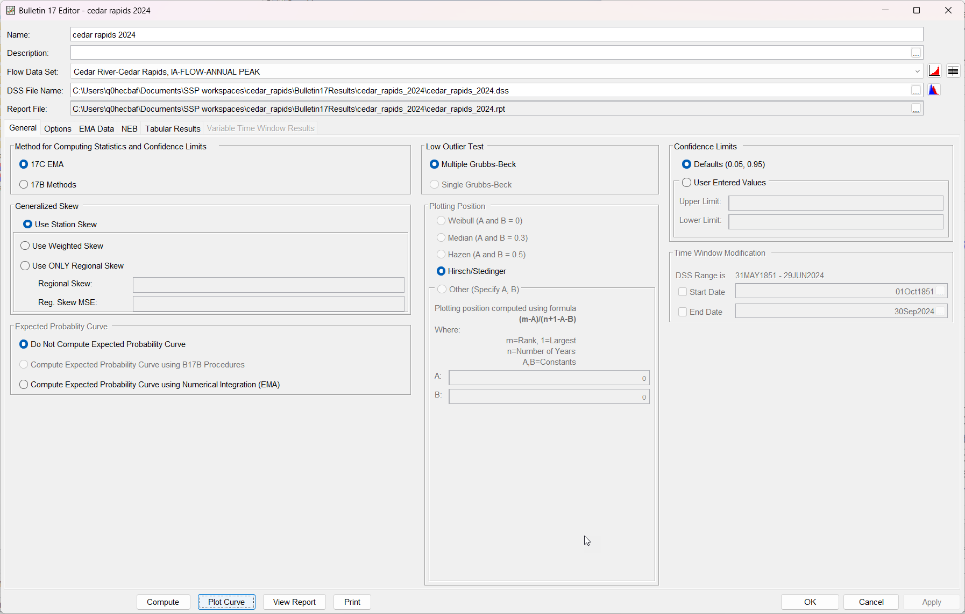
Using HEC-SSP
Notes:
How we go about creating 17C curves is using HEC-SSP. SSP has the ability to compute flow frequency curves that is in line with 17C document.

Slide 27
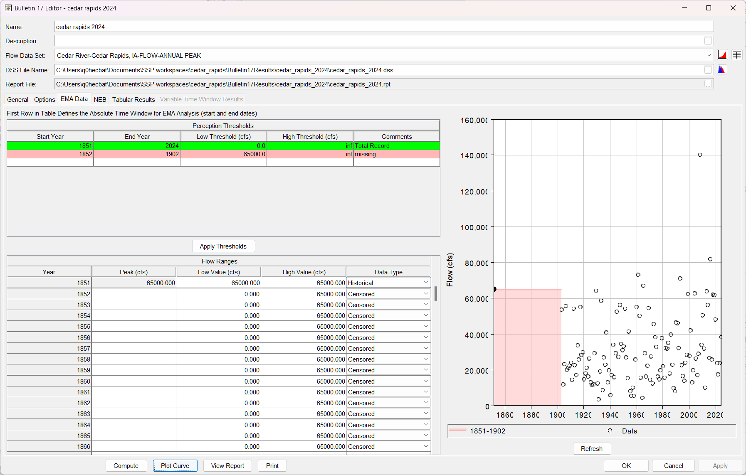
Using HEC-SSP
Notes:
One of the major differences between 17C and 17B is the inclusion of non-standard data. You define perception thresholds and flow ranges if you have historical data.

Slide 28
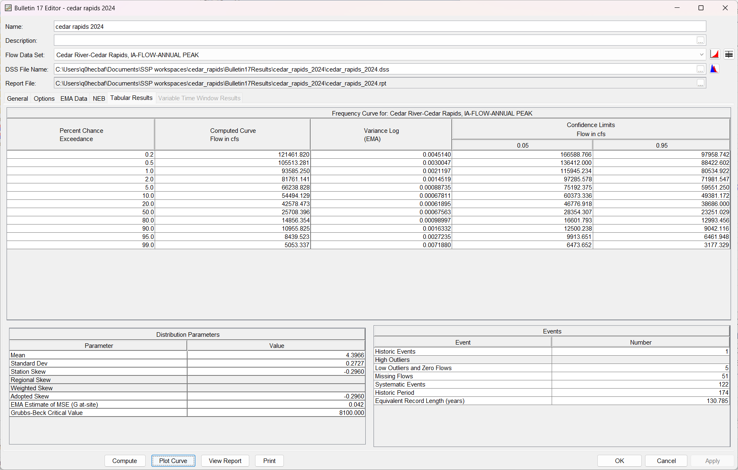
Using HEC-SSP
Notes:
This is the information that you pass into FDA.

Slide 29
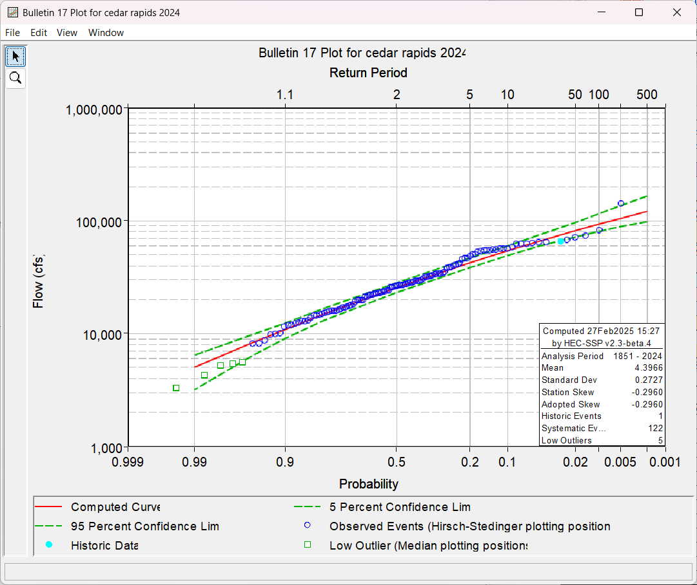
Using HEC-SSP

Slide 30
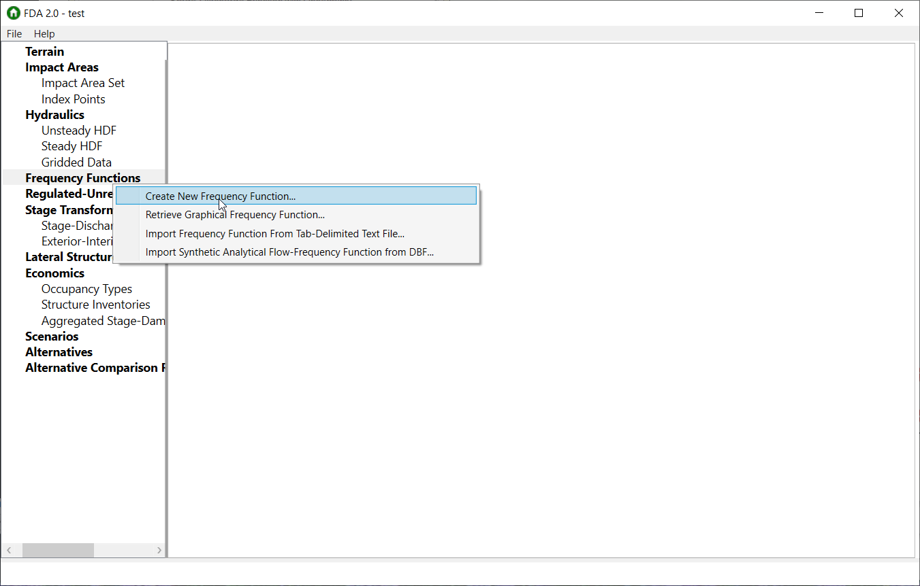
Log Pearson III HEC-FDA input
Entering the LP3 curve into FDA:
Right-click on Frequency Functions
Choose Create New Frequency Function…

Slide 31
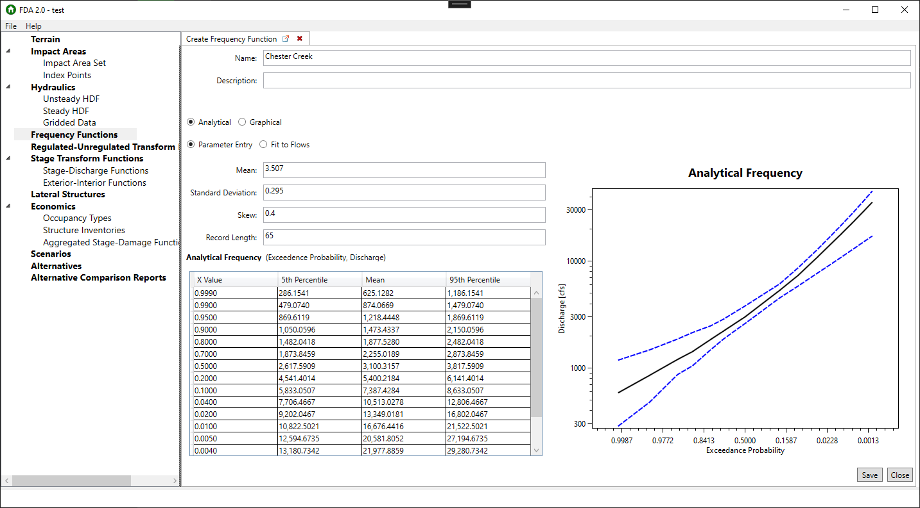
for LP3 distribution
Median

Slide 32
How FDA randomly samples LP3 flow frequency curves for each realization
Perform a “parametric bootstrap” for record length N:
Generate a random sample of size N from original LP3
Re-compute the sample statistics – mean, variance, skew
Use sample statistics as the parameters of a new LP3, for each realization
i.e., the parametric bootstrap from earlier
This method produces uncertainty consistent with Bulletin 17C, not 17B
Flow
Non-Exceedance Probability

Slide 33
Hydrologic Modeling Approach ….using Frequency-based Precipitation
Notes:
So I know that was a lot and the topic is complex. The important concepts to take from this is our frequency curves are uncertain because of measurement, data transform, from stage to flow, from model selection, and sampling error. We can mainly account for sampling error which is not enough data to represent our population. We are not confident to make our design decisions off one frequency curve which gives us one value per quantile. We have to consider the uncertainty surrounding the curve. The way we do this is through a bootstrap parametric approach that creates a bunch of frequency curves off the original curve.
We will now move onto Hydrologic Modeling using Precipitation Frequency curves to generate flow frequency curves.

Slide 34
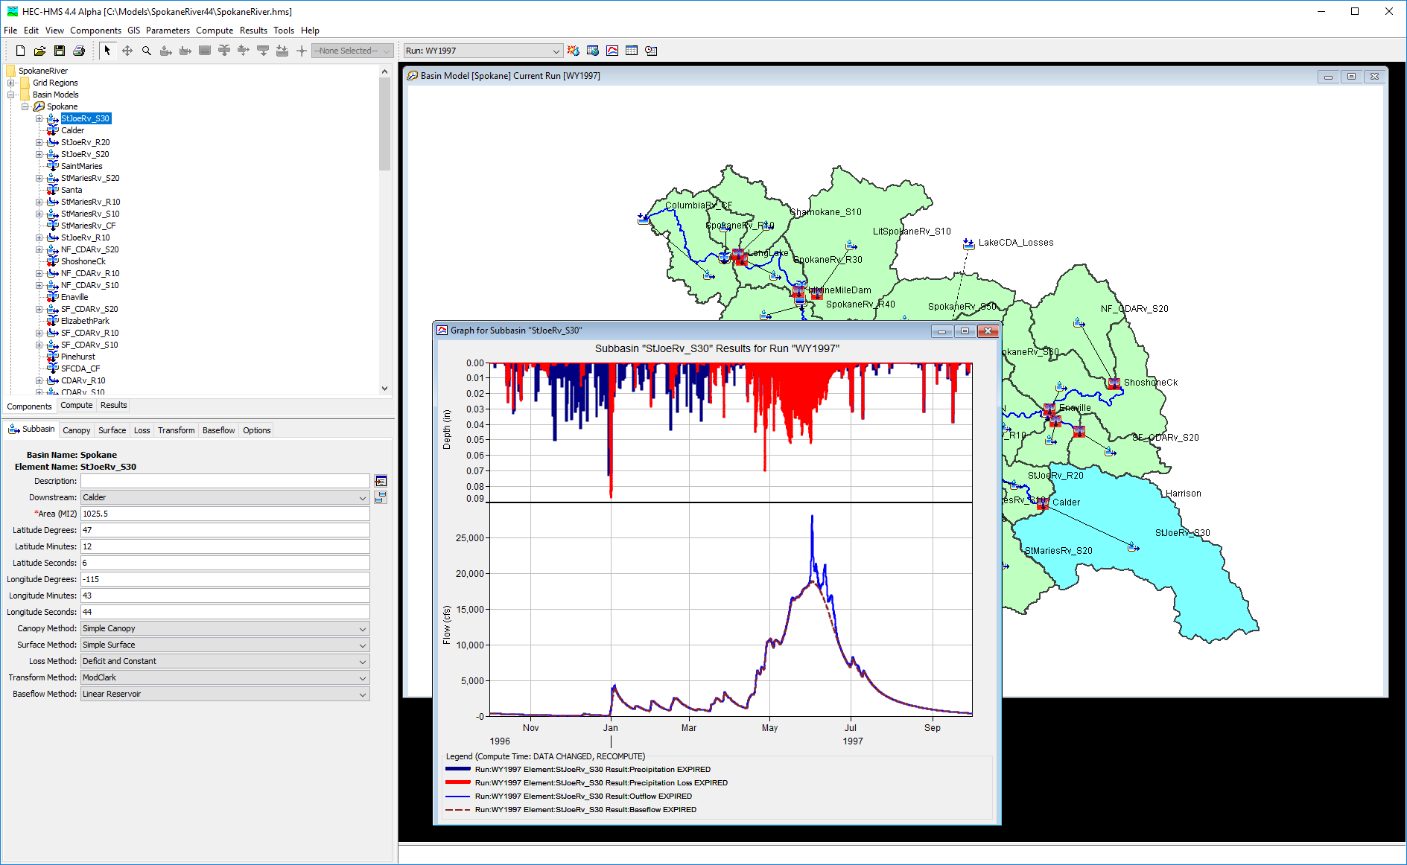
Probabilistic Precip. Approach
Model the Hydrologic Cycle:
precipitation, snowmelt, canopy, infiltration, surface runoff, baseflow, and channel routing among others.
Given a rain event, calculate the flow rates throughout the watershed
The Hydrologic Modeling System (HEC-HMS) is a modeling tool capable of performing this task
Simulate a range of frequency-based precipitation events to produce a flow-frequency curve
Notes:
Using a rainfall runoff model is another method for estimating frequency flows. At USACE, we use HMS software for inputting design storms to get design floods.

Slide 35
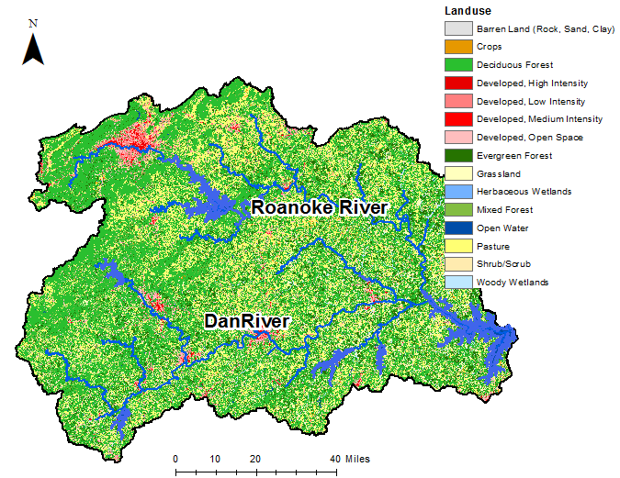
Why use Precip Frequency?
Precipitation data may be more plentiful.
Precip. studies can use regionalization.
flow-frequency curves can be derived throughout the watershed.
Improve confidence to 17C curves.
Assumptions:
The hydrologic simulation model can adequately represent the physical processes
The relationship between the precipitation probability and the flow probability is known
Does the 1% Precip Event cause the 1% Flow?
Notes:
We typically go with this method when there are no flow gages available or if we need frequency curves at different parts of the watershed. Assumptions on using a rainfall-runoff model is

Slide 36
Sources of Uncertainty in Hydrologic Modeling Approach
Boundary condition uncertainty
Precipitation data and other atmospheric variables
Precipitation frequency analysis uses regionalization – less uncertainty
Initial condition uncertainty
Soil moisture, channel baseflow, and other initial values of variables
Model uncertainty
Selecting an adequate representation of the hydrologic processes
Parameter uncertainty
Identifying the correct values for the modeling parameters in each hydrologic process representation
Notes:
Within rainfall-runoff modeling, there is also uncertainty in the models. There is uncertainty in the rainfall statistical moments.

Slide 37
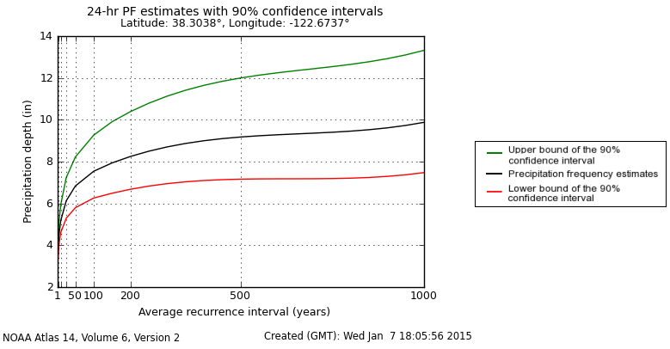
Precip-Frequency Uncertainty
Boundary Condition
Precipitation-frequency curve, NOAA Atlas 14
“average recurrence interval” = 1/AEP
Notes:
The most common method of getting precip-frequency is through NOAA Atlas 14. Most modelers would just take the median value but there is uncertainty surrounding the frequency estimates. Atlas 15 is supposedly coming online next year that includes climate projections.

Slide 38
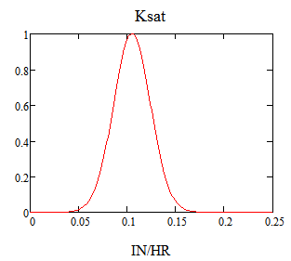
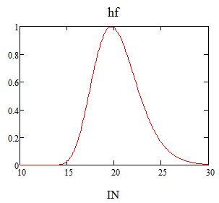
Parameter Uncertainty
Green and Ampt Infiltration
Ksat hf
saturated hydraulic conductivity
wetting front suction
Ksat hf
Notes:
Basin parameters have uncertainty. If you’ve ever tired calibrating a rainfall runoff model, you’ll get different values for each storm event.

Slide 39
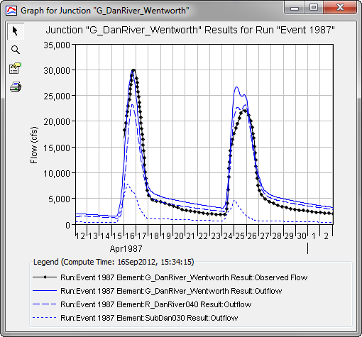
Model Uncertainty
HEC-HMS, SWAT, PRMS, WEPP
Model Structure
Modeling methods
Deficit and Constant
Curve Numbers
Lumped/Distributed
Notes:
You have model uncertainty. There are different hydrologic models out there each with their own set of assumptions.

Slide 40
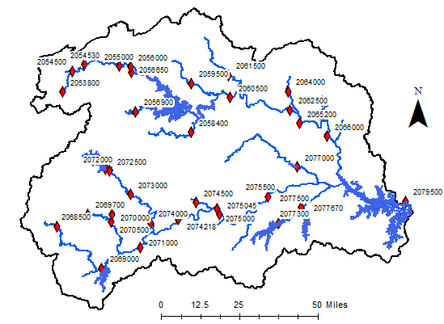
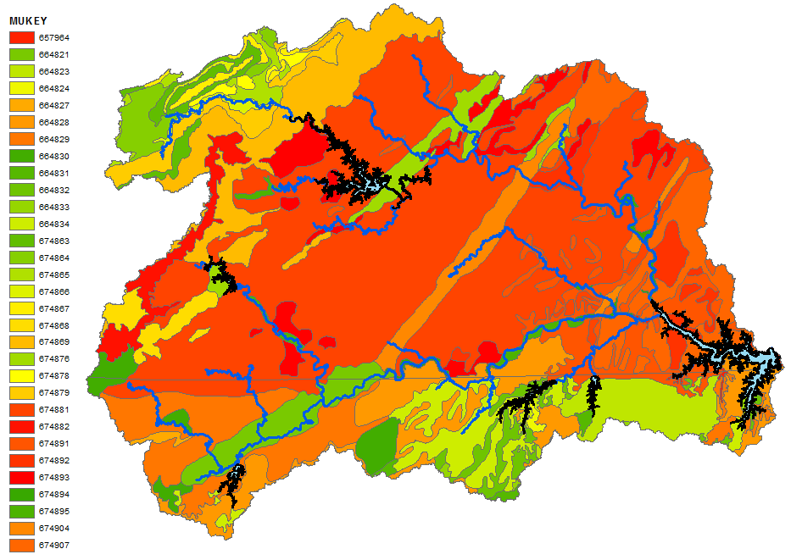
Developing the Model
Delineate the watershed to identify subbasins, reaches, and junctions
Estimate parameters for the model components from:
terrain data, soil property maps, land use maps, channel cross sections, and other sources
Use historical events to calibrate the portions of the model that control timing of surface runoff and channel flood waves
Notes:
When developing the model, make sure you delineate the watershed to include junctions at every location that needs a flow frequency curve and where flow observations are available. Estimate your initial parameters using terrain data and soil data. Then make sure to calibrate the model to your observed flow gages. You won’t always be able to calibrate to a gage. In those situations, use regional regression equations, previous studies, or regional flow per square mile graphs to check your results.

Slide 41
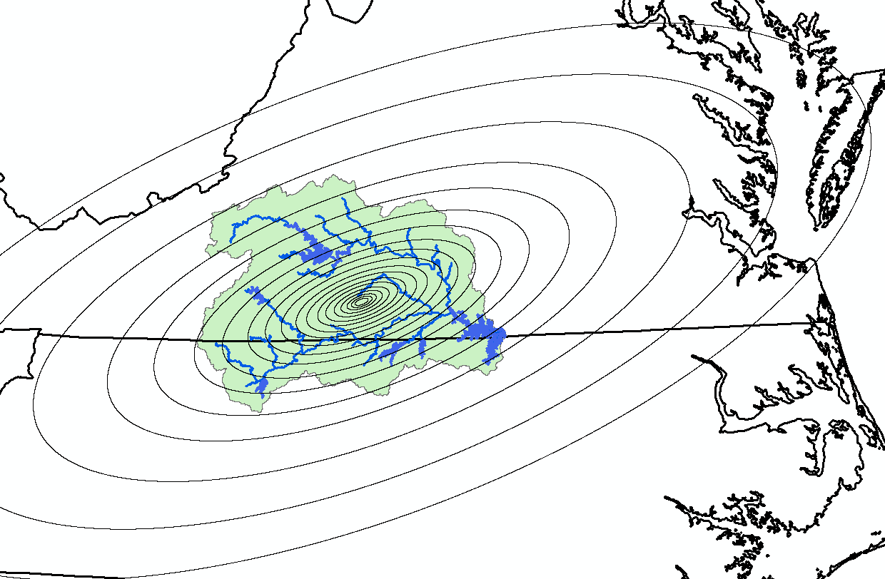
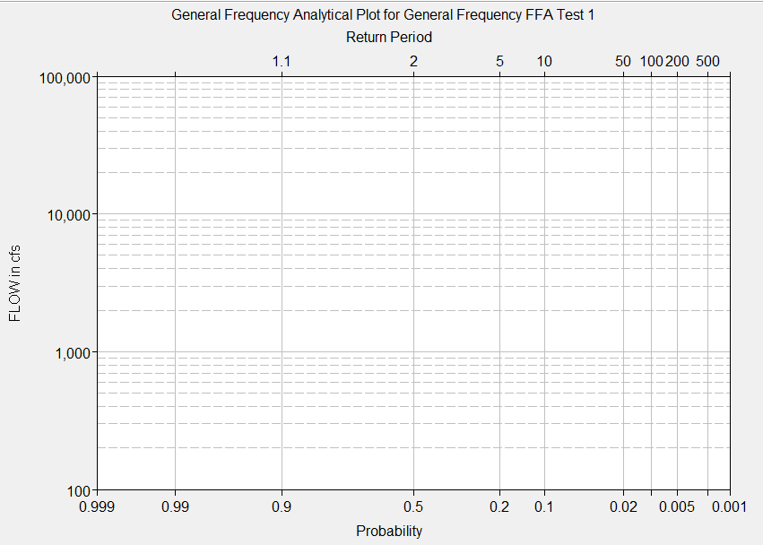
Developing the Frequency Curves
Generate a flow-frequency curve at a gage site (using frequency analysis)
Develop a frequency-based precip event for each of several X% exc.probabilities
NOAA Atlas 14
Calibrate so that the X% precipitation produces the X% flow at the gage site
Apply the full range of precipitation events to compute a flow-frequency curve for ungaged locations throughout the watershed
Notes:
Once you have the calibrated model, you can create design storms for the watershed. If you have a gage, you can develop a frequency curve using 17C and match the curve. Then apply different your design storm where you assume the percent AEP rain is the percent AEP flow.

Slide 42
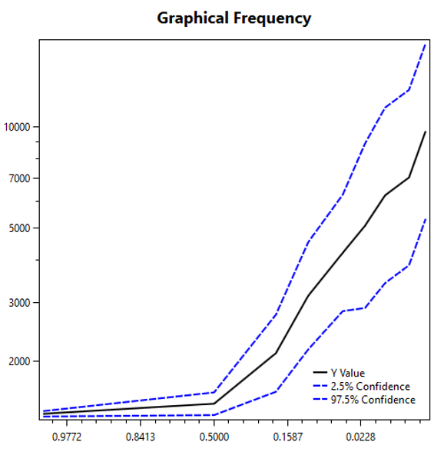

The Less Simple Method
Non-Exceedence Probability
$S_{Y}^{2}=\frac{p\left(1−p\right)}{n{f(y)}^{2}}$
Variance
Value of the PDF = Slope between points
Equivalent Record Length
The Major Variables
Equivalent Record Length
Slope between points

Slide 43
How FDA randomly samples a Graphical Frequency Curve for each Realization
Select a random percentile from a uniform distribution U[0,1]
Use the flow value for that percentile (based on a normal sampling distribution) at each frequency
90%
80%
Uncertainty is based on a Normal distribution
70%
60%
50%
40%
30%
20%
Flow (cfs)
10%
Exceedance Probability
Notes:
The uncertainty for graphical curves use a percentile. FDA will create percentile curves and will randomly sample a percentile from a uniform distribution. That percentile curve is then used for the flow-stage relationship. The uncertainty is based on ordered statistics and the normal distribution.

Slide 44
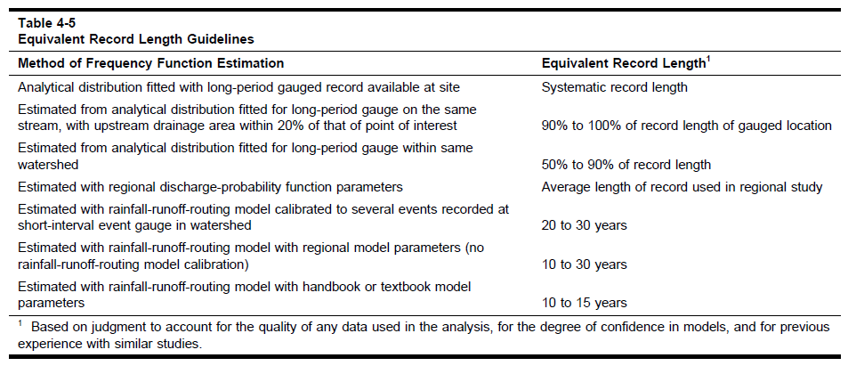
Describing the Uncertainty - Equivalent Years of Record
EM 1110-2-1619
Table is updated and currently in review…
Notes:
In EM 1619, there is a table that tells you how to apply the ERL for frequency curves. This includes both the 17C method and rainfall runoff modeling. This table is getting updated and currently in the review phase with HQ but as of now, this is the guidance.

Slide 45
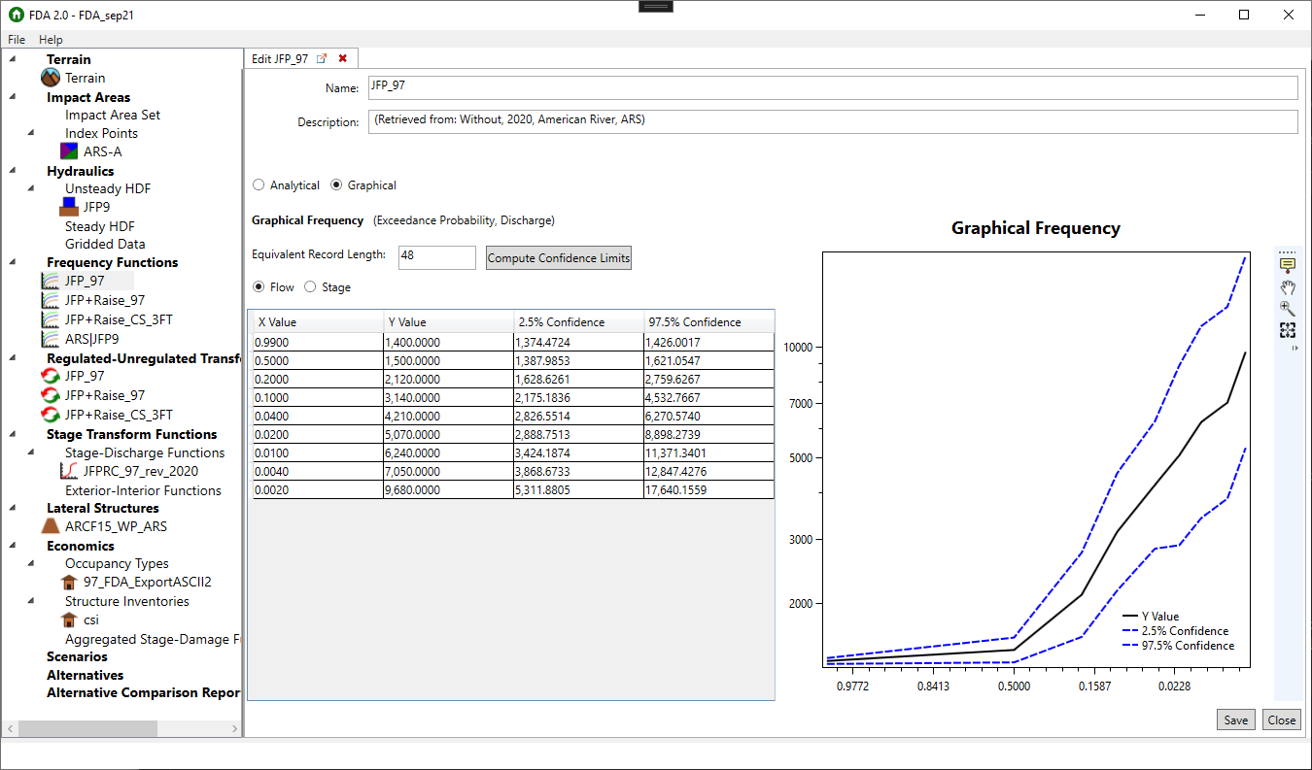
Graphical Frequency FDA input
Notes:
When inputting your rainfall runoff frequency curves into FDA, you will choose the graphical option and enter each flow quantile. You will still enter an ERL to generate uncertainty.

Slide 46
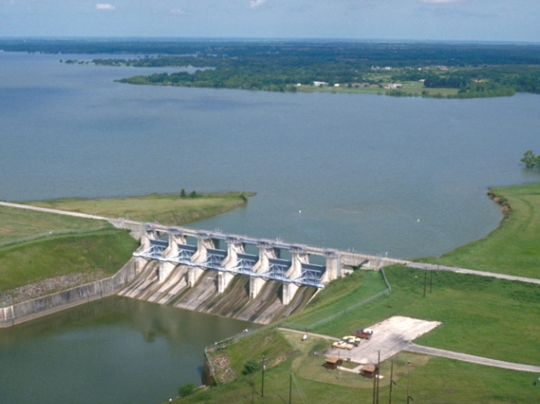
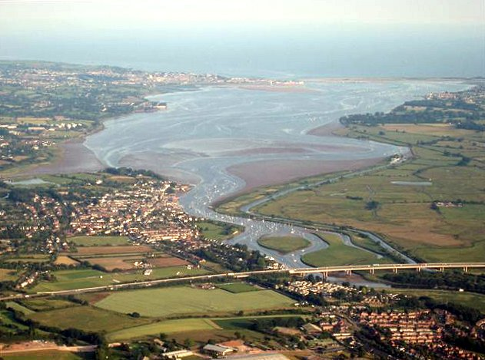
Challenges, alternative curves
Reservoir regulation changes the natural flow-frequency curve, LPIII not appropriate
Use a transform function
Enter the curve into HEC-FDA as a graphical curve
Can estimate an empirical frequency curve from observed or modeled regulated flow data
Can simulate probability-based inflow events in a reservoir model to generate a regulated curve
Stage. Very flat channels or tidal influence means there might not be a one-to-one relationship between flow and stage.
Can estimate an empirical frequency curve from observed or modeled stage data
Can simulate probability-based flow events in a hydraulic model to generate a regulated curve
Enter the STAGE curve into HEC-FDA as a graphical curve
Notes:
If you have reservoir regulation, you will not be able to directly apply 17C method to regulated data. You would need to unregulated the data, then apply a transform to regulate the data. You can pass simulated data to your reservoir model to get a simulated regulated curve. If you are limited in your funds, you could create a simple graphical curve from the regulated data.

Slide 47
Summary
We discussed:
2 methods for estimating flow-frequency curves
Frequency analysis of observations, LogPearson III
Rainfall-Runoff modeling of frequency-based precip
Sources of uncertainty in each method
Characterization of uncertainty by Equivalent Record Length (ERL)
Entering analytical (LPIII) or graphical frequency curves, and ERL, into HEC-FDA

Slide 48
Terms from ER 1105-2-101
Risk – Probability that an area will be flooded, and consequence of that outcome.
Uncertainty – A measure of insufficient knowledge of parameters and functions used to describe the hydrologic, hydraulic, geotechnical, and economic aspects of a project plan.
Variability – A variable whose value changes with time or space.
Risk Analysis – An approach to evaluation and decision making that explicitly incorporates estimates of risk and uncertainty in a flood damage reduction study.
Annual Exceedance Probability (AEP) – The probability that flooding of a given magnitude will occur in any given year, considering the full range of possible annual floods.

Slide 49
What about a more negative skew?
γ = +0.4
γ = –0.4
γ = +0.4
γ = –0.4
Notes:
How does the skew of the data set affect the uncertainty in the estimate? The previous samples are from a distribution with a positive skew of 0.4. Next we compare to samples from a distribution with a negative skew of -0.4.
Note that these are the skews of the logarithms of the flows. On a linear scale, the skew is positive in both cases.

Slide 50
What about a more negative skew?
g = +0.4
g = –0.4
When skew is more negative, change has less influence on the 100-yr event
Notes:
Estimates of mean and standard deviation are unaffected by the skew, and are reasonable with 100 years of record. The estimate of skew is equally as variable. However, the 1% event is much less variable with a negative skew than a positive skew, being less sensitive to the skew value. The result is that a frequency curve with negative skew is less uncertain for the less frequent events (the upper end) than a curve with positive skew.

Slide 51
What about a more negative skew?
g = +0.4
g = –0.4
When skew is more negative, change has less influence on the 100-yr event
Notes:
Estimates of mean and standard deviation are unaffected by the skew, and are reasonable with 100 years of record. The estimate of skew is equally as variable. However, the 1% event is much less variable with a negative skew than a positive skew, being less sensitive to the skew value. The result is that a frequency curve with negative skew is less uncertain for the less frequent events (the upper end) than a curve with positive skew.

Slide 52
Describing the Uncertainty - Equivalent Years of Record
EM 1110-2-1619
Method of Frequency Function Estimation | Equivalent Record Length (ERL) | Reasoning | ERL reduction | Resultant ERL (years)
Analytical distribution fit to observed data using B17C or Bayesian methods | ERL computed using Bulletin 17C methods |  | none | varies
Quantiles or analytical distribution estimated using regional regression analyses | Average Record Length used in regional study | Values are likely from StreamStats. Typical record lengths from the supporting reports are ~35 years | none | 35
Analytical distribution fit to 25+ year continuous simulation results using a calibrated/validated hydrologic model | 90% of the ERL value computed using Bulletin 17C methods | This estimation technique should result in a distribution with less information content than one from observed discharge data. | 0.9 | 39.6
Analytical distribution fit to 25+ year continuous simulation results using an uncalibrated/unvalidated hydrologic model | 50% of the ERL value computed using Bulletin 17C methods | Similar to above, but with uncalibrated/validated hydrologic model | 0.5 | 22
Quantiles estimated from discrete event simulations (e.g., 1/2, 1/5, 1/10, 1/25, 1/50, 1/100, 1/200, and 1/500 AEP) using a calibrated/validated hydrologic model | 75% of the average Record Length used in regional study | Typical average record lengths within Atlas 14 volumes are ~40 years for hourly stations. | 0.75 | 33.75
Quantiles estimated from discrete event simulations using an uncalibrated/validated hydrologic model | 50% of the Average Record Length from Atlas 14 / Atlas 2 | Similar to above, but with uncalibrated/validated hydrologic model | 0.5 | 22.5
¹ Typical average record lengths from reports used to drive StreamStats are on the order of 30 – 40 years.
² Hourly gridded AORC precipitation/temperature is trustworthy and available throughout CONUS from 1979 – current; thus modelers could easily realize 44 years’ worth of continuous simulation output using hourly boundary conditions anywhere in CONUS. Furthermore, daily gridded Livneh precipitation/temperature boundary conditions are available from 1915 – 2011 and offer 96 years’ worth of possible continuous simulation output for larger modeling domains.
³ Typical average record lengths from Atlas 14 volumes (hourly stations) are on the order of 40 – 50 years.

Slide 53
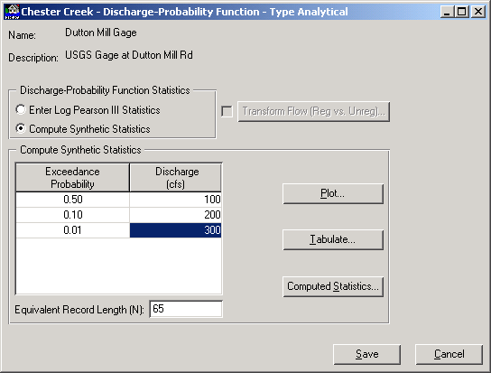
Synthetic LPIII FDA input
When unregulated flows, can still use LogPearson3, LP3
behind “Analytical” button:
FDA uses the equations for SYNTHETIC STATISTICS from B17B pg 5.2
Given estimates of the 2-year, 10-year and 100-year flow values, the LPIII statistics can be estimated

