Slide 1
Surface Erosion in HEC-HMS
Alex Sanchez
Sr. Hydraulic Engineer
Alejandro.Sanchez@usace.army.mil

Slide 2
Outline
Surface erosion and sediment yield in rural watersheds using the Modified Universal Soil Loss Equation (MUSLE).
Sediment yield in urban watersheds using the Build-up and Wash-off model.
Distributing the total sediment yield into a time-series, also called a sedigraph.

Slide 3

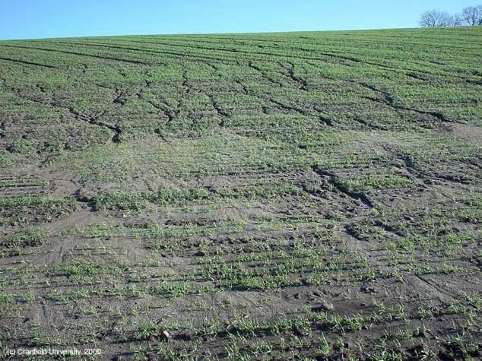
Sediment in Rural Watersheds
Raindrops cause erosion when they impact the soil surface. The mass of the raindrop, falling at terminal velocity, imparts energy to the soil surface that breaks up the soil structure.
Shallow overland flow erodes the soil surface and entrains it.
Eroded soil may settle elsewhere on the land surface before leaving the watershed.

Slide 4
History of MUSLE
Universal Soil Loss Equation (USLE).
Developed by Wischmeier and Smith, 1965, 1978
Predicts the long-term average soil loss due to sheet and rill erosion
Rainfall energy factor describes detachment due to precipitation
Modified Universal Soil Loss Equation (MUSLE).
Developed by Williams, 1975.
Rainfall energy factor replaced by Runoff factor
Incorporates detachment and transport
Applicable to individual storms
Notes:
The modified USLE method (Williams, 1975) was adapted from the original Universal Soil Loss Equation. The original equation was based on precipitation intensity, and consequently could not differentiate between storms with low or high infiltration. With high infiltration, there is little surface runoff and little surface erosion. Conversely, low infiltration events have more surface runoff and surface erosion. The modifications to the original USLE equation changed the formulation to calculate erosion from surface runoff instead of precipitation. The components of the original formulation remained the same. The method works best in agricultural environments for which it was developed. However, some people have the method to developed and urben environments.

Slide 5
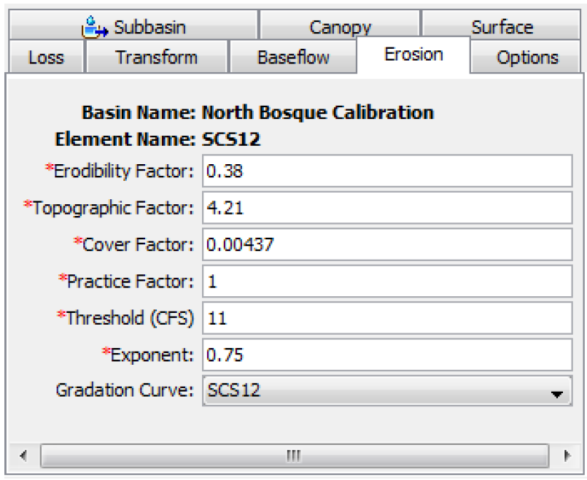
MUSLE Equation
Sed = Sediment Yield per Event (metric tons)
Q_{surf} = Surface Runoff Volume (m³)
q_{peak} = Peak Runoff Rate (m³/s)
K = Soil Erodibility Factor
LS = Topographic Factor
C = Cover and Management Factor
P = Support Practice Factor

Slide 6
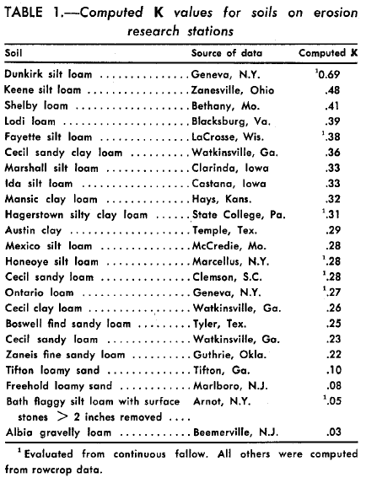
K : Soil Erodibility Factor
Some soil erodes more easily than others even when all other factors are the same. This is due to the properties of the soil itself:
Texture, structure, organic matter, permeability.
Direct measurement of the erodibility factor is time and cost prohibitive. We need indirect methods to estimate it.
Notes:
The erodibility factor describes the difficulty of eroding the soil. The factor is a function of the soil texture, structure, organic matter content, and permeability. Typical values range from 0.05 for unconsolidated loamy sand to 0.75 for silty and clayey loam soils.

Slide 7
K Factor from Equation (Wischmeier et al., 1971)
K = Soil Erodibility Factor
M = (m_{silt} + m_{vfs})(100 - m_{c})
m_{c} = percent clay content (<0.002 mm)
m_{silt} = percent silt content (0.002 – 0.05 mm)
m_{vfs} = percent very fine sand content (0.05 - 0.1 mm)
OM = 1.72 orgC
orgC = percent organic carbon content of the layer (%)
C_{soilstr} = Soil Structure Code
C_{perm} = Profile Permeability Class

Slide 8
Soil Structure Code (c_{soilstr}) (Wischmeier et al., 1971)
Soil Structure Code used in Soil Classification. It takes on one of four possible values:
1 (very fine granular)
2 (fine granular)
3 (medium or coarse granular)
4 (blocky, platy, prism-like or massive)

Slide 9
Profile Permeability Class (c_{perm}) (Wischmeier et al., 1971)
Permeability is defined as the capacity of the soil to transmit water and air through the layer.
C_{perm} is defined based on the lowest saturated hydraulic conductivity in the profile.
1 (rapid, > 150 mm/hr)
2 (moderate to rapid, 50 – 150 mm/hr)
3 (moderate, 15 -50 mm/hr)
4 (slow to moderate, 5-15 mm/hr)
5 (slow, 1-5 mm/hr)
6 (very slow, < 1mm/hr)

Slide 10
K Factor from Equation (Williams, 1995)
K = Soil Erodibility Factor
f_{csand} = factor that gives low erodibility factors for soil with high coarse-sand contents and high value for soil with little sand (K i: high coarse-sand content h)
f_{cl-si} = factor that gives low soil erodibility factors for soil with high clay to silt ratios (K i: high clay/silt ratios h)
f_{orgc} = factor that reduce soil erodibility for soils with high organic carbon content (K i: high organic carbon content h)
f_{hisand} = factor that reduce soil erodibility for soils with extremely high sand content (K i: high sand content h)

Slide 11
Subfactors for Williams Equation
m_{s} = percent sand content (0.05-2.00mm)
m_{silt} = percent silt content (0.002-0.05mm)
m_{c} = percent clay content (<0.002mm)
orgC = percent organic carbon content

Slide 12
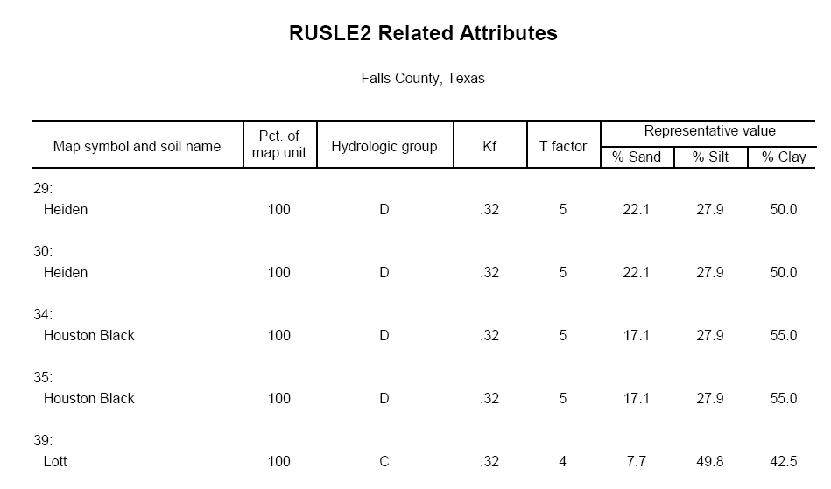
K Value from SSURGO

Slide 13
LS : Topographic Factor
Describes effect of length and slope
LS is the expected ratio of soil loss per unit area from a field slope to that from a 22.1-m length of uniform 9 percent under otherwise identical conditions.
L_{hill} = slope length (m)
m = 0.6(1-exp[-35.835 * slope])
Slope is specified in meters per meter.
Data source: SSURGO component table
Notes:
The topographic factor describes the susceptibility to erosion due to length and slope. It is based on the observation that long slopes have more erosion than short slopes, and that steep slopes have more erosion than flat slopes. Typical values range from 0.1 for short and flat slopes to 10 for long or steep slopes.

Slide 14
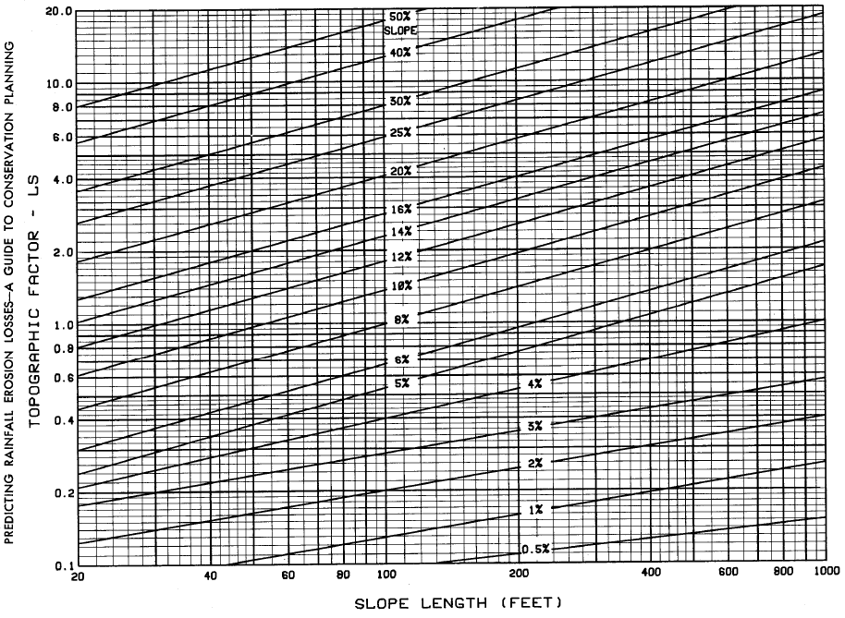
Topographic Factor Chart

Slide 15
C : Cover and Management Factor
The C factor is defined as the ratio of erosion between a specific ground cover and bare ground.
The C factor represents the site's cover protection from rainfall impact.
The plant canopy affects erosion by reducing the effective rainfall energy of intercepted raindrops.
Notes:
The cover factor describes the influence of plant cover on surface erosion. Bare ground is the most susceptible to erosion while a thick vegetation cover significantly reduces erosion. Typical values range from 1.0 for bare ground, to 0.1 for fully mulched or covered soils, to as small as 0.00001 for forest soils with a well developed soil horizon under a dense tree canopy.

Slide 16
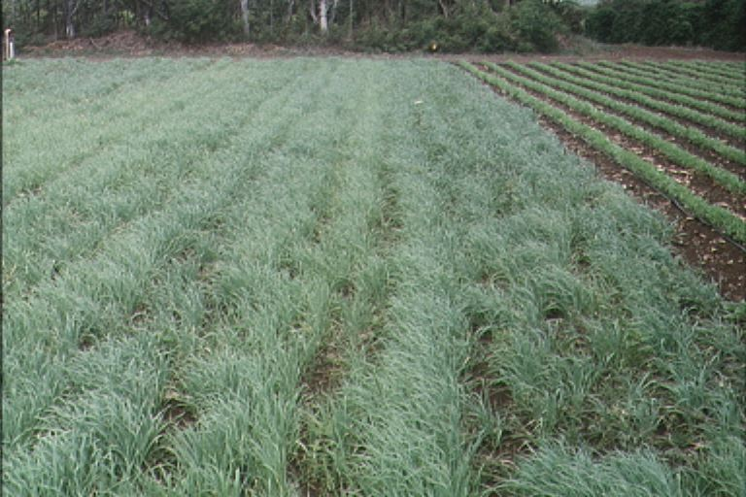
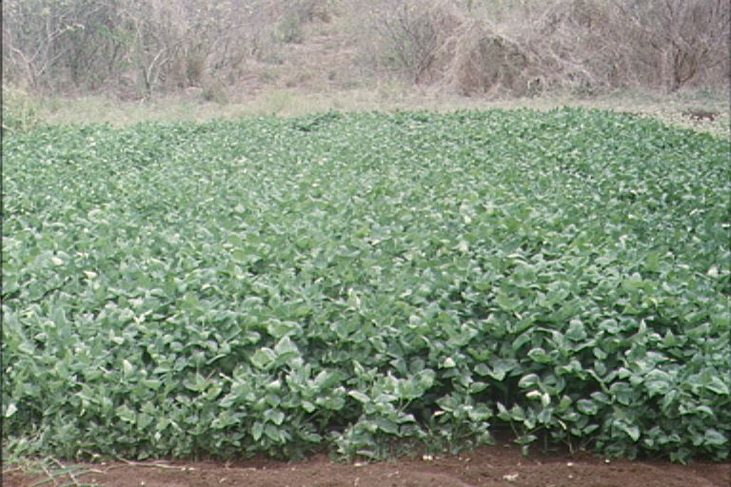
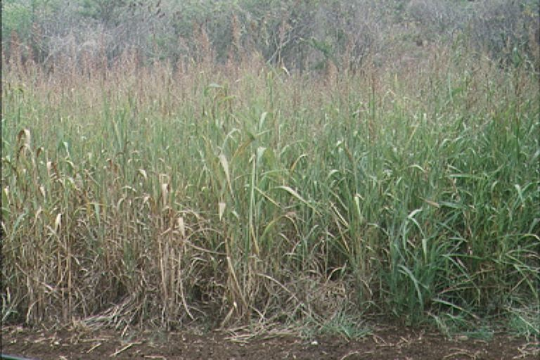
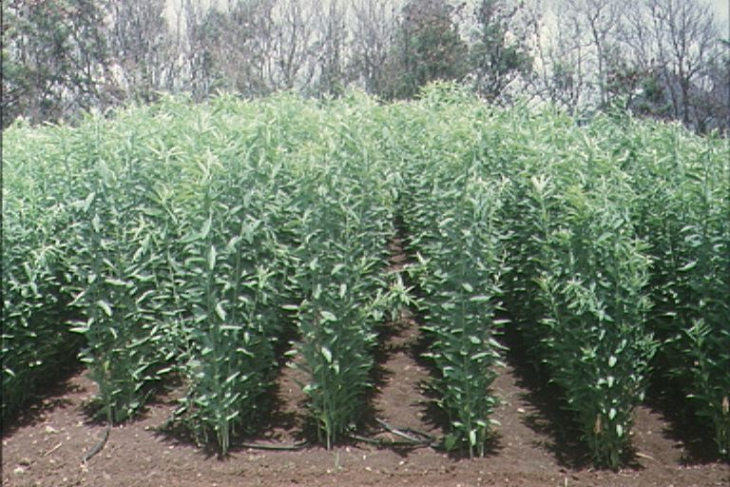
Cover Crops

Slide 17
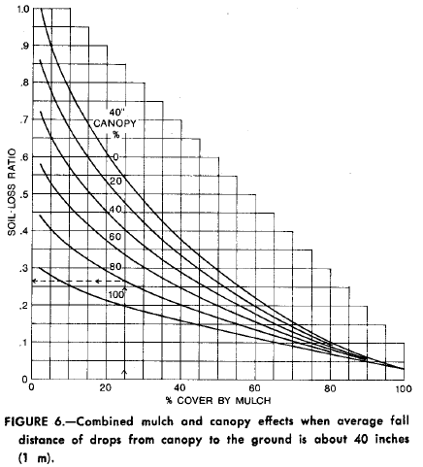
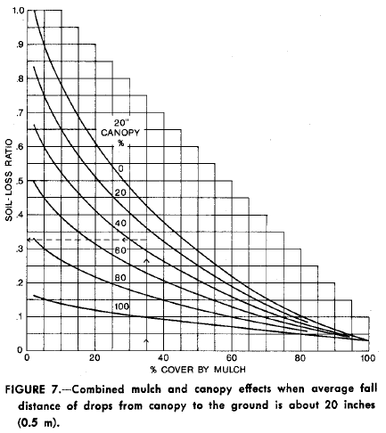
Cover Crops

Slide 18
C Factor from Equation (Arnold and Williams, 1995)
C = Cover and Management Factor.
C_{mn} = Minimum value for the cover and management factor for the land cover.
C_{mn} = 1.463ln[C_{aa}]+0.1034
C_{aa} = average annual C factor for the land cover
rsd_{surf} = Amount of residue on the soil surface (kg/ha)

Slide 19
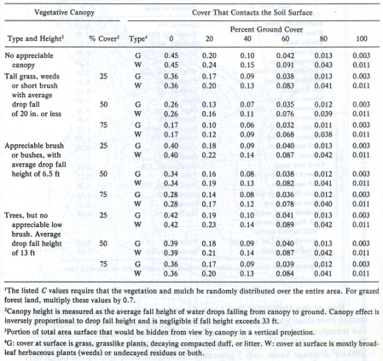
C Factor for Range Lands

Slide 20
C Factor for Forest Lands
Percentage of Area Covered by Canopy of Trees and Undergrowth | Percentage of Area Covered by Litter | C Value
100 – 75 | 100 – 90 | 0.0001 – 0.001
70 – 45 | 85 – 75 | 0.002 – 0.004
40 - 20 | 70 – 40 | 0.003 – 0.009

Slide 21
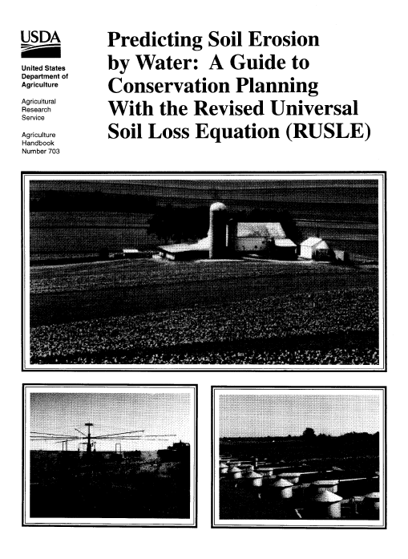
C Factor from RUSLE
Total C factor computed from sub-categories:
Canopy
Ground cover
Soil surface roughness
Ridge height
Soil biomass
Soil consolidation
Ponding effect
Antecedent soil moisture

Slide 22
P : Support Practice Factor
P factor is defined as ratio of soil loss with a specific support practice to the corresponding loss with up-and-down slope culture.
Agricultural land support practices
Strip cropping
Terrace cropping
Contour strip cropping
Construction or urban land practices
Silt fence
Hydro seeding
Settling basin
Notes:
The practice factor describes the effect of specific soil conservation practices, sometimes called best management practices. Agricultural practices could include strip cropping, terracing, or contouring. Construction and urban practices could include silt fences, hydro seeding, and settling basins. It is difficult to establish general ranges for these practices as they are usually highly specific.

Slide 23
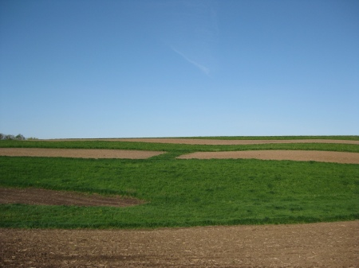
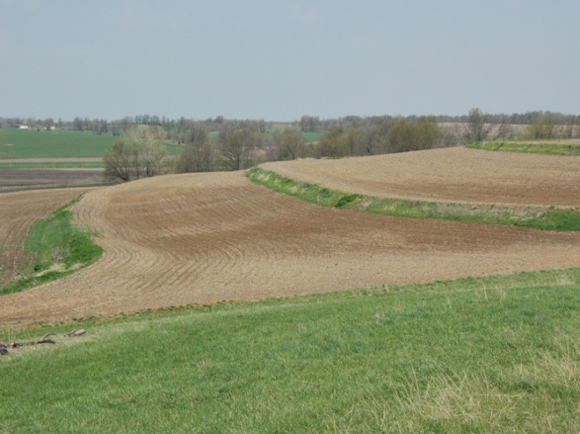
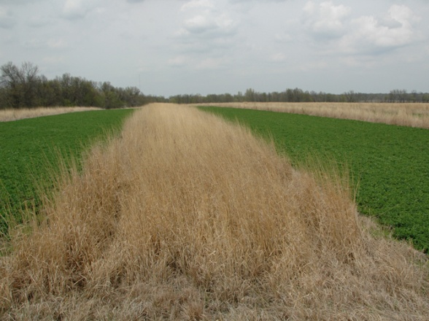
Agricultural Land Practices
Contour Strip Cropping
Terrace Cropping
Strip Cropping

Slide 24
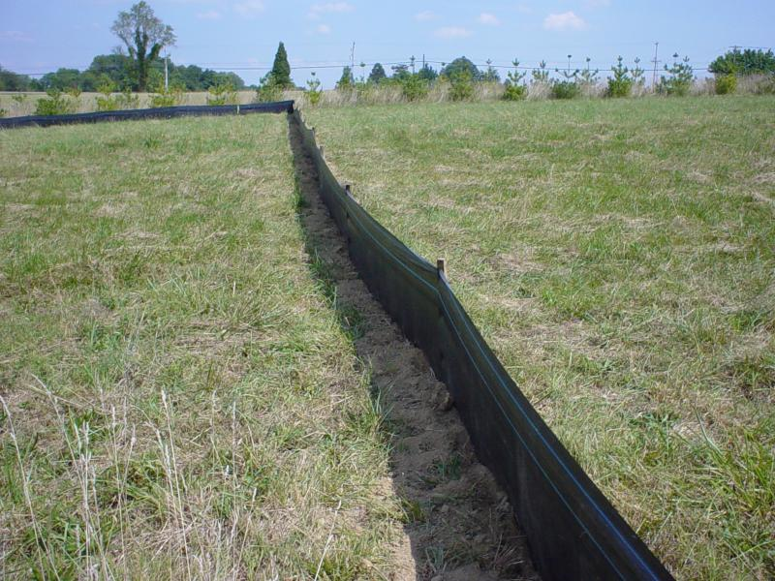
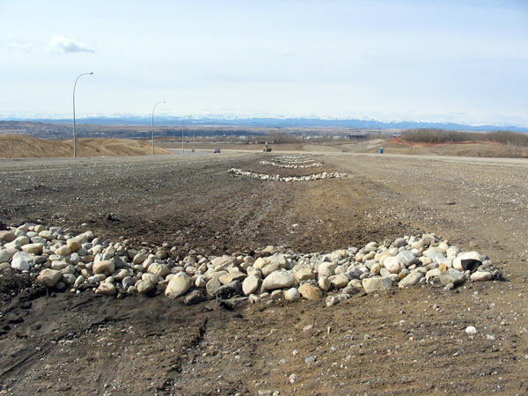
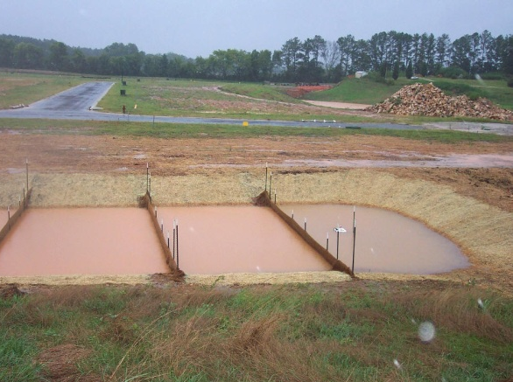
Construction Land Practices
Silt Fence
Rock Check Dam
Settling Basin

Slide 25
P Factor for Strip Cropping (Wischmeier and Smith, 1978)
Land Slope (%) | P Value |  |  | Strip Width (m) | Max Length (m)
 | A | B | C
1 to 2 | 0.30 | 0.45 | 0.60 | 40 | 244
3 to 5 | 0.25 | 0.38 | 0.50 | 30 | 183
6 to 8 | 0.25 | 0.38 | 0.50 | 30 | 122
9 to 12 | 0.30 | 0.45 | 0.60 | 24 | 73
13 to 16 | 0.35 | 0.52 | 0.70 | 24 | 49
17 to 20 | 0.60 | 0.60 | 0.80 | 18 | 37
21 to 25 | 0.68 | 0.68 | 0.90 | 15 | 30
A: For 4-year rotation of row crop, small grain with meadow seeding, and 2 years of meadow. A second row crop can
replace the small grain if meadow is established in it.
B: For 4-year rotation of 2 years of row crop, winter grain with meadow seeding, and 1-year meadow.
C: For alternate strips of row crop and winter grain.

Slide 26
P Factor for Contour Tillage (Wischmeier and Smith, 1978)
Contour tillage and planting provides almost complete protection against erosion from storms of low to moderate intensity, but little or no protection against severe storms that cause extensive breakovers of contoured rows.
Land Slope (%) | P | Max Length (m)
1 to 2 | 0.60 | 122
3 to 5 | 0.50 | 91
6 to 8 | 0.50 | 61
9 to 12 | 0.60 | 37
13 to 16 | 0.70 | 24
17 to 20 | 0.80 | 18
21 to 25 | 0.90 | 15

Slide 27
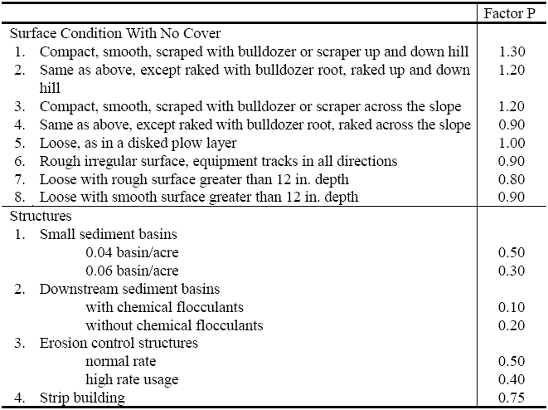
P Factor for Construction Sites (Ports, 1973)

Slide 28
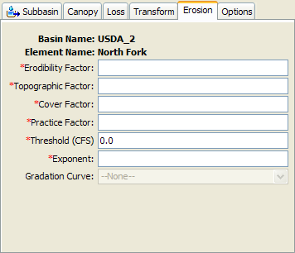
Threshold Peak Flow
Relatively weak events do not produce surface erosion
Events with a peak flow less than the threshold will have no sediment erosion or yield

Slide 29
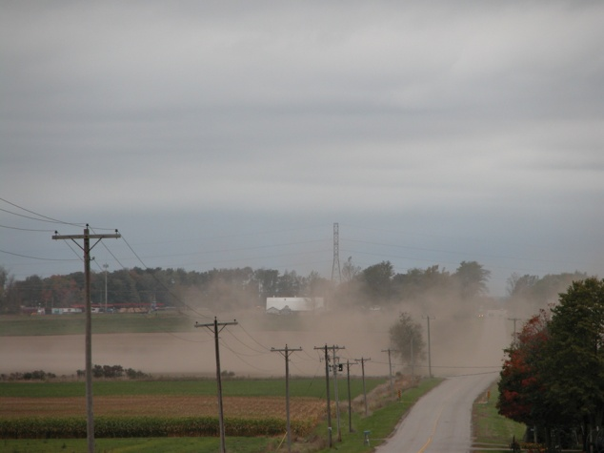
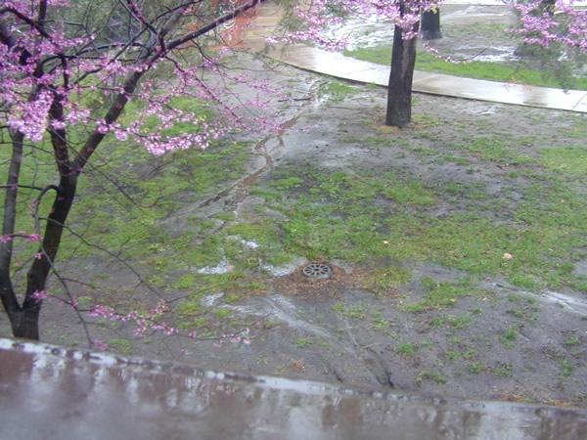
Sediment in Urban Watersheds
Wind can erode dry soil from exposed land and deposit it in urban watersheds, especially when urban areas are adjacent to rural lands.
Poorly covered ground within the urban landscape may erode.
Wind and other deposits usually accumulate in gutters, then become entrained in stormwater.
Many urban areas discharge stormwater directly to streams.

Slide 30
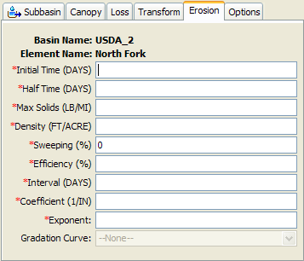
Build-Up and Wash-Off
It is difficult to use the build-up and wash-off model without detailed local knowledge
Must know the rate at which sediment accumulates on the watershed, and maximum accumulation amount
Street sweeping option:
Density of street curb
Percentage of curbs swept
Efficiency of sweeping equipment
Frequency of sweeping
Notes:
The initial time is an initial condition for the method. It specifies the number of days since the last sweeping operation when the simulation begins.
The half time specifies the number of days required for half of the maximum solids to accumulate in the street curb under continuously dry conditions.
The maximum solids amount is the limit to the accumulated sediment in the street curb under continuously dry conditions. Sediment will not exceed this amount even if there is no precipitation for an extended period of time.
Street Sweeping:
The density specifies the total length of street curb whether or not the curb is subject to sweeping operations. The density should consider whether the street has curbs on one side or both sides of the street. The sweeping percentage specifies the percentage of the curb length subject to sweeping. The percentage should account for the possible presence of parked cars which result in missed curbs. The efficiency percentage specifies the efficiency of the sweeping equipment at removing the accumulated sediment. Finally, the interval specifies the number of days between scheduled sweeping operations.

Slide 31
Solids Build-Up on Dry Days
Build-up happens according to Michaelis-Menton kinetics.
SED = solids build up (kg/curb km) td days since SED = 0
SED_{max} = maximum accumulation of solids possible for the land type.
t_{half} = length of time needed for solids to increase from 0 to half of SED_{mx}
t_{d} = Time dry in days
Dry day is a day with no precipitation

Slide 32
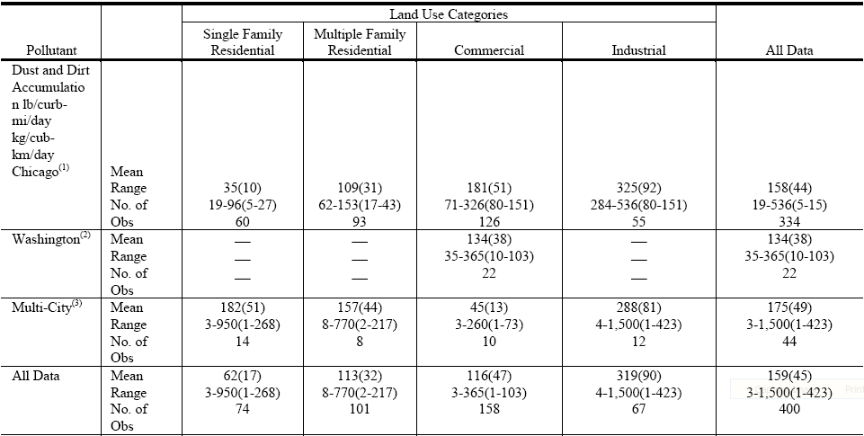
Dust and Dirt Build-Up Rates (Manning et al., 1977)

Slide 33
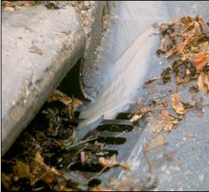
Wash-Off Process (Huber and Dickinson, 1988)
Y_{SED} = cumulative amount of solids washed off at time t (kg/curb km)
SED₀ = amount of solids build up on the impervious area at the beginning of the precipitaiton event (kg/curb km)
kk = urb_{coef} x q_{peak}
Urbcoef = wash off calibration coefficient (0.039 – 0.39 mm⁻¹)
q_{peak} = peak event flow rate (mm/hr)
Y_{SED} x L_{curb} is the sediment load

Slide 34
Curb Length Density (Heaney et al., 1977; Sullivan et al., 1978)
Land Use | Tulsa, Oklahoma |  |  | 10 Ontario Cities
 | mi/ac | km/ha | ft/ac | mi/ac | km/ha | ft/ac
Residential | 0.076 | 0.300 | 400 | 0.042 | 0.170 | 220
Commercial | 0.081 | 0.320 | 430 | 0.057 | 0.230 | 300
Industrial | 0.042 | 0.170 | 220 | 0.025 | 0.099 | 130
Park | 0.042 | 0.170 | 220 | - | - | -
Open | 0.016 | 0.063 | 85 | 0.015 | 0.056 | 79
Institutional | - | - | - | 0.030 | 0.120 | 160

Slide 35
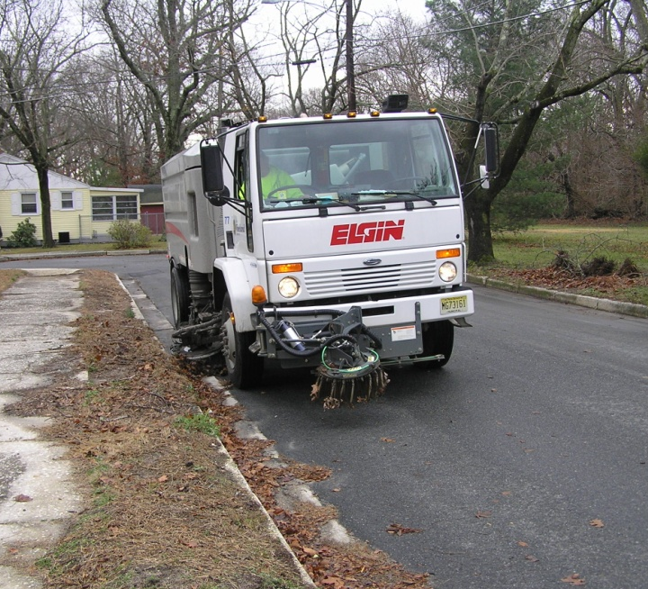
Street Sweeping Process (Huber and Dickinson, 1988)
SED = amount of solids remaining after sweeping (kg/curb km)
SED₀ = amount of solids present prior to sweeping (kg/curb km)
fr_{av} = fraction of the curb length available for sweeping
Reff = removal efficiency of the sweeping equipment

Slide 36
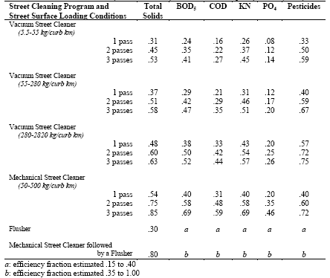
Sweeping Equipment Efficiency (Pitt, 1979)

Slide 37
Time Distributing Sediment Yield
The sediment yields predicted by MUSLE or Build-up and Wash-off must be distributed in time to provide a time-series, or sedigraph.
The sediment time-series from subbasins is passed with the flow time-series to downstream elements in the flow network.
Eventually, flow and sediment time-series can be passed to a hydraulic channel model (HEC-RAS).
Distribution procedure assumes that concentration is a power function of water discharge (Haan, 1994).

Slide 38
Simple Sedigraph Procedure (Haan, 1994)
Power function of water discharge.
c = k qª and q_{s} = c q
q_{s} = k q^{a+1}
q = water discharge
a = exponent between 0.5 and 2
Notes:
The exponent, a, is used to distribute the sediment load into a time-series sedigraph. A small value flattens the sedigraph and a large value makes the sedigraph more peaky.

Slide 39
Sediment Concentration

Slide 40
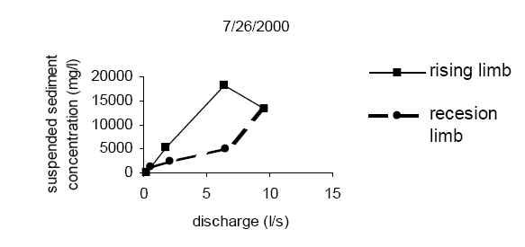
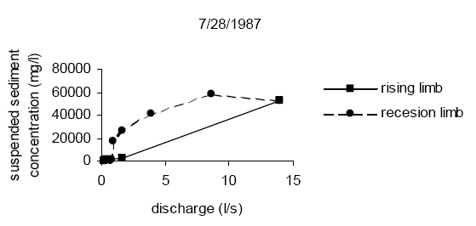
Power Function Weaknesses (Bača, 2002)

Slide 41
MUSLE Parameter Estimation
Initial Parameters
K: SSURGO Soil Data
LS: Terrain Data (10 m DEM)
C: Land use Data
Gradation Curve: SSURGO Soil Data
Major Calibration Parameters
One of MUSLE Factors
Threshold (CFS)
Gradation Curve

Slide 42
Build-up Wash-Off Parameter Estimation
Initial Parameters
None
Major Calibration Parameters
Sweeping %
Coefficient

Slide 43
Summary
MUSLE can be used to estimate erosion from rural watersheds, especially in farm areas. It is largely an empirical model.
Build-up and wash-off can be used to estimate erosion in urban watersheds, including street sweeping effects. It is also largely an empirical model.
The sediment yield estimated with MUSLE or build-up and wash-off is distributed in a time-series using a power function relationship.
Erosion estimates usually have an order of magnitude more uncertainty than flow estimates.

Slide 44
References
Arnold, J.G. and J.R. Williams. 1995. SWRRB—A watershed scale model for soil and water resources management. p. 847-908. In V.P. Singh (ed) Computer models of watershed hydrology. Water Resources Publications.
Huber, W.C. and R.E. Dickinson. 1988. Storm water management model, version 4: user’s manual. U.S. Environmental Protection Agency, Athens, GA
S.L. Neitsch, J.G. Arnold, J.R. Kiniry, J.R. Williams. 2005. Soil and water assessment tool theoretical documentation, version 2005. USDA-ARS
Williams, J.R. 1975. Sediment-yield prediction with universal equation using runoff energy factor. p. 244-252. In Present and prospective technology for predicting sediment yield and sources: Proceedings of the sediment yield workshop, USDA Sedimentation Lab., Oxford, MS, November 28- 30, 1972. ARS-S-40.
Williams, J.R. 1995. Chapter 25: The EPIC model. p. 909-1000. In V.P. Singh (ed.) Computer models of watershed hydrology. Water Resources Publications

Slide 45
References
Pitt, R. 1979. Demonstration of non-point pollution abatement through improved street cleaning practices. EPA-600/2-79-161 (NTIS PB80-108988), U.S. Environmental Protection Agency, Cincinnati, OH.
USDA Soil Conservation Service. (1983) National Engineering Handbook, Section2, Sedimentation, 2d. Ed.
Manning, M.J., R.H. Sullivan, and T.M. Kipp (1977). Nationwide Evaluation of Combined Sewer Overflows and Urban Stormwater Discharges. Vol. III: Characterization of Discharges. U.S. Environmental Protection Agency. Cincinnati, OH. October.
Heaney, J., W. Huber, and S. Nix (1977). Storm Water Management Model: Level I-Preliminary Screening Procedures. U.S. Environmental Protection Agency. EPA -600/2-76-275. Cincinnati, OH.
Ports, M.A. (1973) “Use of the universal soil loss equation as a design standard,“ Paper presented at the Water Resources Engineering Meeting, ASEA, Washington, DC

Slide 46
References
Peter Bača (2002) Temporal variability of suspended sediment availability during rainfall-runoff events in a small agricultural basin, ERB and Northern European FRIEND Project 5 Conference, Demänovská dolina, Slovakia, 2002
Wischmeier, W.H., C.B. Johnson, and B.V. Cross. 1971. A soil erodibility nomograph for farmland and construction sites. Journal of Soil and Water Conservation 26:189-193.
Wischmeier, W.H. and D.D. Smith. 1965. Predicting rainfall-erosion losses from cropland east of the Rocky Mountains. Agriculture Handbook 282. USDA-ARS
Wischmeier, W.H. and D.D. Smith. 1978. Predicting rainfall erosion losses: a guide to conservation planning. Agriculture Handbook 282. USDA-ARS

