Slide 1
Hydrologic Modeling for PMP/PMF Events
Mike Bartles, P.E.
Hydrologic Engineering Center
September 2022

Slide 2
Outline
Modeling purpose
Model calibration
Model validation
Hypothetical events vs. observed events
Model adjustments for PMF simulations
Investigate uncertainty
Case study

Slide 3
Modeling Purpose
Why do we model?
  Modeling allows us to estimate the behavior of a system that is not otherwise captured in time or in space.
What are we modeling?
  Precipitation-runoff processes during extreme events.
What processes are most important?
  Processes and inputs that determine large-scale runoff generation should be given the most attention.
How do we ensure that estimates of hypothetical events are reasonable?
  Model calibration and validation!

Slide 4
Model Calibration
“Calibration is the estimation and adjustment of model parameters and constants to improve the agreement between model output and a data set.” -Rykiel (1996)
Notes:
A definition of calibration from Rykiel (1996).

Slide 5
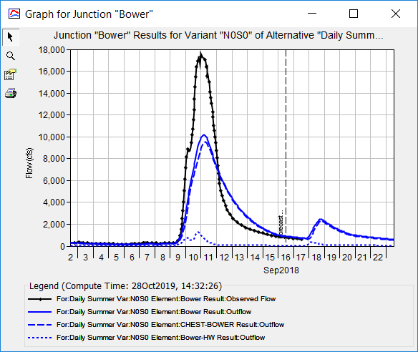
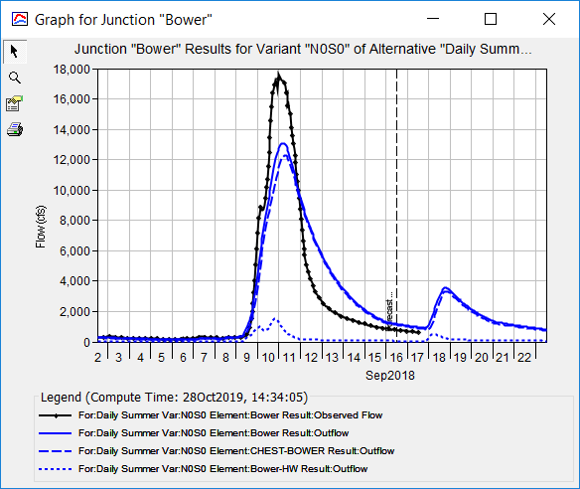
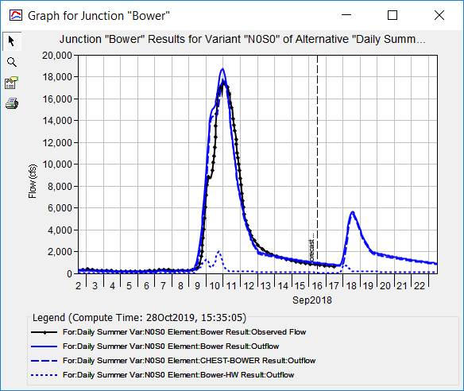
Model Calibration

Slide 6
Model Calibration
Start
Raw Data
Method Selection
Parameterization
Model Run
Model Output
Acceptable
Evaluate
Model Validation
Performance
Metrics
Calibrate
Not Acceptable

Slide 7
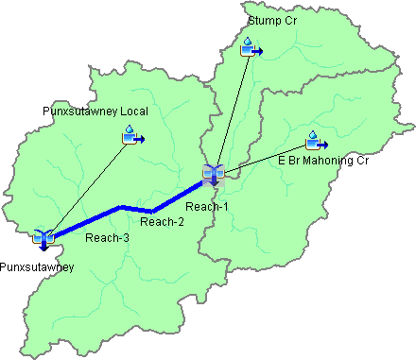

Model Calibration Considerations
Event vs continuous
Event / time period selection
Boundary conditions
Lumped vs. distributed
Modeling processes
Parameterization
Manual vs. “automatic calibration”
Model performance evaluation

Slide 8
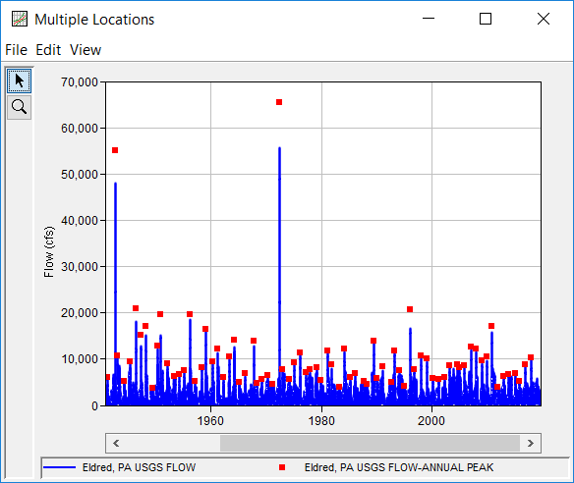
Model Calibration Strategy
Choose appropriate events for simulation
Start in the headwaters and move downstream
Adjust as few parameters as possible
UNDERSTAND the processes; prevent unreasonable parameter choices
Manually calibrate first
Use statistical metrics
Which events are most appropriate for use?
Notes:
Strategy
Choose appropriate events
Calibrate headwater basins first
Adjust as few parameters as possible
Understand the process – prevent unreasonable parameter values
Manual calibration, then automatic
Use statistical metrics to gauge goodness of fit

Slide 9
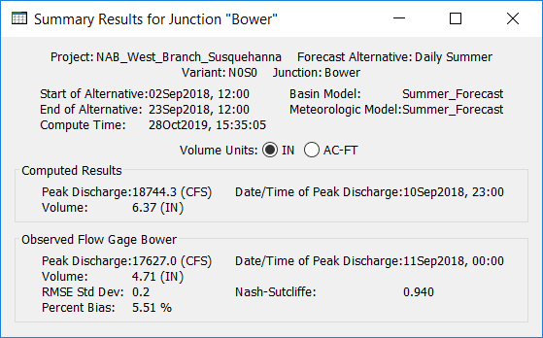
Model Calibration
Use statistical metrics to better evaluate model performance
  Nash-Sutcliffe efficiency
  Root Mean Square Error / Std. Dev.
  Percent Bias
Notes:
Compare peak, timing, and volume of the event being modeled.
Also, statistical performance metrics should be used to quantify model performance.

Slide 10
Model Validation
“(Validation is) when a model that has been calibrated for one data set is evaluated against a different data set of the same variables, at the same site as used in the calibration (the classical ‘split-record test’).” –Bevan and Young (2003)
Notes:
A definition of calibration from Rykiel (1996).

Slide 11
Model Validation
Model Calibration
Acceptable
Evaluate Performance Metrics
Independent Event Simulation
Not Acceptable
Model Output
Acceptable
Evaluate Performance Metrics
End
Not Acceptable

Slide 12
Model Validation
Validation events should be similar to calibration events (e.g. extreme precipitation, time of year)
Boundary conditions will change, but model parameters will remain unchanged from calibrated model
Evaluate performance metrics similar to calibration
If validation fails, go back to calibration – reconsider processes and parameterization
Notes:
Sometimes calibration performance will decrease to achieve an acceptable validation.

Slide 13
Model Adjustments for PMF Simulations
In most cases, the PMP and/or PMF are far beyond anything in recorded history.
  How do we make reasonable extrapolations of model processes and parameters?
Notes:
This amount of precipitation from large events usually PALES in comparison to the Probable Maximum Precipitation.

Slide 14

Model Adjustments for PMF Simulations
Have humans witnessed events comparable to the PMP or PMF?
  Yes!
What can we learn from those extreme events?

Slide 15
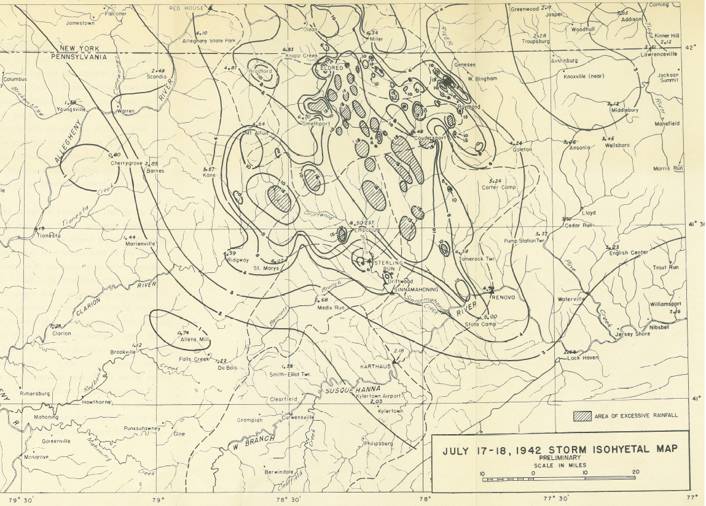
Smethport, PA – July 17-18, 1942
20” – 30”
Notes:
The first, and probably best, example of an event approaching the PMP/PMF is the Smethport, PA event that occurred in June 1942.
This is the isohyetal map for the July 1942 Event, commonly referred to as the “Smethport Storm”. This event caused extreme damage within the Allegheny River and Sinnemahoning Creek watersheds. Over a 10 sq mi area, this storm produced between 20 and 30 inches of rainfall within 6 hours!

Slide 16
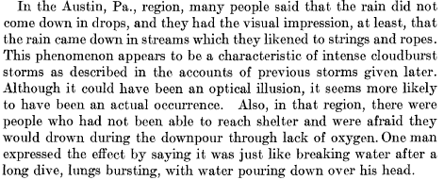

Smethport, PA – July 17-18, 1942

Slide 17
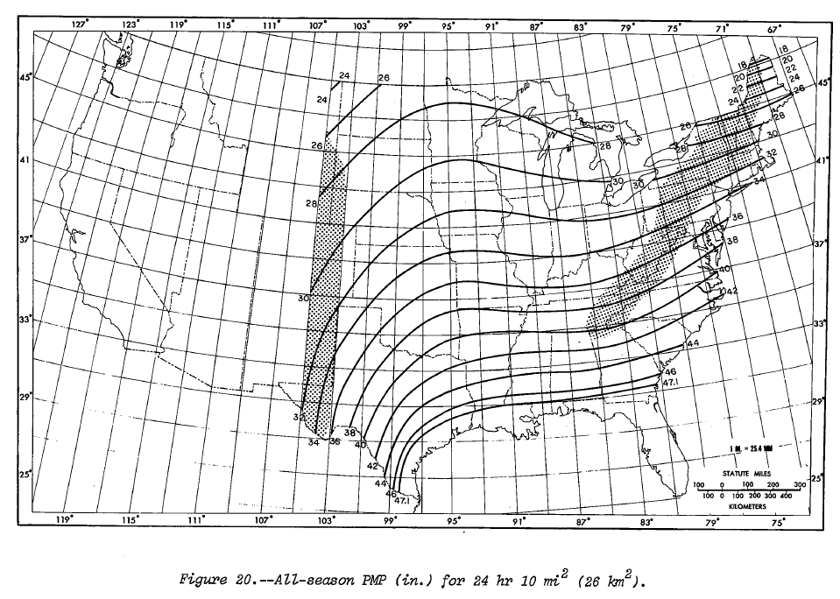
Smethport, PA – July 17-18, 1942
Smethport, PA
24hr, 10mi² = +/- 32 inches
Notes:
In fact, the 24hr, 10 mi2 accumulation from HMR 51 is only 32 inches, which is about 6% greater than the same DA accumulation for the Smethport event. Notice the far reaching consequences of this event throughout the entire northeast.
Chuck McWilliams can explain better than I can, but this event should only be transposed to a limited region of the eastern U.S.

Slide 18
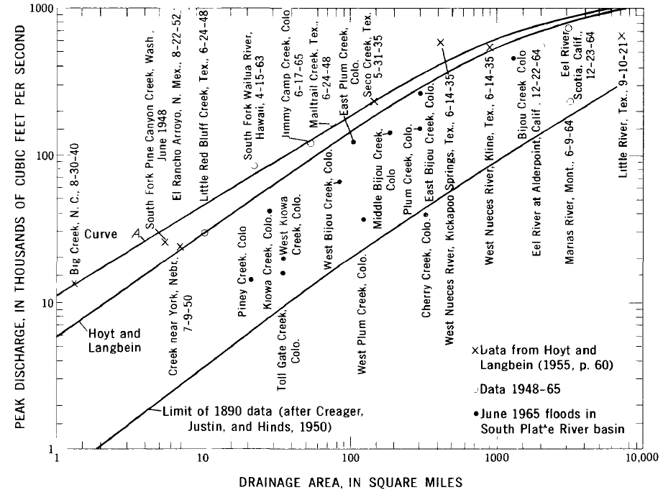
Envelope Curves
Largest measured discharges plotted against drainage area
  Direct and indirect measurements
Plot estimates of extreme discharges against these types of curves for a reality check
Notes:
At 1 square mile, floods have been observed with peak discharges nearing 10,000 cfs.
At 10 square miles, floods have been observed with peak discharges nearing 50,000 cfs.
At 100 square miles, floods have been observed with peak discharges nearing 200,000 cfs.
If your PMF estimate is way less than those that have been observed for similar drainage areas, take a closer look

Slide 19
Model Adjustments for PMF Simulations – Reservoir Pool
“Experience has demonstrated that an unusual sequence of floods can result in filling all or a major portion of the flood control storage in a reservoir before the beginning of the IDF.” (ER 1110-8-2)
Simulate multiple antecedent pools
  Normal pool
  Top of active storage (i.e. uncontrolled spillway crest)
  Pool elevation after ½ PMF w/ 5 day separation of peaks

Slide 20
Model Adjustments for PMF Simulations – Reservoir Pool
January 1969
Whittier Narrows Dam
19”
21”
1-day
Notes:
The Jan 1969 event was a Very Significant Event in the Historical Record for the Whittier Narrows watershed
1969 Antecedent Event Average Precipitation = 19 inches
1969 Main Event Average Precipitation = 21 inches
% Antecedent to Main Event = 90%
Lag Between Antecedent Event and Main Event = 1 Day

Slide 21
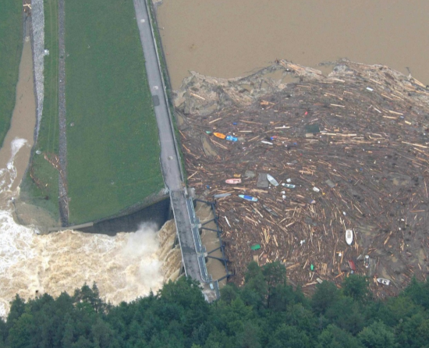
Model Adjustments for PMF Simulations – Dam Structure
Outlet Works
  “…should not be assumed operable… unless they are specifically designed for such a purpose.”
  Investigate conduit blockage and/or gate failure
Thurnberg Dam, Austria
Notes:
Do not assume that outlets will be operable during large events unless they’re specifically designed to handle the stressors that will be placed upon them.
For instance, debris blockage can dramatically reduce the outlet works or spillway capacity during large events.

Slide 22
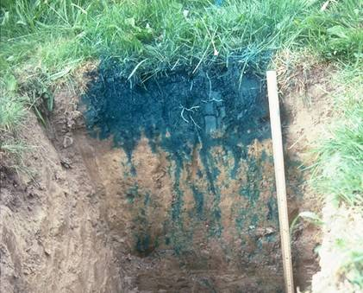
Model Adjustments for PMF Simulations - Losses
Initial Losses
  Should be minimal due to the assumption of saturated conditions
Loss Rates
  Lowest rates developed from historic events calibration

Slide 23
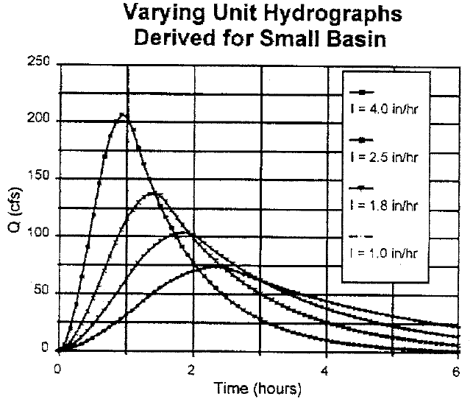
Model Adjustments for PMF Simulations – Unit Hydrograph
Unit Hydrograph Transform
  Inherently linear response function
  Extreme historical events have shown unit response increase of 25 – 50%
Notes:
According to Sherman, 1932, who originally proposed the unit hydrograph concept, the unit hydrograph of a watershed is “…the basin outflow resulting from one unit of direct runoff generated uniformly over the drainage area at a uniform rainfall rate during a specified period of rainfall duration.” This implies that the response of 2 inches of runoff over a given time is 2 times the response of 1 inches of runoff over the same amount of time.
However, due to differences within hydraulic reactions between large and small precipitation events, the corresponding unit hydrographs of a given watershed have not been found to be equal, as implied by unit hydrograph theory. Minshall, 1960 was one of the first people to explore the different runoff hydrographs that resulted from differing intensities of precipitation. The graph shown here is from his classic report in 1960. He showed that as precipitation intensity increases, runoff tends to arrive sooner in time and with a greater peak flow rate. This is due to greater depths in stream channels and overland planes; as water depth increases, effective roughness decreases leading to shorter travel times, etc.

Slide 24
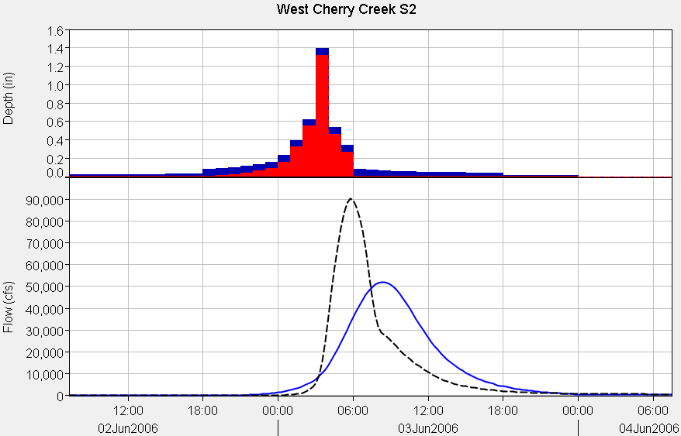
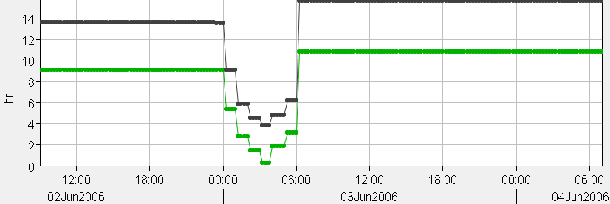
Model Adjustments for PMF Simulations – Unit Hydrograph
For small drainage areas:
  Adjust the unit response at the dam site by 25 – 50% during times of peak excess
  Route 1” of excess with no losses or baseflow to peak response
  Can use Variable Clark
  Variable Clark Tutorial and Guide
Precip
Excess Precip
Variable Clark
Standard Clark
T_{c}
R

Slide 25
Model Adjustments for PMF Simulations – Unit Hydrograph
Peaking Factor | Peak Flow (cfs) | Time to Peak (hr)
1 | 13771 | 4.5
1.25 | 17214 | 3.75
1.5 | 20659 | 3.25
1.75 | 24116 | 2.75
2 | 27578 | 2.5
Notes:
Here are examples of peaking the unit response inflow to a dam by 25-, 50-, 75-, and 100-percent. Notice that the peak flow rate increases, time to peak decreases, but the total runoff volume remains the same (ONE INCH).

Slide 26
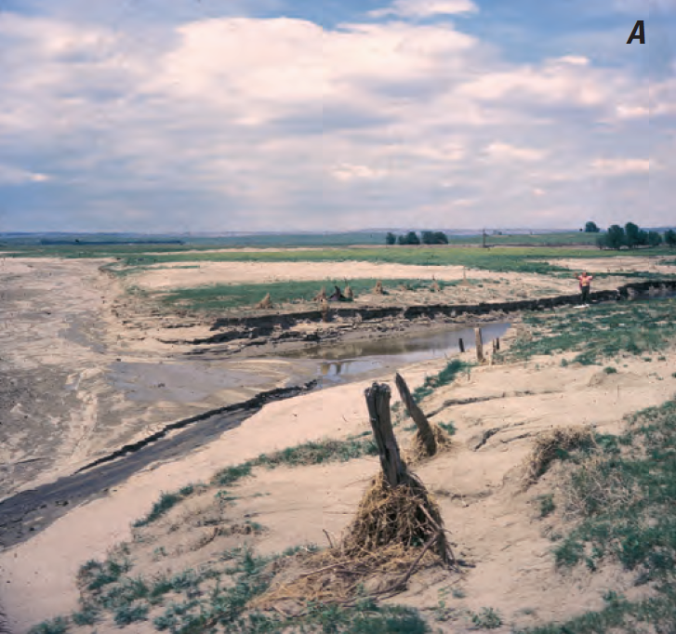
Model Adjustments for PMF Simulations – Channel Routing
Muskingum
  How do K, X, and # steps change as a flood gets larger?
Muskingum-Cunge
  How do travel length, friction slope, and roughness change as a flood gets larger?
Modified Puls
  Have enough hydraulic simulations been performed to completely define storage-outflow?
Jimmy Camp Creek, CO
Drainage area = 54.3 sq mi
June 1965 peak discharge = 124,000 cfs

Slide 27
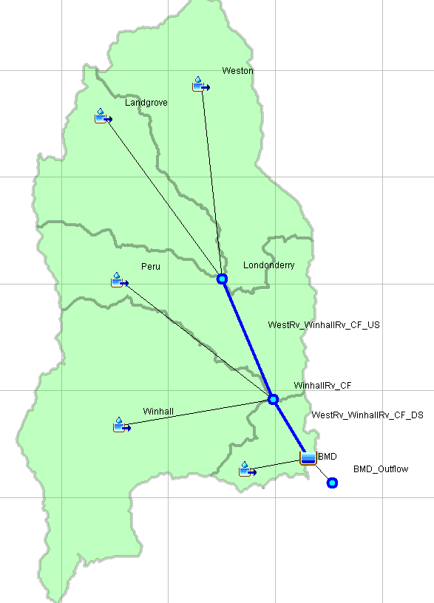
Model Adjustments for PMF Simulations – More Peaking?
Subbasin
25% “Peaked”
Subbasin
25% “Peaked”
Routing Reach
Not “Peaked”
Subbasin
25% “Peaked”
Routing Reach
Not “Peaked”
Subbasin
25% “Peaked”
INFLOW
25% “Peaked”???
Subbasin
25% “Peaked”

Slide 28
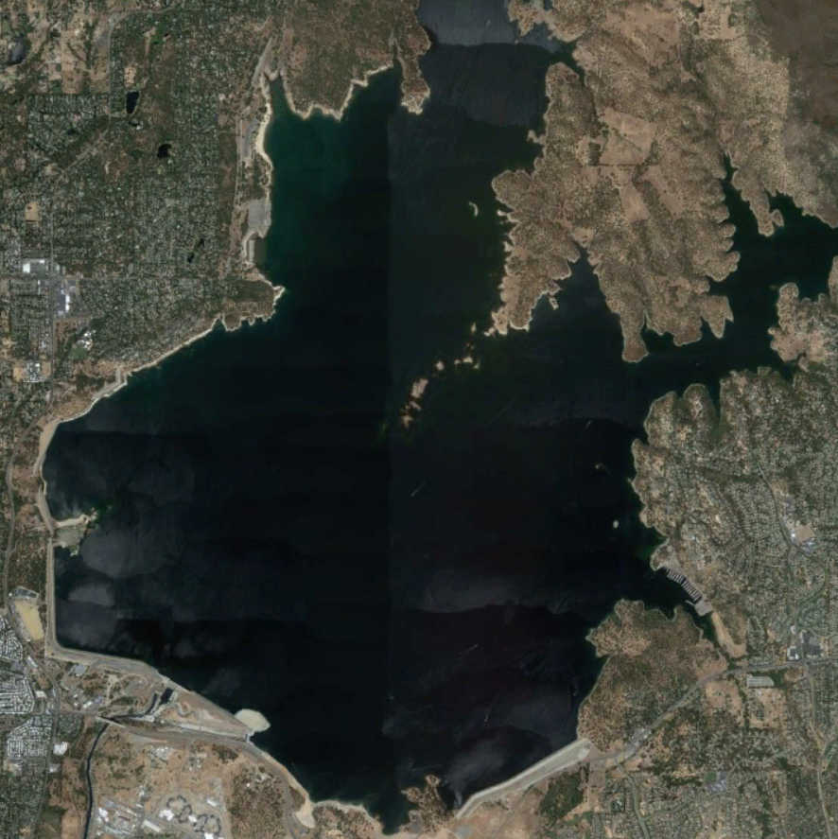
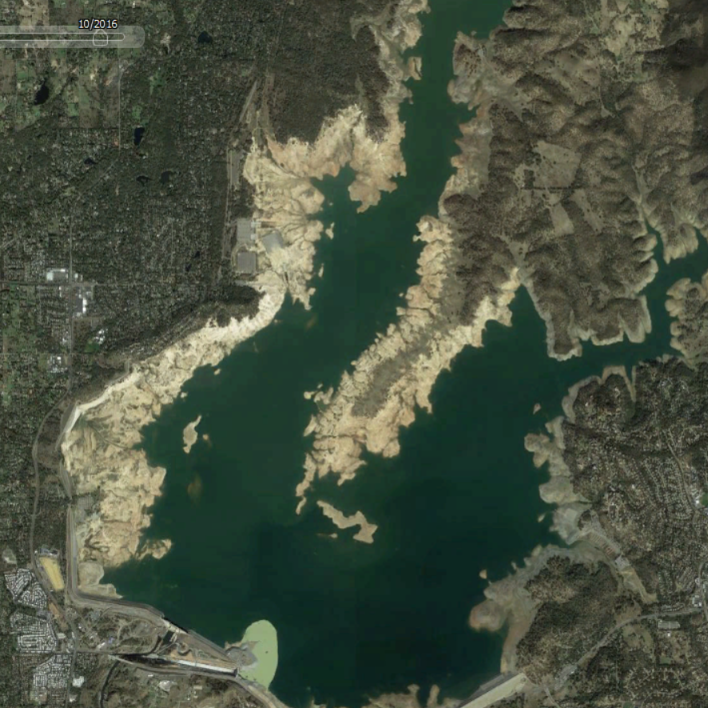
Model Adjustments for PMF Simulations – Other
Baseflow
  Is mass conserved?
  runoff < precipitation?
Impervious Area
  As the pool grows larger in extent, should directly connected impervious area increase?

Slide 29
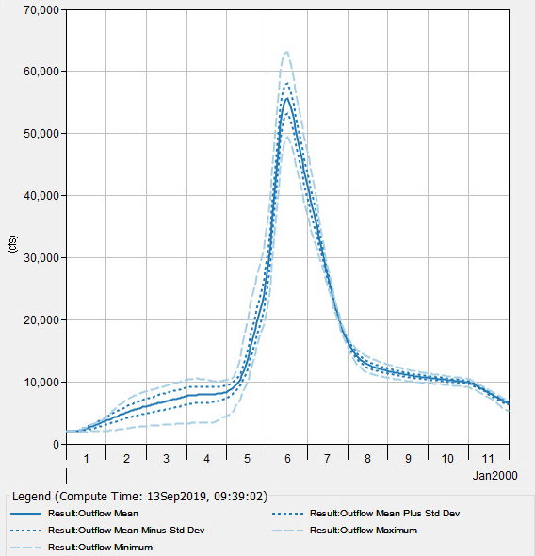
Model Adjustments for PMF Simulations – Uncertainty
How much uncertainty is there within the predicted runoff response?
Ascertain using:
  “Sensitivity” analyses
  HEC-HMS Uncertainty analysis

Slide 30
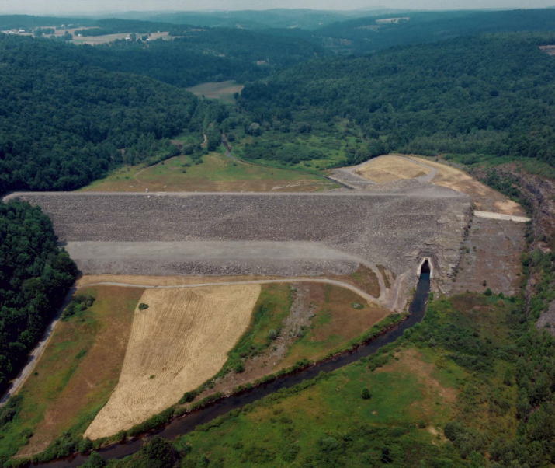
Case Study – Jadwin Dam
~110 ft tall earthen embankment dam
Located in northeastern Pennsylvania
Drainage area = 64.5 mi²
~7 in of flood control storage
No permanent pool
Ungated conduit and spillway

Slide 31
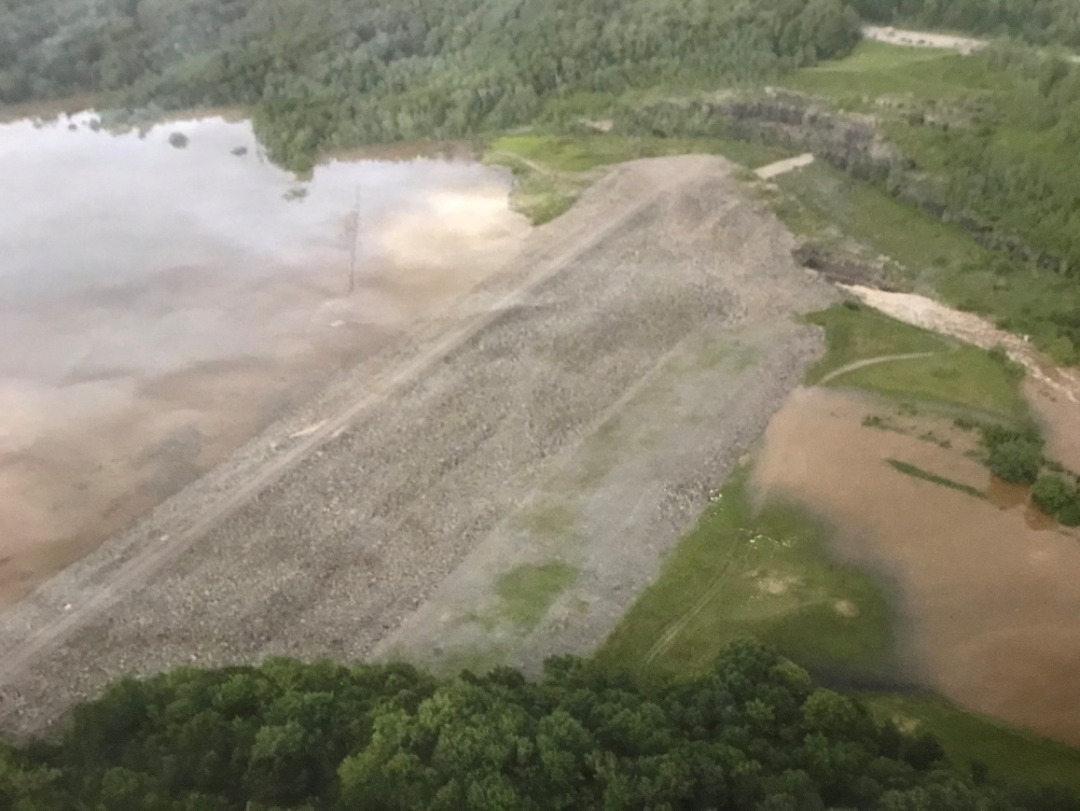
Case Study – Jadwin Dam
Detail the largest recorded historical events
  When do large events occur?
  What are the prevailing mechanisms?
Collect previous design studies

Slide 32
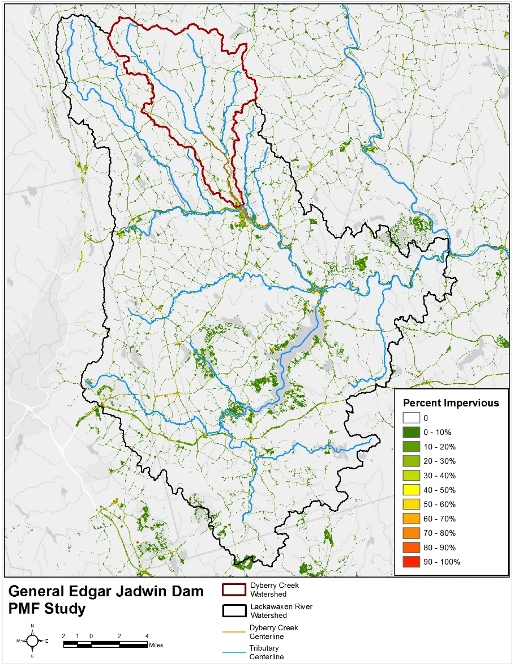
Case Study – Jadwin Dam
Develop a conceptual model
  Hydrography
  Topography
  Climate
  Streamflow
  Land Use
  Soils
  Geology

Slide 33
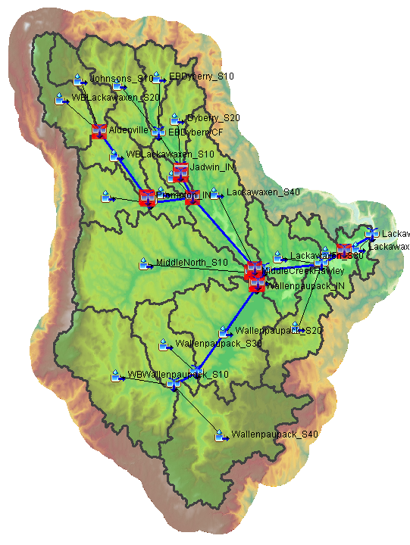
Case Study – Jadwin Dam
Construct a hydrologic model using the conceptual model
Choose appropriate modeling processes and parameterize
  Deficit and Constant Losses
  ModClark Unit Hydrograph Transform
  Recession Baseflow
  Muskingum-Cunge and Mod Puls Channel Routing

Slide 34
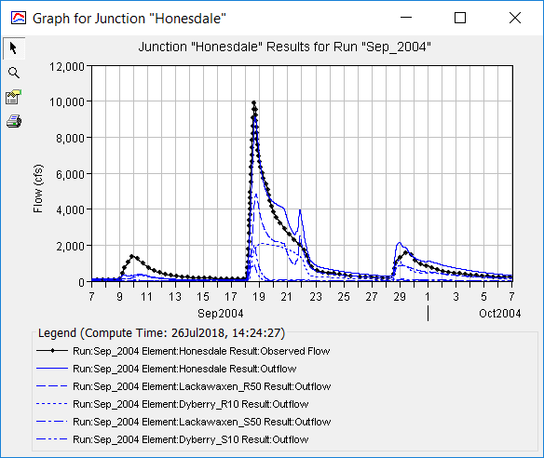
Case Study – Jadwin Dam
Calibrate using large events
  Used 5 large rain-only and rain-on-snow events
Develop best estimate parameters
Validate using large events
  Used 5 large rain-only and rain-on-snow events

Slide 35
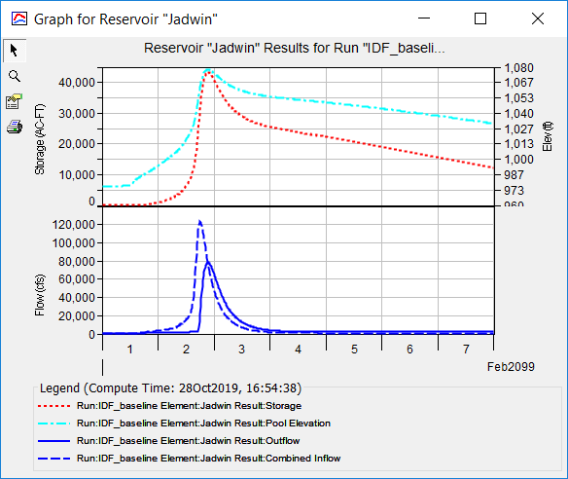
Case Study – Jadwin Dam
Develop PMP
Modify best estimate parameters for PMF simulation
  Minimum losses
  Peak unit response
  Antecedent pool
Develop “Best Estimate” PMF

Slide 36
Case Study – Jadwin Dam
120k cfs
62.5 mi²
Notes:
As a sanity check, the best estimate PMF was plotted on the nationwide envelope curve
The best estimate of ~120,000 cfs plots near the envelope curve for a ~60 mi² drainage area

Slide 37
Case Study – Jadwin Dam
Investigate PMF uncertainty
  PMP parameters
  Infiltration
  Unit Hydrograph Transform
  Antecedent Pool Elevation
  Channel Routing
  Conduit blockage
Develop “Reasonable Best” and “Reasonable Worst” PMF

Slide 38
Review
Modeling allows for the estimation of runoff response due to hypothetical events
However, the model must be calibrated and validated
Events approaching the PMF have occurred
Model adjustments must be made when simulating large events
Uncertainty should be investigated

