Slide 1
Routing the PMF Hydrograph through a Reservoir Model to Compute the Peak Reservoir Stage

Slide 2
Outline
Using a model to route the PMF to compute a peak stage
Major assumptions
  Initial conditions
  Reservoir operation
Results

Slide 3
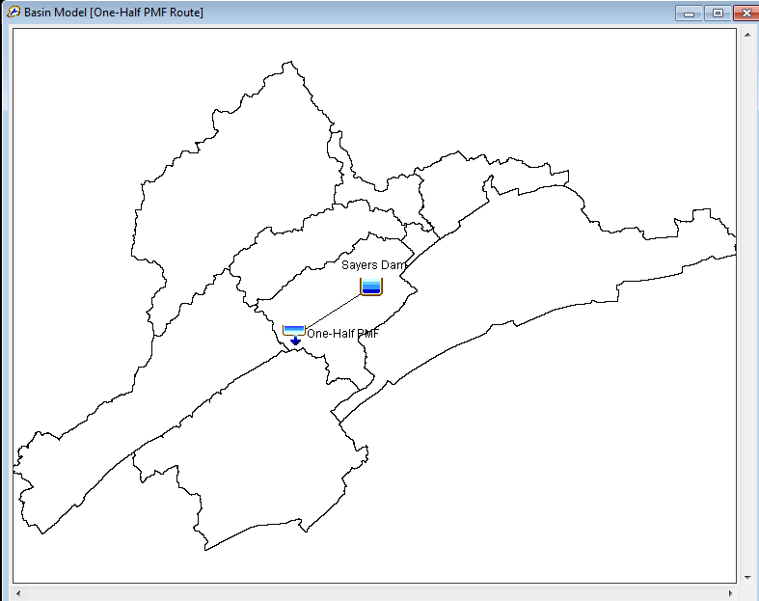
Routing the PMF using a Model
Existing HEC-HMS or HEC-ResSim models can be used for routing the PMF, or simple models can be quickly configured (no spreadsheet routing).
Information Required for Modeling
  Elevation-storage relationship
  Appropriate elevation-discharge information (must include spillway and dam top) or a physical description of spillway and dam top.
  Boundary conditions
Notes:
A model lets you perform a sensitivity analysis of boundary conditions, initial conditions, and model parameters. A simple reservoir model can be created in HEC-HMS (no downstream operations) or within HEC-ResSim where modeling assumptions can be explored.

Slide 4
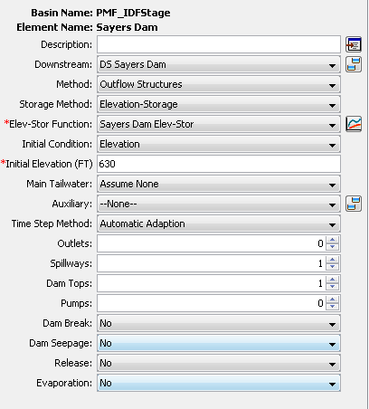
Reservoir Element in HEC-HMS

Slide 5
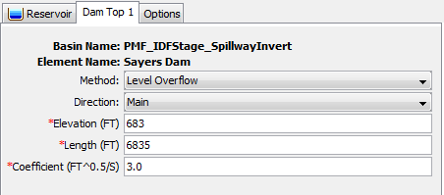
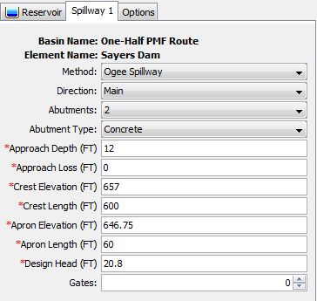
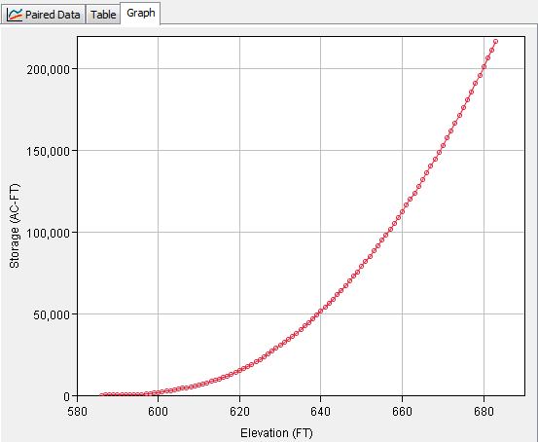
Routing the PMF using a Model
Reservoir storage and outlet information is found in the Reservoir Regulation Manual. All paired data curves should be extended beyond the top of the dam in case of overtopping during the PMF simulation.
Notes:
The main pieces of information needed for a simple reservoir model (for the PMF routing) is 1) Elevation-Storage information, 2) information about the releases for the reservoir (can be defined as a storage-discharge curve or physical characteristics of the spillway), 3) characteristics of the dam top, and 4) initial conditions prior to routing the PMF hydrograph.

Slide 6
Model Assumptions for PMF Simulation
According to ER 1110-8-2, the minimum starting elevation for routing the PMF will be assumed as the full flood control pool (spillway invert) or the elevation prevailing five days after the last significant rainfall of a storm that produces one-half the PMF.
Start the PMP hyetograph 5 days after the maximum 24-hour precipitation from Antecedent Storm. Setup addition scenarios where duration is less than 5 days, 3 days and 2 days.
Use other scenarios if they have been defined regionally.

Slide 7
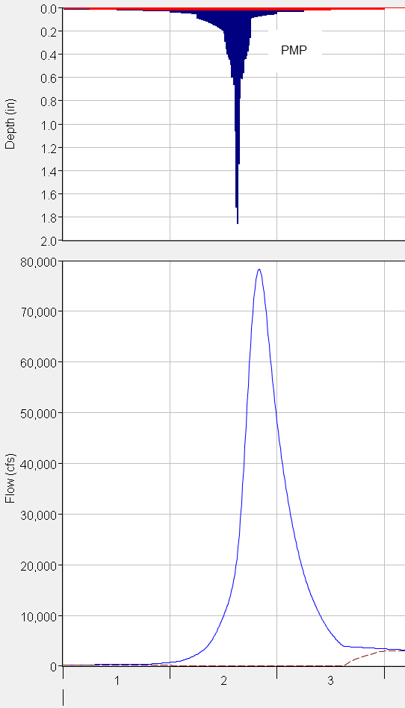
Model Assumptions for PMF Simulation
Maximum 24-hour precipitation from PMP - begin countdown from this point

Slide 8
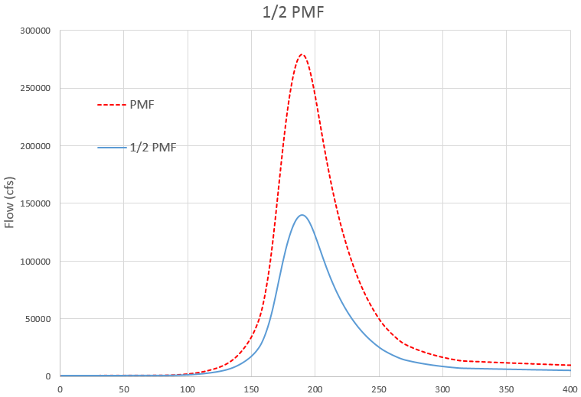
Initial Reservoir Storage for PMF
Use Excel to determine ½ PMF hydrograph
Enter the ½ PMF hydrograph into the HEC-HMS or HEC-ResSim model
Route the ½ PMF hydrograph assuming:
  Normal pool conditions for initial reservoir storage (season can be important)
  Simplified operations (consider using a specified release to simulate releases after the flood wave passes)

Slide 9
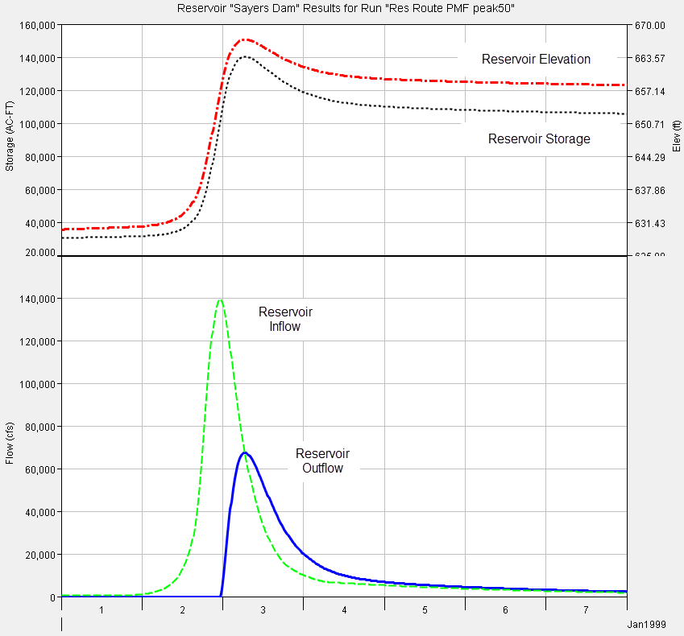
2-days
3-days
5-days

Slide 10
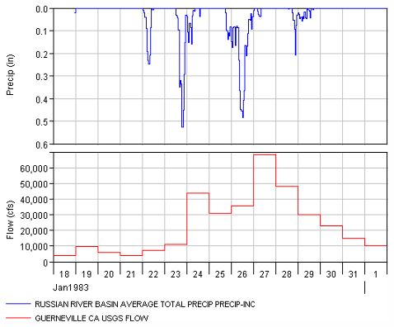
Historical Information Supporting Duration between Antecedent Storm and PMF
Identify up to 10 major events by evaluating flow and precipitation data.
Choose a representative precipitation gage and evaluate duration between major flood and preceding event.
Determine if there is evidence to support a duration less than 5-days for separating an antecedent flood and the PMF.

Slide 11
Historical Information Supporting Duration between Antecedent Storm and PMF
Experience has shown that meteorologic and hydrologic characteristics of the watershed should be evaluated for setting the initial reservoir storage. In some locations, it might be appropriate to assume only a 1-day lag time because historic storms do show large rainfall events separated by only 1-day.
January 1969 Event
Whittier Narrows Dam
19 in
21 in
1-Day Lag
Notes:
The Jan 1969 event was a Very Significant Event in the Historical Record for the Whittier Narrows watershed
1969 Antecedent Event Average Precipitation = 19 inches
1969 Main Event Average Precipitation = 21 inches
% Antecedent to Main Event = 90%
Lag Between Antecedent Event and Main Event = 1 Day

Slide 12
Model Assumptions for PMF Simulation
According to ER 1110-8-2, reservoir outlets “should not be assumed operable during the occurrence of an IDF, unless they are specifically designed for such a purpose.”
According to ER 1110-8-2, mis-operation of gated spillways should be considered when the lag time between intense rainfall and peak inflow is less than 12 hours.

Slide 13
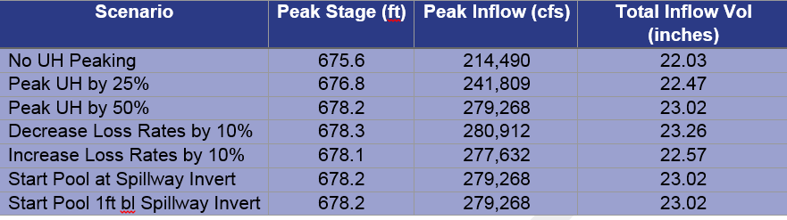
Results from PMF Analysis
One of the final products from the PMF routing analysis is a table of peak stage, peak inflow, and total inflow volume.
Addition summary information should include a discussion about differences in the current PMF and peak stage as compared to historic studies (note that historic studies did/did not use current HMR information, did/did not peak unit hydrograph parameters, loss rate values, and initial reservoir condition prior to PMF routing).

