Slide 1
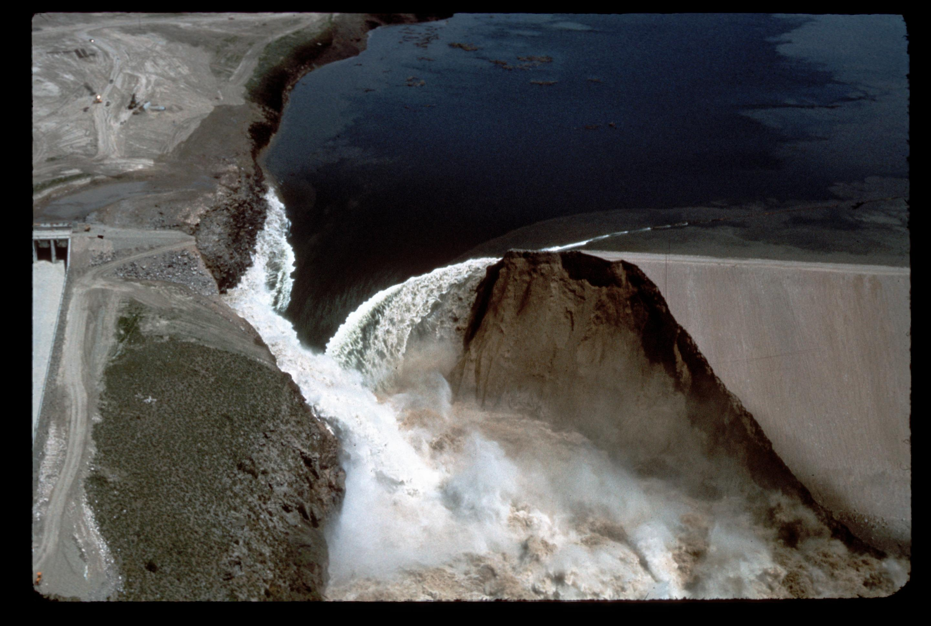
Hydrologic Loading
Gregory S. Karlovits, P.E., P.H., CFM
Hydrologic Engineering Center
H&H for Dam Safety
September 2022

Slide 2
Student Goals
Understand the role of hazard curves in risk assessments
Identify level of effort required for hazard curve development
Become familiar with HEC software used to develop hazard curves
Overall: Tie together the dam safety risk assessment process and the H&H software needed to succeed!

Slide 3
What We’re Not Doing
Disclaimer!
Not a recipe for doing hydrologic loading on your own
See Risk Management Center (RMC) SQRA workshops
Higher-level studies usually need guidance from senior H&H cadre members

Slide 4
Risk
Three components:
  Hazard
  Performance
  Consequence
Hydrologic loading is concerned with the hazard

Slide 5
Hazard
Hazards have a chance to cause harm.
Some loads can be hazardous.
Potentially hazardous load examples:
A reservoir fills to the crest.
Spillway flow begins.
High winds cause waves running up the side of the dam.
Notes:
Load for example hazards:
1: The reservoir stage is considered the load (we may overtop, or initiate internal erosion, etc.)
2: The flow over the spillway is the load (we may erode the spillway, for example)
3: The volume of water overwashing the dam is the load (we may erode the dam embankment, for example)

Slide 6
Performance
Hazards do not cause harm if the structure performs.
If the structure fails, consequences can occur.
Failure is not always certain for a load.

Slide 7
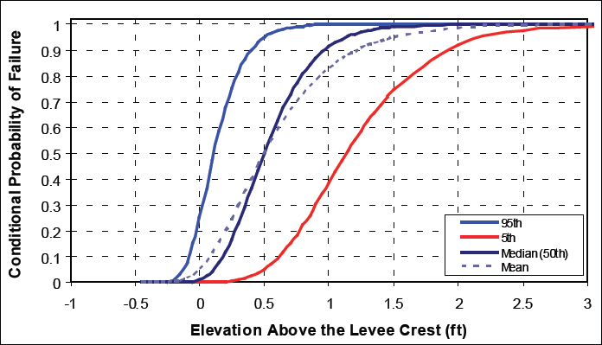
Performance Example
Levee Fragility
National Research Council. 2013. Levees and the National Flood Insurance Program: Improving Policies and Practices.
Notes:
Levee loading is on the x-axis (what is the river stage relative to the height of the levee?) while p(fail | load) is on the y-axis (how likely is the levee to fail at this loading?) Note for a given load (e.g. 0.5 ft overtopping) the width of the uncertainty about p(fail), here it’s about 0.05 – 0.95 with a mean of 0.5. This one can fail before it overtops as well.

Slide 8
Consequences
Dam failure consequences usually entail:
  Economic damage
  Loss of life
A range of consequences are possible depending on the failure
H&H input to consequence modeling is usually inundation mapping
  Covered later this week!

Slide 9
Risk
risk =
load *
performance | load *
consequence | performance
“given”

Slide 10
Overtopping Example
Load
  Stage ≥ dam crest elevation
Performance
  What is the probability the dam fails if it is overtopped?
Consequence
  What is the life loss/economic damage if the dam fails due to overtopping?

Slide 11
Loading Probability
Missing piece:
  What is the probability of the load?
  We can imagine bigger and bigger loads, but how likely are they?
For hydrologic failure modes, stage is the most important load
Reservoir stage-frequency curves establish loading probability

Slide 12
Stage-Frequency Curve
Reservoir Stage
Annual Chance of Exceeding Stage

Slide 13
Stage-Frequency Curves
Drawn like flow-frequency curves
Extends well past observed data
Shows annual exceedance probability (AEP) for critical stages
  Spillway activation
  Top of dam
  Inflow design flood (IDF)

Slide 14
Stage-Frequency Curve
Top of Dam
Reservoir Stage
AEP OT
Annual Chance of Exceeding Stage

Slide 15
Risk Assessment Recap
Estimating dam risk requires understanding the probability of hazardous loads
Hydrologic loading/hazard curves show the AEP of a range of reservoir stages
  Stage-frequency curve

Slide 16
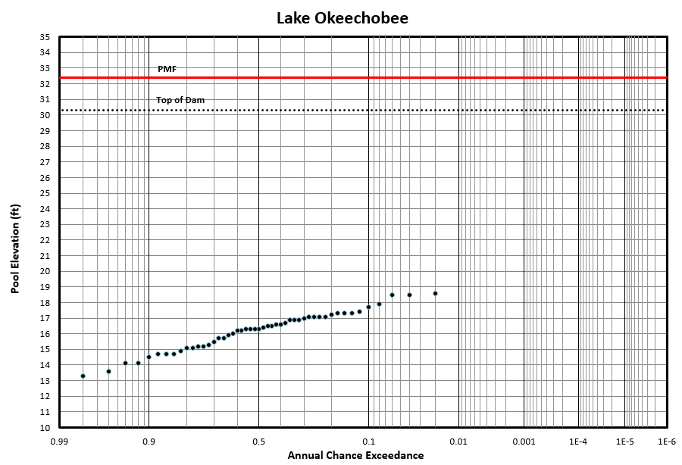
The Challenges
No Observations
in Hazard Range
Limited Record of
Observed Stages
Reservoir Stage
Annual Chance of Exceeding Stage

Slide 17
Extrapolation
Can’t we just draw a line?
Notes:
This is the same idea as just fitting a probability distribution to the annual maximum stages. In general it doesn’t work – we violate one of the big assumptions of doing a frequency analysis – that the data are identically distributed. Operation of the dam is not the same for different floods. Usually once the water gets higher behind the dam we are interested in releasing it more aggressively to save the dam.

Slide 18
Extrapolation
Account for Anticipated
Behavior Here
Reservoir Stage
Annual Chance of Exceeding Stage
Notes:
If we know how we would operate the dam for large floods, we just need to create some yet-unseen large floods and operate the dam. Sounds easy, right?

Slide 19
Flood Stages
How high does the pool get during a flood?
Depends on:
  How high the pool was before the flood
  How big the flood is
    Total inflow volume
    Peak inflow
  How the dam is operated
    Gate operations
    Downstream controls

Slide 20
Reservoir Peak Stage
Starting Stage
Operations
Peak Stage
Flood Hydrograph

Slide 21
Extrapolation
What can we extrapolate better than stages?
  Flow-frequency curves
    Easier to develop
    Harder to create big sample sizes
    Harder to model multiple dams
  Precipitation-frequency curves
    Harder to develop
    Easier to create big sample sizes
    Requires hydrologic modeling to get runoff
    Possibly easier to model multiple dams

Slide 22
Streamflow-Frequency Method
Assume peak stage primarily driven by magnitude of flood
  Starting stage causes far less variability
Flood magnitude varies due to natural variability
Use Monte Carlo simulation

Slide 23
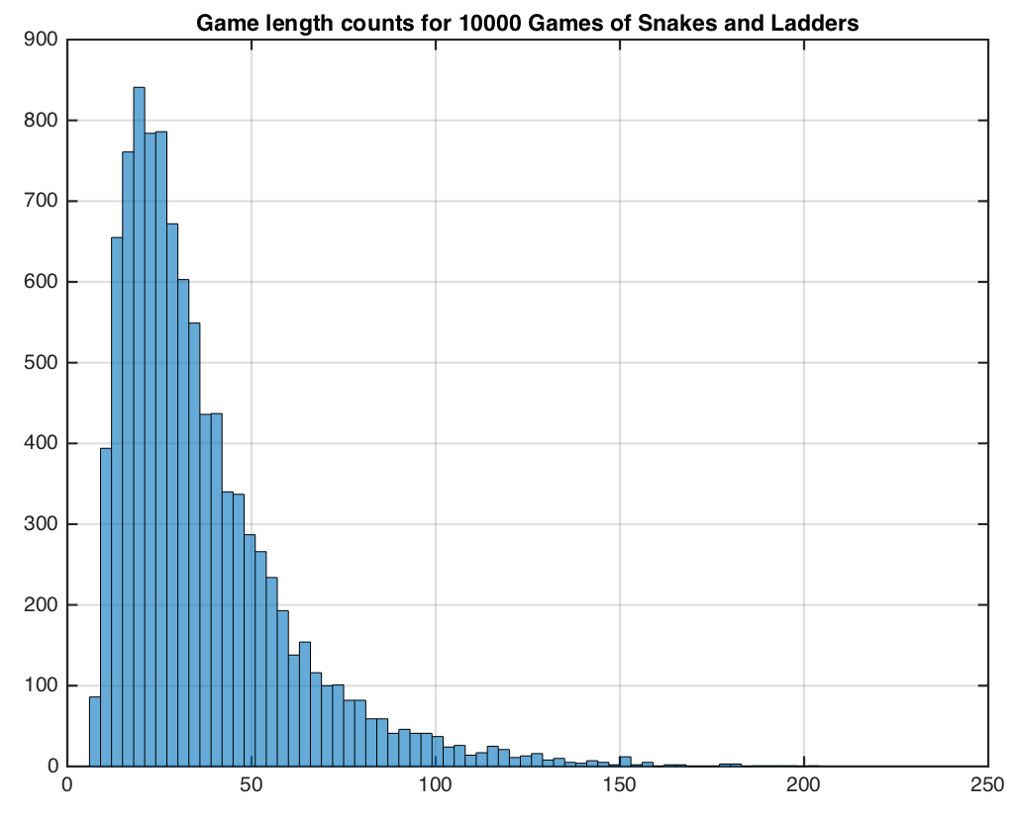

Monte Carlo Simulation
f(x)
Replace a probability distribution with a large sample that follows that distribution

Slide 24
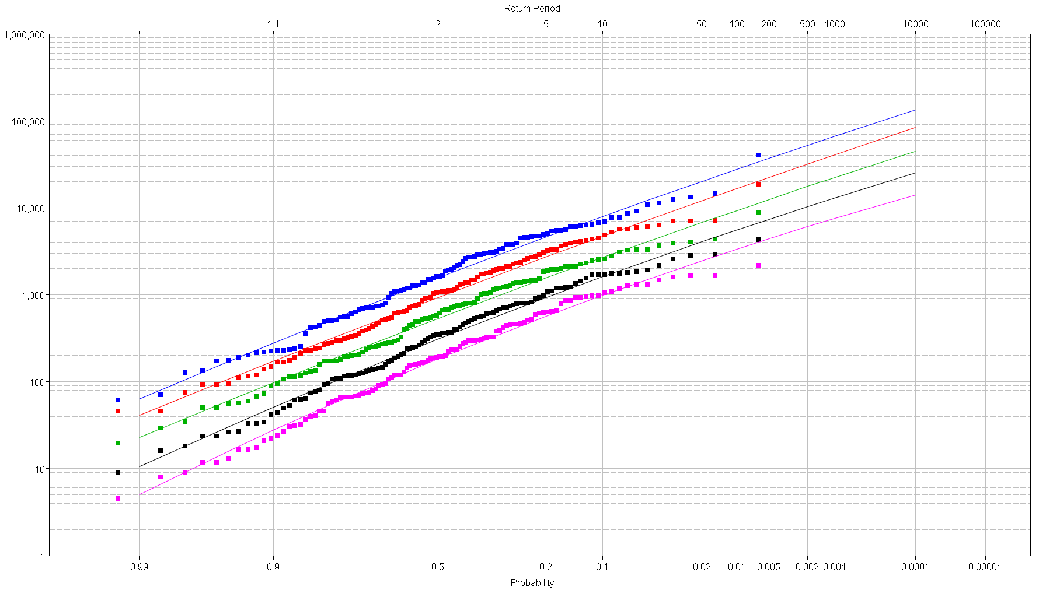
Streamflow-Frequency Method
1-day
3-day
7-day
Observed Inflows
15-day
30-day
Daily Average Flow
Model Extrapolation
Annual Chance of Exceeding Flow

Slide 25
Large Streamflow Sample Generation
Template Hydrograph Shapes
Inflow
Frequency
Curve
Scaling
Q
Flood Hydrograph
To Route
p
Repeat (a lot)

Slide 26
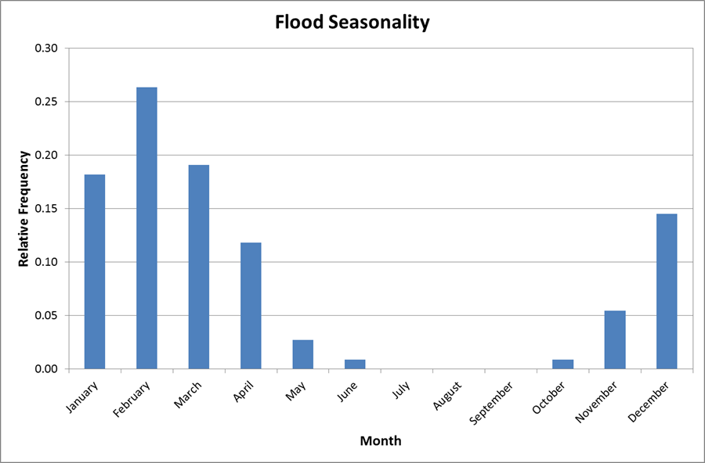
Starting Stage
Starting stage may be affected by season of event
  Seasonal operations

Slide 27
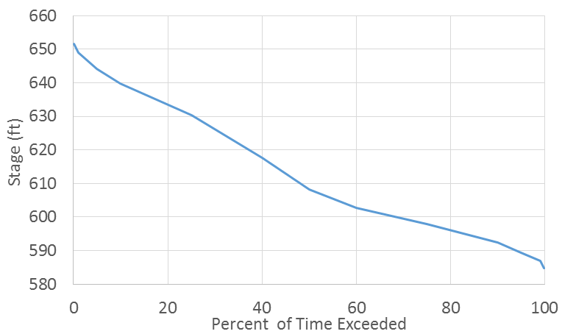
Starting Stage
Modeled by one or more seasonal stage-duration curves
Curve Depends on Season
Sample Each
Flood Event

Slide 28
Operations
Generally treated deterministically
If gate failures are being considered, those may be modeled randomly
  Generally not at PA/SQRA level

Slide 29
Reservoir Peak Stage
Starting Stage
SAMPLED
Operations
Peak Stage
ROUTED
RESULT
SAMPLED
Flood Hydrograph

Slide 30
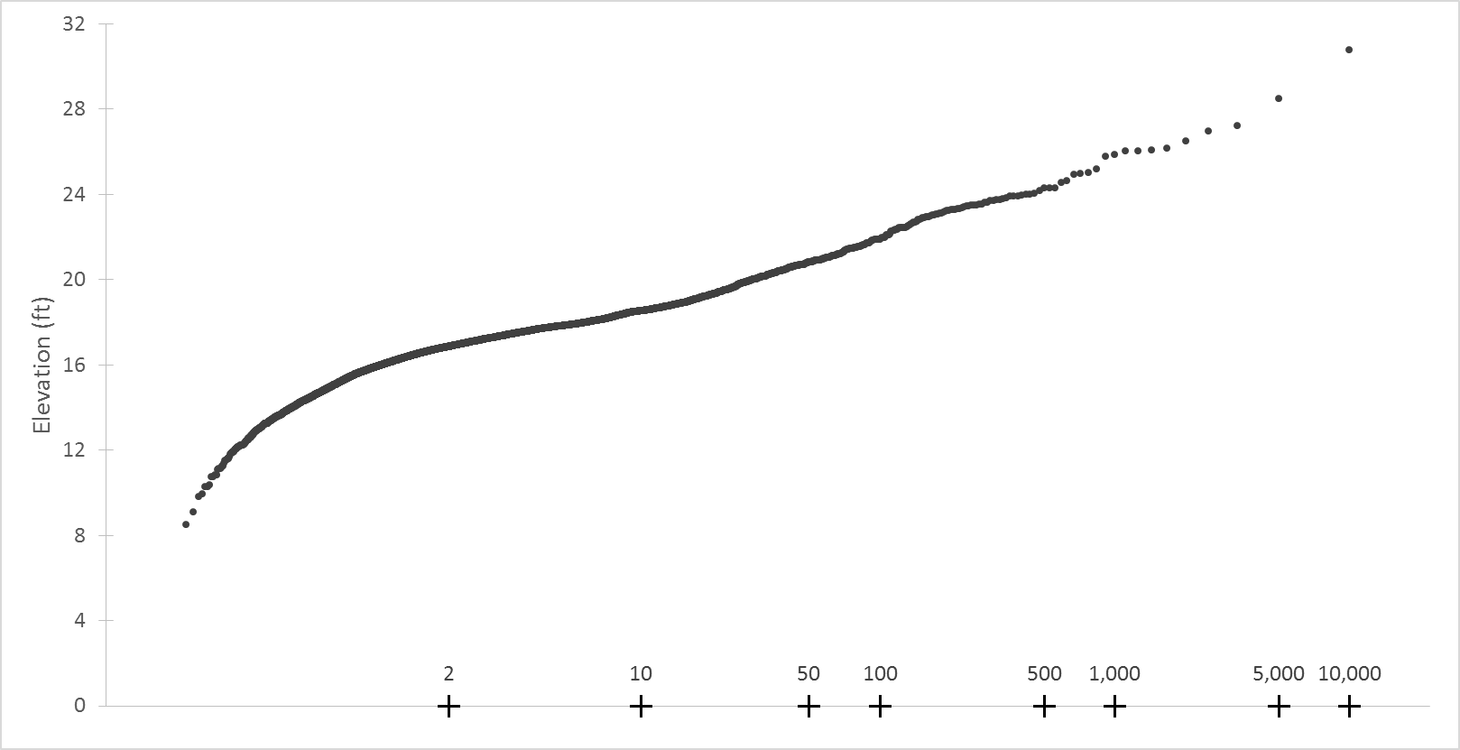
Results
Each pt is a
routed event
Maximum Reservoir Stage
Simulation count controls
frequency limits
Average return interval (years)
Notes:
A note/disclaimer about using average return intervals. It’s like picking your nose, just don’t do it in public. Within hydrology we generally use this as shorthand with the implicit understanding that it’s the imaginary average amount of time between events with a very small probability of occurring in any given year. The public seizes on the number without nuance. It can unintentionally lead to risky behavior, so it’s better in official/public communication to use annual exceedance probability (AEP) instead.

Slide 31
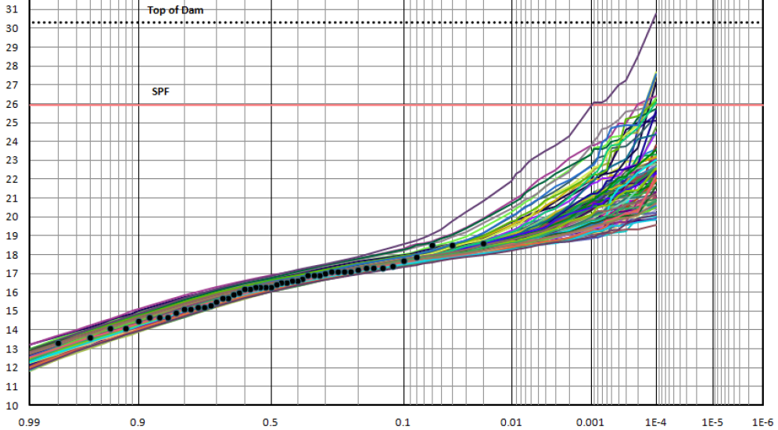
Uncertainty
Run the simulation, varying the flow frequency parameters
Each line is
a realization
Uncertainty for rare events substantial

Slide 32
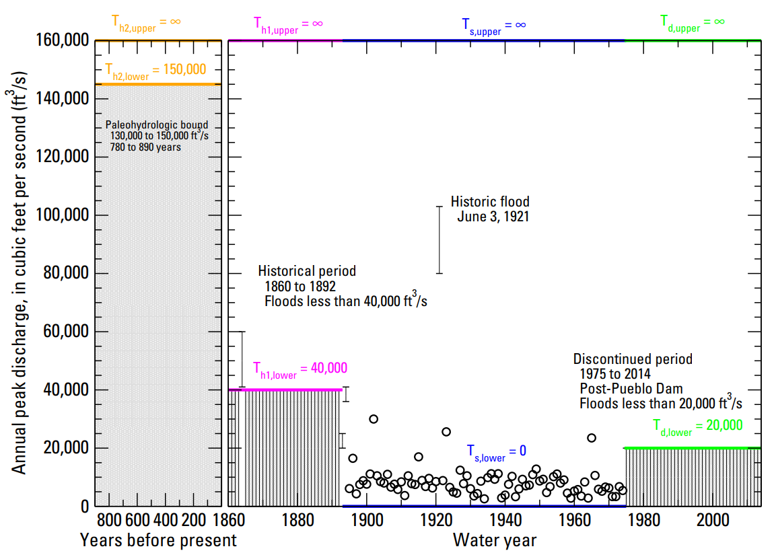
Including More Information
Notes:
There are quite a few sources of what might be called non-traditional data that are useful for including more information in a flood-frequency curve.
Historical floods, where a gauge may not have observed the actual flow but one is known to have occurred, is sometimes included in a USGS gauge record. Sometimes you have to go to a newspaper article and decipher a photo captioned “The peak of the 1874 flood inundated the third step of the courthouse downtown…” The flow you derive from these estimates may be uncertain, and modern flow frequency analysis can deal with so-called “interval” flows – you know the flood magnitude was somewhere in an interval.
Alternatively, you may have information that suggests that “nothing happened” for a while, in the sense that if a flood was big enough, someone would have noticed and a record would occur. It might be up to you as the analyst to decide what “big enough” was, but looking at other floods for the time period may be helpful. “Well, they recorded the 1874 flood, and that was at least 40,000 cfs, so if any floods 40kcfs or larger occurred in this time period, someone would have noticed.” Modern flow frequency analysis can use “left-censored” data; that is, the value is below some level but its precise value is unknown.
This framework also works for paleofloods. Paleofloods are observed indirectly, usually through geological or botanical evidence. Alternatively, geological or botanical evidence can be used to suggest that no floods of a significant size have occurred for a long period of time. Carbon dating sediment deposits from a historical flood can give the approximate date of a flood, and hydraulic modeling can recover its magnitude. On the flipside, evidence for landscape stability that can be dated and modeled can suggest that “no floods inundated this area for at least 1,000 years” and all flows must be below that level.

Slide 33
Level of Effort – Streamflow Frequency
(Periodic Assessment)
(Semi-Quantitative Risk Assessment)
PA/SQRA
  At-site volume-frequency
  Regional skew information if available
  Historical information if available
IES/DSMS
  At-site volume-frequency
  Historical information
  Regional skew highly recommended
  Paleoflood analysis if possible
  Precipitation-based methods may be preferable
(Issue Evaluation Study)
(Dam Safety Modification Study)
Notes:
At the higher levels you may be able to get away with doing streamflow-based methods if the hydrologic failure modes are not driving the risk, or if other things keep you from going to precipitation-based methods.

Slide 34
Precipitation-Frequency Method
Instead of sampling inflows, sample precipitation
Compute runoff with a hydrologic model
Route inflow hydrographs

Slide 35
Precipitation-Frequency
Analyze annual maximum precipitation
Regionalize the estimates
  Space-for-time substitution
Handle the tradeoff:
  More storms of the same kind, but
  Multiple stations can be dominated by the exact same events
Notes:
If you get several storms of the same type in an area (say tropical storms), there’s a chance that each storm causes the annual maximum rainfall at any number of the stations in the region. If half the stations get their annual maximum in one storm and half in another, that’s two observations of heavy rainfall of a single kind in a year which improves our estimates.

Slide 36
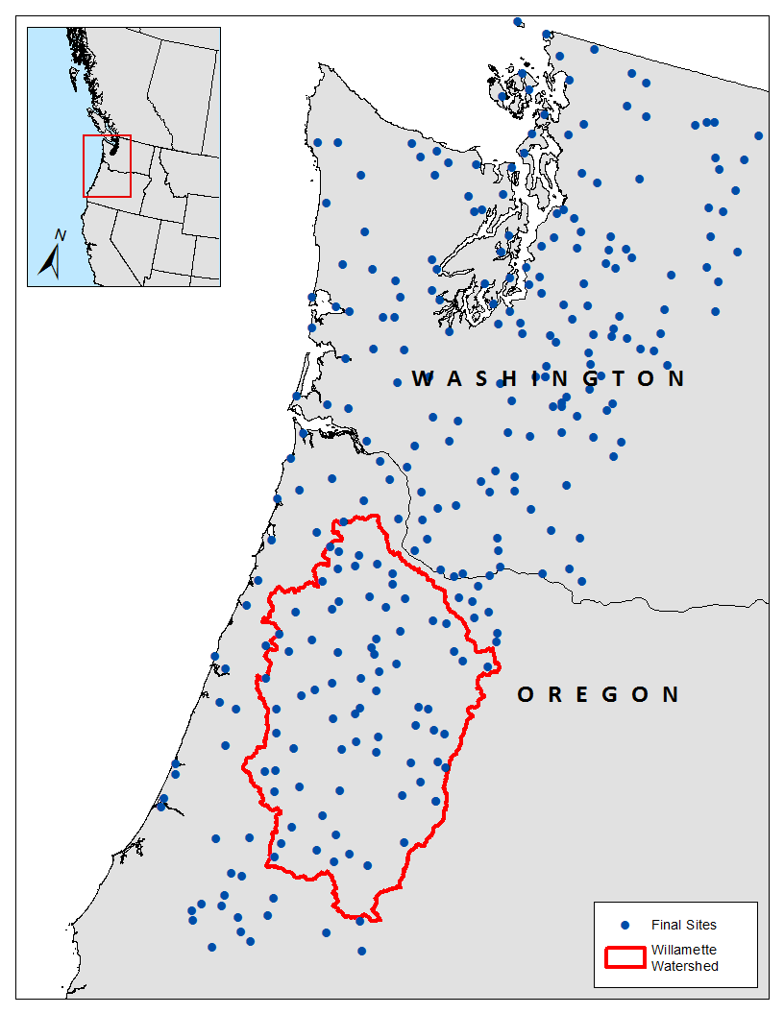
Space for Time Substitution
Gather up weather stations with similar climatology to the area of interest
295 final sites for
the Willamette Basin
Notes:
The included stations in general are dominated by the same meteorology. Here, for the WRB we were concerned with wintertime 72-hour storms which roughly corresponds to atmospheric river (synoptic scale) events. This isolated us to the west face of the Cascade mountains in Oregon and Washington (characteristics changed too much as you go south, and definitely too much after you went to the dry side/east face of the mountains).

Slide 37
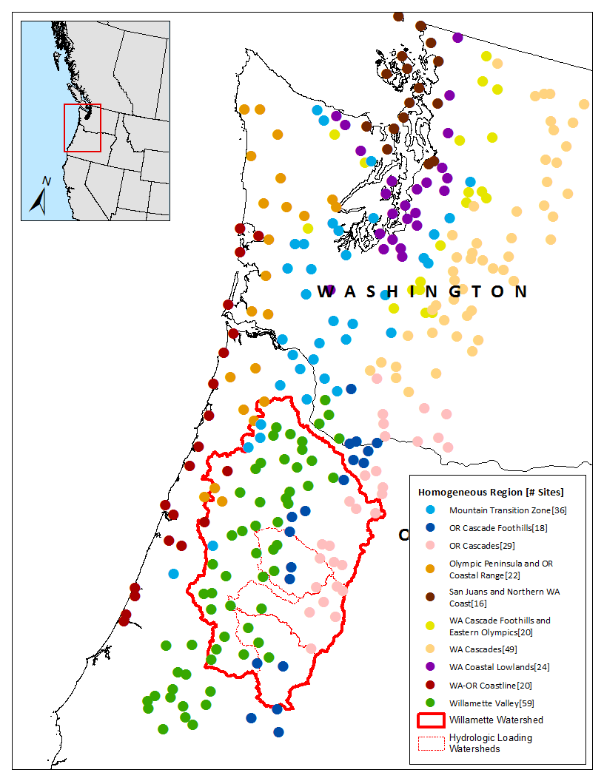
Space for Time Substitution
Partition stations into meteorologically homogeneous regions
10 final regions for
the Willamette Basin
Notes:
Break that climatologically-homogeneous area into smaller chunks that accounts for local variability. Here you can see valleys and mountains, coastal and continental mountains, etc. They all have the same large-scale meteorology but respond slightly differently to those events. This partitioning aims to account for that. These regions also form the basis for the spatial mapping of the statistics. Statistics of extreme rainfall for these regions are relatively stable, so using the physical characteristics of the regions to explain variability in the rainfall statistics helps us make estimates for rainfall statistics where there are no stations.

Slide 38
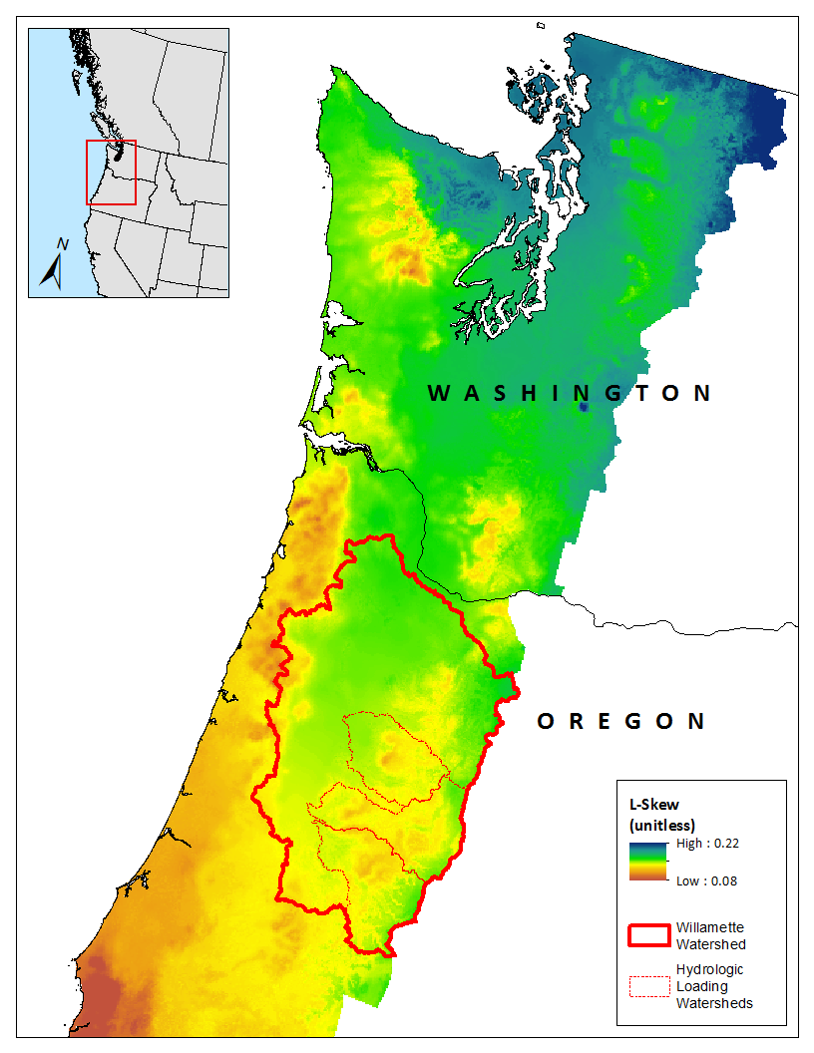
Space for Time Substitution
Analyze regional trends in rainfall statistics
Predict rainfall statistics using physical characteristics
Notes:
The variability in the rainfall statistics across the regions can be explained by variations in physical properties. We can extend that relationship to locations that don’t have a weather station, but has measures of the physical properties we used to create the relationship.

Slide 39
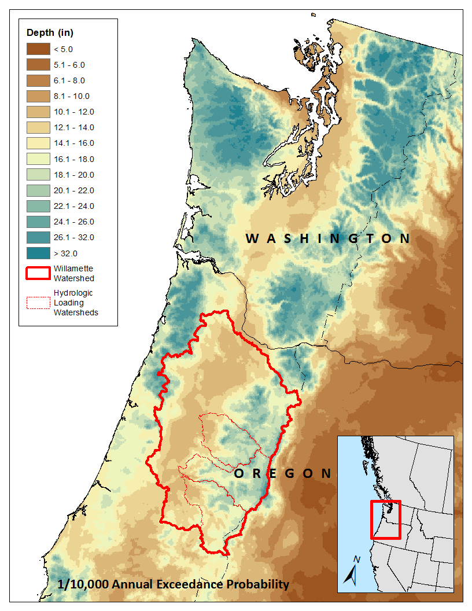
Space for Time Substitution
Fit a probability distribution using the mapped statistics
Notes:
Once we have the spatial distribution of those rainfall statistics, we can use a probability distribution with those statistics to estimate the point precipitation frequency, for example here the 1/10,000 AEP 72-hour wintertime rainfall.

Slide 40
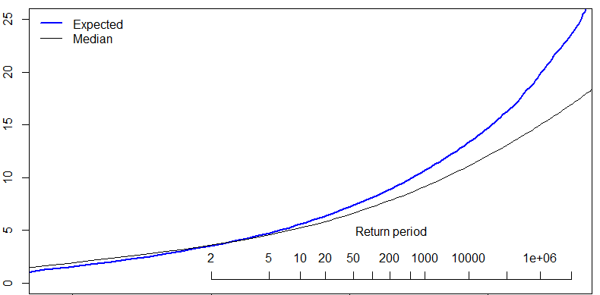
Spatial Average + Point-to-Area Reduction
Choose Frequency
Compute Everywhere
Take Basin Average
Apply ARF
Basin-Average Precipitation (in)
Notes:
One way to get to a watershed-averaged precipitation is to average the point values and apply an areal reduction factor.

Slide 41
Q
p
Precip Frequency
Spatial Pattern
Temporal Pattern
Pattern
Depth
Scaling
Scaled Spatial Pattern
Scaled Temporal Pattern

Slide 42
Scaled Spatial Pattern
Hydrologic Model
Flood Hydrograph
Scaled Temporal Pattern

Slide 43
Reservoir Peak Stage
Starting Stage
Operations
Peak Stage
Flood Hydrograph

Slide 44
Why Bother?
Larger sample sizes
  Regionalization
Homogeneous samples
  Storm typing
Complex hydrology
  Continuous meteorology
  Multiple events per year
  Multiple reservoirs
Notes:
What I just illustrated was for single events in a year. In some situations you care about a multiple-month window, or perhaps the entire year. In that case, you will need to sample multiple heavy precipitation events, and also explain the rainfall that occurs during the year but is not caused by extreme rainfall events.

Slide 45
Level of Effort – Precipitation-Based
IES/DSMS
  Develop regional precipitation-frequency
  Calibrate hydrologic model(s)
  Generate plausible hydrometeorology
  Simulate synthetic events and route to reservoirs
Significantly more work than streamflow-based.

Slide 46
Level of Effort Recap
Screening/limited studies:
  Streamflow
Hydrologic failures not driving:
  Streamflow
Single dam/simple ops/simple hydrology, IES/DSMS:
  Event precipitation, maybe streamflow
Multiple dams/complex ops/complex hydrology:
  Continuous precipitation

Slide 47
HEC-SSP
Statistical analysis software
Flow frequency analysis with EMA
  Bulletin 17 Analysis
Duration analyses
  E.g. reservoir stage, flow
Seasonality analysis
  Within Distribution Fitting Analysis

Slide 48
HEC-HMS
Hydrologic modeling software
Capable of simulating parameter uncertainty
Optimization tools for calibration
Very simple reservoir operations
Needed for precipitation-based methods
  Hypothetical storm modeling tools
Notes:
Rule-based reservoir operations are currently under development.

Slide 49
HEC-RAS
1D/2D hydraulic modeling software
May be necessary for routing floods through very tricky areas
Not a usual part of the sequence

Slide 50
HEC-ResSim
Reservoir operations simulation software
Model operations from very simple to extremely complex
Model one or more reservoirs
Random samples of states
  Starting elevation/storage, etc.

Slide 51
HEC-WAT
Ties together HEC models
  “Every model is a plug-in”
Manages simulations
  Plug-in sequencing
  Data hand-offs
  Distributed computing
Handles plug-in output

Slide 52
Hydrologic Sampler
Plug-in for HEC-WAT
Produces random samples of hydrologic variables
  Streamflow
  Precipitation
Performs scaling procedures
Multiple variables
Parameter uncertainty
Notes:
This is probably the thing most people who have heard of WAT imagine when they think of WAT.

Slide 53
Stochastic Weather Generator
Combine together continuous and intermittent weather
Incorporate precipitation-frequency into longer periods
Multiple sites
Multiple variables
Parameter uncertainty
Stratified sampling
Notes:
Applied in some past high-level studies

Slide 54
Tools Recap
To estimate a hazard curve, you will need one or more of these HEC tools:
  HEC-SSP and/or R
  HEC-ResSim
  HEC-HMS
  HEC-RAS
  HEC-WAT
    Hydrologic Sampler
    Weather Generator

Slide 55
HEC-WAT
Hydrologic Sampler
HEC-SSP
HEC-ResSim
Streamflow-Based Methods

Slide 56
[R]
HEC-WAT
Hydrologic Sampler
HEC-RAS
HEC-HMS
HEC-ResSim
Event Precipitation-Based Methods

Slide 57
[R]
HEC-WAT
HEC-RAS
Weather Generator
HEC-HMS
HEC-ResSim
Continuous Precipitation-Based Methods

Slide 58
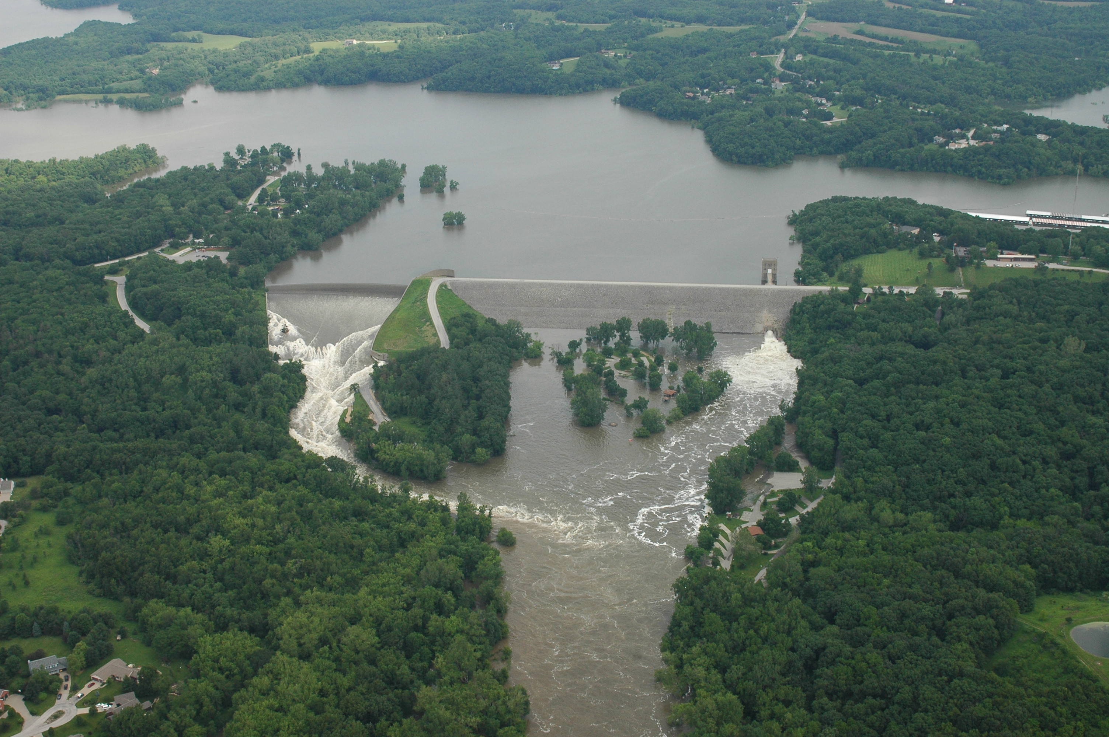
Questions?

