Slide 1
Development of Flow- and Volume-Frequency for Use in Dam Safety Studies
Mike Bartles, P.E.
Hydraulic Engineer
Hydrologic Engineering Center
Some slides adapted from Beth Faber
September 2022

Slide 2
Overview
Why is this important?
USACE guidance
Bulletin 17C Methodology
Types and sources of data
Data Transformation
Expected Probability Adjustment
Workshop
Notes:
Types and sources of data will discuss:
Annual maximum vs partial duration series
Calendar Year vs Water Year
DSS data types
Data Transformation will discuss:
Regulated / Unregulated data sets
How to fill in missing periods

Slide 3
Why are flow- and volume-frequency analyses important?
$$Risk =P\left(Hazard\right)×P\left(Failure | Hazard\right)×Consequences|Failure$$
Flow- and volume-frequency analyses are used multiple times throughout the development of hydrologic hazard curves
  Creation of hypothetical events
  Estimating probability of hypothetical events (i.e. PMF)
  Bulletin 17C procedures can be used to estimate flow- and volume-frequency
  A family of flow- and volume-frequency curves should be developed
  An expected probability adjustment must be made for all durations
A rough estimate of time that should be dedicated to the flow- and volume-frequency analyses is ~15% of total effort

Slide 4
Purpose
Extrapolation of Stage-Frequency
???
Obs. Events
Notes:
Due to the age of most USACE projects, there is usually not enough observed data to directly estimate a stage-frequency relationship for relatively remote ACE (i.e. < 1/100). In order to provide adequate information for use in risk analyses, extrapolation of stage-frequency curves to remote ACE is often needed.
So, how do we extrapolate this much-needed stage-frequency estimate?
Also, how do we estimate the probability of hypothetical events like the SDF or PMF?

Slide 5
Purpose
Extrapolation of Stage-Frequency
Sample Flow- and/or Volume-Frequency
Build Balanced Hydrograph
Route through the Reservoir
Store Results
Repeat Thousands of Time

Slide 6
Purpose
Extrapolation of Stage-Frequency
Stochastic Sim. – Best Estimate
Stochastic Sim. – 90% CL
Observed Events
June 1972 – Bal. Hydrographs
Sep 2004 – Bal. Hydrographs
Dec 2010 – Bal. Hydrographs
Mar 1936 – Bal. Hydrographs
June 1972 – Multi Bal. Hydro.
Notes:
Due to the age of most USACE projects, there is usually not enough observed data to directly estimate a stage-frequency relationship for relatively remote ACE (i.e. < 1/100). In order to provide adequate information for use in risk analyses, extrapolation of stage-frequency curves to remote ACE is often needed.
So, how do we extrapolate this much-needed stage-frequency estimate?
Also, how do we estimate the probability of hypothetical events like the SDF or PMF?

Slide 7
Terminology
Annual Chance Exceedance (ACE)
Annual Exceedance Probability (AEP)
Flow-Frequency
Volume-Frequency
Analytical Distribution
Empirical Distribution
Water Year
Calendar Year
Perception Threshold
Flow Range
Low Outlier / Potentially Influential Low Flood
Notes:
Annual Chance Exceedance refers to the probability of a flow/stage/precip depth/etc being equaled or exceeded in a given year
Flow-Frequency: the frequency with which an instantaneous maximum flow rate is expected to be equaled or exceeded
Volume-Frequency: the frequency with which a flow over a given duration is expected to be equaled or exceeded. Volume must always be specified with a duration. Typically, volume-frequency is presented using units of flow (i.e. cfs) so that the different durations can be plotted together.
Analytical Distribution:
Empirical Distribution:
Water Year: the 12-month period from October 1 to September 30. The water year is designated by the calendar year in which it ends and which includes 9 of the 12 months.
Calendar Year: the 12-month period from January 1 to December 31.

Slide 8
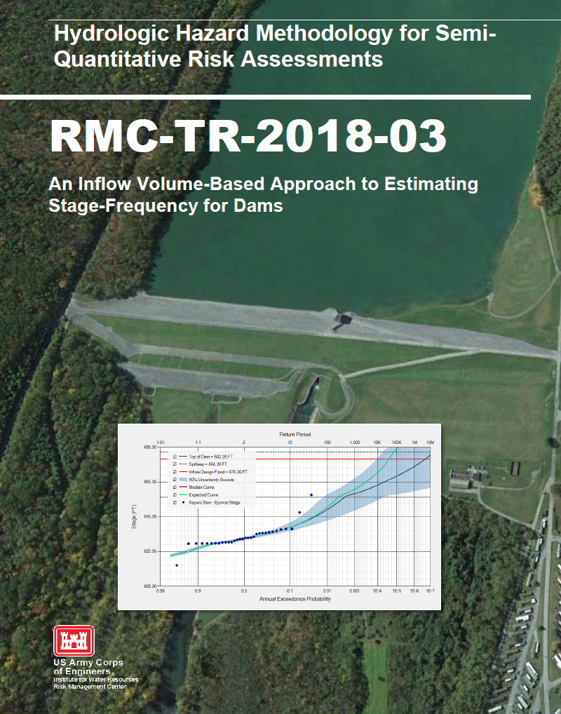
SQRA Guidance
Inflow volume-based approach
Extrapolate pool stage-frequency using multiple methods:
  Stochastic Modeling
  Balanced Hydrographs
Notes:
The Risk Management Center has developed draft guidance using an inflow volume-based approach to determine pool stage-frequency curves at very rare exceedance probabilities. Two methods are used to define these curves:
Balanced hydrographs and
Simplified Stochastic Modeling

Slide 9
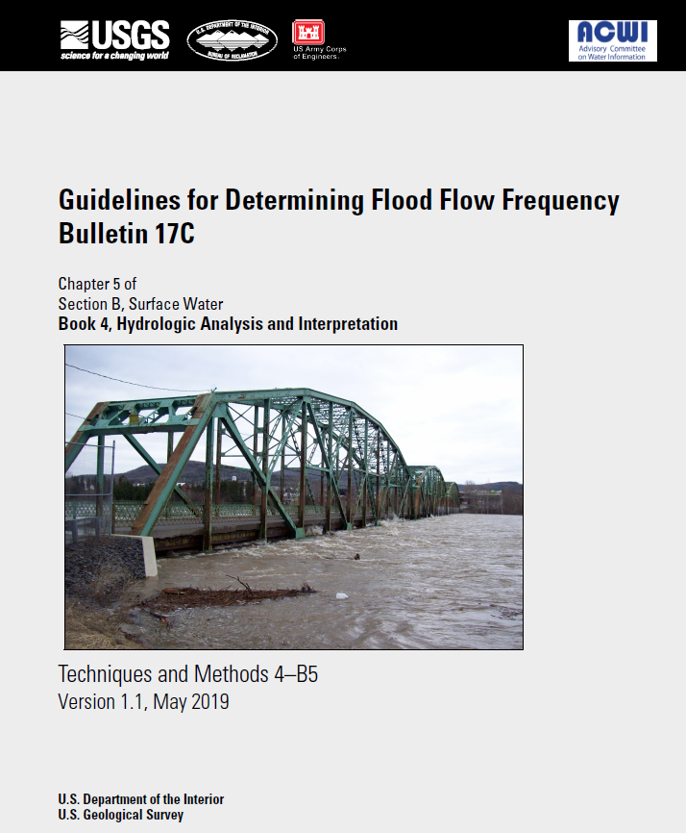
Bulletin 17C
Both methods of extrapolation require flow- and volume-frequency estimates
Utilize Bulletin 17C procedures
  Expected Moments Algorithm
  Multiple Grubbs-Beck Test
  Confidence Limits
  Equivalent Record Length
Notes:
Both methods require the estimation of flow- and volume-frequency curves. To do this, we are utilizing the much anticipated Bulletin 17C procedures. These procedures fit the Log Pearson Type III distribution to an annual maximum series of unregulated peak flows using:
Expected Moments Algorithm
Multiple Grubbs-Beck Test
They also aid in the development of improved confidence limits and an estimation of an appropriate equivalent record length given various forms of information.

Slide 10
Bulletin 17C
Generalized description of at-site flow data
  “Interval” vs.“Point”, Perception Thresholds
Expected Moments Algorithm (EMA) for fitting the LP3 distribution
  Improvements for historical info and low outliers
New procedure for detecting “low outliers”
  potentially influential low floods, PILFs
Improved regional skew estimation
  Bayesian GLS linear regression
Uncertainty
  More accurate confidence intervals

Slide 11
B17C Data Representation
Q_{Y}
Conventional (“Point”):
Represent each observation, Q_{Y}, by a single value, Q_{Y}
Generalized (“Interval”):
Represent each “observation,” Q_{Y}, by an interval, (Q_{Y,lower}, Q_{Y,upper})
Peak flow (cfs)
1961 1962 1963
Q_{Y, upper}
Q_{Y, lower}
Peak flow (cfs)
1961 1962 1963

Slide 12
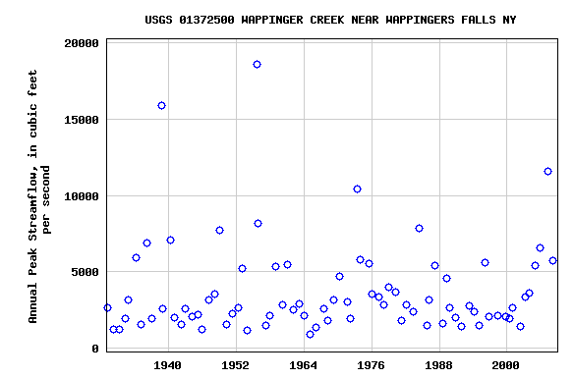
B17C Data Representation
“Classical”
gaged flow measurements are POINT values
“EMA”
an uncertain estimate can be represented as an interval

Slide 13
B17C Data Representation
Interval Data Can Represent…
Uncertain flow estimates
  Limited range of measurable flow
  crest stage gages
Low outliers, or PILFs
    censored, and redefined as interval below
Historical and paleo flood information
Unobserved years with information about threshold exceedance or non-exceedance
  Tree or slack water deposit provides minimum
  Landmark never flooded provides maximum

Slide 14
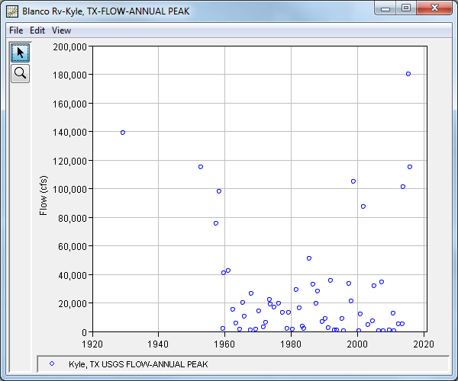
Perception Thresholds
Missing Periods
Notes:
How do you fill in missing data?
B17B, without any adjustments for historical events, would simply disregard these periods. To adjust, you can give systematic years weights that are greater than 1 to represent unobserved years when computing sample statistics. Confusing!
B17C requires the user to enter non [zero – inf] perception thresholds for these periods.

Slide 15
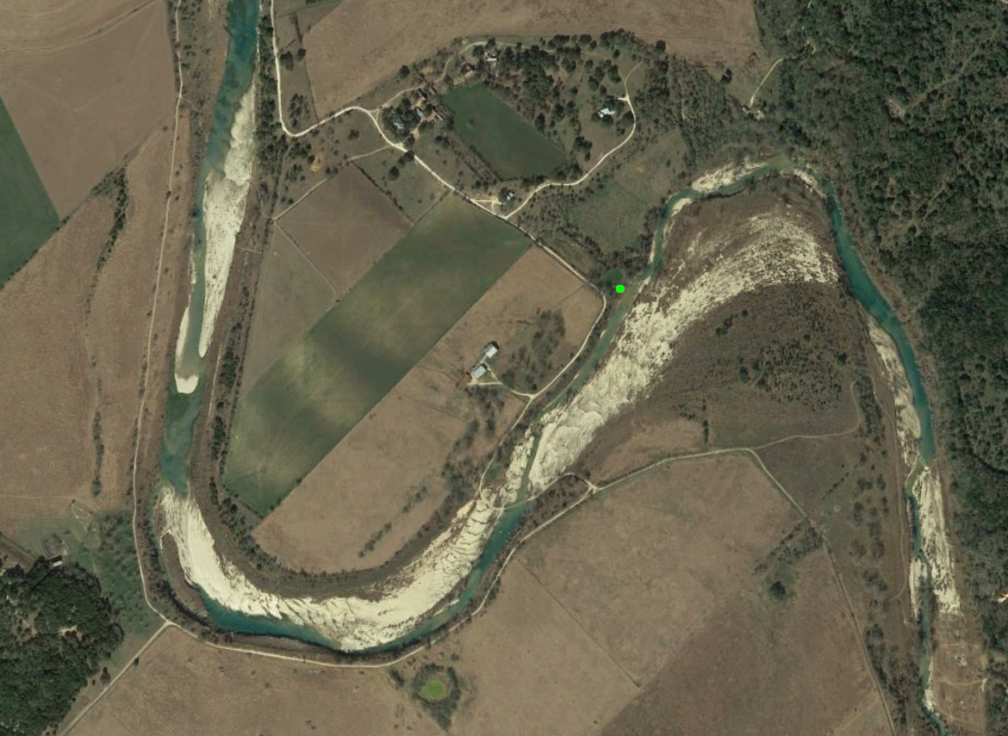
Perception Thresholds
The owners of the farm were interviewed and said that, other than the 1929 and 1952 events, they didn’t have water reach their first floor elevation since they/their family has lived there. The farm has been occupied since 1929. HEC-RAS model from CWMS Implementation implies that a peak flow rate of 100,000 cfs is needed to reach the first floor elevation at this location.

Slide 16
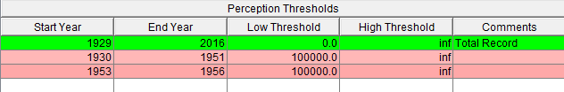
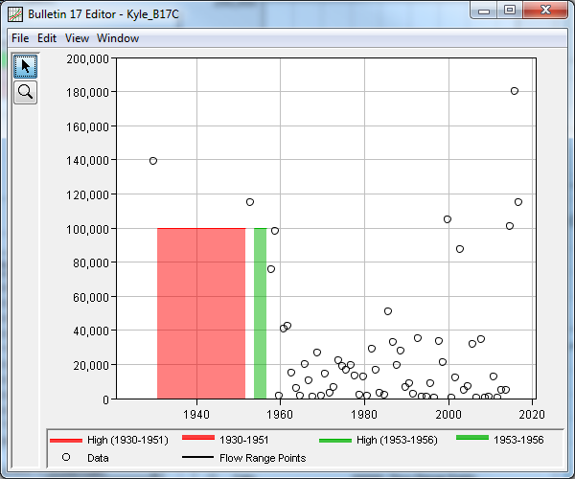
Perception Thresholds and Flow Ranges
Since the first floor hasn’t been flooded (other than 1929 and 1952 events) and the stream still existed, we can assume that all events during the missing periods MUST HAVE BEEN LESS THAN 100,000 cfs.

Slide 17
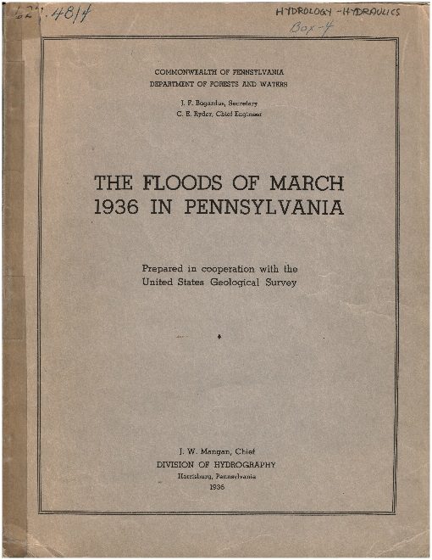
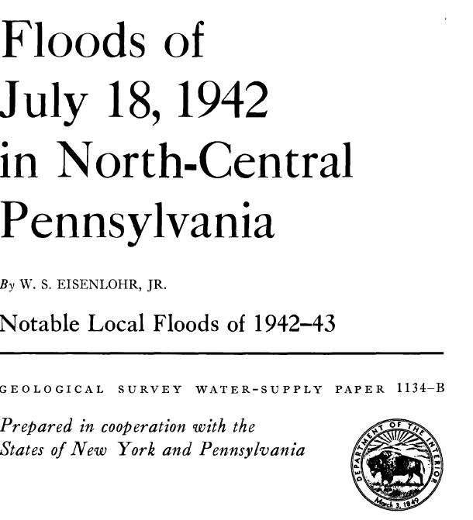
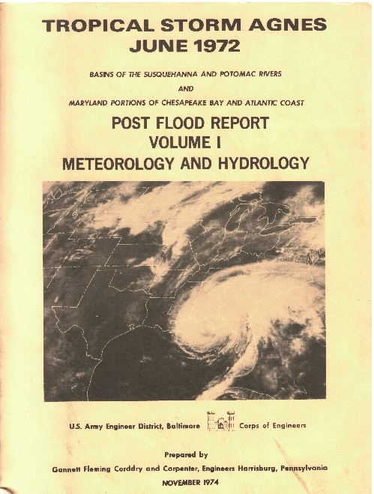
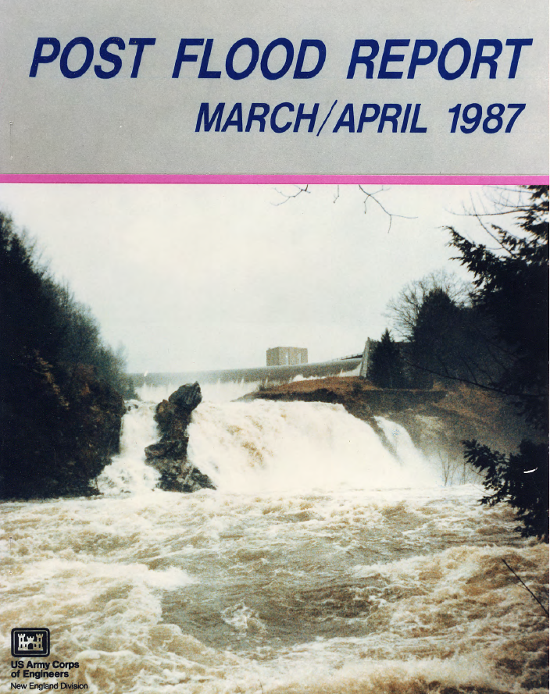
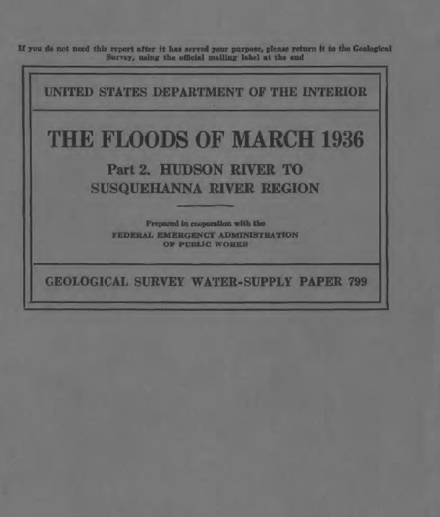
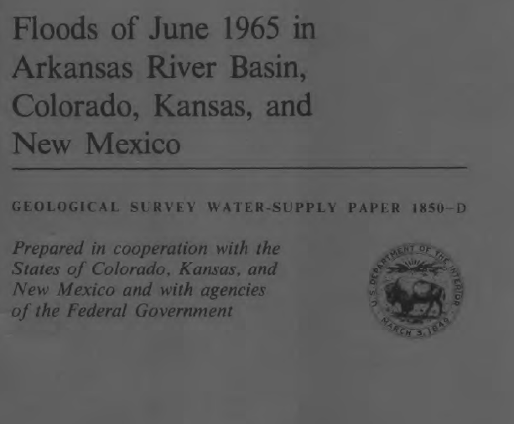

Post Flood Reports
$$https://pubs.er.usgs.gov/$$
Notes:
Post Flood Reports are oftentimes prepared following major flood events. Information within these reports can be used for a multitude of purposes.
These reports are available through a multitude of sources ranging from the U.S. Geological Survey, USACE districts, Bureau of Reclamation, state agencies, etc.
Google is your friend when searching for these types of documents.
The following slides present just a small sample of the information that is usually contained within these publications. Getting copies of them and doing research is a MUST!

Slide 18
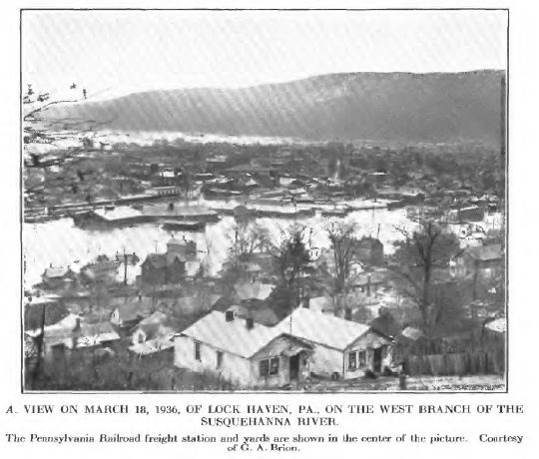
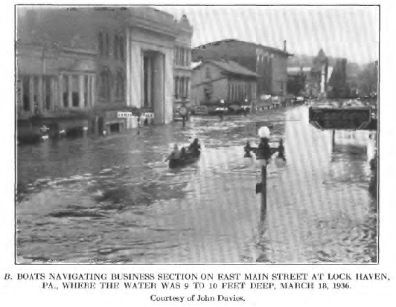
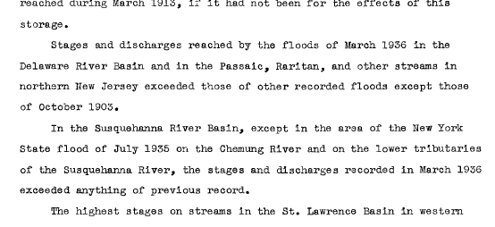
Post Flood Reports
Pictures and Text Descriptions of Flooding
Notes:
Post Flood Reports will usually contain pictures and textural depictions of flooding conditions, antecedent conditions, operations at reservoirs, timelines of events, etc.
This information can be used to inform flow- and volume-frequency analyses, recreate conditions w/in a hydrologic model, etc.
For instance, the highlighted sections can be used to inform the selection of perception thresholds to extend and/or fill in missing information for flow- and volume-frequency analyses.

Slide 19
Low Outliers
EMA is sensitive to low values
B17C uses the Multiple Grubbs-Beck test
“For it is by no means hydrologically obvious why the regime of the highest floods should be affected by the regime of flows in years when no floods occur, why the probability of a severe storm hitting this basin should depend on the accumulation of snow in the few driest winters, why the return period of a given heavy rain should be by an order of magnitude different depending, say, on slight temperature fluctuations during the melting seasons of a couple of years.” (Klemes, 1986)
Hydrologic judgment is still necessary when dealing with low outliers

Slide 20
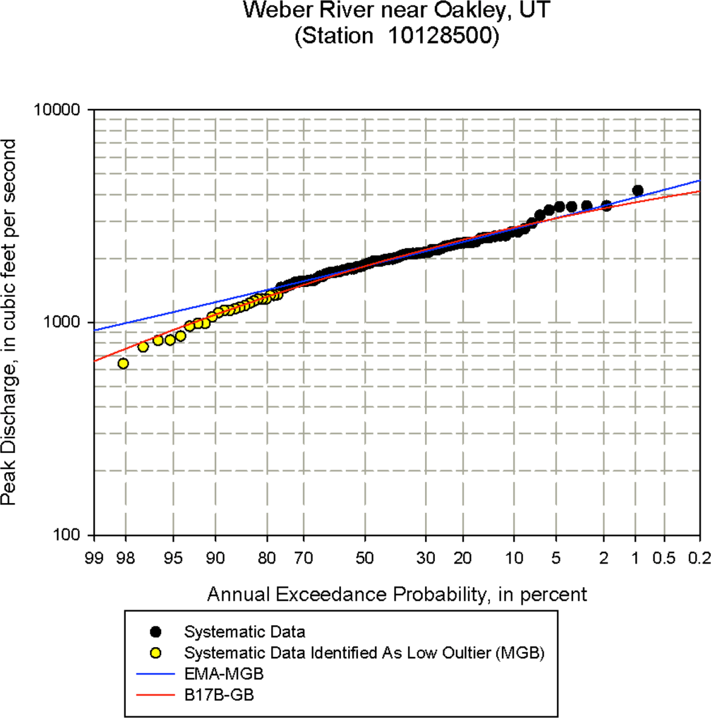
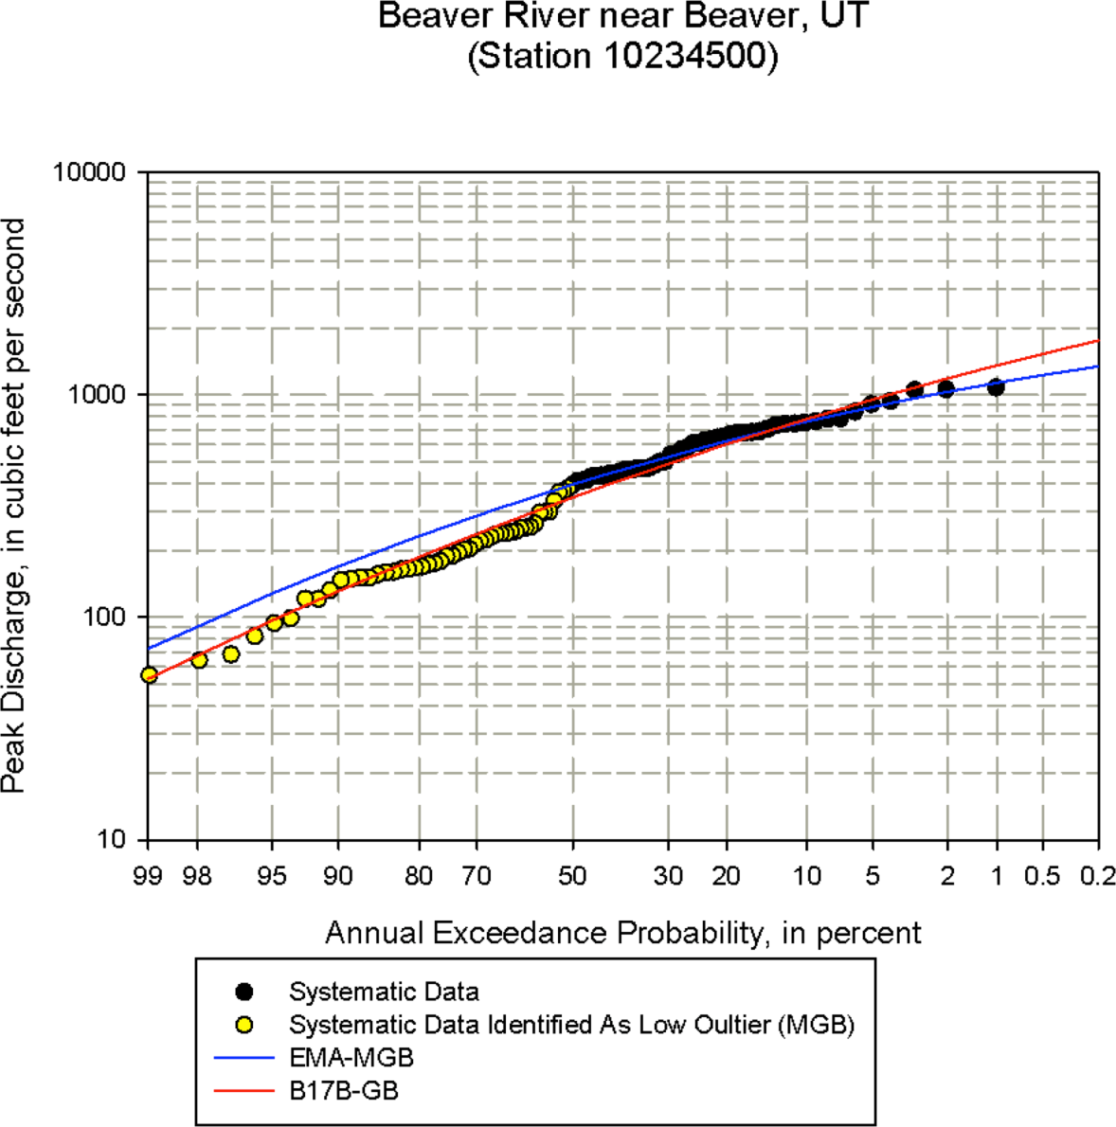
Low Outliers
Notes:
In the plot on the left, B17B/GB found 0 low outliers while B17C/MGB found 24.
The largest event would be +/- 1/1000 ACE for B17B while B17C puts it closer to 1/200 ACE
In the plot on the right, B17B/GB found 0 low outliers while B17C/MGB found 48.
B17B implies that the relative probability of the three largest events (out of ~100) is +/- 1/25 ACE. Does that make sense?

Slide 21
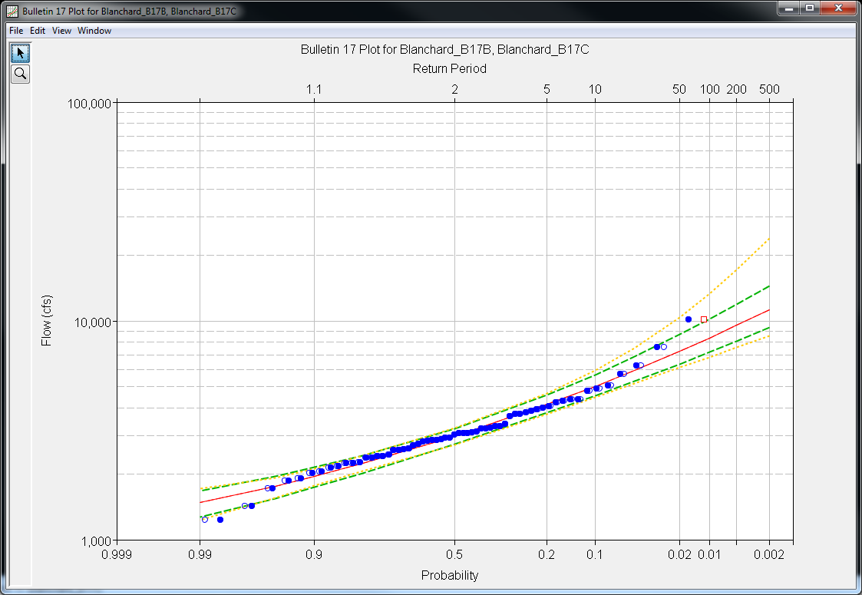
B17C Results
When there are no historical events/periods and no low outliers, B17B and B17C procedures will produce the same LPIII distribution. However, the confidence limits will be different; B17C considers uncertainty in skew and will always be wider.
B17C Conf. Limits
B17B and B17C Estimate
B17B Conf. Limits

Slide 22
Calendar Year vs. Water Year
Within SSP, Bulletin 17 analyses using EMA/B17C require that only one peak be present in any given water year
  i.e. If the linked DSS data set contains two values in water year 1969 (01Oct1968 – 30Sep1969), your analysis will fail
  Exception catching will prevent users from computing using these data sets w/in B17 analyses in the future
If your watershed has more than one peak in a water year that must be included (i.e. partial duration) or calendar year is more appropriate to use, contact HEC or RMC
Notes:
Water Year: the 12-month period from October 1 to September 30. The water year is designated by the calendar year in which it ends and which includes 9 of the 12 months.
Calendar Year: the 12-month period from January 1 to December 31.

Slide 23
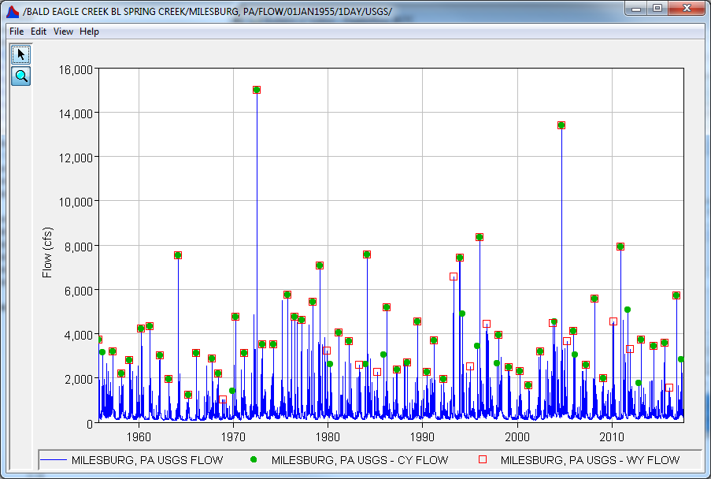
Calendar Year vs. Water Year
Water Year
Calendar Year

Slide 24
Partial Duration vs Annual Maximum
Typically, analytical distributions should not be fit to Partial Duration Series
  Inclusion of frequently occurring points causes analytical moments/parameters to be very wrong for infrequent events
  Use a graphical / empirical fit
  Exception to this rule being the use of two models
    e.g. Poisson for occurrence(s) and Generalized Pareto for magnitude(s)
If you encounter the need to analyze multiple flood events in a single year, contact HEC for help
Notes:
Notice that the AMS tends to underpredict the magnitude of floods for ACE greater than 1/10 which can result in underestimation of the risk for PFMs that might be initiated by annual loading events (i.e. internal erosion). This occurs because the probability of two or more events occurring in the same year decreases as ACE decreases. This probability becomes negligible between the 1/10 and 1/100 ACE.
Another way to look at this is: multiple flood events do not commonly occur within the same year. If they do, you’re studying a wonky watershed and may need to investigate the use of a partial duration series.

Slide 25
Partial Duration vs Annual Maximum
Notes:
Notice that the AMS tends to underpredict the magnitude of floods for ACE greater than 1/10 which can result in underestimation of the risk for PFMs that might be initiated by annual loading events (i.e. internal erosion). This occurs because the probability of two or more events occurring in the same year decreases as ACE decreases. This probability becomes negligible between the 1/10 and 1/100 ACE.
Another way to look at this is: multiple flood events do not commonly occur within the same year. If they do, you’re studying a wonky watershed and may need to investigate the use of a partial duration series.

Slide 26
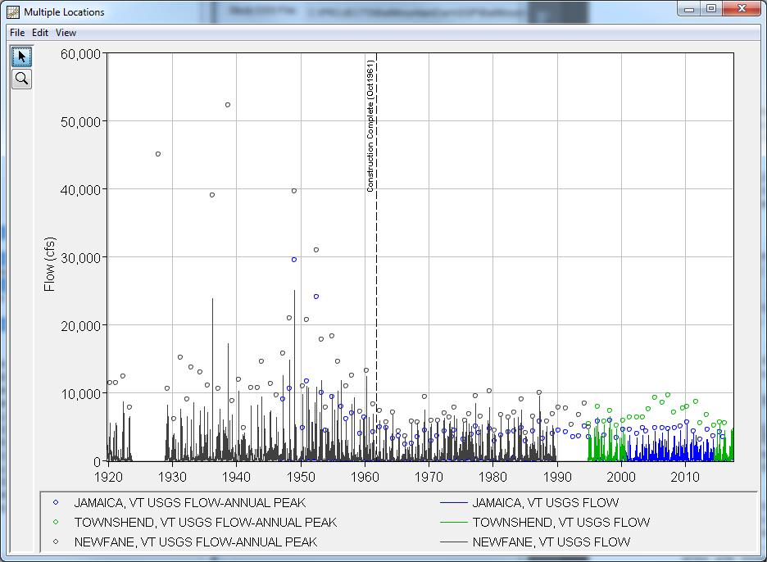
Regulation
No U/S Regulation
Not Identically Distributed or Homogeneous
Major Regulation U/S
Notes:
Regulation effects need to be removed prior to fitting an analytical distribution. This can be achieved through the use of indirect computations (i.e. instead of using the D/S gage record, which is regulated, compute inflow to the project using the change in pool stage and outflow records), modeling (i.e. Period of Record simulation w/in HMS or ResSim), or transference of data from another, similar location. This is discussed on the next page.

Slide 27
Regulation
Notes:
Regulation effects need to be removed prior to fitting an analytical distribution. This can be achieved through the use of indirect computations (i.e. instead of using the D/S gage record, which is regulated, compute inflow to the project using the change in pool stage and outflow records), modeling (i.e. Period of Record simulation w/in HMS or ResSim), or transference of data from another, similar location. This is discussed on the next page.

Slide 28
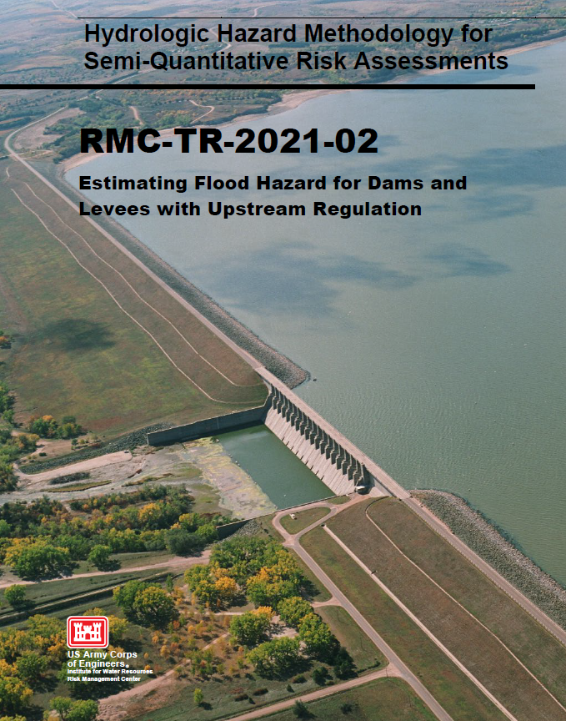
Regulation
Examine data
Evaluate effects of upstream regulation
Develop unregulated data set
Fit a probability distribution to unregulated data

Slide 29
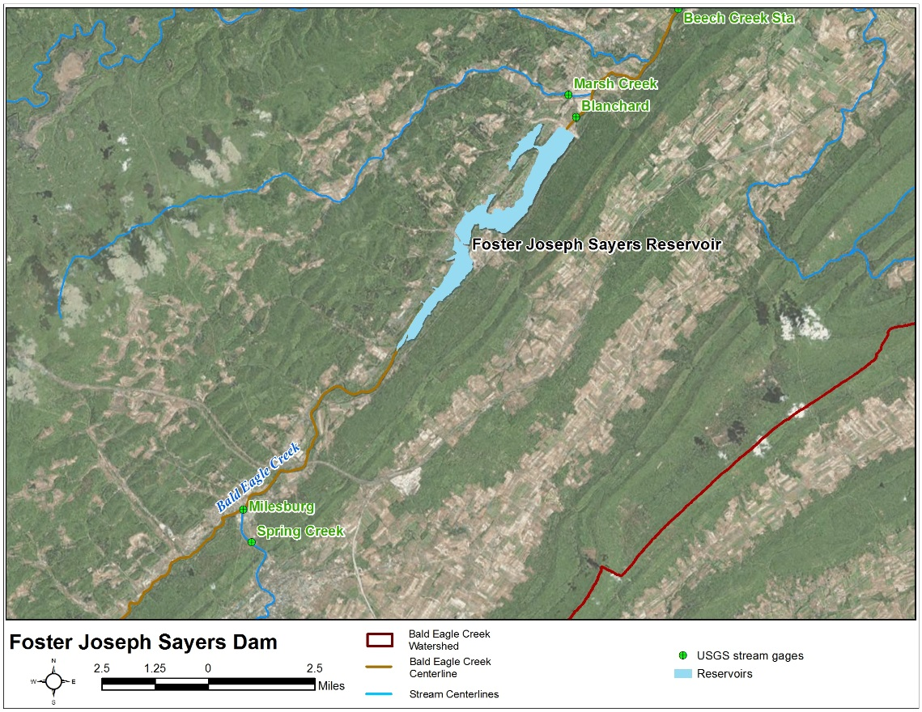
Record Extension
Dam Inflow w/
Short Period of Record
Drainage Area = 339 sq mi
Transformation
Upstream Gage w/
Longer Period of Record
Drainage Area = 265 sq mi

Slide 30
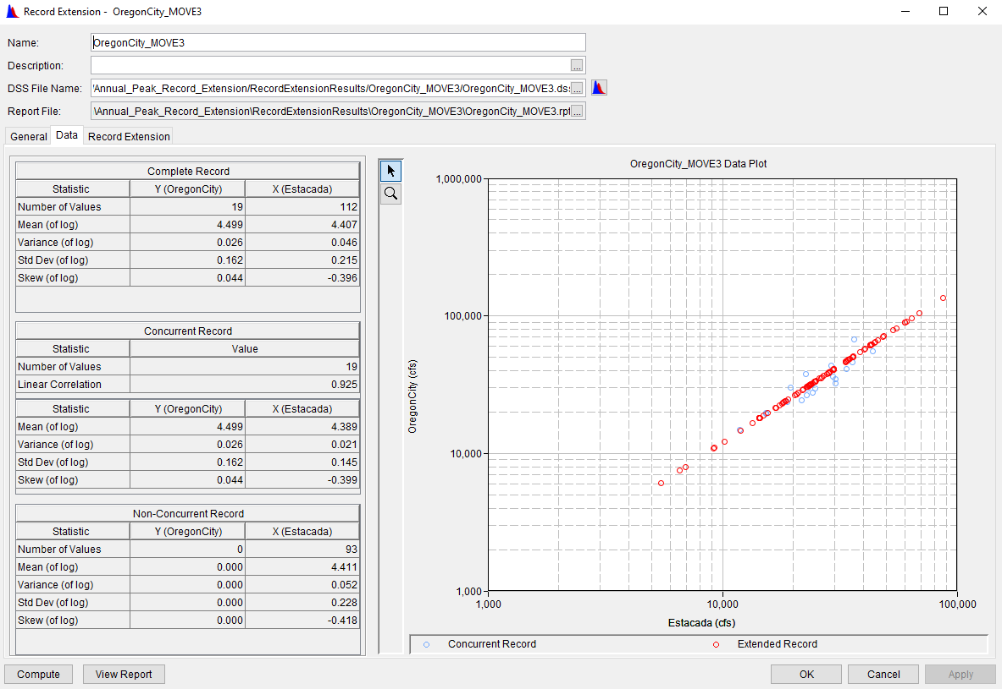
Record Extension

Slide 31
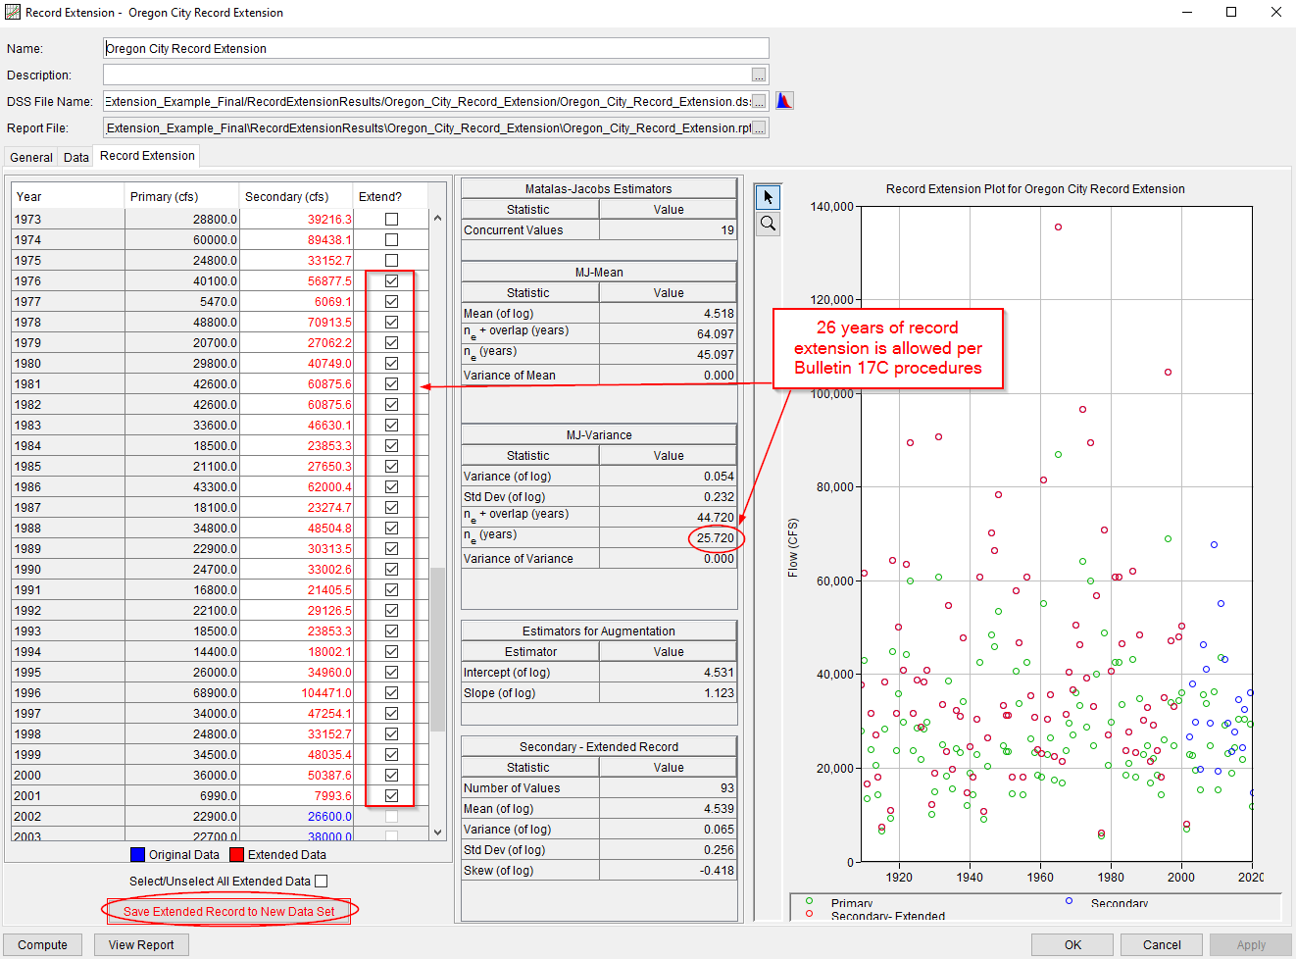
Record Extension

Slide 32
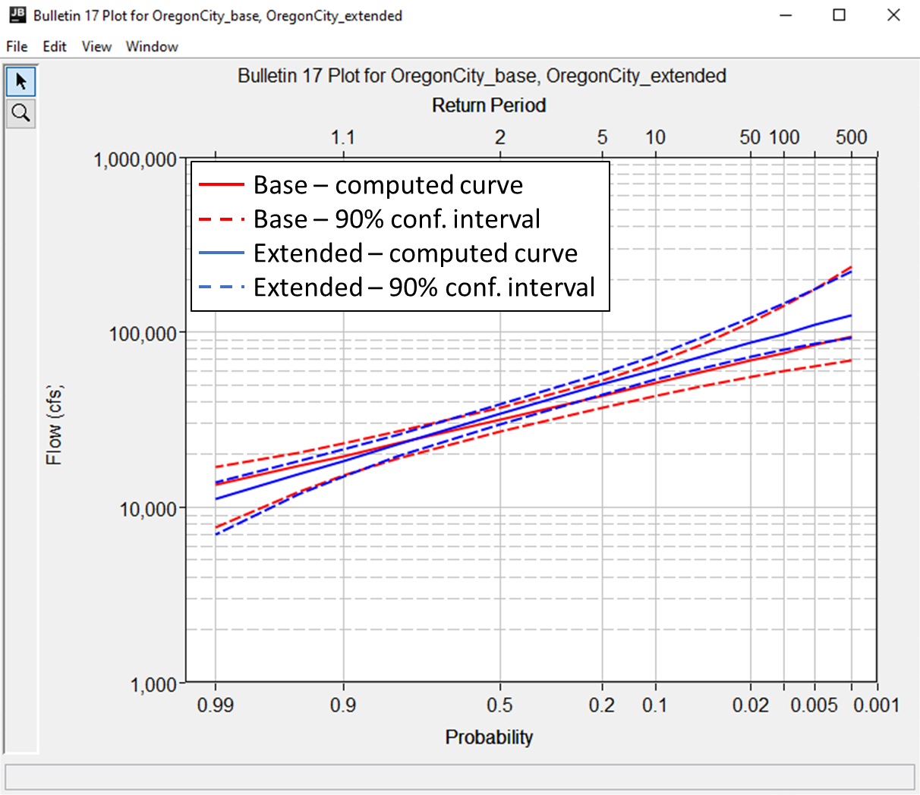
Record Extension

Slide 33
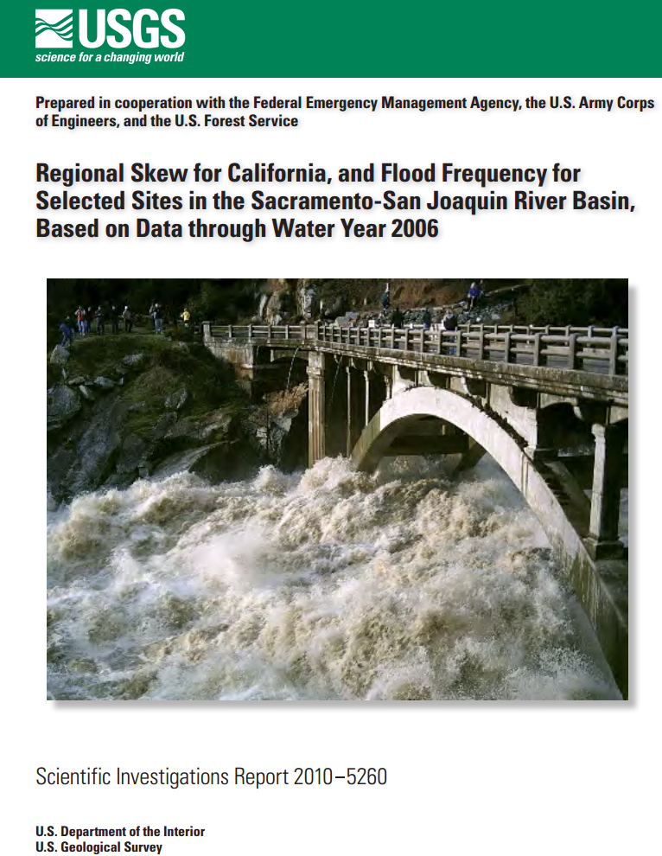
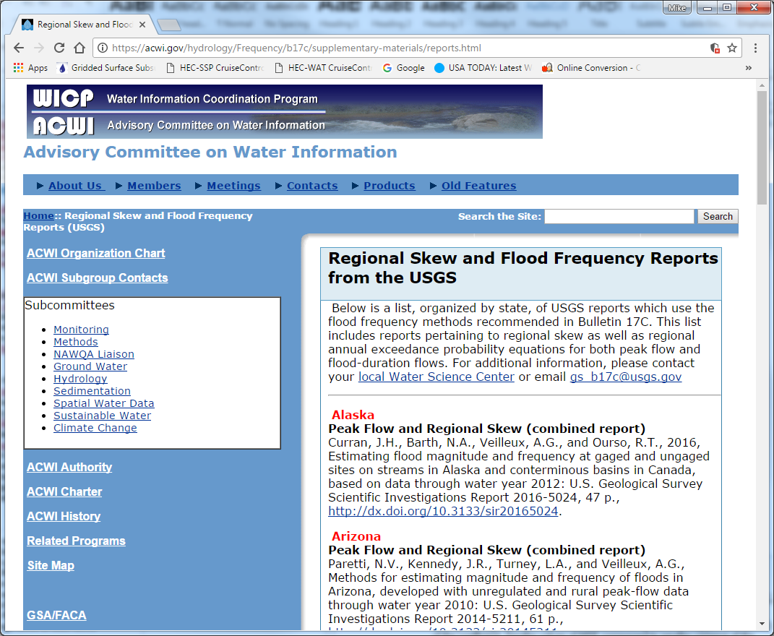
Regional Skew
https://acwi.gov/hydrology/Frequency/b17c/supplementary-materials/reports.html
Notes:
The Hydrologic Frequency Analysis Workgroup \ Advisory Committee on Water Information’s website for Bulletin 17C contains regional skew studies that have been recently published by the USGS. Check this site to see if there is regional skew information for the study location.

Slide 34
Regional Skew
There are 2 main reasons for using regionalization in probability estimation:
  We can generate probability estimates for ungaged areas that have no data for frequency analysis
  We can improve our probability estimates by “pooling” data from many gages to gain the effect of a larger sample size

Slide 35
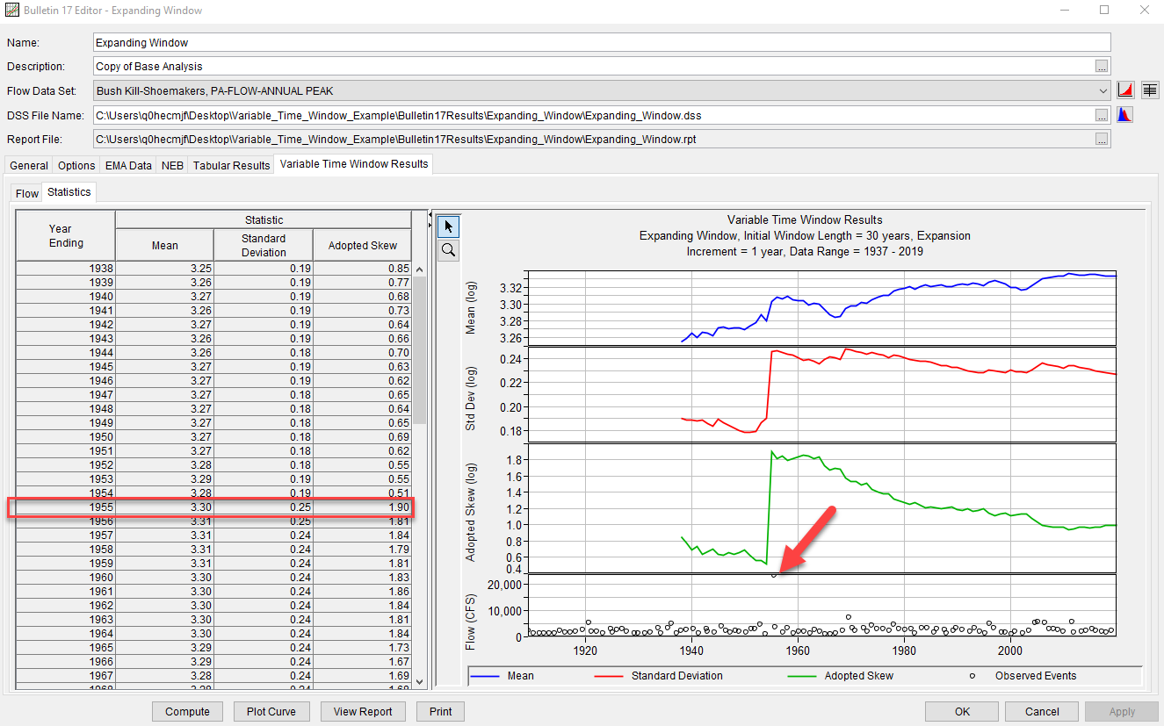
Regional Skew

Slide 36
Combining Multiple Sources
Notes:
Black circles = CWMS database (extracted annual max from 15-min data)
Blue squares = AMS prior to dam construction; can come from gages prior to regulation and/or record extension
Orange triangles = AMS post construction; can come from CWMS database and/or record extension
Green diamonds = historical events from Post Flood Reports

Slide 37
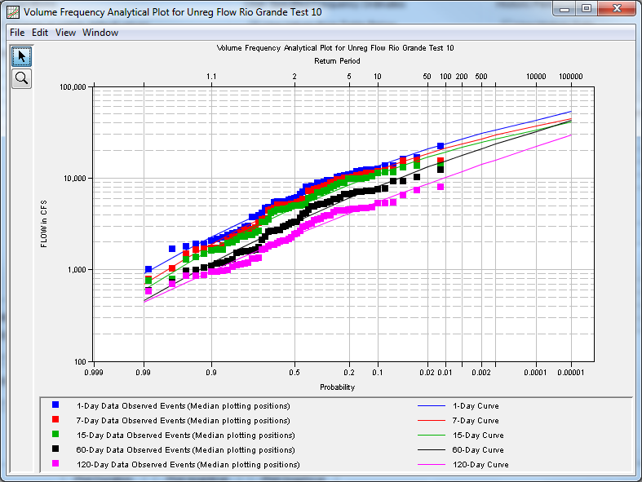
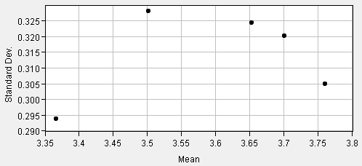
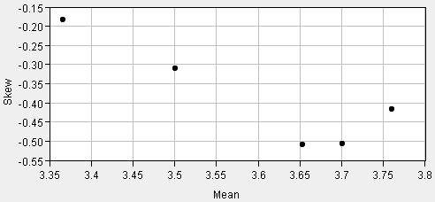
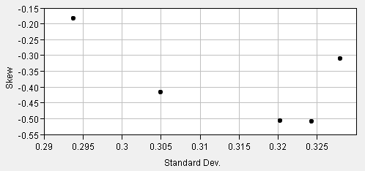
Statistical Smoothing
Notes:
EM 1110-2-1415:
“… it is desirable to coordinate the variation in standard deviation and skew with that of the mean. This can be done graphically…” “For a given skew coefficient, there is a maximum and minimum allowable slope for the standard deviation-versus-mean relation which prevents the curves from crossing within the established limits.”

Slide 38
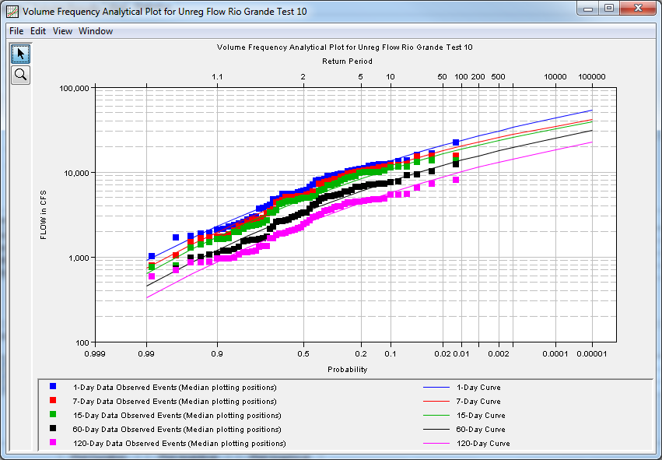
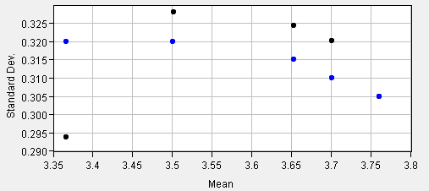
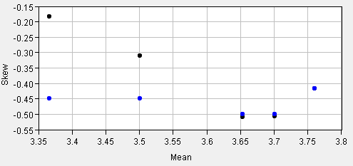
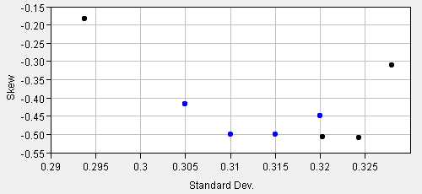
Statistical Smoothing
Notes:
EM 1110-2-1415:
“… it is desirable to coordinate the variation in standard deviation and skew with that of the mean. This can be done graphically…” “For a given skew coefficient, there is a maximum and minimum allowable slope for the standard deviation-versus-mean relation which prevents the curves from crossing within the established limits.”

Slide 39
Family of Flow- and Volume-Frequency Curves
Notes:
Through the combination of systematic, historical, and other types of data, the LPIII distribution was fit to annual maximum series for the inst. peak, 1-, 2-, 3-, and 4-day durations. Also, the expected probability of exceedance was computed using a naïve bootstrapping algorithm.
The use of an “expected probability of exceedance”, in lieu of the median estimate provided by the LPIII CDF, reflects the fact that the probability of exceeding a flow is itself a random variable due to sample error, which causes parameter uncertainty. The expected probability curve reflects the expected long-run proportion of exceedances of a threshold flow when accounting for both natural variability and sample error caused by short record length or small sample size.

Slide 40
Conclusion
Bulletin 17C procedures can be used to estimate flow- and volume-frequency
Software has been developed to aid the analysis
However, engineering judgement is still required
Expected probability adjustment becomes important as AEP decreases
Family of flow- and volume-frequency curves need to be provided
Flow- and volume-frequency estimates are used throughout the development of hydrologic hazard curve

Slide 41
Extra Slides

Slide 42
DSS Data within SSP
Bulletin 17 (and General Frequency) analyses require the use of irregular data sets
  Please use IR-CENTURY
Regular data sets will not be selectable
  If you don’t see the data set you just entered, it’s because it’s not irregular
Volume Frequency analyses require the use of regular data sets
  Use 1DAY
Irregular data sets will not be selectable

Slide 43
Data Storage System (DSS)
Data is stored within the file in “blocks”, for example:
  Time Series (hourly data stored in months)
  Paired Data (flow vs stage curve w/ single stage axis and multiple flow axes)
  Gridded (single radar scan)
Multiple blocks may make up a single “data set”, e.g., 50 years of hourly data is one data set
Each block is called a “record”
A HEC-DSS file can have many records
Name of a record is called a “pathname”
Each pathname within a file must be unique

Slide 44
DSS
Time Series Data | Pathnames
Pathname self-documents the data
Consists of 6 parts, separated by forward slashes “/”
Parts are labeled A – F: “/A/B/C/D/E/F/”
Each part can be 0 to 64 characters long
A single pathname can be up to 391 characters long
Example:
  /SACRAMENTO/RED BLUFF/FLOW/01MAR1972/1HOUR/OBS/

Slide 45
DSS
Time Series Data | Pathnames
/A/B/C/D/E/F/
Part Description
A Group, basin, river, region or study name
B Location or gage name
C Data parameter
D Starting date for block (not 1st data)
E Time interval (standard)
F Version or additional information
/SACRAMENTO/RED BLUFF/FLOW/01MAR1972/1HOUR/OBS/

Slide 46
DSS
Conventions
Use optional part names
Be descriptive, but not “overly” descriptive
Please do not do this:
“///FLOW/01JUN1972/1HOUR//” (i.e. no A-, B-, or F-parts)
Instead, do this:
“/BALD EAGLE CREEK/SAYERS/FLOW/01JUN1972/1HOUR/COMPUTED/”

Slide 47
DSS
Time Series Data | Interval
Each record contains a “header”
  Data Units (e.g., FEET, CFS)
  Data Type:
    PER-AVER Period Average (daily average flows)
    INST-VAL Instantaneous (15-min flows)
    PER-CUM Period Cumulative (daily precip accumulation)
    INST-CUM Instantaneous Cumulative (incremental precip)
  Time offset (e.g., daily data read at 8:00 am)
Missing data flags (-901.) are used as a place holder

Slide 48
DSS
Time Series Data | Regular
Blocks are “standard size” (there are always 365 or 366 values for one year of daily data)
Interval Block Length
1MIN, 2MIN, 3MIN, 4MIN, One day
5MIN, 6MIN, 10MIN, 12MIN
15MIN, 20MIN, 30MIN, 1HOUR, One month
2HOUR, 3HOUR, 4HOUR,
6HOUR, 8HOUR, 12HOUR
1DAY One year
1WEEK, TRI-MONTH, One decade
SEMI-MONTH, 1MON
1YEAR One century

Slide 49
DSS
Time Series Data | Irregular
Same as regular-interval, except:
Date and time store with each data value (which makes data sets much larger)
Blocks (E parts) are:
  IR-DAY
  IR-MONTH
  IR-YEAR
  IR-DECADE
  IR-CENTURY
Block sizes are (user) variable length. Try to limit sizes between 100 and 1000 values per block

Slide 50
Data Transformation
Regulation Effects
American River at Fair Oaks
Notes:
This is the daily flow record at the Fair Oaks gage on the American River that was obtained through a period of record analysis using ResSim.

Slide 51
Data Transformation
Regulation Effects
Notes:
The water control plan for Folsom has changed over time. We need to evaluate the most up-to-date regulation schedule, not varying regulation schedules that may be present in observed flows.
Light blue is modeled outflows using a period of record simulation using an homogenous operation schedule. A major goal is to keep regulated outflow below 115,000 cfs due to the levees along the American River but also increase summer low flows (periodically, the American River would be dry if it weren’t for upstream storage reservoirs).

Slide 52
Data Transformation
Regulation Effects
Notes:
Open circles represent annual maximum series from regulated output.

Slide 53
Data Transformation
Regulation Effects
Notes:
Red open circles represent unregulated annual maximum series

Slide 54
Data Transformation
Regulation Effects
Return Period
2
5
10
20
100
Notes:
Does an analytical curve fit to the regulated series make sense? No. Analytical curves don’t deal well with harsh inflection points like you see at 4000 cfs and 115,000 cfs.

Slide 55
Data Transformation
Regulation Effects
1.01
Return Period
2
5
10
20
100
how do we extrapolate?
Notes:
So, use a graphical fit. But, how do you extrapolate?

Slide 56
Data Transformation
Regulation Effects
Often, to extend a regulated frequency curve, we construct synthetic events with a specified frequency, e.g. 100-yr, 200-yr, etc
Estimate frequency curves for longer duration average flows (3-day, 7-day, 30-day, etc)
Construct hydrograph for a given frequency
Route through operation model
NOTE: often, likelihood of peak release is assumed to equal the likelihood of peak inflow
Notes:
So, use a graphical fit. But, how do you extrapolate?

Slide 57
Data Transformation
Regulation Effects
1.01
Return Period
2
5
10
20
100
200
500
Notes:
So, use a graphical fit. But, how do you extrapolate?

Slide 58
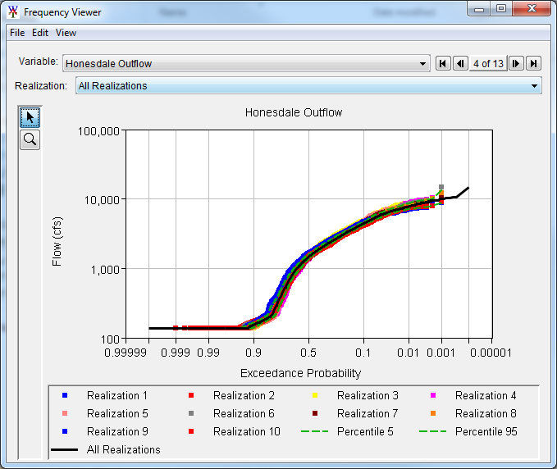
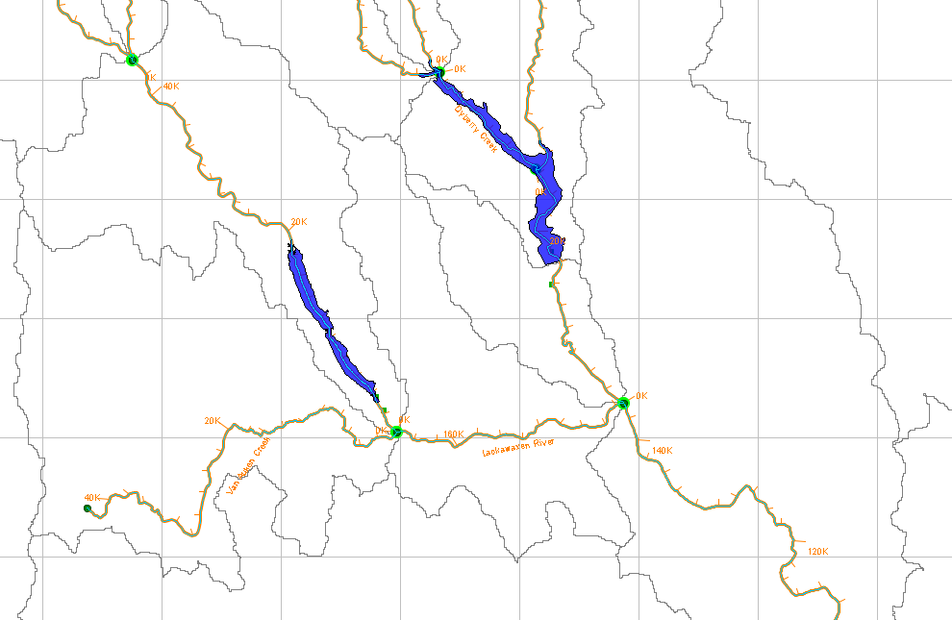
Data Transformation
Regulation Effects
HEC-WAT to the rescue!
Jadwin Dam
Prompton Dam
Honesdale, PA
Notes:
HEC-WAT model for the Lackawaxen River watershed.
Precipitation depth, event time, and starting pool stochastically sampled
HMS model only since Prompton and Jadwin are ungated and only needed flows (not stages)
Total number of simulations = 10000 events
Simulation took ~8 hrs

