Slide 1
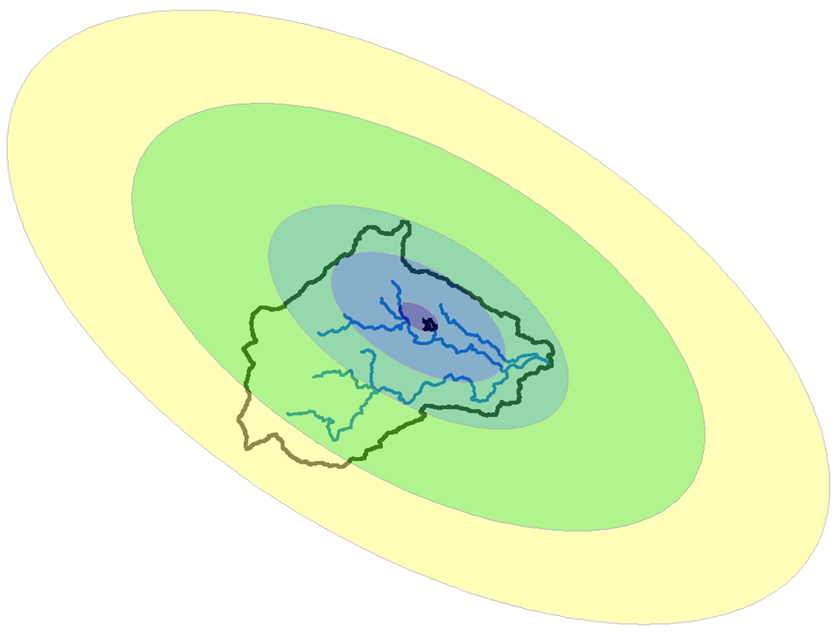
U.S. Army corps of engineers
Development of the Probable Maximum Precipitation (PMP)
12 September 2022
Josh Willis, P.E.

Slide 2
Objectives
Definition of Probable Maximum Precipitation (PMP)
  Why is PMP important?
  Where to find PMP estimates
Procedure for developing PMP Storm for project area
  Storm area
  Storm spatial pattern
  Temporal distribution
  Storm location
  Storm orientation
Introduction to the HMR52 Storm Precipitation Method in HEC-HMS
Notes:
This lecture will primarily cover the meteorologic methodology used in dam safety studies.

Slide 3
OBJECTIVES
Notes:
PMP depth estimates can be found in HMRs published by the NWS. The above index map from HMR 51 can be used to retrieve estimates of the all-season PMP for a storm duration of 72 hours over an area of 10 square miles.

Slide 4
Objectives
Definition of Probable Maximum Precipitation (PMP)
  Why is PMP important?
  Where to find PMP estimates
Procedure for developing PMP Storm for project area
  Storm area
  Storm spatial pattern
  Temporal distribution
  Storm location
  Storm orientation
Introduction to the HMR52 Storm Precipitation Method in HEC-HMS

Slide 5
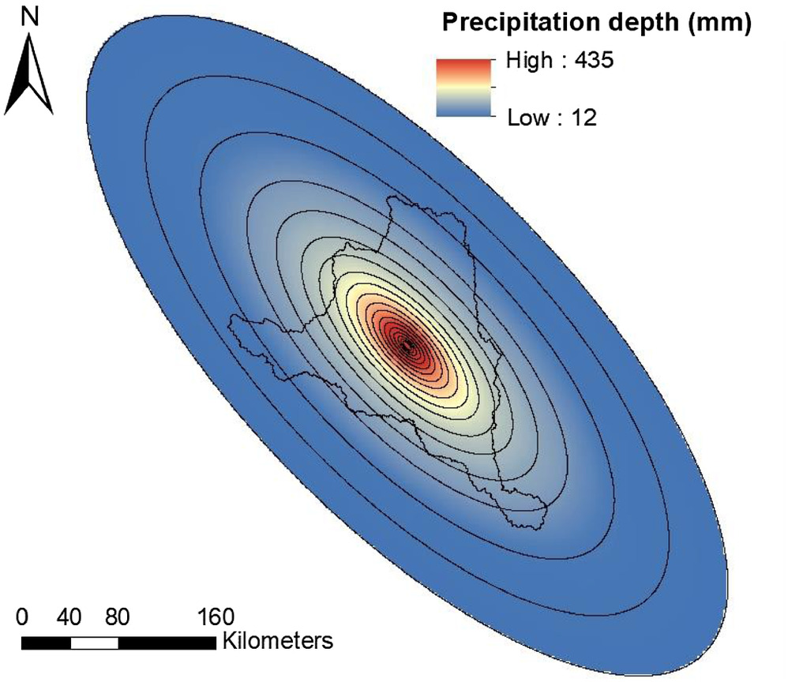
OBJECTIVES
Notes:
HMR 52 outlines how to use PMP depths (from the index maps) to build out a PMS with a given area, orientation, and temporal distribution.

Slide 6
Objectives
Definition of Probable Maximum Precipitation (PMP)
  Why is PMP important?
  Where to find PMP estimates
Procedure for developing PMP Storm for project area
  Storm area
  Storm spatial pattern
  Temporal distribution
  Storm location
  Storm orientation
Introduction to the HMR52 Storm Precipitation Method in HEC-HMS

Slide 7
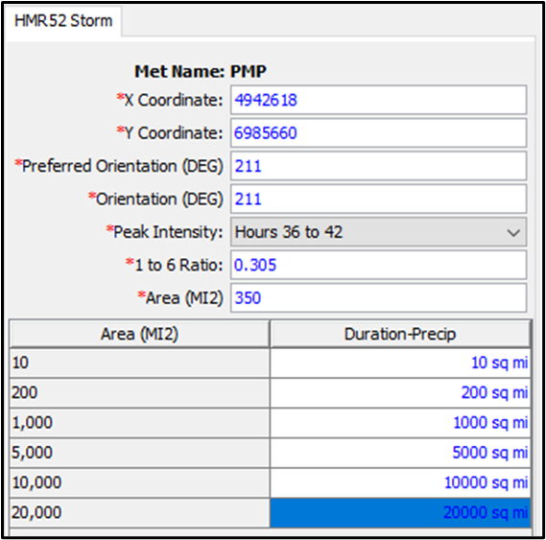
OBJECTIVES
Notes:
HEC-HMS contains an HMR52 meteorologic model that can be used to create an HMR52 storm and to compute the PMF for a watershed of interest.

Slide 8
PMP and PMF Definitions
Definition of Probable Maximum Precipitation (PMP)
  The PMP is defined as “theoretically, the greatest depth of precipitation for a given duration that is physically possible over a given area at a particular geographic location at a certain time of year.” HMR 55A
Definition of Probable Maximum Flood (PMF)
  The PMF is “the flood that may be expected from the most severe combination of critical meteorologic and hydrologic conditions that are reasonably possible in the region.” EM 1110-2-1417 (Section 13)
Notes:
The PMP storm must be centered over the upstream watershed in order to produce the PMP for that area. An alternative centering of the PMP storm over an urban area within the watershed could produce the PMF into the reservoir. You would no longer have the PMP over the upstream drainage area, but you would have the PMF inflow into the reservoir. Developing the PMF inflow could be an iterative process with regards to the storm center and orientation.
EM 1110-2-1417: this Engineer Manual is titled FLOOD-RUNOFF ANALYSIS. Chapter 13 addresses things to consider when computing the PMF.

Slide 9
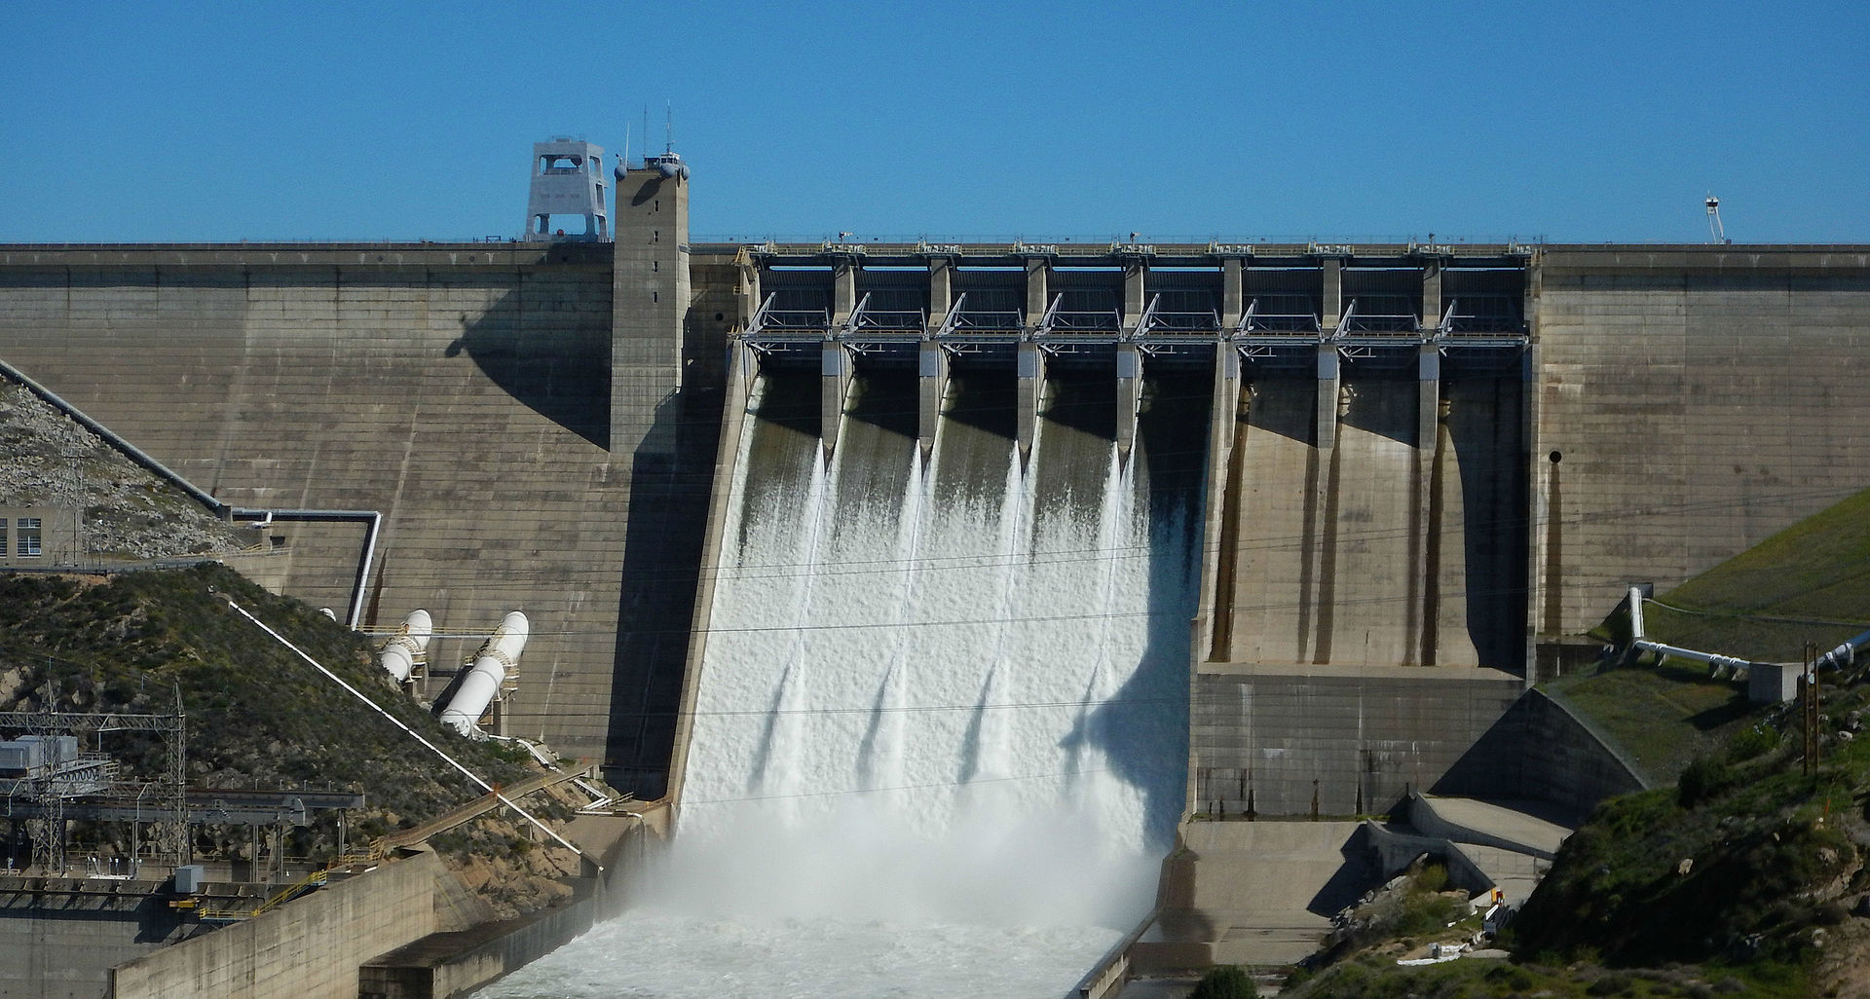
Importance of the PMP
The PMP storm for a given area must be determined before the PMF for a structure of interest (i.e. a reservoir) can be computed.
The ability of a structure to safely handle a PMF is an important design/evaluation criteria of critical infrastructure.
Determining the PMF inflow into a reservoir can be an iterative process.
Notes:
So why is the PMP/PMF important?
The PMP storm must be centered over the upstream watershed in order to produce the PMP for that area. An alternative centering of the PMP storm over an urban area within the watershed could produce the PMF into the reservoir. You would no longer have the PMP over the upstream drainage area, but you would have the PMF inflow into the reservoir. Developing the PMF inflow could be an iterative process with regards to the storm center and orientation.
Illustrate via drawing
Image is of Folsom Dam Spillway

Slide 10
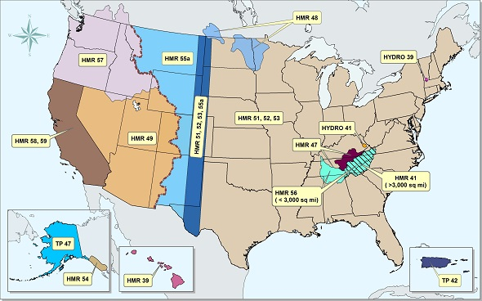
PMP Guidance
https://www.weather.gov/owp/hdsc_pmp
Notes:
The Hydrometeorological Designs Studies Center develops the technical basis of PMP estimates and provides guidelines for developing the PMP for a specific area.
All the Hydrometeorological Reports (HMRs) can be downloaded from NOAA’s Hydrometeorological Designs Studies Center webpage, https://www.weather.gov/owp/hdsc_pmp. For example, HMR 51 discusses how PMP values were developed for the Eastern US (east of 105th meridian) and contains maps of PMP index values, while HMR 52 describes how to compute the PMP for a specific drainage area.
The procedure for developing the PMP in the West is different than what is found in HMR 51 and 52. The biggest differences include only one PMP index map for Western US HMR documents and the lack of a pre-defined spatial PMP storm pattern (due to the complex terrain). Also, HMR 51 and 52 largely ignore orographic effects, while Western US HMR documents account for them.

Slide 11
General Approach For Developing PMP Estimates
The National Weather Service (NWS) used historical storms as the basis of PMP estimates
Due to the limited number of large, intense rainfall events, the NWS used three general procedures for developing PMP estimates over an entire region:
  Moisture Maximization (HMR 51, Section 2.3)
  Storm Transposition (HMR 51, Section 2.4)
  Envelopment (HMR 51, Section 3)
Notes:
There are different methods of developing PMP estimates that can be generalized into two broad categories, namely, physical methods and statistical methods. The Hershfield statistical method is considered a convenient, popular and efficient approach for the estimation of PMP. This method is particularly useful for those locations where sufficiently long precipitation records are available but other meteorological data (e.g., dew point temperature, wind speed, relative and humidity) are lacking, which are essential requirements for other physical methods, such as the moisture maximization and storm transposition technique as used in the HMR documents. With the availability of sufficiently long record of precipitation, the PMP estimates by Hershfield method are found to be closely comparable to those by other physical approaches at different parts of the world.
Moisture Maximization – increase storm rainfall based on maximum moisture possible for specific location and month. Multiply the total observed storm depth by a ratio of maximum precipitable water to that observed in the storm event.
Transposition – relocating a storm within a region of homogeneous terrain and meteorological characteristics. Storms are bounded by barriers, such as the Appalachian Mountains. Distance from coast is used for limiting the transposition of tropical storms.
Envelopment – smoothly interpolating between maximums, think of contour maps.
Various methods are available in for the estimation of PMP, which can be broadly classified into two categories, namely, physical methods and statistical methods. The Hershfield statistical method is considered a convenient, popular and efficient approach for the estimation of PMP. This method is particularly useful for those locations where sufficiently long precipitation records are available but other meteorological data (e.g., dew point temperature, wind speed, relative and humidity) are lacking, which are essential requirements for other physical methods, such as the moisture maximization and storm transposition technique as used in the HMR documents. With the availability of sufficiently long record of precipitation, the PMP estimates by Hershfield method are found to be closely comparable to those by other physical approaches at different parts of the world.

Slide 12
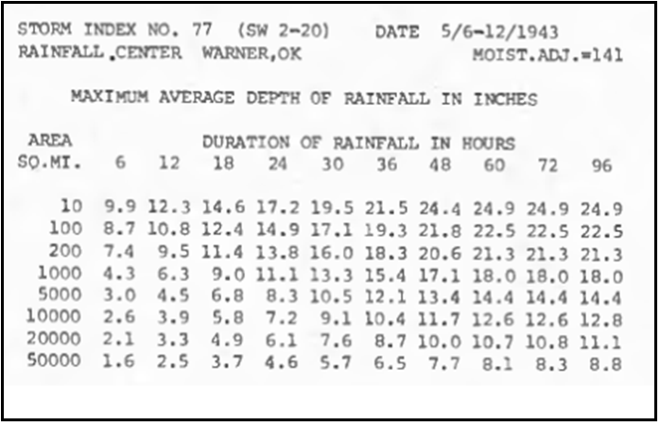
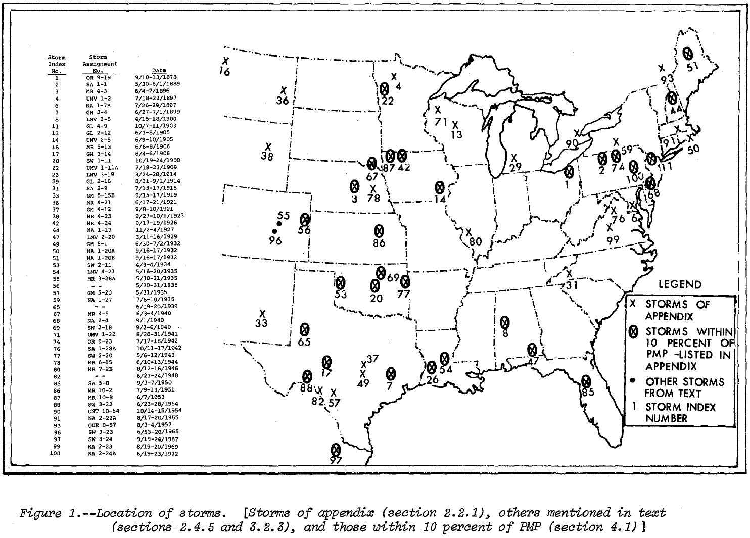
General Approach For Developing PMP Estimates
Notes:
The basic data for the HMR51 study are maximum observed areal precipitation depths for various durations. These data were developed by a standardized depth-area-reduction (D-A-D) analysis of point precipitation amounts.
Over 500 storms were analyzed when developing PMP estimates for the Eastern US. One of the figures on this slide shows the location of the 30 most influential storm events. The other figure shows depth-area-duration values for event number 77 centered over Warner, OK.

Slide 13
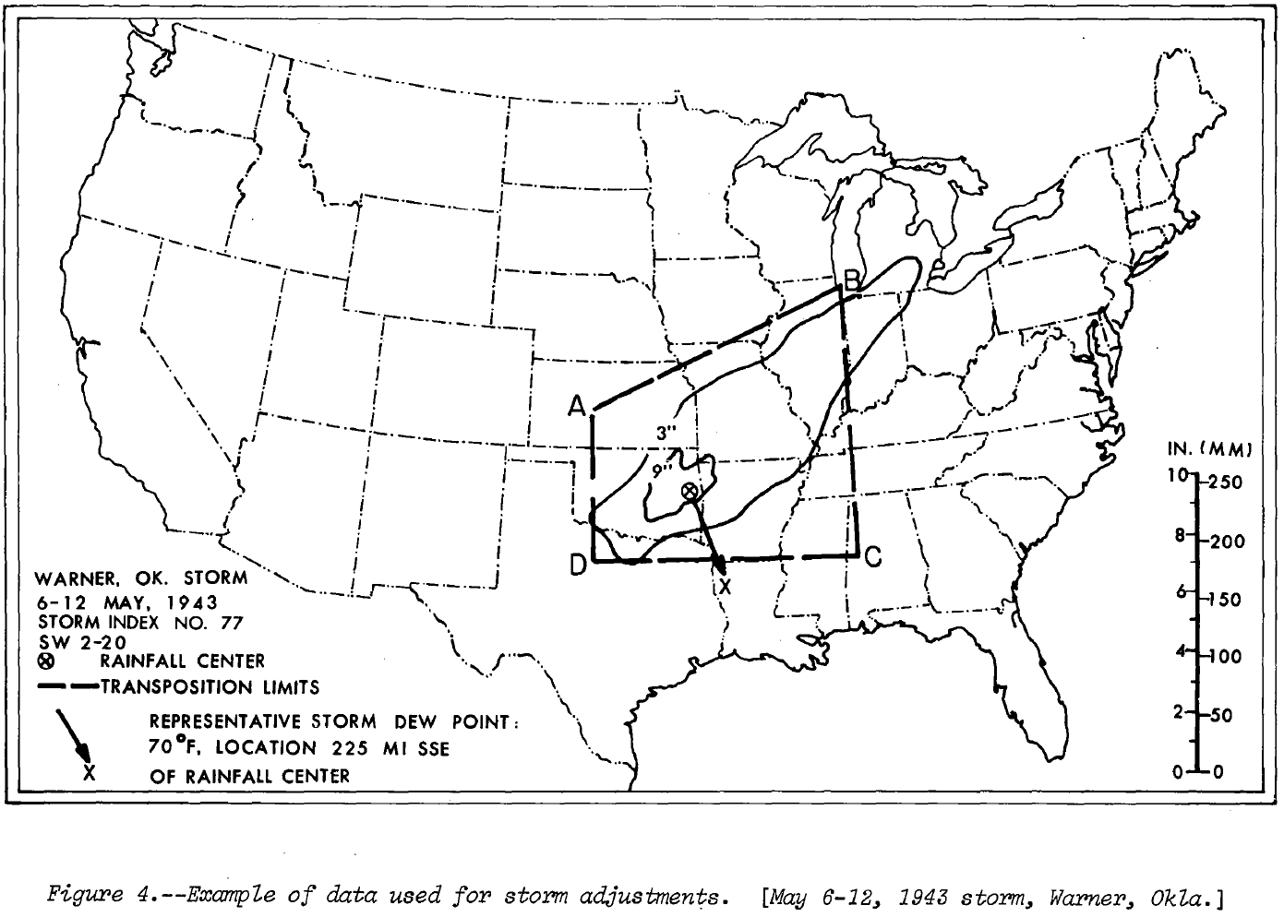
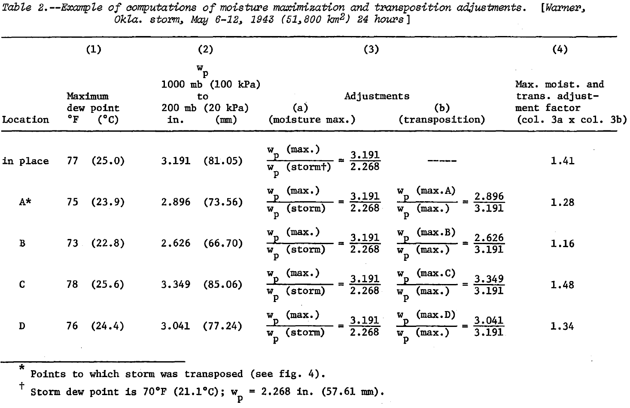
General Approach For Developing PMP Estimates
Notes:
Moisture maximization refers to the process of increasing measured storm rainfall for the storm location and season to account for higher atmospheric moisture than was available in the actual storm. Orographic influences were not considered in the development of the PMP in the East (except in Tennessee Valley); however, they were considered for Western states.
These figures show an example of moisture maximization and storm transposition using the storm centered at Warner, OK. The storm was transposed to four locations, A, B, C, and D, and the precipitation adjusted based on the maximum water available at each location and the water available during the storm event.
The dewpoint temperature, which provides a measure of the actual amount of water vapor in the air, is the temperature to which the air must be cooled in order for that air to be saturated.
Two dew points are required for moisture maximization. One is the dew point representative of moisture inflow during the storm. The other is the maximum dew point for the same location and time of year as the storm.
The measure of atmospheric moisture used is precipitable water (wp). This is the depth of water vapor condensed into liquid in a column of air of unit cross section. Precipitable water is the amount of water potentially available in the atmosphere for precipitation. For a saturated pseudo-adiabatic atmosphere, tables have been prepared (U.S. Weather Bureau 1951) giving wp values based on 1000-mb
(100-kPa) dew points.
In the above example, for the Warner Storm, it was transposed to four locations (points A, B, C, and D). The observed storm dew point is 70deg F. For the month and day of the storm (May 6-12) the maximum 12hr persisting dew point at the in-place, observed location is 77deg F. The corresponding precipitable water values

Slide 14
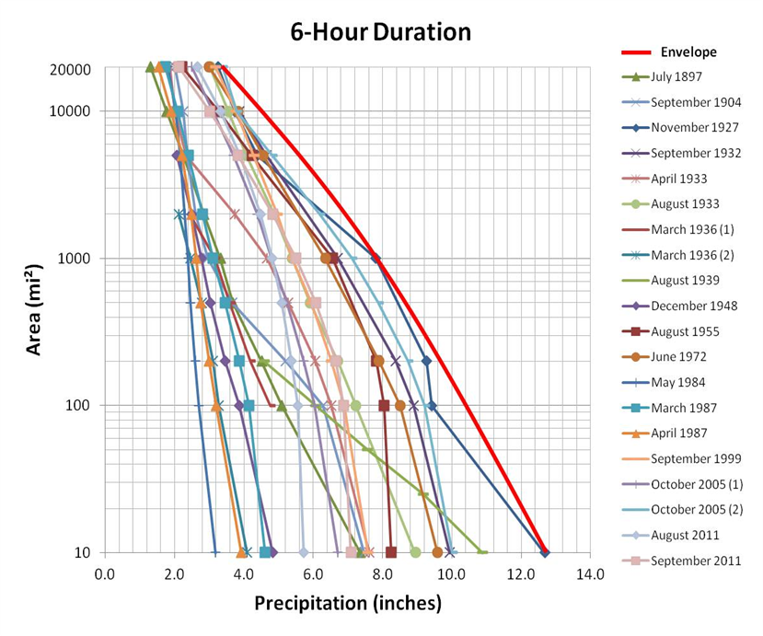
General Approach For Developing PMP Estimates
Notes:
Regional PMP maps were developed using enveloping curves. Not all areas have experienced extreme precipitation, so in order to prevent discontinuities, smooth curves were used to define PMP amounts. Guidance for determining the shape of enveloping curves was obtained from other kinds of rainfall data like greatest monthly precipitation, greatest weekly precipitation, and 1% rainfall maps.

Slide 15
General Approach For Developing PMP Estimates
Notes:
Regional PMP maps were developed using enveloping curves. Not all areas have experienced extreme precipitation, so in order to prevent discontinuities, smooth curves were used to define PMP amounts. Guidance for determining the shape of enveloping curves was obtained from other kinds of rainfall data like greatest monthly precipitation, greatest weekly precipitation, and 1% rainfall maps.

Slide 16
PMP Estimates
Notes:
PMP maps for the Eastern US are found in HMR 51 and HMR 52. A separate map was created for storms of duration 1, 6, 12, 24, 48, and 72 hours and area from 10-20000 sq miles (30 maps). The figures on this slide show the 6- and 72-hour PMP for a storm of 10 sq miles. These maps implicitly contain depth-area and depth-duration information. The greyed out areas above, between the 103rd and 105th meridian and near the Appalachians, demonstrate that the generalized PMP estimates may not be sufficient due to the omission of the effect of terrain on the estimates.
Other HMRs contain PMP maps for western regions. For example, HMR 59 contains a map for the 10 square mile 24 hour PMP. Instead of containing maps for multiple depths and durations, HMR 59 contains depth-area and depth-duration tables for computing the PMP for your specific watershed.
Orographic affects – HMR 47, 55A, 57, and 59 incorporate orographic influences on PMP estimates.
Snowmelt – HMR 36 and EM 1110-2-1406 contain guidelines for rain on snow.

Slide 17
Objectives
Definition of Probable Maximum Precipitation (PMP)
  Why is PMP important?
  Where to find PMP estimates
Procedure for developing PMP Storm for project area
  Storm area
  Storm spatial pattern
  Temporal distribution
  Storm location
  Storm orientation
Introduction to the HMR52 Storm Precipitation Method in HEC-HMS

Slide 18
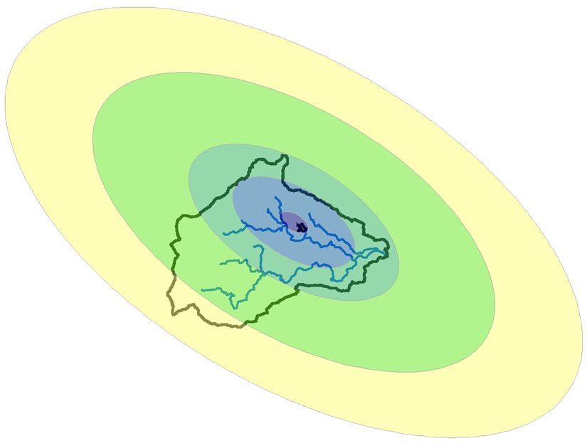
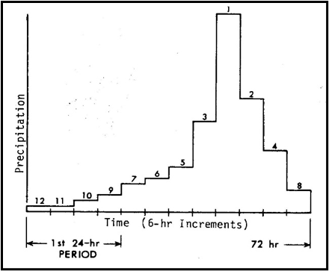
Developing the PMP Storm for a Project Area
Storm Area
Temporal Pattern
Spatial Pattern
Storm Location
Storm Orientation
Notes:
This slide shows five important factors to consider when developing the PMP hyetograph for a specific project. HMR 52 (Eastern US) contains guidelines that aid the user in applying PMP depth estimates from HMR 51 to a specific drainage area of interest. We will look at storm area, which is needed for depth-area reduction, how the storm varies in space and time, and how to orient and center the storm to produce the PMF inflow into the reservoir.

Slide 19
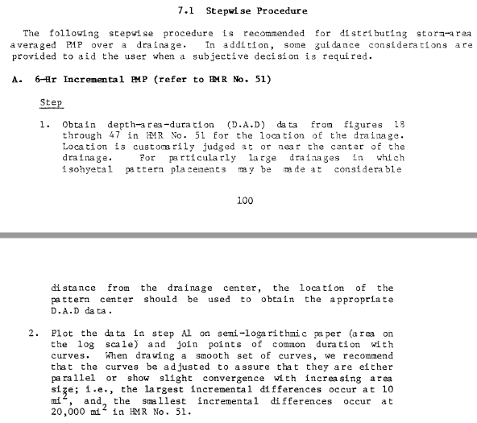
Developing the PMP Storm for a Project Area
Notes:
Chapter 7 of HMR 52 lists procedural steps (30+ steps) and example applications to help explain and simplify some of the PMP storm methodology explained in earlier chapters.

Slide 20
Developing the PMP Storm
- Storm Area -
Notes:
Storm area – think of this as the area of maximum intensity. This is necessary because rainfall for contributing areas downstream of the point of interest (reservoir) is also important. Storm area is selected to produce the PMF for project area; however, residual rainfall is needed to compute stream flow from downstream areas.
The figure on this slide shows depth-area PMP values for different durations. The values were found using Figures 18 – 47 in HMR 51. For the Eastern US, it is important to find the storm area that maximizes runoff into the reservoir. The storm center and orientation are needed to determine storm area.

Slide 21
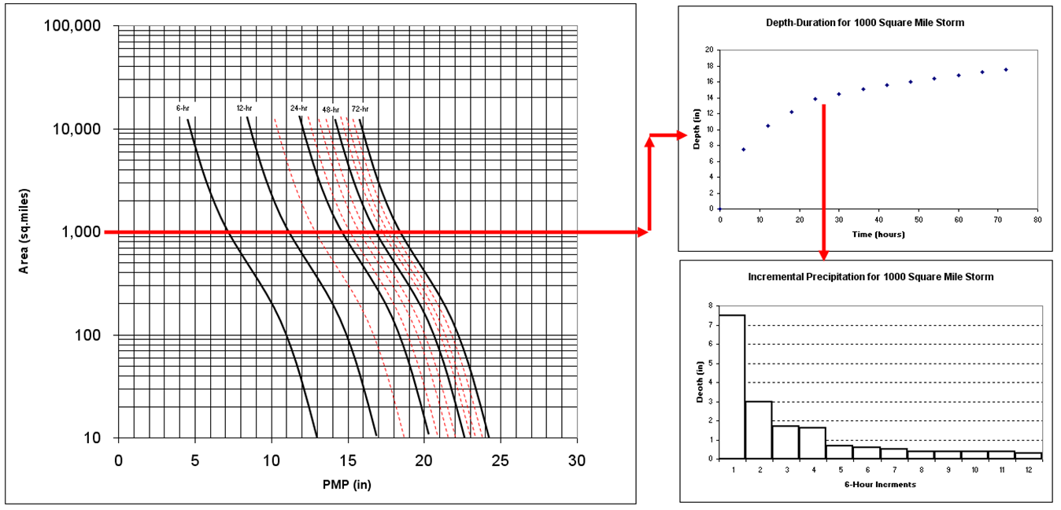
Developing the PMP Storm
- Temporal Pattern -
Notes:
This figure shows another example of how the incremental precipitation is computed using the depth-area-duration curves. The first graph is used to determine the cumulative depth-area-duration information for a specific storm area. Then the incremental precipitation is computed by taking successive differences from the cumulative curve. The final step would be to arrange the incremental precipitation by assuming a temporal pattern.

Slide 22
Developing the PMP Storm
- Temporal Pattern -
Notes:
Recommended guidance for distributing the PMP depths in time can be found in HMR 52. The guidance is based on examining 28 storms. HMR 52 recommends arranging individual 6-hr increments such that they decrease progressively to either side of the greatest 6-hr increment and placing the four greatest 6-hr increments at any position in the sequence except within the first 24-hr period of the storm sequence.
Following these guidelines, the goal is to develop a time pattern that maximizes runoff. It makes sense to place the more intense precipitation toward the end of the 72-hour event. You can maximum runoff by applying the most intense rainfall when the watershed is saturated. Additionally, historic storms in your area could be used as a source for developing the temporal pattern.

Slide 23
Developing the PMP Storm
- Spatial Pattern -
Notes:
For the eastern US, an idealized elliptical pattern was developed, as shown on this slide. The PMP depth decreases as the elliptical area increases. This pattern is overlaid on top of the watershed delineation to compute a subbasin average PMP. Tables in HMR 52 contain multipliers for each ellipse. These tables are broken up into 6-hour increments. The 6-hour increments are referred to based on intensity. The 1st 6-hour increment contains the most intense 6-hour precipitation depth. This increment contains the most spatial variability. No spatial variability is observed for the 4-12 6-hour increments.
Spatially, major storm isohyetal patterns were analyzed for statistics on pattern shape and a major-minor axis ratio of 2.5:1 was adopted.

Slide 24
Developing the PMP Storm
- Spatial Pattern -
Notes:
The general idea of the spatial pattern is to place and orient the isohyetal ellipses to the center of the basin. Try to place the greatest number of whole isohyets completely within the drainage, since the isohyets that enclose smaller area sizes contain proportionately higher rain amounts.
Emphasize PMP Area (Largest solid isohyet completely within the watershed boundary) vs Residual Area (the largest dashed isohyet needed to completely cover the watershed with rainfall).
Only the first through the third most intense 6-hour blocks of PMP rainfall have spatial variability (top image). No spatial variability is observed for the 4-12 6-hour increments, a uniform PMP depth is applied (bottom image). Residual rainfall (dashed lines) is the rainfall that falls outside of the PMP area. Residual rainfall is needed to cover the remainder of the watershed that is not covered by the elliptical pattern for the area of the PMP.

Slide 25
Developing the PMP Storm
- Spatial Pattern -
Notes:
Only the first through the third most intense 6-hour blocks of PMP rainfall have spatial variability (top image). No spatial variability is observed for the 4-12 6-hour increments, a uniform PMP depth is applied (bottom image). Residual rainfall (dashed lines) is the rainfall that falls outside of the PMP area. Residual rainfall is needed to cover the remainder of the watershed that is not covered by the elliptical pattern for the area of the PMP.

Slide 26
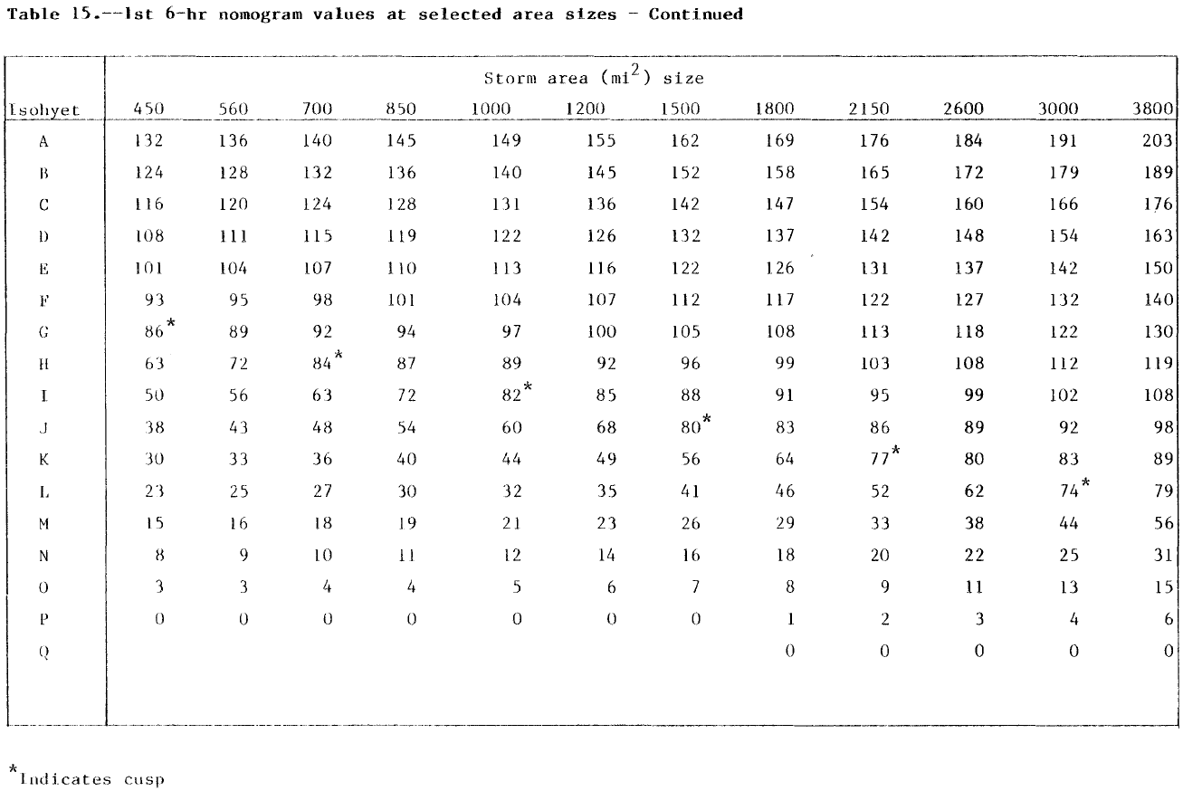
Developing the PMP Storm
- Spatial Pattern -
Notes:
The table on this slide shows the multiplier used for each ellipse for storm areas from 450 to 3800 square miles. These multipliers are used to create the spatial pattern for the most intense 6-hour increment. Separate tables were developed for the 2, 3, and 4-12 6-hour increments.

Slide 27
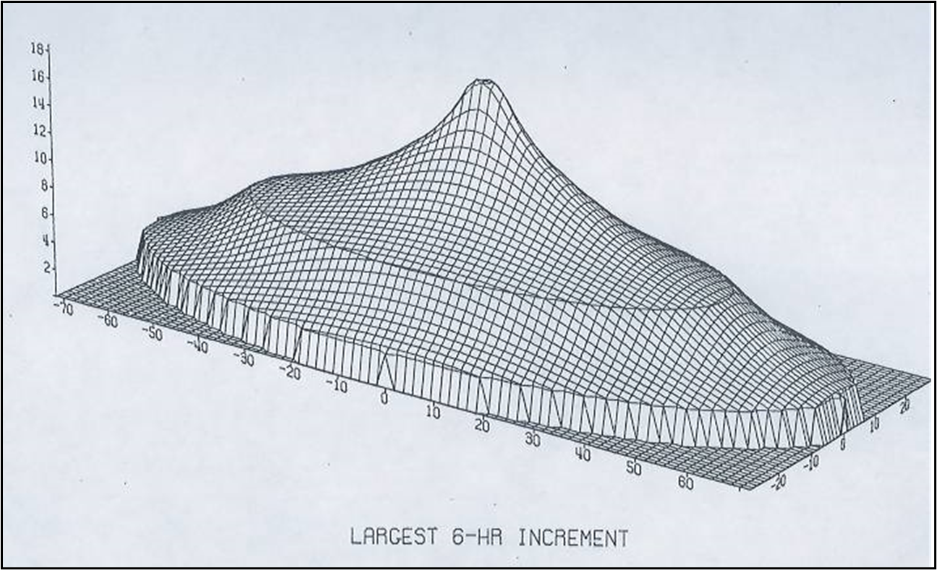
Developing the PMP Storm
- Spatial Pattern -
Notes:
The figure on this slide shows a 3D view of the spatial pattern for the most intense 6-hour increment.

Slide 28
Developing the PMP Storm
- Spatial Pattern -
Notes:
The table on this slide shows the multiplier used for each ellipse for storm areas from 450 to 3800 square miles. These multipliers are used to create the spatial pattern for the 2nd most intense 6-hour increment. These multiplier values are smaller and lead to a less drastic spatial distribution when compared to the most intense 6-hour increment.

Slide 29
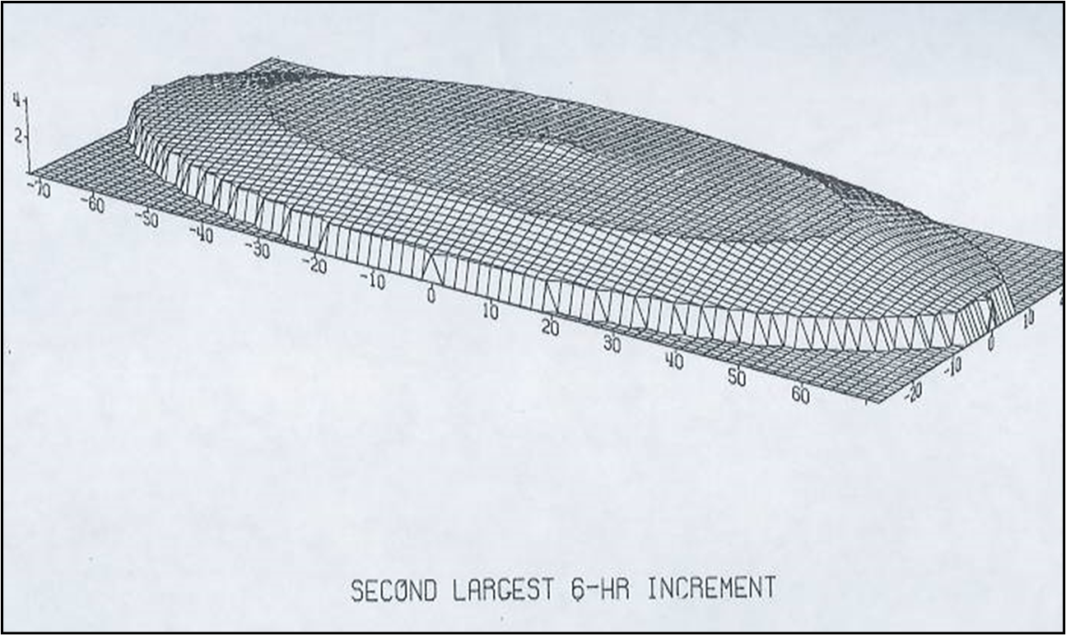
Developing the PMP Storm
- Spatial Pattern -
Notes:
The figure on this slide shows a 3D view of the spatial pattern for the 2nd most intense 6-hour increment.

Slide 30
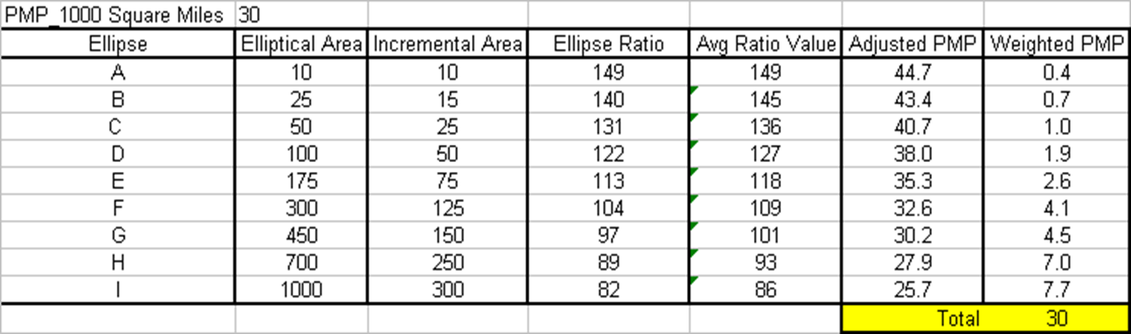
Developing the PMP Storm
- Spatial Pattern Example -
A
43.4
40.7
38.0
35.3
I
H
G
F
B
D
C
B
44.7
32.6
30.2
27.9
25.7
30
Notes:
This slide shows an example calculation of the spatial distribution for a storm that has an area of 1000 square miles – for the 1st 6-hour duration. The average PMP for this storm area is 30 inches. The elliptical pattern on this slide shows how the PMP varies in space for the most intense 6-hour increment. For ellipse A (area is 10 sq miles) the PMP depth is 44.7 inches and for ellipse I (area is 1000 square miles – the incremental area is 300 sq miles) the PMP depth is 25.7 inches. Even though the PMP depths vary for each ellipse (PMP depth decreases with increasing area) the area-average value is 30 inches.

Slide 31
Developing the PMP Storm
- Storm Location-
Notes:
An initial storm location is the basin centroid. This results in the PMP over the upstream watershed. The goal is to compute the PMF flowing into a reservoir. Due to watershed characteristics, such as impervious land, the PMP storm center might not be the watershed centroid. The result is that you no longer have the PMP over the upstream watershed; however, you are still using the PMP storm to produce the PMF. An iterative process is needed to generate maximum inflow into reservoir.

Slide 32
Developing the PMP Storm
- Storm Orientation-
Notes:
By examining historic storm events, preferred storm orientations were developed for the eastern US. The map on this slide shows the preferred storm orientation (direction from north of the major axis) and location of some of the storms used to develop this map. Figure 10 in HMR 52 contains an adjustment factor if the storm orientation differs by more than 40 degrees from the preferred storm orientation.

Slide 33
Developing the PMP Storm
- Storm Orientation-
Notes:
By examining historic storm events, preferred storm orientations were developed for the eastern US. The map on this slide shows the preferred storm orientation (direction from north of the major axis) and location of some of the storms used to develop this map. Figure 10 in HMR 52 contains an adjustment factor if the storm orientation differs by more than 40 degrees from the preferred storm orientation.

Slide 34
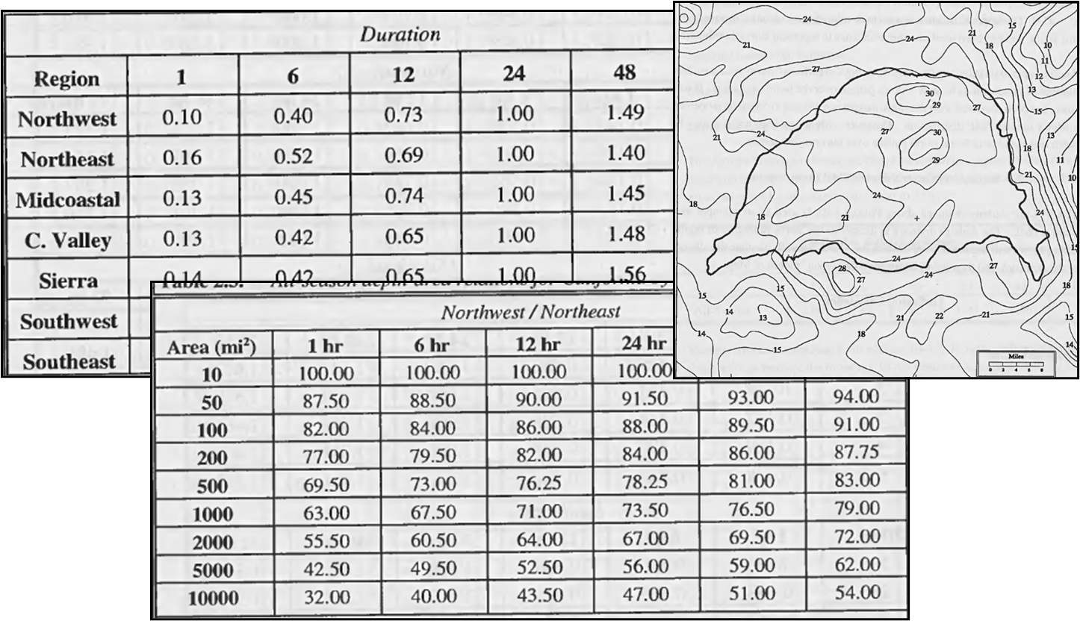
Developing the PMP Storm in the Western U.S.
Notes:
HMRs 49, 55A, 57, and 59 contain procedures for developing PMP hyetographs in the western states. The following steps are a brief description of the procedure.
Develop a map of the watershed boundary at a scale of 1:1,000,000.
Overlay PMP index maps from HMRs and compute basin average PMP (10 square mile – 24 hour).
Use depth-duration relationships, developed from historic events, to distribute PMP from step 2 for the entire storm duration (cumulative curve).
Use area-reductions factors, developed from historic events, to reduce the depth-duration PMP curve for storm area.
Draw a smooth Depth-Duration curve and compute the incremental PMP depths.
Arrange the incremental values into an appropriate storm pattern. HMRs contain some guidance.
If necessary, develop a spatial pattern. This is needed if the basin is subdivided into smaller subbasins and precipitation varies spatially across the basin. The HMRs provide elliptical patterns for storms less than 500 square miles. For larger storms, guidelines state that you could use maps of 1% rainfall (TP 40) or historic events to develop a spatial pattern.

Slide 35
Developing the PMP Storm in the Western U.S.
HMRs 49, 55A, 57, and 59 contain procedures for developing PMP hyetographs in the western states. The following steps are a brief description of the procedure.
Develop a map of the watershed boundary at a scale of 1:1,000,000.
Overlay PMP index maps from HMRs and compute basin average PMP (10 square mile – 24 hour).
Use depth-duration relationships, developed from historic events, to distribute PMP from step 2 for the entire storm duration (cumulative curve).
Use area-reductions factors, developed from historic events, to reduce the depth-duration PMP curve for storm area.
Draw a smooth Depth-Duration curve and compute the incremental PMP depths.
Arrange the incremental values into an appropriate storm pattern. HMRs contain some guidance.
If necessary, develop a spatial pattern. This is needed if the basin is subdivided into smaller subbasins and precipitation varies spatially across the basin. The HMRs provide elliptical patterns for storms less than 500 square miles. For larger storms, guidelines state that you could use maps of 1% rainfall (TP 40) or historic events to develop a spatial pattern.
Notes:
HMRs 49, 55A, 57, and 59 contain procedures for developing PMP hyetographs in the western states. The following steps are a brief description of the procedure.
Develop a map of the watershed boundary at a scale of 1:1,000,000.
Overlay PMP index maps from HMRs and compute basin average PMP (10 square mile – 24 hour).
Use depth-duration relationships, developed from historic events, to distribute PMP from step 2 for the entire storm duration (cumulative curve).
Use area-reductions factors, developed from historic events, to reduce the depth-duration PMP curve for storm area.
Draw a smooth Depth-Duration curve and compute the incremental PMP depths.
Arrange the incremental values into an appropriate storm pattern. HMRs contain some guidance.
If necessary, develop a spatial pattern. This is needed if the basin is subdivided into smaller subbasins and precipitation varies spatially across the basin. The HMRs provide elliptical patterns for storms less than 500 square miles. For larger storms, guidelines state that you could use maps of 1% rainfall (TP 40) or historic events to develop a spatial pattern.

Slide 36
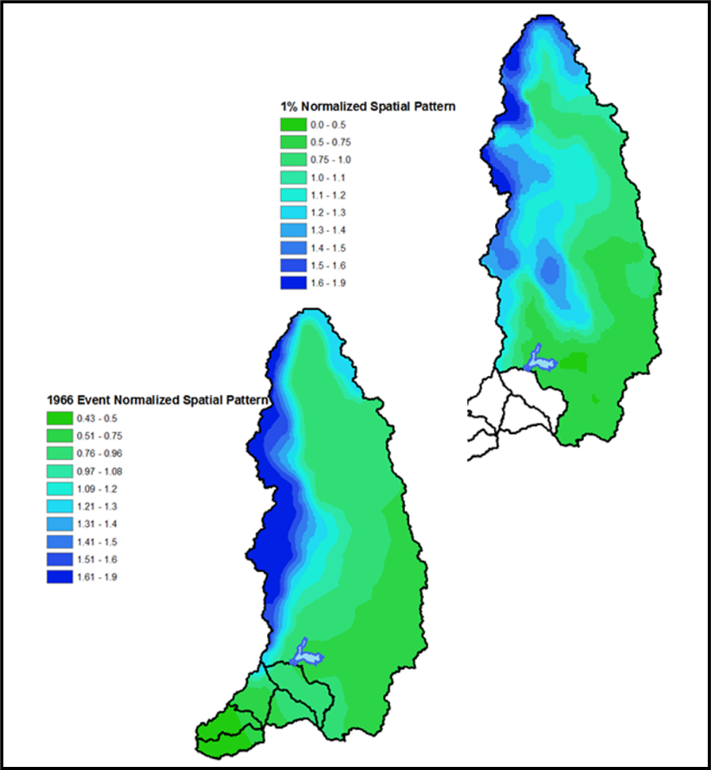
Developing the PMP Storm in the Western U.S.
Notes:
The figures on this slide show two spatial patterns. These were created using ArcGIS tools.
Create a RASTER historic storm and the 1% precipitation.
Use Zonal Statistics to compute the basin average precipitation.
Divide raster by the basin average to create a normalized grid.
Multiply PMP by normalized grid to compute spatial distribution of PMP.
Use Zonal Statistics to compute average PMP for each subbasin.

Slide 37
Objectives
Definition of Probable Maximum Precipitation (PMP)
  Why is PMP important?
  Where to find PMP estimates
Procedure for developing PMP Storm for project area
  Storm area
  Storm spatial pattern
  Temporal distribution
  Storm location
  Storm orientation
Introduction to the HMR52 Storm Precipitation Method in HEC-HMS

Slide 38
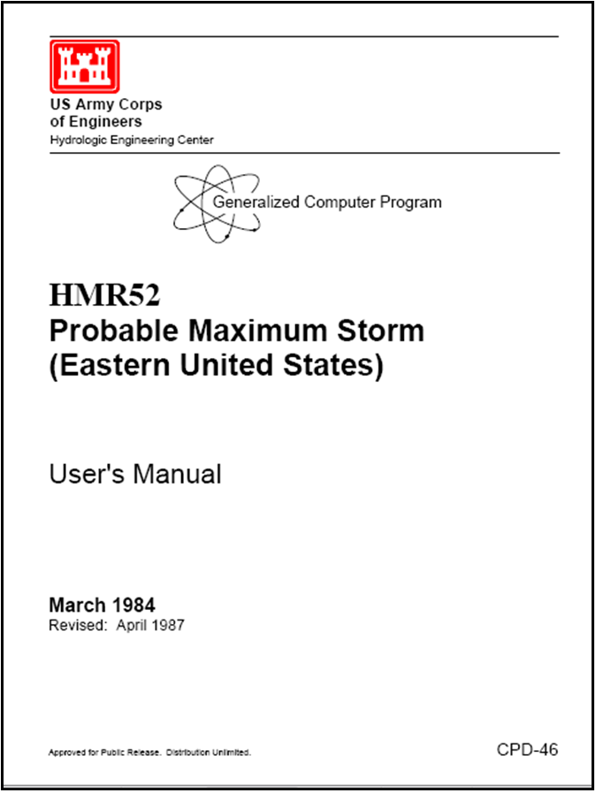
Computing the Optimized PMP Storm – HMR52 Program
HMR52 Program: command-line program that computes subbasin average PMP hyetographs using:
X,Y coordinates
Depth-Area-Duration values from HMR 51
Storm area
Storm orientation
Temporal pattern
Notes:
The HMR52 program is a command line program that requires an input file containing, among many pieces of information, XY coordinates of basin and subbasin boundaries and depth-area-duration information from HMR 51. Using the basin centroid, the program finds the storm area and orientation that maximizes precipitation over the basin. The user has the option to define a different storm center. The user also has the option of defining the temporal pattern.

Slide 39
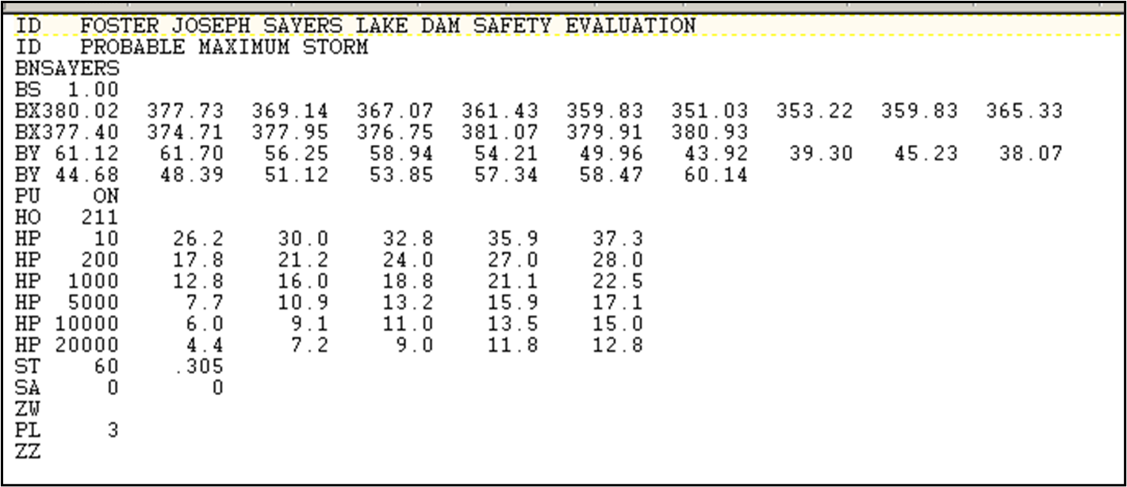
Computing the Optimized PMP Storm – HMR52 Program
Notes:
An example HMR52 input file is shown on this slide. Appendix A in the HMR52 User’s Manual provides a detailed description about what is required in the HMR 52 input file. Pay careful attention to the format of the input file. Each row of text, referred to as a “card,” is divided into a two-column card identification field (columns 1 and 2) and ten data fields. The first data field is limited to six columns, and the remaining nine fields have eight columns.

Slide 40
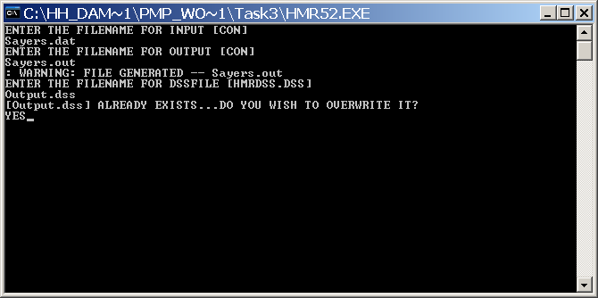
Computing the Optimized PMP Storm – HMR52 Program
Notes:
The HMR52 program is executed using a command prompt. You must enter the name of the completed input file, a name for the output file, and enter a name of a DSS file to store the hyetograph time-series. You must enter the name of a DSS file that already exists. The program cannot create one.

Slide 41
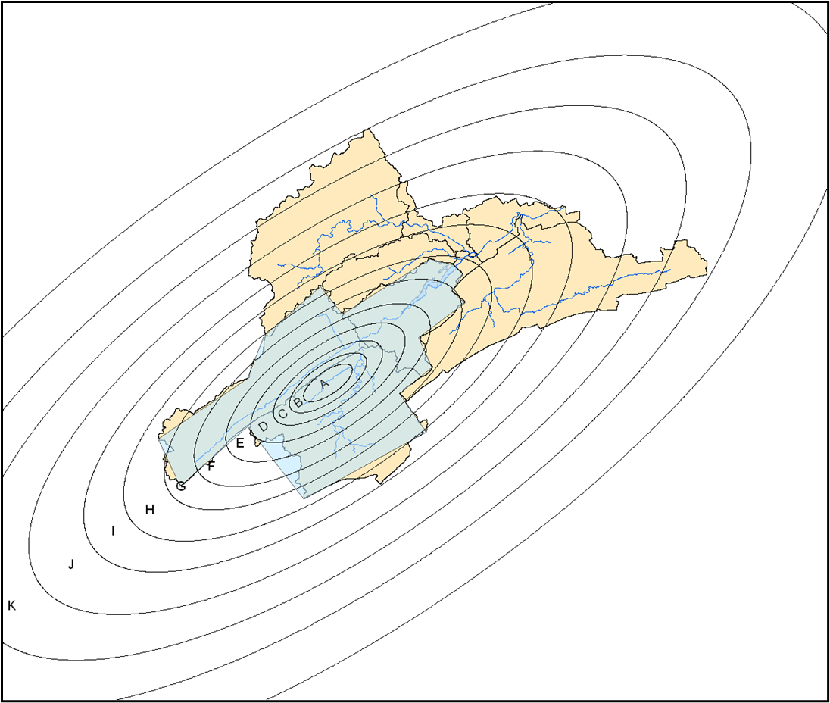
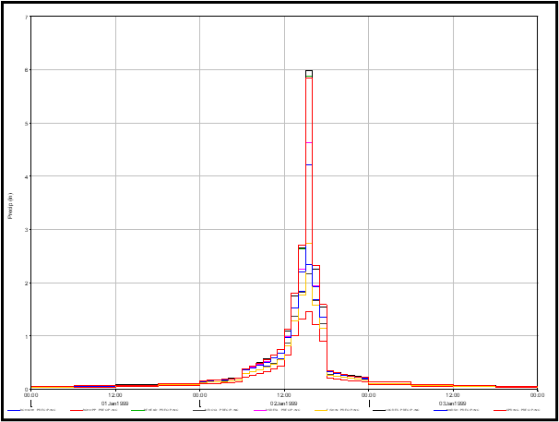
Computing the Optimized PMP Storm – HMR52 program
Notes:
The HMR52 program will intersect the PMP pattern with subbasin boundaries and compute area-average hyetographs. Hyetographs can be written to an HEC-DSS file where they can be read by HEC-HMS. The program will compute the PMP hyetographs and the downstream residual precipitation hyetographs.

Slide 42
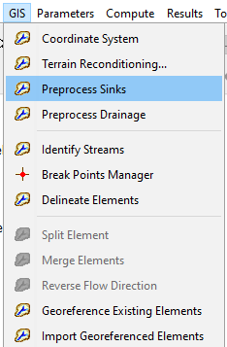
Computing the Optimized PMP Storm – HEC-HMS
The basin model needs to be geo-referenced
  Perform the GIS workflow in HEC-HMS
    Associate a terrain file with the basin model
    Preprocess sinks, preprocess drainage, identify streams, add breakpoint(s), delineate elements
  Or use the GIS | Import Georeferenced Elements menu to import a subbasin shapefile and add GIS elements
Use index maps in HMR 51 to determine depth-area-duration values (or GIS datasets), add Duration-Precipitation Curves to HEC-HMS
Complete the HMR52 Storm Component Editor

Slide 43
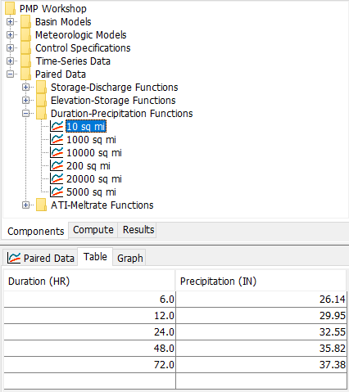
Computing the Optimized PMP Storm – HEC-HMS
The basin model needs to be geo-referenced
  Perform the GIS workflow in HEC-HMS
    Associate a terrain file with the basin model
    Preprocess sinks, preprocess drainage, identify streams, add breakpoint(s), delineate elements
  Or use the GIS | Import Georeferenced Elements menu to import a subbasin shapefile and add GIS elements
Use index maps in HMR 51 to determine depth-area-duration values (or GIS datasets), add Duration-Precipitation Curves to HEC-HMS
Complete the HMR52 Storm Component Editor
Notes:
Refer to index maps in HMR 51 to determine subbasin average PMP depths for durations 1, 6, 12, 24, 48, and 72 hours and storm areas from 10-20000 sq miles (30 maps, Figures 18 - 47). It a good idea to plot the PMP depths to eliminate errors when reading values from the figures. These index maps implicitly contain depth-area and depth-duration information.

Slide 44
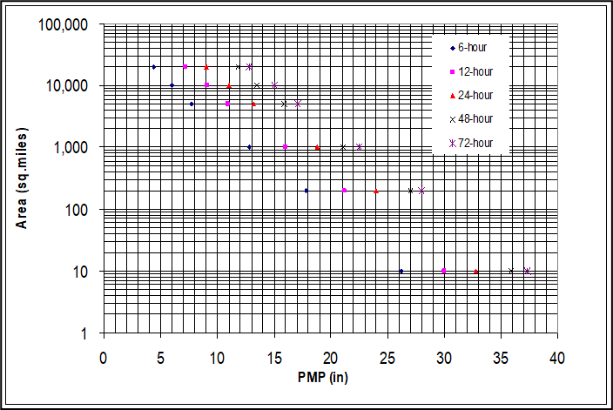
Computing the Optimized PMP Storm – HEC-HMS
Notes:
It a good idea to plot the PMP depths to eliminate errors when reading values from the figures. These index maps implicitly contain depth-area and depth-duration information.

Slide 45

Computing the Optimized PMP Storm – HEC-HMS
The basin model needs to be geo-referenced
  Perform the GIS workflow in HEC-HMS
    Associate a terrain file with the basin model
    Preprocess sinks, preprocess drainage, identify streams, add breakpoint(s), delineate elements
  Or use the GIS | Import Georeferenced Elements menu to import a subbasin shapefile and add GIS elements
Use index maps in HMR 51 to determine depth-area-duration values (or GIS datasets), add Duration-Precipitation Curves to HEC-HMS
Complete the HMR52 Storm Component Editor
Notes:
X and Y Coordinates – start with centroid of basin.
Refer to HMR51 to find the preferred storm orientation.
The Temporal Distribution (ST) card is used to define the time-pattern and time-step for the PMP event. The first variable on the ST card is the time interval. The second variable is the ratio of 1-hr to 6-hr precipitation for isohyet A of a 20000 sq mile storm. Refer to Figure 39 in HMR 52 for the 1 to 6 hour ratio.

Slide 46
Computing the Optimized PMP Storm – HEC-HMS
Start with the basin centroid
HMR 52, Section 4 and Figure 8
HMR 52, Section 2.3, Figure 3
HMR 52, Section 6.5, Figure 39
Start with the basin area
HMR 51, Figures 18 - 47
Notes:
X and Y Coordinates – start with centroid of basin.
Refer to HMR52 to find the preferred storm orientation.
The Temporal Distribution (ST) card is used to define the time-pattern and time-step for the PMP event. The first variable on the ST card is the time interval. The second variable is the ratio of 1-hr to 6-hr precipitation for isohyet A of a 20000 sq mile storm. Refer to Figure 39 in HMR 52 for the 1 to 6 hour ratio.

Slide 47
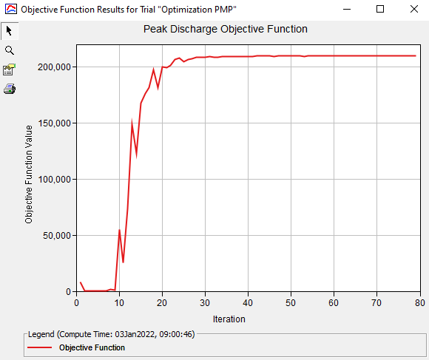
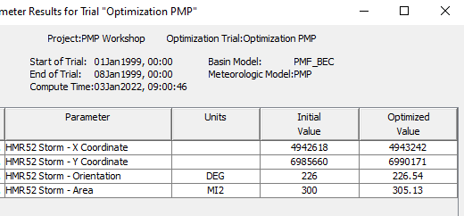
Computing the Optimized PMP Storm – HEC-HMS
Notes:
Optimization trial results show how the storm parameters changes during the maximization search. There are plots and summary tables.

Slide 48
References
HMR 39 Probable Maximum Precipitation in the Hawaiian Islands.
HMR 48 Probable Maximum Precipitation and Snowmelt Criteria for Red River of the North Above Pembina, and Souris River Above Minot, North Dakota.
HMR 49 Probable Maximum Precipitation Estimates , Colorado River and Great Basin Drainages.
HMR 51 Probable Maximum Precipitation Estimates, United States east of the 105th Meridian.
HMR 52 Application of Probable Maximum Precipitation Estimates, United States east of the 105th Meridian.
HMR 55A Probable Maximum Precipitation Estimates, United States Between the Continental Divide and the 103rd Meridian.
HMR 56 Probable Maximum and TVA Precipitation Estimates With Areal Distribution for Tennessee River Drainages Less Than 3000 Mi2 in Area.
HMR 57 Probable Maximum Precipitation, Pacific Northwest States, Columbia River, Snake River and Pacific Coastal Drainages.
HMR 58 Probable Maximum Precipitation for California, Calculation Procedures.
HMR 59 Probable Maximum Precipitation for California.
HMR52 Probable Maximum Storm (eastern United States) User’s Manual, Hydrologic Engineering Center, March 1984.

