Slide 1
Reservoir Modeling Methodologies
Advanced Applications of HEC-HMS
March 2023
Gregory S. Karlovits, P.E., PH, CFM
Statistical Hydrologist
US Army Corps of Engineers
Hydrologic Engineering Center

Slide 2
Purpose
Understand and apply appropriate reservoir modeling techniques in HEC-HMS

Slide 3
Outline
Reservoir element overview
Specified release
Outflow curves
Outflow structures
Rule-based routing
Reservoir volume reduction (sediment)

Slide 4
Reservoir Element Overview

Slide 5

Reservoir Element
One of the seven basin model element types
One upstream element
Up to two downstream elements
Main
Auxiliary
Five routing methods
None, Outflow Curve, Outflow Structures, Rule-Based Operations, Specified Release

Slide 6
Geometry (Storage Method)
Reservoir computes the continuity equation
Outflow Curve | Outflow Structures | Rule-Based Operations | Specified Release
Elevation-Area-Discharge | Elevation-Area | Elevation-Area | Elevation-Area
Elevation-Storage-Area-Discharge | Elevation-Storage | Elevation-Storage | Elevation-Storage
Elevation-Storage-Discharge | Elevation-Storage-Area | Elevation-Storage-Area
Storage-Discharge

Slide 7
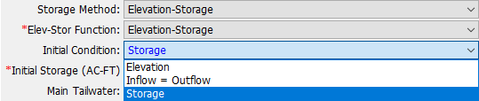
Initial Conditions
State information required for simulation start
Available options depend on selected storage method
Storage (simplest)
Elevation
Discharge
Inflow = Outflow
Notes:
The Discharge method is available for outflow curves – since storage and outflow are 1:1 related, the initial storage can be determined
The Inflow = Outflow method takes the inflow to the reservoir at the beginning of the simulation and determines the pool elevation necessary to cause that outflow through the outlet structures. The pool elevation is then used in the elevation-storage curve to determine the matching storage.

Slide 8
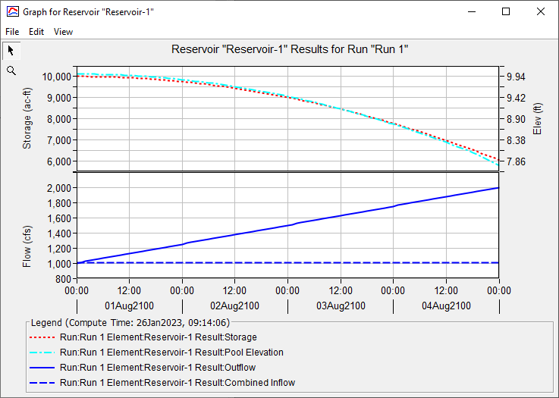
Simulation Results
Notes:
The top plot is for geometry – it shows the reservoir’s storage and elevation for the simulation. Not all routing methods will have an elevation plot, but all of them must compute storage.
The bottom is for flow – the reservoir inflow is dashed, and outflow is solid.

Slide 9
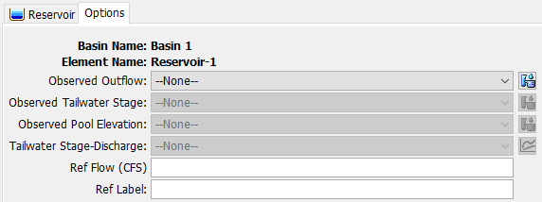
Reservoir Options Tab
Notes:
Observed outflow allows you to set a discharge gage as an observed flow series that you can compare your results to
Observed tailwater stage lets you set a stage gage as an observed stage time series that you can compare computed tailwater stages to (requires a tailwater rating curve)
Observed pool elevation is pretty self-explanatory
Tailwater stage-discharge lets you set a rating curve for the tailwater – this can be important for computing hydraulic structure submergence.
The reference flow and label are for making a nice label on your simulation results graph.

Slide 10
Best Practices
Use a junction upstream and downstream of your reservoir
Calibrate/validate your model isolating out the reservoir first
Use Specified Release method to pass the right flows downstream
Keep it simple
HMS is not ResSim

Slide 11
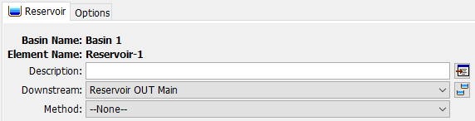
“None” Routing Method
“--None--” will pass flow downstream with no routing

Slide 12
Specified Release

Slide 13
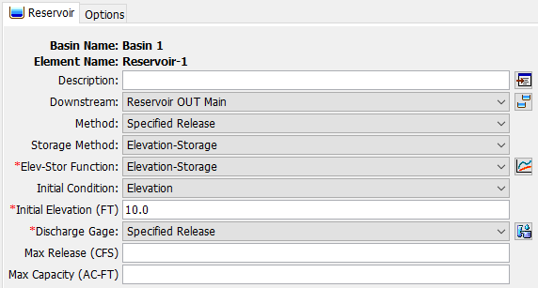
Specified Release
Used when the outflow from a reservoir is known
Elevation/storage computed from simulated inflow and specified outflows

Slide 14
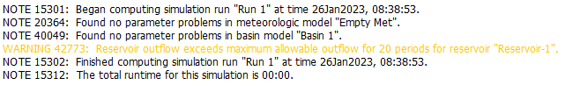
Specified Release
Outflow specified as a discharge gage
Optional settings: Max Release, Max Capacity
Settings do not alter outflows, only produce warnings

Slide 15
Specified Release – When to Use?
Calibration/validation phase of model construction
Releases are determined by something external to HMS

Slide 16
Outflow Curves

Slide 17
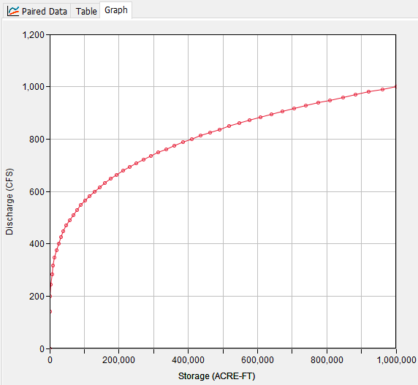
Outflow Curves
Reservoir outflow is determined solely by storage
Ideal for reservoirs with no gates/operations
Can be “calibrated” to represent more complex reservoirs
Notes:
This gets quite a bit of use for detention basin design – most have simple geometry and outflow relationships that makes modeling them very easy.

Slide 18
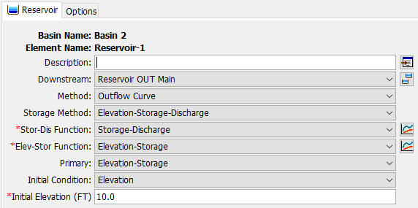
Outflow Curves – Storage Method
Simplest option is the Storage-Discharge storage method
Other methods will compute elevation
Notes:
The “Primary” setting just determines the interpolation scheme. The Outflow Curve method builds a big table for all the geometry variables involved, and the one set as “primary” determines the initial configuration of the table (what rows the other tables are interpolated to.)

Slide 19
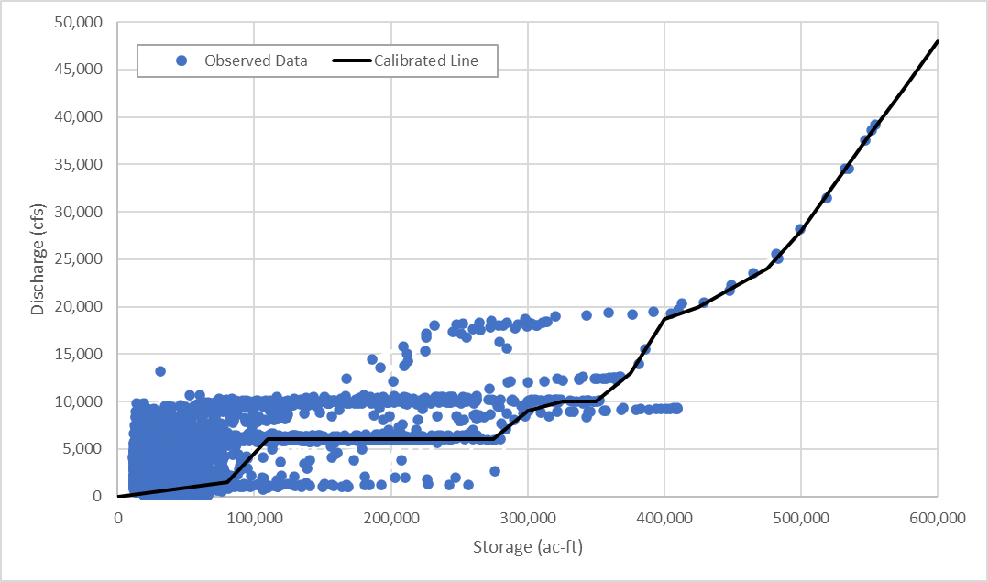
Outflow Curve Calibration
Works best when operations are simple
Iterative process
Build curve
Run simulation
Check stage/storage/ outflow
Modify curve

Slide 20
Outflow Curves – When to Use?
Outflow is always the same for a given storage
Ungated outlets/spillways, dam tops, etc.
Operations can be reasonably simplified to a single curve
Long Term Reservoir Volume Reduction Analysis

Slide 21
Outflow Structures

Slide 22
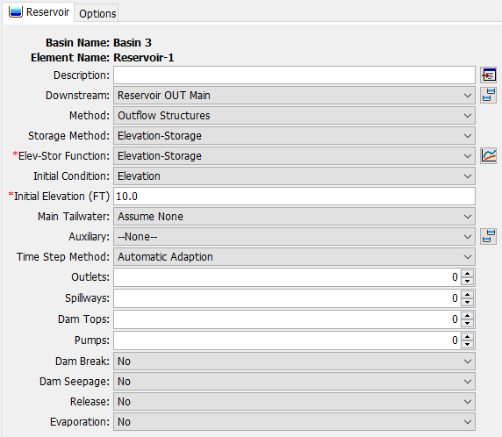
Outflow Structures
Outflow computed by a collection of hydraulic structures
Outlets
Spillways
Dam tops
Pumps
Simulate other kinds of outflows
Dam breaks
Dam seepage
Time-series releases
Evaporation

Slide 23
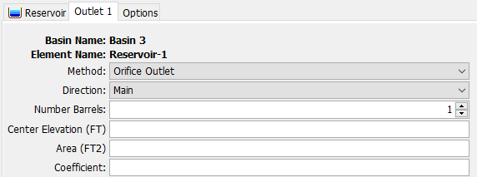
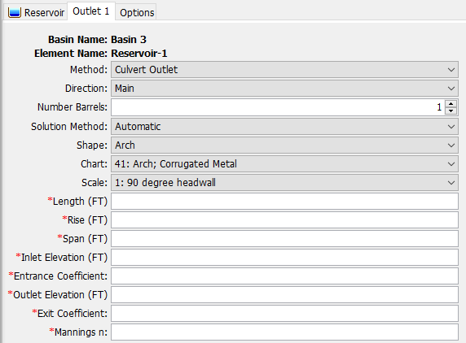
Outlets
Orifice Outlet
Culvert Outlet
Always submerged
Can flow partially full

Slide 24
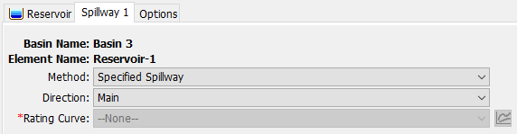
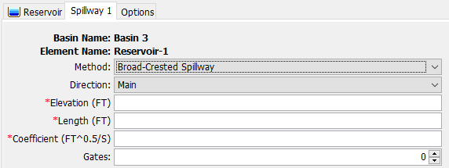
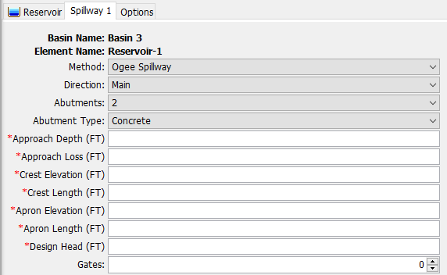
Spillways
Specified
Broad-Crested
Ogee

Slide 25
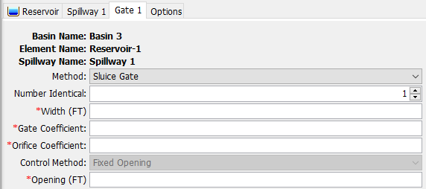
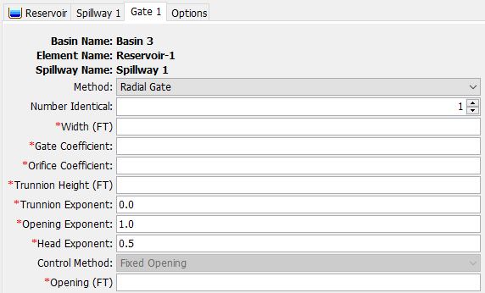
Spillway Gates
Sluice Gate
Radial Gate
Notes:
Note that the only control method is “Fixed Opening” – the gates do not move during the simulation. This will compute the hydraulics through a gate at a fixed setting.

Slide 26
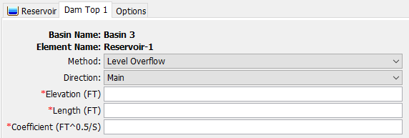
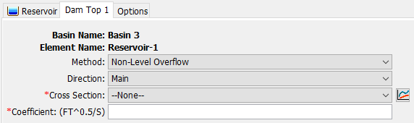
Dam Tops
Level
Non-Level

Slide 27
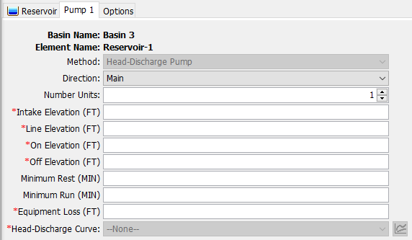
Pumps

Slide 28
Tailwater
Controls determination of submergence for structures
5 options:
Assume None
Reservoir Main Discharge (requires rating curve)
Computed at outlet – no backwater
Downstream of Main Discharge (requires rating curve)
Computed at next element downstream
Specified Stage (requires stage time series)
Fixed Stage

Slide 29
Outflow Structures – When to Use?
Complex combination of ungated hydraulic structures
Need to compute dam breaks, seepage, or evaporation

Slide 30
Rule-Based Reservoir Routing

Slide 31
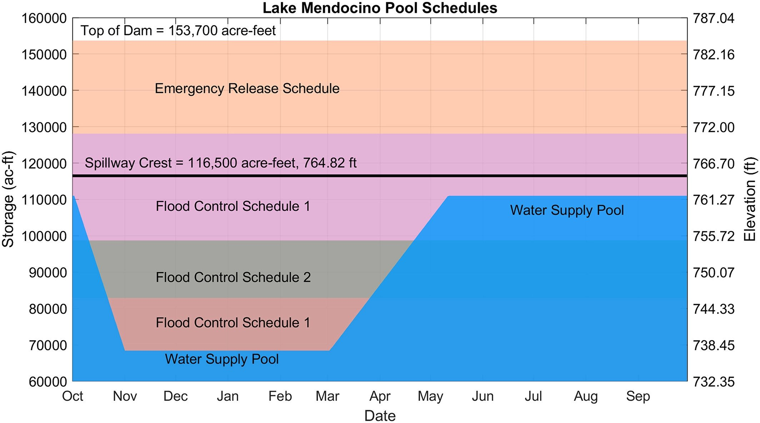
Guide Curve Operations
Notes:
There are three states in guide curve ops.
You can be right on the guide curve (see the yellow dot.) For the day of the year, the reservoir has the desired storage.
You can be above the guide curve (see the blue dot.) For the day of the year, the reservoir is storing more than desired.
You can be below the guide curve (see the orange dot.) For the day of the year, the reservoir is storing less than desired.

Slide 32
Basic Guide Curve Operation
Above the Guide Curve
increase releases as necessary (or possible) to lower the pool elevation to the Guide Curve.
Below the Guide Curve
reduce releases as necessary (or possible) to raise the pool elevation to the Guide Curve.
At the Guide Curve
release “just enough” to maintain the pool elevation at the Guide Curve
Notes:
Basic Guide Curve Operations
1.5-L-04
Klipsch 1.5-L-04
32
From HEC-ResSim Slide

Slide 33
Rule-Based Reservoir Routing
Extension of Outflow Structures routing method
Uses rules and operable structures to determine releases
Zones determine what rules are applied
Reservoir elevation
Day of the year

Slide 34
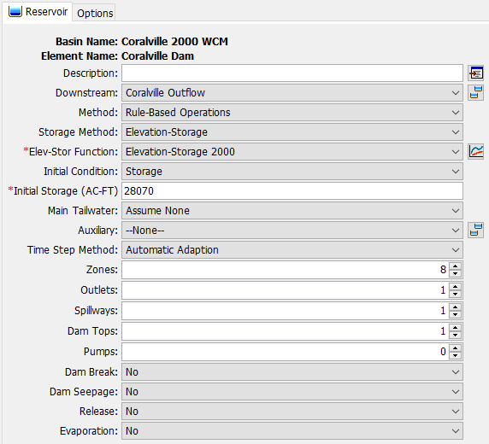
Rule-Based Reservoir Routing
Based on Outflow Structures
Additional control for Zones

Slide 35
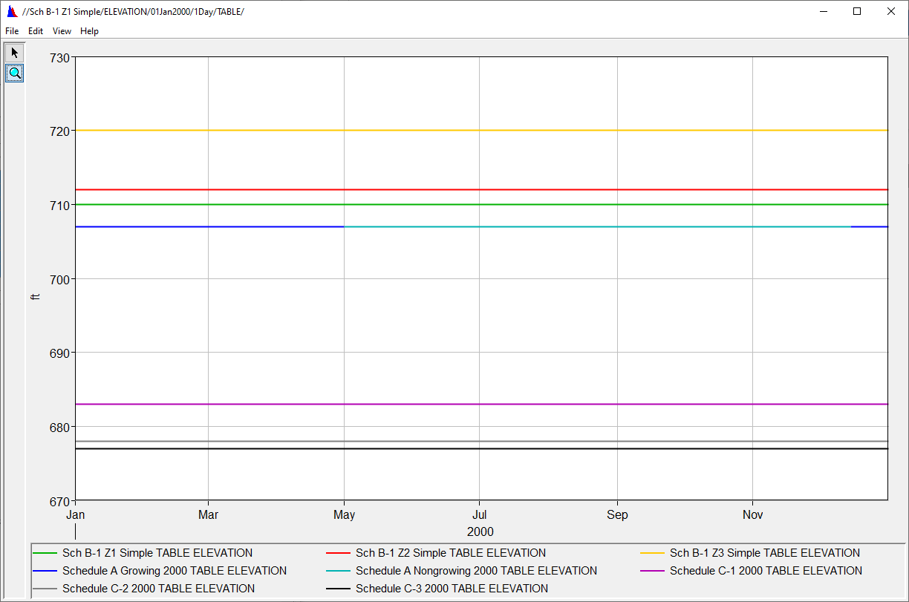
Zones
A grouping of homogeneous rules
Defined by an elevation range and day of year for each zone
Finds first Maximum Elevation curve above the current elevation/day
Need at least one for operations to work

Slide 36
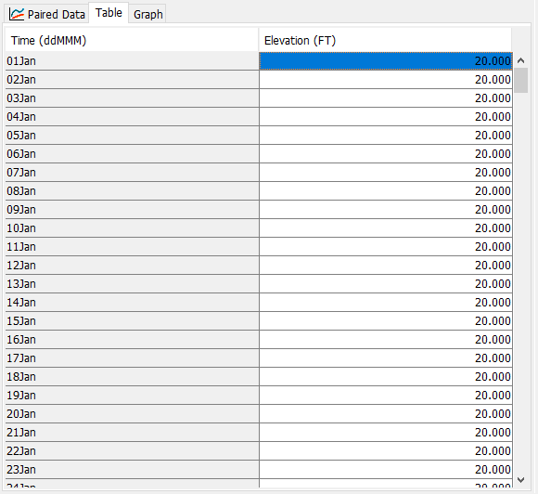
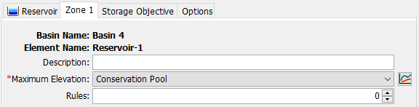
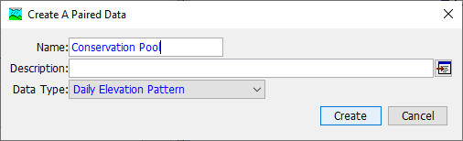
Maximum Elevation

Slide 37
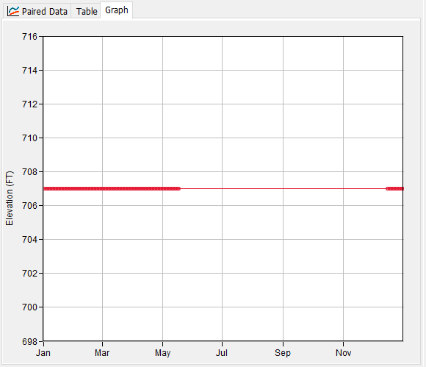
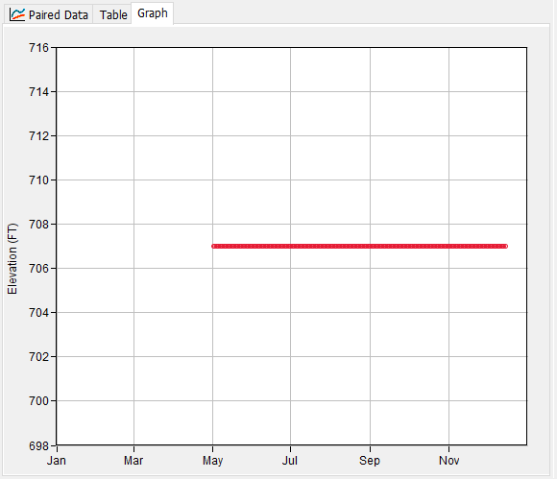
Maximum Elevation
Schedule A Non-Growing Season
Daily Elevation Pattern Paired Data
Top zone should cover entire range of elevations and dates
Curve does not need to be defined for every day of the year
If nothing defined, zone will not be used for that day
Schedule A Growing Season
Notes:
In the example on the right, a regulation manual calls its basic flood operations “Schedule A”. The dam has the potential to cause agricultural damages, so maximum releases are limited during the growing season compared to the non-growing season, so despite these having the same overall elevation (707 ft) the rules they contain would be different.

Slide 38
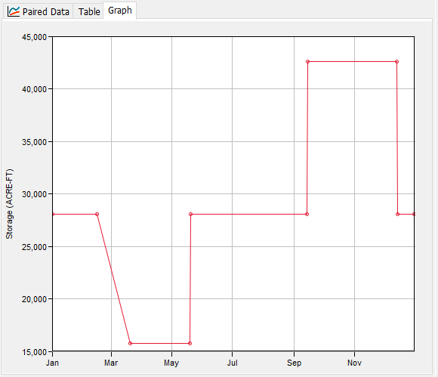
Storage Objective (Guide Curve)
For every day of the year, what is the desired storage?
Currently able to be defined for each zone
May change to a single guide curve in the future
Recommend using only one unless you have really specific needs
Flood Pool
Conservation Pool

Slide 39
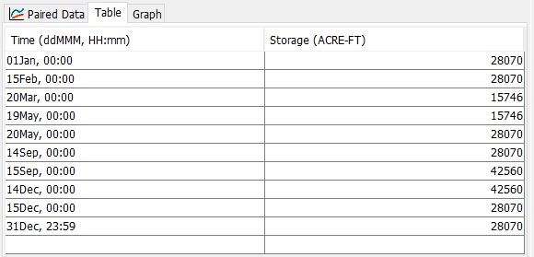
Storage Pattern
Interpolates between points
Needs to cover entire year

Slide 40
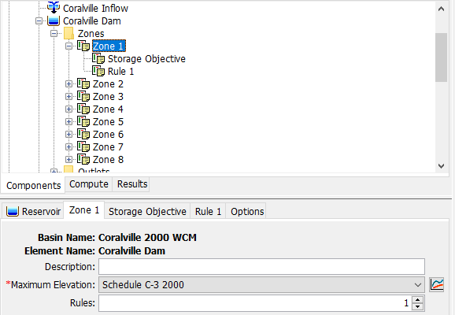
Rules
Added via Zone
Rules are specific to a single zone

Slide 41
Rule Types (10)
Type | Limits | Operation
Main Release | Min, Max, Specified | Sets a target for releases in the main direction
Auxiliary Release | Min, Max, Specified | Sets a target for releases in the auxiliary direction
Downstream Flow* | Min, Max, Specified | Sets a target for an element downstream
Rate of Flow Change | Max | Limits how much releases can change
*requires iterative trial releases

Slide 42
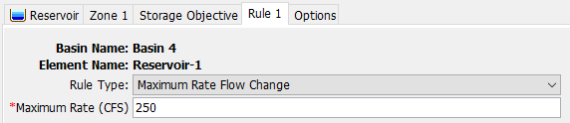
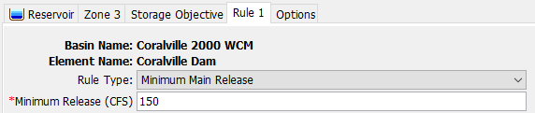
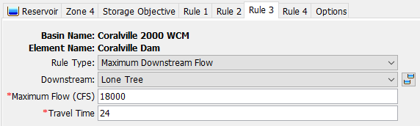
Rules
No limit to what you can specify
Try not to make them conflict

Slide 43
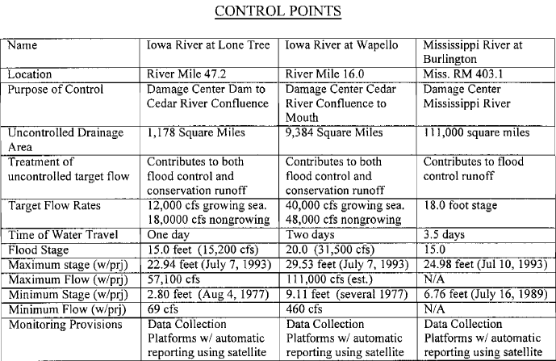
Downstream Controls
Require iterative trial releases
Significantly add to simulation time
Keep them as simple as possible

Slide 44
Outflow Structures
All features of Outflow Structures method available
Only some structures have parts that can be operated
Outlets
General Outlet
Gated Orifice
Broad-Crested and Ogee Spillways
Radial Gates
Sluice Gates

Slide 45


Gate Control Methods
Adjustable Gate Control
Fixed Opening
Percent Annual Pattern
Percent Time Series
Notes:
Adjustable gate control is what allows the rule-based operations to work.
Some structures (e.g. gated orifice, spillway gates) have a fixed opening option.

Slide 46
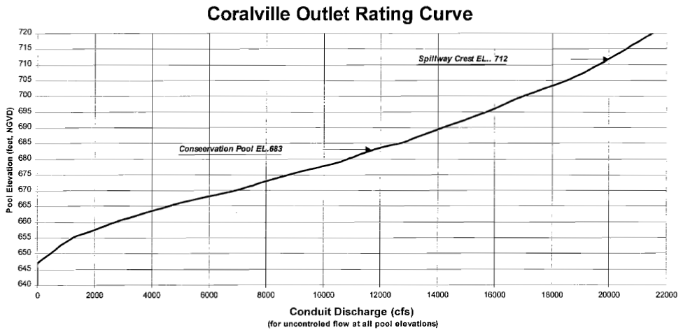
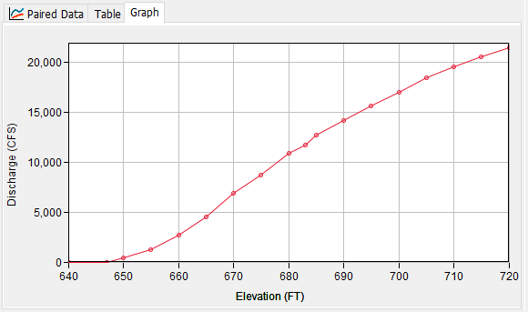
General Outlet
Simplified outlet based on rating curves
Min and max rating
Gates at 0% and 100% open
Specify from a regulation manual

Slide 47
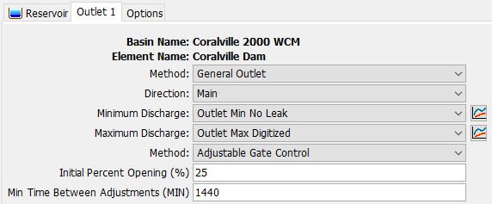
General Outlet

Slide 48
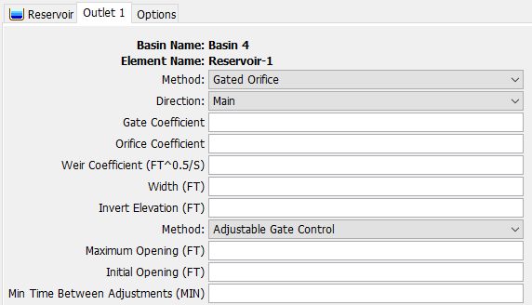
Gated Orifice Outlet

Slide 49
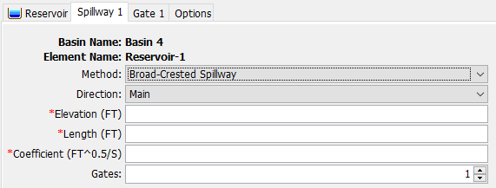
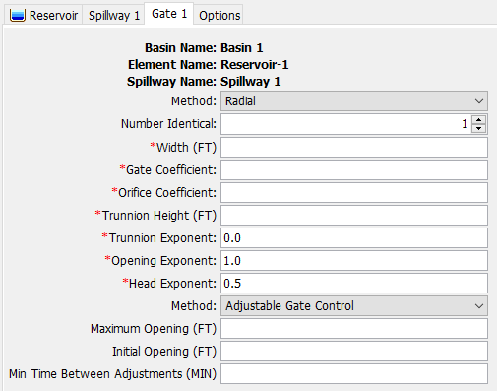
Gated Spillway
Operable sluice and radial gates for Broad-Crested and Ogee spillways

Slide 50
Calibration
Isolate reservoir by using a source element with a timeseries gage
Calibration by adjusting rules
These may deviate from the regulation manual
Add other rules or settings for stability
Rate of change rules help even if not included in WCM
Calibration by adjusting structures
Adjust rating curves for outlets or spillways using simple methods

Slide 51
Rule-Based Reservoir Routing – When to Use?
Storage target and releases vary seasonally
Complex rules and operable structures determine releases
You will be surprised how far you can get with simple guide curve operations for many models!

Slide 52
Reservoir Volume Reduction
Slides by Dr. Jay Pak

Slide 53
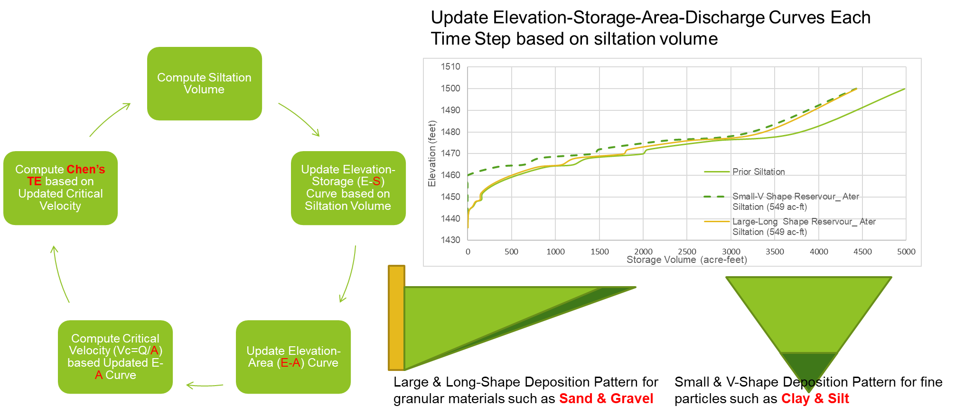
Reservoir Volume Reduction Process

Slide 54
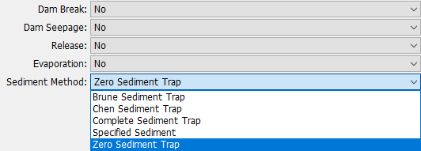
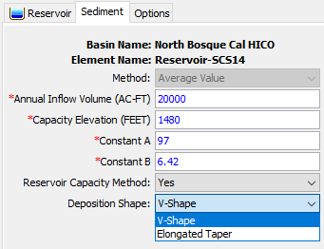
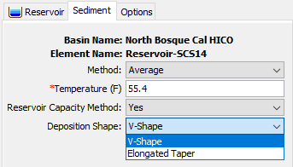
Reservoir Volume Reduction Chen & Brune Trap Efficiency
Notes:
Sediment must be turned on in the basin model in order to use these capabilities.

Slide 55
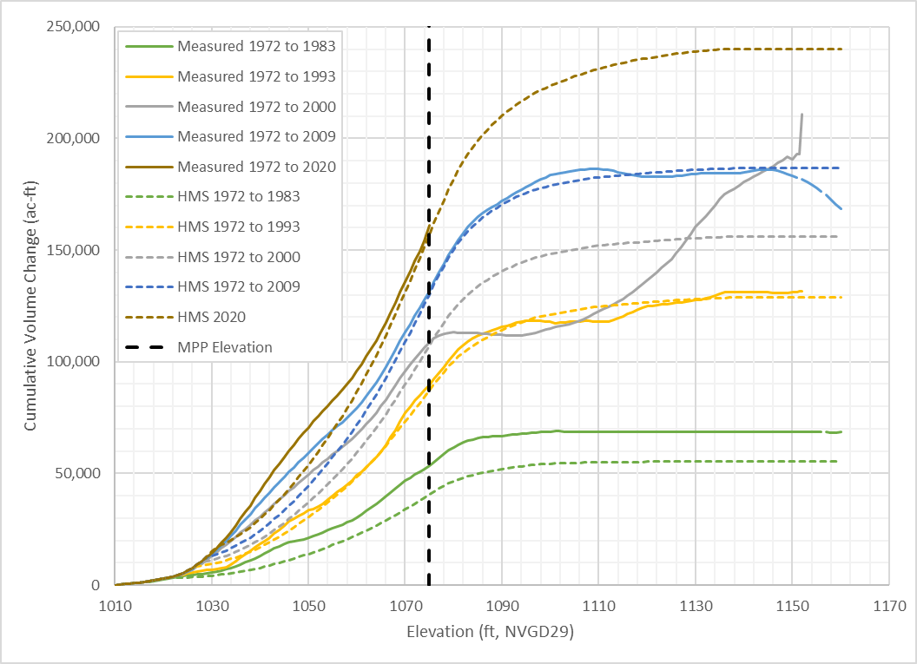
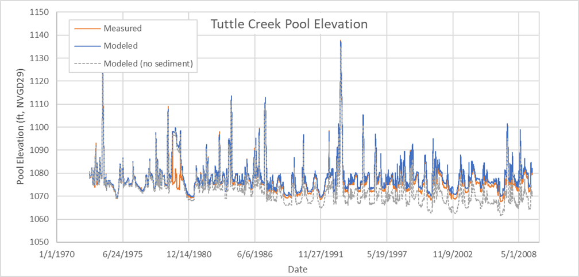
Tuttle Creek Results with Reservoir Volume Reduction

Slide 56
Questions?

