Slide 1
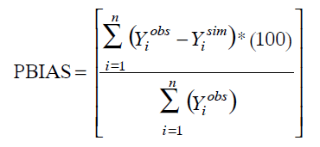
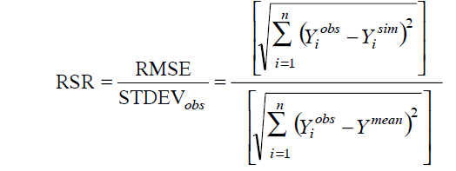
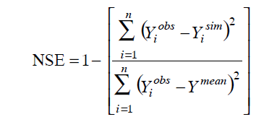
Calibration Metrics
The Nash-Sutcliffe efficiency (NSE)
is a normalized statistic that determines the relative magnitude of the residual variance (“noise”) compared to the measured data variance (“information”) NSE indicates how well the plot of observed versus simulated data fits the 1:1 line.
Percent bias (PBIAS) measures
the average tendency of the simulated data to be larger or
smaller than their observed counterparts,
RSR is the ratio of the RMSE and standard deviation of measured data
The optimal value of PBIAS is 0.0, with low-magnitude values indicating accurate model simulation. Positive values indicate
model underestimation bias, and negative values indicate model overestimation bias
RSR varies from the optimal value of 0 (perfect model
Simulation) to a large positive value.
NOTE:
Yi obs is the ith observation for the constituent being evaluated,
Yi sim is the ith simulated value for the constituent being evaluated,
Ymean is the mean of observed data for the constituent being evaluated, and
n is the total number of observations.
Modified from: Moriasi et al, 2007
Notes:
It is necessary for a model of something as complex as the flow of water through the environment to contain approximations and simplifications of the real world. Even if we could represent the entire watershed at the atomic level, the measurement of the physical properties of the watershed necessary to model all the physics would contain uncertainty. Then, applying the physics at that scale would be computationally prohibitive.
Models should be as simple of a representation of the system being modeled as needed to answer the question or perform the experiment. When several related processes are rolled into one algorithm to represent them, the parameters of that algorithm become more and more abstract and uncertain. While the parameters become more uncertain, their level of abstraction also lends them well to being determined empirically.

