Slide 1

Meteorologic Models
Historic Precipitation
Hydrologic Modeling with HEC-HMS
30 January 2024
Alex Flanigan
US Army Corps of Engineers
Omaha District

Slide 2
Objectives
Review the meteorologic model and its components
Discuss methods for precipitation, evapotranspiration, and snowmelt
Gain an understanding of when to apply each method and what data is needed

Slide 3
Meteorologic Model Overview
Overview
Precipitation
Evapo-transpiration
Snow

Slide 4
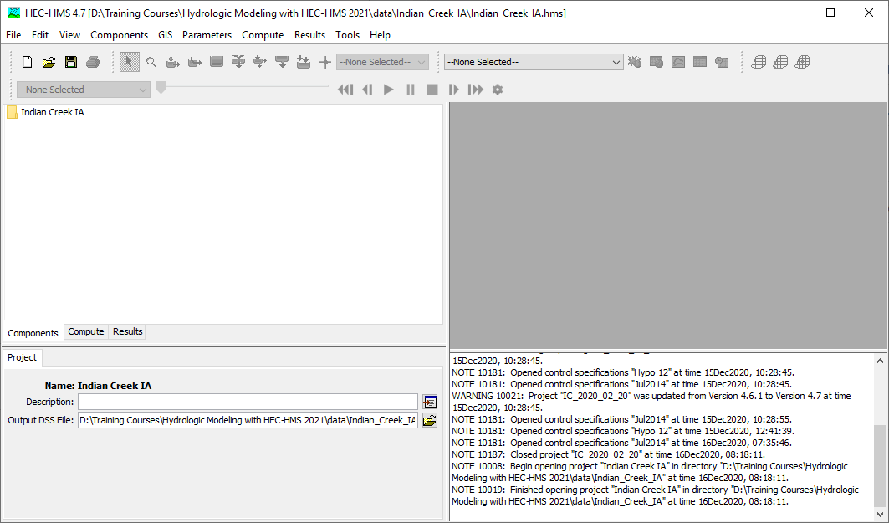
Watershed Explorer
Basin Map
Component Editor
Message Console
Notes:
Before we start discussing the meteorologic model, let’s go over a brief review of the HEC-HMS user interface.
The top bar of the window contains several menus. The most important menu for working with the meteorologic model is the Components menu.
Beneath the menu bar is a collection of toolbars. Aside from the well-known buttons on the left, these buttons and menus are mainly for working with the basin map and for viewing results.
The watershed explorer in the top-left contains an organized tree of all the components in the project. Components include things like basin models, meteorologic models and so on. As you add complexity to your project, the tree grows, and keeps everything organized.
The component editor in the bottom left lets you edit the component that you have selected in the watershed explorer. This is the most common way to change settings or parameters for components.
The basin map in the top right gives you a view of the basin model that you are currently working with.
The message console in the bottom right alerts you to what HEC-HMS is doing. It will display warnings and errors if they occur.

Slide 5
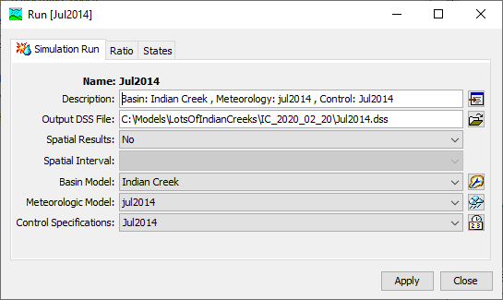
Simulation Run
Basin model
Meteorologic model
Control specification
Notes:
The simulation run is one type of simulation available in HEC-HMS and is the most used one. All simulation types require a basin model and a meteorologic model (the control specification is unique to the simulation run.)

Slide 6
Meteorologic
Model
Meteorology Model
Atmospheric boundary conditions
Basin Model
Notes:
Water can only enter the system in two ways in HMS: through a hydrologic element that produces discharge (e.g. source elements) or through the atmosphere.
A meteorologic model can be used with any number of basin models, as long as they are set up to do so.
The name is deliberate. The met model is more than just a set of data. It contains several models for representing atmospheric processes. However, it is not an atmospheric model in the vein of a weather forecast model or GCM. For example, there are precipitation methods that take precipitation gages as inputs and compute area averages from them in a couple of different ways. There are methods for computing potential evapotranspiration from atmospheric data. The met model controls simulation of snow accumulation and melt. And so on.

Slide 7
Meteorologic
Model
Meteorology Model
Atmospheric boundary conditions
Precipitation
Snowmelt
Potential ET
Solar radiation
Basin Model
Notes:
Water can only enter the system in two ways in HMS: through a hydrologic element that produces discharge (e.g. source elements) or through the atmosphere.
A meteorologic model can be used with any number of basin models, as long as they are set up to do so.
The name is deliberate. The met model is more than just a set of data. It contains several models for representing atmospheric processes. However, it is not an atmospheric model in the vein of a weather forecast model or GCM. For example, there are precipitation methods that take precipitation gages as inputs and compute area averages from them in a couple of different ways. There are methods for computing potential evapotranspiration from atmospheric data. The met model controls simulation of snow accumulation and melt. And so on.

Slide 8
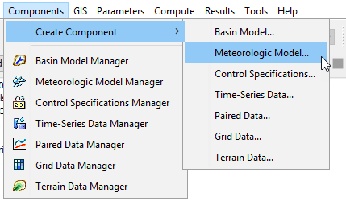
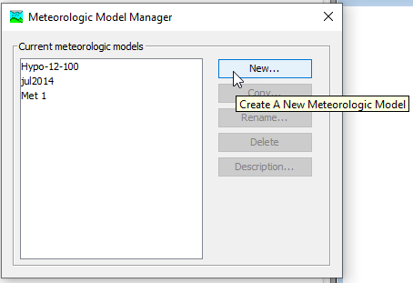
Creating a Meteorologic Model
Notes:
Met models can be created through the Components menu. All simulation types require a basin model and a meteorologic model. Precipitation is one of the modeling methods inside of a meteorologic model. The meteorologic model is meant to manage all the atmospheric boundary conditions necessary for hydrologic modeling.

Slide 9
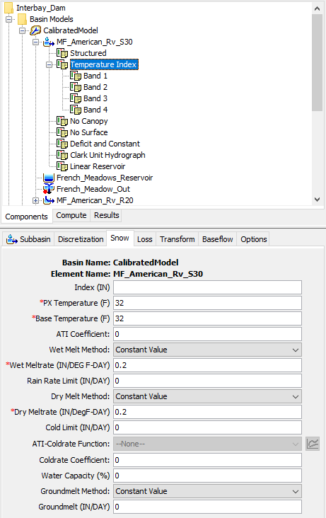
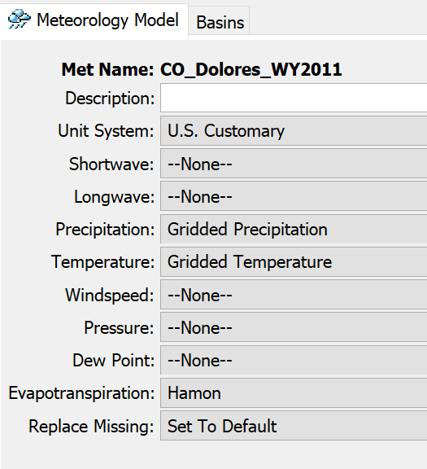
Meteorologic Model
User chooses methods for modeling each process
As of v.4.10, snowmelt is part of the basin model
Notes:
To access the component editor for the met model, click on the met model in the watershed explorer.
For each of the boundary conditions, there is a collection of methods for modeling it. Not all processes are necessary for all models, and the simplest models may only use precipitation. As methods are added, generally the data requirements increase. Some methods are more complex than others and require more types of data.
Each of these process are more than just data – they are models for representing states of the atmosphere and require data as an input. For example, note that there is no “temperature” process in the met model. However, temperature is a data input for snowmelt, evapotranspiration, etc.
You may notice there is no snowmelt option in the met model. As of HMS version 4.10, snowmelt has been migrated to the basin model since it is a land surface process.

Slide 10
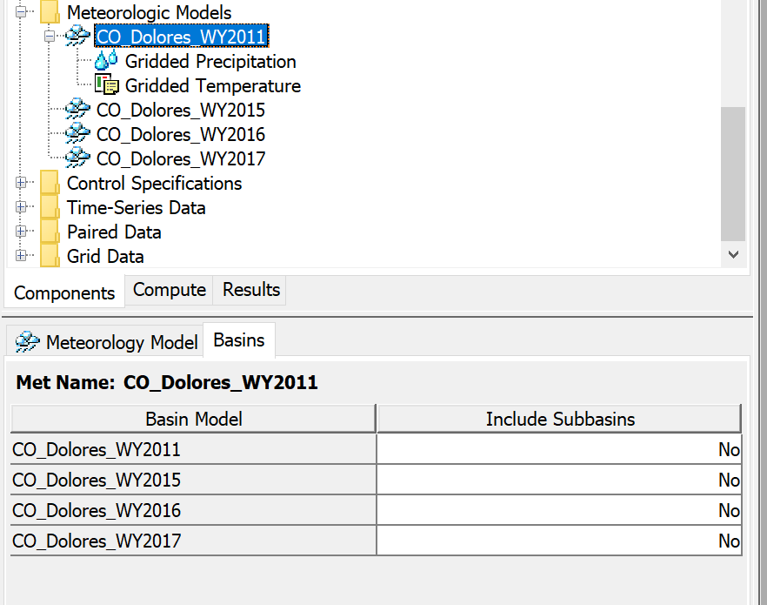
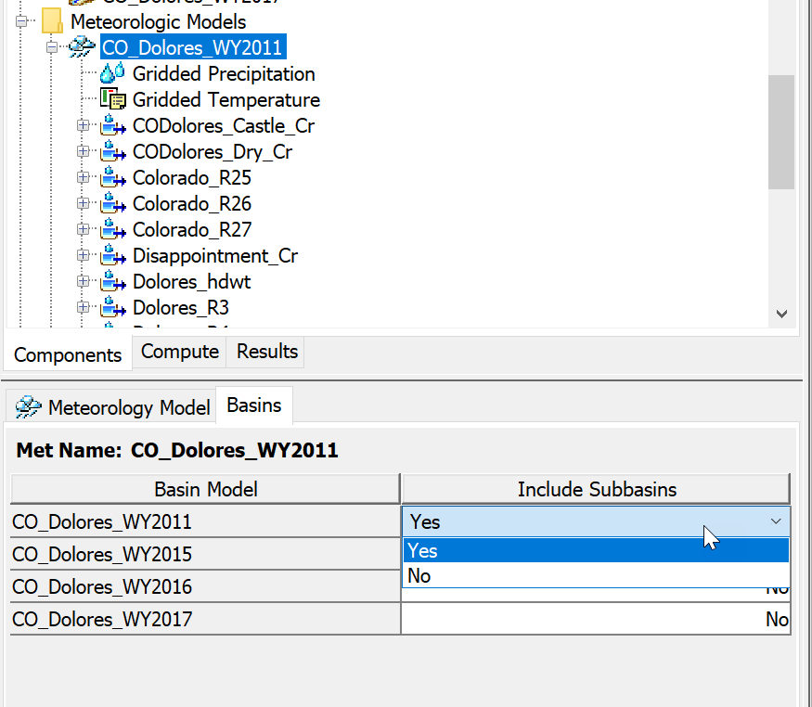
Include Subbasins
Notes:
Met models are independent of basin models – since they are general representations of atmospheric boundary conditions and can be set up to work with any basin model, they don’t know anything about a basin model unless you tell them.
In the component editor for the met model, there is a “basins” tab. Here you will see all the basin models in your project. If you want a basin model to be usable with this met model, you must select “include subbasins – yes” in this menu. Otherwise two things will happen. 1) you will not be able to set any subbasin-level settings or parameters if your methods have them and 2) the simulation run will fail and inform you that the met model is not set up to work with the basin model.
This is a common pitfall – it is easy to forget to set your met model and basin model to work together.

Slide 11
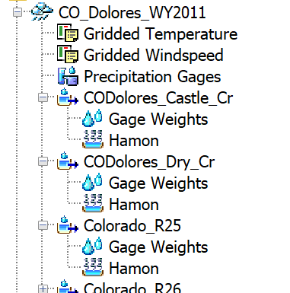
Watershed Explorer
Settings for entire met model
Met settings for subbasins
Notes:
You can specify whichever methods are appropriate for your modeling goals. Typically, at minimum a precipitation method will be specified.
In the Watershed Explorer, the selected methods will appear beneath the met model. Clicking on any of those will open the component editor below.
The topmost set of icons are for the processes that have been selected in the met model component editor. Clicking on any of these will let you edit settings for that method. The settings at this level are used across all hydrologic elements. However, some processes are controlled in a much more granular way, such as snowmelt. Gridded methods will eliminate a lot of granularity because they already explicitly handle the atmospheric process in space.

Slide 12
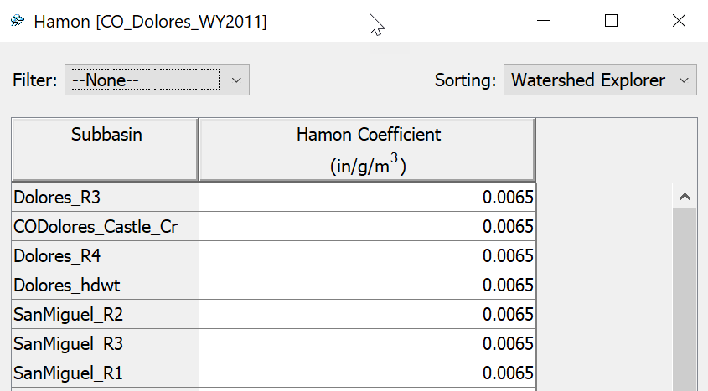
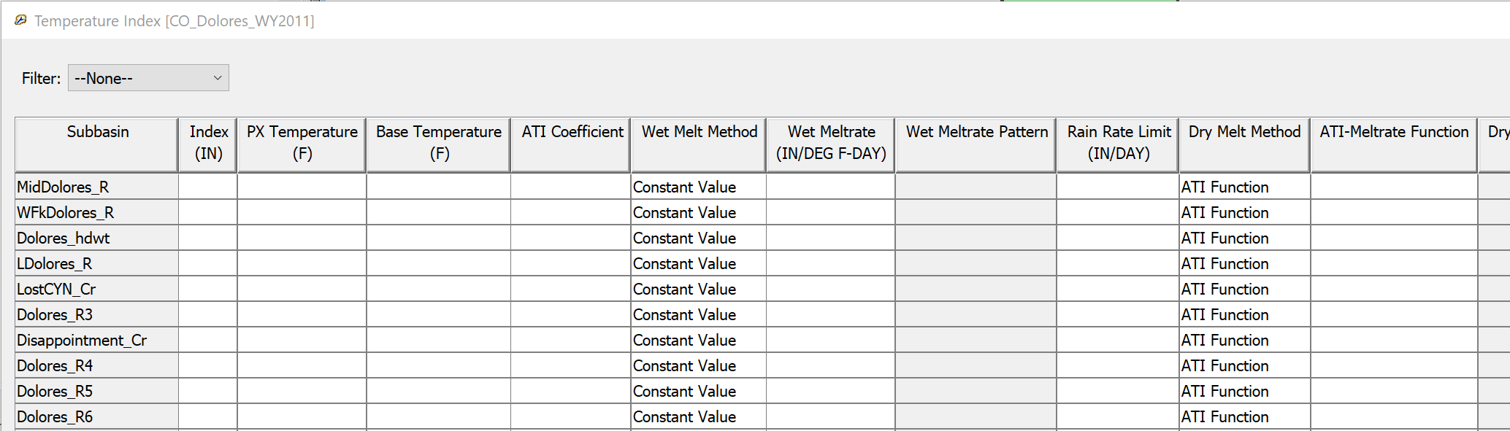
Global Editors
Hamon (Met Model)
Temperature Index (Basin Model)
Notes:
Here is an example of a global editor for the temperature index snowmelt method. Because the TI method has parameters that are controllable at the subbasin level, it can be cumbersome to click through each node of the watershed explorer tree to set them. The global editor is a faster way to enter these parameters. You can open the global editor for snowmelt by selecting the met model in the watershed explorer, then choosing the Parameters menu, and selecting Snowment then temperature index (or gridded temperature index.)

Slide 13
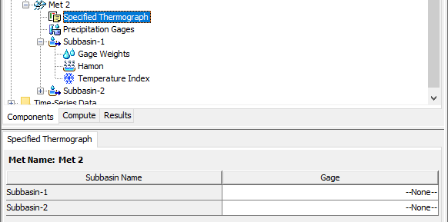


Data Requirements
Non-gridded
  At the Met Model or Subbasin level
Gridded
  At the Met Model level
  Should cover entire modeling domain
Notes:
For non-gridded methods each met variable has a few methods for specifying information. For example here in temperature, the “Specified Thermograph” method lets you link a temperature gage directly to a subbasin. For precipitation there’s “Gage Weights” that lets you combine up multiple gages for a subbasin. There are also interpolated methods for many met variables that allow you to specify how to interpolate several gages to a subbasin.
For gridded methods, grids of meteorologic data should cover the entire modeling domain. These models are explicitly georeferenced, meaning the location of all the hydrologic elements and the meteorologic data are known, and referenced to a common datum. Gridded precipitation and temperature (and other gridded met variables) link directly to a gridset. Processes like ET or snow look to the met model for the variables they need in order to compute – for example gridded Hamon and gridded TI require temperature data. In this met model they would look to the temperature gridset specified in the Gridded Temperature method.
Creating the required data, and details on the meteorological methods are covered in other tutorials.

Slide 14
Precipitation Methods
Overview
Precipitation
Evapo-transpiration
Snow

Slide 15
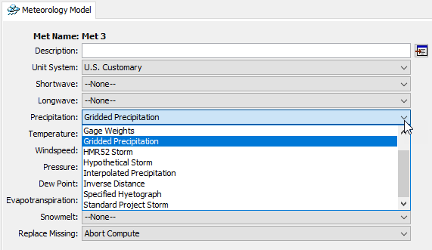
Setting a Precipitation Method
Set the method in your meteorologic model
Notes:
If there are subbasin elements in your basin model, you will be required to choose a precipitation method in order to run the model. It can be selected in the meteorologic model component editor.
Let’s take a look at the most important precipitation methods in HEC-HMS.

Slide 16
What is my modeling goal?
I am trying to reproduce a precipitation event that occurred in the past.
  Historical storm method
I am trying to design something, perform a risk analysis, or otherwise model an idealized event.
  Hypothetical storm method
Notes:
There are two categories of precipitation methods in the HEC-HMS meteorologic model. HMS doesn’t label the methods with these categories, but it’s valuable to know which methods are related and what they are intended for.
Historical storm methods help you create precipitation boundary conditions for a storm or a period of time that has already occurred, so that you can simulate the hydrology for some time in the past. They may also be used creatively to model future forecasted conditions or other hypotheticals, but their primary purpose is representing past precipitation.
When you are designing something, performing a risk analysis, or doing any other kind of hydrologic analysis that makes many simplifying assumptions about the behavior of precipitation in space or time, hypothetical storm methods are the precipitation methods to use. These are also sometimes called design storms, or synthetic storms, but the idea is that they do not represent a specific storm event that has occurred. Instead, it is a generalization of storm behavior that allows the user to specify something interesting for design or analysis purposes.

Slide 17

Historical Storm Methods
Gage weights
Gridded precipitation
Interpolated precipitation
Inverse distance
Specified hyetograph
→ Key: driven by observed precipitation data
Notes:
Historical storm methods are means for providing precipitation boundary conditions to a basin model in a way that it reasonably represents an event that occurred in the past. Historical events are unique like fingerprints or snowflakes, varying in precipitation depth, temporal and spatial pattern, and so on. These methods intend to capture the things that make an event unique.
When you are calibrating a hydrologic model so that it represents a real watershed, use of a historical storm method is necessary. You need to represent the input precipitation as well as you can in order to isolate the uncertainty in the model to just the hydrologic parameters.
These are listed in the order HMS shows them. The first two we will cover in more detail later in the presentation.
Gage weights is a method for combining information from multiple precipitation gages and can vary the combination of gages for each subbasin in the model.
The controls for the gage weights method are at the subbasin level, since each subbasin has its own combination of gages that you can set. The selections tab lets you choose which of the precipitation gages to use for the selected subbasin. The weights tab lets you set the depth weight and time weight for each gage.
You would use this method when you have gage data scattered across your watershed, and you want control over how each one is used to estimate the volume and timing of precipitation for each subbasin.
The controls for gridded precipitation are very simple – choose a precipitation gridset. If there are time zone issues (for example your observed flow data and precipitation data are in different time zones) you can shift the precipitation grid times by whole hours.
The gridded precipitation method is very simple to set up, because most of the hard work is handled by the data itself. These grids are at a regular time interval, so that controls any temporal patterning. The grids themselves contain spatial patterns. The data are spatially-referenced, and the sub-basins know their locations if the model is georeferenced. This means that setting up the model is very simple.
If you have gridded precipitation data, you should use it. This is the method we recommend today.
Gridded precipitation is just what the name says: a way to use gridded precipitation products as a boundary condition.

Slide 18
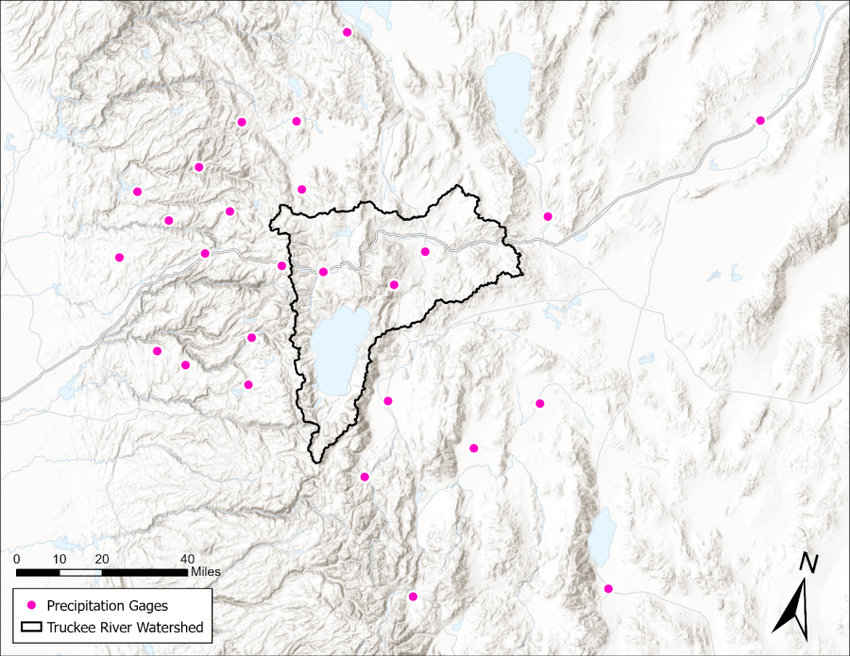
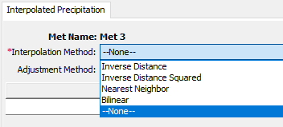
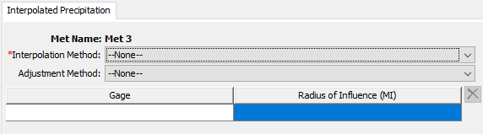
Historical Storm Methods
Gage weights
Gridded precipitation
Interpolated precipitation
Inverse distance
Specified hyetograph
Notes:
Interpolated precipitation is a generalized framework for interpolating precipitation gages to a grid

Slide 19
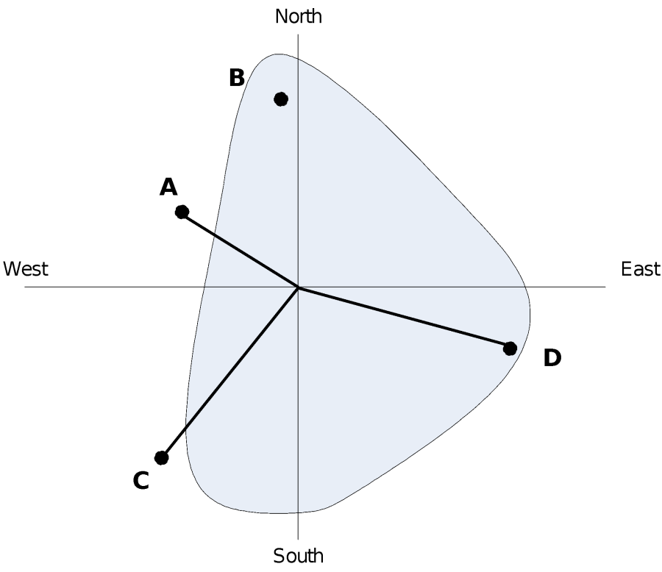
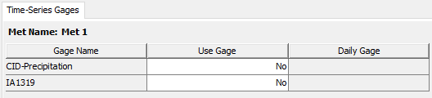
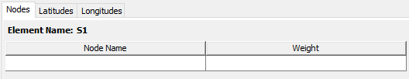
Historical Storm Methods
Gage weights
Gridded precipitation
Interpolated precipitation
Inverse distance
Specified hyetograph
Notes:
Inverse distance is also a method for combining information from multiple precipitation gages using inverse distance interpolation.
Inverse distance weights the gages based on their location, which means the latitude and longitude information must be specified.
This method can be useful when you want to take the work out of estimating how gages contribute to a basin average, and want the inverse distance routine to figure it out. It can run into challenges when dealing with averaging time patterns, so the gage weights method can be preferable.

Slide 20
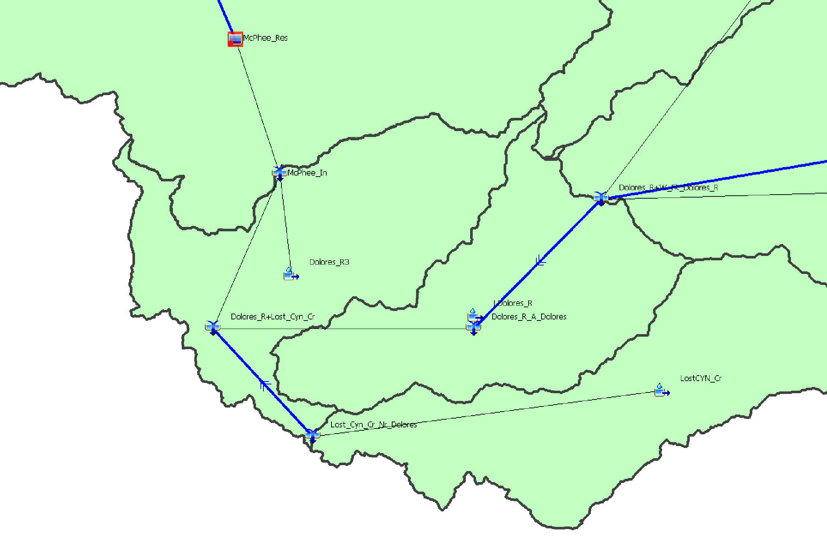
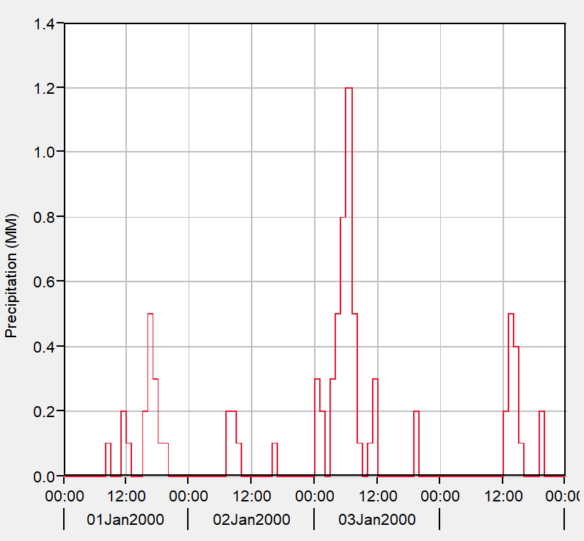
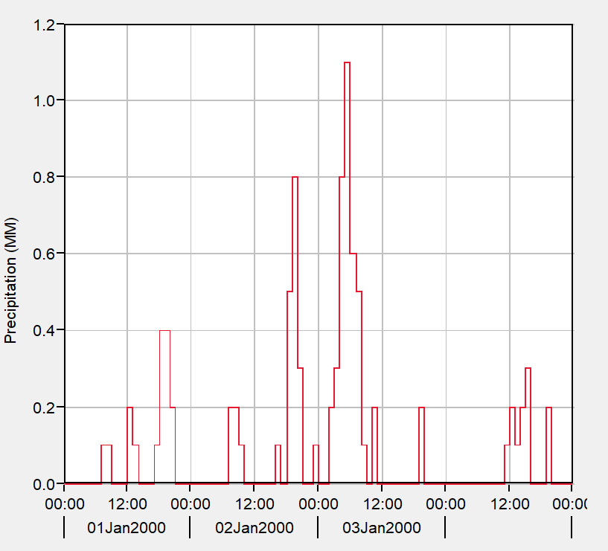
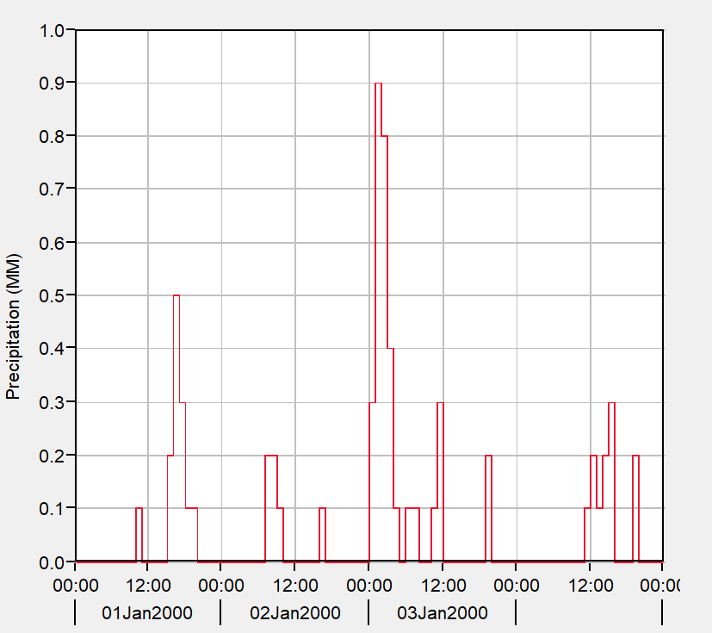
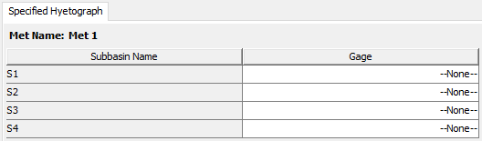
Historical Storm Methods
Gage weights
Gridded precipitation
Interpolated precipitation
Inverse distance
Specified hyetograph
Notes:
Finally, the specified hyetograph method is a simple way to represent precipitation for each subbasin in the model. Each subbasin gets its own precipitation gage. This can be a “real” gage, i.e. a weather station, or you can externally compute the subbasin-averaged precipitation using another method, and feed it in this way.
The specified hyetograph method is very straightforward – for each subbasin, choose a precipitation gage.
This method is very flexible and you might use it for a number of reasons. The most common usage today is when precipitation timeseries for each subbasin are computed externally to HEC-HMS, and you want HMS to apply exactly that precipitation data. The biggest advantage is that this method is the most performant method in HMS, requiring no additional computation steps to apply precipitation to a subbasin.
One other application that isn’t strictly a “historic” event would be using HMS for forecasting – however, the input data is probably from a model that reasonably represents the coming precipitation, and a good model will be close to the precipitation that actually occurs.

Slide 21

Hypothetical Storm Methods
Frequency storm
HMR52 storm
Standard project storm
Hypothetical storm
→ Key: intended to model highly idealized storms, usually for design
Notes:
Hypothetical storms are also called design storms, or synthetic storms. They control for a small number of design criteria, and then make a large number of simplifying assumptions about the remainder of a storm’s properties. These methods will not be covered in detail during this course, but more information can be found in the HMS user’s manual, and with the HMS tutorials and guides online.
Frequency storm is a very specific method for defining a storm pattern using precipitation-frequency information. It was designed to work with older precipitation-frequency information, such as HYDRO35, TP40, or TP49. Today, the recommendation is to use the hypothetical storm method instead.
The HMR52 storm is meant to perform probable maximum flood analyses for the central and eastern United States. It has a very specific application and is not intended for general use.
The standard project storm is no longer used in practice; however, HEC-HMS maintains this capability in order to support older projects where it may still be necessary. This storm has an extremely specific application and should not be used for general modeling.

Slide 22
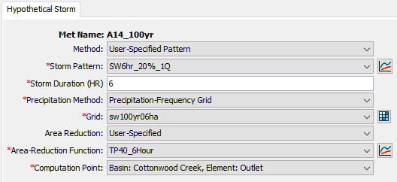
Hypothetical Storm Methods
Frequency storm
HMR52 storm
Standard project storm
Hypothetical storm
Notes:
The hypothetical storm method is a flexible and generalized modeling method that subsumed the old SCS storm methods of HMS 4.2.1 and prior. It allows a user full control over the storm temporal pattern, point-to-area conversion, and can be used directly with precipitation-frequency grids from NOAA Atlas 14. I highly recommend this method for all idealized storm modeling needs. Tutorials on this method are available online with the HMS tutorials and guides.
The hypothetical storm method offers the user a lot of control, so there are many settings to be specified for it to run. This instance of the hypothetical storm requires the user to specify a dimensionless storm temporal pattern, a storm duration, a precipitation-frequency grid to pull depth information from, an area reduction method, an area reduction function, and a computation point to compute the storm area for.
Of the hypothetical or synthetic storm methods, this is the most flexible and applicable one. Unless you have specific project needs that require one of the other methods, it is recommended to use this method.

Slide 23
Gage Weights
Overview
Precipitation
Evapo-transpiration
Snow
Gage Weights
Gridded Precip

Slide 24
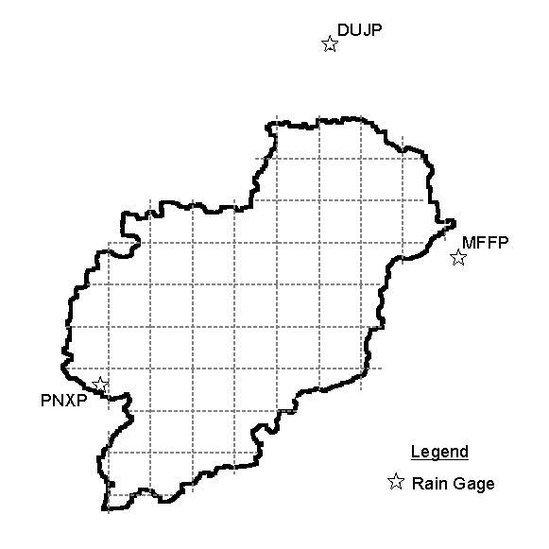
Gage Weights Precipitation Method
Pros
  Flexible
  Accounts for space and time variation
  Can be calibrated
Cons
  Still dependent on gage data
  Up to you to determine weights
Notes:
Gage weights is recommended for the general case of dealing with multiple imperfect precipitation gages used to estimate precipitation in a subbasin. Consider the figure on the right – there are three gages, which is fortunate. However, it’s hard to say if any of these will represent the rainfall for the watershed well. It’s likely that a combination of the three could work, because the three gages span the basin. Gage weights let you decide how these three gages will combine to estimate the precipitation over the subbasin of interest. You can specify how each of these gages combine into the basin average estimate.
For events where radar data aren’t available, this method offers the most control over using gages for watershed modeling. It gives you options to combine gage data in various ways, account for gauges with varying time resolution or no time information at all, and adjust for variations in climatology.
However, there is a significant hitch in all of this – gages have to be available for the event you are trying to model. In some areas, gages are sparse, and you must do your best to find the best available information. For small watersheds, there may not be any gages inside the boundary at all, and you may be making estimates using gages that are distant. Luckily, this method gives you several controls that let you adjust how these gages are combined to achieve the optimal result.

Slide 25
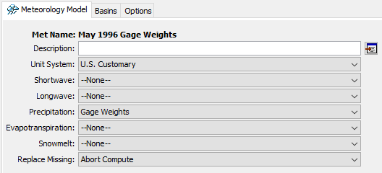
Setting Up A Gage Weights Model
Notes:
First, as always, create a new meteorologic model, by selecting one of the options in the Components menu. Then, in the met model component editor, select the Gage Weights method for precipitation.

Slide 26
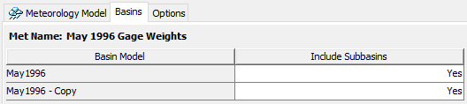
Include Subbasins
Notes:
This step is often forgotten, but what it does is tells the met model which subbasin elements are going to be controlled. Switch to the Basins tab of the met model editor. Here, you can decide which basin models are usable with the met model by selecting Yes for Include Subbasins. When the subbasins are included, they appear beneath the met model in the watershed explorer.
If you want to use multiple basin models with a met model, this can get cluttered sometimes, especially if your basin models have a lot of elements. For organization purposes, it can make more sense to make a copy of the met model and set up met models so they are 1:1 with basin models.

Slide 27
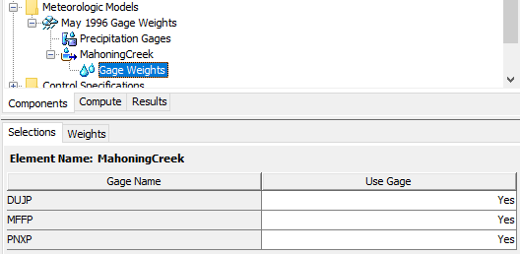
Use Gages
Notes:
This step tells the subbasin which gages will be used in the computation step. Expand the subbasin node of the watershed explorer, then select Gage Weights underneath it. On first click it will take you to the weights tab, where you will notice that there are no gages listed. Don’t panic, you need to switch over to the Selections tab and turn on any gages. If you don’t see any gages on this tab, that means you haven’t set up any precipitation gages yet. To do that you’ll need to create some time series components. Review that video if you need a refresher on how to do that.

Slide 28
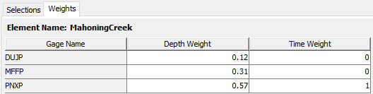
Weights
Notes:
After enabling some gages, you’ll be able to give them weights on a subbasin-by-subbasin basis. There are two types of weights: depth, and time.
Depth weights set what the total volume of rainfall will be for the simulation.
Time weights set how the time pattern will be computed for the simulation.
These values don’t have to add up to 1, but HEC-HMS will normalize the values during the simulation so that they do.

Slide 29
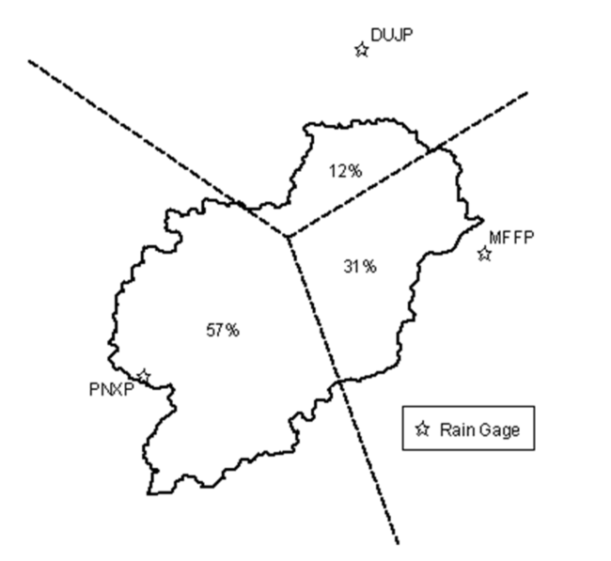
Estimating Depth Weights
Notes:
You are free to determine the depth weights in whatever method you find appropriate, but a good starting point is to use the Thiessen polygon method. This method tells you how much of the watershed is closest to each precipitation gage you are using. The percents can be used as weights directly. If you have a shapefile of your watershed and the gage locations, generating Thiessen polygons and intersecting them with the basin polygon is trivial in GIS.

Slide 30
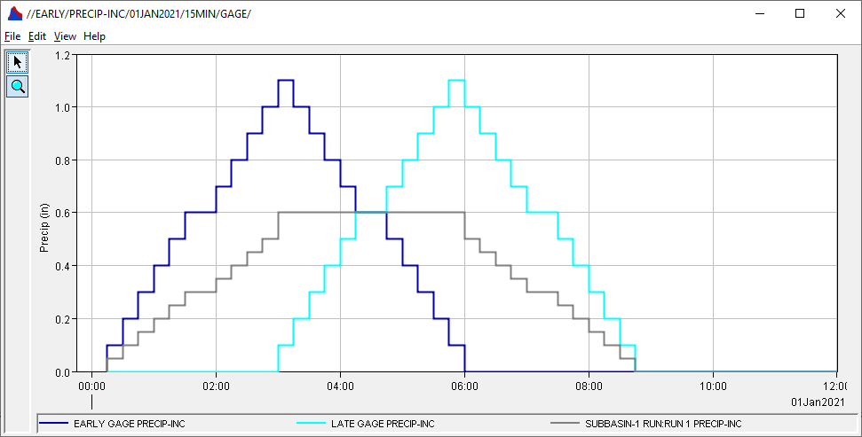

Estimating Time Weights
Best practice: use a weight of 1 for the “best” gage, considering:
  Granularity of data – finer is better
  Location of gage – near the center of subbasin is better
Use 0 for the rest
Notes:
For time weights, the best practice is to not average together gages to get a time pattern. If your precipitation stations have different time resolutions (for example one at daily level, and one at hourly), consider choosing the one with the finer time step to give you better estimates for the precipitation at shorter time steps. Also consider the location of the stations – if you have one near the center of the subbasin, it probably represents the rainfall inside the subbasin better than ones outside of it.
The effect of time-averaging is shown in the graph. Here, two completely made-up gages (in dark blue and light blue) were given an equal depth weight and time weight. When HMS computed the basin-averaged precipitation, the result is the grey Mayan Pyramid…
If you want to make sure you’re capturing the peak intensity of this storm, then time-averaging two non-coincident peaks will result in a hyetograph with a broad, flat peak, which may not be what you desire. If this helps describe the storm as it occurred in your watershed, feel free to break with best practices. However, if you’re finding that you’re underestimating peak storm intensity and you’re using time averaging, consider trying something else.

Slide 31
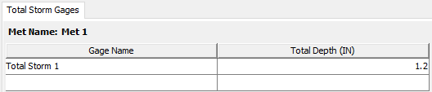
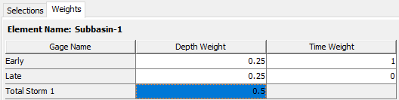
Total Storm Gages
Total precipitation known
Time distribution unknown
Notes:
In some situations, especially when modeling the most extreme of extreme floods, there are observations for total storm depth, but no time information was captured. Sometimes these are called “bucket surveys” and are literally an open container of some kind that was left outside (intentionally or not) during a storm event and filled up with water. You can add a total storm gage by filling in the row of the Total Storm Gages table under the Precipitation Gages node. It asks for a name, and a total depth. When you add this information, this gage will be selectable in the Selections tab, and then you can give it a depth weight, but not a time weight, because it has no timing information.

Slide 32
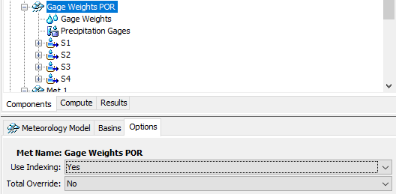

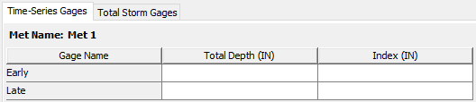
Optional Settings in Met Model Editor
Use Indexing
  Adjust for climatology
Total Override
  Override total depth for a gage
Notes:
If you click on the met model and switch over to the Options tab, you’ll see two options: “Use Indexing” and “Total Override”. These give you even more control over how HMS computes properties of the storm.
Enabling indexing adds an extra node underneath the met model, and also adds a new tab under the “precipitation gages” node that’s already there.
Indexing allows you to adjust gage depth averaging to account for variation in things like climatology. For example, in a mountainous area where the annual total precipitation changes quite rapidly with elevation, you may choose to use the annual total precipitation to adjust your estimate for how the depth should be applied to the subbasin. You would set the annual total precipitation for each gage in the Index column of the Time-Series Gages table, and then set the value for annual total precipitation in the Index column of the Gage Weights table. This lets you account for systematic differences in how precipitation might be recorded due to gage location. For small project areas this may not be necessary, but for larger project extents where the behavior of precipitation varies significantly, this allows you to adjust the estimated precipitation for the subbasins of interest.
Total override allows you to set the total depth for the gage instead of letting HMS compute it by taking the total of all timesteps in the gage entry.

Slide 33
Gridded Precipitation
Overview
Precipitation
Evapo-transpiration
Snow
Gage Weights
Gridded Precip

Slide 34
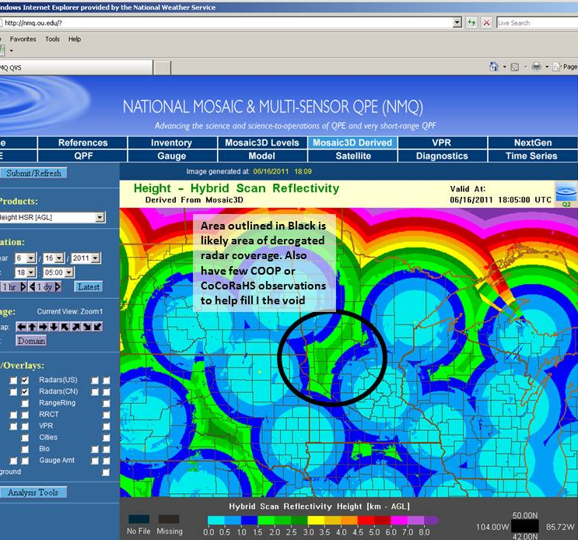
Gridded Precipitation
Pros
  Spatially distributes precipitation
    Ex: RADAR vs. precip gage
  Increasing number of sources available
    National & Local Availability
Cons
  May require conversion
  Quality of data varies
    Quality control recommended
      Gage comparison
      RADAR coverage
Notes:
The primary benefit of applying gridded precipitation to an HMS model is that the precipitation is then spatially distributed across the watershed as it’s been observed by RADAR or other products (versus a lump measurement being applied homogenously across the entire basin). Another positive note is that an increasing number of gridded precipitation sources are becoming available.
One slight drawback is that available gridded datasets may require conversion from their native format to an HEC-DSS record to be usable within HMS. However, conversion tools are available to make most conversions quick & easy!
It’s also important to note that the quality of the various available gridded datasets will vary. When selecting a gridded precipitation source, it’s recommended to perform spot-checks against established precipitation gage sites to determine how accurate that particular source is within your watershed. If applying RADAR data, a visual of RADAR coverage throughout the watershed may help with product quality control as well.

Slide 35
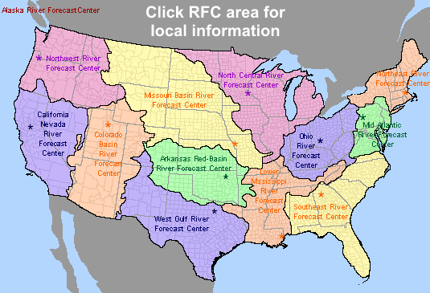
Gridded Precipitation Sources
National Products
  National Digital Guidance Database (NDGD) (2007-Present)
Regional Products
  NWS River Forecast Centers NEXRAD
CWMS
  USACE Water Management data
Add’l Other Products
Notes:
There are an increasing number of gridded precipitation products available. This includes both nationwide products as well as more locally developed sources such as from your local National Weather Service River Forecast Centers. Some of the most popular products include:
The National Digital Guidance Database (NDGD) has Real-Time Mesoscale Analysis (RTMA) hourly precipitation available for CONUS for download from 2007 to present.
NEXRAD RADAR data is a NWS product available regionally. There are currently 160 operational NEXRAD radar systems deployed throughout the United States and at selected overseas locations. Stage III and Multisensor Precipitation Estimator (MPE) products are hourly precipitation estimates that are computed by taking raw radar measurements and applying corrective algorithms. Rain gage data and satellite images are used to “correct” the raw data. Estimates from multiple radars are mosaicked together to create a precipitation grid (HRAP) for the entire river forecast center region. The period of record for NEXRAD data varies regionally.
There are several more gridded precipitation products available than those listed here and the quality of each product can greatly vary by region. As part of the USACE Corps Water Modeling System (CWMS) efforts, most USACE districts currently have real-time gridded precipitation products included within their Water Management server databases. It’s highly recommended to discuss the data available through CWMS with your local water management staff when searching for gridded precipitation products as there has likely already been some searching and testing of the available precipitation products within your region completed.
Also, as part of the USACE CWMS model development, many districts have gridded precipitation data available for their region on their water management servers.
Dipper.nws.noaa.gov/hdsb/data/nexrad/nexrad.html

Slide 36

Converting & Creating Precipitation Gridsets
Utilities available:
  HEC-HMS | Vortex
    Most file types can be imported directly within HMS using the Vortex tools
      NetCDF, Grib, HDF, ASC & more
    Also allows for clipping, re-projecting, resampling, normalization, etc.
  Interpolated Methods
    Create grids by interpolating point values
Notes:
Once you’ve decided to apply gridded precipitation to your model, how do you convert the raw precipitation data to an HEC-DSS file for use in HMS?
There are a few options available for converting formats or creating grids—
HMS can actually import select gridded file formats directly into HMS—(File > Import > Import Gridded Data…for more information, please see the Shared Data Components: Grid Data lecture).
VORTEX tool which can convert several native data formats to HEC-DSS, allows for additional spatial manipulation during the processing and is also user-friendly. More information on the VORTEX tool is included in a later lecture.
Interpolated methods – similar to the old gageInterp program, but completely contained within HEC-HMS; creates grids by interpolation. These methods take point data (such as rain gage data) and create grids where the value for each cell is computed by weighting values from all gages within a specified distance. Weights can be computed using a simple average or distance.

Slide 37
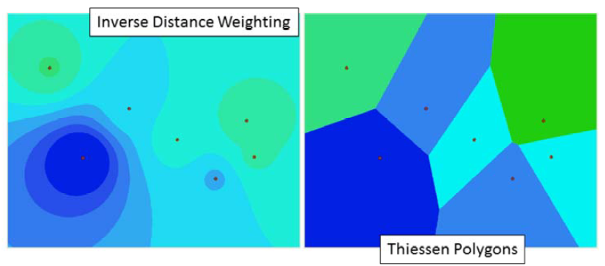
Creating Precipitation Gridsets from Point Data
Interpolated Precipitation Method
  Converts observation points to grids
Notes:
When creating precipitation grids from observed gage data, the Interpolated Precipitation method is useful.
This method takes point values, like those from precipitation gages, and creates grids by interpolation.
The value at each grid cell is estimated by calculating a weighted average of all gages located within a certain distance.
The weights are computed by taking a simple average or using distance to gages.
The figures on this slide show two examples of distance being used to compute a weight. The figure on the left was computed by giving more weight to the closest gage.
Grid cell values become similar to gage values the closer they are to the gage (bulls-eye). The figure on the right was computed by assigning grid cell values using only the closest gage--using the Thiessen Polygon method (any point, or grid cell in this case, within a polygon is closer to that gage than any other).

Slide 38
Gridded Precipitation
DSS Pathnames for Grids in HEC-HMS
/A-part/B-part/C-part/D-part/E-part/F-part/
A – grid system (SHG, HRAP)
B – region or watershed name
C – the data variable (precip, temp, …)
D – starting time for grid (ex: 04JAN2021:1500)
E – ending time for grid (ex: 04JAN2021:1600)
F – additional identification (e.g. obs, radar, NWS, …)
Notes:
When converting or creating gridded datasets, it’s important to clearly name the resulting DSS-file pathnames so that it is clear where the data came from, the extent of the data and—most importantly—the data type and time.
The recommended naming convention for gridsets and parameter grids are shown on this slide. HEC-HMS requires specific C-part names. The program will not use the grid unless the C-part name is correct (the next slide shows correct C-part names for each grid type).
Gridsets, precipitation, temperature, solar radiation and crop coefficient will have both D and E-part pathnames. The parameter grids do not need E-part pathnames and only the parameter grids used by snowmelt require D-parts.

Slide 39
Gridded Precipitation
Grid Type | C-Part | Units | Data Type
Precipitation | PRECIPITATION | MM, IN | PER-CUM
Temperature | TEMPERATURE | DEG C DEG F | PER-AVER INST-VAL
Solar Radiation | SOLAR RADIATION | WATT/M2 LANGLEY/M IN | PER-AVER INST-VAL
Crop Coefficient | CROP COEFFICIENT | UNSPECIF | PER-AVER INST-VAL
Storage Capacity | STORAGE CAPACITY | MM, IN | INST-VAL
Percolation Rate | PERCOLATION | MM/HR IN/HR | INST-VAL
Storage Coefficient | STORAGE COEFFICIENT | HR | INST-VAL
Moisture Deficit | MOISTURE DEFICIT | MM, IN | INST-VAL
Impervious Area | IMPERVIOUS AREA | % | INST-VAL
SCS Curve Number | CURVE NUMBER | UNSPECIF | INST-VAL
Elevation | ELEVATION | M, FT | INST-VAL
Cold Content | COLD CONTENT | MM, IN | INST-VAL
Cold Content ATI | COLD CONTENT ATI | DEG C DEG F | INST-VAL
Meltrate ATI | MELTRATE ATI | DEGC-DAY DEGF-DAY | INST-VAL
Liquid Water | LIQUID WATER | MM, IN | INST-VAL
Snow Water Equivalent | SWE | MM, IN | INST-VAL
Grids must have:
  Correct C-part pathname
  Correct units
  Valid Data type
  Values for each grid cell
Notes:
HEC-HMS will not load a grid if the C-part pathname, Units or Data Type is incorrect. The table on this slide contains the correct C-part pathnames, Units and Data Type for each grid type in HEC-HMS.

Slide 40
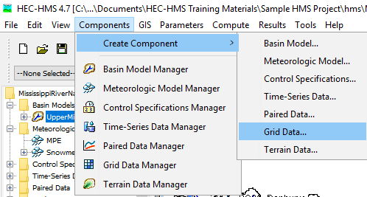
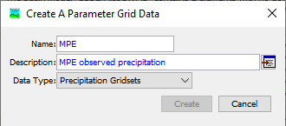
Adding Gridded Precipitation to HMS
Notes:
Once gridded precipitation has been converted to the HEC-DSS format and clearly labeled, it is ready to be added to the HMS model.
To create a precipitation gridset in HMS: Components > Create Component > Grid Data…
Within the Create a Parameter Grid Data dialog, ensure Precipitation Gridsets is selected as the Data Type and be sure to name and describe the precipitation data you are importing.
Select Create to add the grid to the Gridded Data Manager

Slide 41
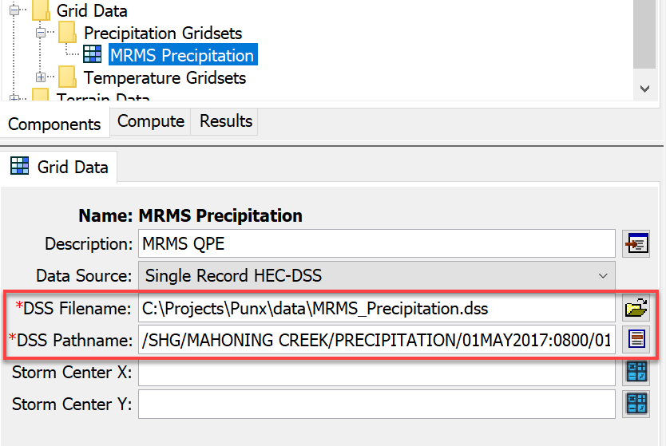
Gridded Data Manager
Notes:
Once the precipitation gridset is created and named, it is added to the Gridded Data Manager within the watershed explorer dialog.
Now, the gridded DSS record must be linked to the precipitation gridset by navigating to the dss file and selecting the appropriate pathname.

Slide 42
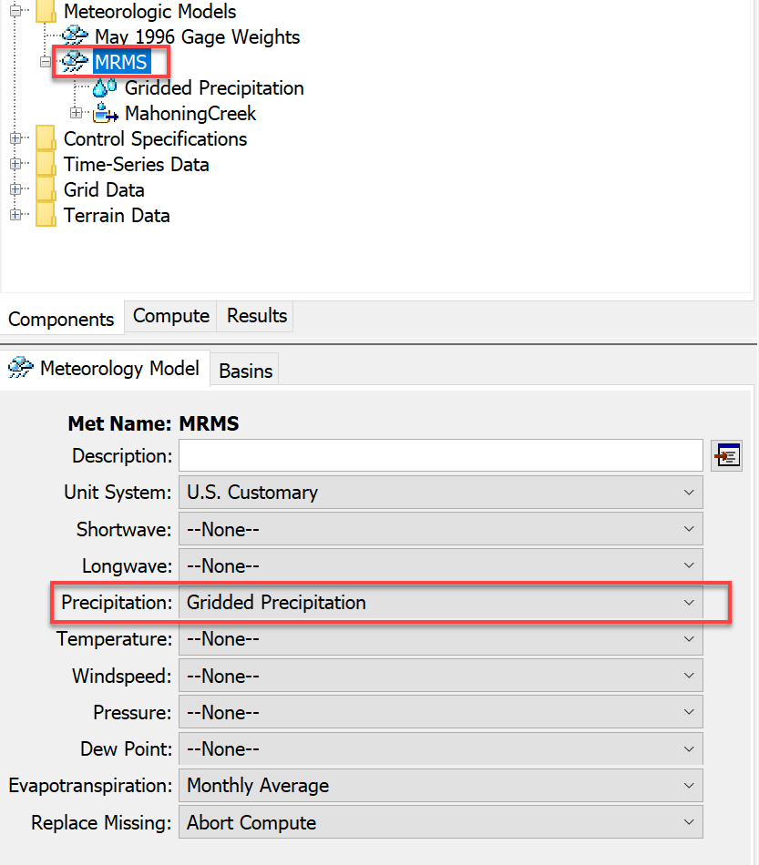
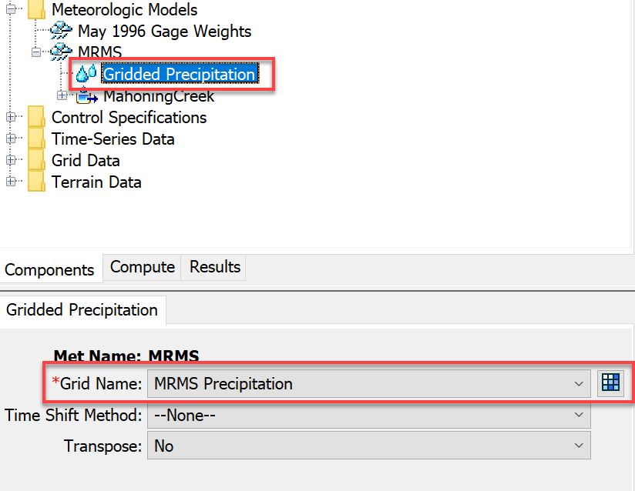
Linking Gridded Precipitation to Met Model
Notes:
Next, the meteorologic model must be configured to use gridded precipitation by highlighting the Meteorologic Model name and selecting Gridded Precipitation
The gridded precipitation data must then be linked to that Meteorologic Model by highlighting Gridded Precipitation and selecting the name of the precipitation grid in the dialog box below.

Slide 43
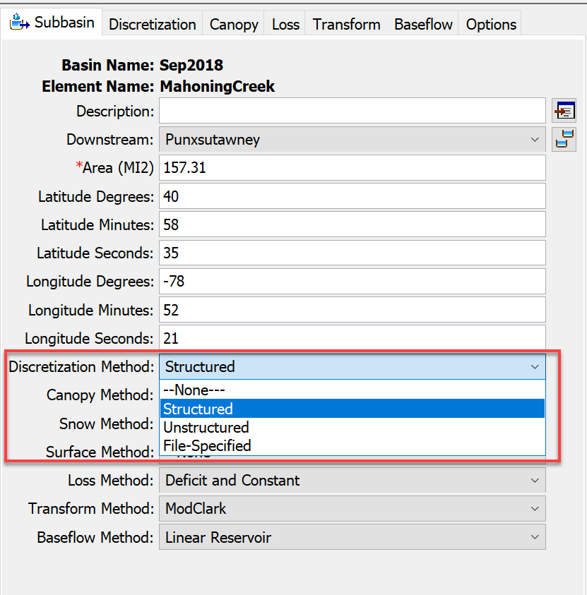
Defining Discretization
Required to run HMS with gridded components
Spatially relates gridded datasets to subbasins
Specified by subbasin
Four Discretization Methods:
  Structured
  Unstructured
  File-Specified
  None
Notes:
Defining a discretization method is required to run HMS with spatially-discrete components such as precipitation gridsets. Defining the discretization allows the HMS model to spatially relate gridded components (precip, storage, etc.) to subbasin elements, enabling spatial variability within each subbasin vs. applying a singular value throughout the entire subbasin (ie, lumped-parameter).
Discretization is defined by subbasin and has four methods to choose from.

Slide 44
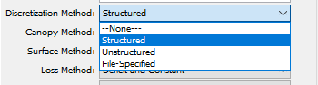
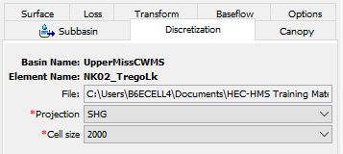
Defining Discretization
Four Discretization Methods:
  Structured*
    “Automatic” Method
    Defaults to standard SHG grid & 2-km cell size
  Unstructured
    Any coord. System
    Allows unstructured grid such as RAS plan files (ex: *.p##.hdf)
  File-Specified
    Points to HEC-HMS “Grid Cell Files” (*.mod)
  None
    “Lumped-Parameter”
    No variation within subbasin
Notes:
The “Structured” discretization method is a quick & easy approach to discretizing the model as it applies the Standard Hydrologic Grid (SHG) at a resolution. The structured method can also be used to apply a Universe Transverse Mercator (UTM) projection and various grid cell sizes ranging from 50 to 10,000 meters.
The Unstructured Method allows the application of any coordinate system (not just SHG or UTM) and can be easily defined with HEC-RAS plan files.
File-Specified allows the user to point directly to the HEC-HMS grid cell file (that was required in HMS version 4.2 & older).
Defining a “None” discretization assumes no variation of variables within the subbasin, resulting in a “lumped-parameter,” non-gridded approach.
Once the Discretization has been defined, the gridded precipitation can be added to a Simulation and the HMS model can be run.

Slide 45
Evapotranspiration
Overview
Precipitation
Evapo-transpiration
Snow

Slide 46
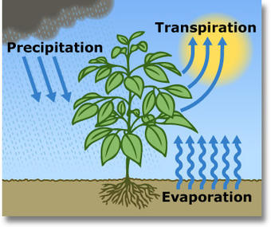
Role of Evapotranspiration
ET comprises two processes:
  Transpiration from plants
  Evaporation from surfaces
Key component of continuous hydrologic models
  Significant moisture is lost to the atmosphere
  Deficits created through ET
Notes:
A good continuous hydrologic model requires evapotranspiration modeling, especially for multi-year simulations. ET removes water from the soil and transmits it to the atmosphere, which can create a moisture deficit prior to flood events that reduces or eliminates direct runoff early during a precipitation event. HMS can simulate surface evaporation, plant canopy evaporation, and plant transpiration.

Slide 47
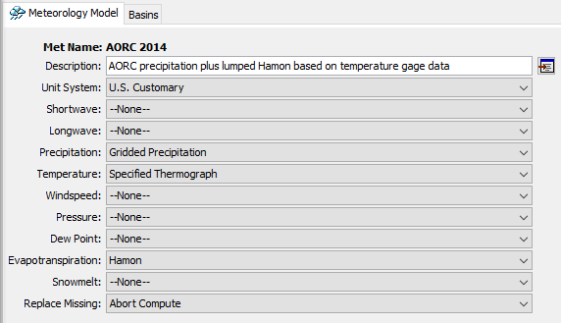
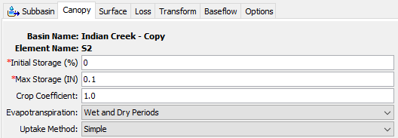
ET Modeling Requirements
Meteorologic model method
  Computes potential/reference ET
Canopy method in basin model
  Computes actual ET
  Creates moisture deficit
Notes:
In order to simulate the ET part of the water cycle in HMS, two components are needed.
The meteorologic model allows HMS to use atmospheric data to estimate the potential evapotranspiration. PET is dependent on the energy input and the ability to transport evaporated water vapor away from the surface, but is not limited by the supply of water.
Actual evapotranspiration is handled by the basin model. Within the subbasin component is the canopy method, which serves two purposes. The first is to model canopy interception. The second is to compute the actual amount of water that can be evaporated and transpired. The maximum amount is the potential evapotranspiration, but this amount is reduced depending on the type of vegetation (controlled by the crop coefficient) and is also reduced by the availability of water. At the maximum deficit, no more water can be transpired to the atmosphere.

Slide 48
Simple Canopy Settings
Evapotranspiration timing
  Wet and dry periods
  Only dry periods
Uptake method
  Simple
  Tension reduction
    SMA only!
Notes:
The simple canopy method is what you should use in the vast majority of cases. The storage terms control interception. The ET settings are below – you can choose your crop coefficient, during which periods actual ET is computed, and the uptake method. Unless you are using the SMA loss method, use the simple uptake method.

Slide 49

ET Impact
Max Deficit
Daily Actual ET
Initial
Deficit
Notes:
When performing continuous modeling using loss methods, for example deficit and constant or SMA, deficit increases when plant uptake draws water from soil storage. If no method for increasing deficit is specified, soil storage will fill up and infiltration will only occur at the specified constant rate.
Here is an example of the impact of modeling ET on the soil moisture deficit. The initial deficit is zero. No water is input to this system. The diurnal cycle of ET creates a stair-step shaped accumulation of deficit until the maximum deficit is reached. The steepness of the growth is controlled by atmospheric conditions and the crop coefficient. The initial and maximum deficit are controlled by the subbasin loss method.

Slide 50
HMS – a spectrum of ET methods
Monthly Average
Priestly-Taylor
Penman-Monteith
Hamon
Hargreaves
Simple
Complex
Typical Methods
+ gridded options
Notes:
HMS includes a range of evapotranspiration methods. The simplest is to choose the monthly average value, which for some regions may be published data. Data and modeling requirements go up as you move to the right. The Hamon method is a temperature-based PET method, which approximates the energy balance using temperature data. The other methods begin to require radiation, wind speed, and relative humidity data. In data limited environments, the first two methods are usually adequate. Consider the role of ET in your model – if you are most interested in large flood peaks, then spending a lot of time on additional details for ET may not make sense.
Most of these methods have gridded counterparts as well, where the input data is specified with grids instead of time series.

Slide 51


Calibration Considerations
Changing ET parameters can change overall water volumes
Two primary changes:
  ET method coefficients
  Crop coefficients
Notes:
Only consider making adjustments to ET parameters if there is volume error that you suspect is attributable to a mismatch in the type of vegetation in play. In some locations, using a crop coefficient equal to 1.0 is not reasonable when the vegetation tends towards higher ET, for example corn during the peak of its growth. You can also toggle between whether or not HMS will compute ET during periods when precipitation occurs.

Slide 52


Dynamic Canopy
In long hydrologic simulations where vegetation changes drastically throughout the year, a dynamic canopy method may help
Notes:
For long-term continuous hydrologic modeling, HMS is capable of simulating a dynamic canopy, which varies the crop coefficient throughout the simulation using a time series gage or a gridset that you provide. I would only suggest using this approach in situations when modeling soil moisture deficits throughout the year can’t be captured with a single crop coefficient.

Slide 53
Takeaways
Evapotranspiration
  Important for continuous hydrology models
  Requires a canopy method in the subbasin
  Simple methods typically adequate
Notes:
Here are the three key takeaways for evapotranspiration modeling in HMS. First, ET is an important part of continuous hydrology models. Second, in order to compute actual evapotranspiration, a canopy method is required for your subbasins. Finally, the simplest methods for ET and canopy are typically adequate – use methods with fewer data requirements where you can.

