Slide 1
Shared Data Components
Hydrologic Modeling with HEC-HMS
30 January 2024
David Bogema
US Army Corps of Engineers
Nashville District

Slide 2
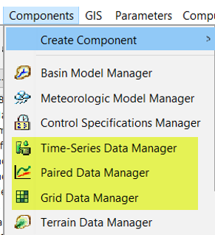
Overview
Introduce shared data in HEC-HMS
Discuss shared data types:
  time-series data
  paired data and
  gridded data
Demonstrate how to import and use each data type within HEC-HMS
Notes:
This will be a very hands-on how-to lecture with lots of demos.
We will talk about what shared data is, where it can be found, types of shared data in HEC-HMS, and how it’s used in the program.

Slide 3
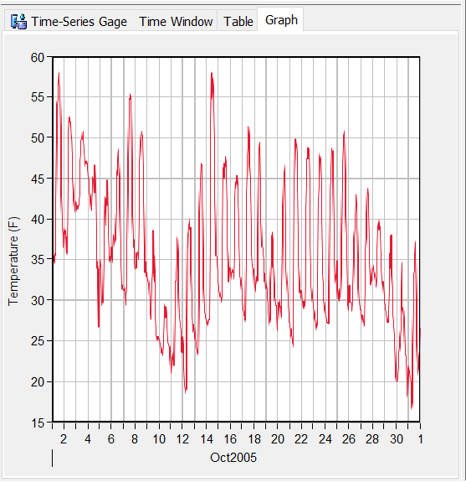
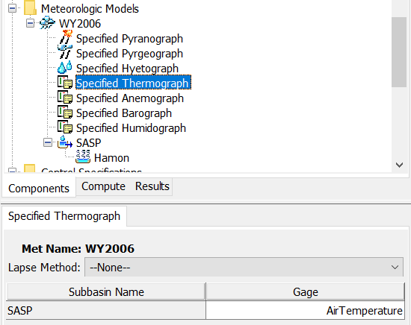
Example of shared data use in HEC-HMS
Air Temperature Gage
Add to Met Model
Compute Priestly-Taylor ET
Compute Snow Water Equivalent time series in Energy Budget snow model
Notes:
Shared data can be shared by different model components, such as multiple met models, or land processes in basin elements.
For example, air temperature gage can be added to a meteorological model and then can be used together with solar radiation gage to compute ET in Priestly-Taylor method,
As well as , in combination with a few other inputs, for computing snow water equivalent in the subbasin process of Energy Budget snow model.
-

Slide 4
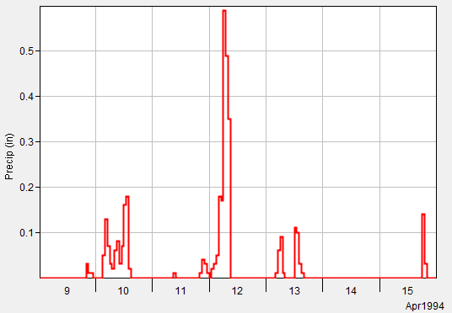
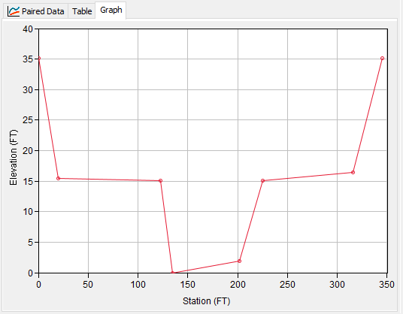
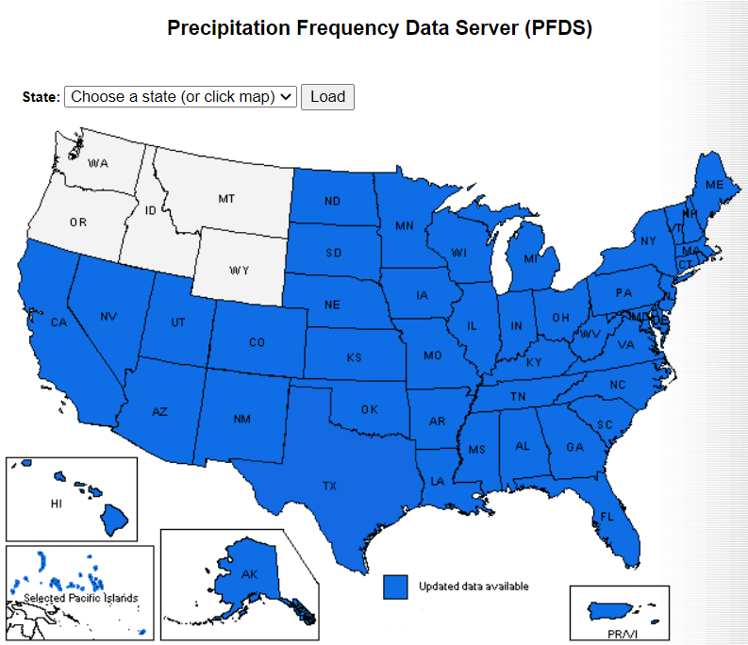
Types of Shared Data
Time-Series Data
Paired Data
Gridded Data
Terrain Data
https://hdsc.nws.noaa.gov/pfds/
Notes:
There are four types of shared data in HMS. Will discuss the first three.
Terrain data was introduced in the lecture and workshops for HEC-HMS delineation tools

Slide 5

PAIRED DATA
USGS Rain Gage
Image Credit: USGS
https://waterdata.usgs.gov/md/nwis/uv/?site_no=392703076162801

Slide 6
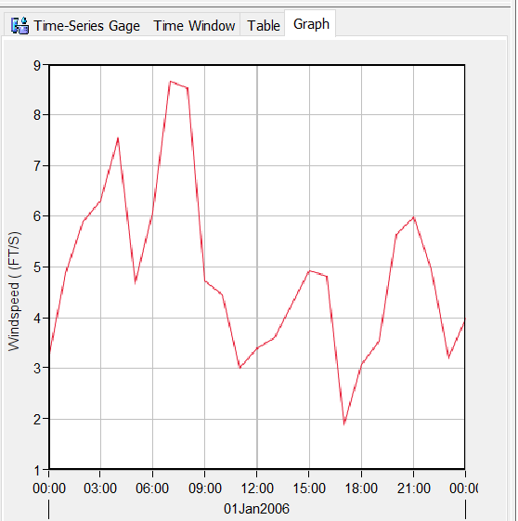
Time-Series Data
Observations of a variable that are indexed by time
Frequently used as hydrologic model boundary conditions.
Notes:
Time Series Data are observations of a hydrometeorological variable that are indexed by time.
Frequently, time-series data are used as boundary conditions for a hydrologic simulation.
This screenshot is of a wind speed time series

Slide 7
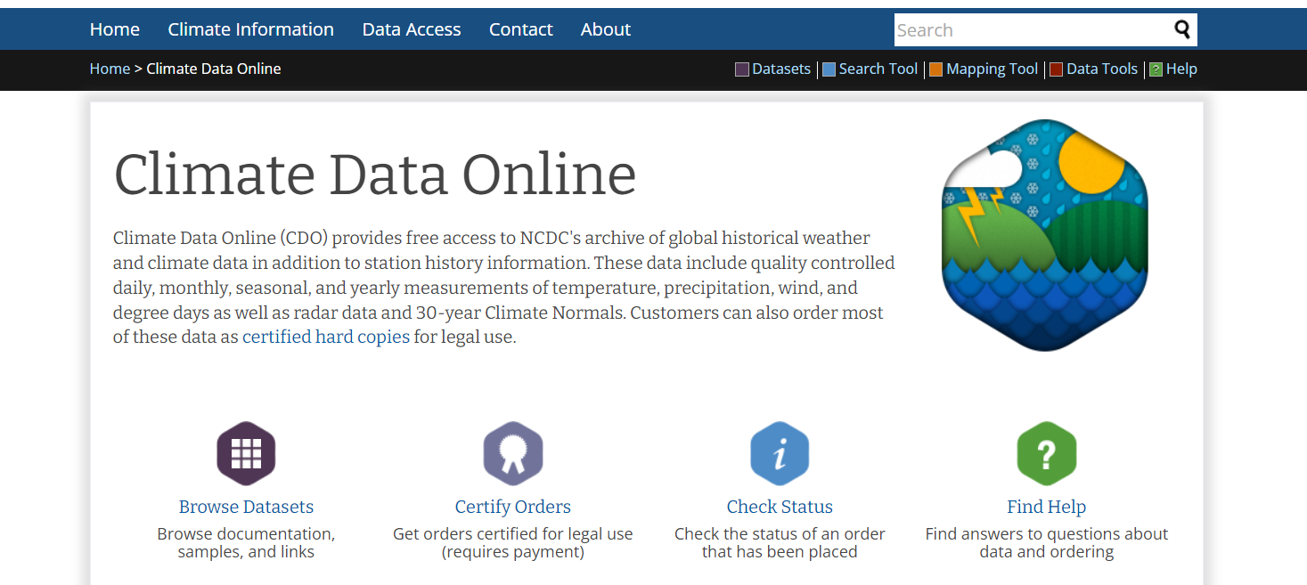
Some Sources of Time-Series Data
NOAA online climate data
  Historical temperature and precipitation data https://www.ncdc.noaa.gov/cdo-web/
Notes:
For this course, we will provide all the required datasets, but good to know where the data can be found.
We have a few resources on finding, evaluating and downloading shared data. I added some links in the end of this presentation.
This example is a good source for historical temperature and precipitation data from NWS observation stations can be accessed through NOAA website

Slide 8
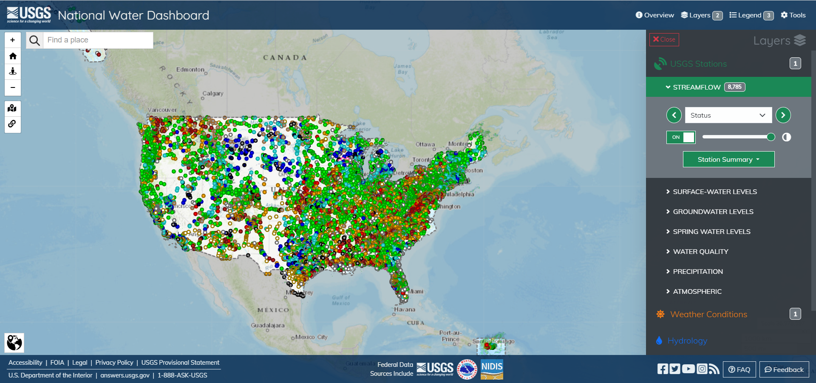
Some Sources of Time-Series Data
  USGS National Water Dashboard
  Precipitation, flow, water quality and other data at USGS observation stations
  https://dashboard.waterdata.usgs.gov/app/nwd/en/?aoi=default
Notes:
Can import automatically using HEC-SSP software

Slide 9
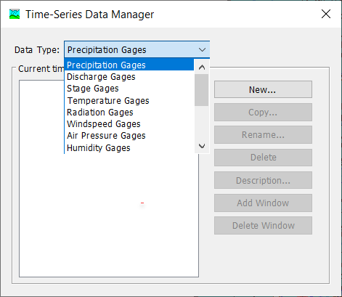
Time-Series Data
Common examples:
  Discharge
  Stage
  Precipitation
  Temperature
Notes:
Common examples of time-series data include daily average streamflow, fifteen-minute precipitation gage observations, hourly surface temperature measurements and more.

Slide 10
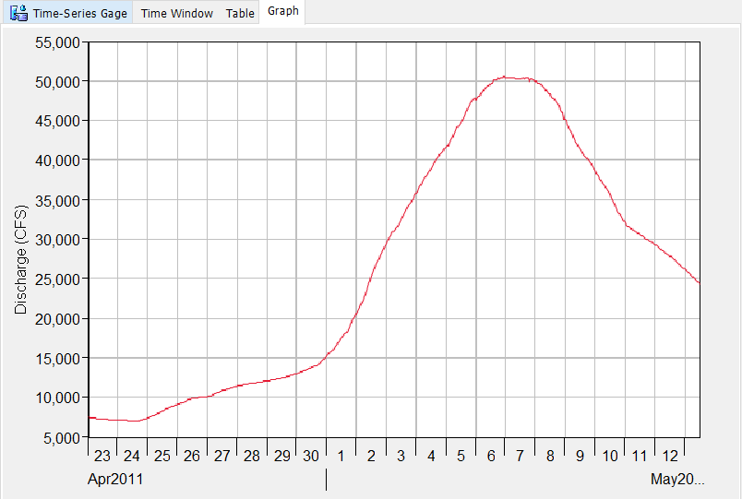
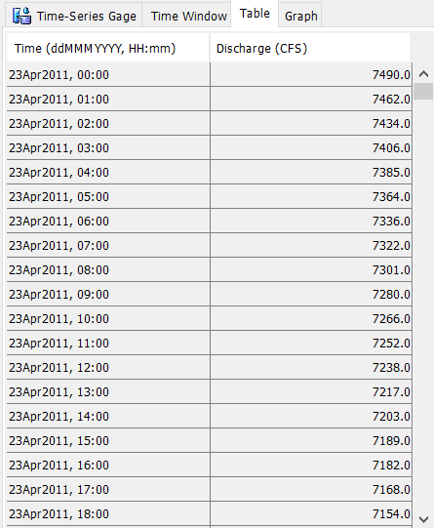
Time-Series Data:
Discharge Gage
Notes:
Here is an example of Time-Series Data with a Discharge Gage.
The table on the left is one view that HMS offers of Time-Series Data. It includes the time and value of the parameter.
The graph on the right is the other HMS view of Time-Series components. It plots the timestamp (Date) on the x-axis and the value of the parameter on the y-axis.

Slide 11
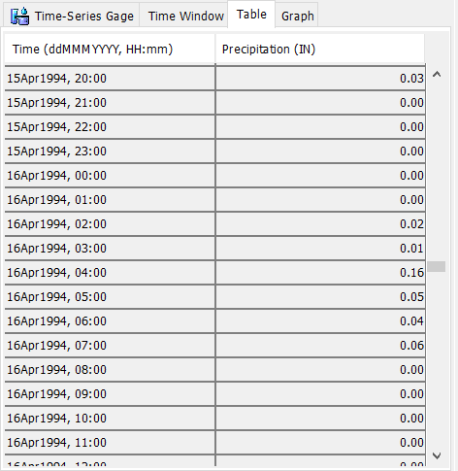
Time-Series Data:
Precipitation Gage
Notes:
Here is another example of Time-Series Data with a Precipitation Gage
Again, the table on the left is one view that HMS offers of Time-Series Data. It includes the time and value of the parameter.
The graph on the right is the other HMS view of Time-Series components. It plots the timestamp (Date) on the x-axis and the value of the parameter on the y-axis.

Slide 12
Time-Series Data
Demos:
Notes:
Now I will go ahead with some live demos on time-series data. The screenshots are included in these slides, if you need to refresh your memory.

Slide 13
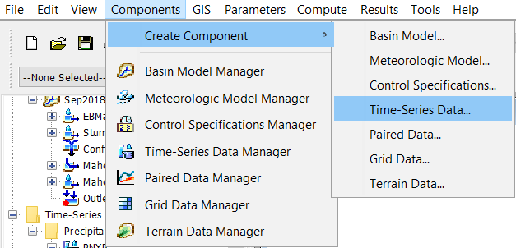
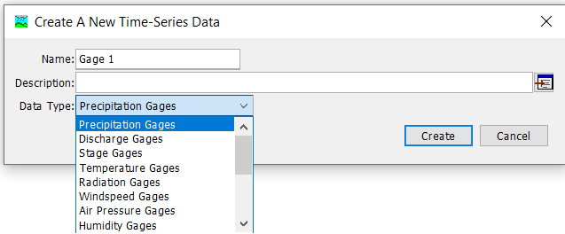
Creating a new gage
via Create Component menu
Notes:
There are two paths to creating new Time-Series Data Components.
The first is to use the Create Component > Time-Series Data… menu option. You will then be prompted with a window that asks for a name, a description and a data type. Select the data type first, then enter a name and description. As long as the name is unique for the data type, you can select Create and a new Time-Series Data Component will be created.

Slide 14
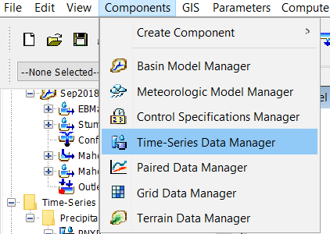
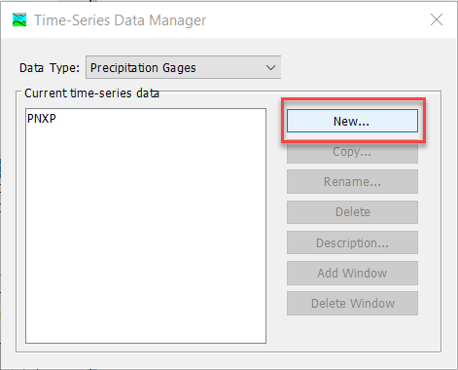
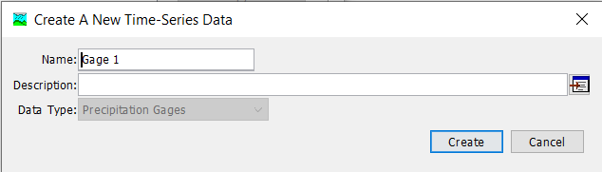
Creating a new gage
via Time-Series Data Manager menu
Notes:
The second path to creating a time series component is to use the Time-Series Manager menu option. A window will open that allows you to see all of the Time-Series Components that have been created for each type. Select the type of interest in the top menu, and the window will show all the Time-Series Components of that type that have been created, if any. To create a new one, select the New… button and then you will get a window like the lower left.

Slide 15
Time-Series Data Manager
View existing data by type
Create new
Copy
Rename
Delete
Notes:
Once the time-series data gage is created, it appears in the project tree on the left.
You can then create a new gage, copy, rename or delete a gage.

Slide 16
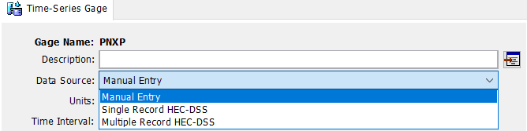
Adding Time-Series Data
Enter data manually
Link to an existing HEC-DSS file
Notes:
The gage then needs to be populated with time-series data.
Time Series Data can be populated within HMS in one of two ways—manually (by copy/pasting data directly into the HMS time-series table) or by linking the time-series record from an existing DSS-file.

Slide 17
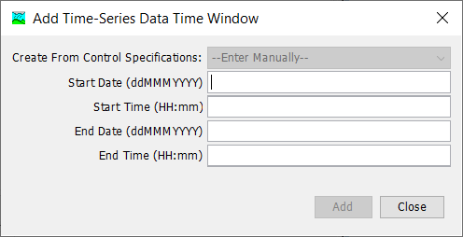
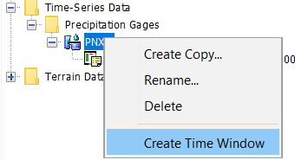
Time-Series Manual Entry
Create Time Window
Spreadsheet-like table
Copy-and-paste
Advanced functions
Notes:
To add a time-series data entry manually, you must first create a Time Window for the data.
Right-click on the gage > Create Time Window
Populate Add Time-Series Data Time Window Box
The compute time window that you specified in the control specs usually makes sense
Make sure to follow the format (e.g. 01Jan2002, 05:00)

Slide 18
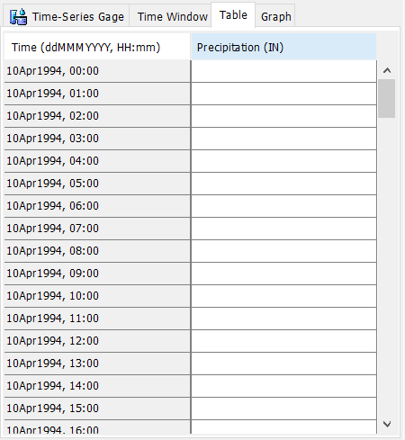

Time-Series Manual Entry
Create Time Window
Spreadsheet-like table
Copy-and-paste
Advanced functions
Notes:
Highlight the time window to enable the Manual Time Entry Table

Slide 19
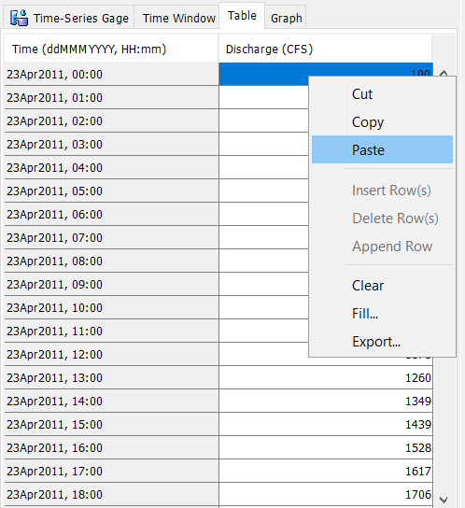
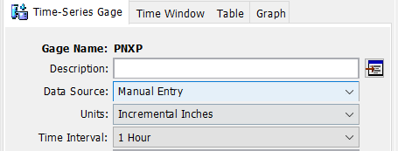
Time-Series Manual Entry
Create Time Window
Spreadsheet-like table
Copy-and-paste
Advanced functions
Notes:
The manual entry table behaves much like a spreadsheet. It is very easy to copy-and-paste from other applications like Excel to populate your time series data entry.
On the main tab, you must specify the units & time interval that you are entering for manual entry.

Slide 20
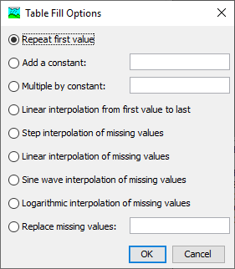
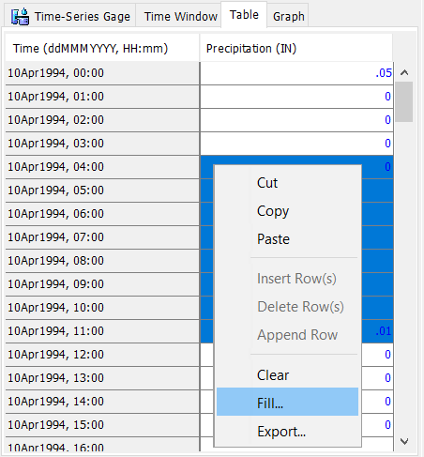
Time-Series Manual Entry
Create Time Window
Spreadsheet-like table
Copy-and-paste
Advanced functions
Notes:
The Fill… feature offers several advanced functions such as interpolating/filling in missing values.
The values in the table save to the projectName.dss file in the project directory and will be available next time you open the project.

Slide 21
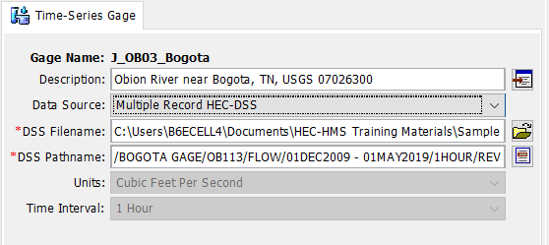
Time-Series from DSS-File
Link to existing time-series data in a DSS file
See User’s Manual for DSS pathway conventions:
https://www.hec.usace.army.mil/confluence/hmsdocs/hmsum/latest/shared-component-data/time-series-data
Notes:
Linking time series data directly to an HEC-DSS record is convenient when the time-series data already exists and you want to link it to the HMS model.
To do this, Simply point HMS to the correct DSS-File and Pathname to link the data to the time-series gage within HMS.

Slide 22
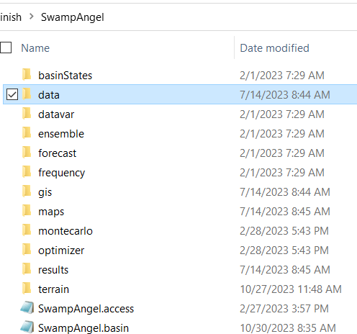
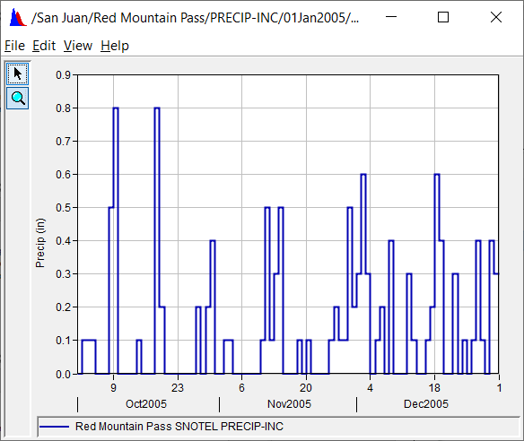
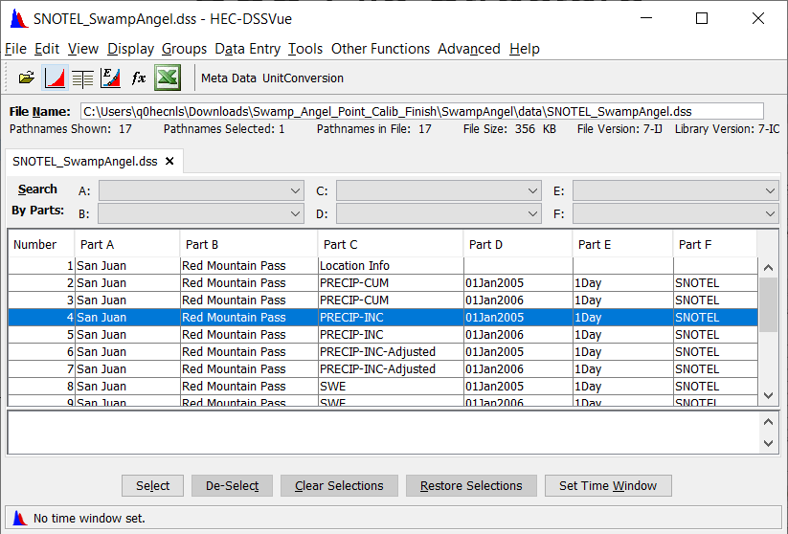
DSS-File Structure
Notes:
This is a good place to look where this data goes in the project folder. You shouldn’t be changing anything in the project folder unless you know what you’re doing,
But it’s still useful to know where to find everything.
When you import shared data from the external file, a good place to store those external files is in the project’s data folder.
You can click on the individual records (or rows) to view the data.

Slide 23
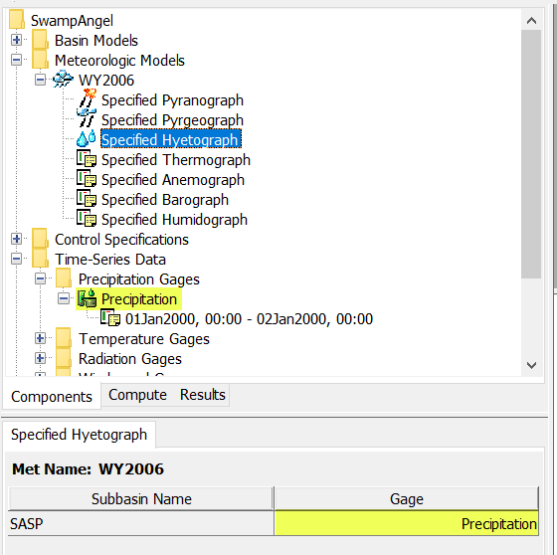
Reference Time-Series Gage in Met Model
Notes:
The new time-series gage is now available to be added to the met model.

Slide 24
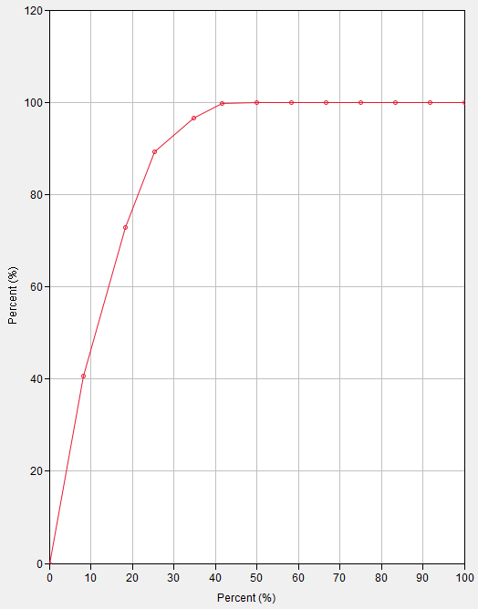
Paired Data

Slide 25
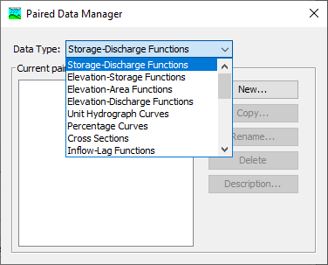
Paired Data
Data represented as
  Y = f(X)
Usually monotonically increasing
Notes:
Paired data in HMS are used to compute the value of one variable from another. Usually this is a functional relationship, where there is some Y that is a function of a given X. An example of this is a rating curve, which lets HMS compute stage for a given amount of flow.
One very important thing to note about paired data is that HMS will never attempt to extrapolate paired data. It will only interpolate.
Here is the Paired Data Manager, available by selecting Components > Paired Data Manager in the main window toolbar.
The Manager lists each type of Paired Data that are available in HMS. The Manager also allows the user to create a new Paired Data Component or create/rename/delete existing ones.

Slide 26
Important Examples
Elevation-storage function
Elevation-discharge function
Dimensionless storm pattern
Channel cross-sections
(reservoirs)
(rating curve)
(hypothetical storm)
(channel routing)
Notes:
There are many types of Paired Data that are used in HEC-HMS. HMS assigns specific types to each curve to prevent them from accidentally being confused with one another. Each type has its own units for the X and Y variables.
Some of the most commonly used Paired Data types are shown. The elevation-storage function is used to define the geometry of a reservoir, converting between reservoir stage and reservoir storage.
The elevation-discharge function, or rating curve, is used to compute flow stage at an element.
Dimensionless storm patterns are percent-percent curves that allow for creating storm patterns of any duration and intensity.
Channel cross-sections are mentioned because they break the monotonically-increasing rule. They are a special case.
Many other types are available for other types of modeling. Temperature Index snow modeling often requires one or more Paired Data curves as parameters. Hypothetical Storm precipitation often uses Paired Data for defining time patterns of storms, or point-to-area reduction functions.

Slide 27
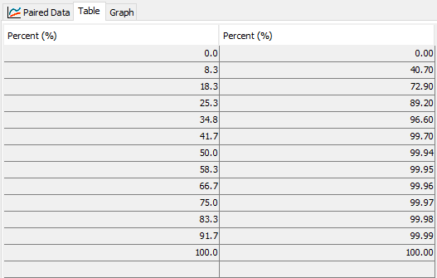
Percentage Curve
Notes:
Here is an example of a Paired Data of type Percentage Curve. It has X and Y values that are percentages (up to 100.) The values must be monotonically increasing. Most types of paired data behave in this way.
The table on the left is one view HMS offers of a Paired Data Component. It shows in two columns the X and Y values.
The graph on the right is the other HMS view of the Paired Data Component, and is an X vs. Y graph of the same table.

Slide 28
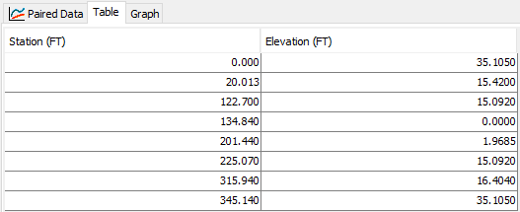
Cross-Section
Notes:
Here is an example of a Paired Data of type Cross-Section. It has X and Y values that are in feet, where X is the stationing along the channel cross section, and Y is the elevation for each point along the cross section. These paired data are used in the Muskingum-Cunge reach routing method and require that the cross-section is defined using eight points. Cross-sections are one of the special cases of paired data that are not functional or monotonically increasing.

Slide 29
Paired Data
Demos:
Notes:
I’ll quickly demo some of the steps for adding paired data.
Many of them are similar to the time-series data.

Slide 30
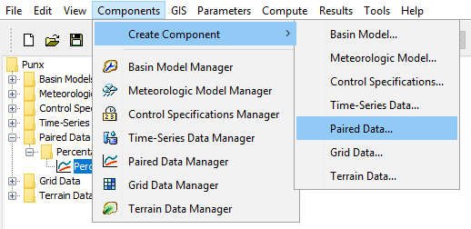
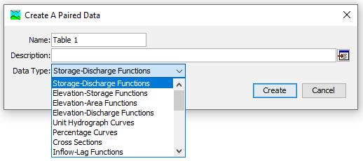
Notes:
Similar to the time-series data, there are two paths to creating new Paired Data Components.
The first is to use the Create Component > Paired Data… menu option. You will then be prompted with a window that asks for a name, a description and a data type. Select the data type first, then enter a name and description. So long as the name is unique for the data type, you can select Create and a new Paired Data Component will be created.

Slide 31
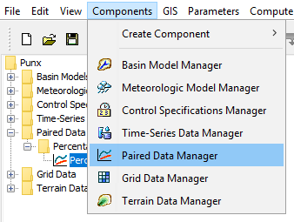
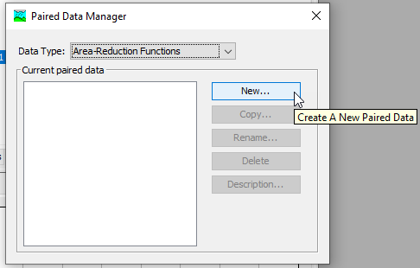
Notes:
There are two paths to creating new Paired Data Components.
The second path is to use the Paired Data Manager menu option. A window will open that allows you to see all the Paired Data Components that have been created for each type. Select the type of interest in the top menu, and the window will show all the Paired Data Components of that type that have been created, if any. To create a new one, select the New… button and then you will get a window like the “Create a Paired Data” window on the previous slide.

Slide 32
Paired Data Manager
View existing data by type
Create new
Copy
Rename
Delete

Slide 33
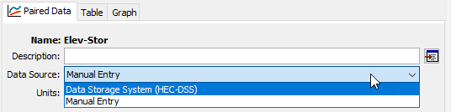
Data Sources
Link to an existing HEC-DSS file
Enter data manually
Notes:
There are two choices for paired data sources: HEC-DSS files, and manual entry. Choosing one or the other presents you with different options.

Slide 34
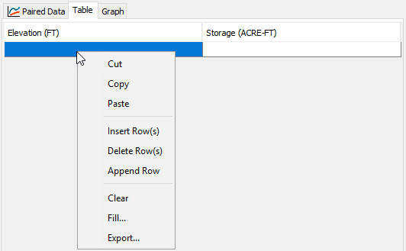
Manual Entry
Spreadsheet-like table
Copy-and-paste
Advanced functions
Notes:
The manual entry table behaves much like a spreadsheet. It is very easy to copy-and-paste from spreadsheets to fill out your paired data. This is the primary way of creating paired data, as most data that are used are stored in formats like CSV files and spreadsheet workbooks.
On the main tab you must specify the units that you are entering for manual entry.
There are other controls to change the shape of the table, such as inserting, deleting, and appending (adding to the end) rows.
The Fill… feature offers several advanced functions for filling the values in a column. This is especially handy for dealing with missing values.

Slide 35
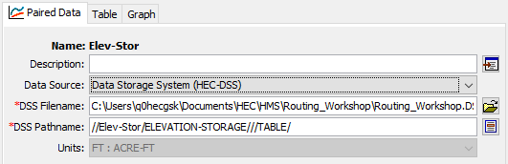
HEC-DSS File
Link to existing paired data in a DSS file
See User’s Manual for DSS pathway conventions:
  https://www.hec.usace.army.mil/confluence/hmsdocs/hmsum/latest/shared-component-data/paired-data
Notes:
HEC-DSS is convenient when a paired data object has been created already that you want to re-use. The easiest way to create one in the first place is to create it using manual entry in HMS. This makes sure that the pathname and unit conventions for the type of table you are trying to create are correct.
The C-part of the pathname controls the data type. Importing from DSS automatically handles data units.

Slide 36
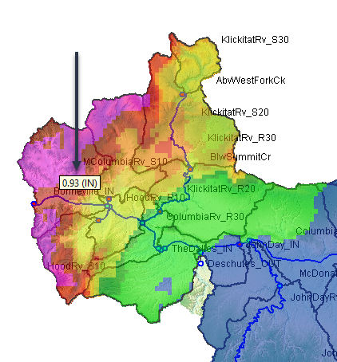
Gridded Data

Slide 37
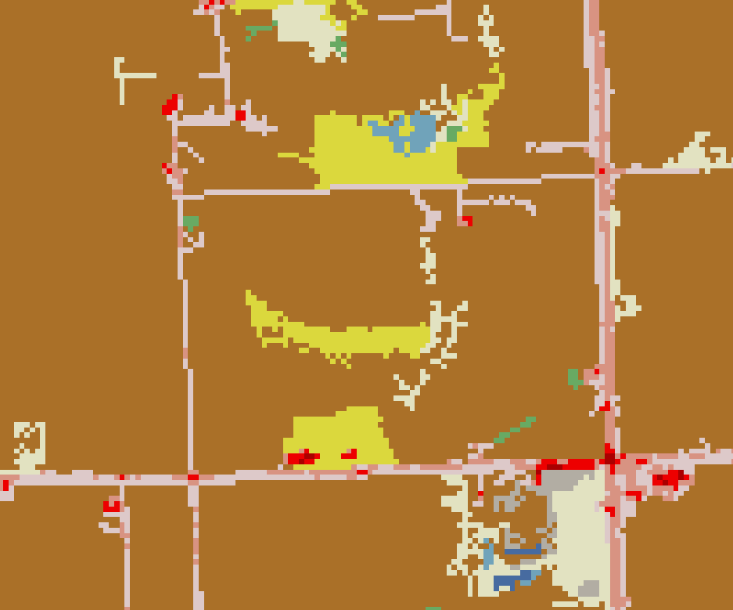
What’s a Grid?
Spatial data on a regular lattice
  Raster data
Each pixel represents an average value over the cell
Notes:
A regular lattice implies that the cell size is the same for the entire dataset, and that the cell location can be referenced from an index location (e.g. an origin, like the coordinates (0, 0)) and then an offset from it (row 10, column 26). If you work with GIS frequently you are already familiar with raster datasets – that is what we’re talking about with grid data.
The value for each cell is constant across the cell. For continuous data (numeric data that can take on any value over a range) the cell usually represents the average value of the true information. For example, a grid of elevation data is likely to represent the average of the true elevation over the grid cell.

Slide 38
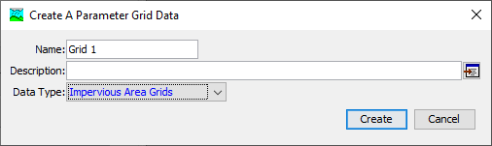

Two Grid Approaches in HEC-HMS
A grid is a raster with no notion of time
A gridset is a set of rasters with each indexed by time
Notes:
In traditional HMS modeling, grid data are most frequently used to model precipitation boundary conditions, such as radar-based precipitation measurement. As HMS capabilities have grown, additional types of grid or raster data have been added to address modeling needs.
An important distinction exists between grids and gridsets in HMS.
Grids are static – they are an unchanging snapshot and are not associated with any sort of time. The example above shows an impervious area grid, which stays constant with respect to time. (Yes in real life impervious area amounts can change, but HMS cannot currently model time-varying impervious area.) These datasets contain a single grid.
Gridsets are not static, and are what you would use to represent boundary conditions like precipitation or temperature. The gridset contains many grids, and each grid is associated with a date and time. The example here shows a temperature gridset, which might contain a set of grids that are observations of surface temperature taken each hour.

Slide 39
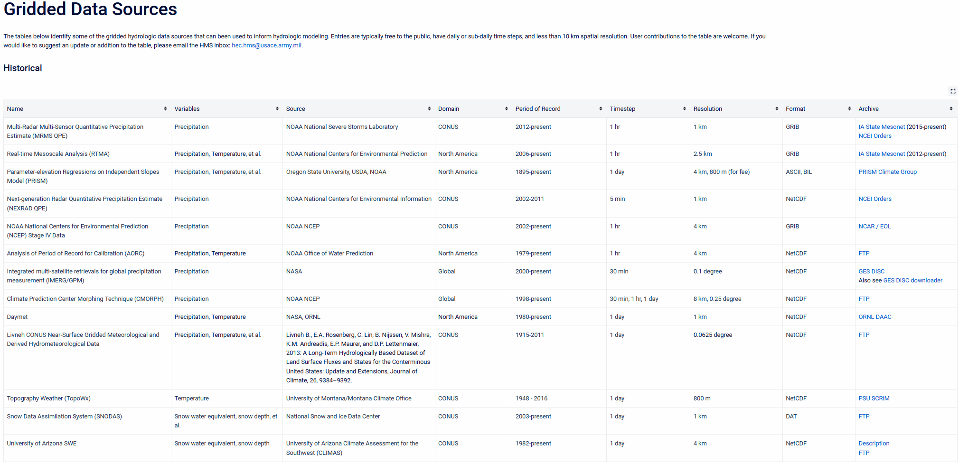
Gridded Data Sources
https://www.hec.usace.army.mil/confluence/hmsdocs/hmsguides/working-with-gridded-boundary-condition-data/gridded-data-sources
Notes:
Some examples of gridded data. More examples and more information can be found at the link.

Slide 40
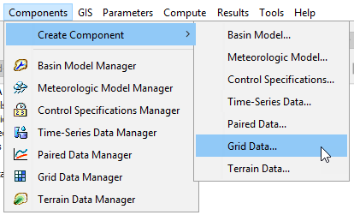
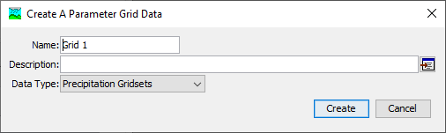
Notes:
Similarly to the other two types, here are two ways to create a grid data component. The first is to choose Components > Create Component > Grid Data…
You will see a dialog box like this. Choose the type of grid in the drop down menu, then give it a name. Pressing create adds a new grid data object to the watershed explorer.

Slide 41
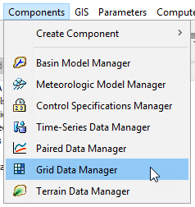
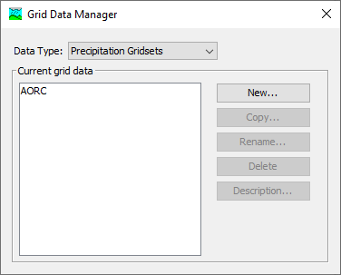
Notes:
The second way is to go through the Grid Data Manager, which can be accessed in the Components menu. The Grid Data Manager allows you to see all the grids that have already been created, organized by type. It also lets you create new ones, or copy/rename/delete existing ones. Pressing the New… button will launch the same creation dialog as the creation option from the previous slide.

Slide 42


Data Sources
Varies by type of data
All can use HEC-DSS
Grids can use raster data formats
  ASCII
  GeoTIFF
Notes:
Depending on whether you’re working with a grid or a gridset, you can link an HMS grid component to different sources of data.
In any case, HEC-DSS can be used as a data source for a grid component. HMS underneath the hood is always dealing with HEC-DSS for data storage, so this format is always applicable. For gridsets, this is the only type of data that currently can be used. However, utilities for converting data from one format (e.g., NetCDF, HDF, etc.) to HEC-DSS are available and will be discussed in just a bit.
For grids, there are also two formats of raster data that can be linked up. GeoTIFF is the most common format used for these types of data. ASCII grids are mainly provided as an option for precipitation-frequency grids, but certainly can be used for other data types if that is how the source data are stored.

Slide 43

Gridset Workflow
Gridsets are more complicated because a time-series of grids is involved
Import source data to HEC-DSS
Create gridset in HEC-HMS
Link the datasource
https://cms.accuweather.com/wp-content/uploads/2020/09/HurricaneSallyTueMornLoop.gif
Notes:
Often the data we want to use for gridded boundary conditions are in a format that HMS cannot directly use. Commonly, NetCDF or HDF is used to store high-dimensional data, such as meteorologic or climatic data. Many times each time step of the data is in a separate source data file, meaning that a day’s worth of hourly timestep data might be in 24 files.
To get HEC-HMS to use these, they need to be placed in a DSS file, with the correct convention. Then, you will need to create the correct type of grid data component and link the DSS file you created to that component.

Slide 44

Grid Data Importer
A set of utilities for importing grid data to DSS are available
  Import from one or many files
  Choose which variables to import
  Clip
  Handle projections
  Resample
Notes:
HEC-HMS now features a tool for importing grid data from a variety of formats in the HEC-DSS format. It is able to handle one or many files as inputs, filter down to the variables of interest, clip the grid domains to a user-specified spatial extent, deal with projecting the grid data, and resampling the grid resolutions. It is available by going into the File menu, dropping down to Import, and selecting Import Gridded Data. The following slides will walk through a simple import using this tool.

Slide 45

Export Subbasins Layer
Notes:
I like to start by exporting my subbasins layer. We will use the subbasins layer to clip grids on import.

Slide 46

Step 1. File Selection
Notes:
On the first screen, you can select as many files as you want to import into the DSS file at the end. Select the browse button on the right and add the files. Supported formats will be shown in the browsing dialog.
Some data are contained all within one file, as in the case shown here. In other cases, the data are spread across a number of files. In either instance you can add those source data files to the wizard.

Slide 47

Step 2. Variable Selection
Notes:
The variable selection step is important in case the source data store multiple kinds of data at a time. Some data have a convention that store latitude and longitude as grids as well, and we don’t want to import those. In this case we have selected the “prcp” data variable and moved it to the right side, meaning any data with the “prcp” variable type will be imported. The import utility will automatically interpret this as precipitation data. Many types of data are supported with this import utility, which recognizes most of the common abbreviations or variable names for gridded meteorologic data.

Slide 48

Step 3. Clipping, Projection, and Resampling
Notes:
The third step handles all of the spatial processing.
Using a clipping datasource can drastically reduce the size of the output, especially when the source data covers a much larger spatial extent than the project area you are trying to model. One handy way to get a clipping datasource is to export the watershed polygon shapefile from your HEC-HMS watershed delineation.
The target WKT controls what projection the output data should be in. If you click the browse icon, you can browse to a source of spatial data and use the projection information for that dataset. Or, you can select the globe icon, which will give you some built in options, such as SHG, which is commonly used for HEC-HMS models in the United States.
The target cell size controls how the data will be resampled. This is the cell size that the output data will be in (measured in meters.) The output size is dependent on the resolution needed for the project. Use a cell size that is at smallest the size of the input data. Coarsening the resolution of the data will reduce file size. Typical options are selectable if you select the grid icon to the right of the box. A typical resolution for HMS models that takes into account the typical resolution of gridded data is 2,000 meters.
Finally the resampling method controls what method HEC-HMS will use to convert the source data to the target data. For meteorologic data, bilinear is typically adequate.

Slide 49

Step 4. DSS Output Selection
The importer will automatically handle the C, D, and E parts based on the import data.
Refer to the users manual for DSS file naming conventions https://www.hec.usace.army.mil/confluence/hmsdocs/hmsum/latest/shared-component-data/
Notes:
Finally, choose the destination for the data import. This can be an existing or a new HEC-DSS files. Then, specify the A, B, and F parts of the target DSS paths.
Refer to the users manual for DSS file naming conventions https://www.hec.usace.army.mil/confluence/hmsdocs/hmsum/latest/shared-component-data/
The importer will automatically handle the C, D, and E parts based on the import data.

Slide 50

Step 5. Add grid data in HEC-HMS
Notes:
Add a gridded data object in HEC-HMS to contain the gridded data.

Slide 51

Visualizing the Gridset in DSS file
The grided data can now be visualized in HEC-DSSVue
  https://www.hec.usace.army.mil/software/hec-dssvue/downloads.aspx
Notes:
The grid in the newly created DSS file can be visualized in HEC-DSSVue, which can be downloaded. Note that each data record represents a time step.
Nick and Tom are currently working on allowing HEC-HMS to work directly with the major grid formats, so that this intermediate DSS file creation will no longer be required.

Slide 52

Step 6. Add Gridded Data to HMS
Link to previously created HEC-DSS file
Notes:
Finally, create a new grid data component and link it to the DSS file you just created.
The data source should be set to “Single Record HEC-DSS”. The DSS Filename should be the pathname of the new DSS file and a single pathname from the DSS file needs to be selected. Any pathname within the DSS file can be selected here.
Note that *.tiff and *.asc files can also be linked here.

Slide 53


Add Gridded Data to HMS
Link gridset to a Meteorological Model
Notes:
Create a new or select existing meteorologic model. Select the “Gridded Precipitation” option within the Precipitation drop down menu.

Slide 54
Helpful Resources
HEC-HMS user’s manual: https://www.hec.usace.army.mil/confluence/hmsdocs/hmsum/latest
USGS national water dashboard:
https://dashboard.waterdata.usgs.gov/app/nwd/lang-en/?aoi=default
NCEI link to 15-min and hourly historical precip: https://www.ncei.noaa.gov/access/metadata/landing-page/bin/iso?id=gov.noaa.ncdc:C00313
HEC-HMS guide: working with gridded data: https://www.hec.usace.army.mil/confluence/hmsdocs/hmsguides/working-with-gridded-boundary-condition-data
Vortex tools: https://github.com/HydrologicEngineeringCenter/Vortex
Notes:
These are some additional sources on obtaining and working with commonly used shared data.

Slide 55

Precipitation-Frequency Importer

Slide 56


Precipitation-Frequency Importer

