Slide 1
Flood Forecasting with
HEC-HMS
Hydrologic Modeling with HEC-HMS
02 February 2024
Mike Bartles
US Army Corps of Engineers
Hydrologic Engineering Center

Slide 2
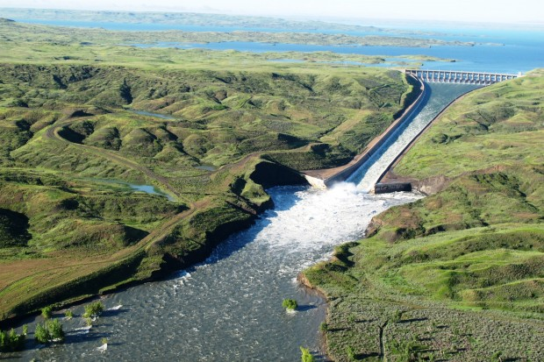
Overview
Corps Water Management System (CWMS) / HEC-RTS overview
Purpose of HEC-HMS in the forecast sequence
Forecast terminology
Tips for forecasting application model construction
HEC-HMS forecasting features
2

Slide 3
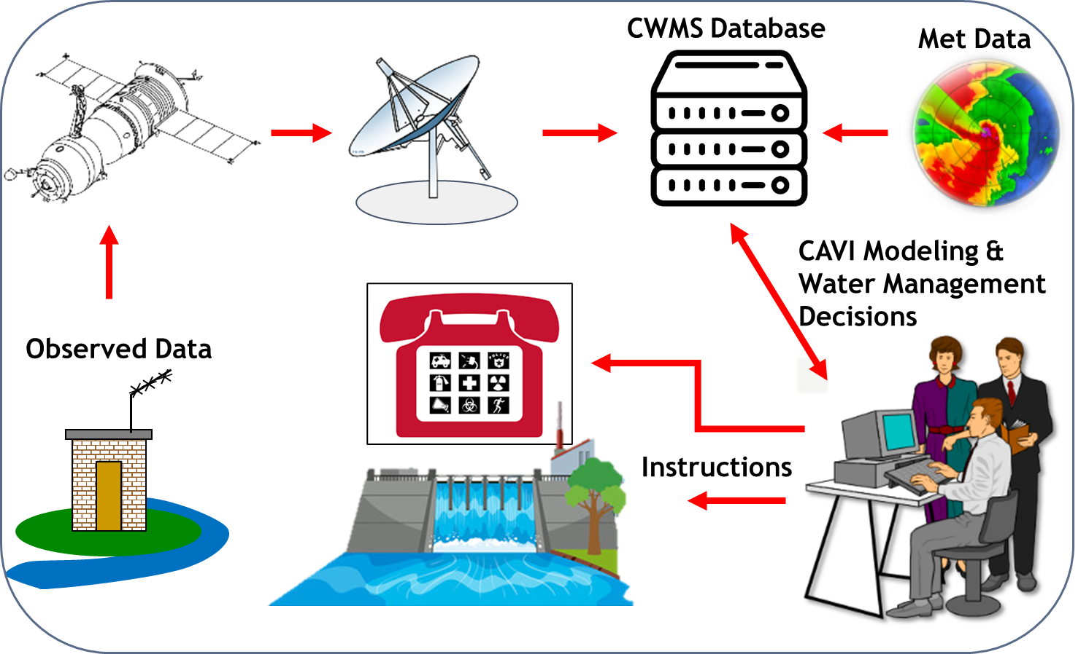
Corps Water Management System (CWMS)
    CWMS is the USACE tool to help water managers
    Automated Information System (AIS) to collect, process, and store real-time data
    Suite of modeling tools to run real-time forecast simulations and help achieve a wide range of reservoir authorized purposes
    Designed to meet USACE initiatives, the WM mission, and other legislative requirements
    Real Time Simulation (HEC-RTS) is the public version of CWMS
      https://www.hec.usace.army.mil/software/hec-rts/
3

Slide 4

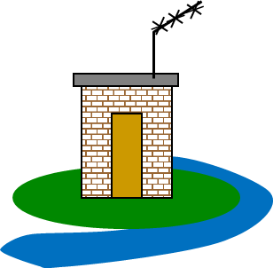
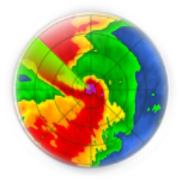
Real-Time Data Acquisition
Collect
Decode
Transform
Validate
Make corrections
Use data for monitoring and forecasting
CWMS Server/Database
4

Slide 5
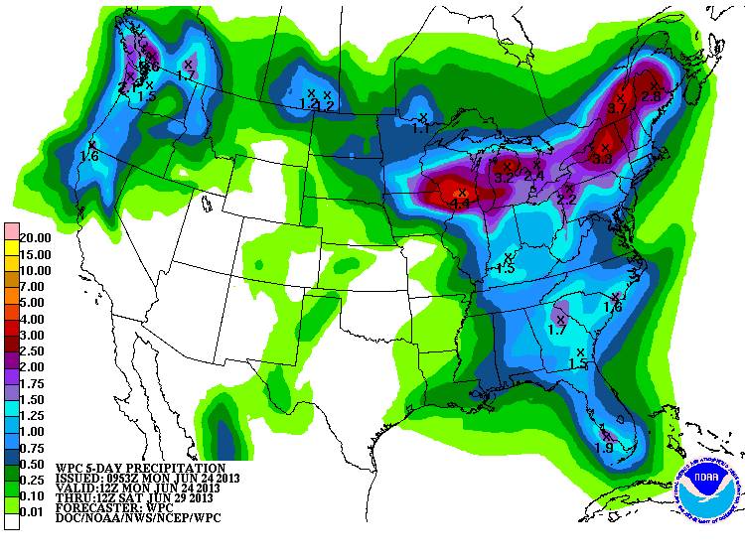
Observed and Forecasted Met Data
NOAA/NWS Support:
  Quantitative Precipitation Estimates (QPEs)
  Provides Quantitative Forecast Precipitation (QPFs)
  RFCs provide river stage/flow forecasts
5

Slide 6
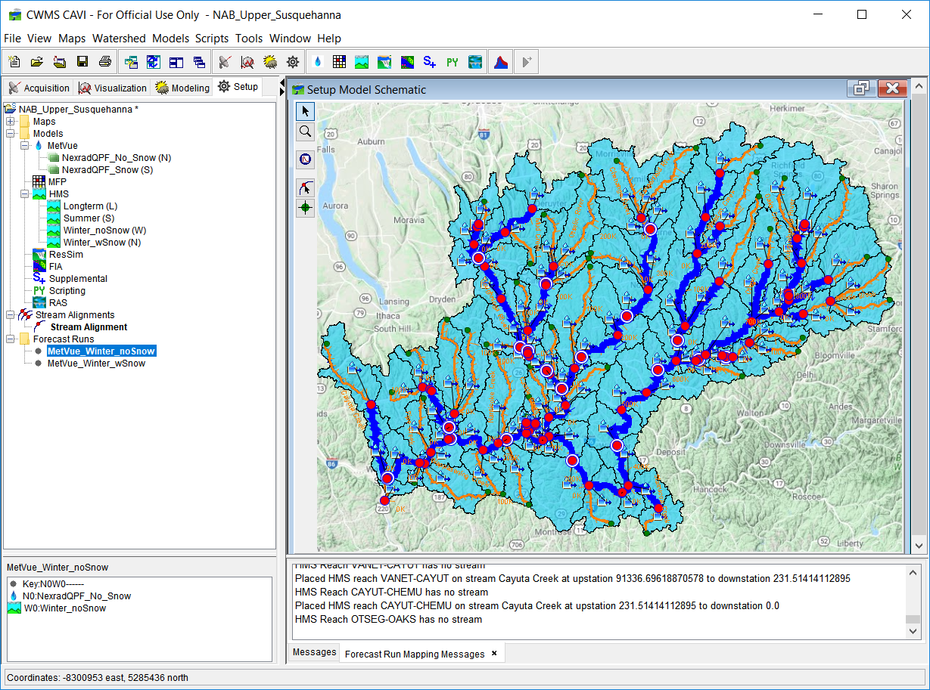
CAVI
Control and Visualization Interface
  Integrates real-time data acquisition, data visualization and modeling tools
6

Slide 7





CWMS Modeling Tools
Meteorology
Reservoir Operations
Consequences
Hydrology
Hydraulics
7

Slide 8
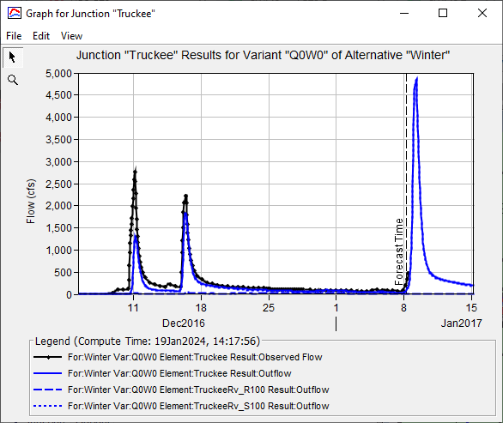
Hydrologic Modeling: HEC-HMS
Compute runoff and uncontrolled flows given input meteorological data
Predict inflows to reservoirs and locations downstream of reservoirs
Model output used as input to reservoir operations and hydraulics models
8

Slide 9
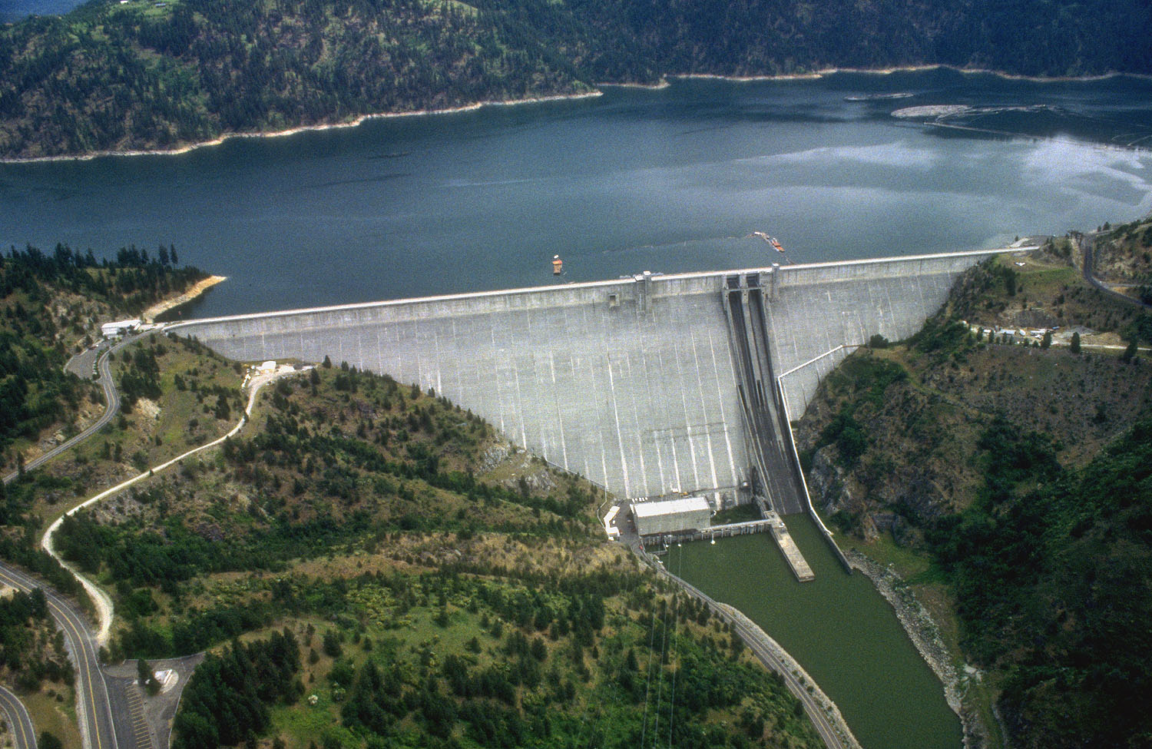
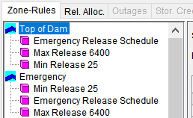
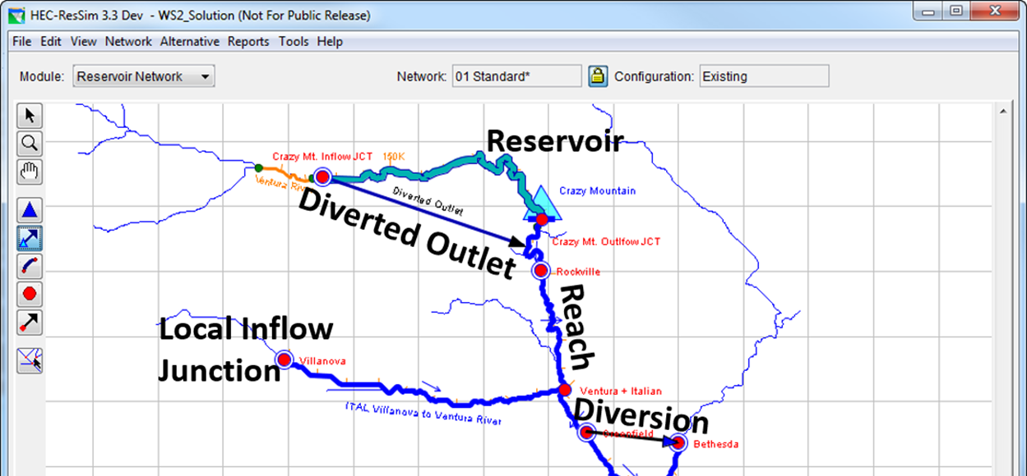
Reservoir Operations: HEC-ResSim
Given stream flows and water control rules, simulate reservoir operations
Override operations to test operating plan scenarios
Model output used as input to hydraulics and consequences models
9

Slide 10
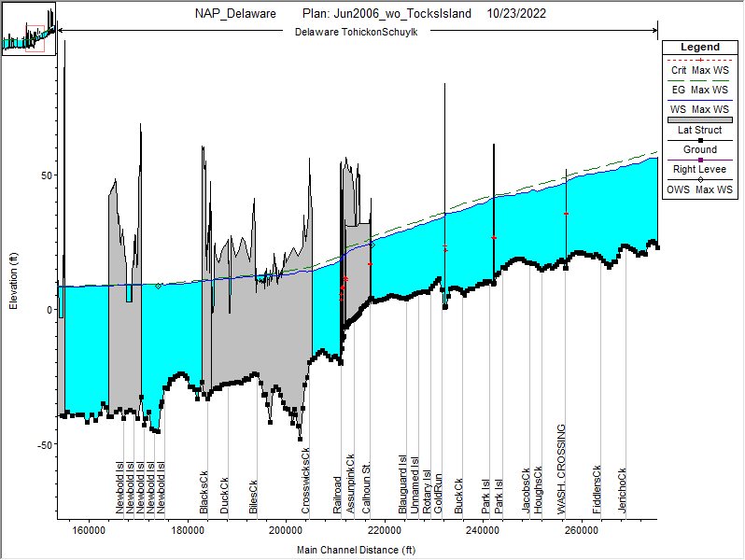
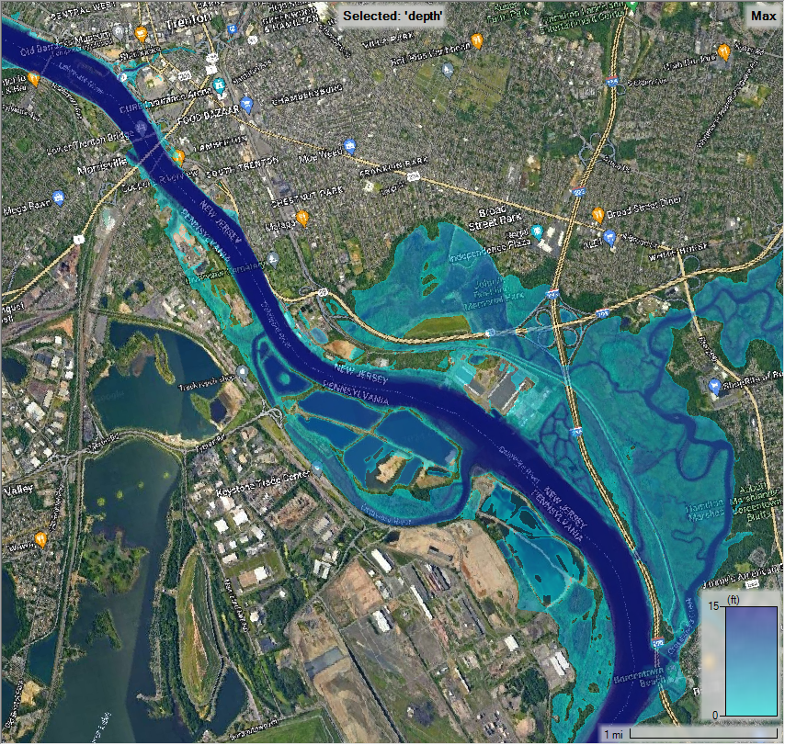
River Hydraulics: HEC-RAS
Given flow hydrographs, compute water surface profiles
Predict hydraulic variables (depths, WSEL, inundation extents, velocities, etc.)
Model output used as input to consequences models
10
Notes:
10

Slide 11
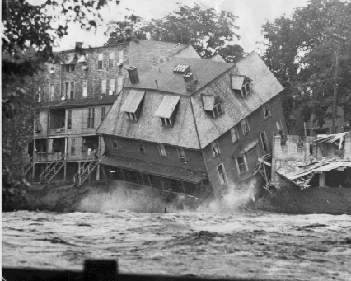
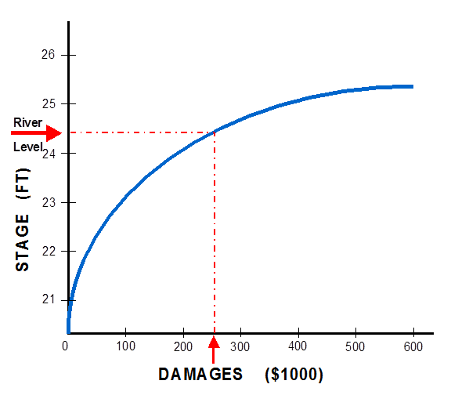
Consequences: HEC-FIA
HEC-FIA (Flood Impact Analysis) identifies the consequences from a flood event
Given river stages and damage data, computes damages to structures and estimates life loss
Computes project benefits
Response tables provide a list and of actions to take during an event, based on forecasted stages
11

Slide 12
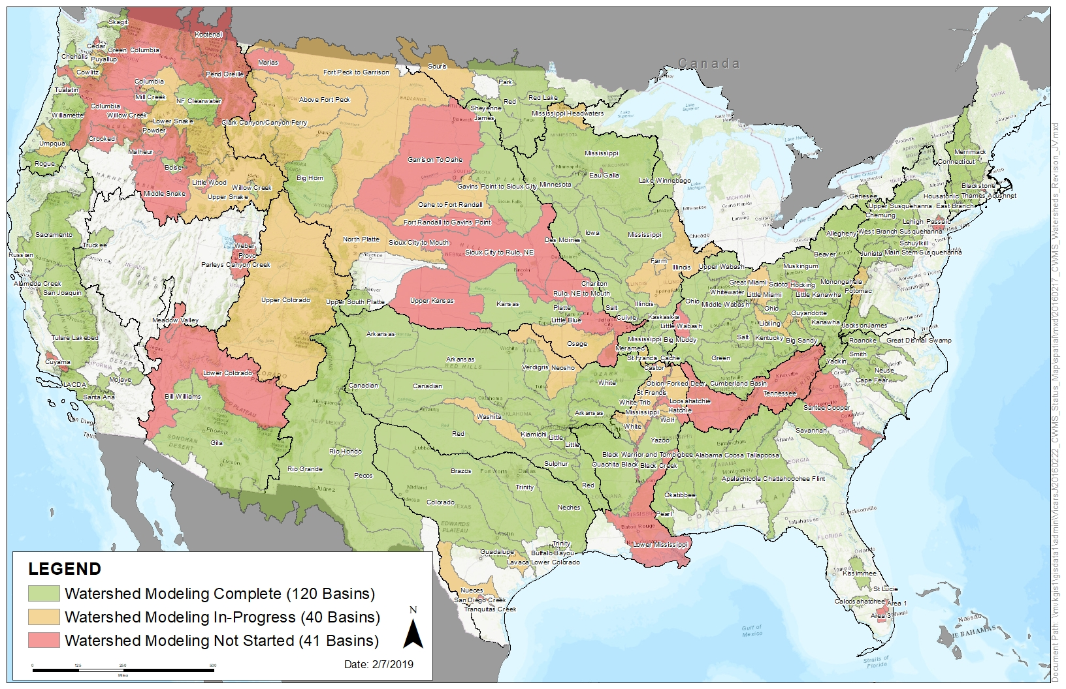
CWMS National Implementation
12

Slide 13
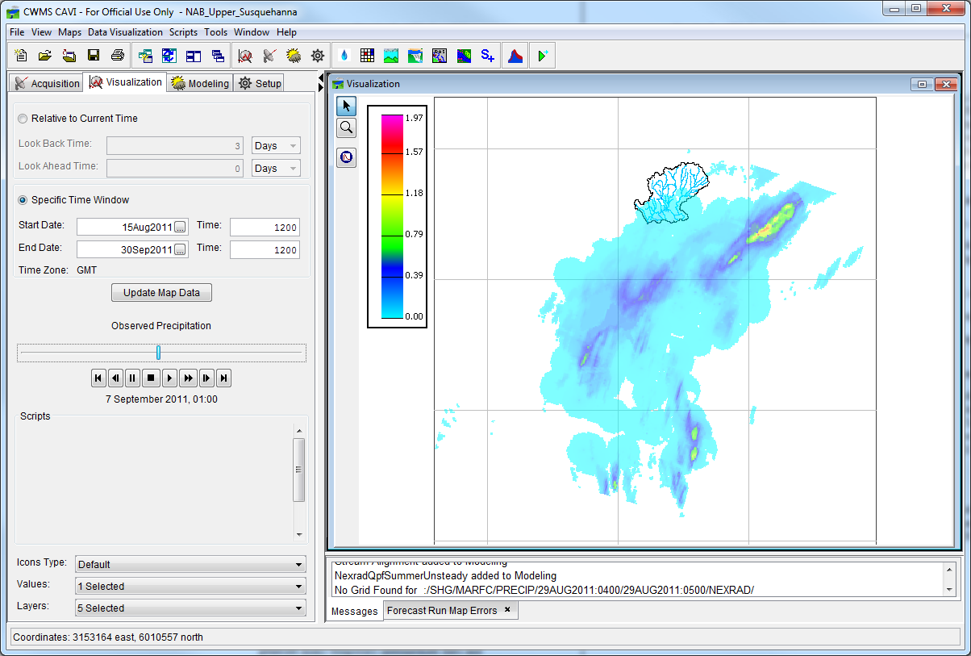
HEC-HMS Within CWMS
13
Notes:
You can do really cool stuff within the CAVI. Things as simple as viewing precipitation distributions are incredibly useful.

Slide 14
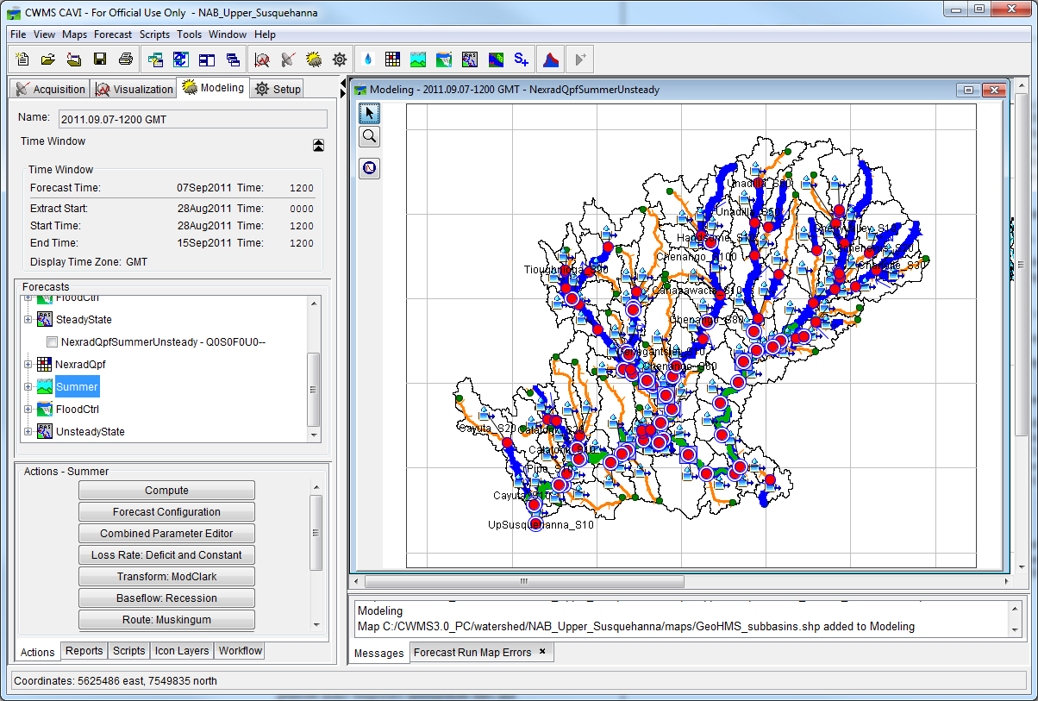
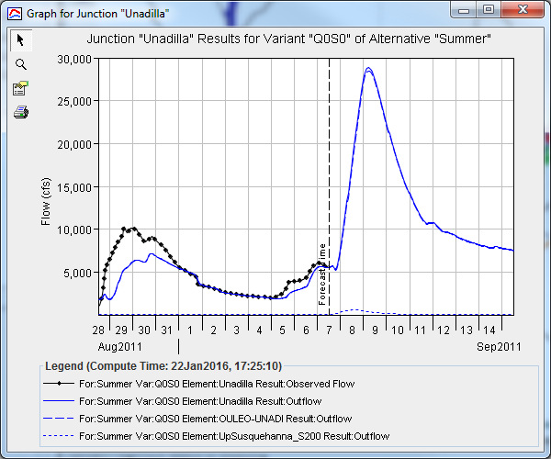
HEC-HMS Within CWMS
14
Notes:
However, the real meat of the tools are the actual modeling applications.
In this case, a forecast simulation was created for the same time frame as a historical event to demonstrate the model’s ability to accurately predict streamflow when there is data to compare against. This is a sample of the output from the HMS portion of the forecast.

Slide 15
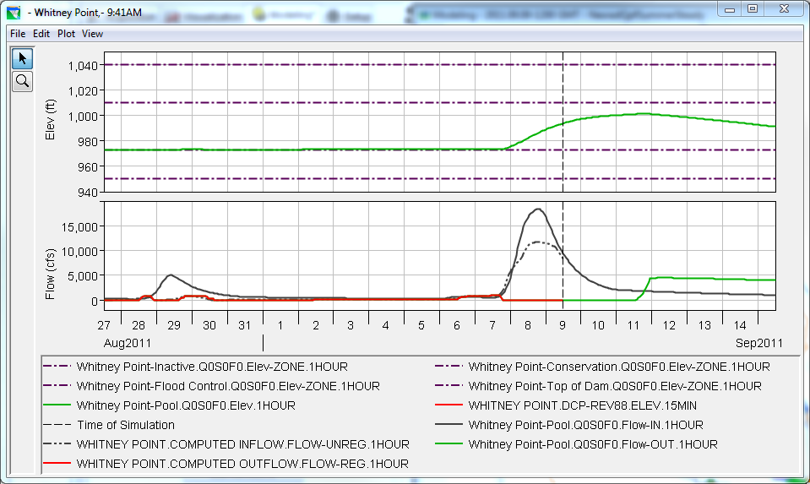
HEC-HMS Within CWMS
15
Notes:
Here’s a sample of the output from the ResSim model which uses the input from the HMS model to simulate reservoir operations. In this case, the operations at Whitney Point Dam are shown here for a high flow event. Notice the gate closing and expected opening points/dates. This will help the reservoir operators to better predict when they should close/open the gates.

Slide 16
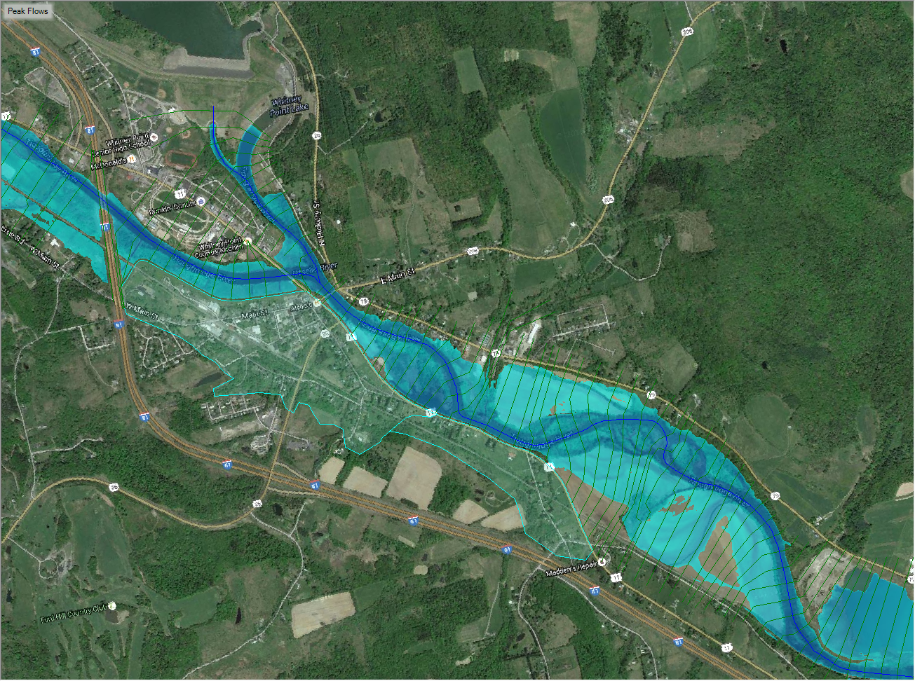
HEC-HMS Within CWMS
16
Notes:
Here’s a sample of the output from the RAS portion of the model which uses output from the HMS and ResSim portions.

Slide 17
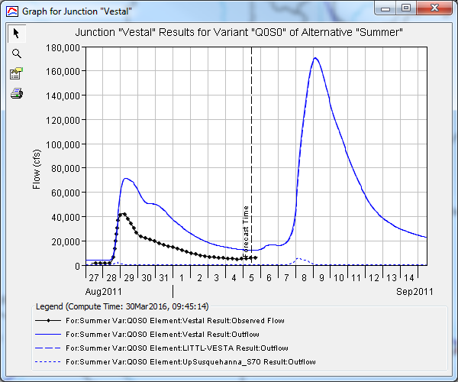
Forecast Simulation Time Window
Forecast
Lookback
Simulation Start
Time of Forecast
Simulation End
17
Notes:
The components of a forecast are as follows:
Simulation start: the start date/time of the simulation. This is usually the same as the start of the extract.
Time of forecast: the date/time of the forecast simulation. This is usually slightly behind the actual time (for instance, if it is 12:00 now, you should give yourself a little leeway and use a time of forecast of 09:00 to ensure there is data for the entirety of the lookback period.
Lookback: this is the time between the simulation start and the time of forecast. There should be observed data for this entire length of time.
Simulation end: the date/time of the end of the simulation. The end date/time is dependent upon the boundary conditions (how long / how much is it going to rain?) and the watershed in question. Some watersheds will need a longer forecast time than others to ensure the flood wave travels to the critical points in the watershed.
Forecast: this is the time between the simulation end and the time of forecast. There will not be observed data for this length of time since this is in the future.

Slide 18
Considerations for Forecasting
Computational Speed
  As the number of elements increases, the longer the computations take to complete
    Nonlinear relationship
  Computational Time Step
    Normally one hour within CWMS models
    Some models may need smaller time steps
  Use of gridded vs. gage/subbasin average data
    Normally gridded computes are used within CWMS models
    Gridded computes require more data handling
  Not all elements are equal
    Subbasins can take more time to compute than junctions or routing reaches
18
Notes:
The first (and arguably the most important) component in this process is the hydrologic model, which usually is an HEC-HMS model. If this model doesn’t perform well, the rest of the CWMS models won’t because error is transferred from this point on.
The process to build an HEC-HMS model from scratch starts with HEC-GeoHMS. GeoHMS allows the user to delineate subbasins, set up element names, develop initial parameter estimates, and a whole bunch of other geospatial functions.

Slide 19
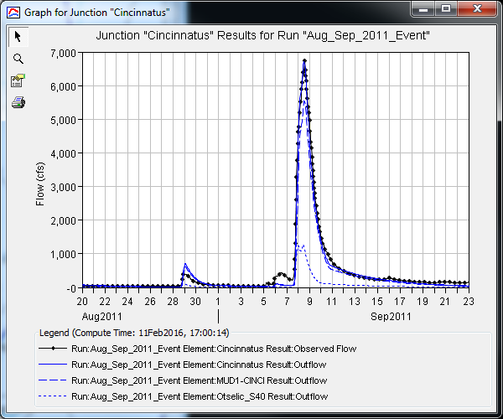
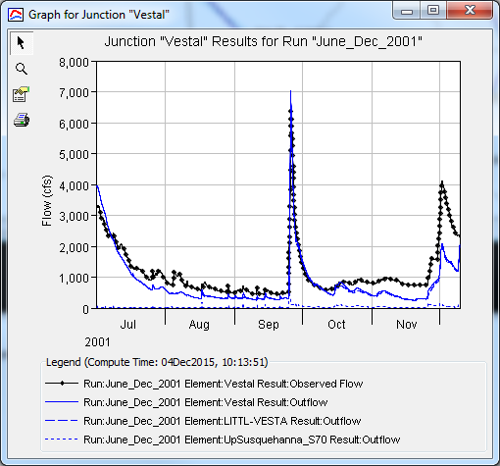
Considerations for Forecasting
Calibrate to appropriate events
  Choose events that are the same as the eventual use of the model
Develop ranges of parameters that can be used in future forecasts
High Flow
Low Flow / Long Term
19
Notes:
Calibration – using historic precipitation and streamflow (pool elevation) to develop hydrologic parameters, such as loss rate and unit hydrograph.
Validation – testing the calibrated model.
Strategy
Calibrate headwater basins first
Adjust as few parameters as possible
Understand the process – prevent unreasonable parameter values
Manual calibration, then automatic

Slide 20
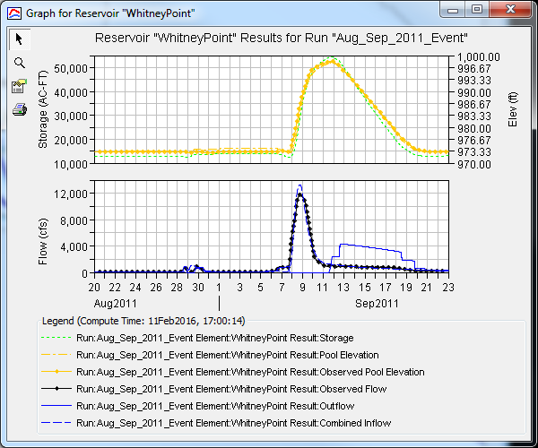
Reservoir Elements
DO NOT USE SOURCES/SINKS!
Use an actual reservoir element
This allows you to calibration to pool elevation in addition to computed inflow
20
Notes:
A reservoir routing option was added to the program that allows the user to specify a known/gaged outflow from the reservoir. This can be useful when calibrating the model. The program will compute storage and elevation given the gaged outflow and elevation-storage curve. The computed elevation could be compared with observed elevation.
If there are no records of outflow from the reservoir, you can model it using a storage-discharge curve or specify outlets (culverts) and let the program compute outflow.
Ensure your elevation-storage or elevation-area (or elevation-discharge) curves go high enough. HMS will not extrapolate for you.

Slide 21
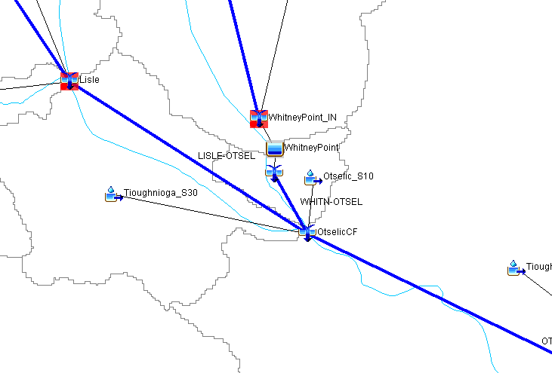
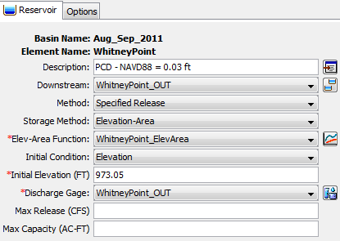
Reservoir Elements
Use the specified release option for reservoirs with known outflow
Ensure your elevation-area, elevation-storage, and/or elevation-discharge curves go high enough
  HEC-HMS will not extrapolate!
21
Notes:
A reservoir routing option was added to the program that allows the user to specify a known/gaged outflow from the reservoir. This can be useful when calibrating the model. The program will compute storage and elevation given the gaged outflow and elevation-storage curve. The computed elevation could be compared with observed elevation.
If there are no records of outflow from the reservoir, you can model it using a storage-discharge curve or specify outlets (culverts) and let the program compute outflow.
Ensure your elevation-storage or elevation-area (or elevation-discharge) curves go high enough. HMS will not extrapolate for you.

Slide 22
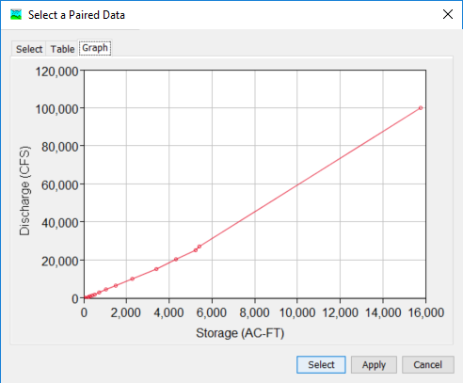
Reach Elements
Modified Puls > Muskingum Cunge > Muskingum
Convert as many reaches to Modified Puls as possible
  Use output from HEC-RAS model
Ensure your storage-outflow curves go high enough
  HEC-HMS will not extrapolate!
22
Notes:
Ensure your storage-outflow curves go high enough. You don’t want to extrapolate these curves during an extreme flood event when speed is essential.

Slide 23
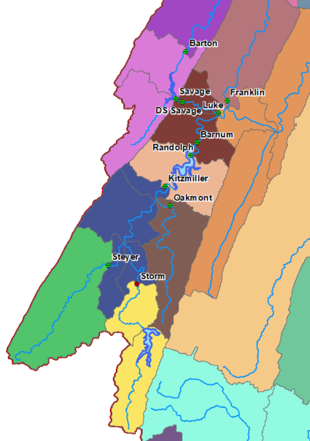
Forecast HEC-HMS Model Calibration
Start in the headwaters, then move downstream
Adjust as few parameters as possible
Use Computation Points
Use Zones
Use Compute to Point
Use Calibration Aids
Keep records of your changes!
23
Notes:
The strategy for calibrating an HEC-HMS model during a forecast run is essentially the same as a simulation run for an historical event.
Start in the headwaters and work downstream.
Use Zones.
Use slider bars.
Adjust as few parameters as possible.
Record your changes! Forecast alternatives will not store anything to memory unless you change parameter values within a specific element.
For reservoirs, use the specified release option.

Slide 24
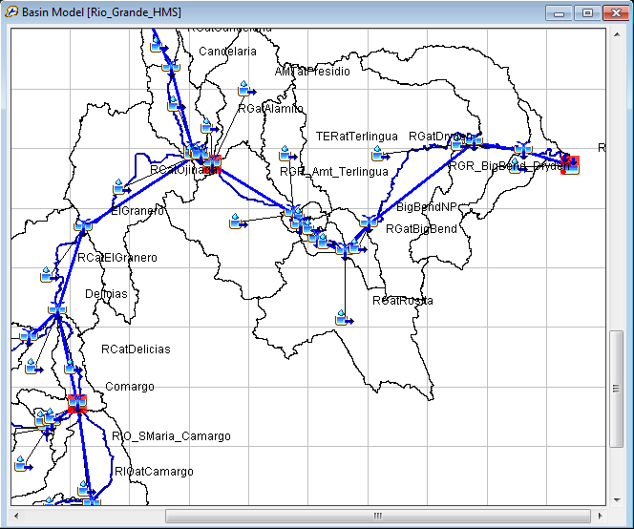
Computation Points
Any element in the basin model can be designated a computation point
A special highlight color is used in the Basin Map
The highlight color is customized in the Program Settings, accessible from the Help menu
Observed data is the most common reason for designation
A slider editor and custom results can be configured for each computation point
24

Slide 25
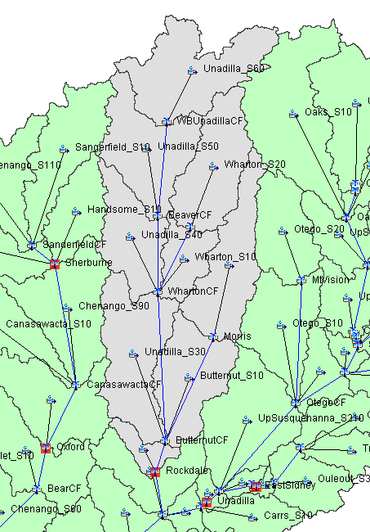
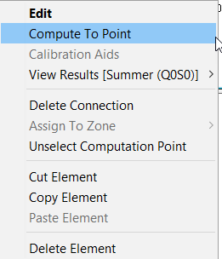
Compute to a Point
Compute only the elements upstream (that have been changed)
Any computation point can be used
Incredibly useful feature!
25

Slide 26
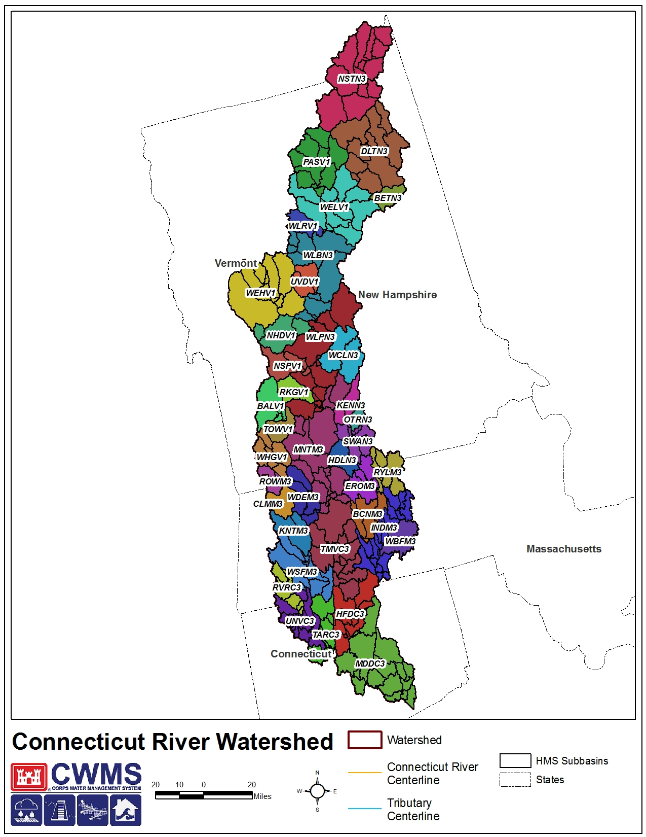
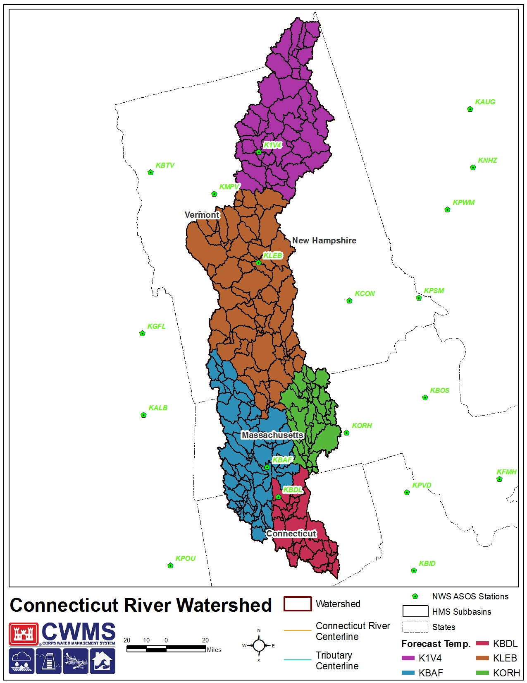
Zones
26

Slide 27
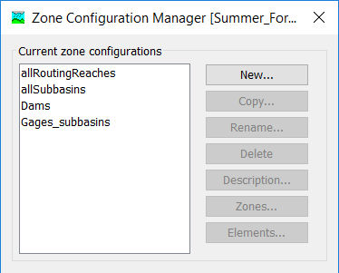
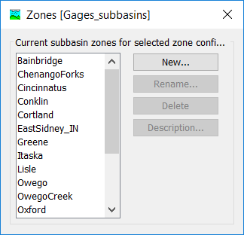
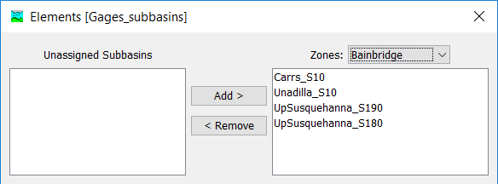
Zones
Steps to create/setup:
Create a zone configuration
  Select either subbasins or reaches
Create zones
  Can use multiple zones
Populate zones with elements
  Can also right-click add elements to zones
27

Slide 28
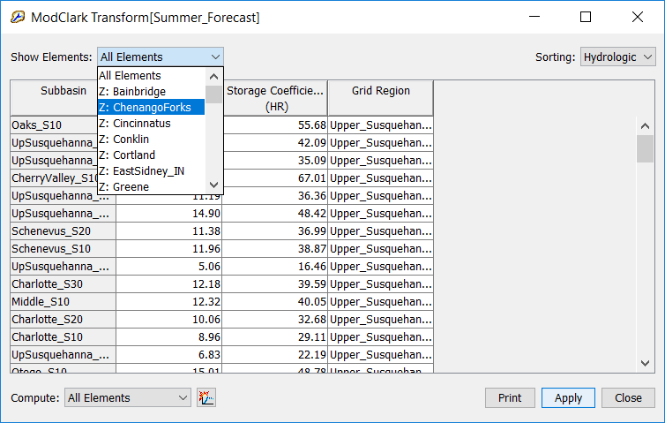
Zones
Allow for the global adjustment of parameters in a Simulation Run:
28
Notes:
Within the global editors, use the drop down menu in the upper left corner to select the zone in question. It will be designated with a “Z:”.
Similarly, if routing reaches were selected for use within the zone, these elements and parameters are available for adjustment on a “zonal” basis.

Slide 29
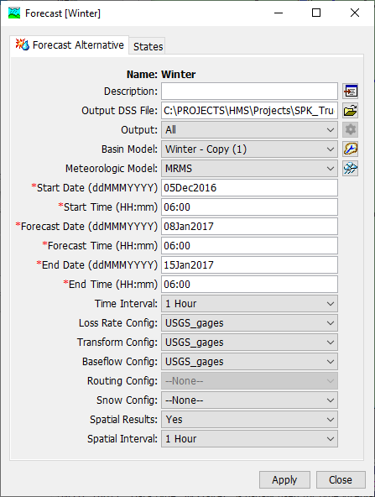
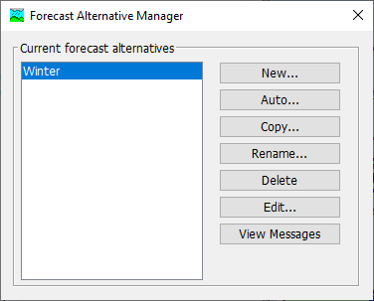
Zones
Allow for the global adjustment of parameters in a Forecast:
29
Notes:
When you are in a simulating a forecast, you can bring up an additional global parameter editor. Your zones must be associated with the Forecast Alternative. To change these within HMS, you can open the Forecast Alternative Manager, Edit, and change the zones that are associated with each modeling process. You can associate different zone configurations with each process.

Slide 30
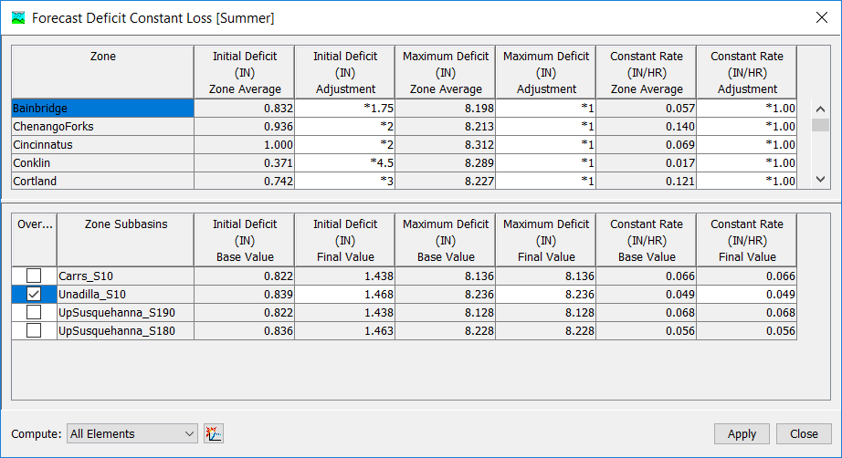
Zones
30
Notes:
Then, using the zone configuration you specified, you can globally adjust the parameters for a given zone. “+” values adjust upwards by the given value and “–” values adjust downwards. These are increments, NOT multipliers. You can also override and paste parameter values into this editor by clicking the radio buttons on the left and changing the desired value for the desired element.

Slide 31
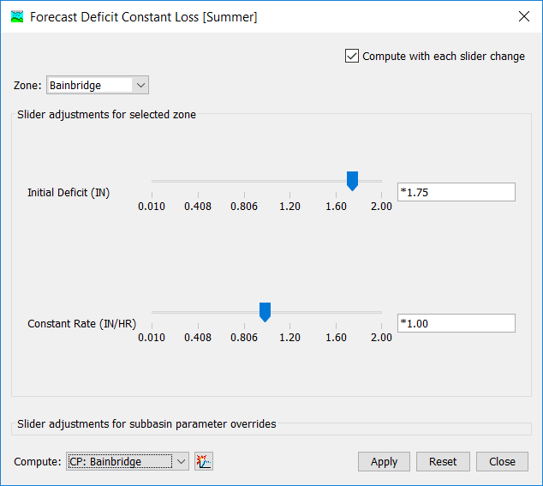
Forecast Slider Adjustments
Steps to create/setup:
Select Processes and Parameters using previously-defined zones
Set Adjustment Types and Ranges
31

Slide 32
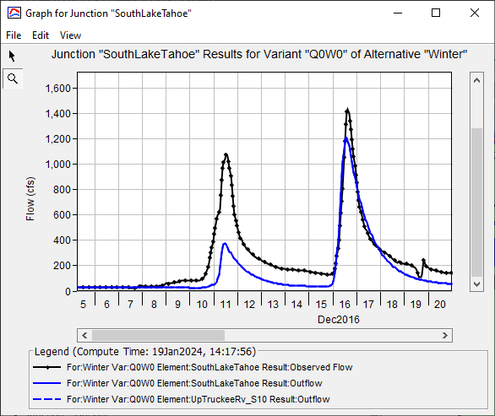
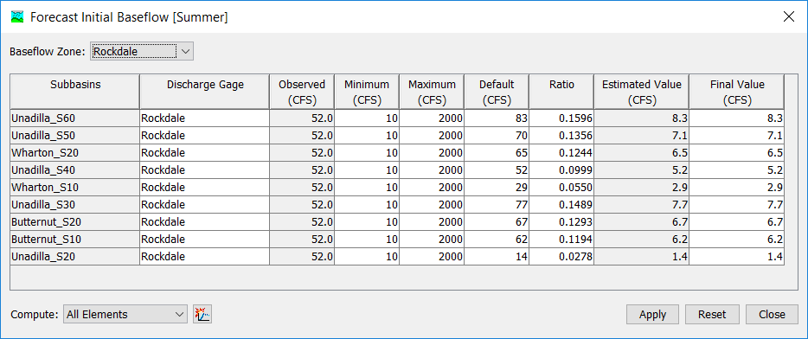
Automatic Initialization – Subbasin Baseflow
32

Slide 33
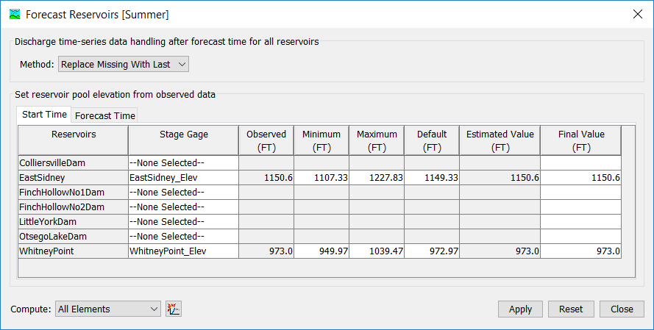

Automatic Initialization – Reservoir Elevation
33

Slide 34
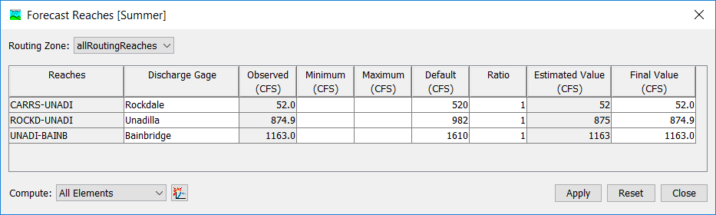
Automatic Initialization – Reach Outflow
34

Slide 35
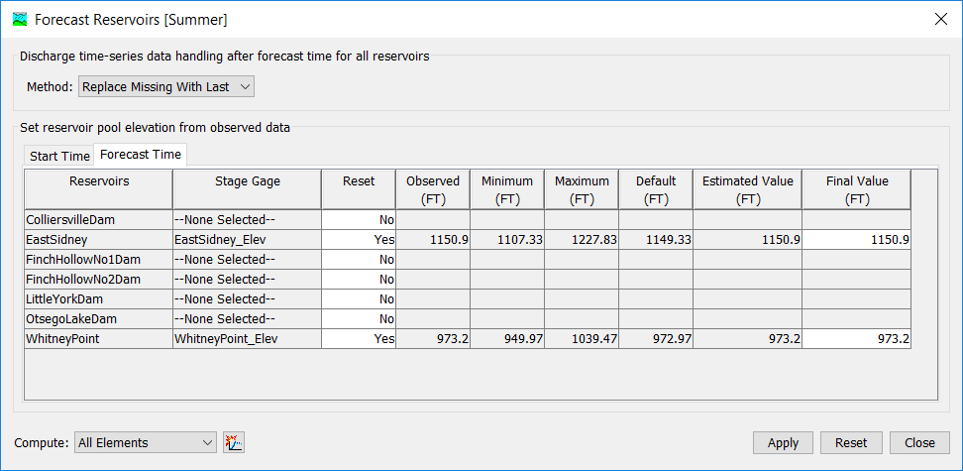
Forecast State Change – Reservoir Elevation
35

Slide 36
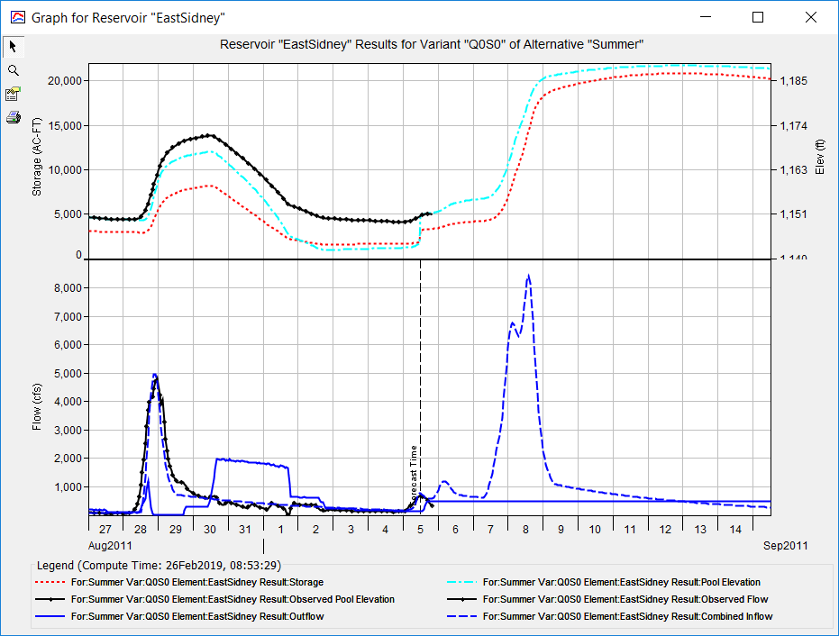
Forecast State Change – Reservoir Elevation
Stage Reset
36

Slide 37
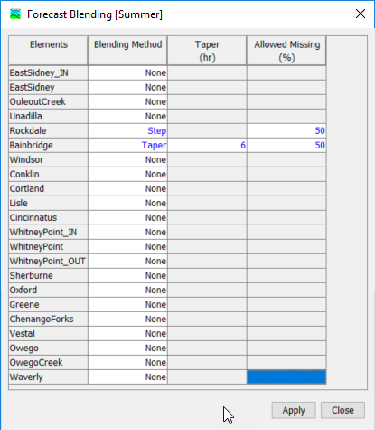
Forecast Blending
Replaces the computed results with observed results during the lookback period
Do not replace calibration with blending
If you use the specified release option, then this IS NOT necessary
If you use junctions in lieu of reservoir elements, then this IS necessary
37
Notes:
Blending can be used to mimic complex gated operations at a dam during the lookback period. However, it is best to not “over use” this option. Do not replace calibration with blending!

Slide 38
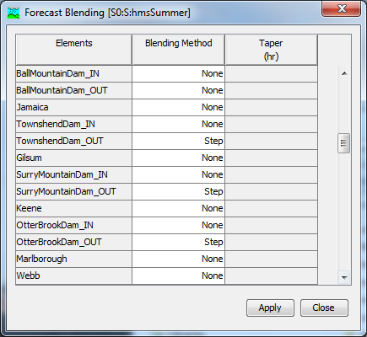
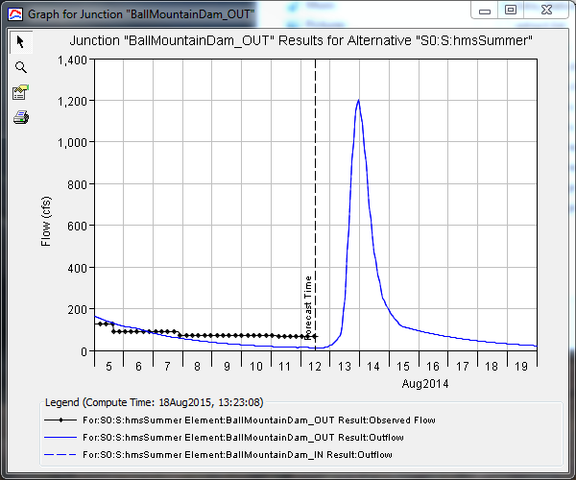
Forecast Blending – None
38
Notes:
Forecast blending is used to overwrite the computed results during the lookback period. This comes in handy at dams/reservoirs where HMS has a hard time recreating the complicated outflow from a gated structure. For instance, HMS computes a smooth outflow hydrograph during the lookback period from Ball Mountain Dam. However, the gates were being adjusted during the lookback period resulting in the observed, “stepped” hydrograph. We’d like to simply use the observed results during the lookback period and then revert to the computed results during the forecast period.
HMS contains three options for blending the computed and observed results: None, Taper, and Step. Each have their own implications and uses.
When the blending method is set to “None”, no blending is performed between the lookback period and the forecast period, as the name suggests. This is the default and should probably be used at all locations that don’t correspond to the outflow from a dam.

Slide 39


Forecast Blending – Taper (0 hours)
39
Notes:
When “Taper” is selected, the observed flow will be used during the lookback period but the computed results will completely take over at some point in the forecast time period. That’s where the length of taper comes in play; the shorter then length, the faster the results will switch from the observed results to the forecasted results. Using a taper of “0” hours results in an instantaneous switch.

Slide 40


Forecast Blending – Taper (10 hours)
40
Notes:
When the “Taper” time is increased, the time in which the results are merged/smoothed with the observed flow is lengthened. This results in a more gradual transition from the observed data that’s used during the lookback period to the computed results during the forecast time.

Slide 41


Forecast Blending - Step
41
Notes:
When “Step” is selected, the difference between the observed and computed discharge at the time of forecast is maintained throughout the remainder of the simulation. Therefore, if your computed results are 100 cfs below the observed flow at the time of forecast, then you’re going to maintain a difference of 100 cfs throughout the remainder of the simulation.
In general, you should only be using the blending option for reservoir outflows. Be wary of using blending though; do not assume that you don’t need to calibrate the model during the lookback period.

Slide 42

Upcoming Forecasting Features
Nested Optimization
Ensembles
  Meteorologic boundary conditions
  Land surface processes
  Combinations
42

Slide 43
Review
Discussed CWMS/HEC-RTS and the CWMS National Implementation
Described the purpose of HEC-HMS within the forecast sequence
Summarized Forecast terminology
Provided some considerations when using models for forecasting applications
Detailed several HEC-HMS forecasting features
43

