Slide 1

Probable Maximum Precipitation
H&H for Dam Safety
March 2024
Gregory S. Karlovits, P.E., PH, CFM
Hydrology and Statistics Division
US Army Corps of Engineers
Hydrologic Engineering Center

Slide 2
Objectives
Understand the role of probable maximum precipitation in infrastructure risk assessment
Advance understanding of heavy precipitation mechanics
Know which HMR document affects your project
Apply a PMP procedure in software using HMR-52

Slide 3
Lecture Outline
Background on PMP and meteorology
PMP Documents
HMR-52 in HEC-HMS

Slide 4

Background
Probable Maximum Precipitation
Probable Maximum Flood
Meteorology of Precipitation

Slide 5
PMP Definition
The WMO defines Probable Maximum Precipitation (PMP) as:
“... the greatest depth of precipitation for a given duration meteorologically possible for a given size storm area at a particular location at a particular time of year, with no allowance made for long-time climatic trends.” (WMO, 1986).

Slide 6
PMP: What’s it Good For?
The PMP is a combination of science, engineering, and politics
It is an:
  engineering procedure
  to approximate real science
  to estimate an institutional limit
It tries to answer the question,
When do we stop design/risk analysis of a significant hazard structure?

Slide 7
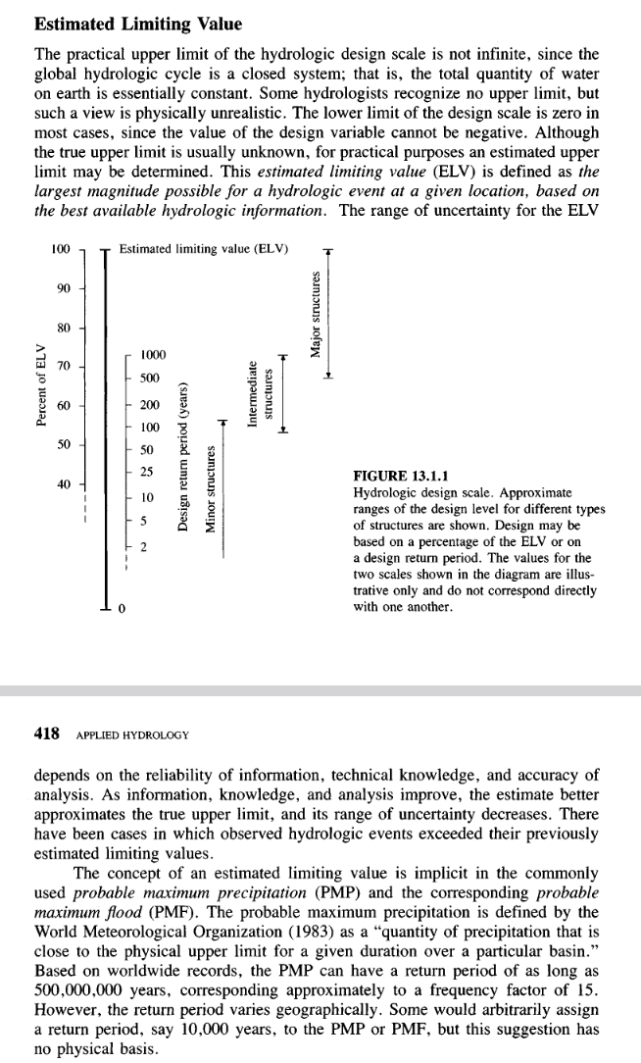
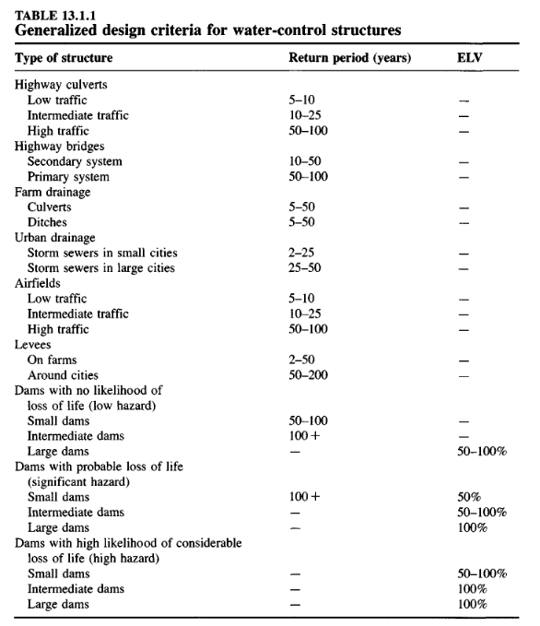
Estimated Limiting Value (ELV)
“…the largest magnitude possible for a hydrologic event at a given location, based on the best available hydrologic information.”
Notes:
How ok are you (or is your institution) with this structure failing?

Slide 8
PMP and PMF
The PMP is part of a procedure used to develop the
probable maximum flood
The “general” or “all-season” PMP may not produce the PMF
Special considerations for hydrologic interactions such as snow and soil moisture
More to come on PMF modeling

Slide 9
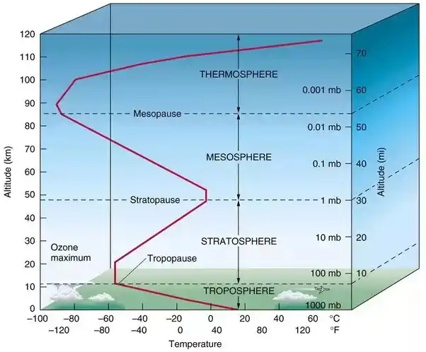
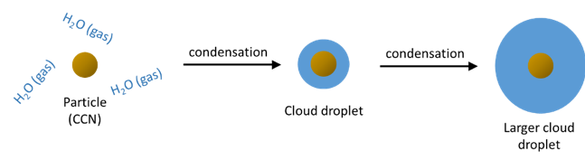
Precipitation in a Nutshell
Cool,
Saturated Air
Lifting Force
Warm, Moist, Unsaturated Air
Notes:
Cloud condensation nucleus: if there’s nothing in the atmosphere to condense upon, you can’t get rain. This is where the principle of “cloud seeding” comes from. Aerosols (little particles suspended in air) give water vapor somewhere to condense. Dust and sea salt are two examples.
As the droplets get heavier and heavier due to condensation, they begin to fall out of the atmosphere. There is also a component of the collision of these particles causing them to split, or to grow, as well. The growing process by collision is called “collision-coalescence”.

Slide 10
Humidity and Dewpoint
Air is a combination of various gases
Humidity is the concentration of water vapor
Relative humidity = percent saturation at temperature
Specific humidity = mass ratio of water
Dew point = cooling temperature for saturation
Rain happens when an air parcel exceeds saturation
Notes:
Dew point is the best way to understand how nasty it is outside in hot, humid climates. The relative humidity doesn’t tell you a lot if it’s also really warm outside, but the dew point communicates the combination of the two.
For example, 80 degrees with a 70 degree dew point has a RH of about 72%, but is very nasty outside.
68 degrees at 100% RH has a dew point of 68, and is sticky but much more comfortable.
Since the dewpoint really can’t be higher than the temperature, if the dewpoint equals the dry bulb temperature, the air is considered saturated.

Slide 11
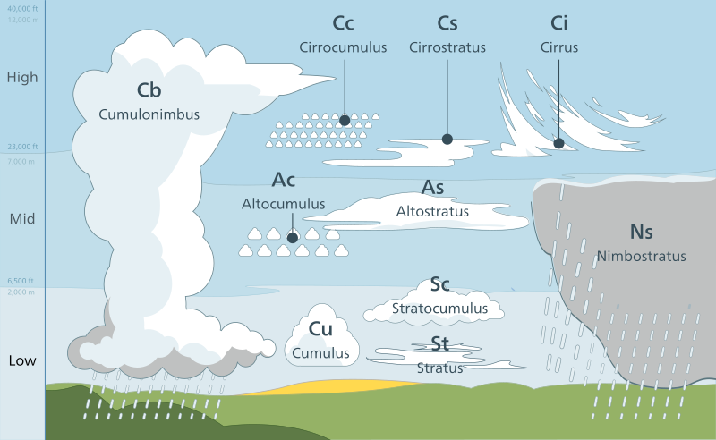
Lifting Forces
Fronts/cyclones
Orography
Convection
Notes:
These are the three primary processes considered in the PMP documents, with a heavy focus on the first two. You might see fronts and cyclones under “convergence” or “non-orographic” PMP.

Slide 12
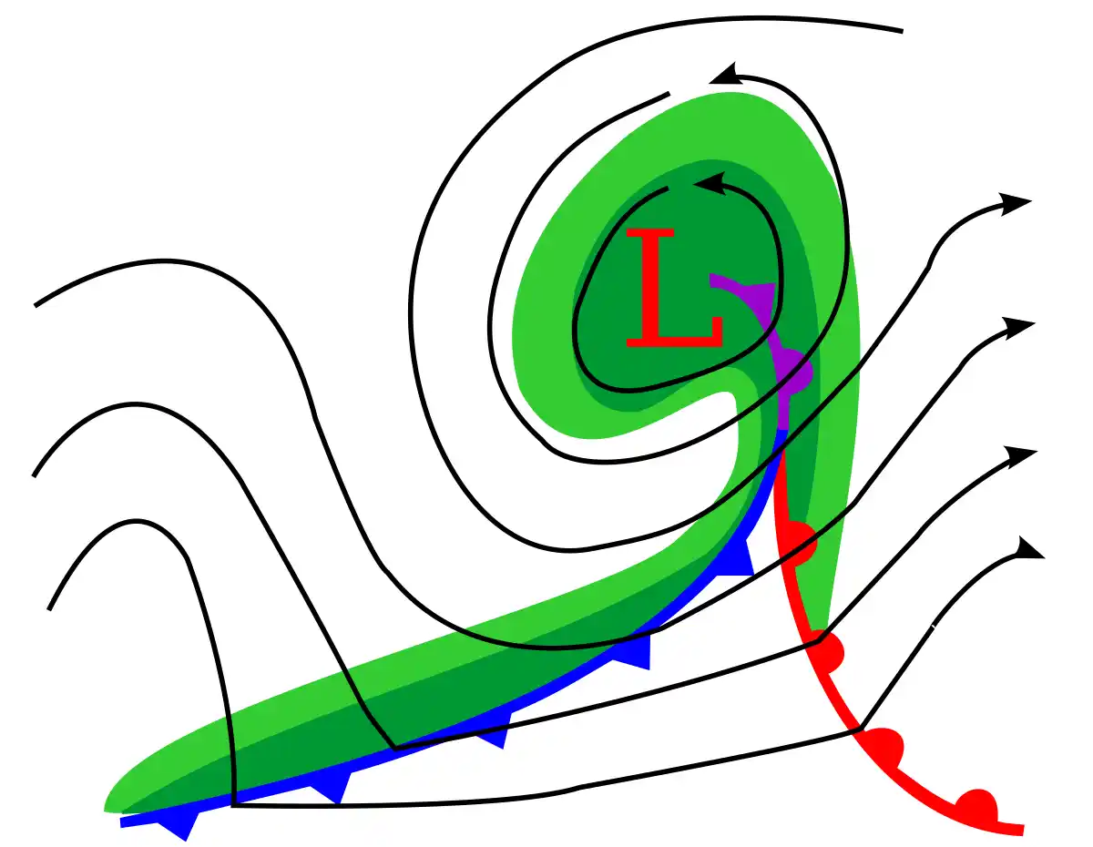
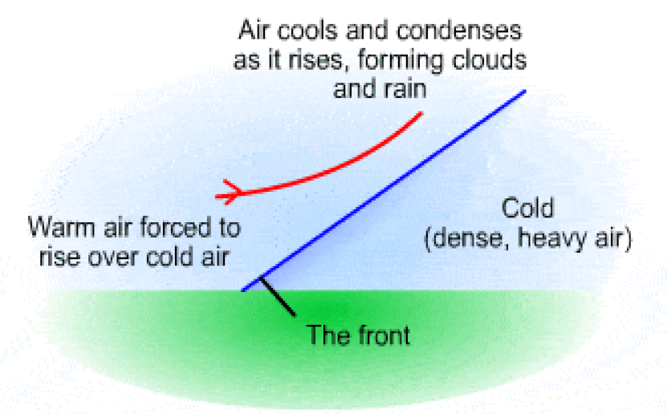
Frontal Rainfall and Cyclones
Cyclone with occlusion
Notes:
Synoptic scale meteorology
Remember – warmer air is less dense, so when a cold air mass and warm air mass meet, there is vertical stratification in the atmosphere
The right side is from a surface map. The colored lines are front, the lines are isobars (same pressure)
The little nodes on the front show which way the front is moving
Cyclones obey the right hand rule in the northern hemisphere – air is rising (thumb) and the rotation is counterclockwise (fingers curled). Cooler air is typically found in the north, warmer in the south, so the circulation often brings a cold front which catches up with a warm air mass.
Occlusion causes a “trough of warm air aloft” aka TROWAL – the bottom of the warm front is not at the surface since it has climbed up the cold front

Slide 13




Orographic Rainfall
T = 62.7°F
T_{d} = 62.7°F
Lifting Condensation Level
Lapse Rates (°F / 1,000 ft)
Dry adiabatic = -5.4
Dew point = -1.0
T = 75°F
T_{d} = 65°F
Notes:
The same mechanics of cooling and condensation happen for all the lifting types – but it’s easiest to see here on orographic effects.
As the air parcel cools and creates precipitation, the humidity drops. Then, once the parcel is pushed over the mountain and sinks on the other side, the air is much drier than on the windward side of the mountain. This is called a “rain shadow”.

Slide 14




Convection
Saturation
Increased Buoyancy
Solar Radiation
Evaporation
Near-Surface Moisture
Thermal Energy
Notes:
Mesoscale meteorology – this can happen at a scale as small as a single cloud (ordinary thunderstorms)

Slide 15
Maximum Precipitation
The heaviest rainfall has:
  Plentiful moisture
  Strong, sustained source of uplift
  Continued feed of moist air
We use historical observations of the most severe rainfall to estimate the limits of these ingredients
  Basic thermodynamic relationships let us “maximize” the storms
Notes:
One discussion in PMP documents, especially when mountains come into play, is barriers. If there are places where moisture flow can be interrupted, then the PMP is likely to not be as high if the location could be continuously connected to moisture.
Locations with ample access to warm moist air (such as near the ocean) with nothing in the way to interrupt the flow (like mountains) can produce the highest PMP estimates.

Slide 16
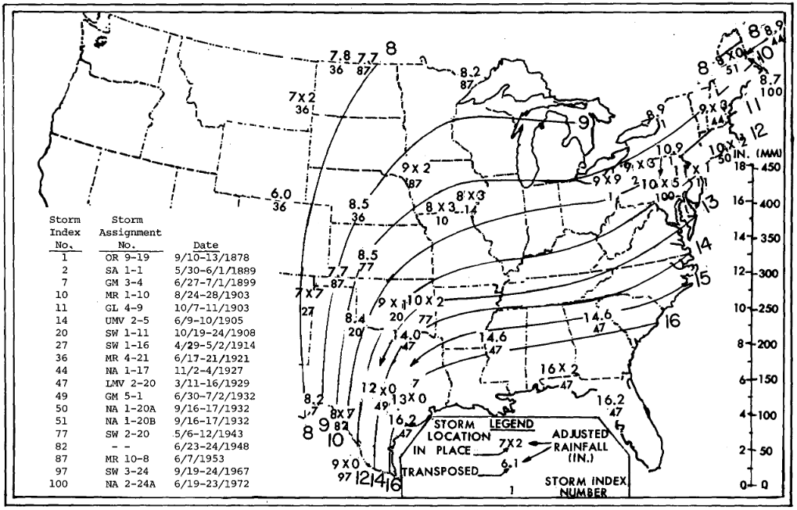
Simplified PMP Development Workflow
Identify controlling storms in a region
Maximize their precipitation
Transpose them to the target location
Adjust for the transposition
Create envelope curves
Generalized PMP (HMRs) are maps at a small scale (e.g. 10 mi²)

Slide 17
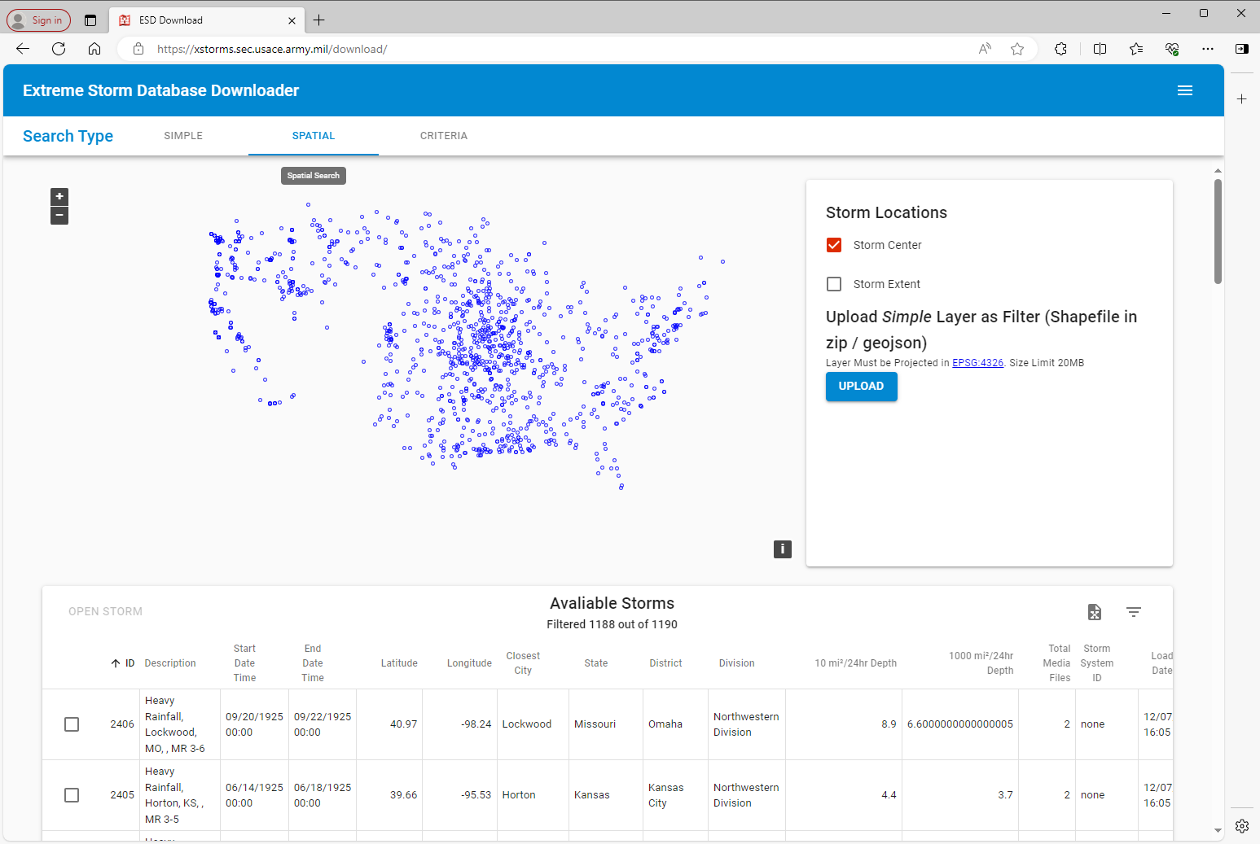
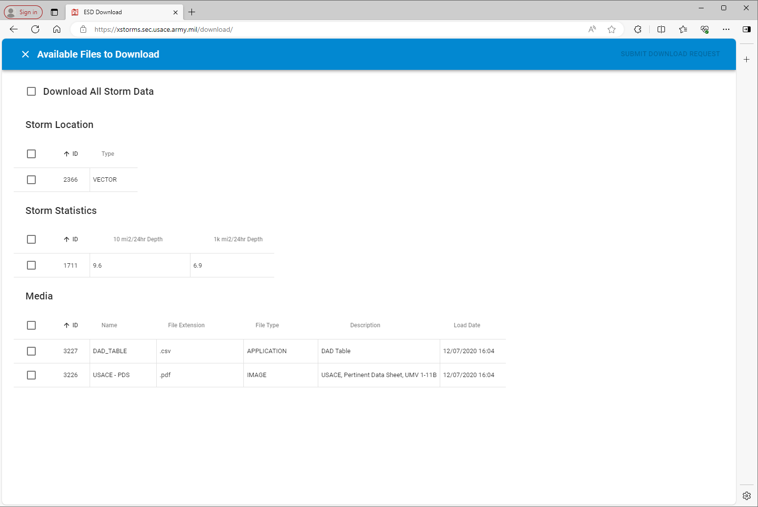
Storm Catalog
Collection of the most severe storms on record
USACE Extreme Storms database

Slide 18
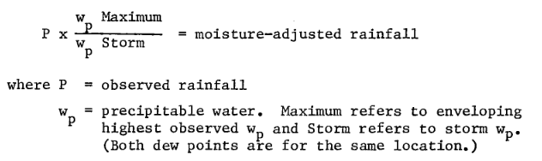
Precipitation Maximization
Atmospheric moisture data not available for many storms
Persisting surface dew point used as an index
  e.g. maximum 12-hour minimum
  Precipitable water (w_{p}) computed from dew point
Compare w_{p} at storm’s inflow
to climatology
Adjust rainfall by ratio of
storm w_{p} to maximum w_{p}
Notes:
Other considerations for the moisture adjustment might be included, like elevation and barriers

Slide 19
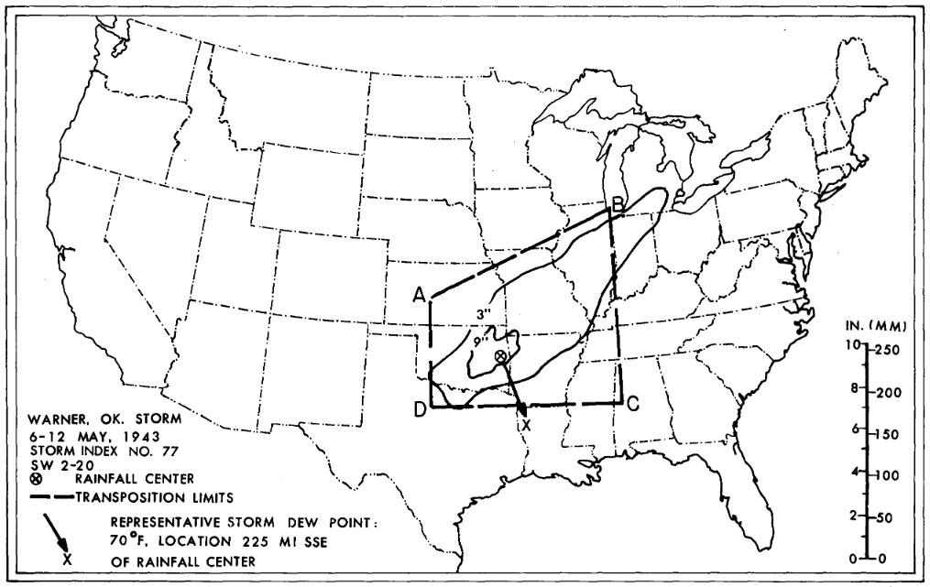
Transposition
Translation/movement in x and y only
Only allowed within a defined transposition domain
Second moisture adjustment
  Ratio of new location max w_{p}
  to observed location max w_{p}
Notes:
The same principles are applied for developing precipitation and flow frequency using stochastic storm transposition.

Slide 20
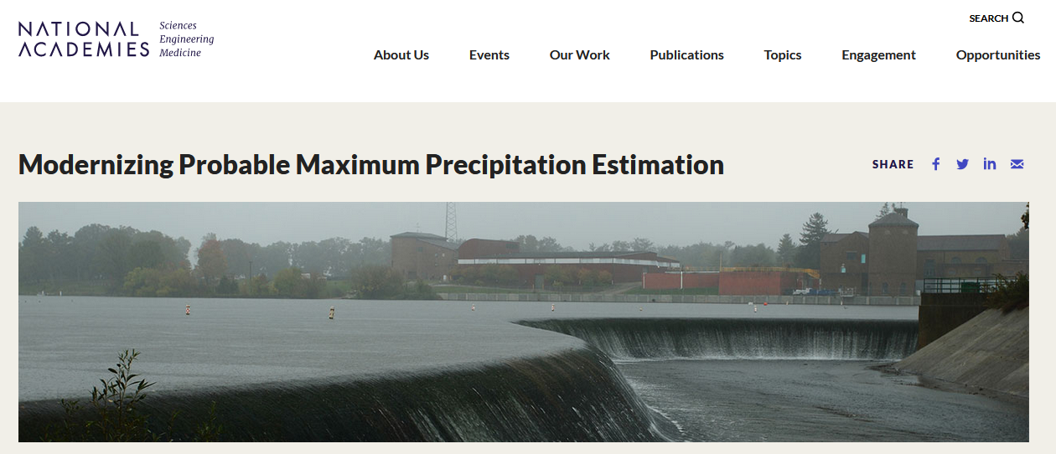
Physics-Based Modeling of PMP
Notes:
Produce a single approach for the entire United States instead of piecemeal documents with different workflows.
Start using numerical weather prediction (NWP) models such as WRF for estimating physical limits to rainfall.

Slide 21
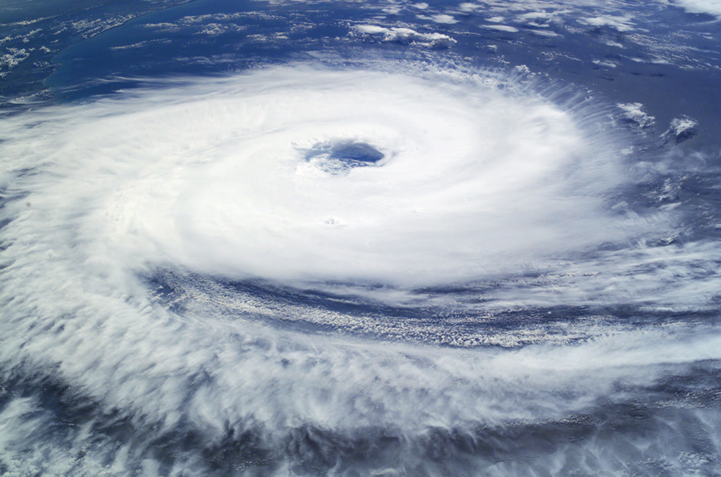
PMP Documents
NOAA Hydrometeorological Reports

Slide 22
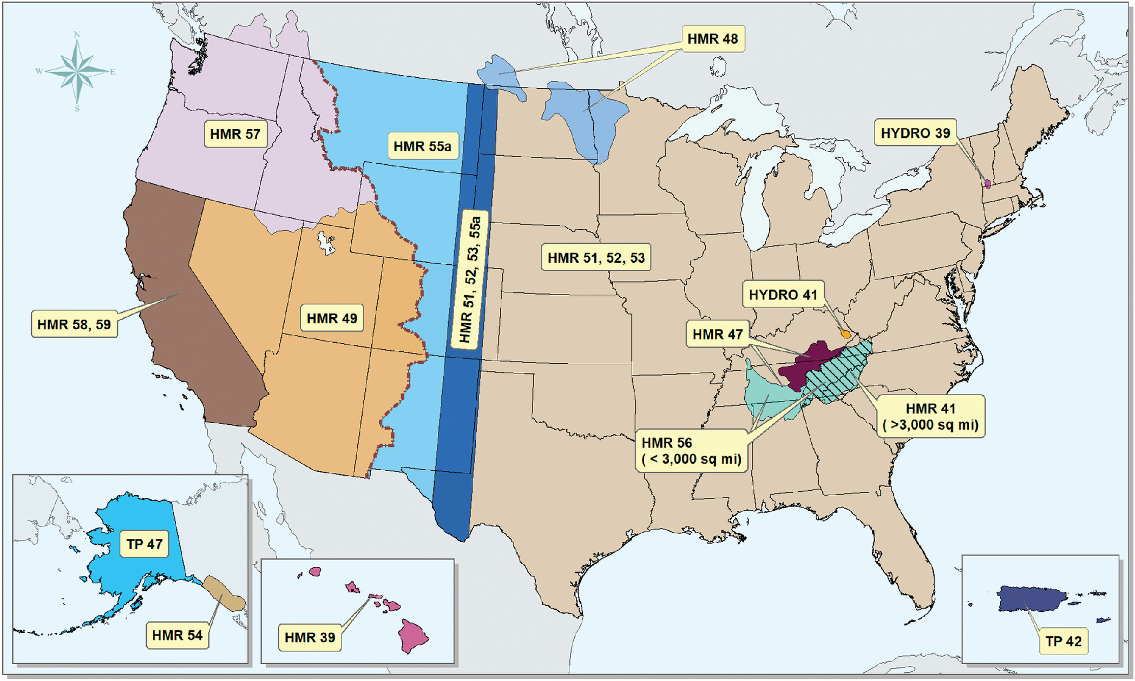
PMP Documents Across the US
https://www.weather.gov/owp/hdsc_pmp

Slide 23
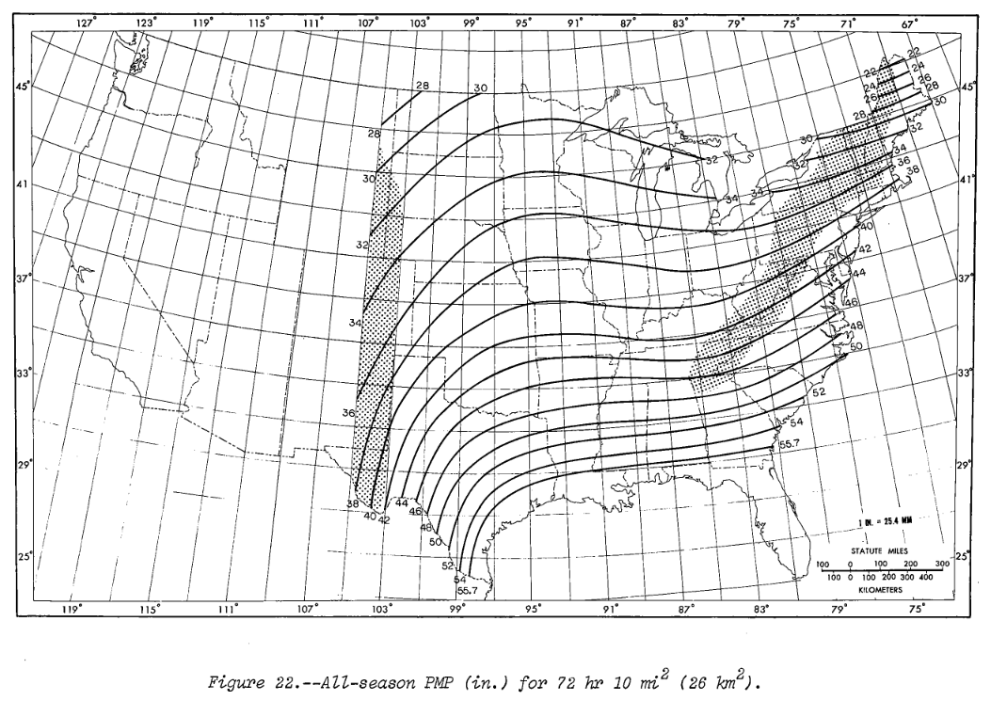
Document Contents
Inventory of storms used in analysis
Description of analysis procedure
Index maps
Application procedure
  Adjustments for local conditions
  Spatial pattern
  Temporal pattern
This is where you come in!

Slide 24
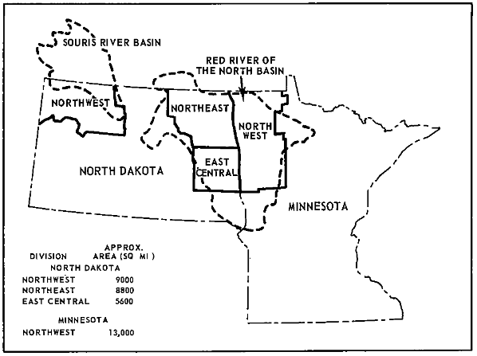
HMR-48 (1973)
PMP and Snowmelt Criteria For Red River of the North Above Pembina, and Souris River Above Minot, ND
  PMP index tables for multiple durations
  Geographic/seasonal adjustments
  Temporal patterns and isohyets
    72-hour storm in 6-hour blocks
Snowmelt procedures
  Initial snowpack
  Meteorological data
    Wind, temperature, dewpoint

Slide 25
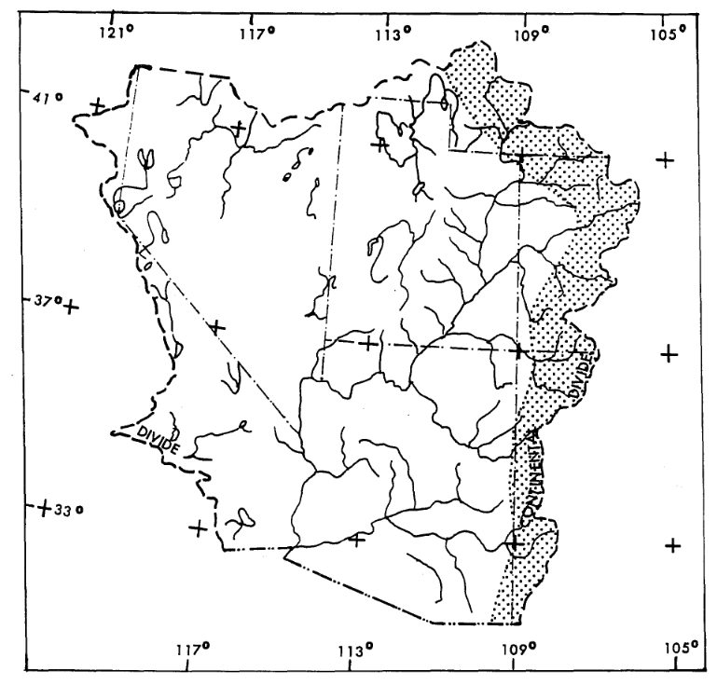
HMR-49 (1977)
PMP Estimates, Colorado River and Great Basin Drainages
Generates estimates of orographic and
non-orographic (convergence) precipitation
Application is a weighted average of the
two components

Slide 26
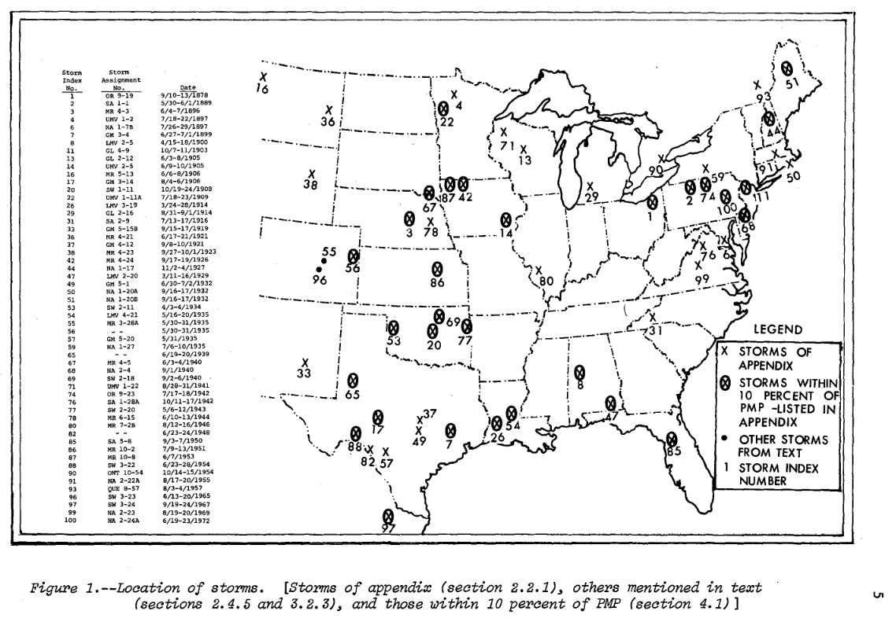
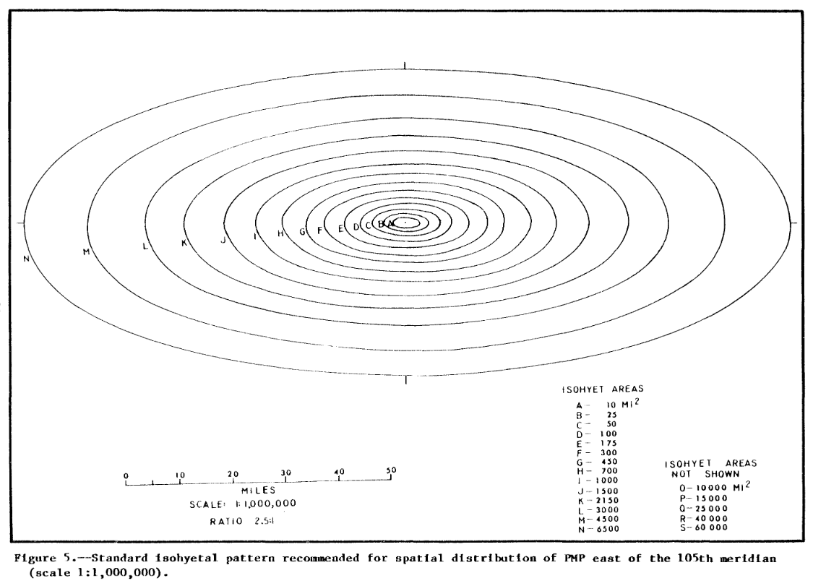
HMR-51, 52, 53
General PMP approach for the entire US east of 105°W
  HMR-51: development of PMP estimates
  HMR-52: application of PMP
  HMR-53: seasonality analysis
Key: non-orographic rainfall
Procedure is (relatively) straight-
forward to apply

Slide 27
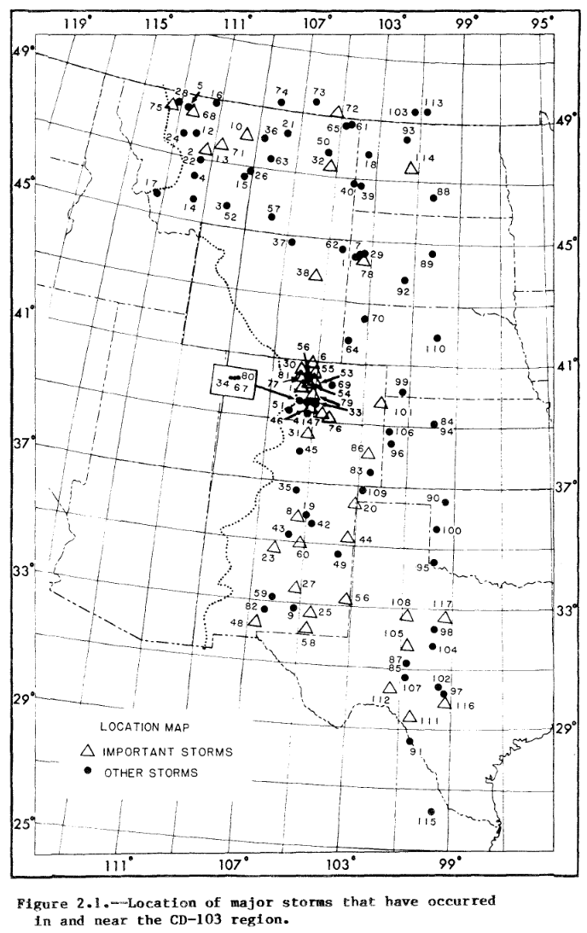
HMR-55a
PMP Estimates – US Between the Continental Divide and the 103rd Meridian
Wrestles with the transition from non-orographic to orographic rainfall
Produces a depth-duration curve from 4 index maps and ARFs
Like HMR-49, weighted average of two processes

Slide 28
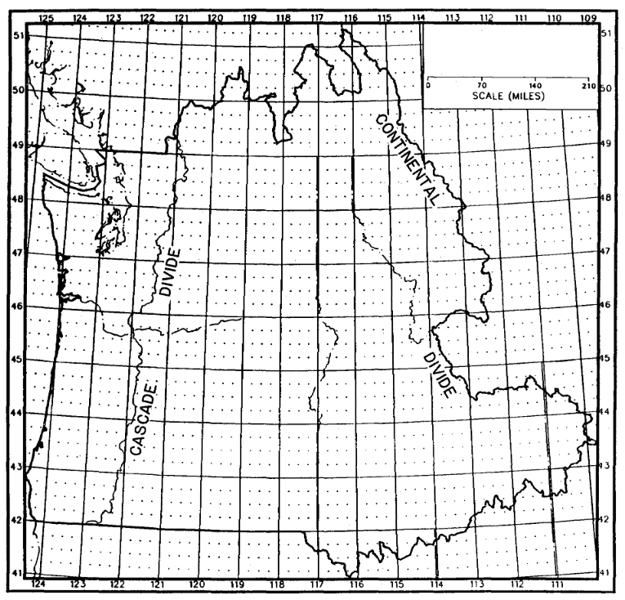
HMR-57
PMP – Pacific Northwest States
Another area with significant orographic influence
Uses a storm separation method to allow
non-orographic precipitation to be transposed
Orographic component like HMR-55a
Still uses temporal distribution from HMR-43
Considerations for snowmelt
Notes:
Supersedes HMR-43
One of the first studies to really take advantage of computer processing of storms data

Slide 29
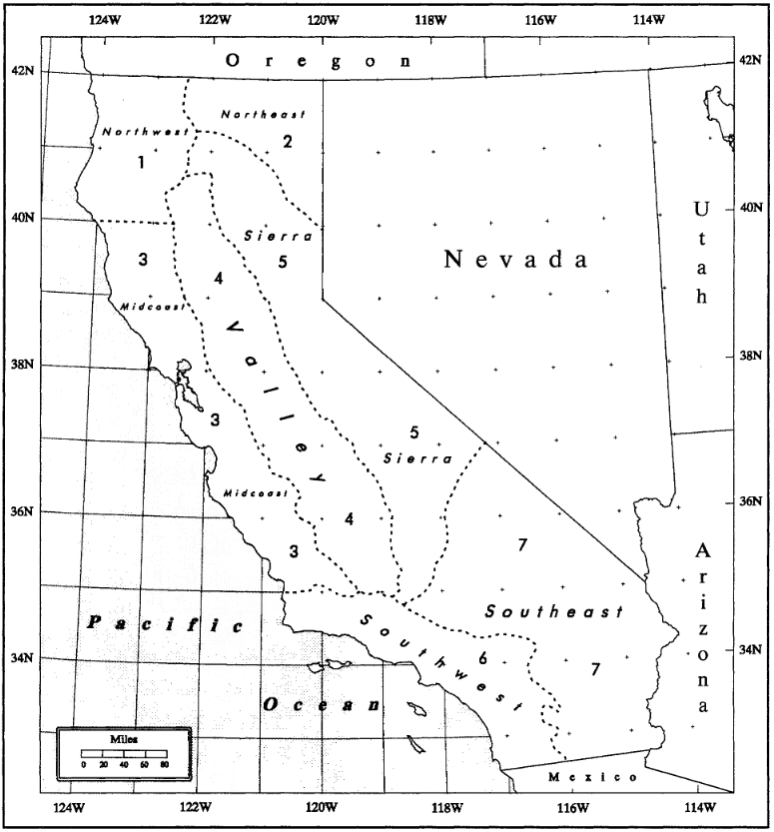
HMR-58, 59
PMP for California
First HMR to produce all figures/results as digital data
Procedure is straightforward despite complexity of meteorology
Includes snowmelt (from HMR-36)
Notes:
Supersedes HMR-36 and HMR-49
Drainage outline
All-season or seasonal PMP?
All-season PMP estimate from index maps (24 hr 10 sq mi)
Seasonal PMP estimates from index maps (only if decision in 2 says so)
Depth-duration relations by subregions
Area reduction factors
Incremental depths
Snowmelt, temporal/areal distributions

Slide 30
Others
HMR-39: Hawaii
HMR-41, 56: TVA - 41: >3,000 mi²; 56: <3,000 mi²
HMR-46: Mekong River Basin
HMR-47: Subbasins in the Tennessee/Cumberland watersheds
HMR-54: Southeast Alaska
HMR-56: TVA small basins (<3,000 mi²)
HYDRO-39: Upper Deerfield River (MA/VT)
HYDRO-41: Dewey Dam, KY
TP-42: Puerto Rico and Virgin Islands
TP-47: Alaska

Slide 31
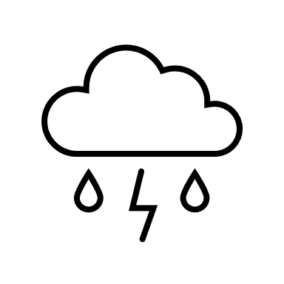


The Bottom Line
Read the documents! They are very clear and helpful.
PMP is a recipe meant to be consistently applied

Slide 32
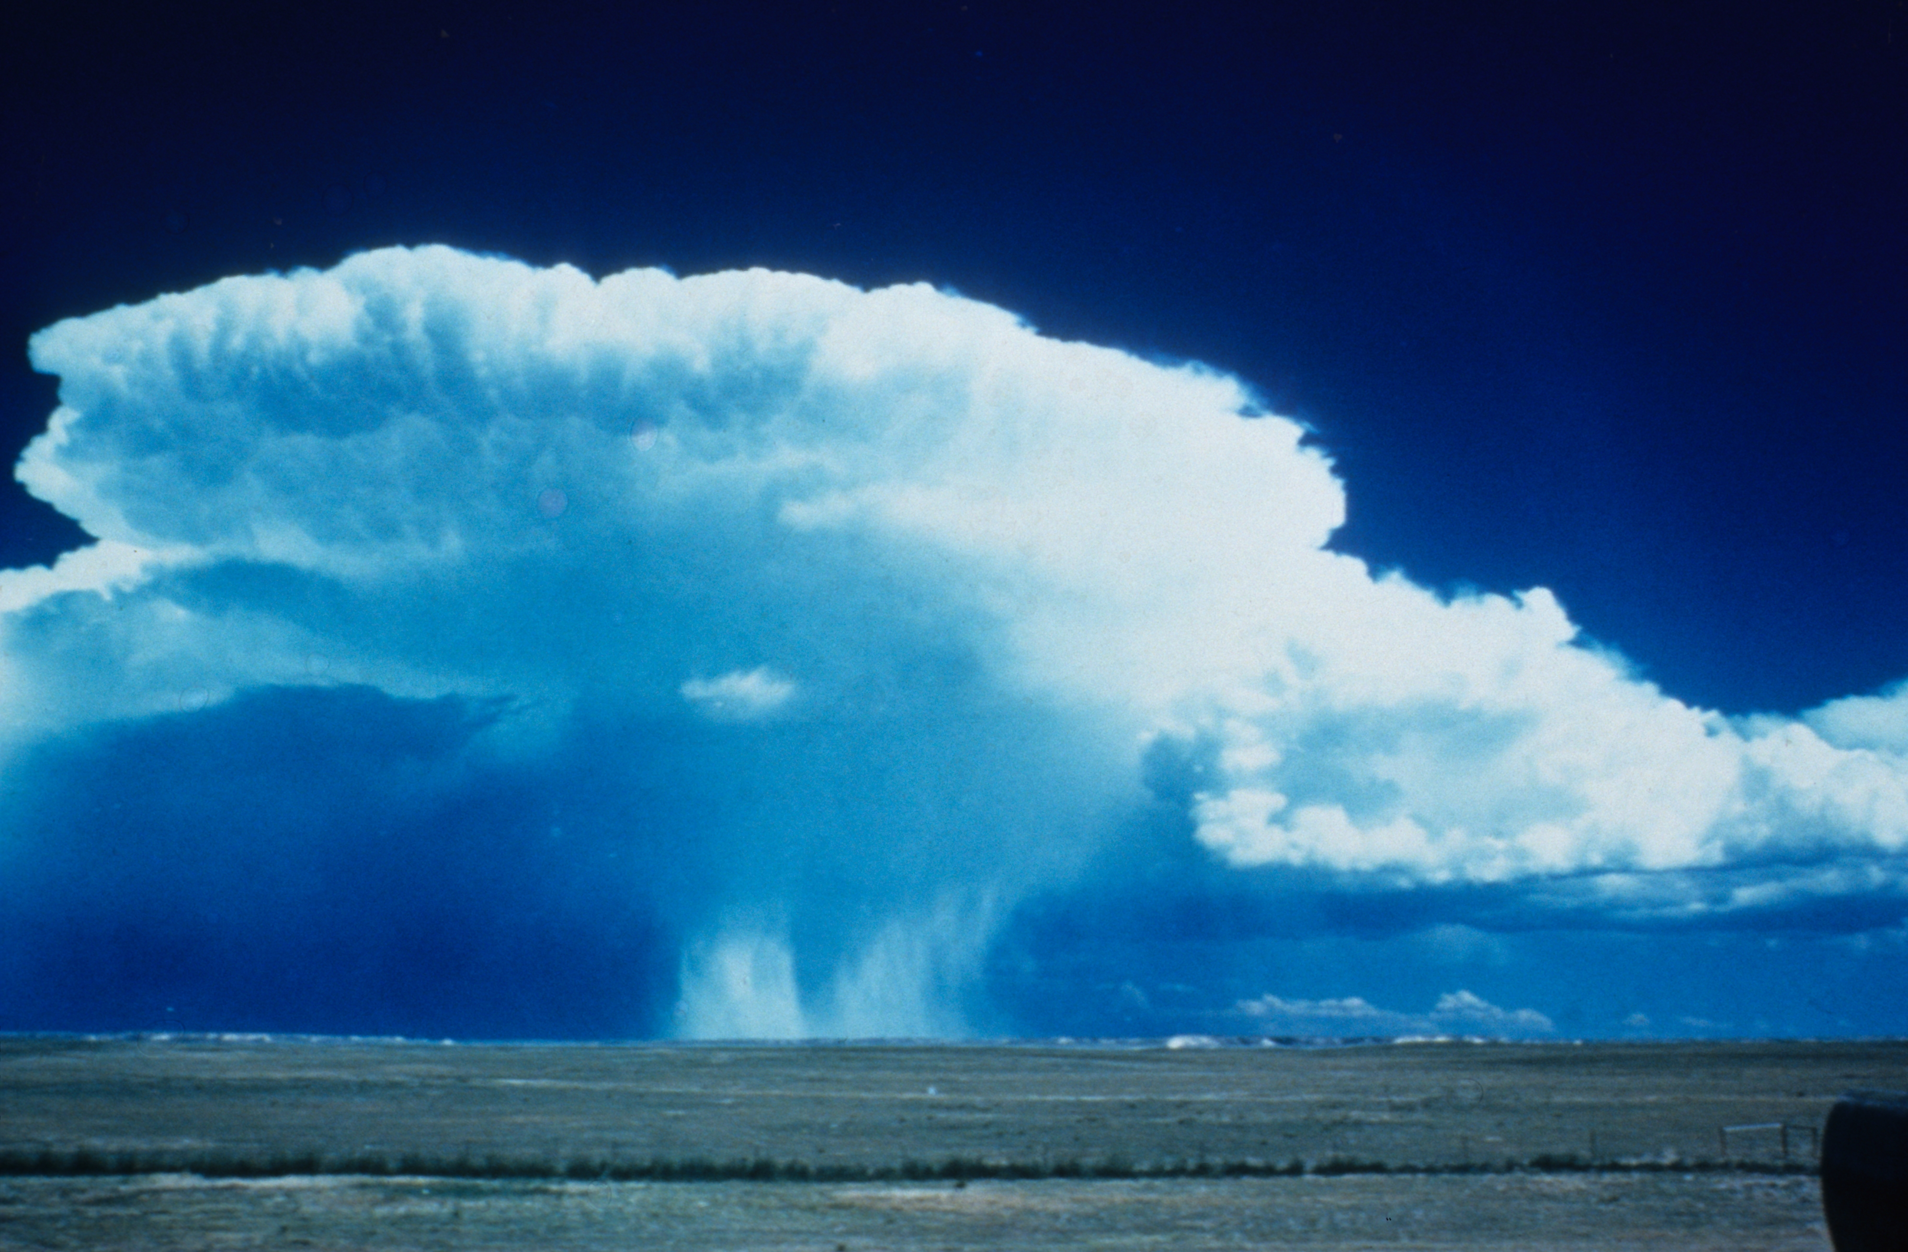
HMR-52 in HEC-HMS
Using the HMR-52 Meteorologic Model
With slides from Josh Willis, Matt Fleming, and others

Slide 33
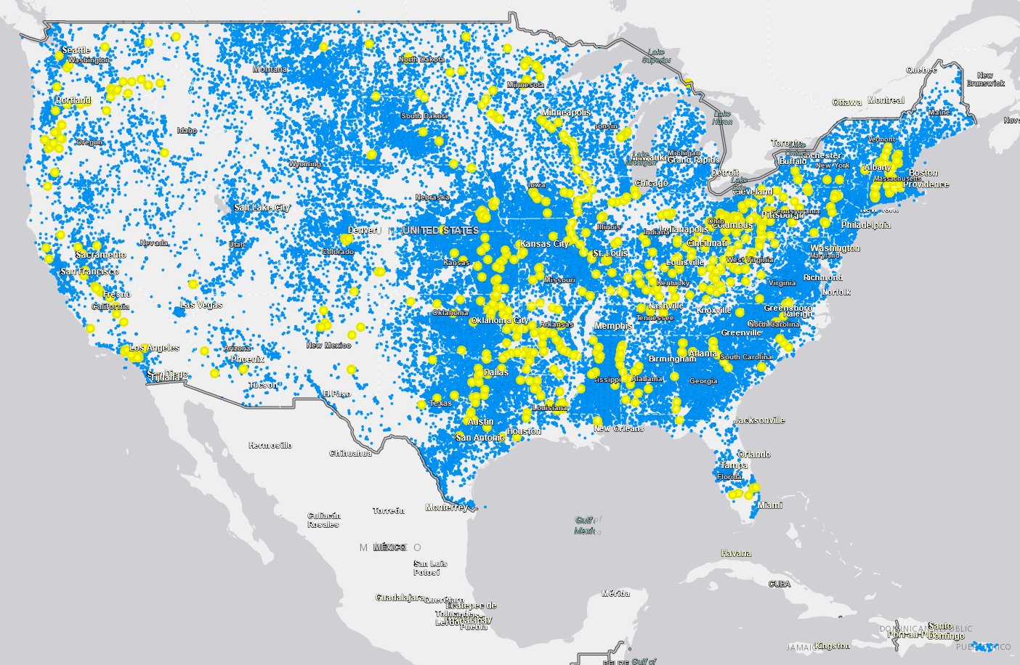
Why HMR-52?
USACE Dams (748) from NID

Slide 34
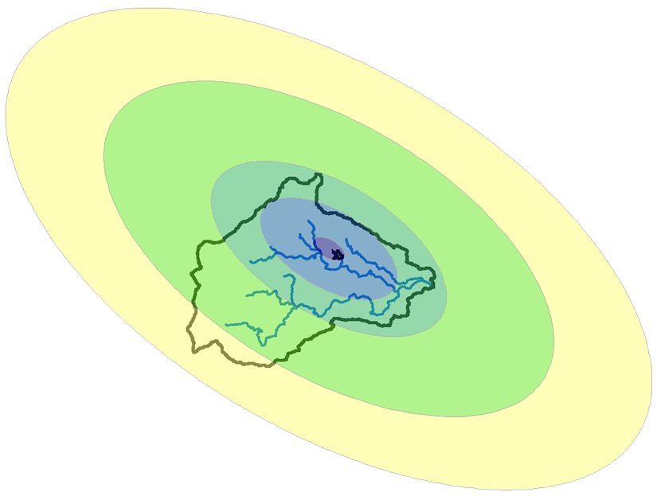
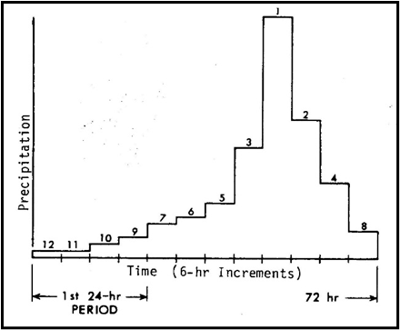
Developing the PMP Storm for a Project Area
Storm Area
Temporal Pattern
Spatial Pattern
Storm Location
Storm Orientation
Notes:
This slide shows five important factors to consider when developing the PMP hyetograph for a specific project. HMR 52 (Eastern US) contains guidelines that aid the user in applying PMP depth estimates from HMR 51 to a specific drainage area of interest. We will look at storm area, which is needed for depth-area reduction, how the storm varies in space and time, and how to orient and center the storm to produce the PMF inflow into the reservoir.

Slide 35
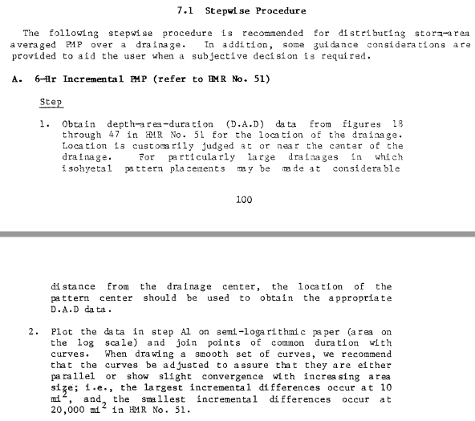
Developing the PMP Storm for a Project Area
Notes:
Chapter 7 of HMR 52 lists procedural steps (30+ steps) and example applications to help explain and simplify some of the PMP storm methodology explained in earlier chapters.

Slide 36
Developing the PMP Storm
- Storm Area -
Notes:
Storm area – think of this as the area of maximum intensity. This is necessary because rainfall for contributing areas downstream of the point of interest (reservoir) is also important. Storm area is selected to produce the PMF for project area; however, residual rainfall is needed to compute stream flow from downstream areas.
The figure on this slide shows depth-area PMP values for different durations. The values were found using Figures 18 – 47 in HMR 51. For the Eastern US, it is important to find the storm area that maximizes runoff into the reservoir. The storm center and orientation are needed to determine storm area.

Slide 37
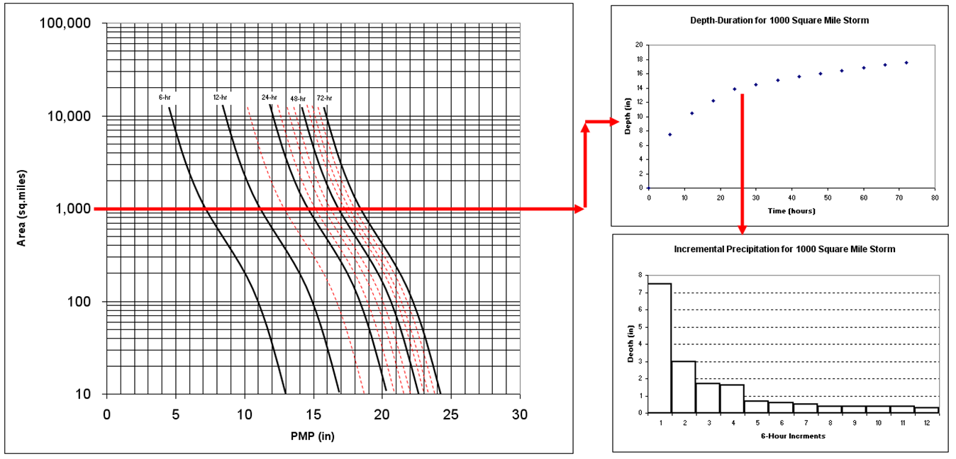
Developing the PMP Storm
- Temporal Pattern -
Notes:
This figure shows another example of how the incremental precipitation is computed using the depth-area-duration curves. The first graph is used to determine the cumulative depth-area-duration information for a specific storm area. Then the incremental precipitation is computed by taking successive differences from the cumulative curve. The final step would be to arrange the incremental precipitation by assuming a temporal pattern.

Slide 38
Developing the PMP Storm
- Temporal Pattern -
Notes:
Recommended guidance for distributing the PMP depths in time can be found in HMR 52. The guidance is based on examining 28 storms. HMR 52 recommends arranging individual 6-hr increments such that they decrease progressively to either side of the greatest 6-hr increment and placing the four greatest 6-hr increments at any position in the sequence except within the first 24-hr period of the storm sequence.
Following these guidelines, the goal is to develop a time pattern that maximizes runoff. It makes sense to place the more intense precipitation toward the end of the 72-hour event. You can maximum runoff by applying the most intense rainfall when the watershed is saturated. Additionally, historic storms in your area could be used as a source for developing the temporal pattern.

Slide 39
Developing the PMP Storm
- Spatial Pattern -
Notes:
For the eastern US, an idealized elliptical pattern was developed, as shown on this slide. The PMP depth decreases as the elliptical area increases. This pattern is overlaid on top of the watershed delineation to compute a subbasin average PMP. Tables in HMR 52 contain multipliers for each ellipse. These tables are broken up into 6-hour increments. The 6-hour increments are referred to based on intensity. The 1st 6-hour increment contains the most intense 6-hour precipitation depth. This increment contains the most spatial variability. No spatial variability is observed for the 4-12 6-hour increments.
Spatially, major storm isohyetal patterns were analyzed for statistics on pattern shape and a major-minor axis ratio of 2.5:1 was adopted.

Slide 40
Developing the PMP Storm
- Spatial Pattern -
Notes:
The general idea of the spatial pattern is to place and orient the isohyetal ellipses to the center of the basin. Try to place the greatest number of whole isohyets completely within the drainage, since the isohyets that enclose smaller area sizes contain proportionately higher rain amounts.
Emphasize PMP Area (Largest solid isohyet completely within the watershed boundary) vs Residual Area (the largest dashed isohyet needed to completely cover the watershed with rainfall).
Only the first through the third most intense 6-hour blocks of PMP rainfall have spatial variability (top image). No spatial variability is observed for the 4-12 6-hour increments, a uniform PMP depth is applied (bottom image). Residual rainfall (dashed lines) is the rainfall that falls outside of the PMP area. Residual rainfall is needed to cover the remainder of the watershed that is not covered by the elliptical pattern for the area of the PMP.

Slide 41
Developing the PMP Storm
- Spatial Pattern -
Notes:
Only the first through the third most intense 6-hour blocks of PMP rainfall have spatial variability (top image). No spatial variability is observed for the 4-12 6-hour increments, a uniform PMP depth is applied (bottom image). Residual rainfall (dashed lines) is the rainfall that falls outside of the PMP area. Residual rainfall is needed to cover the remainder of the watershed that is not covered by the elliptical pattern for the area of the PMP.

Slide 42
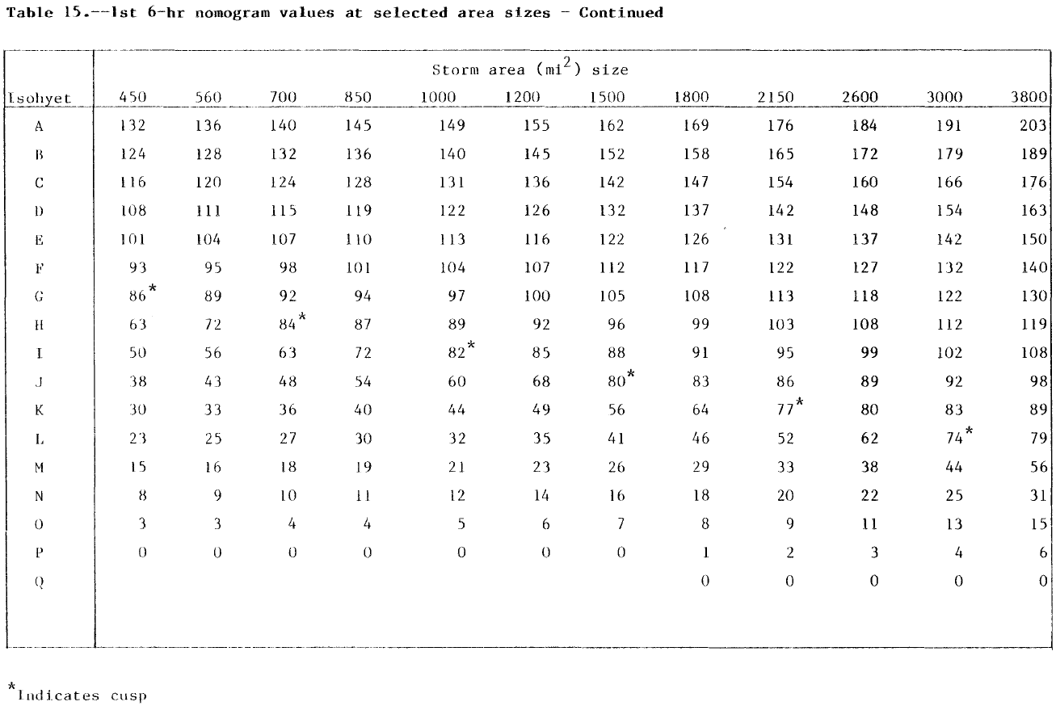
Developing the PMP Storm
- Spatial Pattern -
Notes:
The table on this slide shows the multiplier used for each ellipse for storm areas from 450 to 3800 square miles. These multipliers are used to create the spatial pattern for the most intense 6-hour increment. Separate tables were developed for the 2, 3, and 4-12 6-hour increments.

Slide 43
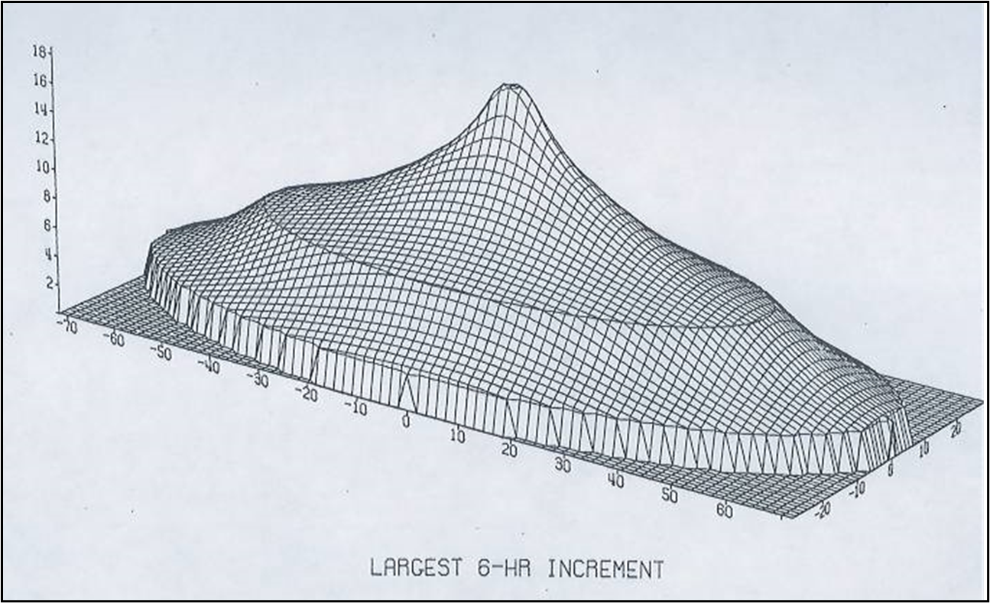
Developing the PMP Storm
- Spatial Pattern -
Notes:
The figure on this slide shows a 3D view of the spatial pattern for the most intense 6-hour increment.

Slide 44
Developing the PMP Storm
- Spatial Pattern -
Notes:
The table on this slide shows the multiplier used for each ellipse for storm areas from 450 to 3800 square miles. These multipliers are used to create the spatial pattern for the 2nd most intense 6-hour increment. These multiplier values are smaller and lead to a less drastic spatial distribution when compared to the most intense 6-hour increment.

Slide 45
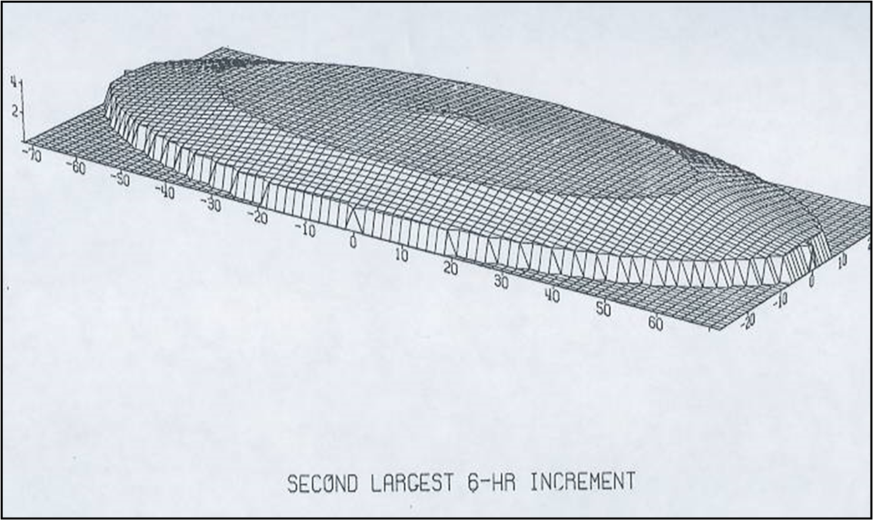
Developing the PMP Storm
- Spatial Pattern -
Notes:
The figure on this slide shows a 3D view of the spatial pattern for the 2nd most intense 6-hour increment.

Slide 46
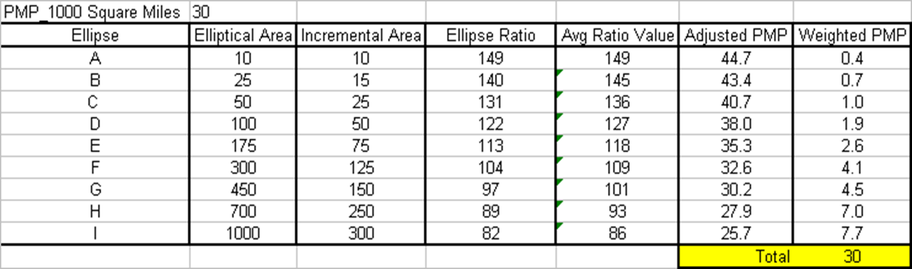
Developing the PMP Storm
- Spatial Pattern Example -
A
43.4
40.7
38.0
35.3
I
H
G
F
B
D
C
B
44.7
32.6
30.2
27.9
25.7
Notes:
This slide shows an example calculation of the spatial distribution for a storm that has an area of 1000 square miles – for the 1st 6-hour duration. The average PMP for this storm area is 30 inches. The elliptical pattern on this slide shows how the PMP varies in space for the most intense 6-hour increment. For ellipse A (area is 10 sq miles) the PMP depth is 44.7 inches and for ellipse I (area is 1000 square miles – the incremental area is 300 sq miles) the PMP depth is 25.7 inches. Even though the PMP depths vary for each ellipse (PMP depth decreases with increasing area) the area-average value is 30 inches.

Slide 47
Developing the PMP Storm
- Storm Location-
Notes:
An initial storm location is the basin centroid. This results in the PMP over the upstream watershed. The goal is to compute the PMF flowing into a reservoir. Due to watershed characteristics, such as impervious land, the PMP storm center might not be the watershed centroid. The result is that you no longer have the PMP over the upstream watershed; however, you are still using the PMP storm to produce the PMF. An iterative process is needed to generate maximum inflow into reservoir.

Slide 48
Developing the PMP Storm
- Storm Orientation-
Notes:
By examining historic storm events, preferred storm orientations were developed for the eastern US. The map on this slide shows the preferred storm orientation (direction from north of the major axis) and location of some of the storms used to develop this map. Figure 10 in HMR 52 contains an adjustment factor if the storm orientation differs by more than 40 degrees from the preferred storm orientation.

Slide 49
Developing the PMP Storm
- Storm Orientation-
Notes:
By examining historic storm events, preferred storm orientations were developed for the eastern US. The map on this slide shows the preferred storm orientation (direction from north of the major axis) and location of some of the storms used to develop this map. Figure 10 in HMR 52 contains an adjustment factor if the storm orientation differs by more than 40 degrees from the preferred storm orientation.

Slide 50
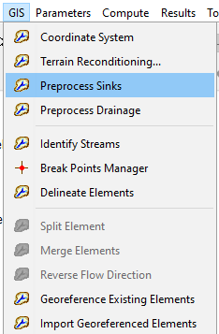
Computing the Optimized PMP Storm – HEC-HMS
The basin model needs to be geo-referenced
  Perform the GIS workflow in HEC-HMS
    Associate a terrain file with the basin model
    Preprocess sinks, preprocess drainage, identify streams, add breakpoint(s), delineate elements
  Or use the GIS | Import Georeferenced Elements menu to import a subbasin shapefile and add GIS elements

Slide 51
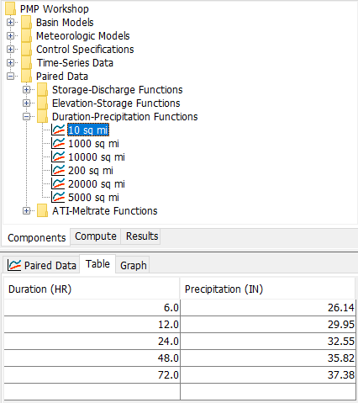
Computing the Optimized PMP Storm – HEC-HMS
Use index maps in HMR 51 to determine depth-area-duration values (or GIS datasets), add Duration-Precipitation Curves to HEC-HMS
Notes:
Refer to index maps in HMR 51 to determine subbasin average PMP depths for durations 1, 6, 12, 24, 48, and 72 hours and storm areas from 10-20000 sq miles (30 maps, Figures 18 - 47). It a good idea to plot the PMP depths to eliminate errors when reading values from the figures. These index maps implicitly contain depth-area and depth-duration information.

Slide 52
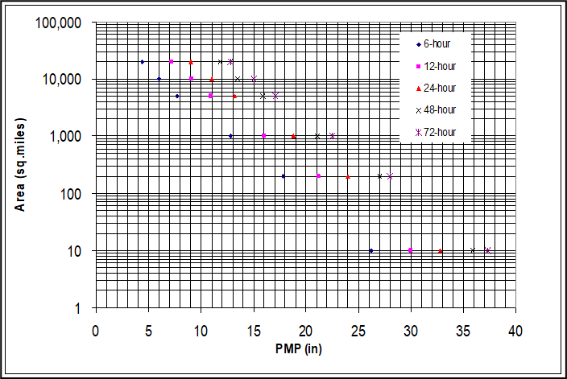
Computing the Optimized PMP Storm – HEC-HMS
Notes:
It a good idea to plot the PMP depths to eliminate errors when reading values from the figures. These index maps implicitly contain depth-area and depth-duration information.

Slide 53
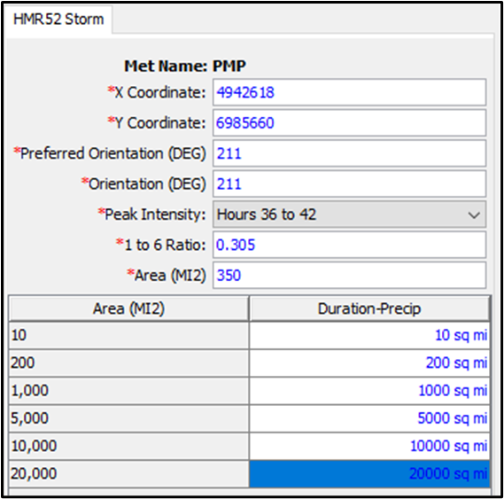
Computing the Optimized PMP Storm – HEC-HMS
Complete the HMR52 Storm Component Editor
Notes:
X and Y Coordinates – start with centroid of basin.
Refer to HMR51 to find the preferred storm orientation.
The Temporal Distribution (ST) card is used to define the time-pattern and time-step for the PMP event. The first variable on the ST card is the time interval. The second variable is the ratio of 1-hr to 6-hr precipitation for isohyet A of a 20000 sq mile storm. Refer to Figure 39 in HMR 52 for the 1 to 6 hour ratio.

Slide 54
Computing the Optimized PMP Storm – HEC-HMS
Start with the basin centroid
HMR 52, Section 4 and Figure 8
HMR 52, Section 2.3, Figure 3
HMR 52, Section 6.5, Figure 39
Start with the basin area
HMR 51, Figures 18 - 47
Notes:
X and Y Coordinates – start with centroid of basin.
Refer to HMR52 to find the preferred storm orientation.
The Temporal Distribution (ST) card is used to define the time-pattern and time-step for the PMP event. The first variable on the ST card is the time interval. The second variable is the ratio of 1-hr to 6-hr precipitation for isohyet A of a 20000 sq mile storm. Refer to Figure 39 in HMR 52 for the 1 to 6 hour ratio.

Slide 55
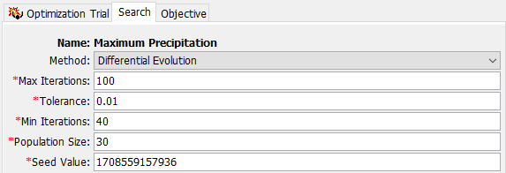
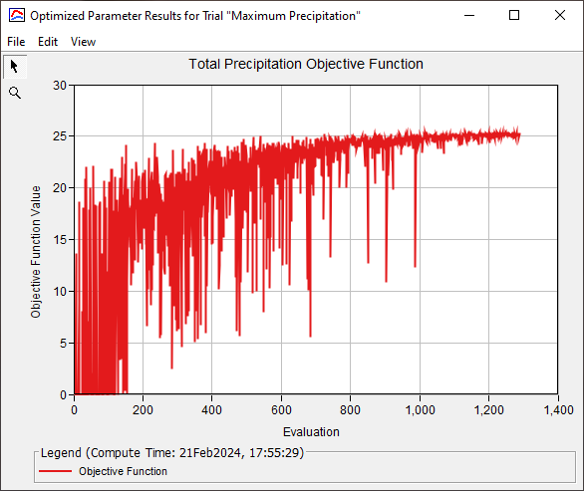
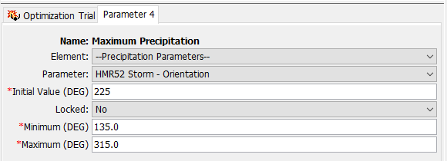
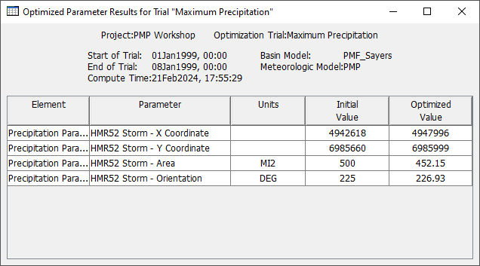
Computing the Optimized PMP Storm – HEC-HMS
Notes:
Optimization trial results show how the storm parameters changes during the maximization search. There are plots and summary tables.

Slide 56
Developing the PMP Storm in the Western U.S.
HMRs 49, 55A, 57, and 59 contain procedures for developing PMP hyetographs in the western states. The following steps are a brief description of the procedure.
Develop a map of the watershed boundary at a scale of 1:1,000,000.
Overlay PMP index maps from HMRs and compute basin average PMP (10 square mile – 24 hour).
Use depth-duration relationships, developed from historic events, to distribute PMP from step 2 for the entire storm duration (cumulative curve).
Use area-reductions factors, developed from historic events, to reduce the depth-duration PMP curve for storm area.
Draw a smooth Depth-Duration curve and compute the incremental PMP depths.
Arrange the incremental values into an appropriate storm pattern. HMRs contain some guidance.
If necessary, develop a spatial pattern. This is needed if the basin is subdivided into smaller subbasins and precipitation varies spatially across the basin. The HMRs provide elliptical patterns for storms less than 500 square miles. For larger storms, guidelines state that you could use maps of 1% rainfall (TP 40) or historic events to develop a spatial pattern.
Notes:
HMRs 49, 55A, 57, and 59 contain procedures for developing PMP hyetographs in the western states. The following steps are a brief description of the procedure.
Develop a map of the watershed boundary at a scale of 1:1,000,000.
Overlay PMP index maps from HMRs and compute basin average PMP (10 square mile – 24 hour).
Use depth-duration relationships, developed from historic events, to distribute PMP from step 2 for the entire storm duration (cumulative curve).
Use area-reductions factors, developed from historic events, to reduce the depth-duration PMP curve for storm area.
Draw a smooth Depth-Duration curve and compute the incremental PMP depths.
Arrange the incremental values into an appropriate storm pattern. HMRs contain some guidance.
If necessary, develop a spatial pattern. This is needed if the basin is subdivided into smaller subbasins and precipitation varies spatially across the basin. The HMRs provide elliptical patterns for storms less than 500 square miles. For larger storms, guidelines state that you could use maps of 1% rainfall (TP 40) or historic events to develop a spatial pattern.

Slide 57
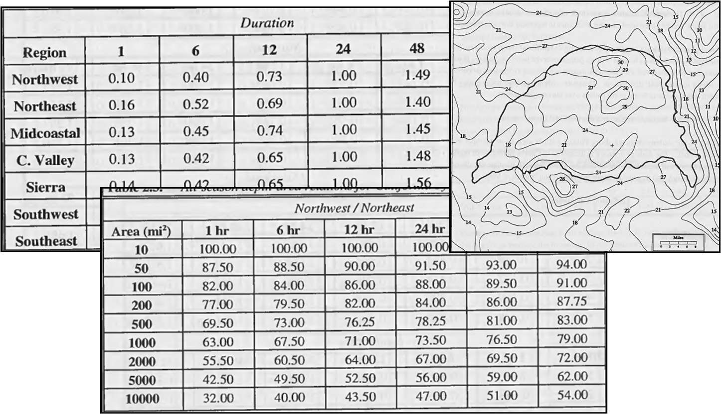
Developing the PMP Storm in the Western U.S.
Notes:
HMRs 49, 55A, 57, and 59 contain procedures for developing PMP hyetographs in the western states. The following steps are a brief description of the procedure.
Develop a map of the watershed boundary at a scale of 1:1,000,000.
Overlay PMP index maps from HMRs and compute basin average PMP (10 square mile – 24 hour).
Use depth-duration relationships, developed from historic events, to distribute PMP from step 2 for the entire storm duration (cumulative curve).
Use area-reductions factors, developed from historic events, to reduce the depth-duration PMP curve for storm area.
Draw a smooth Depth-Duration curve and compute the incremental PMP depths.
Arrange the incremental values into an appropriate storm pattern. HMRs contain some guidance.
If necessary, develop a spatial pattern. This is needed if the basin is subdivided into smaller subbasins and precipitation varies spatially across the basin. The HMRs provide elliptical patterns for storms less than 500 square miles. For larger storms, guidelines state that you could use maps of 1% rainfall (TP 40) or historic events to develop a spatial pattern.

Slide 58
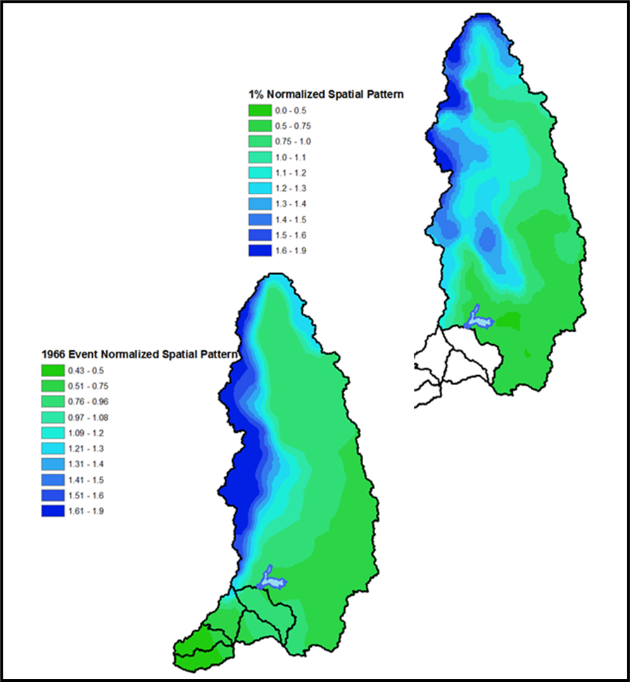
Developing the PMP Storm in the Western U.S.
Notes:
The figures on this slide show two spatial patterns. These were created using ArcGIS tools.
Create a RASTER historic storm and the 1% precipitation.
Use Zonal Statistics to compute the basin average precipitation.
Divide raster by the basin average to create a normalized grid.
Multiply PMP by normalized grid to compute spatial distribution of PMP.
Use Zonal Statistics to compute average PMP for each subbasin.

Slide 59
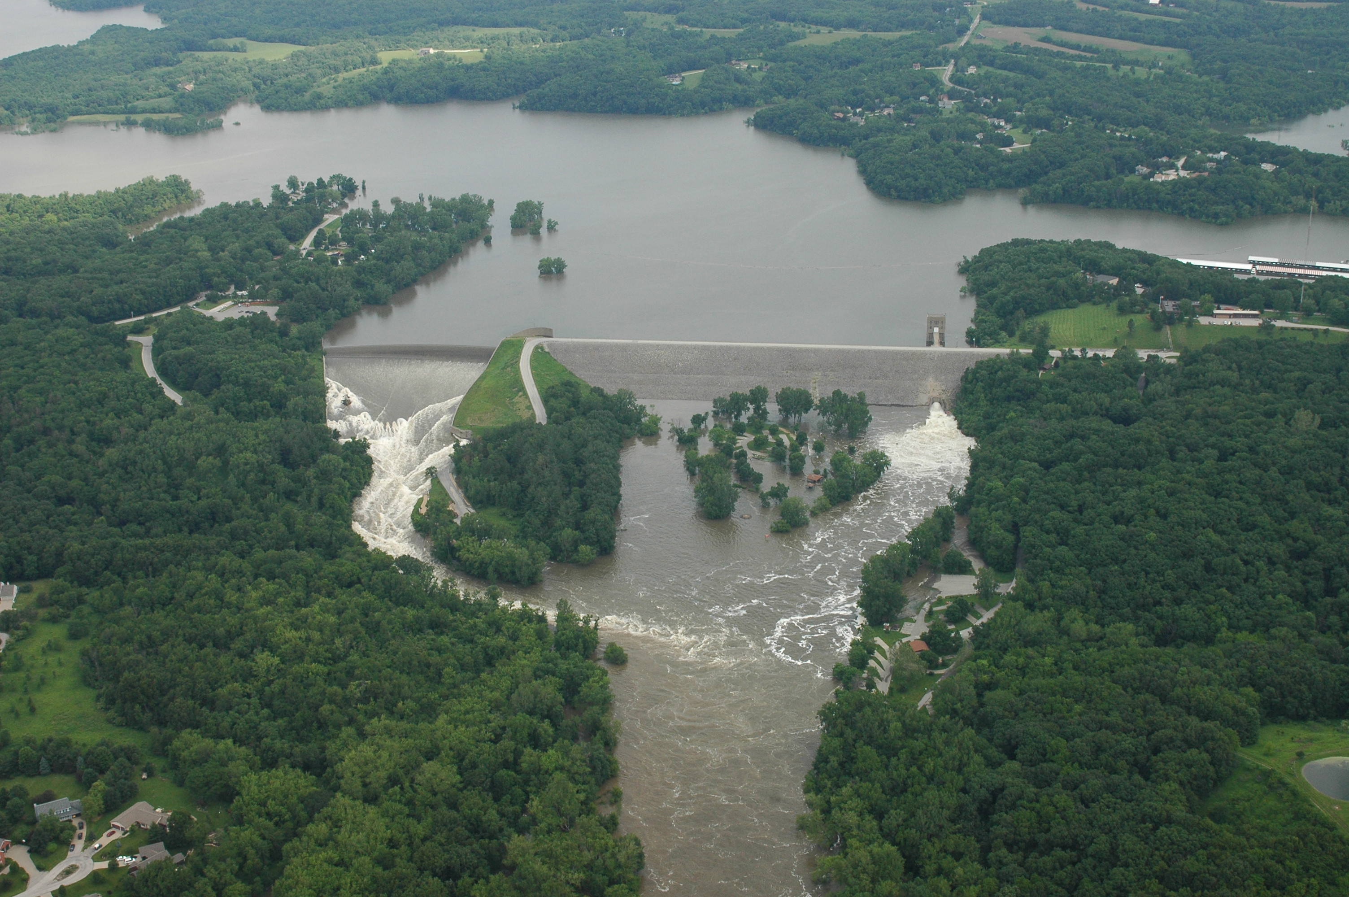
Questions?

