Slide 1
Routing the PMF Hydrograph through a Reservoir Model to Compute the Peak Reservoir Stage
Lauren Coe, P.E.
Hydraulic Engineer
Hydrologic Engineering Center
March 2024

Slide 2
Outline
Using a model to route the PMF to compute a peak stage
Major assumptions
  Initial conditions
  Reservoir operation
PMF Sensitivity
Hydrologic Capacity
Overtopping Duration
Results

Slide 3
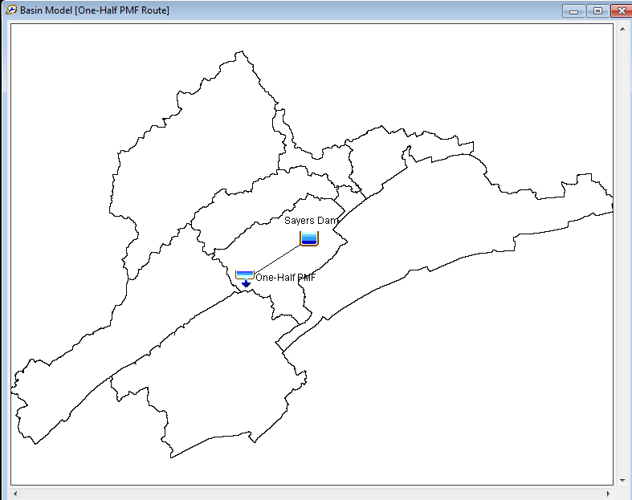
Routing the PMF using a Model
Existing HEC-HMS or HEC-ResSim models can be used for routing the PMF, or simple models can be quickly configured (no spreadsheet routing).
Information Required for Modeling
  Elevation-storage relationship
  Appropriate elevation-discharge information (must include spillway and dam top) or a physical description of spillway and dam top.
  Boundary conditions
Notes:
A model lets you perform a sensitivity analysis of boundary conditions, initial conditions, and model parameters. A simple reservoir model can be created in HEC-HMS (no downstream operations) or within HEC-ResSim where modeling assumptions can be explored.

Slide 4
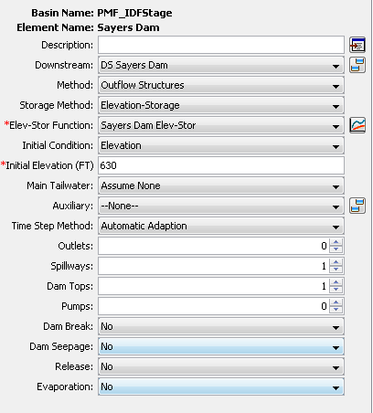
Reservoir Element in HEC-HMS

Slide 5
PMF Reservoir Routing in HMS
Outflow curve
  Represent all outflow with single storage-outflow relationship
  Tutorial: Outflow Curve Option for an HEC-HMS Reservoir Element
Outflow Structures
  Add Dam Top, Spillways and Outlets separately
  Can use physical characteristics or elevation-discharge tables
Rule-Based Operations
  Outflow Structures with additional rules for gated outlets by zones
  Tutorial: Rule-Based Option for an HEC-HMS Reservoir Element

Slide 6
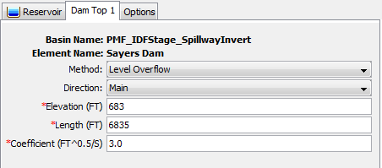
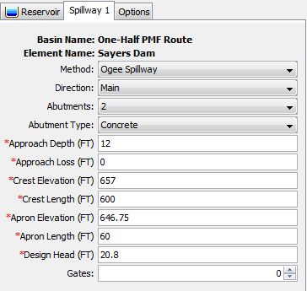
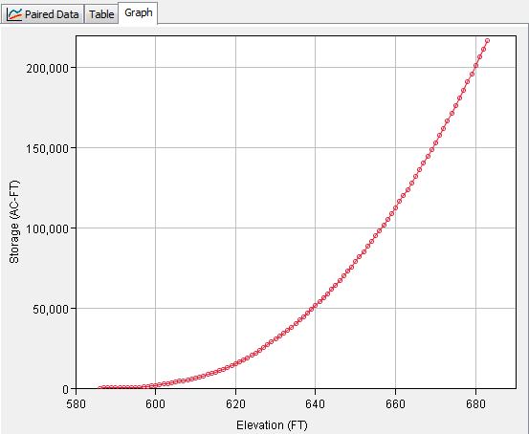
Routing the PMF using a Model
Reservoir storage and outlet information is found in the Reservoir Regulation Manual. All paired data curves should be extended beyond the top of the dam in case of overtopping during the PMF simulation.
Notes:
The main pieces of information needed for a simple reservoir model (for the PMF routing) is 1) Elevation-Storage information, 2) information about the releases for the reservoir (can be defined as a storage-discharge curve or physical characteristics of the spillway), 3) characteristics of the dam top, and 4) initial conditions prior to routing the PMF hydrograph.

Slide 7
Model Assumptions for PMF Simulation
According to ER 1110-8-2, the minimum starting elevation for routing the PMF will be assumed as the full flood control pool (spillway invert) or the elevation prevailing five days after the last significant rainfall of a storm that produces one-half the PMF.
Start the PMP hyetograph 5 days after the maximum 24-hour precipitation from Antecedent Storm. Setup additional scenarios where duration is less than 5 days, 3 days and 2 days.
Arrange PMF so peak occurs 5 days after ½ PMF peak, use pool elevation at start of PMF
Use other scenarios if they have been defined regionally.

Slide 8
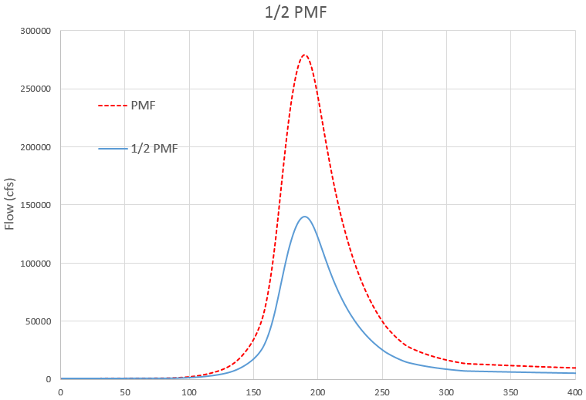
Initial Reservoir Storage for PMF
Determine ½ PMF hydrograph
Enter the ½ PMF hydrograph into the HEC-HMS or HEC-ResSim model
Route the ½ PMF hydrograph assuming:
  Normal pool conditions for initial reservoir storage (season can be important)
  Simplified operations
    Use Outflow Curve or simulate with Specified Releases

Slide 9
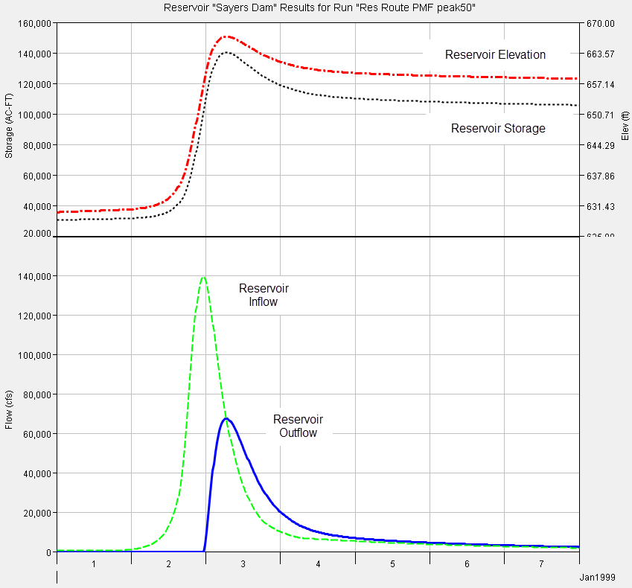
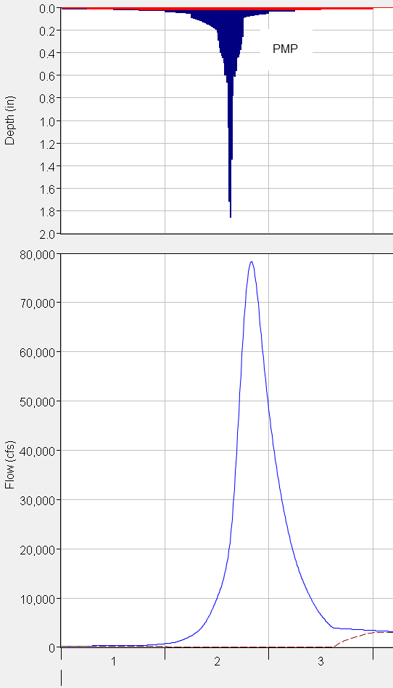
2-days
3-days
Maximum 24-hour precipitation from PMP - begin countdown from this point
5-days

Slide 10
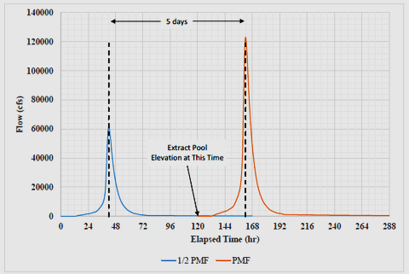
5 days
Extract Pool Elevation at this time-step

Slide 11
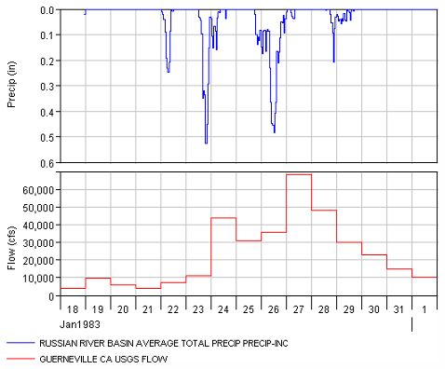
Historical Information Supporting Duration between Antecedent Storm and PMF
Identify up to 10 major events by evaluating flow and precipitation data.
Choose a representative precipitation gage and evaluate duration between major flood and preceding event.
Determine if there is evidence to support a duration less than 5-days for separating an antecedent flood and the PMF.

Slide 12
Historical Information Supporting Duration between Antecedent Storm and PMF
Experience has shown that meteorologic and hydrologic characteristics of the watershed should be evaluated for setting the initial reservoir storage. In some locations, it might be appropriate to assume only a 1-day lag time because historic storms do show large rainfall events separated by only 1-day.
January 1969 Event
Whittier Narrows Dam
19 in
21 in
1-Day Lag
Notes:
The Jan 1969 event was a Very Significant Event in the Historical Record for the Whittier Narrows watershed
1969 Antecedent Event Average Precipitation = 19 inches
1969 Main Event Average Precipitation = 21 inches
% Antecedent to Main Event = 90%
Lag Between Antecedent Event and Main Event = 1 Day

Slide 13
Model Assumptions for PMF Simulation
According to ER 1110-8-2, reservoir outlets “should not be assumed operable during the occurrence of an IDF, unless they are specifically designed for such a purpose.”
According to ER 1110-8-2, mis-operation of gated spillways should be considered when the lag time between intense rainfall and peak inflow is less than 12 hours.

Slide 14
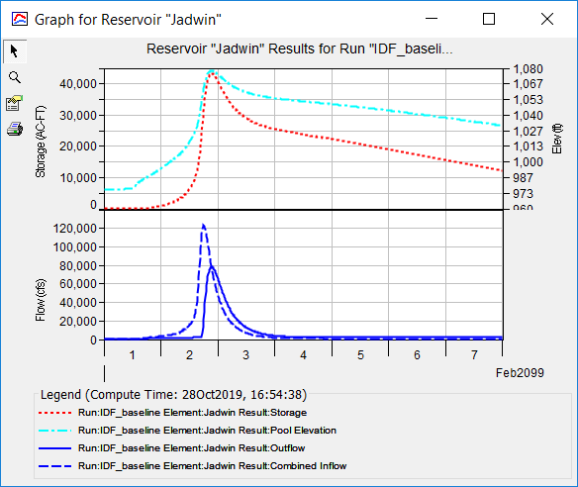
Case Study – Jadwin Dam
Develop PMP
Modify best estimate parameters for PMF simulation
Develop “Best Estimate” PMF
Consider site-specific characteristics
Notes:
When developing the Best Estimate, you’ll start with the basic reasonable assumptions: minimal losses, 50% UH peaking and an antecedent pool based on 1-5 day lag following half the PMF. Next, begin to take into consideration the unique characteristics of your dam and watershed. In the case of Jadwin Dam, it’s located in northern PA. What can that tell us about the seasonality and mechanisms that drive large storms?

Slide 15
Case Study – Jadwin Dam
Investigate PMF uncertainty
  Summer vs. Spring Storm
  Unit Hydrograph Transform
  Antecedent Pool Elevation
  Channel Routing
  Ungated outlets blockage
Develop “Reasonable Best” and “Reasonable Worst” PMF
Notes:
Jadwin is typically empty and the largest events often occur in the summer or fall usually driven by tropical storms. Because snowmelt is also of concern, a spring-specific PMP should also be added to the analysis for comparison. Outlets here are ungated, however consider if the conduits become blocked in the case of gated outlets, we would consider the outlets inoperable either due to mechanical issues or lack of access to dam operators.

Slide 16
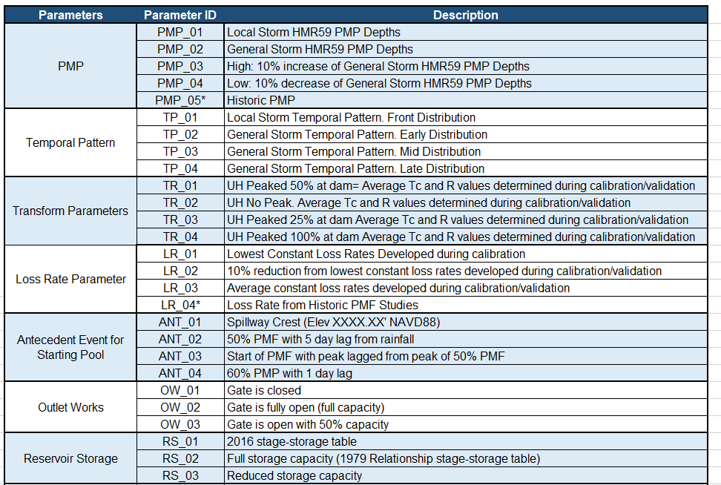
PMF Sensitivity Parameters
Run antecedent pool sensitivity at minimum
Additional sensitivities inform recommended PMF
Notes:
PMF sensitivities will help bracket your PMF and better inform your estimates for the recommended plan, low plan and high plan. If PMF stage, inflow or outflow is highly sensitive to a particular parameter, it may warrant additional attention and refinement to ensure accuracy. Sensitivity runs can be tailored to the site specific characteristics of your system. A reservoir that experiences heavy sedimentation may be sensitive to the stage-storage relationship from varying years. Watersheds that experience multiple storm seasons may be sensitive to the type of storm and the temporal pattern and duration of precipitation or anticipated antecedent starting pool.

Slide 17
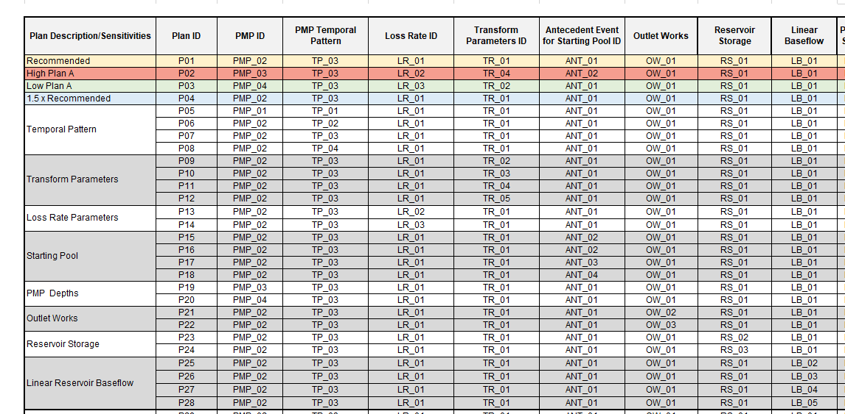
PMF Sensitivity Matrix
HMS Simulation Runs
Parameter value from Reasonable Best is control in other sensitivities
Notes:
The full range of sensitivity relies on building a matrix in which parameter values are set as the reasonable best estimate and carried forward as the control for that parameter as other parameter “knobs” are turned. This process can be somewhat iterative because an early assumption about a parameter value in the Reasonable Best plan may be changed as sensitivity analysis and discussions provide more information.

Slide 18
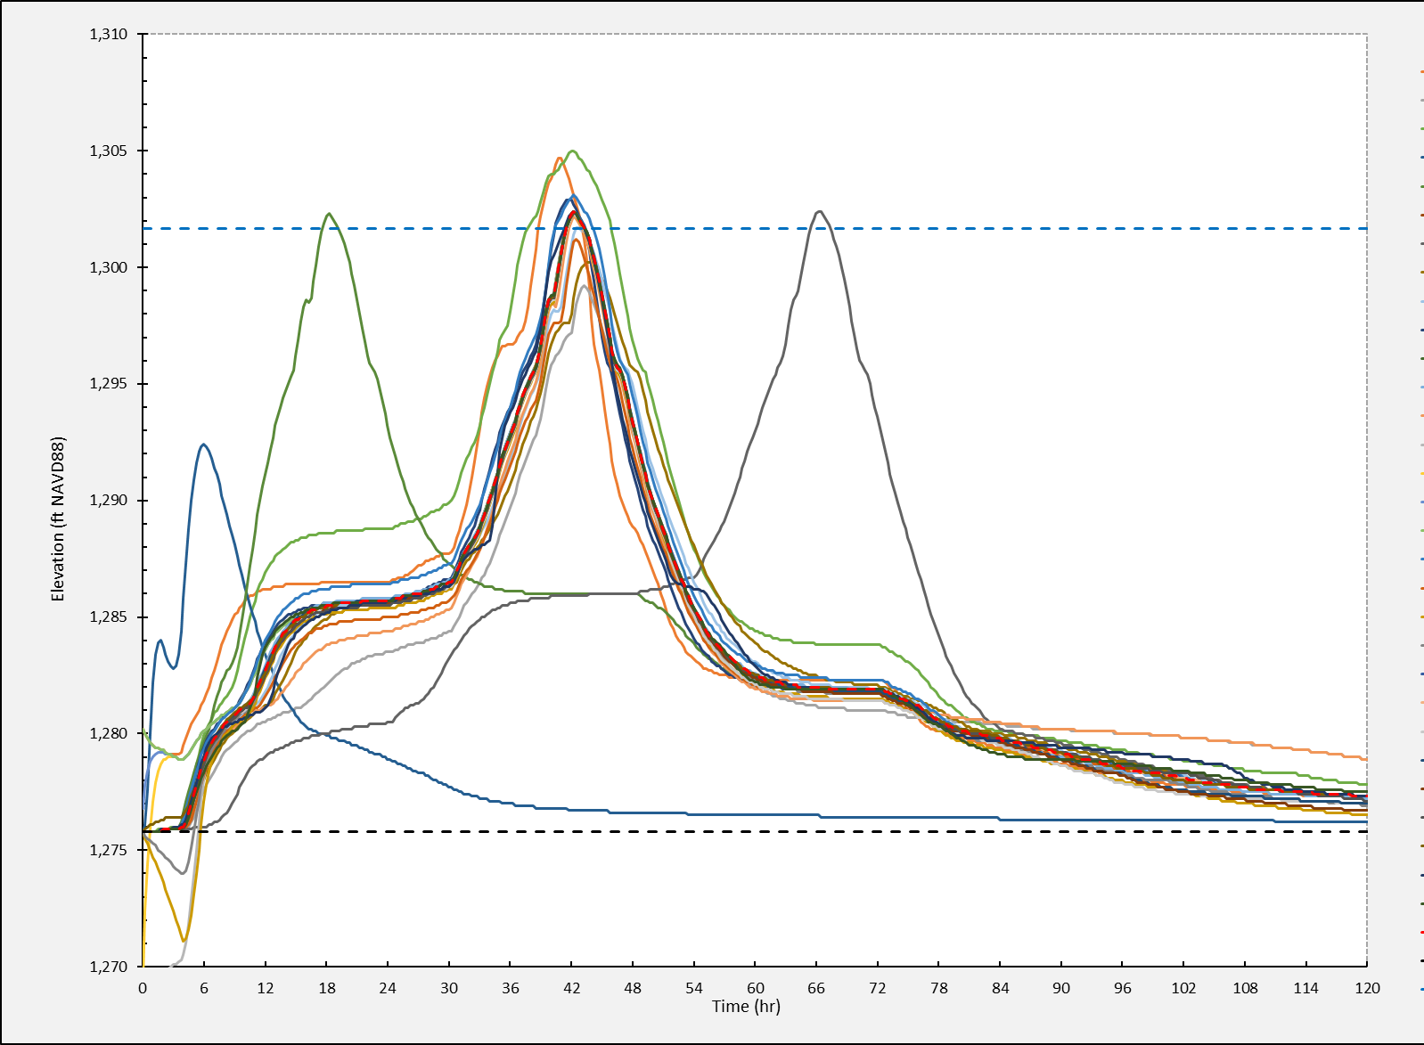
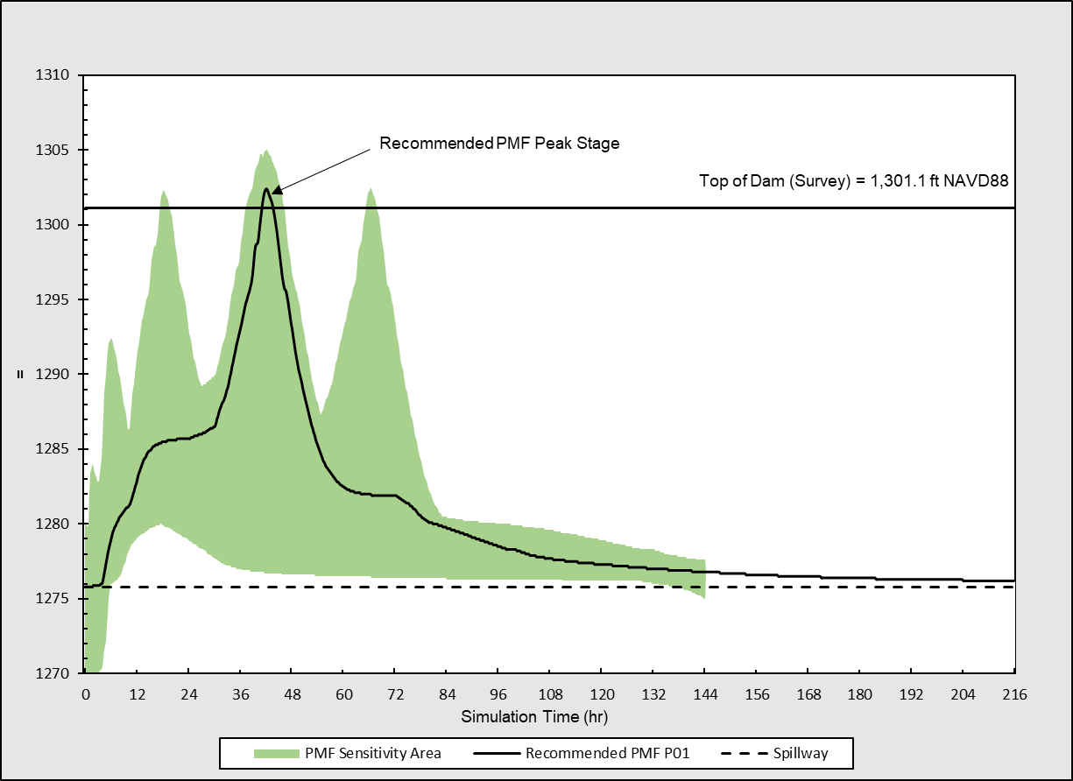
PMF Sensitivity Range of Outcomes
Notes:
Graph on the right shows a seemingly large range of possibilities for stage, By examining the graph on the left, the majority of the sensitivity runs are grouped right around the Reasonable best estimate. This helps support the selection of the Reasonable Best PMF.

Slide 19
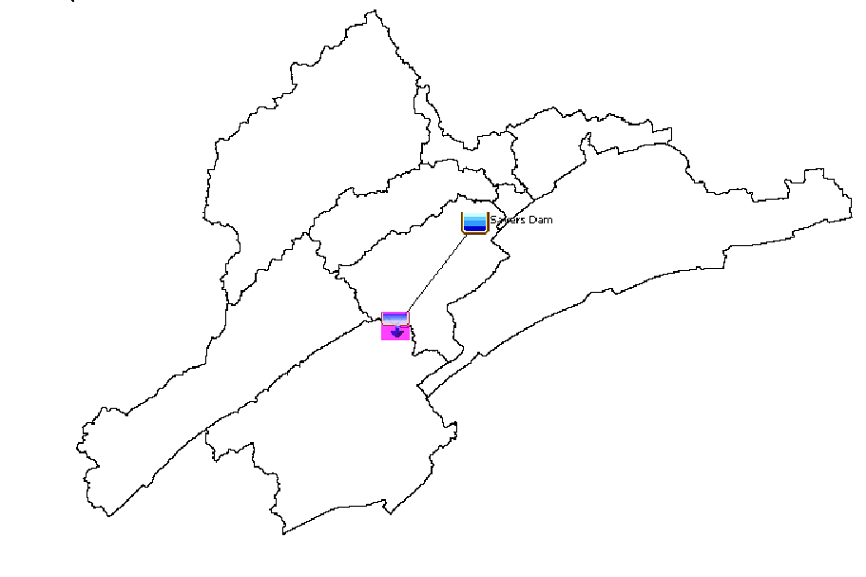
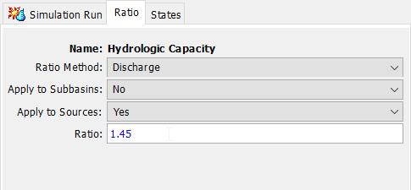
Estimating Hydrologic Capacity
What % of the PMF can the reservoir hold?
What % of the PMF is equal to 1 FT or 2 FT of overtopping?
Apply ratio to a Source and iterate

Slide 20
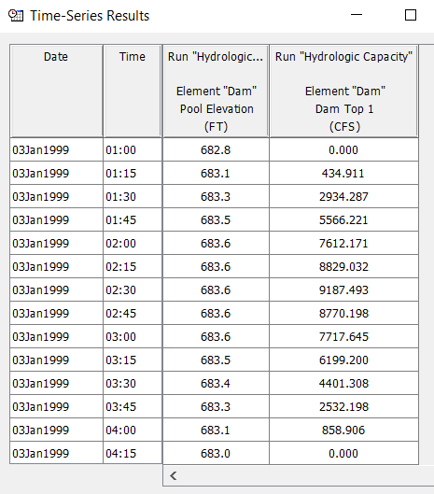
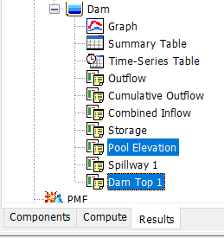
Overtopping Duration
If overtopping occurs, duration is critical in a risk assessment
View graphically or time-series in HMS
ELEV
FT
OT
OUTFLOW
CFS
Notes:
Outflow through any of the dam structures can be isolated in HMS to determine flow over dam top, through spillway or any outlets. Viewing results with elevation allows user to also determine the duration of different heights of overtopping over the invert and answer questions such as “How long is the dam overtopping by 0.5 FT or 1 FT?” These answers are important to determining risk. Similarly, the duration of flow over the spillway and height of flow over spillway can be determined.

Slide 21
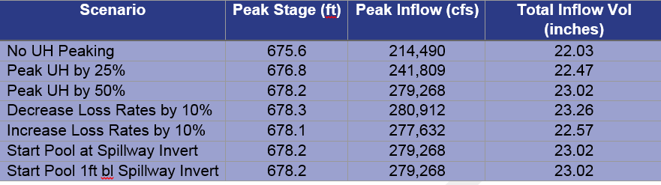
Results from PMF Analysis
One of the final products from the PMF routing analysis is a table of peak stage, peak inflow, and total inflow volume.
Additional summary information should include a discussion about differences in the current PMF and peak stage as compared to historic studies (note that historic studies did/did not use current HMR information, did/did not peak unit hydrograph parameters, loss rate values, and initial reservoir condition prior to PMF routing).
Notes:
An additional column can be added with peak outflows. Peak outflow can be further split into outflow through ungated spillways and dam overtopping for the purposes of assessing risk to each structure.

