Slide 1
Evapotranspiration
Thomas Brauer, P.E.
Hydrologic Engineering Center

Slide 2
Objectives
Summarize evapotranspiration physical processes
Compare evapotranspiration methods in HEC-HMS

Slide 3
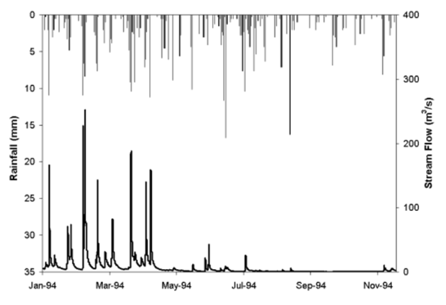
Importance of Evapotranspiration
Notes:
Why do the large precipitation events in June, July, and August not trigger a runoff response?
This is a good figure to show the importance of ET in the water cycle. This figure shows a hydrograph and precipitation hyetograph from a gage just upstream of the stream flow gage. Most of the runoff from the upstream watershed is observed in the winter and early spring months (when ET is at its smallest), whereas 43.0 percent of the total rainfall and 7.9 percent of the total stream is observed in the summer and fall months.

Slide 4
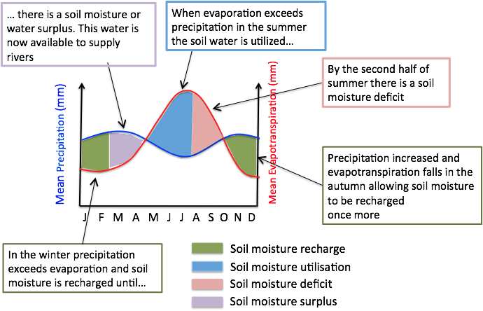
Annual water balance
Source: https://www.groundwatergovernance.org/
Notes:
When can we expect runoff events to occur?

Slide 5
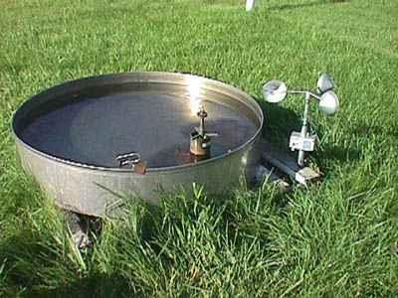
Evaporation Basics
Source: Iowa State University Department of Agronomy
Notes:
Evaporation is the process by which water changes from a liquid to a gas or vapor. Evaporation is the primary pathway through which water moves from the liquid state back into the water cycle as atmospheric water vapor. Studies have shown that the oceans, seas, lakes, and rivers provide nearly 90 percent of the moisture in the atmosphere via evaporation, with the remaining 10 percent being contributed by plant transpiration. The figure on this page shows annual evaporation from water surfaces as measured by evaporation pans.
Factors effecting evaporation include solar radiation, wind, temperature, and humidity.
Solar radiation: the higher the solar radiation, the more evaporation
Wind speed: the higher the wind speed, the more evaporation
Temperature: the higher the temperature, the more evaporation
Humidity: the lower the humidity, the more evaporation

Slide 6
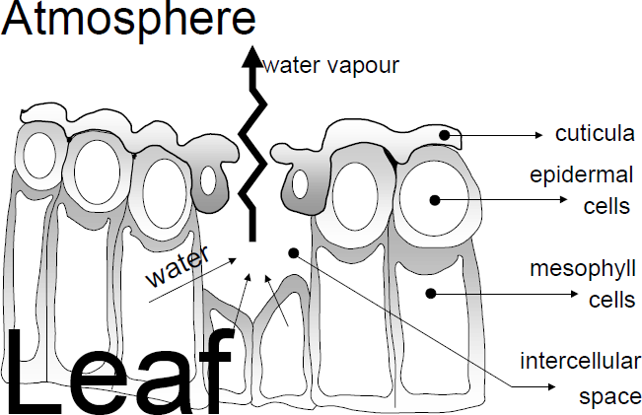
Transpiration Basics
Source: WMO FAO56
Notes:
Plants extract water from the soil in a process called transpiration. Water is not pumped up from the roots, but in fact begins in the leaves with structures called stomata. Stomata are almost always located on the underside of leaves. The picture above shows a plant leaf with cell boundaries visible and, prominently, two stomata openings. The stomata are actually shaped like bowls with the open part facing the surface of the leaf.
Each stomata opening is formed by two guard cells. The guard cells open when the water pressure inside the cells is increased. When the pressure is decreased, the cells relax and the opening closes. The plant controls the degree of opening and closing through bio-chemical feedback mechanisms. In general the stomata are closed at night and open during the day. Many factors affect stomata opening: air temperature, amount of solar radiation, plant growth stage, availability of water and nutrients, interior plant temperature, disease, and others.
The structure inside the plant leaf is not solid. There are gaps between individual cells that create a sponge-like structure. In a plant that is alive, the gaps are filled with water. When the stomata are open, water will evaporate from the surfaces on the inside of the stomata.
There are gaps between the cells that form the interior surface of the stomata. These gaps act like a capillary space. Water in the capillaries forms a concave meniscus, which exerts a negative pressure force on the water. It is not intuitive that water can support a negative pressure force, since this is a tensile or suction force. However, the unique structure of the water molecule leads to hydrogen bonding. Hydrogen bonding is strong enough to support the negative pressure force. In fact it can be transmitted to a vertical height of 100m, the height of giant redwood trees.
The vascular system of the plant begins just below the stomata and runs throughout the plant. The pressure force developed in the stomata is transmitted to water in the vascular system. From there, the force is transmitted throughout the plant, including down into the root system. Hairs on the roots have small openings in them. The pressure force is transmitted through the root hair openings and into water in the adjacent soil pore space. This acts as a suction force to bring water into the plant. As water continues to evaporate in the stomata, water will move throughout the plant and eventually leave through the stomata opening.
In this whole process, the plant does not exert any energy to move water. The water movement is achieved through the properties of water and solar-driven evaporation in the stomata. The plant uses the moving water to transmit minerals and organic molecules throughout the plant. However, just as important as obtaining water for life processes, transpiration cools the plant. Without transpiration, plants could not produce enough energy through photosynthesis to obtain water or cool themselves.

Slide 7
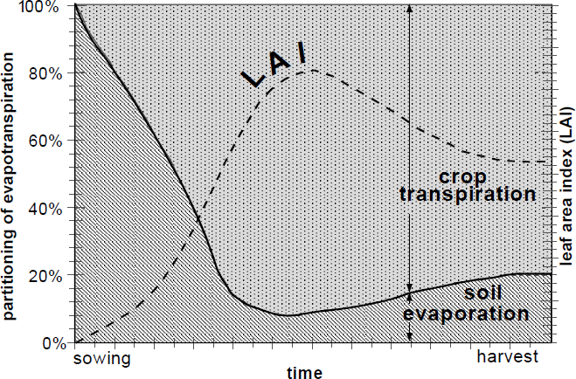
Evapotranspiration Basics
Source: WMO FAO56
Notes:
Evaporation and transpiration occur simultaneously. The figure on this slide shows the seasonal fluctuations of evaporation and transpiration. When plants are small in size or dormant, water is lost mainly due to evaporation. As they grow and become active, transpiration dominates.
Factors affecting evapotranspiration (ET) include weather, vegetation characteristics, and environmental factors.
The main weather characteristics affecting ET are radiation, temperature, humidity, and wind speed. Many equations for estimating ET use these parameters.
Vegetation characteristics affecting ET include vegetation type and stage of development.
Salinity, soil characteristics, the use of fertilizers, and disease are some of the many environmental factors affecting ET.
The Leaf Area Index (LAI), a dimensionless quantity, is the leaf area (upper side only) per unit area of soil below it.

Slide 8
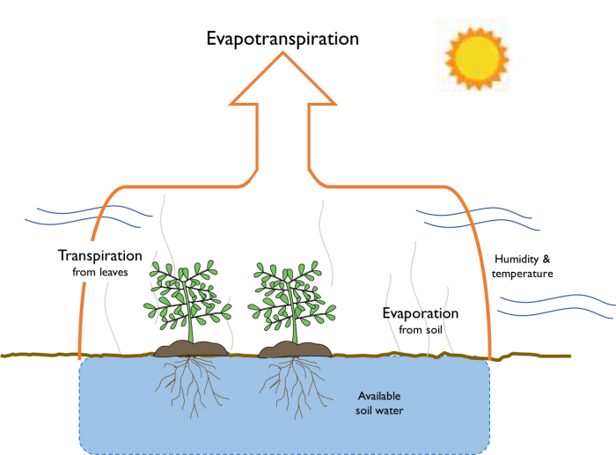
Evapotranspiration Basics
Credit: Figure drawn by Gigi Richard, adapted from Bates, R.L. &amp;amp; J.A.Jackson, Glossary of Geology, Second Edition, American Geology Institute, 1980
Notes:
The amount of evapotranspiration depends on multiple factors:
Atmospheric conditions
Temperature
Solar radiation
Windspeed
Relative humidity
Plant species and density
Life stage of the plants
Available water

Slide 9

ET methods – a spectrum of Complexity
Monthly Average
Hargreaves
Penman-Monteith
Simple
Complex
Hamon
Priestly-Taylor
Notes:
HMS includes a range of evapotranspiration methods.

Slide 10
Configuration Requirements
Method | Temperature | Shortwave | Longwave
Monthly Average | No | No | No
Hamon | Yes | No | No
Hargreaves | Yes | Yes¹ | No
Penman-Monteith | Yes | Yes² | Yes³
Method | Humidity | Windpseed
Monthly Average | No | No
Hamon | No | No
Hargreaves | No | No
Penman-Monteith | Yes | Yes
1 Hargreaves Shortwave recommended
2 Specified Pyranograph or Hargreaves Shortwave recommended
3 FAO56 Longwave recommended

Slide 11
Data Requirements
Method | Temperature | Windspeed | Humidity | Shortwave
Monthly Average | No | No | No | No
Hamon | Yes | No | No | No
Hargreaves | Yes | No | No | No
Penman-Monteith | Yes | Yes | Yes | Yes

Slide 12
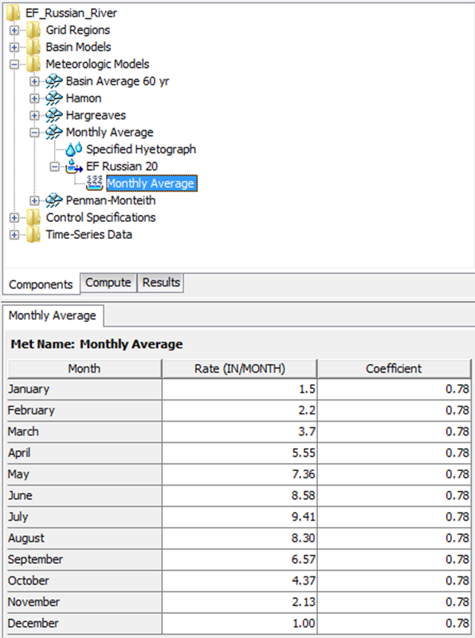
Monthly Average ET
Notes:
The Monthly Average ET method computes a constant potential evapotranspiration rate for each time-step in a month by scaling the monthly values entered in the component editor (shown on this slide). The Coefficient is used to adjust the monthly rate. Within the meteorologic component editor, the monthly average rate is simply multiplied by the coefficient. Monthly average ET rates and Coefficients must be entered for each subbasin in the basin model. Some methods for estimating evapotranspiration, like evaporation pans, require this pan coefficient to relate evaporation from a water body to crop transpiration. The pan coefficient can be used to reduce or increase the monthly rate to account for vegetation and environmental characteristics such as plants not actively transpiring or disease.

Slide 13
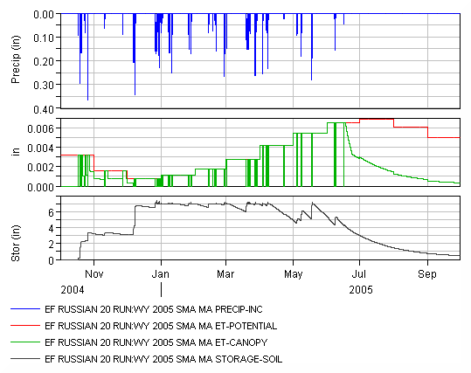
Monthly Average ET
Notes:
Two separate simulations were created to illustrate differences in Monthly Average ET when applied to the deficit constant and SMA loss methods. Notice Potential ET is a constant value over the entire month. The figure on the left shows potential ET, actual soil ET and moisture deficit. The moisture deficit decreases at the potential ET rate unless it there is precipitation for the time period or moisture deficit = Maximum Deficit. In this simulation the maximum deficit (6.5 inches) is reached in mid-September. The figure on the right shows potential ET, actual soil ET, and Soil Storage. Notice in April and May how the soil storage decreases due to ET. In late May enough precipitation falls to fill tension storage.

Slide 14

Hamon ET
$${ET}_{o}=CDρ_{t}$$
ET_{o} reference evapotranspiration
C Hamon evapotranspiration coefficient
D possible hours of daylight in units of 12 h
ρ_{t} saturated water vapor density at daily mean temperature
Notes:
Reference Hamon 1960, 1961, 1963.

Slide 15
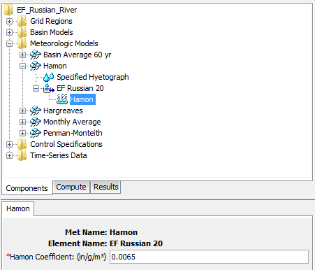
Hamon ET

Slide 16
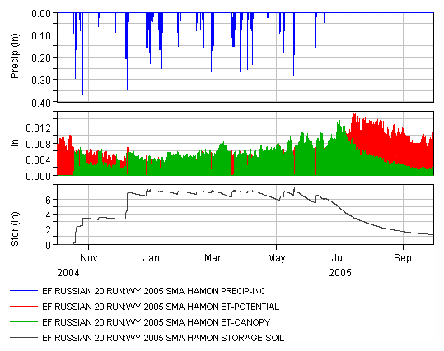
Hamon ET

Slide 17


Hargreaves ET
$${ET}_{o}=KET R_{S} (T+17.8)$$
ET_{o} reference evapotranspiration
K_{ET} evapotranspiration coefficient
R_{S} solar radiation at the crop surface
T mean daily air temperature at 2 m height
$$R_{S}=K_{RS} R_{a} {TR}^{0.5}$$
R_{S} solar radiation at the crop surface
K_{RS} solar radiation coefficient
R_{S} extraterrestrial radiation at the crop surface
TR temperature range (T_{max} – T_{min}) for day
Notes:
Reference Hargreaves and Allen, 2003.

Slide 18
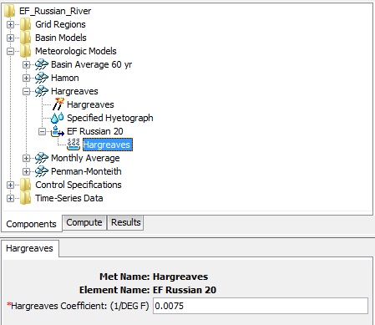
Hargreaves ET

Slide 19
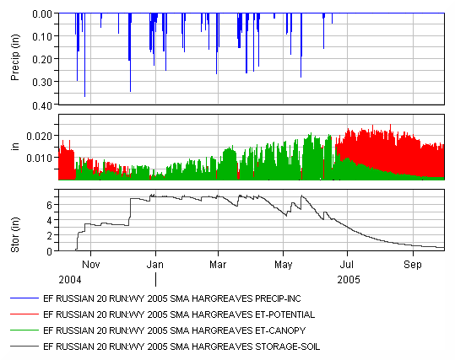
Hargreaves ET

Slide 20
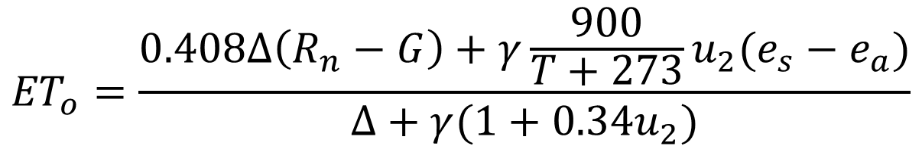
Penman-Monteith ET
$${ET}_{o}=\frac{0.408∆\left(R_{n}−G\right)+γ\frac{900}{T+273}u_{2}(e_{s}−e_{a})}{∆+γ(1+0.34u_{2})}$$
ET_{o} reference evapotranspiration [mm day⁻¹],
R_{n} net radiation at the crop surface [MJ m⁻² day⁻¹],
G soil heat flux density [MJ m⁻² day⁻¹],
T mean daily air temperature at 2 m height [°C],
u2 wind speed at 2 m height [m s⁻¹],
e_{s} saturation vapour pressure [kPa],
e_{a} actual vapour pressure [kPa],
e_{s}-e_{a} saturation vapour pressure deficit [kPa],
Δ slope vapour pressure curve [kPa °C⁻¹],
γ psychrometric constant [kPa °C⁻¹].

Slide 21
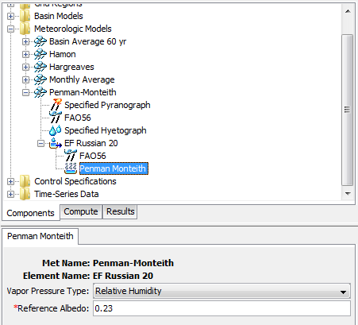
Penman-Monteith ET
Notes:
“ET_{o} can be computed from meteorological data. As a result of an Expert Consultation held in May 1990, the FAO Penman-Monteith method is now recommended as the sole standard method for the definition and computation of the reference evapotranspiration. The FAO Penman-Monteith method requires radiation, air temperature, air humidity and wind speed data.” –FAO56

Slide 22
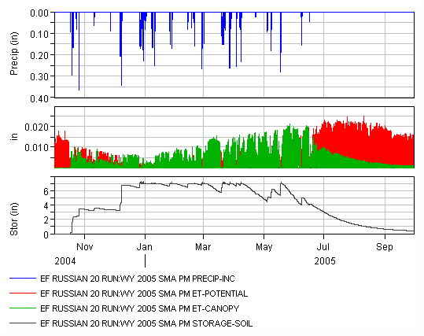
Penman-Monteith ET
Notes:
The first thing you notice on this slide is that the Potential ET is not a constant value, like that computed by the monthly average method. You can see how the potential ET varies from day-to-day and how the overall pattern increases from winter to summer. Notice in April and May how the soil storage decreases due to ET. In late May enough precipitation falls to fill tension storage.

Slide 23
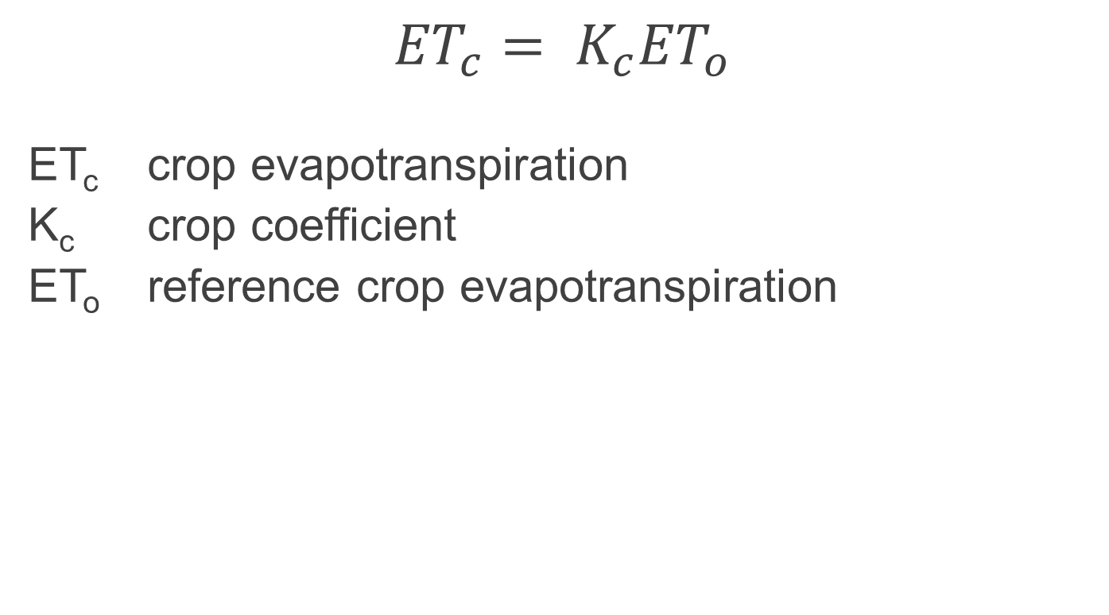
Crop Coefficient
$${ET}_{c}= K_{c}{ET}_{o}$$
ET_{c} crop evapotranspiration
K_{c} crop coefficient
ET_{o} reference crop evapotranspiration
Notes:
FAO56 Equation 56.
The Crop Coefficient is used to adjust the potential ET from that computed for a reference vegetation to a vegetation typically found in the watershed. A constant value or one that changes throughout the year can be used to model the growing season. A discussion of crop coefficient can be found in FAO56 Chapter 5: Introduction to crop evapotranspiration (Et_{c})

Slide 24
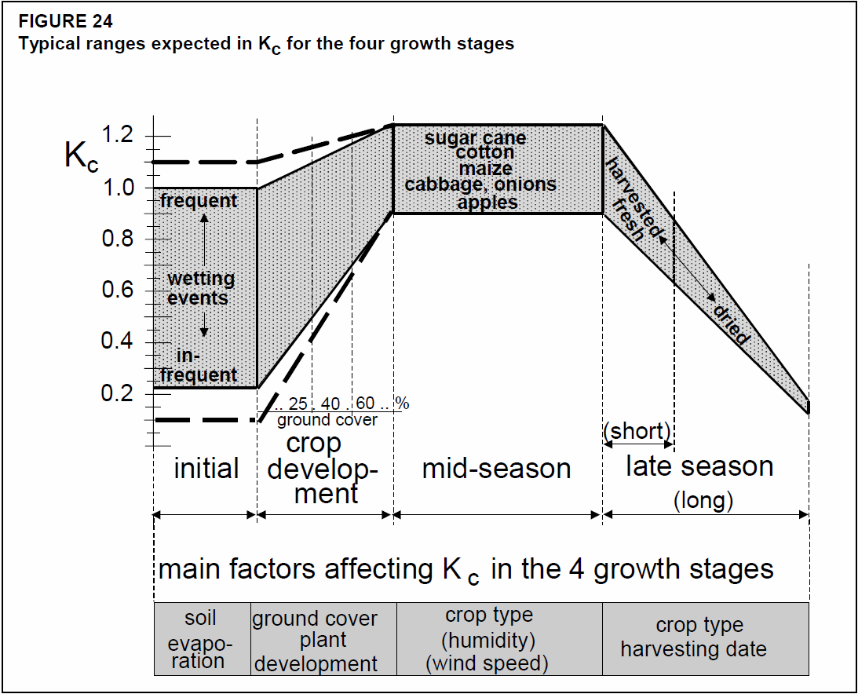
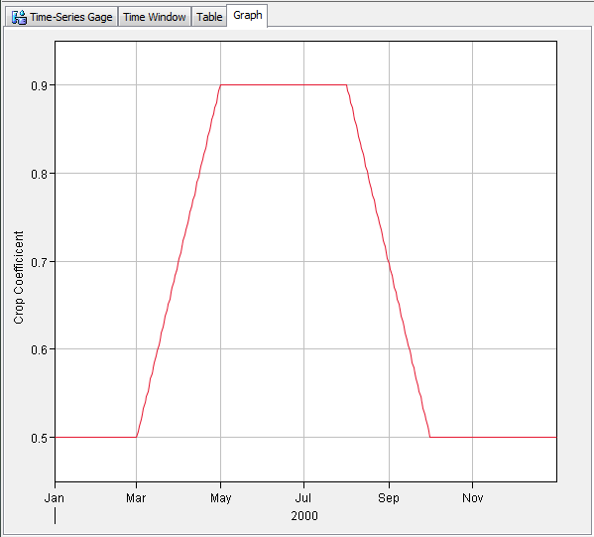
Crop Coefficient
Notes:
The crop coefficient can be set as a constant or specified as a time-series. You can quickly create the crop coefficient time-series using the Fill option in an HEC-HMS table.

Slide 25
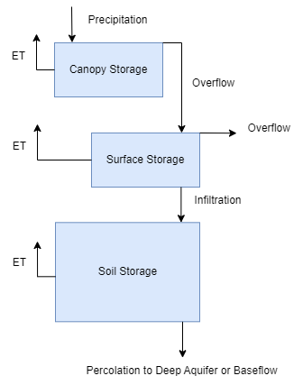
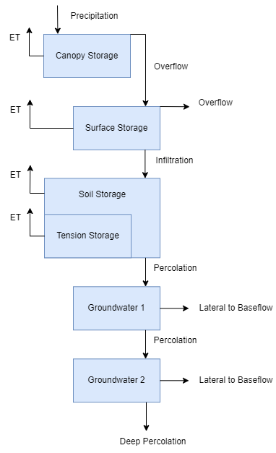
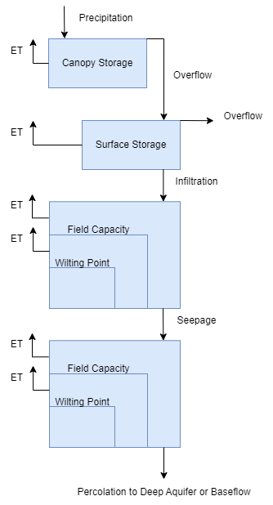
Evapotranspiration LOSSES
Deficit and Constant
Soil Moisture Accounting
Layered Green and Ampt
Notes:
ET losses are applied consistently to the canopy and surface, regardless of loss method.
Evapotranspiration calculations, like precipitation calculations, begin at the canopy layer. First, an attempt is made to satisfy the entire potential evapotranspiration from the canopy storage. In the first case, the canopy storage exceeds potential evapotranspiration. The result is that the canopy storage is reduced by the potential evapotranspiration and there is no evapotranspiration from any of the other layers. In the second case, the canopy storage is less than potential evapotranspiration. The result is that the canopy storage goes to zero and the remaining evapotranspiration is applied to the surface layer. In the third case, the canopy storage is already empty so all of the potential evapotranspiration is applied to the surface layer.
Once the canopy storage is empty, the potential evapotranspiration is applied to the surface layer. If there is storage in the surface, it is reduced by the evapotranspiration amount. If there is not enough surface storage to satisfy the potential demand, the remaining amount is applied to the soil layer. It is often the case that there is no evapotranspiration from the surface since that storage often infiltrates while the evapotranspiration is being applied to the canopy. When the surface layer is empty, any portion of the potential evapotranspiration that still remains is applied to the soil.
Deficit and Constant:
Evapotranspiration happens during intervals when there is no precipitation. The moisture deficit increases each time interval by an amount equal to the potential evapotranspiration rate computed by the meteorologic model. There is no actual evapotranspiration once the moisture deficit reaches the maximum deficit value. This could result in some amount of evapotranspiration greater than zero but less that the potential occurring in the time step when the maximum deficit is reached.
SMA:
Evapotranspiration removes water from the soil layer at the potential rate while the current storage exceeds the tension storage. During this phase the soil water will also be percolating to groundwater. Evapotranspiration from the soil layer while in the tension zone is controlled by the canopy’s tension reduction method. If tension reduction is selected the amount of evapotranspiration from the tension zone is a function of the storage. Tension reduction represents the fact that water is increasingly difficult for plants to remove from the soil as the soil dries out. If the simple uptake method is used, water is extracted from the tension zone at the rate of actual evapotranspiration, that is potential evapotranspiration factored by the crop coefficient and limited by available water.
Layered Green and Ampt:
Evapotranspiration removes soil moisture from the conceptual soil layers at the rate of actual evapotranspiration when soil moisture amount is greater than the wilting point. Evapotranspiration demands are applied to the first soil moisture layer, before applying to the second.

Slide 26
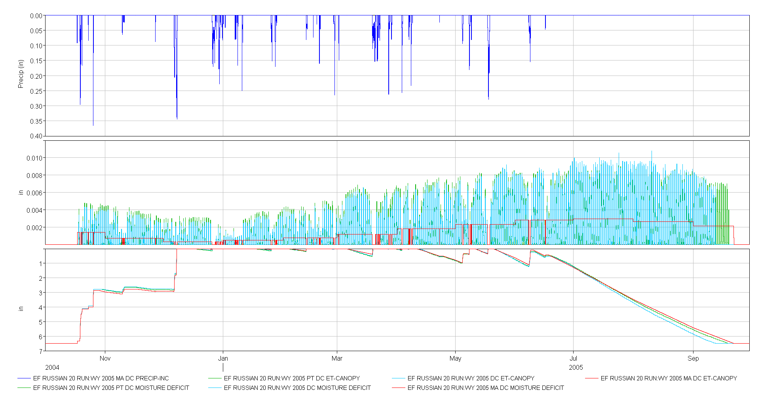
Comparison of Methods
Deficit and Constant Loss
Notes:
This graphic show the soil moisture state over the entire water year 2005 using the deficit and constant loss method. You can see evapotranspiration is computed differently between monthly average (RED), Priestley-Taylor (LIGHT BLUE), and Penman-Monteith (GREEN), but the soil moisture state tracks closely regardless of the ET method employed.

Slide 27
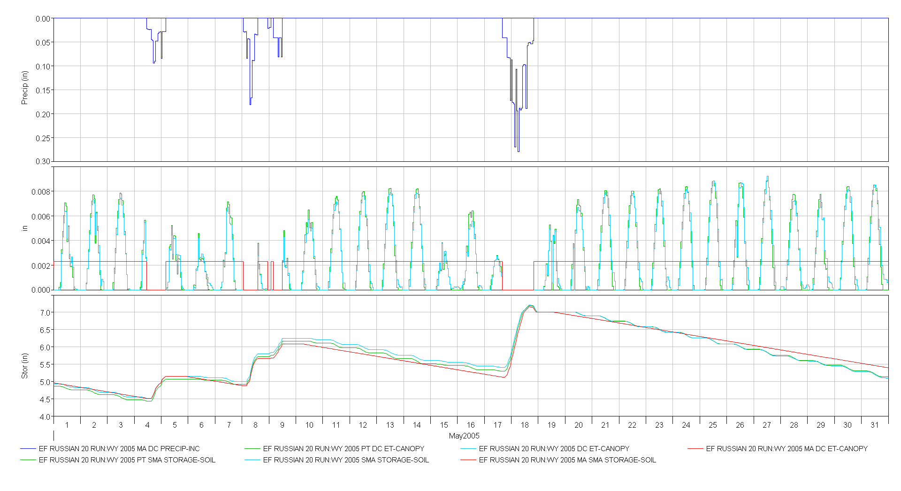
Comparison of Methods
Deficit and Constant Loss
Notes:
This graphic show the soil moisture state over the month of May 2005 using the deficit and constant loss method. You can see evapotranspiration is computed differently between monthly average (RED), Priestley-Taylor (LIGHT BLUE), and Penman-Monteith (GREEN), but the soil moisture state tracks closely regardless of the ET method employed. You can see the diurnal ET cycle in the Priestley-Taylor and Penman-Monteith calculations, and how that effects soil moisture state. Monthly Average ET has a linear effect on soil moisture state that likely overestimates at the beginning of the month and underestimates at the end of the month.

Slide 28
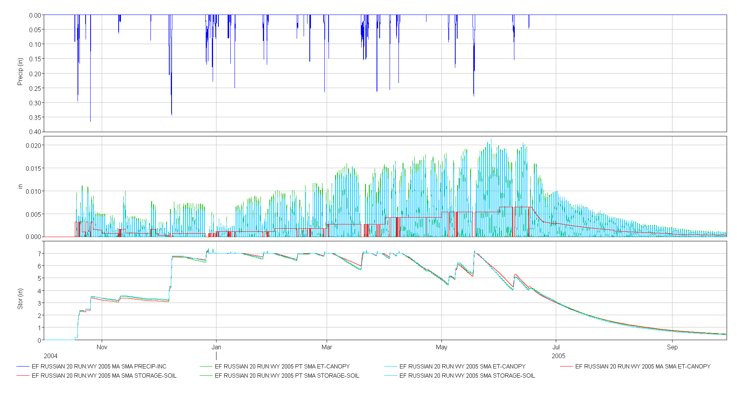
Comparison of Methods
Soil Moisture Accounting Loss
Notes:
This graphic show the soil moisture state over the entire water year 2005 using the soil moisture accounting loss method with tension reduction. You can see evapotranspiration is computed differently between monthly average (RED), Priestley-Taylor (LIGHT BLUE), and Penman-Monteith (GREEN), but the soil moisture state tracks closely regardless of the ET method employed. Notice the shape of the soil moisture curve as the soil dries out. Tension reduction yields and exponentially decreasing function while the simple uptake method would result in a linear function.

Slide 29
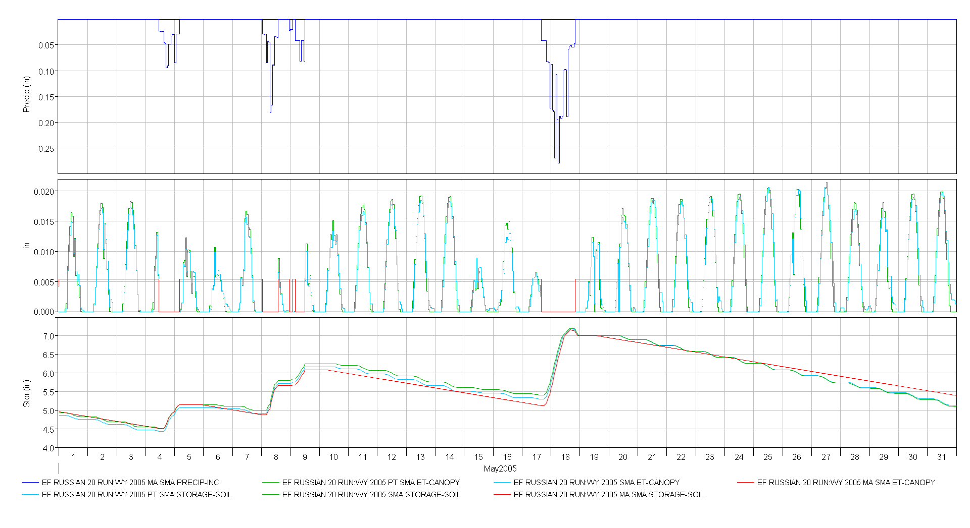
Comparison of Methods
Soil Moisture Accounting Loss
Notes:
This graphic show the soil moisture state over the month of May 2005 using the soil moisture accounting loss method. You can see evapotranspiration is computed differently between monthly average (RED), Priestley-Taylor (LIGHT BLUE), and Penman-Monteith (GREEN), but the soil moisture state tracks closely regardless of the ET method employed. You can see the diurnal ET cycle in the Priestley-Taylor and Penman-Monteith calculations, and how that effects soil moisture state. Monthly Average ET has a linear effect on soil moisture state that likely overestimates at the beginning of the month and underestimates at the end of the month.

Slide 30
Calibration
Options:
  Calibrate to a station (e.g. CIMIS)
  Calibrate to ET products (e.g. MODIS)
  Calibrate to published values
  Calibrate to water balance

Slide 31
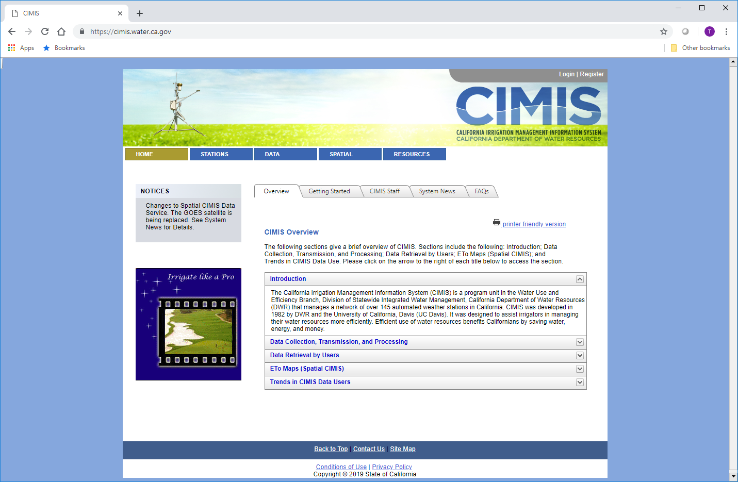
Data – CIMIS
Notes:
CIMIS provides station data for California (https://cimis.water.ca.gov/). See if there is a similar network in your area.

Slide 32

Data – Ameriflux
Notes:
http://ameriflux.lbl.gov/

Slide 33
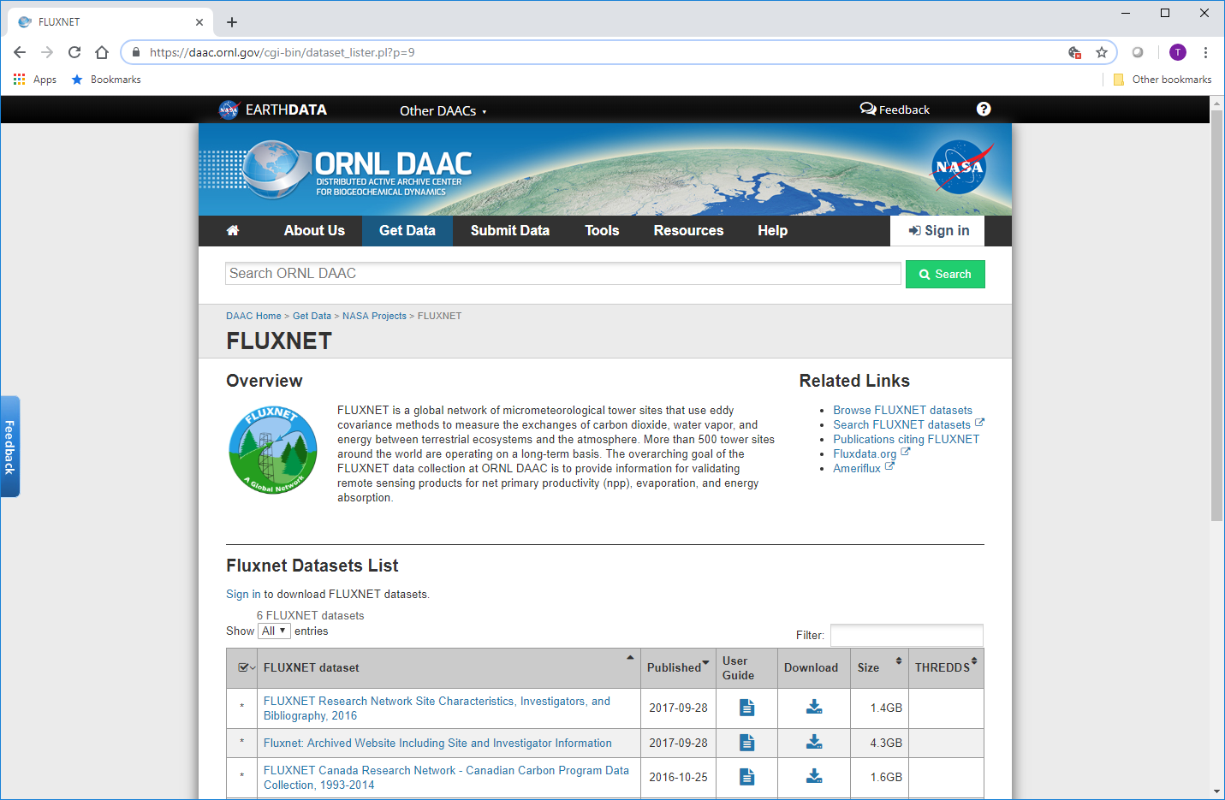
Data – Fluxnet
Notes:
https://daac.ornl.gov/cgi-bin/dataset_lister.pl?p=9

Slide 34
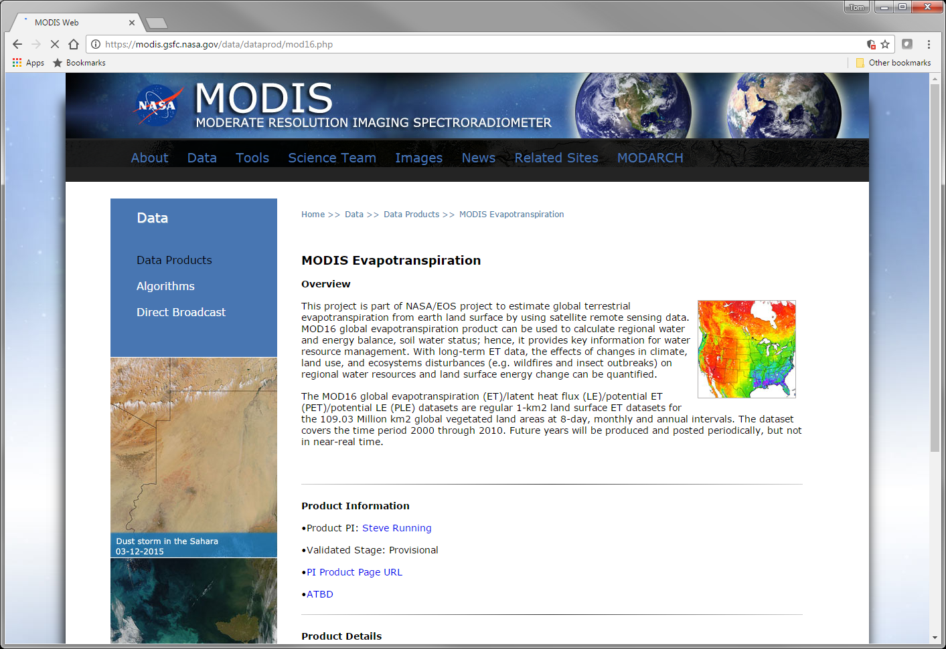
Data – MODIS ET
Notes:
https://modis.gsfc.nasa.gov/data/dataprod/mod16.php

Slide 35
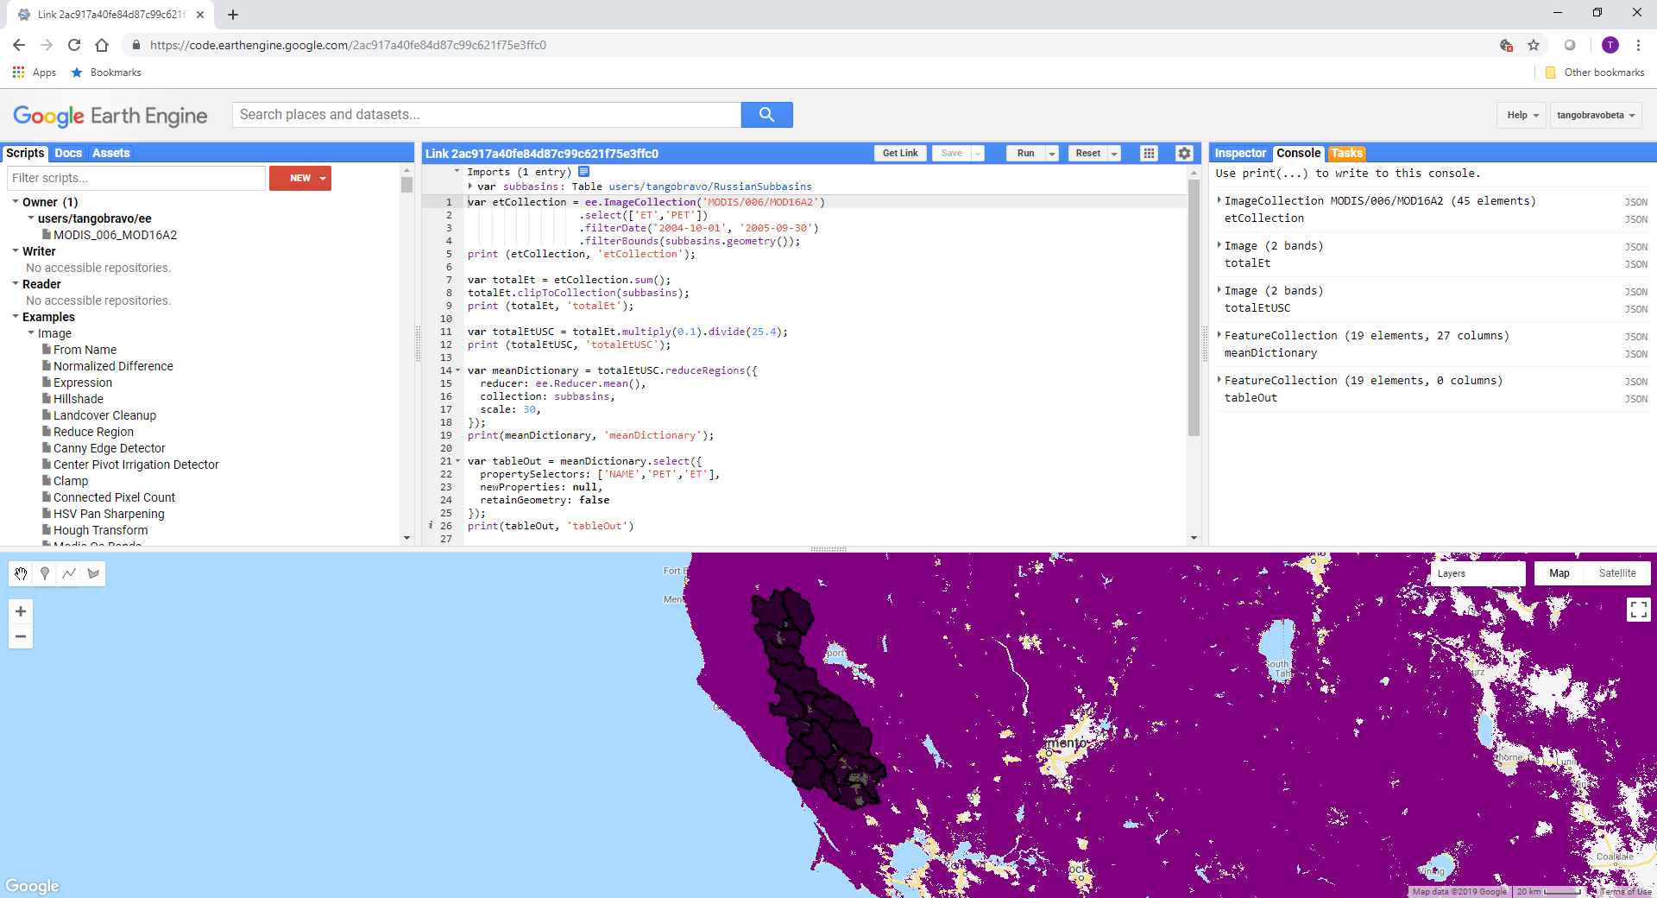
Data – MODIS ET
Notes:
MODIS ET analyzed from Google Earth Engine.

Slide 36
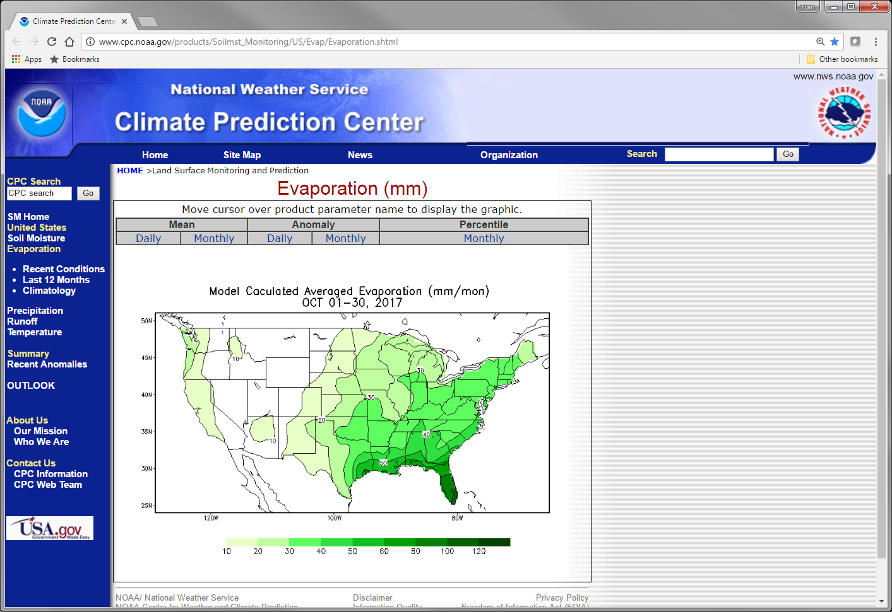
Data – Climate Prediction Center
Notes:
https://www.cpc.ncep.noaa.gov/products/Soilmst_Monitoring/US/Evap/Evaporation.shtml

Slide 37

Data - USAF
Notes:
https://climate.af.mil/
Temperature, windspeed, humidity, and radiation data can be gathered for locations around the world by submitting a support request (SAR) to the USAF 14th Weather Squadron (https://climate.af.mil/).

Slide 38
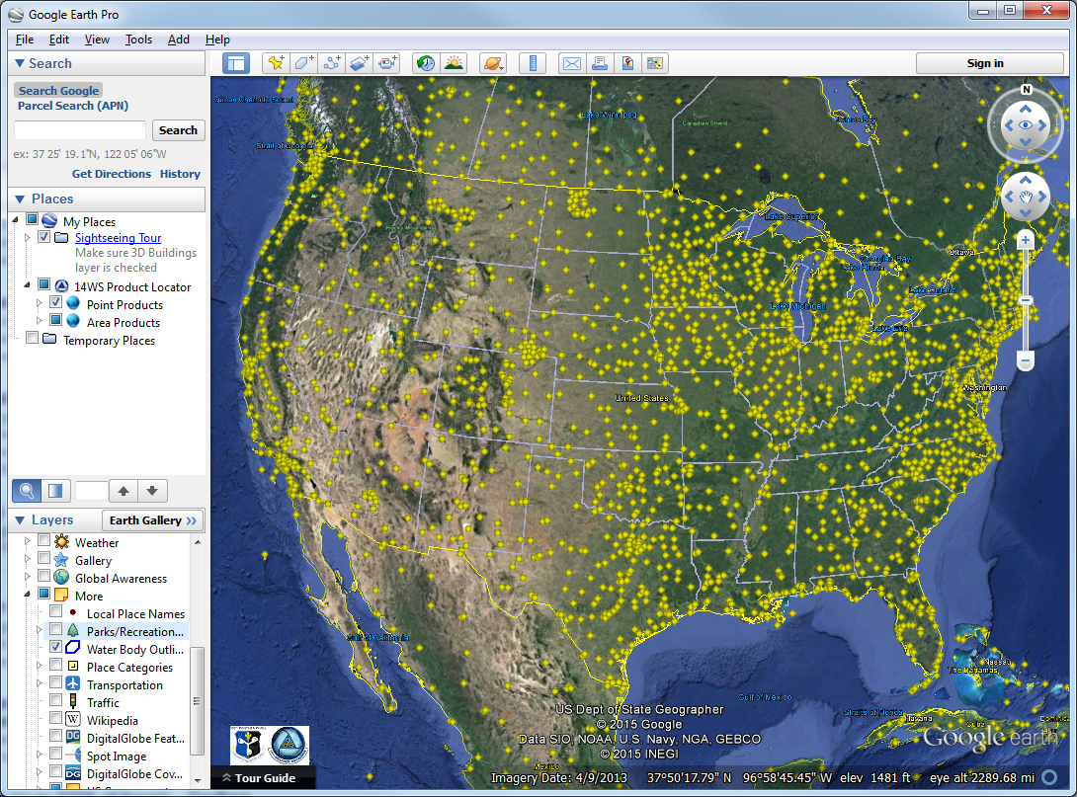
Data - USAF
USAF product locator kml
Notes:
USAF product locator kml

Slide 39

Data – U. Oregon
Notes:
https://solardata.uoregon.edu/

Slide 40
Review
Summarized evapotranspiration physical processes
Compared evapotranspiration methods in HEC-HMS

Slide 41
References
Allen, R.G., Pereira, L.S., Raes, D., Smith, M. 1998. Crop evapotranspiration —guidelines for computing crop water requirements. FAO Irrigation and drainage paper 56. Food and Agriculture Organization, Rome.
Hamon, W.R. 1961. "Estimating Potential Evapotranspiration," Journal of the Hydraulics Division, ASCE. 87(HY3):107-120.
Hargreaves, G.H., and Z.A. Samani. 1985. Reference crop evapotranspiration from temperature. Applied Engrg. in Agric. 1:96-99.

