Slide 1
Period of Record Simulation of the Russian River Watershed with HEC-HMS
Thomas Brauer,
Matthew Fleming
US Army Corps of Engineers
Hydrologic Engineering Center
Presented at EWRI 2017
24 May 2017
Image: Sonoma County Water Agency

Slide 2

FIRO
“The goal of FIRO is to update standard flood control guidelines in order to improve water supply and environmental outcomes without diminishing flood risk reduction or dam safety.”
Notes:
This hydrology study was a part of the larger FIRO study that you have probably heard about this week.
“The goal of the FIRO is to update standard flood control guidelines in order to improve water supply and environmental outcomes with out diminishing flood risk or dam safety.”
The Corps’ involvement in FIRO focused on flood risk.
For the FIRO study we wanted to create a hydrology model that accurately predicted runoff flow, volume, and soil moisture for the 60 year PoR.

Slide 3
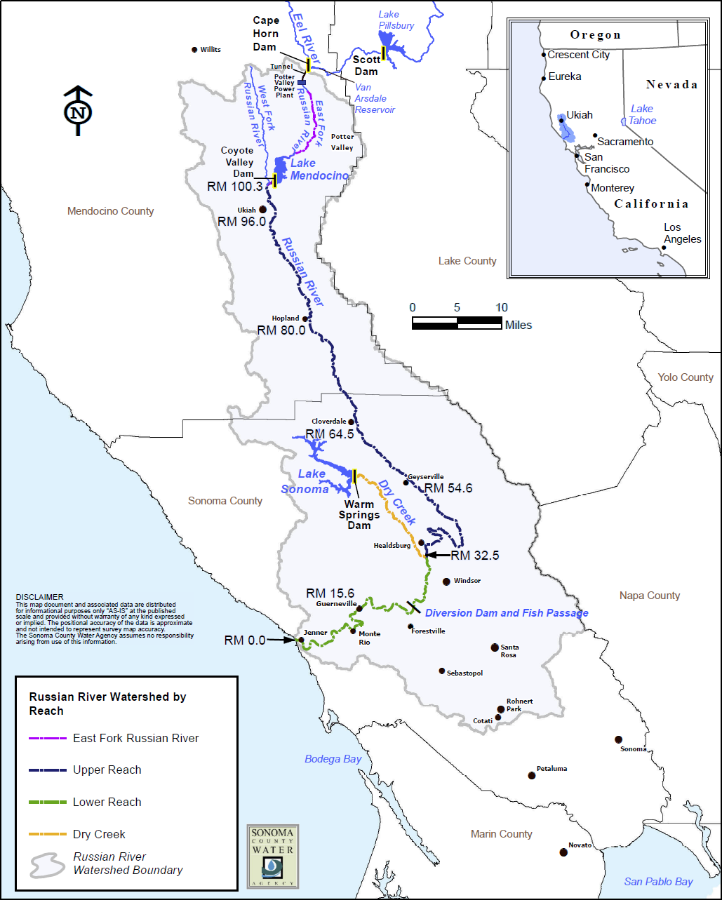
Russian River Basin
Notes:
Coyote Valley Dam is located in the upper portion of the basin and serves as the sole water supply for most of the river, and has become very stressed.
Municipal/industrial/agricultural demands have greatly increased since built in 1959.
USACE tried to determine how much more can we store in CVD without increasing flood risk

Slide 4

Hydrology Model
HEC-HMS
Meteorologic Model
Simulation Run
Basin Model
Control Specifications
Notes:
Meteorologic model - Establishes precipitation and evapotranspiration boundary conditions
Basin model - Establishes physical representation of watershed through hydrologic elements
Control specifications - Establishes temporal extent and resolution of simulation

Slide 5
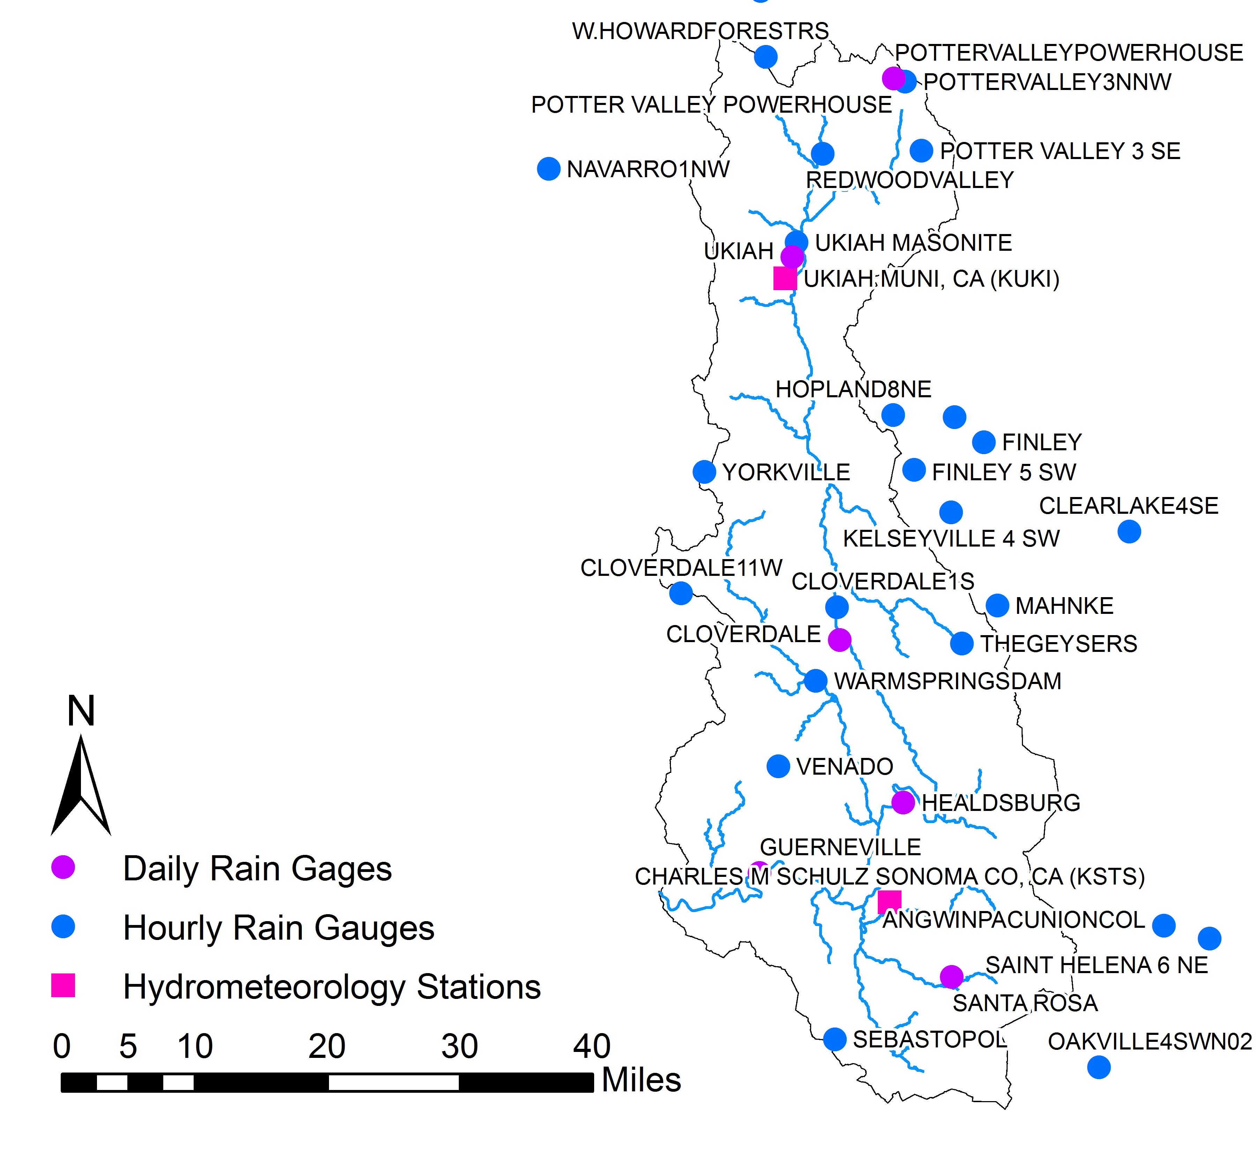
Meteorologic Data
Notes:
Precip
28 hourly point precipitation gages; data downloaded from NCDC
ET
Penmen-Monteith evapotranspiration method
Data sources: Air Force 14th Weather Squadron, NCDC

Slide 6
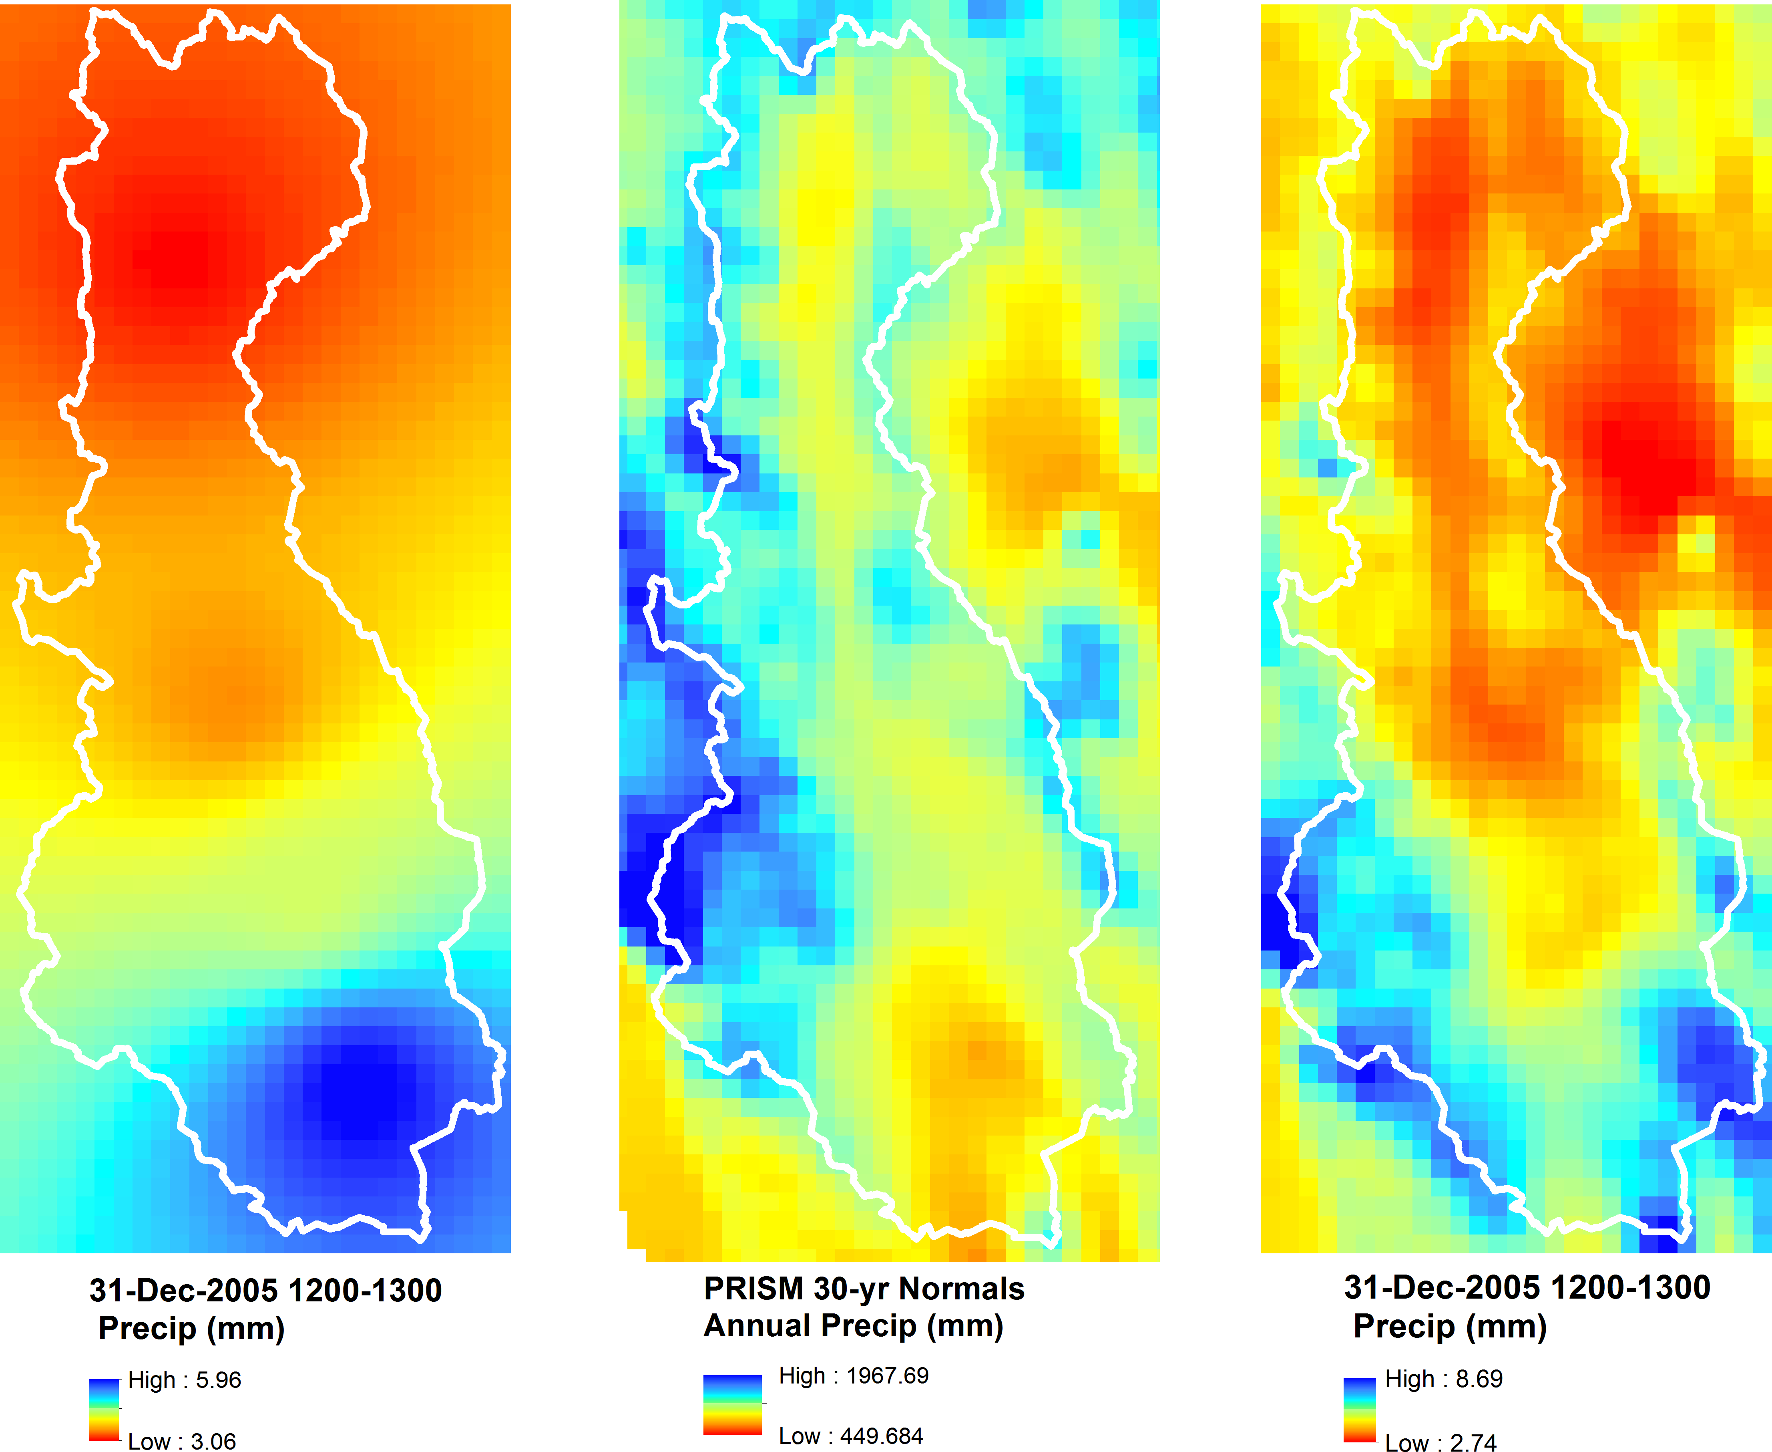
Precipitation
Notes:
We used GageInterp utility to create a gridded precipitation record; uses inverse distance squared interpolation
PRISM grid applied in GageInterp to improve the interpolation process by spatially distributing precipitation normal to the 30 year pattern

Slide 7
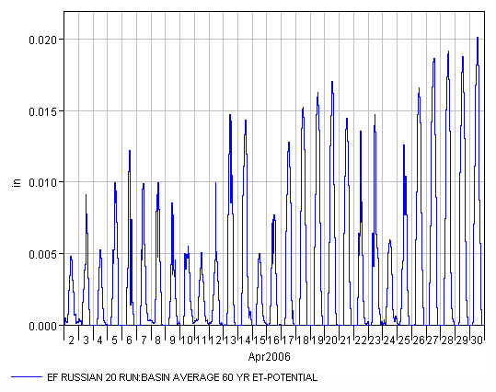
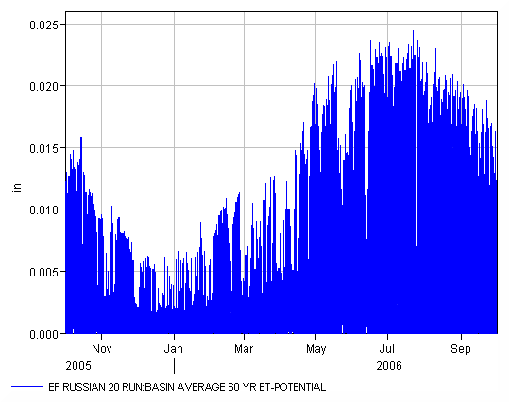
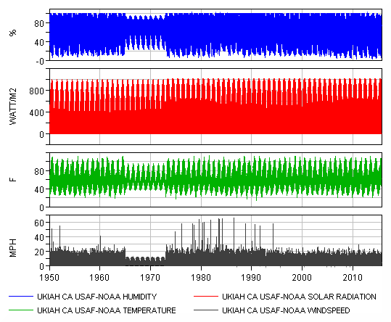
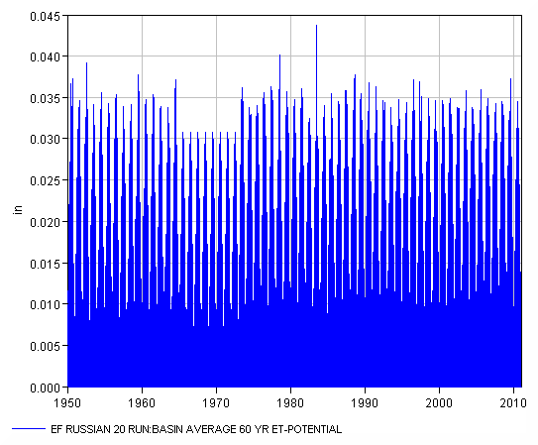
Evapotranspiration
Notes:
The FAO Penman-Monteith method requires radiation, air temperature, air humidity and wind speed data.
Illustration show 60 years of data, 60 years of potential ET, one year of potential ET, then one month of potential ET

Slide 8
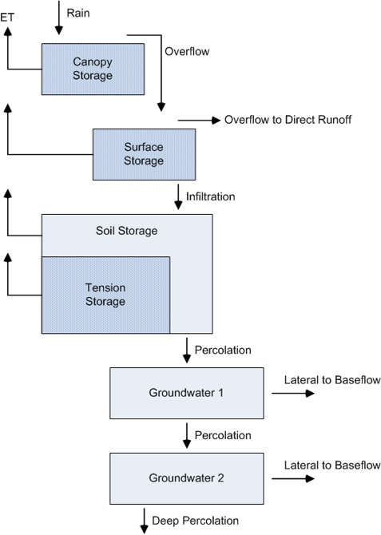
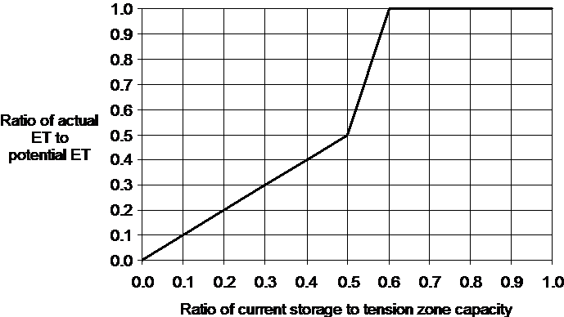
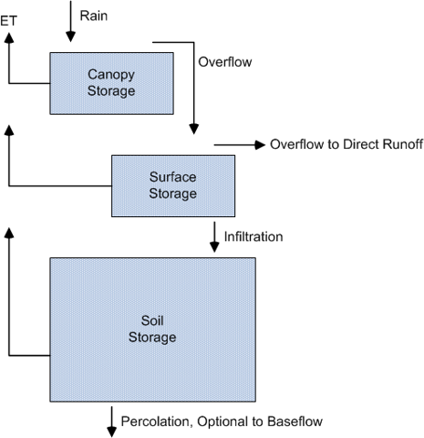
Subbasin Losses
Notes:
There are two loss methods available in HEC-HMS for continuous simulation.
Soil Moisture Accounting is the more complex using 5 conceptual layers.
Additionally SMA uses a tension reduction uptake method to extract moisture form the soil. It represents the fact that water is increasingly difficult for plants to remove from the soil as the soil dries out.
Deficit and Constant is the more simple loss method using 3 conceptual layers. Moisture from the soil is extracted at the rate of ET.

Slide 9
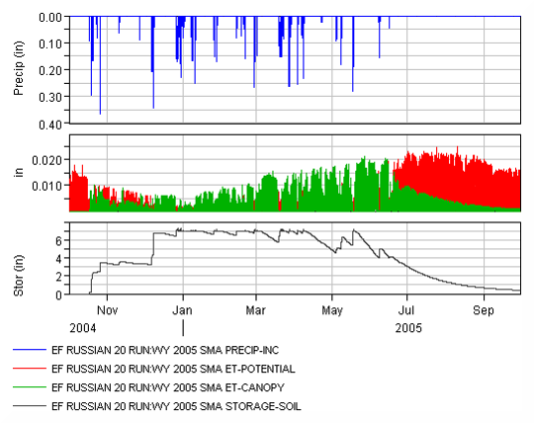
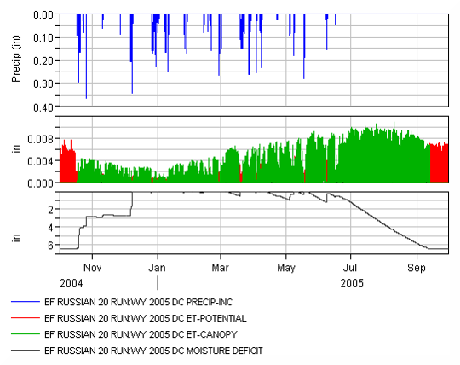
Loss Method Comparison
Soil Moisture Accounting
Deficit and Constant
Notes:
This slide shows a comparison between loss methods for a single water year.
As you can see SMA makes a more physically appropriate accounting of soil moisture as the soil dries out.
For this reason we chose to use the SMA loss method upstream of CVD, the focus of the reservoir re-operation study,
while using the easier to calibrate deficit and constant method downstream where sole concern was reproducing flow.

Slide 10
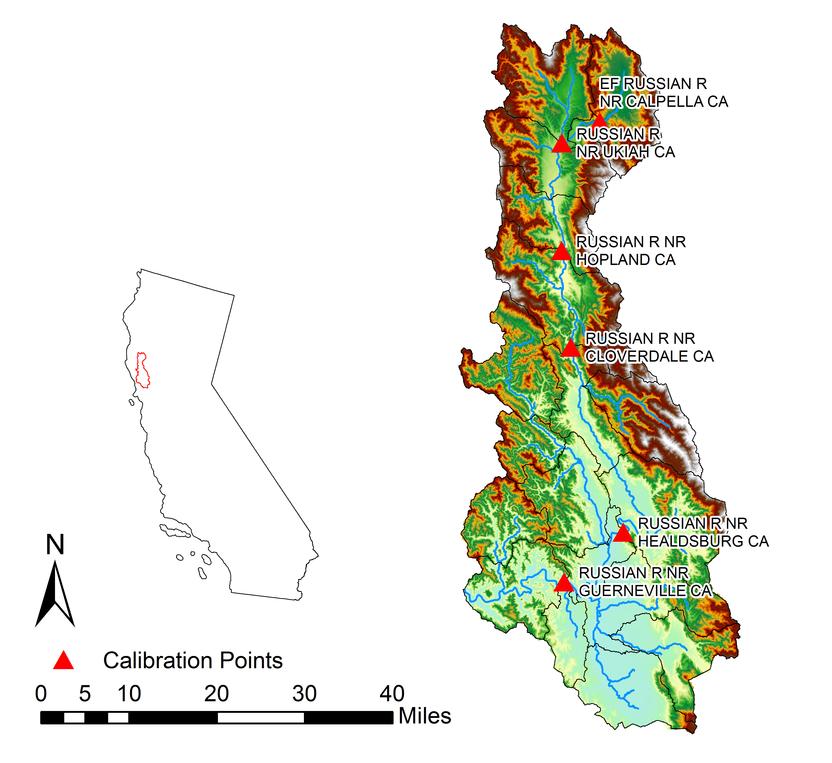
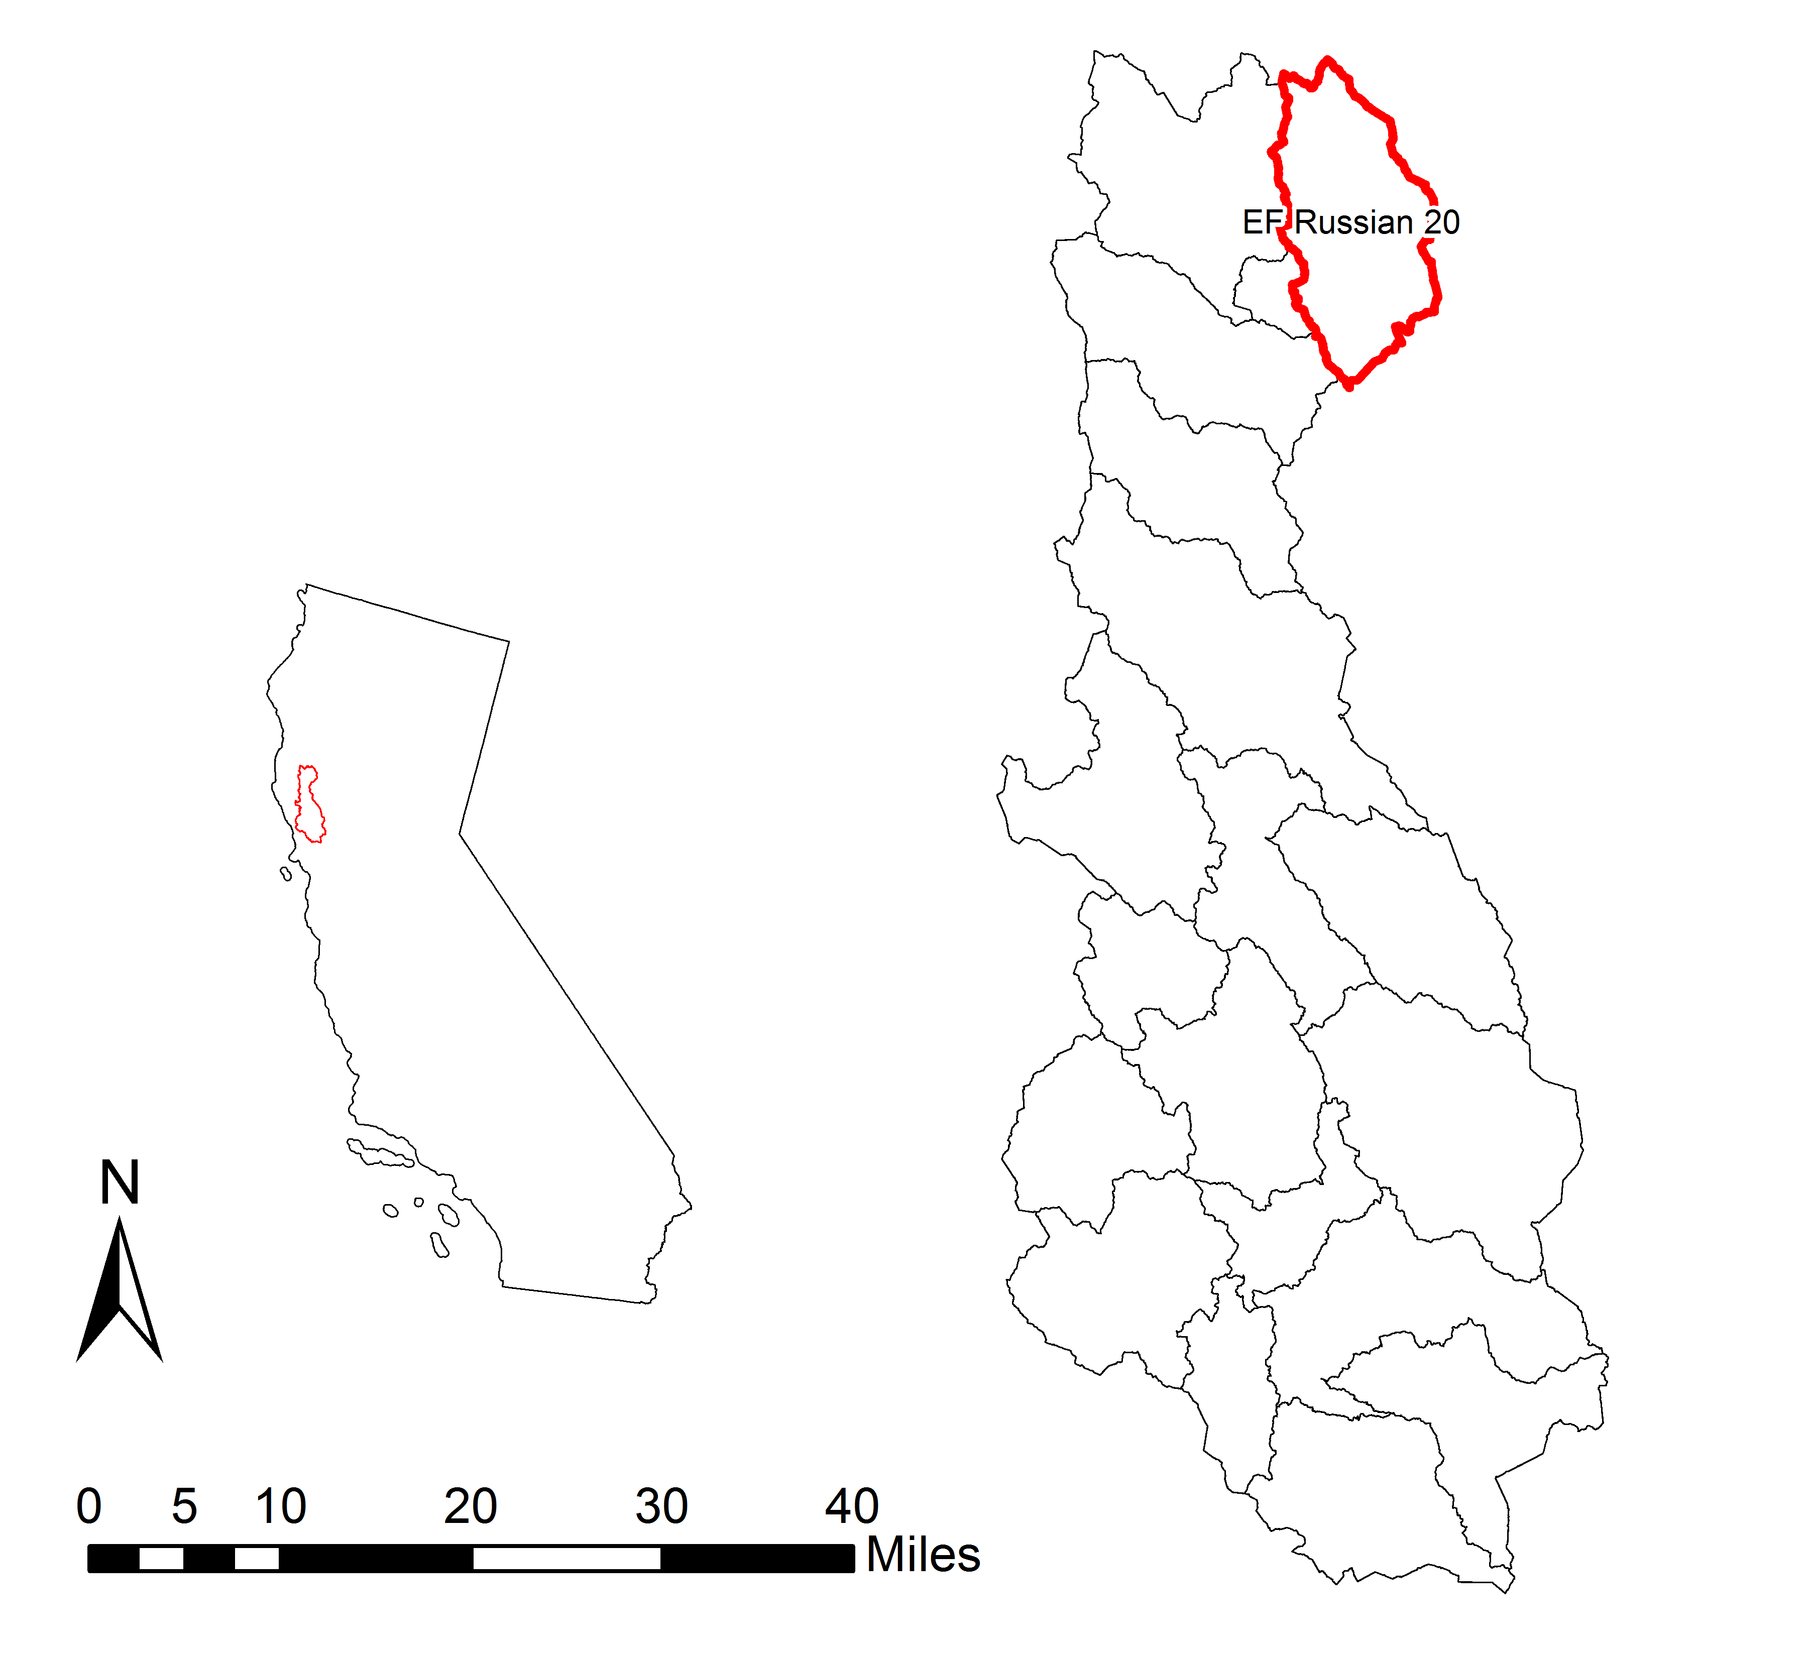
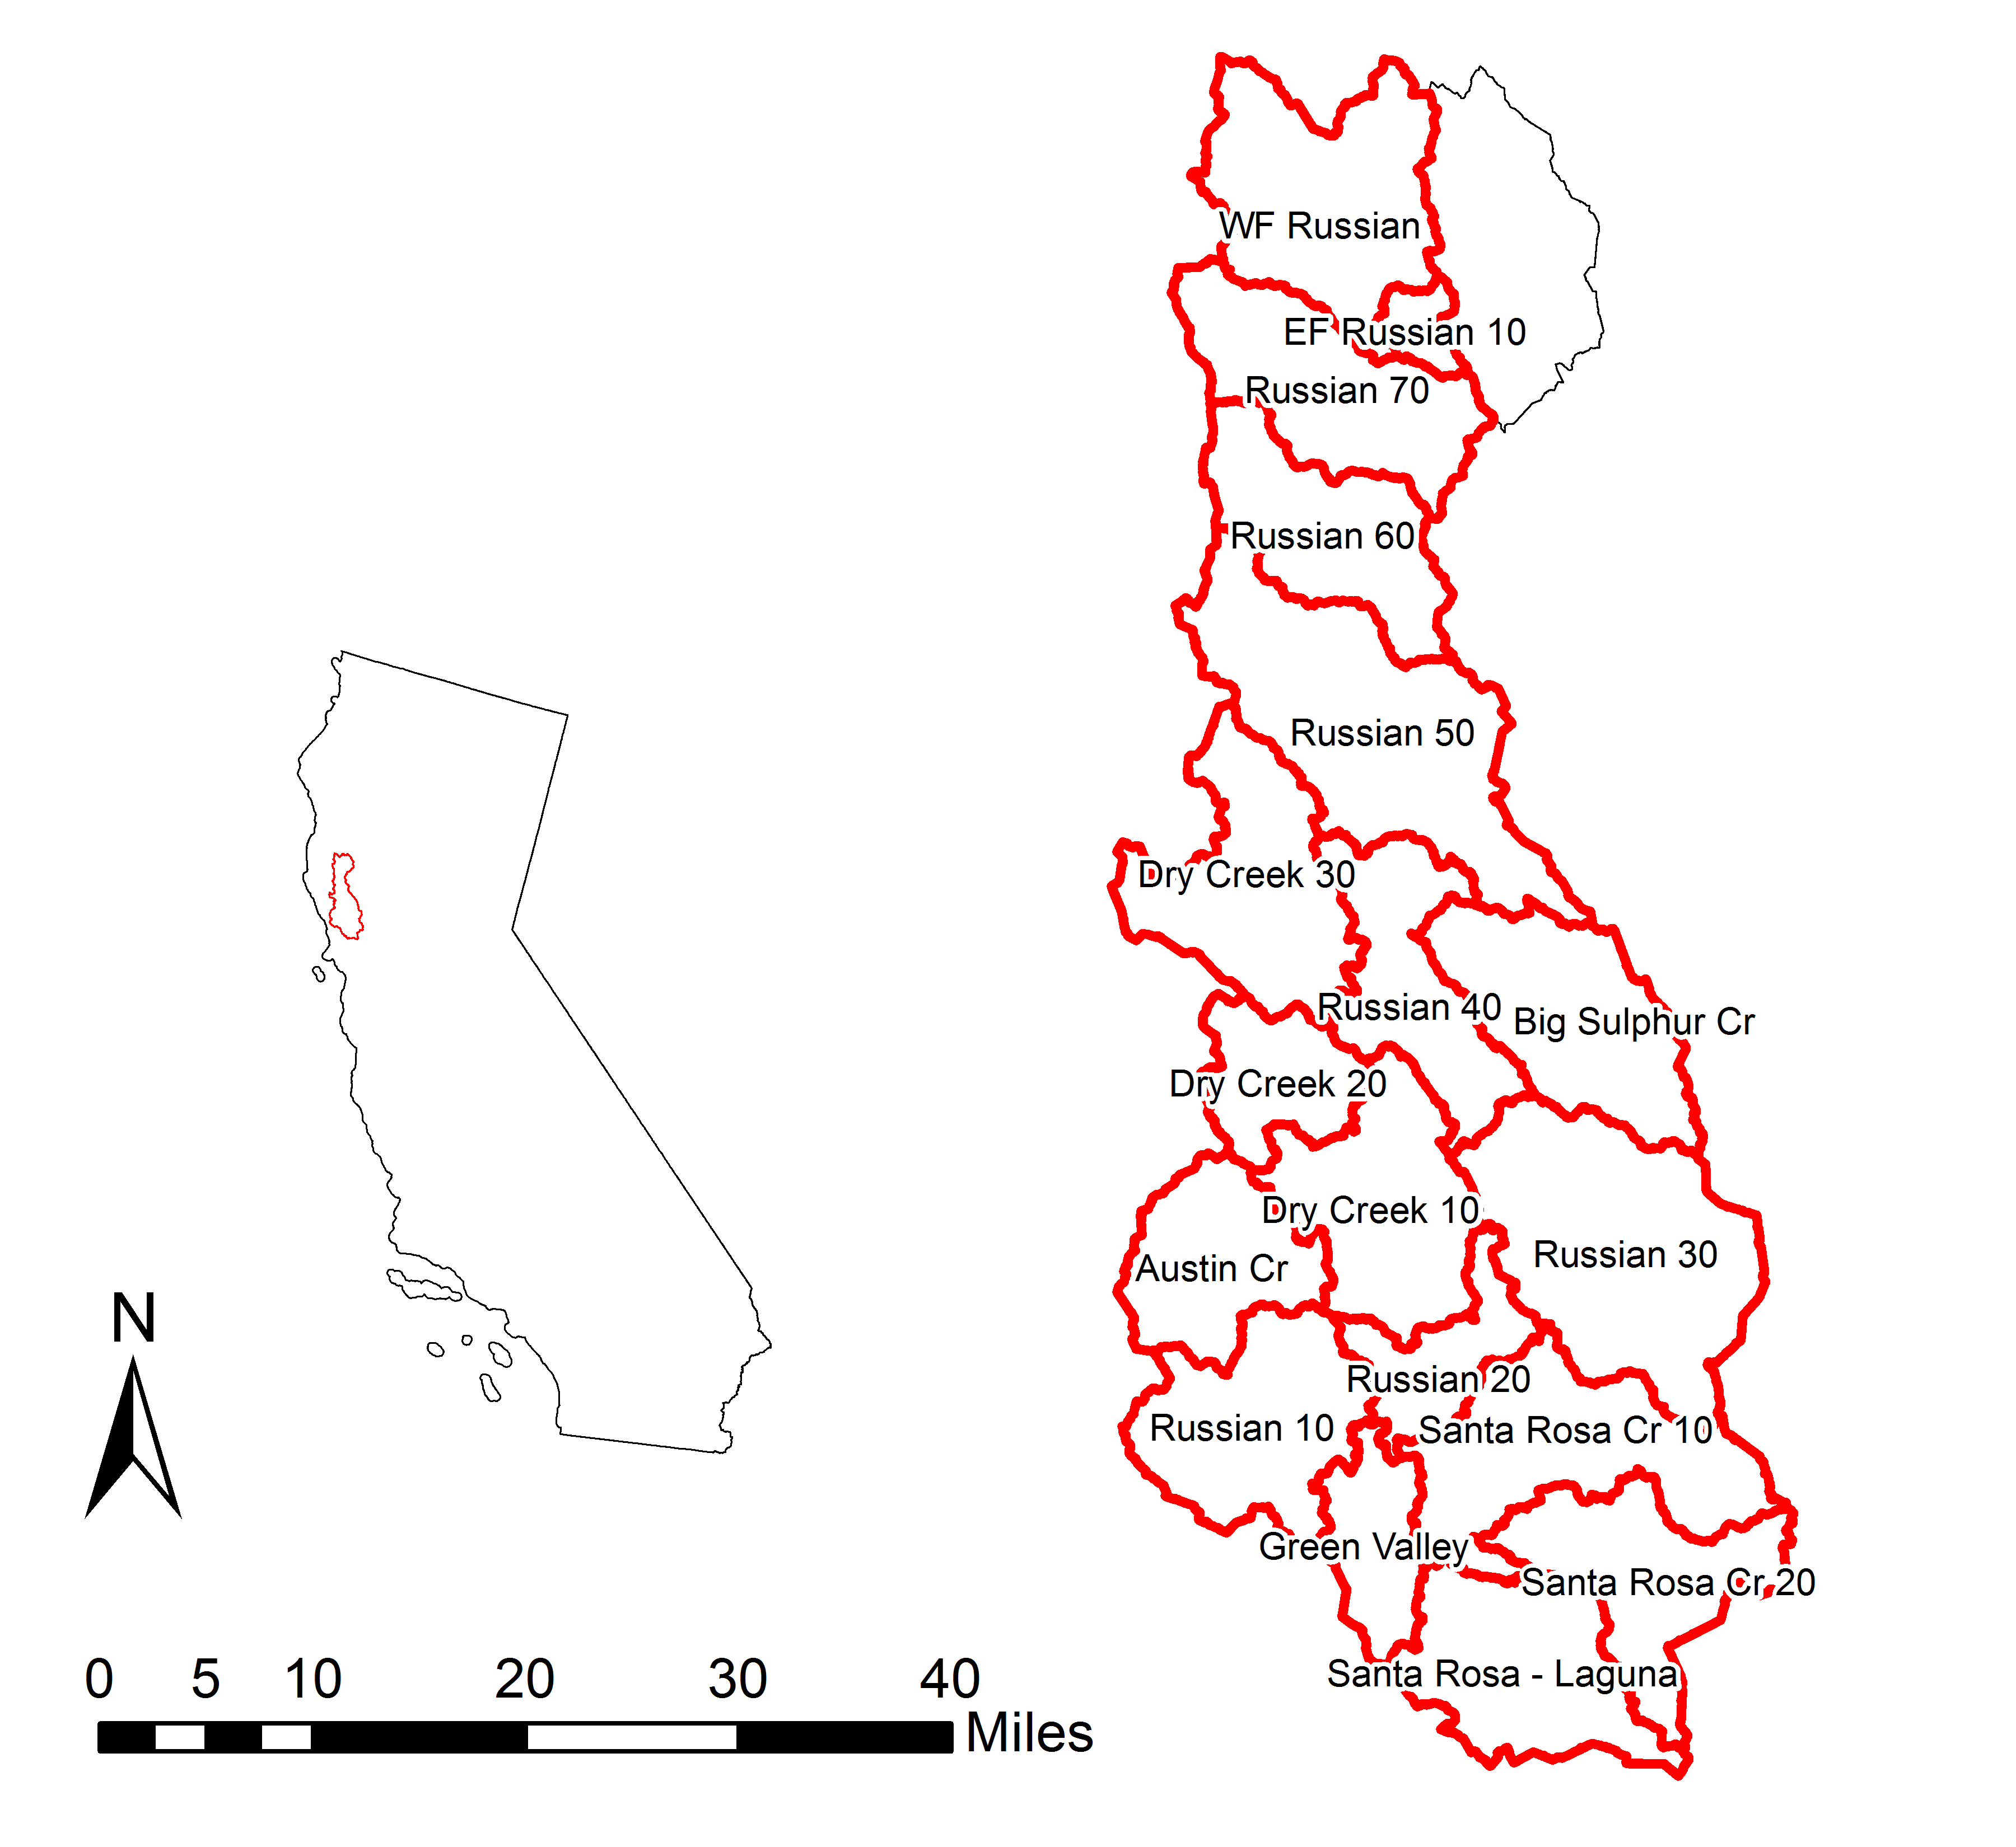
Subbasin Delineation
Notes:
Subbasin delineation
A digital elevation model (DEM) was downloaded from the USGS National Elevation Dataset (USGS 2013)
HEC-GeoHMS utility delineated the stream and subbasin boundary network based on the USGS DEM, and also forced subbasins at reservoir and stream gauge locations as calibration points

Slide 11
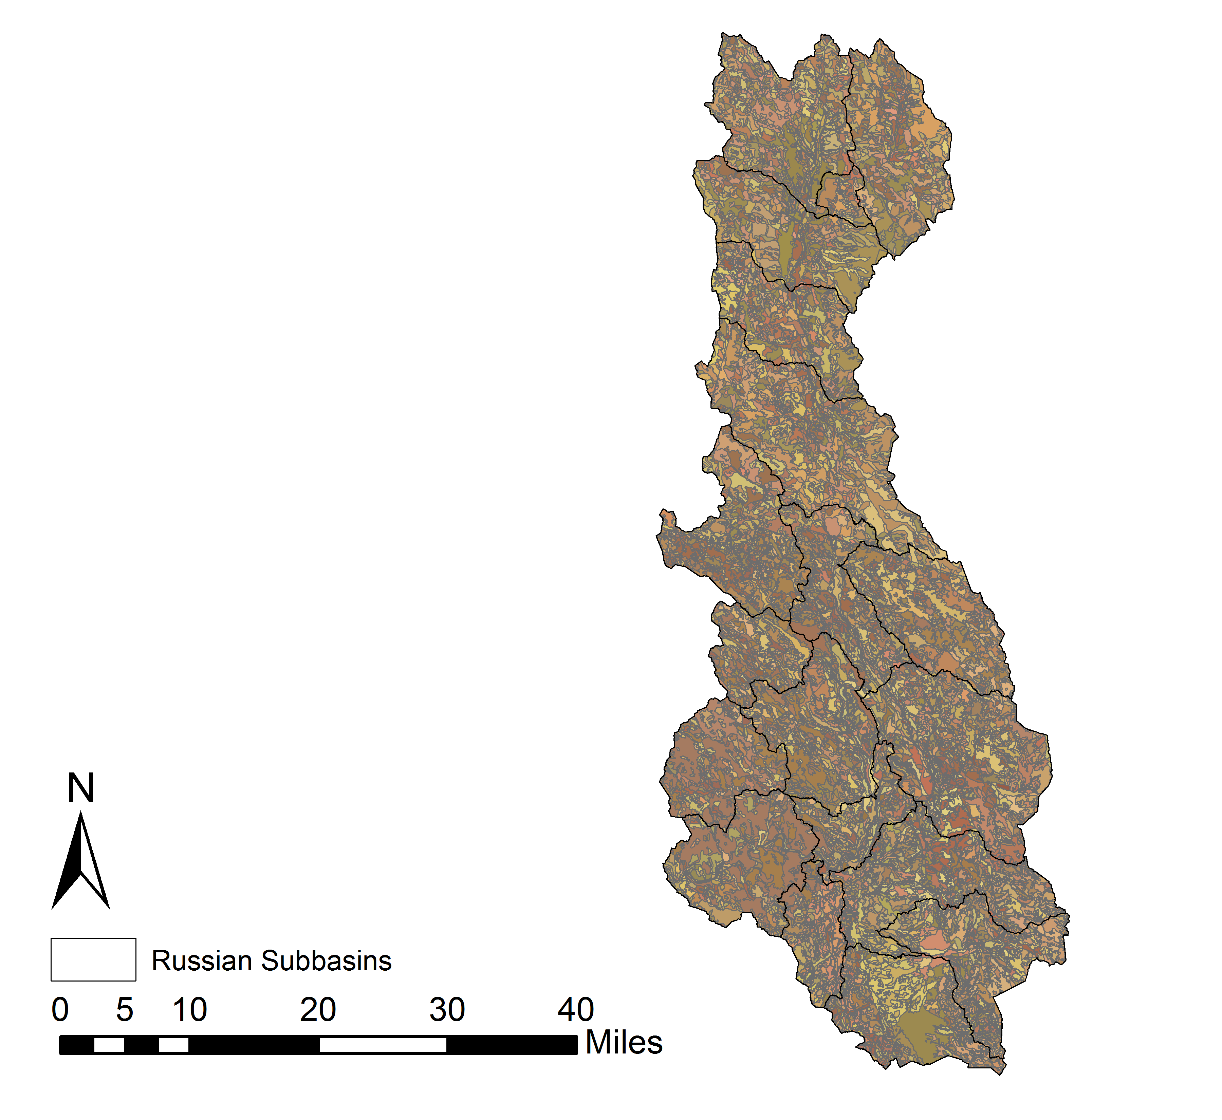
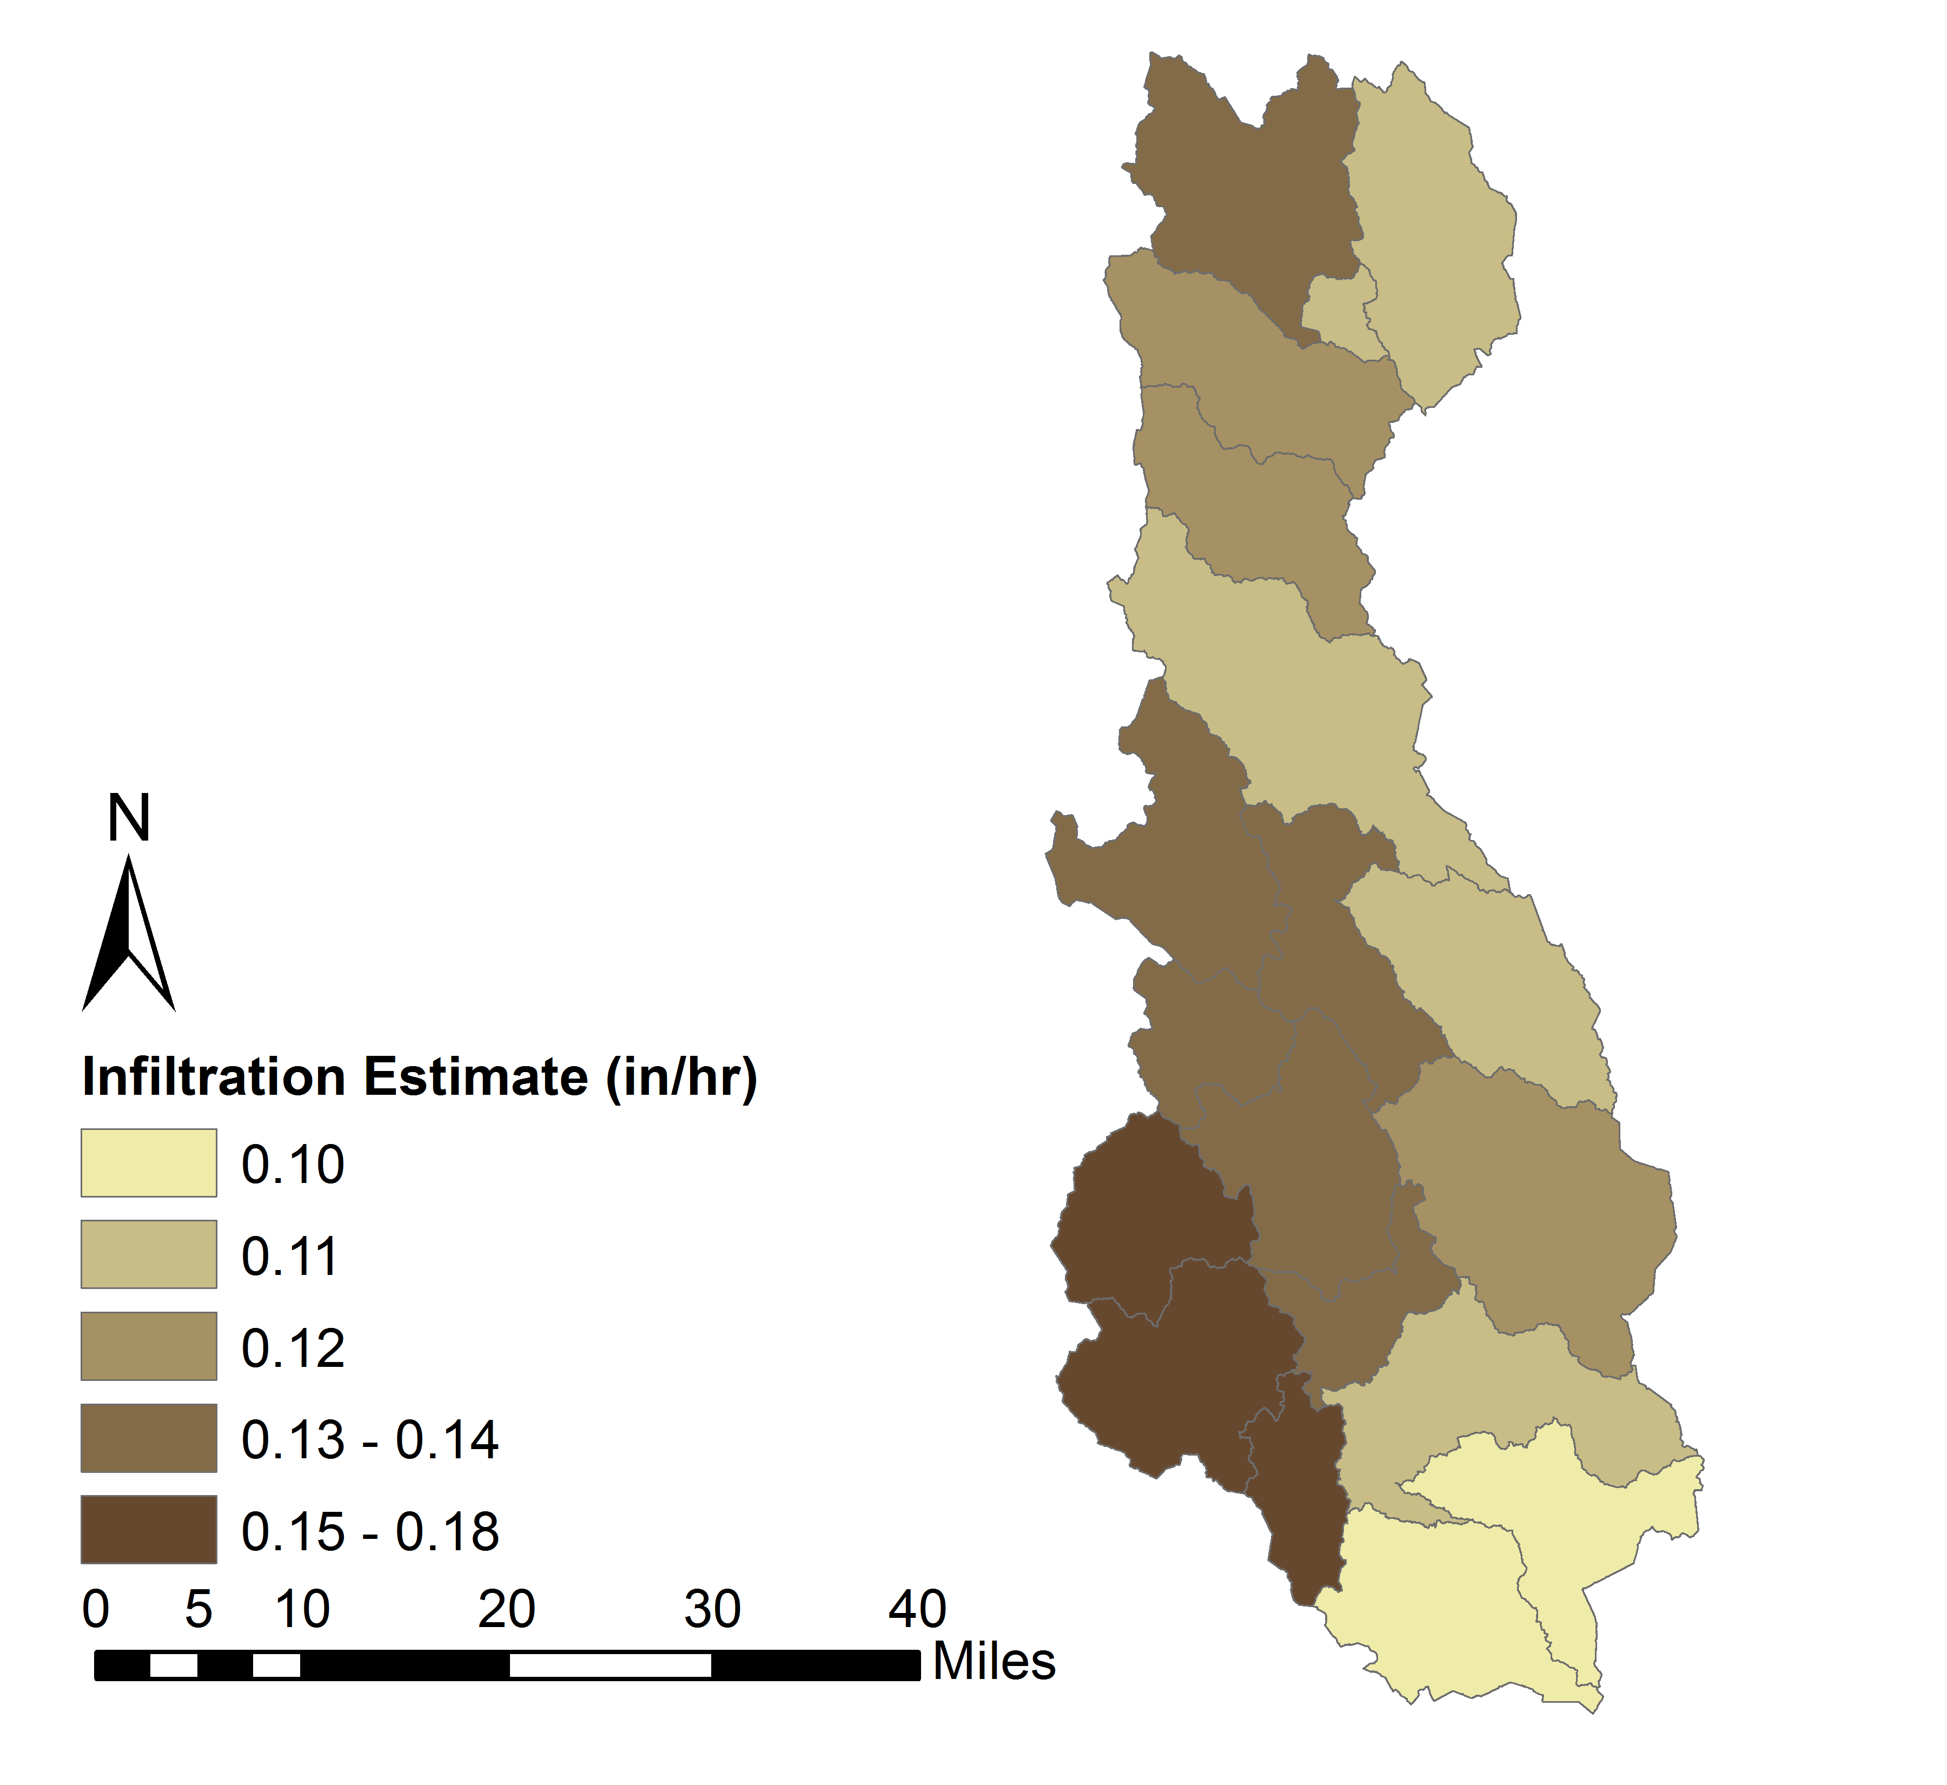
Initial Loss Parameter Estimates
Notes:
The SSURGO data were used to initially estimate loss parameters for the Deficit and Constant (e.g. Constant Rate) and Soil Moisture Accounting (e.g. Maximum Infiltration) loss methods
The land use dataset was used to compute the percent impervious area

Slide 12
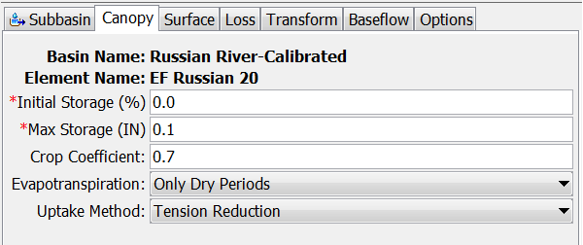
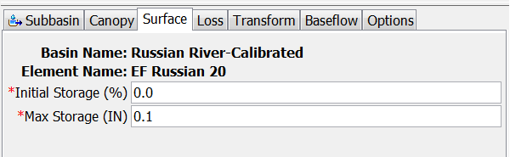
Parametrization: Canopy/Surface
Notes:
This slide shows parameterization of the canopy and surface storage portions of the loss model.

Slide 13
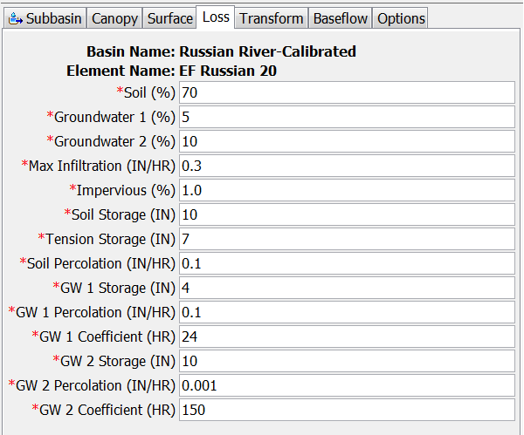
Parametrization: SMA Loss
Notes:
This slide shows parameterization of the SMA loss method.

Slide 14
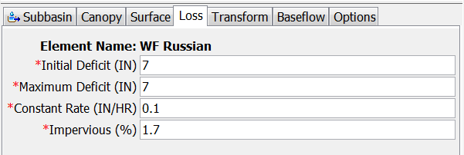
Parametrization: Deficit & Consant
Notes:
This slide shows parameterization of the deficit and constant loss method.

Slide 15
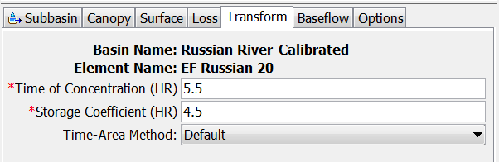
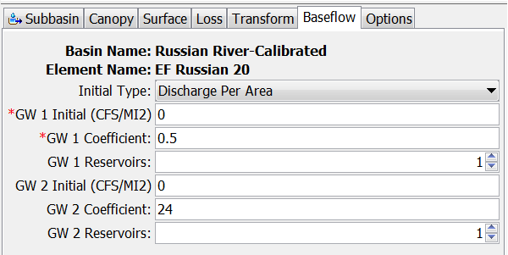
Parametrization: Transform/Baseflow
Notes:
This slide shows parameterization of the Clark Unit Hydrograph and linear-reservoir baseflow transforms.
The linear reservoir baseflow method is the only mass conserving baseflow method available in HEC-HMS and is suitable for long-period simulations.

Slide 16
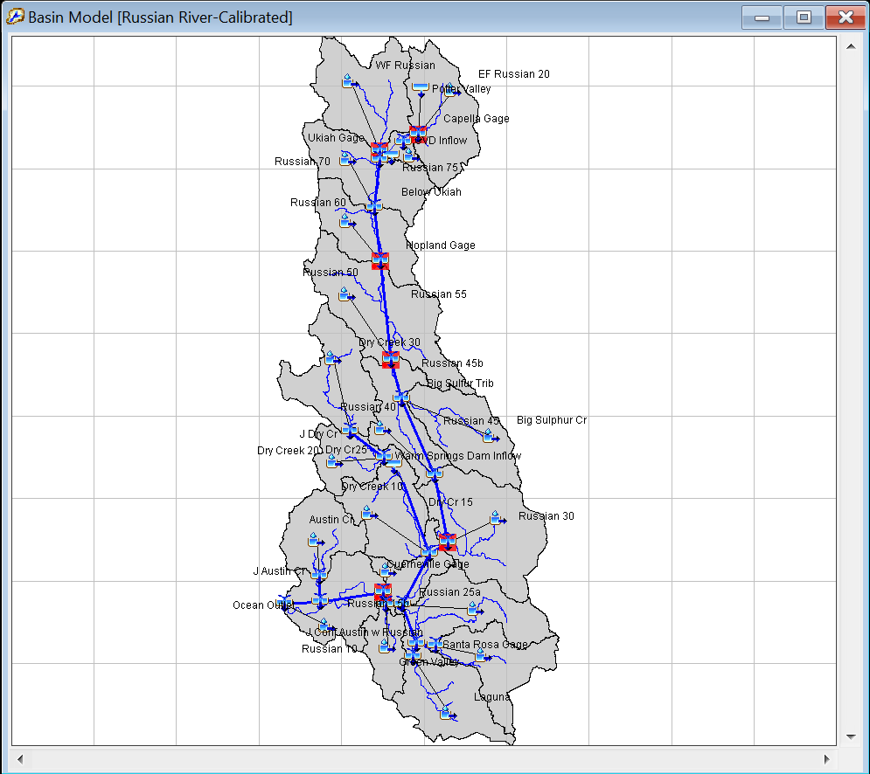
Basin Model
Notes:
This slide shows the parameterized basin model in HEC-HMS
Modified-Puls routing was implemented for reaches along the Russian River and Dry Creek
Elevation-discharge relationships for the routing reaches using a calilbrated HEC-RAS model.

Slide 17
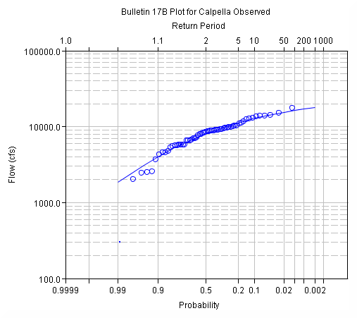
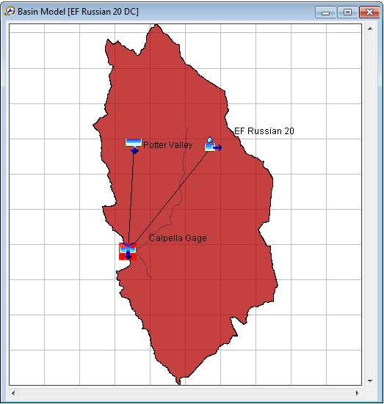
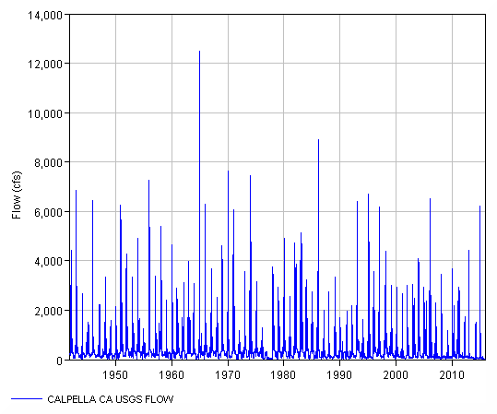
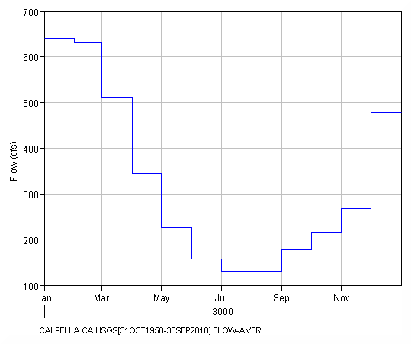
Calibration: Runoff Signatures
Notes:
Signatures are response patterns.
The most familiar is the runoff hydrograph but
from the runoff hydrograph we can derive an annual maximum flow series
and seasonal (or monthly) volume distribution

Slide 18
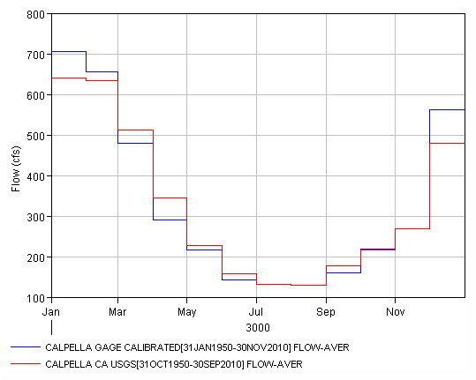
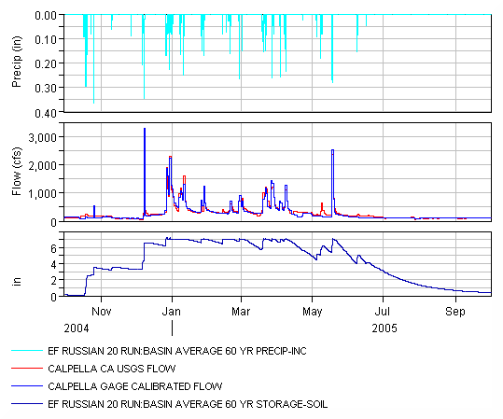
Calibration: Monthly Volume
Notes:
The calibration started with monthly volume.
A single water year calibration would focus on the timing of the first major runoff event of the year, then soil moisture state between events during the wet season.
This is subject to the Crop Coefficient and
Soil Storage and Tension Storage for SMA and
Maximum Deficit for Deficit and Constant
For period of record the modeler should adjust these parameters while considering monthly flow volumes.
Monthly flow is subject to natural, municipal, industrial, and agricultural demands.
The average monthly runoff volume was considered to ensure that the water supply operations of the reservoir model were representative of the existing conditions and suitable for use in determining the additional storage possible under FIRO.

Slide 19
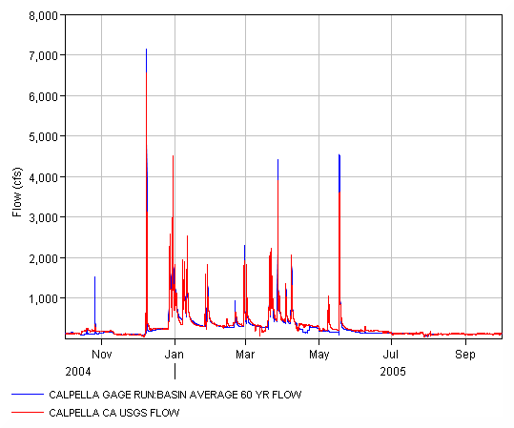
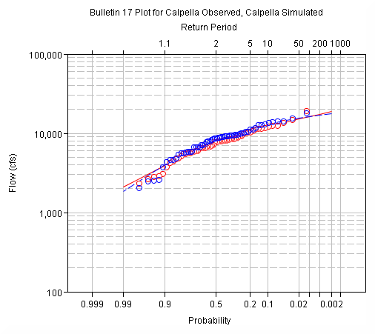
Calibration: Annual Maximum Flows
Notes:
The annual maximum flow-frequency curve was considered as the goal of this study to assess flood risk (low probability events) under FIRO alternatives.
A single water year calibration would focus on individual hydrograph peaks.
Peak flows were sensitive to Maximum Infiltration for SMA.
Peak flows were sensitive to Constant Rate for Deficit and Constant.
An aggregated approach for the period of record focuses on the flow-frequency curve.
The focus of calibration was overall correlation between computed and observed with emphasis on low probability events since the study was focused on floods.

Slide 20
Calibration: Runoff Hydrograph
Notes:
Finally the runoff hydrograph, including timing of peak flows, and the recession limb of hydrographs was considered to ensure fine resolution accuracy
Focus of calibration was on recession limb of hydrographs and baseflow recession curves. It was helpful to evaluate early wet season events looking at hourly flow as well.
daily flow was sensitive to linear-reservoir baseflow parameters for soil moisture accounting loss and deficit and constant loss method.

Slide 21
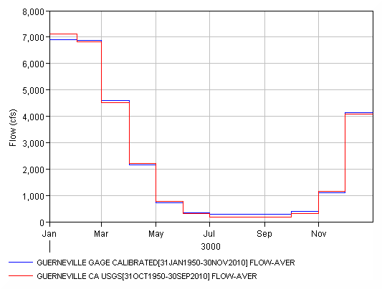
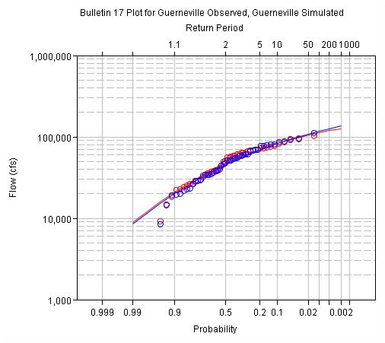
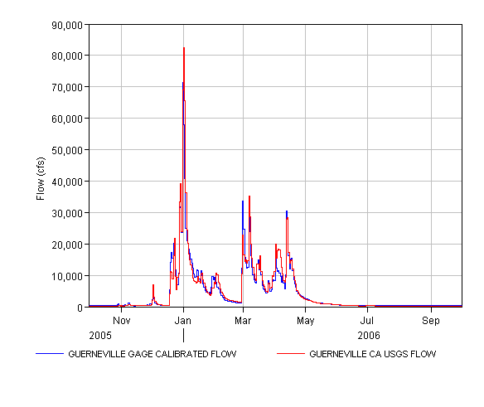
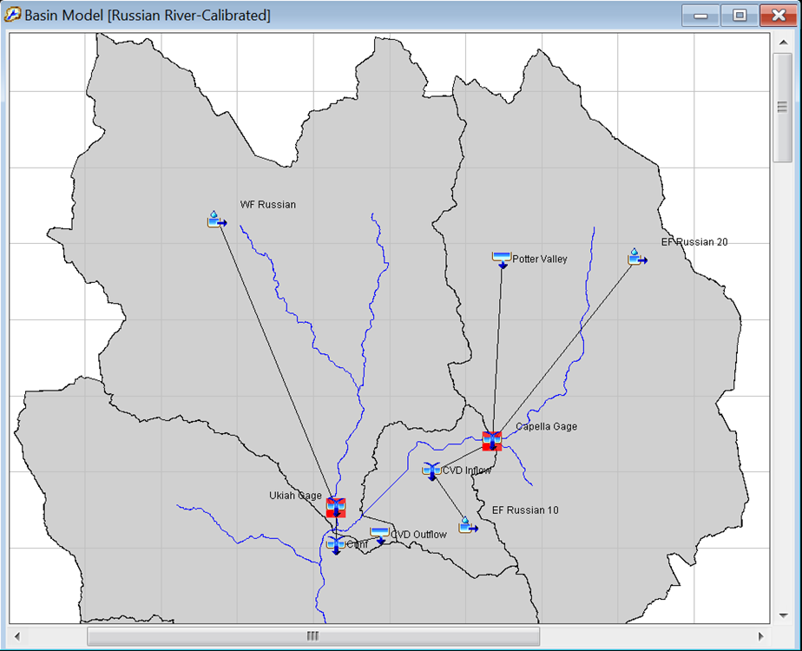
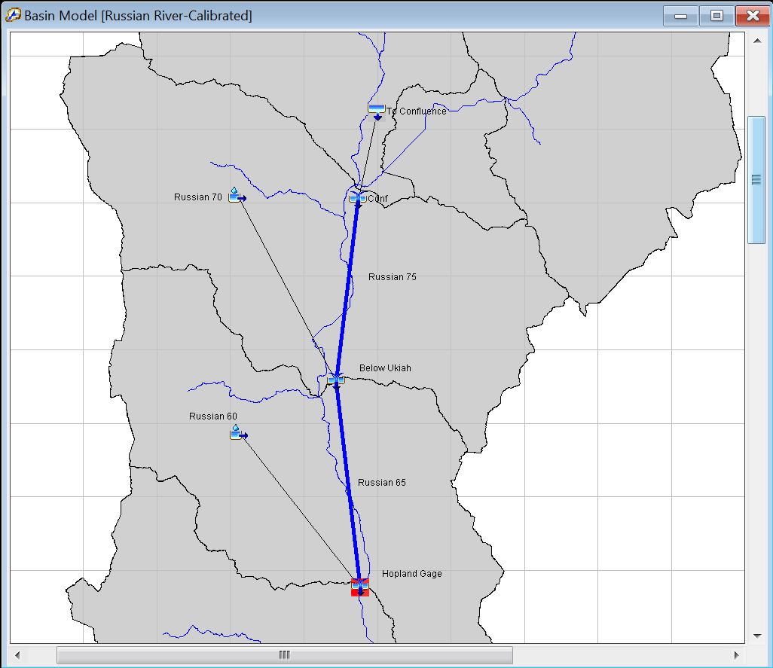
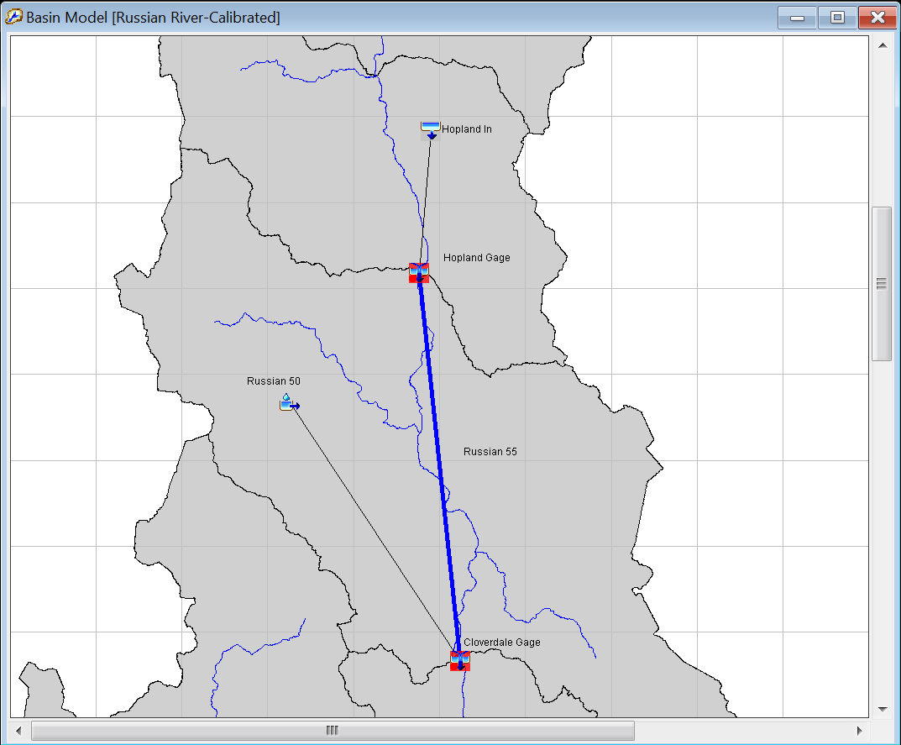
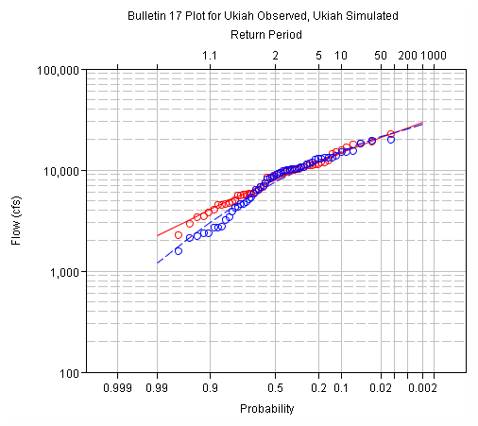
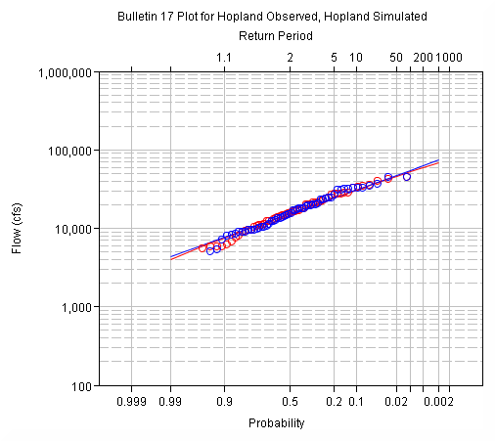
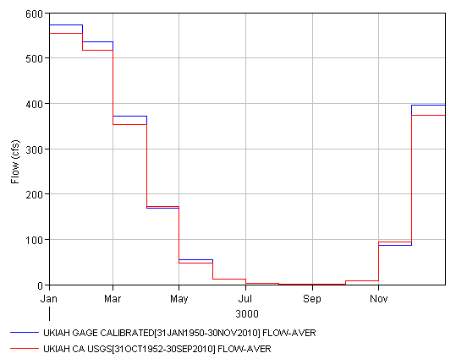
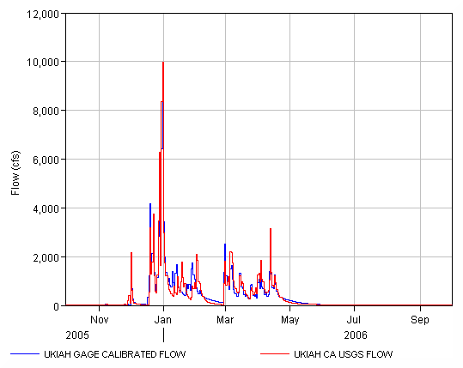
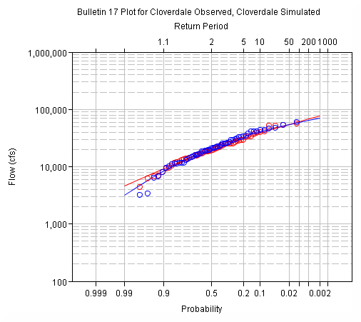
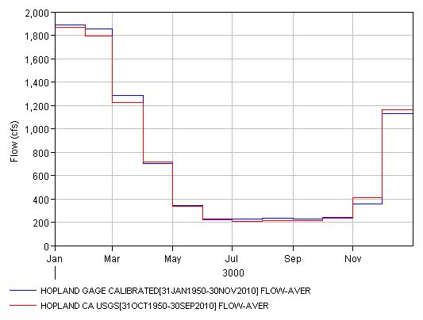
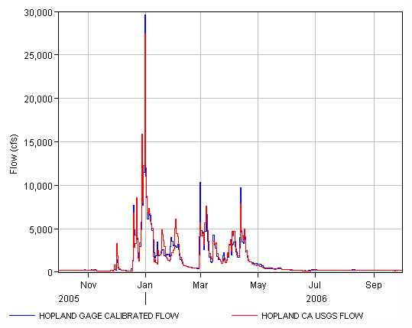
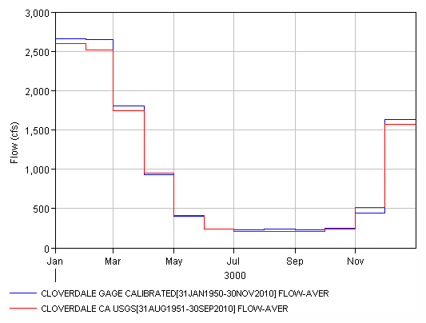
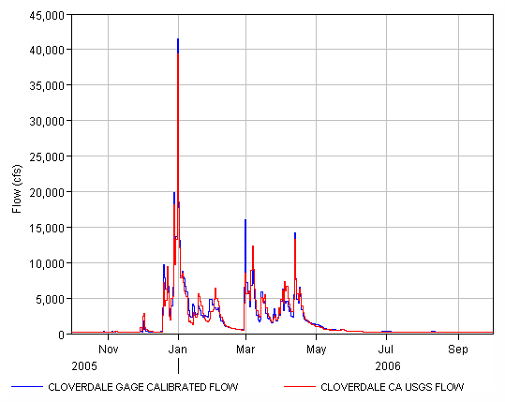
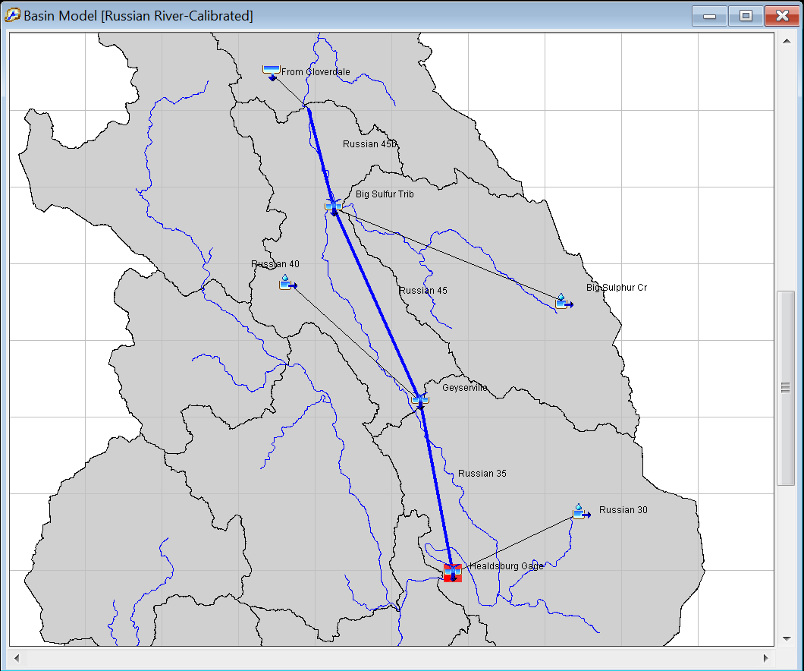
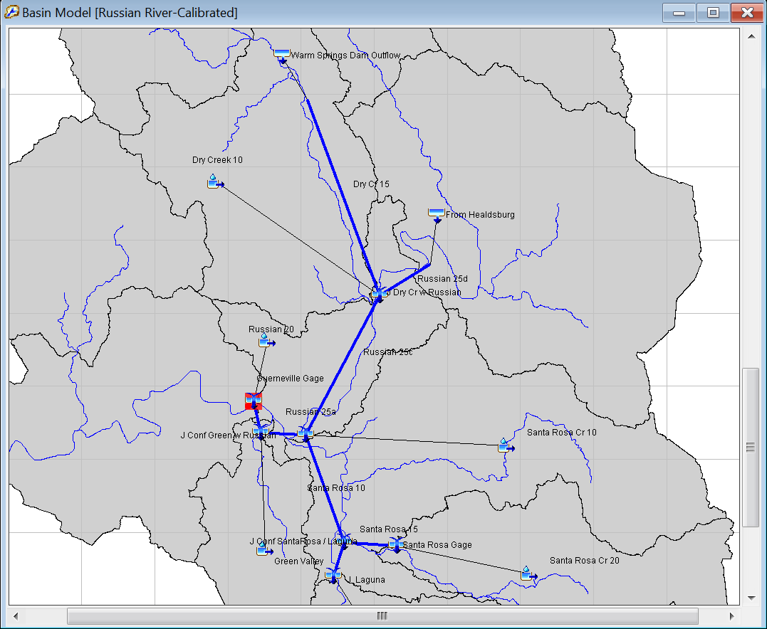
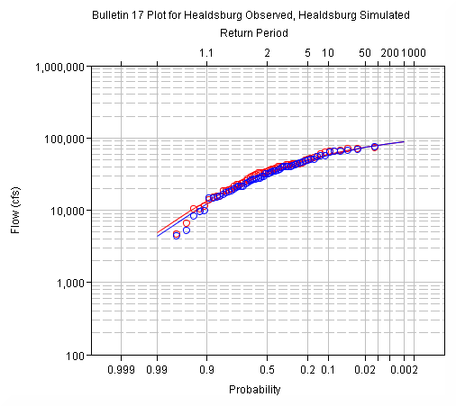


Calibration Sequence
Notes:
Calibration proceeded from upstream to downstream at calibration points
Model was broken down into smaller models to decrease compute time during calibration

Slide 22

Evaluating Model Output
In general, the modeler should try to reproduce observed peaks, timing, and volume
Statistics used for model evaluation:
  Coefficient of Determination (R²)
  Nash-Sutcliffe Efficiency (NSE)
  Root Mean Square Error (RSR)
  Percent Bias (PBIAS)
Notes:
In general, the modeler should try to reproduce observed peaks, timing, and volume. The objective of calibration is to minimize the difference between simulated values and observed (measured) values.
Statistical methods are used to quantify how simulated values compare to observed values.
While a graphical fit is often a first pass in calibration there is more than meets the eye. Calibration must be quantified using statistical analyses.

Slide 23
Model Performance
Performance Rating | NSE | RSR | R² | PBIAS
Very Good | 0.65<𝑁𝑆𝐸≤1.00 | 0.00<𝑅𝑆𝑅≤0.60 | 0.65<𝑅2≤1.00 | 𝑃𝐵𝐼𝐴𝑆< ±15
Good | 0.55<𝑁𝑆𝐸≤0.65 | 0.60<𝑅𝑆𝑅≤0.70 | 0.55<𝑅2≤0.65 | ±15≤𝑃𝐵𝐼𝐴𝑆<±20
Satisfactory | 0.40<𝑁𝑆𝐸≤0.55 | 0.70<𝑅𝑆𝑅≤0.80 | 0.40<𝑅2≤0.55 | ±20≤𝑃𝐵𝐼𝐴𝑆<±30
Unsatisfactory | 𝑁𝑆𝐸≤0.40 | 𝑅𝑆𝑅>0.80 | 𝑅2≤0.40 | 𝑃𝐵𝐼𝐴𝑆≥±30
Location | NSE | RSR | R² | PBIAS
Calpella | 0.854 | 0.382 | 0.892 | -1.242
Ukiah | 0.880 | 0.347 | 0.880 | -2.350
Hopland | 0.913 | 0.295 | 0.919 | -1.435
Cloverdale | 0.927 | 0.270 | 0.931 | -2.710
Healdsburg | 0.915 | 0.292 | 0.916 | -2.210
Guerneville | 0.938 | 0.250 | 0.939 | -3.233
Notes:
Moriasi et al (2007)n
The model performed “Very Good” for all summary statistics.

Slide 24

Application: Soil Moisture
Notes:
The goal of the HEC-HMS modeling effort was to provide the reoperation study team with a reliable hydrology model that accurately predicted soil moisture and runoff for the drainage above Coyote Valley Dam and runoff for the watershed downstream of the dam.

Slide 25

Application: Continuous Simulation
Notes:
PoR tested reservoir re-operation scenarios for with and without project conditions for the period of record.

Slide 26

Application: FRA Compute
Notes:
The continuous simulation informed Monte-Carlo analysis including seasonal sampling of soil moisture and creating precipitation shapesets for major precipitation events.
FRA compute extended the study to consider storms outside the events experienced in the period of record.

Slide 27

Application: Flow Frequency
Notes:
This slide shows extension of flood-frequency curve beyond observed data.

Slide 28

Questions
?
Notes:
Observed high water marks on the theater at Monte Rio.

