Slide 1
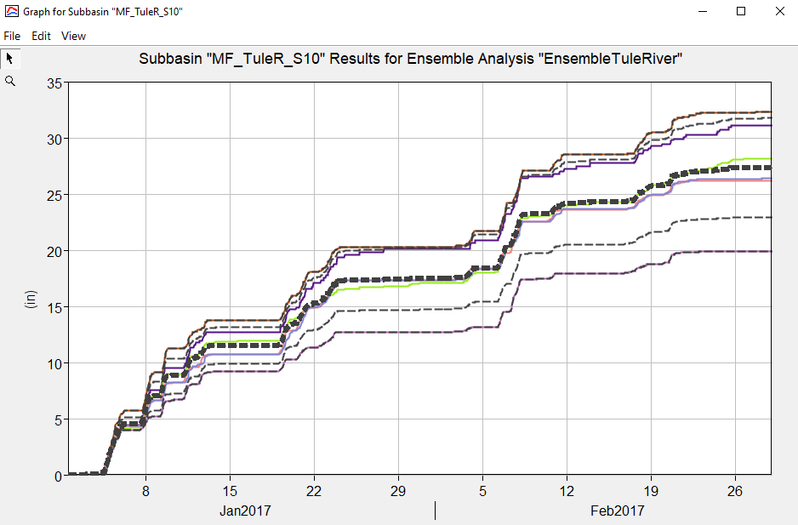
U.S. Army corps of engineers
Ensemble Analysis Simulation in HEC-HMS
June 2024
Lauren Coe, P.E.
Slides by Josh Willis, P.E.
Notes:
The ensemble analysis simulation is the newest compute type in HEC-HMS. It was implemented in HMSv4.11. This presentation will provide a general overview of the ensemble analysis and its application within HEC-HMS.

Slide 2
Objectives
What is an Ensemble Analysis?
  Definition
  Application within HEC-HMS
Performing an Ensemble Analysis
  Why perform an ensemble analysis?
  Selecting ensemble members
  Aggregating ensemble member results
Examples of Ensemble Analysis Configurations
Future Ensemble Enhancements in HEC-HMS
Ensemble Analysis Demos in HEC-HMS
  Creating an Ensemble Analysis Compute
  Applying the Ensemble Compute to Flood Forecasting
  Applying the Ensemble Compute to Downscaled Climate Model Datasets
Notes:
We’ll begin by talking about what an ensemble analysis (or model) is and how it can be applied in HEC-HMS
Then we’ll talk the advantages of performing an ensemble analysis and how to actually set one up
Next I’ll provide a few different examples of applying the ensemble analysis in HEC-HMS in different ways to achieve different goals
Lastly, I’ll talk about some future enhancements that are planned for the ensemble analysis, and then we will jump into some live demos

Slide 3
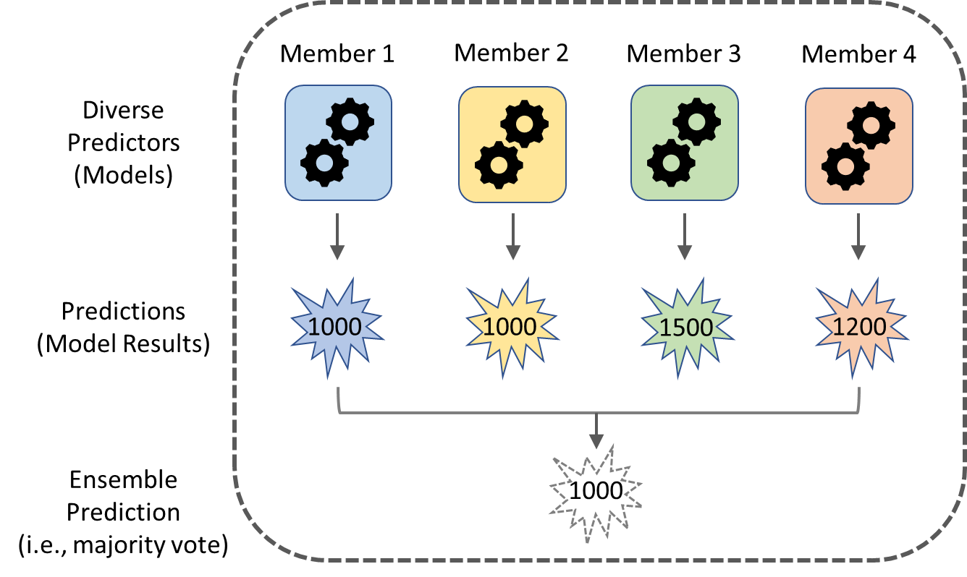
What is an Ensemble Analysis?
An ensemble model is a collection of multiple, diverse models that are created to predict an outcome
An ensemble model is a way to pool predictions from several base models
  These other base models are often called “ensemble members”
Notes:
When I think of the word “ensemble”, I think of a collection of members or parts, each of which are unique but also related
An ensemble model is a collection of multiple, diverse models that are created to predict an outcome
Ensemble learning methods are often used in the fields of machine learning and statistics
In the illustration on this slide, the ensemble model is made up of everything within the dotted rectangle
This ensemble is made up of 4 members (or base models)
Although different, each base model is designed to accurately predict the same end goal
In this example, ensemble member 1 and member 2 each predicted an outcome of 1000, member 3 1500, and member 4 1200
There are different ways to aggregate each of the member predictions (results) into an ensemble prediction (result)
In this example, majority vote was used, and the ensemble result is 1000 since it was most frequently predicted by the member models

Slide 4
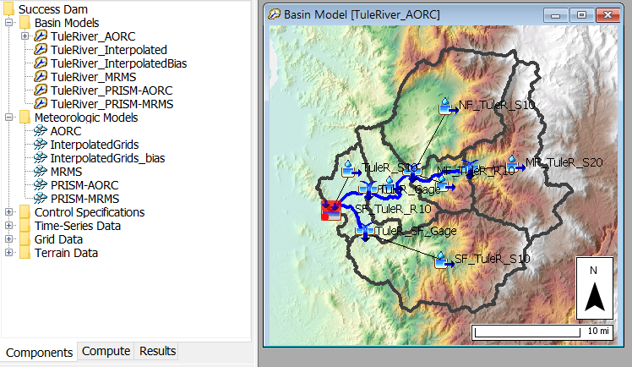
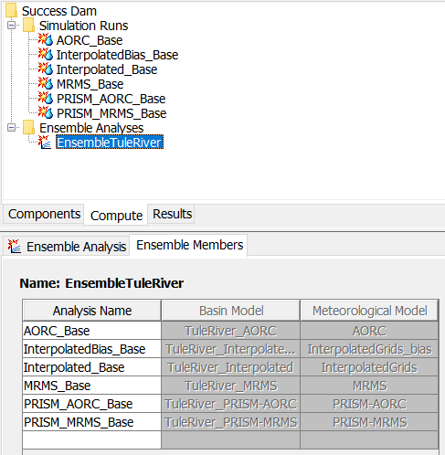
Application within HEC-HMS
The ensemble analysis compute within HEC-HMS is a useful tool for combining multiple simulation runs / forecast alternatives
This new compute type can be applied to analyze different configurations of…
  Boundary conditions
    Forecast models
    Climate model projections
  Basin models
    Antecedent conditions
    Parameterizations
    Structures
    Modeling methods
Notes:
Let’s talk about ensemble analyses specifically as the apply to HEC-HMS
This is, again, the newest compute type in the HEC-HMS software, and it is extremely useful for combining multiple runs
There are two types of runs that can currently be added to an ensemble analysis: traditional simulation runs and forecast alternatives
The ensemble analysis can be used to analyze different configurations of two central components: boundary conditions and basin models
For boundary conditions, an example of an ensemble analysis application might be to analyze the effect that different precipitation or temperature data sources can have on the computed rainfall runoff for a subbasin
It could also be used to analyze the uncertainty in different weather forecasts and in different climate model projections
In HMS, basin models represent the physical processes of the watershed
To measure uncertainty in antecedent conditions, different basin models could be set up with differing amounts of initial baseflow, initial losses, and even different starting reservoir elevations
To measure the impacts of structures, an “as-is” basin model configuration could be set up and then other basin model configurations could be added to represent the addition or removal of structures such as reservoirs or diversions
HEC-HMS is a unique and powerful hydrologic modeling software in that it allows the users to choose the individual methods that they would like to use for key operations such as transform, baseflow, losses, etc.
A particularly insightful application of the ensemble analysis that I am excited about is using ensembles to analyze the uncertainty introduced from choosing different modeling methods
i.e. set up one basin model with muskingum routing reaches, another with muskingum-cunge, and a third with mod-puls and then analyze their impacts on the timing and peak of outflow hydrographs

Slide 5
Objectives
What is an Ensemble Analysis?
  Definition
  Application within HEC-HMS
Performing an Ensemble Analysis
  Why perform an ensemble analysis?
  Selecting ensemble members
  Aggregating ensemble member results
Examples of Ensemble Analysis Configurations
Future Ensemble Enhancements in HEC-HMS
Ensemble Analysis Demos in HEC-HMS
  Creating an Ensemble Analysis Compute
  Applying the Ensemble Compute to Flood Forecasting
  Applying the Ensemble Compute to Downscaled Climate Model Datasets
Notes:
We have given a few definitions of what ensemble models or analyses are and some very general applications of what they can be used for in HEC-HMS
Are there any questions at this point on what we have covered thus far?
Now let’s talk about performing an ensemble analysis, both the “why” and the “how”

Slide 6
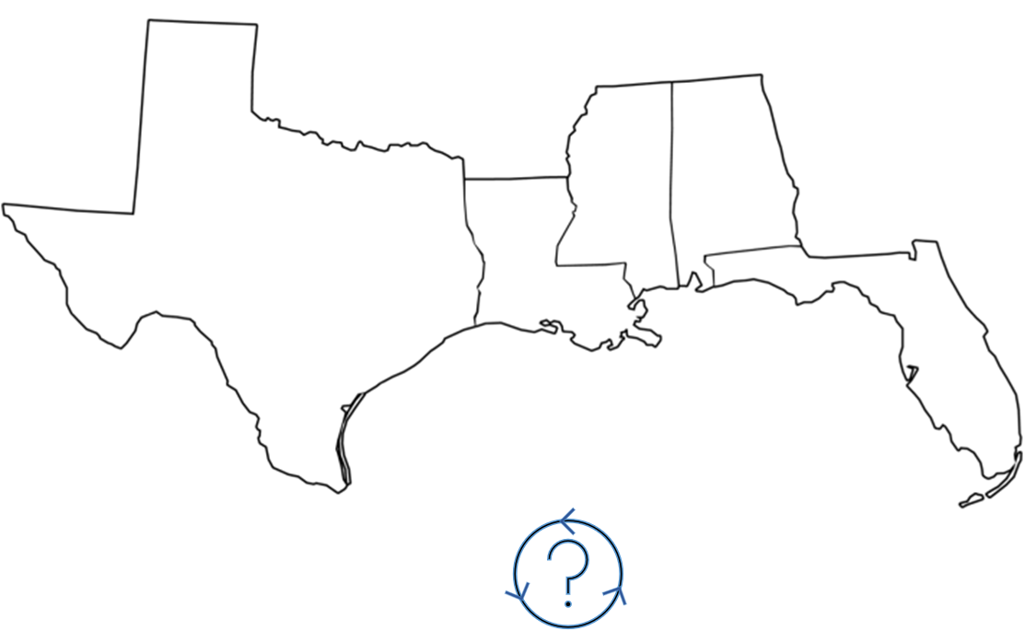
Why Perform An Ensemble Analysis?
One of the key aims of the ensemble analysis approach is to reduce uncertainty in the modelled predictions
Combining the predictions of multiple, independent models can produce a more accurate prediction overall
Notes:
So why is it important to perform an ensemble analysis? The main reason is that it can help to reduce the uncertainty in the modelled predictions.
There are many different research papers and studies that seem to show that an ensemble model (made up of multiple member models) usually outperforms a single model
Combining the predictions of multiple, independent models (and we’ll talk about what independent means specifically a few slides from now) can produce a more accurate prediction overall
Let’s talk about the image on this slide…
Let’s pretend for a second that we live near Mobile, Alabama and that we have a hurricane forming in the Gulf of Mexico
Based on the current projected paths for the hurricane, how confident can we be that we can avoid evacuating further inland?
If we look at a single model result, it appears that the hurricane is predicted to cross through Mobile (click once)
But we know that there are many different factors that determine the paths that hurricanes ultimately take, so how sure can we be?
Let’s look at additional models to see if they can shed some additional light or consensus (click a second time and a third time)
It now appears that most of the models agree that the hurricane will make landfall further west near the Texas border
Although we can’t be sure that the hurricane will not cross through Mobile, looking at different models (each with their own set of assumptions) certainly helped to reduce the uncertainty on where the hurricane will likely land

Slide 7




Ensemble Analysis Tradeoffs
Creating and running multiple models to improve prediction accuracy is good in theory, but at what cost?
  Time and money are often ALWAYS constraints
Occam’s razor (law of parsimony) typically governs our choices as H&H modelers
  The modeling methods that are the simplest with the fewest parameters (while still producing generally acceptable results) are often favored
B
B
A
A
“When faced with two equally good models, choose the simpler one.”
Notes:
We have briefly discussed some of the advantages of ensemble modeling, now let’s look at some of the tradeoffs
Time and Money do need to be considered when weighing the benefits of an ensemble analysis
Unfortunately, most USACE studies/forecasts need to be performed quickly and typically have very little flexibility in analyzing the uncertainty of using different boundary condition data and/or different basin model configurations or parameterizations
For this reason, the principle of Occam’s razor (also sometimes referred to as the law of parsimony) typically governs our choices as H&H modelers
The modeling methods that are simple, with parameters that are few in number and simple to calibrate, that still produce generally acceptable results are the ones that are often chosen
“When faced with two equally good models, choose the simpler one.”
My argument to this quote would be ‘do we for sure know that one model, or assumption, is equally as good as another without some initial investigation first’?
While creating the multiple boundary conditions and/or basin model configurations needed to perform an ensemble analysis in HEC-HMS does take time, I think there are cases where it is absolutely warranted and where you as a modeler can gain a significant amount of additional insight and confidence for only a nominal amount of extra burden

Slide 8
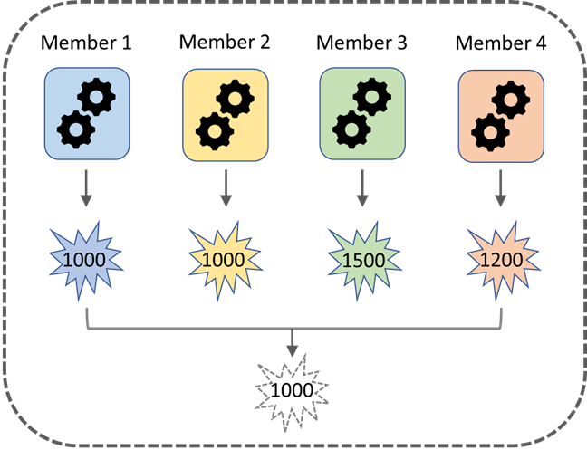
Selecting Ensemble Members
How do I select Ensemble Model Members?
  Each member should be performant
    It should be designed and equipped to accurately model the intended outcome/goal of the ensemble analysis
    I.e., if the study goal is to model the 100-year event, do not include models that were only designed/calibrated to predict relatively common, low-flow events
  Each member should be independent
    It is desirable to use a suite of models that are constructed in different ways and that make different assumptions
    Independent models lead to less correlated prediction errors
    I.e., for hydrologic modeling…
      an ensemble model might include member models that each use different boundary condition datasets
      an ensemble model might include member models that each have different HEC-HMS basin model configurations and parameter sets, including initial conditions
Notes:
When performing an ensemble analysis, there are two main steps to perform
1) the selection of ensemble members
2) the aggregation of individual ensemble member results
Let’s talk about things to consider when selecting which ensemble members to include in an ensemble analysis

Slide 9
AGGREGATION TIME-SERIES in HEC-HMS
Incremental Precipitation
Cumulative Precipitation
Outflow
Cumulative Outflow
Reservoir Elevation
Moisture Deficit
SWE (snow-water equivalent)
LWASS (liquid-water at soil surface)
Air Temperature
Sediment Load (total amounts and individual amounts for clay, silt, sand, gravel, cobble and boulder)
Sediment Volume (total amounts and individual amounts for clay, silt, sand, gravel, cobble and boulder).
Notes:
This figure shows a plot generated in HEC-HMS after computing an ensemble analysis
In this example, each ensemble member used a different boundary condition data source (precipitation) to model the same event period
The colored lines represent SWE computations for each ensemble member (there were 6 in this example)
The black, dotted lines represent different aggregations of the ensemble member results
The highlighted black line (in bold) represents the mean SWE result of all the ensemble member runs
The other dotted black lines represent other types of aggregations (minimum, maximum, and + and – one standard deviation

Slide 10
Aggregating Ensemble Member Results
How do I aggregate each member’s results into a single ensemble result?
  There are a few main categories for aggregating predictions
    Averaging: take each member prediction and calculate the overall average
    Weighted Average: assign weights to favor the strongest ensemble members and to disfavor the weakest
    Bias correction models
      Adjust mean/variance to correct bias with observed data
      Quantile mapping
      Binomial coefficient ensemble method - method for assigning weights to ensemble members (based on performance)
      Multi-variable linear regression during the calibration period
      Multivariable probability functions - copula functions.
      Normal quantile transform (NQT)
      General Linear Model Post-Processor (GLMPP)
      Granger-Ramanathan average variant C (GRC)
      Bayesian model
      BP neural network
Notes:
Now let’s talk about the second main consideration in performing an ensemble analysis…how to aggregate each individual member result into a single ensemble model result

Slide 11
Aggregating Ensemble Member Results
Current Prediction Aggregation Options in HEC-HMS
  Mean, + and – 1 Standard Deviation, Maximum, and Minimum
Future Prediction Aggregation Options in HEC-HMS
  Weighting Schemes
    User assigned weights
    Computed weights
  Bias Correction Options
    Adjusted mean/variance to correct bias with observed data
      Assume a normal distribution for each set of data
      Link observed and simulated data by percentile
    Quantile mapping
      Assume an empirical CDF for each set of data
      Link observed and simulated data by percentile
      paired data of cdfs is generated
    Linear model
      Assume pairwise relationship between simulated and observed is related linearly
Notes:
Again, the current aggregation capabilities in HEC-HMS include mean, plus and minus one standard deviations, maximum, and the minimum
There are plans to add more aggregation options though in the very near future
There are many advanced statistical techniques that can be used for bias correction with observed data, each having the same end goal of leveraging the ensemble members that perform best historically.
Weighted average techniques can also be applied by assigning weights to favor the strongest ensemble members and to disfavor the weakest.

Slide 12
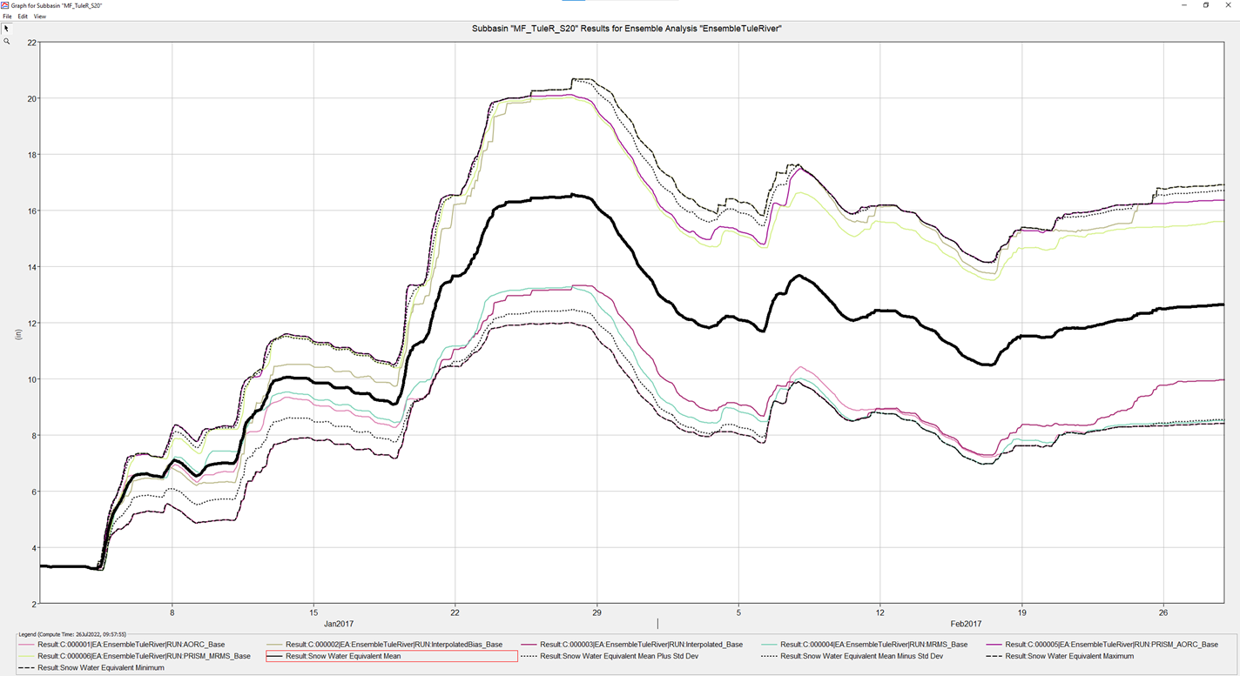
Aggregating Ensemble Member Results
Current Prediction Aggregation Options in HEC-HMS
  Mean, + and – 1 Standard Deviation, Maximum, and Minimum
Notes:
This figure shows a plot generated in HEC-HMS after computing an ensemble analysis
In this example, each ensemble member used a different boundary condition data source (precipitation) to model the same event period
The colored lines represent SWE computations for each ensemble member (there were 6 in this example)
The black, dotted lines represent different aggregations of the ensemble member results
The highlighted black line (in bold) represents the mean SWE result of all the ensemble member runs
The other dotted black lines represent other types of aggregations (minimum, maximum, and + and – one standard deviation

Slide 13
Objectives
What is an Ensemble Analysis?
  Definition
  Application within HEC-HMS
Performing an Ensemble Analysis
  Why perform an ensemble analysis?
  Selecting ensemble members
  Aggregating ensemble member results
Examples of Ensemble Analysis Configurations
Future Ensemble Enhancements in HEC-HMS
Ensemble Analysis Demos in HEC-HMS
  Creating an Ensemble Analysis Compute
  Applying the Ensemble Compute to Flood Forecasting
  Applying the Ensemble Compute to Downscaled Climate Model Datasets
Notes:
We have now talked about what ensemble analyses are, why they are beneficial, and how to perform them
Are there any questions at this point on what we have covered thus far?
Now let’s give some general examples on how ensembles can be set up in HEC-HMS and how the ensemble member results can be aggregated to achieve different objectives
Then we’ll dive into the software and do some live HMS demos

Slide 14
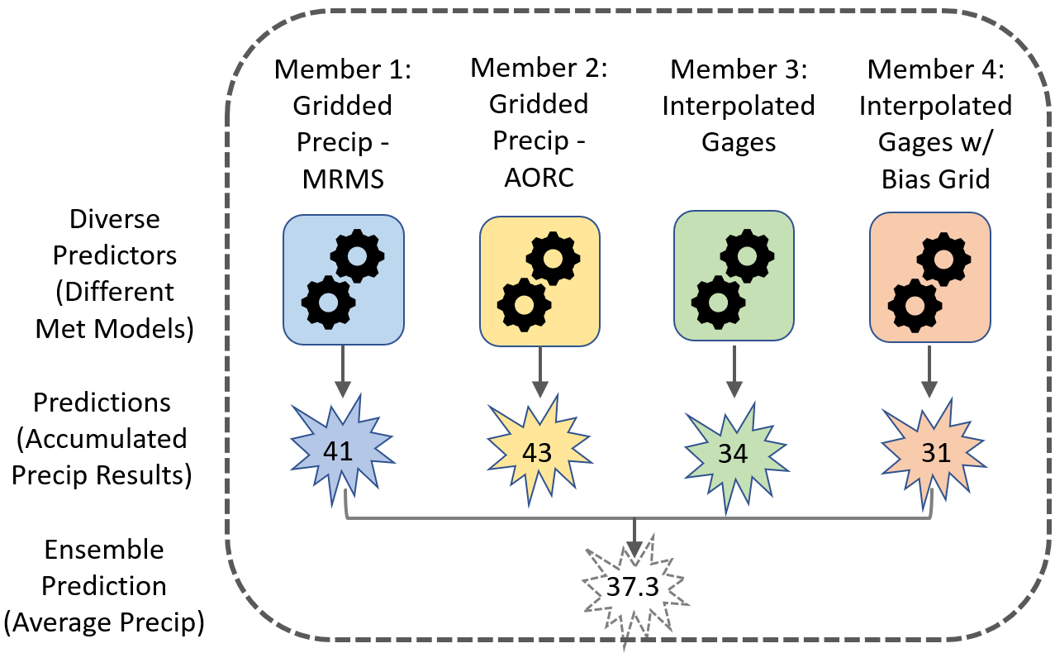
HEC-HMS Ensemble Analysis Example 1
Modeling Objective: capture uncertainty in historic rainfall data sources
Ensemble Configuration: setup simulation runs that use different meteorologic models

Slide 15
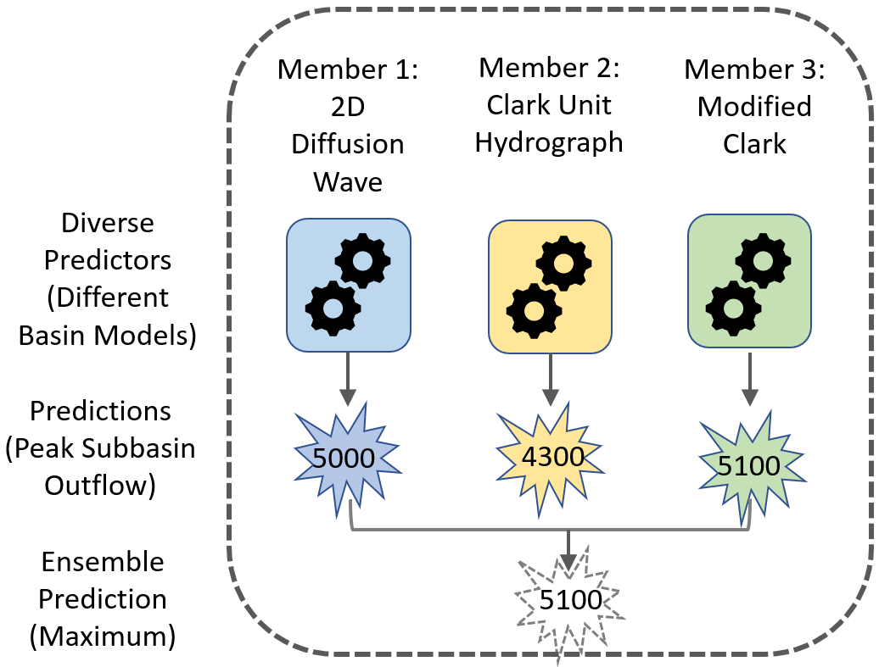
HEC-HMS Ensemble Analysis Example 2
Modeling Objective: capture model uncertainty in different transform methods with respect to subbasin outflow
Ensemble Configuration: setup simulation runs that use different basin models (with different transform methods)

Slide 16
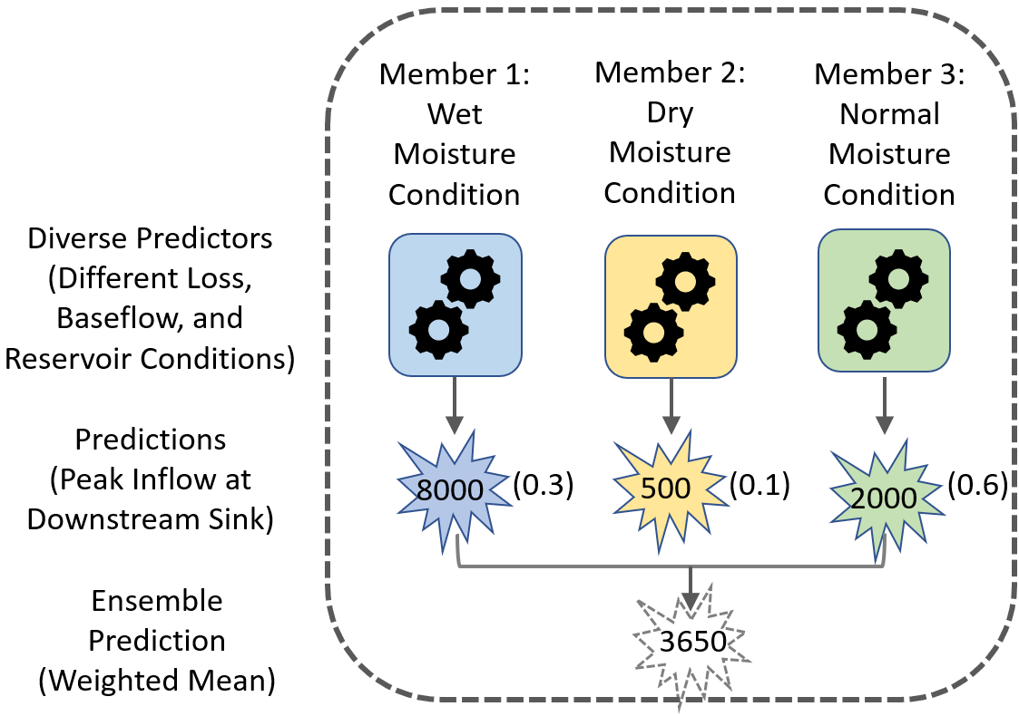
HEC-HMS Ensemble Analysis Example 3
Modeling Objective: capture model uncertainty in different initial antecedent moisture conditions
Ensemble Configuration: setup simulation runs that use basin models with different baseflow and loss parameters and different starting reservoir elevations
Notes:
This could help to capture the range of outcomes with different calibration events.

Slide 17
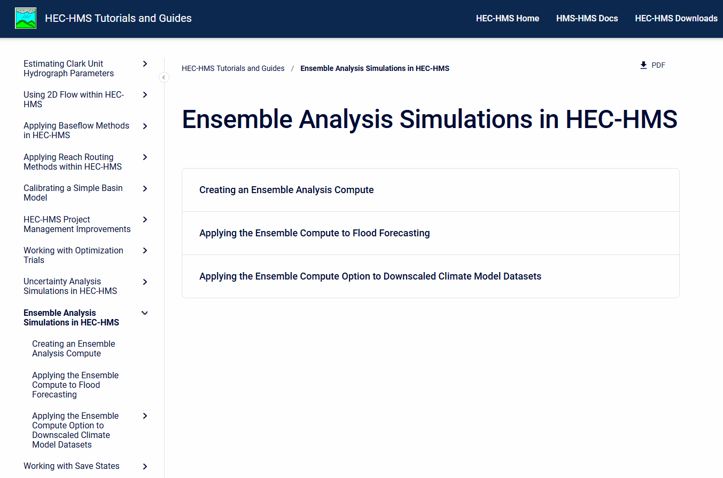
Ensemble Analysis Demos
Ensemble Viewer Users Guide - HEC-WAT Plugin Documentation - HEC Confluence (army.mil)
Notes:
Here is the tutorial and guide page on our website
There are several guides specifically geared towards ensemble analyses
I will now be doing a live demo and will walk you through the “Applying the Ensemble Compute to Flood Forecasting” tutorial and guide
You may watch me perform the demo, or you may download the tutorial and follow along with me on your own computer if you prefer

