Slide 1
Model Calibration and Validation
2024 Advanced HEC-HMS Class
Hydrologic Engineering Center
Presented by: David Ho
Original Slides: Matt Fleming

Slide 2
Objectives
Discuss modeling theory
Discuss Model Classification
Overview of calibration in the modelling process
Discuss event vs continuous simulation
Quantify model accuracy through performance metrics
  Recommendations for reporting calibration results
Discuss model validation

Slide 3

Why do we model?

Slide 4
Why do we model?
Modeling allows us to estimate the behavior of a system that is not otherwise captured in time or in space
Examples:
  What will flow in a river be 3 days from now?
  How will runoff response change if we build a project?
  How much water will be in a reservoir 3 months from now?
  How would damages change under different operations?

Slide 5
What are we modeling?

Slide 6

Watershed Processes

Slide 7
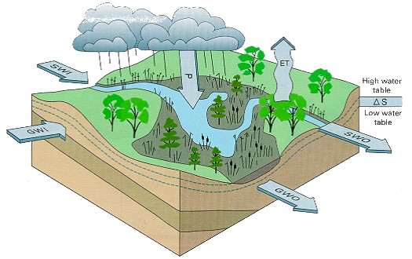
Watershed Processes

Slide 8
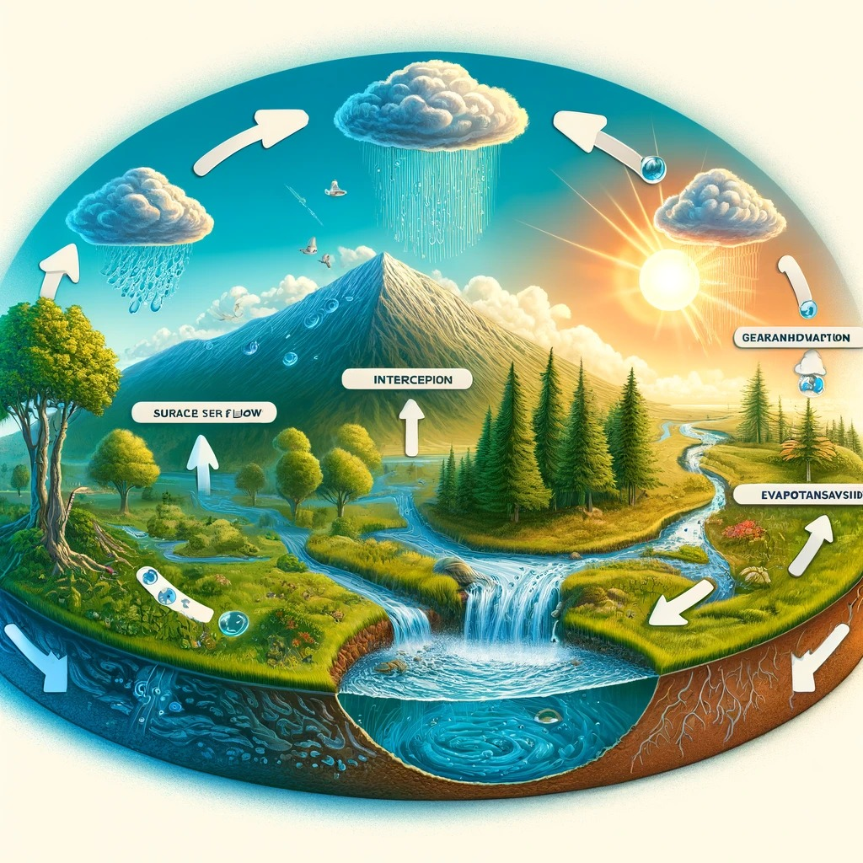
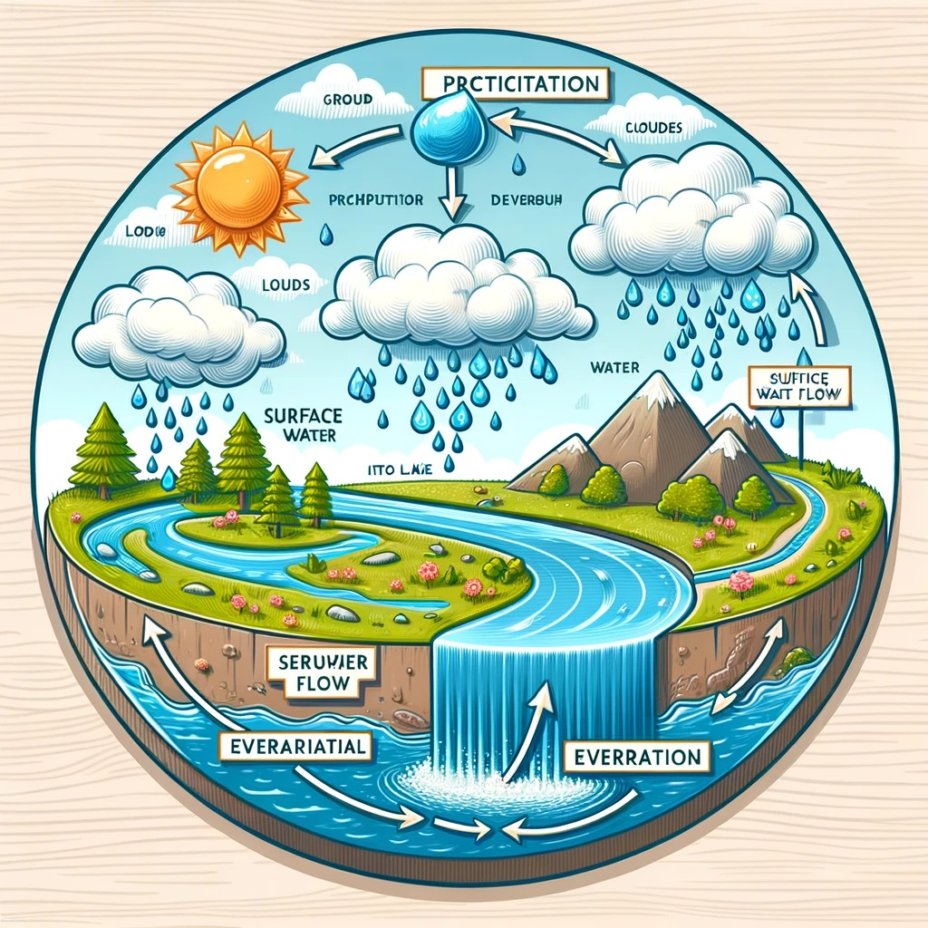
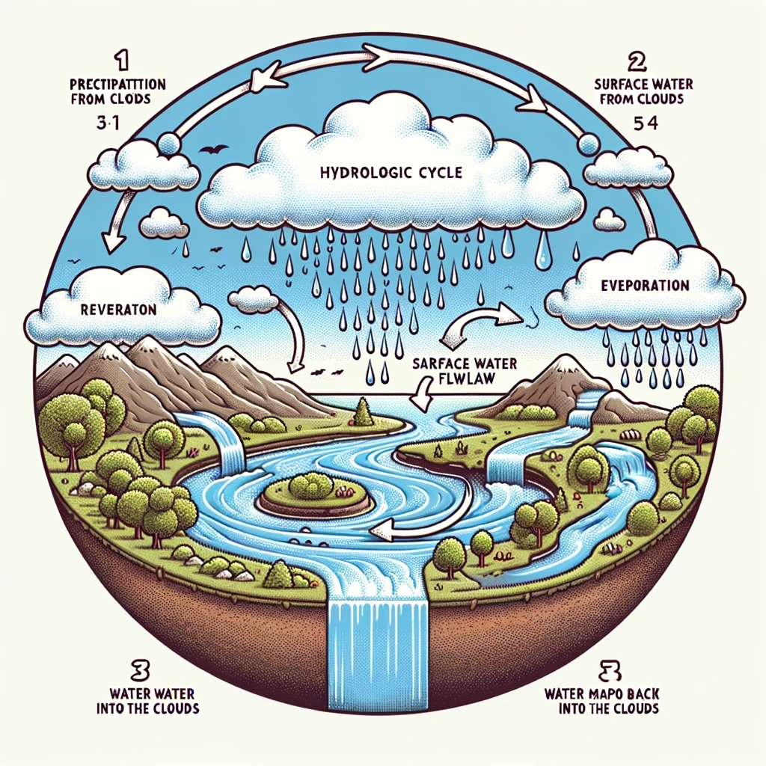
OpenAI DALL-E version!

Slide 9
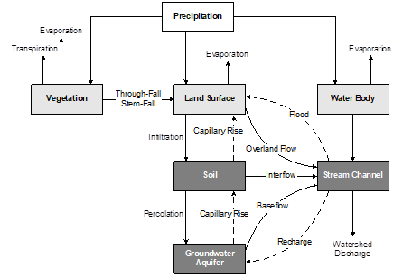
Watershed Processes
Notes:
Here is an even simpler representation of the watershed processes where we break down the cycle into individual processes. We are tracking the water volume once precipitation falls either on vegetation, land surface, or a water body. From each location, we continue to track where the water volume moves. We are looking to account for where all of this water is going.

Slide 10
What is a mathematical model?

Slide 11
What is a mathematical model?
…a quantitative expression of a process or phenomenon one is observing, analyzing, or predicting (Overton and Meadows, 1976)
…simplified systems that are used to represent real-life systems and may be substitutes of the real systems for certain purposes. The models express formalized concepts of the real systems. (Diskin, 1970)
…a symbolic, usually mathematical representation of an idealized situation that has the important structural properties of the real system. A theoretical model includes a set of general laws or theoretical principles and a set of statements of empirical circumstances. An empirical model omits the general laws and is in reality a representation of the data. (Woolhiser and Brakensiek, 1982)
…idealized representations…They consist of mathematical relationships that state a theory or hypothesis. (Meta Systems, 1971)

Slide 12
Model Classification
Mathematical models can be classified using several different criteria
Classifications focus on the mechanics of the model: how it deals with time, how it addresses randomness, etc.
Helpful in deciding which of the models to use for various applications
Question: Is HEC-HMS a model or a program?

Slide 13
Model Classification
Event or Continuous
Spatially Averaged (lumped) or Distributed
Empirical or Conceptual
Deterministic or Stochastic
Measured Parameter or Fitted Parameter

Slide 14
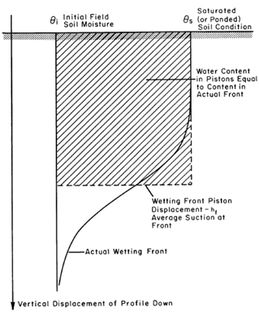
Classification: Event or Continuous
An event model simulates a single storm
  Does not include redistribution of the wetting front between storms and therefore does not account for drying of the soil through evaporation and transpiration (i.e. Green & Ampt)
  Some baseflow models are classified as event because they compute receding flow based on the peak flow rate computed during a storm event (i.e. Recession)
Notes:
This distinction applies primarily to models of infiltration, surface runoff, and baseflow. An event model simulates a single storm. The duration of the storm may range from a few hours to a few days. The key identifying feature is that the model is only capable of representing watershed response during and immediately after a storm. Event infiltration models do not include redistribution of the wetting front between storms and do not account for drying of the soil through evaporation and transpiration. Often but not always, event infiltration models use a function of cumulative loss to compute infiltration capacity. Some baseflow models are classified as event because they compute receding flow based on the peak flow rate computed during a storm event. These same methods must include a capability to reset between storms to begin the next recession; nevertheless they remain event models.

Slide 15
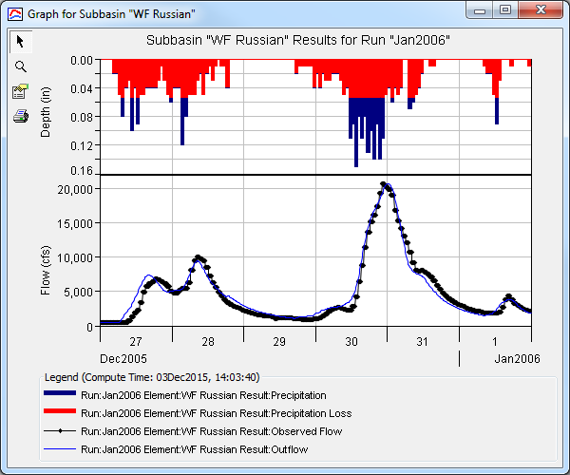
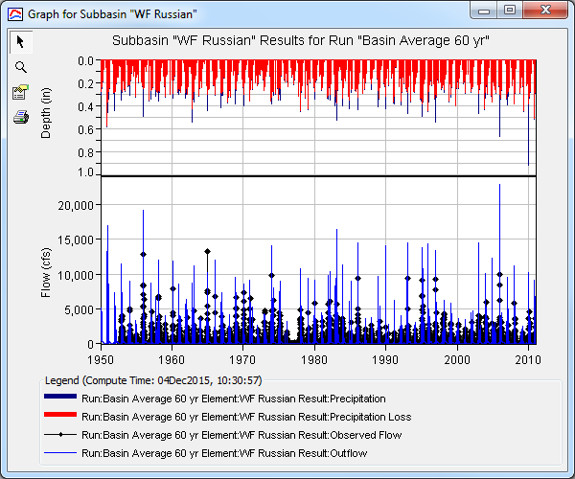
Event or Continuous
A continuous model simulates multiple events
  Infiltration models must consider the drying processes that occur in the soil between precipitation events
  Baseflow methods are increasingly important because the vast majority of the hydrograph is defined by inter-storm flow characteristics
Question: Does HEC-HMS contain event or continuous models?
Question: What are the requirements for continuous simulation modeling in HEC-HMS?

Slide 16
Classification: Spatially-Averaged or Distributed
Distributed model:
  Spatial (geographic) variations of characteristics and processes are considered explicitly
  Often distributed models represent the watershed as a set of grid cells
Spatially-averaged model (lumped):
  Spatial variations are averaged or ignored
Question: Is a multi-subbasin model spatially-averaged or distributed?
Question: Is a gridded model spatially-averaged or distributed?
Notes:
This distinction applies mostly to models of infiltration and surface runoff. A distributed model is one in which the spatial (geographic) variations of characteristics and processes are considered explicitly, while in a spatially-averaged model, these spatial variations are averaged or ignored. While not always true, it is often the case that distributed models represent the watershed as a set of grid cells. Calculations are carried out separately for each grid cell. Depending on the complexity of the model, a grid cell may interact with its neighbor cells by exchanging water either above or below the ground surface.
It is important that note that even distributed models perform spatial averaging. As we will see later in detail, most of the models included in HEC-HMS are based on differential equations. These equations are written at the so-called point scale. By point scale we mean that the equation applies over a length ∆x that is very small (differential) compared to the size of the watershed. In a spatially-averaged model, the equation is assumed to apply at the scale of a subbasin. Conversely, in a distributed model the equation is typically assumed to apply at the scale of a grid cell. Therefore it is accurate to say that distributed models also perform spatial averaging but generally do so over a much smaller scale than typical spatially-averaged models. HEC-HMS includes primarily spatially-averaged models.

Slide 17
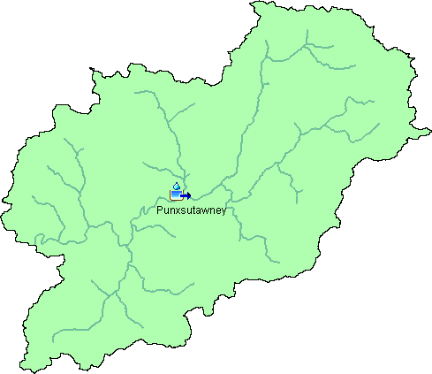
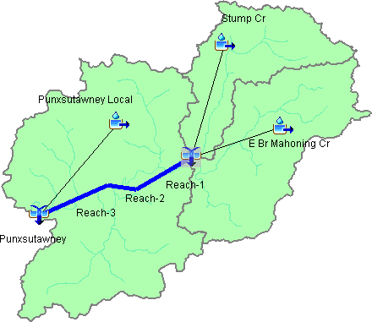

Spatially-Averaged or Distributed
Notes:
Illustration. In our class, you will work with both lumped and distributed modeling

Slide 18
Classification: Empirical or Conceptual
Conceptual model
  Built on knowledge of the physical processes that act on the input to produce the output
  A control volume is established and equations for the conservation of mass and either momentum or energy are written for the control volume
Notes:
Conceptual models are built on the knowledge of the physical process. The way a conceptual model is typically created is using a control volume approach and using the conservation of mass or momentum to determine what is coming out of the control volume.

Slide 19
Empirical or Conceptual
Empirical model
  Built upon observation of input and output, without necessarily seeking out the physical process
  Sometimes called "black box" models because they convert input to output without any details of the actual physical process involved
  Data is analyzed statistically and a mathematical relationship is sought between input and output
  Can be very effective so long as they are applied under the same conditions for which they were originally developed
  Example in HMS
    Curve Number loss method
Notes:
An empirical model is built upon observation of input and output, without seeking to represent explicitly the process of conversion. These types of models are sometimes called "black box" models because they convert input to output without any details of the actual physical process involved. A common way to develop empirical models is to collect field data with observations of input and resulting output. The data is analyzed statistically and a mathematical relationship is sought between input and output. Once the relationship is established, output can be predicted for an observed input. For example, observations of inflow to a river reach and resulting flow at a downstream location could be used to develop a relationship for travel time and attenuation of a flood peak through the reach. These empirical models can be very effective so long as they are applied under the same conditions for which they were originally developed. HEC-HMS includes both empirical and conceptual models.

Slide 20
Classification: Deterministic or Stochastic
Deterministic
  Assumes that the input is exactly known
  Assumes that the process described by the model is free from random variation
Stochastic
  Attempts to explicitly describe random variation
  Includes the statistics of variation in both the input and processes
Notes:
A deterministic model assumes that the input is exactly known. Further, it assumes that the process described by the model is free from random variation. In reality there is always some variation. For example, you could collect a large sample of soil in the field and take it into a laboratory. Next you could divide the large sample into 10 equal small samples and estimate the porosity of each one. You would find a slightly different value for the porosity of each small sample even though the large sample was collected from a single hole dug in the field. This is one example of natural variation in model input. Process variation is somewhat different. Suppose a flood with a specific peak flow enters a section of river. The flood will move down through the reach and the resulting outflow hydrograph will show evidence of translation and attenuation. However, the bed of the river is constantly moving in response to both floods and inter-flood channel flows. The movement of the bed means that the exact same flood with the same specific peak flow could happen again, but the outflow hydrograph would be slightly different. While you might try to describe the reach carefully enough to eliminate the natural variation in the process, it is not practically possible to do so.
Deterministic models essentially ignore variation in input by assuming fixed input. The input may be changed for different scenarios or historical periods, but the input still takes on a single value. Such an assumption may seem too significant for the resulting model to produce meaningful results. However, deterministic models nevertheless are valuable tools because of the difficulty of characterizing watersheds and the hydrologic environment in the first place. Stochastic models, on the other hand, embrace random variation by attempting to explicitly describe it. For example, many floods in a particular river reach may be examined to determine the bed slope during each flood. Given enough floods to examine, you could estimate the mean bed slope, its standard deviation, and perhaps infer a complete probability distribution. Instead of using a single input like deterministic models, stochastic models include the statistics of variation both of the input and process.

Slide 21
Classification: Measured-Parameter or Fitted-Parameter
Measured-parameter
  Model parameters can be determined from system properties, either by direct measurement or by indirect methods that are based upon the measurements
  Example: Green & Ampt loss parameters
Fitted-parameter
  Parameters cannot be measured
  Parameters must be found by fitting the model with observed values of the input and the output
  Example: Muskingum “X” parameter
Notes:
This distinction between measured and fitted parameters is critical in selecting models for application when observations of input and output are unavailable. A measured-parameter model is one in which model parameters can be determined from system properties, either by direct measurement or by indirect methods that are based upon the measurements. The Green and Ampt infiltration model is an example of a measured parameter model. It includes hydraulic conductivity and wetting front suction as parameters. Both parameters can be measured directly using appropriate instruments imbedded in the soil during a wetting-drying cycle. Many other parameters used in infiltration models can be reliably estimated if the soil texture is known; texture can be determined by direct visual examination of the soil.
A fitted-parameter model, on the other hand, includes parameters that cannot be measured. Instead, the parameters must be found by fitting the model with observed values of the input and the output. The Muskingum routing model is an example of a fitted parameter model. The K parameter can be directly estimated as the travel time of the reach. However, the X parameter is a qualitative estimate of the amount of attenuation in the reach. Low values of X indicate significant attenuation while high values indicate pure translation. The only way to estimate the value of X for a particular reach is to examine the upstream hydrograph and the resulting outflow hydrograph. HEC-HMS includes both measured-parameter models and fitted-parameter models.

Slide 22
Calibration - Defined
“Calibration is the estimation and adjustment of model parameters and constants to improve the agreement between model output and a data set.” -Rykiel (1996)
Notes:
A definition of calibration from Rykiel (1996).
If we use the example of flow, you are trying to match your simulated flow to your observed flow by adjusting your model parameters.

Slide 23
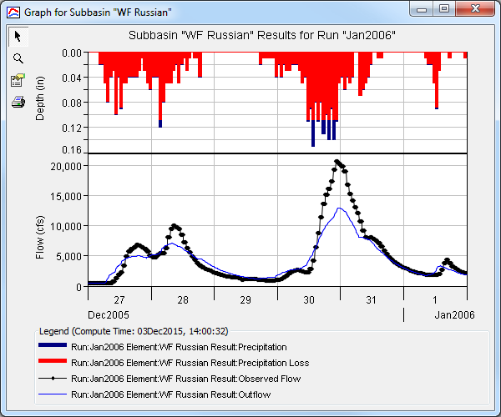
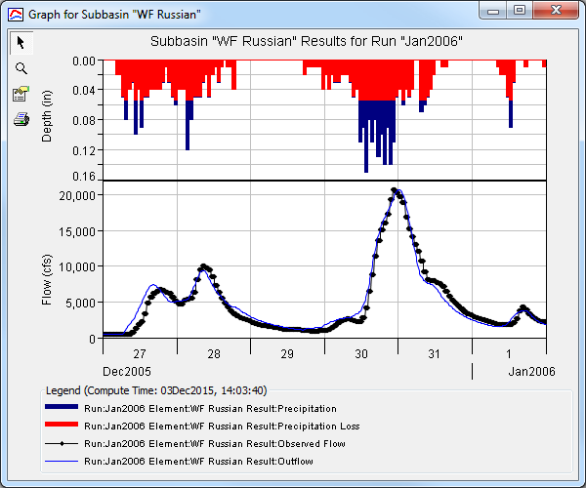
Calibration - Illustrated
Pre-calibration
Post-calibration
Notes:
This slide illustrates calibration for a single event. The blue line is the simulation result. The black line is the observed flow. The calibration process reduces the discrepancy between the simulated flows and the observed.

Slide 24
Calibration in the Modelling Process
Notes:
The purpose of this flow chart is not to illustrate a step-by-step procedure of a hydrologic study or the hydrologic modelling process but rather emphasize where calibration comes into the modelling process.
Calibration is necessary to generate a useful model and is often an iterative process. In the modelling process the modeler first collects raw data. This may include precipitation, hydrometeorolgical, and discharge records as well as elevation, soil, land use, and field survey data. The modeler then selects modelling methods that are appropriate for the study area and capable of being modelled given the data available. The modeler then generates the model inputs required by the modelling methods selected. Some model inputs require more processing from their raw data form than others. Model inputs form the initial and boundary conditions for the model. The model is run and output is generated. The model outputs are evaluated against observed data using performance metrics. If the performance metrics yield an acceptable result then the is considered calibrated. If the performance metrics are beyond acceptable then the model must be adjusted to achieve the desired performance. Raw data sources, model methods, and model inputs should be considered when calibrating a model.

Slide 25
Calibration – Raw Data
Data sources should be the first consideration during calibration
  Bad precipitation data is frequently the source of bad model performance
Question to ask yourself:
  Is raw data the source of any discrepancies between simulation and observation?
  Example: Adjusting parameters outside reasonable bounds to get matching results.
Consider:
  Accuracy
  Spatial and Temporal Extent
  Spatial and Temporal Resolution
Notes:
The accuracy of raw data should also be considered during calibration. Calibration can reveal bad data sources that should be eliminated or replaced; e.g. a rain gage with consistently low precip values could indicate a regional anomaly or it could reveal a recording instrument that was out of calibration – in the latter case the data should probably be removed, and the basin supplemented with data from a nearby gage.
The modeler should consider the spatial and temporal extent of data when setting up the model, nonetheless, it is worth reviewing during the model calibration process.
The modeler must consider the spatial and temporal extent of raw data. Time-series data should be available for the time period being modeled and adequately cover the spatial extent of the modelling domain. Spatial data should be relevant to the temporal extent of the modelling domain; e.g. if the study is based on a 1995 event then land use data from 1995 is probably more applicable than the latest available. In the case of missing data – sometimes approximations can be made using appropriate techniques; e.g. using climatic norms for evapotranspiration inputs when hydrometeorological data is not defined.
The resolution of raw data should also be considered. Spatial data should be at an appropriate resolution for the area of the project; e.g. is a 30m DEM enough resolution to properly capture watershed divides? Time-series data should be at a resolution fine enough to meet the objectives of the project; e.g. will you be calibrating to a daily peak flow or 15 minute discharge data?

Slide 26
Calibration – Model Methods
While modelling methods are initially selected during model setup, calibration may reveal that alternate modelling methods perform better
Question to ask yourself:
  Are the selected modeling methods properly modelling the system?
  Example: Standard Clark UH to Variable Clark UH, Temp Index to RTI or Energy Balance
Consider:
  Regional performance of modelling method
  Physical basis of the modelling method
Notes:
The modeler selects modelling methods appropriate for the study during the initial model setup. Modelling methods include the precipitation method (e.g. gaged, spatially distributed), the loss method (e.g. SCS, Green & Ampt, Initial & Constant, Soil Moisture Accounting), the transform method (e.g. Clark UH, Snyder UH, SCS UH), the baseflow method (e.g. Nonlinear, Boussinesq, Recession), the routing method (e.g. Muskingum-Cunge, Modified Puls), etc. While modelling methods are initially selected during model setup, calibration may reveal that alternate modelling methods perform better.
Regional performance: Some methods were developed for certain areas or certain types of terrain.
Physical basis: Physically based methods usually based more on measured data and less on coefficients.
Time step: The time step selected should capture the level of detail of the observed data.
Example of methods that can be adjusted during calibration: SCS Peak Rate Factor, sediment transport potential method

Slide 27
Calibration – Parameter Adjustment
Parameter adjustment is fine-tuning parameters to improve model output
Find parameter sets that do reasonably well across events
Questions to ask yourself:
  Which parameters can be adjusted?
  How much can a parameter be adjusted?
Consider:
  Physically reasonable range
  Error bounds on parameter estimates
  Sensitivity of parameters
Notes:
Once you’ve settled on your boundary condition and modeling methods, you can move onto parameter adjustments.
Parameter adjustment is the part of the modelling process that is typically identified as “calibration”. Parameter adjustment is the fine tuning portion where parameters are adjusted to improve model output. Initial parameter estimates are made based on previous modelling experience, geospatial analysis, and regression analysis. Parameters are first initialized during model setup and then adjusted during calibration to achieve an acceptable level of performance. When calibrating, it is important to identify, first, which parameters can be adjusted, and second, how much these parameters can be adjusted – do the parameters make sense physically?

Slide 28
Calibration – Parameter Adjustment Guidelines
Work from upstream to downstream
Adjust one parameter at a time
Adjust uncertain parameters (sensitivity analysis)
Look for physical evidence
Beware of tendency to adjust only parameters with higher individual impacts
Notes:
Can also consider optimization to help with fine tuning your parameter values.
These are recommendations to follow when you are calibrating a model.
Adjusting 1 parameter is a manual “replication” of the univariate search approach employed by the HMS optimization computations. If you adjust more than one at a time then it is difficult to determine the impact of each parameter separately.
When adjusting parameters to fit a frequency curve it is important that you don’t adjust parameters outside of their physically possible range.
Look for physical evidence to support or motivate parameter adjustments
Take care in adjusting loss rate parameters. Initially make changes to match volume. Losses during the first part of the event are indicative of antecedent conditions and can have a major impact on the computed peak.
Don’t just adjust parameters that have the greatest impact on the results. This could lead to unrealistic parameters
Manual calibration is useful since it helps you understand the impact of the parameters you are adjusting.

Slide 29
Event vs. Continuous - Calibration
Event calibration
  Focus: peak, timing, volume for event
Continuous calibration
  Focus: volume, performance metrics, runoff signatures such as flow-frequency
In both cases performance metrics will be used to quantify performance
Notes:
Other than knowing that event based and continuous based simulations are different in their time scale, the strategy for calibration is different.
Runoff signatures are statistical metrics used to described the behavior and response of a river or watershed area to rainfall events.
The focus of event calibration is to simulate the peak, timing, and volume of the event being modelled.
The focus of event calibration is to capture the behavior of the hydrologic system over time – this includes peak and volume but with less emphasis on single events. The modeler should evaluate performance metrics as a part of the continuous calibration process.
In both cases performance metrics should be used to quantify calibration.

Slide 30
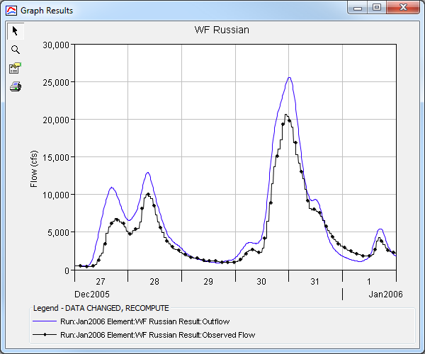
Calibration – Event Example
Notes:
Volume too much.

Slide 31
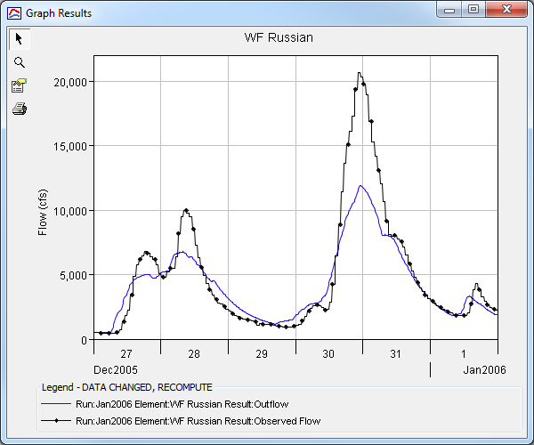
Calibration – Event Example
Notes:
Volume too little.

Slide 32
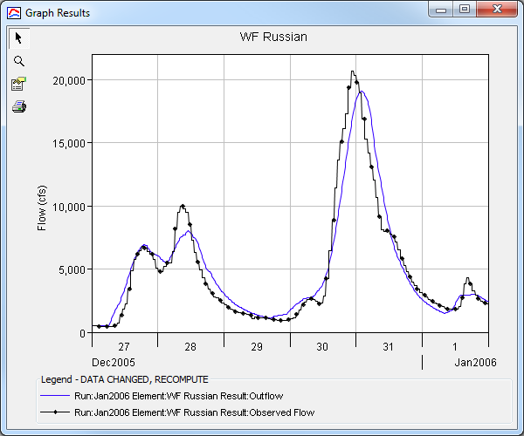
Calibration – Event Example
Notes:
Timing too late.

Slide 33
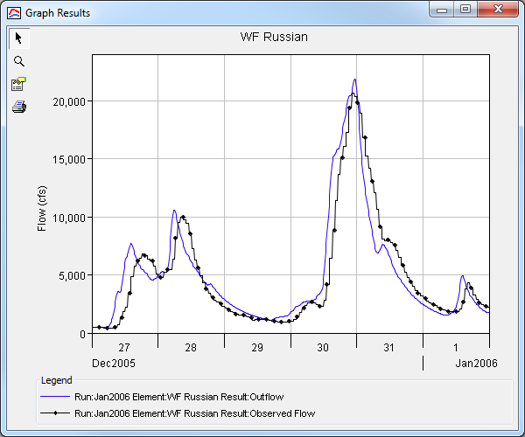
Calibration – Event Example
Notes:
Timing too soon.

Slide 34
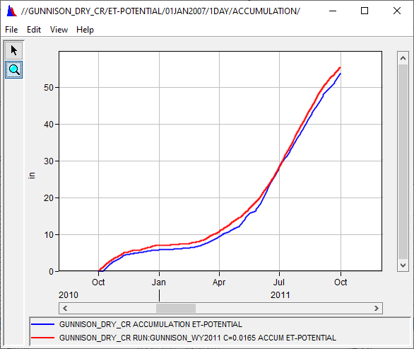
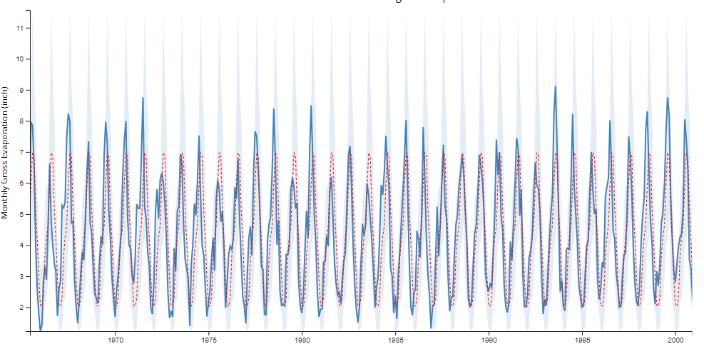
Calibration – Continuous Simulation Example
Evapotranspiration
  Point measurements
    Pan estimates
    Eddy covariance systems
  Moderate Resolution Imaging Spectroradiometer (MODIS16) PET
  Land Data Assimilation System (LDAS)
https://www.waterdatafortexas.org/lake-evaporation-rainfall

Slide 35
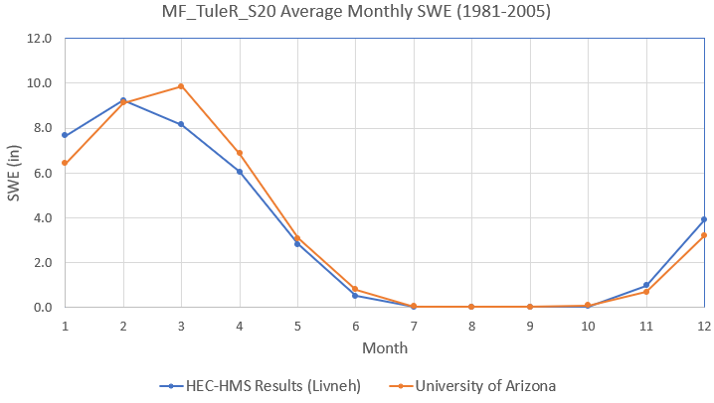

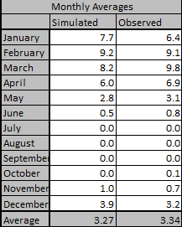
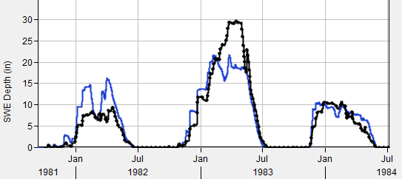
Calibration – Continuous Simulation Example
Notes:
Next, you move onto snow accumulation and melt if your system requires snowmelt
The parameters would just be the snowmelt parameters. Try not to adjust Met model or Basin model.
You will have a presentation on snowmelt processes and where to obtain simulated results for comparison.
If you are just looking at a few years, you can look at the simulated and observed time series and make your parameter adjustments to match your observe values. When you are looking at decades of simulations, it would be easier to calibrate based on the months. This would be performing a cyclic analysis and estimating the average SWE per month.
Other variables to calibrate can be snow covered area.
Use DSSVue and convert HEC model results to monthly average value. Then average the monthly values over the calibration period.

Slide 36
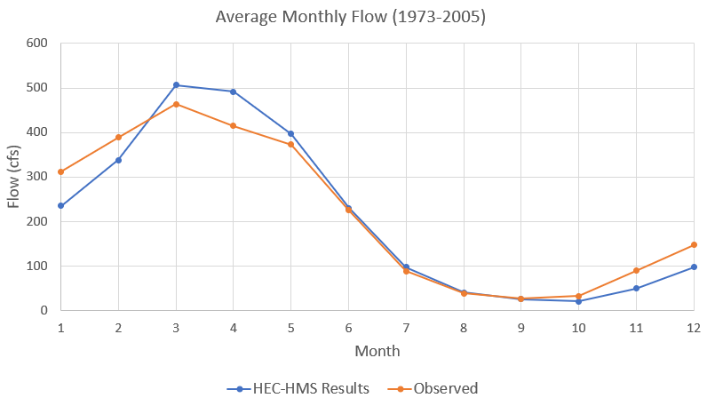

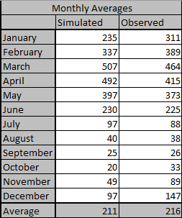
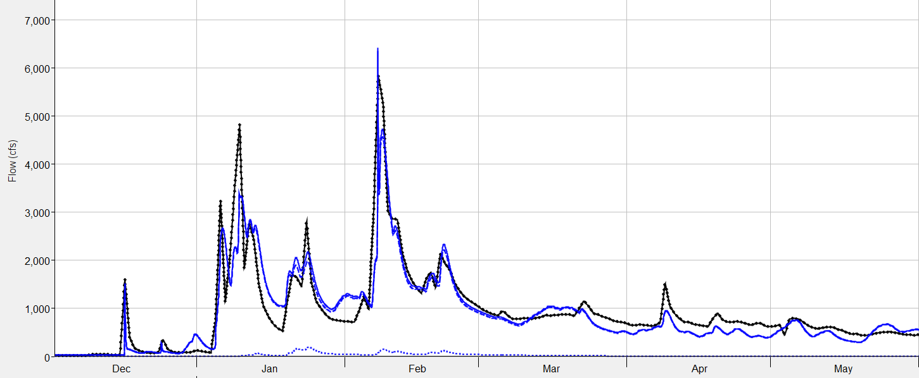
Calibration – Continuous Simulation Example
Notes:
Lastly, evaluate flow at locations with observed flow.
Similar to snow, when modeling decades of simulations results, you should look at the monthly average volumes between your simulated and observe.
Here, you would start adjusting your soil loss, transform, and baseflow. Ideally, you don’t need to adjust your ET or snowmelt parameters. Not a hard a fast rule though.
Use DSSVue and convert HEC model results to monthly average value. Then average the monthly values over the calibration period. You can compute metrics as well.

Slide 37
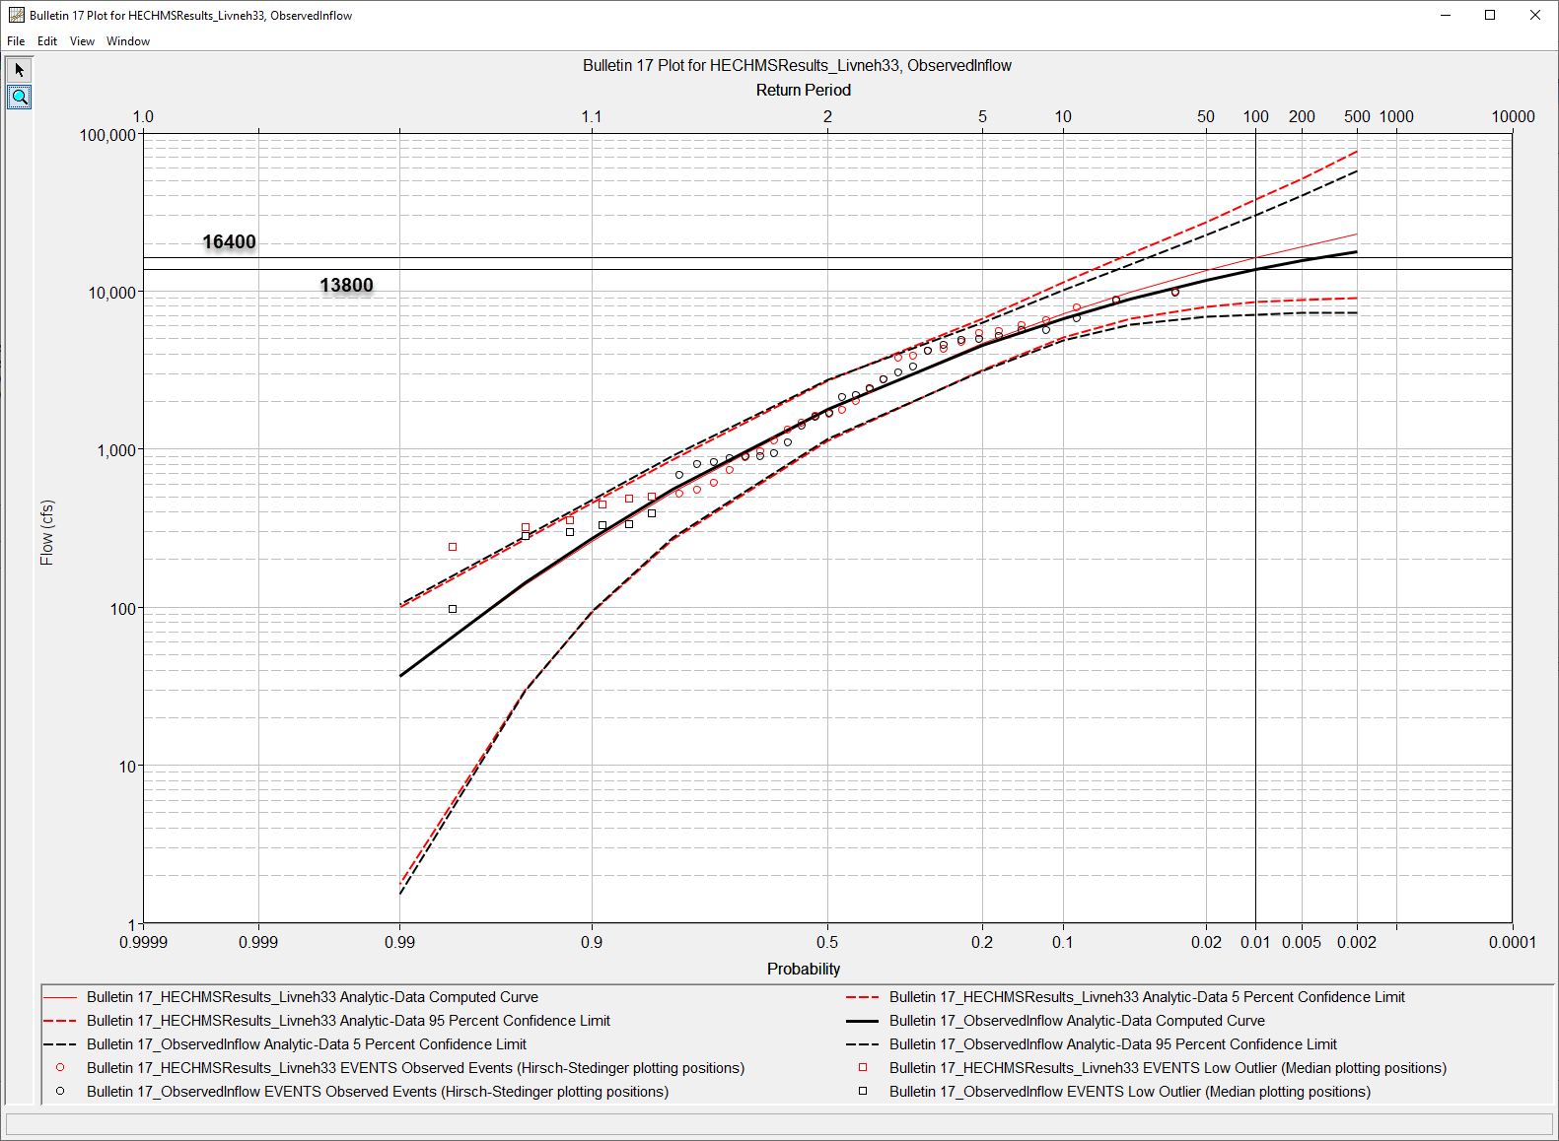
Calibration – Continuous Simulation Example
Notes:
Extract annual maximum flows and use HEC-SSP to perform a flow frequency analysis.

Slide 38
Evaluating Model Output
In general, the modeler should try to reproduce observed peaks, timing, and volume
Statistics used for model evaluation:
  Coefficient of Determination (R²)
  Nash-Sutcliffe Efficiency (NSE)
  Root Mean Square Error (RSR)
  Percent Bias (PBIAS)
Notes:
In general, the modeler should try to reproduce observed peaks, timing, and volume. The objective of calibration is to minimize the difference between simulated values and observed (measured) values. In addition to visual assessments of you rsimulation, Statistical methods are used to quantify how simulated values compare to observed values. These are also used to help assess your volumes but they boil down the performance to a single value.
There are other statistic metrics out there that can be relevant to your basin but these are the basic ones we provide in HMS.
While a visual inspection is often a first pass in calibration there is more than meets the eye. Calibration must be quantified using statistical analyses.

Slide 39

Statistics - Coefficient of Determination (R²)
Measures the strength and direction of a linear relationship between simulated and observed values
Indicates the proportion of the variance in observed data that can be explained by the model
  R² = 0, model cannot explain any of the variability in the measured data
  R² = 1, model accounts for all of the variability in the measured data
  0 < R² < 1, extent to which model reproduces observations
$$R^{2}={\left[\frac{Σ_{i=1}^{n}(Y_{i}^{obs}−{\overline{Y}}^{obs})(Y_{i}^{sim}−{\overline{Y}}^{sim})}{\sqrt{{Σ_{i=1}^{n}(Y_{i}^{obs}−{\overline{Y}}^{obs})}^{2}}\sqrt{{Σ_{i=1}^{n}(Y_{i}^{sim}−{\overline{Y}}^{sim})}^{2}}}\right]}^{2}$$
Notes:
Coefficient of Determination (R²). The coefficient of determination (R²) describes the degree of collinearity between simulated and observed data. R² describes the proportion of the variance in measured data explained by the model. R² is oversensitive to outliers and insensitive to additive and proportional differences between model predictions and measured data (may not effectively capture differences in the absolute or relative values between the predictions generated by the model and the actual data).
$Y_{i}^{obs}$ is the ith observation for the constituent being evaluated, $Y_{i}^{sim}$ is the ith simulated value for the constituent being evaluated, ${\overline{Y}}^{obs}$ is the mean of observed data for the constituent being evaluated, ${\overline{Y}}^{sim}$ is the mean of simulated data for the constituent being evaluated, and n is the total number of observations. It is the square of the Pearson correlation coefficient between the simulated and observed data.
R^2 quantifies how much of the spread (or variability) in the response variable (observed data) can be accounted for or explained by the independent variable(s) (simulated data) in the model

Slide 40
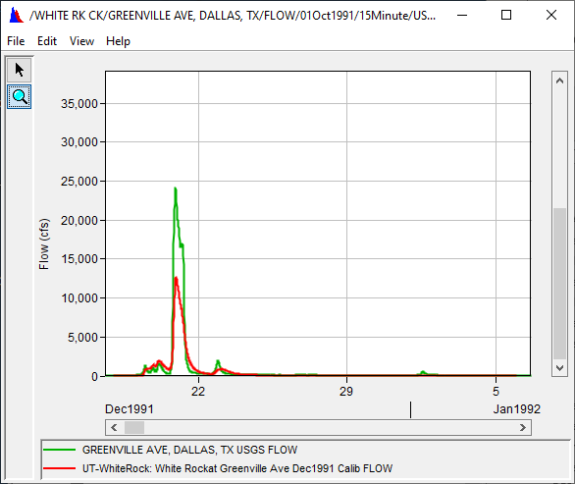
Statistics - Coefficient of Determination (R²)
Advantages
  Widely used in hydrological modeling
Disadvantage
  Overly sensitive to extreme values
  Insensitive to additive and proportional differences

Slide 41
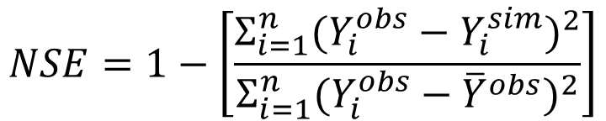
Statistics - Nash-Sutcliffe Efficiency (NSE)
Indicates a correlation of computed values and agreement of the means
  NSE=1, perfect model match computed to observed
  NSE=0, computed values as precise as mean of observed data
  NSE<0, mean of observations better predictor than model predicted
$$NSE=1−\left[\frac{{Σ_{i=1}^{n}(Y_{i}^{obs}−Y_{i}^{sim})}^{2}}{{Σ_{i=1}^{n}(Y_{i}^{obs}−{\overline{Y}}^{obs})}^{2}}\right]$$
Notes:
Nash-Sutcliffe Efficiency (NSE). The Nash-Sutcliffe Efficiency (NSE) measures the relative magnitude of the residual variance compared to the measured data variance. NSE ranges between -∞ and 1.0 (1 inclusive), where NSE = 1 is optimal. Values of NSE ≤0.0 indicate the mean observed value is a better predictor than the simulated value, meaning that the performance is unacceptable.
Measurement of residual variance. Residuals are the difference between your observed and your simulated. The variance is measuring how spread out your residuals are. Closer to zero means low variance. NSE normalizes the residuals based on the differences in mean values. Outliers will again have a sizable affect on the NSE value

Slide 42
Statistics - Nash-Sutcliffe Efficiency (NSE)
Advantages:
  Good for use with continuous simulation and how well the model simulates trends
  Robust, can be used for various output responses: flow, sediment, nutrients
  Commonly used
Disadvantage:
  Cannot identify model bias
  Cannot identify differences in timing, magnitude, and shape of recession
  Sensitive to extremes

Slide 43
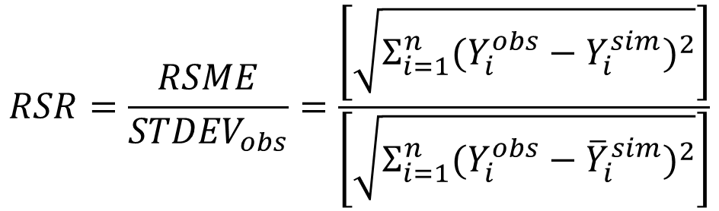
Statistics - Root Mean Square Error (RSR)
Standardizes the root mean square error (RMSE) using the observation standard deviation
  The optimal value of RSR is 0.0 which presents zero RMSE for perfect model simulation
  Lower RSR values present better model performance
$$RSR=\frac{RSME}{{STDEV}_{obs}}=\frac{\left[\sqrt{{Σ_{i=1}^{n}(Y_{i}^{obs}−Y_{i}^{sim})}^{2}}\right]}{\left[\sqrt{{Σ_{i=1}^{n}(Y_{i}^{obs}−{\overline{Y}}_{i}^{sim})}^{2}}\right]}$$
Notes:
Root Mean Square Error –Observed Standard Deviation Ratio (RSR). The root mean square error (RMSE) is valuable because it indicates the error in the units of the constituent of interest, where the lower the RMSE the better the model performance. The RMSE –Observed Standard Deviation Ratio (RSR) normalizes the root mean square error by using the standard deviation of the observations, incorporating the benefits of error index statistics so that the resulting statistic can be applied to various constituents.

Slide 44
Statistics - Root Mean Square Error (RSR)
Advantage
  Incorporates error index statistics and includes scaling/normalization factor
Disadvantage
  Give more weight to high values due to square difference
  Not commonly used
Notes:
One of the benefits is reducing error through optimization.

Slide 45
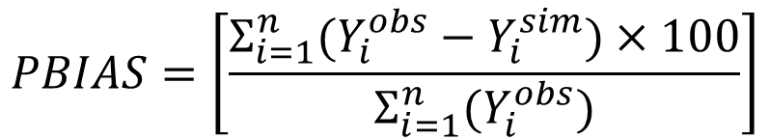
Statistics - Percent Bias (PBIAS)
Measures the average tendency of simulated values to be larger or smaller than observed values
  The optimal value of PBIAS is 0.0
  Positive values present model underestimation bias
  Negative values present model overestimation bias
Some have separated PBIAS into Volume (V) and Peak (P)
$$PBIAS=\left[\frac{Σ_{i=1}^{n}(Y_{i}^{obs}−Y_{i}^{sim})×100}{Σ_{i=1}^{n}(Y_{i}^{obs})}\right]$$
Notes:
Percent Bias (PBIAS). Percent bias (PBIAS) measures the average tendency of the simulated data to be larger or smaller than the observed data. The optimal value for PBIAS is 0.0, with low absolute percent bias indicating accurate model simulation. Positive values mean the model underestimation bias when compared to the observed, whereas negative values indicate the model overestimation bias.
The negative positive sign can be confusing (positive is underestimation, negative is overestimation) but this is because Observation is first in the equation. If you switch it to simulated, then the signs get switched.

Slide 46
Statistics - Percent Bias (PBIAS)
Advantages
  Useful for continuous simulations
  Robust and commonly used
  Identify average model bias of overprediction or underprediction
Disadvantages
  Cannot be used for differences in timing, peak magnitude, and shape

Slide 47
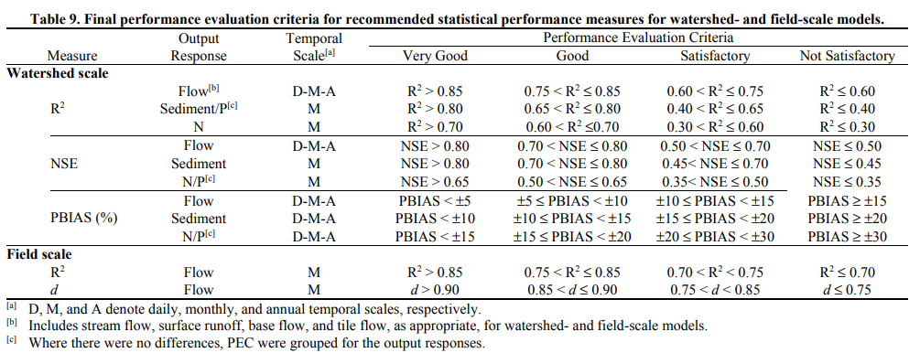
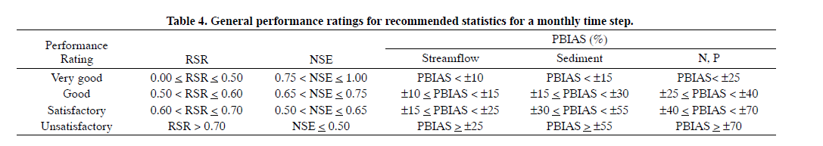
Statistics – Performance Ratings
Moriasi et al., 2015
Moriasi et al., 2007
Notes:
Once the performance metrics are calculated, the model is a assigned a performance rating for each metric based on the chart above. It is recommended that model performance is presented in the study report along with stud

Slide 48
Statistics – Performance Ratings
Performance evaluation criteria can be adjusted based on:
  Data availability
  Quality and quantity of the data
  Spatial and temporal scale of the data
  Project scope and magnitude

Slide 49
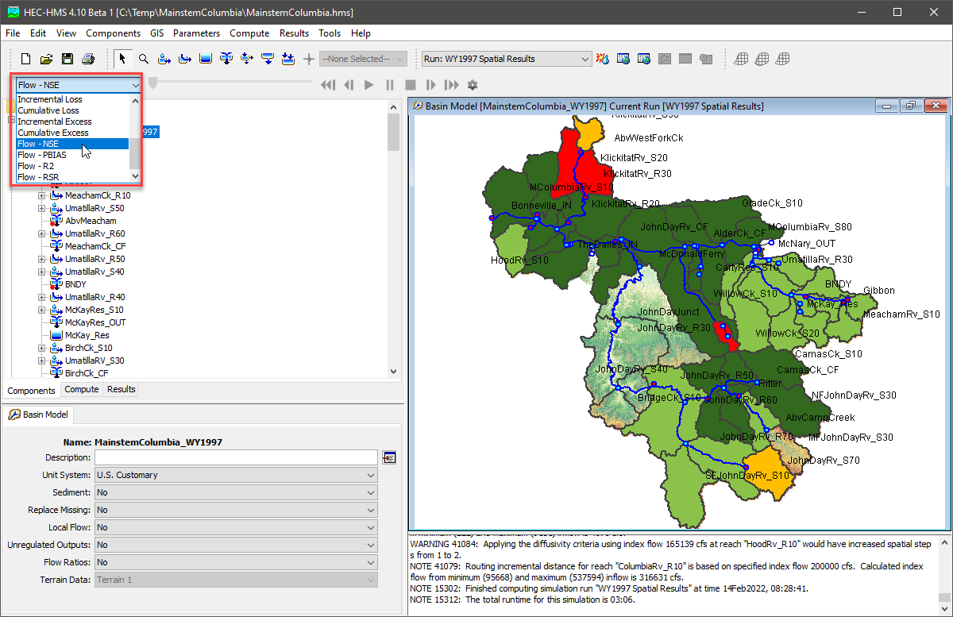
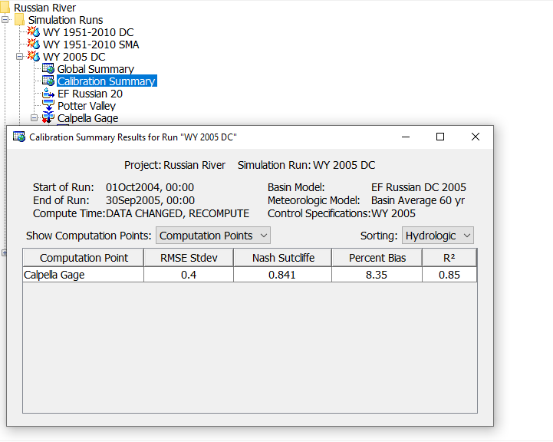
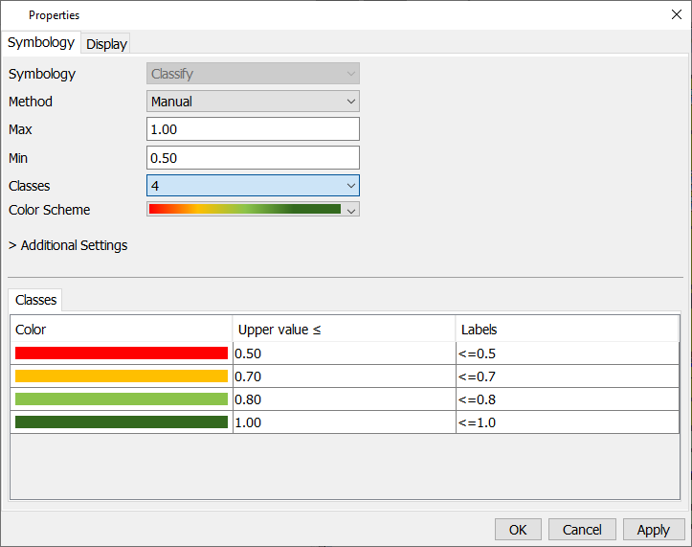
Statistics – Performance Ratings
Notes:
You can now visualize metrics from the spatial results toolbar (for SWE and flow).
You can make changes to your performance metrics.

Slide 50
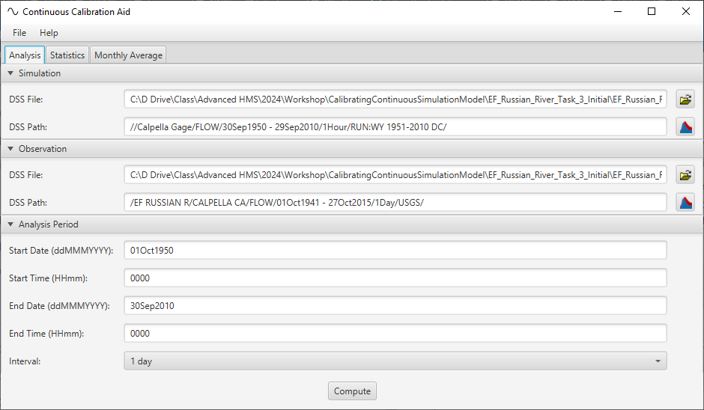
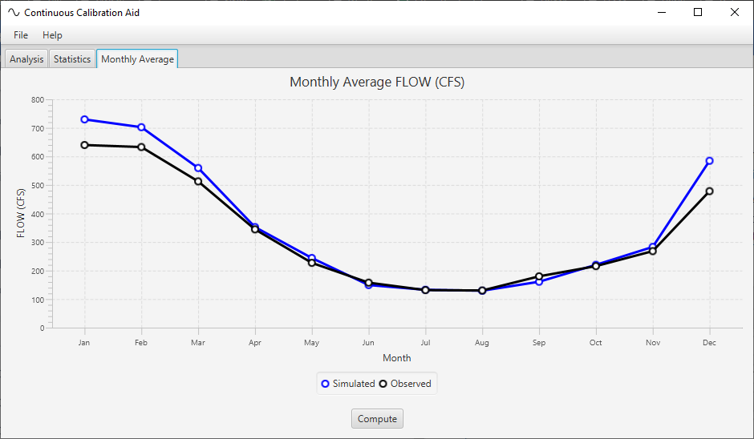
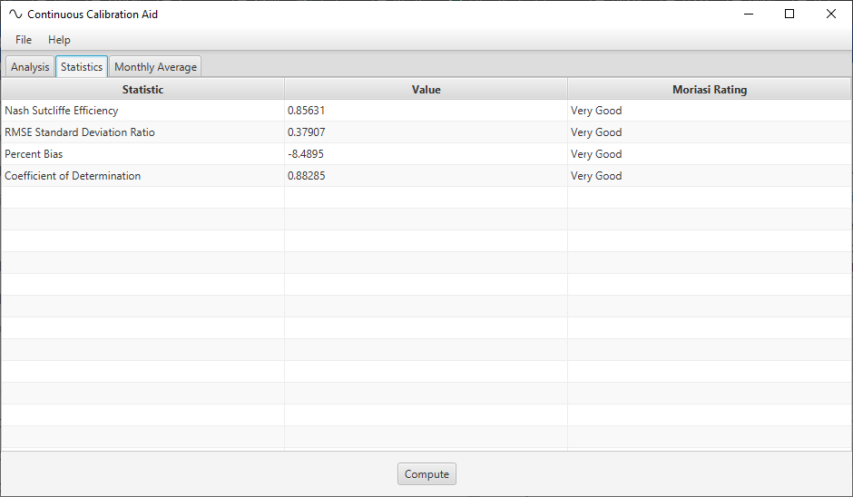
Calibration-App

Slide 51
Reporting Model Performance (flow)
Event modeling
  Graphical comparison between simulated and observe time series
  Peak magnitude and timing
  Performance metrics and Performance rating
Continuous Modeling
  Runoff signatures
    Monthly volumes
    % AEP
  Graphs
    Scatter plots (R^2 linear regression line)
    Cumulative distributions
    Flow duration curves
  Performance metrics and Performance rating

Slide 52
Validation - Defined
“(Validation is) when a model that has been calibrated for one data set is evaluated against a different data set of the same variables, at the same site as used in the calibration (the classical ‘split-record test’).” –Bevan and Young (2003)
Calibration Event | Validation Events
Jan 2004 | Jan 1997
August 2017 | December 2010
December 2020
November 2024
Notes:
A definition from Bevan and Young (2003).

Slide 53
Validation in the Modelling Process
Notes:
Validation is performed after the model has been calibrated.

Slide 54
Validation
Validation events or period should of same or similar duration with similar behavior to calibration period (e.g. wet/dry cycles)
Boundary conditions will change, Model parameters will remain unchanged from calibrated model (except for initial condition, initial conditions are event specific!)
Define your performance criteria up front
  If validation fails go back to calibration – reconsider processes and parameterization
EM-1110-2-1417 suggests 2 validation events
Notes:
Sometimes calibration performance will decrease to achieve an acceptable validation.

Slide 55
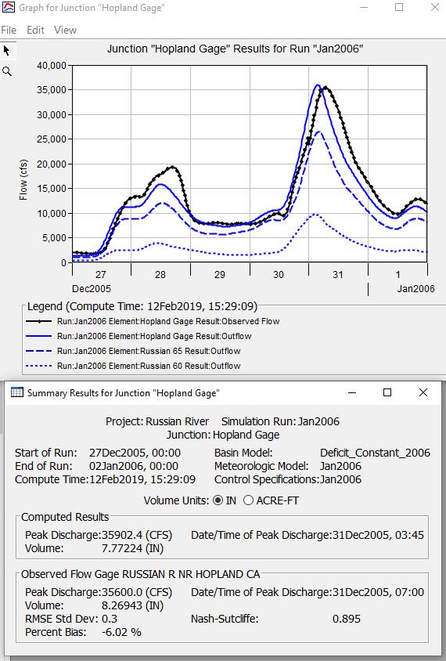
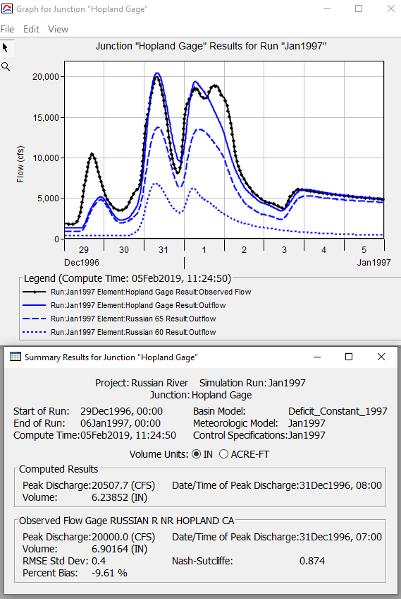
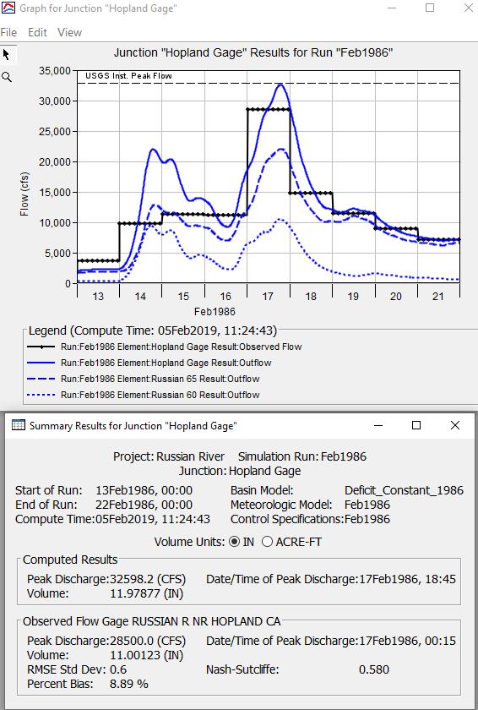
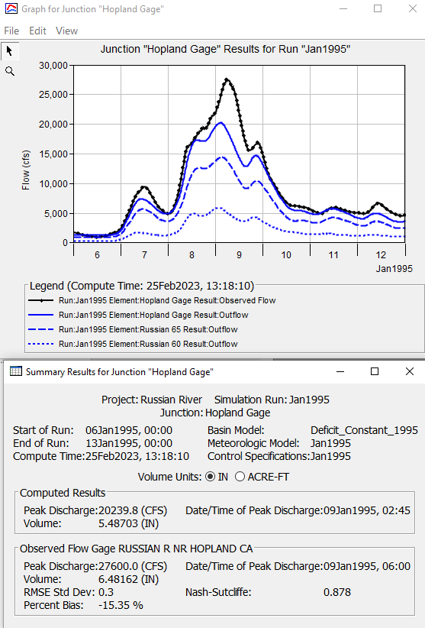
Validation Event
Calibration Events

Slide 56
Summary
Discuss modeling theory
Discuss Model Classification
Overview of calibration in the modelling process
Discuss event vs continuous simulation
Quantify model accuracy through performance metrics
  Recommendations for reporting calibration results
Discuss model validation
Notes:
Here are the objectives of the presentation

Slide 57
References
Moriasi, D. N., Gitau, M. W., Pai, N., & Daggupati, P. (2015). Hydrologic and Water Quality Models: Performance Measures and Evaluation Criteria. Transactions of the American Society of Agricultural and Biological Engineers, 58(6), 1763-1785.
Beven, K., and P. Young (2013), A guide to good practice in modeling semantics for authors and referees, Water Resour. Res., 49, 5092–5098, doi:10.1002/wrcr.20393.
Moriasi, D. N., J.G. Arnold, M.W. Van Liew, R.L. Bingner, R.D. Harmel, and T.L. Veith, Model evaluation guidelines for systematic quantification of accuracy in watershed simulations, Transactions of the ASABE 50 (3), 885-900, 2007
Rykiel, E.J., Jr. 1996. Testing ecological models: the meaning of validation. Ecological Modeling, 90:229-244.

Slide 58
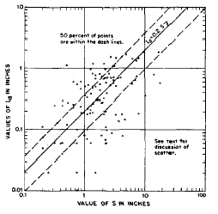
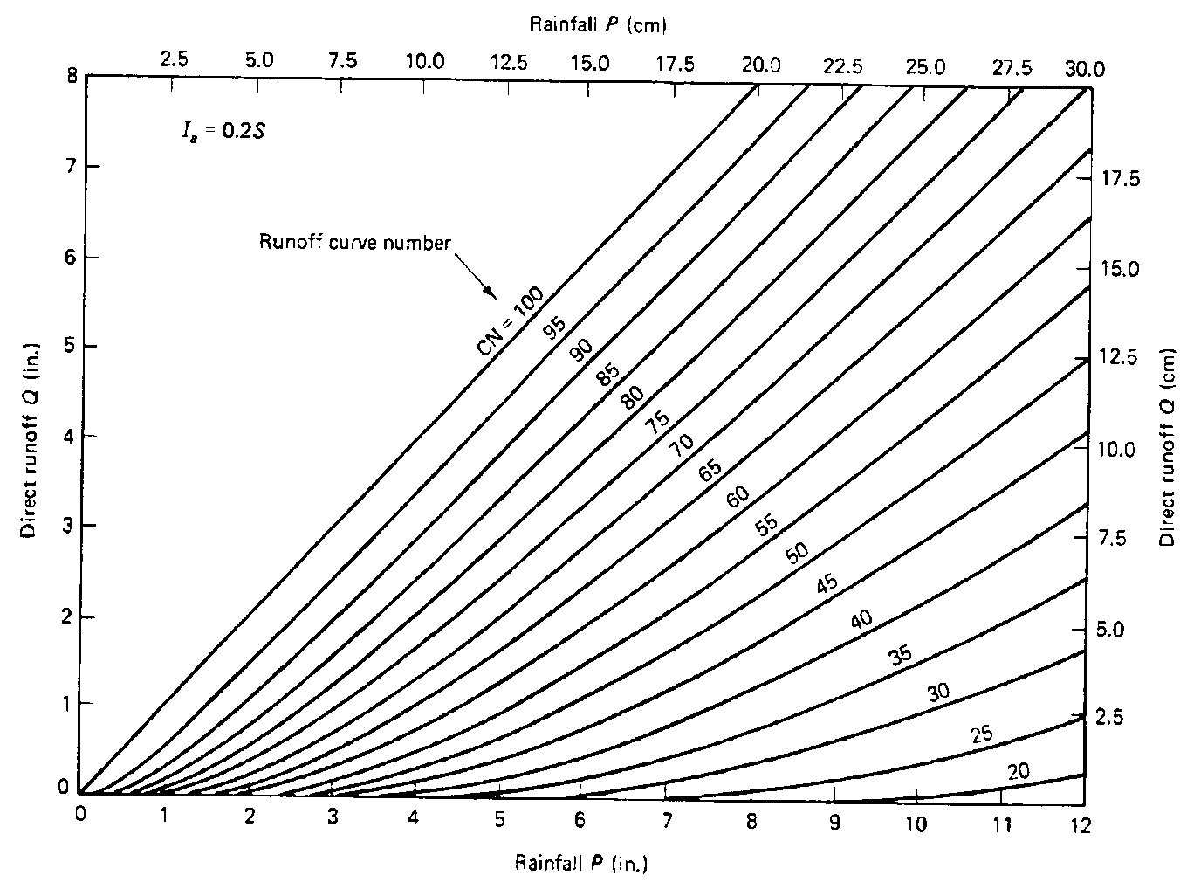
Example Model
Notes:
Consider hiding this
The relationship Ia = 0.2S is based on data from small (less than 10 acres) agricultural watersheds in the mid-western US (Mockus 1964). Notice the large scatter in the Ia vs. S graph. In HMS, the SCS method sets the initial abstraction (Ia) at the default value of (0.2S). HMS currently allows for the overriding of this initial abstraction term. However, since the relationship between initial abstraction and watershed retention was critical to the reported CN calibration, the uncertainties and limitations in specifying values of initial abstractions should be considered.
The curve numbers have been related to readily measurable soil and land use characteristics. Watersheds with single cover and soil types were used to develop these relationships. The total rainfall vs. runoff volumes were used to determine the appropriate CN for the cover and soil types for each watershed.

Slide 59
Event or Continuous
Event(s)
Continuous
Notes:
The figure on the left shows an event being modelled over the course of 6 days. The figure on the right shows a continuous simulation over a 60yr period.

Slide 60
Constituents of a Model
Initial conditions - knowledge about the state of the system at the beginning of the simulation
Boundary conditions - values of the system input—the forces that act on the hydrologic system and cause it to change
Parameters - numerical measures of the properties of the real-world system
State variables - represent the state of the hydrologic system at a particular time and location
Notes:
What are the parts of the model that users need to set up.
These constituents are important to know when you start your calibration.

