Slide 1
Uncertainty in Hydrologic Modeling
2024 Advanced HEC-HMS Class
Josh Willis
June 2024
Hydrologic Engineering Center

Slide 2

Overview
Understand the different types of uncertainty in hydrologic modeling.
Look at how uncertainty can be incorporated into several types of hydrologic studies.
Learn how the Uncertainty Analysis component in HEC-HMS should be configured to describe the uncertainty in a watershed model and produce results.
Notes:
The first half of this lecture will be focused on uncertainty in hydrologic modeling in a broad sense.
The second half of this lecture will be HMS-centric.
We will look at examples of how uncertainty can be applied to common modeling scenarios.
We will look at how to configure an Uncertainty Analysis in HMS and produce results.

Slide 3
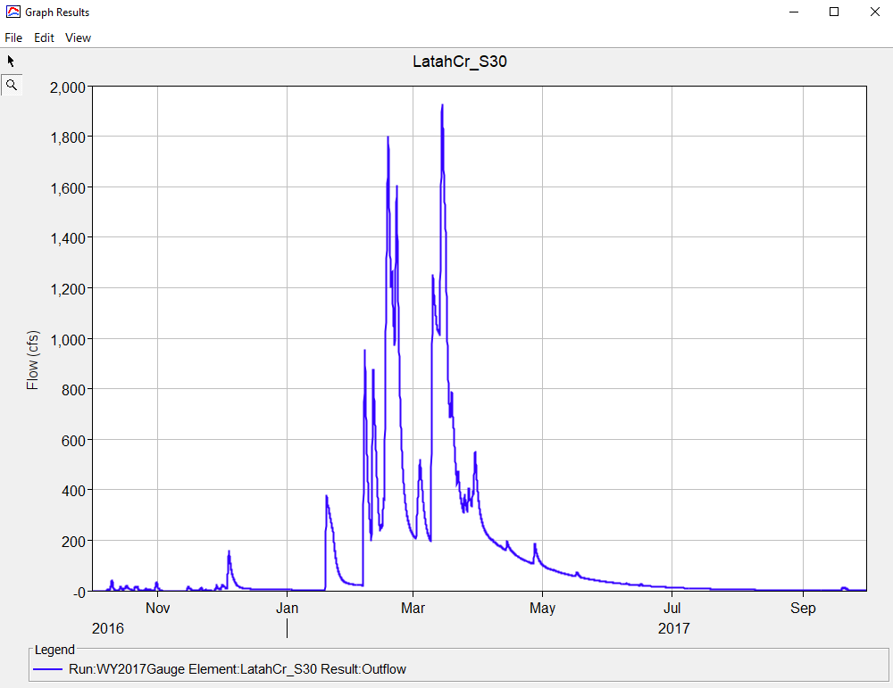
Hydrologic Modeling Uncertainty
What are some sources of uncertainty in hydrologic modeling?
Notes:
Types of uncertainty in hydrologic modeling include…
Input Uncertainty
i.e., rainfall data
Calibration Uncertainty
i.e., USGS streamflow data
Model/Structure Uncertainty
i.e., all modeling methods make assumptions that can introduce uncertainty
Parameter Uncertainty
i.e., time of concentration parameters can change from one calibration event to another, which value should be adopted?

Slide 4
Types of Uncertainty
Input uncertainty:
  Precipitation data and other atmospheric variables.
  Sources of inflow to the watershed.
Calibration uncertainty:
  Observed discharge and rating curves.
Model/Structure uncertainty:
  Selecting a correct representation of the hydrologic processes.
  Watershed delineation and the trade-off between model accuracy and parameter uncertainty
Parameter uncertainty:
  Identifying parameter values in the process representation.
In HMS, we can model Input, Structure, and Parameter uncertainty
Notes:
hydrologic modeling, we generally understand there to be 4 types of uncertainty.
1. There’s the input uncertainty. This is usually some type of measurement data, such as precipitation or temperature data and there are likely errors in the measurement.
2. There’s calibration data uncertainty, which is similar to input data uncertainty. You can have errors in measurement within your discharge rating curve which you are calibrating to so then your outputs are biased to whatever your observed data is showing
3. There’s the model or structure uncertainty. This is selecting the correct representation for your watershed. There’s many different processes and methods to represent those processes available
Then there’s parameter uncertainty. Once you’ve identified your methods, figuring out the parameter values which controls the model outputs.
In HMS, we allow users to model for Input uncertainty (through the Ensemble Analysis compute type), Structure Uncertainty (also through the Ensemble Analysis), and parameter uncertainty (through the Uncertainty Analysis). We will only focus on parameter uncertainty part for this discussion.

Slide 5
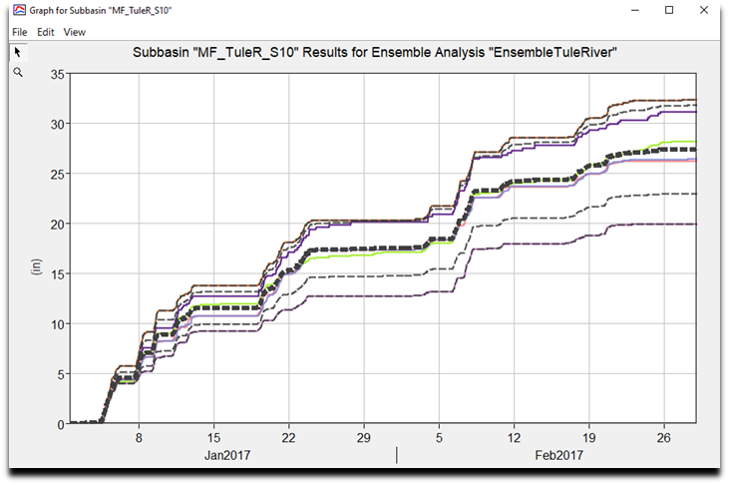
Input Uncertainty
Notes:
Precipitation data is a common example/source of input uncertainty
This figure shows a cumulative precipitation plot generated in HEC-HMS after computing an ensemble analysis
In this example, each ensemble member used a different boundary condition data source (precipitation) to model the same event period
MRMS, AORC, Interpolated Gage, and PRISM normalized precipitation datasets were compared
The colored lines represent rainfall computations for each ensemble member (there were 6 in this example)
The black, dotted lines represent different aggregations of the ensemble member results
The highlighted black line (in bold) represents the mean precip result of all the ensemble member runs
The other dotted black lines represent other types of aggregations (minimum, maximum, and + and – one standard deviation

Slide 6
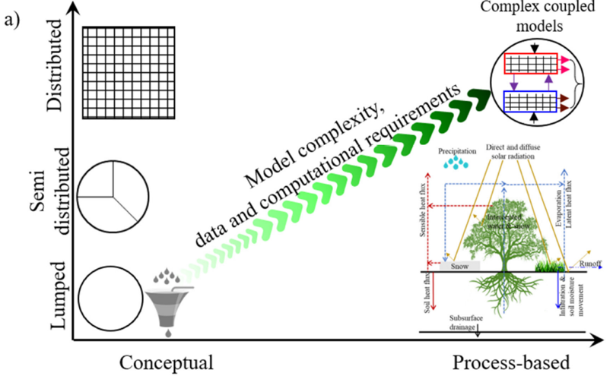
Model/Structure Uncertainty
All modeling methods, even the most physically based methods, make assumptions and propagate uncertainty
Model structure, i.e. lumped vs gridded, propagate uncertainty

Slide 7
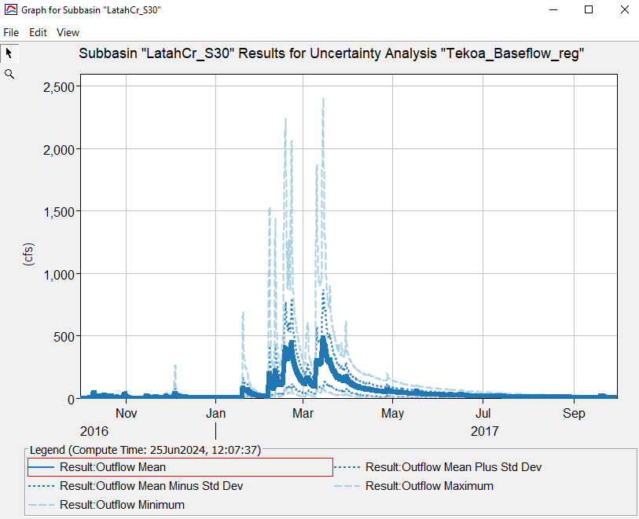
Parameter Uncertainty

Slide 8




Parsimony Principle
Occam’s razor (law of parsimony) typically governs our choices as H&H modelers
  The modeling methods that are the simplest with the fewest parameters (while still producing generally acceptable results) are often favored
Complex models do not necessarily provide the best results
Applied to hydrologic models
  Parsimonious models can provide better insight and comprehension
  Improve accuracy, efficiency, and predictive capabilities
  Require fewer data to achieve same accuracy
  When dealing in uncertainty, understanding which modeling parameters are most sensitive will be of greatest interest
B
B
A
A
“When faced with two equally good models, choose the simpler one.”

Slide 9
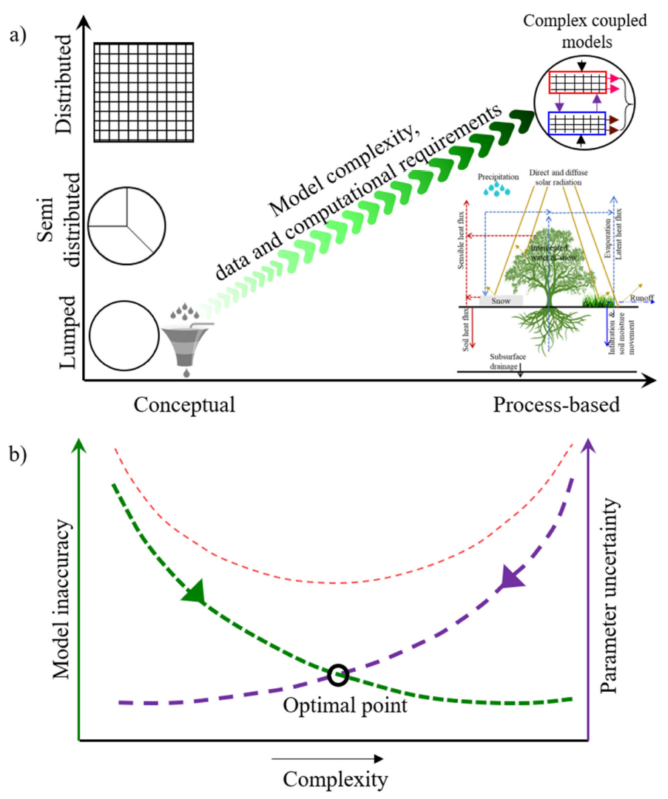
Moges et. al
Notes:
Here’s a pretty cool figure from a paper that describes our best effort as modelers to balance model accuracy, complexity, and parameter uncertainty. The graph at the top shows different levels of complexity from lumped based modeling to distributed on the y axis and conceptual to process based. Your model becomes increasingly more complex as you go from bottom left to top right.
The graph on the bottom, you are searching for the optimal point and balancing the accuracy, complexity, and parameter uncertainty. As engineers, we are doing our best to represent the hydrologic system but its also important to recognize we are making tradeoffs.
Conceptual – The model components are based on mathematical approximations to the physical process. The parameters may be empirical or may be physically measurable.
Physically Based – The model components are built from conservation equations written at a point and applied at scales ranging from meters to kilometers. Parameters are usually physically measurable.
Figure 4. (a) The span of model complexity with respect to spatial resolutions and process complexity, (b) The bias–variance
tradeoff curve relating model complexity and uncertainty. The green curve indicates the decrease in bias (model inaccuracy)
as model complexity increases while the purple curve indicates a decrease in variance (parameter uncertainty) because of a
decrease in model complexity. The red curve indicates the net effect of bias and variance.

Slide 10
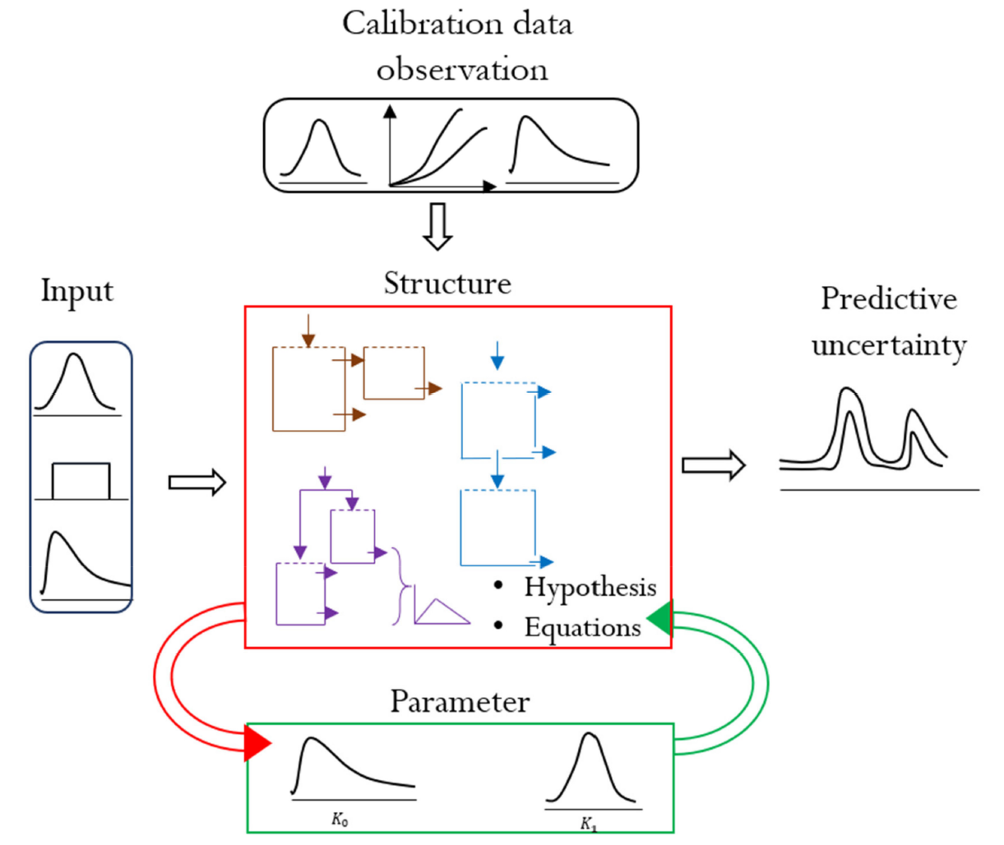
Moges et. al
Notes:
Heres another cool graph from Moges showing the different sources of uncertainty.

Slide 11
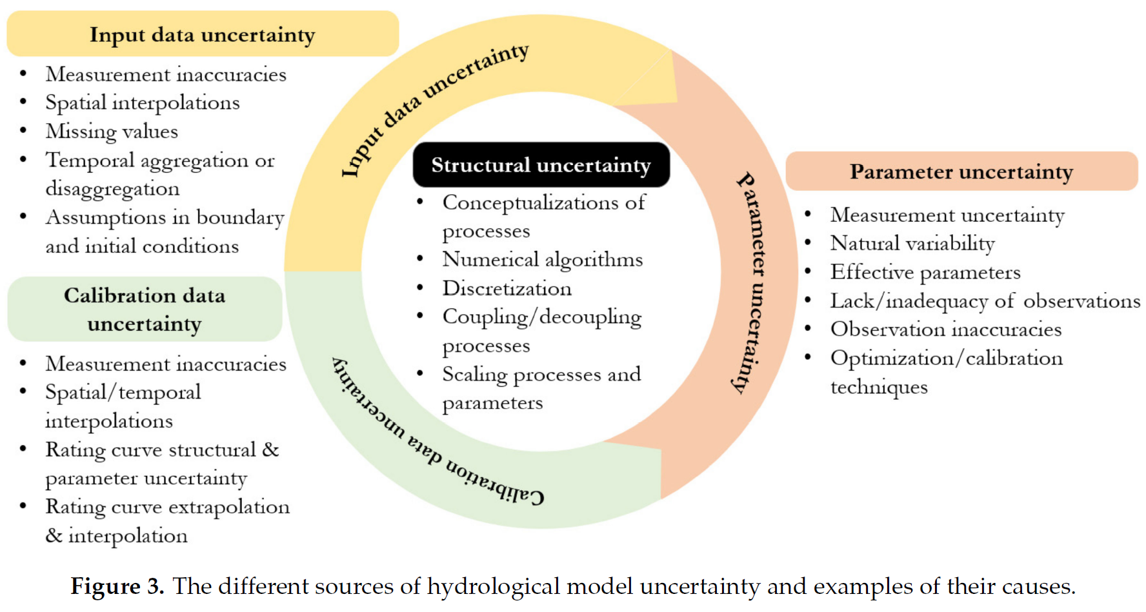
Moges et. al
Notes:
Here’s another graphic from Moges listing out for each source, where you might get errors and uncertain values.
Understanding the causes and interactions of uncertainty sources is critical in disentangling
and reducing predictive uncertainty. The different causes and interactions of
the four sources are summarized in Figure 3. Some of the causes can be common across
the different sources (Figure 3). Structural uncertainty is at the core and interacts with all
sources of uncertainty. The interactions between input and structural uncertainty are not
direct. They interact through the parameters of the model. On the other hand, although
input and calibration data uncertainties are independent, they both interact with parameter
uncertainty. The interaction between input and parameter uncertainties may lead to biased
parameter estimates [74], which can dominate the overall model uncertainty [137,138].
Similarly, input errors can be compensated by parameters [139–141]. However, this compensation
can be misleading since the causes of input uncertainty are independent of
any model and its parameters. This is particularly a concern when the model is used for
conditions that are different from the ones used for model development. Thus, it is better
to independently address the causes of input errors instead of relying on compensation.

Slide 12
Overview
Understand the different types of uncertainty in hydrologic modeling.
Look at how uncertainty can be incorporated into several types of hydrologic studies.
Learn how the Uncertainty Analysis component in HEC-HMS should be configured to describe the uncertainty in a watershed model and produce results.

Slide 13
Regulatory Floodplain Studies
Traditional Approach
  Develop a calibrated hydrology model:
  Apply a synthetic 1% precipitation event created from the mean rainfall depth listed in the NOAA 14 statistical data.
  Take the computed peak flow rate and use a hydraulics model to determine the floodplain map. It is either wet or dry.
Future of Flood Risk Data (incorporates uncertainty)
  Future of Flood Risk Data (FFRD) is exploring a probabilistic framework for modeling flood losses for fluvial, pluvial and coastal flood hazards by improving the nation’s understanding of flood risk from a range of flood hazards
  Understand impact on the nation’s people and infrastructure to more adequately rate flood insurance policies and thoughtfully plan mitigation actions. This work particularly supports FFRD Element One, a shift from binary to graduated risk analysis.

Slide 14
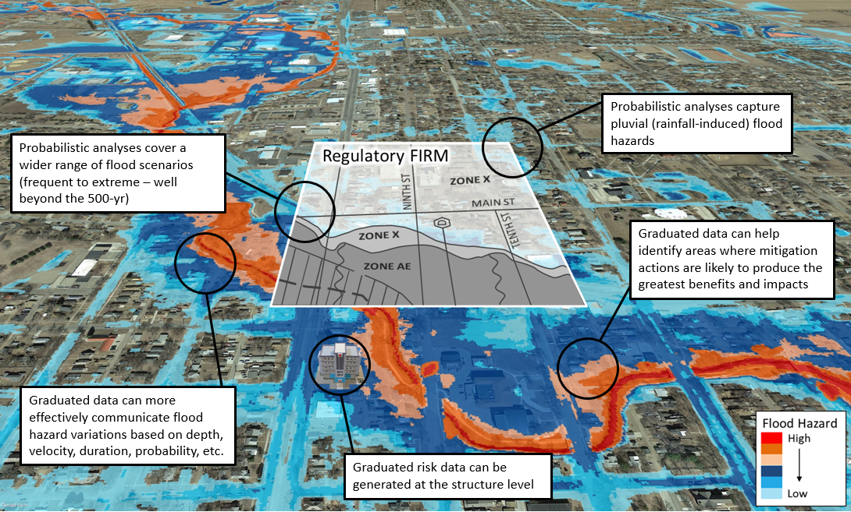
Notes:
Here’s a comparison between a static FEMA map and a graduated Flood Risk Map that incorporates variability. With static maps, we have defined flood zone regions. This zone is in the1% AEP floodplain. With graduated Flood Risk Map, we can show a range of flood scenarios, from a high flood hazard to a low flood hazard. These flood plains are computed by incorporating uncertainty into your results.
Derived from probabilistic analyses, where a more comprehensive range of flood and storm events (frequent to extreme, mild to intense) and hazard sources (fluvial, pluvial, coastal, etc.) are evaluated, graduated data offer new opportunities beyond mapping and insurance to promote mitigation action and risk awareness.

Slide 15
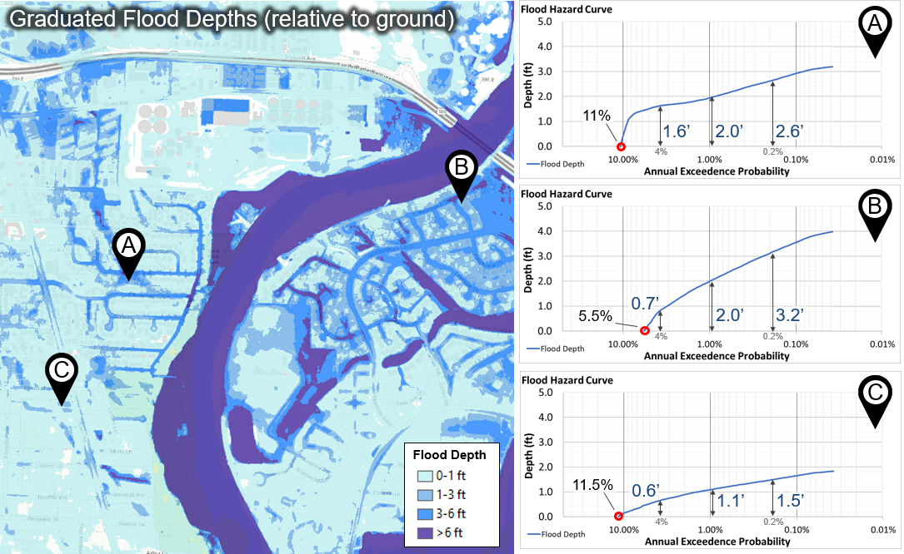
Flood Damage Reduction
Prepare the hydrology model for use:
  Calibrate using historic storms.
  Perform a Bulletin 17C statistical analysis of flow gage data.
  Develop synthetic precipitation events ranging from 50% to 0.2%.
  Investigate soil parameterization and develop a relationship between precipitation frequency and flow frequency.
Produce adjusted flow-frequency curves throughout the watershed.
Assess equivalent years of record, and assume the uncertainty in the computed frequency curves is the same as observed curves.
A peek at the future…
  Precipitation uncertainty across the range of events is fully described. The uncertainty in watershed physical processes drives the uncertainty around the computed flow-frequency curves without using equivalent years of record.
Notes:
Natural variability vs knowledge uncertainty – plans to introduce knowledge uncertainty to these plots
https://www.hec.usace.army.mil/confluence/fdadocs/techref/natural-variability-vs-knowledge-uncertainty-159155807.html

Slide 16
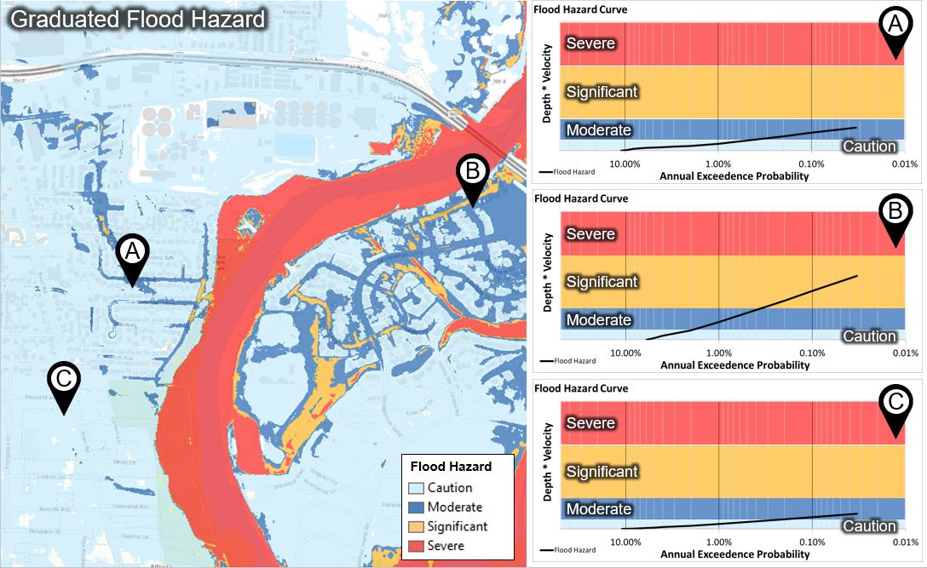
Notes:
Here’s another figure showing how you can create hazard classifications based off a depth vs velocity probability plot.

Slide 17
Dam Safety Studies
Mix of Deterministic and Stochastic Analysis
  Developing PMP/PMF
    Prepare a calibrated hydrologic model using historic events. Adopt parameters with a bias toward larger events.
    Apply the modifications specified by regulation:
    Apply the Probable Maximum Precipitation (PMP) event and determine if the spillway capacity is exceeded. Determine downstream hydrographs with and without dam failure.
  Developing Stage Frequency Curve
    Randomly sample from precipitation or flow frequency curve
    Sample from Flood Histogram
    Sample from reservoir starting stage
    Compute multiple realizations of stage-frequency curves

Slide 18
Pool Stage Frequency Curve
Max Peak Stage With Soil Loss Uncertainty
Deterministic Peak Stage
Min Peak Stage With Soil Loss Uncertainty
Mean Peak Stage With Soil Loss Uncertainty
Notes:
Here’s is an example of a stage frequency curve that compares the deterministic stage frequency, shown in purple, with the stage frequency computed stochastically, shown in green. The variation they did was allowing the soil loss parameter to vary for each event. In Dam Safety, you would plot the deterministic PMF stage value and estimate the probability range of the PMF stage. This information is used as part of the risk assessment.

Slide 19
Flow Forecasting Approaches
CWMS modeling
  Prepare a calibrated hydrology model using historic storms with observed precipitation and flow. Add the model to the forecast suite.
  Use the hydrology model to make a flow forecast:
    Start the model several days before the forecast date.
    Evaluate the model performance against flow observations.
    Adjust model parameters.
    Apply the forecasted precipitation.
    Modify the forecasted flow based on model errors at the forecast date.
  Use the forecasted flow to make operational decisions.
Ensemble forecasts
  Incorporate ensemble forecasts into models and generate metrics to make operational decisions

Slide 20
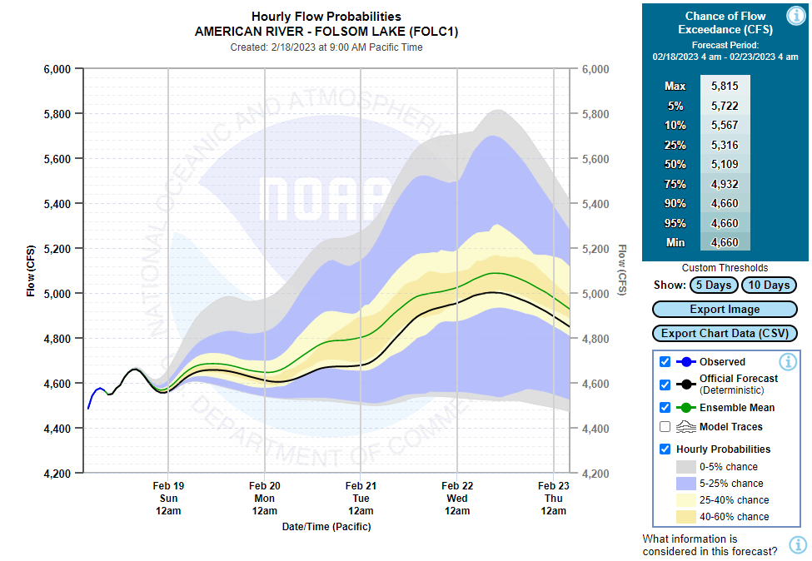
Notes:
Here’s an image from the California Nevada River Forecast Center showing projected ensemble flows for the next 5 days. You have the observed flows, official forecasted flow (deterministic flow), the various probabilities based off the ensemble dataset, and the ensemble mean in green. The ensemble mean is higher than the deterministic forecast. You can see a huge spread in the ensemble data, just indicating how uncertain we are about the event. Hopefully as our knowledge gets better, the uncertainty will start to narrow.
https://www.youtube.com/playlist?list=PLsyDl_aqUTdHa11s6-Su9EMyFcRsFH9fK

Slide 21
Overview
Understand the different types of uncertainty in hydrologic modeling.
Look at how uncertainty can be incorporated into several types of hydrologic studies.
Learn how the Uncertainty Analysis component in HEC-HMS should be configured to describe the uncertainty in a watershed model and produce results.

Slide 22
Monte Carlo Technique
A traditional hydrologic model is deterministic. Given a set of parameters, it will always compute the same result because it does not include randomness.
Assume we can describe the uncertainty in each parameter using a probability distribution function.
Use a very good pseudo-random number generator to sample a random value for each parameter.
Compute the model with sample parameter values and store the important results. Assume each sample is equally likely.
After a sufficient number of samples, use statistics to estimate key output variables with uncertainty.
Notes:
The uncertainty analysis compute type uses a monte carlo approach to account for these uncertainties. In contrast, the simulation compute type is a deterministic compute. You choose your best estimate parameters and run the simulation and get the same results each time.
With the uncertainty analysis, you can describe the uncertainty in a parameter using a probability distribution function
We’re going to use a pseudo-random number generator to sample random values for each parameter. It will sample as many times as you specified in the component editor and it does this for all the parameters. So if you entered 500 samples and added 5 parameters, each of those parameters will be sampled from 500 times.
At the end of the compute, you can look at the results you selected in the Analysis Points (we do not show you all of the results) in the form of mean, max, and min, and +/1 1one std from the mean.

Slide 23
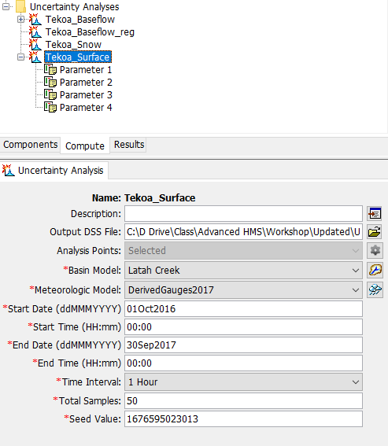
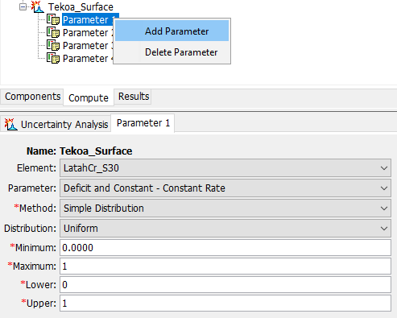
Uncertainty Analysis

Slide 24
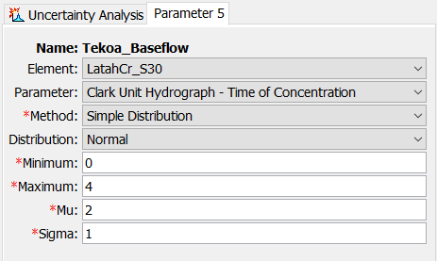
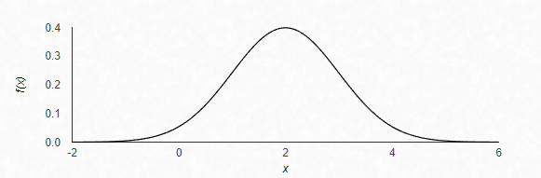
Selecting Parameters
Most parameters in the basin model can be selected for analysis.
  The HMS User’s Manual contains a full list of selectable parameters
Minimum and maximum limits
  Useful for unbounded distributions
  Consider these limits carefully because they lead to distribution clipping.
Notes:
Most HMS model parameters can be selected in an Uncertainty Analysis. You can even sample initial conditions, such as the initial loss or initial SWE. If there isn’t a parameter that you see but would like to add, you can request it.
One possibly confusing input when you are entering parameters is the minimum and maximum. This is meant to keep the random sampling within appropriate bounds by limiting the tails of the distribution. For example, the normal distribution example shows values to -2. You can limit the sampling from 0 to 4.

Slide 25
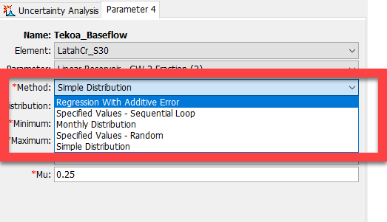
Notes:
In the parameter component editor, there are 5 distribution methods available. Its technically 4 since the Specified Values is the same method.

Slide 26
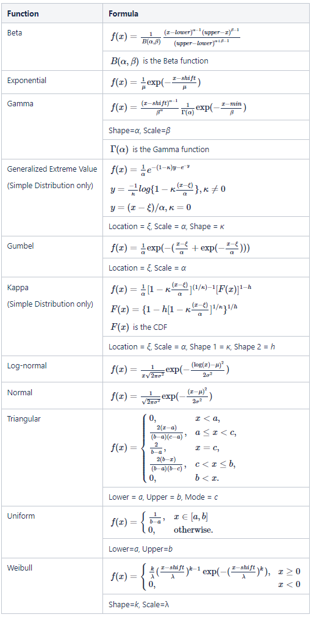
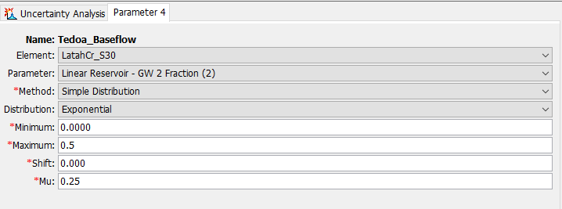
Simple Distribution
Choose a distribution function and enter parameters.
The terminology for the distribution parameters is specific to each distribution.
Notes:
Simple Distribution method, you can select from 11 different distribution types which are listed to the right. Each function will have its own set of parameters that you will need to populate. We don’t provide any guidance on which to choose for which parameter. We let you decide which is appropriate for your parameter. Additionally, you can use a “User-Specified” distribution and choose a Cumulative Probability Distribution that has been entered in the project.
When you use this method in conjunction with multiple parameters, the sampling between parameters is independent of each other. There is no dependency happening between parameters. If you have parameter 1 and parameter 2, parameter 1 doesn’t know what’s happening in parameter 2 and vise versa. There is no relationship.

Slide 27
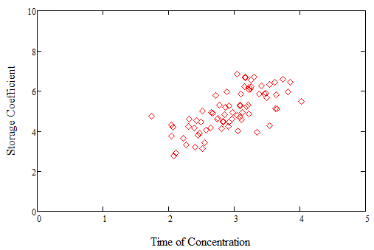
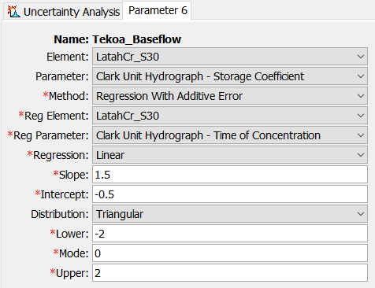
Regression With Additive Error
Method that assigns dependency between two parameters (same subbasin or across different subbasins).
Create a linear or log-linear relationship
Need independent parameter that is already created.
Enter the intercept and slope for the relationship to the independent parameter.
  Select a distribution function for the epsilon error term and enter parameters.
  Independent parameter is sampled first and then the regression relationship is applied with error term to compute value for this parameter.
Notes:
The next method is the Regression with Additive Error. This method was designed so you can assign dependency between parameters. You can also assign dependency between parameters from different subbasins too. This is creating a linear or log-linear relationship with your two parameters outside of HMS and bring that relationship you determined back into HMS. So you’ll have one parameter that acts as the independent variable. This independent parameter would be created from one of the other sampling methods. You enter the intercept and slope for the dependent variable. You can select a error distribution to reflect uncertainty in the regressed value. The distributions you can select are the same as the simple distribution.

Slide 28
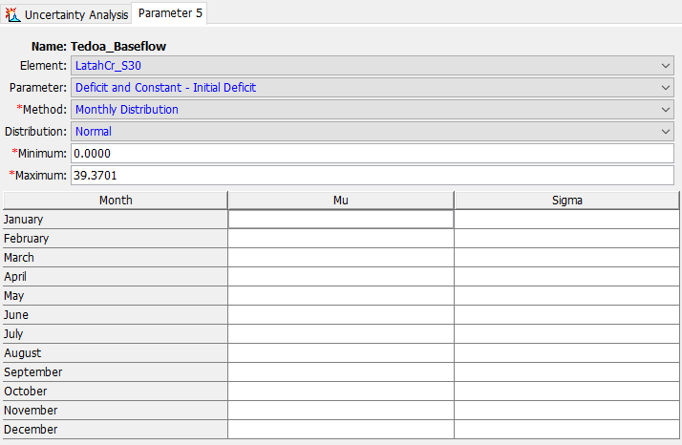
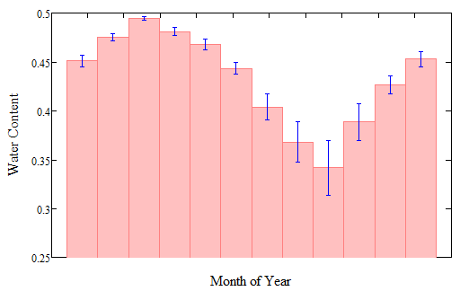
Monthly Distribution
Choose a distribution function and enter different parameters for each month. For example, a normal distribution with different mean and standard deviation for each month.
The start time determines which parameters will be used.
Parameters do not change during the rest of the simulation.
The best use is for initial conditions that are strongly correlated with season.

Slide 29
Specified Values
The selected parameter is based off a table of values determined in an external analysis.
  Paired Data - Parameter Values Sample Data Type
  Create a table for each parameter to sample
The parameter set is sampled based on the index position
Two options for sampling
  Sequential Loop
  Random
 | Parameter 1 | Parameter 2 | Parameter 3
Index 1 | 0.51 | 0.58 | 0.58
Index 2 | 0.51 | 0.90 | 0.56
Index 3 | 0.21 | 0.21 | 0.09
Index 4 | 0.11 | 0.97 | 0.78

Slide 30
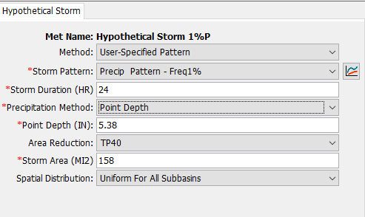
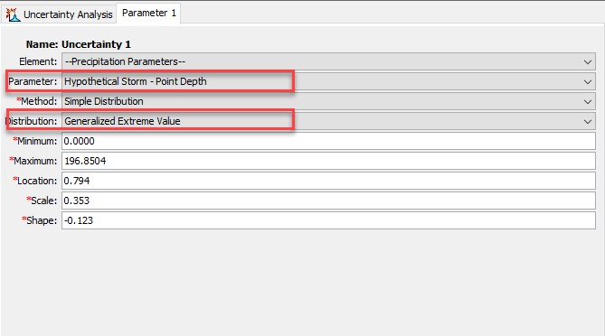
Hypothetical Storm Sampling
If an Uncertainty Analysis is linked to a hypothetical storm met model, several precipitation-related parameters can be sampled
  Point depths
  Precipitation Gridsets
  Storm Patterns
  Area Reduction Functions

Slide 31
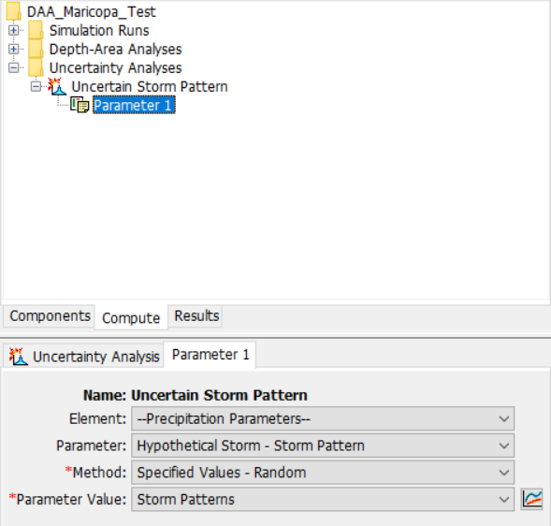
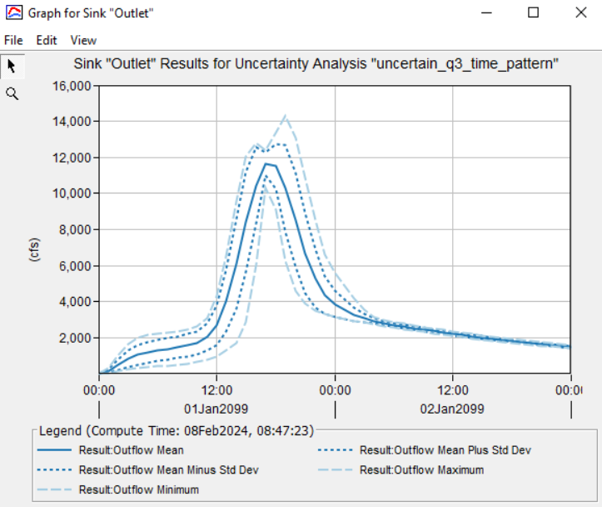
Hypothetical Storm Sampling

Slide 32
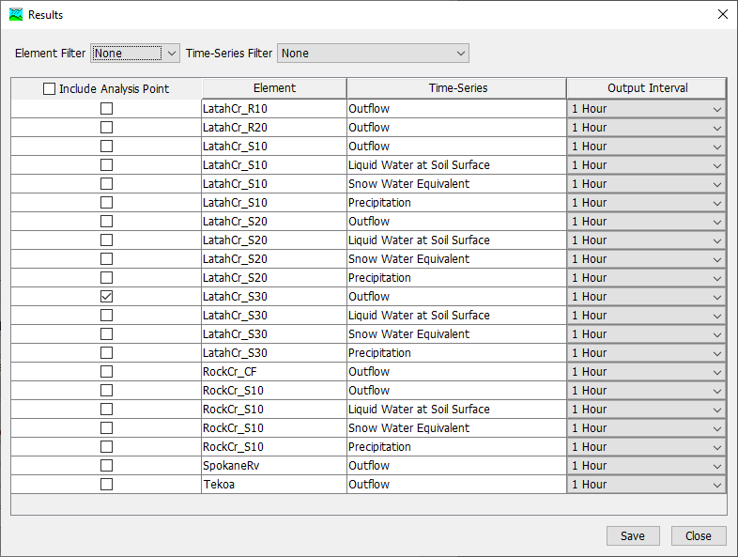
Configuring Results
The simulation of 30,000 samples would produce 30 Gb to 30 Tb of results.
Time-series results are only kept when specifically selected. The result from each sample is kept and used to compute statistics:
  Min, max, mean, ± standard deviation.
Additional statistics are computed for certain types of time-series results.
  Peak flow and volume.
  Reservoir peak pool elevation.

Slide 33
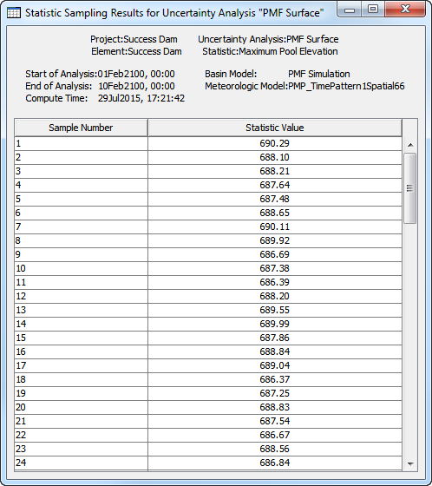
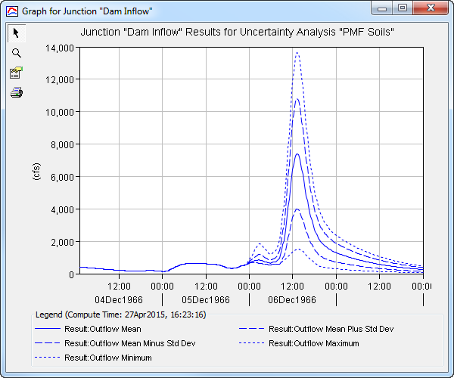
Configuring Results

Slide 34
Summary
Understand the different types of uncertainty in hydrologic modeling.
  Input
  Calibration
  Model/Structure
  Parameter
Look at how uncertainty can be incorporated into several types of hydrologic studies.
Learn how the Uncertainty Analysis component in HEC-HMS should be configured to describe the uncertainty in a watershed model and produce results.
  Monte Carlo Approach

Slide 35
References
Moges, E.; Demissie, Y.; Larsen, L.; Yassin, F. Review: Sources of Hydrological Model Uncertainties and Advances in Their Analysis. Water 2021, 13, 28. https://dx.doi.org/10.3390/w13010028
HEC-HMS User’s Manual
  https://www.hec.usace.army.mil/confluence/hmsdocs/hmsum/4.13/assessing-model-uncertainty
HEC-HMS Technical Reference Manual
  https://www.hec.usace.army.mil/confluence/display/HMSTRM/Uncertainty

