Slide 1
Optimization and Uncertainty Analysis Case Study
Advanced Applications of HEC-HMS
June 2024
Gregory S. Karlovits, P.E., PH, CFM
Statistical Hydrologist
US Army Corps of Engineers
Hydrologic Engineering Center

Slide 2
Purpose
Demonstrate application of the HEC-HMS optimization trial and uncertainty analysis computes

Slide 3
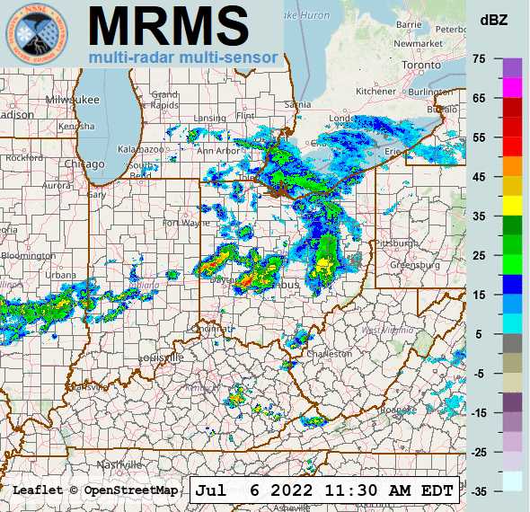
Outline
Optimization of historical storms
Stochastic storm transposition
Notes:
These topics are two sides of the same coin – providing flood risk information for a watershed based on storms within a region. One aims to understand the upper limiting behavior of floods and precipitation, and the other aims to develop a frequency relationship of precipitation and floods.

Slide 4
Optimization of Historical Storms
Fort Worth Silver Jackets Study

Slide 5

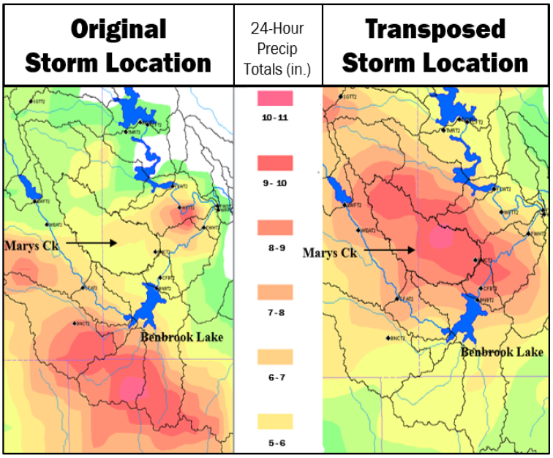
Purpose of Storm Optimization
Silver Jackets study with Ft. Worth District and local entities
Look at near-miss events in the Upper Trinity watershed
Identify how regional storms could have impacted flooding
Evaluate impact of initial conditions on flow maximization
  Reservoir storage, baseflow, soil moisture, etc.
Notes:
The results and discussion we’re showing here are a specific application of the optimization tools in HMS that re-produce a study done in Ft. Worth district.

Slide 6
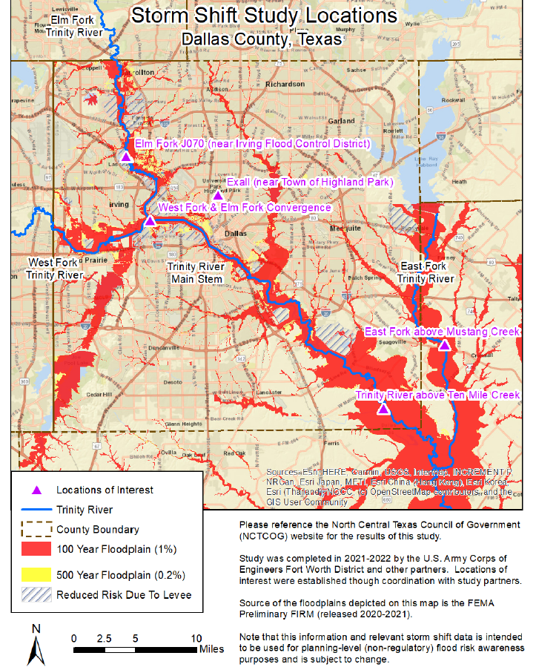

Slide 7
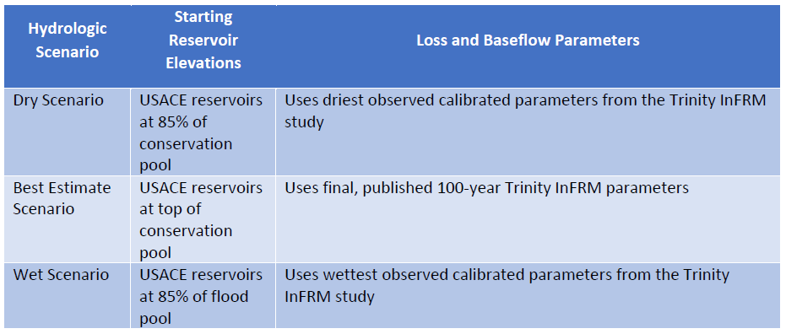
Hydrologic Scenarios
Three different antecedent condition scenarios were analyzed

Slide 8
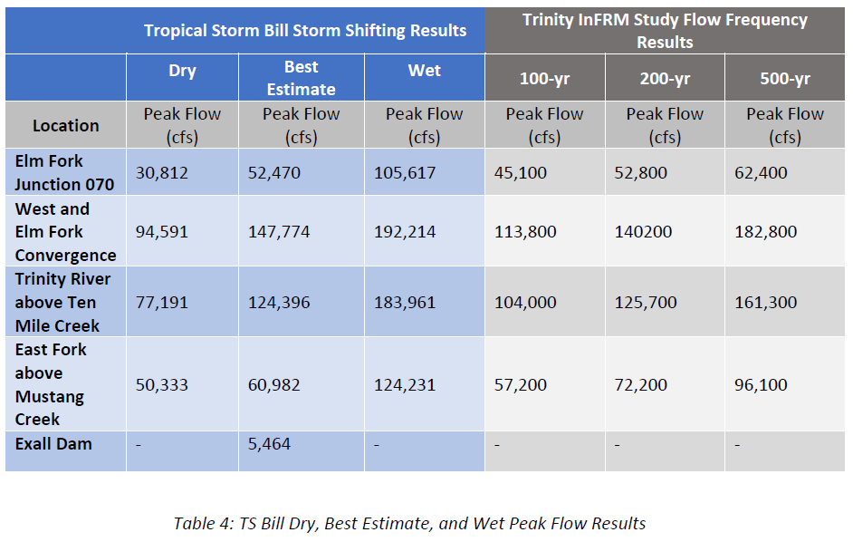
Silver Jacket study results

Slide 9
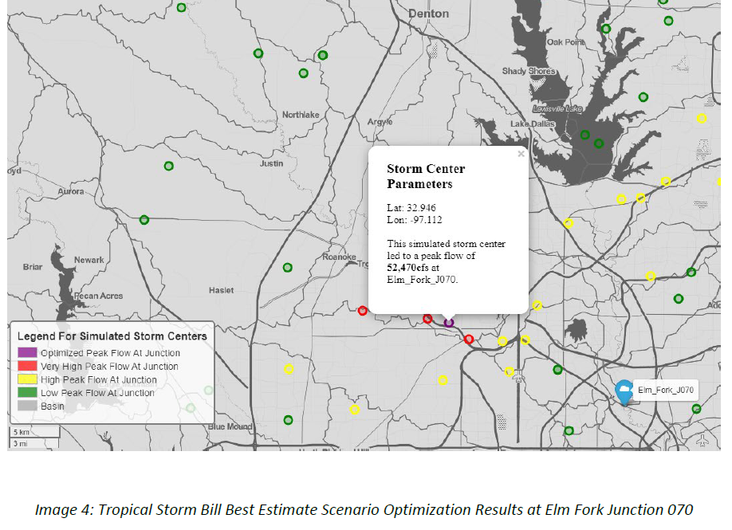
Silver Jacket study results

Slide 10
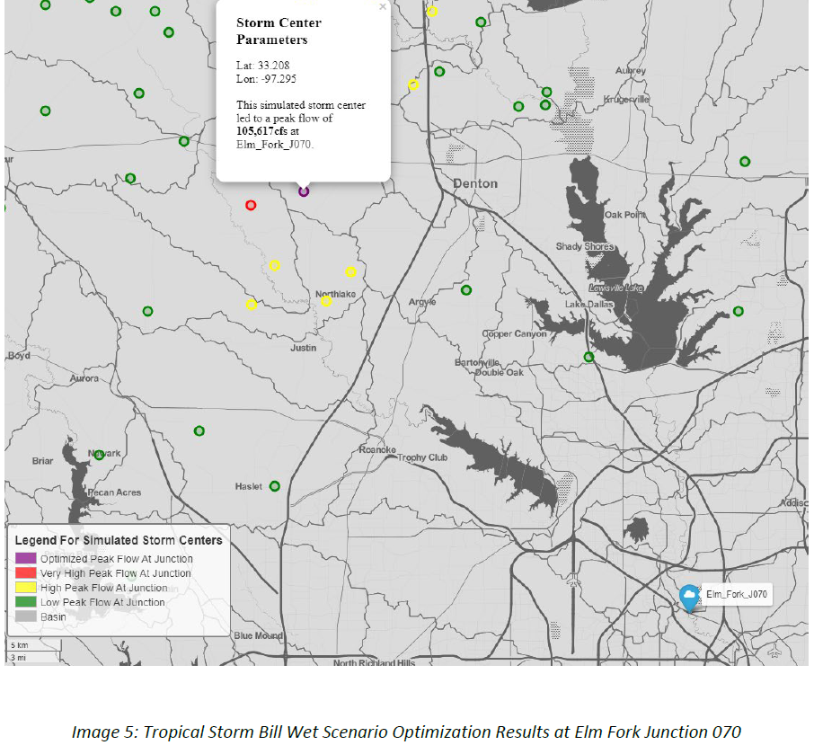
Silver Jacket study results

Slide 11
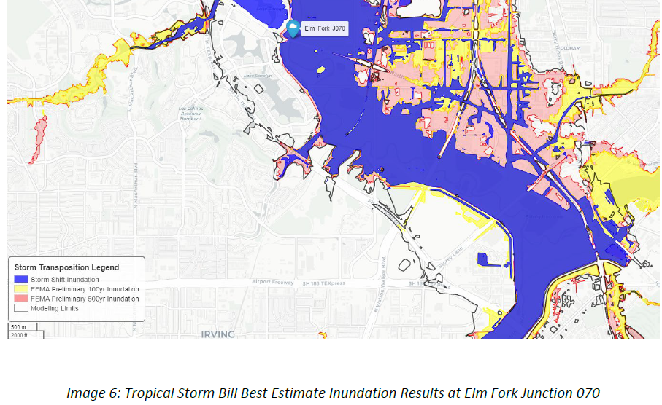
Silver Jacket study results

Slide 12
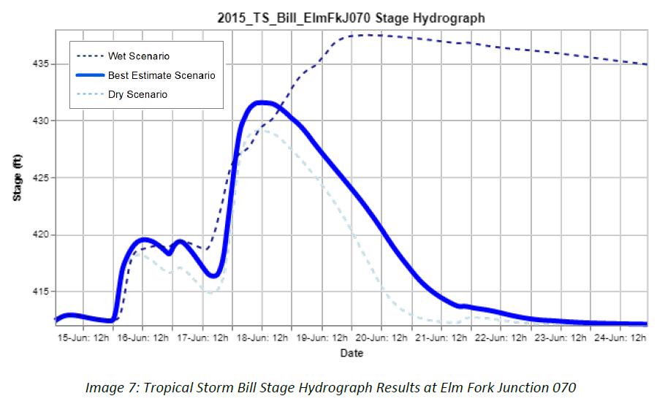
Silver Jacket study results

Slide 13
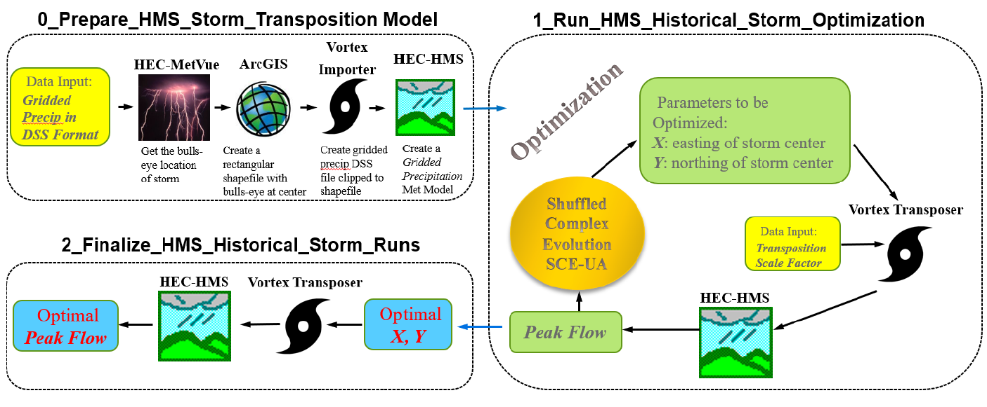
Silver Jackets study workflow
This study was performed prior to the gridded storm optimization capability being added to HEC-HMS
Notes:
The results and discussion we’re showing here are a specific application of the optimization tools in HMS that re-produce a study done in Ft. Worth district.

Slide 14
Joshua 1-9 Jun 2000

Slide 15
Joshua Optimized

Slide 16
Mansfield 26 Jul - 5 Aug 2004

Slide 17
Mansfield Optimized

Slide 18
TS Bill 15-24 Jun 2015

Slide 19
TS Bill Optimized

Slide 20
TS Patricia 21-31 Oct 2015

Slide 21
TS Patricia Optimized

Slide 22
Optimized Storm Centers

Slide 23
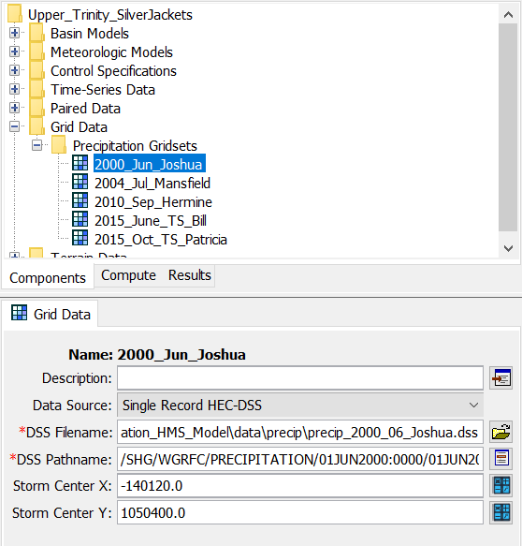
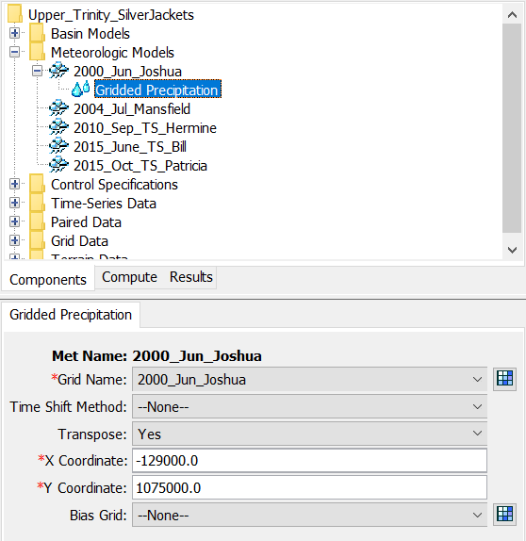
HEC-HMS Meteorology Setup
Notes:
https://www.hec.usace.army.mil/confluence/hmsdocs/hmsguides/working-with-optimization-trials/optimizing-gridded-precipitation

Slide 24
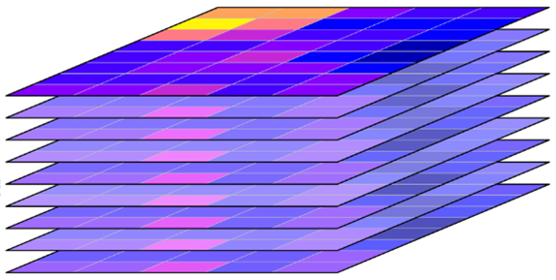
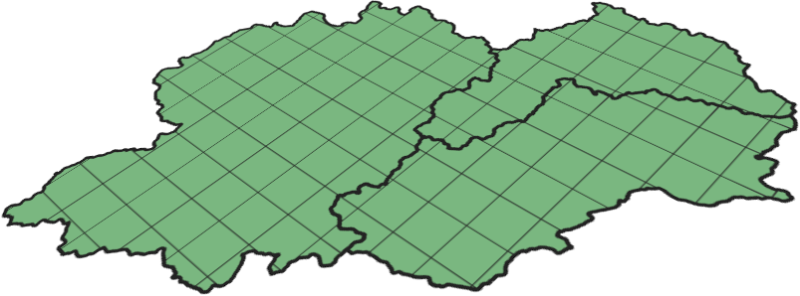
Grid Transposition: Under the Hood
X Coordinate
Y Coordinate
Conceptually, precipitation is being transposed relative to the basin
Time
Computationally, the basin is being transposed relative to the precipitation

Slide 25
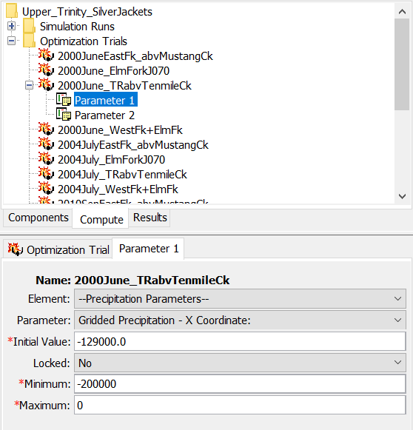
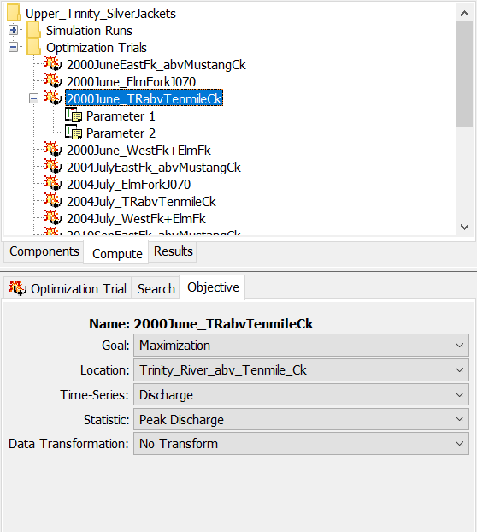
HEC-HMS Optimization Setup

Slide 26
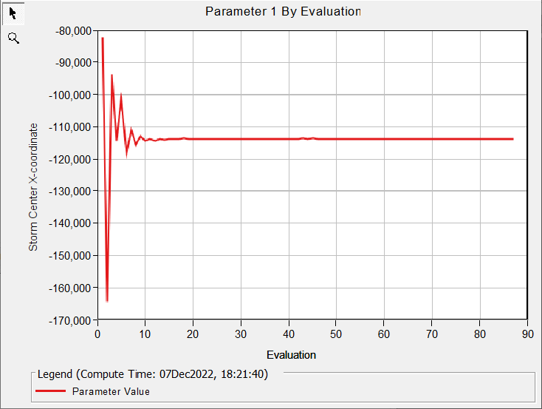
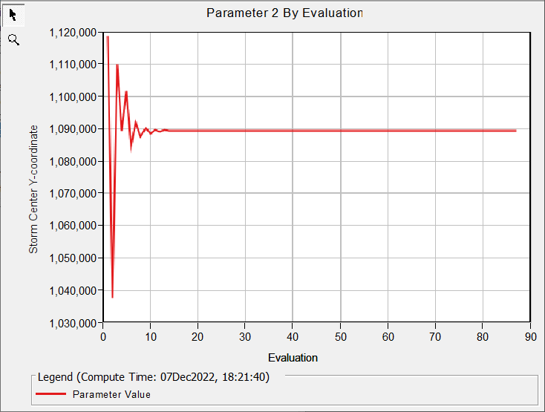
Optimization

Slide 27
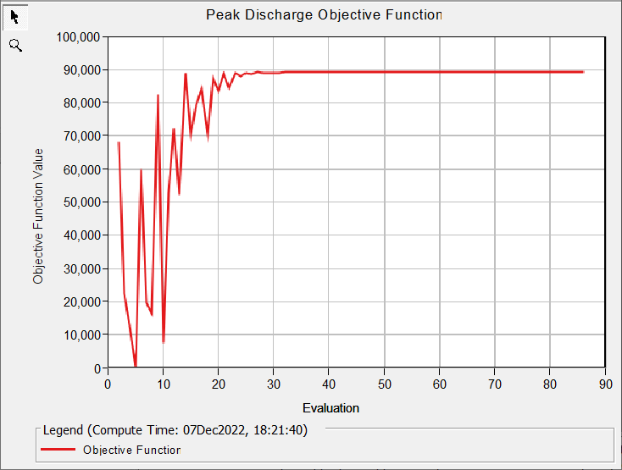
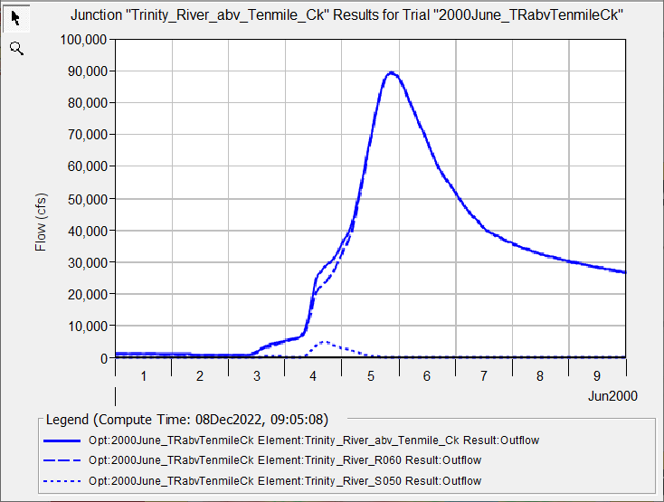
Optimization

Slide 28
Additional Gridded Storm Optimization Resources
Silver Jacket Study Report
  https://www.nctcog.org/getmedia/5a5afb4e-ce02-44c1-b46f-381a53522933/Report_Upper-Trinity-River-Storm-Shifting-Silver-Jackets-Study.pdf
T&G on Transposing Gridded Precipitation in HEC-HMS
  https://www.hec.usace.army.mil/confluence/hmsdocs/hmsguides/new-tutorials-to-check-out/transposing-gridded-precipitation
T&G on Optimizing Gridded Precipitation in HEC-HMS
  https://www.hec.usace.army.mil/confluence/hmsdocs/hmsguides/working-with-optimization-trials/optimizing-gridded-precipitation

Slide 29
Stochastic Storm Transposition
Future of Flood Risk Data (FFRD) Initiative

Slide 30
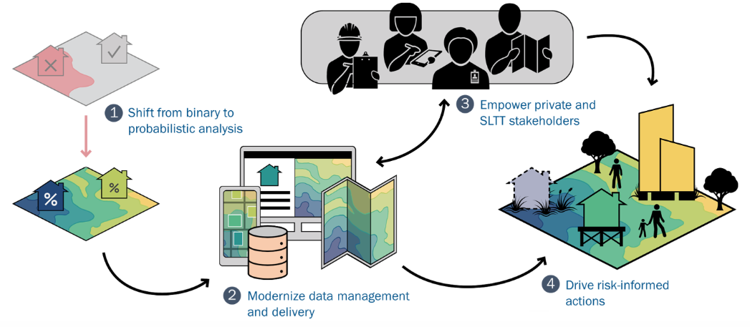
Future of Flood Risk Data Background
The FFRD team is working on a methodology to shift from binary 100-year floodplains to probabilistic methods that produce graduated floodplains from approximately the 5-year to the 2000-year.
This methodology is being tested and refined in three ongoing pilot projects across the nation and being documented in Standard Operating Procedures to ensure consistency in the development and computation of models across the nation.

Slide 31
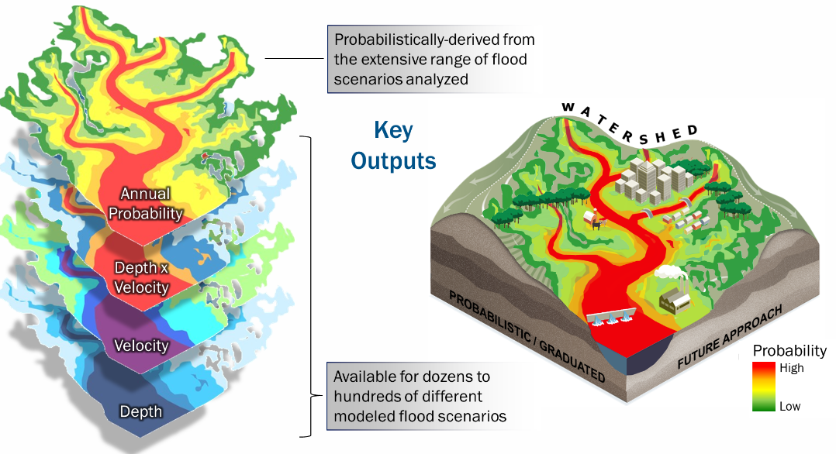
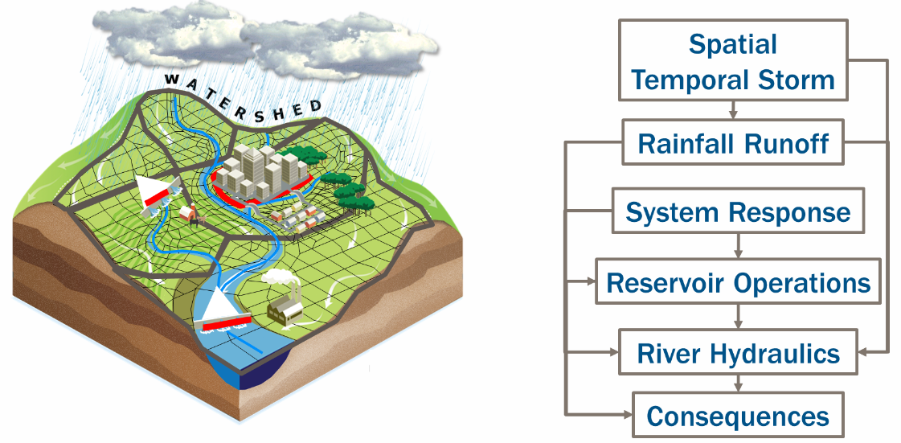
Future of Flood Risk Data Background
For the hydrology portion of the FFRD modeling sequence, HEC-HMS and new Stochastic Storm Transposition Tools within the Uncertainty Analysis are being used to determine precipitation-frequency curves and flow-frequency curves
FFRD Modeling Sequence
Probabilistically-derived Results

Slide 32
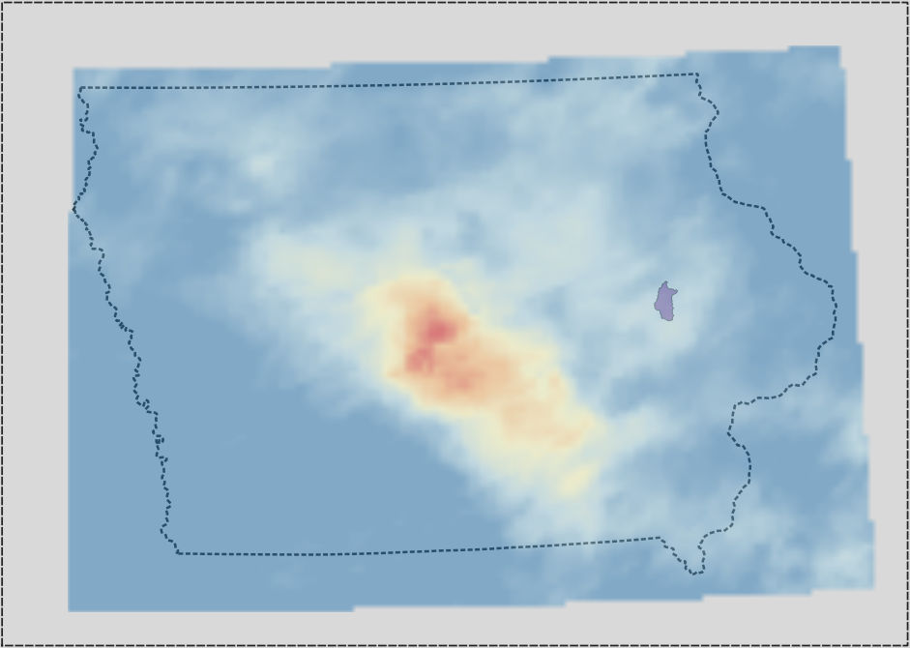
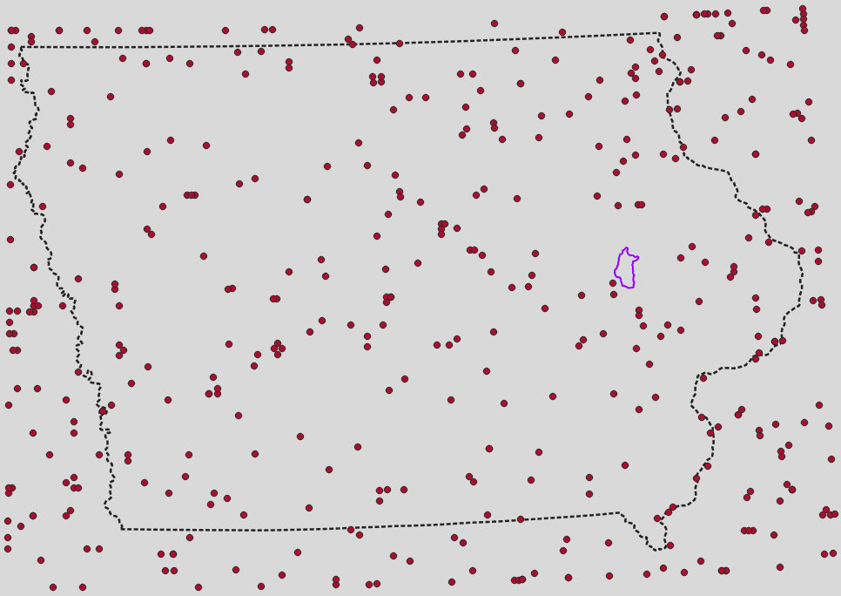
Overview of SST Method
Data-driven method for watershed precipitation frequency
Based on a “catalog” of severe storms
Simulated by random selection of storms and their position
1 real storm…
…out of a whole catalog of storms

Slide 33
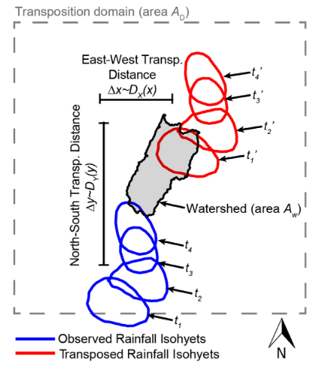
Overview of SST Method
Non-parametric space-for-time substitution
Resample severe storm events from a catalog
Preserve properties of real storms
Develop watershed-average precipitation-frequency
Transpose multiple storms per year
  Use a data-driven approach to reduce assumptions
Wright, Smith, and Baeck (2013)

Slide 34
Precipitation-Frequency
Stochastic Storm Transposition
Regional analysis of point data
Assumed temporal and spatial pattern
Duration-area-reduction
One hydrology simulation per storm
Regional analysis of grid data
Observed/varying temporal and spatial patterns
Explicit area averages
Large number of hydrology simulations

Slide 35
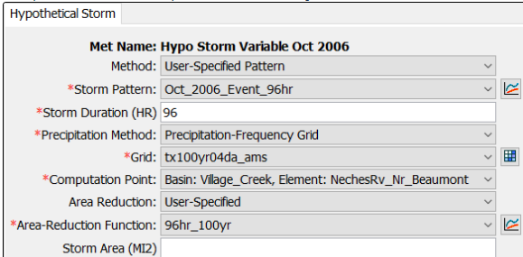
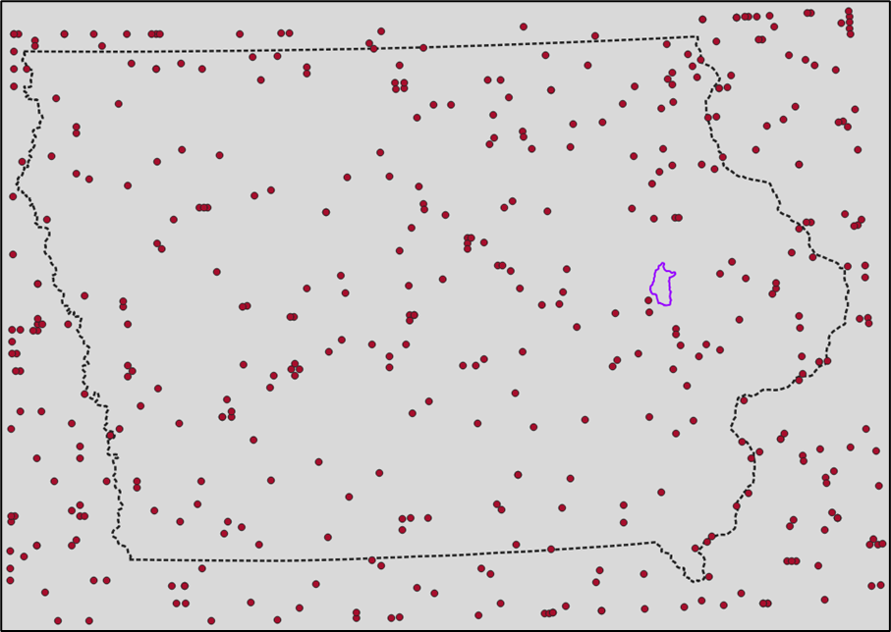
Precipitation-Frequency
Stochastic Storm Transposition
Regional analysis of point data
Assumed temporal and spatial pattern
Duration-area-reduction
One hydrology simulation per storm
Regional analysis of grid data
Observed/varying temporal and spatial patterns
Explicit area averages
Large number of hydrology simulations

Slide 36
Building a Catalog
Determine a transposition domain
Apply the severity criteria
Extract storm precipitation data
  Sub-daily grids for entire duration
440 storm centers for Iowa
10 largest 72-hour 100 mi² storms

Slide 37
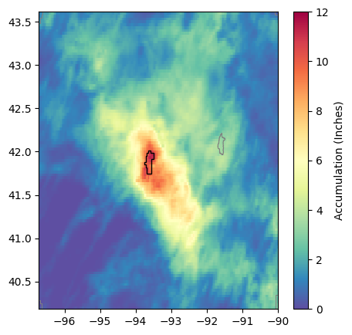
Severity Criteria
Decision metric for inclusion of storms in a catalog
Usually considers several traits:
  Average depth of precipitation
  Averaged over some area
  Accumulated over some duration of time
Example:
The 10 largest 72-hour precipitation events per year, averaged over an area the size and shape of the target watershed

Slide 38
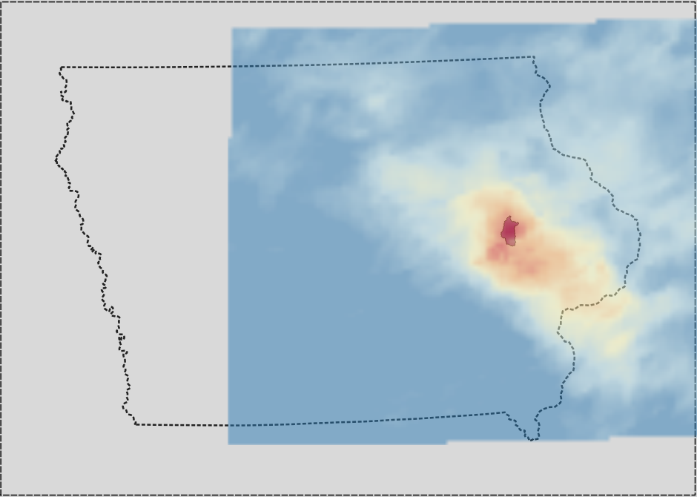
Transposing Storms
Δx ~ uniform
Δy ~ uniform
observed
transposed

Slide 39
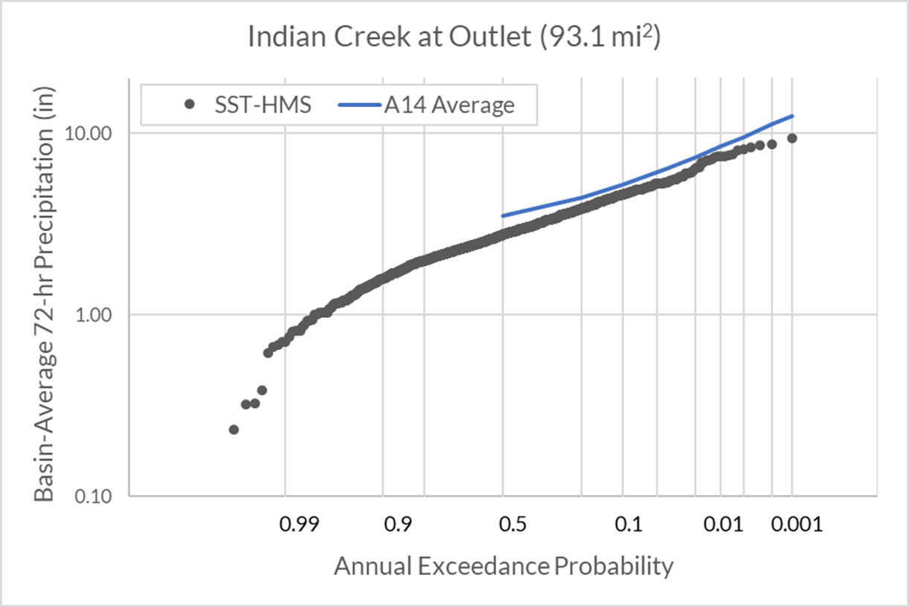
SST Precipitation-Frequency
For some large number of years of storms:
Sample number of storms for the year
For each storm:
  Select one from the catalog
  Transpose it uniformly within the domain
  Compute area-average precipitation over watershed
Plot annual maximum storm totals as a frequency curve
Notes:
SST can be used to generate watershed-averaged precipitation frequency curves by selecting storms at random from the catalog, transposing them at random inside the transposition domain, and computing the watershed-averaged precipitation from each transposition. Each simulation year contains multiple transpositions, and an empirical annual maximum distribution is extracted from the largest transposition of each year. The number of storms per year can vary, usually sampled from a Poisson distribution with a mean rate equal to the mean rate of storms per year in the storm catalog. Storms are altered by transposition only, and the fields are not rotated or scaled in any way.
The structure of the simulation has more years than the rarest desired return interval. For example, if an estimate for the 1/1,000 AEP event is desired, the simulation will have more than 1,000 years of transpositions.

Slide 40
Precipitation → Flow
Option 1:
  Use precipitation-frequency curve for traditional hypothetical storms
Option 2:
  Couple in a hydrologic model and compute flows right away

Slide 41
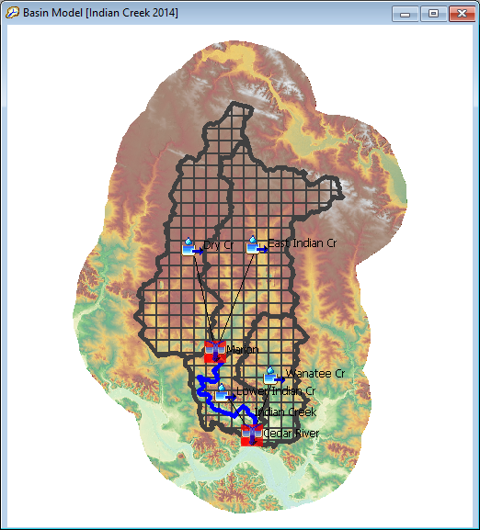
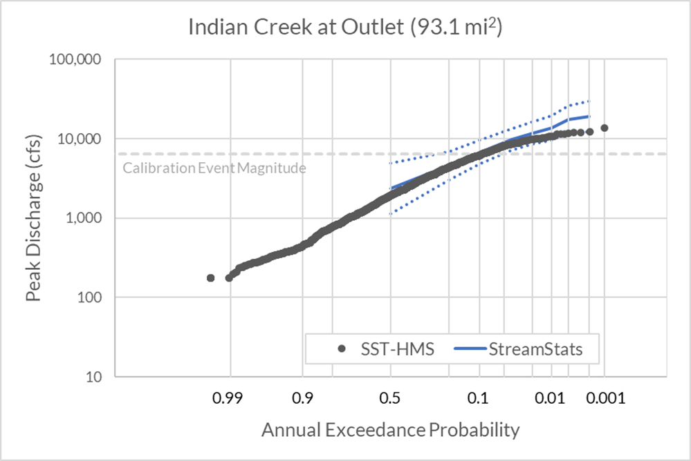
SST Flow Frequency
For some large number of years of storms:
Sample number of storms for the year
For each storm:
  Select one from the catalog
  Transpose it uniformly within the domain
  Initialize and run the hydrologic model
  Extract peak discharge
Plot annual maximum flows as a frequency curve

Slide 42
SST
Reduces assumptions
  Uses space-time patterns of real storms
  No need for area-reduction
Takes advantage of space-for-time substitution
Compute flow results at multiple locations in a single simulation
Reliant on a good catalog
Monte Carlo simulation can have long run-times

Slide 43
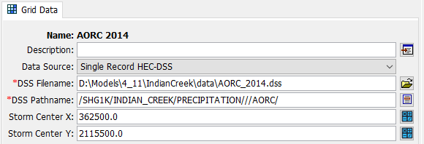
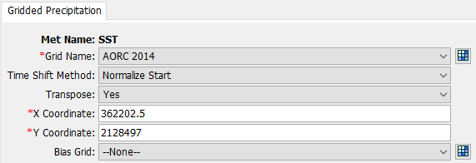
SST in HMS
New meteorologic model settings
Time shift snaps storm to the simulation time window start

Slide 44
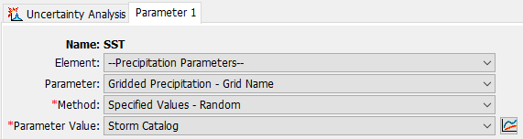
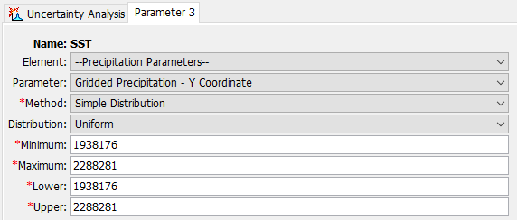
SST in HMS
Simulation using Uncertainty Analysis
Uniform X and Y will always create a rectangle full of points

Slide 45
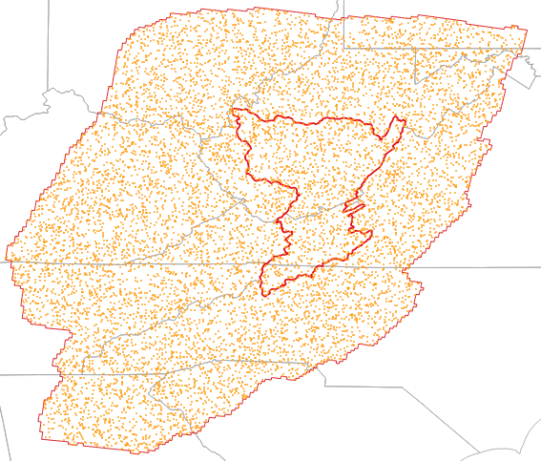
Restricted Points
Fills a non-rectangular shape
QGIS*:
  Vector >
  Research Tools >
  Random Points in Polygons
10,000 points inside the transposition domain
*this does not constitute an official endorsement

Slide 46
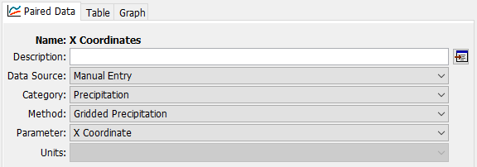
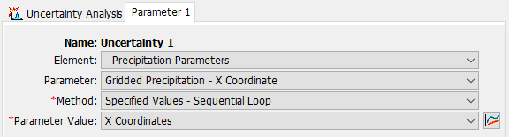
SST in HMS –
Restricting Transposition Points
Notes:
Step 1 is to generate the sample of (x, y) coordinate pairs inside the domain – for example, generate a huge number of them, pull them into GIS, select the ones inside the domain, and export them so you have enough for the simulation.
Step 2 is to import them into HMS – a separate set for X and Y. You want to make sure the sequence keeps the pairs together – that the first X coordinate goes with the first Y coordinate, and so on.

Slide 47
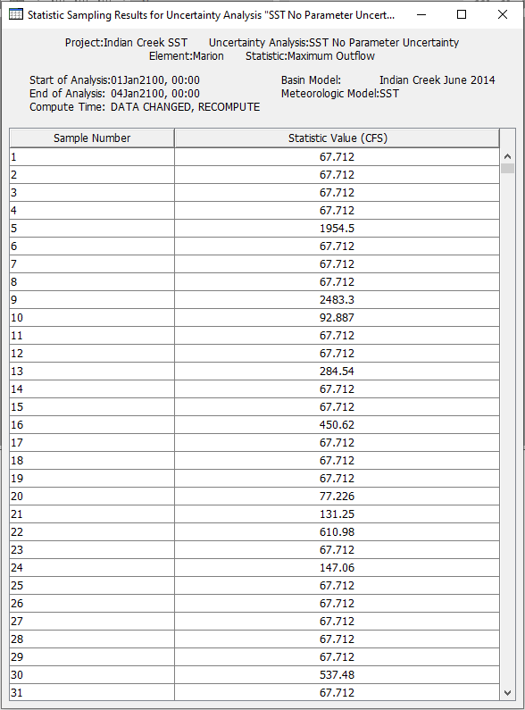
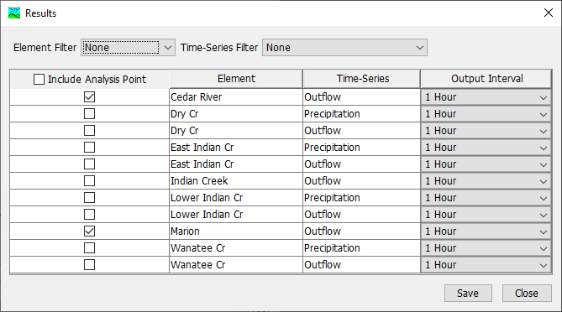
Output and Results

Slide 48
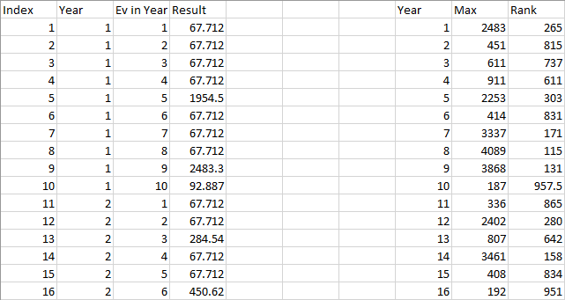
Post-Processing for Frequency Curves
HMS only simulates a total number of transpositions
Need to transform them into annual maxima
Will be native support later

Slide 49
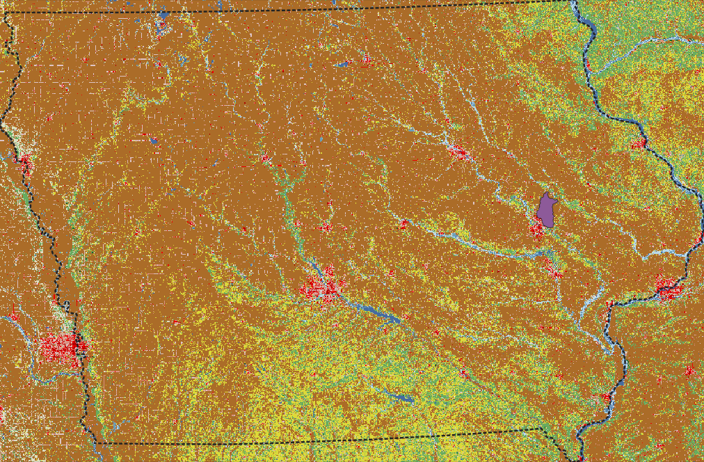
Pilot Study Site
Indian Creek watershed near Cedar Rapids, IA
Mixed agricultural-urban
93 mi² at outlet
Very limited USGS streamgage record

Slide 50
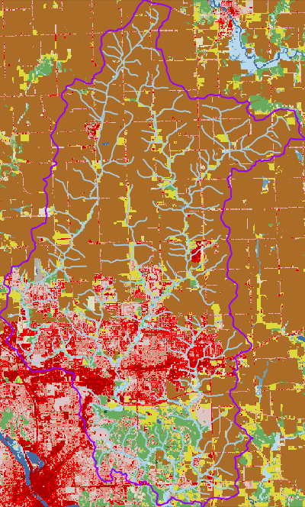
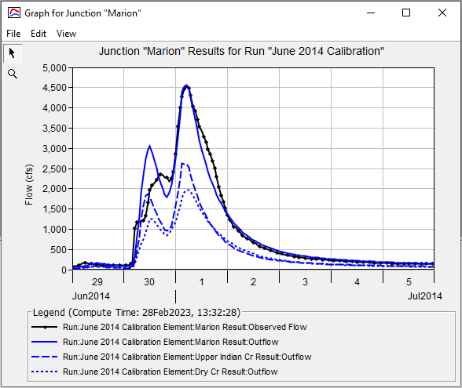
Pilot Study Site
About a 1/10 AEP event
USGS 05464695

Slide 51

SST Precipitation Frequency Results
Area Reduction
1,000 yr x
10 transpositions/yr -> max transposition

Slide 52
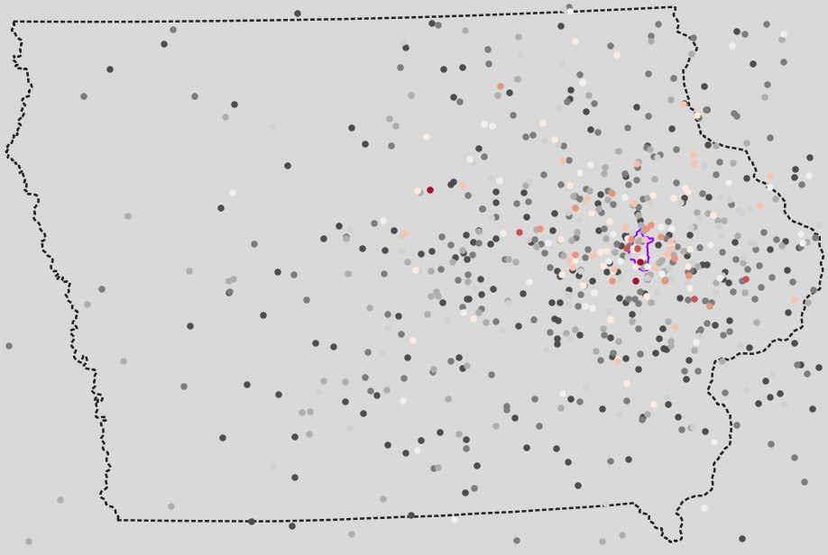
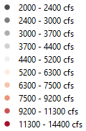
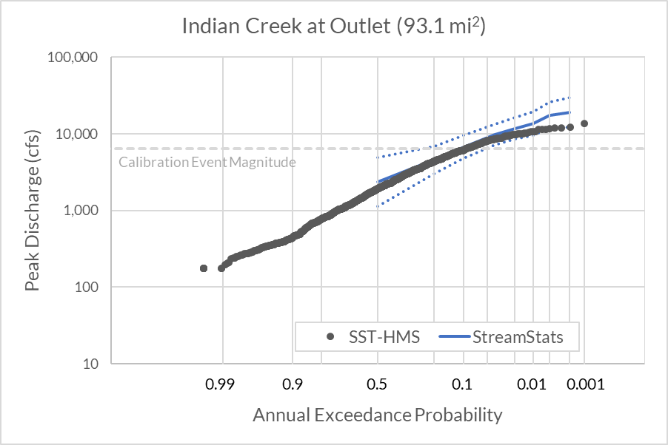
SST Flow Frequency Results
Non-Linearity
1,000 yr x
10 transpositions/yr ->
max transposition
10,000 transpositions showing those greater than 2,000 cfs at Marion

Slide 53
Additional SST Resources
HEC Newsletter on FEMA’s FFRD Initiative
  https://www.hec.usace.army.mil/confluence/hecnews/spring-2023/fema-s-future-of-flood-risk-data-initiative
HEC Newsletter on Stochastic Storm Transposition in HEC-HMS
  https://www.hec.usace.army.mil/confluence/hecnews/spring-2023/stochastic-storm-transposition-in-hec-hms
HEC Technical Seminar on Precipitation and Flow Frequency Analysis Using Stochastic Storm Transposition
  https://www.youtube.com/watch?v=AZMGbCK4d7w
2023Q4 HEC-HMS Stochastic Storm Transposition Quarterly Webinar
  https://www.youtube.com/watch?v=vy1alePFTg4&t=11s

Slide 54
Questions?

