Slide 1
Rainfall-Runoff Modeling Surface Runoff in HEC-HMS
Hydrologic Engineering Center

Slide 2
Agenda
Transform Methods Introduction
Unit Hydrograph Derivation
Clark Unit Hydrograph
SCS Unit Hydrograph

Slide 3
HEC-HMS Surface Runoff Transform Methods Introduction

Slide 4
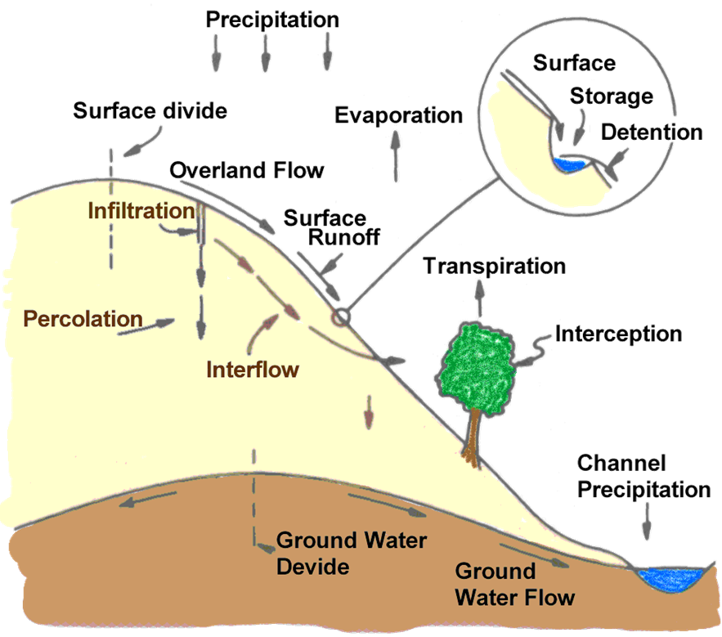
Source:http://www.comet.ucar.edu/class/hydromet/09_Oct13_1999/docs/fiedler/oct99_unit_hydrograph/sld002.htm
Notes:
We start our discussion by reviewing the physical processes that take place once you start getting precipitation onto the watershed. This figure shows the various hydrologic processes that could occur once rainfall falls to the ground. Much of the rainfall is subject different losses; you can get infiltration of your rainfall into the soil, there could be rainfall that falls on canopy and gets stuck there, your ground surface may contain storage that traps rainfall or movement of flow. These losses can all be subtracted from the amount of precipitation that falls on a basin. When losses are subtracted we are left with the excess precipitation, meaning it’s the rainfall amount left over after you account for the losses we just described. Excess precipitation over the basin ends up on the surface, which is converted to a runoff and makes its way to the channel and basin outlet.

Slide 5
Excess Precipitation Transformation
Precipitation
Loss
Excess
Precipitation
Model
Computation
Transformation
Interflow + Baseflow
Outlet
Channel
Total Subbasin
Flow
Routing
Runoff
Notes:
In rainfall-runoff modeling, we attempt to model the various hydrologic processes that occur when you get rainfall over a basin. The component that handle’s surface runoff is the transformation of excess precipitation as shown here in red. The excess precipitation gets converted or transformed into surface runoff which feeds into the total hydrograph. To reiterate, the excess precipitation just looks at the surface runoff. There are other components to the total outlet flow, such as interflow and groundwater flow, but we’ll be focusing our discussion on just the transformation of excess rainfall.

Slide 6
Hydrograph - Illustrated
Crest (peak)
Direct runoff
Rising limb
Inflection Point
Flow
Interflow
Falling limb
Base flow
Time
Notes:
One of the main purposes of a rainfall-runoff model is to produce a hydrograph at a specified located. A hydrograph is simply a plot of discharge vs time for a given location. The term “Hydrograph” is synonymous with terms runoff, discharge, or flow and you might hear these interchangeably. The excess rainfall transformed to runoff makes up a part of the total hydrograph, which we call direct runoff. Interflow and baseflow, which deals with the subsurface movement of water, are also important components to the total hydrograph. Other components to the hydrograph are the rising limb, which is the start of direct runoff up to the hydrograph peak, and the falling limb, which begins from the hydrograph peak to the end of direct runoff. The falling limb is also known as the recession limb. The inflection point is generally the point at which direct runoff ends and interflow or baseflow drive the rest of the hydrograph.
Size of the watershed – greater the area, the larger the flow
Shape of watershed – elongated shapes tend to produce flatter peaks, Pear shared drainages produce larger peaks
Well define channels – less attenuation than channels that are not well defined
Land slope – steeper hydrograph slopes for steeper basins than flatter slopes

Slide 7
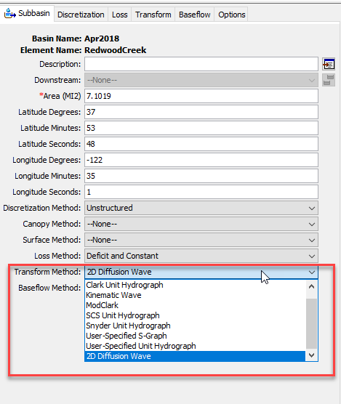
Surface Transform Methods in HMS
Unit Hydrograph
Kinematic Wave
2D Diffusion Wave
Notes:
How do we go about transforming excess rainfall to surface runoff? In HMS, we have three transform methods available for us: the Unit Hydrograph Method, Kinematic Wave, and 2D Diffusion Wave Transform.

Slide 8
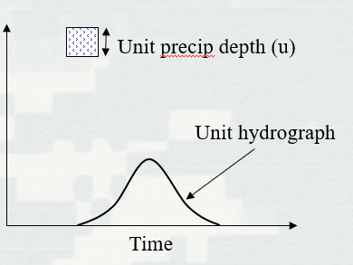
Unit Hydrograph
Defined as the “basin outflow resulting from 1.0 inch (1.0 mm) of direct runoff generated uniformly over the drainage area at a uniform rainfall rate during a specified period of rainfall duration.” (Sherman, 1932)
Often used for “lumped” parameter modeling
User Specified Unit Hydrograph, User-Specified S-Graph, Clark and ModClark, SCS, and Snyder’s
Notes:
The first method, and most well known, is the Unit Hydrograph. The concept was developed by guy name of Sherman. Sherman (1932) defined the unit hydrograph (UH) as the “basin outflow resulting from 1.0 inch (1.0 mm) of direct runoff generated uniformly over the drainage area at a uniform rainfall rate during a specified period of rainfall duration.”
“Sherman originally used the word "unit" to denote a unit of time, but it has since been interpreted as a unit depth of excess rainfall which is why we use 1 inch or 1 mm.”
The unit hydrograph is often used for lumped parameter modeling, meaning the parameters that characterize the unit hydrograph is an average over the watershed area and ignore spatial variation. There are exceptions to this with the ModClark method, which we will discuss in a different video.
There are different ways to apply the unit hydrograph concept. In HMS, you have the ability to select from a number of different methods, such as Clark and SCS, and variations to the unit hydrograph, such as the S-Hydrograph Method.

Slide 9
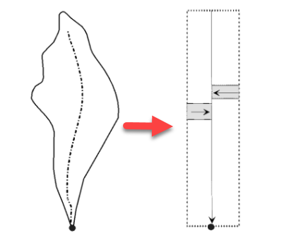
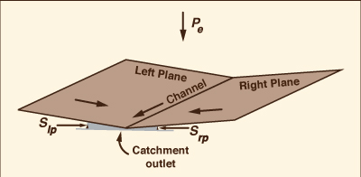
Kinematic Wave
Conceptual model using 1 or 2 planes
Sub-collector, collector, and channel
momentum and continuity equation
Unsteady, uniform flow
Primarily designed for representing urban regions
http://ponce.sdsu.edu/the_kinematic_wave_controversy.html
Notes:
The 2nd transform method available is the Kinematic Wave Transform. The Kinematic Wave represents the watershed as two plane surfaces over which water runs until it reaches the channel. The water then flows down the channel to the outlet. The watershed and its channels are conceptualized as shown in this Figure, where you have water move as overland flow on the planes and then as channel flow. Another way of looking at this is resembling something like an open book, with the water running parallel to the text on the page and then into the channel that follows the book's center binding. This method solves the energy and continuity equations for both the planes and the open channel to compute the watershed runoff hydrograph. The kinematic wave as designed in HMS is useful for representing urbanized regions.
Unsteady flow – flow changes with respect to time
Uniform flow – flow does NOT change with respect to distance

Slide 10
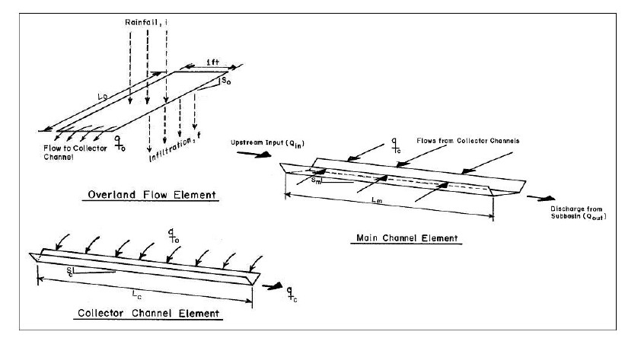
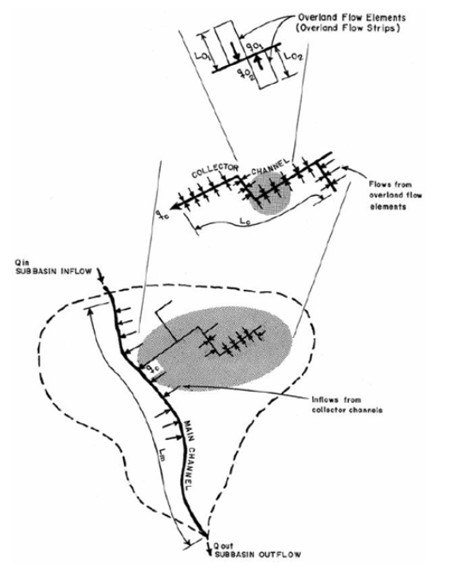
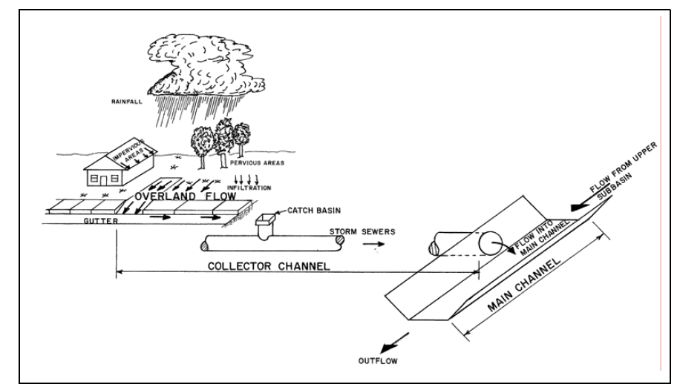
HEC, 1993

Slide 11
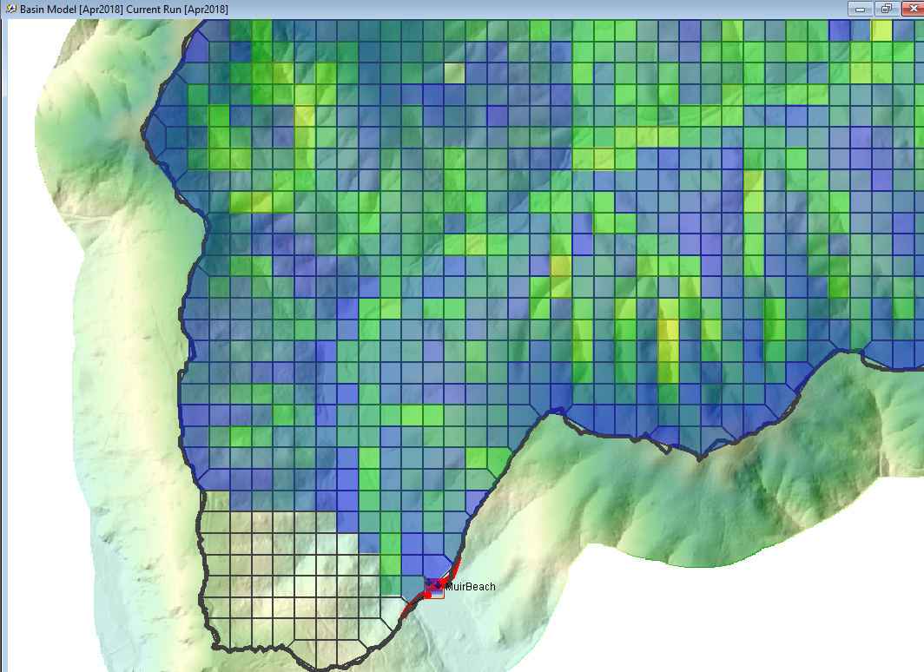
2D Diffusion Wave
Routes excess precipitation using continuity and momentum equations
Neglects the acceleration term
Represents subbasins using a 2D mesh of both grids cells and grid faces
Create this in HEC-RAS
Distributed parameter modeling
Ability to visualize spatial variables such as water surface elevation and average velocity
Notes:
A relatively recent feature in HMS is the ability to route water using the 2D Diffusion Wave method. The 2D Diffusion Wave transform method routes excess precipitation using the combination of the continuity and momentum equations. One of the main advantages to using this method compared to using the unit hydrograph transform methods, this transform can be used to simulate the non-linear movement of water throughout a subbasin. The 2D diffusion represent subbasins using a 2D mesh, which at this time requires RAS 2D to create. Since the transform does occur on a grid cell by grid cell basis as well as the routing of flow, this method allows for distributed parameter modeling, meaning the model accounts for behavior variations from a grid cell to grid cell throughout the system. The 2D diffusion wave also has the capability of visualizing computed variables spatially such as the water surface elevation and average velocity on a grid cell by grid cell basis.

Slide 12
HEC-HMS Surface Runoff Unit Hydrograph Derivation
Notes:
The method we will focus on is the unit hydrograph method. Again, this is the simplest representation of the transform methods. We’ll go into the theory behind the unit hydrograph and build some intuition on how it generates flow

Slide 13
Unit Hydrograph
Defined as the “basin outflow resulting from 1.0 inch (1.0 mm) of direct runoff generated uniformly over the drainage area at a uniform rainfall rate during a specified period of rainfall duration.”
User Specified Unit Hydrograph, User-Specified S-Graph, Clark and ModClark, SCS, and Snyder’s
Notes:
We’ll spend most of our time talking about unit hydrograph because this is most often the method used for transform for hydrologic modeling. Much less parameterization and efficient computing.
Let’s review the definition of a unit hydrograph again. The unit hydrograph is defined as the “basin outflow resulting from 1.0 inch (1.0 mm) of direct runoff generated uniformly over the drainage area at a uniform rainfall rate and during a specified period of rainfall.” The unit hydrograph is one of the available techniques to transform excess precipitation to discharge.
The unit hydrograph is often used for lumped parameter modeling and there are different methods available in HEC_HMS to characterize the unit hydrograph.

Slide 14
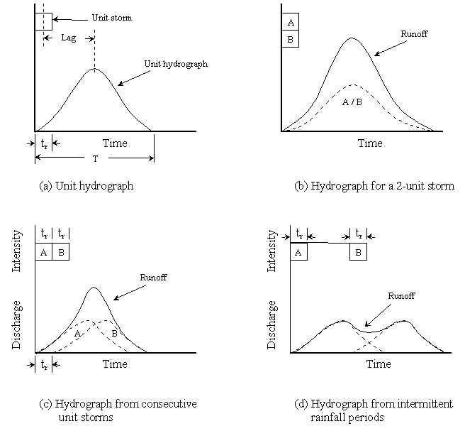
Unit Hydrograph Assumptions
Rainfall excesses of equal duration are assumed to produce hydrographs with equivalent time bases regardless of the intensity of the rain
Direct runoff ordinates for a storm of given duration are assumed directly proportional to rainfall excess volumes. Twice the rainfall produces a doubling of hydrograph ordinates (superposition)
The time distribution of direct runoff is assumed independent of antecedent precipitation (time invariance)
Excess precipitation is spatially distributed uniformly and has a constant intensity throughout the time interval
Notes:
The unit hydrograph comes with a set of assumptions and principles that are important to understand.
Excess rainfall of equal duration are assumed to produce hydrographs with equivalent time bases regardless of the intensity of the rain. Time base is referring to the duration of direct runoff (after accounting for losses and removing baseflow). Regardless of how many inches your rainfall within a specified duration, you will get the same time base.
The direct runoff ordinates for a storm of given duration are assumed directly proportional to rainfall excess volumes. That means if you have 2 times the rainfall, you will get a doubling of the hydrograph ordinates. This highlights the principle of superposition - if you compare the runoff from 1 inch of rainfall to the runoff from 2 inches of rainfall, you essentially get a hydrograph that’s twice the size.
The time distribution of direct runoff is assumed independent of antecedent precipitation. This is the principle of time-invariance. Regardless of the state of the watershed, if you have one inch of rainfall over your basin, you will always get the same hydrograph regardless of when that rainfall occurs. The excess runoff on a wet basin and dry basin will look the same
Excess precipitation is spatially distributed uniformly and has a constant intensity throughout the time interval. This is described in the definition of the unit hydrograph and restated again. Example, if this room was a watershed, what this means is we’d have 1 inch of rainfall applied uniformly. We’d be equally drenched.

Slide 15
UH - Limitations
Normally do not see proportional behavior in river flow.
Time-invariance can be affected by the seasons
Areal distribution of rainfall rarely uniform over time and space
But the Unit Hydrograph method still works well…when we calibrate!
Notes:
Now that you have an understanding of the assumptions, you could probably tell there are limitations to this concept when applied to natural catchments. We’ll describe three limitations to applying the UH. The assumption of proportionality and superposition mostly conflicts with the observed behavior of river flow, which are typically non-proportional (or non-linear). The antecedent conditions of the ground, whether the ground starts off as saturated or unsaturated, can have a significant affect on the behavior of runoff. Rainfall intensities have also been shown to affect the runoff behavior as non-linear with increasing rainfall intensities.
The assumption of time-invariance can be affected by the season. The response hydrograph can be expected to vary based on the time of year. For example, vegetation might be at its highest development during the spring or summer and therefore hydraulic behavior of the catchment might be rougher and affect the runoff response.
The assumption of excess rainfall uniformly distributed in space and time is also not normally seen. More often, storms tend to vary in intensity in both space and time and the contributing runoff areas will expand and contract as the catchment dries and wets. However, this last limitation can be accounted for in your modeling by selecting a smaller rainfall duration to capture the changes in intensities. The changes in space can be accounted for by delineating your watershed to smaller subbasin if the data is available.
Despite these limitations, the unit hydrograph method is still used widely because of its simplicity to apply to many different types of watersheds and is still the basis for many analysis and estimation techniques.

Slide 16
Unit Hydrograph – Derivation Example
Notes:
Let go over how someone would derivate a unit hydrograph from an observed hydrograph and rainfall. The method I am going to show you nobody does this anymore. In case you are reading old reports or you still need to take the PE or PH exams, you don’t need to know this in great detail.

Slide 17
Unit Hydrograph - Derived
Separate interflow and base flow
Excess precip depth (d)
Excess precip depth (d)
Direct runoff
Direct runoff
Flow
Flow
Interflow
Base flow
Time
Time
Notes:
The first step to deriving a unit hydrograph for your watershed is to separate the interflow and baseflow. The main goal of separating these out is so we can analyze just the direct runoff. There are many different techniques for separating interflow and baseflow from the hydrograph, all of which require some user judgement. In this example, direct runoff begins at the onset (click) of excess precipitation. The inflection point (click) on the recession limb of the hydrograph is used to indicate the change in physical processes controlling discharge which we infer is the interflow or baseflow. So a straight line (click) is drawn from the start of excess rainfall to the inflection point on the hydrograph. What you (click) are left with is the direct runoff.

Slide 18
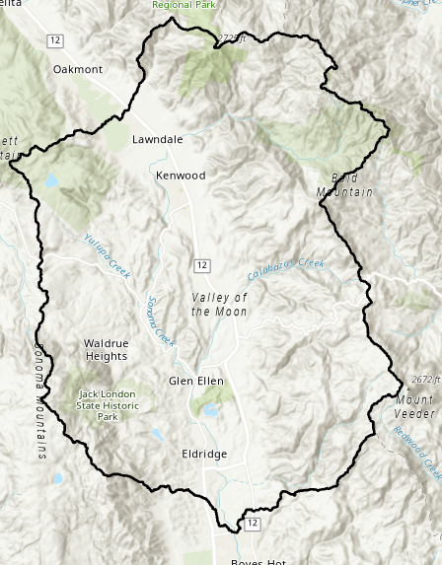
Unit Hydrograph - Derived
Measure the total volume of direct runoff under the hydrograph and convert this to depth over the watershed
$$Depth of Runoff(d):$$
$$d=\frac{V}{A}$$
$$where:$$
$$V=Volume of runoff$$
$$A=Area of basin$$
Area (A)
Excess precip depth (d)
Flow
Direct runoff (V)
Time
Notes:
Once we have the direct runoff hydrograph, we measure the total volume of direct runoff which is the area under the hydrograph (click) and convert to a depth over the watershed. The depth could be computed simply done by dividing the volume (click) under the direct runoff curve by the area (click) of the watershed.

Slide 19
Unit Hydrograph - Derived
Divide the ordinates of the direct runoff by the depth of runoff (d)
Excess precip depth (d)
Unit precip depth (u)
Direct runoff
Direct runoff
Flow
$$×\frac{1}{d}$$
Flow/u
Time
Time
Notes:
So we have the direct runoff hydrograph and the depth of runoff under our hydrograph. We scale our direct runoff hydrograph by dividing (click) the ordinates of direct runoff by the depth of runoff that we computed in step 2. We divide by the depth because we are interested in getting the unit depth of 1 inch or 1 mm. Once you divide each ordinate by the depth, you will obtain (click) your unit hydrograph
In practice this procedure would be conducted for a number of storms and the ordinates averaged to determine the final unit hydrograph for the basin.

Slide 20
Unit Hydrograph - Derived
Estimate the duration of the unit hydrograph
Excess Rainfall Duration
Precip
Φ index
Time
Notes:
We have our unit hydrograph. Our last step is to estimate the duration of the unit hydrograph using the observed rainfall. The unit hydrograph derived from an observed hydrograph is tied to a rainfall duration. For example, it could be that 3 hours of excess rainfall generated our unit hydrograph. So we would call the unit hydrograph, a 3-hr unit hydrograph, where the 3-hrs came from the duration of excess precipitation. The rainfall storm itself could be longer than 3-hours but we are just interested in the excess rainfall after we remove losses. So, to estimate the duration, we take the depth of direct runoff that we estimated in step 2, determine the total volume of your rainfall, and subtract your rainfall losses until you match the depth of direct runoff to estimate the effective duration.
One simple technique to accomplishing this is to use the Φ index (click) such that the depth of excess precipitation is equal to the depth of direct runoff. The Φ index is based on the assumption of a uniform infiltration rate so it would be up to the hydrologist or engineer to decide if that is reasonable assumption. As you can probably tell, you would want to be selective in the types of storms and hydrographs you choose to analyze. You would want to select storms with simple structures where you can get a defined, single peaked hydrograph. Select storms where you can get a uniform distribution of rainfall throughout the period of excess, and uniform spatial distribution over the entire watershed.

Slide 21
Unit Hydrograph – Derivation Example
Excess Rainfall Duration
= 0.84 inches (Step 2)
Precip
Rainfall total depth (5 hours) = 3.34 inches
Φ index = 0.5 in/hr
Time
Rainfall duration = 3-hr
Notes:
To compute the rainfall duration, we estimate the total rainfall depth of 3.34 inches (click). We are looking to get 0.84 inches of excess rainfall which we had computed from the depth of direct runoff. The direct runoff depth could be obtained by using a constant loss estimate of 0.5 in/hr (click). This leaves us with 3-hrs as the excess rainfall (click) and therefore can call the unit hydrograph as a 3-hr unit hydrograph. Try not to get confused between the excess rainfall duration and the time interval of the unit hydrograph. In the previous slide, we see that the time interval for the unit hydrograph was 2-hours, but that does not make it a 2-hr unit hydrograph. The rainfall duration defines the type of unit hydrograph.

Slide 22
Unit Hydrograph – Derivation Example
Notes:
Here is unit hydrograph derivation example starting with an observed streamflow over 24 hours. We use a simple baseflow separation technique of 35 cfs which gets subtracted from the hydrograph to get our direct runoff as well as calculating the volume of our direct runoff. In this case, the volume was calculated using the trapezoid method. Once we got our total volume, we divide by the watershed area to get the runoff depth. We scale our direct runoff by dividing the runoff depth to obtain our unit hydrograph. To confirm that we have a unit hydrograph, we can calculate the area under the unit hydrograph, get the total volume, and divide by the watershed area. We should receive a depth of 1 inch.
You divide by .84 as a factor, not as 0.84 inches.

Slide 23
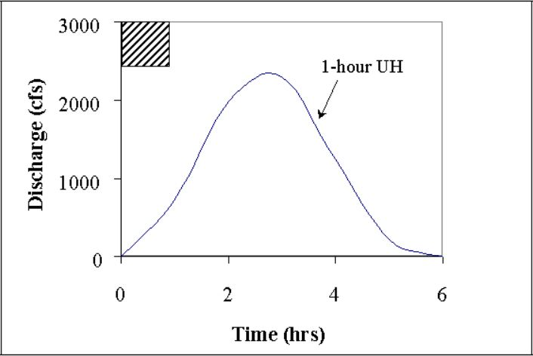
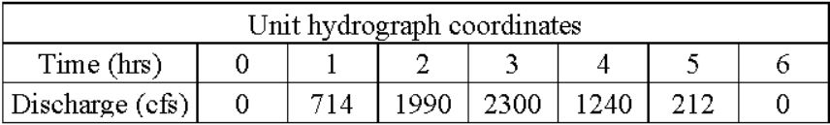
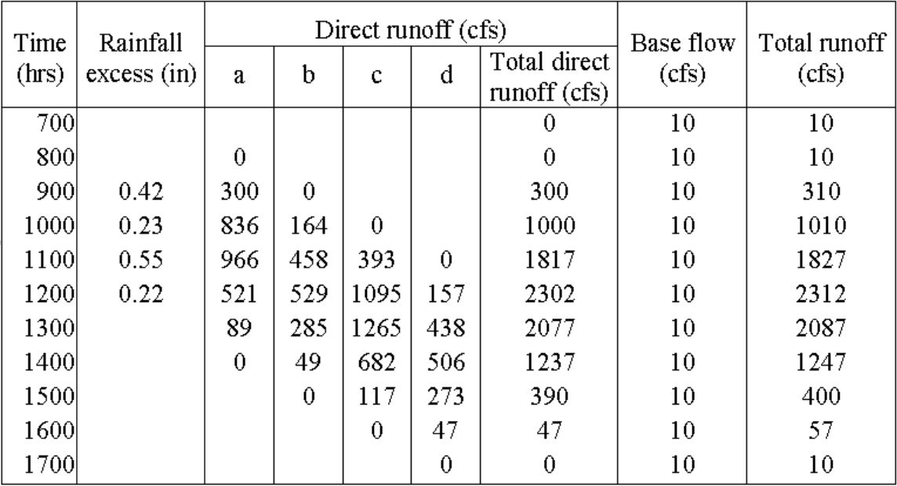
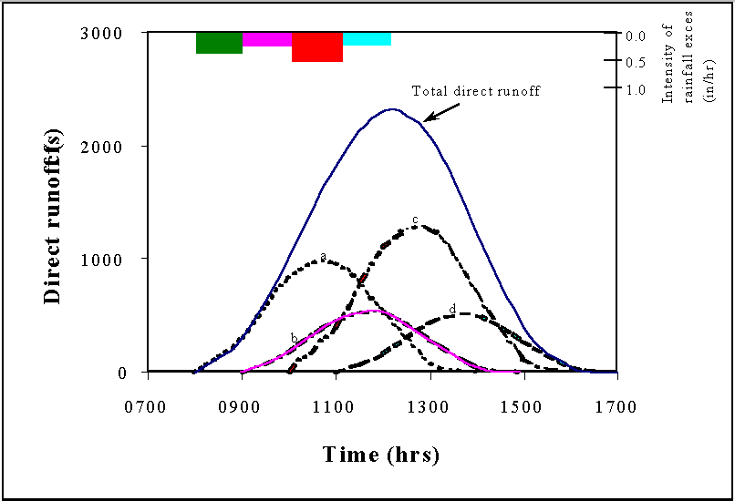
Unit Hydrograph – Convolution Example
Notes:
This slide presents an example unit hydrograph application. The unit hydrograph is presented on the top left. The unit hydrograph ordinates are presented on the top right. Precipitation volumes are applied to the unit hydrograph in time to generate the runoff hydrograph on the bottom right. This demonstrates the principles of time invariance and superposition. The final runoff hydrograph is presented on the bottom left.
The process of multiplying unit hydrograph ordinates by excess precipitation amounts and adding and lagging them in a sequence to produce a storm runoff hydrograph is known as convolution.

Slide 24
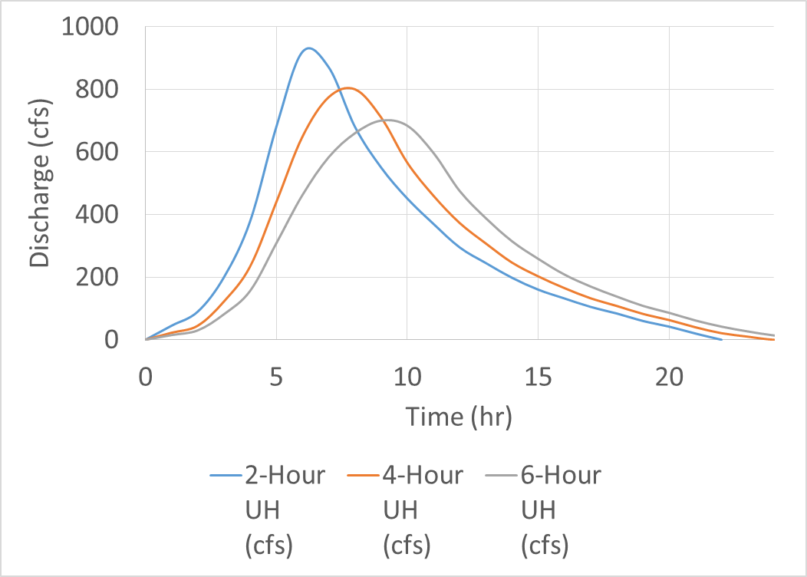
Unit Hydrograph – Changing Duration
Notes:
A Unit hydrograph is valid only for a given storm duration. It may be necessary to change the duration of a unit hydrograph.

Slide 25
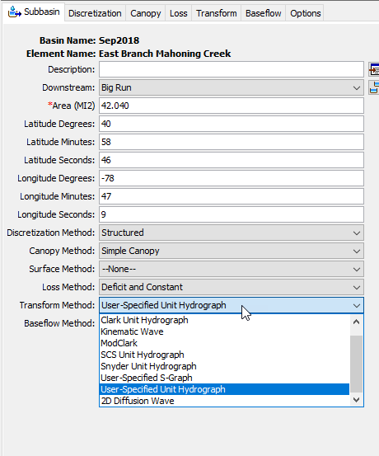
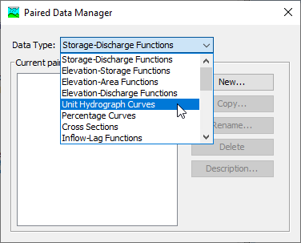
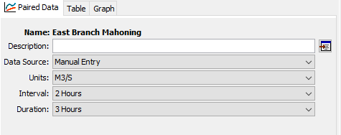
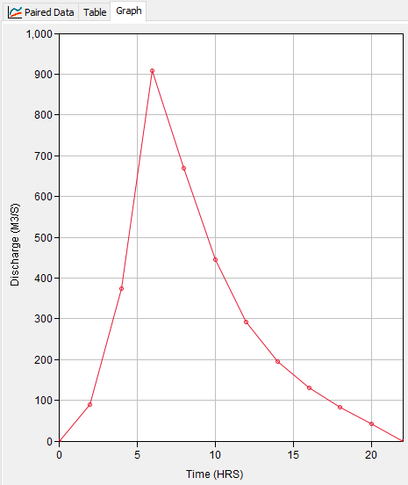
Unit Hydrograph in HEC-HMS
Notes:
So now that you’ve come up with your unit hydrograph, you’ll want to add it to HMS. The first step (click) is to select the transform method User Specified Unit Hydrograph. Next, (click) you will need to create a Unit Hydrograph Curve in the Paired Data Manager. Once you have a paired data created, (click) you need to set the Interval which is the interval of your hydrograph and the duration which is the duration of excess rainfall. In our example, we have a hydrograph interval of 2 hours and a duration of 3 hours, which we calculated in step 4. Lastly, (click) add your newly created unit hydrograph by either manually entering in the values or by importing through DSS if you created your unit hydrograph there.

Slide 26
HEC-HMS Surface Runoff Synthetic Unit Hydrographs – Clark Unit Hydrograph

Slide 27
Synthetic Unit Hydrograph
Synthetic unit hydrograph methods derive the unit hydrograph for a basin using theoretical or empirical formulas to relate hydrograph peak flow and timing to watershed characteristics (Bedient et al. 2008)
Utilizes instantaneous unit hydrographs
Synthetic unit hydrograph methods in HMS:
Clark (ModClark)
SCS
Snyder
Notes:
In a previous video, we discussed how to derive a unit hydrograph from a recorded discharge hydrograph. In a synthetic (click) unit hydrograph, we derive the unit hydrograph for a basin using theoretical or empirical formulas that relate the hydrograph peak flow and timing to its watershed characteristics. One of the original intents for synthetic unit hydrographs was for modeling ungauged watersheds where you do not have an observed hydrograph. Instead, you develop the unit hydrograph based on the watershed characteristics. With a synthetic unit hydrograph, the principals and assumptions of unit hydrograph theory still remain the same but the development of the hydrograph is based on a function of one or two parameters. Synthetic UH are not limited to only ungauged basins and are used in gaged or ungaged systems to estimate surface runoff.
Synthetic (click) UH makes use of the instantaneous Unit Hydrograph, which is the runoff response that would result from an instantaneous unit input of excess rainfall. This allows you to construct a unit hydrograph that can be applied to any duration rainfall and not constricted to a specific rainfall duration. The IUH It’s still a unit of excess rainfall but it provides flexibility in the rainfall duration. In the previous unit hydrograph derivation, we derived a 3-hr hydrograph based off a 5-hour storm. If you wanted a 1-hr UH, you need to find a storm and hydrograph that had an excess depth of 1-hr or you would use the S-graph method to compute a 1-hr Unit Hydrograph. With instantaneous UH, we don’t need to worry about the duration of the unit hydrograph.
In HEC-HMS (click), there are three unit hydrograph methods available, Clark SCS, and Snyder’s method. This video will look at the Clark Unit Hydrograph method as well as briefly talk about the ModClark method.

Slide 28
Clark Unit Hydrograph Theory
Clark's model derives a watershed UH by representing two critical processes:
Translation or movement of excess runoff from its origin throughout the drainage to the watershed outlet.
Modelled using a time-area relationship
Time of concentration, “Tc”
Attenuation of the magnitude of the discharge as the excess is stored throughout the watershed
Modeled using a Linear Reservoir
Storage Coefficient, “R”
Notes:
The Clark unit hydrograph derives a UH by representing two critical processes, that of Translation and attenuation. Translation is the movement of excess runoff to the watershed outlet in response to gravity. (click) Translation in the Clark method is modeled using a time-area curve and the critical parameter to estimating translation is the time of concentration.
The second process is attenuation which is the reduction of the discharge magnitude due to frictional forces and/or storage within the channel or basin that resist flow. (click) The attenuation effects are modeled using a linear reservoir and the parameter that controls attenuation is the storage coefficient.

Slide 29
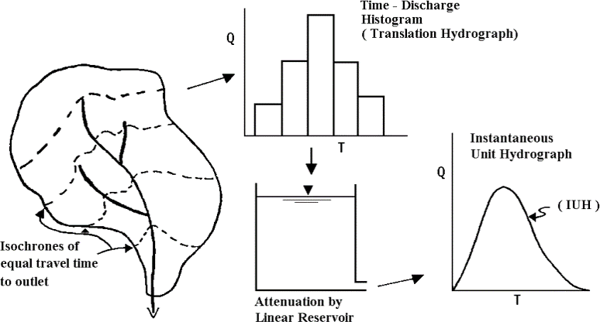
Source: USACE (1994)
Notes:
This slide illustrates the two processes modeled in Clark. First is the time-area histogram and the second is the attenuation. The time-histography is created by discretizing your watershed regions based on the time it takes for runoff generated on that area to reach the watershed outlet. We call the contours (click) that delineate those regions isochrones. You can develop a time-area histogram that graphs the regions with equal travel time to the outlet with the associated area. In this graph, you may have noticed a Q on the y axis which stands for discharge, and this is because the area was multiplied by a rainfall depth and divided by the time, but it essentially looks the same as a time-area graph. Once you’ve determined your time-area relationship, the second process is to have the runoff carried out by a single linear reservoir to get your instantaneous unit hydrograph, which we had mentioned, isn’t confined to a specific rainfall duration. The next few slides will go into more detail on the time-area relationship and the linear reservoir.

Slide 30
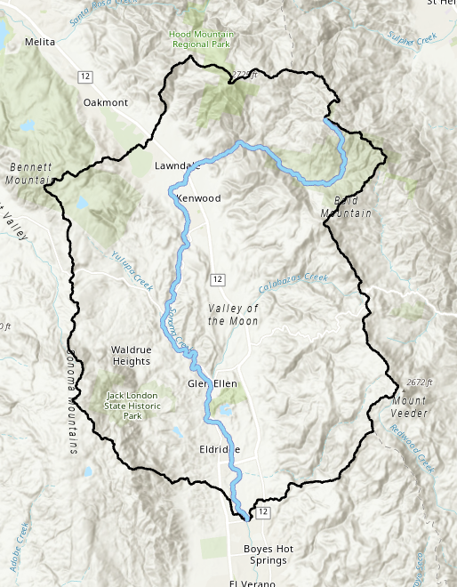
Clark Time of Concentration
Time of Concentration – time required for runoff to travel from the hydraulically most distant point in the watershed to the outlet
TR-55 (USDA)
Regional Specific Regression Equations
Notes:
We generalize the time area histogram by selecting the time of concentration as a function of the isochrones. We noted that the translation process was governed by one parameter called the time of concentration, which is defined as the hydraulically most distant point with the longest travel time to the watershed outlet. You can imagine a raindrop at the most remote part of the watershed and the time it takes for that raindrop to travel through the watershed to the outlet. There are various methods out there that try to estimate the time of concentration from basin characteristics. One of the most popular ways is the TR-55 method developed from the U.S Department of Agriculture. Other methods of estimating the time of concentration is using region specific regression equations.
The image we are showing is suggesting runoff that starts from the longest flow path would estimate the time of concentration. This is not necessarily true, as there may be other parts of the watershed that may reach the outlet later, although its probably not too far off from the longest flowpath.

Slide 31
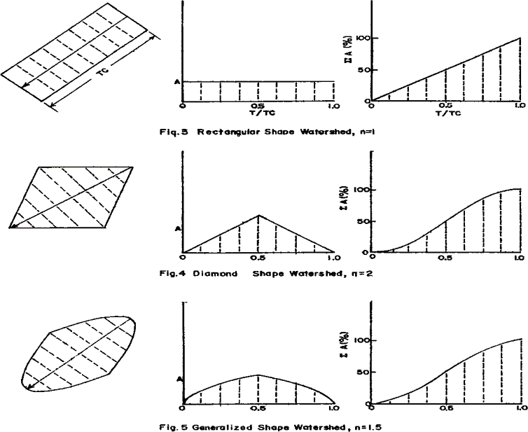
Clark UH – Time-Area Relationship
Notes:
The time-area relationship governs the translation portion if the hydrograph. This relationship divides the watershed into regions of equal runoff time to reach the outlet. Once the areas are divided, estimates of the runoff generated on each part of the catchment is delayed by a proportion of the time of concentration.
The examples you see are time-area graphs for three (click) different watershed shapes where each line represents an isochrone (click). The time-area (click) relationship is expressed in the dimensionless form with area as a percent of total basin area and time as a percent of time of concentration. This is where the time of concentration parameter comes into play; if you increase your time of concentration, you increase the amount of time it takes for each of your isochrone regions to reach the watershed outlet. If we use the rectangle watershed shape as an example for the time-area relationship, the first region (click) in the rectangle is closest to the outlet location and would appear first in our time-area relationship. The last region (click) in the rectangle, which is equal to the Tc, would appear last in our time-area relationship. You can get a unit hydrograph from the time area relationship by multiplying the area by a rainfall depth of 1 unit and dividing by the time interval. As you noticed, the time-area relationship can vary based on watershed shape. The default in HMS program (click) utilizes this generalized, oval shaped pattern but you can change the time-area relationship.

Slide 32





Clark UH Linear Reservoir
Linear Reservoir
Continuity Equation
Storage Coefficient
Notes:
The next process for Clark is the attenuation process controlled by the storage coefficient parameter. The way that attenuation occurs is through the Linear Reservoir and Continuity Equation method. The storage coefficient is defined by the R value. If you increase R, you increase the storage. You combine the linear reservoir equation with the continuity equation to solve for outflow at time t.
The storage coefficient is a coefficient that represents the temporary storage of precipitation excess in the watershed as it drains to the outlet point. The greater your R value, the more time your excess runoff remains in storage. In contrast to Tc which has a definition that can be physically quantified, the storage coefficient is a bit more nebulous. The easiest way to estimate R is via calibration if gaged precipitation and streamflow data are available. R can also be estimated through empirical equations that have been developed through regression analysis.

Slide 33
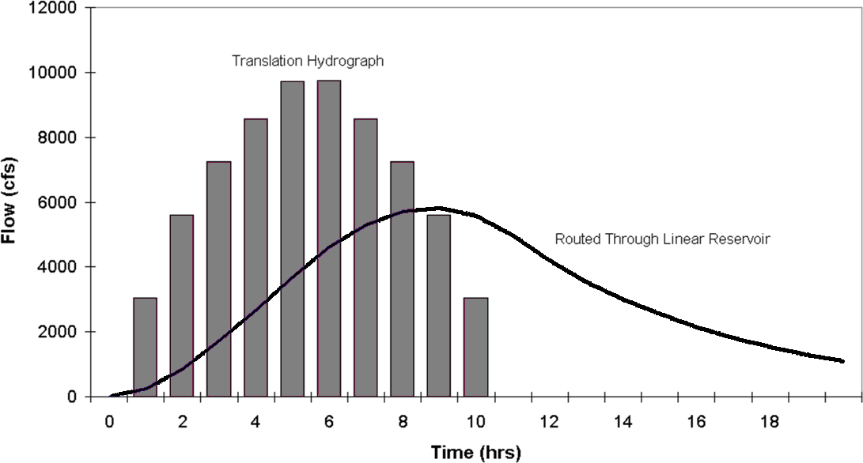
Clark UH – Linear Reservoir
1 inch of rainfall
Unit Hydrograph for Clark!
Notes:
This figure shows the discharge after its gone through translation from the synthetic time area curve. This was assuming a default watershed shape, constant velocity, and 1 inches of rainfall over the watershed. You can then see the results of the discharge histogram after getting routed through a linear reservoir resulting in the final unit hydrograph for using the Clark Method. You can see the affects of routing through the linear reservoir as the peak flow is decreased and the time base of the hydrograph is spread out.

Slide 34
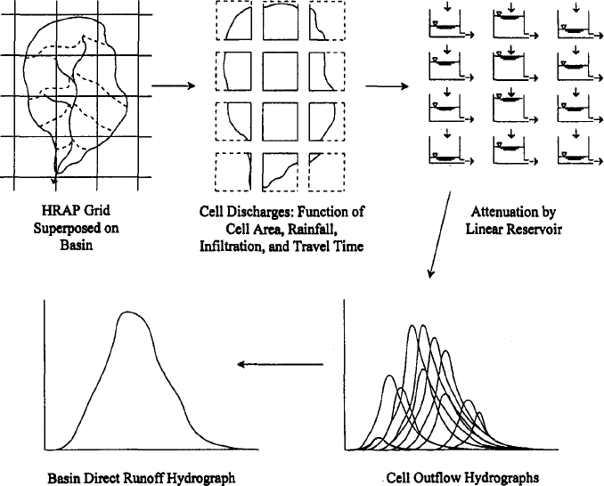
ModClark UH - Illustrated
Differences and advantage:
Eliminate the time-area curve
Use a separate travel time index for each
grid cell to compute the travel time from the
cell to the watershed outlet (quasi-distribution
transform method)
Source: Kull and Feldman (1998)
Notes:
There is a variation to the Clark UH method that can transform rainfall to flow on a gridcell basis and that is the ModClark UH method. ModClark method is a linear, quasi-distributed transform method that is based on the Clark unit hydrograph. The modClark represents the subbasin as a collection of grid cells. You still need to estimate time of concentration and storage coefficient but the difference and advantage between the lumped Clark method and ModClark, is that ModClark eliminates the time-area curve and instead uses a separate travel time index for each grid cell. Before, you would need to come up with your own Time-Area Curve or use the default relationship; now, there is, in a unique time-area relationship created for each watershed that gets generated automatically when applying this method. There is a travel time index computed for each cell that represents the travel time from the cell to the watershed outlet, and is scaled by the overall time of concentration. You can get a discharge value per cell based on the cell area, excess rainfall depth, and the cell travel time. The cell discharge still gets attenuated by a linear reservoir. The outputs from the linear reservoirs of the cells are combined to produce the final hydrograph which you can see in the figure. This method is quasi-distributed, meaning we can spatially account for the flow transform for each grid cell but this method does not route the discharge from one cell to the next, hence why we call it quasi-distributed.

Slide 35
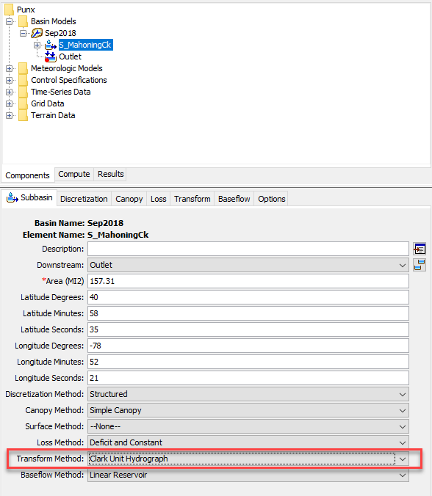
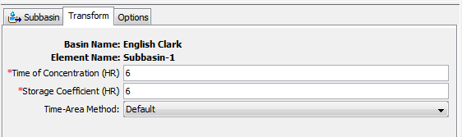
Clark UH - Implementation in HEC-HMS
Notes:
To implement the Clark UH method, you will need to select your subbasin, and select Clark Unit Hydrograph method under the Transform method. Move over to your Transform tab and enter in your Tc and R values. This is also where you can define the Time-Area Method. You are given a default value, which uses a generalized semi-oval watershed shape. The default shape has been shown to approximate the timing of surface runoff very well for typical subbasins. However, there is also an option to provide a user-specified curve for the time versus area relationship. The relationship must be defined as a percentage curve in the paired data manager before it can be used in the subbasin element.

Slide 36
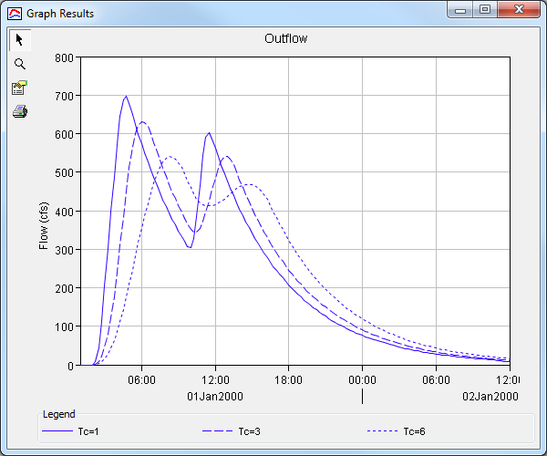
Clark UH – Adjusting Tc
Notes:
Example adjusting time of concentration where you see the affects of translation when keeping the storage coefficient constant

Slide 37
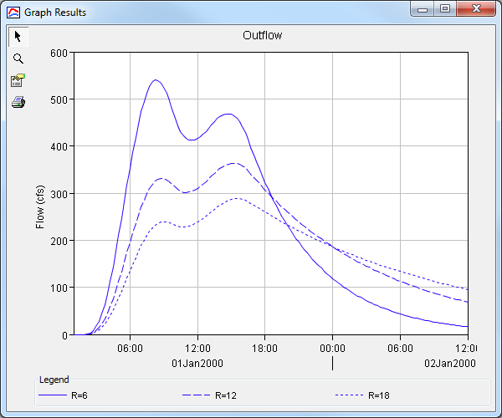
Clark UH – Adjusting R
Notes:
Example adjusting storage coefficient where you see the affects of attenuation when keeping the time of concentration constant. Note how the hydrograph peak decreases as you increase you storage coefficient and the time base gets extended further out.

Slide 38
HEC-HMS Surface Runoff Synthetic Unit Hydrographs – SCS Unit Hydrograph

Slide 39
SCS
The Soil Conservation Service (SCS) Unit Hydrograph is based on a dimensionless unit hydrograph
Developed from average of UHs derived from gaged rainfall and runoff for a large number of small agricultural watersheds throughout the US
Ordinates of dimensionless unit hydrograph are relative to peak flow, Q_{P,} and time to peak, T_{P}.
Notes:
The SCS method, named after the Soil Conservation Service, is based on a dimensionless unit hydrograph. The dimensionless UH was developed from an average of UHs derived from gaged rainfall and runoff for a large number of small agricultural watersheds throughout the United States. The ordinates of the dimensionless unit hydrograph are relative to the peak flow, or Qp, and the time of rise, Tr

Slide 40
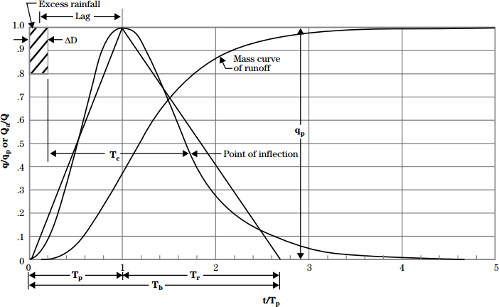
SCS UH – Illustrated
37.5%
62.5%
Source: NRCS (2007)
Notes:
This is the most common form of the dimensionless UH that uses the peaking factor coefficient value of 484. The hydrograph is called dimensionless since the discharge on the y axis is expressed as a ratio of the (click) peak discharge while the time scale on the x-axis (click) is expressed as a ratio of the time-to-peak. The time to peak is not the same as the time of concentration, which we had discussed in another video. The time to peak, as defined by the SCS method, is from the start of your excess rainfall to the hydrograph peak. There is also another travel time component called Lag, which is defined as the center of mass of your rainfall to the hydrograph peak. We will touch upon lag in the next slide
The dimensionless UH can be represented by an (click) equivalent triangles to come up with an estimate of your peak flow. Using the geometry of the triangle, the unit hydrograph has 37.5% of its volume on the rising limb, and the remaining 62.5% on the recession side. Peak discharge can be calculated using the triangular geometric relationship.

Slide 41
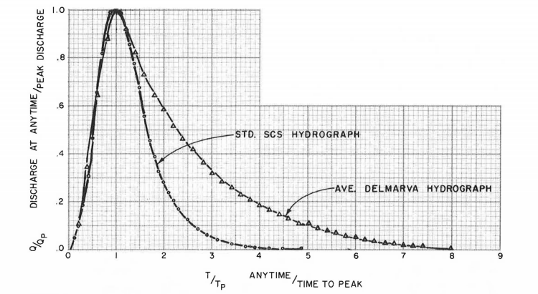
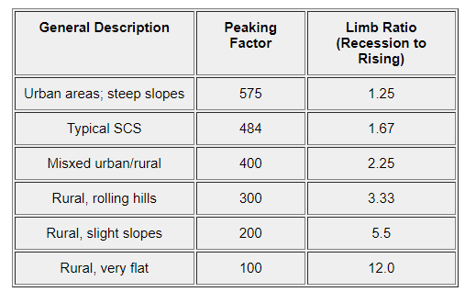
Welle & Woodward, 1989
Wanielista, et al. 1997
HEC-HMS provides you the ability to select 13 different peaking factors.
Notes:
There are various forms of the dimensionless unit hydrograph. The most form of the SCS UH has a peaking factor of 484. The peaking factor reflects the ability of the watershed to retain and delay flow. In the table, the (click) peaking factor changes depending on the type of terrain. Steep terrain and urban areas tend to produce higher early peaks while flatter terrain may produce lower, and later peaks. This dimensionless unit hydrograph would look different if you were to use a different peaking factor (click) as shown by the Delmarva dimensionless Unit Hydrograph . HEC-HMS provides you the ability to select 13 different peaking factors.
Limb ratio is the ratio of peak to the inflection point. Similar to the Recession method for ratio to peak parameter. Ratios closer to 1 will have narrow hydrographs while ratios larger than 1 will be wider hydrographs.

Slide 42
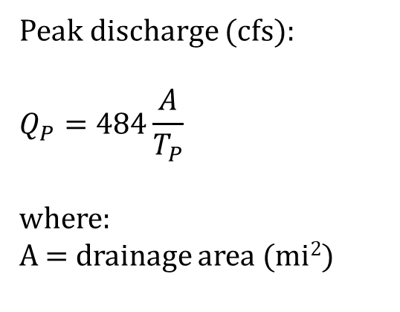

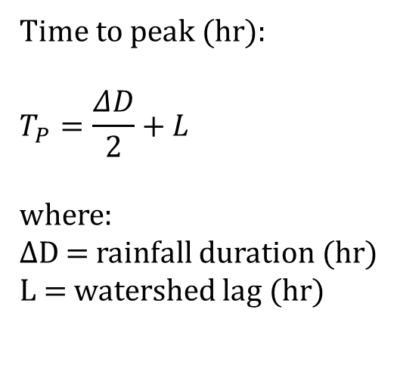
SCS UH – Equations
$\text{Time} \text{to} \text{peak}\text{ (}\text{hr}\text{)}$:
$$T_{P}=\frac{ΔD}{2}+L$$
where:
$ΔD$ = rainfall duration (hr)
L = watershed lag (hr)
Peak discharge (cfs):
$$Q_{P}=484\frac{A}{T_{P}}$$
where:
A = drainage area (mi²)
where:
l= longest flowpath (ft)
Y = average watershed slope (%)
S = potential maximum retention (in)
$$L=\frac{l^{0.8}{\left(S+1\right)}^{0.7}}{1900Y^{.5}}$$
Mockus, 1961
Notes:
To scale the dimensionless SCS hydrograph, you need to calculate the Time of Peak and the Peak discharge. As you might quickly notice, the Time to peak and Peak discharge are related. The parameter that HMS requires is the Lag. HMS will compute rainfall duration (or the computation time step) and perform the Time to peak and peak discharge compute to scale the SCS UH.
To compute the SCS hydrograph by hand, the method requires you to estimate the Time to peak and the Peak discharge. Time to Peak is computed by dividing the rainfall duration by half and adding to the watershed Lag value. We saw earlier that lag represents the center of mass of excess rainfall to the time of peak. There are various equations available to estimate watershed lag. If you have your time of concentration computed, one simple estimate of lag is to multiple the Time of concentration by 0.6. Another method (click) is to use the equation shown here.
Qp is estimated using the peaking factor coefficient, 484, multiplied by the watershed area divided by your computed time to peak. Again, the peaking factor could change depending on your location, such as steep mountains or flat valley. Larger peaking values correspond to steeper terrain, while lower values correspond to flatter terrain.

Slide 43
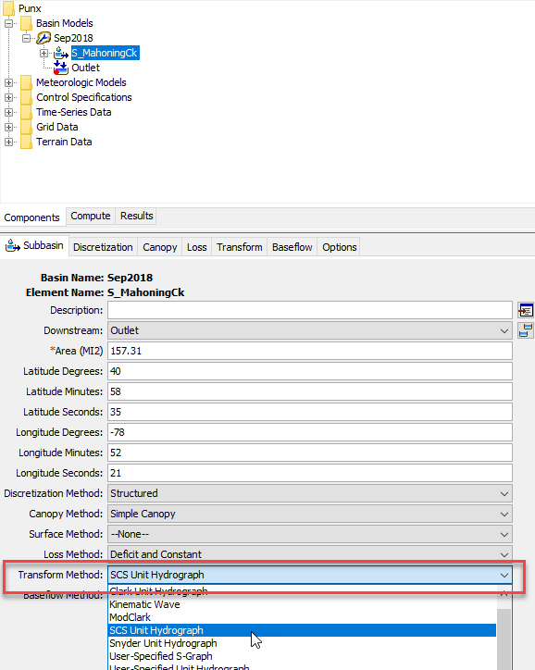
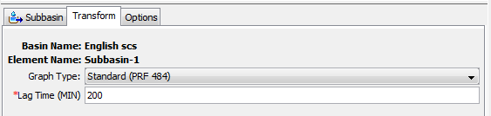
SCS UH - Implementation in HEC-HMS
Notes:
In HEC-HMS, the SCS Unit hydrograph can be selected in the Transform Method after selecting a subbasin. Navigate over to the Transform tab. You’ll notice that the only parameter being asked is the Lag value. That is because HMS will compute for you the rainfall duration and the watershed area you provide to your subbasin. The modeler has the option to select a Peak Rate Factor in HMS which can range from 100 to 600.

Slide 44
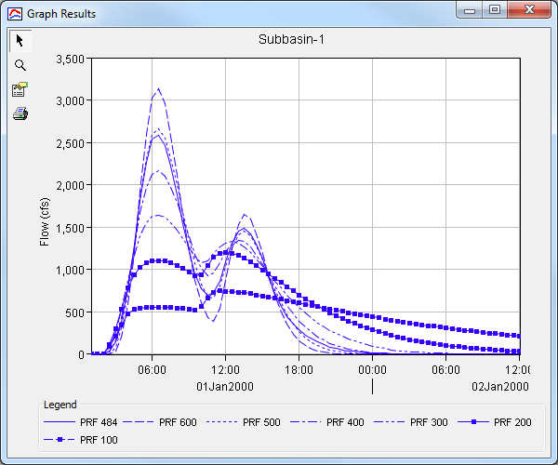
SCS UH – Adjusting Peak Rate Factor
Notes:
This slide provides an example of how your hydrograph changes when adjusting peak rate factor while keeping a constant lag value. The lower the peak rate value represents mild runoff response while higher peak rate values represent a quicker runoff/flashier response. You can see there is large differences in your hydrograph shape, peak value, and the recession limb with different peak rate factors.

Slide 45
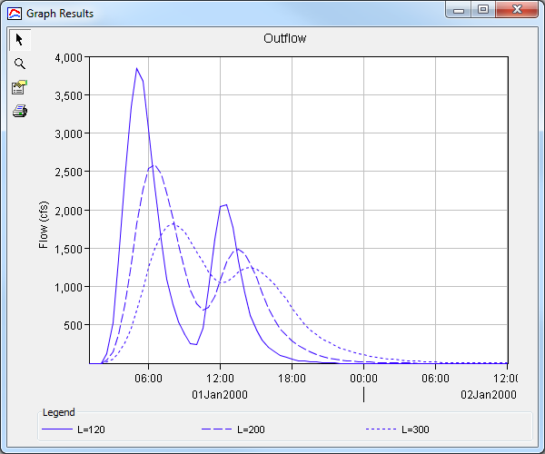
SCS UH – Adjusting Lag Time
Notes:
Here is an example of adjusting the lag time. The higher the lag value, the longer it takes for your floodwave to reach the outlet. You can see the affects of attenuation as you increase your lag value, since you are increasing your Time to Peak and reducing your Discharge peak value.

Slide 46
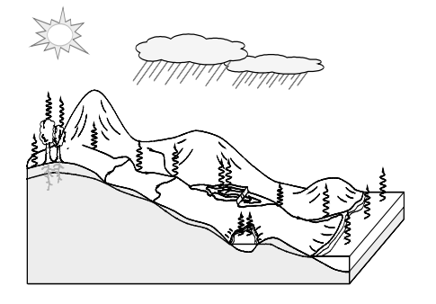
Thank you for listening!
Visit our website!
https://www.hec.usace.army.mil/confluence/hmsdocs/hmsum/4.7
https://www.hec.usace.army.mil/software/hec-hms/

