Slide 1

Meteorologic Models
Historic Precipitation
Hydrologic Modeling with HEC-HMS
06 August 2024
David Ho
Slides by:
Greg Karlovits (HEC), Emily Moe (MVP)

Slide 2
Objectives
Review the meteorologic model and its components
Discuss methods for precipitation
  Non-gridded and Gridded methods
  Gain an understanding of when to apply each method and what data is needed
Provide an overview of evapotranspiration and snowmelt

Slide 3
Meteorologic Model Overview
Overview
Precipitation
Evapo-transpiration
Snow

Slide 4
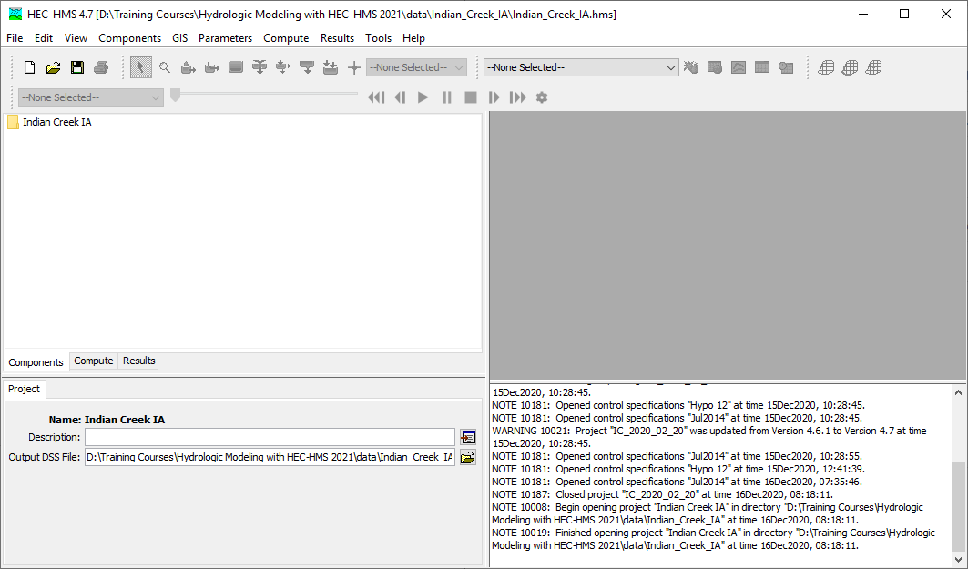
Watershed Explorer
Basin Map
Component Editor
Message Console
Notes:
Before we start discussing the meteorologic model, let’s go over a brief review of the HEC-HMS user interface.
The top bar of the window contains several menus. The most important menu for working with the meteorologic model is the Components menu.
Beneath the menu bar is a collection of toolbars. Aside from the well-known buttons on the left, these buttons and menus are mainly for working with the basin map and for viewing results.
The watershed explorer in the top-left contains an organized tree of all the components in the project. Components include things like basin models, meteorologic models and so on. As you add complexity to your project, the tree grows, and keeps everything organized.
The component editor in the bottom left lets you edit the component that you have selected in the watershed explorer. This is the most common way to change settings or parameters for components.
The basin map in the top right gives you a view of the basin model that you are currently working with.
The message console in the bottom right alerts you to what HEC-HMS is doing. It will display warnings and errors if they occur.
Consider hiding this slide

Slide 5
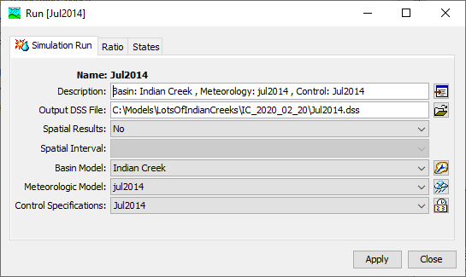
Simulation Run
Basin model
Meteorologic model
Control specification
Notes:
When you perform a Simulation Run (90% of the time you will do this), you will see that you need a basin model, a met model, and control spec). We will be talking about this Met Model
The simulation run is one type of simulation available in HEC-HMS and is the most used one. All simulation types require a basin model and a meteorologic model (the control specification is unique to the simulation run.)

Slide 6
Meteorologic
Model
Meteorology Model
Atmospheric boundary conditions
Precipitation
Snow
Potential ET
Longwave rad.
Shortwave rad.
Dew Point
Pressure
Windspeed
Temperature
Basin Model
Notes:
Met Model has to do with the sky, the atmosphere. Water can only enter the system in two ways in HMS: through a hydrologic element that produces discharge (e.g. source elements) or through the atmosphere. Its how we get rainfall into our basin.
The name is deliberate. The met model is more than just a set of data. It contains several models for representing atmospheric processes. However, it is not an atmospheric model in the vein of a weather forecast model or GCM. For example, there are precipitation methods that take precipitation gages as inputs and compute area averages from them in a couple of different ways. There are methods for computing potential evapotranspiration from atmospheric data. The met model controls simulation of snow accumulation and melt. And so on.

Slide 7
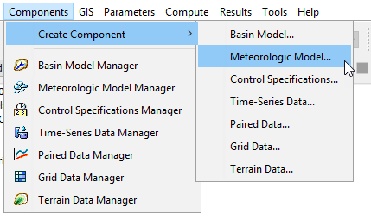
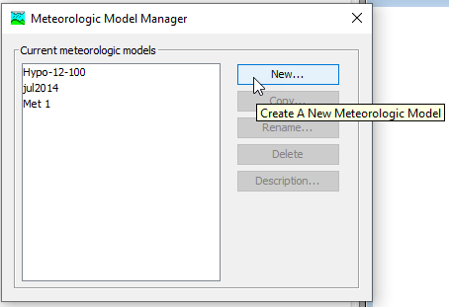
Creating a Meteorologic Model
Notes:
Met models can be created through the Components menu. All simulation types require a basin model and a meteorologic model. Precipitation is one of the modeling methods inside of a meteorologic model. The meteorologic model is meant to manage all the atmospheric boundary conditions necessary for hydrologic modeling.

Slide 8
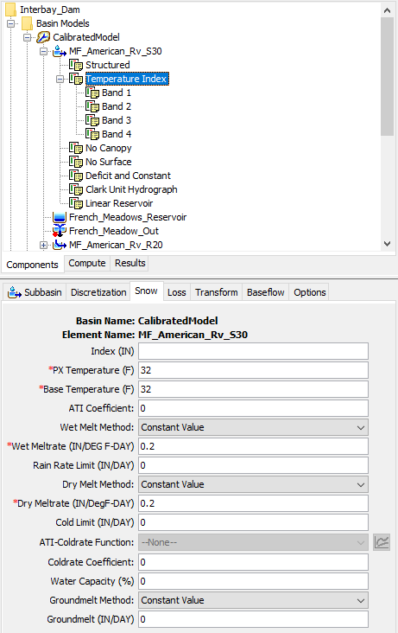
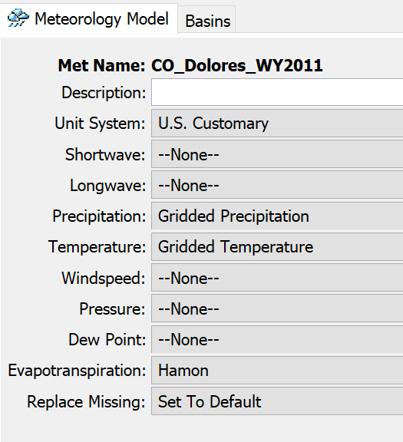
Meteorologic Model
User chooses methods for modeling each process
As of v.4.10, snowmelt is part of the basin model
Notes:
This only creates the container for the Met Model. You will see this image in HMS. There are a bunch of different atmospheric fluxes you can model. You need to choose the methods you want to model each process and there are a bunch of methods you can choose from. An important point is you do NOT need to model all these fluxes. In most cases, you will probably just care about Precipitation. It depends on your watershed and the type of modeling you will perform.
For those of you who have used snowmelt, the snowmelt capabilities are now in the Basin Model and not in the Met Model.
To access the component editor for the met model, click on the met model in the watershed explorer.
For each of the boundary conditions, there is a collection of methods for modeling it. Not all processes are necessary for all models, and the simplest models may only use precipitation. As methods are added, generally the data requirements increase. Some methods are more complex than others and require more types of data.
Each of these process are more than just data – they are models for representing states of the atmosphere and require data as an input. For example, note that there is no “temperature” process in the met model. However, temperature is a data input for snowmelt, evapotranspiration, etc.
You may notice there is no snowmelt option in the met model. As of HMS version 4.10, snowmelt has been migrated to the basin model since it is a land surface process.

Slide 9
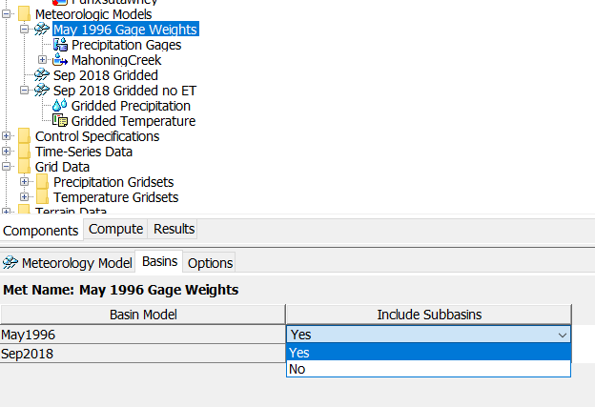
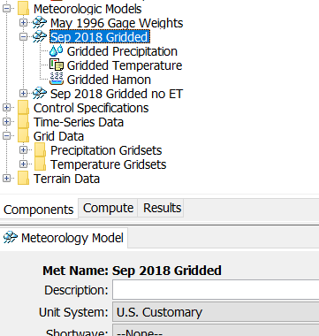
Include Subbasins for Non-Gridded Meteorological Model
Non-gridded
Gridded
Notes:
This is a common pitfall – it is easy to forget to set your met model and basin model to work together. Once you created a met model and method and its not a gridded method, you will need to specify which basin model this Met Model can work with. That happens in the Basin tab and selecting the basin to work with the Met model. Once you set it up, you will see your subbasins populate underneath the Met model. Who has been tripped up by this before?
Met models are independent of basin models – since they are general representations of atmospheric boundary conditions and can be set up to work with any basin model, they don’t know anything about a basin model unless you tell them.
In the component editor for the met model, there is a “basins” tab. Here you will see all the basin models in your project. If you want a basin model to be usable with this met model, you must select “include subbasins – yes” in this menu. Otherwise two things will happen. 1) you will not be able to set any subbasin-level settings or parameters if your methods have them and 2) the simulation run will fail and inform you that the met model is not set up to work with the basin model.

Slide 10
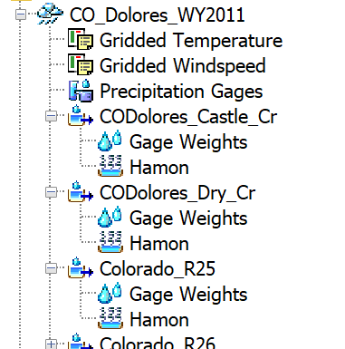
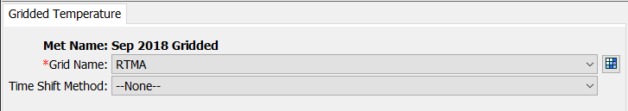
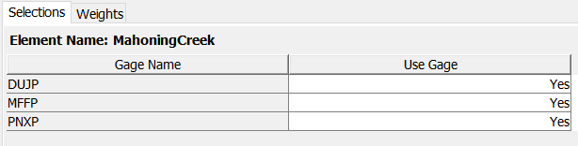
Watershed Explorer
Settings for entire met model
Met settings for subbasins
Notes:
Once you’ve created your met model and selected a method, look over at the Watershed Explorer to see your met model. When you expand your met model, you’ll see the methods you selected and subbasin settings.
You can specify whichever methods are appropriate for your modeling goals. Typically, at minimum a precipitation method will be specified.
In the Watershed Explorer, the selected methods will appear beneath the met model. Clicking on any of those will open the component editor below.
The topmost set of icons are for the processes that have been selected in the met model component editor. Clicking on any of these will let you edit settings for that method. The settings at this level are used across all hydrologic elements. However, some processes are controlled in a much more granular way, such as snowmelt. Gridded methods will eliminate a lot of granularity because they already explicitly handle the atmospheric process in space.

Slide 11
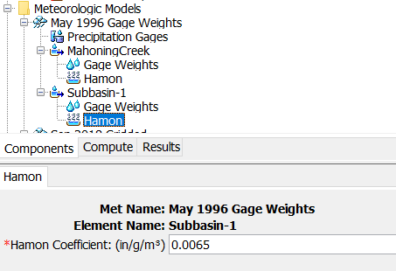


Data Requirements
Non-gridded
  At the Met Model or Subbasin level
Gridded
  At the Met Model level
  Should cover entire modeling domain
Notes:
Another requirement when setting up a Met Model, for non-gridded met models you will need to specify a gage for each subbasin. You need to tell the Met model what information is needed for each subbasin.
For gridded models, the gridded dataset is already spatially referenced. The gridded rainfall or temperature already knows where the rain falls within the model. It doesn’t need to be explicitly specified.
For non-gridded methods each met variable has a few methods for specifying information. For example here in temperature, the “Specified Thermograph” method lets you link a temperature gage directly to a subbasin. For precipitation there’s “Gage Weights” that lets you combine up multiple gages for a subbasin. There are also interpolated methods for many met variables that allow you to specify how to interpolate several gages to a subbasin.
For gridded methods, grids of meteorologic data should cover the entire modeling domain. These models are explicitly georeferenced, meaning the location of all the hydrologic elements and the meteorologic data are known, and referenced to a common datum. Gridded precipitation and temperature (and other gridded met variables) link directly to a gridset. Processes like ET or snow look to the met model for the variables they need in order to compute – for example gridded Hamon and gridded TI require temperature data. In this met model they would look to the temperature gridset specified in the Gridded Temperature method.
Creating the required data, and details on the meteorological methods are covered in other tutorials.

Slide 12
Precipitation Methods
Overview
Precipitation
Evapo-transpiration
Snow

Slide 13
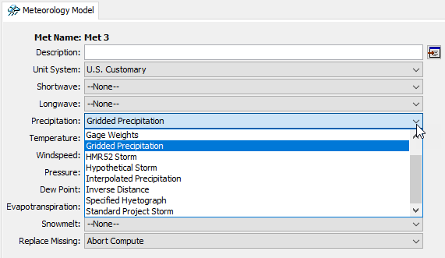
Setting a Precipitation Method
Set the method in your meteorologic model
Notes:
If there are subbasin elements in your basin model, you will be required to choose a precipitation method in order to run the model. It can be selected in the meteorologic model component editor.
Let’s take a look at the most important precipitation methods in HEC-HMS.

Slide 14
What is my modeling goal?
I am trying to reproduce a precipitation event that occurred in the past.
  Historical storm method
I am trying to design something, perform a risk analysis, or otherwise model an idealized event.
  Hypothetical storm method
Notes:
There are two categories of precipitation methods in the HEC-HMS meteorologic model. HMS doesn’t label the methods with these categories, but it’s valuable to know which methods are related and what they are intended for.
Historical storm methods help you create precipitation boundary conditions for a storm or a period of time that has already occurred, so that you can simulate the hydrology for some time in the past. They may also be used creatively to model future forecasted conditions or other hypotheticals, but their primary purpose is representing past precipitation.
When you are designing something, performing a risk analysis, or doing any other kind of hydrologic analysis that makes many simplifying assumptions about the behavior of precipitation in space or time, hypothetical storm methods are the precipitation methods to use. These are also sometimes called design storms, or synthetic storms, but the idea is that they do not represent a specific storm event that has occurred. Instead, it is a generalization of storm behavior that allows the user to specify something interesting for design or analysis purposes.

Slide 15
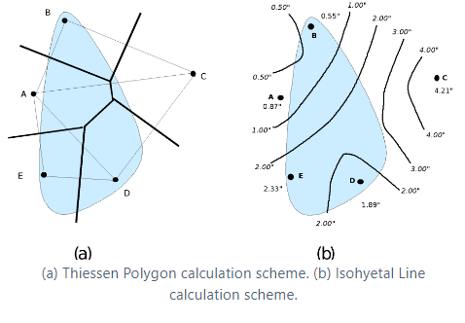
Historical Storm Methods
Interpolated precipitation
Inverse distance
Specified hyetograph
Gage weights
Gridded precipitation
→ Key: driven by observed precipitation data
Notes:
Historical storm methods are means for providing precipitation boundary conditions to a basin model in a way that it reasonably represents an event that occurred in the past. Historical events are unique like fingerprints or snowflakes, varying in precipitation depth, temporal and spatial pattern, and so on. These methods intend to capture the things that make an event unique.
When you are calibrating a hydrologic model so that it represents a real watershed, use of a historical storm method is necessary. You need to represent the input precipitation as well as you can in order to isolate the uncertainty in the model to just the hydrologic parameters.
These are listed in the order HMS shows them. The first two we will cover in more detail later in the presentation.
Gage weights is a method for combining information from multiple precipitation gages and can vary the combination of gages for each subbasin in the model.
The controls for the gage weights method are at the subbasin level, since each subbasin has its own combination of gages that you can set. The selections tab lets you choose which of the precipitation gages to use for the selected subbasin. The weights tab lets you set the depth weight and time weight for each gage.
You would use this method when you have gage data scattered across your watershed, and you want control over how each one is used to estimate the volume and timing of precipitation for each subbasin.
The controls for gridded precipitation are very simple – choose a precipitation gridset. If there are time zone issues (for example your observed flow data and precipitation data are in different time zones) you can shift the precipitation grid times by whole hours.
The gridded precipitation method is very simple to set up, because most of the hard work is handled by the data itself. These grids are at a regular time interval, so that controls any temporal patterning. The grids themselves contain spatial patterns. The data are spatially-referenced, and the sub-basins know their locations if the model is georeferenced. This means that setting up the model is very simple.
If you have gridded precipitation data, you should use it. This is the method we recommend today.
Gridded precipitation is just what the name says: a way to use gridded precipitation products as a boundary condition.

Slide 16
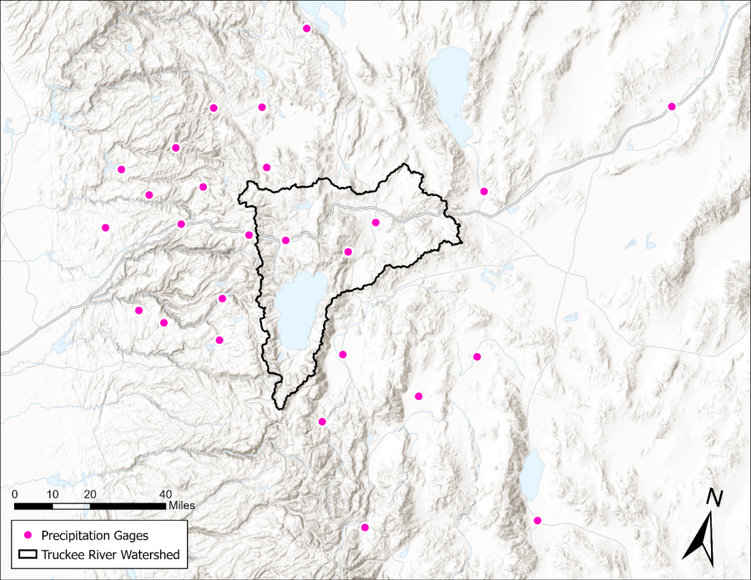
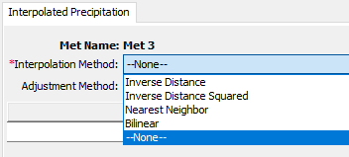
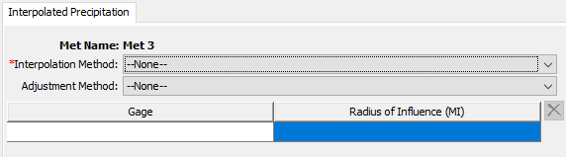
Historical Storm Methods
Interpolated precipitation
Inverse distance
Specified hyetograph
Gage weights
Gridded precipitation
Notes:
Interpolated precipitation is a generalized framework for interpolating precipitation gages to a grid
Who has used GageInterp program?

Slide 17
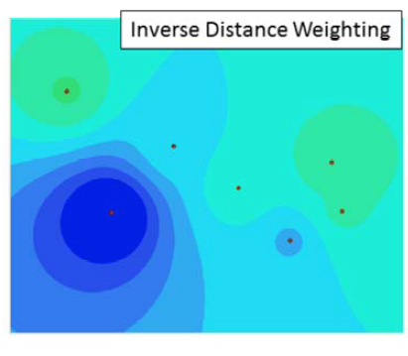
Creating Precipitation Gridsets from Point Data
Interpolated Precipitation
  Converts observation points to grids
Notes:
When creating precipitation grids from observed gage data, the gageInterp program is useful.
gageInterp takes point values, like those from precipitation gages, and creates grids by interpolation. GageInterp estimates the value at each grid cell by calculating a weighted average of all gages located within a certain distance. The weights are computed by taking a simple average or using distance to gages. The figures on this slide show two examples of distance being used to compute a weight. The figure on the left was computed by giving more weight to the closest gage. Grid cell values become similar to gage values the closer they are to the gage (bulls-eye). The figure on the right was computed by assigning grid cell values using only the closest gage--using the Thiessen Polygon method (any point, or grid cell in this case, within a polygon is closer to that gage than any other).

Slide 18
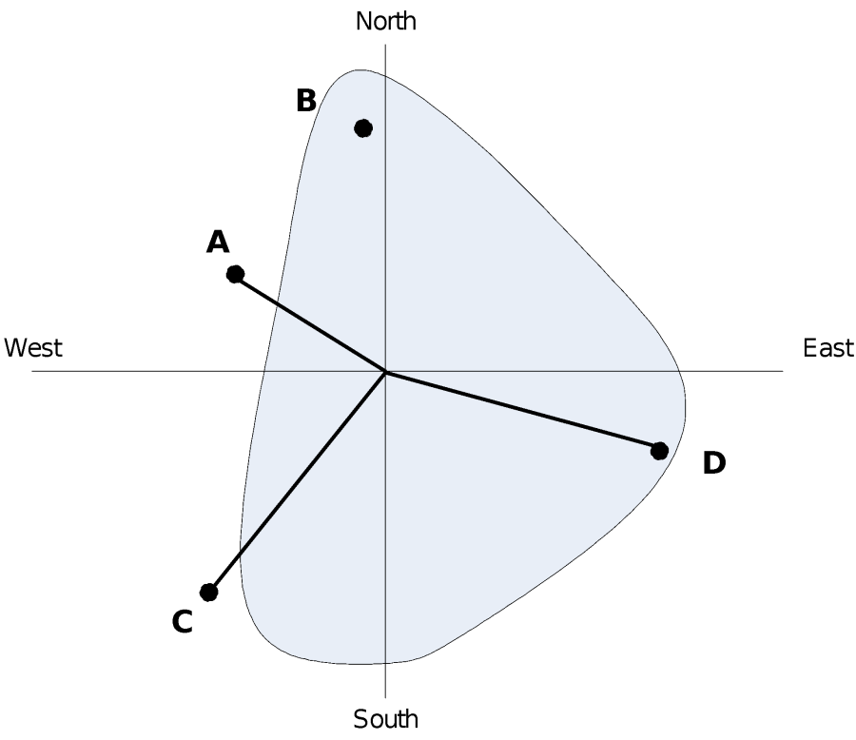
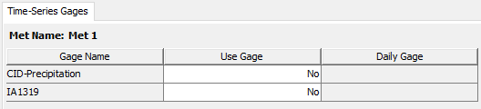
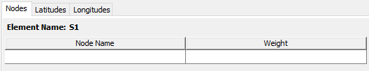
Historical Storm Methods
Interpolated precipitation
Inverse distance
Specified hyetograph
Gage weights
Gridded precipitation
Notes:
Just use Interpolated Precipitation.
Inverse distance is also a method for combining information from multiple precipitation gages using inverse distance interpolation.
Inverse distance weights the gages based on their location, which means the latitude and longitude information must be specified.
This method can be useful when you want to take the work out of estimating how gages contribute to a basin average, and want the inverse distance routine to figure it out. It can run into challenges when dealing with averaging time patterns, so the gage weights method can be preferable.

Slide 19
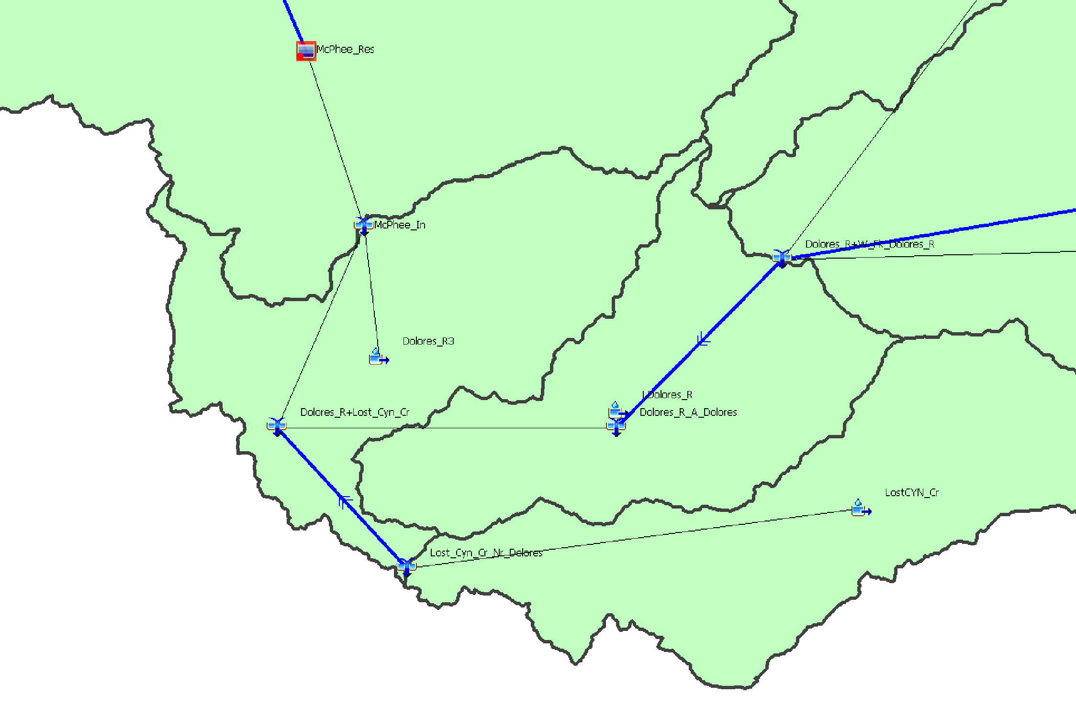
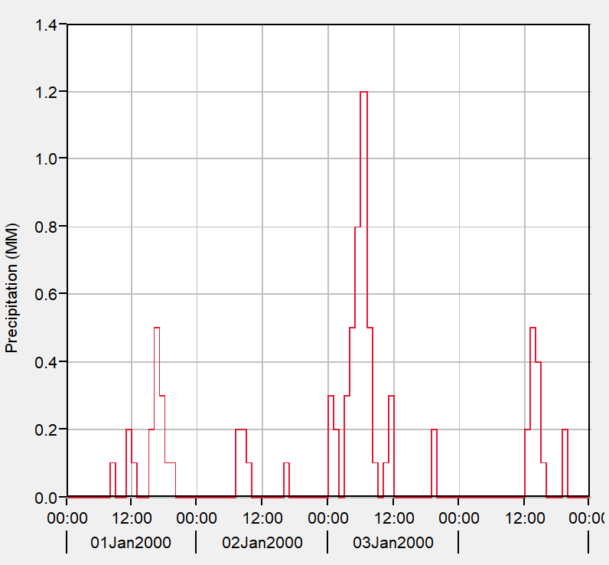
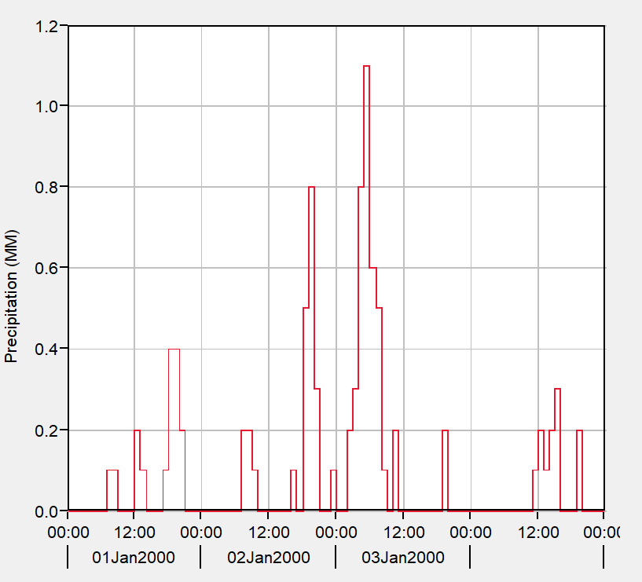
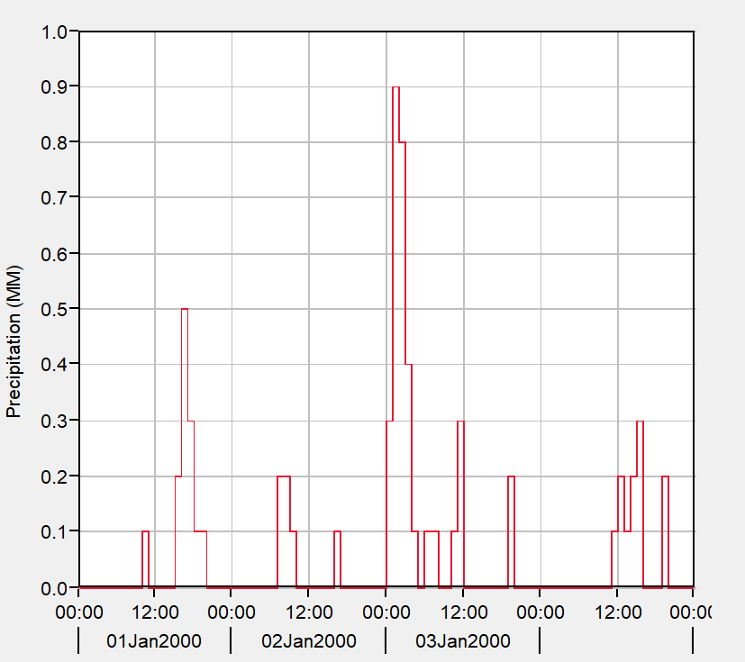
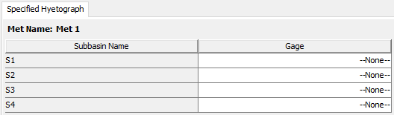
Historical Storm Methods
Interpolated precipitation
Inverse distance
Specified hyetograph
Gage weights
Gridded precipitation
Notes:
This is the simplest method for representing rainfall. You specify a rainfall gage you create (What type of data is precipitation time (timeseries, paired data, grid)?) and you specify for each subbasin which gage to use. If you have a lot of subbasins, this can get cumbersome to set up. But this is the most performant method. A model that uses Specified Hyetograph will run really fast. One technique I’ve done before was to compute basin average rainfall from a gridded dataset, create a specified hyetograph Met Model and insert the basin average hyetograph created from the gridded rainfall, then perform my calibration on the Specified Hyetograph. Another use case is for forecasting. Not all forecasts are in gridded form and you may need to use a specified approach to input the data.
Finally, the specified hyetograph method is a simple way to represent precipitation for each subbasin in the model. Each subbasin gets its own precipitation gage. This can be a “real” gage, i.e. a weather station, or you can externally compute the subbasin-averaged precipitation using another method, and feed it in this way.
The specified hyetograph method is very straightforward – for each subbasin, choose a precipitation gage.
This method is very flexible and you might use it for a number of reasons. The most common usage today is when precipitation timeseries for each subbasin are computed externally to HEC-HMS, and you want HMS to apply exactly that precipitation data. The biggest advantage is that this method is the most performant method in HMS, requiring no additional computation steps to apply precipitation to a subbasin.
One other application that isn’t strictly a “historic” event would be using HMS for forecasting – however, the input data is probably from a model that reasonably represents the coming precipitation, and a good model will be close to the precipitation that actually occurs.

Slide 20
Gage Weights
Overview
Precipitation
Evapo-transpiration
Snow
Gage Weights
Gridded Precip

Slide 21
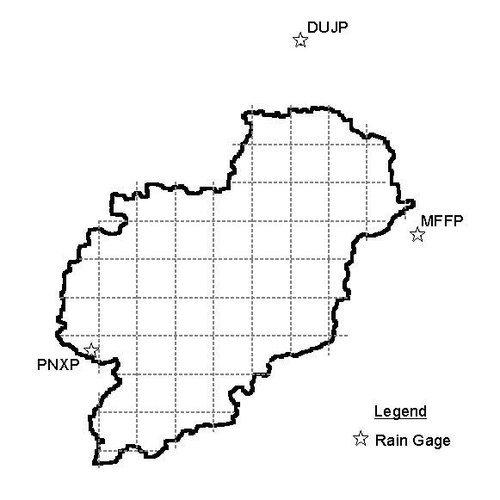
Gage Weights Precipitation Method
Pros
  Flexible
  Accounts for space and time variation
  Can be calibrated
Cons
  Still dependent on gage data
  Up to you to determine weights
Notes:
Gage weights is recommended for the general case of dealing with multiple imperfect precipitation gages used to estimate precipitation in a subbasin. Consider the figure on the right – there are three gages, which is fortunate. However, it’s hard to say if any of these will represent the rainfall for the watershed well. It’s likely that a combination of the three could work, because the three gages span the basin. Gage weights let you decide how these three gages will combine to estimate the precipitation over the subbasin of interest. You can specify how each of these gages combine into the basin average estimate.
For events where radar data aren’t available, this method offers the most control over using gages for watershed modeling. It gives you options to combine gage data in various ways, account for gauges with varying time resolution or no time information at all, and adjust for variations in climatology.
However, there is a significant hitch in all of this – gages have to be available for the event you are trying to model. In some areas, gages are sparse, and you must do your best to find the best available information. For small watersheds, there may not be any gages inside the boundary at all, and you may be making estimates using gages that are distant. Luckily, this method gives you several controls that let you adjust how these gages are combined to achieve the optimal result.

Slide 22
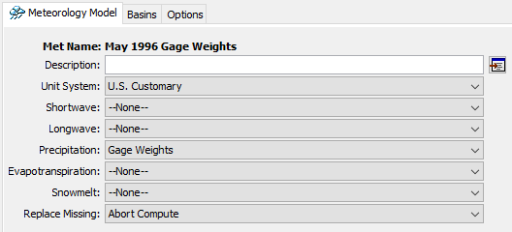
Setting Up A Gage Weights Model
Notes:
First, as always, create a new meteorologic model, by selecting one of the options in the Components menu. Then, in the met model component editor, select the Gage Weights method for precipitation.

Slide 23
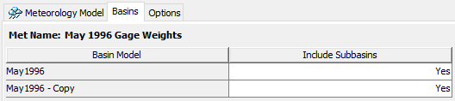
Include Subbasins
Notes:
This step is often forgotten, but what it does is tells the met model which subbasin elements are going to be controlled. Switch to the Basins tab of the met model editor. Here, you can decide which basin models are usable with the met model by selecting Yes for Include Subbasins. When the subbasins are included, they appear beneath the met model in the watershed explorer.
If you want to use multiple basin models with a met model, this can get cluttered sometimes, especially if your basin models have a lot of elements. For organization purposes, it can make more sense to make a copy of the met model and set up met models so they are 1:1 with basin models.

Slide 24
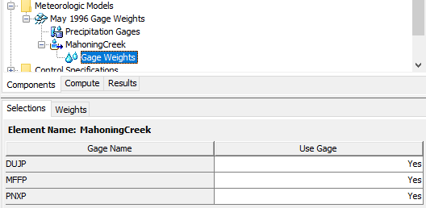
Use Gages
Notes:
This step tells the subbasin which gages will be used in the computation step. Expand the subbasin node of the watershed explorer, then select Gage Weights underneath it. On first click it will take you to the weights tab, where you will notice that there are no gages listed. Don’t panic, you need to switch over to the Selections tab and turn on any gages. If you don’t see any gages on this tab, that means you haven’t set up any precipitation gages yet. To do that you’ll need to create some time series components. Review that video if you need a refresher on how to do that.

Slide 25
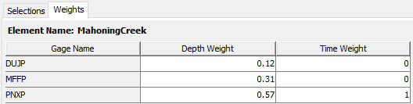
Weights
Notes:
After enabling some gages, you’ll be able to give them weights on a subbasin-by-subbasin basis. There are two types of weights: depth, and time.
Depth weights set what the total volume of rainfall will be for the simulation.
Time weights set how the time pattern will be computed for the simulation.
These values don’t have to add up to 1, but HEC-HMS will normalize the values during the simulation so that they do.

Slide 26
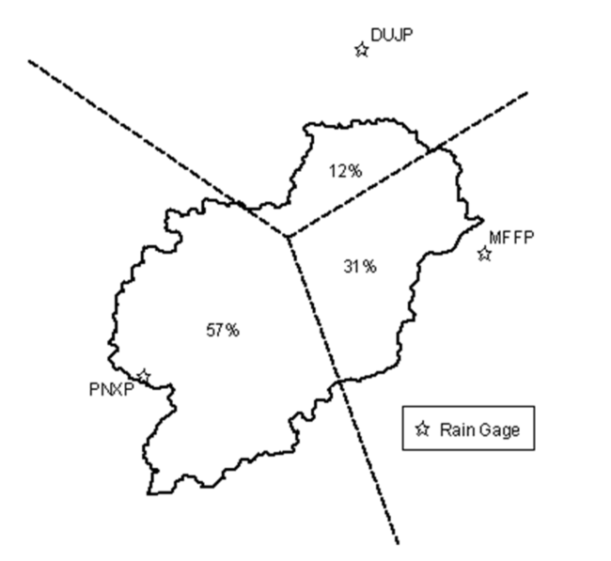
Estimating Depth Weights
Notes:
You are free to determine the depth weights in whatever method you find appropriate, but a good starting point is to use the Thiessen polygon method. This method tells you how much of the watershed is closest to each precipitation gage you are using. The percents can be used as weights directly. If you have a shapefile of your watershed and the gage locations, generating Thiessen polygons and intersecting them with the basin polygon is trivial in GIS.

Slide 27
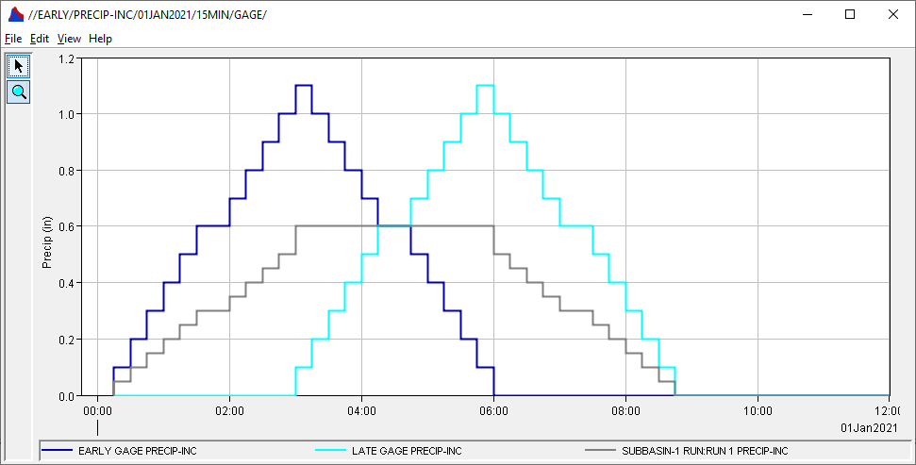

Estimating Time Weights
Best practice: use a weight of 1 for the “best” gage, considering:
  Granularity of data – finer is better
  Location of gage – near the center of subbasin is better
Use 0 for the rest
Notes:
For time weights, the best practice is to not average together gages to get a time pattern. If your precipitation stations have different time resolutions (for example one at daily level, and one at hourly), consider choosing the one with the finer time step to give you better estimates for the precipitation at shorter time steps. Also consider the location of the stations – if you have one near the center of the subbasin, it probably represents the rainfall inside the subbasin better than ones outside of it.
The effect of time-averaging is shown in the graph. Here, two completely made-up gages (in dark blue and light blue) were given an equal depth weight and time weight. When HMS computed the basin-averaged precipitation, the result is the grey Mayan Pyramid…
If you want to make sure you’re capturing the peak intensity of this storm, then time-averaging two non-coincident peaks will result in a hyetograph with a broad, flat peak, which may not be what you desire. If this helps describe the storm as it occurred in your watershed, feel free to break with best practices. However, if you’re finding that you’re underestimating peak storm intensity and you’re using time averaging, consider trying something else.

Slide 28
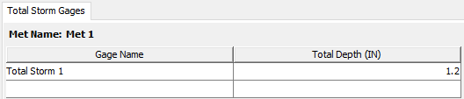
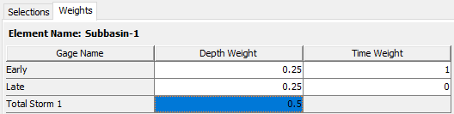
Total Storm Gages
Total precipitation known
Time distribution unknown
Notes:
In some situations, especially when modeling the most extreme of extreme floods, there are observations for total storm depth, but no time information was captured. Sometimes these are called “bucket surveys” and are literally an open container of some kind that was left outside (intentionally or not) during a storm event and filled up with water. You can add a total storm gage by filling in the row of the Total Storm Gages table under the Precipitation Gages node. It asks for a name, and a total depth. When you add this information, this gage will be selectable in the Selections tab, and then you can give it a depth weight, but not a time weight, because it has no timing information.

Slide 29
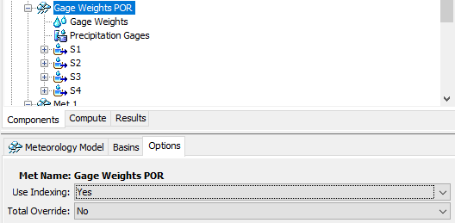

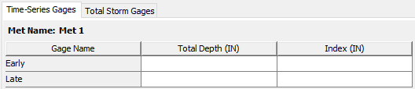
Optional Settings in Met Model Editor
Use Indexing
  Adjust for climatology
Total Override
  Override total depth for a gage
Notes:
If you click on the met model and switch over to the Options tab, you’ll see two options: “Use Indexing” and “Total Override”. These give you even more control over how HMS computes properties of the storm.
Enabling indexing adds an extra node underneath the met model, and also adds a new tab under the “precipitation gages” node that’s already there.
Indexing allows you to adjust gage depth averaging to account for variation in things like climatology. For example, in a mountainous area where the annual total precipitation changes quite rapidly with elevation, you may choose to use the annual total precipitation to adjust your estimate for how the depth should be applied to the subbasin. You would set the annual total precipitation for each gage in the Index column of the Time-Series Gages table, and then set the value for annual total precipitation in the Index column of the Gage Weights table. This lets you account for systematic differences in how precipitation might be recorded due to gage location. For small project areas this may not be necessary, but for larger project extents where the behavior of precipitation varies significantly, this allows you to adjust the estimated precipitation for the subbasins of interest.
Total override allows you to set the total depth for the gage instead of letting HMS compute it by taking the total of all timesteps in the gage entry.

Slide 30
Gridded Precipitation
Overview
Precipitation
Evapo-transpiration
Snow
Gage Weights
Gridded Precip
Notes:
Which of these methods do you like most so far?

Slide 31
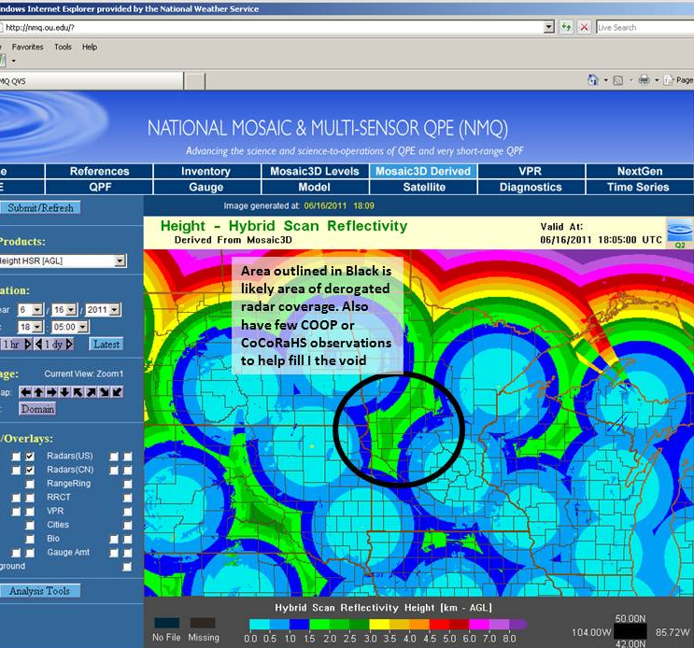
Gridded Precipitation
Pros
  Spatially distributes precipitation
    Ex: RADAR vs. precip gage
  Increasing number of sources available
    National & Local Availability
Cons
  May require conversion
  Quality of data varies
    Quality control recommended
      Gage comparison
      RADAR coverage
Notes:
The primary benefit of applying gridded precipitation to an HMS model is that the precipitation is then spatially distributed across the watershed as it’s been observed by RADAR or other products (versus a lump measurement being applied homogenously across the entire basin). Another positive note is that an increasing number of gridded precipitation sources are becoming available.
One slight drawback is that available gridded datasets may require conversion from their native format to an HEC-DSS record to be usable within HMS. However, conversion tools are available to make most conversions quick & easy!
It’s also important to note that the quality of the various available gridded datasets will vary. When selecting a gridded precipitation source, it’s recommended to perform spot-checks against established precipitation gage sites to determine how accurate that particular source is within your watershed. If applying RADAR data, a visual of RADAR coverage throughout the watershed may help with product quality control as well.

Slide 32
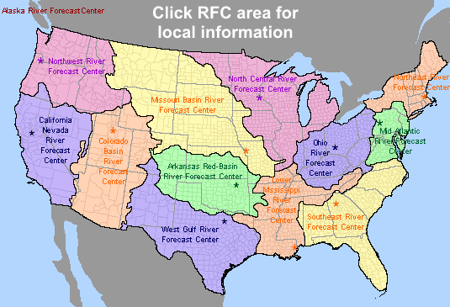
Gridded Precipitation Sources
National Products
  National Digital Guidance Database (NDGD) (2007-Present)
Regional Products
  NWS River Forecast Centers NEXRAD
CWMS
  USACE Water Management data
Add’l Other Products
Notes:
There are an increasing number of gridded precipitation products available. This includes both nationwide products as well as more locally developed sources such as from your local National Weather Service River Forecast Centers. Some of the most popular products include:
The National Digital Guidance Database (NDGD) has Real-Time Mesoscale Analysis (RTMA) hourly precipitation available for CONUS for download from 2007 to present.
NEXRAD RADAR data is a NWS product available regionally. There are currently 160 operational NEXRAD radar systems deployed throughout the United States and at selected overseas locations. Stage III and Multisensor Precipitation Estimator (MPE) products are hourly precipitation estimates that are computed by taking raw radar measurements and applying corrective algorithms. Rain gage data and satellite images are used to “correct” the raw data. Estimates from multiple radars are mosaicked together to create a precipitation grid (HRAP) for the entire river forecast center region. The period of record for NEXRAD data varies regionally.
There are several more gridded precipitation products available than those listed here and the quality of each product can greatly vary by region. As part of the USACE Corps Water Modeling System (CWMS) efforts, most USACE districts currently have real-time gridded precipitation products included within their Water Management server databases. It’s highly recommended to discuss the data available through CWMS with your local water management staff when searching for gridded precipitation products as there has likely already been some searching and testing of the available precipitation products within your region completed.
Also, as part of the USACE CWMS model development, many districts have gridded precipitation data available for their region on their water management servers.
Dipper.nws.noaa.gov/hdsb/data/nexrad/nexrad.html

Slide 33

Converting & Creating Precipitation Gridsets
Utilities available:
  HMS – certain file types can be imported directly within HMS
  VORTEX/Importer – converts several formats to HEC-DSS Records
    NetCDF, Grib, HDF, ASC & more
    Also allows for clipping, re-projecting, resampling, etc.
Notes:
Once you’ve decided to apply gridded precipitation to your model, how do you convert the raw precipitation data to an HEC-DSS file for use in HMS?
There are a few options available for converting formats or creating grids—
HMS can actually import select gridded file formats directly into HMS—(File > Import > Import Gridded Data…for more information, please see the Shared Data Components: Grid Data lecture).
VORTEX tool which can convert several native data formats to HEC-DSS, allows for additional spatial manipulation during the processing and is also user-friendly. More information on the VORTEX tool is included in a later lecture.
gageInterp tool which is a stand-alone program that creates grids by interpolation. The program takes point precipitation data (such as rain gage data) and creates a grid where the value for each cell is computed by weighting values from all gages within a specified distance. Weights can be computed using a simple average or distance.

Slide 34
Gridded Precipitation
DSS Pathnames for Grids in HEC-HMS
/A-part/B-part/C-part/D-part/E-part/F-part/
A – grid system (SHG, HRAP)
B – region or watershed name
C – the data variable (precip, temp, …)
D – starting time for grid (ex: 04JAN2021:1500)
E – ending time for grid (ex: 04JAN2021:1600)
F – additional identification (e.g. obs, radar, NWS, …)
Notes:
When converting or creating gridded datasets, it’s important to clearly name the resulting DSS-file pathnames so that it is clear where the data came from, the extent of the data and—most importantly—the data type and time.
The recommended naming convention for gridsets and parameter grids are shown on this slide. HEC-HMS requires specific C-part names. The program will not use the grid unless the C-part name is correct (the next slide shows correct C-part names for each grid type).
Gridsets, precipitation, temperature, solar radiation and crop coefficient will have both D and E-part pathnames. The parameter grids do not need E-part pathnames and only the parameter grids used by snowmelt require D-parts.

Slide 35
Gridded Precipitation
Grid Type | C-Part | Units | Data Type
Precipitation | PRECIPITATION | MM, IN | PER-CUM
Temperature | TEMPERATURE | DEG C DEG F | PER-AVER INST-VAL
Solar Radiation | SOLAR RADIATION | WATT/M2 LANGLEY/M IN | PER-AVER INST-VAL
Crop Coefficient | CROP COEFFICIENT | UNSPECIF | PER-AVER INST-VAL
Storage Capacity | STORAGE CAPACITY | MM, IN | INST-VAL
Percolation Rate | PERCOLATION | MM/HR IN/HR | INST-VAL
Storage Coefficient | STORAGE COEFFICIENT | HR | INST-VAL
Moisture Deficit | MOISTURE DEFICIT | MM, IN | INST-VAL
Impervious Area | IMPERVIOUS AREA | % | INST-VAL
SCS Curve Number | CURVE NUMBER | UNSPECIF | INST-VAL
Elevation | ELEVATION | M, FT | INST-VAL
Cold Content | COLD CONTENT | MM, IN | INST-VAL
Cold Content ATI | COLD CONTENT ATI | DEG C DEG F | INST-VAL
Meltrate ATI | MELTRATE ATI | DEGC-DAY DEGF-DAY | INST-VAL
Liquid Water | LIQUID WATER | MM, IN | INST-VAL
Snow Water Equivalent | SWE | MM, IN | INST-VAL
Grids must have:
  Correct C-part pathname
  Correct units
  Valid Data type
  Values for each grid cell
Notes:
HEC-HMS will not load a grid if the C-part pathname, Units or Data Type is incorrect. The table on this slide contains the correct C-part pathnames, Units and Data Type for each grid type in HEC-HMS.

Slide 36
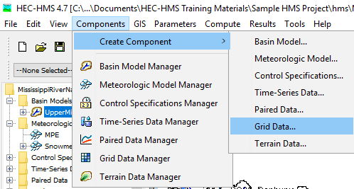
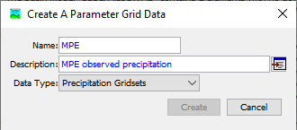
Adding Gridded Precipitation to HMS
Notes:
Once gridded precipitation has been converted to the HEC-DSS format and clearly labeled, it is ready to be added to the HMS model.
To create a precipitation gridset in HMS: Components > Create Component > Grid Data…
Within the Create a Parameter Grid Data dialog, ensure Precipitation Gridsets is selected as the Data Type and be sure to name and describe the precipitation data you are importing.
Select Create to add the grid to the Gridded Data Manager

Slide 37
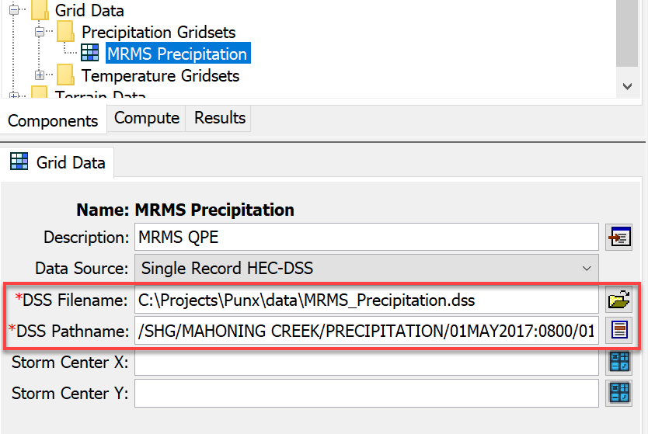
Gridded Data Manager
Notes:
Once the precipitation gridset is created and named, it is added to the Gridded Data Manager within the watershed explorer dialog.
Now, the gridded DSS record must be linked to the precipitation gridset by navigating to the dss file and selecting the appropriate pathname.

Slide 38
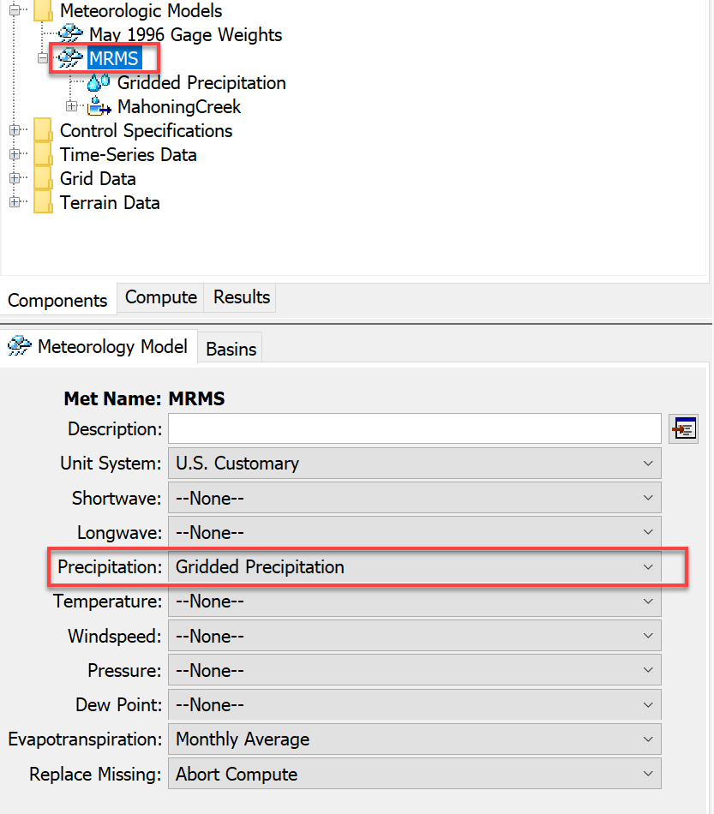
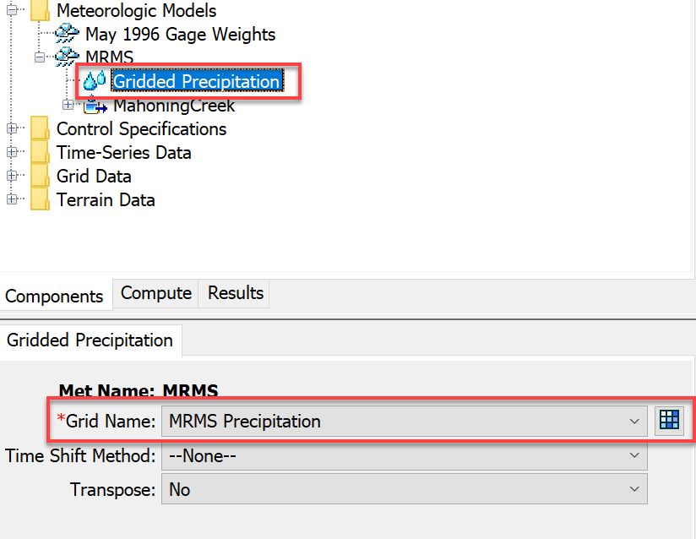
Linking Gridded Precipitation to Met Model
Notes:
Next, the meteorologic model must be configured to use gridded precipitation by highlighting the Meteorologic Model name and selecting Gridded Precipitation
The gridded precipitation data must then be linked to that Meteorologic Model by highlighting Gridded Precipitation and selecting the name of the precipitation grid in the dialog box below.

Slide 39
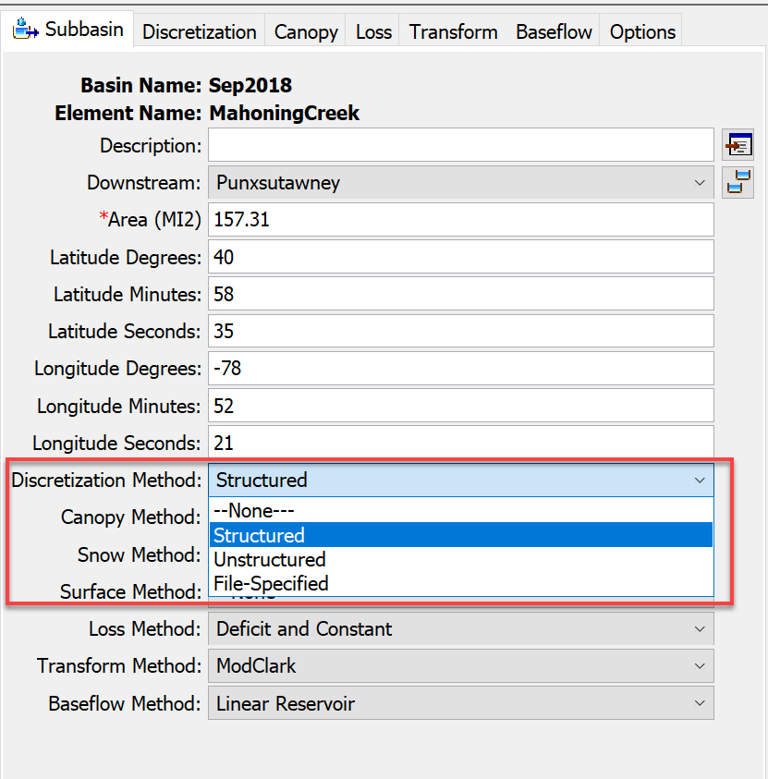
Defining Discretization
Required to run HMS with gridded components
Spatially relates gridded datasets to subbasins
Specified by subbasin
Four Discretization Methods:
  Structured
  Unstructured
  File-Specified
  None
Notes:
Defining a discretization method is required to run HMS with spatially-discrete components such as precipitation gridsets. Defining the discretization allows the HMS model to spatially relate gridded components (precip, storage, etc.) to subbasin elements, enabling spatial variability within each subbasin vs. applying a singular value throughout the entire subbasin (ie, lumped-parameter).
Discretization is defined by subbasin and has four methods to choose from.

Slide 40
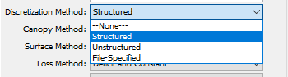
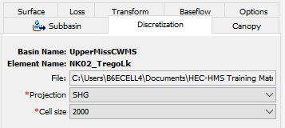
Defining Discretization
Four Discretization Methods:
  Structured*
    “Automatic” Method
    Defaults to standard SHG grid & 2-km cell size
  Unstructured
    Any coord. System
    Allows unstructured grid such as RAS plan files (ex: *.p##.hdf)
  File-Specified
    Points to HEC-HMS “Grid Cell Files” (*.mod)
  None
    “Lumped-Parameter”
    No variation within subbasin
Notes:
The “Structured” discretization method is a quick & easy approach to discretizing the model as it applies the Standard Hydrologic Grid (SHG) at a resolution. The structured method can also be used to apply a Universe Transverse Mercator (UTM) projection and various grid cell sizes ranging from 50 to 10,000 meters.
The Unstructured Method allows the application of any coordinate system (not just SHG or UTM) and can be easily defined with HEC-RAS plan files.
File-Specified allows the user to point directly to the HEC-HMS grid cell file (that was required in HMS version 4.2 & older).
Defining a “None” discretization assumes no variation of variables within the subbasin, resulting in a “lumped-parameter,” non-gridded approach.
Once the Discretization has been defined, the gridded precipitation can be added to a Simulation and the HMS model can be run.

Slide 41
Evapotranspiration
Overview
Precipitation
Evapo-transpiration
Snow
Notes:
Presentation 2 -5 minute break
Another critical process in the meteorological methods is Evapotranspiration. We talk more about ET in our advanced HMS class.

Slide 42
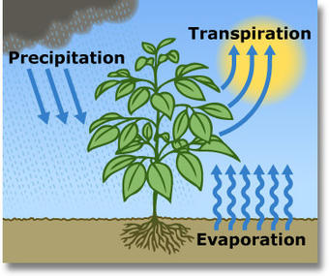
Role of Evapotranspiration
ET comprises two processes:
  Transpiration from plants
  Evaporation from surfaces
Key component of continuous hydrologic models
  Significant moisture is lost to the atmosphere
  Deficits created through ET
Notes:
ET is comprised of transpiration from plants and evaporation from the surface. These processes are interrelated and so they are often just combined at ET.
This is a critical process if you are performing continuous simulation modeling. Continuous simulation just means you are simulating a longer period of time, starting from about a week to decades.
A good continuous hydrologic model requires evapotranspiration modeling, especially for multi-year simulations. ET removes water from the soil and transmits it to the atmosphere, which can create a moisture deficit prior to flood events that reduces or eliminates direct runoff early during a precipitation event. HMS can simulate surface evaporation, plant canopy evaporation, and plant transpiration.

Slide 43
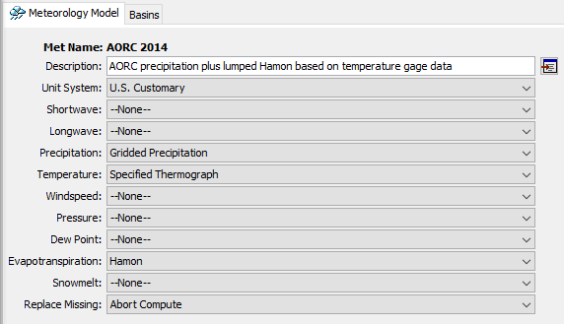
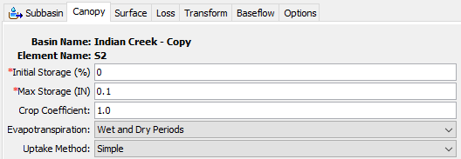
ET Modeling Requirements
Meteorologic model method
  Computes potential/reference ET
Canopy method in basin model
  Computes actual ET
  Creates moisture deficit
Notes:
The potential evapotranspiration (PET) represents the amount of water that would evaporate and transpire under ideal conditions given the available energy and moisture in the environment.
In order to simulate the ET part of the water cycle in HMS, two components are needed.
The meteorologic model allows HMS to use atmospheric data to estimate the potential evapotranspiration. PET is dependent on the energy input and the ability to transport evaporated water vapor away from the surface, but is not limited by the supply of water.
Actual evapotranspiration is handled by the basin model. Within the subbasin component is the canopy method, which serves two purposes. The first is to model canopy interception. The second is to compute the actual amount of water that can be evaporated and transpired. The maximum amount is the potential evapotranspiration, but this amount is reduced depending on the type of vegetation (controlled by the crop coefficient) and is also reduced by the availability of water. At the maximum deficit, no more water can be transpired to the atmosphere.

Slide 44
Simple Canopy Settings
Evapotranspiration timing
  Wet and dry periods
  Only dry periods
Uptake method
  Simple
  Tension reduction
    SMA only!
Notes:
The simple canopy method is what you should use in the vast majority of cases. The storage terms control interception. The ET settings are below – you can choose your crop coefficient, during which periods actual ET is computed, and the uptake method. Unless you are using the SMA loss method, use the simple uptake method.

Slide 45

ET Impact
Max Deficit
Daily Actual ET
Initial
Deficit
Notes:
When performing continuous modeling using loss methods, for example deficit and constant or SMA, deficit increases when plant uptake draws water from soil storage. If no method for increasing deficit is specified, soil storage will fill up and infiltration will only occur at the specified constant rate.
Here is an example of the impact of modeling ET on the soil moisture deficit. The initial deficit is zero. No water is input to this system. The diurnal cycle of ET creates a stair-step shaped accumulation of deficit until the maximum deficit is reached. The steepness of the growth is controlled by atmospheric conditions and the crop coefficient. The initial and maximum deficit are controlled by the subbasin loss method.

Slide 46
HMS – a spectrum of ET methods
Monthly Average
Priestly-Taylor
Penman-Monteith
Hamon
Hargreaves
Simple
Complex
Typical Methods
+ gridded options
Notes:
HMS includes a range of evapotranspiration methods. The simplest is to choose the monthly average value, which for some regions may be published data. Data and modeling requirements go up as you move to the right. The Hamon method is a temperature-based PET method, which approximates the energy balance using temperature data. The other methods begin to require radiation, wind speed, and relative humidity data. In data limited environments, the first two methods are usually adequate. Consider the role of ET in your model – if you are most interested in large flood peaks, then spending a lot of time on additional details for ET may not make sense.
Most of these methods have gridded counterparts as well, where the input data is specified with grids instead of time series.

Slide 47


Calibration Considerations
Changing ET parameters can change overall water volumes
Two primary changes:
  ET method coefficients
  Crop coefficients
Notes:
Only consider making adjustments to ET parameters if there is volume error that you suspect is attributable to a mismatch in the type of vegetation in play. In some locations, using a crop coefficient equal to 1.0 is not reasonable when the vegetation tends towards higher ET, for example corn during the peak of its growth. You can also toggle between whether or not HMS will compute ET during periods when precipitation occurs.

Slide 48


Dynamic Canopy
In long hydrologic simulations where vegetation changes drastically throughout the year, a dynamic canopy method may help
Notes:
For long-term continuous hydrologic modeling, HMS is capable of simulating a dynamic canopy, which varies the crop coefficient throughout the simulation using a time series gage or a gridset that you provide. I would only suggest using this approach in situations when modeling soil moisture deficits throughout the year can’t be captured with a single crop coefficient.

Slide 49
Takeaways
Evapotranspiration
  Important for continuous hydrology models
  Requires a canopy method in the subbasin
  Simple methods typically adequate
Notes:
Here are the three key takeaways for evapotranspiration modeling in HMS. First, ET is an important part of continuous hydrology models. Second, in order to compute actual evapotranspiration, a canopy method is required for your subbasins. Finally, the simplest methods for ET and canopy are typically adequate – use methods with fewer data requirements where you can.

Slide 50
Snow Modeling
Overview
Precipitation
Evapo-transpiration
Snow
Notes:
Our last process is snow modeling. So, this topic is an artifact when snow modeling was set in the meteorological model. It is now set in the basin model since melt and accumulation processes are happening on the basin. We won’t be doing any snow modeling and this is more for your awareness.
(Maybe remove this topic…)

Slide 51

Importance of Snow for Water Resources
Snow represents a volume of water storage distributed over a watershed, that when melted into liquid water contributes a significant inflow into rivers, streams and reservoirs that must be dealt with in an efficient & effective manner.
Notes:
In some regions, snow represents a significant volume of water storage within the watershed that can produce powerful impacts as it melts, contributing significant additional inflow into rivers streams and reservoirs.
In California, about 30% of the water is stored in the mountains and released during the spring summer period. In the Upper Colorado basin, that number sky rockets to over 80% is met by snow.

Slide 52

Snow Hydrology Goals
Snow Accumulation
  Estimation of the distribution of watershed snow water equivalent (SWE)
Snow Melt (Ablation)
  Timing and magnitude of snowmelt
Routing of Meltwater
  Where, When, How Much?
Notes:
Within snow hydrology, we are looking to model the snow accumulation and melt accurately. The variable that we model is called snow water equivalent (SWE). This is the amount of liquid for a given snow depth. In the graph, we see snow accumulate to almost 60 inches. Within a two month period, all of this volume is melted and moved down the watershed. There is a steep slope around the beginning of June that indicates the highest melt period but generally, snow melt is a gradual process compared the rainfall and we can better predict and control the volume coming down from the mountains.

Slide 53

Snowmelt Methods
Empirically based
Temperature Index
Gridded Temperature Index
Gridded Hybrid
Energy Balance
Gridded Energy Balance
Physically based
Notes:
HMS has three snowmelt methods. Each method has a gridded version. Temperature Index, Radiation derived Temperature Index (RTI), and Energy Balance. TI is more empirically based and requires just temperature as an input but has a lot of parameters. You more to more physically based methods with the energy balance which has a lot of parameters and a lot of input.
The Temperature Index method is based on a degree-day model, where there is a fixed amount of snowmelt for each degree above freezing. This method uses air temperature as a proxy for total heat transfer. There are both banded and gridded implementations.
The Hybrid method, also called the Radiation-derived Temperature Index or RTI, uses a radiation balance rather than temperature as a proxy for available energy in the snowpack. This method can be difficult to parameterize as measurements of solar radiation are not always available. This method accounts for some modes of heat transfer.
The Energy Balance method is a physically-based energy and mass balance model, where energy is exchanged between the snowpack, the air above, and the soil below. There are both banded and gridded implementations. This method accounts for each mode of heat transfer.

Slide 54

Precipitation
Air Temperature
Rain
Rain or Snow?
Snow
Add to Liquid Water
Add to Snowpack
Yes
Above Freezing?
Melt Snowpack
Add to Liquid Water
Temperature
Index Method
No
Yes
Snowpack
Below Freezing?
Refreeze Liquid Water
No
Liquid Water Limit
Groundmelt
Liquid Water to
Soil Surface
Notes:
We will talk briefly and generally about the Temperature Index method. This is one of the more common methods for snowmelt modeling because it only requires temperature as an input. The simplest description is the TI tracks whether the precipitation is falling as rain or snow and whether the snow is freezing or melting.
HMS utilizes the Temperature Index Method to simulate snowmelt processes.
The Temperature Index Method essentially looks at falling precipitation with respect to air temperature to determine whether the precipitation is falling as rain or snow. If the temperature is over a specified limit, it’s considered rain and falls as liquid water; if the temperature is under the set threshold, the precipitation volume is added to the snowpack.
Next, the temperature index method determines if the air temperature is above freezing. If it is below freezing, no change in snowpack occurs; if it’s above freezing, the snowpack begins to melt and is added to the liquid water volume within the snowpack.
Then it considers—is the Snowpack temperature below freezing? If yes, the liquid water within the snowpack re-freezes; if the temperature of the snowpack is above freezing, the amount of liquid water within the snowpack is considered. If the liquid water volume within the snowpack exceeds a specified percentage of the overall snowpack (ex: 5%), the “Liquid Water Limit” is exceeded and water is released from the snowpack.
Additional melt may occur due to groundmelt and the melted snowpack is released as liquid water to the soil’s surface as runoff.
The flow chart for the temperature index snowmelt model shows how the information on the following slides comes together as a simulation algorithm.

Slide 55

Snowmelt - Temperature Index Method Parameters
Temperature Index (TI)
Snowmelt Calibration Parameters
Lapse Rate: 0 for most; >0 for mountainous regions
*Px Temp: 32-34F
Base Temp: 32F
ATI-Meltrate Coefficient: 0.98-1.0 (typ.=1.0)
* Wet Meltrate: 0.05-0.15 in/F-day
* Rain Rate Limit: 0.25-0.50 in/day
* Dry-Meltrate: 0.015-0.15 in/F-day
Cold Limit = 0.2 in/day
ATI-Coldrate Fn: 0.01-0.045
ATI-Coldrate Coeff: 0.2-0.5
  0.2=Shallow Snowpack to 0.5=Deep Snowpack
Water Capacity: 3-5%
Groundmelt: Typically = 0 in/day
*Common Calibration Parameter
Notes:
Temperature index method parameters must be assigned by subbasin within the Meteorologic Model.
The figure in the center of this slide shows the (lumped parameter) Temperature Index dialog.
The far right of the page includes common parameter values as well as which parameters are typically adjusted during calibration.
The meltrate is the most sensitive parameter that will always have a direct impact on the snow calibration.

Slide 56

Snowmelt – Gridded Temperature Index Method Parameters
Gridded Temperature Index (GTI)
Snowmelt Calibration Parameters
Initial SWE, CC = Observed Data Grids
Initial Liquid, CC ATI, Melt ATI = Zero (acceptable assumption)
*Px Temp: 32-34 F
Base Temp: 32 F
* Wet Meltrate: 0.05-0.15 in/F-day
* Rain Rate Limit: 0.25-0.50 in/day
ATI-Meltrate Coefficient: 0.98-1.0 (typ.=1.0)
* ATI-Meltrate Fn: 0.015-0.15 in/F-day
Cold Limit = 0.2 in/day
ATI-Coldrate Coeff: 0.2-0.5
  0.2=Shallow Snowpack to 0.5=Deep Snowpack
ATI-Coldrate Fn: 0.01-0.045
Water Capacity: 3-5%
Groundmelt: Typically = 0 in/day
*Common Calibration Parameter
Notes:
Gridded temperature index method parameters must be assigned by subbasin within the Meteorologic Model.
The figure in the center of this slide shows the (distributed parameter) Gridded Temperature Index (GTI) dialog.
Initial Values for the GTI method can be set to spatially distributed parameter grids (as shown above) or can be set to default values (which reverts the initial conditions similar to the general TI method, but still determines future snowmelt on a gridded distribution).
The far right of the page includes common parameter values as well as which parameters are typically adjusted during calibration. Observed data is desirable for initial Snow Water Equivalent (SWE) and Cold Content (CC), but Zero-value grids can be used for the remaining gridded initial conditions (liquid water, cold contend ATI, Meltrate ATI) if no observed initial data is available.
Once again, the meltrate is the most sensitive parameter in the GTI approach (just like in the TI approach)--it will always have a direct impact on the snow calibration.

Slide 57

Snowmelt – Approach to Calibration
Calibrate snowmelt SWE first (before runoff calibrations).
Compare Modeled to Observed Snow Water Equivalent (SWE) Values.
Once melt of snowpack is calibrated, proceed with runoff calibration.
Notes:
When modeling snowmelt within HMS, you must first calibrate the melting of the snow component. To do this, we consider the Snow Water Equivalent (SWE) within the model and calibrate the modeled SWE to closely mirror the actual observed SWE. Once the snowpack is melting similarly to the observed data, you can proceed with the runoff calibration (infiltration, routing, etc.) to complete the event.

Slide 58

Snowmelt – Snow Observation Data
Source: https://www.wcc.nrcs.usda.gov/snow/snow_map.html
Notes:
Where can you find observed snow data?
Luckily, several snow observation sites are available throughout the Western United States—shown here in Blue. Western US sources include both Snow Telemetry (SNOTEL) automated data collection sites as well as Snow Course sites where data is manually collected.
Unfortunately, observed snow data is more difficult to come by in the Midwest and Eastern United States—with just a handful of SCAN (Soil Climate Analysis Network) sites available—shown here in Red.

Slide 59


Snowmelt – Alternate “Observed” Snow Data
Snow Data Assimilation System (SNODAS)
PROS
Available nationwide (CONUS)
Includes HMS snowmelt distributed inputs
  SWE, Cold Content, etc.
Model is updated with observed data
  Gamma flights
  Point observations
  Corrections documented at: NOHRSC SNODAS Adjustments
CONS
SWE is a model output (not observed)
Observational updates not always timely
Still lack of “observed” data
Notes:
In regions where observed snow data is scarce, an alternate source may be adopted as “observed” snow data—the Snow Data Assimilation System (SNODAS).
SNODAS is actually a snow simulation model produced by the National Operational Hydrologic Remote Sensing Center (NOHRSC).
Benefits of the SNODAS data is that it’s available nationwide and includes information required for the HMS Temperature Index and Gridded Temperature Index snowmelt methods. While the SNODAS data is actually model output, the SNODAS model is corrected with observed data from gamma flights and point observations. Model corrections are then documented online.
Drawbacks of using the SNODAS data is that it is in itself model output and not actually observed. Updates made to the SNODAS model from field observations are not always timely and there’s still a large discrepancy of “observed” data availability in the non-Western United States.

Slide 60
Takeaways
Snowmelt
  Important driver in several watersheds
  Calibrated 1st (before runoff calibration)
  Several parameters required
  Observed (or est. observed) data are available

Slide 61
Meteorologic Models
Historic Precipitation
Hydrologic Modeling with HEC-HMS

Slide 62

Hypothetical Storm Methods
Frequency storm
HMR52 storm
Standard project storm
Hypothetical storm
→ Key: intended to model highly idealized storms, usually for design
Notes:
This is where you are creating storms for design purposes or assessing flood inundation risks.
Hypothetical storms are also called design storms, or synthetic storms. They control for a small number of design criteria, and then make a large number of simplifying assumptions about the remainder of a storm’s properties. These methods will not be covered in detail during this course, but more information can be found in the HMS user’s manual, and with the HMS tutorials and guides online.
Frequency storm is a very specific method for defining a storm pattern using precipitation-frequency information. It was designed to work with older precipitation-frequency information, such as HYDRO35, TP40, or TP49. Today, the recommendation is to use the hypothetical storm method instead.
The HMR52 storm is meant to perform probable maximum flood analyses for the central and eastern United States. It has a very specific application and is not intended for general use.
The standard project storm is no longer used in practice; however, HEC-HMS maintains this capability in order to support older projects where it may still be necessary. This storm has an extremely specific application and should not be used for general modeling.

Slide 63

Hypothetical Storm Methods
Frequency storm
HMR52 storm
Standard project storm
Hypothetical storm
Notes:
The hypothetical storm method is a flexible and generalized modeling method that subsumed the old SCS storm methods of HMS 4.2.1 and prior. It allows a user full control over the storm temporal pattern, point-to-area conversion, and can be used directly with precipitation-frequency grids from NOAA Atlas 14. I highly recommend this method for all idealized storm modeling needs. Tutorials on this method are available online with the HMS tutorials and guides.
The hypothetical storm method offers the user a lot of control, so there are many settings to be specified for it to run. This instance of the hypothetical storm requires the user to specify a dimensionless storm temporal pattern, a storm duration, a precipitation-frequency grid to pull depth information from, an area reduction method, an area reduction function, and a computation point to compute the storm area for.
Of the hypothetical or synthetic storm methods, this is the most flexible and applicable one. Unless you have specific project needs that require one of the other methods, it is recommended to use this method.

Slide 64


Global Editors
Hamon (Met Model)
Temperature Index (Basin Model)
Notes:
Here is an example of a global editor for the temperature index snowmelt method. Because the TI method has parameters that are controllable at the subbasin level, it can be cumbersome to click through each node of the watershed explorer tree to set them. The global editor is a faster way to enter these parameters. You can open the global editor for snowmelt by selecting the met model in the watershed explorer, then choosing the Parameters menu, and selecting Snowment then temperature index (or gridded temperature index.)

Slide 65

Importance of Snow within USACE
Reservoir Operation
  Timing, volume, optimization
  Release schedules, gate settings
Snowmelt Flooding
  Peak Runoff, Timing, Rain on snow
Planning & Design Studies
Source: https://atlas.niu.edu/klot/snowclimatology/USSnowContours.png
Notes:
This is pointing out a good chunk of the US has snow considerations (more than half the US). With respects to reservoir operations, snow accumulation and melt can significantly impact reservoir operations.
A large portion of the United States is impacted by the effects of snowmelt. Within USACE, the effects of snowmelt can impact reservoir operations, produce flooding and impact planning & design studies.

