Slide 1
Loss Methods within HEC-HMS
Hydrologic Modeling with HEC-HMS
Jay Pak
Slides by: Mike Bartles
US Army Corps of Engineers
Hydrologic Engineering Center
Notes:
This lecture is meant to serve as an introduction and will not be an exhaustive, detailed look at all the various options that are contained within the software.
We won’t be deriving equations or even delving into too much math.
Instead, we’ll focus more on concepts and how losses are accounted for within HEC-HMS.

Slide 2
Objectives
Describe how losses are simulated within HEC-HMS
Provide an overview of the available canopy, surface, and loss methods within HEC-HMS
Supply commonly used parameter values, data sources, and parameter estimation techniques
Discuss factors that affect losses
Summarize calibration techniques
Present advantages and disadvantages
Notes:
This lecture is meant to serve as an introduction and will not be an exhaustive, detailed look at all the various options that are contained within the software.
We won’t be deriving equations or even delving into too much math.
Instead, we’ll focus more on concepts and how losses are accounted for within HEC-HMS.

Slide 3
Outline
Introduction to Loss Methods in HEC-HMS
Canopy and Surface Methods in HEC-HMS
Loss Methods in HEC-HMS
Initial and Constant Loss Method
Deficit and Constant Loss Method
Green and Ampt Loss Method

Slide 4
Runoff Process – Hydrologic Cycle
Notes:
Let’s begin by taking a look at the hydrologic cycle, which begins with the evaporation and/or transpiration of water which can occur from the land surface, from vegetation, from lakes, from rivers, or the surface of the ocean.
As moist air is lifted, it cools and water vapor condenses to form clouds.
Moisture is transported around the globe until it returns to the surface as precipitation. This precipitation can fall in multiple forms like rain or snow.
Once the water reaches the ground, one of two processes may occur;
Some of the water may evaporate back into the atmosphere or
The water may penetrate the surface and become groundwater.
Groundwater either seeps its way to into the oceans, rivers, and streams, or is released back into the atmosphere through evapotranspiration.
The balance of water that remains on the earth's surface is runoff, which empties into lakes, rivers and streams and is carried back to the oceans, where the cycle begins again.

Slide 5
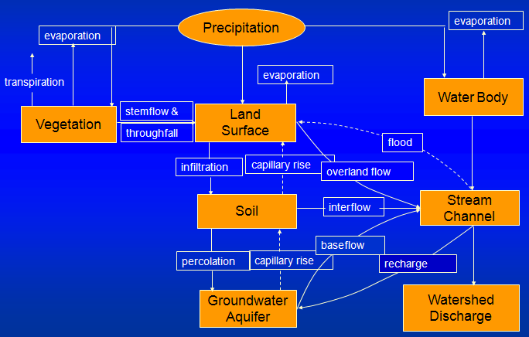
Runoff Process – HEC-HMS
Notes:
This is the hydrologic cycle, broken into a logical set of steps, and included within HEC-HMS.
These processes are all simulated within HEC-HMS, to varying levels of detail.
Pretty complicated, huh?
Don’t worry.
We’re only going to focus on the processes located in the center of the image.
Other lectures will discuss additional processes.
But, all of these processes work together to estimate the discharges from a watershed.

Slide 6
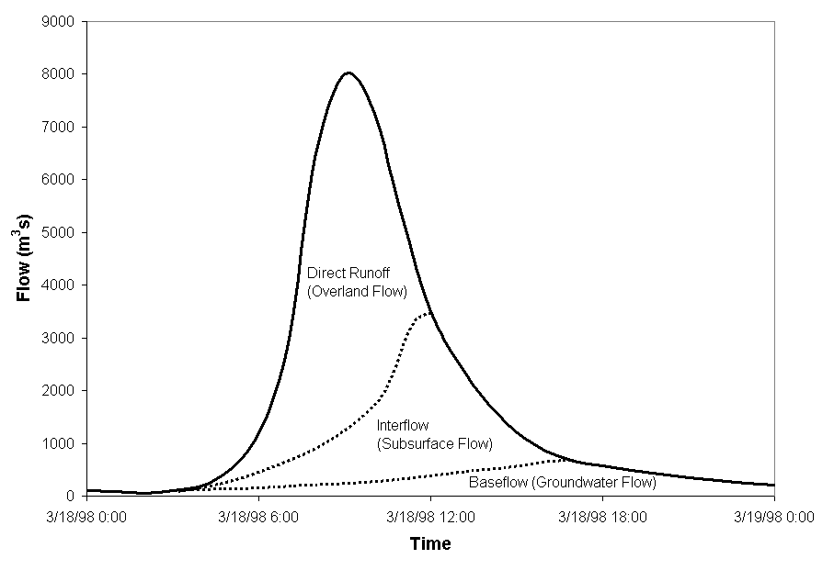
Hydrograph Components
Notes:
A hydrograph is a graphical representation of discharge with respect to time.
A streamflow hydrograph is a result of the runoff process, which is comprised of overland flow (direct runoff), interflow (flow in the upper soil layer), and groundwater flow (saturated flow through alluvial deposits or other water-bearing formations).
In this set of lectures, we’re going to pay particular attention to direct runoff (click to animate). As you can see, this volume is primarily responsible for the “peak” in the runoff hydrograph.
Water that is lost due to infiltration can still contribute to the total runoff hydrograph in the form of the slower responding interflow and baseflow. These volumes are also accounted for within HEC-HMS, but we’re not going to focus on them within these lectures.

Slide 7
Computing Runoff Volumes with HEC-HMS
Excess
Precipitation
Transformation
Loss
Computation
Precipitation
Interflow + Baseflow
Total Subbasin
Runoff
Outlet
Flow
Channel
Routing
Notes:
A key element for the simulation of the precipitation-runoff process is the determination of the portion of rainfall that contributes to direct runoff.
Direct runoff is the portion of runoff that enters the stream quickest and contributes the most to peak discharges.
The portion of precipitation that leads to direct runoff is called excess precipitation.
The difference between precipitation and excess precipitation is defined as loss.
Let’s look closer at the loss computations within HEC-HMS.

Slide 8
Simplifying Assumptions
For each subbasin or grid cell:
Uniform initial conditions
Uniform spatial distribution of precipitation
Uniform spatial distribution of losses due to interception/infiltration
Precipitation and losses are constant for each time step
Notes:
Regardless of the method, there are some universal assumptions made within HEC-HMS. Within a subbasin or grid cell:
All initial conditions are uniform, precipitation and losses are uniformly spatially distributed, and precipitation and losses are constant over a time step.

Slide 9
Losses within HEC-HMS
Interception / Canopy Storage
Evapotranspiration
Surface /
Depression
Storage
Losses
Infiltration / Soil Storage
Excess Precipitation
Notes:
The principle loss components are:
Interception and canopy storage,
Surface and depression storage and
Infiltration and soil storage
Precipitation that is captured and stored in either the canopy, surface, or soil layers can be evaporated or transpired back into the atmosphere
Precipitation that exceeds the storage capacity of these layers becomes excess precipitation

Slide 10
Canopy and Surface Losses within HEC-HMS
Interception / Canopy Storage
Evapotranspiration
Surface /
Depression
Storage
Losses
Infiltration / Soil Storage
Excess Precipitation
Notes:
As a quick review, within this set of lectures, we’re focused on modeling losses
Within HEC-HMS, precipitation can be lost to interception by the vegetation canopy, within surface depressions, or to the soil through infiltration
In this specific lecture, we’re going to focus on interception by the vegetation canopy and surface depressions (animate)
The next couple of lectures will look at infiltration

Slide 11
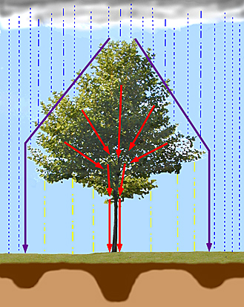
Canopy Interception
Vegetation can intercept precipitation and reduce the amount of that arrives at the ground surface
Vegetation can also extract water from the soil in a process called transpiration
Evaporation and transpiration are often combined and referred to as evapotranspiration
Notes:
Precipitation can be intercepted by plants and trees before reaching the soil surface
In this image, precipitation falling from the sky must first get through the vegetation, if present, to get to the ground.
Vegetation doesn’t just slow the vertical movement of water to the soil either. It can also capture and store precipitation in addition to extracting infiltrated water from the soil through a process call transpiration.
Commonly, evaporation from the surface and transpiration from vegetation are combined into one process and referred to as evapotranspiration
When using a canopy method in HEC-HMS, precipitation will not reach the surface or soil layers until the available canopy storage is filled.

Slide 12
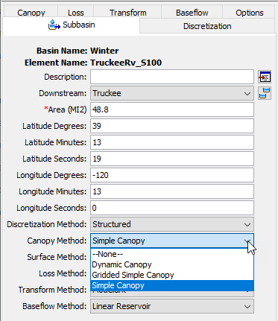
Available Canopy Methods
Dynamic Canopy
  Long-Term Simulation
  Time-Dependent Storage Capacity & Crop Coefficient
Gridded Simple Canopy
Simple Canopy
Notes:
There are three canopy methods available for use within HEC-HMS and the Simple Canopy is the most commonly used method.
As its name implies, it’s simple to use and parameterize. Conceptually, all precipitation is intercepted until the canopy storage capacity is filled. Once the available storage is filled, any additional precipitation will fall to the surface or directly to the soil if no surface method is included.
The Gridded Simple Canopy method implements the simple canopy method on a grid cell basis instead of at the subbasin level. Within this method, each grid cell can have separate parameter values, separate precipitation inputs, and separate storage values.
The Dynamic canopy method includes the ability to vary storage capacity and crop coefficient over time. This method is useful for long term simulations over months to years where vegetation and its impacts change drastically.

Slide 13
Common Canopy Storage Values
Zinke (1967) gives the following canopy interception depths:
These values must be calibrated and validated!
Canopy Description | Storage (in)
General Vegetation | 0.05
Grasses and Deciduous Trees | 0.08
Coniferous Trees | 0.1
Notes:
Here are some common canopy storage values presented for your use.
These values come from a study conducted by Zinke in 1967.
Typically, canopy storage is very small when compared to infiltration into the soil in addition to uncertainty in precipitation depths which can be HUGE.
However, no matter where your initial parameter estimates come from, they must be calibrated and validated using observed data!

Slide 14
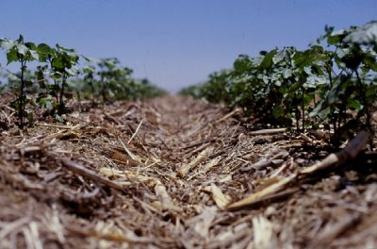
Surface / Depression Storage
Surficial depressions can temporarily store water
  Puddles
  Rough areas
Captured precipitation empties over time due to infiltration and/or evapotranspiration
Notes:
Moving on from the canopy, water reaching the ground can infiltrate into the soil, form puddles, or flow across the land surface.
Water that is captured in puddles is called depression storage.
Depression storage results from micro- and macro-relief depressions in the surface topography that store water
Given enough time, this water on the surface will either runoff, infiltrate, or evaporate.
You can imagine a significant amount of precipitation being captured between the rows of crops shown in this image.
When using a surface method in HEC-HMS, runoff will not begin until the precipitation rate exceeds the soil infiltration capacity and depression storage is filled.

Slide 15
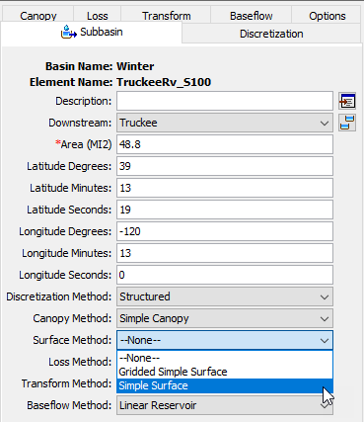
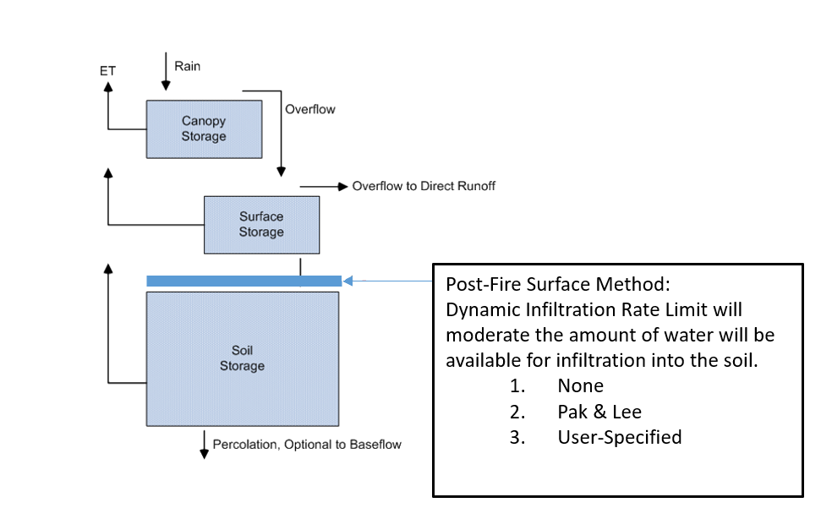
Available Surface Methods
Gridded Simple Surface
Simple Surface
Gridded Dynamic Surface
Dynamic Surface
  Post-Wildfire Recovery
Notes:
There are four surface methods available for use within HEC-HMS.
The Simple Surface is the most commonly used Surface method within HEC-HMS.
Similar to the Simple Canopy method, this method is simple to use and parameterize. All precipitation is captured and stored on the surface until the available storage is filled. Once the storage is filled, all further precipitation goes to the soil layer. Water in surface storage infiltrates into the soil whenever it is present in storage. That is, water will infiltrate even when the storage capacity is not full.
The Gridded Simple Surface method implements the simple surface method on a grid cell basis. Each grid cell has separate parameter values and separate precipitation inputs.
The Dynamic Surface method was introduced to HEC-HMS in version 4.11. This method can be used for post-wildfire or other scenarios where a surface layer of vegetation and/or soil limits the amount of precipitation that is able to infiltrate into the soil layer. Post-fire watershed modeling is important for estimating flood risk after fire and the rate of erosion, or recovery, of the hydrophobic surface layer.

Slide 16
Common Depression Storage Values
Bennet (1998) gives the following surface depression depths:
These values must be calibrated and validated!
Surface Description | Storage (in)
Steep, smooth slopes | 0.04
Most areas with impervious surface | 0.125 – 0.250
Most areas with pervious surface | 0.25 – 0.50
Flat agricultural land with conservation tillage | 2.0
Notes:
Here are some common surface storage values that come from a study conducted by Bennet in 1998. Again, these aren’t the only values that you can use; they’re just common values.
Like canopy storage, the amount of storage afforded by the surface is typically very small when compared against infiltration and precipitation uncertainty.
Don’t forget, these values must be calibrated and validated!

Slide 17
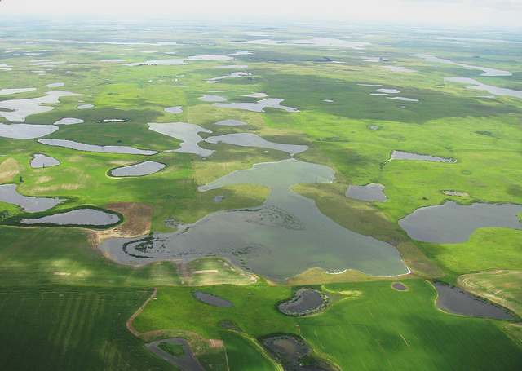
Depression Storage: “Prairie Potholes”
Notes:
While surface storage isn’t commonly a huge concern when simulating runoff from a watershed, within areas like the upper Midwestern United States or agricultural areas subjected to conservation practices, surface storage amounts can be relatively large.
Here’s one such example. These areas are commonly referred to as “prairie potholes” and you can see why.
Prairie potholes are depressional wetlands that formed in areas previously covered by glaciers.

Slide 18
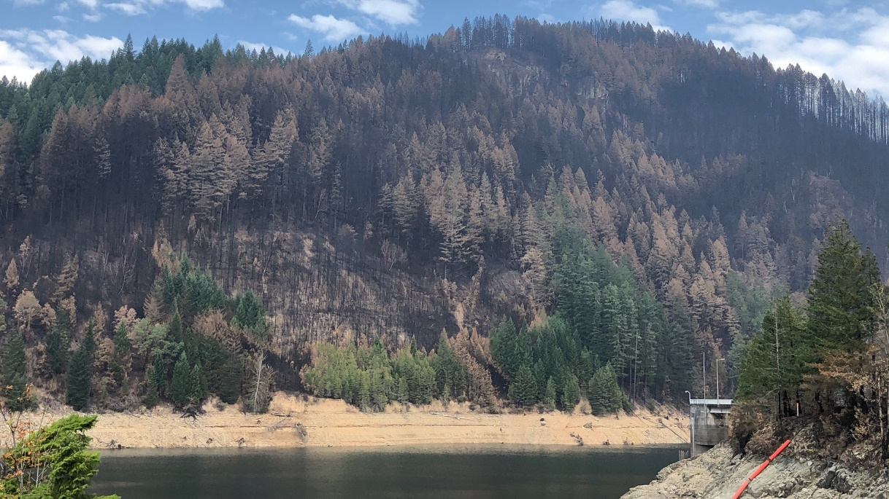
Factors that Affect Canopy Interception and Surface / Depression Storage
Storm character
  Duration
  Intensity
  Precipitation form
Time of year
Vegetation
  Type
  Density
Catchment slope
Drought
Wildfire
Blue River Lake, Sep 2020
Notes:
Now, moving onto factors that can affect canopy and surface storage.
While there are numerous phenomena that can alter canopy and surface storage, the type of storm, time of year, vegetation type, and vegetation density, are typically the most impactful.
This is an important topic to consider if your watershed is different than your reference.
For instance, if it rains in the winter when the leaves have fallen off the deciduous trees, there will be less canopy storage than if it rains in the summer.
Overland slopes can also drastically impact the available surface storage. The steeper the area, the less surface storage will be available.
Special consideration must be given to drought and wildfire. As exemplified in recent years within the western United States, drought and wildfire can heavily impact canopy interception and surface depression storage.
This image here is from Blue River Lake in Oregon, which is a USACE project. Notice the stark brown areas on the hillside; these areas were ravaged by wildfires in 2020. The amount of storage available in these areas will be drastically different than unburned areas and must be taken into consideration.

Slide 19
Losses within HEC-HMS
Interception / Canopy Storage
Evapotranspiration
Surface /
Depression
Storage
Losses
Infiltration / Soil Storage
Excess Precipitation
Notes:
Quick review: precipitation can be lost to interception by the vegetation canopy, within surface depressions, and to the soil through infiltration
In this specific lecture, we’re going to focus on infiltration into the soil

Slide 20
Infiltration
Infiltration is the process of water entering into the soil through the soil surface.
Notes:
So, what is infiltration?
Infiltration is the process of water entering the soil through the soil surface.

Slide 21
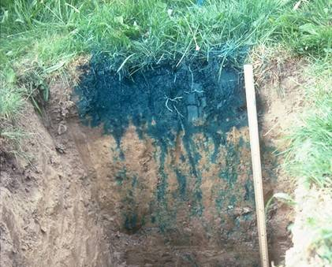
Infiltration in the Real World
Notes:
Infiltration in the real world is complicated!
Within this image, water with blue dye was placed on the top of soil and allowed to infiltrate. After a short time, a backhoe then excavated a trench to show how the blue dye had progressed downward.
This image was first shown to me in grad school almost a decade ago and has stuck with me ever since. I think it does an awesome job visualizing the complexities that the real world has to offer.
You can see how several flanges of blue dye have moved downward further than the bulk of the infiltrated water.
This is due to heterogeneities in this soil and is a pretty common thing out in the wild.
Even though this soil may be predominantly, say, silt loam, there are vertical and horizontal lenses of soil that allow water to move downward easier and faster.

Slide 22
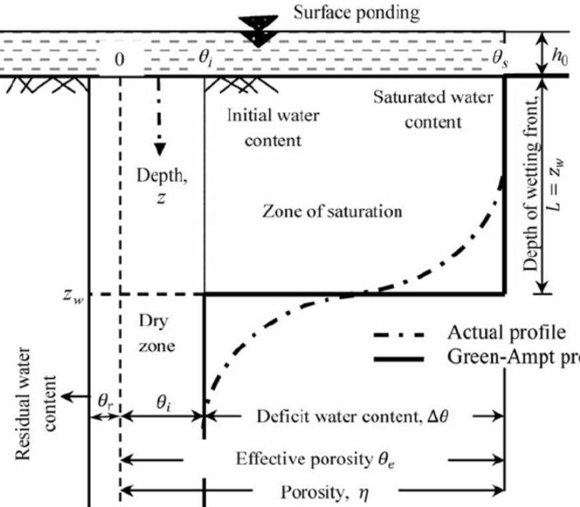
Infiltration in a Textbook
Notes:
It’s impossible to exactly predict infiltration in a heterogenous soil over the scales that we’re commonly expected to model, like hundreds to thousands of square miles.
As such, many simplifications are made to allow for efficient and tractable solutions.
This is the reason why it seems like everybody and their brother has a different infiltration method: each method simplifies the real world a little differently.
However, it’s important to remember that each method is a simplification of the real world.
For instance, this diagram shows the simplified downward movement of infiltrated water through a soil profile when using the Green and Ampt method. Notice that the wetting front is flat.
You need to understand how a specific method simplifies the real world to accurately apply it to your specific watershed.

Slide 23
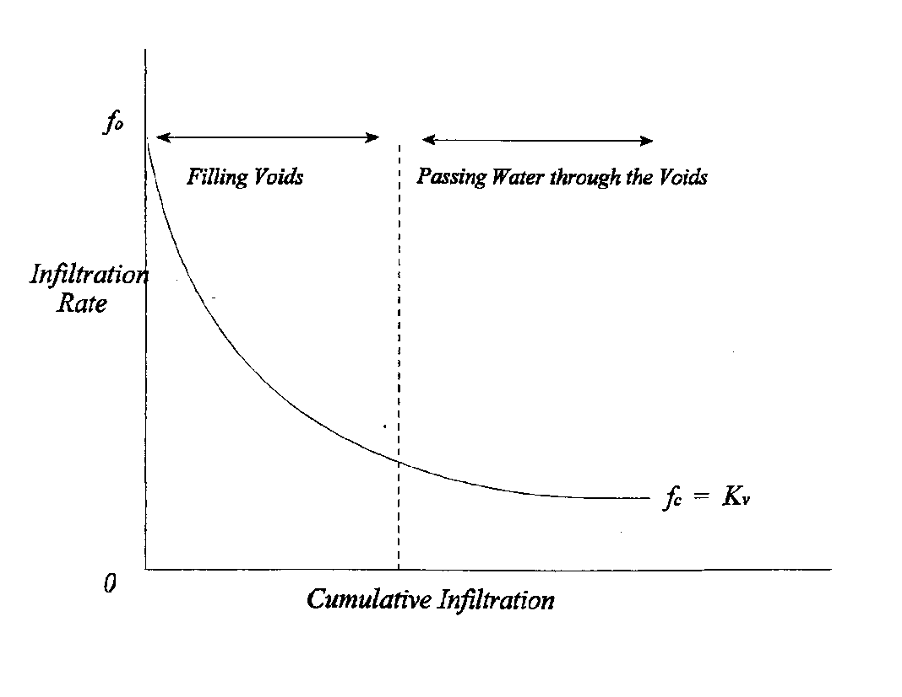
Infiltration
1) An exponential decrease in the infiltration rate with cumulative infiltration and
2) As moisture potential approaches zero, the infiltration rate decreases to a rate equivalent to saturated vertical hydraulic conductivity.
Notes:
Many, many experiments have shown that, under steady precipitation and with adequate drainage, infiltration starts at an initially high rate and decreases exponentially as more and more water is infiltrated.
However, the infiltration rate does not go to zero. This is a very important fact and one that I want to drive home.
In fact, the infiltration rate approaches an asymptotic limit which is known as the saturated hydraulic conductivity.
Saturated hydraulic conductivity is defined as the rate at which water moves through a unit area of saturated soil in a unit time under a unit hydraulic gradient.
We’ll come back to this figure in future videos as well.

Slide 24
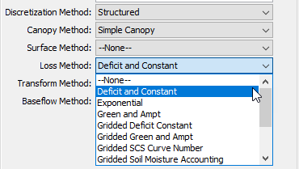
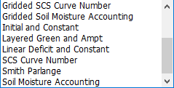
Available Infiltration Methods
Deficit and Constant
Linear Deficit and Constant
Exponential
Green and Ampt
Gridded Deficit Constant
Gridded Green and Ampt
Gridded SCS Curve Number
Gridded Soil Moisture Accounting
Initial and Constant
Layered Green and Ampt
SCS Curve Number
Smith Parlange
Soil Moisture Accounting
Notes:
There are thirteen infiltration methods available for use within HEC-HMS. Within HEC-HMS, infiltration methods are referred to as loss methods.
These options range from simple, like Initial and Constant, to complex, like Soil Moisture Accounting.
We’ll go through a few of these methods in future lectures.

Slide 25
GIS Databases
Gridded Soil Survey Geographic (gSSURGO)
Info gathered by walking over the land and observing the soil
Some soil samples analyzed in laboratories
Collected at scales of 1:12,000 to 1:63,360
U.S. General Soil Map (STATSGO)
Created by generalizing more detailed survey maps
Scales of 1:250,000 (CONUS) and 1:1,000,000 (Alaska)
Soils of similar areas were studied and the probable classification and extent of the soils were determined
USDA Geospatial Data Gateway: https://gdg.sc.egov.usda.gov/
USDA Web Soil Survey website: http://websoilsurvey.nrcs.usda.gov/app/HomePage.htm
Notes:
Commonly, geographic information systems are used to demarcate different soil types and, as such, different infiltration properties.
The two most commonly-used data sources in the U.S. Army Corps of Engineers are Gridded Soil Survey Geographic, gSSURGO, and U.S. General Soil Map, STATSGO. Both data sources are made available through the U.S. Department of Agriculture.
gSSURGO has much finer resolution than STATSGO and receives higher usage.
Hyperlinks are provided here for your use. But, if you Google “gSSURGO” or “STATSGO”, you’ll find your way to these data sets.

Slide 26
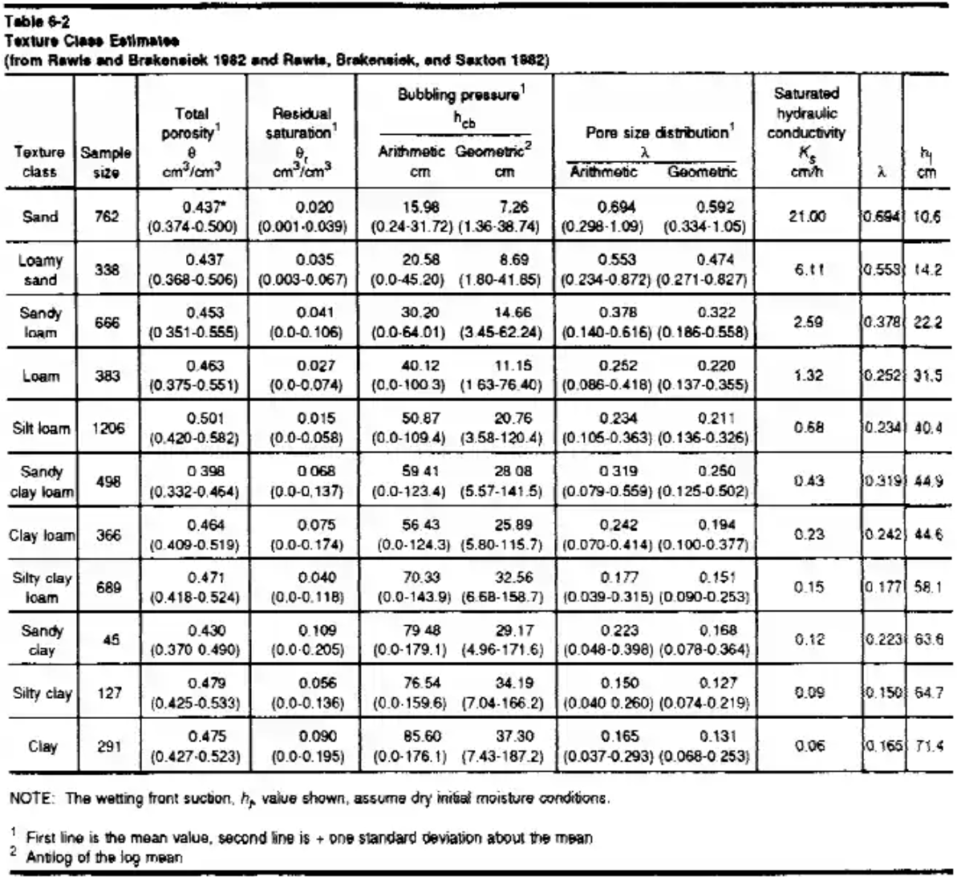
Parameter Estimation
Recommendation:
  Do not use actual parameter values within the soils database tabular data
  Get surficial texture from soils database
    e.g. silt, loam, sandy loam, etc
  Relate to literature values
    Engineer Manual 1110-2-1417
    Rawls, Brakensiek, and Miller (1983)
  Initial estimates must be calibrated and validated!
Notes:
My recommendation is: don’t use the actual parameter values, like saturated hydraulic conductivity or wetting front suction head, within the soils database.
Instead, get the surficial texture from the soils database and relate to literature values. For instance, within Engineer Manual 1110-2-1417 Flood Runoff Analysis, tables are presented that contain infiltration parameters for various soil textures. Use these instead.
But, don’t forget, these initial estimates, wherever they come from, must be calibrated and validated.

Slide 27
Factors Affecting Infiltration
Storm Character
Time of Year
Soil Compaction
Slope
Cracks
Roots
Vegetation
Soil Moisture
Litter
Temperature
Soil Compaction
Crusting
Soil Type
Imperviousness
Drought
Wildfire
Notes:
Infiltration into a soil is dependent upon a whole slew of factors like storm character, vegetation, and soil compaction.
Keep these in mind when estimating and using infiltration parameters. Were the initial infiltration parameter estimates based upon different soil or vegetation characteristics than those that prevail now?

Slide 28
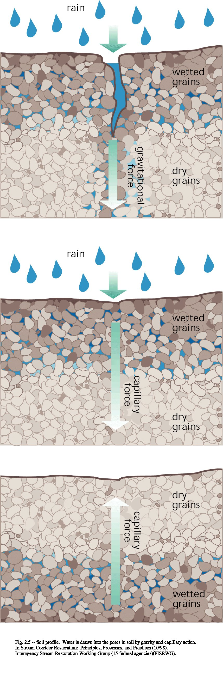
Notes:
As an example, here’s a graphic that demonstrates how much quicker precipitation can be infiltrated into a soil when cracks are present.
These cracks can be introduced by multiple mechanisms like machinery, extreme low or high temperatures, or extended drought.

Slide 29
How to Select an Infiltration Method
All methods are a simplification of the real world
An appropriate method:
  Captures the significant aspects of the system in question
  Provides the necessary information to meet study objectives
Questions to ask yourself:
  What is the required accuracy of the model?
  What are the required outputs?
  What type of physical and/or observed data is available?
  How much time and $$$ is available?
  With what methods are you familiar?
Notes:
Keep in mind that all infiltration methods are simplifications of the real world. But, appropriate methods capture the important aspects of the system and meet the study objectives.
So, ask yourself: what does my model have to provide, how accurate does it have to be, how much time and money is available for the study, and what methods am I most familiar with?
Ultimately, HEC-HMS presents you with many modeling choices. You can choose different methods, try them, and compare and contrast the consequences.

Slide 30
Initial and Constant Loss Method
All rainfall is lost until an initial loss is satisfied.
A constant loss rate is applied to the remaining precipitation.
There isn’t a way to extract infiltrated water!
Notes:
When using the initial and constant method, all rainfall is lost until an initial loss volume is satisfied.
After that volume has been filled, any additional precipitation is lost at a constant rate. Anything that’s not infiltrated will become excess precipitation.
Simple, right?
I gotta mention up front that there isn’t a way to extract infiltrated water when using this method. If you want to do that, you’ll have to step up to something a bit more complicated. We’ll talk about another option that can do that within the next video.

Slide 31
Initial and Constant Loss Method
Initial Loss
Constant Loss
Notes:
Let’s revisit a figure from a previous lecture. Recall that infiltration has been shown to start an initially high rate and decrease exponentially towards an asymptotic limit called the saturated hydraulic conductivity.
When using the initial and constant loss method, you only have an initial loss volume, which is the green rectangle in this image, and a constant rate, which is the top of the red rectangle in this image, to recreate this exponential curve.
As such, you’ll typically over estimate infiltration rates at some times and underestimate it at other times in order to provide a good fit throughout the entire simulation time window.

Slide 32
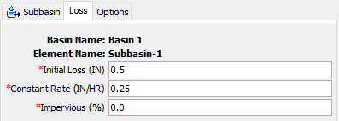
Example
Time | Precip (in) | Loss (in) | Excess (in)
0200 | 0.5 | 0.5 | 0.0
0300 | 0.5 | 0.25 | 0.25
0400 | 1.0 | 0.25 | 0.75
0500 | 0.5 | 0.25 | 0.25
0600 | 0.0 | 0.0 | 0.0
0700 | 0.0 | 0.0 | 0.0
0800 | 0.0 | 0.0 | 0.0
0900 | 0.0 | 0.0 | 0.0
1000 | 0.5 | 0.25 | 0.25
1100 | 0.5 | 0.25 | 0.25
1200 | 0.5 | 0.25 | 0.25
1300 | 0.5 | 0.25 | 0.25
1400 | 0.5 | 0.25 | 0.25
Notes:
This method requires two parameters, initial loss and constant rate. A directly connected impervious area can also be specified. When a non-zero value for directly connected impervious area is specified, infiltration computations won’t be carried out on that portion of the subbasin or grid cells and all precipitation will become excess.
This example shows how precipitation excess/loss is computed with this method.
In the first time step, half an inch of precipitation is lost to initial losses (animate). From there on out, precipitation is lost at a constant rate of 0.25 inches per hour.
In the next time step, another half inch of precipitation falls, 0.25 inches of constant loss is applied, and 0.25 inches of excess is generated (animate).
In the next time step, 1 inch of precipitation falls, 0.25 inches of constant loss is applied, and 0.75 inches of excess is generated (animate).
In the next time step, half an inch of precipitation falls and 0.25 inches is lost due to the constant rate resulting in 0.25 inches of excess being generated (animate).
Then, there’s a lull in precipitation for four hours. No infiltrated water is extracted because you can’t do that with this method. So, any additional precipitation is only subjected to the constant loss rate, as shown in the remaining time steps (animate).

Slide 33
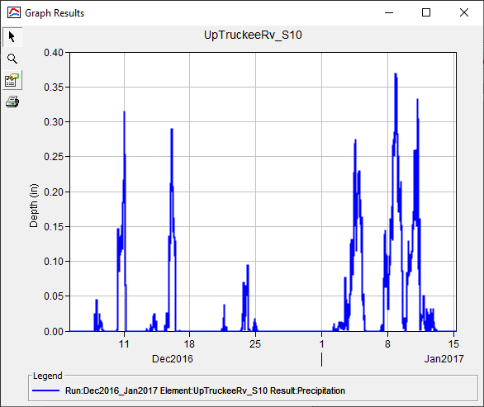
Parameter Estimation – Initial Loss
Based upon antecedent conditions and soil
Did it rain a day/week/month before the simulation start?
Precipitation
Notes:
When estimating an appropriate initial loss volume, you should scrutinize the prevailing antecedent conditions prior to the start of your simulation.
For instance, did it rain a week prior to the start, or has it not rained in several months?
Also, how long does it typically take for infiltrated precipitation to be removed from the system through either drainage or evapotranspiration?
In this image, a moderate amount of precipitation fell approximately 1 to 2 weeks prior to January 1st, which is the start of my simulation. Also, this particular watershed takes several weeks to dry out in between precipitation events. So, I should start by using a small initial loss volume because I’d expect there to be a good amount of moisture still within the soil at the start of my simulation.

Slide 34
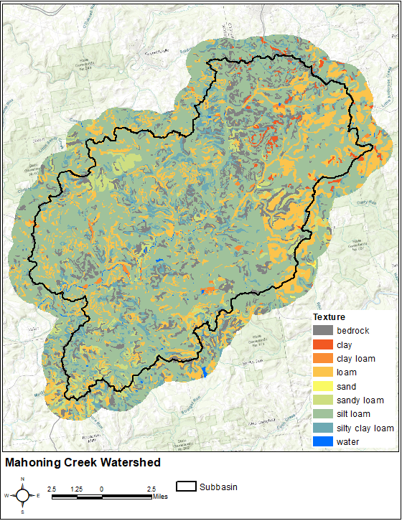
Parameter Estimation – Constant Rate
Get surficial texture from soils database
  e.g. silt, loam, sandy loam, etc.
Relate texture to saturated hydraulic conductivity in literature values
  Engineer Manual 1110-2-1417
  Rawls, Brakensiek, and Miller (1983)
Notes:
When estimating a constant loss rate for your watershed, remember my recommendation from the previous lecture: don’t use the actual parameter values from a soils database to estimate this parameter!
Instead, get the surficial texture from the soils database and relate to published saturated hydraulic conductivity values for the predominant soils.
In this image, over half of the subbasin of interest is covered by silt loam. So, a decent place to start would be to use an estimate of saturated hydraulic conductivity for silt loam and begin calibrating from there.

Slide 35
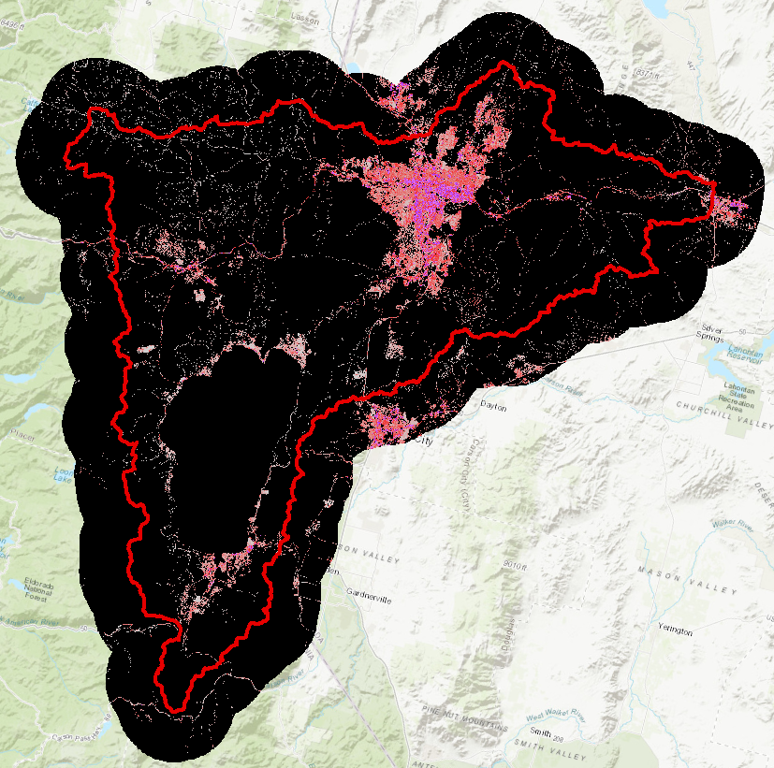
Parameter Estimation – Impervious Area
Estimate using GIS
National Land Cover Database (NLCD)
  NLCD 2021
Include large, standing water bodies
Notes:
When estimating percent impervious area, it’s okay to use a GIS source like the National Land Cover Database.
You should also include large, standing water bodies in these estimates as rain falling directly onto a large lake or reservoir should not be subject to infiltration.
In this image, percent impervious cover from the NLCD 2016 version is shown. Black areas indicate little to no impervious cover while magenta areas indicate high degrees of impervious cover.

Slide 36
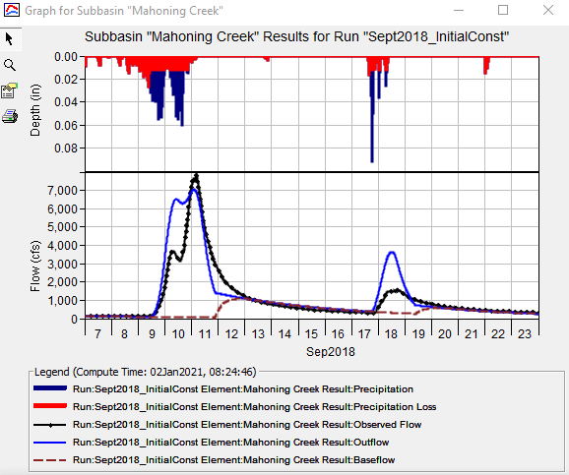
Calibration Techniques
Match initiation of runoff
Match observed runoff volume
Use multiple statistical metrics
  Nash-Sutcliffe Efficiency
  Root Mean Square Error
  Percent Bias
Notes:
When calibrating the initial and constant method, I like to start by modifying my initial parameter estimates until I get the initiation of runoff correct. Specifically, I’m trying to match the time at which the computed runoff starts to rise when compared to the observed runoff.
Then, I try to match the observed runoff volume.
In this example, observed flow is shown in black and computed flow is shown in blue.
I’ve matched the time of runoff initiation pretty well, but my initial runoff is too high. So, I need to increase my initial loss and/or constant rate.
When calibrating, it’s important to use more than just the eyeball test to gauge whether your model is accurate. Multiple statistical metrics, like Nash-Sutcliffe Efficiency, are reported in HEC-HMS for locations with observed data. Use all of these to measure model performance as they compare your results from different perspectives.

Slide 37
Initial and Constant Loss Method
Advantages
"Mature" method that has been used successfully in thousands of studies throughout the U.S.
Easy to set up and use.
Parameters can be related to predominant soil textures and estimated using multiple literature sources.
Method is efficient; it includes only a few parameters necessary to explain the variation of runoff volume.
Disadvantages
Difficult to apply to ungaged areas due to lack of direct physical relationship of parameters and watershed properties.
Method may be too simple to predict losses within event, even if it does predict total losses well.
Does not allow for continuous simulation.
Notes:
The main advantage of this method is that it’s simple! Because it’s simple, it’s been successfully used all over the world for numerous purposes. The required parameters can be easily estimated from observed data. Also, this method is parsimonious in that a small number of variables (or parameters) are used to explain something. This allows for easy investigation of model uncertainty, which is an advanced topic that we’ll revisit in another video.
However, the primary disadvantage of this method is also that it’s simple. There will be some situations where you just can’t predict the infiltration within complicated scenarios using this method because there aren’t a lot of predictor variables or parameters.
So, being simple is a double edged sword, so to say.

Slide 38
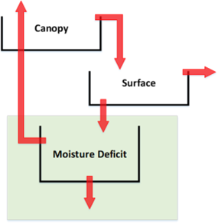
Deficit and Constant Loss Method
Keeps track of the moisture state using a simple 1-layer storage volume
Precipitation first satisfies the moisture deficit and then a constant loss rate is applied to remaining precipitation.
When ET is included, the moisture deficit will increase until a maximum value is reached.
Notes:
This method is similar to the initial and constant method in that an initial volume must be satisfied and, afterwards, any additional precipitation is lost at a constant rate. Anything that’s not infiltrated will become excess precipitation.
However, this method is capable of continuous simulation by accounting for the subbasin moisture deficit.
To do this, a maximum moisture deficit and evapotranspiration data are also required.
Evapotranspiration increases the subbasin moisture deficit during periods of no precipitation. In other words, evapotranspiration acts to dry out the soil.

Slide 39
Deficit and Constant Loss Method
ET
Initial Deficit
Constant Loss
Notes:
Recall again that infiltration has been shown to start an initially high rate and decrease exponentially towards an asymptotic limit called the saturated hydraulic conductivity.
When using the deficit and constant loss method, there’s only an initial loss volume, which is the green rectangle in this image, and a constant rate, which is the top of the red rectangle in this image, to recreate this exponential curve.
As such, just with like the initial constant method, you’ll typically over estimate infiltration rates at some times and underestimate it at other times in order to provide a good fit throughout the entire simulation time window.

Slide 40
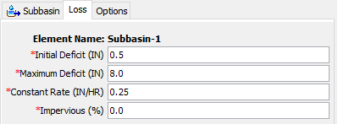
Example
Time | Precip (in) | Loss (in) | Excess (in)
0200 | 0.5 | 0.5 | 0.0
0300 | 0.5 | 0.25 | 0.25
0400 | 1.0 | 0.25 | 0.75
0500 | 0.5 | 0.25 | 0.25
0600 | 0.0 | 0.0 | 0.0
0700 | 0.0 | 0.0 | 0.0
0800 | 0.0 | 0.0 | 0.0
0900 | 0.0 | 0.0 | 0.0
1000 | 0.5 | 0.45 | 0.05
1100 | 0.5 | 0.25 | 0.25
1200 | 0.5 | 0.25 | 0.25
1300 | 0.5 | 0.25 | 0.25
1400 | 0.5 | 0.25 | 0.25
Evapotranspiration, ET = 0.05 in/hr
Notes:
This method requires three parameters, an initial deficit, a maximum deficit, and a constant rate. A directly connected impervious area can also be specified. When a non-zero value for directly connected impervious area is specified, infiltration computations won’t be carried out on that portion of the subbasin or grid cells and all precipitation will become excess.
I should also mention that evapotranspiration is an optional meteorologic parameter as well. It doesn’t have to be used. Without it, this method functions exactly the same as the initial and constant method.
Now let’s step through an example computation.
In the first time step, half an inch of precipitation is lost to satisfy the initial deficit (animate).
In the next time step, another half inch of total precipitation fell and 0.25 inches of constant loss is applied resulting in 0.25 inches of excess (animate).
In the next time step, 1 inch of total precipitation fell, 0.25 inches of constant loss is applied, and 0.75 inches of excess results (animate).
In the next time step, a half inch of total precipitation fell, 0.25 inches of constant loss is applied, and 0.25 inches of excess results (animate).
Then, there’s a lull in precipitation. During this time, ET is applied which increases the moisture deficit by 0.05 inches per hour. Since it doesn’t rain for 4 hours, the moisture deficit reaches 0.2 inches by hour 10 (animate). A half inch of precipitation falls during this time step of which 0.2 inches goes to the moisture deficit and an additional 0.25 inches is lost to the constant rate. This results in 0.05 inches of excess.
For the remaining time steps, only the constant rate of 0.25 inches is in play.

Slide 41
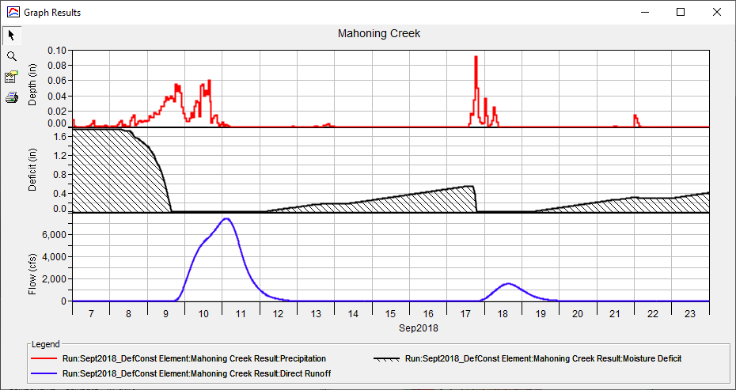
Example
Precipitation
Moisture Deficit
Direct Runoff
Notes:
This figure shows a different 2 week simulation using the deficit and constant loss method and highlights the continuous simulation capabilities that this method affords.
The top viewport shows precipitation in red, the middle viewport shows moisture deficit in black, and the bottom viewport shows direct runoff in blue.
Notice how the moisture deficit increases during periods of no precipitation and decreases when it rains.
Specifically, a half inch of moisture deficit is recovered by September 17th which must be satisfied before runoff initiates.

Slide 42
Parameter Estimation – Initial Deficit
Based upon antecedent conditions, evapotranspiration, and soil
Did it rain a day/week/month before the simulation start?
Start your simulation far enough back in time so initial conditions don’t affect results at the time of interest
Precipitation
Notes:
Now, let’s talk about parameter estimation for this method.
When estimating an appropriate initial deficit, you should scrutinize the prevailing antecedent conditions prior to the start of your simulation.
For instance, did it rain a week prior to the start, or has it not rained in several months?
But, when using this method, I like to start my simulations at times that are far away from my time period of interest such that initial conditions don’t matter.
Given reasonable evapotranspiration and a sensible maximum deficit, which I’ll talk about next, I can avoid spending too much time worrying about initial conditions with this method, which is nice.

Slide 43
Parameter Estimation – Maximum Deficit
The driest a soil can become under the influence of gravity, evaporation, and transpiration.
  Saturation storage minus wilting point storage
Get surficial texture from soils database
Relate texture to required parameters in literature values
Notes:
Now, for the maximum deficit.
Maximum deficit refers to the driest a soil can become after being drained by gravity, evaporation, and transpiration.
This parameter must be specified as an effective depth in either inches or millimeters.
Typically, maximum deficit is estimated as the difference between the saturation storage and the wilting point storage of a soil over an assumed active layer depth. I typically assume an active layer depth of 24 to 36 inches.
Saturation storage refers to the amount of moisture that can be held within a soil column when all air bubbles have been forced out. A soil’s effective porosity is a pretty good estimate of saturation storage.
Wilting point storage refers to the amount of water that is so tightly bound to soil particles that it cannot be evaporated or transpired. Technically, this parameter is defined as the water remaining within an initially saturated soil column when subjected to a sustained pressure of -15 bar (i.e. 217.5 pounds per square inch).
Like I’ve previously said, this parameter is best estimated using surficial texture from a soils database and related to literature values.

Slide 44
Parameter Estimation – Constant Rate
Get surficial texture from soils database
Relate texture to saturated hydraulic conductivity in literature values
Notes:
Similarly, the constant rate can be estimated by first extracting surficial textures from a soils database and relating them to published saturated hydraulic conductivity values for the predominant soils.
In this image, over half of the subbasin of interest is covered by silt loam. So, a decent place to start would be to use an estimate of saturated hydraulic conductivity for silt loam and begin calibrating from there.

Slide 45
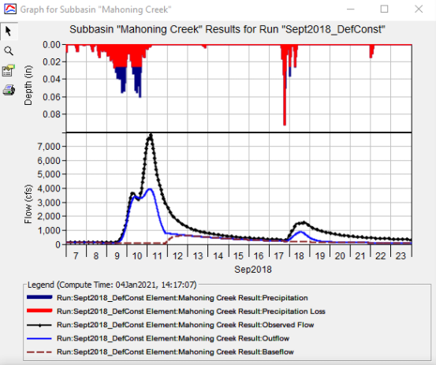
Calibration Techniques
Match initiation of runoff
Match observed runoff volume
Use multiple statistical metrics
  Nash-Sutcliffe Efficiency
  Root Mean Square Error
  Percent Bias
Notes:
Like I talked about in the Initial and Constant video, when calibrating the Deficit and Constant method, I like to start by modifying my initial parameter estimates until I get the initiation of runoff correct.
Specifically, I’m trying to match the time at which runoff starts to rise.
Then, I try to match the observed runoff volume.
In this example, observed flow is shown in black and computed flow is shown in blue.
I’ve matched the time of runoff initiation pretty well, but my the peak on Sep 10th isn’t matching the observed data. So, I need to decrease my constant loss rate.
As always, when calibrating, use multiple statistical metrics, like Nash-Sutcliffe Efficiency and percent bias to measure model performance as they compare your results from different perspectives and are better than the eyeball test.

Slide 46
Deficit and Constant Loss Method
Advantages
Similar to advantages of Initial and Constant method
  Mature method
  Easy to set up and use
  Parameters can be related to predominant soil textures
  Parsimonious
Method is scalable in that it allows for continuous simulation (but is not required for use).
Disadvantages
Similar to disadvantages of Initial and Constant method
  Difficult to apply to ungaged areas
  Method may be too simple
Notes:
The advantages of the Deficit and Constant method are similar to the Initial and Constant method in that it’s simple, it’s been used successfully many, many times, the required parameters can be easily estimated from observed data, and the method is parsimonious.
However, the Deficit and Constant method has an additional advantage in that it allows for infiltrated water to be extracted through evapotranspiration.

Slide 47
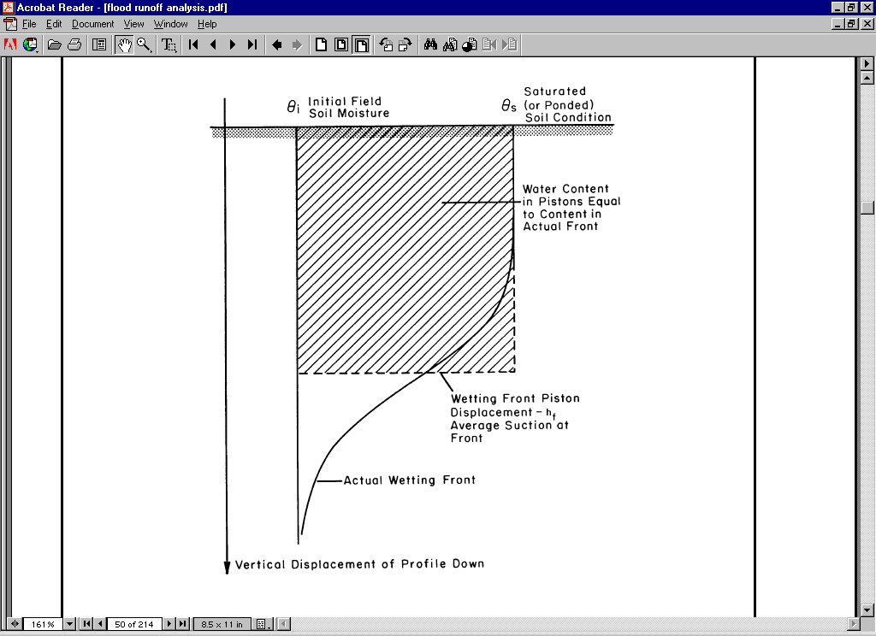
Green and Ampt Loss Method
Physically-based loss method first proposed in 1911
Assumes a uniform soil profile of infinite depth and constant initial water content
This method does not allow for evapotranspiration: Event model only
Real World
Green and Ampt
Notes:
The Green and Ampt infiltration equation is more physically-based than the previously-discussed options.
This method was first proposed in 1911 by two guy’s named Green and Ampt, as the name implies.
I’ll spare you the gory mathematical details, but within this method, infiltration proceeds with so-called piston displacement, as shown in the figure in the bottom right. Remember infiltration in the real world, as shown in the bottom left figure. The Green and Ampt method tracks the downward movement of water, but it doesn’t allow for heterogeneities to out-pace the bulk of infiltrated water. Everything proceeds downward in a uniform front and this wetting front, as it’s called, is a sharp boundary dividing the saturated portion of the soil from the unsaturated portion.
The total amount of infiltration is equal to the depth of infiltrated water times the change in soil moisture from initial conditions to saturation.
While this method doesn’t allow for evapotranspiration, there is a Layered Green and Ampt option also within HEC-HMS that DOES allow for evapotranspiration to be included.

Slide 48
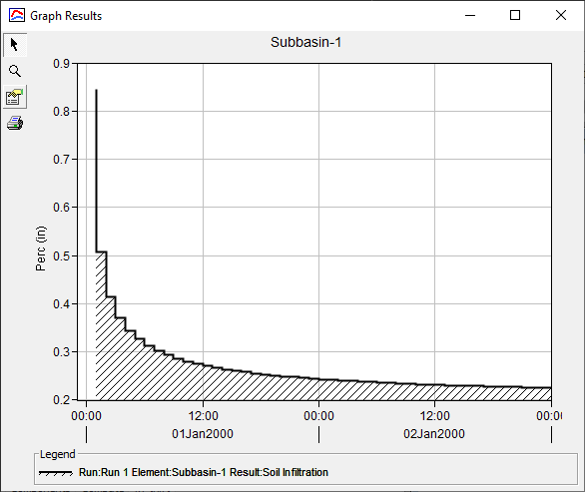
Green and Ampt Loss Method
Notes:
Remember the figure on the left from previous videos? The initial and constant and deficit and constant infiltration methods could only approximate the exponential decrease in infiltration rate with blocky rectangles of initial loss and constant loss.
However, the Green and Ampt method CAN recreate that exponential decrease and eventual asymptotic limit at the saturated hydraulic conductivity.
Compare the images. They look pretty similar right? That’s what Green and Ampt set out to do when they devised this method in 1911.

Slide 49
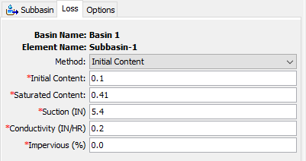
Example
Time | Precip (in) | Loss (in) | Excess (in)
0200 | 1.0 | 0.85 | 0.15
0300 | 1.0 | 0.51 | 0.49
0400 | 1.0 | 0.42 | 0.58
0500 | 1.0 | 0.37 | 0.63
0600 | 1.0 | 0.34 | 0.66
0700 | 1.0 | 0.33 | 0.67
0800 | 1.0 | 0.31 | 0.69
0900 | 1.0 | 0.3 | 0.7
1000 | 1.0 | 0.29 | 0.71
1100 | 1.0 | 0.29 | 0.71
1200 | 1.0 | 0.28 | 0.72
1300 | 1.0 | 0.28 | 0.72
1400 | 1.0 | 0.27 | 0.73
Notes:
This method requires the user to specify either four or five parameters, depending upon the choice of initial condition method.
In this example computation, a subbasin using the parameters shown to the left is subjected to a constant precipitation rate of 1 inch.
In the table to the right, notice that the loss rate is initially high, but decreases exponentially towards the specified saturated hydraulic conductivity of 0.2 inches per hour. It doesn’t quite reach that limit in this example, but given more precipitation, it would get closer and closer.

Slide 50
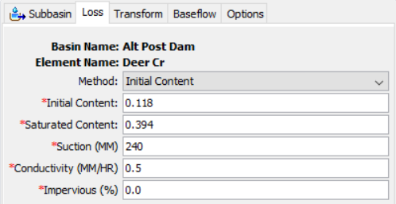
Parameter Estimation – Initial Condition
Two choices: Initial Content and Initial Deficit
Based upon antecedent conditions, evapotranspiration, and soil
Did it rain a day/week/month before the simulation start?
Precipitation
Notes:
Now, let’s talk about parameter estimation for this method.
You must specify the initial condition in one of two ways; as an Initial Content or as an Initial Deficit.
In either case, the initial condition must be specified in terms of a volume ratio like in3/in3.
The initial condition should be estimated like it was for initial and constant and deficit and constant: scrutinize the prevailing antecedent conditions prior to the start of your simulation.
But, this should then be related to the saturated content, as I’ll talk about on the next slide.

Slide 51
Parameter Estimation – Saturated Content
Must be specified when using the Initial Content method
Refers to the maximum water holding capacity
Effective porosity is a good place to start
Get surficial texture from soils database
  e.g. silt, loam, sandy loam, etc.
Relate texture to required parameters in literature values
  Engineer Manual 1110-2-1417
  Rawls, Brakensiek, and Miller (1983)
Notes:
The saturated content parameter must be specified when using the Initial Content method. However, when using the Initial Deficit method, you’ll still need to know what this is to actually calculate an initial deficit.
This parameter refers to the maximum water holding capacity of the soil and, usually, the soil’s effective porosity is a good place to start with this parameter.
Similar to the initial content or initial deficit, this parameter must be specified as a volume ratio like in3 / in3.
Like most other infiltration parameters, I like to estimate the saturated content of a soil by relating the surficial texture from a soils database to published literature values.

Slide 52
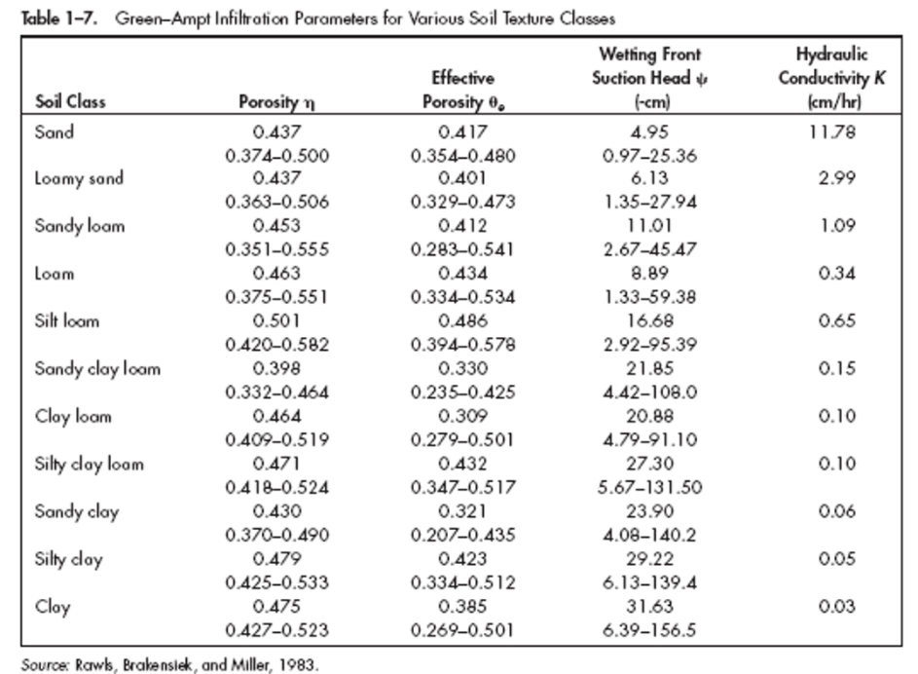
Parameter Estimation – Wetting Front Suction
Describes the movement of water downwards through the soil column
Estimate using surficial texture from soils database and literature values
The drier and finer texture the soil (e.g. clay is finer than sand), the greater the suction
Notes:
The wetting front suction head describes how infiltrated water moves downwards through the soil column. It’s essentially the force that is exerted on infiltrated water by the soil that acts in the downward direction.
Soil suction is a capillary effect. The drier and finer texture the soil (e.g. clay is finer than sand), the greater the suction.
This parameter must be specified as an effective depth, like inches or millimeters
I also estimate this parameter by first extracting surficial textures from a soils database and relating them to published values for the predominant soils.

Slide 53
Parameter Estimation – Saturated Hydraulic Conductivity
Minimum rate at which precipitation will be infiltrated into the soil layer after it is fully saturated
Estimate using surficial texture from soils database and literature values
Notes:
A soil’s saturated hydraulic conductivity refers to the minimum rate at which precipitation will be infiltrated after the soil is fully saturated
This parameter can also be estimated by first extracting surficial textures from a soils database and relating them to published saturated hydraulic conductivity values for the predominant soils.

Slide 54
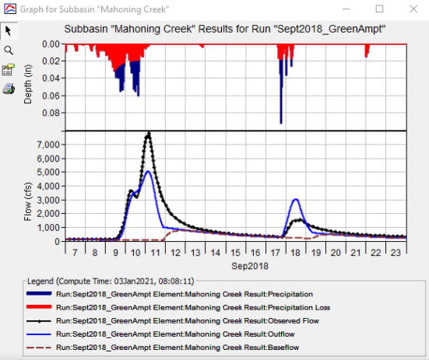
Calibration Techniques
Match initiation of runoff then attempt to match observed runoff volume
Use multiple statistical metrics
  Nash-Sutcliffe Efficiency
  Root Mean Square Error
  Percent Bias
Notes:
Like I talked about before, I like to calibrate by first modifying my initial parameter estimates until I get the initiation of runoff correct then attempt to match the observed runoff volume.
In this example, observed flow is shown in black and computed flow is shown in blue.
The initiation of runoff looks good, but my peak is off. So, I need to decrease my saturated hydraulic conductivity to allow for more runoff and less infiltration.
Make sure you use multiple statistical metrics, like Nash-Sutcliffe Efficiency and percent bias, to measure model performance.

Slide 55
Green and Ampt Loss Method
Advantages
Parameters can be related to predominant soil textures and estimated using multiple literature sources.
Predicted values are in accordance with classical unsaturated flow theory (Richards Equation) (good for ungaged watersheds).
Disadvantages
Not widely used, so less mature.
Not as much experience in professional community as simpler methods.
Less complex than simpler methods.
Does not allow for continuous simulation.
Notes:
The primary advantages when using the Green and Ampt method is that all of the parameters can be related to predominant soil textures and predicted infiltration is in accordance with classical unsaturated flow theory (Richards equation). This means that it’s a good choice when you don’t have observed runoff data.
However, this method is more complicated that either the Initial and Constant and Deficit and Constant methods. Because of that, it hasn’t been applied as many times as Initial and Constant or Deficit and Constant. Also, since it has more parameters, this method is less parsimonious than simpler methods.

Slide 56
Key Takeaways
Introduced loss simulation within HEC-HMS
Three different ways precipitation can be “lost” within HEC-HMS:
  Canopy
  Surface
  Infiltration
Thirteen infiltration methods are available within HEC-HMS
In general, canopy and surface losses are small; infiltration losses are much larger than canopy and/or surface losses
GIS is commonly used to estimate infiltration method parameters
Notes:
In this video, we introduced loss simulation within HEC-HMS
As we discussed, there are three ways in which precipitation can be lost: due to canopy, surface, and/or infiltration. You can simulate all of them, two of them, one of them, or none of them.
It’s important to remember that typically, the amount of loss due to the canopy and surface are small compared to infiltration into the soil in addition to uncertainty in meteorologic inputs.
We also took a look at common parameter estimation techniques that use soils databases and published literature.
Typically, the amount of precipitation lost to infiltration is much, MUCH larger than the amount that is lost to canopy or surface depressions. So, care must be taken to choose an appropriate method, estimate realistic parameters, and understand how these parameters can be impacted by various factors.

