Slide 1
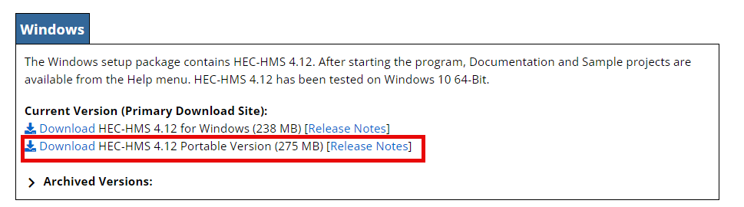
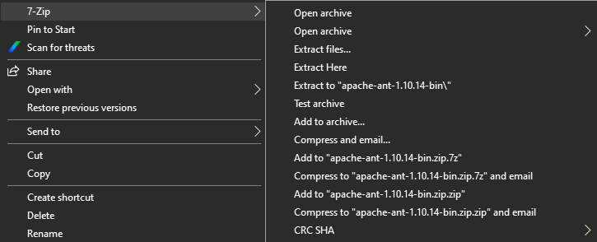
Download the portable version of HEC-HMS version 4.12 from the HEC-HMS website
Create a folder on your C drive (C:\Programs) and save the portable version there
Extract the portable version using 7-zip
Open HMS by double clicking on HEC-HMS.exe

Slide 2
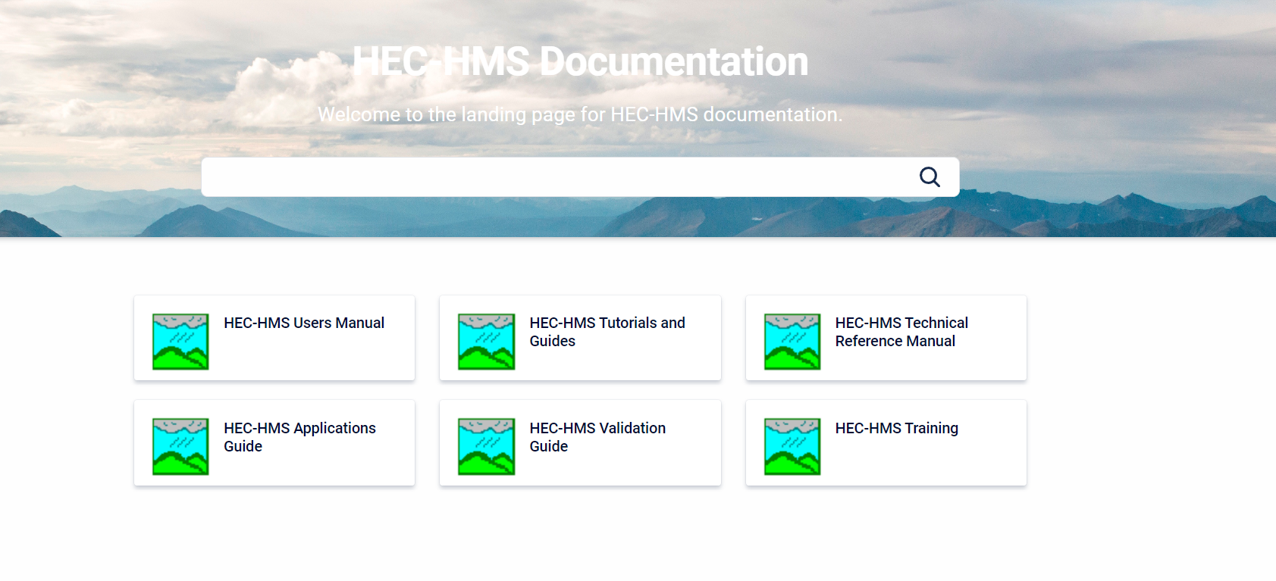
https://www.hec.usace.army.mil/confluence/hmsdocs

Slide 3
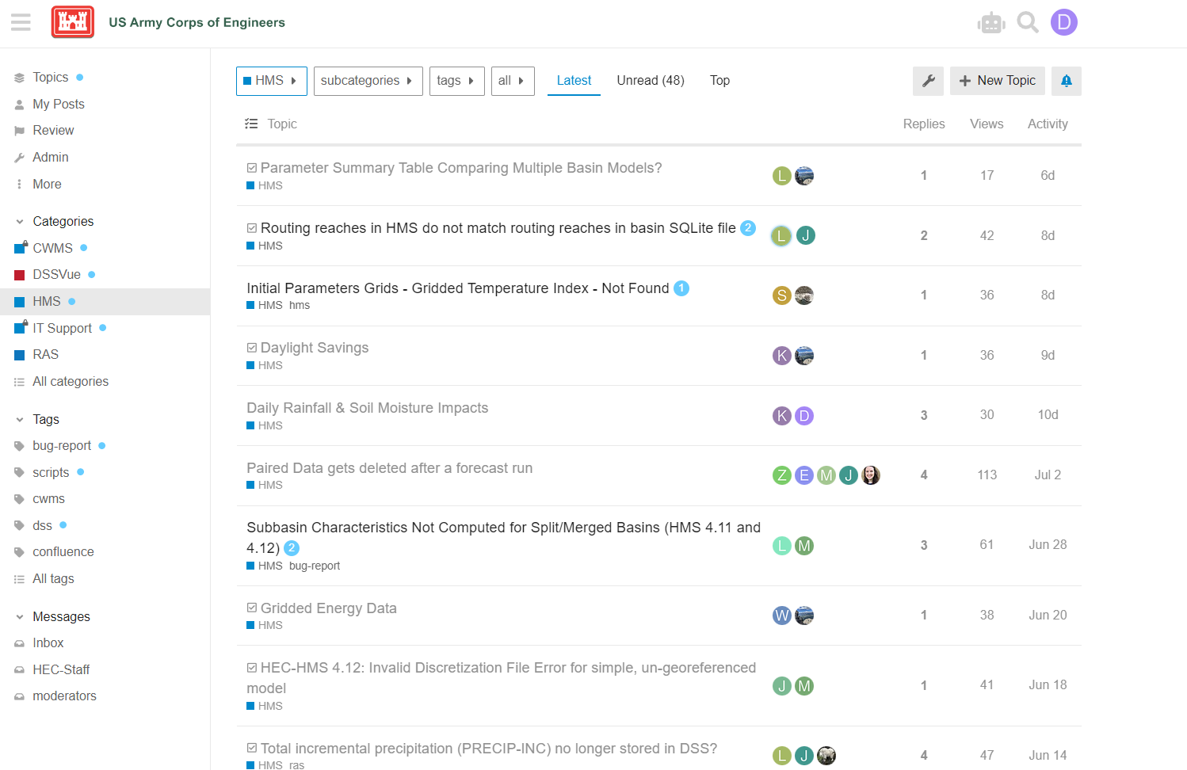
https://discourse.hecdev.net/c/hms/9

Slide 4
Purpose
Feel confident modeling a watershed using HEC-HMS project
Setup an event-based model and calibrate the model
Know where can obtain resources to further your HEC-HMS skills

Slide 5
Tips for successful class
Ask questions
Do the workshops
Play around with the parameters
Work in pairs

Slide 6
Agenda
https://www.hec.usace.army.mil/confluence/display/HMSTR/Hydrologic+Modeling+with+HEC-HMS+3-day

