Slide 1
Frequency and Hypothetical Storm Methodologies
Advanced Applications of HEC-HMS
June 2024
Melissa Mika, P.E.
(slides courtesy of Greg Karlovits)
US Army Corps of Engineers
Hydrologic Engineering Center

Slide 2
Outline
What is a hypothetical storm?
Precipitation-frequency analysis products
Developing flow-frequency curves
Frequency storm method
Hypothetical storm method
Stochastic storm transposition method

Slide 3
What is a Hypothetical Storm?

Slide 4
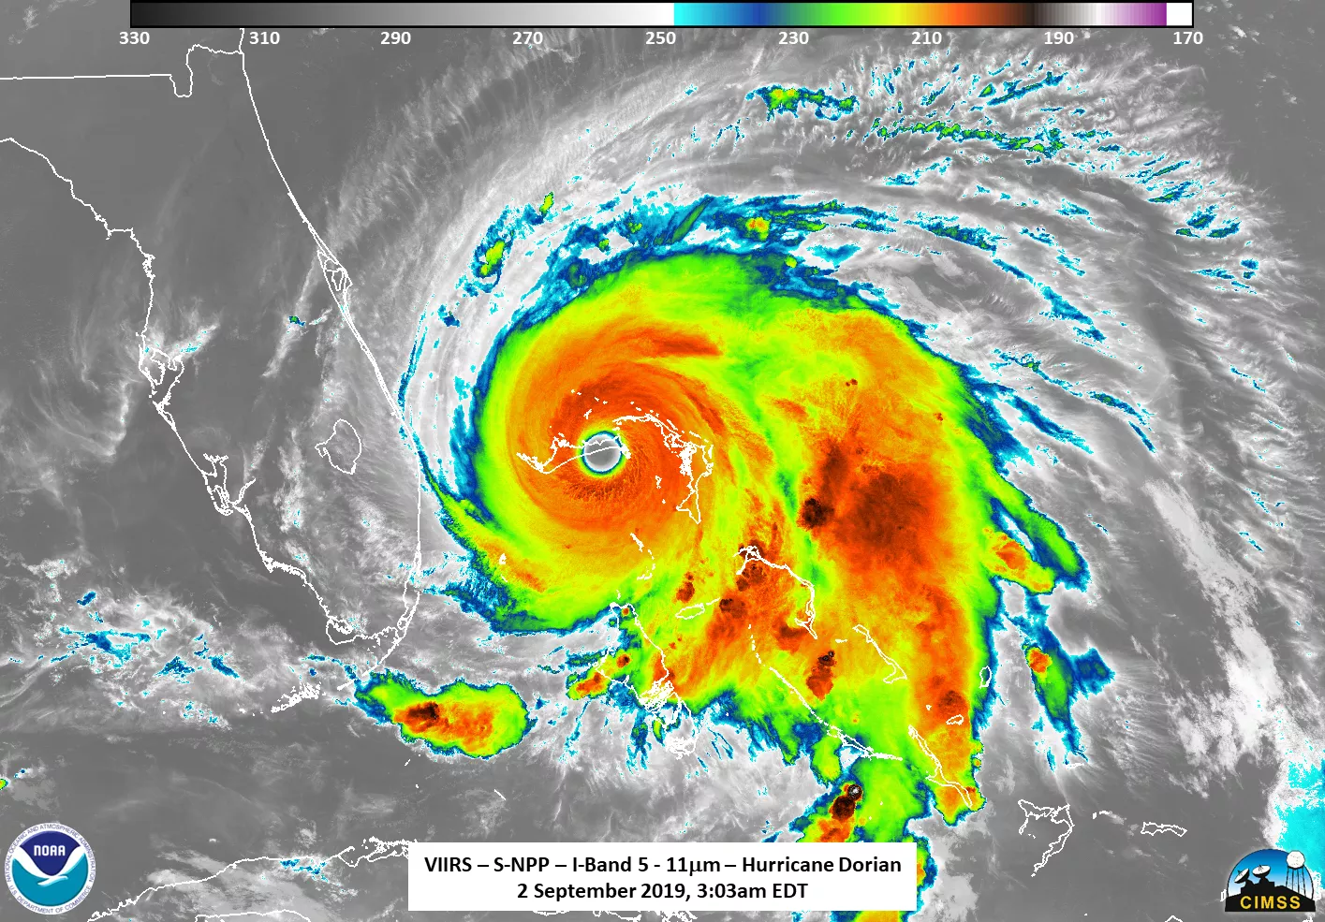
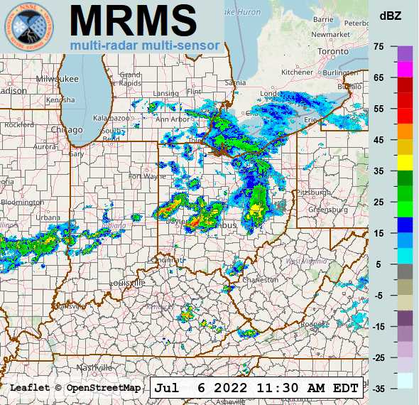
Real Precipitation
Notes:
These radar images represent real, observed historical storms. We use historical precipitation to model historical events or calibrate our models to observed dat
Often there is a need to simulate a “what if” scenario, or an even that hasn’t occurred before. For this, we can use a hypothetical storm.

Slide 5
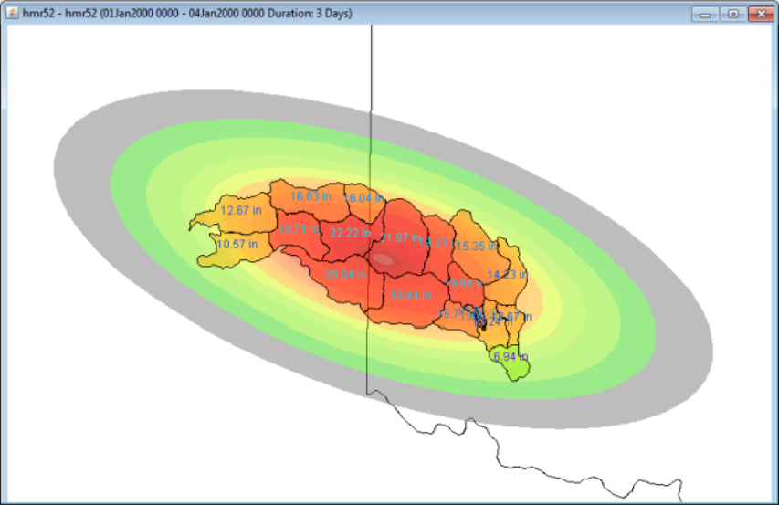
Hypothetical Storms
Idealized precipitation events used for design or risk analysis
Simplified versions of real storms with desirable properties
Notes:
A hypothetical storm does not represent a real observed event, but rather an event that has idealized conditions. These typically represent a specific recurrence interval or annual exceedance probability (AEP) and are used for design or risk analysis.
Or, a hypothetical storm can also be a simplified version of a real storm where we have changed the properties of the storm, such as moving the location or orientation to maximize runoff.

Slide 6
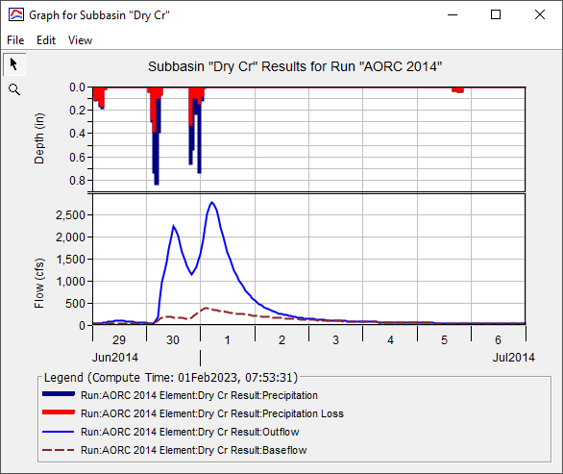
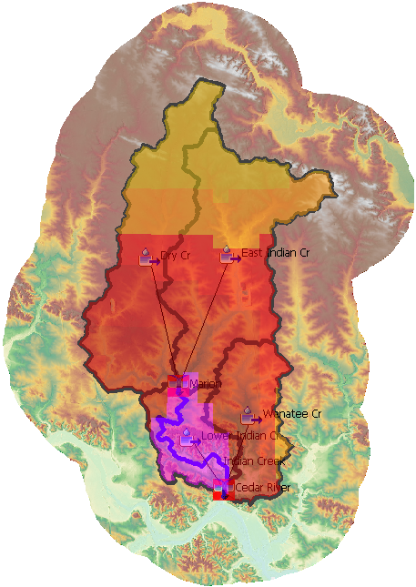
Simplifications
Storm duration
Temporal patterns
Spatial patterns
Notes:
The storms applied in hypothetical storm methods are simplifications of real storms, which are often chaotic in spatial and temporal pattern.
These are the properties of a storm which can be simplified: duration, temporal pattern, spatial pattern.

Slide 7
Design Properties
Need to take some design depth-duration information and make a storm out of it
Probable maximum precipitation (PMP)
  Location- and season-specific depth of precipitation
  Operational upper bound
Depth-duration-frequency
  Relationship between depth, duration, and probability for a location
Notes:
When creating a hypothetical storm used for design or risk analysis, certain depth and duration properties form the basis of the design storm. Such as 2.5 inches over 72 hours.
The PMP is an example of a hypothetical storm that’s often used for risk analysis and for developing a Probable Maximum Flood (PMF)
New PMP publication (2024) by the National Academies: https://nap.nationalacademies.org/catalog/27460/modernizing-probable-maximum-precipitation-estimation

Slide 8
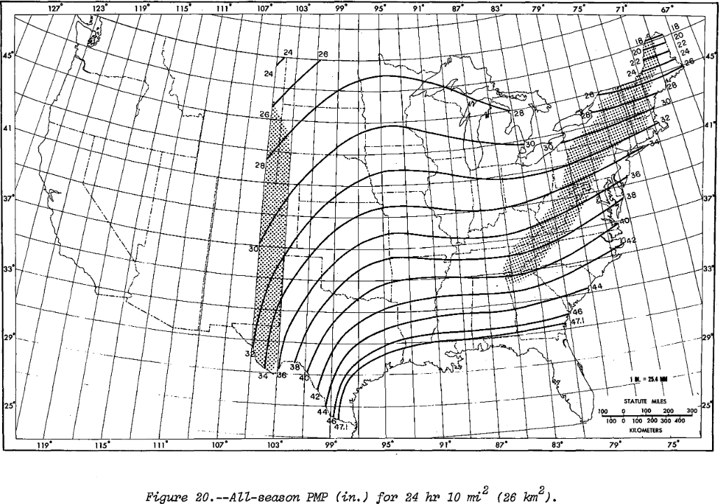
Probable Maximum Precipitation

Slide 9

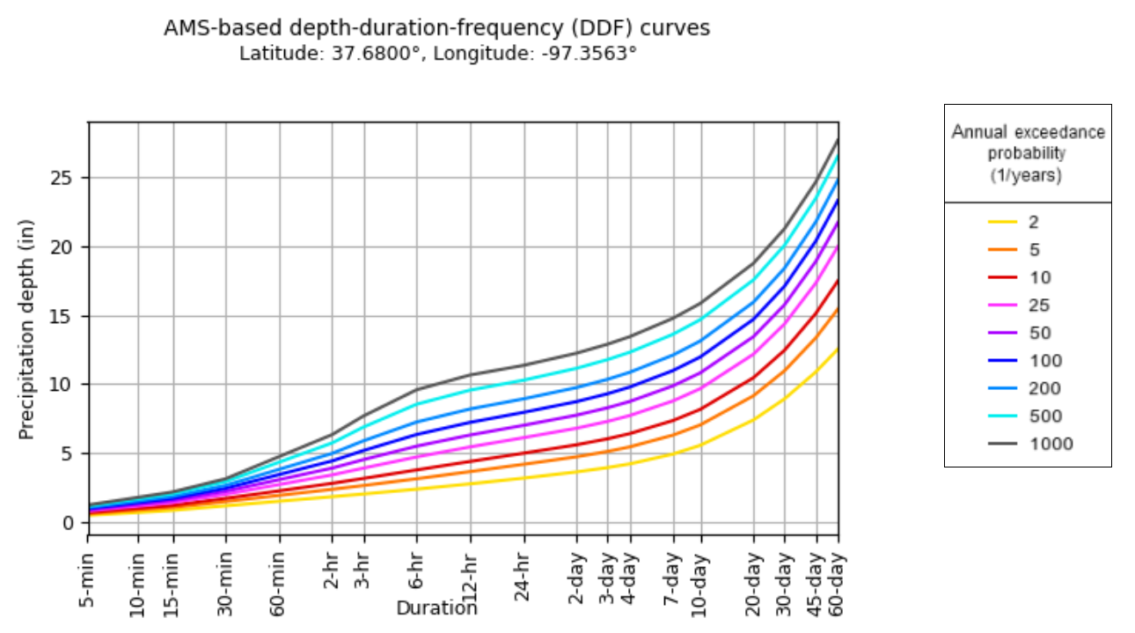
Depth-Duration-Frequency (DDF)
Depth- or intensity-duration-frequency curves are common design tools in engineering
Data for a point
Loses information about shorter durations
Notes:
Depth-duration-frequency (DDF) curves describe rainfall depth as a function of duration for given return periods. Similar curves are the intensity-duration-frequency (IDF).
These describe storm properties for a region across many frequencies. Storm properties for a single storm are often described by a depth-area-duration (DAD) table.

Slide 10
Hypothetical Storm Methods in HMS
Design Storms
  HMR52 Storm
  Standard Project Storm
Frequency-Based Storms
  Frequency Storm
  Hypothetical Storm
  Used for PMP
  Legacy projects only
Our focus today
  More traditional approach
  More data-driven approach
These are all
Precipitation
Meteorologic Models
in HMS

Slide 11
Precipitation-Frequency Analysis Products

Slide 12
Recap: How we define a design storm
Duration
Area Reduction
Depth
Temporal Pattern
Spatial Pattern

Slide 13

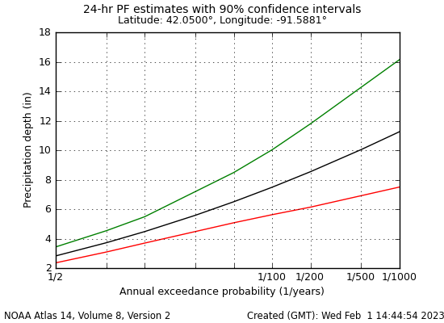
Precipitation-Frequency Analysis
Analysis of the maximum rainfall depth per year at a gage
Considers multiple durations of accumulation
  Dependent on gage recording interval
Develop a probability relationship for maximum depths

Slide 14
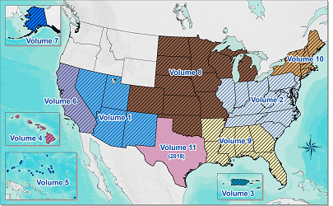
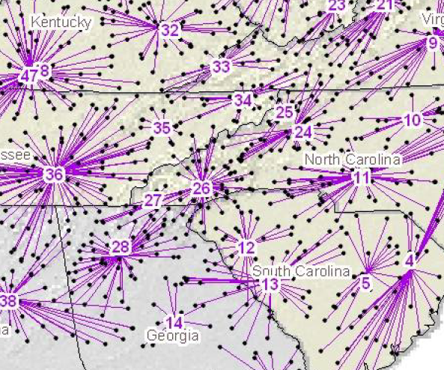
NOAA Atlas 14
Regional precipitation-frequency analysis for the nation
Frequencies up to 1/1,000
Uses a regional approach:
  Improves sample sizes
  Allows estimation where there aren’t gages
Notes:
Volume 1 was developed as far back as 20 years ago (2004). NOAA Atlas 15, which will be a CONUS-wide approach, is actively under development.

Slide 15
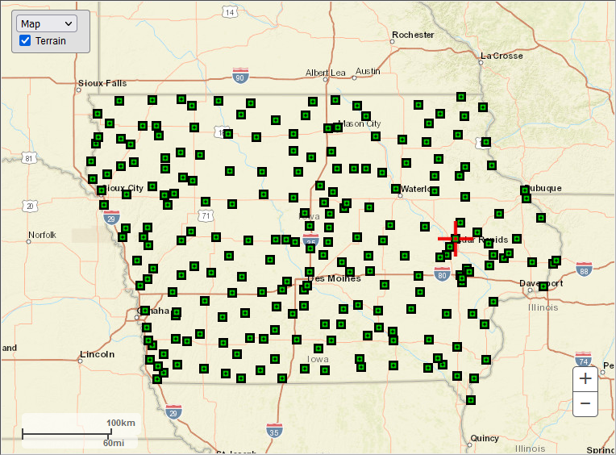
Point Data
Precipitation is measured at gages

Slide 16
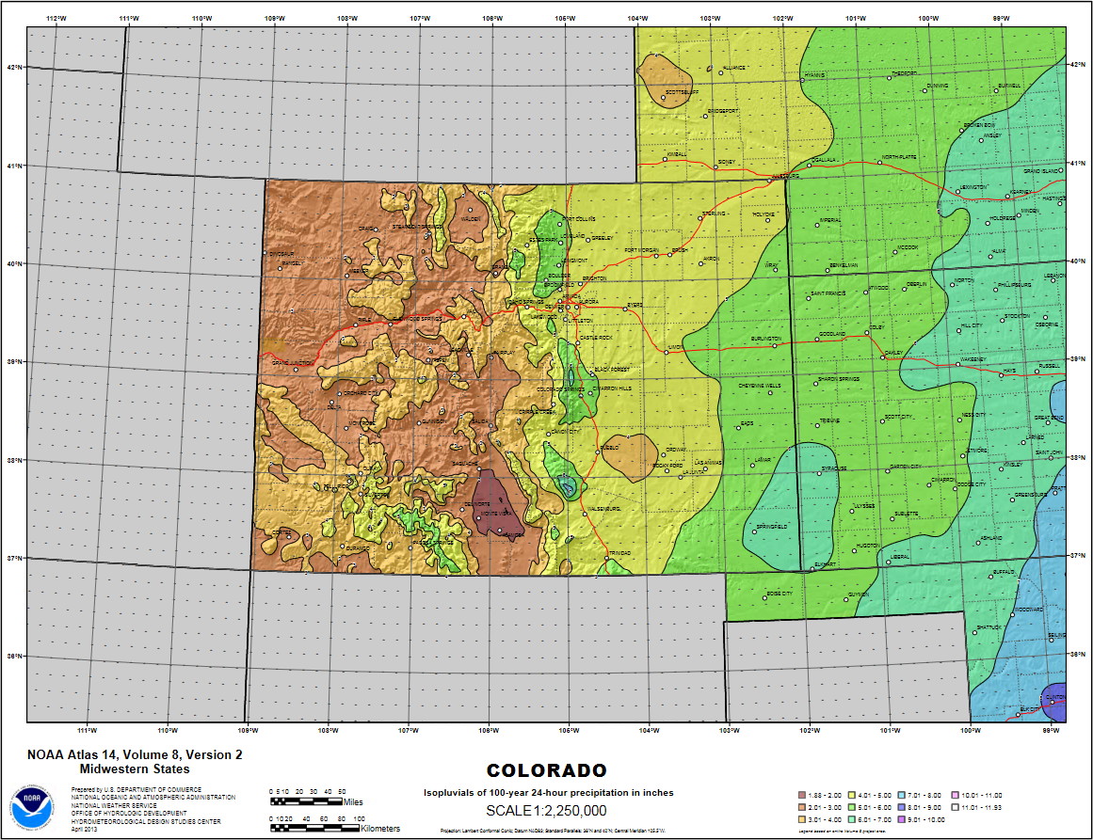


Precipitation-Frequency Grids
Depth for a duration and frequency as a map
NOT a storm pattern
Put a pin in the map and get depth anywhere

Slide 17


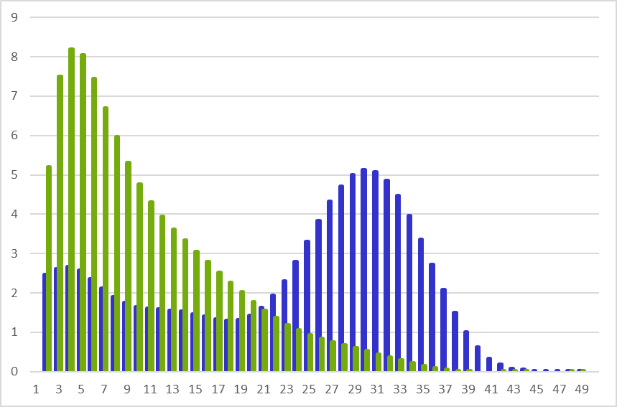
Temporal Patterns
Probabilistic analysis of time patterns of heavy rainfall
4 durations: 6-hour, 12-hour, 24-hour, 96-hour
Classified by “quartile” and “percentile”
Quartile = which quarter of storm has the most volume
Percentile = ranking of peakedness of storms in a quartile
Q1 Q2 Q3 Q4

Slide 18
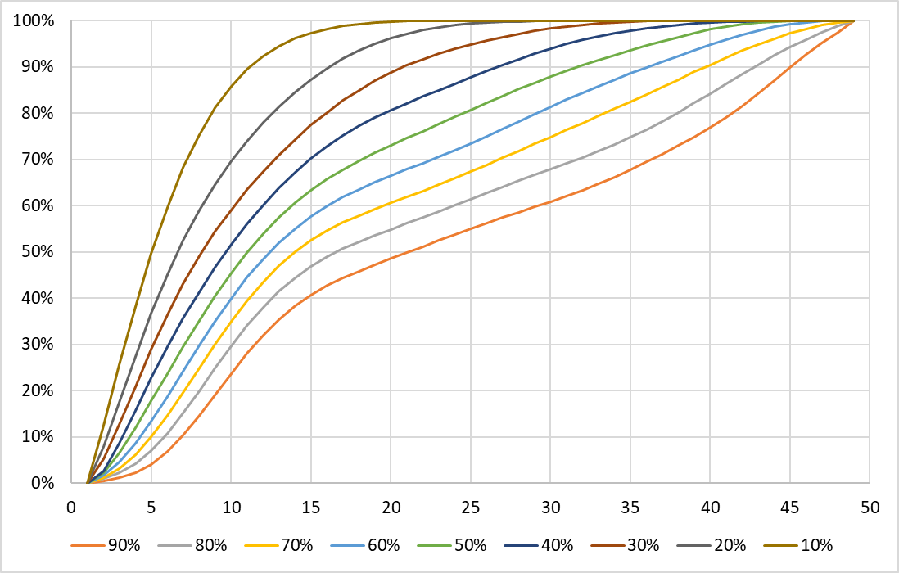
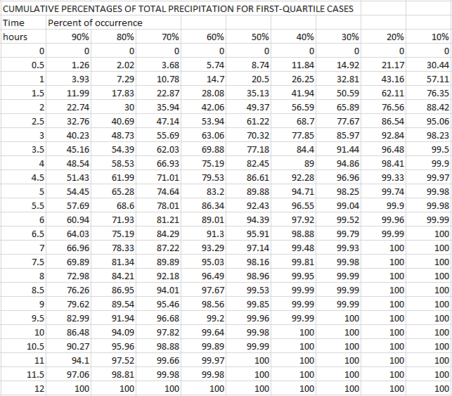
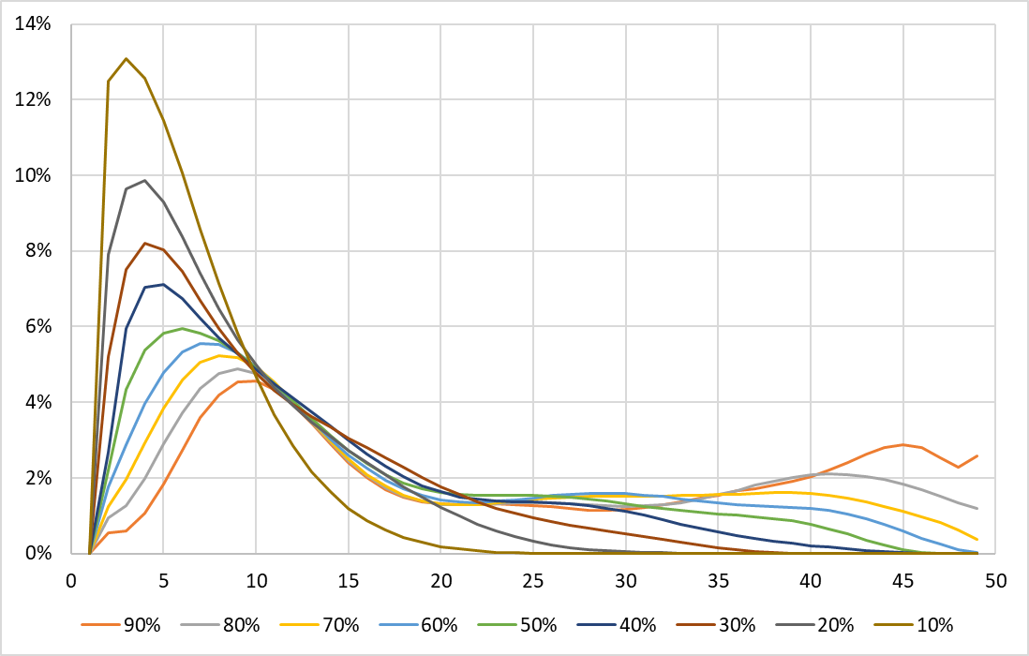
First Quartile
Cumulative
Incremental
Notes:
These are cumulative curves – cumulative time vs. cumulative percent of total precipitation.

Slide 19

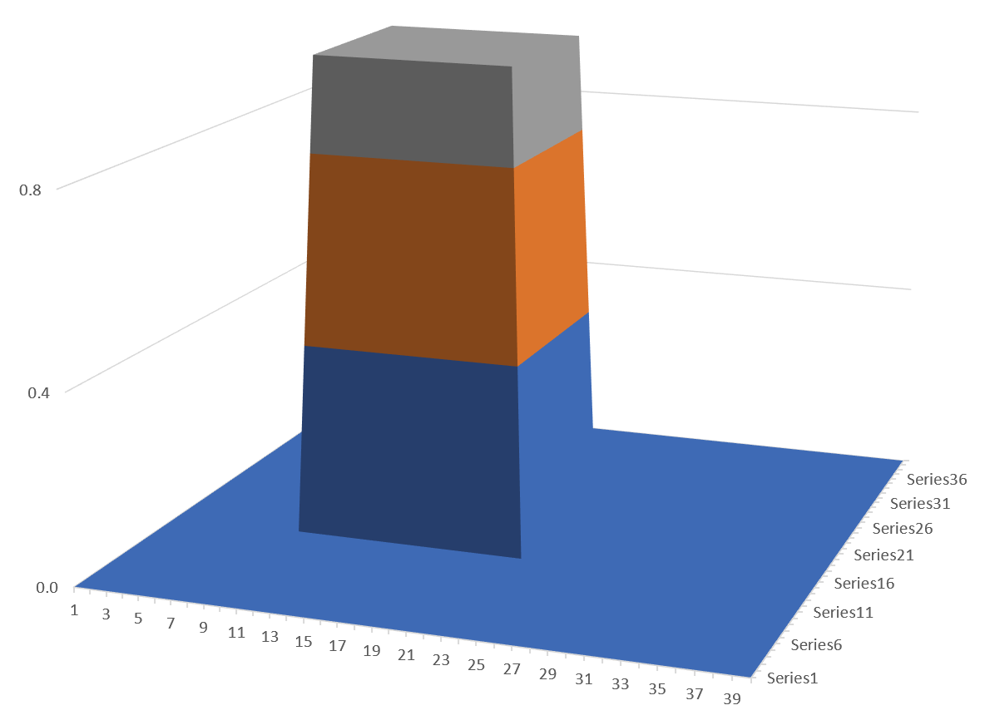
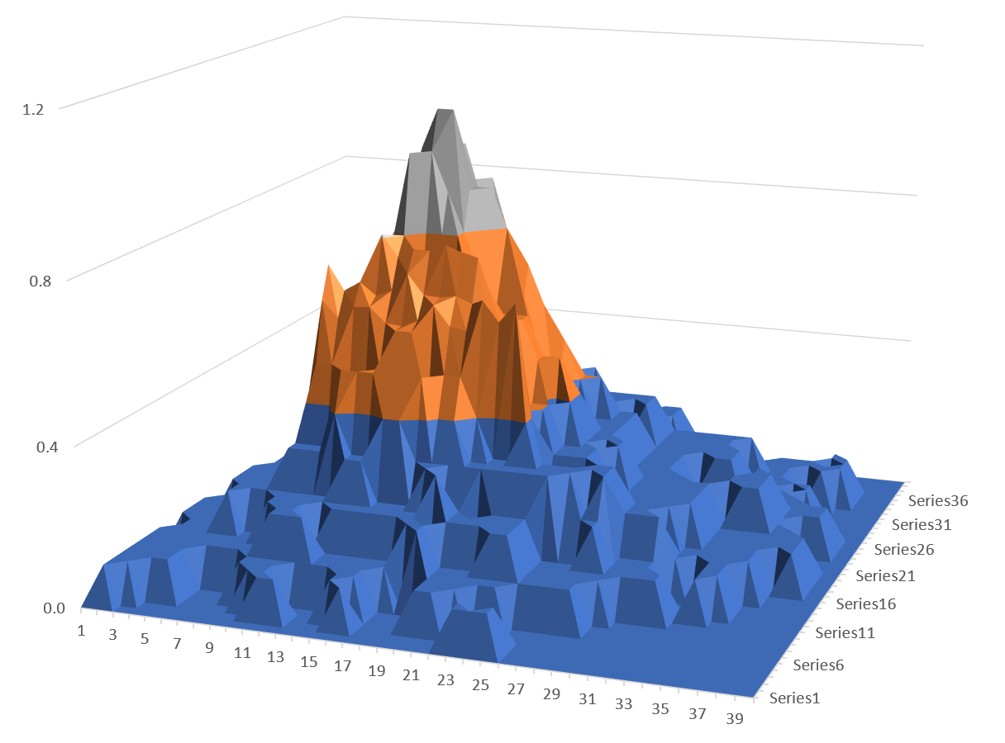
Area Reduction
Precipitation averaged over an area is less than point maximum
Effect more pronounced at shorter durations
Simplification of spatial pattern
Larger watershed, more important

Slide 20
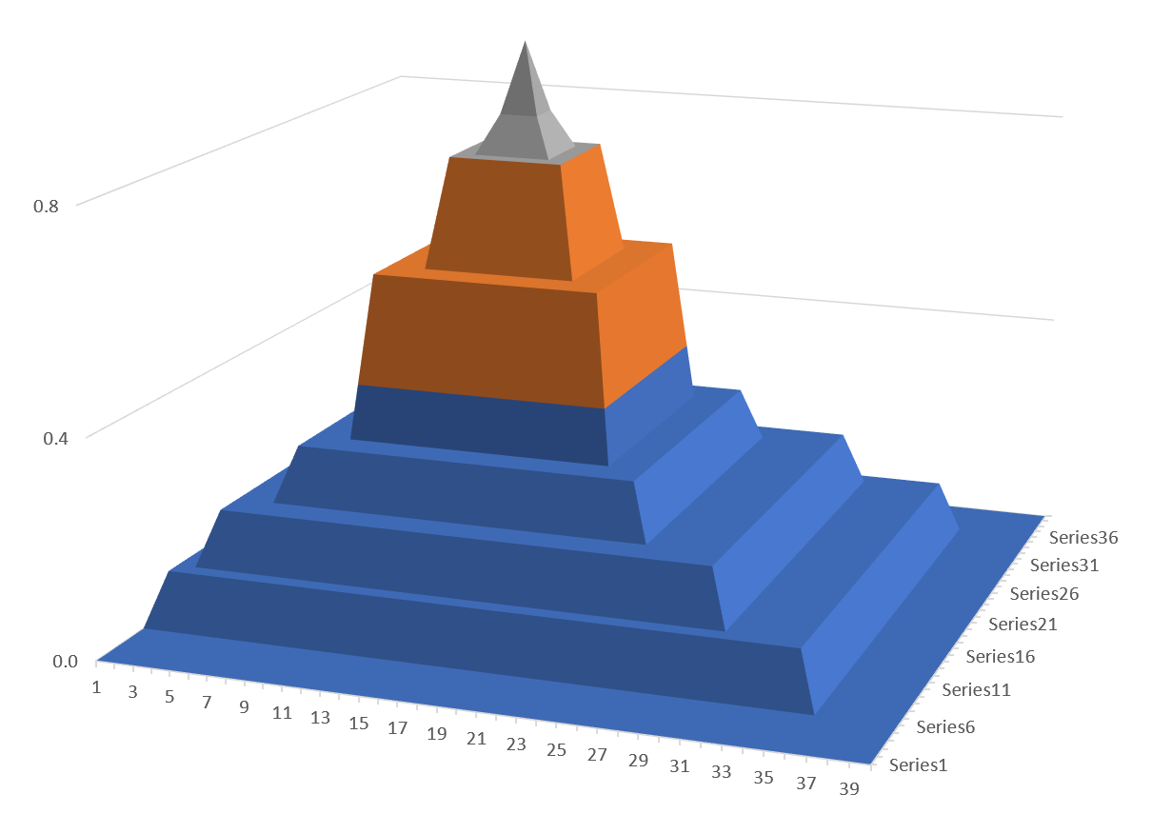
Area Reduction
10 mi² maximum:
100%
10 mi² maximum:
5 in
100 mi²
200 mi² average:
4.2/5 = 84%
200 mi² average:
4.2 in
Precipitation Depth (in)
Percent of Maximum
500 mi²
1,000 mi²

Slide 21
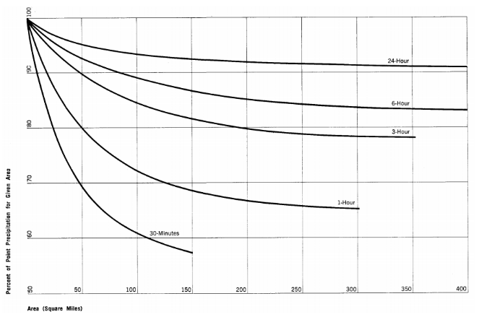
Area Reduction
Usually assumed that storm area = watershed area
Conservative assumption
Assumes the worst rainfall perfectly coincides with watershed
24-hour
6-hour
3-hour
Percent of Point (%)
1-hour
30-min
Area (mi²)

Slide 22
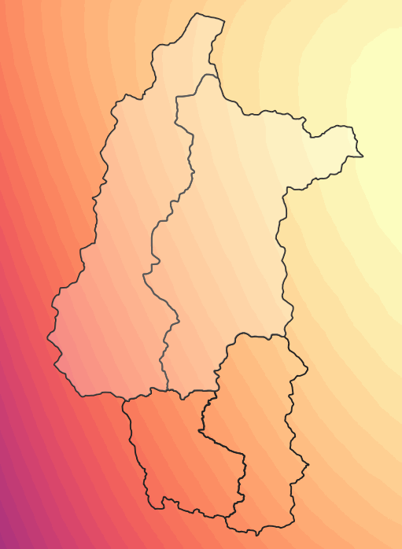
Area-Averaged Precipitation Frequency
Find the area-averaged point depth for duration/frequency
  GIS Zonal Statistics
  HEC-HMS
Apply an ARF for that area and duration
Average = 7.50 in
Computation Point

Slide 23
Developing Flow-Frequency Curves

Slide 24
Motivation
Precipitation-Frequency Data
Rainfall-Runoff Model
Flow Frequency Curve
Notes:
Our motivation is to take precipitation frequency data, construct storm events to run in a rainfall-runoff model, in order to assess the magnitude and frequency of floods.
This workflow is used extensively in design, floodplain management, and risk analysis. It can be used in ungaged watersheds, but also in gaged watersheds to add information to a flow frequency curve.
Because it’s used so often, and used to make decisions, the HMS team has been improving these modeling tools so modelers can develop better models faster.

Slide 25
Flow-Frequency Modeling
Key assumption:
  Probability of rainfall equals probability of flow
  “AEP neutral”
Model flow with a combination of met and basin model
Notes:
The AEP neutral technique assumes you can calibrate the hydrologic model so that this is true.

Slide 26
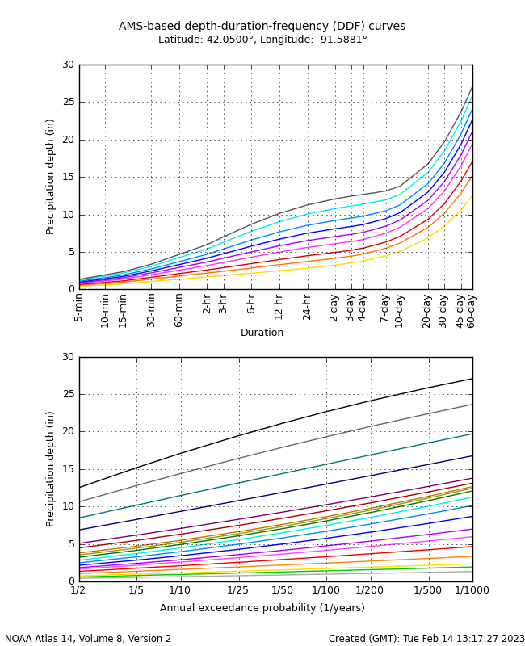
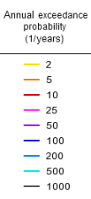
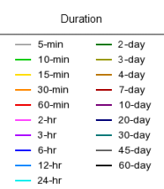
Data

Slide 27
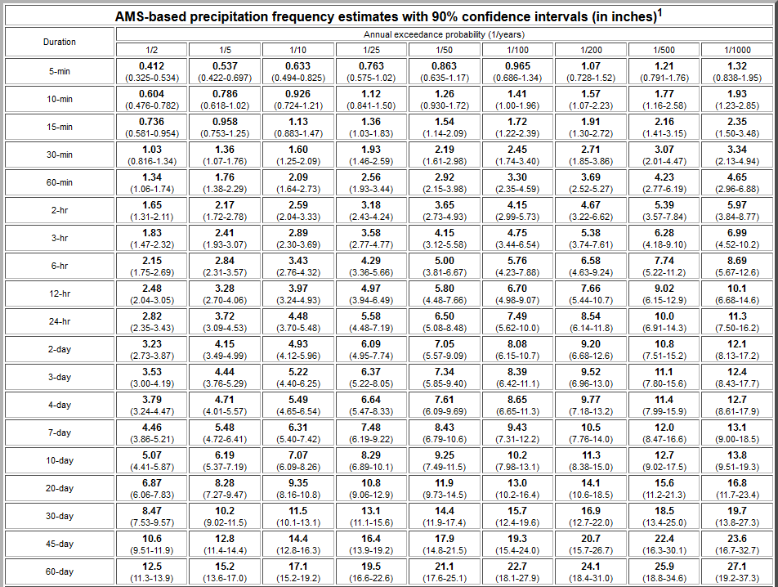
Data

Slide 28
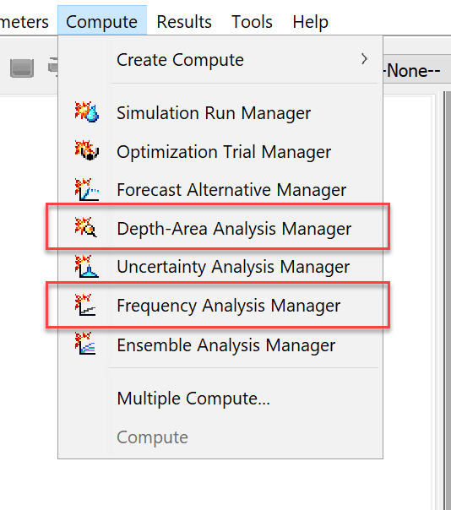
Tools in HEC-HMS
Depth-Area Analysis Compute
  Compute flows for same frequency at multiple locations
  Allows storm area to vary
Frequency Analysis Compute
  Compute multiple frequency flows for a location
  Summarize and plot results

Slide 29
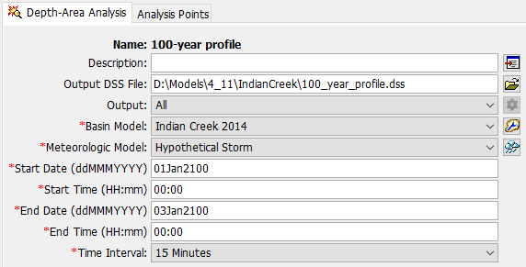
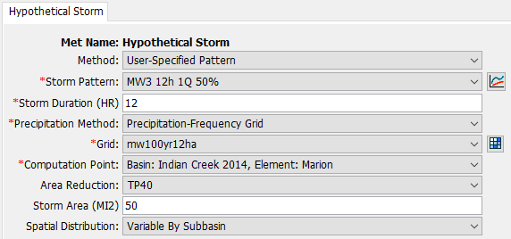
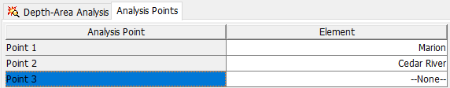
Depth-Area Analysis
Iterates over analysis points
Updates met model with storm area
Notes:
Overrides the computation point setting in the met model. For each analysis point computes the drainage area upstream and plugs it into the met model if it has that setting.

Slide 30
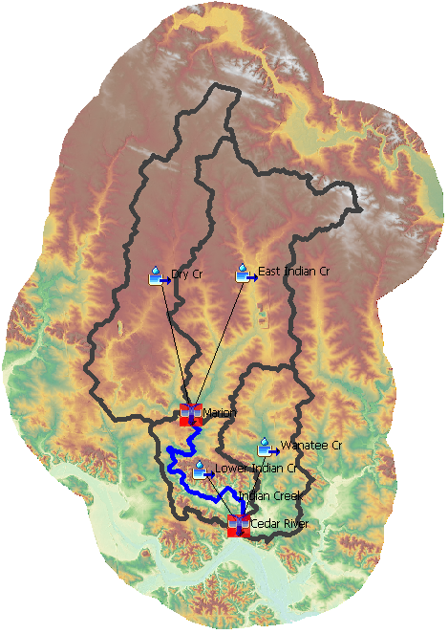
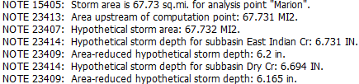
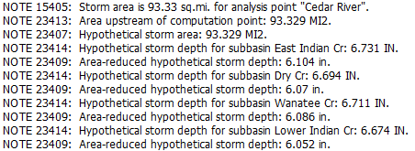
Simulation Notes
67.7 mi²
93.3 mi²

Slide 31
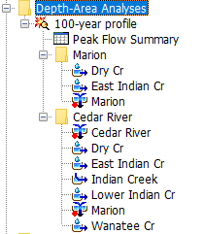
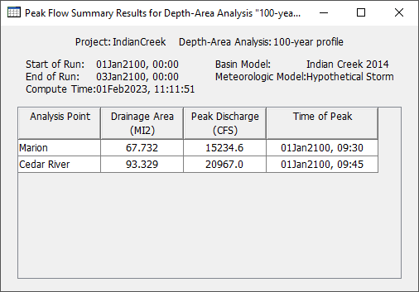
Depth-Area Analysis

Slide 32
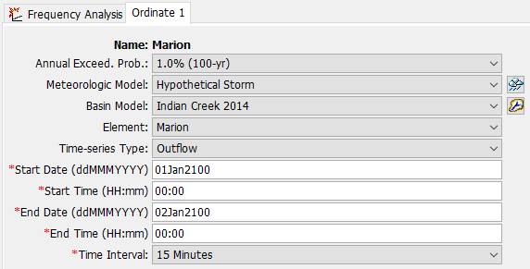
Frequency Analysis
Define frequency ordinates for a location
Combination of met model and basin model for each

Slide 33
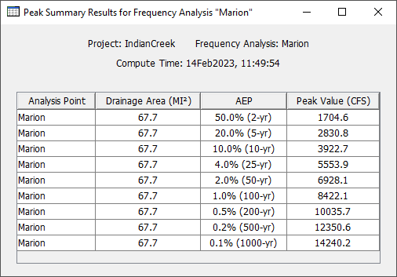
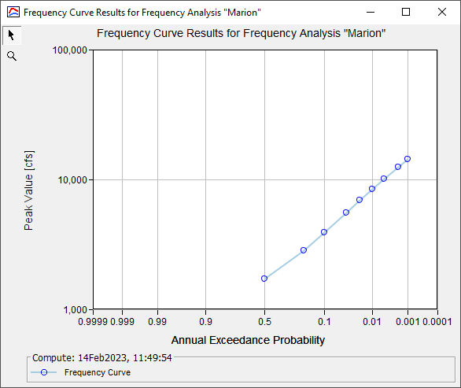
Frequency Analysis

Slide 34
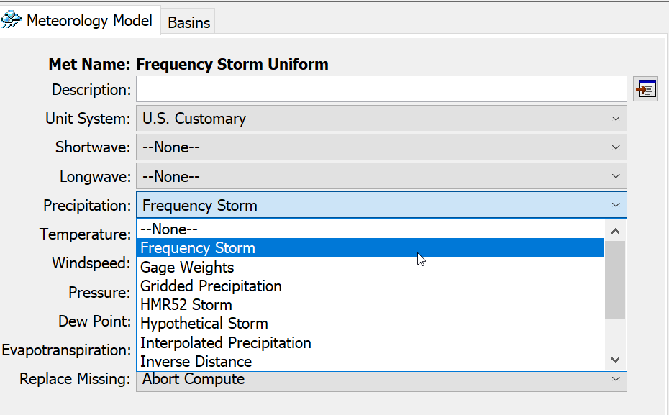
Frequency Storm Method

Slide 35
Frequency Storm Method
Not the same as the Frequency Analysis compute type!
Precipitation method in the meteorologic model
Creates a synthetic storm where all durations use the same frequency depth (“nested”)
  6-hour, 12-hour, 1-day, 2-day, etc. all have same frequency
No “critical” duration assumption
Assumes same frequency for all durations is reasonable

Slide 36
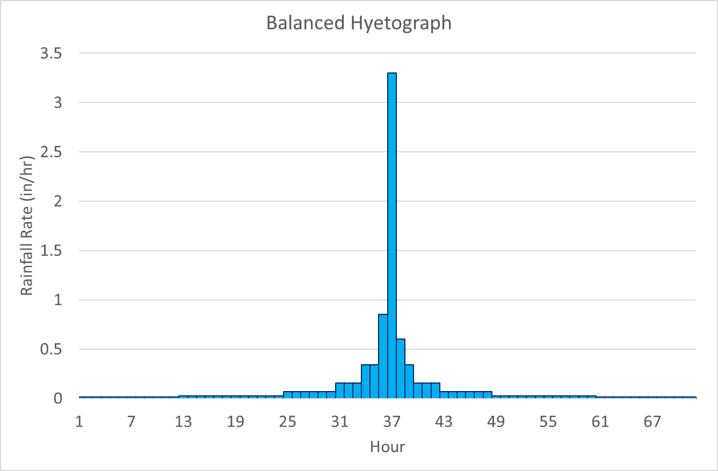
Intensity Duration
1-hour
2-hour
3-hour
Storm Duration
6-hour
24-hour
12-hour
48-hour
72-hour

Slide 37
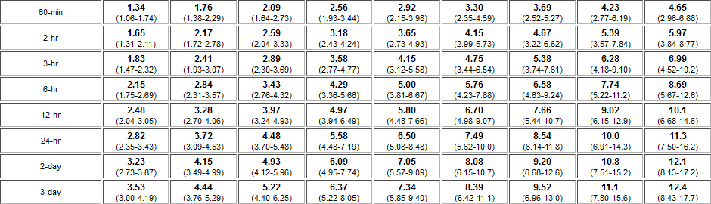
Frequency Storm Data
Intensity Duration
Storm Duration
Multiple durations and depths

Slide 38

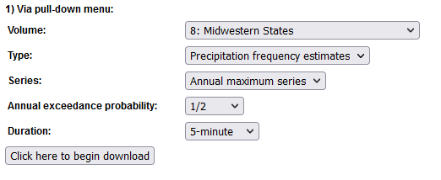
Frequency Storm Data

Slide 39
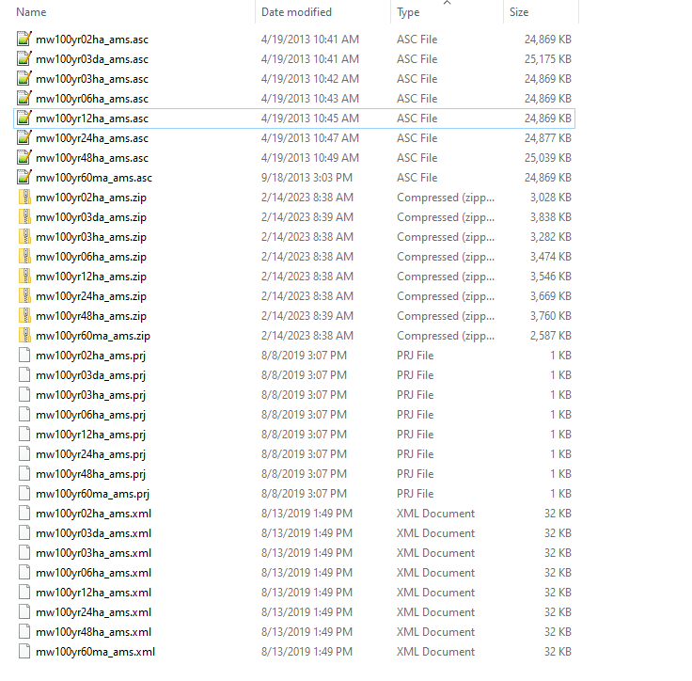
Data

Slide 40
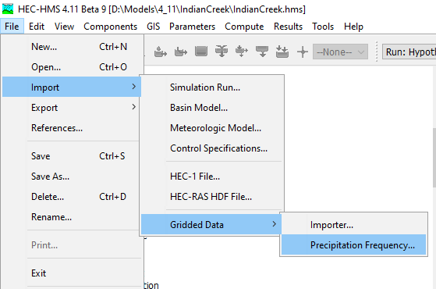
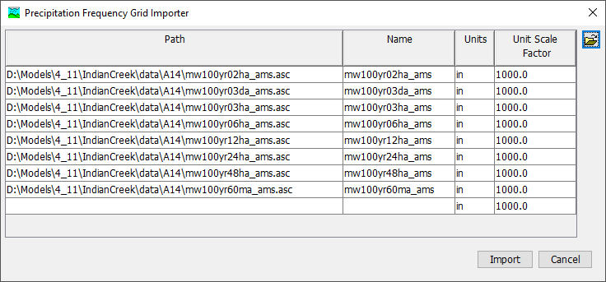
Importing Data

Slide 41
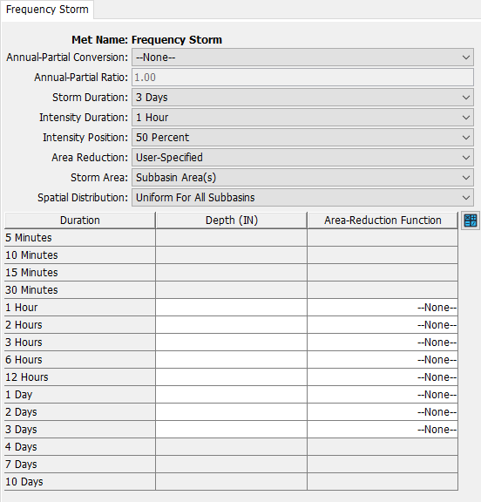
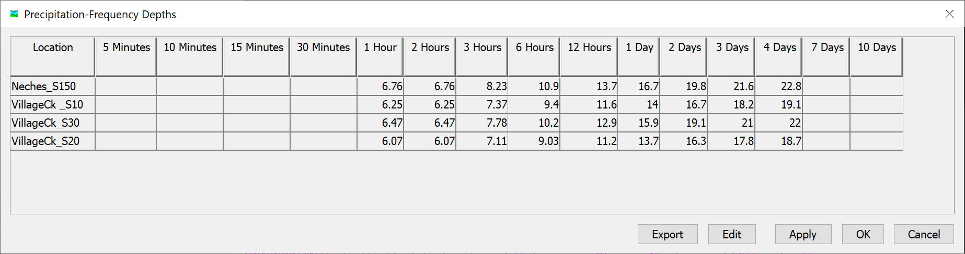
Frequency Storm
Calculator

Slide 42
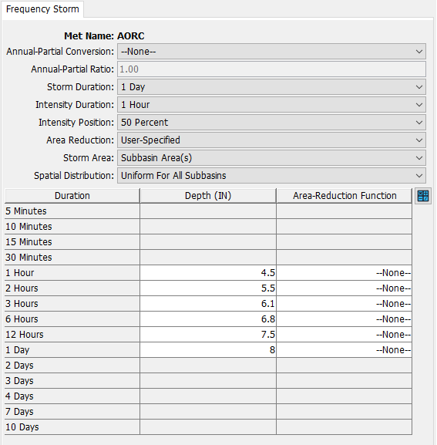
Frequency Storm Key Settings
Storm duration
  total duration
Intensity duration
  shortest increment
Intensity position
  peak timing
Area reduction
  point-to-area method
Storm area
  determines area reduction
Spatial distribution
  equal or by subbasin
Don’t use the Annual-Partial conversion setting unless it’s for a legacy project!

Slide 43
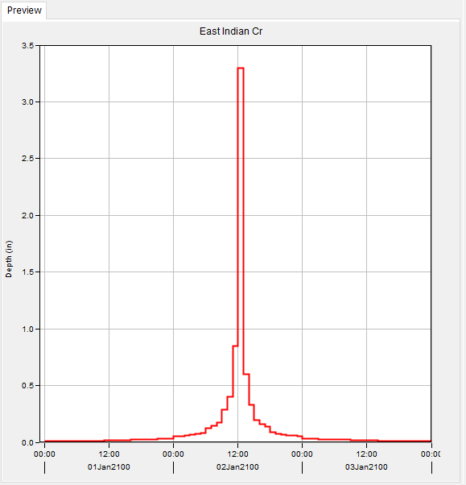
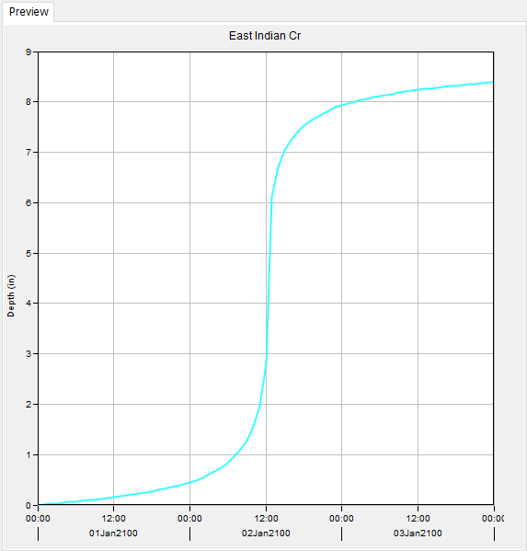
Synthetic Hyetograph

Slide 44
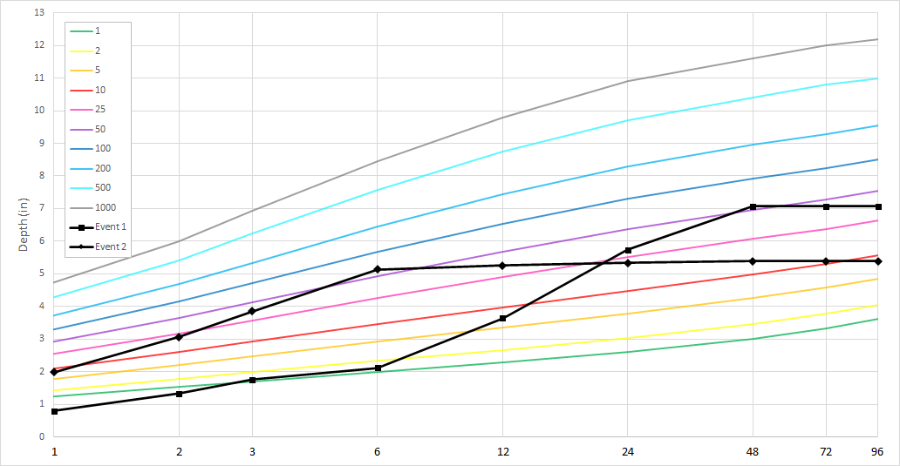
Limitations of Frequency Storm
Example: Cedar Rapids, IA
Aug 2009
Aug 2016
Notes:
The frequency storm method is very conservative. It assumes every duration has the same frequency of intensity, but this is not the case for real storms. See example for two storms in Cedar Rapids, IA

Slide 45

Hypothetical Storm Method

Slide 46
Hypothetical Storm Method
Precipitation method in the meteorologic model
3 sub-methods:
  Area-Dependent Pattern
  SCS Storm
  User-Specified Pattern
Creates a synthetic storm based on a single duration
Assumes you choose the right duration for AEP neutrality

Slide 47
Hypothetical Storm Data
One duration, one depth

Slide 48

Area-Dependent Pattern
Meant to be used with the Depth-Area Analysis
Vary time pattern with storm area
Advanced method

Slide 49


SCS Storm
Notes:
Puerto Rico should probably be in Type 3, for the record.

Slide 50


SCS Storm
Very simple design storm approach
Always 24-hour storms
Notes:
The spatial distribution of the rainfall can either be uniform for all of them (specified by this point depth) or if you use Variable by Subbasin, you can set it individually for each subbasin as in the image below.

Slide 51
User-Specified Pattern
Average = 7.50 in
User-defined time pattern
Ability to read PF grids
Depth-Area Analysis magic
  Computes precipitation above each comp. pt.
  Gets drainage area
  Computes area reduction
Computation Point

Slide 52


Temporal Patterns
Percentage curve paired data
Atlas 14 has data
Notes:
I copy the right column from the A14 temporals CSV file and paste it into the table. Then I set the first to 0.000 and 100.0000 and use the interpolation function to fill in the left column.
Note that values can repeat in the right column – in older versions of HMS they had to be strictly increasing. Now they just have to be non-decreasing.

Slide 53



Synthetic Hyetograph
Midwest Region 3
2nd Quartile, 50%
Volume matches area-reduced subbasin amount

Slide 54
Stochastic Storm Transposition
Notes:
We covered the background of SST and how to do basic SST simulation in HMS in an earlier lecture – this is just a note about the direction we’re headed with respect to SST.

Slide 55


Overview of SST Method
Data-driven method for watershed precipitation frequency
Based on a “catalog” of severe storms
Simulated by random selection of storms and their position
1 real storm…
…out of a whole catalog of storms

Slide 56

Overview of SST Method
Non-parametric space-for-time substitution
Resample severe storm events from a catalog
Preserve properties of real storms
Develop watershed-average precipitation-frequency
Transpose multiple storms per year
  Use a data-driven approach to reduce assumptions
Wright, Smith, and Baeck (2013)

Slide 57

Transposing Storms
Δx ~ uniform
Δy ~ uniform
observed
transposed

Slide 58

SST Precipitation-Frequency
For some large number of years of storms:
Sample number of storms for the year
For each storm:
  Select one from the catalog
  Transpose it uniformly within the domain
  Compute area-average precipitation over watershed
Plot annual maximum storm totals as a frequency curve
Notes:
SST can be used to generate watershed-averaged precipitation frequency curves by selecting storms at random from the catalog, transposing them at random inside the transposition domain, and computing the watershed-averaged precipitation from each transposition. Each simulation year contains multiple transpositions, and an empirical annual maximum distribution is extracted from the largest transposition of each year. The number of storms per year can vary, usually sampled from a Poisson distribution with a mean rate equal to the mean rate of storms per year in the storm catalog. Storms are altered by transposition only, and the fields are not rotated or scaled in any way.
The structure of the simulation has more years than the rarest desired return interval. For example, if an estimate for the 1/1,000 AEP event is desired, the simulation will have more than 1,000 years of transpositions.

Slide 59
Questions?

