Slide 1
Transform Methods
Hydrologic Modeling with HEC-HMS
November 2024
Gregory S. Karlovits, P.E., PH, CFM
US Army Corps of Engineers
Hydrologic Engineering Center

Slide 2
Transform Methods
What are they?
Surface runoff models
Timing of direct runoff
Subbasin outlet
Outline
Introduction
Specified UH
Synthetic UH
Other methods
Unit Hydrographs

Slide 3
Transform Method Introduction

Slide 4
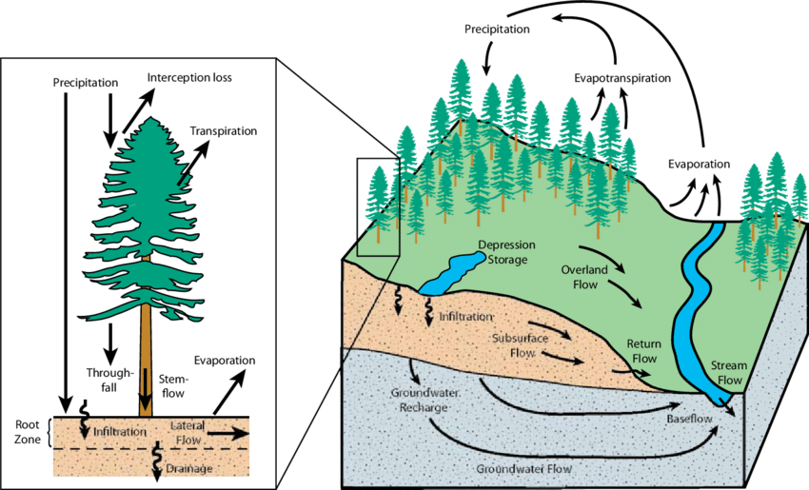
Adapted from Winkler et al. (2008)
Notes:
We start our discussion by reviewing the physical processes that take place once you start getting precipitation onto the watershed. This figure shows the various hydrologic processes that could occur once rainfall falls to the ground. Much of the rainfall is subject different losses; you can get infiltration of your rainfall into the soil, there could be rainfall that falls on canopy and gets stuck there, your ground surface may contain storage that traps rainfall or movement of flow. These losses can all be subtracted from the amount of precipitation that falls on a basin. When losses are subtracted we are left with the excess precipitation, meaning it’s the rainfall amount left over after you account for the losses we just described. Excess precipitation over the basin ends up on the surface, which is converted to a runoff and makes its way to the channel and basin outlet.

Slide 5
Precipitation Model
Combined Losses
Excess Precip Transform
Baseflow
Watershed Outlet
Channel Routing
Total Runoff
Notes:
In rainfall-runoff modeling, we attempt to model the various hydrologic processes that occur when you get rainfall over a basin. The component that handle’s surface runoff is the transformation of excess precipitation as shown here in red. The excess precipitation gets converted or transformed into surface runoff which feeds into the total hydrograph. To reiterate, the excess precipitation just looks at the surface runoff. There are other components to the total outlet flow, such as interflow and groundwater flow, but we’ll be focusing our discussion on just the transformation of excess rainfall.

Slide 6
Crest (peak)
Flow
Falling limb
Rising limb
Direct runoff
Inflection Point
Interflow
Baseflow
Time
Notes:
One of the main purposes of a rainfall-runoff model is to produce a hydrograph at a specified located. A hydrograph is simply a plot of discharge vs time for a given location. The term “Hydrograph” is synonymous with terms runoff, discharge, or flow and you might hear these interchangeably. The excess rainfall transformed to runoff makes up a part of the total hydrograph, which we call direct runoff. Interflow and baseflow, which deals with the subsurface movement of water, are also important components to the total hydrograph. Other components to the hydrograph are the rising limb, which is the start of direct runoff up to the hydrograph peak, and the falling limb, which begins from the hydrograph peak to the end of direct runoff. The falling limb is also known as the recession limb. The inflection point is generally the point at which direct runoff ends and interflow or baseflow drive the rest of the hydrograph.

Slide 7
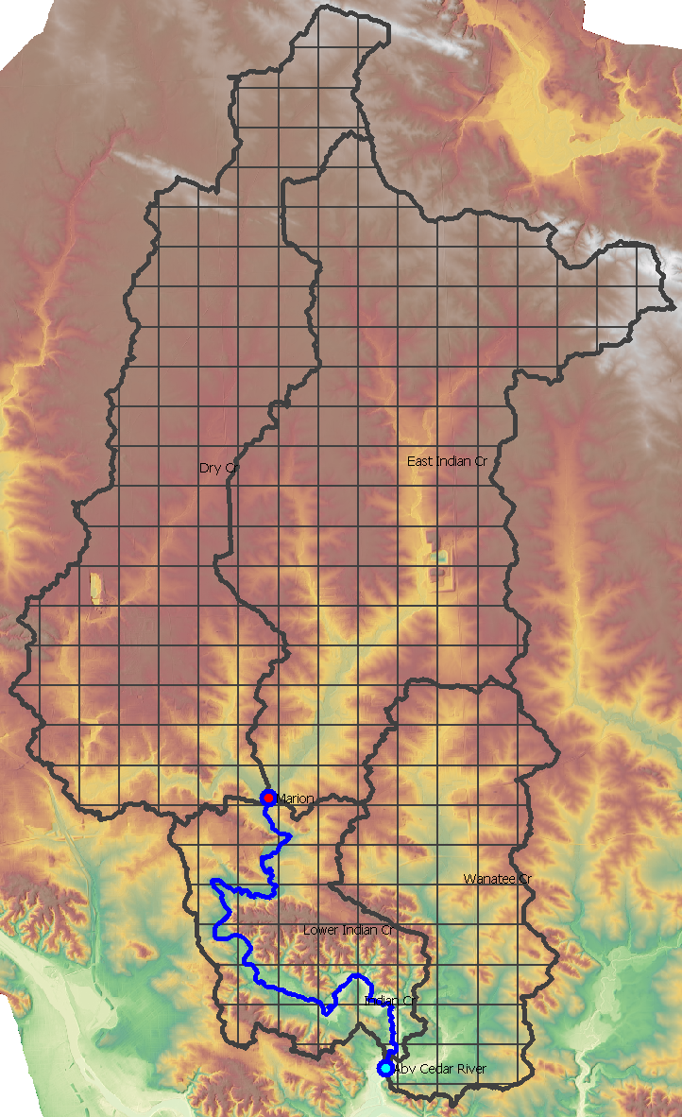
Transform Models
Model water movement across
the surface
Lumps all modes of transport
  Sheet flow
  Shallow concentrated flow
  Open channel flow
Notes:
The part of the hydrologic cycle we’re dealing with now is how all the water that plans to make its way to the outlet by flowing across the surface gets there, and how quickly.
Precipitation coming into our watershed gets captured by the canopy, stored in depressions on the surface, and more than anything else, infiltrated into the soil. Different processes deal with the fate of that lost precipitation.
The excess of that flows across the surface until it gets to a sub-basin outlet where it is typically then handled by a stream, or reach section.
Anybody who recalls the SCS methods from school might remember that the travel time can be estimated by looking at the speed at which three kinds of surface flow occur: sheet flow, which is in the first 100 or so feet of headwaters surface flow; shallow concentrated flow, where the flow depth is deeper because it has concentrated in terrain features resembling channels like swales; and finally open channel flow, where a well-defined channel exists.
Our transform models approximate all three of those modes of travel in one process.

Slide 8
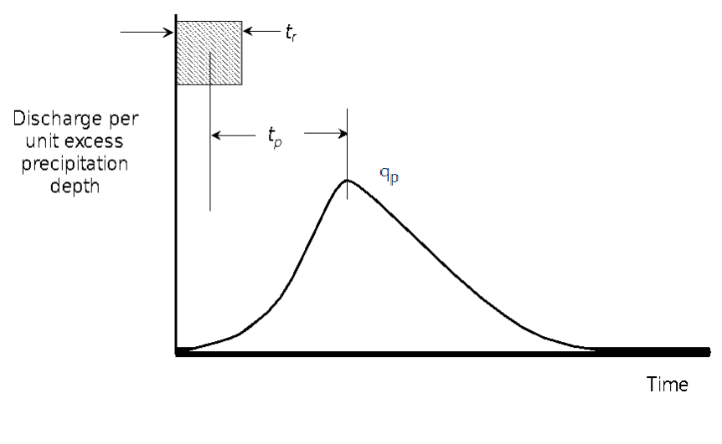
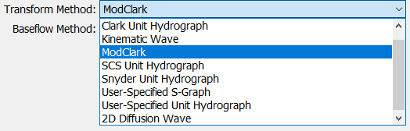
Unit Hydrographs
A watershed’s response to a unit input of excess precipitation
Excess =
After Losses
1 inch
Notes:
The first transform method, and most well known, is the Unit Hydrograph. The concept was developed by guy name of Sherman. Sherman (1932) defined the unit hydrograph (UH) as the “basin outflow resulting from 1.0 inch (1.0 mm) of direct runoff generated uniformly over the drainage area at a uniform rainfall rate during a specified period of rainfall duration.”
The unit hydrograph is often used for lumped parameter modeling, meaning the parameters that characterize the unit hydrograph is an average over the watershed area and ignore spatial variation. We will talk about one type of unit hydrograph that is designed to handle this spatial variation.

Slide 9
Why Unit Hydrographs?
Generalize a watershed’s response
Simplified, lumped model
Scale linearly
Notes:
Unit hydrographs let us come up with a good general representation of the behavior of precipitation excess for a specific watershed. We will look at two types, a derived, or empirical unit hydrograph, which is a pattern estimated from an observed flood event; and a synthetic, which describes the shape of the direct runoff response using parameters usually discovered by calibration.
The models are fairly simple and generally parsimonious, requiring few parameters to achieve a good answer. They are lumped processes, meaning the represent the average across the entire sub-basin, which may be appropriate, or it may not, depending on your application. A major appeal is the simplicity and speed of computation of these kinds of models.
In the spirit of a general response, unit hydrographs (either derived or synthetic) can be scaled linearly to be used as a model for varying amounts of excess precipitation, which gives us some extrapolation power for events beyond our calibration period. Of course this comes with some caveats we’ll see later.

Slide 10
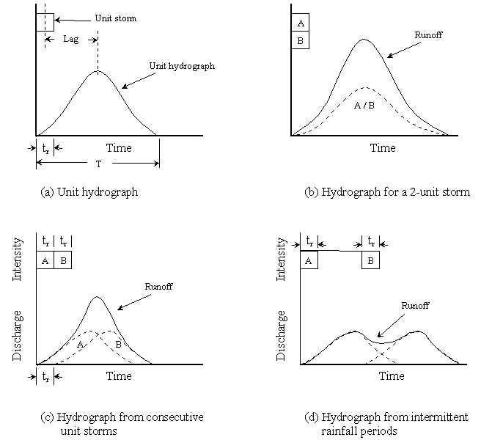
Unit Hydrograph Assumptions
Rainfall excesses of equal duration are assumed to produce hydrographs with equivalent time bases regardless of the intensity of the rain.
Notes:
Excess rainfall of equal duration are assumed to produce hydrographs with equivalent time bases regardless of the intensity of the rain. Time base is referring to the duration of direct runoff (after accounting for losses and removing baseflow). Regardless of how many inches your rainfall within a specified duration, you will get the same time base.

Slide 11
Unit Hydrograph Assumptions
Direct runoff directly proportional to rainfall excess volumes.
Twice the rainfall produces a doubling of hydrograph ordinates (superposition)
Notes:
The direct runoff ordinates for a storm of given duration are assumed directly proportional to rainfall excess volumes. That means if you have 2 times the rainfall, you will get a doubling of the hydrograph ordinates. This highlights the principle of superposition - if you compare the runoff from 1 inch of rainfall to the runoff from 2 inches of rainfall, you essentially get a hydrograph that’s twice the size.

Slide 12
Unit Hydrograph Assumptions
Time distribution of direct runoff is independent of antecedent precipitation (time invariance)
Notes:
The time distribution of direct runoff is assumed independent of antecedent precipitation. This is the principle of time-invariance. Regardless of the state of the watershed, if you have one inch of excess precipitation over your basin, you will always get the same hydrograph regardless of when that rainfall occurs.

Slide 13
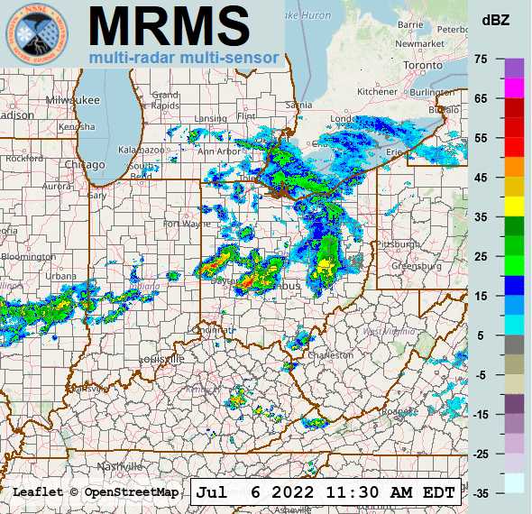
Unit Hydrograph Assumptions
Excess precipitation is spatially distributed uniformly and has a constant intensity throughout the time interval
Notes:
Excess precipitation is spatially distributed uniformly and has a constant intensity throughout the time interval. This is described in the definition of the unit hydrograph and restated again.

Slide 14
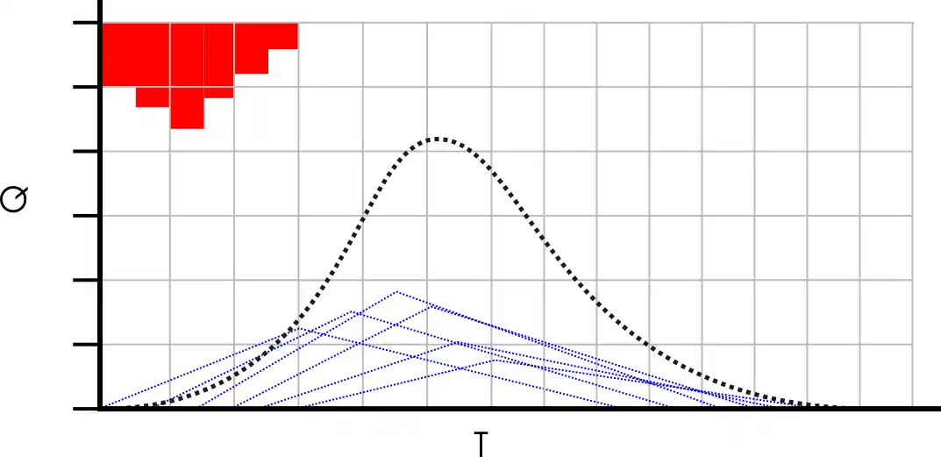
Unit Hydrograph Application
Each pulse of excess generates a hydrograph
Combining these is called convolution
Credit: Practical.Engineering

Slide 15
Unit Hydrograph Limitations
Response typically non-linear
Time-invariance can be affected by the seasons
Areal distribution of rainfall rarely uniform over time and space
https://www.hec.usace.army.mil/confluence/hmsdocs/hmstrm/transform/applicability-and-limitations-of-transform-models
Notes:
Now that you have an understanding of the assumptions, you could probably tell there are limitations to this concept when applied to natural catchments. We’ll describe three limitations to applying the UH. The assumption of proportionality and superposition mostly conflicts with the observed behavior of river flow, which are typically non-proportional (or non-linear). The antecedent conditions of the ground, whether the ground starts off as saturated or unsaturated, can have a significant affect on the behavior of runoff. Rainfall intensities have also been shown to affect the runoff behavior as non-linear with increasing rainfall intensities.
The assumption of time-invariance can be affected by the season. The response hydrograph can be expected to vary based on the time of year. For example, vegetation might be at its highest development during the spring or summer and therefore hydraulic behavior of the catchment might be rougher and affect the runoff response.
The assumption of excess rainfall uniformly distributed in space and time is also not normally seen. More often, storms tend to vary in intensity in both space and time and the contributing runoff areas will expand and contract as the catchment dries and wets. However, this last limitation can be accounted for in your modeling by selecting a smaller rainfall duration to capture the changes in intensities. The changes in space can be accounted for by delineating your watershed to smaller subbasin if the data is available.
Despite these limitations, the unit hydrograph method is still used widely because of its simplicity to apply to many different types of watersheds and is still the basis for many analysis and estimation techniques.

Slide 16
Specified Unit Hydrographs

Slide 17
Specified UH
Derived from event observations
Require baseflow separation
Specific to watershed and event
Notes:
These might also be called “empirical” unit hydrographs as they are computed straight from rainfall and runoff data for a specific watershed.

Slide 18
Derived Unit Hydrograph
Notes:
Let go over how someone would derive a unit hydrograph from an observed hydrograph and rainfall.

Slide 19
Derived Unit Hydrograph
Separate interflow and base flow
Excess precip depth (d)
Flow
Excess precip depth (d)
Flow
Direct runoff
Direct runoff
Interflow
Baseflow
Time
Time
Notes:
The first step to deriving a unit hydrograph for your watershed is to separate the interflow and baseflow. The main goal of separating these out is so we can analyze just the direct runoff. There are many different techniques for separating interflow and baseflow from the hydrograph, all of which require some user judgement. In this example, direct runoff begins at the onset (click) of excess precipitation. The inflection point (click) on the recession limb of the hydrograph is used to indicate the change in physical processes controlling discharge which we infer is the interflow or baseflow. So a straight line (click) is drawn from the start of excess rainfall to the inflection point on the hydrograph. What you (click) are left with is the direct runoff.

Slide 20
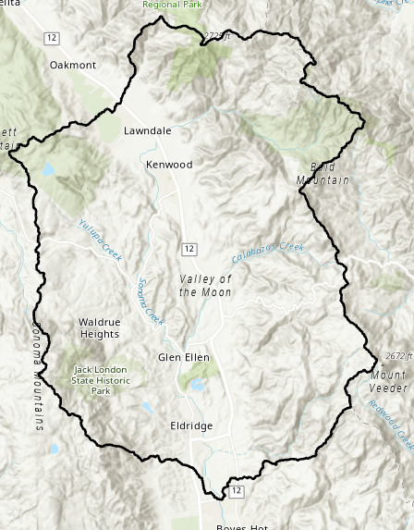

Derived Unit Hydrograph
Estimate volume of direct runoff under the hydrograph and convert to depth over the watershed
Area (A)
Depth of runoff (d):
$$d=\frac{V}{A}$$
Excess precip depth (d)
Flow
Direct runoff (V)
Time
Notes:
Once we have the direct runoff hydrograph, we measure the total volume of direct runoff which is the area under the hydrograph (click) and convert to a depth over the watershed. The depth could be computed simply done by dividing the volume (click) under the direct runoff curve by the area (click) of the watershed.

Slide 21

Derived Unit Hydrograph
Divide ordinates of direct runoff hydrograph by depth of runoff (d)
Excess precip depth (d)
Unit precip depth (u)
Direct runoff
Flow/u
Direct runoff
Flow
$$×\frac{1}{d}$$
Time
Time
Notes:
So we have the direct runoff hydrograph and the depth of runoff under our hydrograph. We scale our direct runoff hydrograph by dividing (click) the ordinates of direct runoff by the depth of runoff that we computed in step 2. We divide by the depth because we are interested in getting the unit depth of 1 inch or 1 mm. Once you divide each ordinate by the depth, you will obtain (click) your unit hydrograph
In practice this procedure would be conducted for a number of storms and the ordinates averaged to determine the final unit hydrograph for the basin.

Slide 22
Derived Unit Hydrograph
Estimate duration of the unit hydrograph
Excess Rainfall Duration
Precip
Φ index
Time
Notes:
We have our unit hydrograph. Our last step is to estimate the duration of the unit hydrograph using the observed rainfall. The unit hydrograph derived from an observed hydrograph is tied to a rainfall duration. For example, it could be that 3 hours of excess rainfall generated our unit hydrograph. So we would call the unit hydrograph, a 3-hr unit hydrograph, where the 3-hrs came from the duration of excess precipitation. The rainfall storm itself could be longer than 3-hours but we are just interested in the excess rainfall after we remove losses. So, to estimate the duration, we take the depth of direct runoff that we estimated in step 2, determine the total volume of your rainfall, and subtract your rainfall losses until you match the depth of direct runoff to estimate the effective duration.
One simple technique to accomplishing this is to use the Φ index (click) such that the depth of excess precipitation is equal to the depth of direct runoff. The Φ index is based on the assumption of a uniform infiltration rate so it would be up to the hydrologist or engineer to decide if that is reasonable assumption. As you can probably tell, you would want to be selective in the types of storms and hydrographs you choose to analyze. You would want to select storms with simple structures where you can get a defined, single peaked hydrograph. Select storms where you can get a uniform distribution of rainfall throughout the period of excess, and uniform spatial distribution over the entire watershed.

Slide 23
Derived Unit Hydrograph
Notes:
Different example (with numbers)
Here is unit hydrograph derivation example starting with an observed streamflow over 24 hours. We use a simple baseflow separation technique of 35 cfs which gets subtracted from the hydrograph to get our direct runoff as well as calculating the volume of our direct runoff. In this case, the volume was calculated using the trapezoid method. Once we got our total volume, we divide by the watershed area to get the runoff depth. We scale our direct runoff by dividing the runoff depth to obtain our unit hydrograph. To confirm that we have a unit hydrograph, we can calculate the area under the unit hydrograph, get the total volume, and divide by the watershed area. We should receive a depth of 1 inch.

Slide 24
Derived Unit Hydrograph
Excess Precipitation = 0.84 inches
Precip
Rainfall total depth (5 hours) = 3.34 inches
Φ index = 0.5 in/hr
Time
Excess precipitation duration = 3-hr
Notes:
To compute the rainfall duration, we estimate the total rainfall depth of 3.34 inches (click). We are looking to get 0.84 inches of excess rainfall which we had computed from the depth of direct runoff. The direct runoff depth could be obtained by using a constant loss estimate of 0.5 in/hr (click). This leaves us with 3-hrs as the excess rainfall (click) and therefore can call the unit hydrograph as a 3-hr unit hydrograph. Try not to get confused between the excess rainfall duration and the time interval of the unit hydrograph. In the previous slide, we see that the time interval for the unit hydrograph was 2-hours, but that does not make it a 2-hr unit hydrograph. The rainfall duration defines the type of unit hydrograph.

Slide 25
Synthetic Unit Hydrographs

Slide 26
Synthetic Unit Hydrographs
Use parameters to control response
  Link to basin characteristics
Generalizes response across events
Instantaneous UH
  Not tied to a duration of excess
HEC-HMS Methods:
Clark • SCS • Snyder

Slide 27
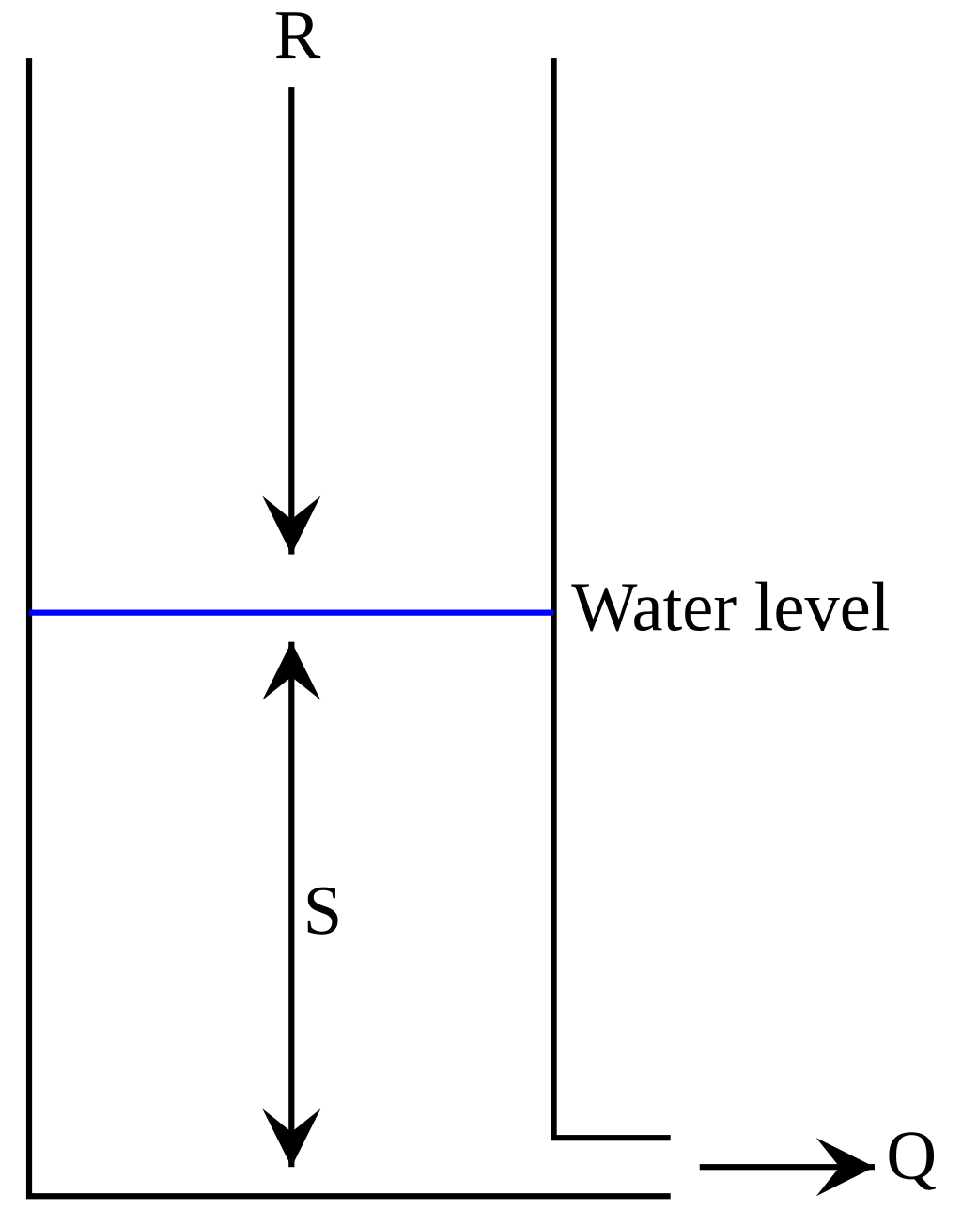
Clark Unit Hydrograph
Derive a watershed’s UH by describing:
  Timing
    time of concentration (tc)
    Time-area relationship
  Attenuation
    storage coefficient (R)
    Linear reservoir
I
S
O

Slide 28
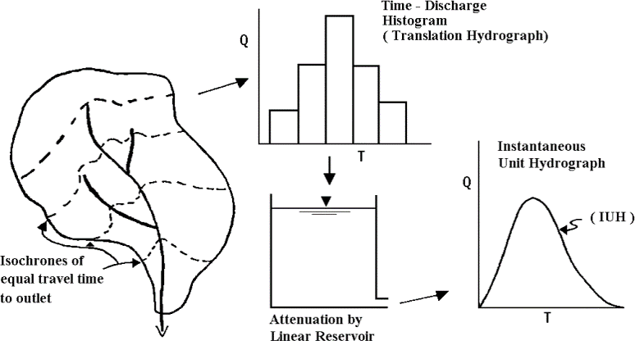
Notes:
This slide illustrates the two processes modeled in Clark. You create time-area histogram by discretizing your watershed regions based on the time it takes for runoff generated on that area to reach the watershed outlet. We call the contours (click) that delineate those regions isochrones. You can develop a time-area histogram that graphs the regions with equal travel time to the outlet with the associated area. In this graph, you may have noticed a Q on the y axis which stands for discharge, and this is because the area was multiplied by a rainfall depth and divided by the time, but it essentially looks the same as a time-area graph. Once you’ve determined your time-area relationship, the second process is to have the runoff carried out by a single linear reservoir to get your instantaneous unit hydrograph, which we had mentioned, isn’t confined to a specific rainfall duration. The next few slides will go into more detail on the time-area relationship and the linear reservoir.

Slide 29
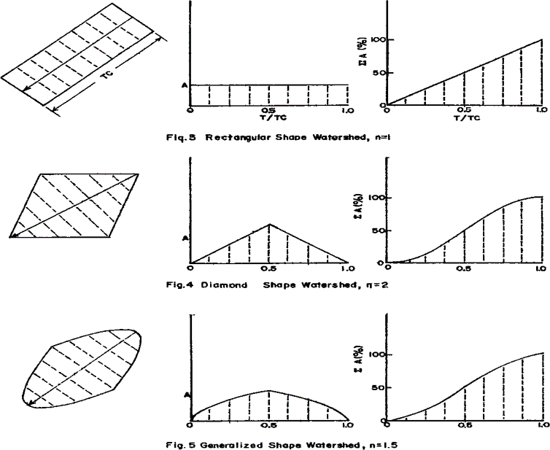
Notes:
The time-area relationship governs the translation portion if the hydrograph. This relationship divides the watershed into regions of equal runoff time to reach the outlet. Once the areas are divided, estimates of the runoff generated on each part of the catchment is delayed by a proportion of the time of concentration.
The examples you see are time-area graphs for three (click) different watershed shapes where each line represents an isochrone (click). The time-area (click) relationship is expressed in the dimensionless form with area as a percent of total basin area and time as a percent of time of concentration. This is where the time of concentration parameter comes into play; if you increase your time of concentration, you increase the amount of time it takes for each of your isochrone regions to reach the watershed outlet. If we use the rectangle watershed shape as an example for the time-area relationship, the first region (click) in the rectangle is closest to the outlet location and would appear first in our time-area relationship. The last region (click) in the rectangle, which is equal to the Tc, would appear last in our time-area relationship. You can get a unit hydrograph from the time area relationship by multiplying the area by a rainfall depth of 1 unit and dividing by the time interval. As you noticed, the time-area relationship can vary based on watershed shape. The default in HMS program (click) utilizes this generalized, oval shaped pattern but you can change the time-area relationship.

Slide 30






Linear Reservoir
Continuity Equation
$$S_{t}=RO_{t}$$
$$\frac{dS}{dt}=I_{t}−O_{t}$$
Storage Coefficient
$$O_{t}=C_{A}I_{t}+C_{B}O_{t−1}$$
$$C_{A}=\frac{∆t}{R+0.5∆t}$$
$$C_{B}=1−C_{A}$$
$${\overline{O}}_{t}=\frac{O_{t−1}+O_{t}}{2}$$
Notes:
Attenuation takes the time-area results and attenuates the flow by routing it through a single linear reservoir model. Linear Reservoir concept is that the watershed behaves as a reservoir in which storage value, S, is linearly related to the outflow and a constant value R, (click) where “R” is the storage coefficient. For other linear reservoir methods, you might see the storage coefficient as “K” value. Using the continuity equation and a finite-difference approximation, you can solve for the outflow ordinates.
The storage coefficient is a coefficient that represents the temporary storage of precipitation excess in the watershed as it drains to the outlet point. The greater your R value, the more time your excess runoff remains in storage. In contrast to Tc which has a definition that can be physically quantified, the storage coefficient is a bit more nebulous. The easiest way to estimate R is via calibration if gaged precipitation and streamflow data are available. R can also be estimated through empirical equations that have been developed through regression analysis.

Slide 31
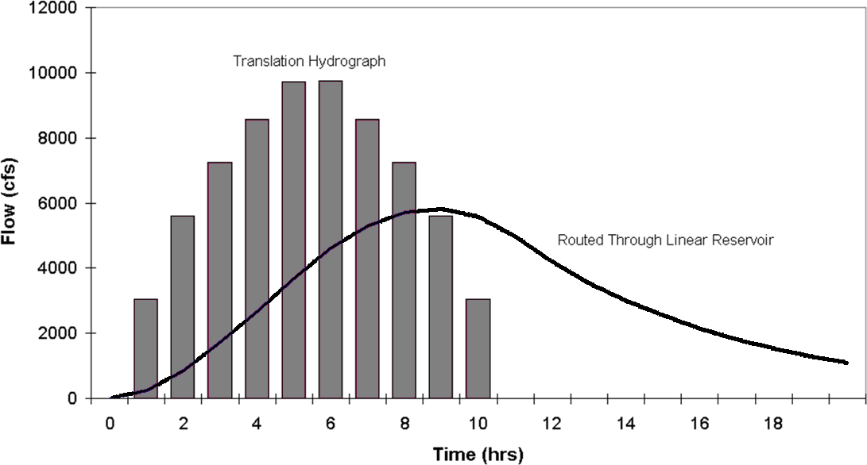
1 inch of rainfall
Unit Hydrograph for Clark!
Notes:
This figure shows the discharge after it’s gone through translation from the synthetic time area curve. This was assuming a default watershed shape, constant velocity, and 1 inches of rainfall over the watershed. You can then see the results of the discharge histogram after getting routed through a linear reservoir resulting in the final unit hydrograph for using the Clark Method. You can see the affects of routing through the linear reservoir as the peak flow is decreased and the time base of the hydrograph is spread out.

Slide 32
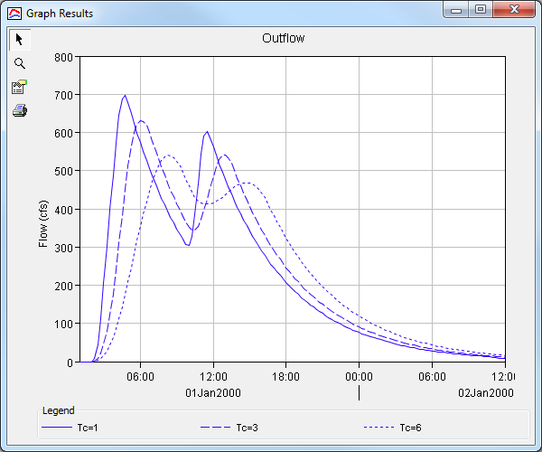
Clark UH – Adjusting Tc
Notes:
Example adjusting time of concentration where you see the affects of translation when keeping the storage coefficient constant

Slide 33
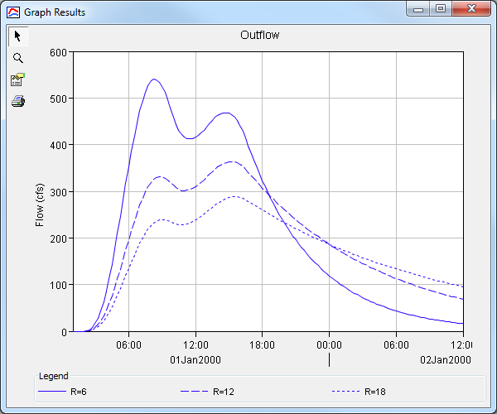
Clark UH – Adjusting R
Notes:
Example adjusting storage coefficient where you see the affects of attenuation when keeping the time of concentration constant. Note how the hydrograph peak decreases as you increase you storage coefficient and the time base gets extended further out.

Slide 34
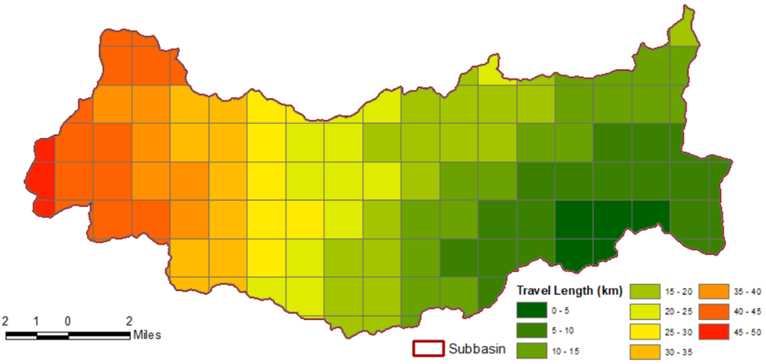
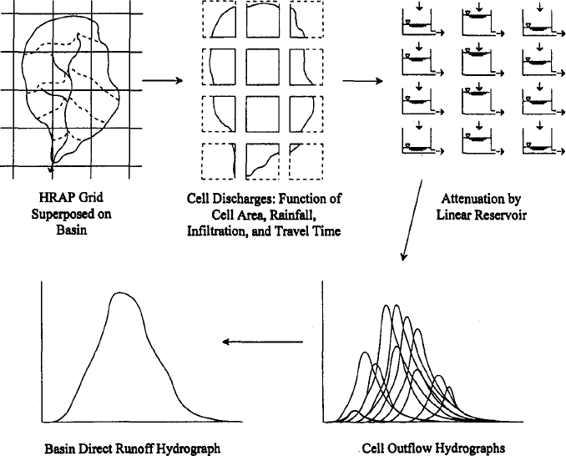
ModClark
Spatial non-uniformity
Eliminate time-area curve
Travel time index per cell
Compute travel time from cell to outlet
Quasi-distributed transform method
Notes:
This slide illustrates the two processes modeled in Clark. You create time-area histogram by discretizing your watershed regions based on the time it takes for runoff generated on that area to reach the watershed outlet. We call the contours (click) that delineate those regions isochrones. You can develop a time-area histogram that graphs the regions with equal travel time to the outlet with the associated area. In this graph, you may have noticed a Q on the y axis which stands for discharge, and this is because the area was multiplied by a rainfall depth and divided by the time, but it essentially looks the same as a time-area graph. Once you’ve determined your time-area relationship, the second process is to have the runoff carried out by a single linear reservoir to get your instantaneous unit hydrograph, which we had mentioned, isn’t confined to a specific rainfall duration. The next few slides will go into more detail on the time-area relationship and the linear reservoir.

Slide 35
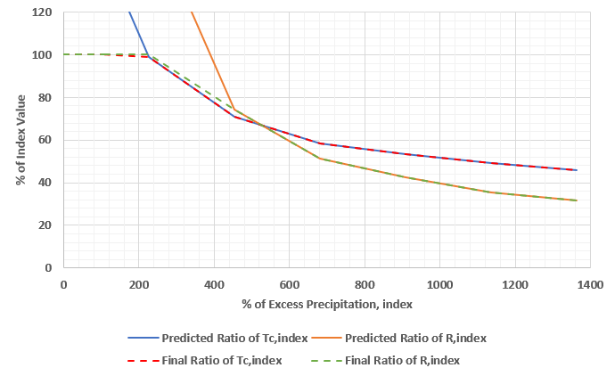
Variable-Parameter Clark
Scale tc and R depending on excess precipitation
Anchor the curve at a calibrated “index” excess, tc, and R

Slide 36
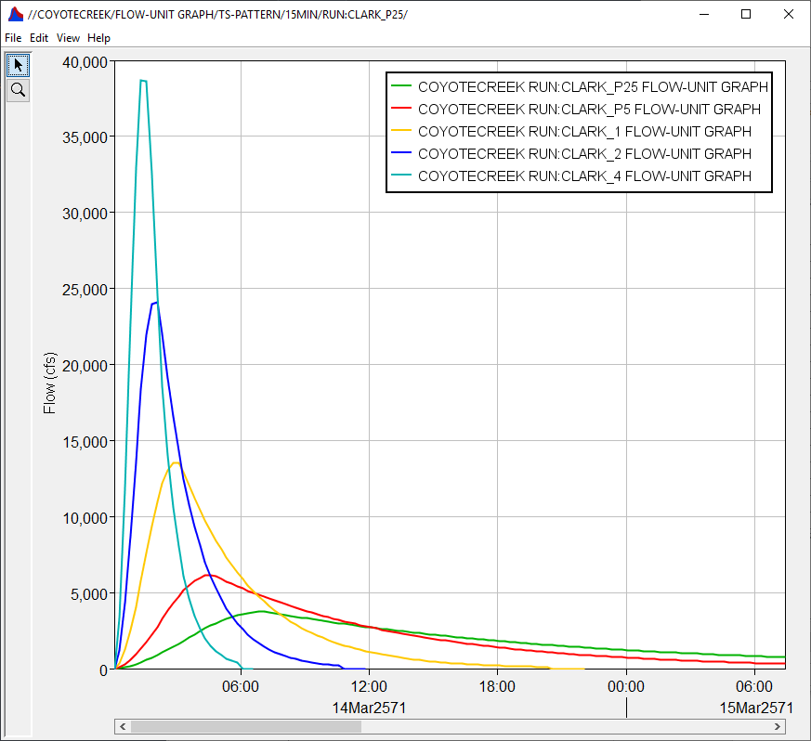
Variable-Parameter Clark
Derive response from
2D HEC-RAS
Tutorials available
  “Creating Variable Clark Transform Method Parameters using the 2D Diffusion Wave Transform Method”
  “Applying the Variable Clark Unit Hydrograph Method”
Notes:
This is now available with both the lumped Clark and ModClark methods.

Slide 37
Other Synthetic UH
SCS Unit Hydrograph
Snyder Unit Hydrograph
Consider using Clark instead

Slide 38
SCS
The Soil Conservation Service (SCS) Unit Hydrograph is based on a dimensionless unit hydrograph
Developed from average of UHs derived from gaged rainfall and runoff for a large number of small agricultural watersheds throughout the US
Ordinates of dimensionless unit hydrograph are relative to peak flow, Q_{P,} and time of rise, T_{R}.
Notes:
The SCS method, named after the Soil Conservation Service, is based on a dimensionless unit hydrograph. The dimensionless UH was developed from an average of UHs derived from gaged rainfall and runoff for a large number of small agricultural watersheds throughout the United States. The ordinates of the dimensionless unit hydrograph are relative to the peak flow, or Qp, and the time of rise, Tr

Slide 39
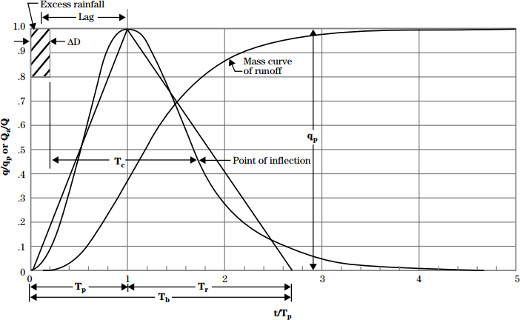
SCS UH – Illustrated
37.5%
62.5%
Source: NRCS (2007)
Notes:
This is the most common form of the dimensionless UH that uses the peaking factor coefficient value of 484. The hydrograph is called dimensionless since the discharge on the y axis is expressed as a ratio of the peak discharge while the time scale on the x-axis is expressed as a ratio of the time-to-peak. The time to peak is not the same as the time of concentration, which we had discussed before. The time to peak, as defined by the SCS method, is from the start of your excess rainfall to the hydrograph peak. There is also another travel time component called Lag, which is defined as the center of mass of your rainfall to the hydrograph peak. We will touch upon lag in the next slide
The dimensionless UH can be represented by equivalent triangles to come up with an estimate of your peak flow. Using the geometry of the triangle, the unit hydrograph has 37.5% of its volume on the rising limb, and the remaining 62.5% on the recession side. Peak discharge can be calculated using the triangular geometric relationship.

Slide 40
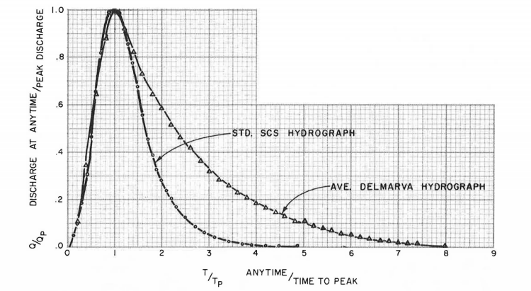
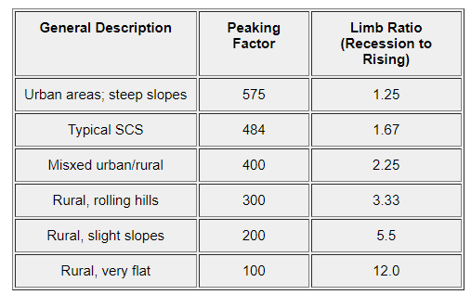
Welle & Woodward, 1989
Wanielista, et al. 1997
HEC-HMS: 13 different peaking factors
Notes:
There are various forms of the dimensionless unit hydrograph. The most form of the SCS UH has a peaking factor of 484. The peaking factor reflects the ability of the watershed to retain and delay flow. In the table, the peaking factor changes depending on the type of terrain. Steep terrain and urban areas tend to produce higher early peaks while flatter terrain may produce lower, and later peaks. This dimensionless unit hydrograph would look different if you were to use a different peaking factor as shown by the Delmarva dimensionless Unit Hydrograph . HEC-HMS provides you the ability to select 13 different peaking factors.

Slide 41



SCS UH – Equations
$\text{Time} \text{to} \text{peak}\text{ (}\text{hr}\text{)}$:
$$T_{P}=\frac{ΔD}{2}+L$$
where:
$ΔD$ = rainfall duration (hr)
L = watershed lag (hr)
Peak discharge (cfs):
$$Q_{P}=484\frac{A}{T_{P}}$$
where:
A = drainage area (mi²)
where:
l= longest flowpath (ft)
Y = average watershed slope (%)
S = potential maximum retention (in)
$$L=\frac{l^{0.8}{\left(S+1\right)}^{0.7}}{1900Y^{.5}}$$
Mockus, 1961
Notes:
To compute the SCS hydrograph by hand, the method requires you to estimate the Time to peak and the Peak discharge. Time to Peak is computed by dividing the rainfall duration by half and adding to the watershed Lag value. We saw earlier that lag represents the center of mass of excess rainfall to the time of peak. There are various equations available to estimate watershed lag. If you have your time of concentration computed, one simple estimate of lag is to multiple the Time of concentration by 0.6. Another method (click) is to use the equation shown here.
Qp is estimated using the peaking factor coefficient, 484, multiplied by the watershed area divided by your computed time to peak. Again, the peaking factor could change depending on your location, such as steep mountains or flat valley. Larger peaking values correspond to steeper terrain, while lower values correspond to flatter terrain.

Slide 42
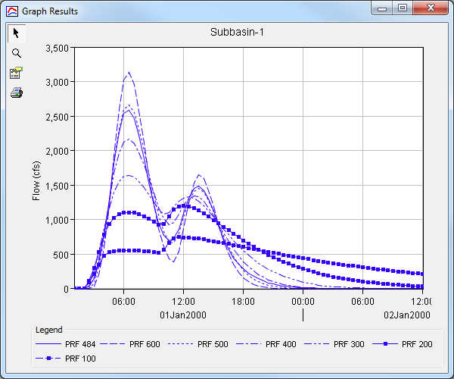
SCS UH – Adjusting Peak Rate Factor
Notes:
This slide provides an example of how your hydrograph changes when adjusting peak rate factor while keeping a constant lag value. The lower the peak rate value represents mild runoff response while higher peak rate values represent a quicker runoff/flashier response. You can see there is large differences in your hydrograph shape, peak value, and the recession limb with different peak rate factors.

Slide 43
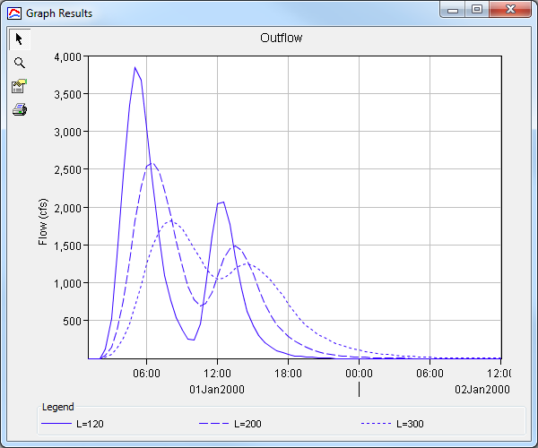
SCS UH – Adjusting Lag Time
Notes:
Here is an example of adjusting the lag time. The higher the lag value, the longer it takes for your floodwave to reach the outlet. You can see the affects of attenuation as you increase your lag value, since you are increasing your Time to Peak and reducing your Discharge peak value.

Slide 44
Snyder UH - Theory
Snyder’s UH originally looked at using hydrograph peak, watershed lag, and the time base as the critical characteristics for the unit hydrograph
Developed from study of watersheds in the Appalachian Highlands ranging from 10 to 10,000 mi²
Notes:
The Synder’s Unit Hydrograph originally looked at using the hydrograph peak, watershed lag, and the timebase to develop the unit hydrograph. This method was developed for a study of watersheds in the Appalachian Highlands with areas ranging from 10 sq miles to 10,000 sq miles.

Slide 45


Snyder UH - Equations
$\text{Basin} \text{lag}\text{ (}\text{hr}\text{)}$:
$$t_{l}=C_{t}{\left(LL_{c}\right)}^{0.3}$$
where:
$L$= length of the main stream from the outlet to the divide (mi)
$L_{c}$ = length along the main stream to a point nearest the watershed centroid (mi)
$C_{t}$=timing coefficient (has been found to range from 1.8 to 2.2 for Appalachian Highland)
$\text{Peak} \text{Discharge}\text{ (}\text{cfs}\text{)}$:
$$Q_{p}=640C_{p}A/{t_{l}}$$
where:
$A$= drainage area (mi²)
$C_{p}$=peaking coefficient can range from 0.4 to 0.8, where larger values of $C_{p}$ are associated with smaller values of $C_{t}$
Notes:
Snyder’s requires two parameters: the watershed lag and the peak discharge. The watershed lag is defined the same as the SCS UH method, which is from the center of mass of rainfall to the hydrograph peak value. Synder’s method provide an equation to estimate watershed lag, by multiplying Ct, which is the timing coefficient, by the length of the longest flow path and the length . Lc is the length of the centroidal flow path. Ct is a variable coefficient best estimated through calibration.
The peak discharge is calculated by multiplying 640 by Cp, which is the peaking coefficient, by the watershed area, and the basin lag. Cp, has values that range from 0.4 to 0.8 (could be lower or higher) and generally represent retention or storage capacity of the watershed. There are tables that provide typical ranges for timing coefficient and storage coefficient but the best way is to calibrate for these parameters.

Slide 46
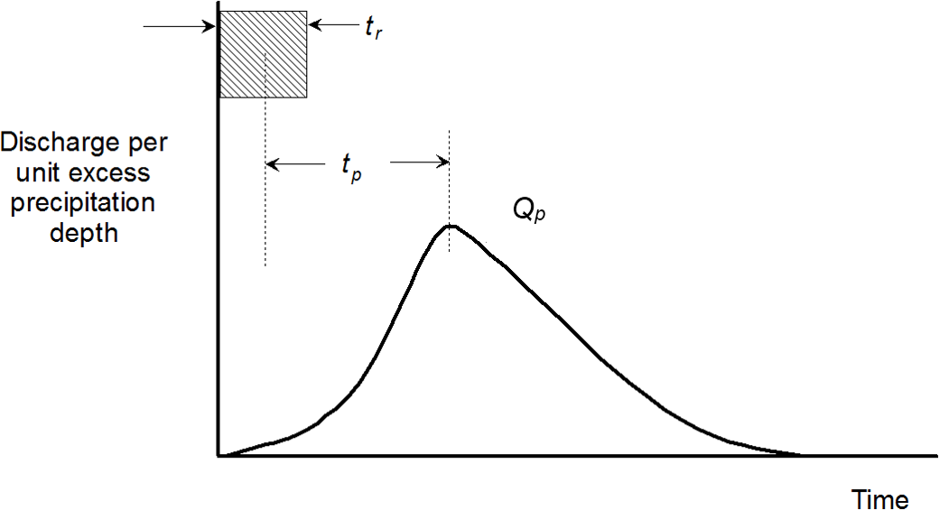
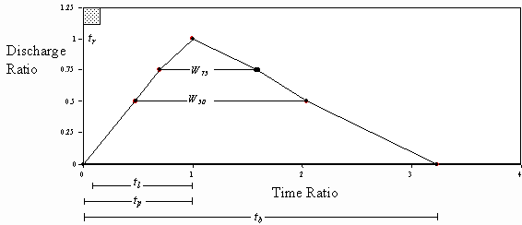
Snyder UH – Illustrated
Notes:
The Snyder method is unique compared to the last two method in that it generates several points to define the hydrograph. There isn’t a dimensionless unit hydrograph or time-area curve to smooth out the rising limb and falling limb. It’s somewhat of a connect the dot exercise to define your shape and making sure the area under the hydrograph is equal to 1 unit. Here is not a lot of definition to the rising limb or falling limb of your unit hydrograph.
In HMS, the Snyder’s method only computes a 0,0 initial base value and the peak value delayed by the lag value. The method actually calls the Clark UH method and iterates through its parameters, Tc and R, to create a unit hydrograph that matches the Snyders hydrograph peak value and peak timing. So you essentially using the Clark Unit Hydrograph method when selecting Snyder’s but you will still get the peak value and peak timing based on the Snyder’s method. If you want to better understand how the Clark Unit Hydrograph works, we have a video under the Basic HMS class that discusses the Clark method

Slide 47
Other Transform Methods

Slide 48
Other Transform Methods
S-Graphs
Kinematic Wave
2D Diffusion Wave

Slide 49

S-Graphs
$$t_{lag}=C{\left(\frac{LL_{ca}}{S^{p}}\right)}^{m}$$
Dimensionless cumulative curve
% volume vs. % lag time
Watershed characteristics
  C - hydraulic efficiency
  L - length along stream centerline to outlet
  Lca - length along stream centerline from centroid to outlet
  S - slope of main watercourse
  p, m – empirical exponents

Slide 50
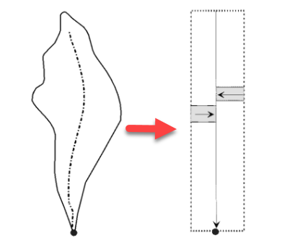
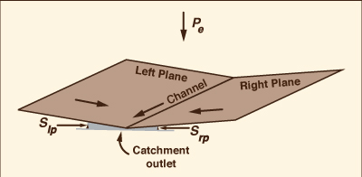
Kinematic Wave
Conceptual model using 1 or 2 planes
Energy and continuity equation
Useful for representing urban regions
http://ponce.sdsu.edu/the_kinematic_wave_controversy.html
Notes:
The 2nd transform method available is the Kinematic Wave Transform. The Kinematic Wave represents the watershed as two plane surfaces over which water runs until it reaches the channel. The water then flows down the channel to the outlet. The watershed and its channels are conceptualized as shown in this Figure, where you have water move as overland flow on the planes and then as channel flow. Another way of looking at this is resembling something like an open book, with the water running parallel to the text on the page and then into the channel that follows the book's center binding. This method solves the energy and continuity equations for both the planes and the open channel to compute the watershed runoff hydrograph. The kinematic wave as designed in HMS is useful for representing urbanized regions.

Slide 51
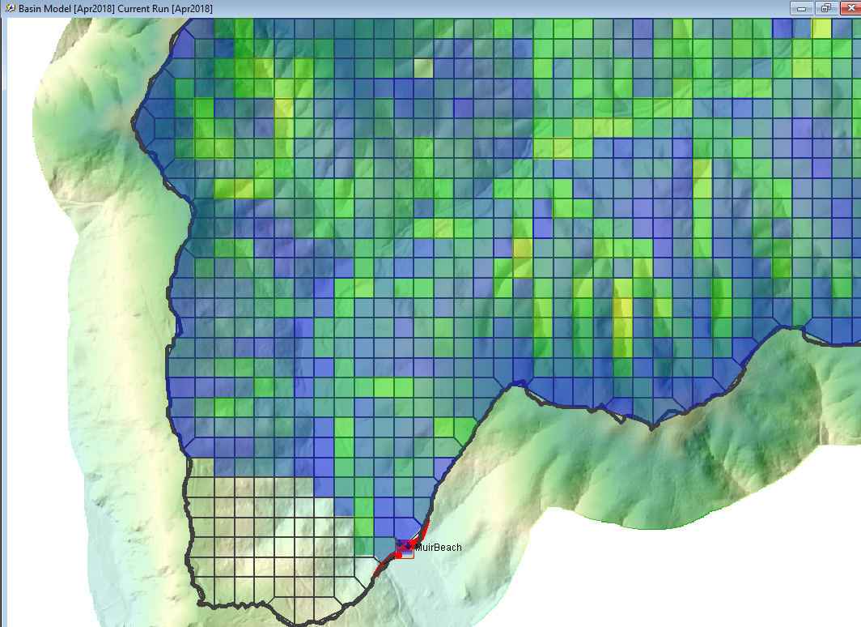
2D Diffusion Wave
Routes excess precipitation using continuity and momentum equations
  Neglects the acceleration term
Represents subbasins using a 2D mesh of both grids cells and grid faces
  Create this in HEC-RAS
Distributed parameter modeling
Ability to visualize spatial variables such as water surface elevation and average velocity
Notes:
A relatively recent feature in HMS is the ability to route water using the 2D Diffusion Wave method. The 2D Diffusion Wave transform method routes excess precipitation using the combination of the continuity and momentum equations. One of the main advantages to using this method compared to using the unit hydrograph transform methods, this transform can be used to simulate the non-linear movement of water throughout a subbasin. The 2D diffusion represent subbasins using a 2D mesh, which at this time requires RAS 2D to create. Since the transform does occur on a grid cell by grid cell basis as well as the routing of flow, this method allows for distributed parameter modeling, meaning the model accounts for behavior variations from a grid cell to grid cell throughout the system. The 2D diffusion wave also has the capability of visualizing computed variables spatially such as the water surface elevation and average velocity on a grid cell by grid cell basis.

Slide 52
Questions?

