Slide 1
HEC-HMS GIS Delineation Tools

Slide 2
Outline
Georeference Elements using Shapefiles
Terrain Data and other Helpful GIS Datasets
HEC-HMS GIS Data Management
Building Walls and Burning Streams
Automated Subbasin and Reach Delineation
Customize Subbasin Reach Delineation
Element Naming and Connectivity
Subbasin Discretization

Slide 3
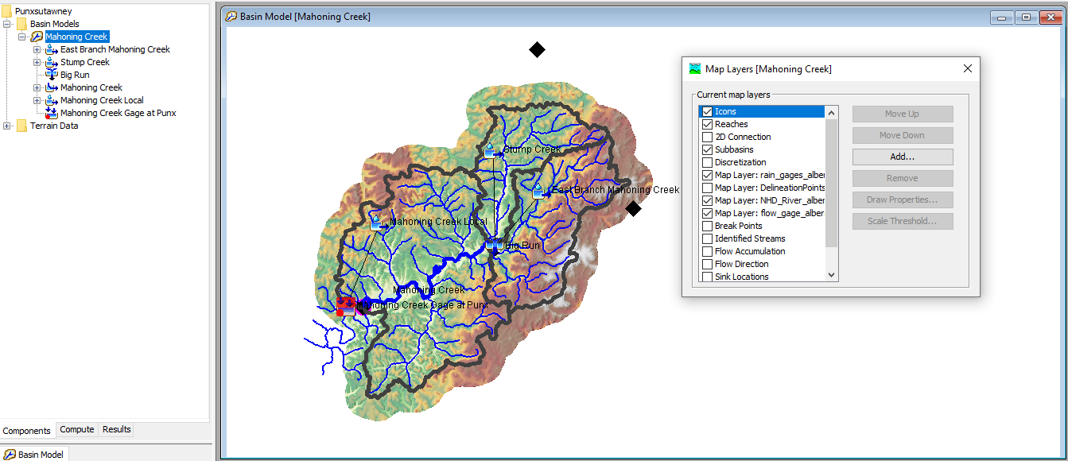
Georeference Elements using Shapefiles
Notes:
When we talk about georeferenced, do you know what that means? Georeferencing – is assigning real world spatial coordinates to digital images or maps that do not have spatial information.

Slide 4
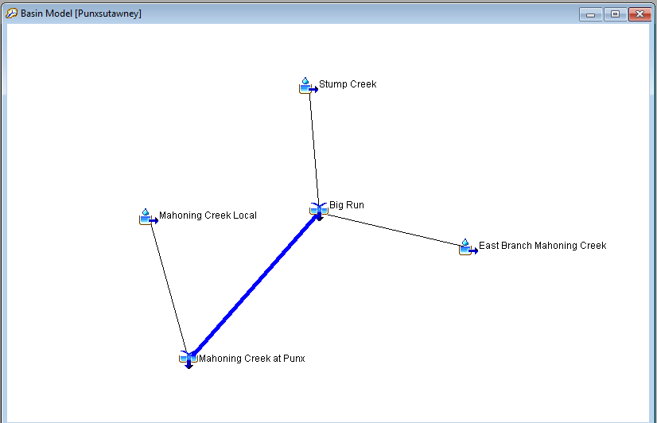
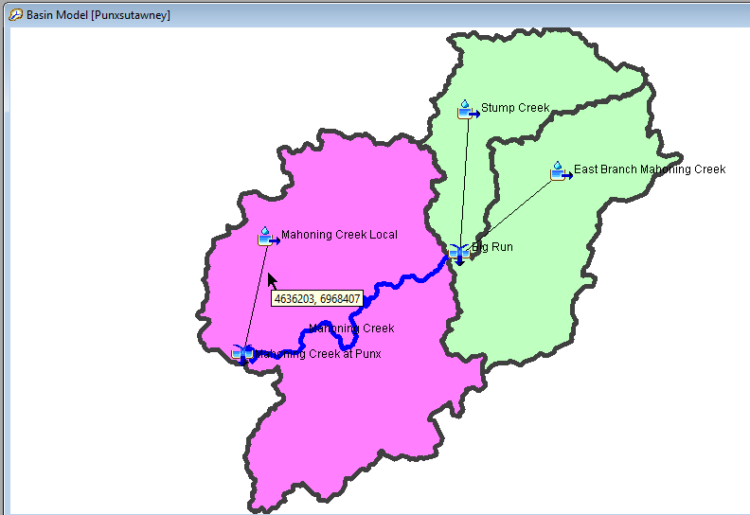
Georeference Basin Model Elements
Before
After
Notes:
Basin models can be created without Georeferenced elements. Element icons can be added to the basin model - a stick-figure representation. However,
Tools are available to convert existing elements to georeferenced elements using shapefiles
Tools are available to import georeferenced subbasin and reach elements using shapefiles

Slide 5
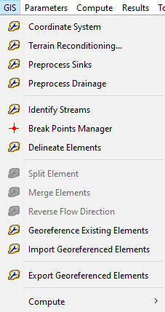
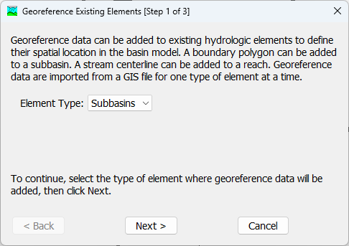
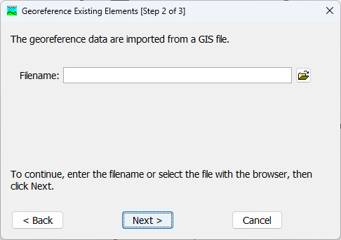
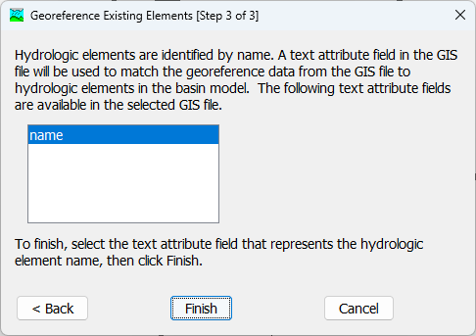
Georeference Existing Elements
Element names must match shapefile attribute table
Notes:
GIS features, subbasins and reaches, can be added to the basin model, where existing elements can be geo-referenced using shapefiles. The features must exist in a shapefile and have a name attribute in order to import them. Part of the process of importing the elements is selecting the shapefile and then the attribute in the shapefile that contains the feature’s name. The GIS feature will be drawn in the basin model using polygons and polylines, and the user can interact with the GIS features.

Slide 6
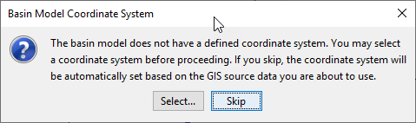
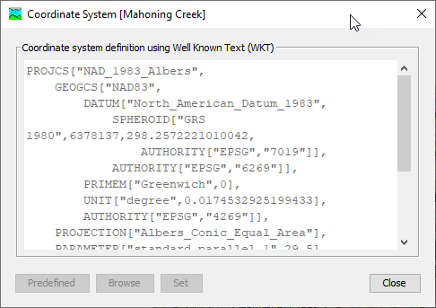
Georeference Existing Elements
A basin model must have a coordinate system defined in order to complete the georeferencing process
The upper image shows a message that pops up when georeferencing existing element
The Selection… button allows you to choose a projection (typically a .prj file)
The Skip button uses the shapefile’s projection

Slide 7
Results from Georeferencing Existing Elements
All elements are georeferenced
  Subbasins = Polygons
  Reaches = Polylines
Mouse coordinates reflect the location withing the basin models geographic projection
Element linkages are maintained

Slide 8
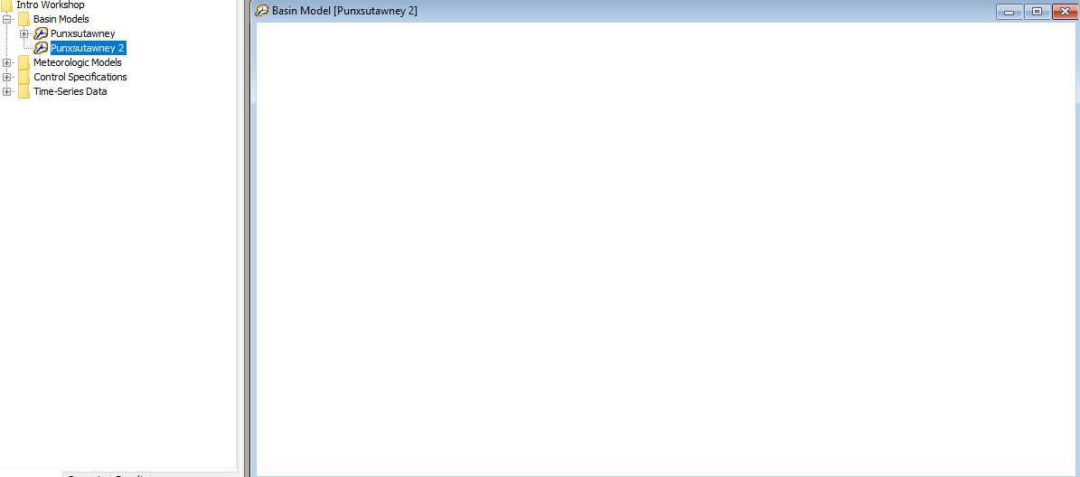
Import Georeferenced Elements
You can import both subbasin and reach elements from shapefiles
You import these georeferenced elements into an empty basin model or into a basin model with existing elements
Set the basin models projection before importing elements. The shapefile’s projection should match the basin model’s projection
Notes:
If you have a shapefile of your subbasins and your reaches, you can import those into your project.

Slide 9
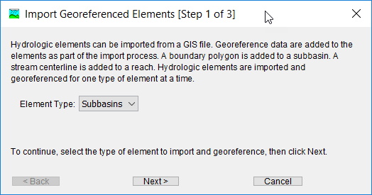
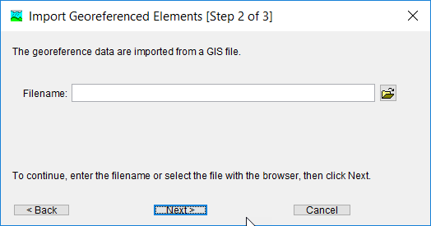
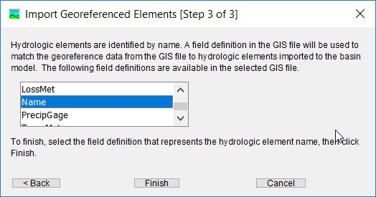
Import Georeferenced Elements

Slide 10
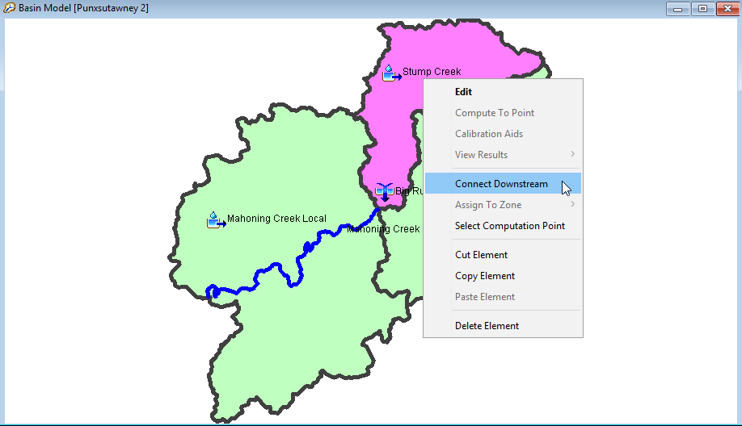
Linking Imported Georeferenced Elements
Elements are not automatically connected to one another
Add junction elements and start connecting the elements to form the hydrologic network
Notes:
Once the GIS features are added to a basin model, they must be connected in hydrologic order. Junctions, reservoirs and other elements must be added, and then all the elements connected from upstream to downstream to create the network. If there is an existing basin model, then the GIS feature import will add subbasin polygons and reach polylines to existing elements that have matching names in the shapefiles.

Slide 11
Outline
Georeference Elements using Shapefiles
Terrain Data and other Helpful GIS Datasets
HEC-HMS GIS Data Management
Building Walls and Burning Streams
Automated Subbasin and Reach Delineation
Customize Subbasin Reach Delineation
Element Naming and Connectivity
Subbasin Discretization

Slide 12
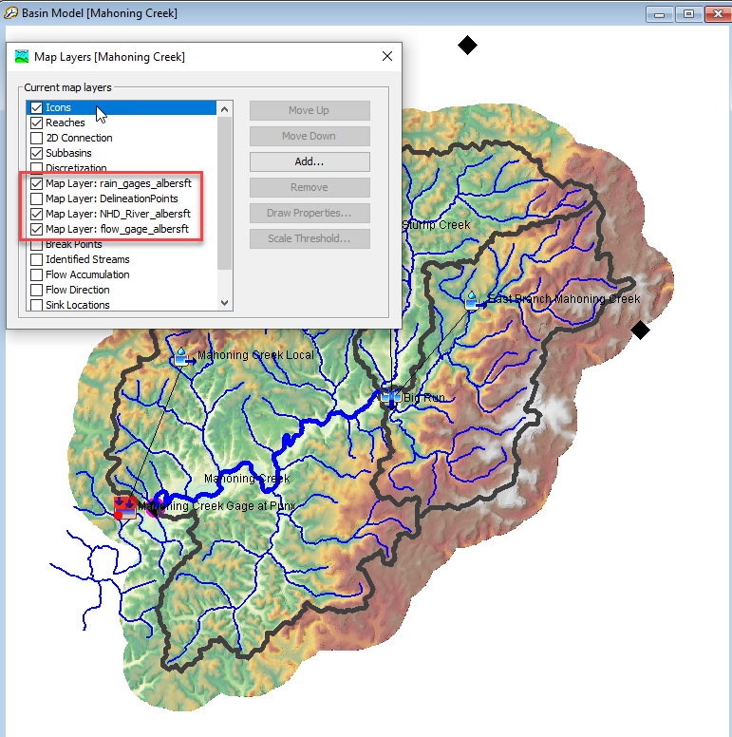
GIS Datasets
Required Datasets for Delineation Tools
Terrain data
Helpful GIS Datasets
NHD (published streams and watersheds)
Gage locations
Reservoir locations
Landuse
Soil
Locations for linking to other models

Slide 13
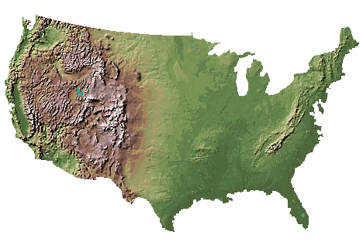
National Elevation Dataset (NED)
A raster product assembled by the U.S. Geological Survey
Provide national elevation data in a seamless form with a consistent datum, elevation unit, and projection
Resolution
  Nationally 1 arc-second (approx 30 meters) and 1/3 arc-second (approx 10 meters) are available (1/9 arc-second limited)
Coordinate System Info
  Elevation values are in meters and are referenced to the North American Vertical Datum of 1988
  Data distributed in geographic coordinates with units of decimal degrees and in conformance with the North American Datum of 1983
Data are distributed through the National Map Viewer: https://apps.nationalmap.gov/downloader/
Notes:
This is a representation of your terrain in a form of a raster file. The USGS collected this data for the entire US with various resolutions. When you download the terrain, they come in tiles (you don’t download the entire terrain for the whole US).
Most of the 30-meter and 10-meter DEMs derived from contour maps and mapped hydrography (some from IFSAR).
NED is continuously updated.
The vertical accuracy for older 30 meter data was +/- 7 meters (production goal). Newer 10 and 30 meter data has a vertical accuracy of one-half a contour interval (1- 3 meters). An analysis of 13305 control points showed that the NED RMSE was 2.44 meters (chapter 4 – The National Elevation Dataset, Gesch, D.B. 2007).
Can also download imagery, topographic maps, and landuse data.
In version 13 beta 2, will soon have terrain importer tool!

Slide 14
Preparing the Terrain Dataset for Automated Delineation
Mosaic terrain tiles into one continuous terrain tile
Project the terrain dataset
Make sure the vertical units are the same as the horizontal units (determined by the projection)
Clip/Extract the terrain dataset
Check and remove missing values
Resample to a larger cell size or convert the grid to an integer grid if appropriate. Keep the terrain file size below 200 mb for most applications.
Preparing Terrain Data for HEC-HMS using ArcMap
Preparing Terrain Data for HEC-HMS using QGIS
Notes:
Here is a step by step on preprocessing your terrain before bringing it into HMS. We will go into each of these steps.

Slide 15
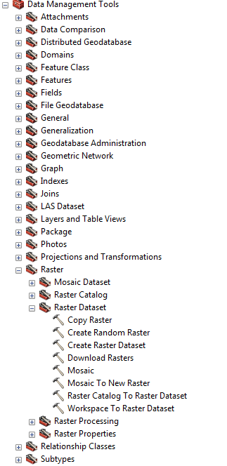
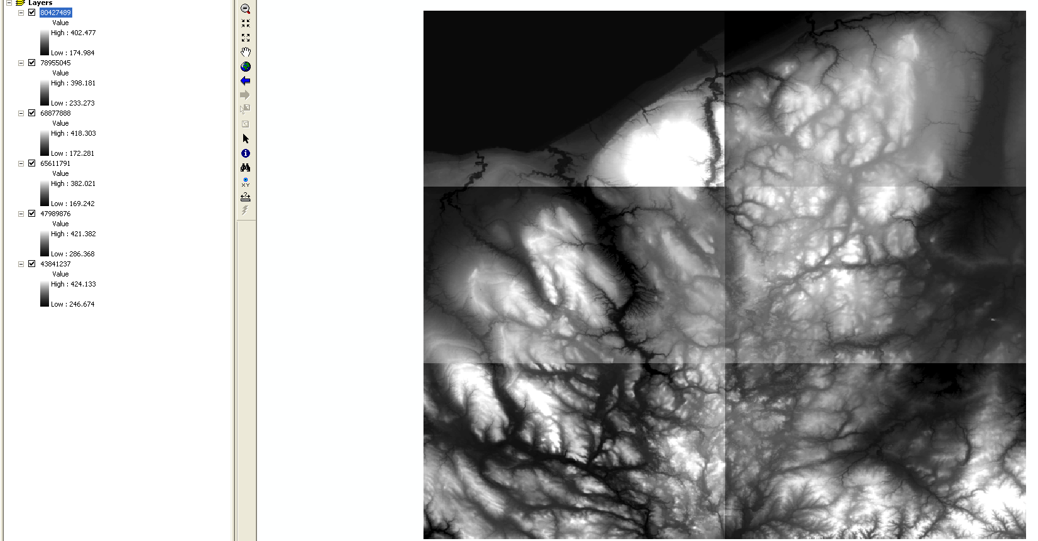
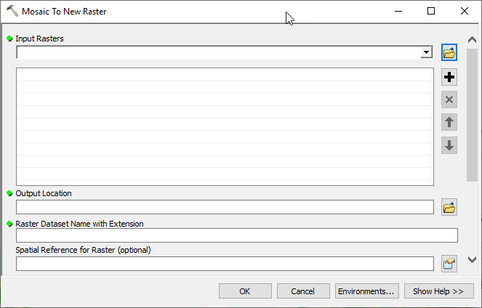
Mosaic Terrain Tiles
Consider Mosaic Operator options to choose overlapping rules
Notes:
At times, you watershed basin might be too large and will cover multiple terrain tiles. In that situation, you will need to stich the tiles together through a process called mosaic which you can do in GIS. We will have a terrain importer tool that will perform this in the near future (beta 2).
NED data will be broken up into tiles if file size is too large. The first step in preparing the data for delineation is to mosaic the tiles into one DEM.
Tools are available from ArcToolbox (Data Management → Raster toolbox).
If you want to use one raster in all areas and just fill in gaps with secondary or average raster values, this can be done with Mosaic Operator options

Slide 16
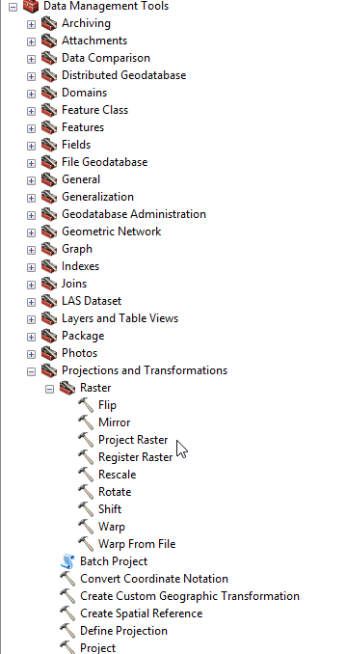
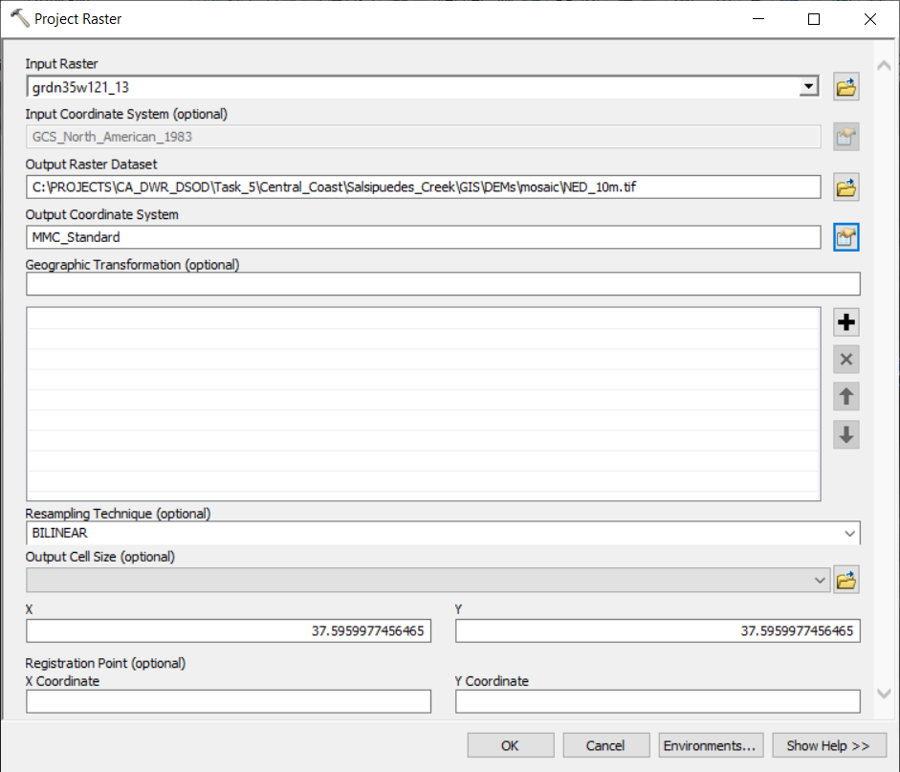
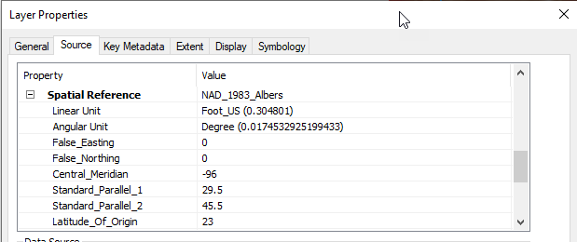
Project the Terrain Dataset
Notes:
The next step in preparing the DEM for delineation is to reproject the DEM to study coordinate system. Tools are available from ArcToolbox (Data Management → Projections and Transformations → Raster).
All data should be in the same projection to ensure all spatial operations run correctly. Recommended projections include: UTM, State Plane, and Albers-Equal Area. Also, horizontal units should be same as vertical units.

Slide 17
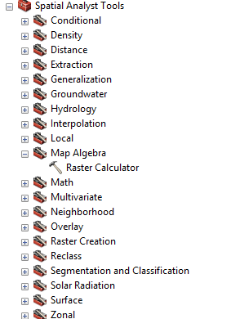
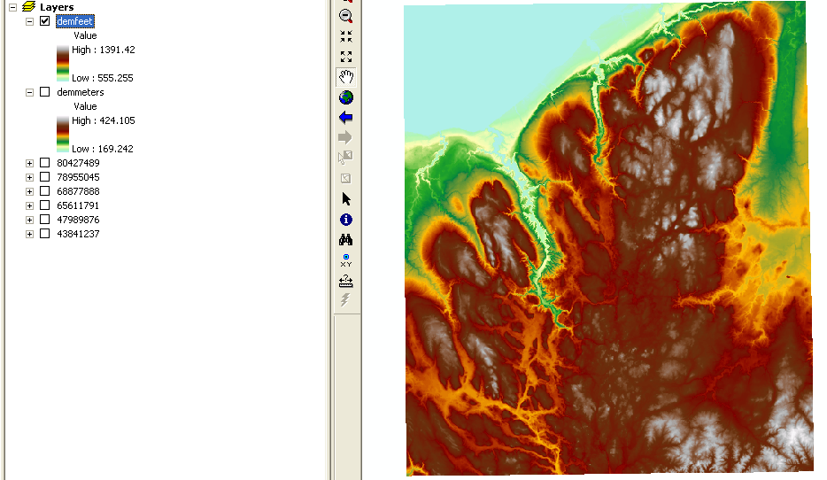
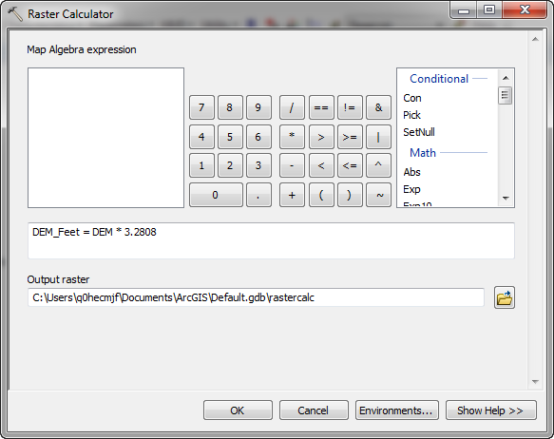
Modify the Vertical Units
Raster calculator only operates on elevation values, not horizontal units or cell size
Notes:
Use the Raster Calculator to convert the vertical units to feet (only if horizontal units are feet).

Slide 18
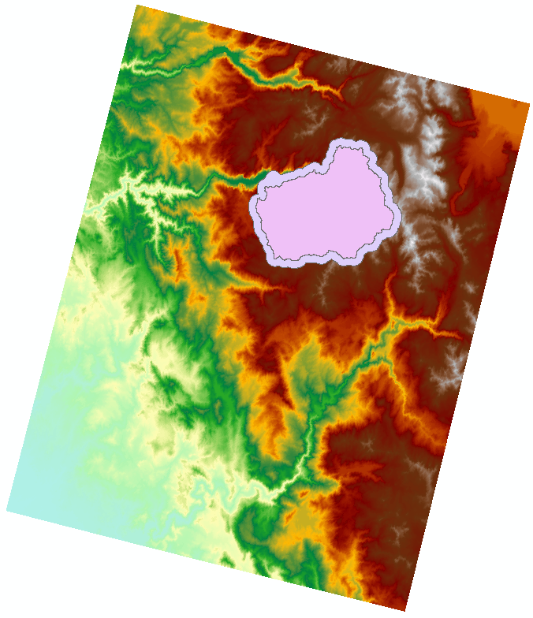
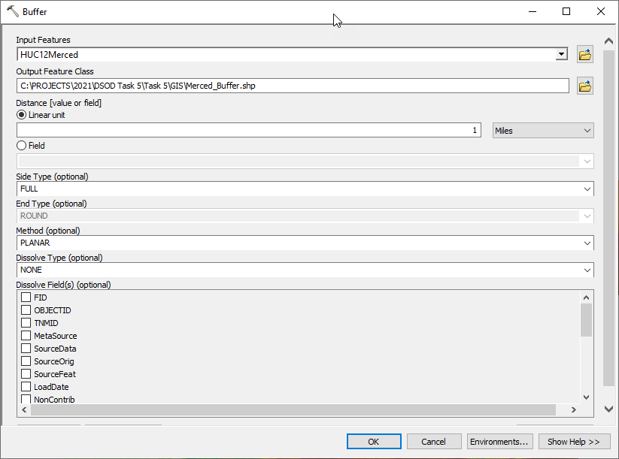
Buffer Watershed Boundary
Use an existing watershed boundary and buffer before extracting the terrain data
Or use a bounding box
Notes:
If you happen to have an existing watershed delineated, you can clip your DEM to the terrain but we suggest buffering the shapefile before clipping. This prevents any edge errors near the boundary of the watershed. This is a good strategy to reduce your file size.

Slide 19
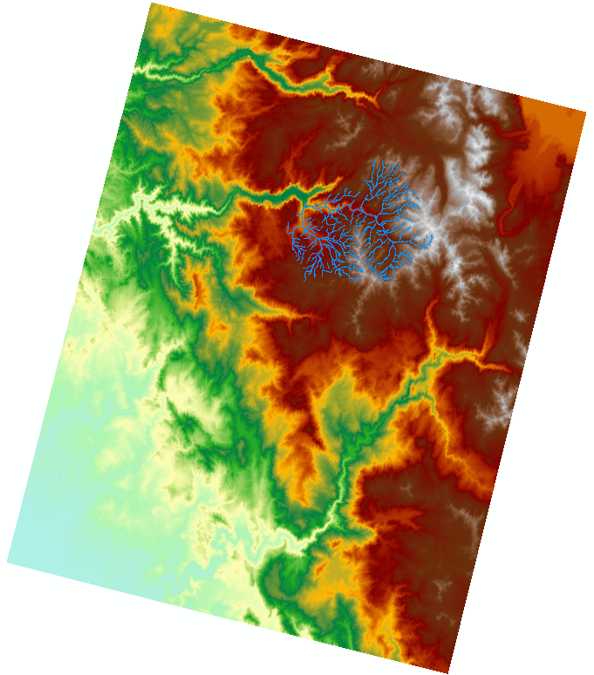
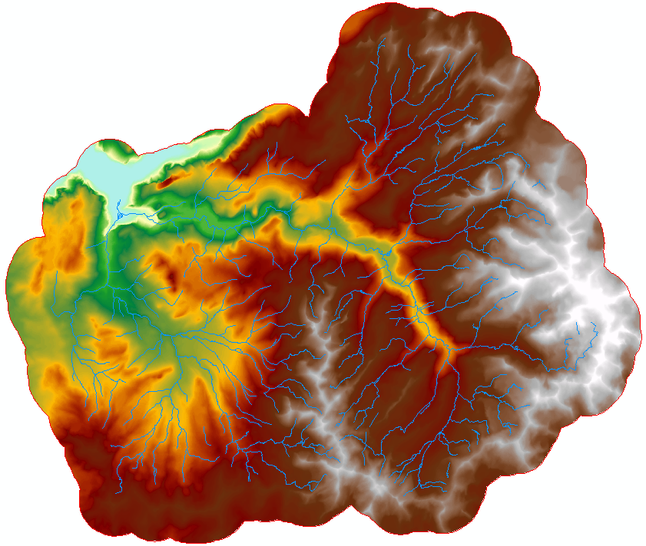
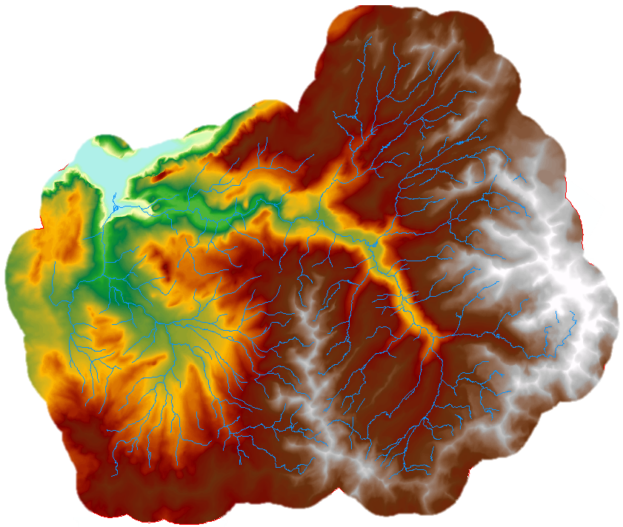
Clip/Extract the Terrain Dataset
446 MB Terrain File
Original Extract by Mask Clip
Notes:
Clip the grid to speed up processing time. This example uses the Subwatershed layer from the NHD dataset to set the bounds in the Clip tool (Data Management → Raster toolbox). The clip operation reduced the file size from 295 to 152 mb. The Mask tool is not the same as the clip tool. Mask keeps the same number of grid cells as the parent raster. It sets grid cell values outside of the mask to “no data”. Clip will remove all grid cells outside of the region of interest.

Slide 20
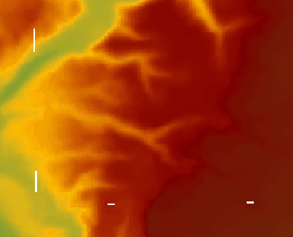
Check and Remove Missing Data
Fill in NoData cells with average value from neighboring cells with Raster Calculator
Identify no data cells: Con(IsNull ("dem"), 1, 200)
No data cells will have a value of 1, cells with a valid value will have a value of 200
Fill no data cells:
Con(IsNull(“dem”), FocalStatistics(‘dem’, NbrRectangle(3,3), “Mean”), “dem”) Fills in no data cells with the average of neighboring cells
Notes:
No Data cells need to be removed before using automated delineation tools. No data cells will prevent the tools from computing the drainage path.
No Data cells could be left over after mosaicking tiles (edges did not exactly line up) or they were part of the NED data.
When using the raster calculator, the following equation can be used. The statements tells the program to replace no data cells with the average grid cell value from a rectangle that is 3 grid cells by 3 grid cells and centered over the No Data grid cell.
Con(IsNull(“dem”), FocalStatistics(‘dem’, NbrRectangle(3,3), “Mean”), “dem”)

Slide 21
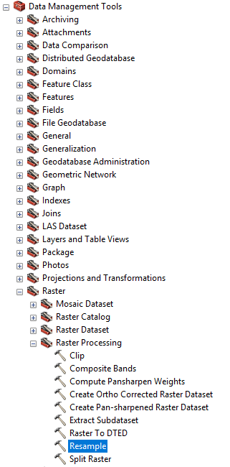
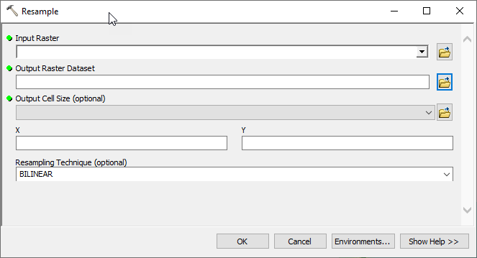
Modify the Terrain Dataset
If the file size exceeds 200 MB after Extracting by Mask or Clipping, then consider resampling to a larger grid cell size or converting to an integer grid
After modifying the terrain, use the Burn Streams and Build Walls tools to enforce the correct drainage
Notes:
We recommend trying to keep your terrain size low. Not always possible but it will make your delineation process smoother. One technique is to increase your grid size to a larger grid or to change your numeric type to integer (DEM elevations stored data as float)

Slide 22
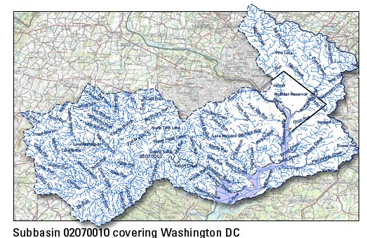
National Hydrography Dataset (NHD)
NHD contains digital spatial data for surface water
The data is contained in a geodatabase that has two feature datasets, one with water bodies and flow lines (Hydrography) and the other containing basin boundaries (WBD)
Surface water obtained from topo maps (1:100k and 1:24k)
http://nhd.usgs.gov/index.html
Notes:
One of the shapefiles you can use for burning streams and building walls is the NHD shapefiles. In this dataset, there are flow lines and watershed boundaries you can use to both burn streams and build walls.
I personally have not needed to do this often. In most cases, I can get by with the terrain but if the terrain is not delineating correctly, I would consider trying this technique.
Can download data from the NHD Viewer or from ftp site (ftp://nhdftp.usgs.gov/SubRegions/) using 4-digit HUC
Data layers are in geographic coordinate system (unprojected)
NHD data can be used to edit DEM
Important Layer: NHD Flowline and Watershed

Slide 23
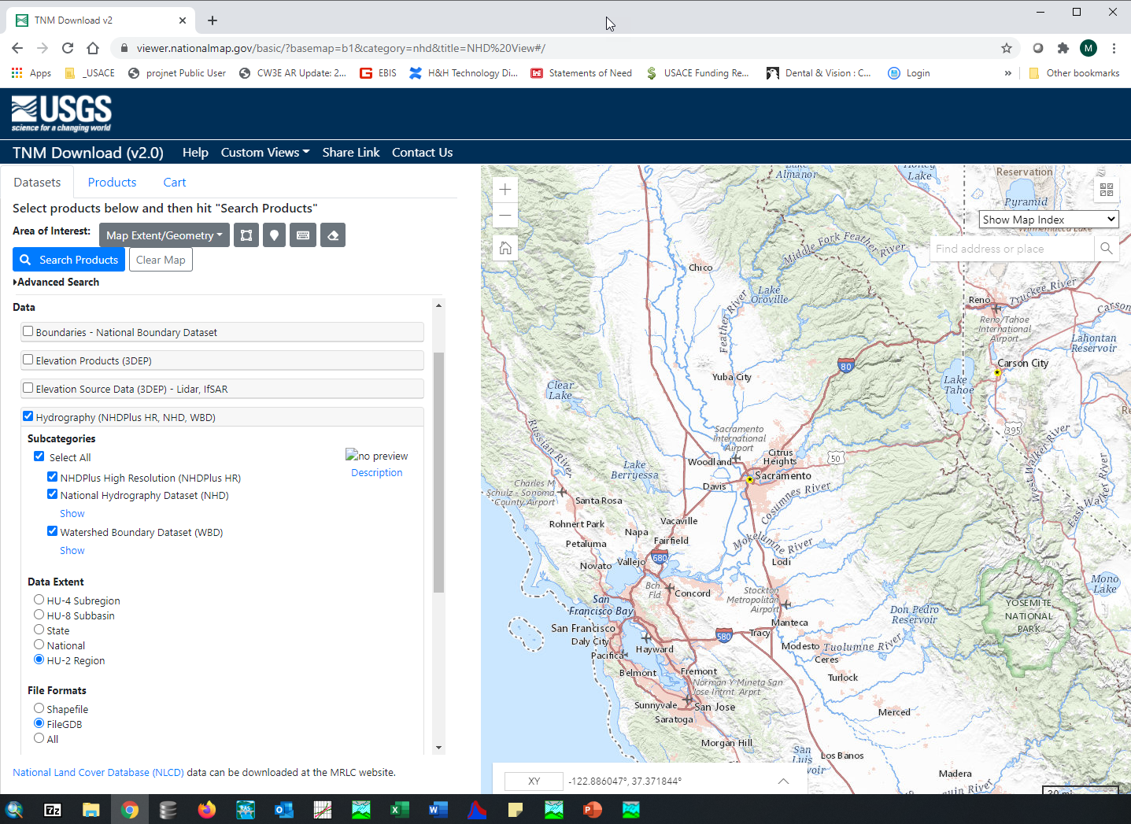
National Hydrography Dataset (NHD)
NHD files can be downloaded from The National Map Downloader in a Geographic Coordinate System (GCS)
Project the Stream and Watershed GIS layers
Edit/Clip the datasets for the watershed
Use these layers to burn streams / build walls
Notes:
The same website you used for terrain delineation can be used for NHD.

Slide 24
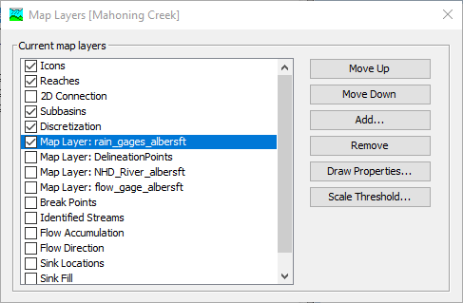
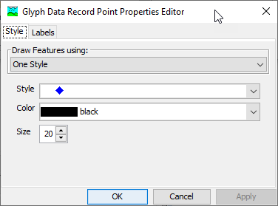
GIS Datasets
Add GIS Datasets (shapefiles) to the Basin Model Map by going to View -> Map Layers
GIS datasets should be in the same projection as the basin model
Use the Draw Properties Editor to edit the display properties

Slide 25
Outline
Georeference Elements using Shapefiles
Terrain Data and other Helpful GIS Datasets
HEC-HMS GIS Data Management
Building Walls and Burning Streams
Automated Subbasin and Reach Delineation
Customize Subbasin Reach Delineation
Element Naming and Connectivity
Subbasin Discretization
Notes:
This section is managing gis files you preprocessed in a GIS software into HMS and the gis files that are created in HMS and stored in the project directory.

Slide 26
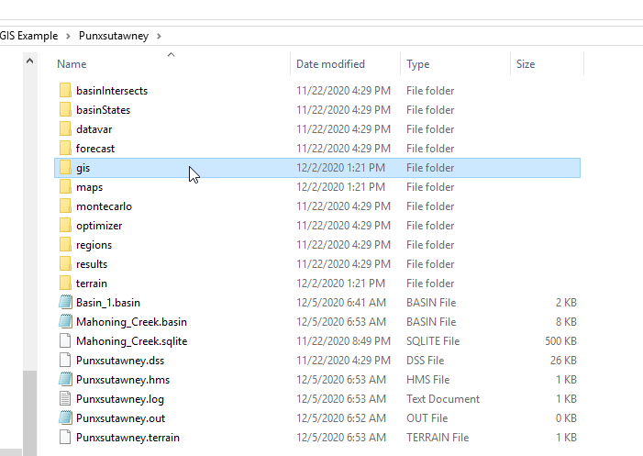
GIS Data Management
Manually add background shapefiles to the maps folder before adding them to a basin model (makes the files relative to the project)
HEC-HMS will save GIS files created during automated delineation to the gis folder
HEC-HMS will save terrain files to the terrain folder
The *.sqlite file contains information for georeferenced elements, including discretization
Typical HEC-HMS Project Directory
Notes:
This image shows the hms project directory. When you create an hms project, you will have this set of folders created.
With respects to gis files, any gis files you are bringing over to hms can be stored in the “maps” folder.
HMS will save gis files created into the gis folder
HMS will save terrain file in the terrain folder
There is this sqlite file that is automatically created that contains the georeferenced elements.

Slide 27
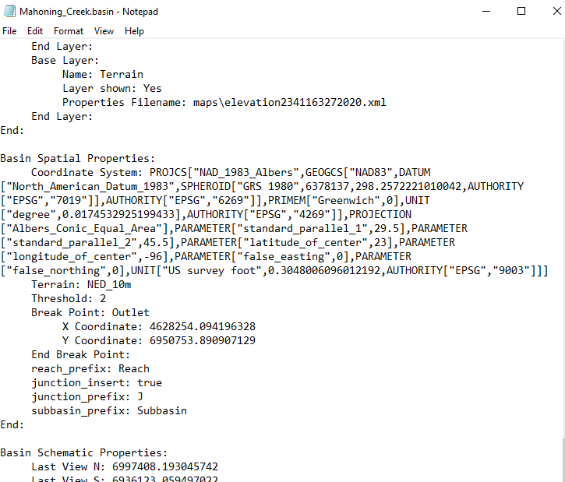
GIS Data Management
The *.basin file contains information about the coordinate system, user settings for delineation, and background map files
Notes:
The .basin file contains information on the coordinate system, user settings for delineation, and background map files.

Slide 28
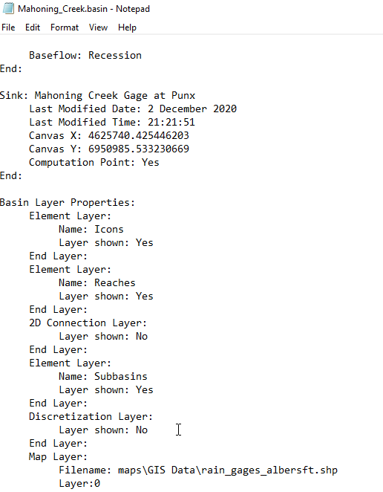
GIS Data Management
Information about the list of background layers added to the basin model map includes the location of the file
Using relative pathnames helps when transferring the project from one computer to another
Notes:
The background files are stored in the .basin file. Storing your shapefiles in maps will make sure your gis files are transferred when you share projects.

Slide 29
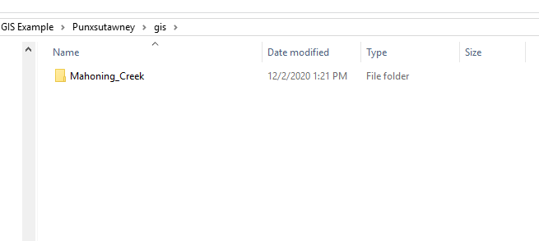
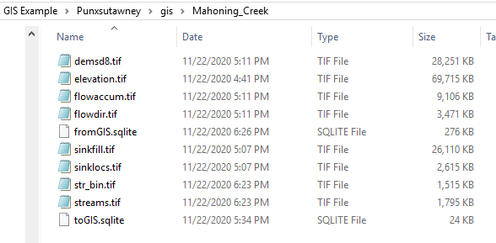
GIS Data Management
The gis directory is where HEC-HMS saves files created during the delineation process
elevation.tif – terrain layer converted to basin model’s projection
Other files are created during the preprocessing sinks and drainage, identify streams, and delineate elements steps
Notes:
Last thing on data management, the gis folder is where HMS saves its gis created data. You can regenerate these files pretty easily if you accidently delete them. When you are looking to save on file size, this is an option to delete but you will lose your delineation capabilities if you delete.
The elevation.tif file is created when you select a terrain grid for the basin model. HEC-HMS creates a copy of the terrain grid and projects the terrain file into the basin model's projection.
The sinkfill.tif and sinklocs.tif files are created with running the Preprocess Sinks tool.
The demsd8.tif, flowdir.tif, and flowaccum.tif files are created when running the Preprocess Drainage tool.
The str_bin.tif and streams.tif files area created when running the Identify Streams tool.
The fromGIS.sqlite and toGIS.sqlite files are created when running the Delineate Elements tool.

Slide 30
Outline
Georeference Elements using Shapefiles
Terrain Data and other Helpful GIS Datasets
HEC-HMS GIS Data Management
Building Walls and Burning Streams
Automated Subbasin and Reach Delineation
Customize Subbasin Reach Delineation
Element Naming and Connectivity
Subbasin Discretization

Slide 31
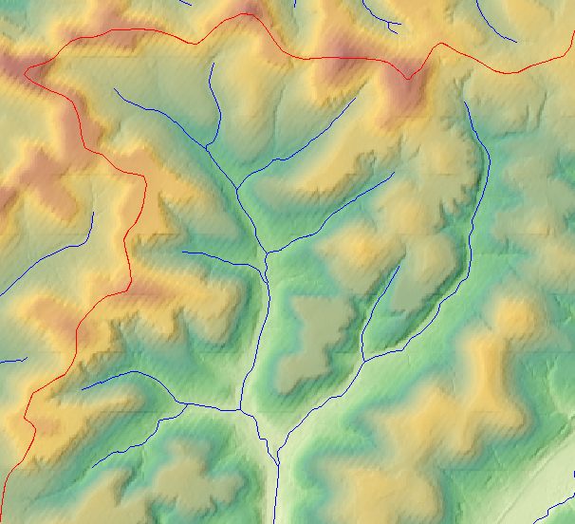
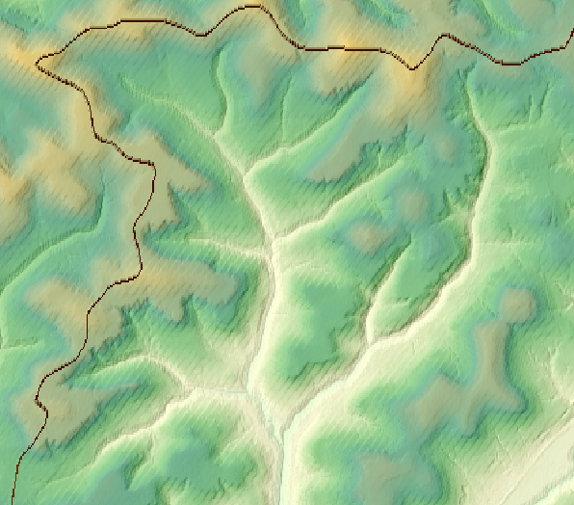
Building Walls and Burning Streams
Original Terrain with desired subbasin boundaries (red) and a stream network (blue).
Reconditioned Terrain.
Notes:
The Terrain Reconditioner consists of two steps. The first step is a build walls step and the second step is a burn streams step. The picture on the left represents an unaltered terrain dataset that is overlaid with two shapefile datasets. In this example the red shapefile represents HUC12 zones from the USGS’ watershed boundary dataset and it is used to build walls. The blue shapefile represents a stream network from the national hydrography dataset which is used for burning streams. The picture on the right represents what a reconditioned terrain might look like after using the Terrain Reconditioner tool. Notice how the elevations have been raised for the cells that intersected the red shapefile that was used to build walls. Also notice how the cell elevations that intersected the blue shapefile have been lowered to burn streams. Lastly, notice how the cells that were lowered for burn streams appear to transition smoothly to the unaltered cells. On the flip side, the cells that were raised for build walls appear to have a sharp transition. This is because a buffer was specified. More on that later. First let’s talk about a few scenarios where you might want to build walls and/or burn streams in your HMS model.

Slide 32
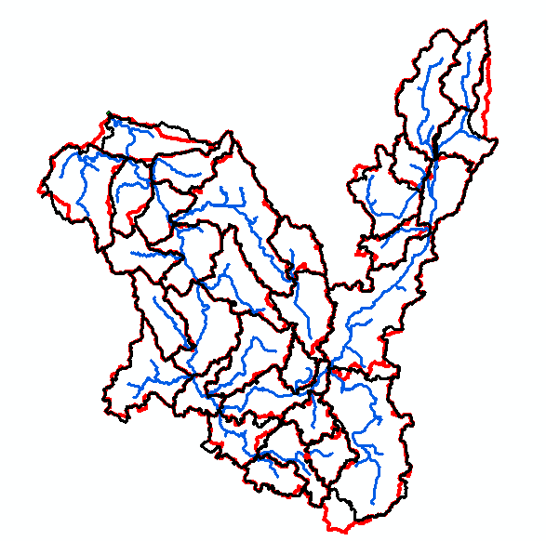
Building Walls and Burning Streams
Auto = 35.7
NRCS = 35.7
Automated delineation tools can result in subbasin boundaries and reach lines that do not match published information
The terrain reconditioning tool in HEC-HMS can be used to modify the terrain so subbasin and reach delineation better matches published information
This step is optional for delineation
Total
Auto = 809
NRCS = 798
Auto = 62.9
NRCS = 61.2
Auto = 17.9
NRCS = 17.8
Auto = 69.6
NRCS = 78.8
Notes:
Let’s talk about a scenario where building walls might come in handy. In this picture, the subbasin delineations outlined in Red are published, handdrawn subbasin boundaries from the NRCS. Those outlined in Black were generated by an automated GIS delineation tool using a 10meter digital elevation map. Notice how the published boundaries differ in a few of the subbasins. Let’s say that the hydrologic study you are involved in requires that your subbasins perfectly match the published NRCS data shown in red. This is a scenario where you could use the Terrain Reconditioner Build walls step in HMS. You could input the published watershed boundary data as a shapefile, raise the cell elevations that intersect the shapefile, and thereby force the delineations in HMS to match the published ones. What about a scenario where you might want to burn streams? Let’s say you want to use the 2D diffusion wave transform method in HMS to model how runoff moves over the terrain and collects at a subbasin outlet. But let’s say you have a coarse terrain data set that doesn’t fully capture the channel bathymetry. What you could do in this scenario, is use the Terrain Reconditioner Burn streams step by inputting a shapefile that represents the stream network, specify a smooth buffer, and gradually lower the cells that fall under or near the intersection of the shapefile.

Slide 33
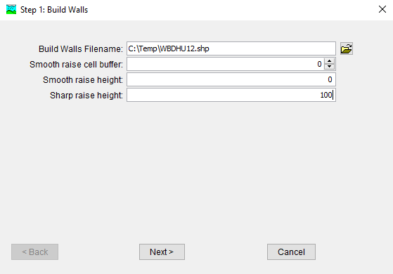
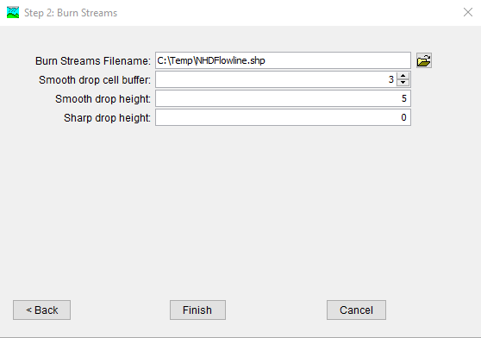
Building Walls and Burning Streams
Notes:
The Terrain Reconditioning is part of the GIS workflow in HMS, but it is optional. It can often times be skipped altogether, but as we saw in the previous slide there are several scenarios where it can be useful. The first step of the Terrain Reconditioning wizard allows you to build walls. If you only desire to burn streams, you can leave the build walls inputs blank and skip to the second step of the wizard. Unless you desire to skip a step, a shapefile path must be specified. You can specify a smooth buffer and elevation adjustment, a sharp elevation adjustment or both. As we discussed earlier, if your goal is to force the HMS subbasin delineations to match an existing dataset, then only a sharp raise height is necessary when building walls. For many cases, buffering and smooth height elevation adjustments are most applicable if you wish to burn streams. Let’s take a closer at smooth elevation adjustments compared to sharp elevation adjustments.

Slide 34
Burning Streams with a Smooth Drop
5 ft
Buffer = 2 cells
Smooth drop = 5 ft
Notes:
This slide shows a cross-section of a terrain dataset near a channel. The black dot represents a stream shapefile going into the screen and the solid orange line represents the original unaltered elevations at this cross-section. The gridded blue rectangle represents the cells of a raster dataset. The picture on the right is an illustration of what happens with the terrain reconditioner burn streams step. In this case, the use has specified a streams shapefile, a smooth buffer of 2 cells, and a smooth drop of 5 feet. The program lowers the elevation of the cell directly below the stream line the 5 feet distance and then gradually lowers the other cells within the buffer so that there is a smooth transition to the existing grade of the cross section.

Slide 35
Burning Streams with a Sharp Drop
5 ft
Sharp drop = 5 ft
Notes:
Again, this slide shows a cross-section of a terrain dataset near a channel. Only this time, the picture on the right is an illustration of what happens with the terrain reconditioner burn streams step when only a sharp drop is specified. The program lowers the elevation of the cell directly below the stream line the 5 feet distance and that’s it. No buffering operation is performed.

Slide 36
Burning Streams with a Smooth and Sharp Drop
5 ft
1 ft
Buffer = 2 cells
Smooth drop = 5 ft
Sharp drop = 1 ft
Notes:
If you wish, you can specify a smooth and a sharp elevation adjustment with the Terrain Reconditioner tool. The program will compute the smooth adjustment first, and then the sharp adjustment will be in addition to the smooth adjustment. So if you have a smooth drop of 5 feet and a sharp drop of 1 foot, the total drop underneath the stream line would be 6 feet.

Slide 37
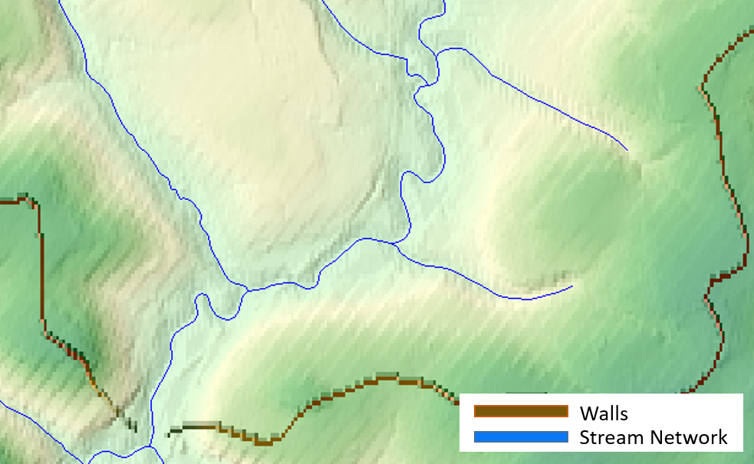
Building Walls and Burning Streams
Notes:
Let’s talk about what happens where walls and streams intersect. If both build walls and burn streams inputs are entered into the terrain reconditioning wizard, the burning of streams will breach the walls near intersections which is what you want to occur. This breaching operation ensures that all cells within the reconditioned terrain drain properly. If you desire to build walls but do not wish to burn streams, I would highly recommend that you input a burn streams filename but leave the other burn streams inputs at 0 so that your walls are breached at the subbasin outlets. The reason being is that the next step in the HMS GIS workflow is filling sinks. If your walls are not breached, the fill sinks step will essentially backfill the elevations behind the walls until all the cells drain to the outlet. This will result in GIS computations that take longer and can possibly produce some erroneous results.

Slide 38
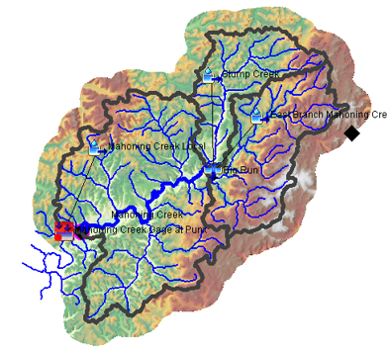
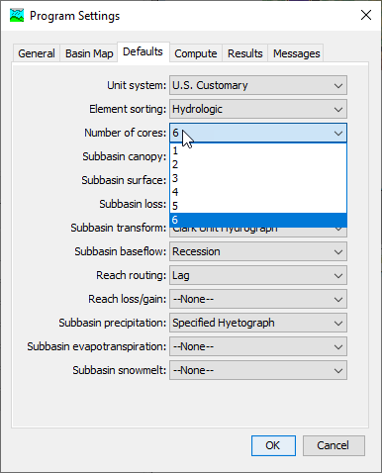
Tips for Building Walls and Burning Streams
Smaller buffers result in faster run times.
Clip geospatial data to your modeling domain.
Take advantage of your CPU’s cores. The default settings can be changed by clicking Tools|Defaults.
Make sure the stream layer extends outside of the terrain – water needs to flow off the terrain.
Notes:
This last slide highlights a few additional tips for building walls and burning streams. And really these apply to the whole GIS workflow in HMS. Smaller buffers result in faster run times. The program will allow you to input large buffers, but these are often not necessary. In the case of building walls, a buffer is not really needed at all. A sharp raise will suffice and is much quicker. Clip geospatial data to your modeling domain. This is very important for decreasing file sizes and GIS compute times in HMS. As demonstrated in this model image, it is recommended to create a buffered polygon slightly larger than your area of interest. Clip the terrain data to the buffered polygon as well as any shapefiles that you might use for building walls or burning streams. Lastly, take advantage of allowing HMS to utilize multiple cores. This can help to significantly decrease computation speeds. Alright. That wraps up this lecture on Building Walls and Burning Streams in HMS. Happy Modeling!

Slide 39
Outline
Georeference Elements using Shapefiles
Terrain Data and other Helpful GIS Datasets
HEC-HMS GIS Data Management
Building Walls and Burning Streams
Automated Subbasin and Reach Delineation
Customize Subbasin Reach Delineation
Element Naming and Connectivity
Subbasin Discretization
Notes:
The next few slides are discussing how the delineation process works.

Slide 40
HEC-HMS GIS Tools
TauDEM GIS library is used to define the flow direction, flow accumulation, and stream grids
The user defines the stream threshold
A default delineation is performed
Tools are available to customize the delineation by merging elements or splitting subbasins and reaches
Notes:
This slide shows the HEC-HMS GIS menu. The delineation process is streamlined for the HEC-HMS workflow. Using the DEM, the flow direction and accumulation are computed using TauDEM (David Tarboton from Utah State). Then streams are identified based on a user defined threshold. Elements are delineated based on the stream threshold and then split and merge options are available for customization.

Slide 41
Automatic Delineation
78
69
71
58
72
71
4
4
4
5
5
74
67
56
49
46
4
4
4
5
5
8-point pour model
69
53
44
37
38
3
3
4
5
6
8
1
2
64
58
55
22
31
2
2
3
4
5
68
61
47
21
16
2
3
3
3
5
7
3
Digital elevation model (DEM)
Flow direction grid
6
5
4
Flow direction codes
0
0
0
0
0
0
1
1
2
1
0
3
8
5
2
0
1
0
19
0
(2 cells +1 cell)
+ (1 cell+1 cell) = 5 cells
0
0
1
2
24
Flow accumulation grid
Stream Network
Notes:
The delineation method uses this 8-point pour model which is used to determine the direction where water moves. The top left shows the elevation. The top right shows the direction of highest gradient at each cell. Bottom left shows the flow accumulation that happens. Flow accumulation is the number of cells that has accumulated up to that cell location. Bottom right shows the stream network as a result of the flow accumulation.

Slide 42
Automatic Delineation
0
0
0
0
0
0
1
1
2
1
0
3
8
5
2
0
1
0
19
0
0
0
1
2
24
Flow accumulation grid
Stream Network
How many subbasins and reaches would be delineated if the stream threshold was set to 3 cells?
Notes:
To answer this question, you would need the stream network and the flow accumulation grids. The initiation of the stream network will start at cell with a flow accumulation of at least 3. Anything above 3 is a stream. A subbasin delineation will happen at stream segments. We end up creating 3 segments at the confluence/junction.

Slide 43


Define the Terrain Data
Use the Terrain Data Manager to add a new Terrain Dataset to the project
Select the source DEM file (many formats are supported) and choose the vertical units
HEC-HMS will add the terrain dataset to the Watershed Explorer
Notes:
To bring terrain data into the hms project, you go to the Terrain Data manager.
The source DEM is the DEM raster that you have downloaded, projected and pre-processed in ArcMap, ArcPro or QGIS -> save in \maps directory
The Terrain Dataset is the terrain file created by HMS -> HMS will save in \terrain directory

Slide 44



Define the Coordinate System
There are three ways to define the coordinate system:
Choose from a predefined system; UTM or Albers projections
Choose an existing projection file with well known text
Use the terrain data’s projection
Notes:
There are three ways to define the coordinate system of your hms project. To clarify, there is the DEM coordinate system and theres the project coordinate system. They can be different but we highly recommend you choose one coordinate system. For your project coordinate system, you can define it in three ways.
Standard Hydrologic Grid is the coordinate system developed by Albers equal-area conic map projection on NAD83 datum commonly used for HMS models

Slide 45


Choose a Terrain Dataset for the Basin Model
Once the projection has been defined and the terrain data selected, the terrain is displayed in the basin model map
The draw properties for the terrain can be modified from the Map Layers editor
GIS delineation tools can now be applied to the terrain data
Notes:
Once you have the terrain data projected, you can see the terrain in HMS. You can toggle the DEM on or off from View -> Map Layers. You can start performing delineations

Slide 46

Preprocess Sinks
Preprocess Sinks automatically fills in low spots in the terrain that prevent water from flowing across the terrain
A Sink Fill terrain layer is created, this is the hydrologically corrected DEM
A Sink Location raster is created showing the locations of the sinks and amount of fill needed
Notes:
There is a preprocessing step called Preprocess sinks. This essentially fills in sinks or depressions that exist within the basin. The point of this is so water can continuously move downstream to your outlet and not get stuck at a sink during the flow accumulation process. Even if the sink is real, you still want to fill in the sinks so you can perform your delineation without any issues. This process will create a “hydrologically corrected DEM” (its not the real terrain) and also the sink locations. HMS is not able to handle sinks. This is not a 2d model like HEC-RAS. If the sink is significant, you can model the sink as a reservoir or you would need to use RAS.

Slide 47

Preprocess Drainage
Preprocess Drainage runs the flow direction and flow accumulation processes
New grid layers are added to the project and displayed in the basin model map
The flow accumulation grid shows the detailed stream network
Notes:
The next processing steps are Preprocess Drainage. This creates the flow direction grid and flow accumulation grids. We need the flow direction to figure out where the cells are moving and the flow accumulation is how many cells upstream are moving to the cells downstream.

Slide 48


Identify Streams
The user must define the drainage area threshold for initiating a stream segment
Once the drainage area exceeds the threshold, the program will identify a stream segment
A new stream segment is identified when there is a confluence
A subbasin will be created for the drainage area of each stream segment
Notes:
Next is to identify a stream. You need to set the threshold to create a stream, which in turn will determine how many subbasin and reaches will get created. In the pervious example, we used number of flow accumulation cells. In the interface, we define the drainage area for a stream to initiate. Once the drainage area exceeds the threshold, then a stream will initiate. This process still uses the flow accumulation grid to determine the stream threshold but looks at the drainage area. The smaller the threshold, the more stream segments and subbasins will be created. The larger the value, the less stream segments and subbasins will be created. This value can be updated. If you don’t like the number of subbasins and stream segments created, you can update the number.

Slide 49


Break Points
Break points are used to define the outlet of the basin model and locations where the user knows a subbasin outlet is required, like at a gage or reservoir location
The break point must be added so that it falls on top of the identified streams layer
Use the break point creation tool and click within the basin model map to add a new break point
Break Points Manager – use GIS layer to define break points and snap to stream cell grids
Notes:
Breakpoints are the outlet of the basin. In most cases, the outlet is a stream gage or a reservoir or the index location to pass off your outputs to another model.

Slide 50


Delineate Elements
Delineate Elements will create the default element network (based on the stream threshold)
There are options to set prefix names for subbasins, reaches, and junctions
Insert junction elements between subbasin and reach elements is a user option
Converting break points to computation points is a user option
Notes:
Once you have your break points, you can click the delineate elements to begin your watershed delineation.

Slide 51
Outline
Georeference Elements using Shapefiles
Terrain Data and other Helpful GIS Datasets
HEC-HMS GIS Data Management
Building Walls and Burning Streams
Automated Subbasin and Reach Delineation
Customize Subbasin and Reach Delineation
Element Naming and Connectivity
Subbasin Discretization
Notes:
Next, we will discuss how to customize your subbasin and reach delineation.

Slide 52


Merging Subbasin and Reach Elements
Subbasin and reach elements must be adjacent in order to merge
Select the elements to merge in the watershed explorer or through the basin model map
Two or more elements can be merged at one time
The program automatically names the new element
Notes:
We talked about how delineating your watershed into subbasin automatically happens based on the stream area threshold. The smaller the area, the more subbasins that will appear. You don’t need to keep iterating on the threshold area to get the right number of basins. You can perform post processing of the watershed by splitting or merging your basins.
In order to merge, your subbasins need to be adjacent to one another. Select the elements of the same type to merge through the basin map. You can merge more than two elements at once.

Slide 53


Hydrologically Adjacent
Will Not Merge
Will Merge
Notes:
Hydrologically adjacent is not the same as “next to each other”. On the left, you have subbasins next to each other but these will not merge. There needs to be a hydrologic connection where flows upstream can be passed downstream.

Slide 54

Merging Subbasin and Reach Elements
Check reach elements after merging subbasin elements
HEC-HMS will automatically delete reach elements when merging headwater subbasins
There can be multiple reach elements segments in interior subbasins, these can be merged
Four reach segments in this interior subbasin
Notes:
Reach element will not be merged automatically when you merge subbasins although headwater reaches will be removed

Slide 55


Split Subbasin and Reach Elements
New subbasin and reach elements can be added using the Split Element tool
First, select an element in the basin model
Then, select the Split Element option on the GIS menu
Zoom into the location where the split will occur and click on an existing identified stream grid cell (or on a stream identified in the flow accumulation grid)
Notes:
You can do the opposite of merging and split subbasins with the Split Element tool. Split happens only on an identified stream. Use flow accumulation grid to help with defining the break point.
Similar to placing break points, zoom into the basin model so that the split element location falls on a stream grid cell

Slide 56

Split Subbasin and Reach Elements
A temporary GIS feature will show the results of the split
Accept the action and a new subbasin and reach elements will be added to the project
A new junction will be added if that option was selected when initially delineating the network

Slide 57
Split Subbasin and Reach Elements
The split point should fall on top of the Identified Streams layer or on top of a “stream” identified in the flow accumulation grid
You can change the drainage threshold and re-run the Identified Stream step if additional stream coverage is needed

Slide 58


Split Subbasin and Reach Elements
The Identified Streams layer does not have to extend through the gage location
Can also use the flow accumulation grid to determine stream location
Notes:
However, you can also use the flow accumulation grid to split subbasins without rerunning the drainage area threshold

Slide 59


Split Subbasin and Reach Elements
HEC-HMS will add a new subbasin element with an outlet at the split subbasin point

Slide 60

Split Subbasin and Reach Elements
Split works on reaches too
Zoom in and make sure you click on a reach line

Slide 61
Outline
Georeference Elements using Shapefiles
Terrain Data and other Helpful GIS Datasets
HEC-HMS GIS Data Management
Building Walls and Burning Streams
Automated Subbasin and Reach Delineation
Customize Subbasin Reach Delineation
Element Naming and Connectivity
Subbasin Discretization

Slide 62

Renaming Basin Model Elements
Rename basin model elements after the delineation process is complete
Right click on an element name in the Watershed Explorer and choose the Rename… option
Use descriptive names for elements; GIS actions can still be applied after elements are renamed
A global rename option is available by right clicking on the basin model name in the Watershed Explorer and choosing Rename Basin Elements

Slide 63


Renaming Basin Model Elements
Descriptive names will aid others in applying the model
Use stream names, gage names, town names and other descriptions that are familiar
For larger models, incorporate a numbering system – Mahoning Creek S10

Slide 64


Hydrologic Element Connectivity
Quickly check element connectivity
Resort elements hydrologically from the Watershed Explorer
Select elements from upstream to downstream to verify connectivity

Slide 65


Check Drainage Area
Verify subbasin area matches published information
Use the global editor

Slide 66
Outline
Georeference Elements using Shapefiles
Terrain Data and other Helpful GIS Datasets
HEC-HMS GIS Data Management
Building Walls and Burning Streams
Automated Subbasin and Reach Delineation
Customize Subbasin Reach Delineation
Element Naming and Connectivity
Subbasin Discretization

Slide 67

Subbasin Discretization
The Discretization method divides subbasin elements into smaller units
The “None” method implies basin average modeling
Gridded meteorologic and subbasin methods required either the Structured or Unstructured methods
The File-Specified method is required to link to the older *.Mod file format or to link to the new structured and unstructured files
Notes:
Subbasin discretization is breaking your model into grids or meshes. This is a way to perform distributed modeling where you can account for the spatial variations in the basin. We make it really easy to set up a distributed model when you delineate your watershed within HMS.

Slide 68
Subbasin Discretization
The Structured discretization method is used to generate a SHG or UTM grid
The Unstructured discretization method is used when importing a 2D mesh from HEC-RAS
Notes:
A note about projections: if you can, try to keep your projections consistent (project basin, terrain, your gridded data, and your mesh).

Slide 69


Subbasin Discretization
Structured Discretization
Choose the Projection, SHG or UTM
Choose the Cell size (50, 100, 200, 500, 1000, 2000, 5000, or 10000)
The program will Compute the structured grid, cell area, and travel length
Travel length is computed as the average value per grid cell using the flow direction grid and computed flow paths
Notes:
2000 m is default

Slide 70

Subbasin Discretization
The discretization method can vary between subbasins in a basin model
HEC-HMS can display the discretization, turn on the Discretization layer from the Map Layers editor

Slide 71

Subbasin Discretization
Projects where the delineation was already completed outside of HEC-HMS can take advantage of the Structured discretization method:
Georeference the subbasin elements
Load a terrain dataset
Run the Preprocess Sinks and Drainage steps (create the flow directions grid)
Choose the Structured Discretization specifications and run the compute grid cells tool

Slide 72
HEC-HMS GIS Delineation Tools

Slide 73

Georeference Existing Elements
Georeferencing only subbasin elements results in a basin model like the one in this figure. Reach and junction elements will remain in the original location while the subbasin elements/icons will move to the polygon locations from the shapefile
You can manually move the reach and junction elements
Or run Georeference Existing Elements again and georeference the reach elements

Slide 74

Results from Importing Georeferenced Elements
Basin Model Map and Watershed Explorer show elements connected upstream → downstream

Slide 75
Terrain Data and other Helpful GIS Datasets
Notes:
Terrain data, rain gage points, NLD flow lines

Slide 76
HEC-HMS GIS Data Management

Slide 77
Building Walls and Burning Streams
Notes:
Hey there HMSers. My name is Josh Willis from the Corps of Engineers Fort Worth District. In this video, we are going to cover the Terrain Reconditioner in HMS that just became available with version 4.8. What this tool allows us to do is to alter terrain data by either building walls and/or burning streams. Before we get into the nitty gritty, let’s take a look of what a reconditioned terrain file might look like.

Slide 78
Automated Subbasin and Reach Delineation

Slide 79
Customize Subbasin and Reach Delineation

Slide 80
Element Naming and Connectivity

Slide 81
Subbasin Discretization

