Slide 1
Modeling Baseflow in HEC-HMS
Hydrologic Modeling with HEC-HMS
November 2024
Avital Breverman, P.E.
US Army Corps of Engineers
Hydrologic Engineering Center

Slide 2
Objectives
Describe how interflow and baseflow/groundwater flow are simulated in HEC-HMS
Provide an overview of the available baseflow methods within HEC-HMS
Discuss the applicability of baseflow methods within HEC-HMS

Slide 3
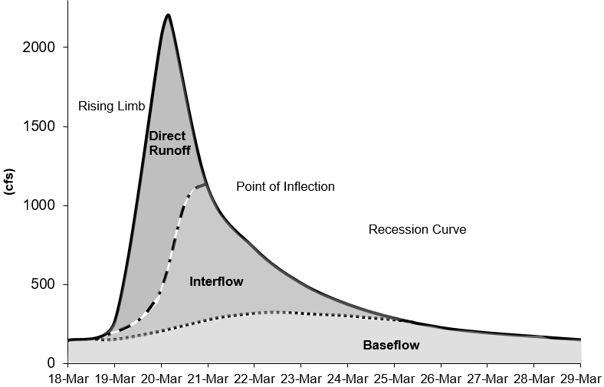
Baseflow in HEC-HMS
Direct runoff → flood magnitude (typically)
Baseflow → runoff volume and duration
Baseflow is comprised of runoff that infiltrates into the ground, flows down gradient, and then flows back onto the land surface in small channels, streams, and rivers.
Baseflow in HEC-HMS includes interflow and baseflow (or saturated groundwater flow).
Notes:
Runoff hydrograph – flow measured at a gage with time.
Direct runoff accounts for the flood magnitude. Baseflow is an important process to consider for modeling runoff volume.
Baseflow is comprised of runoff that infiltrates into the ground, flows down gradient, and then flows back onto the land surface in small channels, streams, and rivers.
Baseflow in HEC-HMS includes interflow and baseflow (or saturated groundwater flow). There are different paths water takes when moving through the ground.
Baseflow important for total volume and duration
Interflow – unsaturated that hits surface and flows in surface channels
Baseflow – saturated underground flow, which is much slower
There are different paths water takes when moving through the ground.
Research using isotopes have distinguished hydrographs as “Event” water or “Pre-event’ water. Hydrograph has still been typically divided into three components (event water, soil water, groundwater).

Slide 4
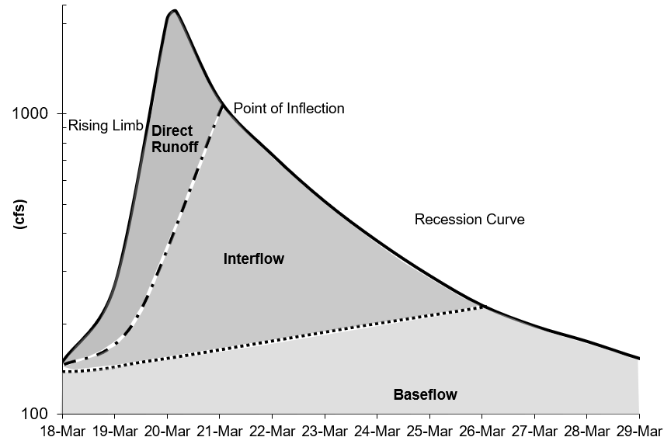
Baseflow in HEC-HMS
Modeling approaches:
  Process-based
  Conceptual (currently: HEC-HMS methods)
Identifying baseflow contributions from hydrographs:
  Point of inflection
  Plotting the hydrograph in log10 space
Notes:
HMS models baseflow conceptually and not process based. We don’t use ground water model to compute our baseflow values. Just like how we don’t use the full momentum equation for routing flow, we can do a pretty decent job at simulating baseflow using conceptual methods.
There have been all kinds of techniques for separating baseflow:
Point of inflection (when the recession curve transitions from concave down to concave up) is where direct runoff is replaced by groundwater flow components.
Plotting the hydrograph in log space shows different baseflow contributions, based on changes in slope on the recession curve.

Slide 5
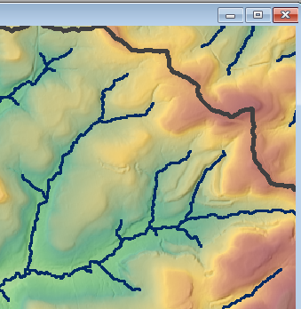
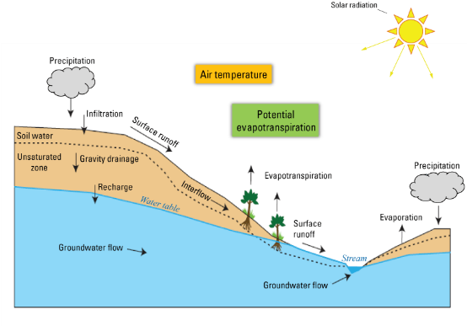
Interflow
    Interflow is where the infiltrated water travels to a stream above the groundwater level (unsaturated zone). The response time for interflow is longer than surface runoff.
Notes:
There is an impeding shallow layer where infiltrated water moves down gradient. Interflow is slower than surface runoff. Some research has suggested interflow only contributes to the streamflow from the lower portions of the hillslope.

Slide 6
Baseflow/Groundwater Flow
Baseflow is where the infiltrated water percolates to a groundwater layer. The groundwater layer will contribute to stream flow when it is high enough. The response time for baseflow is longer than interflow.
Notes:
Water that falls on the basin infiltrates past the shallow layer. This flow is much slower than surface runoff or interflow. This flow could take months before it reaches the stream (if ever).

Slide 7
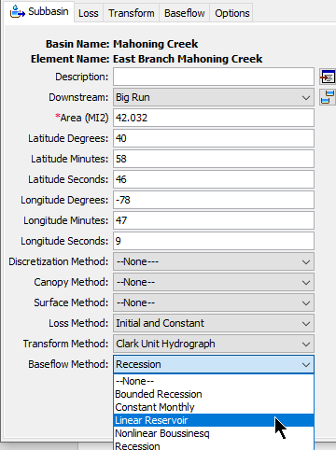
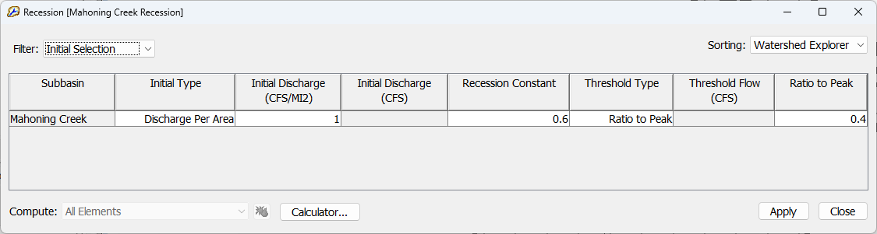
HEC-HMS Baseflow Methods
The Baseflow Method can be selected for each subbasin element (using the Component Editor) or it can be selected using the global change methods tool from the Parameters menu.
Baseflow parameters can be entered from the subbasin element Component Editor or from Global editors.
Notes:
Within the UI, the baseflow method can be selected from the subbasin element.
Enter baseflow parameters from subbasin element tab or from global editor
The Baseflow Method can be selected for each subbasin element (using the Component Editor) or it can be selected using the global change methods tool from the Parameters menu.

Slide 8
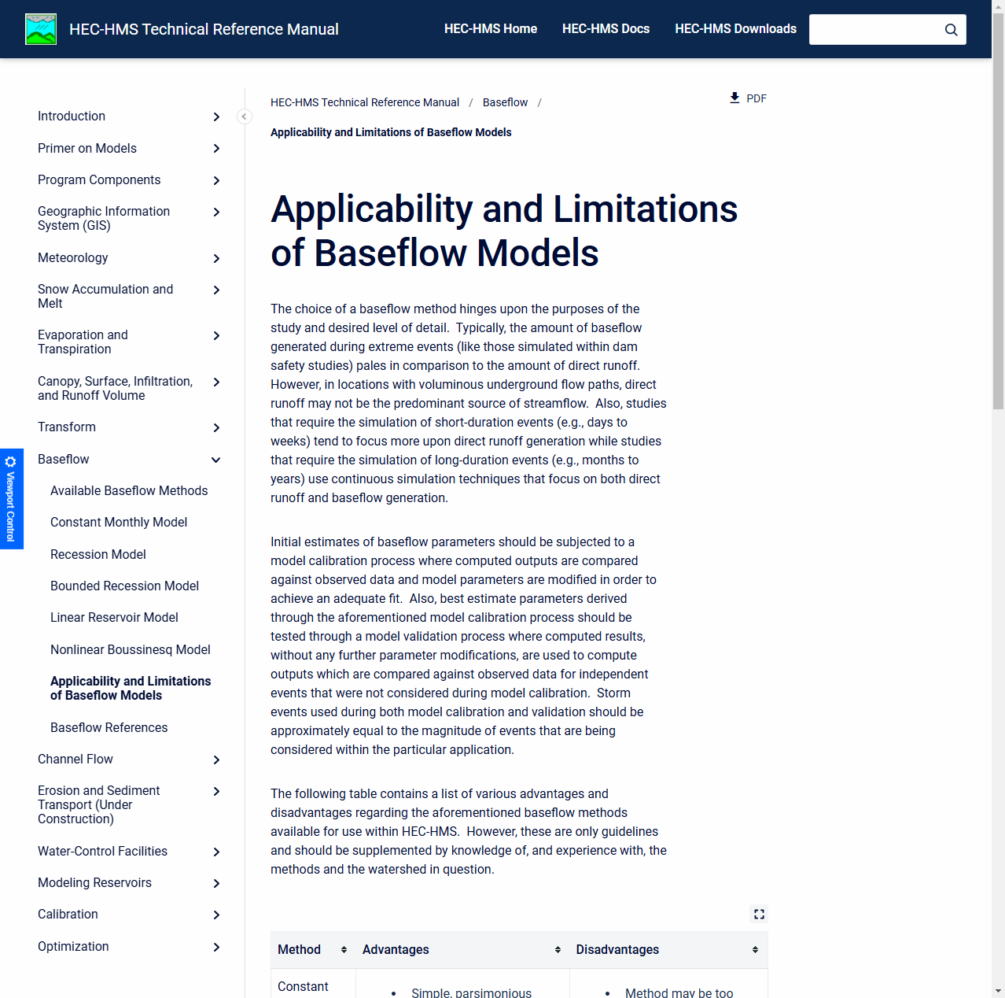
HEC-HMS Baseflow Methods
The HEC-HMS baseflow methods are conceptual.
  Calibration is key
5 Baseflow Methods:
  Constant Monthly
  Recession
  Bounded Recession
  Linear Reservoir
  Nonlinear Boussinesq
The Linear Reservoir method is the only method to conserve volume.
Notes:
Methods are conceptual. You need to calibrate the values
Linear Reservoir method conserves mass. The other baseflow methods do not.
The other baseflow methods could result in runoff volume exceeding precipitation volume.

Slide 9
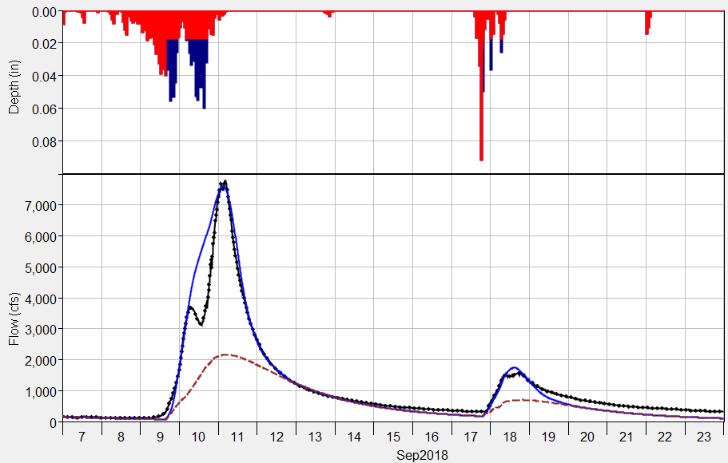
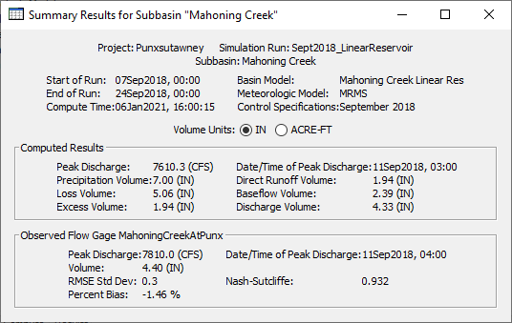
HEC-HMS Baseflow Methods
Baseflow results are displayed in plots and tables for Subbasin elements only.
You can access individual time-series from the Watershed Explorer’s Results tab.
Computed Total Flow
Computed Baseflow
Observed Flow
Notes:
Baseflow results are displayed in plots and tables for Subbasin elements only.
Subbasin plots show the computed runoff (total flow) and the baseflow hydrograph.
Summary tables show baseflow volume.
You can access individual time-series from the Watershed Explorer’s Results tab.

Slide 10
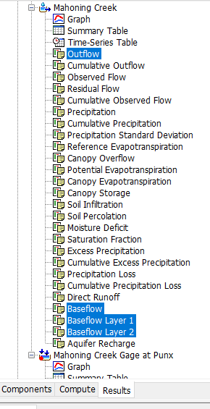
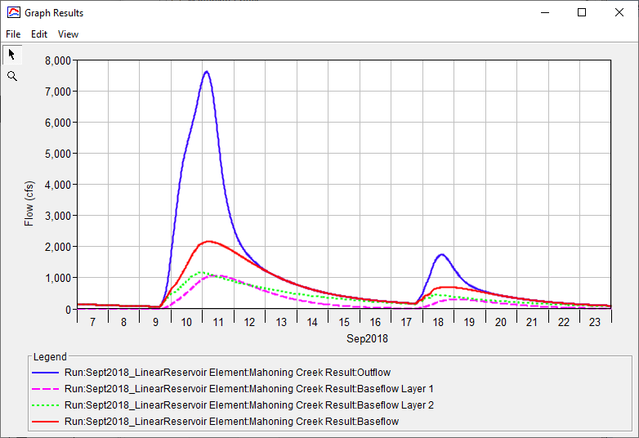
Viewing Results
Notes:
This shows what you can see from the Results tab.
This is an example of the Linear Reservoir baseflow method. There are different layers for this method which you can see the results separately for each layer.

Slide 11
Recession Baseflow Method

Slide 12

Recession Baseflow
Mainly used for event modeling
The Recession baseflow method models a hydrograph’s recession curve using the following equation:
$$Q_{t}= Q_{0}k^{t}$$
Q_{t} = flow at time t
Q₀ = flow at the beginning of the recession curve
k = exponential decay constant
T = time
Notes:
Mainly used for event modeling.
Recession will model the hydrograph recession using the following equation.
Recession starts at the point of inflection or end of direct runoff
Solving for Qt.
Major parameter is k

Slide 13
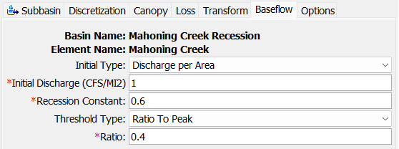
Recession Baseflow
Parameters:
  Initial Discharge
    Specified as a rate OR a rate/area
  Recession Constant
  Threshold for starting the baseflow recession curve
    Specified as a flow threshold or as a ratio to peak
Notes:
In the UI, you need to specify the initial discharge. You can specify either as a set value or discharge per area.
Next, you specify the recession constant
Then the threshold
This is for starting the baseflow recession.
You have two options
Specify as a flow threshold or as a ratio to peak

Slide 14
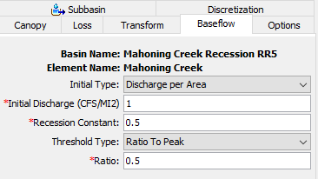
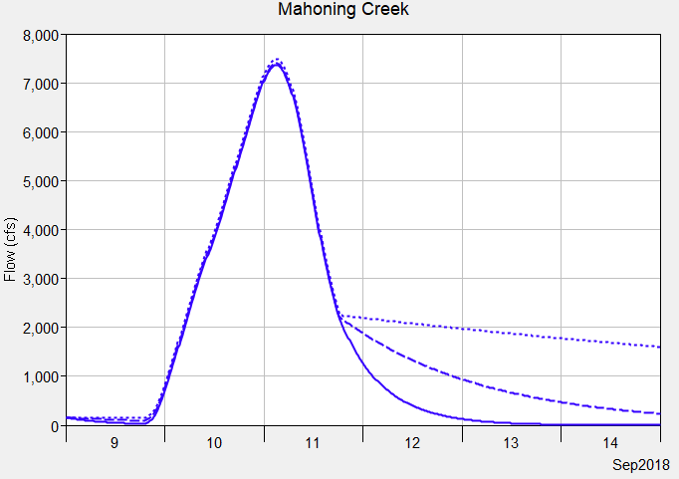
Recession Baseflow
Three different recession constants
  A recession constant closer to 1: flatter recession curve
  A recession constant closer to 0: steeper recession curve
Cannot model both interflow and groundwater flow baseflow components using recession baseflow method
Recession Constant
0.9
0.5
0.1
Notes:
This slide describes how the recession parameter changes your hydrograph.
Recession close to 1 would be a flat curve
Recession close to 0 would be a stee curve
You can’t separate interflow from baseflow
The recession does not affect your flood peak
The initial discharge can affect your flood peak
In contrast to Linear Reservoir where you can adjust parameters that affect flood peak
Notice the recession constant had little impact on the flood peak. The recession constant would impact a second flood event.

Slide 15
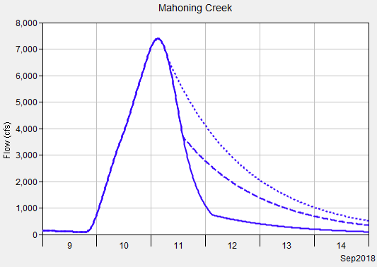
Recession Baseflow
The recession curve turns on when the receding limb of the hydrograph falls below a threshold/trigger flow.
Choice of Threshold Type:
  Ratio to Peak
  Threshold Discharge
Ratio to Peak is easier to apply across the basin model (generally consistent across subbasins).
Ratio to Peak
0.9
0.5
0.1
Notes:
When does the recession curve begin? This is defined by your threshold type which acts as a trigger
You can choose ratio to peak or discharge.
Ratio to peak – you provide a fractional value.
A value of 0.9, your recession will start closer to the peak value
A value of 0.1, your recession will start closer to the bottom of the hydrograph
A ratio to peak of 0.5 and a peak flow of 100 cfs means that the threshold to initiate baseflow is 50 cfs
Ratio to peak is easier to apply and more flexible (dependent on the peak flow value). We’d recommend you use this method.
Discharge – you need to specify one value that gets applied. Likely need to change this value for each simulation

Slide 16
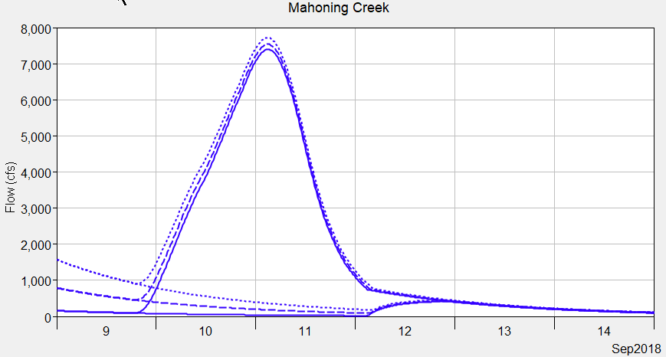
Recession Baseflow
Choice of Initial Discharge Type:
  Discharge per Area
  Discharge
Discharge per Area is easier to apply across the basin model (generally consistent across subbasins).
Set a simulation start date to reduce impacts from prior floods
  Only groundwater baseflow in the system
Initial Discharge
10
5
1
Notes:
Initial discharge type
Two options available for you. Discharge per area or discharge
Discharge per area, a 1 cfs/mi^2 means you would have 100 cfs for a 100 sq miles watershed
The larger the value, the higher your initial flow will be.
Discharge, you just specify one discharge value
The plot on this slide shows different initial discharge per area values.
We recommend going with the discharge per area. Potentially maintain the value for different events and across basins.
Similar to the threshold type, you could potentially obtain a consistent initial discharge value across subbasins by going with the discharge per area.
From one event to the next, could potentially have a consistent value

Slide 17
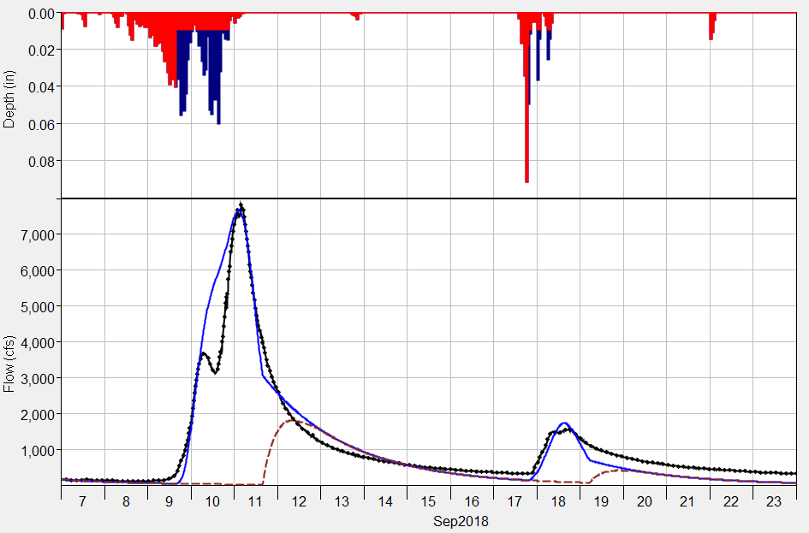
Recession Baseflow
While the recession baseflow method can be used for a continuous simulation, the method should be considered as an event model.
The recession curve resets between flood events, as shown in the plot.
Computed Total Flow
Computed Baseflow
Observed Flow
Notes:
The example on this slide also shows that the recession method cannot model both interflow and groundwater flow (there is only one recession constant).

Slide 18
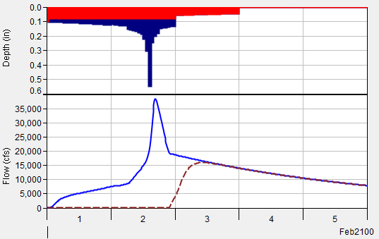
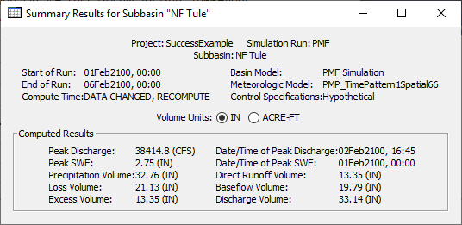
Recession Baseflow
Check the runoff volume when using the recession baseflow method to make sure the discharge volume does not exceed precipitation volume
Applying the calibrated model to a hypothetical event with a much higher flood magnitude can cause unreasonable baseflow volumes.
  Reduce the ratio to peak for extreme hypothetical floods and check computed volume.
Notes:
Look at the Summary results to check the rainfall volumes against the discharge volume
In this example, there is more discharge volume than rainfall. Could be ok when considering initial values
Check that computed volumes are similar to water balance studies in the region
Sometimes, the issue lies in your boundary conditions, such as rainfall. You end up adjusting your baseflow to compensate for a rainfall problem
In some hypothetical storm cases, such as the PMP, you could be getting an enormous amount of baseflow. In those situations, you probably should reduce your ratio to peak and check your computed volumes.

Slide 19
Linear Reservoir Baseflow Method
Notes:
This is our preferred baseflow method. Can be used for both event and continuous modeling and you could model both interflow and baseflow.
This method conserves volume.

Slide 20

Linear Reservoir Baseflow
Uses linear reservoirs to model the movement of infiltrated water.
  Can be used to model Interflow and Baseflow
The continuity equation is used along with a linear relationship between storage and discharge:
$\frac{dS}{dt}= I_{t}$ - $O_{t}$ $S_{t}$ = R$O_{t}$
dS/dt = change in storage at time t
I_{t} = average inflow to storage at time t
O_{t} = outflow from storage at time t
R = linear reservoir coefficient
Interflow –
Linear Reservoir
Baseflow - Linear Reservoir
Notes:
Based off the name, the way baseflow is routed is simply using the linear reservoir routing method. You use a linear relationship between storage and discharge.
The continuity equation is used along with the linear reservoir relationship to solve for outflow.

Slide 21
Linear Reservoir Baseflow
Designed to work with all loss methods.
All losses in the Initial and Constant, Curve Number, and Green and Ampt loss methods are available to the Linear Reservoir Baseflow (can overcome this assumption using the fraction option).
Only constant loss rate losses (represents saturated conditions) in the Deficit and Constant loss method is available to the Linear Reservoir Baseflow.
Canopy
Surface
Deficit/Constant
Moisture Deficit
Constant Loss Rate
Linear Reservoir Baseflow
Layer 1
Layer 2
Layer 3
Notes:
Linear reservoir can work for all loss methods.
All losses are available for certain methods
Only constant losses are available for 3 methods

Slide 22
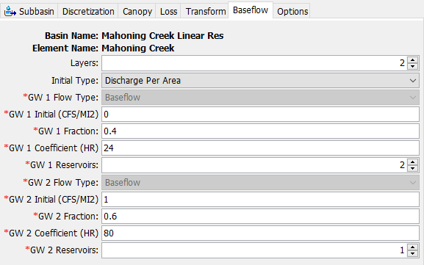
Linear Reservoir Baseflow
1, 2, or 3 linear reservoir layers.
Each layer requires:
  Initial discharge
  Fraction
  Linear reservoir coefficient
  Number of reservoirs
The fractions do not have to sum to 1. If they do not, the remainder represents water percolating to a deep aquifer.
Notes:
Here is the UI for the linear reservoir baseflow method. You can choose up to three layers.
Each layer requires an initial discharge, fraction, reservoir coefficient, and number of steps
Fractions do not need to add up to 1

Slide 23
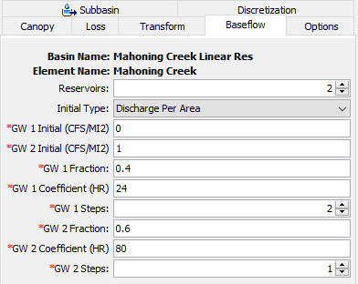
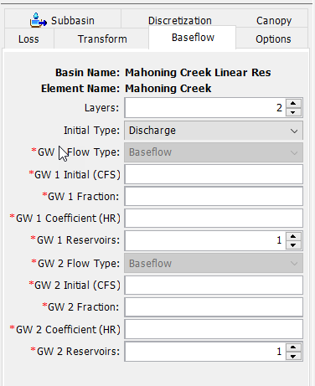




Linear Reservoir Baseflow
Notice the linear reservoir coefficients are different.
Groundwater 1 can be used to model interflow, and groundwater 2 can be used to model groundwater flow.
Canopy
Surface
Deficit/Constant
Moisture Deficit
Constant Loss Rate
Linear Reservoir Baseflow
Layer 1
Layer 2
Layer 3

Slide 24
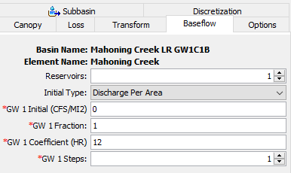
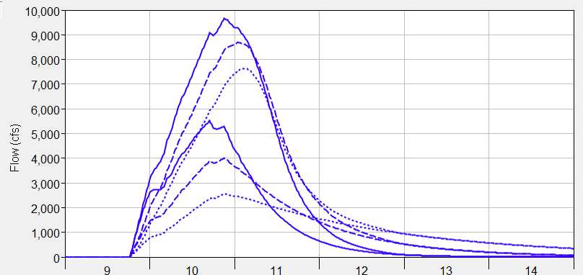
Linear Reservoir Baseflow
Larger coefficient values attenuate the baseflow contribution.
Timing of the baseflow hydrograph is not influenced much by the storage coefficient.
Initially set the coefficients using multipliers of the Clark Storage Coefficient.
Total Flow
Coeff. = 12 hours
Coeff. = 24 hours
Coeff. = 48 hours
Baseflow
Notes:
This slide shows how the GW coefficients affect the baseflow. If you remember in the equation, it’s the “R” value.
Larger coefficients will attenuate the baseflow (infiltrated water spends long duration in the ground)
Timing of baseflow is not affected significantly
Initialize the coefficient based on the Clark storage coefficient

Slide 25
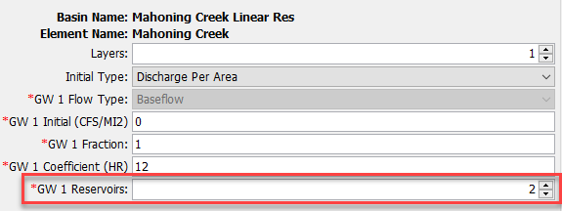
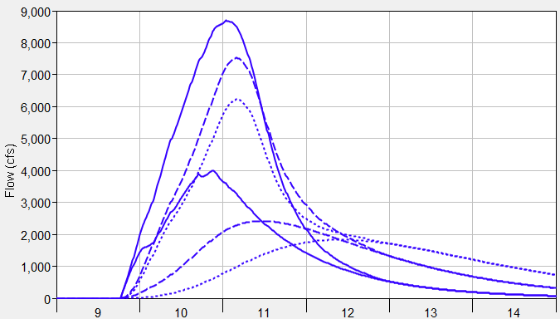
Linear Reservoir Baseflow
Number of Reservoirs
Timing of the baseflow hydrograph is shifted and attenuation is increased as the number of linear reservoirs is increased.
Increasing Number of Reservoirs will delay timing of peak baseflow.
Total Flow
Steps = 1
Steps = 2
Steps = 3
Baseflow
Notes:
This slide shows how changing the “Reservoirs” affects the baseflow
Reservoirs are another way to attenuate the baseflow. A reservoir of “2” means you are passing the flow through two linear reservoirs in a single layer.
2 steps means water flows into one linear reservoir with a coefficient of 24 hours, and then water from the first linear reservoir is routed through a second linear reservoir that also has a coefficient of 24 hours.
Timing of the baseflow is affected by increasing the number of reservoirs
Between the coefficient and number of reservoirs, you will see attenuation in the baseflow.
Reservoir will shift the peak later in time
Baseflow will be smoother than if you were to increase the coefficient

Slide 26
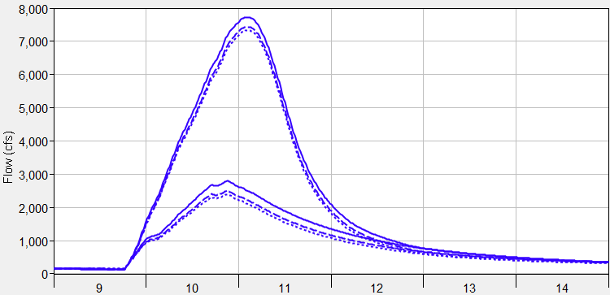
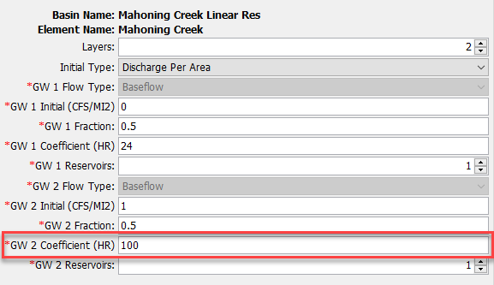
Linear Reservoir Baseflow
Groundwater 2 linear reservoir coefficient was varied.
Groundwater Layers 2 and 3 can be used to model the longer responding groundwater flow.
Little impact on the flood magnitude.
Total Flow
GW2 Coef. = 100 hours
GW2 Coef. = 200 hours
GW2 Coef. = 300 hours
Baseflow

Slide 27
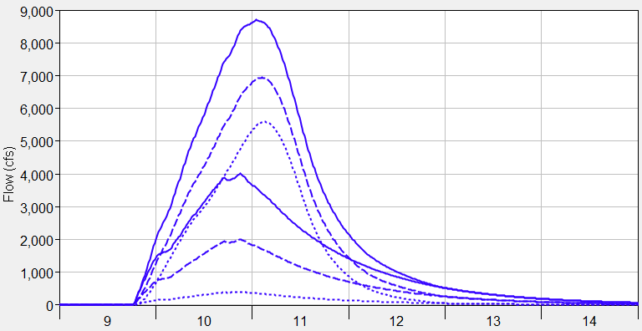
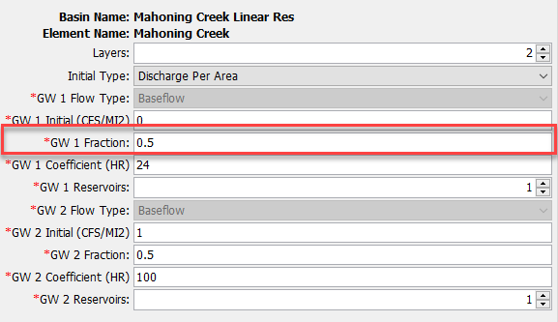
Linear Reservoir Baseflow
GW1 Fraction was varied 0.1 to 1.0.
  The sum of the fractions for all layers cannot exceed 1 but can be less than 1
The fraction can be used to control the magnitude of the baseflow hydrograph (emphasize interflow) and can be used to improve runoff volume.
Total Flow
GW 1 Fraction = 1 (volume 1.6 inches)
GW 1 Fraction = 0.5 (volume 0.8 inches)
GW 1 Fraction = 0.1 (volume 0.2 inches)
Baseflow
Notes:
GW Fraction allows users to control how much baseflow volume makes it out to the hydrograph.
In the figure, with all other parameters held constant but just changing the fraction, you see how the volume of the baseflow is reduced.
Does affect the hydrograph volume and peak if reduced significantly

Slide 28
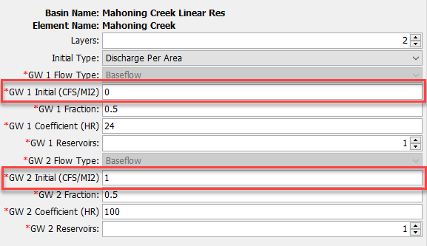
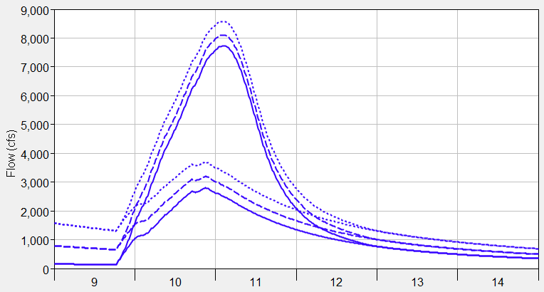
Linear Reservoir Baseflow
Initial discharge type:
  Discharge per Area
  Discharge
Discharge per Area is easier to apply across the basin model (generally consistent across subbasins).
Manually adjust the initial discharge to match observed flow at the beginning of the simulation.
Be strategic when setting the starting date of the simulation
  Interflow could be set to zero and only initial GW2/3 specified.
Initial GW2 Disch. = 1 CFS/MI2
Initial GW2 Disch. = 5 CFS/MI2
Initial GW2 Disch. = 10 CFS/MI2
Notes:
The last parameter is the initial discharge. Similar to Recession, this defines the initial state of the baseflow at the start of the simulation.
You can choose between discharge per area or discharge value.
A discharge per area of 1 CFS/MI2 means the initial flow would be 100 cfs for a 100 square mile subbasin
Recommend going with discharge per area.

Slide 29
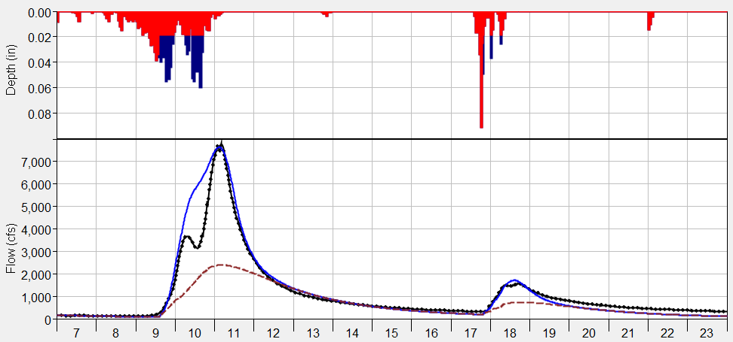
Linear Reservoir Baseflow
Computed Total Flow
Computed Baseflow
Observed Flow
The linear reservoir baseflow method can be used for a continuous simulation.
The linear reservoir method can simulate both interflow and groundwater flow.

Slide 30
Modeling Baseflow in HEC-HMS
Hydrologic Modeling with HEC-HMS
November 2024

Slide 31
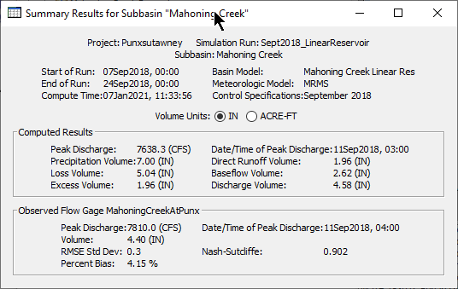
Linear Reservoir Baseflow
Always check the computed runoff volume. You will not have to worry about the total runoff volume exceeding precipitation volume, which could happen when using the other baseflow methods.
Verify modeled volumes are similar to regional water balance studies.

Slide 32
Linear Reservoir Baseflow
The linear reservoir coefficient could be estimated using flow observations, and the slope of the interflow and baseflow recession curve(s):
Q_{t} = flow at time t
Q₀ = flow at the beginning of the recession curve
K_{r} = exponential decay constant
T = time
R = linear reservoir coefficient
Q
=
1
Q
=
Q
×
K_{r}
T
S
=
−
t
R
−
t
o
t
ln(
)
ln(
)
K_{r}
K_{r}

