Slide 1
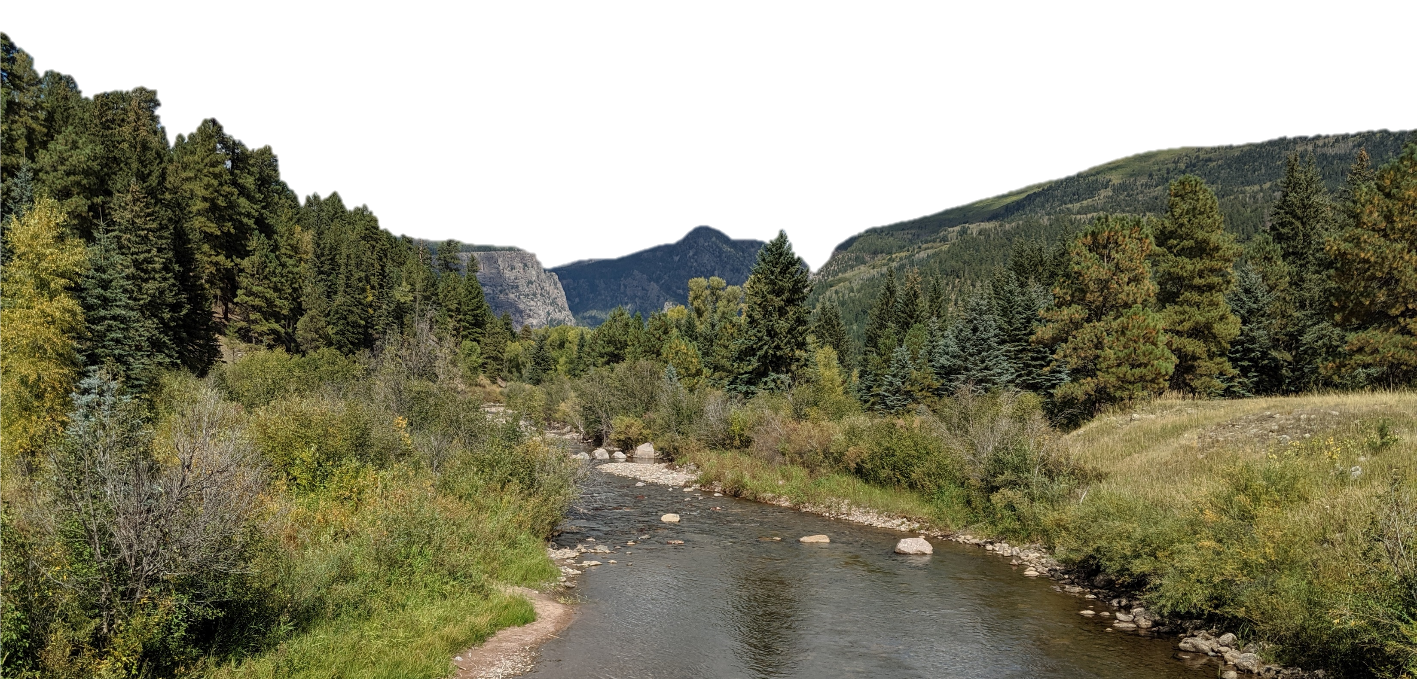
Modeling Open Channel Flow within HEC-HMS
Melissa Mika
US Army Corps of Engineers
Hydrologic Engineering Center
Hydrologic Modeling with HEC-HMS
November 2024

Slide 2
Objectives
Provide an overview of open channel flow processes and common applications
Discuss how hydrologic routing differs from hydraulic routing
Describe channel routing simulation within HEC-HMS and show the available reach routing methods
Introduce several channel routing routines within HEC-HMS
Discuss important study objectives and physical considerations
Provide rules of thumb

Slide 3
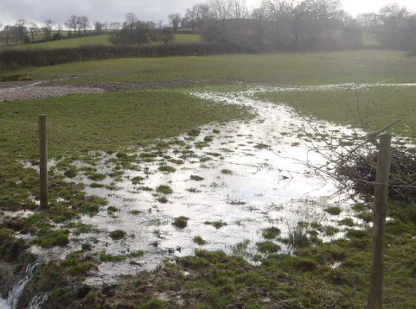
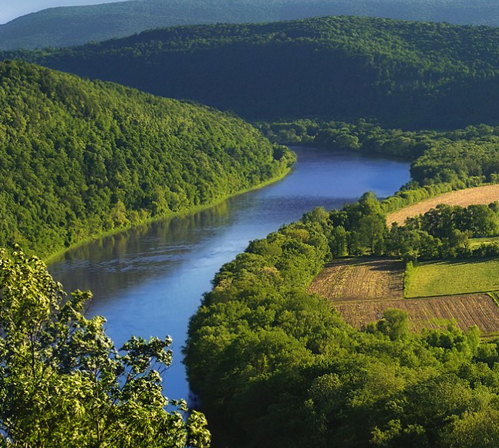
Overland vs. Open Channel Flow
Notes:
As runoff from subbasin elements reach defined channels, as shown in the left-hand image, depths increase and the predominant flow regime begins to transition to open channel flow, as shown in the right-hand image.
At this point, open channel flow approximations are used to represent translation and attenuation effects as flood waves move downstream.

Slide 4
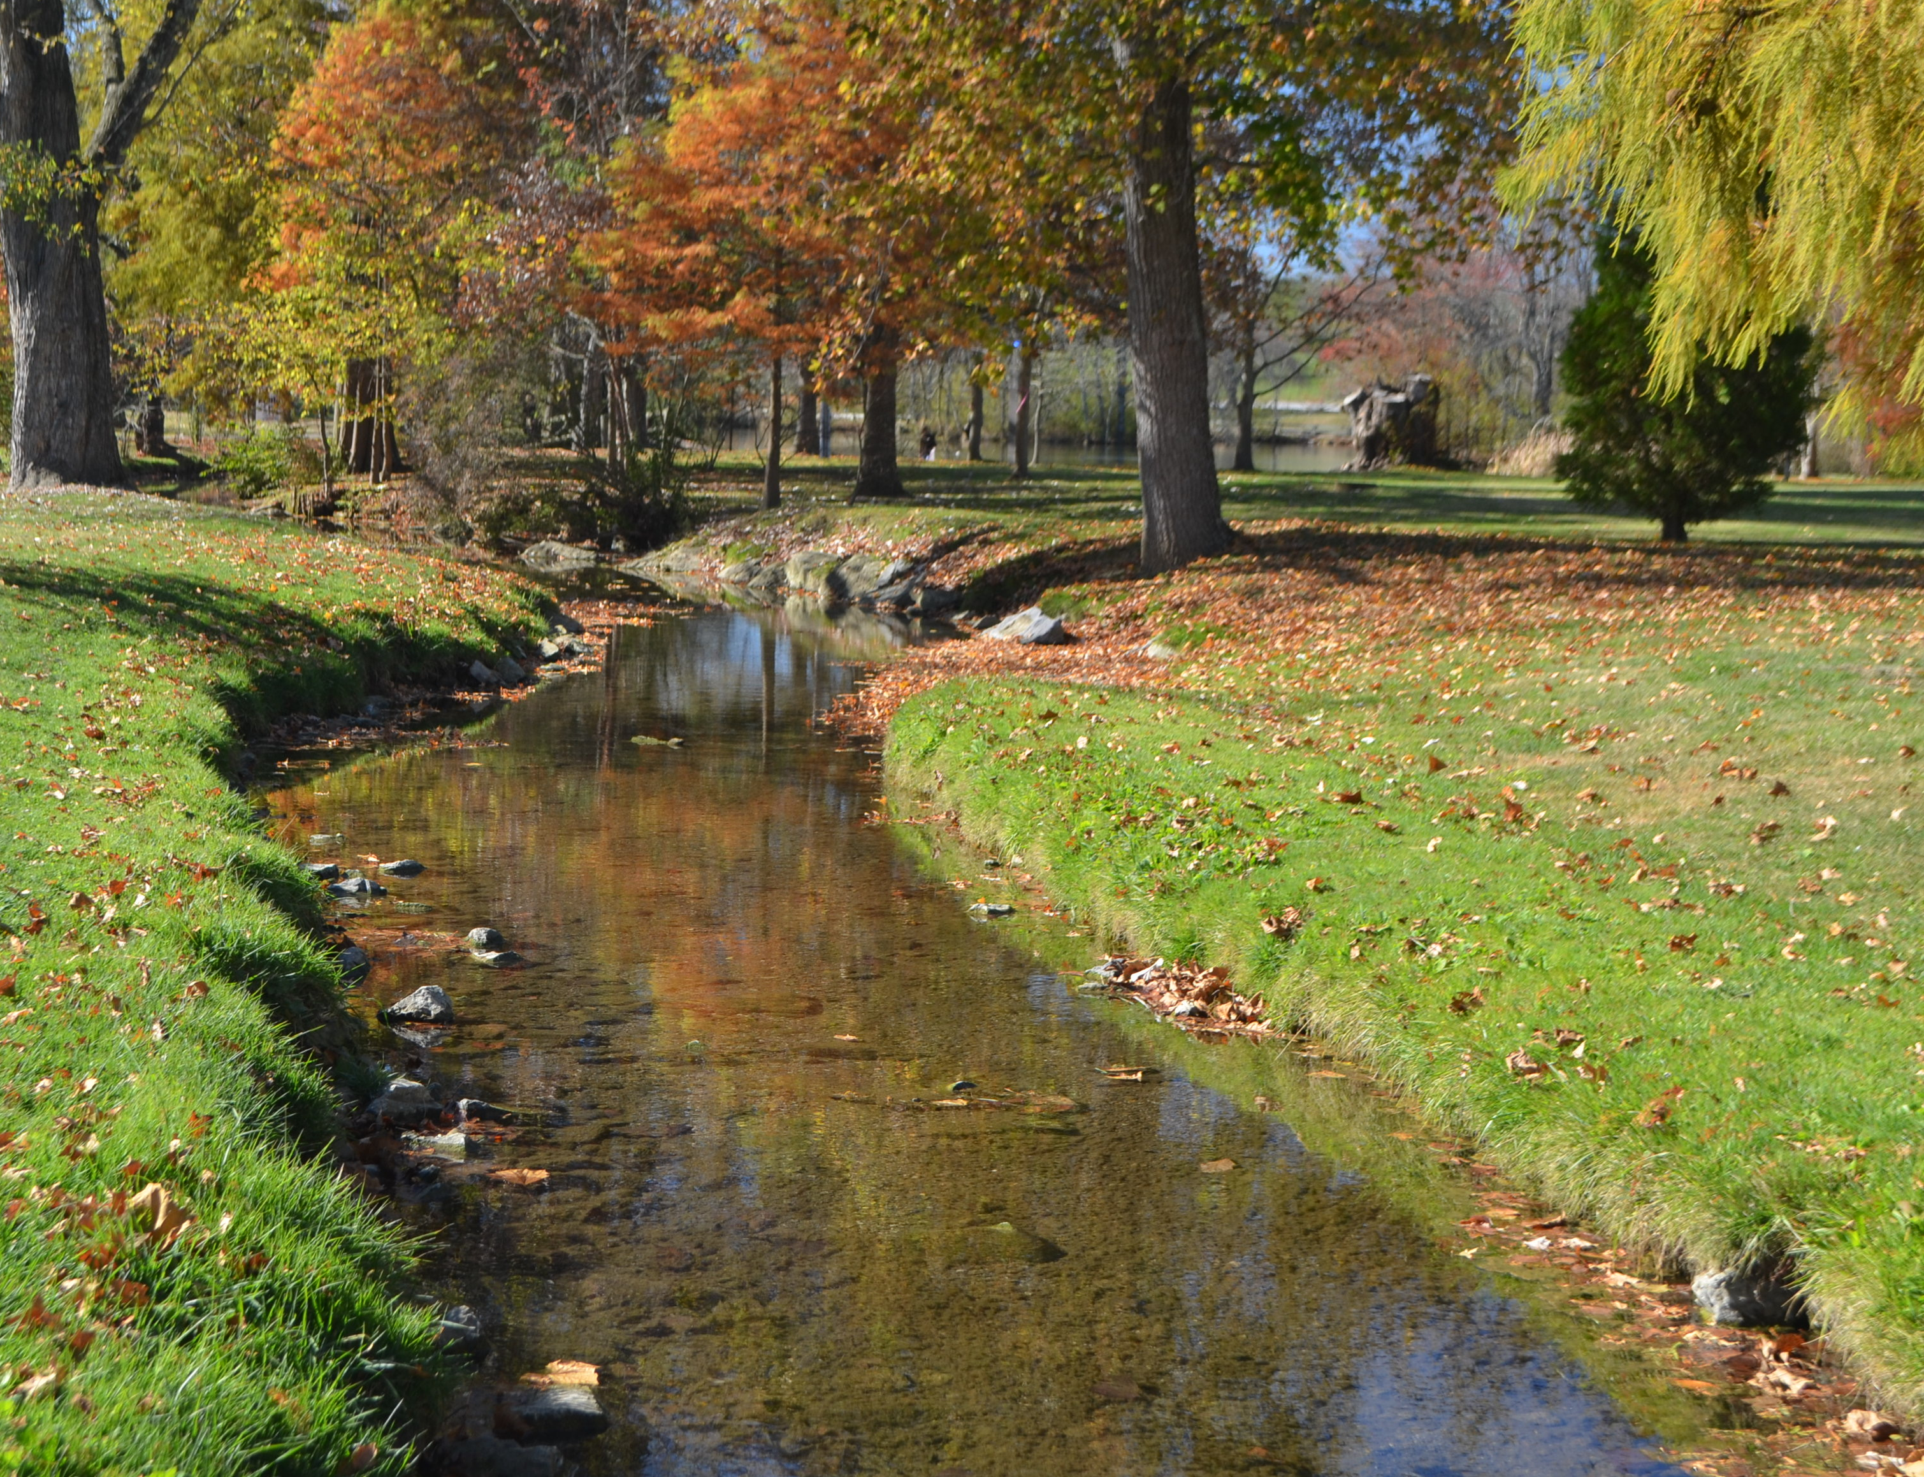
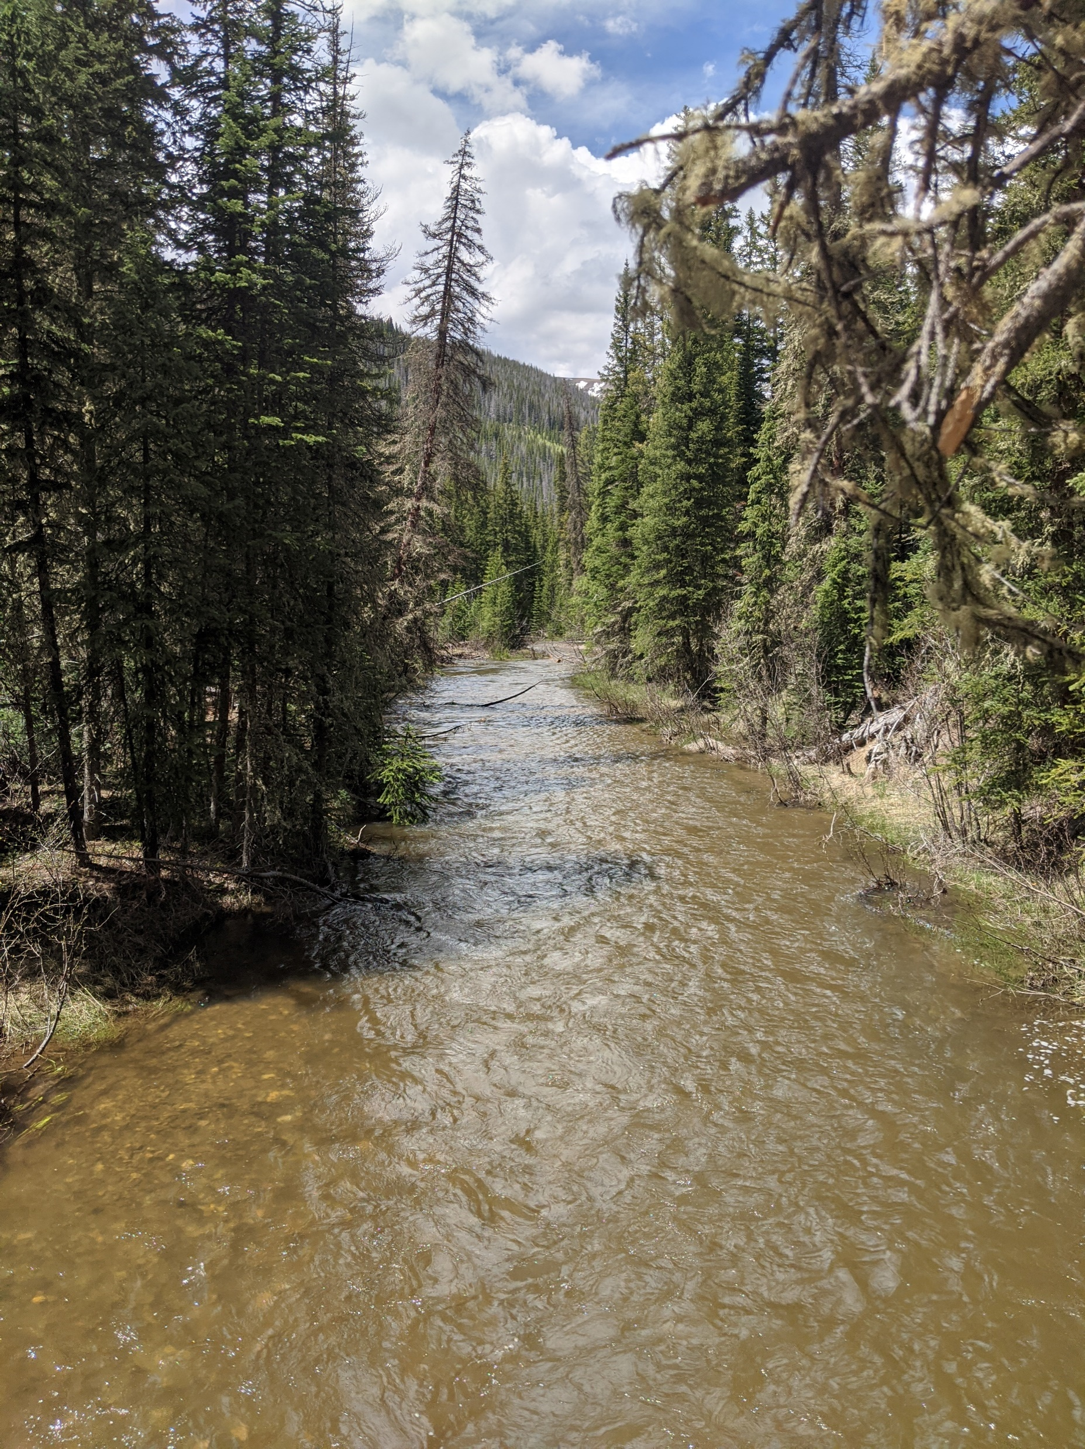
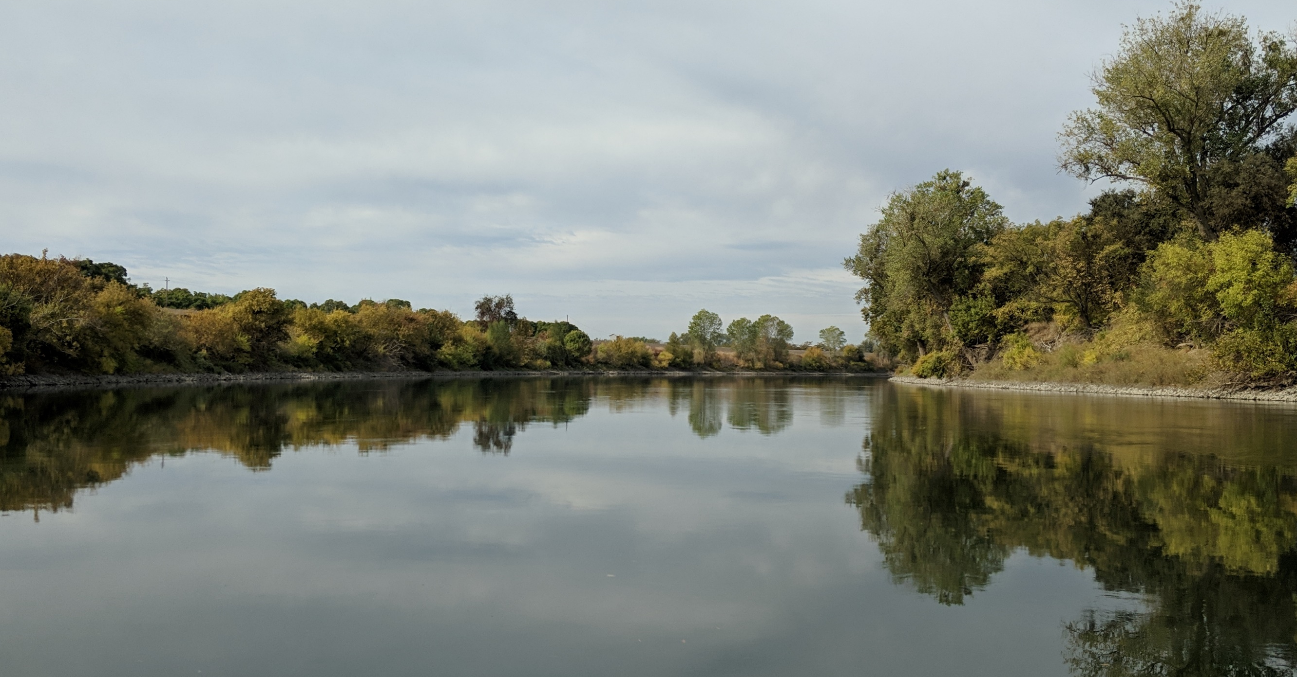

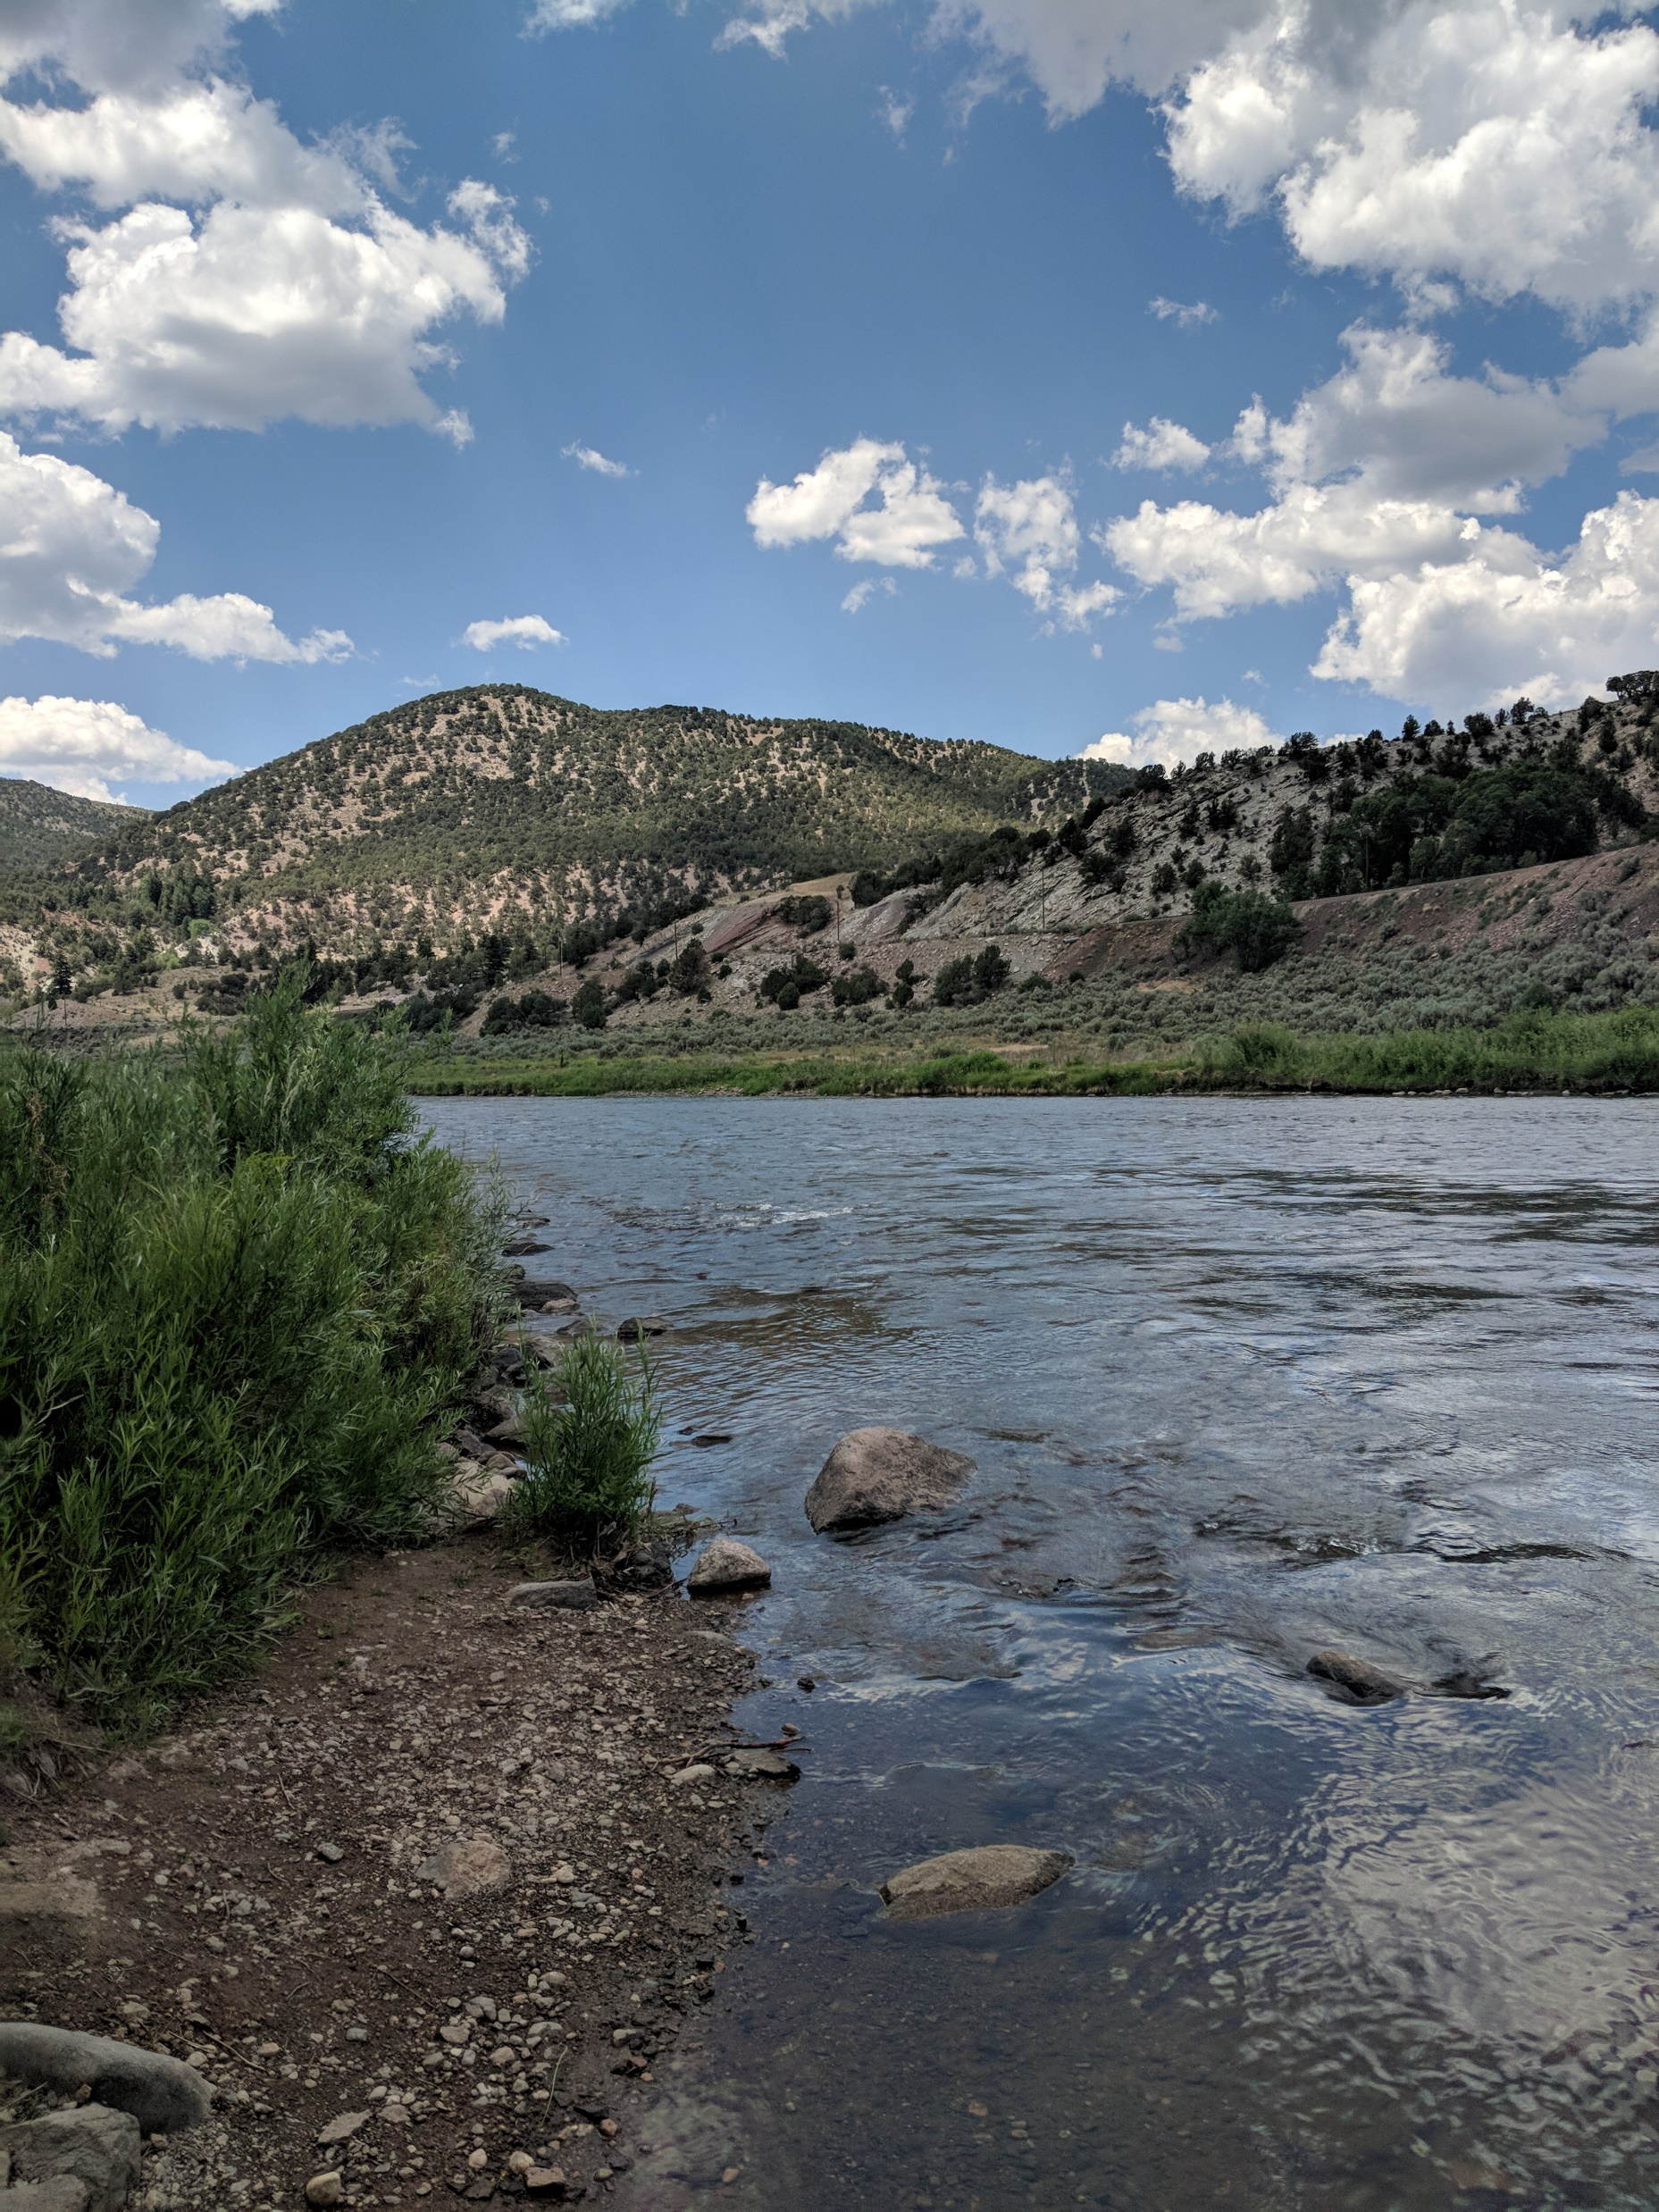
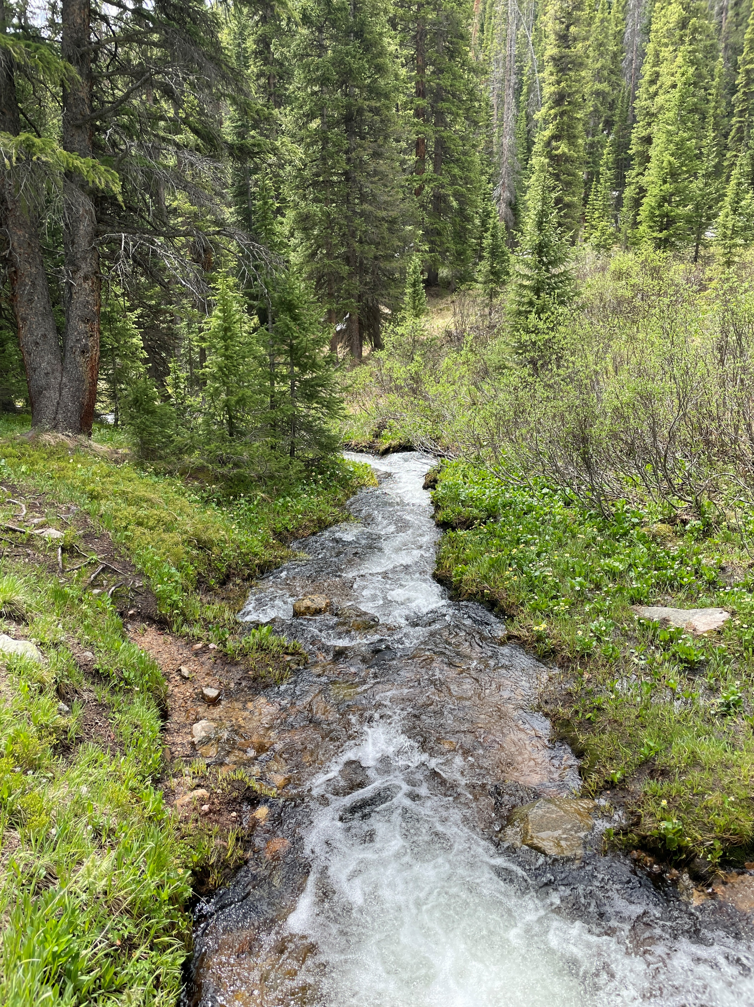
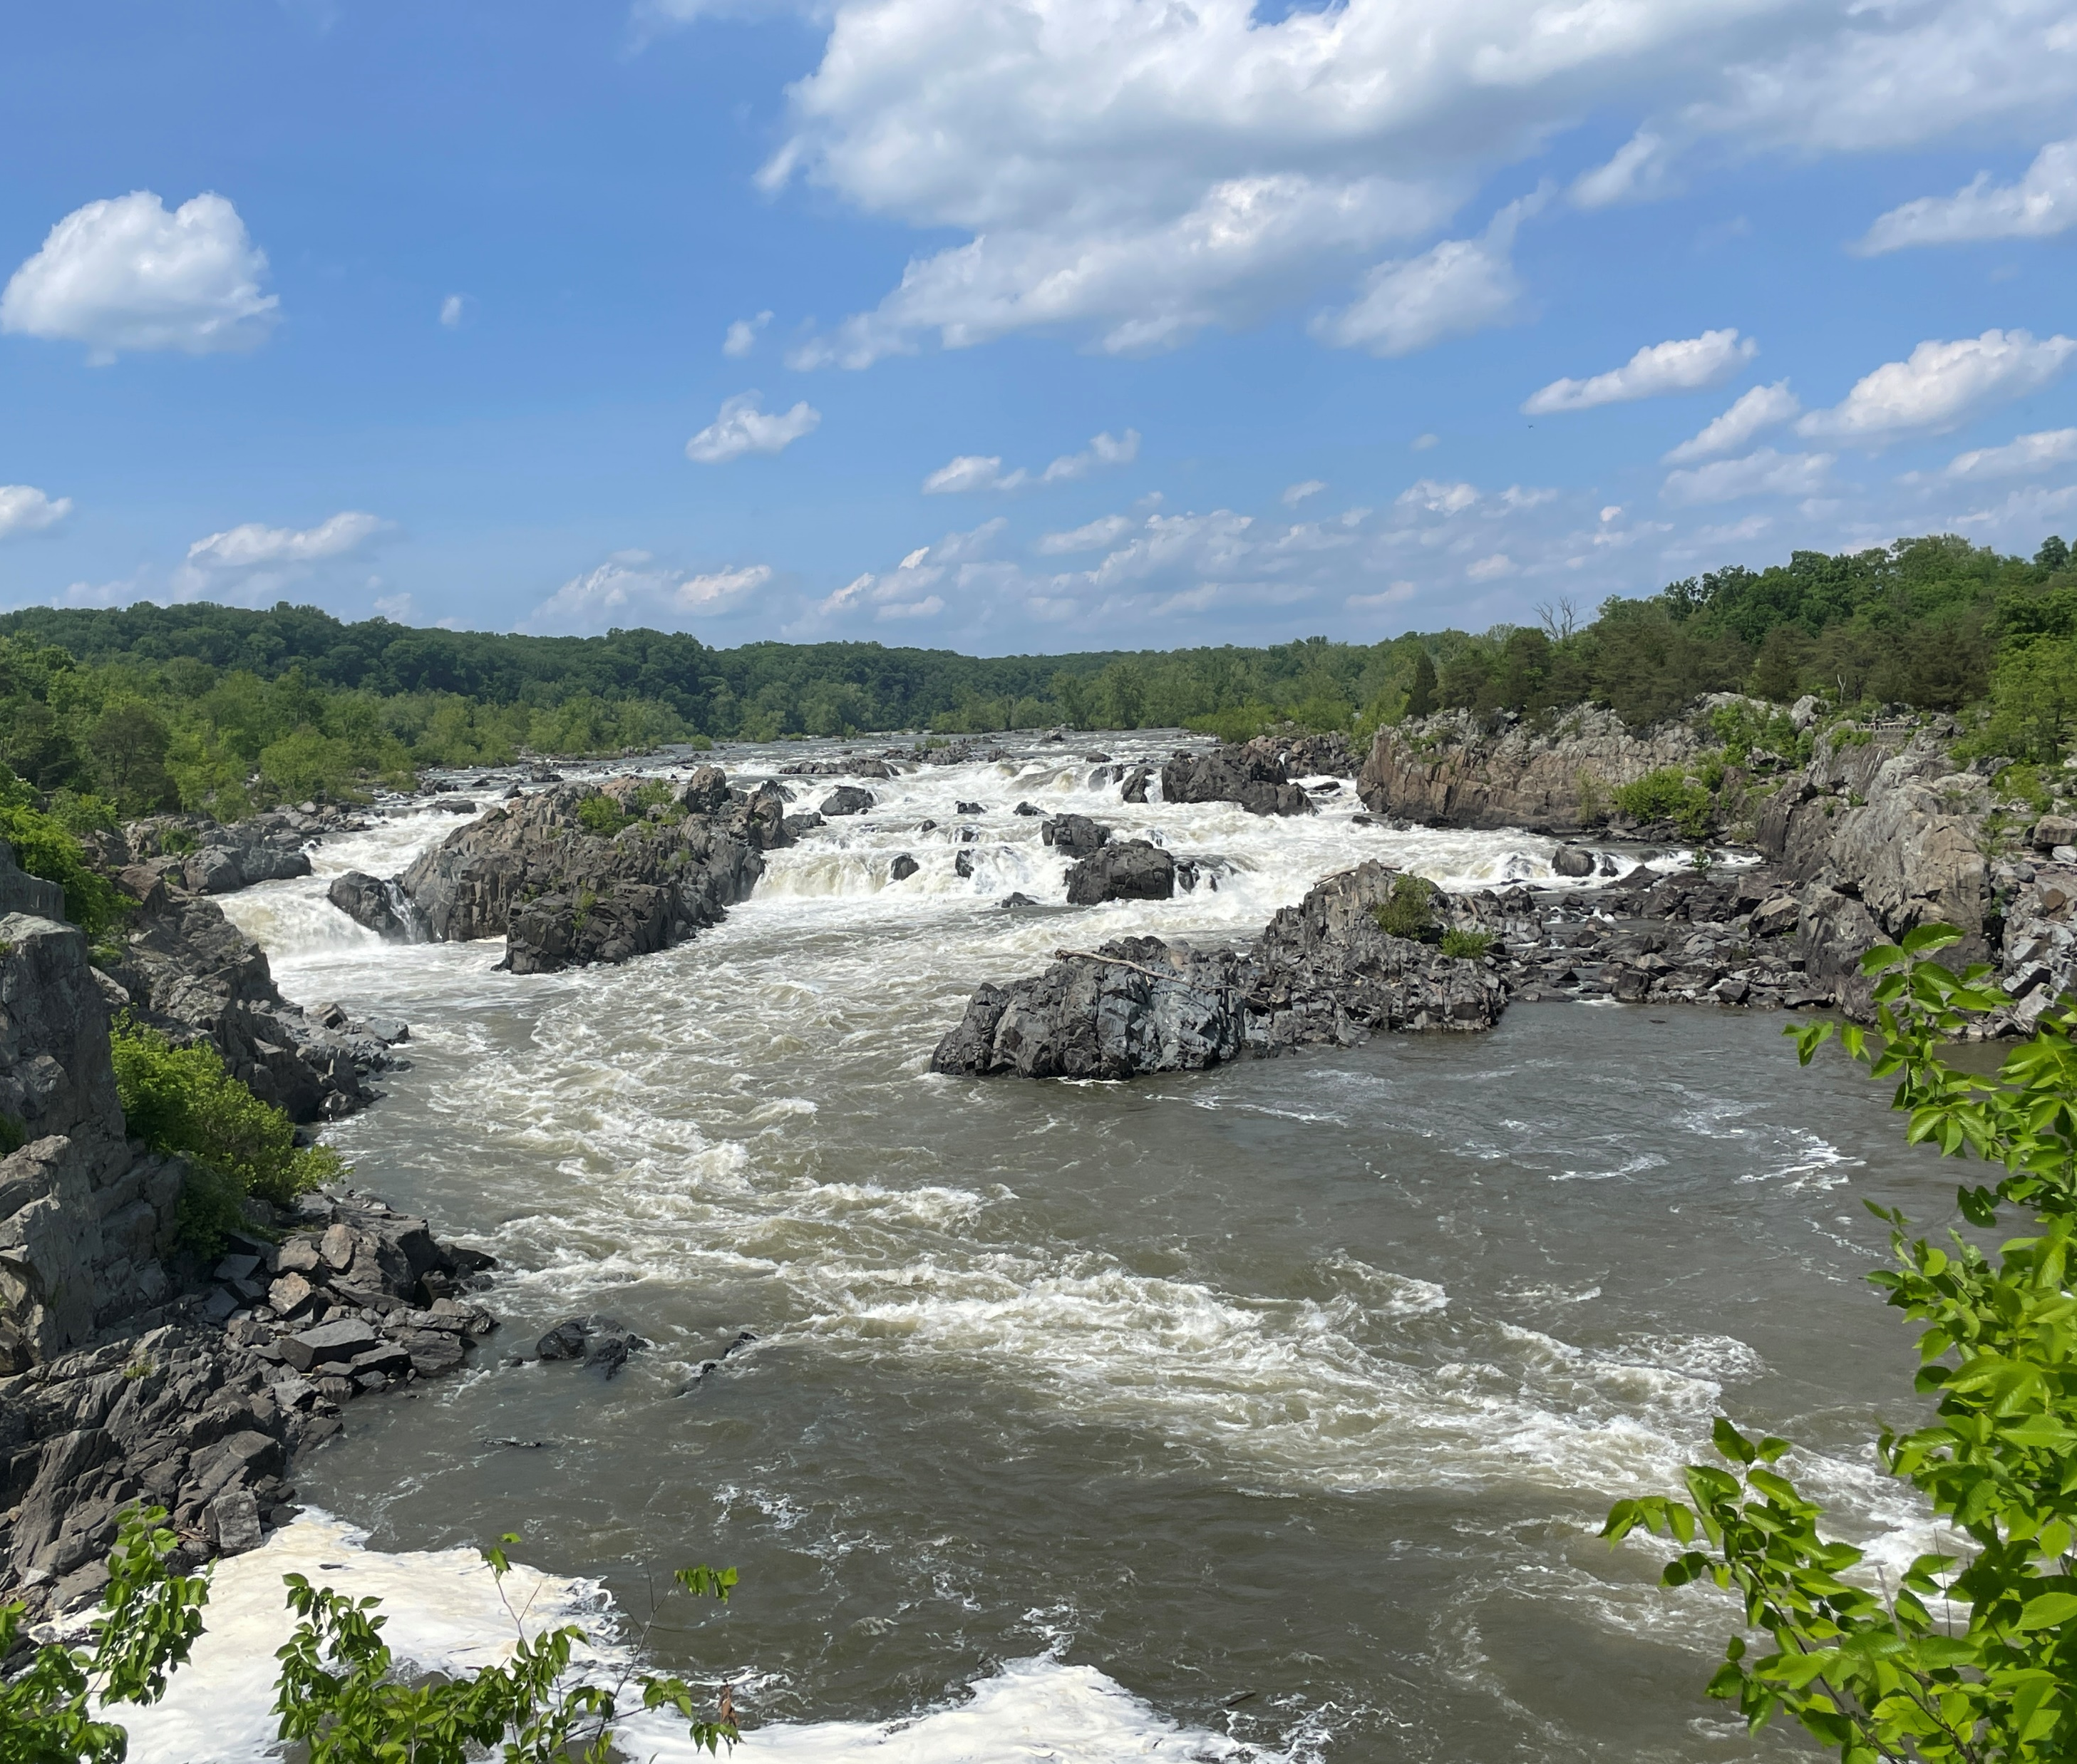
Notes:
However, channel flow behavior varies widely based on characteristics such as slope, roughness, cross-sectional area, shape, etc.
Not only are the parameters important, but also selecting the appropriate reach routing method that can accurately represent the channel.

Slide 5
Reach Routing
Notes:
Open channel flow modeling or reach routing, as it’s referred to within HEC-HMS, is an approach that is used to predict the temporal and spatial variations of a hydrograph as it moves through a river or stream.
The effects of storage and flow resistance are reflected by changes in the hydrograph shape and timing as the flood wave moves from upstream to downstream.
The figure shown here demonstrates the major changes that can occur as a hydrograph moves through a reach.
Specifically, the blue inflow hydrograph is translated or shifted in time and the peak inflow is reduced or attenuated to produce the pink outflow hydrograph.

Slide 6
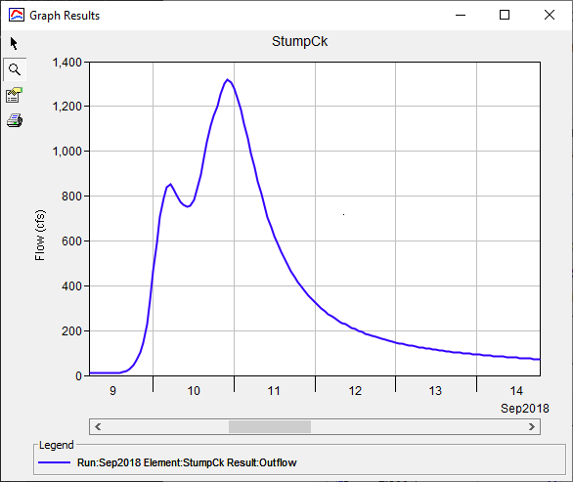
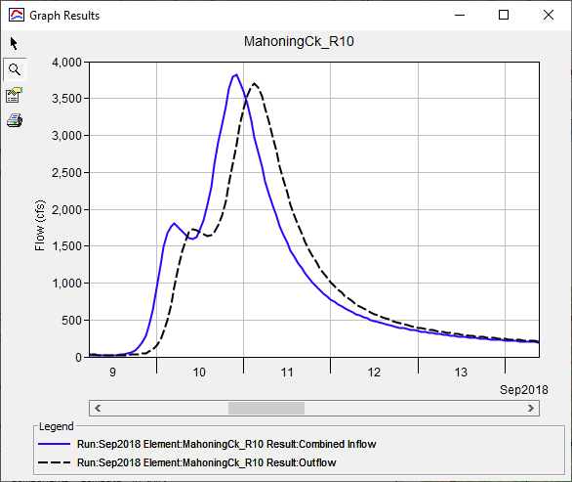
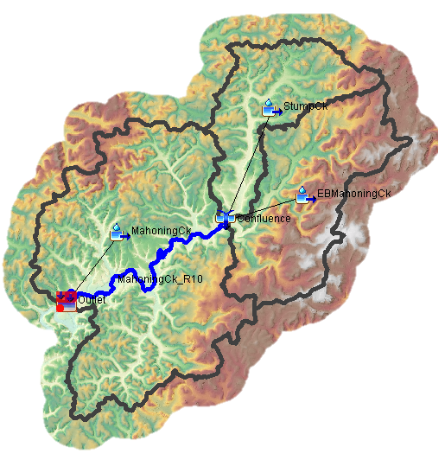
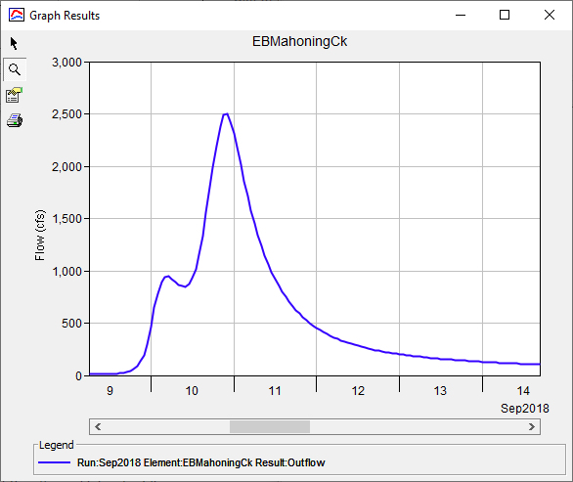
Reach Routing
Notes:
Here’s an example application within HEC-HMS that uses reach routing.
Within this simple model, the runoff from two subbasin elements (animate) are combined and routed through a single routing reach element (animate).
In the routing reach, the blue inflow hydrograph is attenuated and translated to produce the black outflow hydrograph.

Slide 7
Applications of Reach Routing
Flood Forecasting
Reservoir and Channel Design
Floodplain Studies
Water Quality
Sediment Transport
Etc…
Notes:
Reach routing is used in nearly all hydrologic modeling applications from flood forecasting to sediment transport.
Each of these example applications may require different levels of detail and outputs and, as such, may require different reach routing approaches.

Slide 8
Hydraulic vs. Hydrologic Routing
Hydraulic Routing
  Based on Solutions of Partial Differential Eqns.
  St. Venant equations (Dynamic Wave Eqns.)
    Continuity Equation
    Momentum Equation
Hydrologic Routing
  Continuity Equation
  Momentum Equation or Storage-Discharge Relationship
Notes:
In general, routing techniques may be classified into two categories: hydraulic routing and hydrologic routing.
Hydraulic routing techniques are based on the solution of partial differential equations which govern unsteady, open channel flow.
These equations are often referred to as the St. Venant or Dynamic Wave equations.
Hydrologic routing routines employ the continuity equation and either simplified forms of momentum equation or very simplified relationships between storage within the reach and discharge at the outlet as a replacement for the momentum equation.

Slide 9
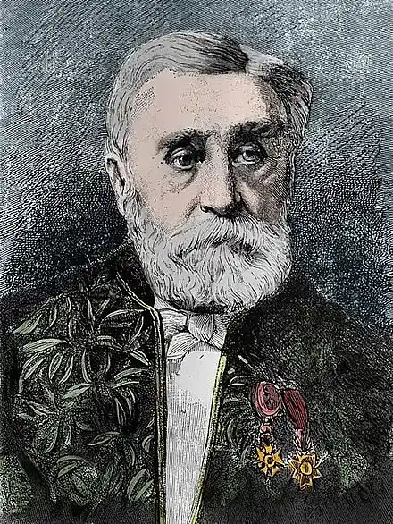
1-D St. Venant Equations
Continuity
Momentum
Notes:
The equations that describe one-dimensional unsteady flow in an open channel consist of a continuity equation and a momentum equation, as shown here.
The solution of these equations defines the propagation of a flood wave with respect to distance along the channel and time.
Solved together with the proper boundary conditions, these equations are the St Venant or Dynamic Wave equations.
The momentum equation accounts for forces that act on a body of water in an open channel (fruction slope as a function of the sum of pressure force, gravitational force, and friction force)
The continuity equation accounts for the volume of water in a reach of an open channel, including the flow into the reach, the flow out of the reach, and stored in the reach

Slide 10
Momentum Equation Approximations
Steady Uniform Flow
Steady Non-uniform Flow
Steady Non-uniform Flow
Unsteady Non-uniform Flow
Kinematic Wave Approximation
Diffusive Wave Approximation
Quasi-Steady State Dynamic Wave Approximation
Full Dynamic Wave Equation
Notes:
Depending on the relative importance of the various terms of the momentum equation, it can be simplified for various applications and not lose too much predictive power.
Approximations to the full dynamic wave equations are created by combining the continuity equation these with various simplifications.
The most common approximations of the momentum equation are shown here and include the Kinematic Wave, Diffusive Wave, and Quasi-Steady State Dynamic Wave Approximation.

Slide 11
Magnitude of Terms in Momentum Equation
Term
Magnitude
With smaller bed slopes, the inertial terms become more relevant
26 .5 .12-.25 .05
Typical values for each of the slope terms (in ft/mile) taken from a steep alluvial river (Henderson, 1966)
Notes:
The use of approximations can be justified when specific terms in the momentum equation are small in comparison to the bed slope.
This is excellently illustrated by an example taken from Henderson’s 1966 book titled Open Channel Flow.
In this example, Henderson computed values for each of the terms on the right hand side of the momentum equation for a steep alluvial stream when subjected to a very fast rising flood hydrograph in which the flow went from 10,000 cfs to 150,000 cfs and back down to 10,000 cfs within 24 hours.
Even in this case, where changes in depth and velocity with respect to distance and time are relatively large, the last three terms are still small in comparison to the bed slope.
For this type of flow situation, an approximation of the full equations can be easily justified, but that’s not always the case.
Henderson, F.M. (1966). Open channel flow. MacMillan Publishing Co. Inc., New York, NY.

Slide 12
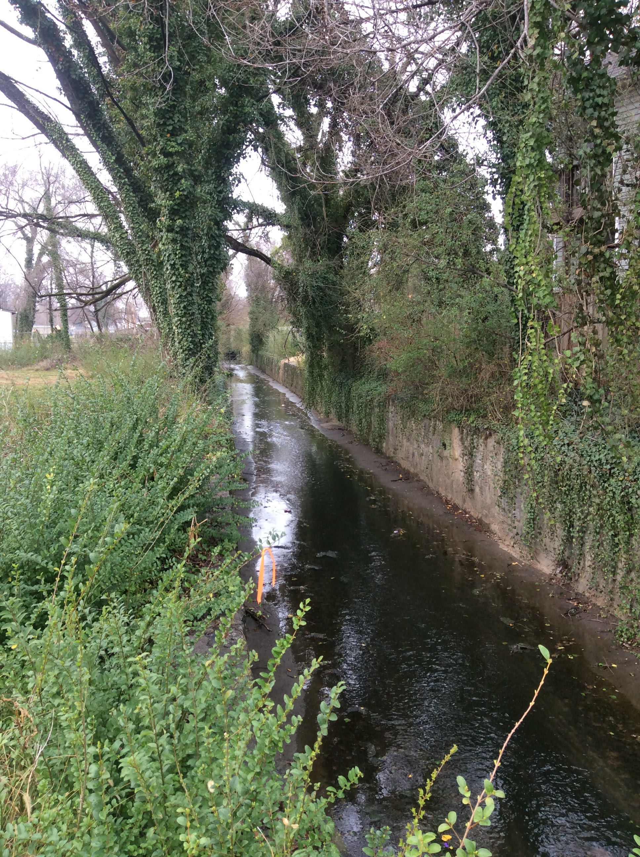
One-Dimensional Routing Assumptions
Velocity is constant and horizontal water surface prevails
All flows are gradually varied
No lateral or secondary circulation
No erosion or deposition
Water is uniform density and resistance can be described by empirical relationships (e.g. Manning’s equation)
Notes:
The use of either the hydraulic or hydrologic routing routines that have been described so far assume that:
Velocity is constant and the water surface is horizontal across any channel section,
All flow is gradually varied with hydrostatic pressure prevailing at all points in the channel. Thus, vertical accelerations can be neglected,
No lateral or secondary circulation occurs,
Channel boundaries are fixed. Erosion and/or deposition do not alter the shape of a channel cross-section during a simulation, and.
Water is of uniform density and resistance to flow can be described by empirical formulas like Manning’s or Chezy's equation.

Slide 13
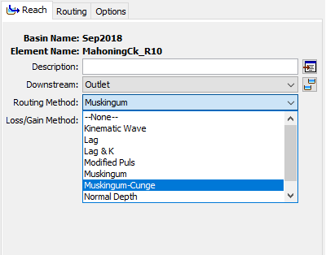
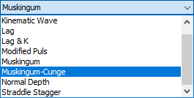
Available Routing Methods
Hydrologic Routing Methods
Lag
Lag & K
Modified Puls
Muskingum
Muskingum-Cunge
Normal Depth
Straddle Stagger
Hydraulic Routing/Transform Methods
Kinematic Wave
2D Diffusion Wave
Notes:
There are eight hydrologic routing methods available for use within HEC-HMS.
Additionally, version 4.7 introduced the 2D Diffusion Wave transform method, which can be used within a subbasin element to route a flood wave using the Diffusion Wave hydraulic routing approach.
Each one of these approaches uses different approximations of the continuity and momentum equations.
We’ll go through a few of these hydrologic routing methods in future lectures.

Slide 14
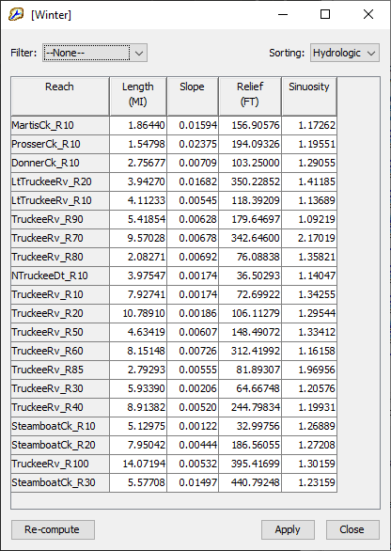
Parameter Estimation
GIS data sets allow for efficient parameter estimation
  e.g., National Hydrography Dataset, National Elevation Dataset, National Land Cover Database, etc.
Reach characteristics can now be computed within HEC-HMS
  Parameters | Characteristics | Reach
Notes:
You can estimate many of the required parameters for each of the aforementioned routing methods using readily-available GIS data sources
For instance, stream alignments can be found within the National Hydrography Dataset, elevations can be sourced from the National Elevation Dataset, and land use can be extracted from the National Land Cover Database
Several reach characteristics, like length, slope, relief, and sinuosity, can also be computed directly within HEC-HMS
I’ll go into greater detail regarding parameter estimation for specific routing methods within future videos

Slide 15
Lag Method
Only represents translation
No attenuation effects
Continuity:
Momentum:
Inflow = Outflow
Notes:
As I stated previously, the Lag method is as simple as it gets with reach routing.
This method only represents translation.
You cannot attenuate an inflow hydrograph when using this method.
Recall that all routing methods start with the equations of motion which includes conservation of mass and momentum.
The Lag method simplifies the continuity equation by setting inflow equal to outflow. There’s no change in storage over time.
The momentum equation is also completely thrown out
These simplifications make the method ultra simple to parameterize and solve but they drastically limit its applicability.
In particular, the required parameter can’t be estimated from physical characteristics of the reach and attenuation isn’t possible when using this method.

Slide 16
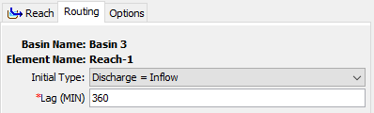
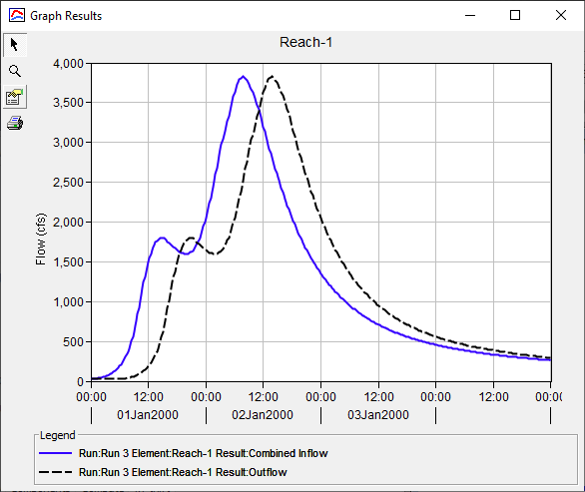
Example
 | Peak (cfs) | Time of Peak
Inflow | 3825 | 1/2/2000 7:45
Outflow | 3825 | 1/2/2000 13:45
Diff | 0 | 6.0 hrs
Notes:
This method requires an initial condition and one parameter: lag time. Lag time cannot vary throughout a simulation so this method cannot simulate variable translation.
This example shows how an inflow hydrograph, shown in blue, is translated and attenuated to produce the outflow hydrograph shown in black.
The inflow hydrograph is uniformly translated in time by 6 hours, which is controlled by, and equivalent to, the lag time parameter.
That’s it. There’s no attenuation or anything else. Just a simple translation.

Slide 17
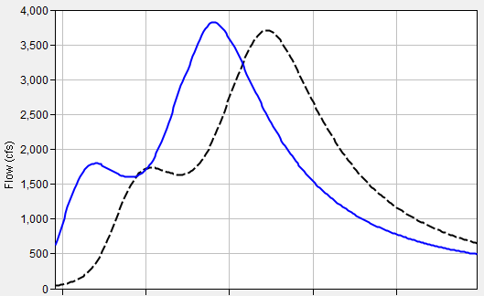

Parameter Estimation – Lag Time
Lag time is equivalent to travel time through the reach
Can estimate in three ways:
  Use known hydrograph data
  Compare flow length to a flood wave velocity
    $K= \frac{Length}{{Velocity}_{wave}}$
  Use regional regression equations
Notes:
When estimating an appropriate lag time, three approaches can be used.
The first approach uses observed data at the start and end of the reach to directly compute the travel time. This approach is depicted in the right-hand image. You can use the elapsed time between centroid of areas of the two hydrographs, between the hydrograph peaks, or between midpoints of the rising limbs. However, it’s usually a rare occurrence that observed data is available at both the upstream and downstream end of the reach, so this approach isn’t too common.
The second approach to estimate lag time uses a computed flood wave velocity and flow length to infer a travel time. Remember that a length divided by a velocity results in a time. This approach is more commonly used.
Finally, regression equations relating parameters like slope and length are available in some regions that can be used to estimate this parameter.

Slide 18
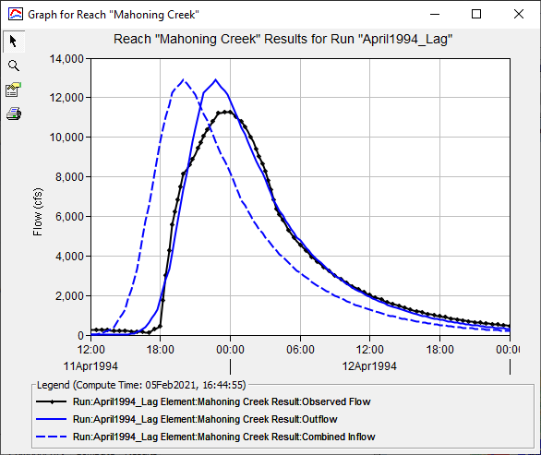
Calibration Techniques
Match rising limb of hydrograph
It the computed peak doesn’t match the observed peak, there’s not much you can do…
Use multiple statistical metrics
  Nash-Sutcliffe Efficiency
  Root Mean Square Error
  Percent Bias
Notes:
When calibrating the Lag method, you can only modify one parameter. Whether you want to align the peak flow rates or better match the rising limb, you’re kind of stuck.
In this example, observed flow is shown in black and computed flow is shown in solid blue.
I’ve matched the rising limb decently well, but my computed peak discharge is too high. But, I can’t do anything to reduce the peak, so that’s about as good as it gets with this method.
Remember to use multiple statistical metrics to gauge whether your model is accurate.

Slide 19
Lag Method
Advantages Disadvantages
Simple, parsimonious method
Method may be too simple; no attenuation effects are simulated by this method
Parameters cannot be estimated using measurable channel characteristics
Only appropriate for use in streams that experience no attenuation
Cannot simulate backwater effects or impacts of hydraulic structures
Notes:
The only advantage of this method is that it’s simple; there’s only one parameter to estimate. This also makes the method parsimonious.
However, it’s so simple that it’s only accurate in steep streams with little to no available storage.

Slide 20
Muskingum Method
Developed to accommodate the looped relationship between storage and outflow that exists in rivers
Relationship between storage and discharge at the outlet is not a unique relationship, it is looped
Notes:
Routing in natural rivers is complicated by the fact that storage in a river reach is not a function of outflow alone.
That’s because the water surface in a channel, during the passage of a flood wave, is not uniform.
The storage and water surface slope within a river reach, for a given outflow, is greater during the rising stages of a flood wave than during the falling stages.
Therefore, the relationship between storage and discharge at the outlet of a channel is not a unique relationship.
Rather it is a looped relationship, as shown in the figure on right.
The Muskingum method was developed in an attempt to accommodate this looped relationship.

Slide 21
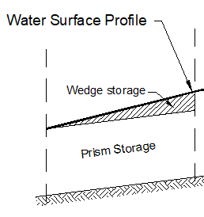
Muskingum Method
Visualize storage as Prism and Wedge parts
Notes:
Within the Muskingum method, storage within a reach is visualized in two parts: Prism and Wedge Storage.
In the example image, prism storage is shown in red and wedge storage is shown in green

Slide 22
Muskingum Method
Rising Limb Falling Limb
Notes:
During the rising stages of the flood wave the wedge storage is positive and added to the prism storage. This situation is depicted in the left-hand image. Here’s prism storage and here’s wedge storage during the rising limb.
Conversely, during the falling stages of a flood wave, the wedge storage is negative and subtracted from the prism storage. This situation is depicted in the right-hand image. Here’s prism storage and here’s wedge storage during the falling limb.

Slide 23
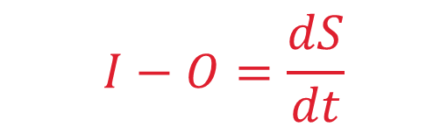
Equations of Motion
$$I−O=\frac{dS}{dt}$$
Continuity:
Momentum:
Relationship between storage in a reach and discharge at the outlet
Notes:
Let’s go back to the continuity and momentum equations.
The Muskingum method starts by simplifying the continuity equation to inflow minus outflow = change in storage over time
The momentum equation is replaced with a relationship relating storage in the reach and discharge at the outlet.
These simplifications make the method simple to parameterize and solve, but they also limit its applicability.
In particular, attenuation is handled numerically and isn’t related to any physically measurable characteristics of the reach.
Because the momentum equation is replaced, this method cannot simulate backwater effects. Also, this method is best applied to steep streams with slopes greater than 2 ft/mi and slowly rising hydrographs.

Slide 24
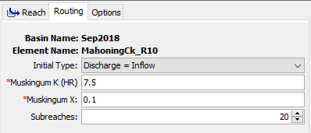
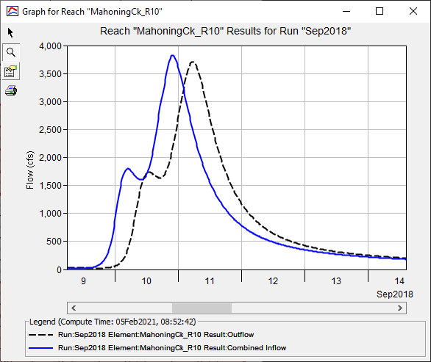
Example
 | Peak (cfs) | Time of Peak
Inflow | 3825 | 9/10/2018 21:45
Outflow | 3705 | 9/11/2018 5:15
Diff | 120 | 7.5 hrs
Notes:
This method requires an initial condition and three parameters: K, X and number of subreaches.
K, X, and number of subreaches are constant throughout time. So, this method cannot simulate variable translation and attenuation.
This example shows how an inflow hydrograph, shown in blue, is translated and attenuated to produce the outflow hydrograph shown in black.
The inflow hydrograph is uniformly translated in time by 7.5 hours, which is controlled by, and equivalent to, the K parameter. I gotta stress the “uniformly translated” portion of that statement. All points along the curve are translated by that much: the peak, the centroid of mass, everything.
The peak of the inflow hydrograph is reduced by 120 cfs, which is controlled by the X parameter and number of subreaches.

Slide 25

Parameter Estimation – K
K is equivalent to travel time through the reach
Can estimate in three ways:
  Use known hydrograph data
  Compare flow length to a flood wave velocity
    $K= \frac{Length}{{Velocity}_{wave}}$
  Use regional regression equations
Notes:
When estimating an appropriate K, three approaches can be used.
The first approach uses observed data at the start and end of the reach to directly compute the travel time. This approach is depicted in the right-hand image. You can use the elapsed time between centroid of areas of the two hydrographs, between the hydrograph peaks, or between midpoints of the rising limbs. However, it’s usually a rare occurrence that observed data is available at both the upstream and downstream end of the reach, so this approach isn’t too common.
The second approach to estimate K uses a computed flood wave velocity and flow length to infer a travel time. This approach is more commonly used and we’ll explore more on the next slide.
Finally, regression equations relating parameters like slope, roughness, and length are available in some regions that can be used to infer this parameter.

Slide 26
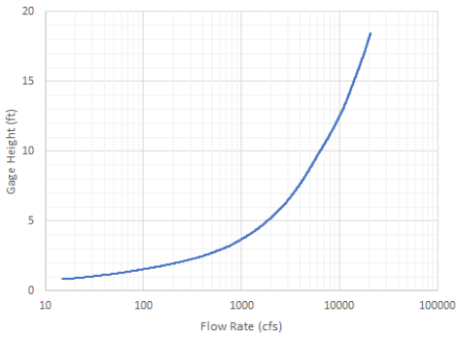

Parameter Estimation – K
Compare flow length to a flood wave velocity
  Manning’s Equation
  Kleitz – Seddon Law
    Flood wave velocity can be approximated from the channel and rating curve
α
    $$V_{wave}=\frac{1}{top width}\left[slope of rating curve\right]$$
Notes:
A value for K can be estimated as the travel time of the flood wave through the routing reach.
The flood wave velocity can be estimated using Manning’s equation or the Kleitz-Seddon Law.
The Kleitz-Seddon law allows you to approximate flood wave velocity from a stage-flow rating curve at representative location for the routing reach.
This method requires you to estimate the slope of the rating curve and the top width, both at a flow rate of interest.
In the image to the right, the flow rate of interest is 10,000 cfs
The slope at this point can then be estimated
The top width must also be estimated for the flow rate of interest using aerial photos, field surveys, or backwater calculations.

Slide 27
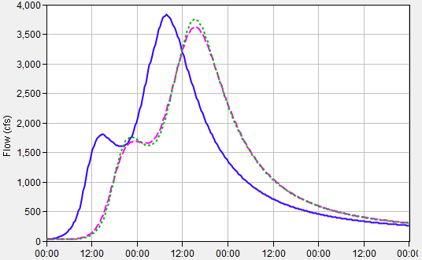
Parameter Estimation – X
Affects attenuation
Dimensionless coefficient
Lacks a strong physical meaning
Limited to bound 0.0 to 0.5
  When X = 0:
    Storage is only a function of outflow
    Maximum attenuation
  When X = 0.5:
    Equal weight to inflow and outflow
    No attenuation; only translation
Start with 0.25 and calibrate
Inflow
Outflow; X = 0.4
Outflow; X = 0.1
Notes:
X is a dimensionless coefficient that controls attenuation.
As I mentioned before, since attenuation is numerical when using this method, this parameter lacks a strong physical meaning and can’t be easily estimated from physical characteristics of the reach.
X must be between 0 and 0.5.
When X=0.0, storage becomes solely a function of outflow and this results in the maximum amount of attenuation.
When X=0.5, storage is equally weighted between inflow and outflow and no attenuation will be simulated.
Typically, I set X equal to 0.25 and then calibrate using observed data.

Slide 28
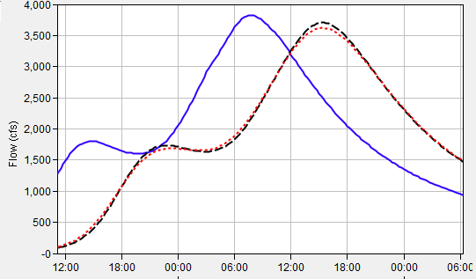

Parameter Estimation – Number of Subreaches
Affects attenuation
Constraint between K and computational interval, Δt
Ideally, Δt = K
  Number of Subreaches = $\frac{K}{∆t}$
However, Δt cannot be less than 2*K*X
Can be treated as a calibration parameter
Inflow
Outflow; # of subreaches = 20
Outflow; # of subreaches = 10
Notes:
The Muskingum routing method has a constraint related to the relationship between the parameter K and the computation interval.
Ideally, the two should be equal, but the computation interval should not be less than 2 * K * X to avoid instabilities.
A long routing reach should be subdivided into sub reaches so that the travel time through each sub reach is approximately equal to the routing computation interval.
This assumes that factors such as channel geometry and roughness have been taken into consideration when estimating K.
To initially estimate this parameter, divide your estimate of K by the computational time interval.
However, this parameter also acts to produce attenuation, so it can be modified during calibration.

Slide 29
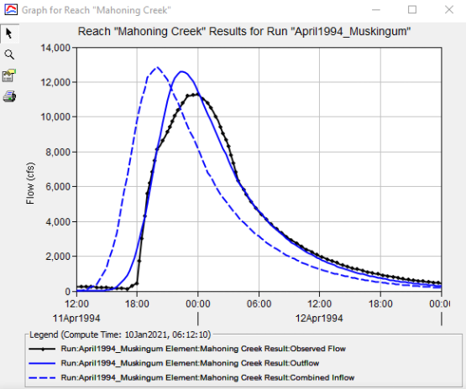
Calibration Techniques
Match rising limb of hydrograph
Match peak discharge
Use multiple statistical metrics
  Nash-Sutcliffe Efficiency
  Root Mean Square Error
  Percent Bias
Notes:
When calibrating the Muskingum method, I like to start by modifying my initial estimate of K to best match the rising limb of the observed hydrograph.
Then, I modify X and number of subreaches in an attempt to match the observed peak flow rate.
In this example, observed flow is shown in black and computed flow is shown in solid blue.
I’ve matched the rising limb decently well, but my computed peak discharge is too high. So, I need to decrease my X parameter and/or number of subreaches.
Remember to use multiple statistical metrics to gauge whether your model is accurate.

Slide 30
Muskingum Method
Advantages Disadvantages
"Mature" method that has been used successfully in thousands of studies throughout the U.S.
Easy to set up and use
Method is parsimonious; it includes only a few parameters necessary to explain the variation of runoff volume
Method may be too simple to accurately predict flood wave translation and attenuation
Only appropriate for use in moderately steep streams (bed slopes > 2 ft/mi)
Cannot simulate variable translation and attenuation
Cannot simulate backwater effects or impacts of hydraulic structures
Notes:
The main advantage of this method is that it’s simple! Because it’s simple, it’s been successfully used all over the world for numerous types of applications.
Also, this method is parsimonious in that a small number of variables (or parameters) are used to explain something which allows for easy investigation of model uncertainty.
However, the primary disadvantage of this method is also that it’s simple.
This method also cannot simulate variable translation and attenuation affects; you only get one go by defining a constant K, X, and number of subreaches for a simulation.

Slide 31
Muskingum-Cunge Method
Builds upon the Muskingum method
  Within the Muskingum method, the X parameter (i.e. attenuation) is not physically based
Cunge set numerical diffusion equal to physical diffusion
  This allowed for parameters to be physically-based as well as improving accuracy and applicability
Notes:
When using the Muskingum method, attenuation is achieved through numerical diffusion rather than physical.
Cunge improved upon the original Muskingum method by setting this numerical diffusion to a physical estimate of diffusion.
The resultant “Muskingum-Cunge” method, as it’s now referred to, has parameters that can be estimated from physical characteristics of the channel, allows for variable translation and diffusion, compares well with full unsteady flow equations over a wide range of flow situations, and is independent of the simulation time step.
This was a big leap forward and major improvement over the Muskingum method! I cannot stress that enough.

Slide 32
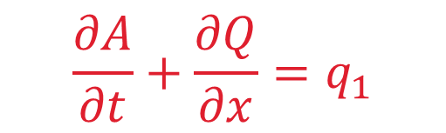
Equations of Motion
$$\frac{∂A}{∂t}+\frac{∂Q}{∂x}=q_{1}$$
Continuity:
Momentum:
Notes:
Recall that all routing methods start with the equations of motion which includes conservation of mass and momentum.
The Muskingum-Cunge method simplifies the continuity equation and neglects the acceleration terms within the momentum equation
These two equations can then be combined to form what’s called the convective diffusion equation.
The use of these simplifications make the method applicable to a wider range of scenarios than the Muskingum method but it still cannot simulate backwater effects. Also, it’s still best applied to steep streams with slopes greater than 2 ft/mi and slowly rising hydrographs.

Slide 33
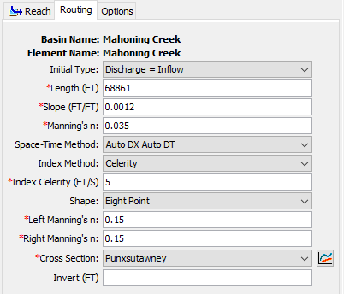
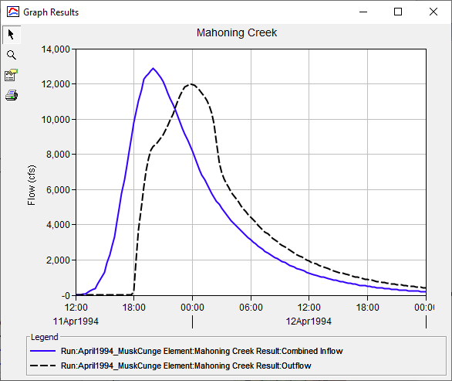
Example
Notes:
This method requires an initial condition and multiple parameters: length, friction slope, manning’s roughness, a space-time interval method and value, an index method and value, and a cross section shape and parameters.
This example shows how an inflow hydrograph, shown in blue, is translated and attenuated to produce the outflow hydrograph shown in black.
The inflow hydrograph is translated in time by a varying amount. Translation isn’t uniform and depends upon the inflow hydrograph and the physical characteristics of the reach in question.
The inflow hydrograph is also attenuated. Similarly, the amount of attenuation depends upon the inflow hydrograph and the physical characteristics of the reach.

Slide 34
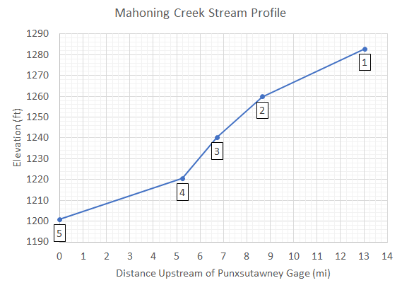
Parameter Estimation – Reach Length and Friction Slope
Compute reach characteristics
  Parameters | Characteristics | Reach
Friction slope can be initially estimated using bed slope
  If slope varies significantly, it may be necessary to use multiple reaches with different slopes
Notes:
Both reach length and friction slope can be estimated directly within HEC-HMS if you have associated a terrain data set with your basin model and your reaches are georeferenced.
When estimating an initial friction slope, I usually equate to the bed slope.
However, if the slope is expected to vary significantly, it may be necessary to use multiple reaches with different slopes instead of just one. This is the case for the image to the right. Three different reaches, each with different slopes, are likely most appropriate for this use case.

Slide 35
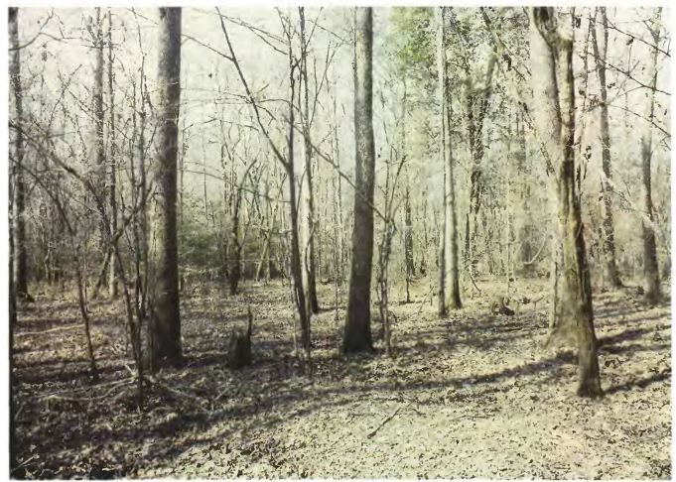
Parameter Estimation – Manning’s Roughness
Average value for the whole reach
Estimate using “reference” streams or through calibration
Bayou de Loutre near Farmerville, LA
Computed roughness: n = 0.11
Depth of flow: 3.6 ft
Notes:
The Manning's n roughness coefficient should be set as the average value for the whole reach.
This value can be estimated using “reference” streams with established roughness coefficients or through calibration.
As an example, the image to the right is of a floodplain in Louisiana with a computed Manning’s n of 0.11.

Slide 36
Parameter Estimation – Space-Time Interval and Index Method
Critical to ensure accuracy and stability
Three Space-Time Interval options:
  Auto DX Auto DT
  Specified DX Auto DT
  Specified DX Specified DT
Two Index options:
  Flow
  Celerity
    5 ft/s
Notes:
A space-time interval and index method are required for each routing reach.
These parameters are critical to ensure accuracy and stability of the method.
For most applications, the Auto DX Auto DT method is adequate.
For most applications, using the Celerity index method and a celerity of 5 ft/s is adequate, but can vary based upon the use case.

Slide 37
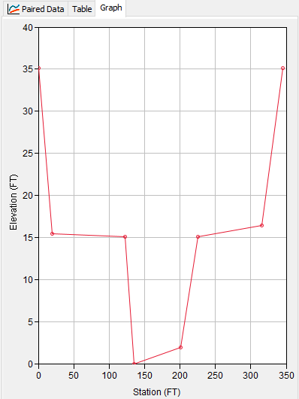
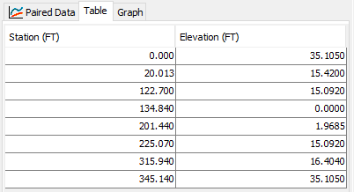
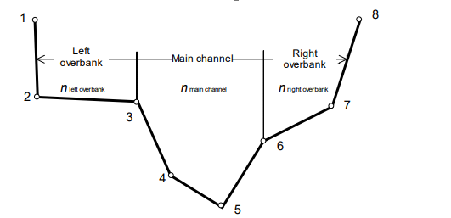
Parameter Estimation – Cross Section
Six shapes:
  Circle
  Eight point
  Rectangular
  Tabular
  Trapezoid
  Triangle
Estimate parameters using GIS information
Notes:
HEC-HMS allows you to specify the required cross section information in the six ways that are shown here.
I personally prefer to use the 8 point cross section shape.
Depending upon the chosen shape, additional information will have to be entered to describe the cross-section shape.
All the required parameters can be estimated using GIS information.
In the example shown here, I took a field-surveyed cross section and simplified it to just eight points, which can be done fairly rapidly.

Slide 38
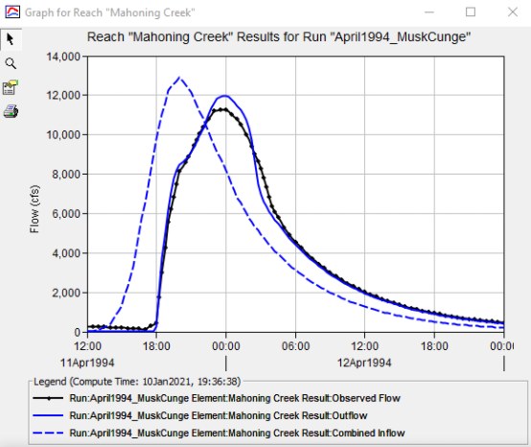
Calibration Techniques
Match rising limb of hydrograph
Match peak discharge
Use multiple statistical metrics
  Nash-Sutcliffe Efficiency
  Root Mean Square Error
  Percent Bias
Notes:
Like all other methods, I like to start calibrating Muskingum-Cunge parameters by first trying to best match the rising limb of the observed hydrograph.
Then, I modify parameters in an attempt to match the observed peak flow rate.
In this example, observed flow is shown in black and computed flow is shown in solid blue.
I’ve matched the rising limb decently well, but my computed peak discharge is too high. In this particular case, it would be best if I split the reach into separate pieces with individual parameters to better match the observed data.
Remember to use multiple statistical metrics to gauge whether your model is accurate.

Slide 39
Muskingum-Cunge Method
Advantages Disadvantages
Similar to advantages of the Muskingum method
Predicted values are in accordance with open channel flow theory
Parameters can be estimated using measurable channel characteristics
Can use cross-section shapes that include overbank areas.
Good for ungaged reaches
Only appropriate for use in moderately steep streams (bed slopes > 2 ft/mi)
Cannot simulate backwater effects or impacts of hydraulic structures
Method is less parsimonious than Muskingum; it requires many more parameters
Notes:
A major advantage of this method is that the predicted values are in accordance with open channel flow theory.
Also, you can simulate variable translation and attenuation.
Finally, the required parameters can be estimated using physically measurable characteristics.
However, this method is less parsimonious than simpler methods in that more parameters are required.
It also cannot simulate backwater effects and is only appropriate for use in streams with slopes greater than 2 ft/mi and situations with slow rising hydrographs.

Slide 40
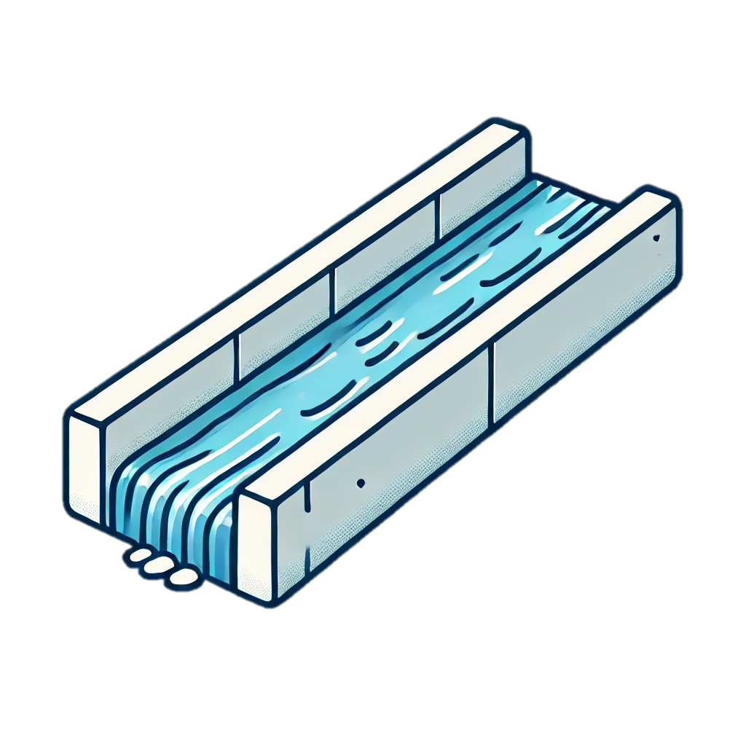
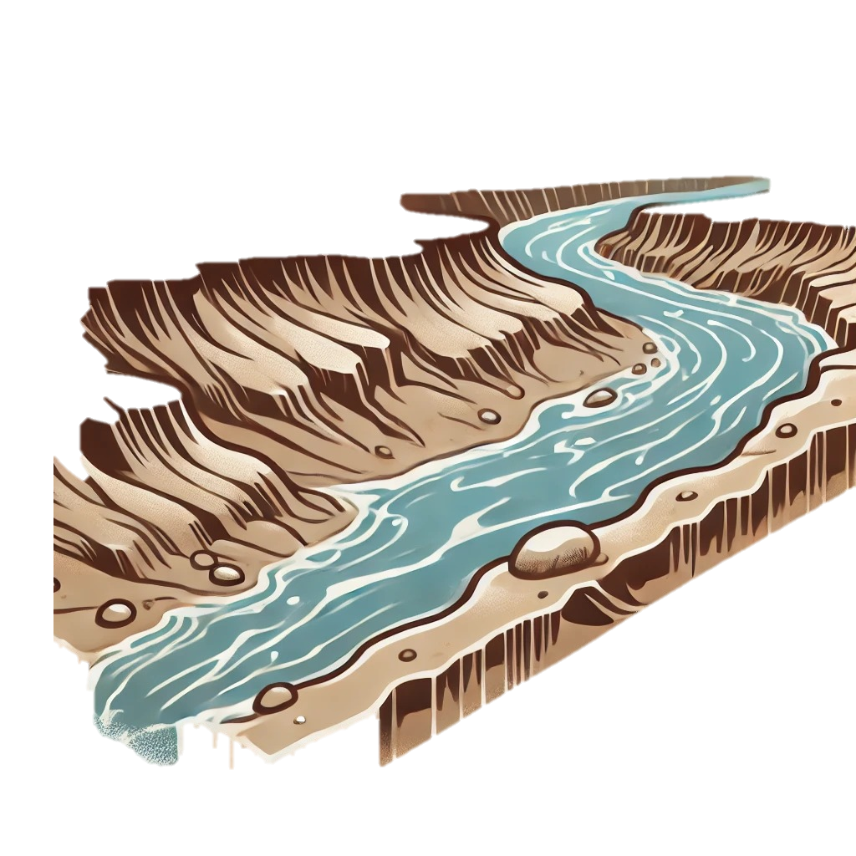
Keep In Mind…
All routing models are simplifications of the real world
An appropriate method captures the significant aspects of the system in question
An appropriate method provides the necessary information to meet study objectives
Notes:
Before we start, keep in mind that all routing models are a simplification of the real world.
Therefore, you must identify the aspects of the physical system that will most affect reach routing and go with the model that best addresses those needs.
For instance, if there is going to be significant amount of structures that affect the water surface profile, you must use a routing method that captures the influence of backwater.
Further, the appropriate routing method provides the necessary information to meet study objectives.
If the goal of the study is, for instance, to identify the peak flow at some point in the watershed for sizing a culvert, a hydrologic method may be an appropriate choice.

Slide 41
Questions to Ask Yourself
For each routing method:
  How does it represent open channel flow processes?
  What are its advantages and disadvantages?
  What input data is required?
  Can it supply the required output information?
Notes:
Here are some questions to ask yourself when starting a study.
For each of the eight available routing methods within HEC-HMS:
How does each method represent open channel flow processes,
What are the method’s advantages and disadvantages,
What input data is required by the method, and
Can the method supply the required output information?

Slide 42
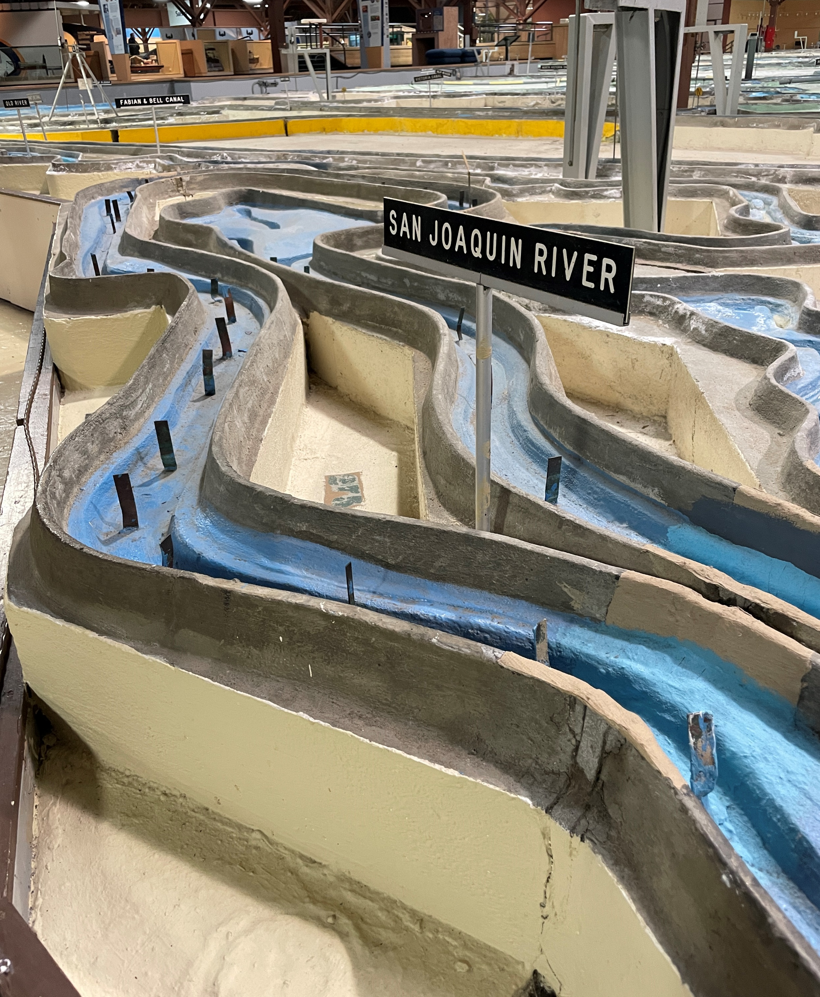
Additional Factors to Consider
What type of study / what will be considered?
  Reservoir design
  Channel modifications
  System effects (changes to the watershed)
Level of detail
  Feasibility, planning, or design
Characteristics of the physical system in question
Familiarity and experience of the modeler
Time and Costs
Notes:
Some additional factors to consider include:
What type of study is being undertaken? What’s going to be considered? Will one or more reservoirs be simulated? Will modifications to one or more channels be simulated?
How much detail is required by the study? Is this study quick and dirty or is a high degree of accuracy required?
What are the characteristics of the physical system in question? We’ll come back to that topic over the next few slides.
What routing methods are you most familiar with?
How much time and money is available for the study?

Slide 43
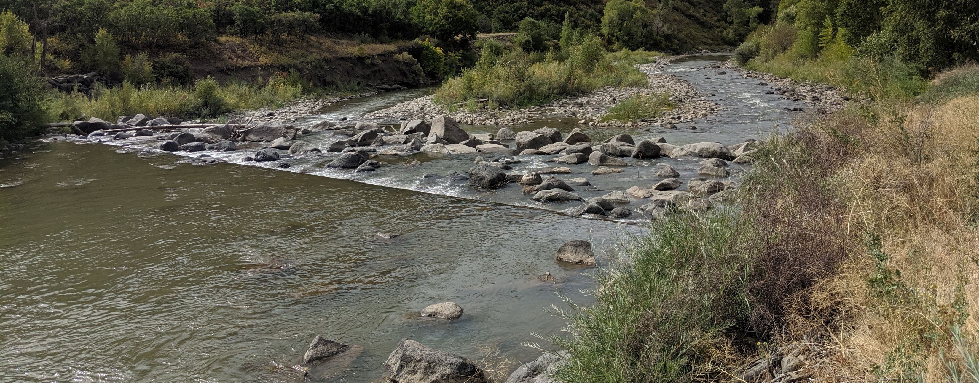
Backwater Effects
Caused by tides, confluences, hydraulic structures, bridges, culverts, channel constrictions, and other obstructions
Hydrologic methods generally do not simulate backwater effects
  Modified Puls can
Hydraulic methods generally do account for backwater
  Kinematic Wave cannot
Notes:
Now, let’s talk about several physical considerations.
Backwater is an increase in the upstream water surface resulting from things like tides, bridges, hydraulic structures, and other obstructions.
In general, hydrologic methods DO NOT simulate backwater effects with the exception of Modified Puls, which can if the storage-outflow relationships that are used were derived from a hydraulic model that included backwater effects.
Conversely, hydraulic methods CAN usually simulate backwater effects. Notably, the Kinematic Wave method cannot simulate backwater effects due to the underlying simplifications of the momentum equation within that method.

Slide 44
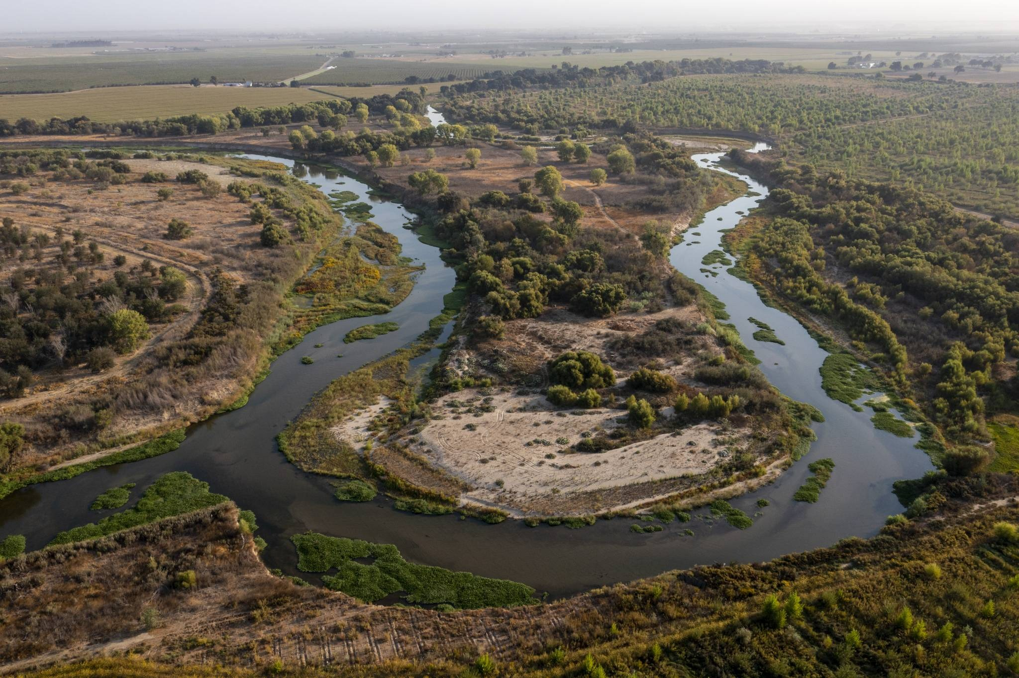
Floodplains
Can have significant impact on routed hydrograph
Important factors include:
  Width
  Slope
  Roughness
Separate overbanks from main channel
Notes:
Floodplains can have a significant impact on routed hydrographs if the amount of storage they provide is large compared to the hydrograph in question.
If there’s little to no storage within the flood plain, the inflow hydrograph will likely experience little to no translation or attenuation as it moves through the reach.
Important factors to consider include the width, slope, and roughness of the floodplain in your specific application.

Slide 45
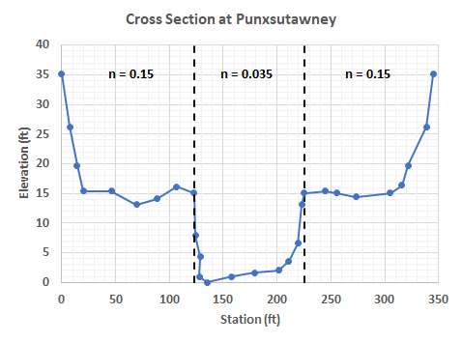
Floodplains
Methods that can simulate flood plain effects:
  Muskingum-Cunge w/ an eight point cross section
  Modified Puls
Very wide and flat floodplains may require 2D modeling
  2D Diffusion Wave method
Notes:
If floodplains are important to include, you must use a method that can separately compute the effects of the overbank areas from the main channel.
For example, the Muskingum-Cunge method, when using an 8 point cross section shape, can do just that. However, the Muskingum method cannot.
If the floodplain is incredibly wide and flat and flow actually moves perpendicular to the main channel, 2D modeling may be required to accurately simulate the movement of water.
In those cases, the 2D Diffusion Wave method can be used.

Slide 46
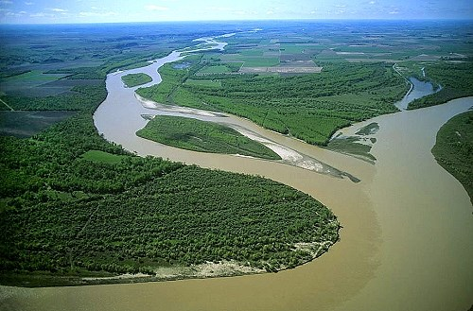
Confluences and Flow Splits
If no significant backwater:
  All hydrologic methods can apply
If significant backwater, use:
  2D Diffusion Wave
  Modified Puls
For full networks with flow splits and reversals, full dynamic wave equations should be applied
  e.g. HEC-RAS
Notes:
Confluences can be sources of backwater effects that were previously mentioned. In the example image to the right, the Yellowstone River and Missouri River confluence is shown. If, say, the Yellowstone River is flooding, significant backwater effects can be experienced for miles on the Missouri River.
If there are significant effects from a tributary, you should use a method that can account for backwater effects. However, if backwater effects from the confluence are negligible, all hydrologic routing methods are fine for use.
When there are flow splits and reversals, like those afforded by tidal bores from tropical storms, for example, the full dynamic wave equations should be applied, which are available for use within HEC-RAS.

Slide 47
Supercritical Flow
Hydrologic methods do not know about flow regime
If supercritical for a long reach, or stage is important, supercritical reach should be isolated
Intermittent supercritical can be ignored for hydrologic routing purposes
Notes:
Regarding sub and supercritical flow, hydrologic methods don’t know the difference between the two.
If the flow regime changes for long stretches within your modeling domain, or if stage is an important factor, the reaches where a different flow regime is present should be broken out and isolated.
In general, intermittent supercritical flow can be ignored for hydrologic routing purposes.

Slide 48
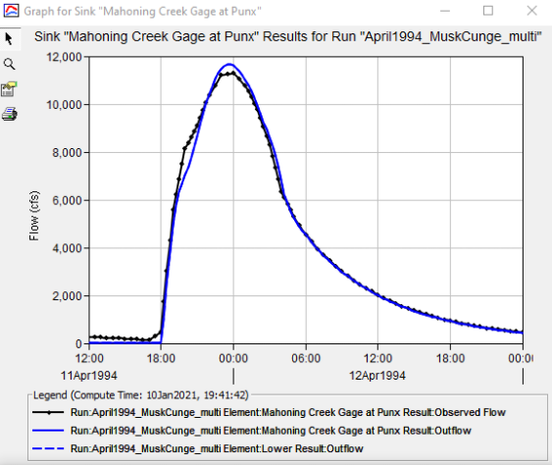
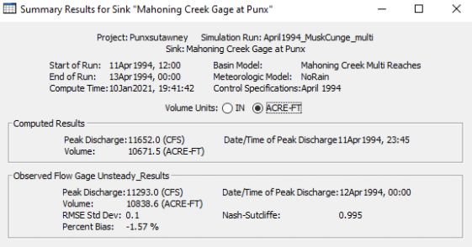
Observed Data
If observed data is not available:
  Physically based methods should be used
    Easier to estimate input data
    More reliable results
When observed data is available:
  Must calibrate and validate
  Use statistical metrics
Notes:
When observed data isn’t available, physically-based methods should be used for two reasons:
It’s easier to estimate the input data and
The results will be more reliable.
However, when observed data is available, your model must be calibrated and validated. Make sure you use multiple statistical metrics to ascertain model performance.

Slide 49
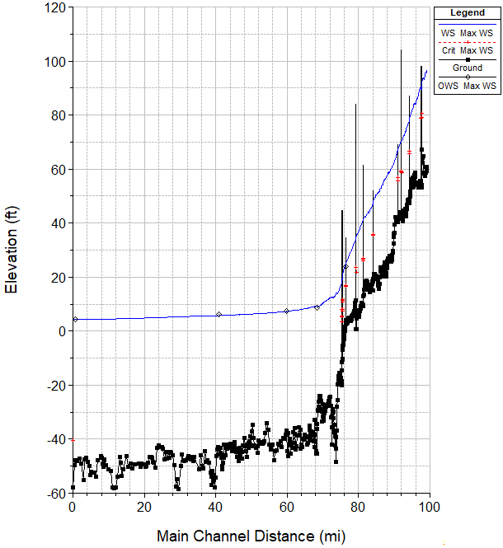
Channel Slope
As slope gets flatter, hydrologic methods begin to fail
  Simplifications become more and more important
  e.g., acceleration terms w/in Momentum equation
Notes:
Slope is an incredibly important factor to consider when choosing a routing method.
In general, as the slope gets flatter, hydrologic methods begin to fail.
This is due to their derivation: all hydrologic methods either get rid of the momentum equation or make massive simplifications.
When slopes get flatter, the acceleration terms within the momentum equation begin to become more and more important.
In the example image here, above river mile 75 or so, the slope is relatively steep. Most hydrologic routing methods will do just fine upstream of that point. However, below river mile 75, the slope dramatically flattens. Very few hydrologic routing methods will be accurate downstream of that point.

Slide 50
Slope and Rate-of-Rise Rules of Thumb
When bed slope > 10 ft/mi:
  Most hydrologic routing methods are okay to use
When bed slope < 2 ft/mi:
  Most hydrologic routing methods will produce erroneous results
When bed slope is between 2 and 10 ft/mi:
  Depends upon the channel properties, chosen method, and rate-of-rise of the hydrograph
Notes:
Here are some rules of thumb that you can use.
For channels with bed slopes greater than 10 ft/mi, most hydrologic routing methods are okay to use
For channels with bed slopes less than 2 ft/mi, most hydrologic routing methods will fail and produce erroneous results
In between 10 and 2 ft/mi is a grey area; the accuracy of the results depend upon the channel properties, the chosen method, and the rate-of-rise of the hydrograph

Slide 51
Ponce (1978) Criterion
Kinematic Wave routed peak within 5% provided the following is satisfied:
where: T = Hydrograph duration in seconds
S_{o} = Friction or Bed Slope (ft/ft)
U_{o} = Reference mean velocity (ft/sec)
d_{o} = Reference flow depth (ft)
Notes:
Ponce published a study in 1978 that took a look at the use of the Kinematic Wave and Diffusion Wave approximations when routing various hydrographs over varying bed slopes.
He found that the Kinematic Wave routine produced reasonable results when the following inequality was satisfied.
If the Kinematic Wave approximation works, most hydrologic routing routines will work fine.

Slide 52
Ponce (1978) Criterion
Diffusion Wave routed peak within 5% provided the following is satisfied:
where: T = Hydrograph duration in seconds
S_{o} = Friction or Bed Slope (ft/ft)
g = Gravitational acceleration (ft/sec²)
d_{o} = Reference flow depth (ft)
Notes:
When using the Diffusion Wave routine, reasonable results were produced when the following inequality was satisfied.
These two criterion, when used together, can be used as book-ends to predict whether certain routing routines will produce reasonable results or not.

Slide 53
Factors to Consider | Appropriate Methods | NOT Appropriate
No observed hydrograph data available for calibration | -Diffusion Wave -Kinematic Wave -Muskingum-Cunge -Modified Puls* | -Lag -Muskingum
Significant backwater that will influence hydrograph | -Diffusion Wave -Modified Puls* | -Lag -Kinematic Wave -Muskingum -Muskingum-Cunge
Flood will go out of bank into the floodplain | -Diffusion Wave -Modified Puls* -Muskingum-Cunge | -Muskingum -Lag -Kinematic Wave
*with storage-discharge curves produced by a hydraulic model
Notes:
Now, I’ll present some tables that summarize the factors we just discussed.
These aren’t hard and fast rules or anything like that. These tables are meant to provide a quick way to identify reasonable modeling choices.
When no observed data is available, it’s difficult, if not impossible, to have faith in estimated parameters for the Lag and Muskingum methods, so it’s best to not use them in those situations. Conversely, methods that can estimate parameters using physically measurable data are a good bet.
When appreciable backwater effects are present that will influence the routed hydrograph, only the Diffusion Wave and Modified Puls methods can produce accurate results. Other hydrologic methods won’t work well.
When floods produce stages that go out of bank and there’s significant storage that will affect the results, only methods that calculate hydraulic properties of the overbanks separately from the main channel are appropriate for use, like Muskingum-Cunge.

Slide 54




Factors to Consider | Appropriate Methods | NOT Appropriate
Slope > 10 ft/mi and: | -Most, if not all, methods | -None
2 < Slope < 10 ft/mi and: | -Diffusion Wave -Muskingum-Cunge -Modified Puls* -Muskingum | -Kinematic Wave -Lag
Slope < 2 ft/mi and: | -Diffusion Wave -Muskingum-Cunge -Modified Puls* | -Kinematic Wave -Muskingum -Lag
Slope < 2 ft/mi and: | -Full Dynamic Wave | -All other methods
$$\frac{TS_{o}u_{o}}{d_{o}}≥171$$
$$\frac{TS_{o}u_{o}}{d_{o}}<171$$
$$TS_{o}{\left(\frac{g}{d_{o}}\right)}^{1/2}≥30$$
$$TS_{o}{\left(\frac{g}{d_{o}}\right)}^{1/2}<30$$
T = Hydrograph Duration [sec]
S₀ = Friction Slope [ft/ft]
u₀ = Average Velocity [ft/s]
d₀ = Flow Depth [ft]
*with storage-discharge curves produced by a hydraulic model
Notes:
Here are some slope and hydrograph considerations.
In general, if channel slopes are over 10 ft/mi and the hydrograph is relatively slow to rise, using the Ponce criterion, most routing methods will do just fine.
But, as channel slopes decrease and if the rate of rise of the hydrograph becomes appreciably fast, hydrologic routing methods start to produce erroneous results.
For channel slopes less than 2 ft/mi, only the full dynamic wave equations will do a good job producing results.

Slide 55
Review
Eight hydrologic routing methods are available within HEC-HMS
GIS data sources can be used to estimate routing parameters
Lag method is the simplest routing method within HEC-HMS
Muskingum method is simple to use and calibrate
Muskingum-Cunge method recreates classical open channel flow phenomena
The most appropriate method depends upon many considerations
Important physical considerations include backwater effects, floodplains, and channel slope
Notes:
In review, in this lecture, I introduced reach routing within HEC-HMS.
We also compared hydrologic routing and hydraulic routing and delved into some of the assumptions that are made when simulating reach routing.
We also quickly discussed parameter estimation, but we’ll revisit this topic in future videos.
Lag:
This is the simplest routing method available within HEC-HMS.
However, it’s simplicity is also a disadvantage for complicated scenarios.
Muskingum
Slightly more advanced than Lag
Also simple to parameterize and use method within HEC-HMS.
Also suffers from over-simplification
Muskingum-Cunge
This method can recreate classical open channel flow phenomena and the required parameters can be estimated using physically measurable characteristics.
This makes it a great choice for locations with little to no observed discharge data.
However, it also requires more parameters than simpler methods.
Selecting the appropriate routine
The most appropriate routing method for a specific situation depends upon many considerations, including study constraints, data availability, output requirements, and physical considerations.
Important physical components of the system in question include backwater effects, floodplains, and channel slope.
Feel free to use the rules-of-thumb and tables presented near the end of this video to quickly screen the available routing methods.

