Slide 1

Advanced Model Calibration
Hydrologic Modeling with HEC-HMS
November 2024
Lauren Coe, P.E.
US Army Corps of Engineers
Hydrologic Engineering Center
Slides by: Thomas Brauer

Slide 2
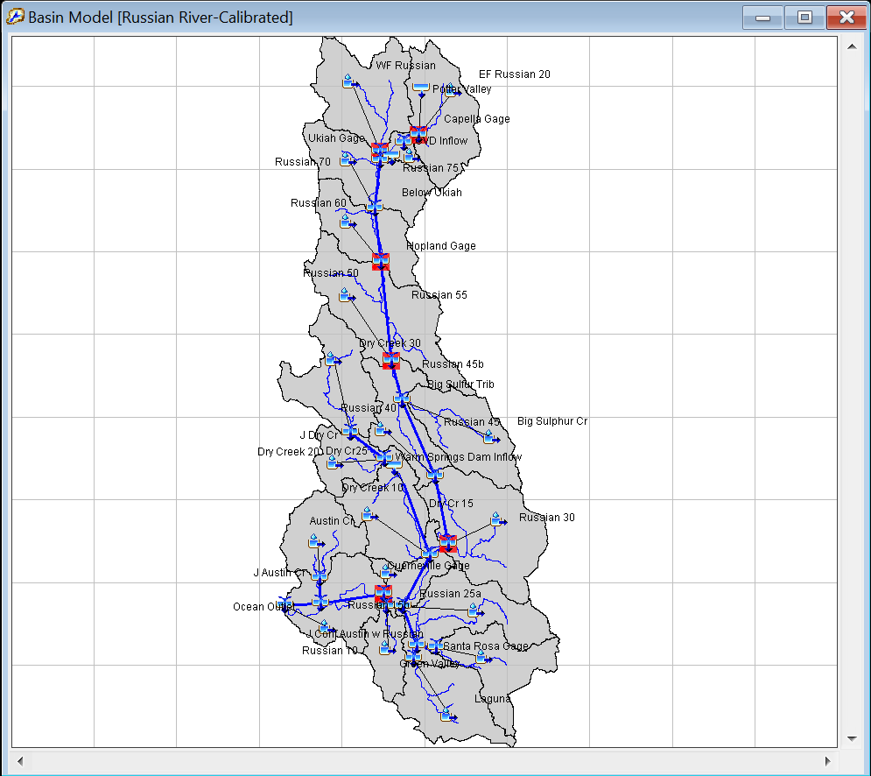
Russian River 60 YR period of record
Notes:
This is the basin map as configured in HEC-HMS. As you can see there are six calibration locations.
This study weighed the competing interests of water supply in the Coyote Valley Dam reservoir (t) vs flood risk downstream (t, t). It was important that both volumes and peak flows were well represented by the model. That’s something you want to keep in mind prior to starting any modeling effort, but especially an advanced model- it will shape what decisions you make during calibration process.

Slide 3
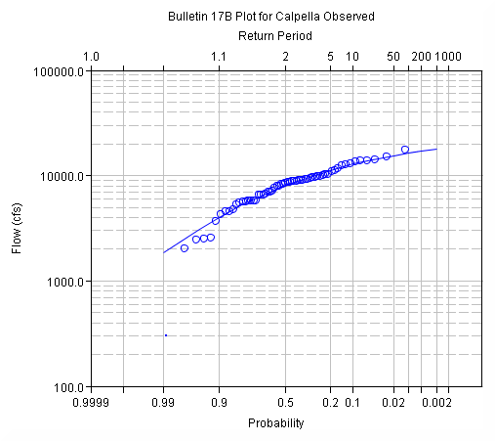
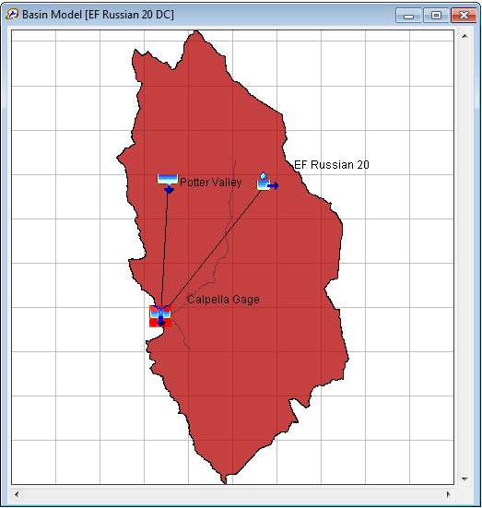
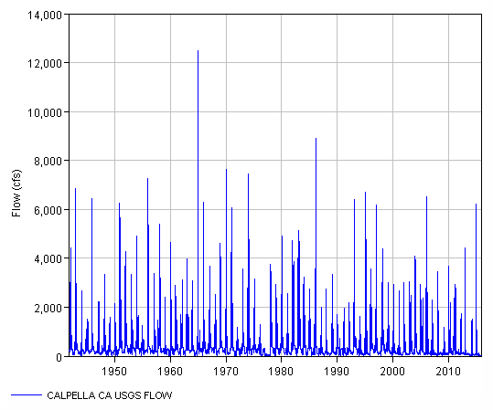
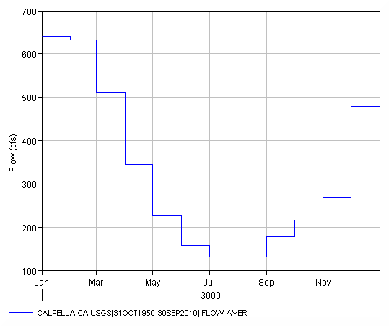
Runoff Signatures
Flow Frequency
Runoff hydrograph
Monthly Volume
Notes:
Calibration should always proceed from upstream to downstream. In this case we are starting with our most upstream subbasin, EF Russian 20. If we run our 60 year simulation, the result is a 60 year runoff hydrograph. (t) How do we calibrate a 60 year hydrograph? In this case we used runoff signatures to make graphical inspections easier (t).
Runoff signatures are response patterns. Examples include:
Annual runoff volumes or depth
Seasonal runoff volumes or depth
A Flow duration curve
Low flow flow frequency
High flow flow frequency
Runoff hydrograph
Of these, the runoff hydrograph is the most familiar, but from the runoff hydrograph we can derive an annual maximum flow series and a monthly volume distribution.

Slide 4

Calibration Steps
Event Calibration
Monthly Volumes
Single Water Year
  Calibrate Early Wet Season
  Baseflow
  Peak Flows
Period of Record
  Annual Maximum
  Flow Frequency

Slide 5
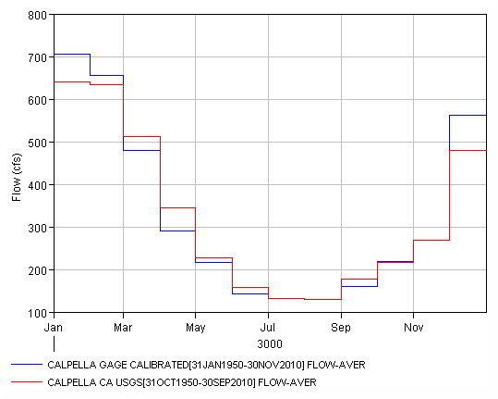
Monthly Volume
Key Parameters:
Canopy
Loss
Baseflow
Notes:
Monthly volumes were important in this study for analyzing water supply.
The calibration started with monthly volumes- these values were calibrated by adjusting canopy, loss, and baseflow parameters.
For period of record the we adjusted these parameters while graphically inspecting (t) the monthly flow volumes.
You can see monthly averages for computed vs observed time-series.

Slide 6
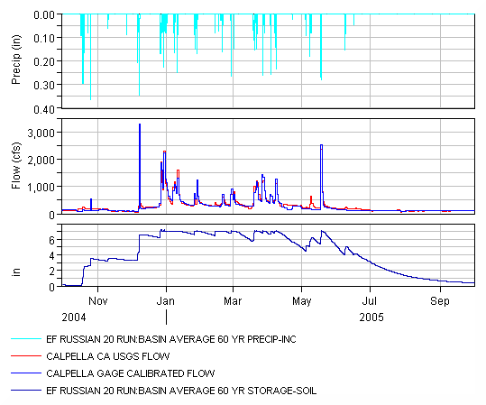
Runoff Hydrograph
Notes:
Next, it can be helpful to start with a single or even a couple of consecutive water years. That’s going to let you run a quicker simulation and still get a feel for how your model can model continuous processes. So if we were modeling a single water year, the calibration would focus on the timing of the first major runoff event of the year (t), then the soil moisture state in between events during the wet season (t).
This is subject to the Crop Coefficient and soil storage parameters.

Slide 7
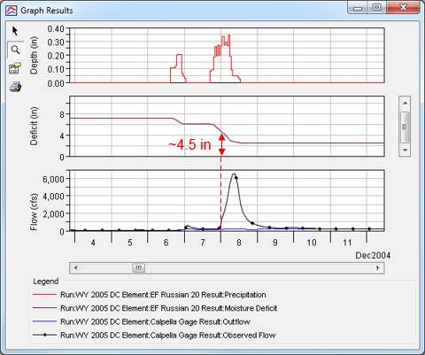
Runoff Hydrograph
The soil deficit should be
~ 0 at the first large flood event
Adjust max soil deficit
Key Parameters:
Crop Coefficient
Soil Moisture Deficit
Notes:
CC ratio applied to the potential evapotranspiration (computed in the Meteorologic Model) when computing the amount of water to actually extract from the soil. CC ~ ET

Slide 8
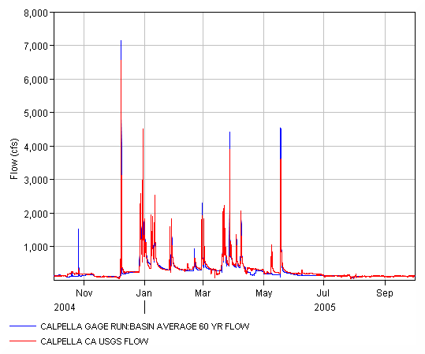
Runoff Hydrograph
Key Parameter:
Baseflow
Notes:
Finally we zoomed in on the runoff hydrograph to calibrate the recession limb of hydrographs (t) and baseflow recession curves. All of the baseflow methods in HEC-HMS require a graphical fit to calibrate coefficients.

Slide 9
Peak Flows
Key Parameter:
Infiltration rate
Notes:
The annual maximum flow-frequency curve was evaluated to characterize flood risk.
If we were doing a single water year calibration, we would focus on individual hydrograph peaks (t).
Peak flows are sensitive to the infiltration rate in the soil loss model.
For the period of record, we adjusted these parameters while graphically inspecting (t) the flow-frequency curve.
The focus of calibration was overall correlation between computed and observed flow frow-frequency curves with emphasis on low probability events (t) since the study was focused on floods.

Slide 10
Annual Maximum Flows

Slide 11
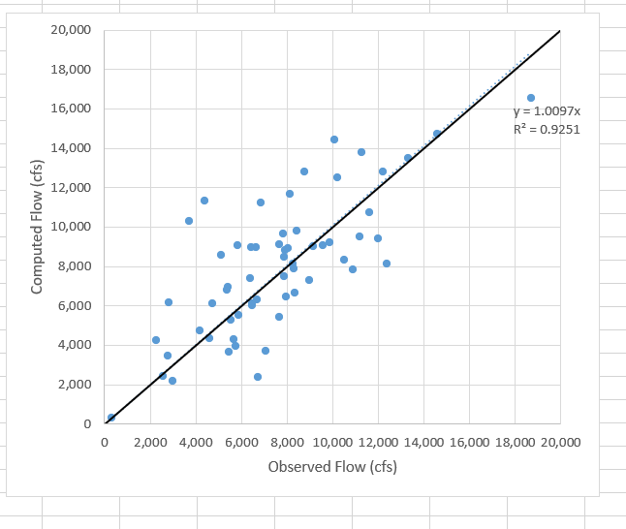
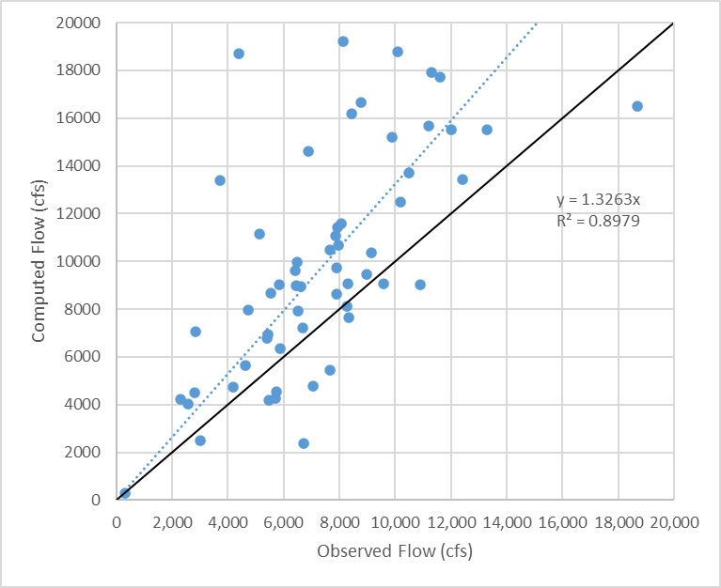
Annual Maximum Flows
WY | Computed | Observed
1951 | 13,771 | 11,300
1952 | 7,888 | 8,300
1953 | 9,054 | 9,580
1954 | 8,319 | 10,500
1955 | 3,467 | 2,800
1956 | 13,505 | 13,300
1957 | 6,960 | 5,430
1958 | 10,735 | 11,600
1959 | 4,334 | 4,620
1960 | 9,004 | 9,160
1961 | 9,045 | 5,850
1962 | 6,036 | 6,490
1963 | 8,802 | 7,940
1964 | 6,638 | 8,340
1965 | 16,517 | 18,700
1966 | 9,221 | 9,890

Slide 12
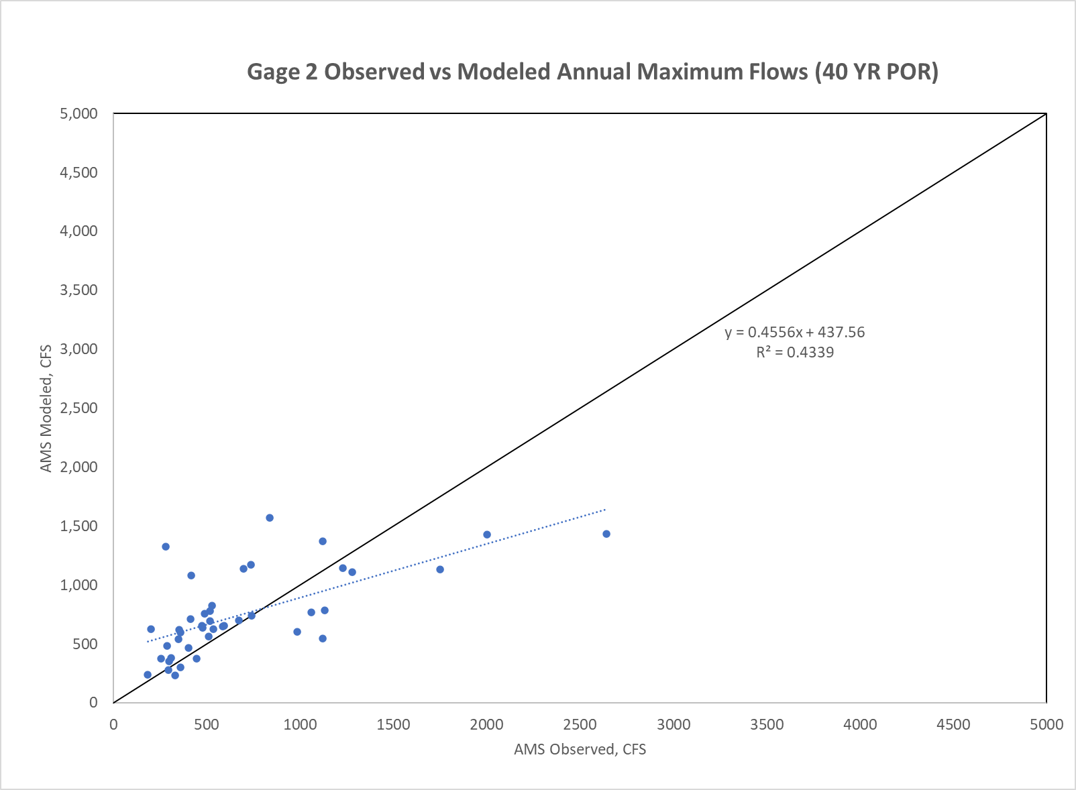
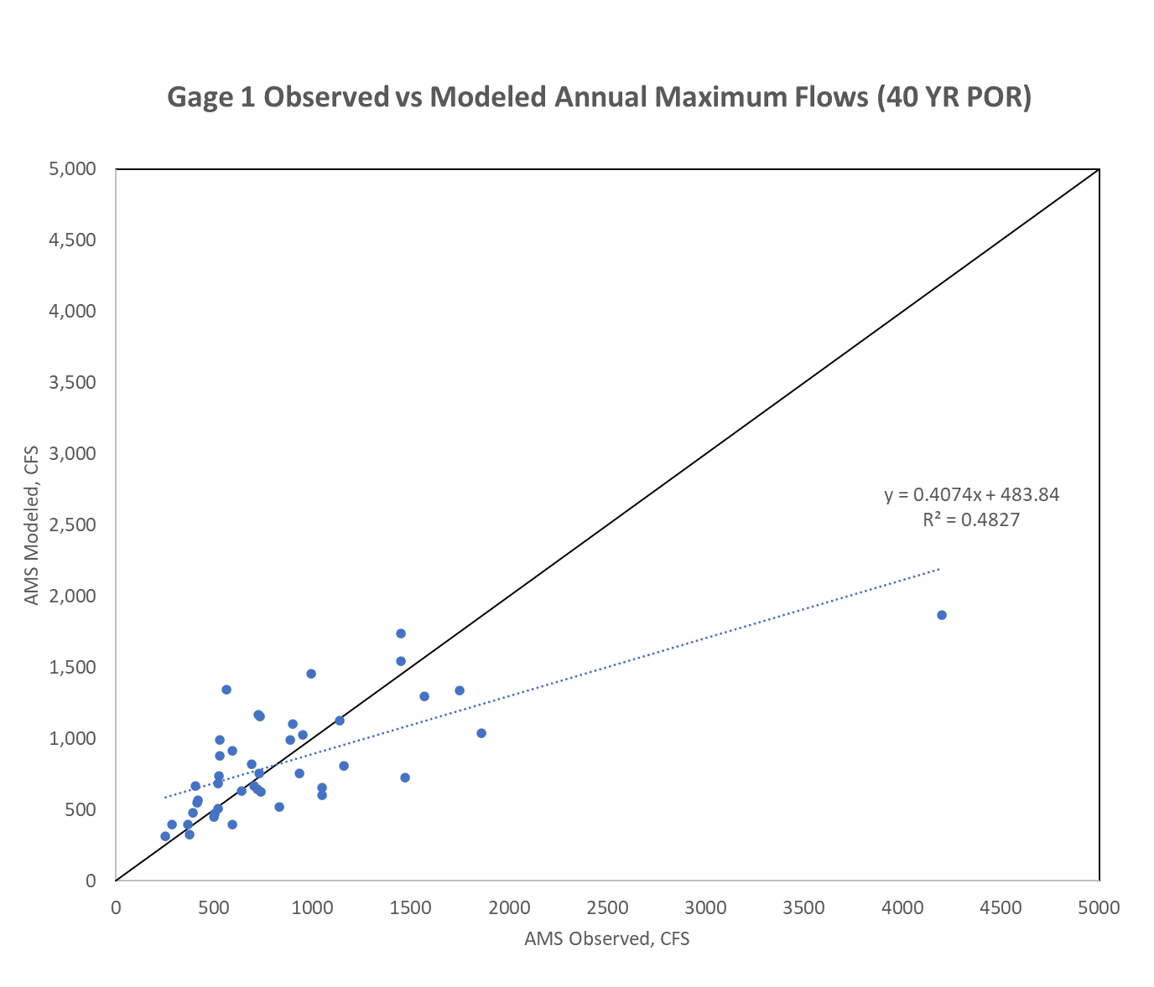
Annual Maximum Flows

Slide 13
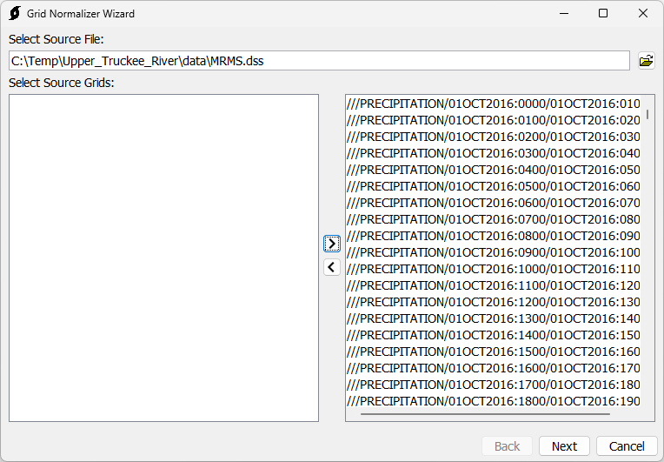
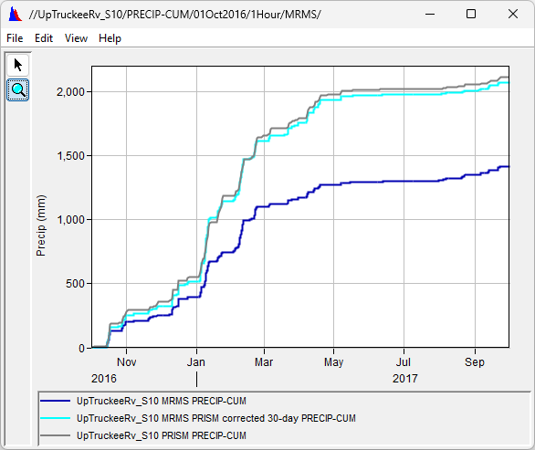
Normalizer
Task 3: Normalizing Precipitation Data - HEC-HMS Tutorials and Guides - HEC Confluence

Slide 14
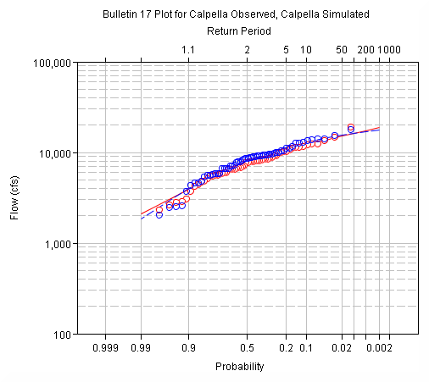
Annual Maximum Flows

Slide 15
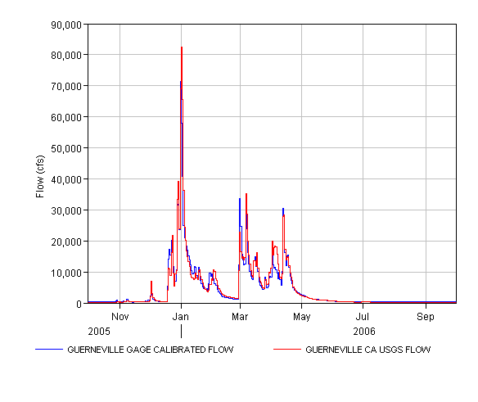
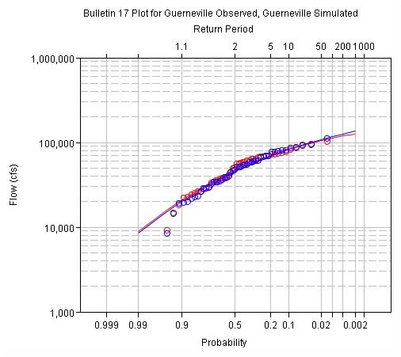
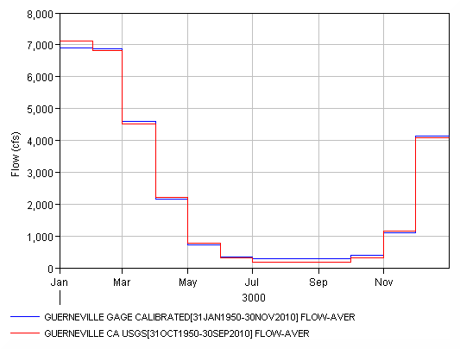
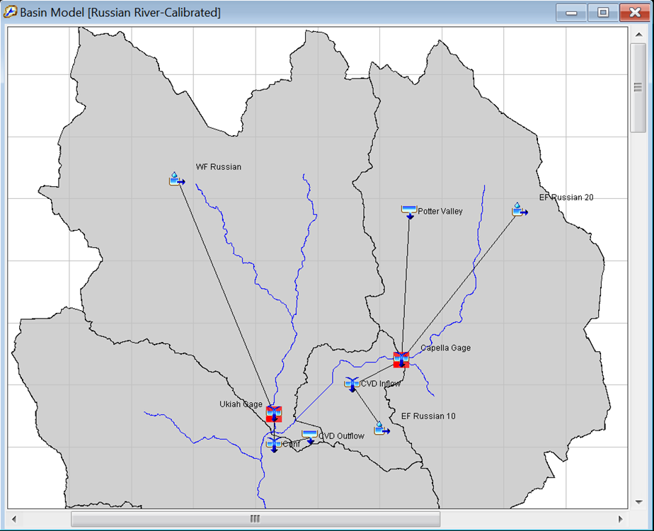
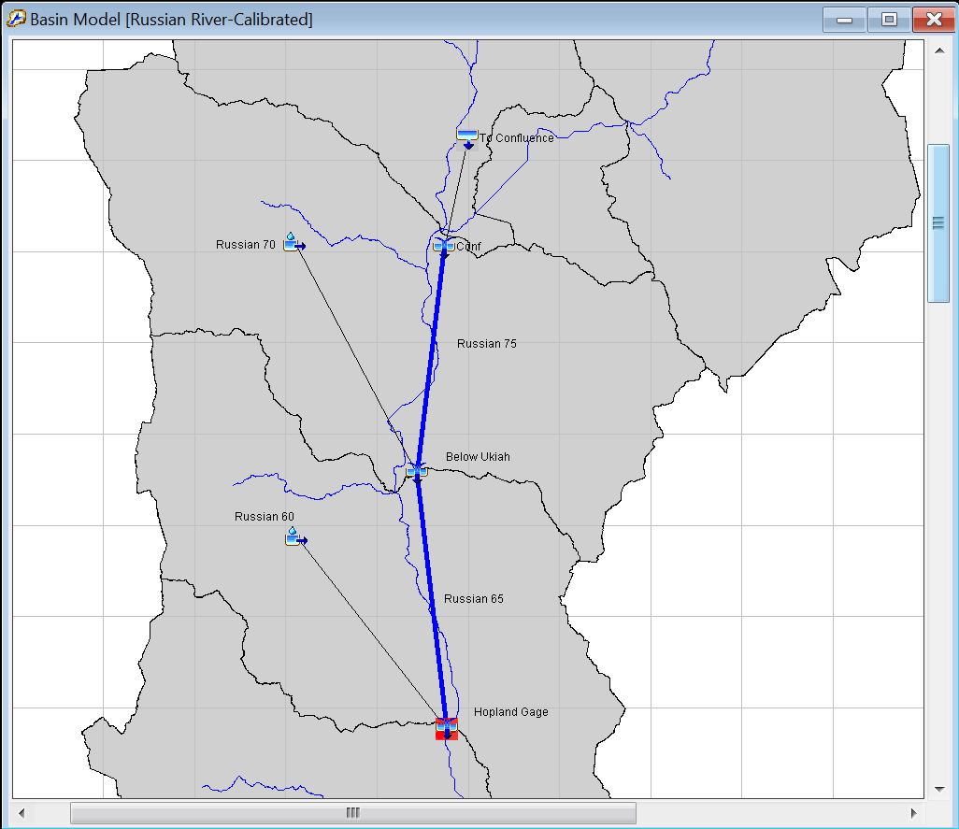
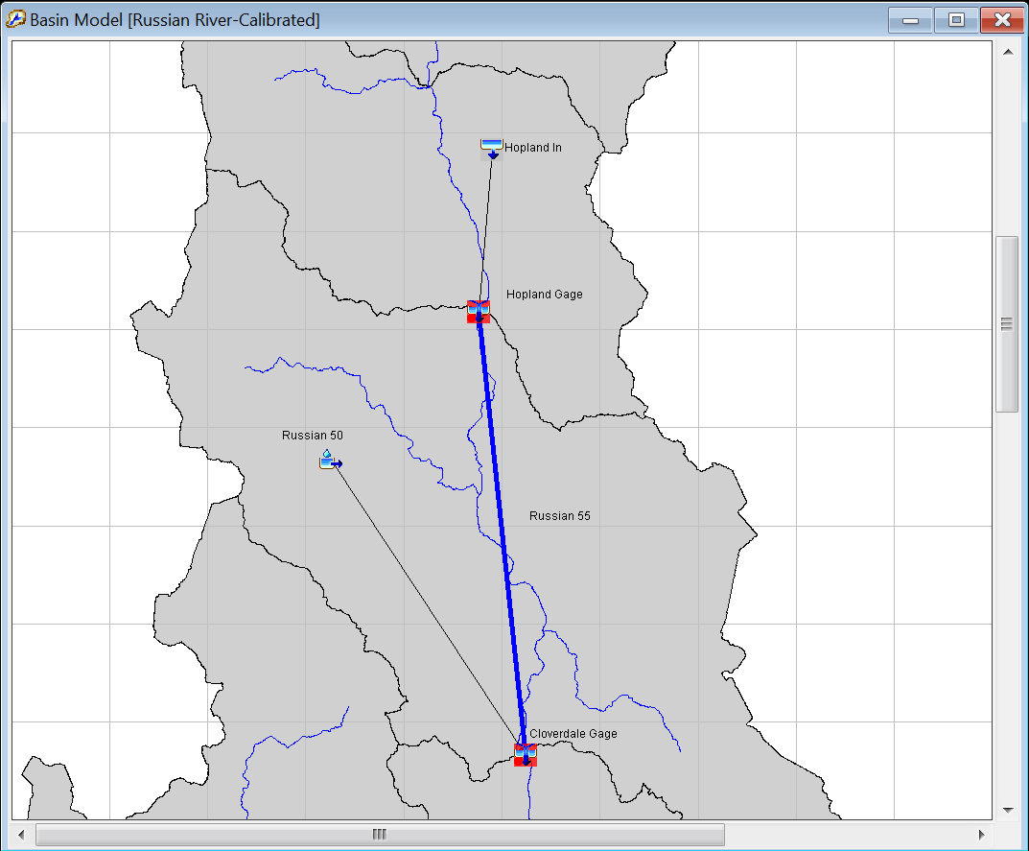
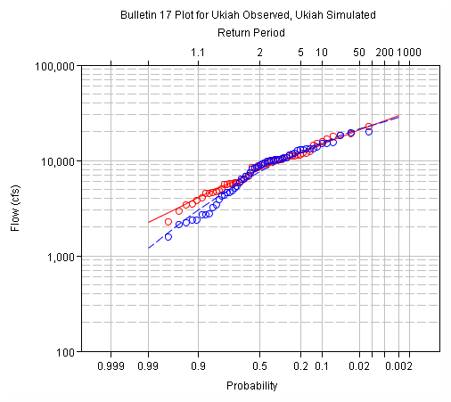
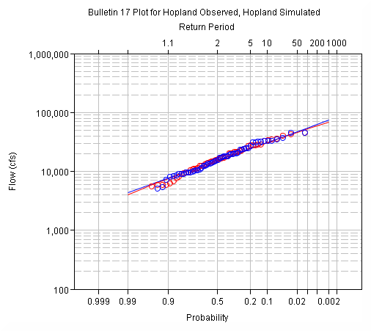
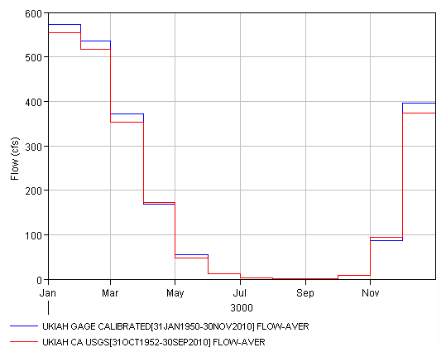
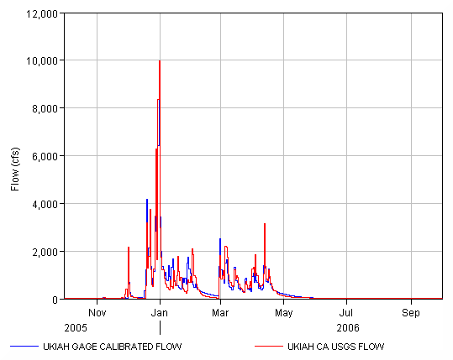
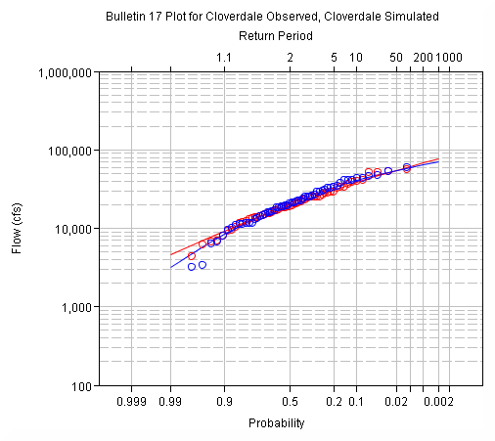
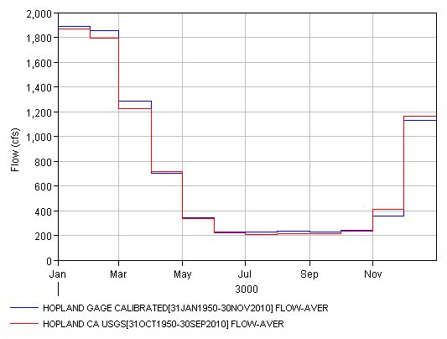
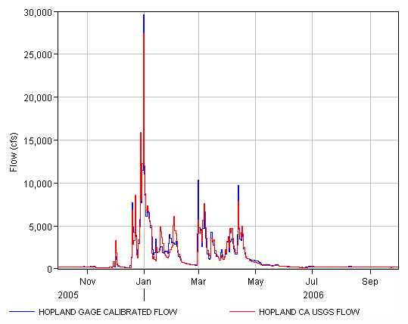
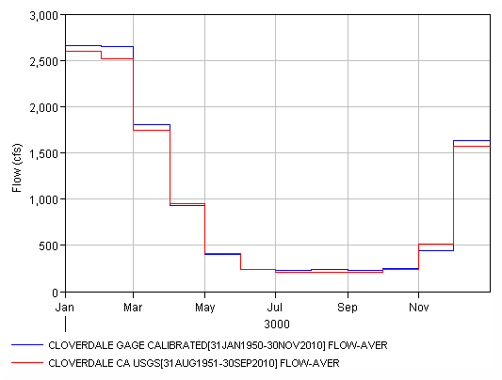
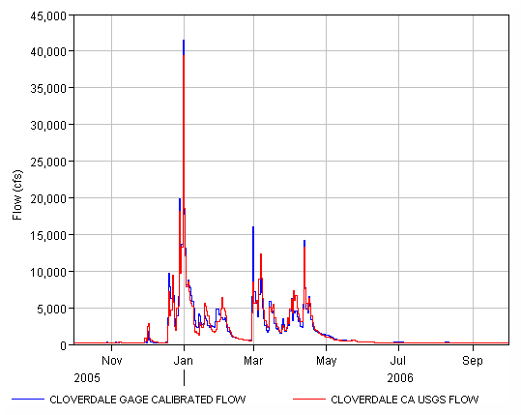
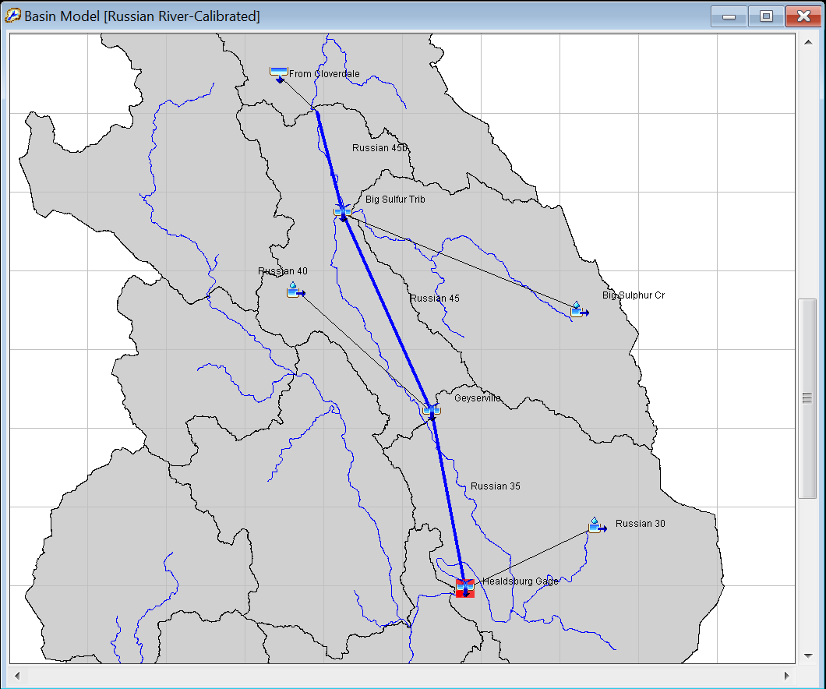
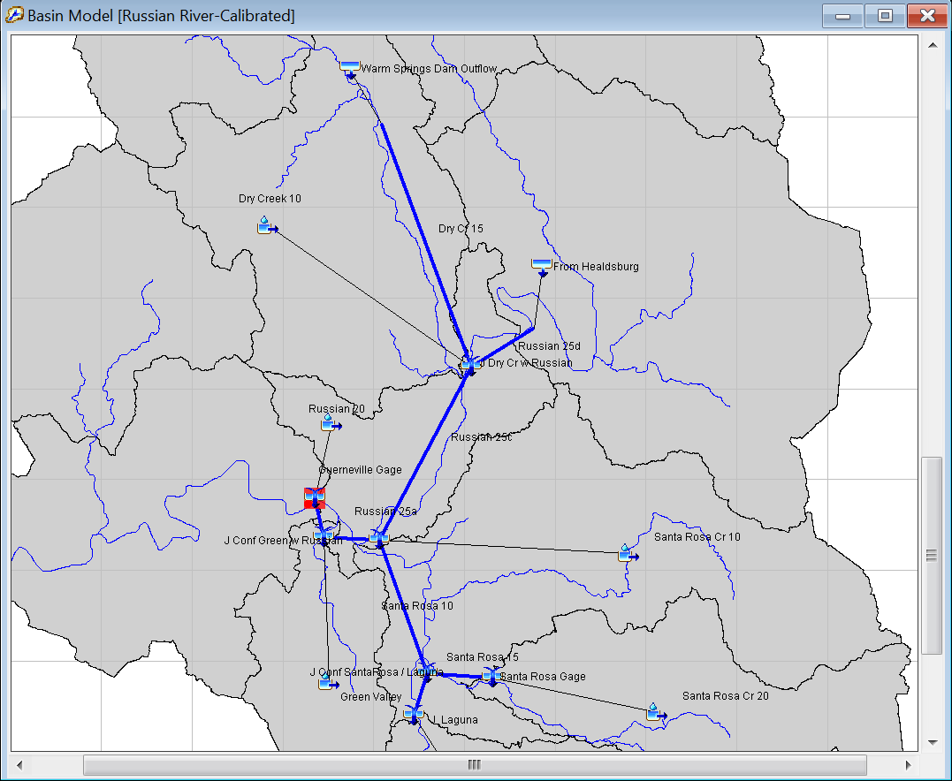
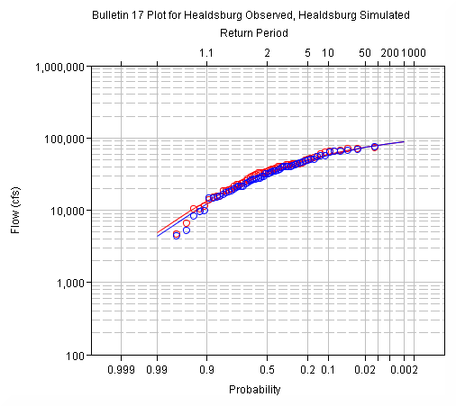
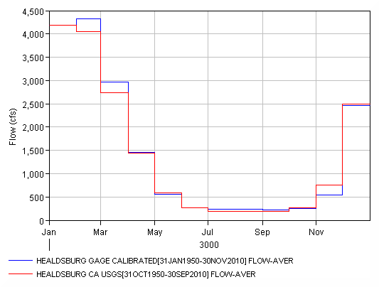
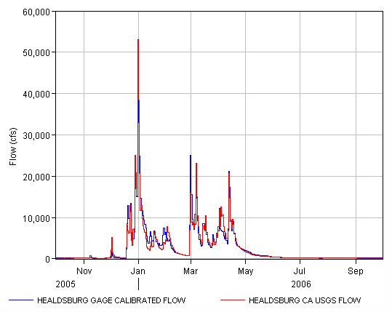
Calibration Sequence
Notes:
The calibration proceeded from upstream to downstream. For each calibration location the monthly volume, annual maximum flow, and runoff hydrograph calibrations were performed. The model was considered calibrated once the calibration at the final modeling location was complete.

Slide 16
Model Performance
Performance Rating | NSE | RSR | R² | PBIAS
Very Good | 0.65<𝑁𝑆𝐸≤1.00 | 0.00<𝑅𝑆𝑅≤0.60 | 0.65<𝑅2≤1.00 | 𝑃𝐵𝐼𝐴𝑆< ±15
Good | 0.55<𝑁𝑆𝐸≤0.65 | 0.60<𝑅𝑆𝑅≤0.70 | 0.55<𝑅2≤0.65 | ±15≤𝑃𝐵𝐼𝐴𝑆<±20
Satisfactory | 0.40<𝑁𝑆𝐸≤0.55 | 0.70<𝑅𝑆𝑅≤0.80 | 0.40<𝑅2≤0.55 | ±20≤𝑃𝐵𝐼𝐴𝑆<±30
Unsatisfactory | 𝑁𝑆𝐸≤0.40 | 𝑅𝑆𝑅>0.80 | 𝑅2≤0.40 | 𝑃𝐵𝐼𝐴𝑆≥±30
Location | NSE | RSR | R² | PBIAS
Calpella | 0.854 | 0.382 | 0.892 | -1.242
Ukiah | 0.880 | 0.347 | 0.880 | -2.350
Hopland | 0.913 | 0.295 | 0.919 | -1.435
Cloverdale | 0.927 | 0.270 | 0.931 | -2.710
Healdsburg | 0.915 | 0.292 | 0.916 | -2.210
Guerneville | 0.938 | 0.250 | 0.939 | -3.233

Slide 17
Model Calibration Aids
Element Results
Continuous Calibration Aid
Global Calibration Summary
Spatial Results
Notes:
First the element results.

Slide 18
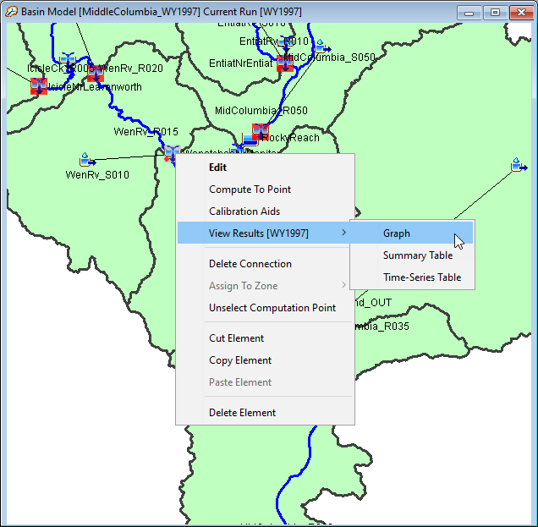
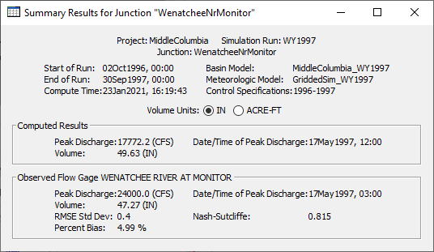
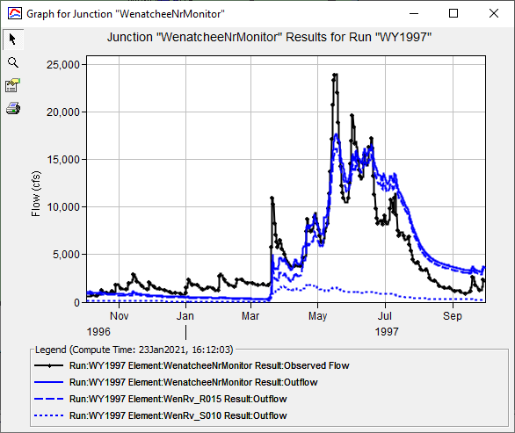
Element Results
Notes:
The element results summary table and graph are integral to HMS. Any time I have observed flow for an element the graph will show both observed and computed flow, and the table will provide goodness of fit metrics such Nash Sutcliffe Efficiency and Percent Bias.
Requirements:
Must have observed flow at a location
Pros:
Easy to access
Automatically updates with each compute
Cons:
There is no ability to change the computation time interval for statistics. The statistics are computed at the simulation time interval. This causes discrepancies when the observed data is in a different interval than the computed results.
There is only a single point per view. The only way to view multiple points at one time is to open multiple results windows or to view

Slide 19
Model Calibration Aids
Element Results
Continuous Calibration Aid
Global Calibration Summary
Spatial Results
Notes:
The next calibration tool that I’ll demonstrate is the continuous calibration aid.

Slide 20
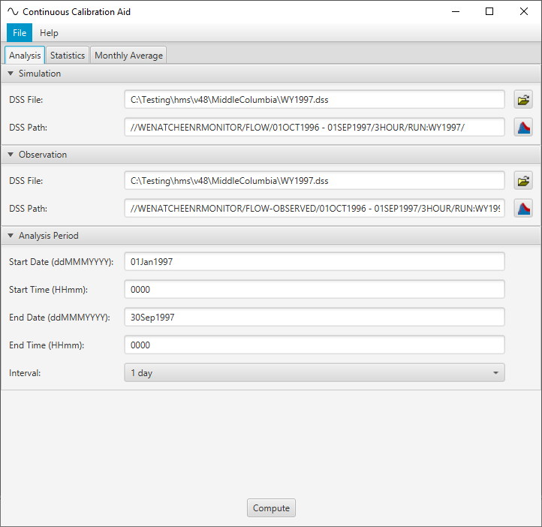
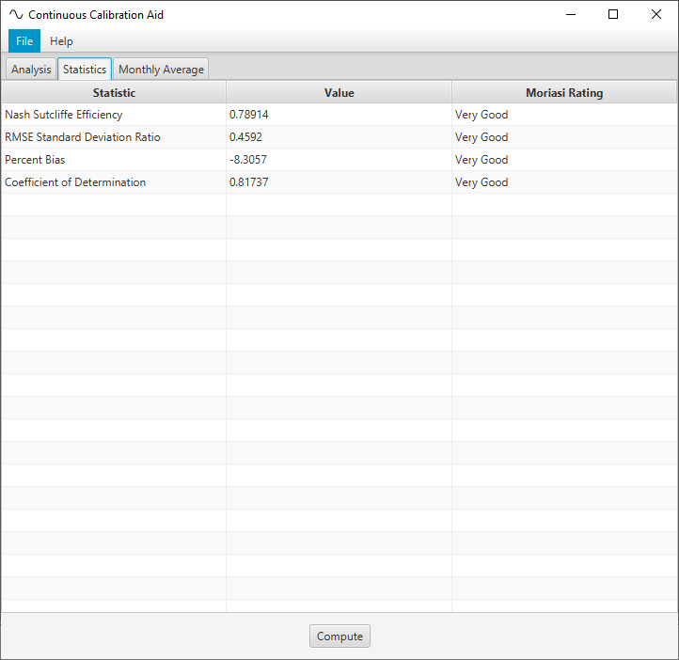
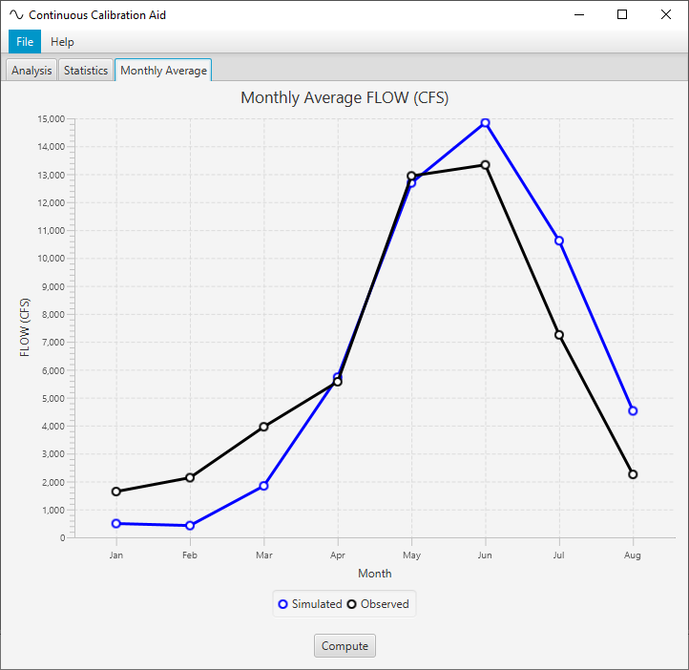
Continuous Calibration Aid
Notes:
The continuous calibration aid was built for a modeling project on the Columbia River where the calibration events were entire water years. For this case it was helpful to be able to quickly view a hydrograph based on monthly average flow. The simulation was also performed at a one day time step while the observed flow was often hourly. The continuous calibration aid allows us to select a statistics time interval that is different from the simulation time interval.
Pros:
Ability to change the computation time interval for statistics.
Ability to change the computation time window for statistics.
Rapidly performs cyclic analysis for continuous simulation
Cons:
Not a tight integration with HEC-HMS. The calibration is a stand-alone utility.
Single point. The only way to view multiple points at one time is to open multiple instances of the tool.
Must recompute with every HMS compute.

Slide 21
Model Calibration Aids
Element Results
Continuous Calibration Aid
Global Calibration Summary
Spatial Results
Notes:
The next calibration tool that I’ll demonstrate is the statistics report.

Slide 22
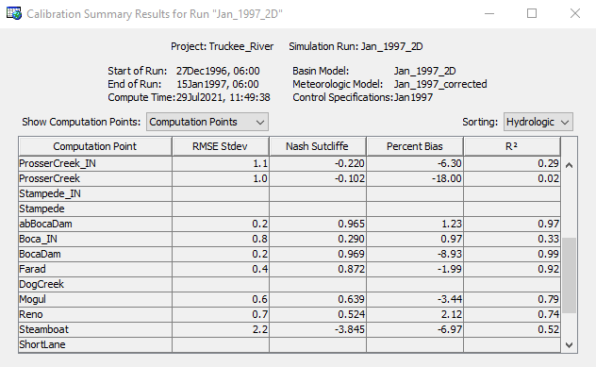
Global Calibration Summary
Notes:
The Global Calibration Summary can be launched from the simulation results tree. Model elements must include observed flow for calibration metrics to be computed.
Pros:
You can view multiple calibration points in one consolidated view.
Cons:
No ability to change the computation time interval for statistics. This causes discrepancies when the observed data is in a different interval than the computed results.

Slide 23
Model Calibration Aids
Element Results
Continuous Calibration Aid
Statistics Report
Spatial Results
Notes:
Finally I’ll talk about spatial results.

Slide 24
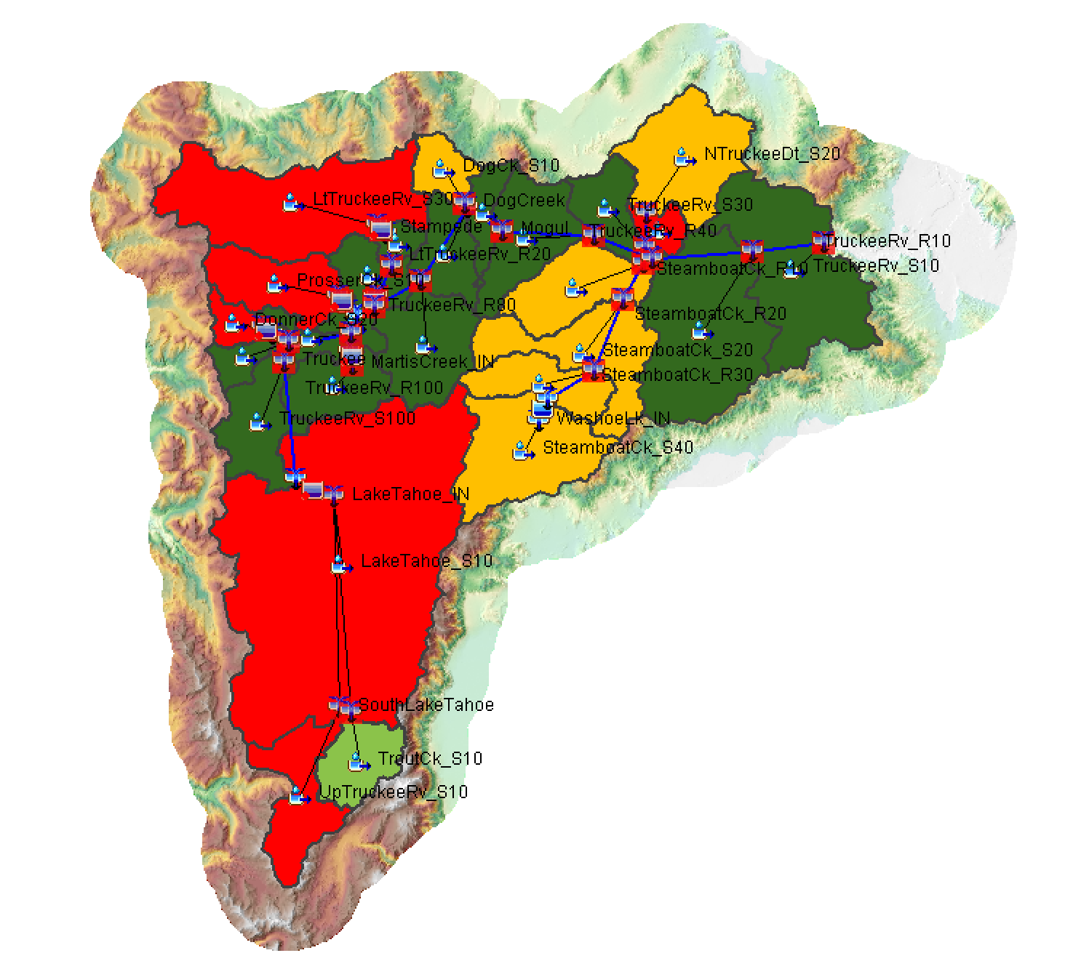
Spatial Results
Notes:
The spatial feature of HEC-HMS can be used to visualize a spatial notion of model calibration. Subbasins are color coded based on their statistical performance at the nearest downstream gage. Calibration metrics include Nash Sutcliffe Efficiency, Coefficient of Determination, Percent Bias, and Root Mean Squared Standard Deviation Ratio. The bins and colors can be controlled by the user through the Raster Properties Editor.
Pros of this approach is that it gives a spatial notion of calibration. Cons of this approach is that only one metric can be visualized at a time. This view can also be misleading given that comparisons of computed vs observed flow are made at point locations while this view projects that comparison spatially.

Slide 25
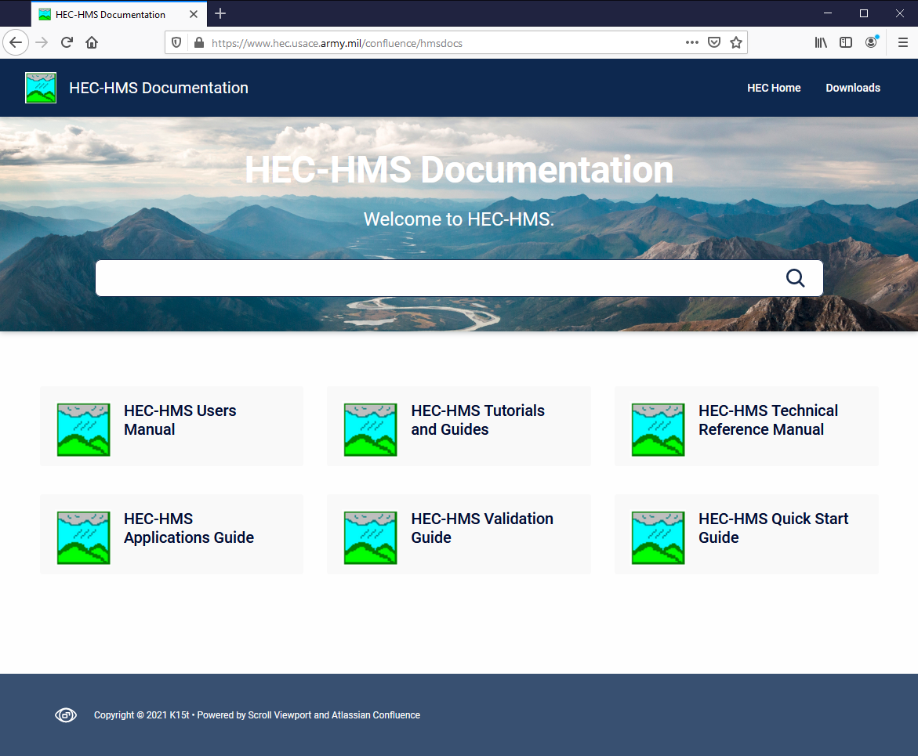
For More…
Notes:
This concludes the presentation on model calibration aids. For more resources on HEC-HMS check out the HEC-HMS documentation website.

Slide 26
References
Moriasi, D. N., J.G. Arnold, M.W. Van Liew, R.L. Bingner, R.D. Harmel, and T.L. Veith, Model evaluation guidelines for systematic quantification of accuracy in watershed simulations, Transactions of the ASABE 50 (3), 885-900, 2007

