Slide 1

Modeling Baseflow in HEC-HMS
Jay Pak, Ph.D., P.E.
US Army Corps of Engineers
Hydrologic Engineering Center

Slide 2
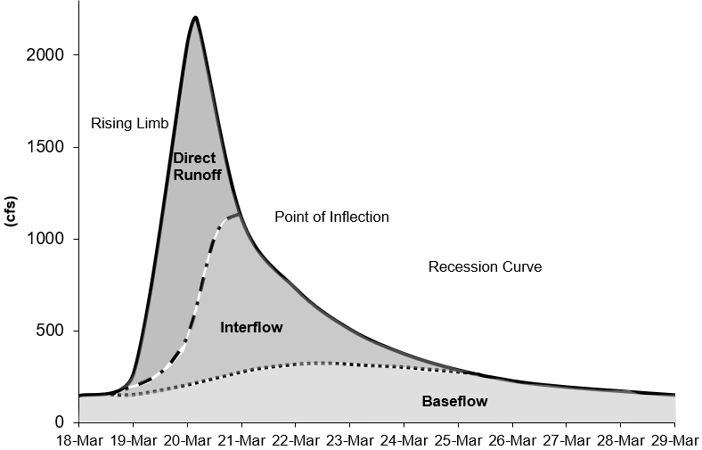
baseflow in HEC-HMS
In many cases, direct runoff accounts for the flood magnitude. Baseflow is an important process to consider for modeling runoff volume.
Baseflow is comprised of runoff that infiltrates into the ground, flows down gradient, and then flows back onto the land surface in small channels, streams, and rivers.
Baseflow includes interflow and baseflow (or saturated groundwater flow). There are different paths water takes when moving through the ground.
Notes:
Runoff hydrograph – flow measured at a gage with time.
Baseflow important for total volume and duration
Interflow – unsaturated that hits surface and flows in surface channels
Baseflow – saturated underground flow, which is much slower
Research using isotopes have distinguished hydrographs as “Event” water or “Pre-event’ water. Hydrograph has still been typically divided into three components (event water, soil water, groundwater).

Slide 3
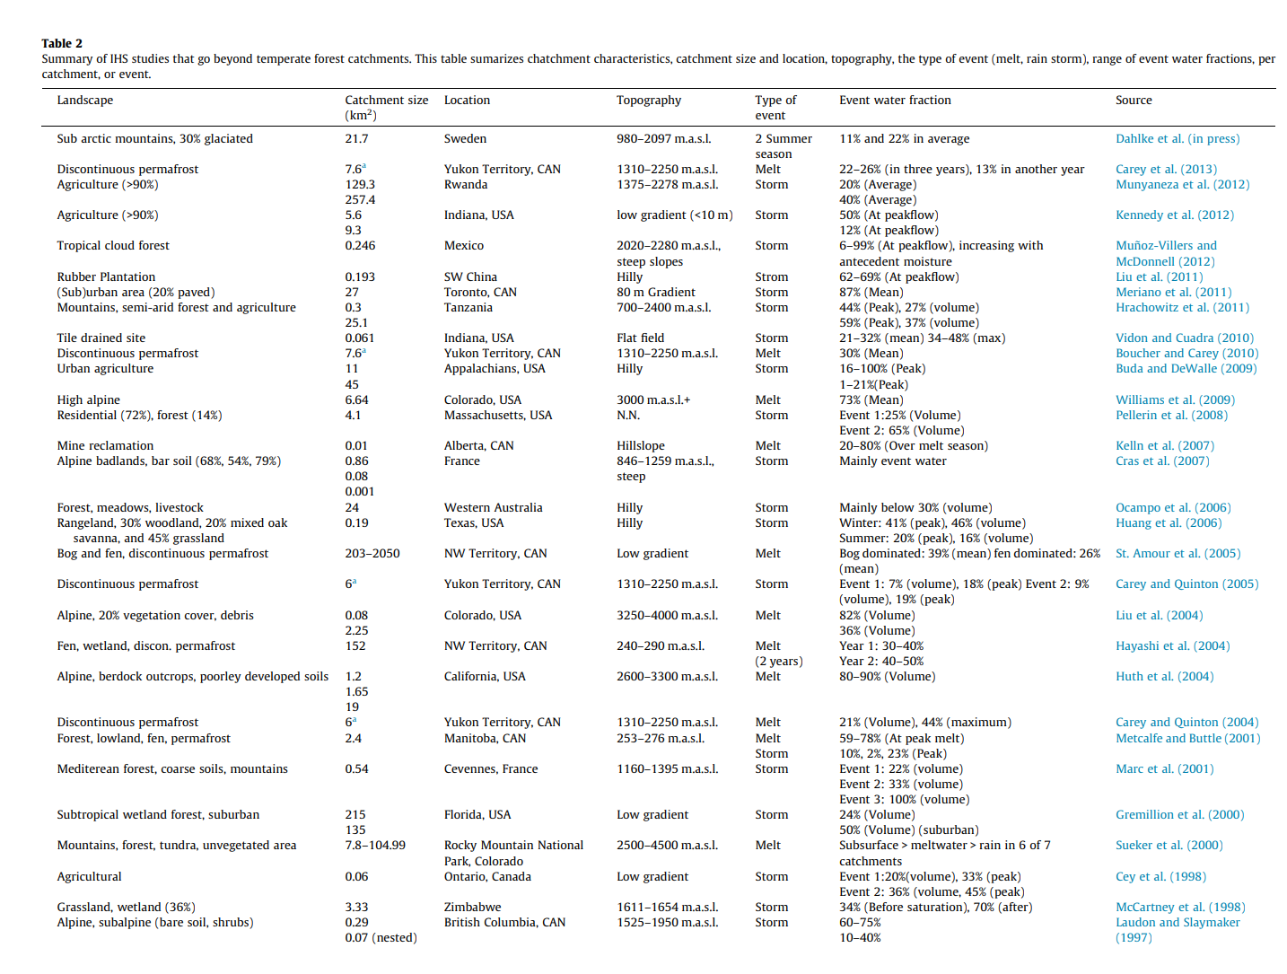
J. Klaus & J. McDonnell, 2013

Slide 4
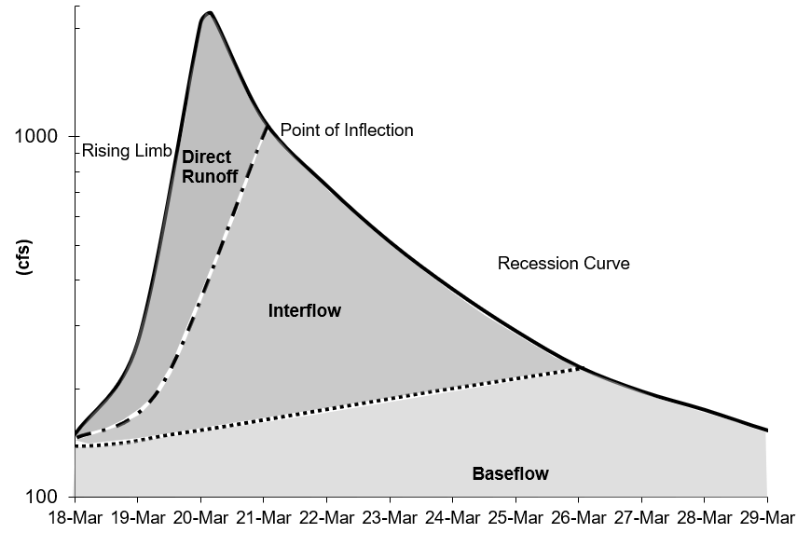
baseflow in HEC-HMS
There are different approaches to modeling baseflow, conceptual vs. process based. Currently, HEC-HMS includes conceptual methods for modeling baseflow.
There are techniques for identifying baseflow contributions from hydrographs:
The point of inflection (when the recession curve transitions from concave down to concave up) is where direct runoff is replaced by groundwater flow components.
Plotting the hydrograph in log space shows different baseflow contributions, based on changes in slope on the recession curve.
Notes:
HMS models baseflow conceptually and not process based. We don’t use ground water model to compute our baseflow values. Just like how we don’t use the full momentum equation for routing flow, we can do a pretty decent job at simulating baseflow using conceptual methods.
There have been all kinds of techniques for separating baseflow.

Slide 5
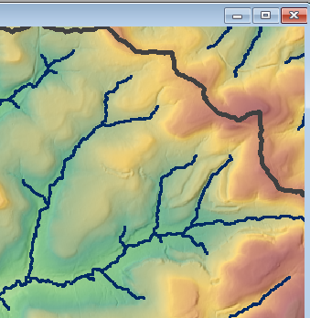

Interflow
Interflow is where the infiltrated water travels to a stream above the groundwater level (unsaturated zone). The response time for interflow is longer than surface runoff.
Notes:
There is an impeding shallow layer where infiltrated water moves down gradient. Interflow is slower than surface runoff. Some research has suggested interflow only contributes to the streamflow from the lower portions of the hillslope.

Slide 6
Baseflow / Groundwater flow
Baseflow is where the infiltrated water percolates to a groundwater layer. The groundwater layer will contribute to stream flow when it is high enough. The response time for baseflow is longer than interflow.
Notes:
Water that falls on the basin infiltrates past the shallow layer. This flow is much slower than surface runoff or interflow. This flow could take months before it reaches the stream (if ever).

Slide 7
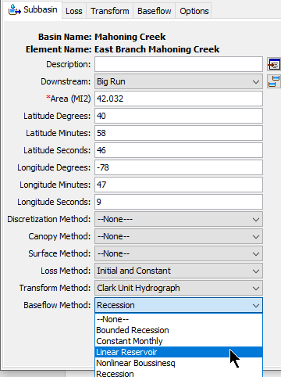
HEC-HMS Baseflow methods
The Baseflow Method can be selected for each subbasin element (using the Component Editor) or it can be selected using the global change methods tool from the Parameters menu.
Baseflow parameters can be entered from the subbasin element Component Editor or from Global editors.
The HEC-HMS baseflow methods are conceptual. The baseflow model should be calibrated using observations.
The Linear Reservoir method is the only method to conserve volume. The other baseflow methods could result in runoff volume exceeding precipitation volume.
Notes:
Within the UI, the baseflow method can be selected from the subbasin element.
Enter baseflow parameters from subbasin element tab or from global editor
Methods are conceptual. You need to calibrate the values
Linear Reservoir method conserves mass. The other baseflow methods do not.

Slide 8
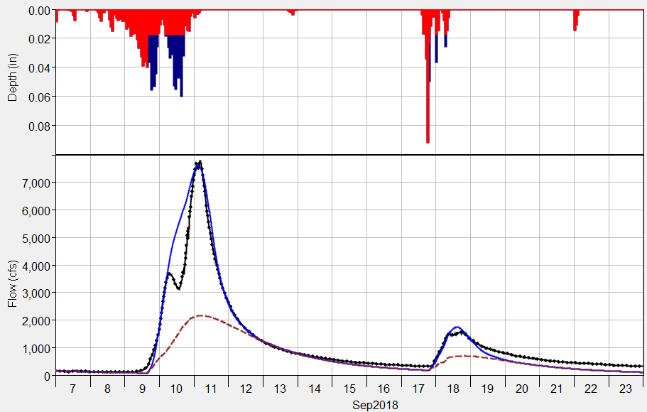
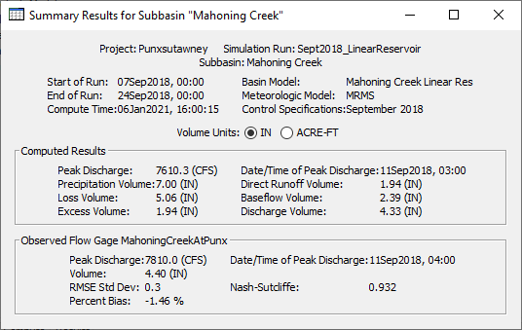
HEC-HMS Baseflow methods
Baseflow results are displayed in plots and tables for Subbasin elements only.
Subbasin plots show the computed runoff (total flow) and the baseflow hydrograph.
Summary tables show baseflow volume.
You can access individual time-series from the Watershed Explorer’s Results tab.
Computed Total Flow
Computed Baseflow
Observed Flow

Slide 9
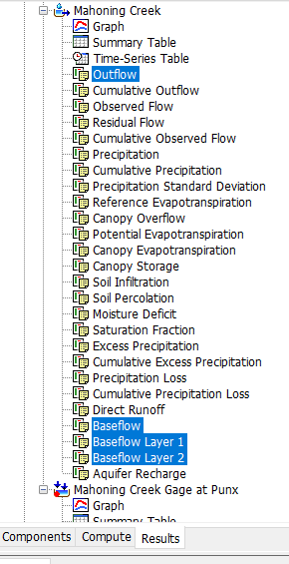
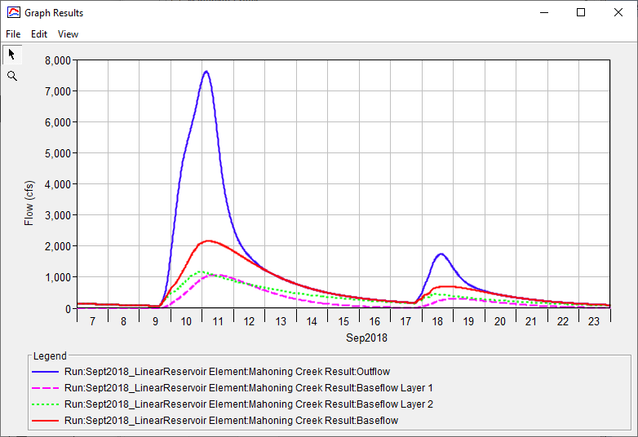
Notes:
This shows what you can see from the Results tab.
This is an example of the Linear Reservoir baseflow method. There are different layers for this method which you can see the results separately for each layer.

Slide 10
Linear Reservoir Baseflow Method
Notes:
This is our preferred baseflow method. Can be used for both event and continuous modeling and you could model both interflow and baseflow.
This method conserves volume.

Slide 11
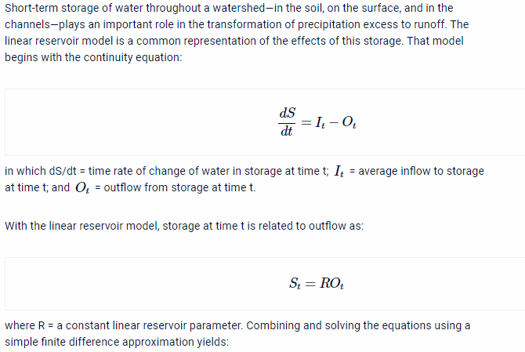
Linear Reservoir Baseflow
The linear reservoir baseflow method uses linear reservoirs to model the movement of infiltrated water.
Can be used to model Interflow and Baseflow
The continuity equation is used along with a linear relationship between storage and discharge:
dS/dt = change in storage at time t
I_{t} = average inflow to storage at time t
O_{t} = outflow from storage at time t
R = linear reservoir coefficient
Interflow - Linear Reservoir
Baseflow - Linear Reservoir
Notes:
Based off the name, the way baseflow is routed is simply using the linear reservoir routing method. You use a linear relationship between storage and discharge.
The continuity equation is used along with the linear reservoir relationship to solve for outflow.

Slide 12
Linear Reservoir Baseflow
The linear reservoir baseflow method is designed to work with all loss methods.
All losses in the Initial and Constant, Curve Number, and Green and Ampt loss methods are available to the Linear Reservoir Baseflow (can overcome this assumption using the fraction option).
Only constant loss rate losses (represents saturated conditions) in the Deficit and Constant loss method is available to the Linear Reservoir Baseflow.
Canopy
Surface
Deficit/Constant
Moisture Deficit
Constant Loss Rate
Linear Reservoir Baseflow
Layer 1
Layer 2
Layer 3
Notes:
Linear reservoir can work for all loss methods.
All losses are available for certain methods
Only constant losses are available for 3 methods

Slide 13
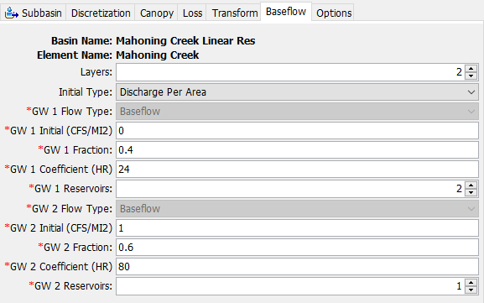
Linear Reservoir Baseflow
You can choose 1, 2, or 3 linear reservoir layers.
Each layer requires an initial discharge, fraction, linear reservoir coefficient, and number of reservoirs.
The fractions do not have to sum to 1. If they do not, the remainder represents water percolating to a deep aquifer.
Canopy
Surface
Deficit/Constant
Moisture Deficit
Constant Loss Rate
Linear Reservoir Baseflow
Layer 1
Layer 2
Layer 3
Notes:
Here is the UI for the linear reservoir baseflow method. You can choose up to three layers.
Each layer requires an initial discharge, fraction, reservoir coefficient, and number of steps
Fractions do not need to add up to 1

Slide 14
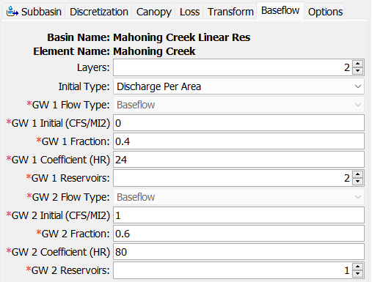


Linear Reservoir Baseflow
The example on this slide shows two linear reservoir layers.
40 percent of the infiltrated water is routed within Layer 1.
60 percent of the infiltrated water is routed within Layer 2.
Notice the linear reservoir coefficients are different. Groundwater 1 can be used to model interflow, and groundwater 2 can be used to model groundwater flow.
Canopy
Surface
Deficit/Constant
Moisture Deficit
Constant Loss Rate
Linear Reservoir Baseflow
Layer 1
Layer 2
Layer 3

Slide 15
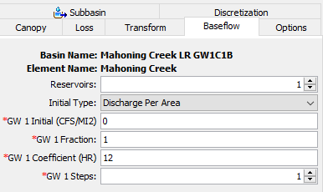
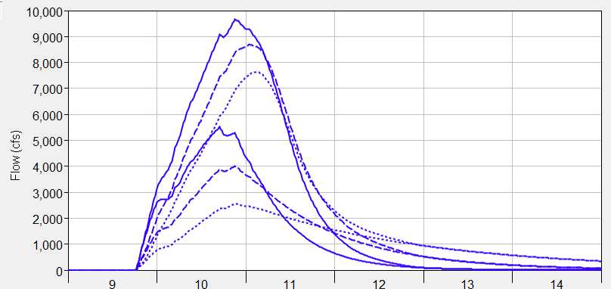
Linear Reservoir Baseflow
The plot on this slide shows three different simulations with different linear reservoir coefficients.
Notice how larger coefficient values attenuate the baseflow contribution, which reflects longer durations the infiltrated water spends in the ground.
Notice that the timing of the baseflow hydrograph is not influenced much by the storage coefficient.
Initially set the coefficients using multipliers of the Clark Storage Coefficient.
Total Flow
Coef. = 12 hours
Coef. = 24 hours
Coef. = 48 hours
Baseflow
Notes:
This slide shows how the GW coefficients affect the baseflow. If you remember in the equation, it’s the “R” value.
Larger coefficients will attenuate the baseflow
Timing of baseflow is not affected significantly
Initialize the coefficient based on the clark storage coefficient

Slide 16
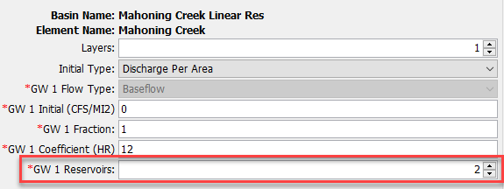
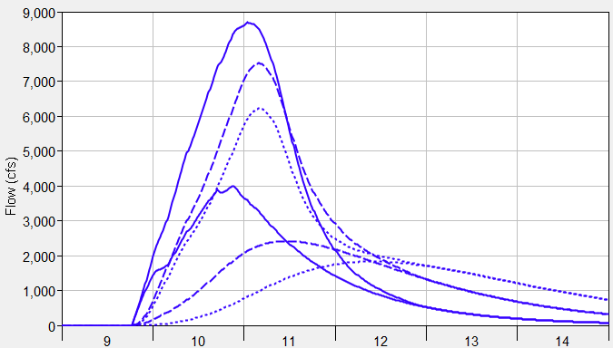
Linear Reservoir Baseflow
The plot on this slide shows three different simulations where the number of steps was varied.
2 steps means water flows into one linear reservoir with a coefficient of 12 hours, and then water from the first linear reservoir is routed through a second linear reservoir that also has a coefficient of 12 hours.
Notice how timing of the baseflow hydrograph is shifted and attenuation is increased as the number of linear reservoirs is increased.
Increase the number of steps so the peak baseflow response occurs after the peak surface runoff response.
Total Flow
Steps = 1
Steps = 2
Steps = 3
Baseflow
Notes:
This slide shows how changing the “Reservoirs” affects the baseflow
Reservoirs are another way to attenuate the baseflow. A reservoir of “2” means you are passing the flow through two linear reservoirs.
Timing of the baseflow is affected by increasing the number of reservoirs
Between the coefficient and number of reservoirs, you will see attenuation in the baseflow.
Reservoir will shift the peak later in time
Baseflow will be smoother than if you were to increase the coefficient

Slide 17
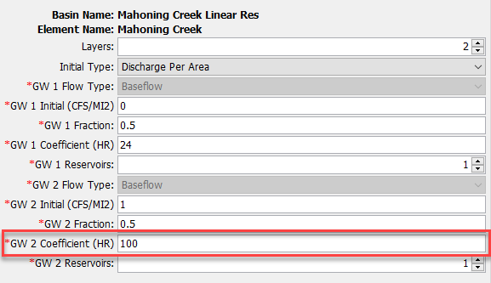
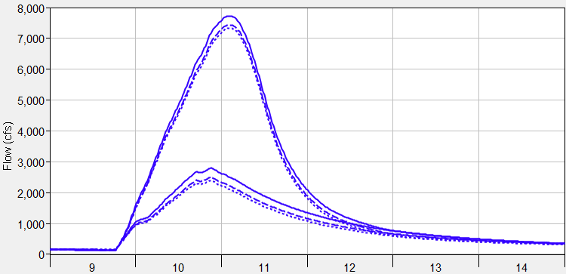
Linear Reservoir Baseflow
The plot on this slide shows three different simulations where the groundwater 2 linear reservoir coefficient was varied (50-50 split in infiltrated losses between layers).
Groundwater 2/3 layers can be used to model the longer responding groundwater flow, these components will not have as much of an impact on the flood magnitude.
Total Flow
GW2 Coef. = 100 hours
GW2 Coef. = 200 hours
GW2 Coef. = 300 hours
Baseflow

Slide 18
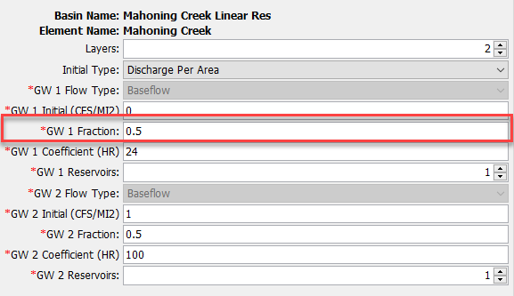
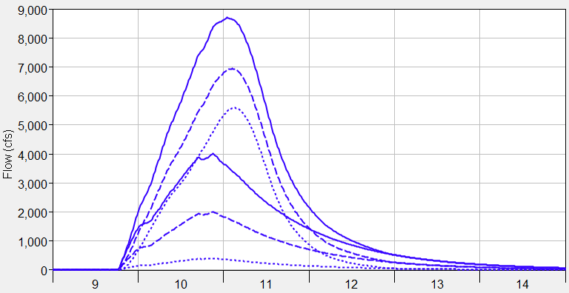
Linear Reservoir Baseflow
The plot on this slide shows three different simulations where the groundwater fraction was varied.
The sum of the fractions for all layers cannot exceed 1 but can be less than 1
The fraction can be used to control the magnitude of the baseflow hydrograph (emphasize interflow), the fraction can be used to improve runoff volume.
Total Flow
GW 1 Fraction = 1 (volume 1.6 inches)
GW 1 Fraction = 0.5 (volume 0.8 inches)
GW 1 Fraction = 0.1 (volume 0.2 inches)
Baseflow
Notes:
GW Fraction allows users to control how much baseflow volume makes it out to the hydrograph.
In the figure, with all other parameters held constant but just changing the fraction, you see how the volume of the baseflow is reduced.
Does affect the hydrograph volume and peak if reduced significantly

Slide 19
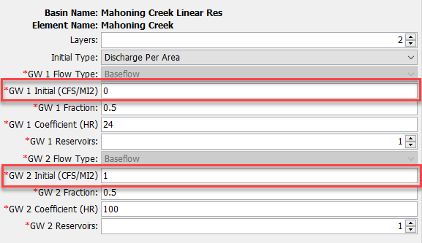
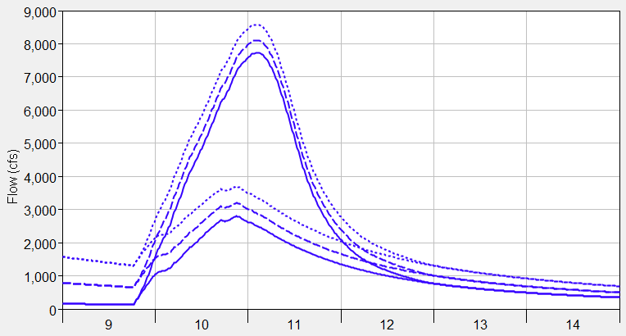
Linear Reservoir Baseflow
You can choose an initial discharge type: Discharge per Area or Discharge (a discharge per area of 1 CFS/MI2 means the initial flow would be 100 cfs for a 100 square mile subbasin)
Discharge per Area is easier to apply across the basin model (generally consistent across subbasins), where a discharge initial type uses one discharge value per subbasin.
The plot on this slide shows different initial discharge per area values, manually adjust the initial discharge to match observations at the beginning of the simulation.
Be strategic when setting the starting date of the simulation, interflow could be set to zero and only initial GW2/3 specified.
Initial GW2 Disch. = 1 CFS/MI2
Initial GW2 Disch. = 5 CFS/MI2
Initial GW2 Disch. = 10 CFS/MI2
Notes:
The last parameter is the initial discharge. Similar to Recession, this defines the initial state of the baseflow at the start of the simulation.
You can choose between discharge per area or discharge value.
Recommend going with discharge per area.

Slide 20
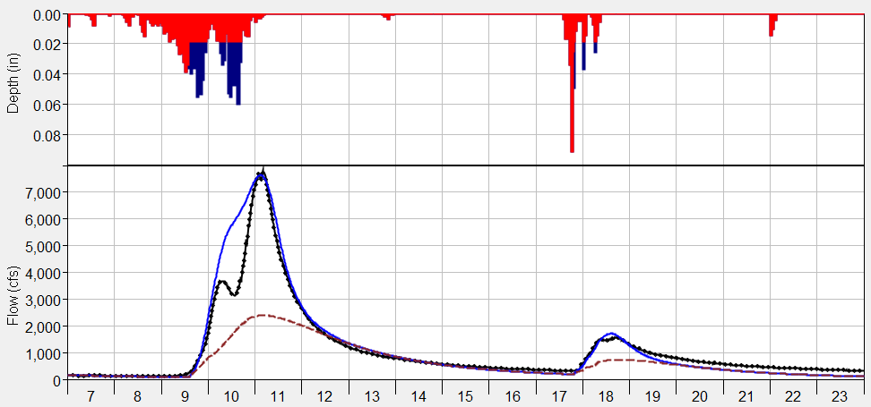
Linear Reservoir Baseflow
Computed Total Flow
Computed Baseflow
Observed Flow
The linear reservoir baseflow method can be used for a continuous simulation.
The plot on this slide also shows that the linear reservoir method can simulate both interflow and groundwater flow (because it includes up to three layers, each layer has its own coefficient).

Slide 21
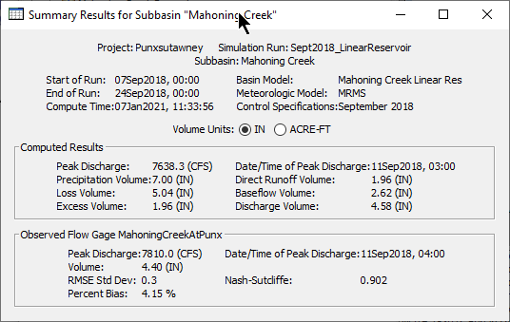
Linear Reservoir Baseflow
Always check the computed runoff volume. You will not have to worry about the total runoff volume exceeding precipitation volume, which could happen when using the other baseflow methods.
Verify modeled volumes are similar to regional water balance studies.

Slide 22
Review
“Baseflow” typically represents both fast responding (interflow) and slow responding subsurface flow (baseflow)
HEC-HMS includes five conceptual methods for modeling baseflow
The Linear Reservoir method is the only method that guarantees mass conservation
The other baseflow methods could result in runoff volume exceeding precipitation volume
Notes:
Runoff hydrograph – flow measured at a gage with time.
Baseflow important for total volume and duration
Interflow – unsaturated that hits surface and flows in surface channels
Baseflow – saturated underground flow, which is much slower
Research using isotopes have distinguished hydrographs as “Event” water or “Pre-event’ water. Hydrograph has still been typically divided into three components (event water, soil water, groundwater).

