Slide 1

Basin Characteristics and the Parameter Expression Calculator
Hydrologic Modeling with HEC-HMS
November 2024
Lauren Coe, P.E.
US Army Corps of Engineers
Hydrologic Engineering Center

Slide 2
Overview
Subbasin Characteristics
Reach Characteristics
Parameter Expression Calculator

Slide 3
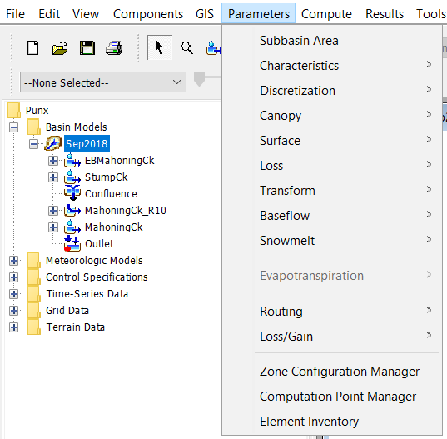
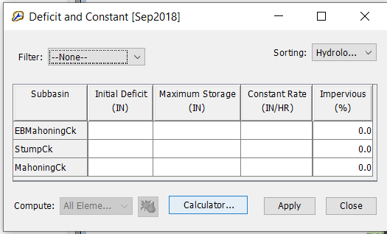
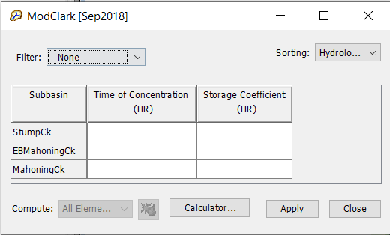
Parameter Estimation
Why do we need these basin characteristics?
Notes:
Here is an example of hydrologic methods: The Deficit and Constant is a loss method with 4 parameters. ModClark is a Transform method with 2 parameters. Our GIS tools can help with populating these parameters more efficiently.

Slide 4
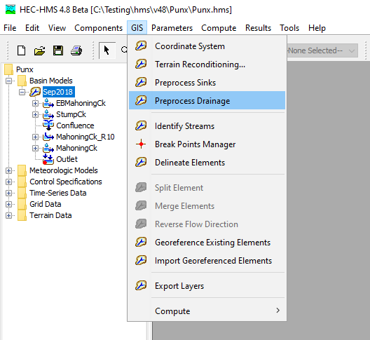
Subbasin Characteristics
Before subbasin characteristics are available:
The basin model must have georeferenced subbasins
The GIS | Preprocess Drainage steps must be computed.
Also recommend you Preprocess Sinks before computing the longest flow path
Notes:
There are a few pre-requisites that need to be met before subbasin characteristics can be computed. First off, your HMS model needs to have georeferenced subbasins and secondly, within the GIS menu, the Preprocess Drainage step (flow direction and flow accumulation) needs to be completed. I would recommend to take this a step further and to also compute the Preprocess Sinks step. If your terrain model has sinks, this will affect the longest flowpath calculations which, in turn, can lead to squirrely subbasin characteristics computations.

Slide 5
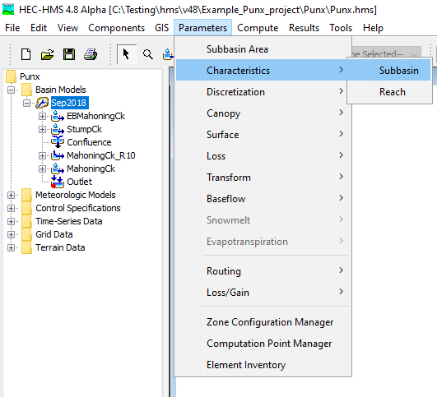
Subbasin Characteristics
Geospatial subbasin characteristics can be computed within HEC-HMS.
Notes:
To access the parameter estimation tools, you simply to go Parameters | Characteristics. There are two options available: Subbasin and Reach.

Slide 6
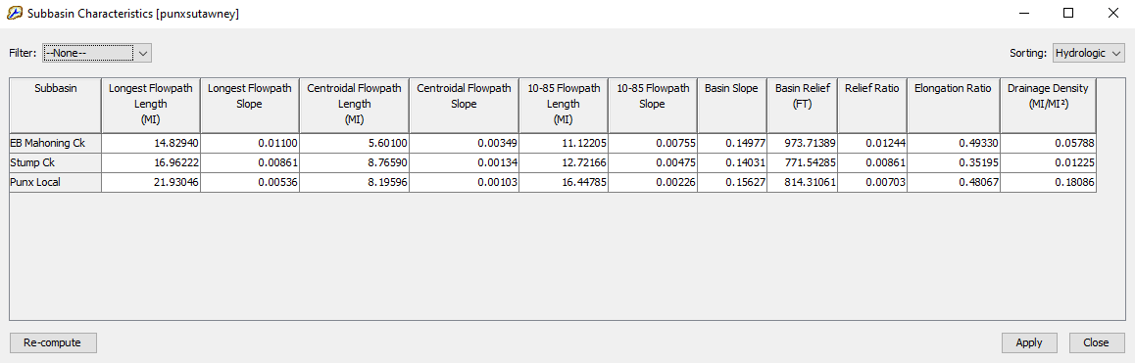
Subbasin Characteristics
Longest Flowpath Length
Longest Flowpath Slope
Centroidal Flowpath Length
Centroidal Flowpath Slope
10-85 Flowpath Length
10-85 Slope
Basin Slope
Basin Relief
Relief Ratio
Elongation Ratio
Drainage Density
Notes:
Once you have the preprocessing steps finished, you can go back to the Parameters | Characteristics menu and select Subbasin. When you click, you will have access to these characteristics. We’ll go into detail on the meaning of each characteristic.
The first time that you access this table, the characteristics for each subbasin will be computed on the fly. The table is editable, so you could manually change some of the computed values if you so choose.

Slide 7
Subbasin Characteristics
Longest Flowpath Length and Slope
The longest flowpath extends from the subbasin outlet to the most hydraulically-remote point upstream. Longest flowpath length is significant in that it is typically used to determine the time of concentration for a watershed.
The longest flowpath slope is the elevation difference of the most hydraulically-remote point and the subbasin outlet point divided by the longest flowpath length.
LongestFlowpathSlope = (UpstreamElevation – OutletElevation) / LongestFlowpathLength
Used for:
Travel time computations
USGS Regression Equations
Lag compute
Notes:
Longest Flowpath Length. This is a measure of the length that water travels from the most hydraulically remote point upstream in a subbasin all the way down to the subbasin outlet. This length is very significant in that it is typically used to determine the time of concentration for a watershed. The point needs to be hydraulically connected. If you had a remote location in a sink that would not count towards the longest flow path.
The longest flowpath slope can be defined as the elevation difference of the most hydraulically-remote point and the subbasin outlet point divided by the longest flowpath length.

Slide 8
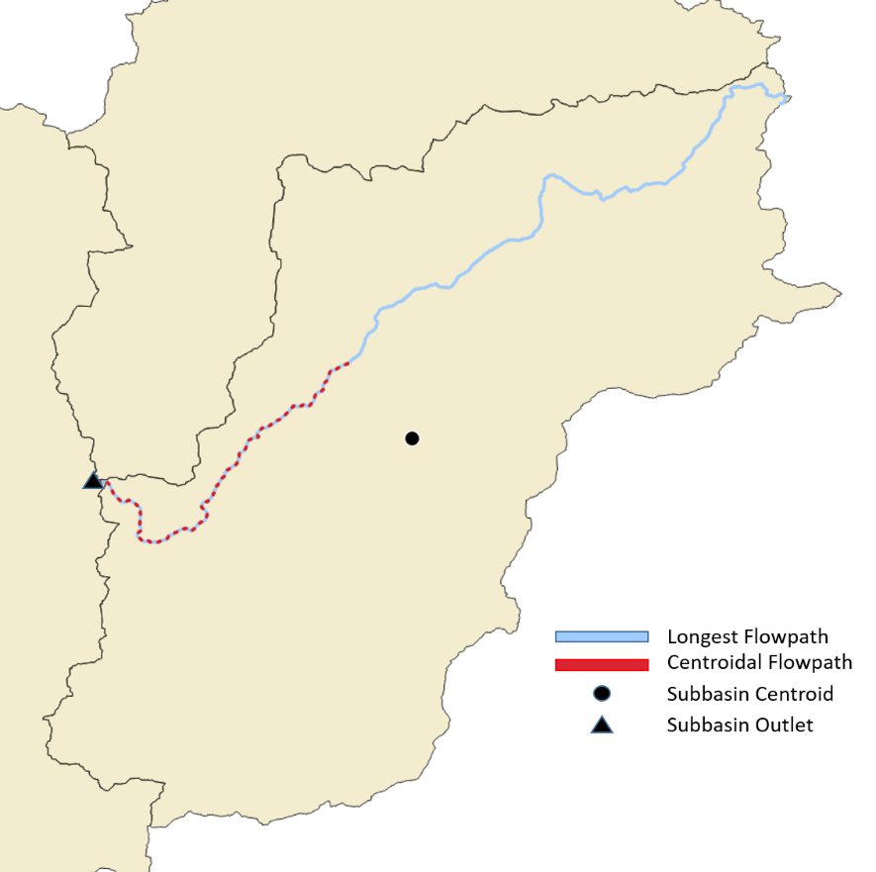
Subbasin Characteristics
Centroidal Flowpath Length and Slope
The centroidal flowpath is a subset of longest flowpath.
It begins at the subbasin outlet and extends upstream along the longest flowpath until it reaches the point along the longest flowpath that is nearest to the subbasin centroid.
CentroidalFlowpathSlope = (UpstreamElevation – OutletElevation) / CentroidalFlowpathLength
Used for:
Variable Clark
USGS Regression
TR-55 method
Lag Compute
Notes:
The next characteristic is the centroidal flowpath. As you can see in the image, you first calculate the subbasin centroid. The centroidal flowpath (shown in red) is a subset of longest flowpath (shown in blue). The upstream end starts at the point nearest to the subbasin centroid and then ends at the subbasin outlet.
Centroidal slope is calculated by dividing the upstream and downstream elevation difference by the centroidal flowpath length.
Centroidal flow path is another parameter used to calculate the “lag” parameter, which is common for the SCS method.

Slide 9
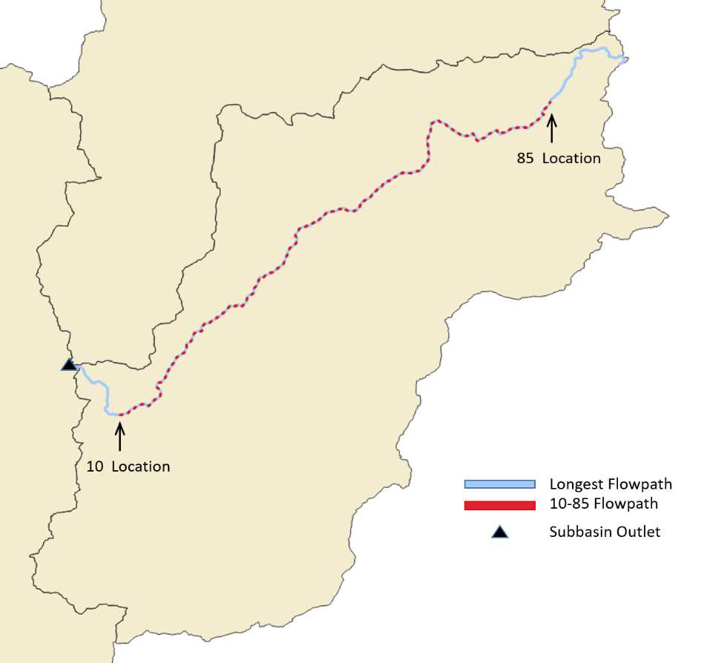
Subbasin Characteristics
10-85 Flowpath Length and Slope
The 10-85 flowpath is also a subset of longest flowpath.
The 10-85 flowpath begins at a point representing ten percent of the total length of the longest flowpath and ends at a point representing eighty-five percent of the total length.
10_85FlowpathSlope = (85Elevation – 10Elevation) / 10_85FlowpathLength
Used for:
Variable Clark
TR-55 method
USGS Regression Equations
Notes:
Next we have the 10-85 flowpath. The 10-85 is also a subset of the longest flow path. In the graphic here, if you think of the subbasin outlet as point zero and the most hydraulically remote point of the longest flowpath as 100, then the 10-85 flowpath extends from the 10 percent location up to the 85 percent location.
The 10-85 slope then, is simply the elevation difference between the 85 and 10 locations, divided by the 10-85 length.
Some equations for time of concentration might use 10-85 flow path and slope. You take away the really high and really low values and get a better average value.

Slide 10
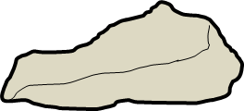
Subbasin Characteristics
Why do we have different length and slope calculations?
10-85
500ft
L_{LFP}
450ft
400ft
Plan View: Longest Flowpath
Profile View: Longest Flowpath
Notes:
For most subbasins, the longest flowpath slope is typically the steepest. Since longest flowpaths extend from the subbasin outlet all the way to the subbasin divide, the higher elevations near the divide can result in a steeper computed slope that is not necessarily representative of the other portions of the flowpath. For this reason, the 10-85 slope is often more representative of the general flowpath slopes as seen throughout most of the subbasin.

Slide 11
Subbasin Characteristics
Basin Slope
The basin slope represents the average slope of the entire subbasin (rise/run). For each elevation raster value within the subbasin, the algorithm scans the surrounding eight neighbors and computes the slope using the maximum scanned elevation difference downgradient.
The algorithm does not weigh north, east, south, and west neighbors more than diagonal neighbors; each neighbor is considered equally. The basin slope output is the average of all the computed slope values in the subbasin.
Used in:
USGS regression
TR-55
Notes:
The basin slope algorithm looks at each elevation cell within a subbasin and then scans the surrounding eight neighbor cells. It then computes a slope using the maximum scanned elevation difference. The basin slope algorithm repeats this process for each cell, and then takes an average at the end.

Slide 12
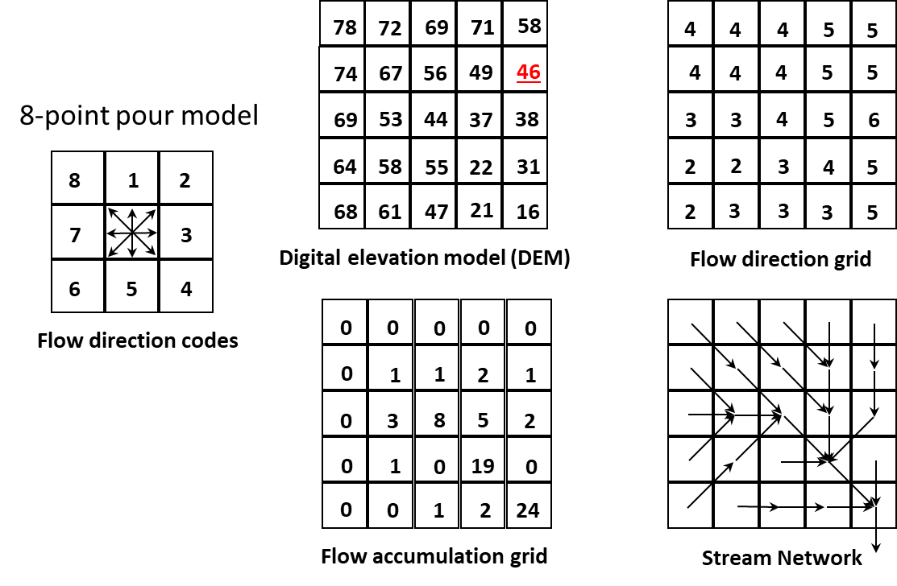
Subbasin Characteristics
Basin Slope
Basin Slope can be thought of as the average slope of all the Stream Network arrows.
Notes:
This slide provides a more visual way of thinking of basin slope. The 8-point pour model, which is discussed in a different video, is used to compute a stream network from a DEM and resulting flow direction and accumulation datasets. The Basin Slope can be thought of as taking the average slope of all of the arrows seen in the stream network part of the figure.

Slide 13
Subbasin Characteristics
Basin Relief
Basin relief represents the elevation difference between the highest point on the drainage divide and the outlet point of the subbasin.
500ft
Used in:
Debris Yield equations
Variable Clark equations
450ft
400ft
Profile View: Longest Flowpath
Notes:
Basin relief is a simple one. It is simply the highest point on the drainage divide minus the outlet elevation. In this example, the basin relief would be about 100 feet.
This is used for debris flow estimation. There are regression equations where basin relief is a parameter.

Slide 14
Subbasin Characteristics
Relief Ratio
The relief ratio is simply the basin relief divided by the length of the longest flowpath.
500ft
Used in:
Debris Yield equations
Variable Clark equations
450ft
L_{LFP}
400ft
Profile View: Longest Flowpath
Notes:
The relief ratio is based on two prior characteristics that we have already discussed. It is the basin relief divided by the longest flowpath length.

Slide 15
Subbasin Characteristics
Elongation Ratio
The elongation ratio is a dimensionless ratio used to categorize the general shape of a subbasin.
It is a ratio between the diameter of a circle with the same area as the subbasin and the basin length.
Elongation ratio values typically range from 0.2 to 1.0, with lower values representing elongated basins and values close to 1 representing circular basins.
ElongationRatio = (Area^{0.5}/Length) ∗ (2/π^{0.5})
D_{C}
L_{LFP}
Elongation Ratio = D_{C} / L_{LFP}
Notes:
The elongation ratio of a subbasin is used to describe the subbasin’s general shape. So if you were to imagine a circle that has the same area as your subbasin of interest, the elongation ratio would be the diameter of the circle divided by the length of your subbasin. And HMS uses the longest flowpath length as an estimate of subbasin length. An elongation ratio close to 1.0 would indicate a circular subbasin whereas an elongation ratio of, let’s say 0.2, would indicate an elongated subbasin shape.

Slide 16
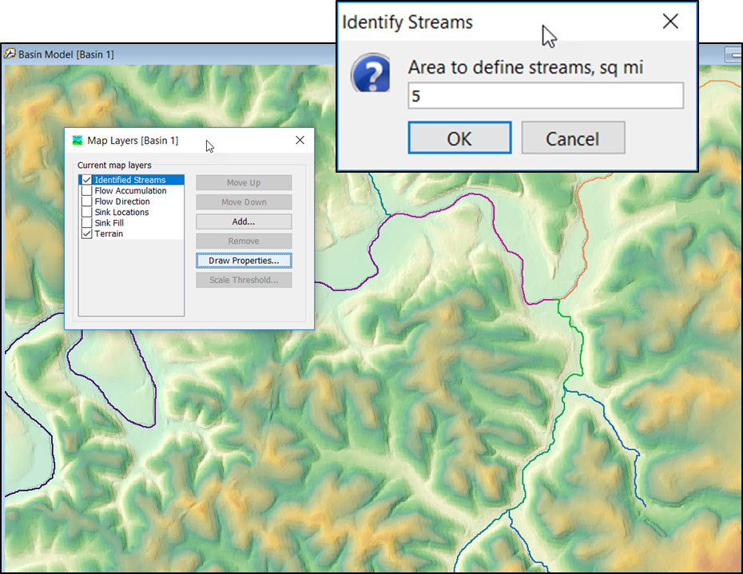
Subbasin Characteristics
Drainage Density
Drainage density is a metric used to describe the efficiency in which a subbasin is drained by stream channels.
It is computed by summing the total length of stream channels within the subbasin and then dividing by the area of the subbasin.
Used for:
Transmissibility, Recharge relationship
Mean Annual Flood estimate (Q = 1.3D^2)
Notes:
Lastly, we have drainage density. This is a metric that describes how well a subbasin is drained by stream channels. Drainage density is the total length of all the stream channels divided by the subbasin area. The basic idea is the higher the drainage density, the more efficient your subbasin is at draining a rain event

Slide 17
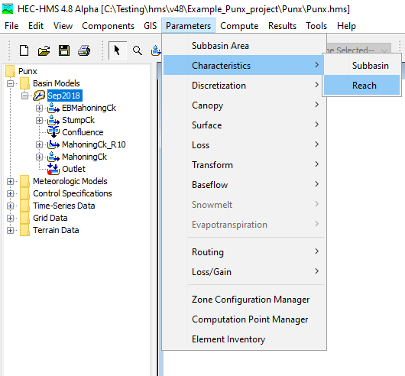
Reach Characteristics
Geospatial reach characteristics can be computed within HEC-HMS.
A basin model must have georeferenced reaches and the GIS | Preprocess Drainage step must be computed before reach characteristics are available.
Notes:
We are going to briefly highlight a few reach characteristics that can be computed in HMS. Similar to subbasin characteristics, reach characteristics have a few pre-requisites that must be met prior to their calculation. 1) the selected basin model must have georeferenced reaches, and 2) the preprocess drainage step on the GIS menu must have been computed. If those criteria have been met, you will be able to access reach characteristics.

Slide 18
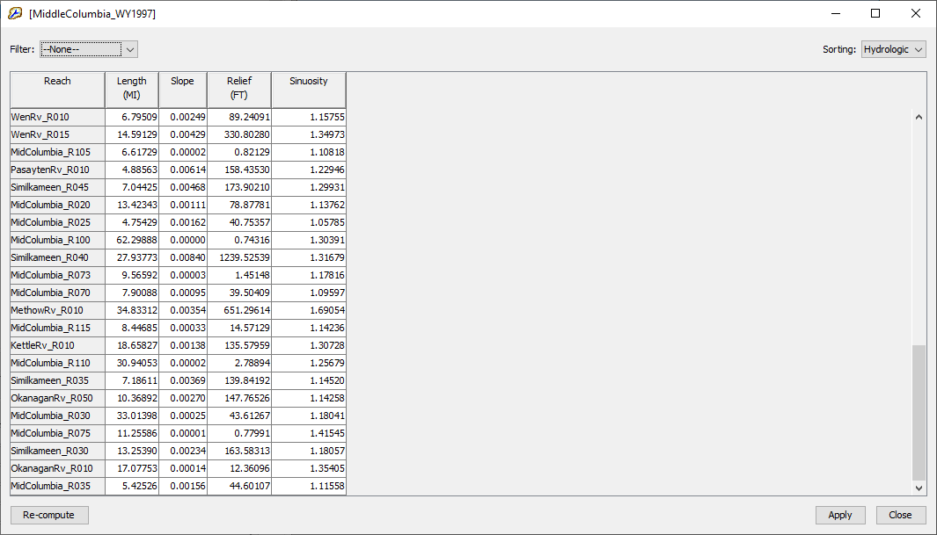
Reach Characteristics
Reach Length
Reach Slope
Reach Sinuosity
Reach Relief
Notes:
The Reach Characteristics will calculate the reach length, slope, sinuosity, and relief.
Just like with subbasin characteristics, when you access reach characteristics for the first time the calculations will occur on the fly and are saved to disk. If you for whatever reason end up redoing any of the GIS workflow, you come back to this reach table and hit the re-compute button which will recalculate the characteristics based on your latest changes. And you can also edit any of the tabular values manually if you choose.
Depending on what you set your stream threshold, these will change.

Slide 19
Reach Characteristics
Reach Slope
The reach slope is calculated using the most upstream point of a reach and the most downstream point of a reach (rise/run).
The tabular result is presented in standard slope format and not as a percent slope.
500ft
450ft
L_{Reach}
400ft
Used for:
Manning’s equation
Profile View: Reach
Notes:
First of we have reach slope. This is a basic one. It is simply the elevation of the most upstream point minus the elevation of the most downstream point divided by the reach length.
This is not the same as the longest flow path slope. This is specific to just the channel

Slide 20
Reach Characteristics
Reach Relief
Reach relief represents the elevation difference between the most upstream point of a reach and its most downstream point.
500ft
450ft
Used for:
Manning’s equation
400ft
Profile View: Reach
Notes:
Reach relief. Also pretty simple. It is the elevation of the most upstream point minus the most downstream point. In this example the reach relief would be 100 feet.

Slide 21
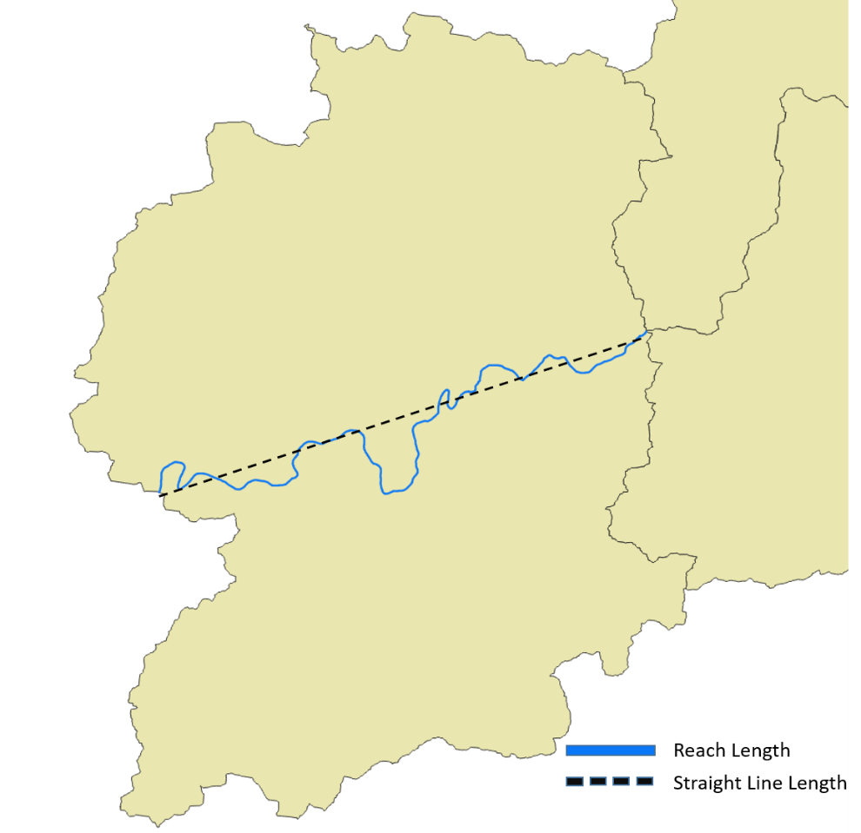
Reach Characteristics
Sinuosity
Reach sinuosity is generally defined as the ratio of actual stream length to valley length. It is a descriptive measure that quantifies the degree to which a channel meanders.
If the reach is perfectly straight, the reach sinuosity value will be 1. The higher the sinuosity value, the more the reach meanders and deviates from a straight path.
Sinuosity = ReachLength / StraightLineLength
Notes:
Lastly we have Reach Sinuosity. This one is my favorite. Stream sinuosity is sometimes defined in literature as the ratio of the actual stream length to the valley length. So really sinuosity is just a measure of how wiggly a stream is. In HMS, we estimate valley length as the straight line distance between the ends of the reach. If your reach is perfectly straight, then it will have a sinuosity of 1. The more the stream deviates from a straight path, the higher the sinuosity value.
This metric is commonly used in geomorphology and ecology. Areas of high sinuosity are good locations for habitat.

Slide 22
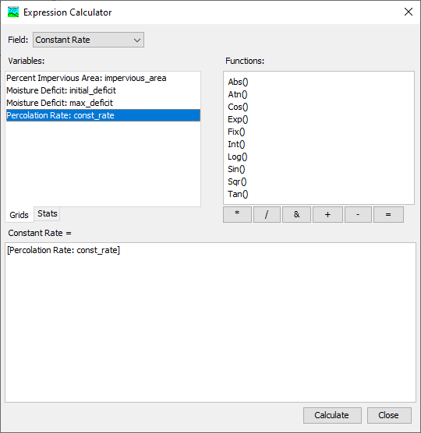
Parameter Expression Calculator
HMS has a built-in Expression Calculator that can be used to facilitate canopy, surface, loss, transform, baseflow, and routing parameter estimation from GIS data.
Notes:
We have built in a Parameter Expression Calculator that can be used to compute initial parameter estimates from GIS data. If you have a really large basin with multiple subbasins, this expression calculator can help you save time.

Slide 23
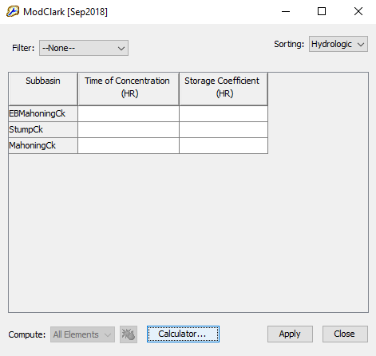
Parameter Expression Calculator
The Expression Calculator can be launched from select global basin editors. Global editors that include the Expression Calculator option are listed below.
  Canopy: Simple Canopy
  Canopy: Dynamic Canopy
  Loss: Deficit and Constant
  Loss: Exponential
  Loss: Green and Ampt
  Loss: Initial and Constant
  Loss: Layered Green and Ampt
  Loss: SCS Curve Number
  Loss: Smith Parlange
  Loss: Soil Moisture Accounting
  Transform: Mod Clark
  Transform: Clark
  Transform: SCS
  Transform: S-Graph
  Transform: Snyder
  Baseflow: Bounded Recession
  Baseflow: Linear Reservoir
  Baseflow: Non-linear Boussinesq
  Baseflow: Recession
  Routing: Kinematic Wave
  Routing: Lag
  Routing: Lag and K
  Routing: Modified Puls
  Routing: Muskingum
  Routing: Muskingum-Cunge
  Routing: Normal Depth
  Routing: Straddle Stagger
Notes:
You can access the expression calculator within the HMS software through the global editors. In this example, we have a global editor open for the ModClark transform method and it’s blank. We need to input initial estimates for the Tc and R parameters. Notice the “Calculator…” button at the bottom of the window. Click on that and the expression calculator will be launched. Currently this functionality exists with select global editors, but it will be added to more in the future.

Slide 24
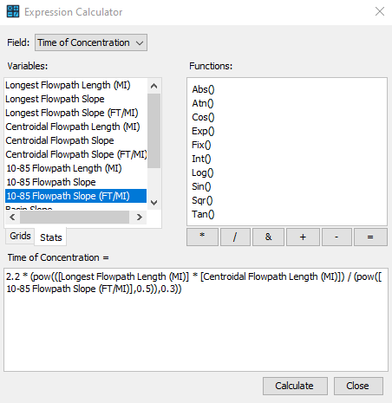
Parameter Expression Calculator
Characteristics are available on the Stats tab. When a characteristic is used in the expression, the characteristic value for a given feature (subbasin or reach element) is used in the calculation.
In the image to the right, flowpath lengths and slopes are used to estimate the time of concentration for each subbasin element in the basin model.
Notes:
When you hit the calculator button and launch the expression calculator it will look something like this.
The first thing you will want to do is set the field that you want to calculate. In this example, since we launched the Expression Calculator from the ModClark global editor, we can choose Time of Concentration or Storage in the field toggle.
Then, if we click on the Stats tab, we can access various subbasin characteristic variables that we can select and enter into our equation box at the bottom.
In this example, we have selected Longest and Centroidal Flowpath Length, 10-85 Flowpath slope and a combination of numbers and function variables to build an equation to estimate Time of Concentration.
I will just mention here that these types of regression equations that are based on GIS traits such as river lengths, river slopes, soil types, etc. are usually developed specifically for certain regions or certain watershed types. So just because a regression equation has been used successfully in one model or study, doesn’t necessarily mean that it is relevant for your specific study.

Slide 25
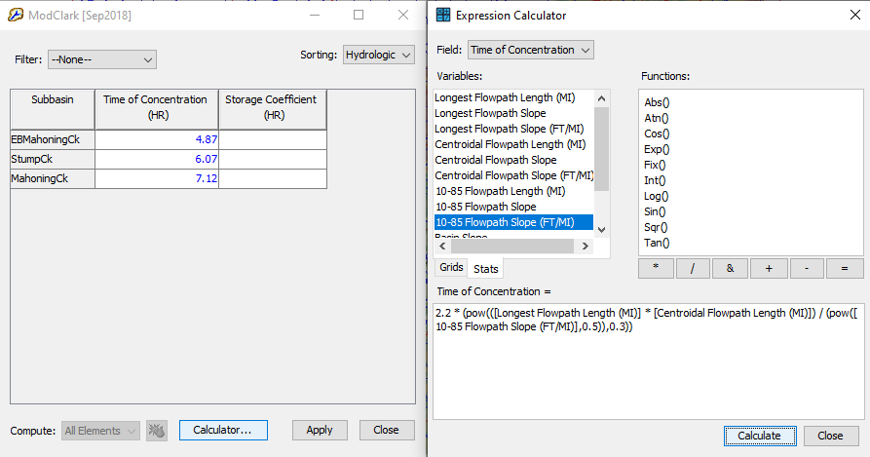
Parameter Expression Calculator
When clicking “Calculate” within the Expression Calculator, the parameter estimates are computed and automatically populated in the Global Editor table.

Slide 26
Parameter Expression Calculator
In the Expression Calculator, in addition to basin characteristics, grids can also be used as variables if they have been previously imported into HEC-HMS.
Grids are available from the Grids tab. When a grid is included in the expression, a zonal average value of the feature on the grid is used in the calculation.
Notes:
Lastly, I did want to mention the grids tab within the Expression Calculator. Here is an example of an expression calculator launched from the Deficit and Constant loss method Global editor, as you will notice that the Field options are different. Now, if you have previously imported grids into your HMS model as in this example, they can be accessed as variables via the Grids tab. In this case, when you hit calculate, the constant rate grid values that fall within each subbasin boundary will be averaged and populated in the global editor.

Slide 27
Gridded Soil Data
Percent Impervious: Urban Imperviousness gridded products are hosted by the Multi-Resolution Land Characteristics Consortium
  https://www.mrlc.gov/data
Percolation Rate: Rawls et al 1982 relates hydraulic conductivity to soil textures
  USACE Publications - Engineer Manual 1110-2-1417
  SSURGO database contains soil survey map data
Moisture Deficit: soil texture and its associated effective porosity and wilting point can be used to estimate the maximum deficit
  Loss Workshop

