Slide 1
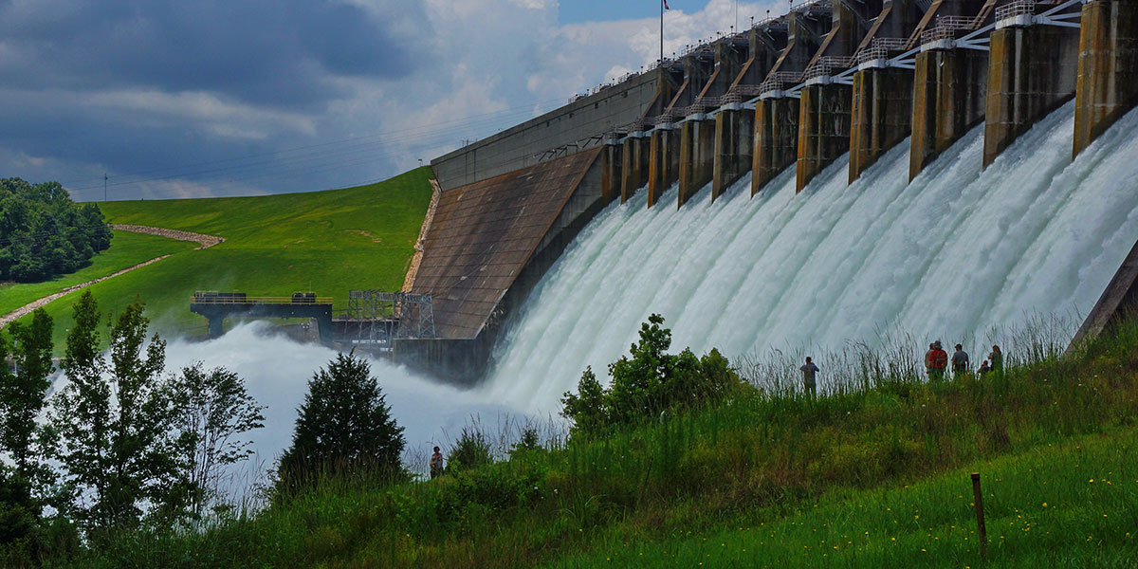
Reservoir Modeling Methodologies
Advanced Applications of HMS
June 2025
Presented by: Lauren Coe, P.E.

Slide 2
Outline
Reservoir element overview
Specified release
Outflow curves
Outflow structures
Rule-based routing
Reservoir Sediment Routing
Notes:
In this lecture we’ll cover an overview of the reservoir elements, including the storage methods available to modelers and initial conditions options before reviewing the four different reservoir routing methods available in HMS. Finally, we’ll discuss the sediment routing capabilities in HMS.

Slide 3
Reservoir Element Overview

Slide 4
Reservoir Routing
A hydraulic process used to predict the temporal changes in water storage, inflow, and outflow of a reservoir. This process relies on elevation-area and elevation-storage curves to understand the relationship between the water level (elevation) and both the surface area and volume of the reservoir.
Notes:
Routing in HMS seeks to predict a change through time of storage, inflow and outflow of a reservoir. These calculations rely on elevation-area or storage curves to relate water surface elevation of the pool to surface area and volume of the reservoir.

Slide 5
Reservoir Element
One of the seven basin model element types
One upstream element (typically a junction)
Up to two downstream elements
Main
Auxiliary
Five routing methods
None
Specified Release
Outflow Curve
Outflow Structures
Rule-Based Operations
Notes:
A reservoir element can have a single upstream element. The convention is that the upstream element be a junction which we can use as a computation point for calibrating observed reservoir inflow.
The reservoir will have at least one downstream element but can have up to two if an Auxiliary outflow is defined.
Five routing methods are available they’re listed here in order of increasing complexity.

Slide 6
Storage Method
Storage method options vary based on routing method selected
Highlighted methods best for Reservoir Sediment Volume Reduction
Outflow Curve | Outflow Structures | Rule-Based Operations | Specified Release
Elevation-Area-Discharge | Elevation-Area | Elevation-Area | Elevation-Area
Elevation-Storage-Area-Discharge | Elevation-Storage | Elevation-Storage | Elevation-Storage
Elevation-Storage-Discharge | Elevation-Storage-Area | Elevation-Storage-Area
Storage-Discharge

Slide 7
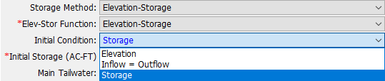
Initial Conditions
State information required for simulation start
Available options depend on selected storage method
Storage
Elevation
Discharge
Inflow = Outflow
Notes:
The initial condition is required for the simulation to start. The storage and elevation options are available for all routing methods.
The Discharge method is available for outflow curves – since storage and outflow are 1:1 related, the initial storage can be determined
The Inflow = Outflow method takes the inflow to the reservoir at the beginning of the simulation and determines the pool elevation necessary to cause that outflow through the outlet structures. The pool elevation is then used in the elevation-storage curve to determine the matching storage. This method is not available for Specified Release because the inflow is pre-defined.

Slide 8
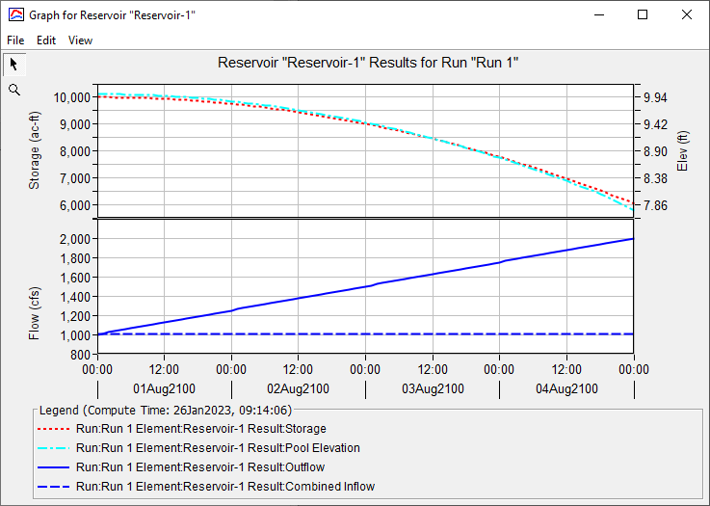
Simulation Results
Notes:
The top plot is for geometry – it shows the reservoir’s storage and elevation for the simulation. Not all routing methods will have an elevation plot, but all of them must compute storage.
The bottom is for flow – the reservoir inflow is dashed, and outflow is solid.

Slide 9
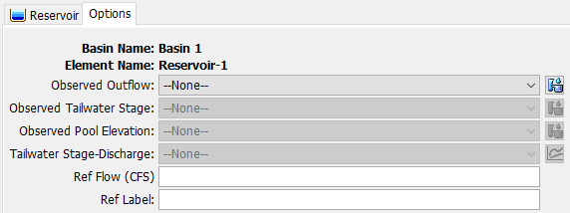
Reservoir Options Tab
Notes:
Observed outflow allows you to set a discharge gage as an observed flow series that you can compare your results to
Observed tailwater stage lets you set a stage gage as an observed stage time series that you can compare computed tailwater stages to (requires a tailwater rating curve)
Observed pool elevation is pretty self-explanatory
Tailwater stage-discharge lets you set a rating curve for the tailwater – this can be important for computing hydraulic structure submergence.
The reference flow and label are for making a nice label on your simulation results graph.

Slide 10
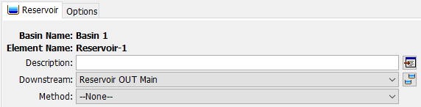
“None” Routing Method
“--None--” will pass flow downstream with no routing

Slide 11
Specified Release

Slide 12
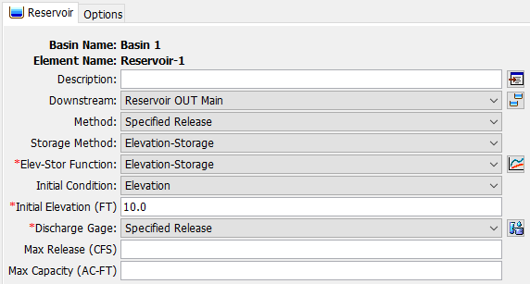
Specified Release
Used when the outflow from a reservoir is known
Elevation/storage computed from simulated inflow and specified outflows
Notes:
Specified release is the simplest of the routing methods. Elevation and Storage are available for Initial Conditions. We typically would use specified release to aid in calibration of the downstream portion of the model.

Slide 13
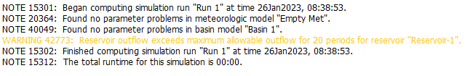
Specified Release
Outflow specified as a discharge gage
Routing will continue even if reservoir “bottoms out”
Optional settings: Max Release, Max Capacity
Settings do not alter outflows, only produce warnings
Notes:
It uses a time-series discharge gage as the outflow and computes the storage based on this outflow and any inflow to the reservoir. Because the outflow is specified, the reservoir can continue to release even if the volume is depleted. This will produce warnings if the reservoir outflow exceeds the max release or max capacity or if the reservoir storage bottoms out, but the simulation will not fail.

Slide 14
Specified Release – When to Use?
Calibration/validation phase of model construction
Releases are determined by something external to HMS, such as a ResSim Model
Model won’t be used in hypothetical simulations
Notes:
As was mentioned Specified Release is useful during the calibration stage.
It can also be useful if releases are handled by an external software, such as ResSim
Finally, if the model will be used for a use-case in which observed inflows are unavailable or impossible to apply, a different routing method must be implemented eventually.

Slide 15
Outflow Curves
Notes:
Next we’ll discuss Outflow Curves routing method.

Slide 16
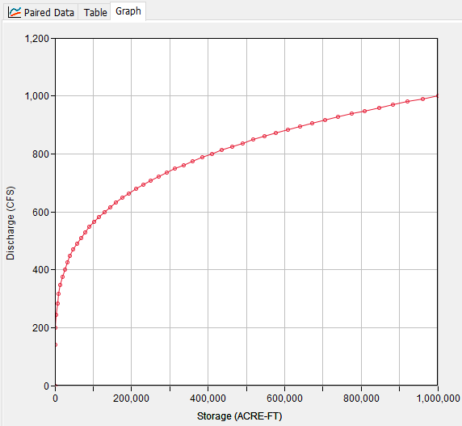
Outflow Curves
Reservoir outflow is determined solely by storage
Ideal for reservoirs with no gates/operations
Can be “calibrated” to observed outflows represent more complex reservoirs
Notes:
For this method, a single storage-discharge curve is used to compute outflows for the reservoir. This is most ideal for reservoirs or detention basins that have simple outflow relationships with no or few gates or complex operations.
That said, you can develop an approximated outflow-storage curve with sufficient observed data even if the reservoir has gated outlets/spillways or operations- see T&G on confluence page.

Slide 17
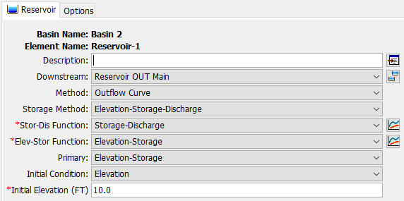
Outflow Curves – Storage Method
Simplest option is the Storage-Discharge storage method
Other methods will compute elevation
Notes:
Based on the Storage Method chosen, you’ll choose the storage discharge and elevation storage paired data tables.
The “Primary” setting just determines the interpolation scheme. The Outflow Curve method builds a big table for all the geometry variables involved, and the one set as “primary” determines the initial configuration of the table (what rows the other tables are interpolated to.)

Slide 18
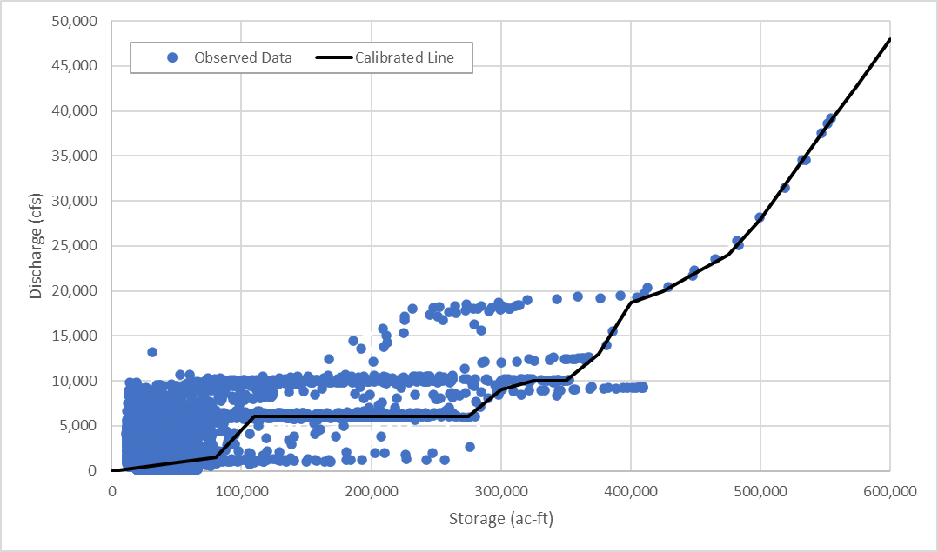
Outflow Curve Calibration
Works best when operations are simple
Iterative process
Build curve
Run simulation
Check stage/storage/ outflow
Modify curve
Outflow Curve Reservoir Routing
Notes:
When calibrating to observed outflows the process will likely be iterative if gates or complex operations are used. You can see on this plot, a given storage in the reservoir is associated with various outflows, so there is some estimation and engineering judgement that comes into play when assigning a single outflow for a given storage/elevation. You can also see at the higher storage conditions the relationship of storage to discharge is more accurately represented by a single curve, this may be where gates are fully opened or discharge is dominated by an uncontrolled spillway.
There is a Tutorial and Guide on the confluence that steps through the process of using observed outflow from a regulated outlet and averaging outflow for 5 ft bands of elevation to create a single outflow curve for the outlet. From there, the outflows from each source: the regulated outlet, uncontrolled spillway, and dam top can be combined to create a single outflow curve for flow routing.

Slide 19
Outflow Curves – When to Use?
Outflow is always the same for a given storage
Ungated outlets/spillways, dam tops, etc.
Operations can be reasonably simplified to a single curve
Long Term Reservoir Volume Reduction Analysis
Notes:
Again the outflow curve is best applied when the operations are fairly simple with ungated outlets/spillways or if observed data can be fit with a single curve. Additionally, if the principal goal of the analysis is long term reservoir reduction analysis and there’s less concern about matching outflows exactly and more emphasis is on capturing long-term volume patterns.

Slide 20
Outflow Structures

Slide 21
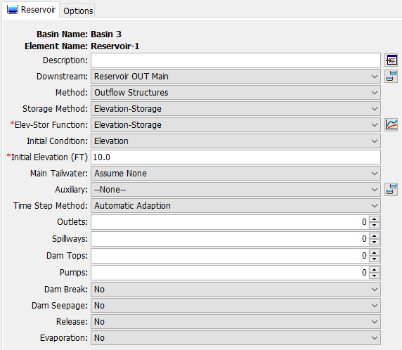
Outflow Structures
Outflow computed by a collection of hydraulic structures
Outlets
Spillways
Dam tops
Pumps
Simulate other kinds of outflows
Dam breaks
Dam seepage
Time-series releases
Monthly Evaporation
Notes:
The outflow structures method uses hydraulic structures and user-defined geometry or rating curves to route flow from the reservoir. This method also allows the user to simulate dam breaks, seepage, additional releases with a flow gage, seepage and evaporation losses.

Slide 22
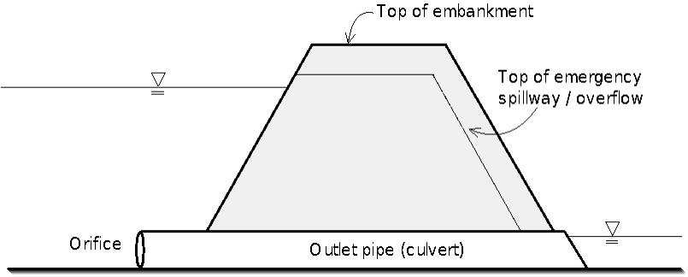
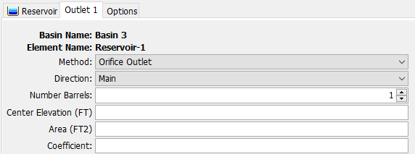
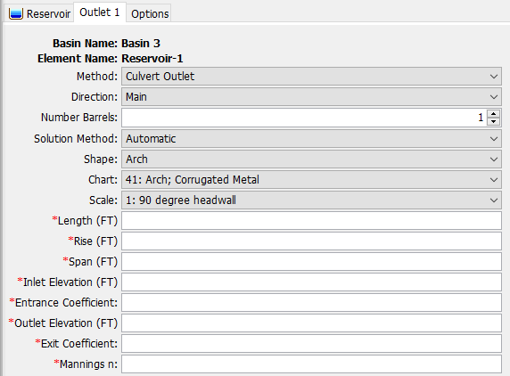
Outlets
Orifice Outlet
Culvert Outlet
Always submerged
Can flow partially full
FHWA Chart and Scale Numbers
Notes:
Two types of outlets are available: orifice or culvert
An orifice outlet assumes sufficient submergence which in this case is at least 0.2 times the diameter of the outlet. Up to ten identical barrels can be defined with a single orifice outlet.
A culvert outlet can flow partially full. The solution method is based on whether inlet or outlet control should be used. Inlet control would indicate a high reservoir pool elevation and outlet control would indicate a high tailwater condition, generally it’s best to use automatic and allow the program to make that determination. The shape of the culvert is the next selection and will populate which of the Federal Highway cross-section charts will be populated in the Chart and Scale selection boxes. Based on these selections certain parameters will be necessary such as diameter, rise and span. Inlet and outlet elevations, entrance and exit coefficients, and the Manning’s roughness are required.

Slide 23
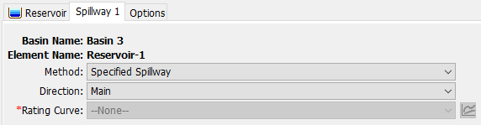
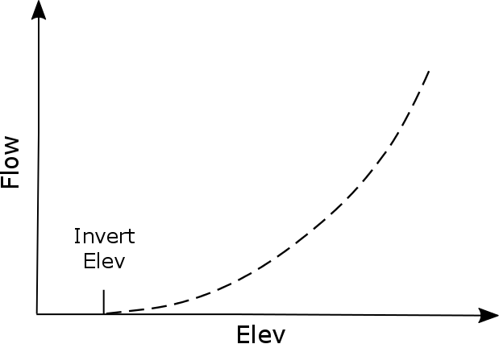
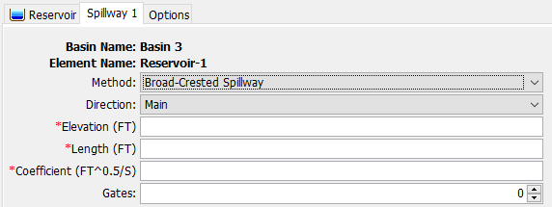
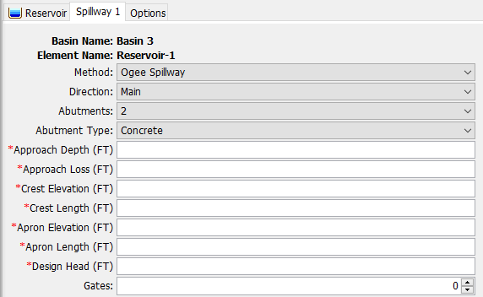
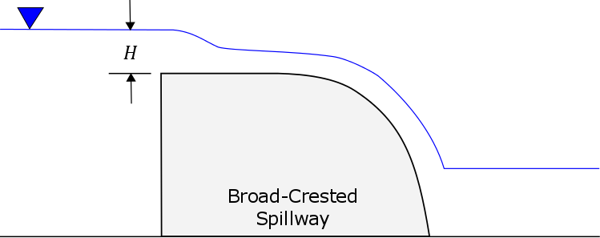
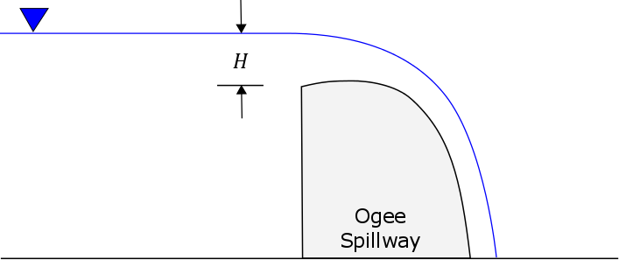
Spillways
Specified
Broad-Crested
Ogee
https://www.hec.usace.army.mil/confluence/hmsdocs/hmstrm/modeling-reservoirs/spillways
Notes:
Spillways can be represented by a rating curve, Broad-crested spillway using the weir equation, or an ogee spillway. The ogee spillway will adjust the energy loss in accordance with the abutment type. The approach channel dimensions will also be specified along with any losses associated. Crest and apron geometry are also defined. The apron elevation and apron width are measured at the bottom of the ogee structure. The design head is input so that the discharge coefficient can be automatically calculated with the head on the spillway departs from the design head.

Slide 24
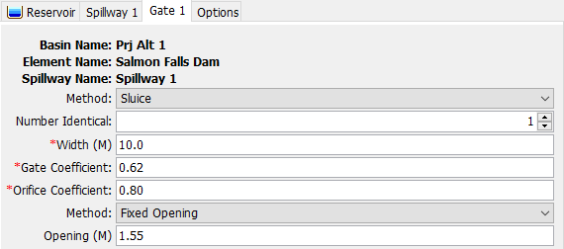
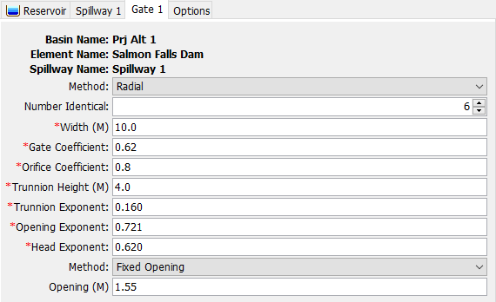
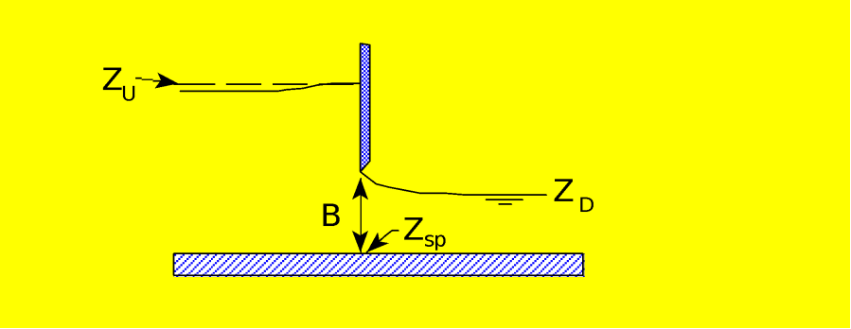
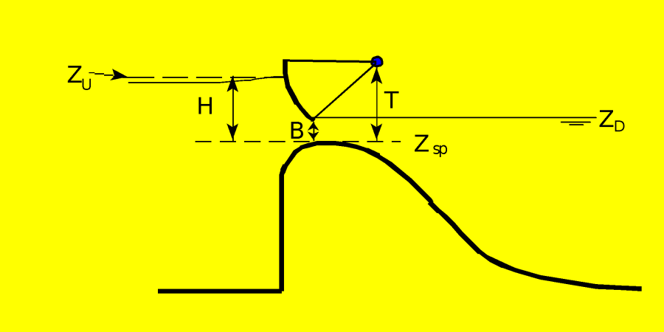
Spillway Gates
Sluice Gate
Radial Gate
https://www.hec.usace.army.mil/confluence/hmsdocs/hmstrm/modeling-reservoirs/spillways
Notes:
Sluice gate moves up and down and a radial or tainter gate rotates
Three gate methods are available: Fixed Opening, Percent Annual Pattern, and Percent Time Series.
The Fixed Opening control method only accommodates a single setting for the gate. The distance between the spillway and the bottom of the gate is specified as the Opening. The same setting is used for the entire simulation time window.
Percent Annual Pattern is defined by a Percent Pattern Paired Data curve. This defines a pattern of gate openings expressed as a percent of the maximum. The gate settings are defined by the day of the year and repeated for every year in the simulation period.
Percent Time Series is defined by a Percent Gage Time Series. This defines a series of specified percent gate openings on a time-series basis instead of based on an annual pattern.

Slide 25
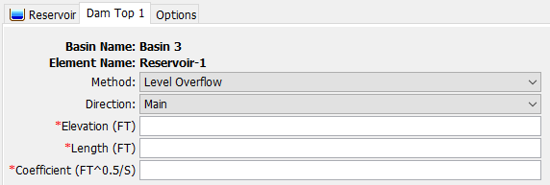
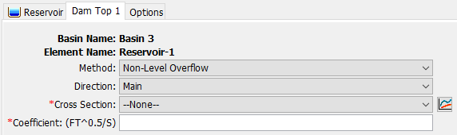
Dam Tops
Level
Non-Level
https://www.hec.usace.army.mil/confluence/hmsdocs/hmstrm/modeling-reservoirs/dam-tops
Notes:
For dam tops the options are level or non-level.
A level dam top is represented the same as the broadcrested spillway.
A non-level dam top is represented with an eight point cross-section. A separate flow calculation is carried out for each segment of the cross section. The broad-crested weir assumptions are made for each segment

Slide 26
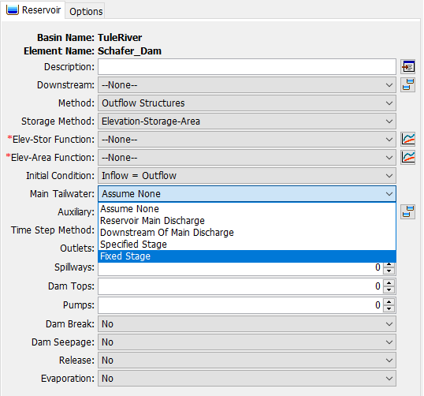
Tailwater
Controls determination of submergence for structures
5 options:
Assume None
Reservoir Main Discharge (requires rating curve)
Computed at outlet – no backwater
Downstream of Main Discharge (requires rating curve, E-D)
Computed (Elevation) at next element downstream
Specified Stage (requires stage time series)
Fixed Stage
Notes:
Reservoir Main Discharge method is typically used when tailwater below the reservoir only comes from the reservoir releases.
In the Downstream of Main Discharge method the outflow from the reservoir is combined with all other inflows to the element downstream of the reservoir. That combined inflow is used in combination with a rating curve to determine the stage for the reservoir tailwater.
Specified Stage is a timeseries of stage elevations
Fixed Stage is a constant- typical for interior ponds or pump stations

Slide 27
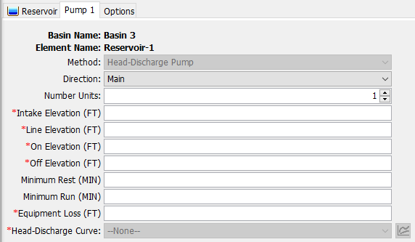
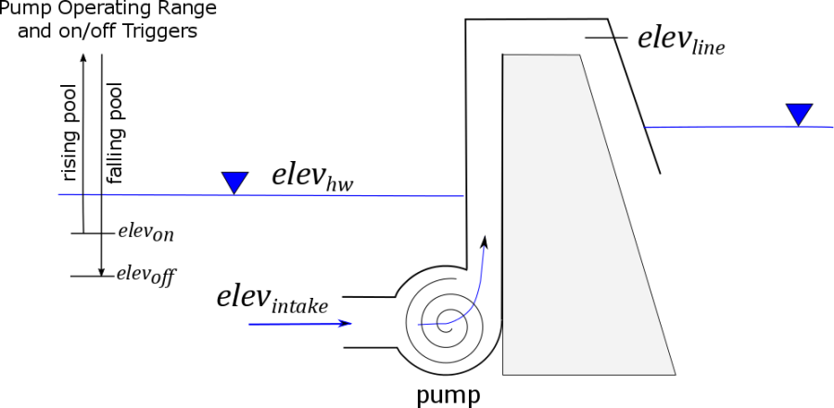
Pumps
https://www.hec.usace.army.mil/confluence/hmsdocs/hmstrm/modeling-reservoirs/pumps
Notes:
These typically represent pumps in interior ponds or pump stations that are intended to move water out of the reservoir and into the tailwater when gravity outlets alone are not sufficient. Parameters include elevations at which the pump turns on and off. The Head-Discharge Curve describes the capacity of the pump as a function of the Total Head. Total head is the head difference due to reservoir pool elevation and tailwater elevation, plus equipment loss.

Slide 28
Additional Options
Evaporation
Dam Breaks
Piping Breach – initiated by seepage
Overtop Breach – erode face of dam, expands as trapezoid from top of dam
Dam Seepage
Can be defined for pool to tailwater or tailwater to pool
Additional Releases

Slide 29
Outflow Structures – When to Use?
Complex combination of ungated hydraulic structures
Need to compute dam breaks, seepage, or evaporation*

Slide 30
Rule-Based Reservoir Routing

Slide 31
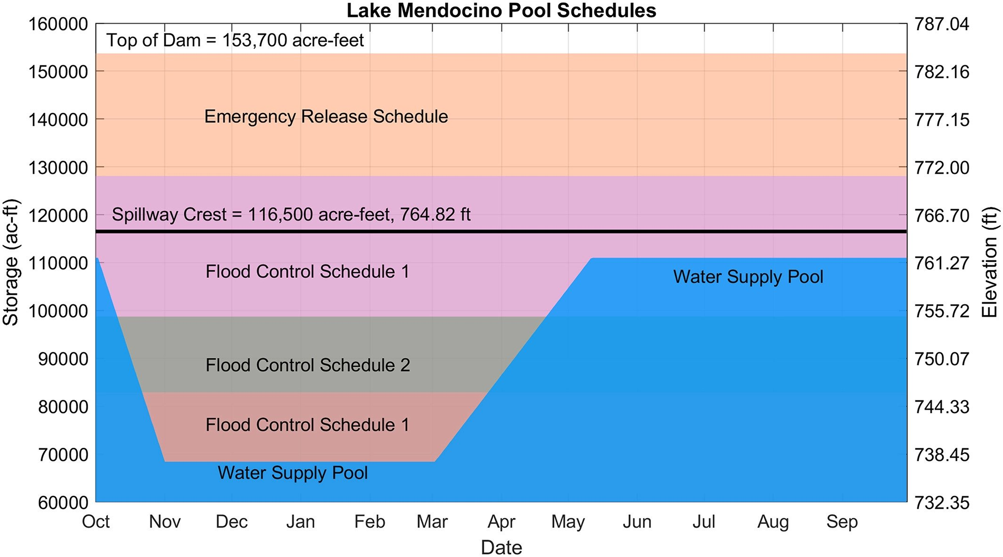
Guide Curve Operations
Above the Guide Curve
increase releases as necessary (or possible) to lower the pool elevation to the Guide Curve.
Below the Guide Curve
reduce releases as necessary (or possible) to raise the pool elevation to the Guide Curve.
At the Guide Curve
release “just enough” to maintain the pool elevation at the Guide Curve
Notes:
Rule-based operations function with guide curve operations, similar to what’s used in ResSim.
There are three states in guide curve ops.
You can be right on the guide curve (see the yellow dot.) For the day of the year, the reservoir has the desired storage.
You can be above the guide curve (see the blue dot.) For the day of the year, the reservoir is storing more than desired.
You can be below the guide curve (see the orange dot.) For the day of the year, the reservoir is storing less than desired.

Slide 32
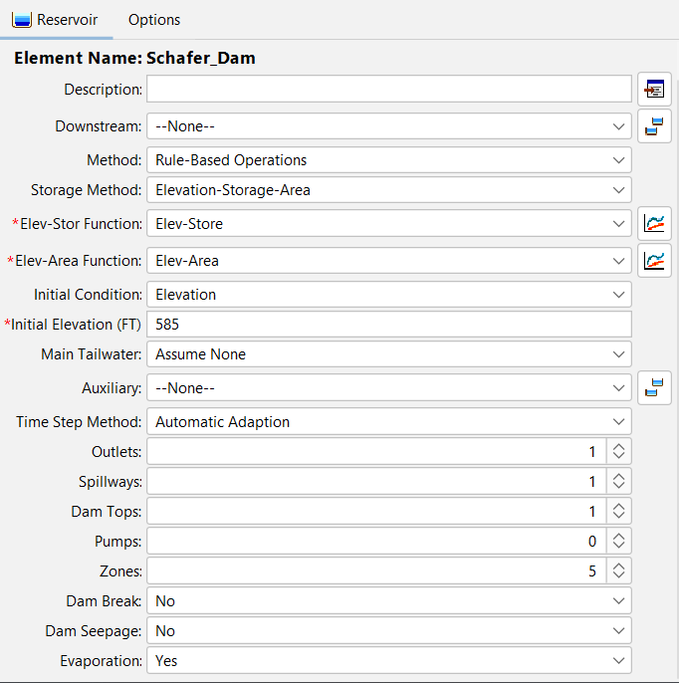
Rule-Based Reservoir Routing
Extension of Outflow Structures routing method
Uses rules and operable structures to determine releases
Zones determine what rules are applied
Reservoir elevation
Day of the year
Notes:
Rule based routing is an extension of the outflow structures method, so it has all of the same options for adding outlets, spillways, etc, but the added feature is Zones and Rules

Slide 33
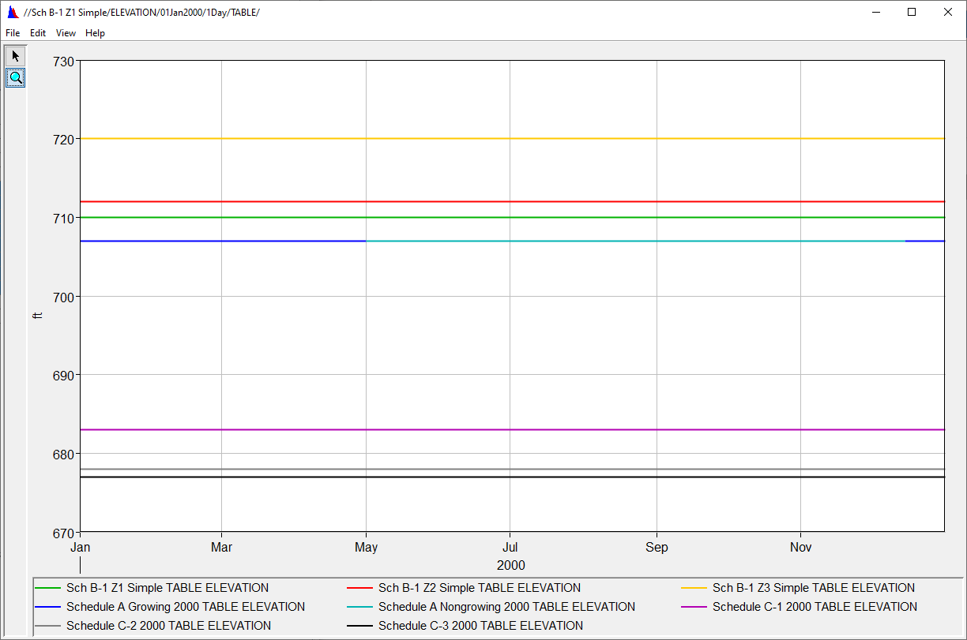
Zones
A grouping of homogeneous rules
Defined by an elevation range and day of year for each zone
Finds first Maximum Elevation curve above the current elevation/day
Need at least one for operations to work
Notes:
Zones are defined by a top elevation and day of the year. At least one zone is required to use RBO. The plot above shows 6 zone definitions with a constant elevation throughout the year, however you can have a variable zone, like the water supply pool in this plot.

Slide 34
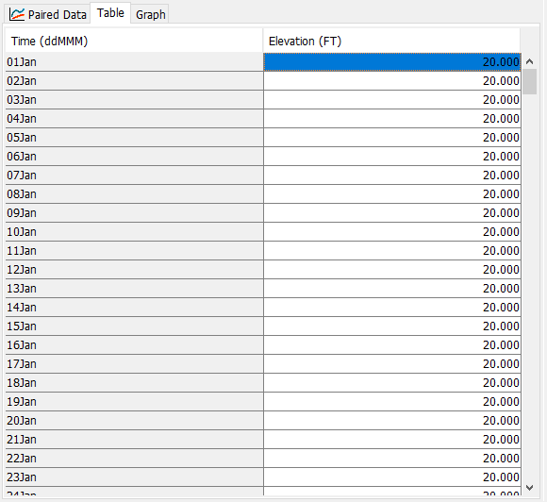
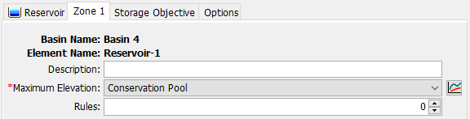
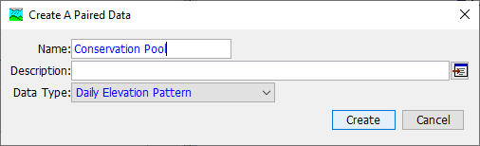
Maximum Elevation
Each Zone is defined by a maximum elevation, which is a Daily Elevation Pattern Paired Data curve.
Notes:
Here’s how a zone is created with a Maximum Elevation Daily Elevation Pattern- which is a paired data type.

Slide 35
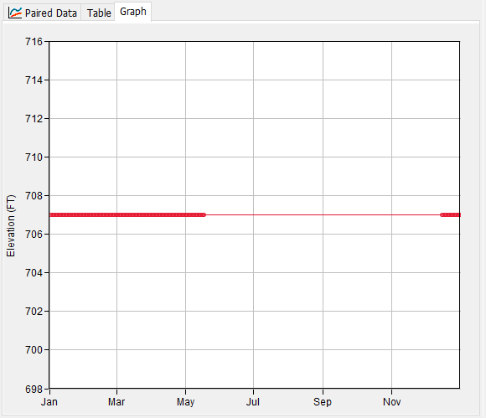
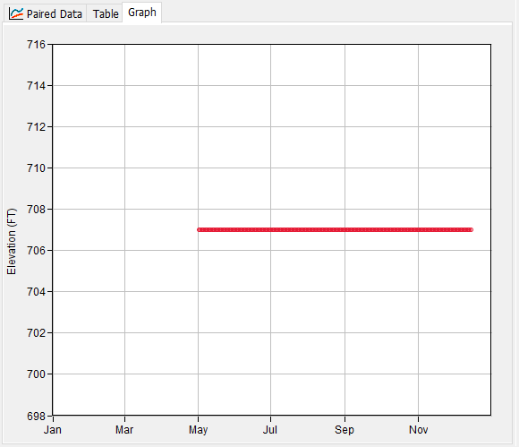
Maximum Elevation
Schedule A Non-Growing Season
Daily Elevation Pattern Paired Data
Top zone should cover entire range of elevations and dates
Curve does not need to be defined for every day of the year
If nothing defined, zone will not be used for that day
Schedule A Growing Season
Notes:
In the example on the right, a regulation manual calls its basic flood operations “Schedule A”. The dam has the potential to cause agricultural damages, so maximum releases are limited during the growing season compared to the non-growing season, so despite these having the same overall elevation (707 ft) the rules they contain would be different.

Slide 36
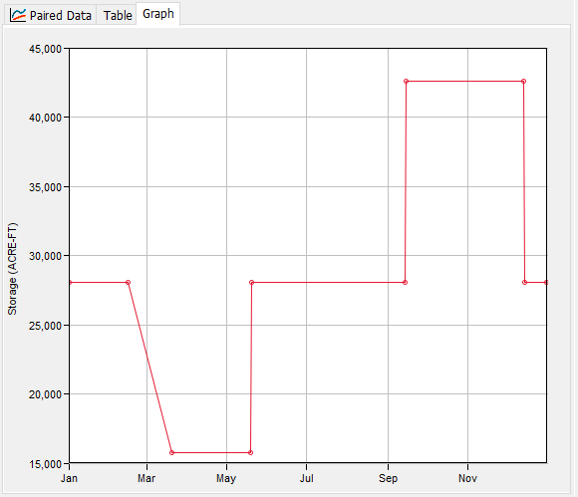
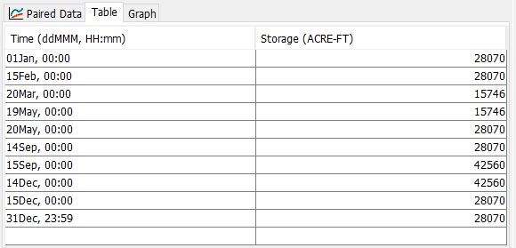
Storage Objective (Guide Curve)
For every day of the year, what is the desired storage?
Currently able to be defined for each zone
May change to a single guide curve for the Dam in the future
Recommend using only one for all zones unless you have really specific needs
Interpolates between points
Needs to cover entire year
Flood Pool
Conservation Pool
Notes:
Next, each zone must have a storage objective- this is your guide curve. Typically only a single guide curve is used for a given reservoir, but the program does allow for different storage objectives in different zones. The Guide Curve will either be a Storage Pattern Paired Data Curve or an Elevation Pattern Paired Data Curve.

Slide 37
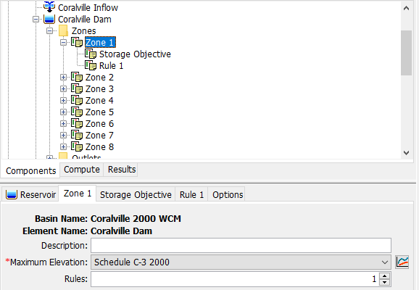
Rules
Added via Zone
Rules are specific to a single zone
Notes:
A Zone may have zero or more additional rules beyond a Storage Objective.

Slide 38
Rule Types (10)
Type | Limits | Operation
Main Release | Min, Max, Specified | Sets a target for releases in the main direction
Auxiliary Release | Min, Max, Specified | Sets a target for releases in the auxiliary direction
Downstream Flow* | Min, Max, Specified | Sets a target for an element downstream
Rate of Flow Change | Max | Limits how much releases can change per each time
*requires iterative trial releases
Notes:
There are ten rule types that can be used.

Slide 39
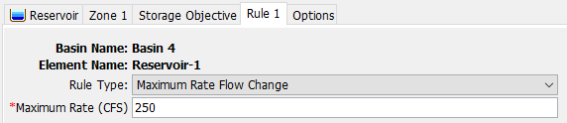
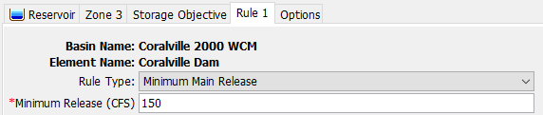
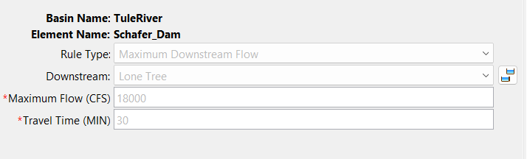
Rules
No limit to what you can specify
Try not to make them conflict

Slide 40
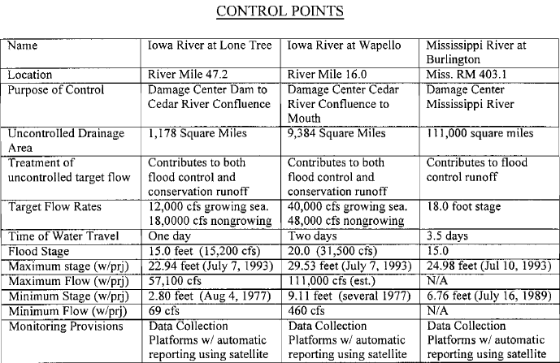
Downstream Controls
Schedule A Non-Growing Season
Require iterative trial releases
Significantly add to simulation time
Keep them as simple as possible
Schedule A Growing Season
Notes:
In this example there are different constraints according to season. 12000 cfs in growing season and 18000 cfs in non-growing season, then at a different downstream point 40kcfs in growing season and 48 kcfs in non-growing season. This would be a use case for two separate zones that may have the same top elevation but cover different dates so that these different downstream rules can be applied based on the day of the year.

Slide 41
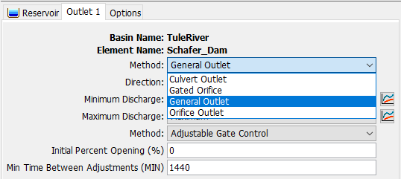
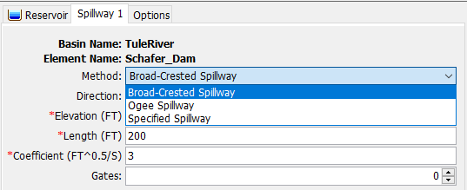
Outflow Structures
All features of Outflow Structures method available
Only some structures have parts that can be operated
Outlets
General Outlet
Gated Orifice
Broad-Crested and Ogee Spillways
Radial Gates
Sluice Gates

Slide 42
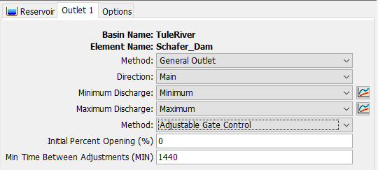
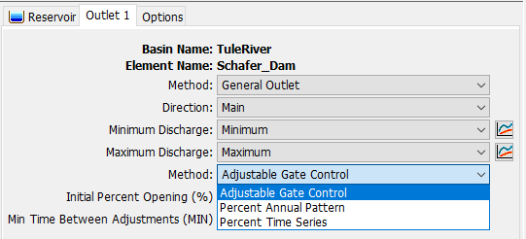
General Outlet
Gate Control Methods
Notes:
The general outlet lets you define a minimum and maximum rating curve for your outlet. The initial percent of opening and the time between adjustments. The minimum time between adjustments will dictate how often your gate settings can be adjusted by HMS.

Slide 43
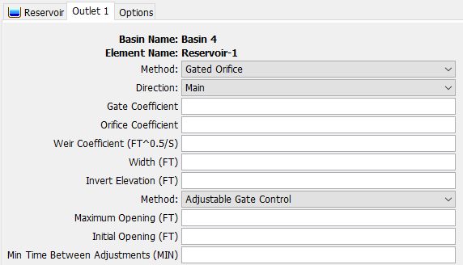
Gated Orifice Outlet
Notes:
For the orifice outlets and gates, if the Adjustable Gate Control method is used there will be an option to define the initial amount of opening and the minimum time between adjustments.

Slide 44
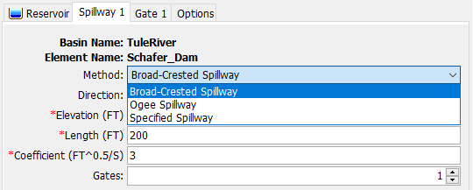

Gated Spillway
Operable sluice and radial gates for Broad-Crested and Ogee spillways
Notes:
The gated spillway options will be very similar to the options of the gated orifice outlet when Adjustable Gate Control is used as the method.

Slide 45
Calibration
Isolate reservoir by using a source element with a timeseries gage
Calibration by adjusting rules
These may deviate from the regulation manual
Add other rules or settings for stability
Rate of change rules help even if not included in WCM
Calibration by adjusting structures
Adjust rating curves for outlets or spillways using simple methods
Notes:
For calibrating operations, eliminate other sources of uncertainty by using a source element with observed inflows. Use simple rules and build complexity as needed. The rate of change rules or rules about time between adjustment can help smooth your curves if you’re noticing instability. Finally, you can make small changes to rating curves for general outlets or spillways to improve calibration as well.

Slide 46
Rule-Based Reservoir Routing – When to Use?
Storage target and releases vary seasonally
Complex rules and operable structures determine releases
You might be surprised how effective simple guide curve operations can be for many models!

Slide 47
Best Practices for Reservoir Modeling
Use a junction upstream and downstream of your reservoir
Calibrate/validate your model isolating out any reservoir operations first
Use Specified Release method to pass the right flows downstream
Next calibrate to observed outflow using appropriate routing method
Keep it as simple as possible
HMS is not ResSim

Slide 48
Reservoir Sediment Routing

Slide 49

Reservoir Volume Reduction Process
Notes:
Very large reservoirs typically trap nearly all incoming sediment. Small reservoirs often trap gravel and sand, while allowing silt and clay to pass through with some attenuation of the sediment pulses. The reservoir reduction process computes the siltation volume based on the trapping efficiency. There are two different sediment trapping methods: Chen or Brune. The main difference on these two methods is the parameters used to compute the trapping efficiency. Chen relies on the reservoir area to compute the critical velocity (Vc = Q/A ) and in turn the TE and Brune relies on the reservoir volume to compute the TE.
So the basic process is that siltation volume is computed and then the elevation-storage and/or elevation-area curves are updated based on the volume of siltation. In Chen’s method, a new critical velocity and TE is then computed based on the new elevation-area curve. In Brune’s method, a new efficiency is computed based on the new elevation storage curve. And then we’re back to the beginning where a the siltation volume is computed based on the trapping efficiency

Slide 50



Chen’s Sediment Trap (Chen 1975)
Critical settling velocity
Trapping Efficiency
Mixed (turbulent) reservoir (lower bound): Chen, 1975
The settling velocity is computed using the method selected for the Basin Model.
The critical settling velocity is computed as the discharge rate (Q) from the reservoir divided by the surface area (A). The computations are performed separately for each grain size class or subclass.
$$v_{c}=\frac{d}{T}=\frac{Q}{A}=overflowrate$$
$$TE=100\left[1−e^{− \frac{v_{s}}{v_{c}}}\right]$$
Verstraeten, G and Poesen, J, 2000. Progress in Physical Geography 24
Notes:
Chen, 1975). The settling velocity is computed using the method selected for the Basin Model. The critical settling velocity is computed as the discharge rate from the resThe trap efficiency of a reservoir is the sediment load retained in the reservoir divided by the total sediment load entering the reservoir. The trap efficiency can be estimated by comparing the settling velocity of the sediment to a critical settling velocity (ervoir divided by the surface area. The computations are performed separately for each grain size class or subclass.
The main parameter for the Chen Sediment Trap Method is the depth-averaged temperature of the water in the reservoir. You may specify a Fixed average Temperature or select a Temperature Time-Series Gage.

Slide 51



Brune’s Sediment Trap (Brune 1953)
Capacity/Annual Inflow Ratio
Vres = Reservoir Capacity
Vinflow = Annual Inflow
(user-specified initial value is required)
Trapping Efficiency
a = Coefficient (Low=95, Medium=97, High=100)
b = Coefficient (Low=5.37, 6.42, High=7.71)
$$V_{∗}=\frac{V_{res}}{V_{inflow}}$$
$$TE=a\left[1−2e^{−bV_{∗}^{0.35}}\right]$$
Notes:
The trap efficiency of a reservoir is the sediment load retained in the reservoir divided by the total sediment load entering the reservoir. Brune (1953) developed the curve with the relation between trap efficiency and reservoir capacity-annual inflow ratio (C/I).

Slide 52

Reservoir Capacity Method
Large & Long-Shape Deposition Pattern for granular materials such as Sand & Gravel
Small & V-Shape Deposition Pattern for fine particles such as Clay & Silt
Notes:
When users choose the "Reservoir Capacity Method" within the HEC-HMS user interface, they are offered a selection between two deposition shape options: "V-Shape" and "Elongated Taper." This choice of deposition shape for each grain size initiates modifications to the Elevation-Storage and Elevation-Area relation curves. You can see the difference in the change to the elevation storage curve based on the deposition pattern chosen.

Slide 53

Reservoir volume reduction calculation
$$\text{Sedimen}t Deposited=Sediment Inflow×TE$$
$$\text{Sediment} Outflow=Suspended Sediment × \frac{\text{Water} \text{Discharge} \text{Volume} \text{from} \text{reservoir}}{\text{Water} \text{Volume} \text{in} \text{reservoir}}$$
Suspended Sediment = Sediment Inflow – Sediment Deposited
Sediment Inflow
Clay = 200 T/d
Silt = 70 T/d
Sand = 1 T/d
Trap Efficiency (TE)
Clay = 0.7
Silt = 1
Sand = 1
Suspended Sediment =
Clay = 60 T/d
Silt = 0 T/d
Sand = 0 T/d
Sediment Outflow
Clay = 60 T/d
By
Volume Ratio
X
Sediment Deposit=
Silt = 140 T/d
Sand = 70 T/d
Gravel = 1 T/d

Slide 54





HEC-HMS GUI for two sediment trap efficiency Methods
Notes:
Here’s an example of the user interface for the sediment methods as well as the results of the changes in elevation vs storage as well as the volume of bottom sediments.

Slide 55

Tuttle Creek Results with Reservoir Volume Reduction
Notes:
Here’s an example comparing a model results with and without sediment deposition considered. In the gray dotted line results where sediment was not considered, there’s up to a ~10 ft difference compared to the observed pool elevations and it’s more pronounced near the bottom of the reservoir where available storage is lower.

Slide 56


Questions?
Check out our Confluence for tutorials, user’s manual, and webinars
https://www.hec.usace.army.mil/confluence/hmsdocs
Notes:
Example Questions Slide with HEC logo

