Slide 1
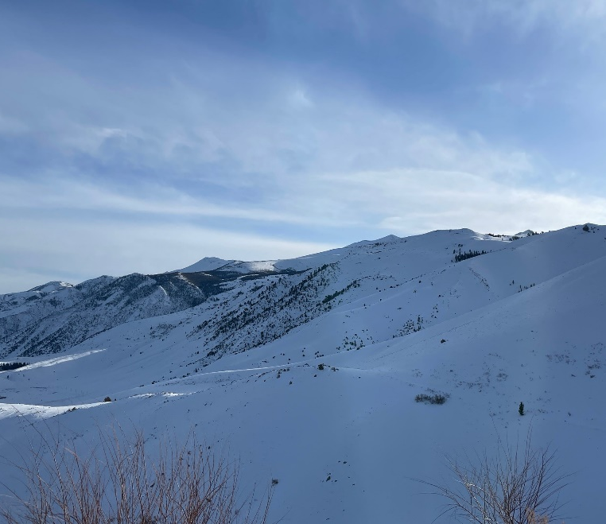
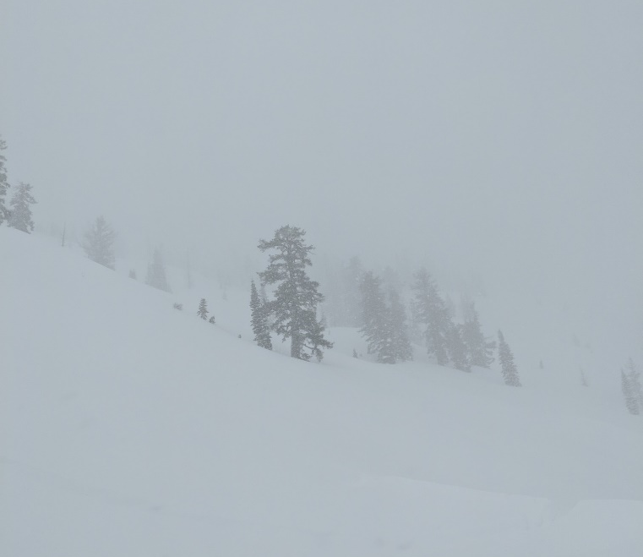
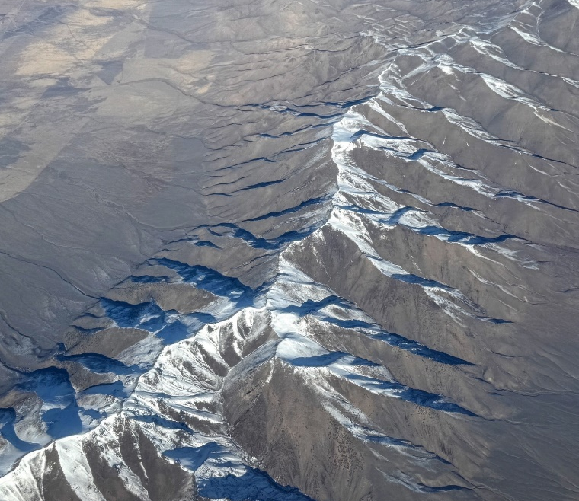
Snow Hydrology and Data
Advanced Applications of HEC-HMS
June 2025
Melissa Mika, P.E.

Slide 2
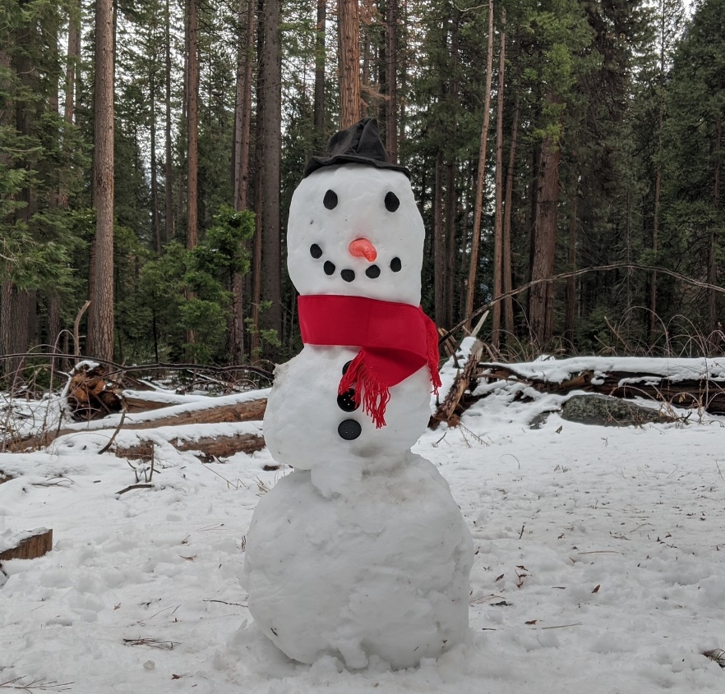
Overview
Understand the importance of snow within water resources
Provide a brief history of snow hydrology
Discuss macro and micro snowpack characteristics
Introduce snowpack energy transfer
Identify sources of snow data in the United States
Explain limitations of each kind of snow data
2

Slide 3
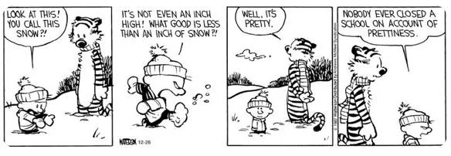
Importance of Snow
3

Slide 4
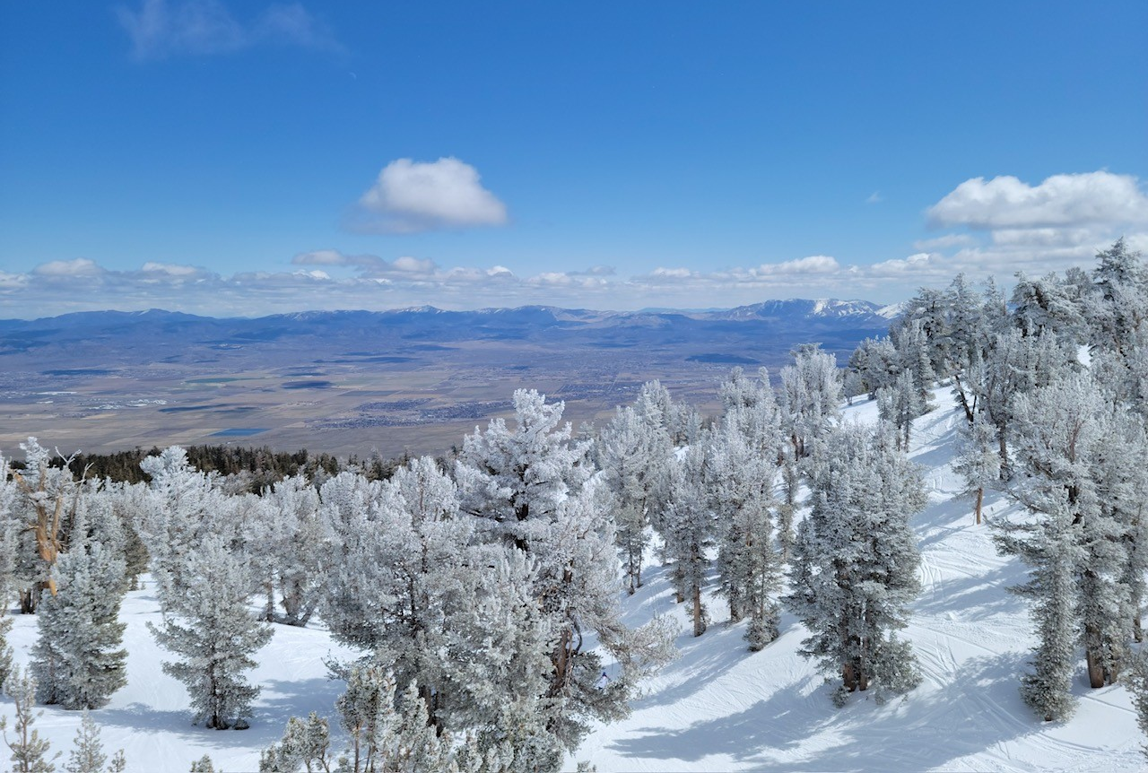
Importance of Snow
80%
CA: of all surface water is snowmelt.
CO: of all surface water is snowmelt.
High albedo of snow and ice influences Earth's radiation balance
Terrestrial snow is a dynamic, fresh-water reservoir that stores precipitation and delays runoff
Snow can be a significant hazard; the largest floods in California are almost all rain-on-snow events
70%
Notes:
From http://snobear.colorado.edu/SnowHydro/intro.html
Some of the reasons you might want to stop ignoring the snow, with the information taken from University of Colorado snow hydrology class.

Slide 5
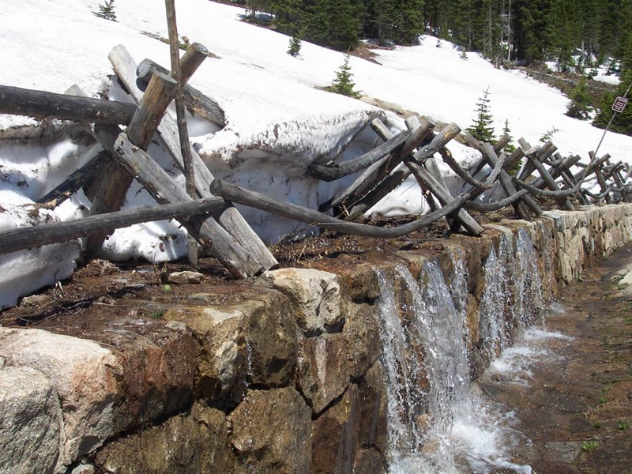
Importance of Snow
Snow represents a source of water that, when melted into a liquid, can represent a significant inflow into rivers, streams and reservoirs that must be dealt with in an efficient and effective manner
5
Notes:
Snow is very important within USACE
We’re in the business of managing water to provide benefits to the nation
That includes things like water supply and hydropower generation, but also flood risk management
When snow melts, it presents both opportunity and risk at the same time
We must effectively manage snowmelt

Slide 6
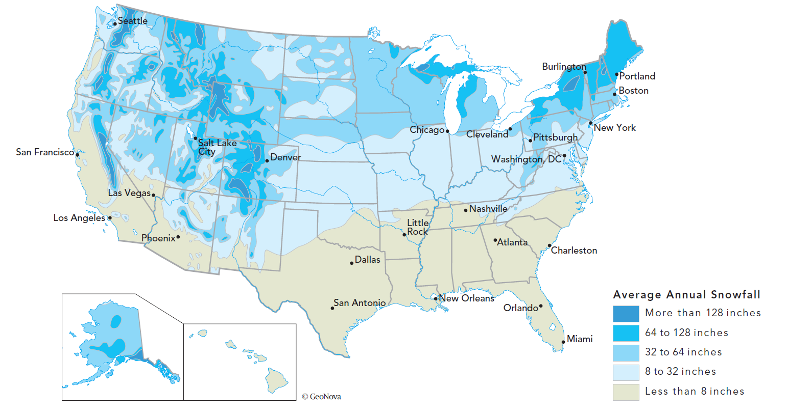
Importance of Snow
Reservoir Operation
Timing, volume, optimization
Release schedules, gate settings
Snowmelt Flooding
Peak Runoff, Timing, Rain on snow
Planning & Design Studies
Requirements vary from District to District depending on seasonal snow conditions
6
Notes:
This figure shows average annual snowfall in the US, and you can see that around 2/3 of the country gets at least 8 inches
A substantial portion of the United States experiences significant snowfall
Some areas, like the mountainous west, rely heavily upon this source of water every year
We’ve built infrastructure like dams, levees, and navigation channels that are aimed at managing runoff from snowmelt
We continue to investigate modifications to existing infrastructure as well as completely new projects that must effectively predict the accumulation and melt of snow
Planning and design studies, depending on a district, may require including snow

Slide 7
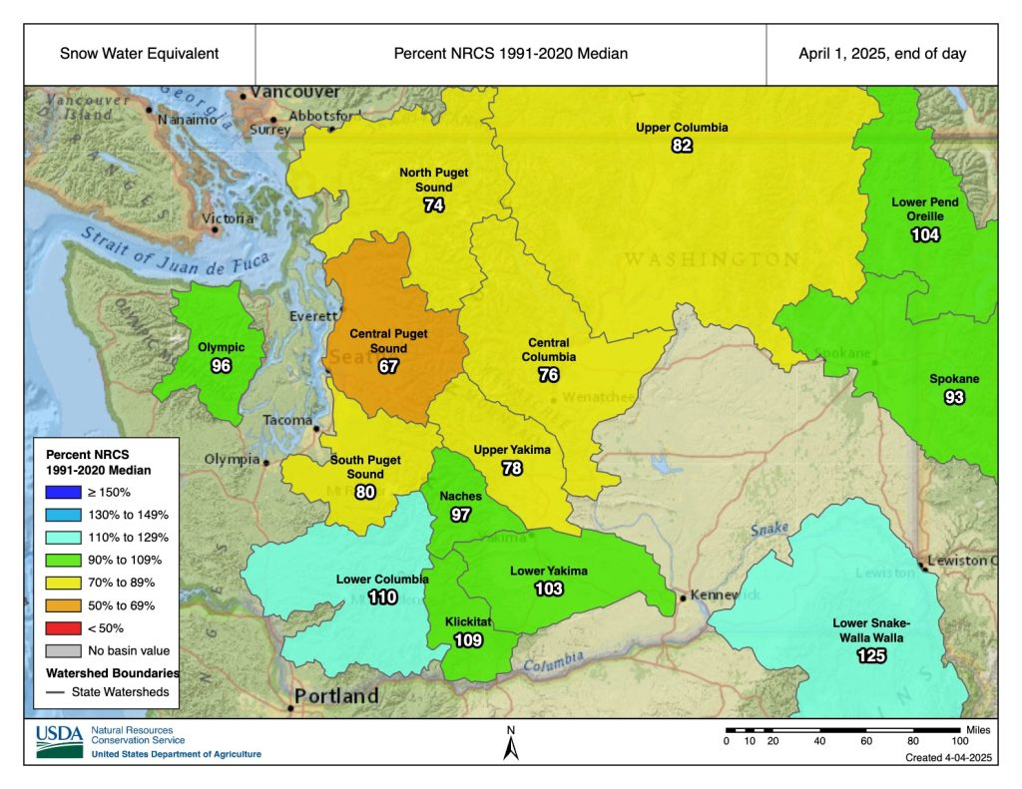
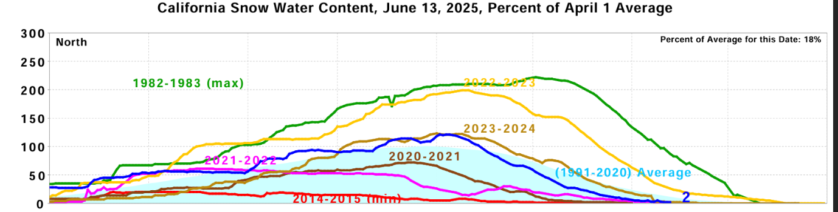
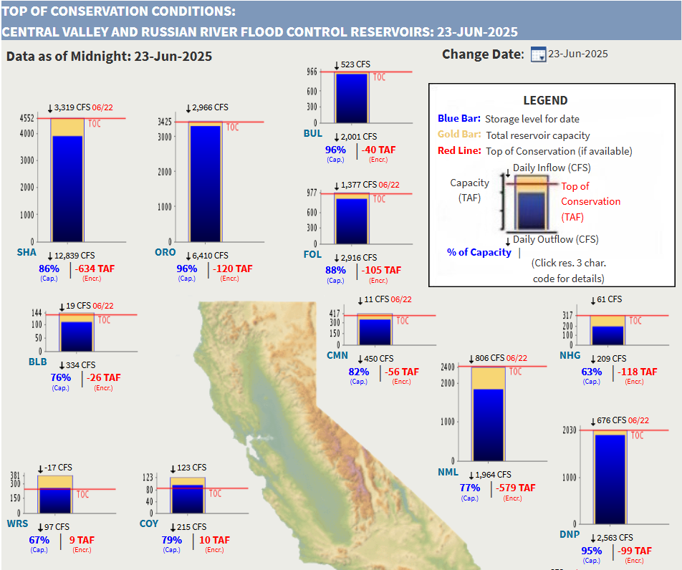
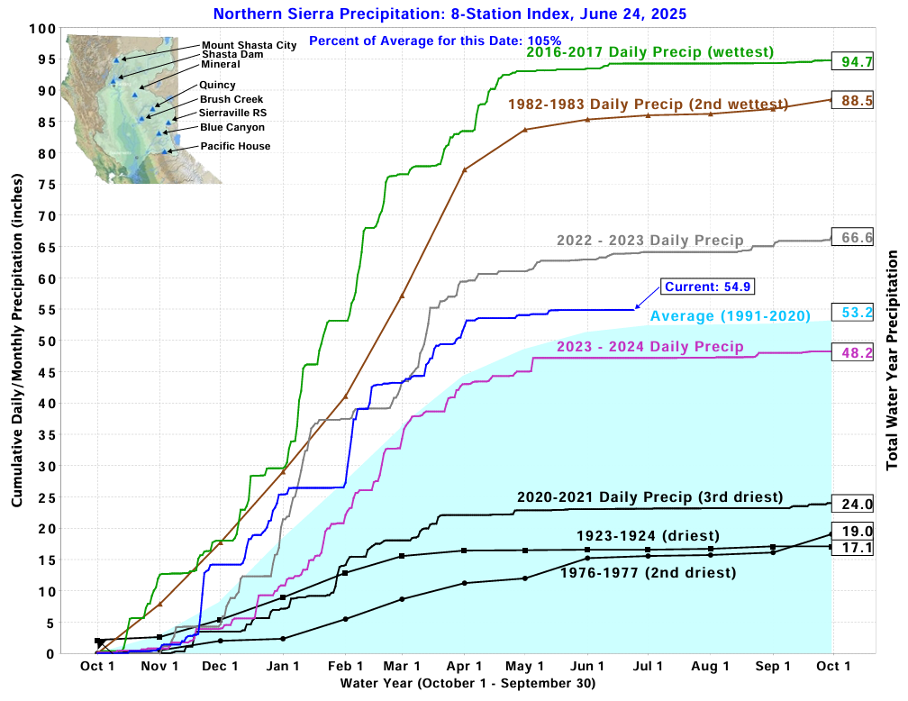
Reservoir Operations
Snowpack and precipitation index maps
SWE and precipitation plots

Slide 8
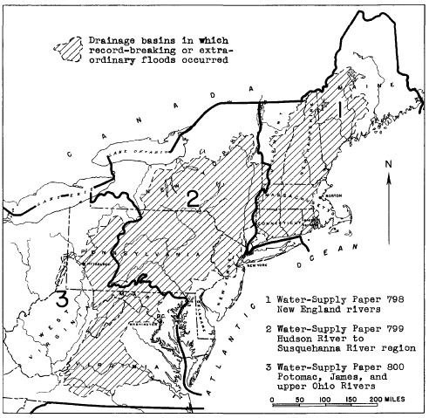
March 1936 Flood
March 9 – 22, 1936
Excessive Precipitation + Large Amounts of Antecedent Snow + High Temperatures + Strong Winds = HISTORIC FLOODS
10 – 30 inches of total water equivalent
100+ fatalities
Affected over 150,000 square miles in the Northeastern U.S.
James River, Ohio River, Susquehanna River, Delaware River, Hudson River, Connecticut River, Merrimack River, Androscoggin River, and every other river in between
8
Notes:
This is an example of a major historical flood in the northeast that was caused by rain-on-snow events in combination with other unfavorable factors such as high temperatures and strong winds
It was a historic flood over large areas.
Over 100 fatalities
Affected over 150,000 sq mi and many rivers

Slide 9
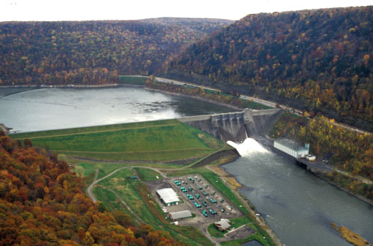
Flood Control Act of 1936
Signed into law 22 June 1936
“Flood control on navigable waters or their tributaries is a proper activity of the Federal Government in cooperation with States, their political subdivisions, and localities thereof.”
In layman’s terms: flood control is an appropriate federal activity overseen by USACE
Led to authorization of hundreds of dams, thousands of miles of levees, and other water resource projects
Kinzua Dam, LRP
9
Notes:
One of the consequences of this flood was the flood control act of 1936 that designated flood control as an appropriate federal activity overseen by USACE

Slide 10
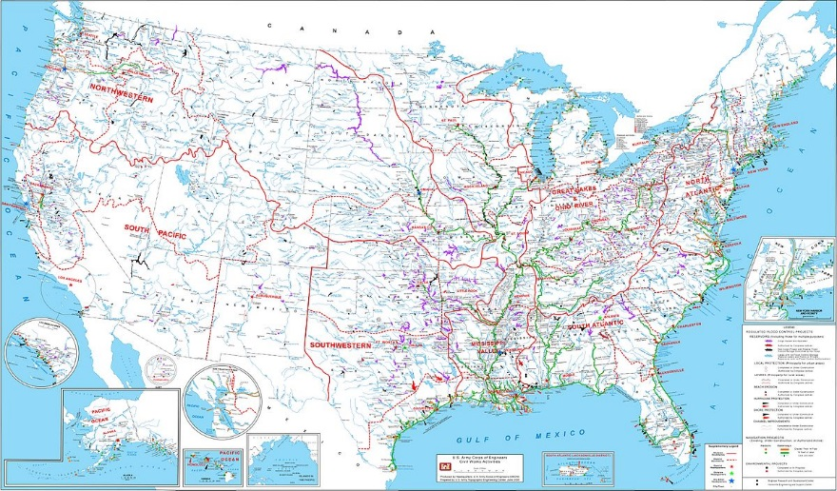
10
Notes:
This figure shows all USACE projects throughout the United States
Notice how many of them are located within areas that experience notable snow accumulation and melt
Also, many of these projects, most notably in the northeastern U.S., were built after the Flood Control Act of 1936 was passed

Slide 11
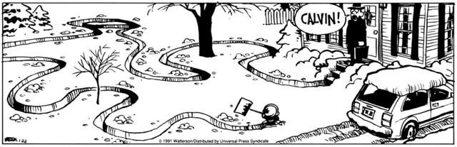
A Brief History of Snow Hydrology
11

Slide 12
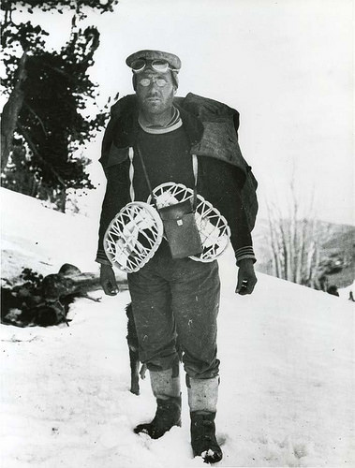
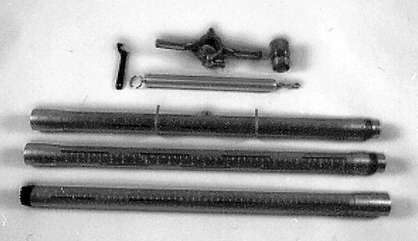
A Brief History of Snow Hydrology
Snow surveying was first introduced in the late 1800s; it’s difficult to determine who was first
Dr. James Edward Church established the first system of snow courses around Lake Tahoe in early 1900s
Invented a snow sampling device – Mt. Rose Sampler
Dr. Church travelled around the world setting up snow courses and advising hydrologists
12
Notes:
https://westernsnowconference.org/about/history/
Snow Surveying was first invented in the late 1800’s in several different locales and it is difficult to ascertain exactly who was first.
From 1870 to 1910 the population of CA grew by 325 percent. Unlike water in the East, water in the West could not be taken for granted;
In the United States a Professor of Philosophy at the University of Nevada, Reno named Dr. James E. Church got interested in water resources of Lake Tahoe area where several groups of people including farmers, property owners, a power company and Paiute Indians all competed for the fresh water.
Understanding the connection between seasonal runoff and snowpack, he understood that being able to systematically measure snow across a watershed would yield the ability to predict seasonal water supply. Hence, the birth of Snow Surveys.
He came up with a stainless-steel cylinder, which he forced through the snow to extract samples from the surface of the snow to the ground. Once obtained, the samples would be weighed, weight being a reliable index of water content. Church's extraction instrument, which was more than six feet long, and onto which extensions could be screwed, came to be known as the Mount Rose sampler, after the mountain where he conducted his first surveys. The current design is based on the original.

Slide 13
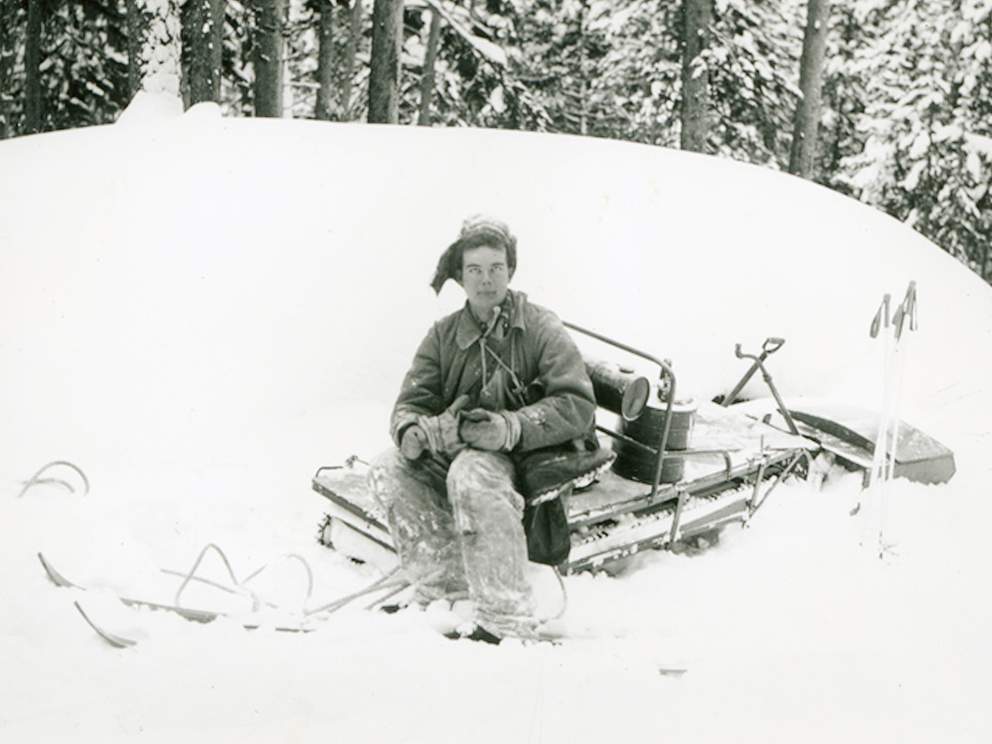
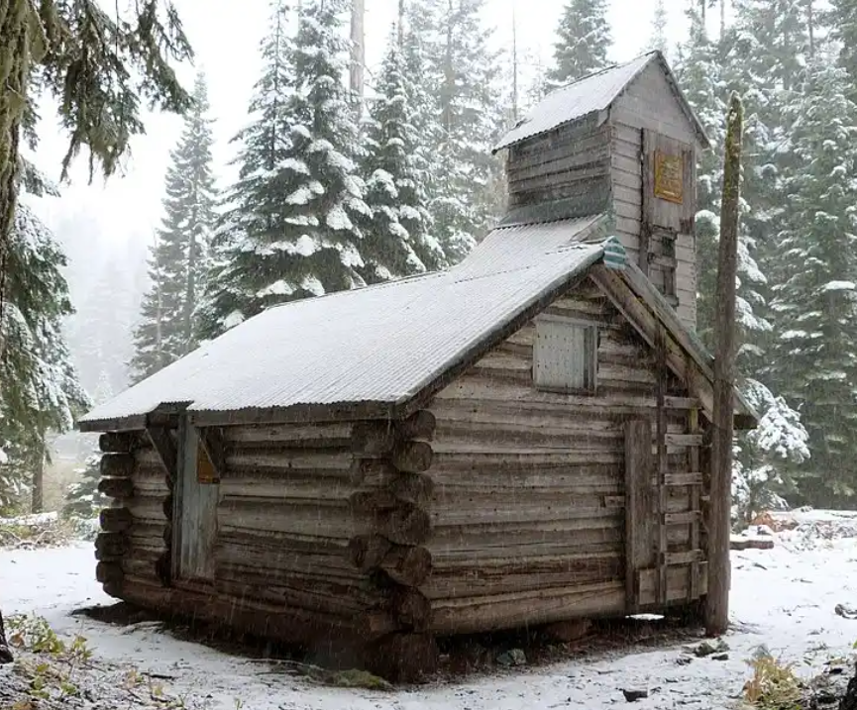
A Brief History of Snow Hydrology
1910 – 1920: systematic snow surveying throughout the world begins
1929: California establishes a statewide Snow Survey Program
2019 total budget = $1.6 million
1934: At least 9 independent snow surveys were being conducted in the west
1935: U.S. Congress passes legislation creating the first federal snow survey program
Eventually transferred to SCS (now NRCS)
“Sno-bug”, 1949: Photo courtesy of USDA NRCS
13
Notes:
By 1911 Church and a U.S. Weather Bureau official named J. Cecil Alter were independently making systematic snow surveys, Church around Tahoe and Alter in the watershed around Great Salt Lake. They each developed the idea of the "snow course"--a series of sampling sites strung across a short distance to be surveyed year after year.
About a 1000 of them throughout the US by 1940s
This is a snow surveyor cabin built in 1937. Note where the door is.

Slide 14
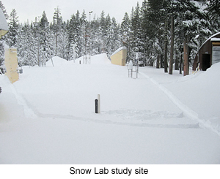
A Brief History of Snow Hydrology
1947 – 1959: Cooperative Snow Investigations Program
Cooperative effort between USACE and U.S. Weather Bureau
Established three laboratories
Donner Pass in California
Upper McKenzie River in Oregon
Glacier National Park in Montana
Central Sierra Snow Lab
14

Slide 15
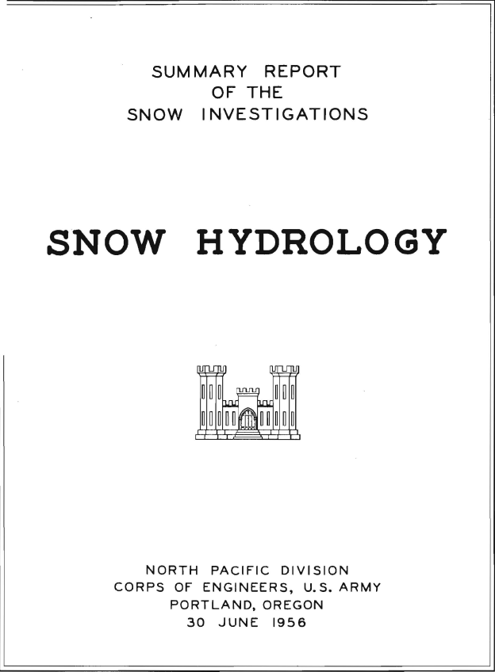
A Brief History of Snow Hydrology
1947 – 1959: Cooperative Snow Investigations Program
Resulted in the publication of Snow Hydrology (1956)
Derived procedures to aid in streamflow forecasts and estimate Spillway Design Floods for major dams in Columbia River watershed
Energy balance method
Temperature Index method
15

Slide 16
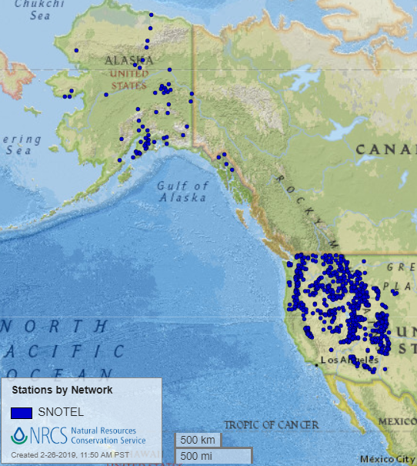
A Brief History of Snow Hydrology
1964: North Pacific Division (now NWD) begins development of Streamflow Synthesis and Reservoir Regulation (SSARR)
1964: NWS SNOW-17 is developed
1975 – 1980: NRCS Snow Telemetry (SNOTEL) automated stations begin to be installed
As of June 2024, there are 900 active stations
16

Slide 17
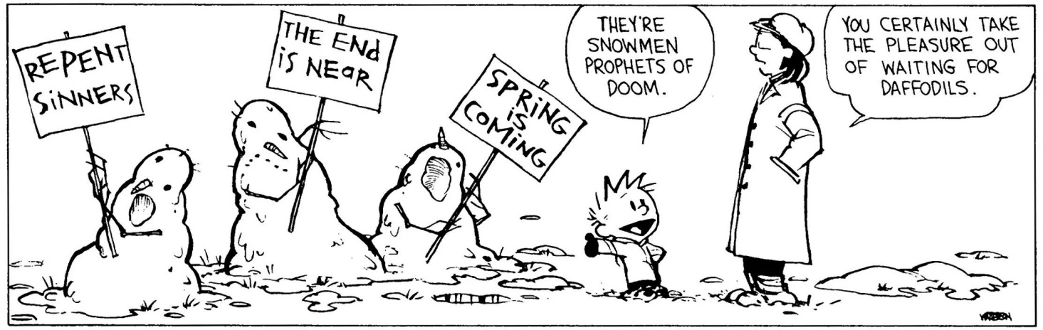
Snowpack Characteristics

Slide 18
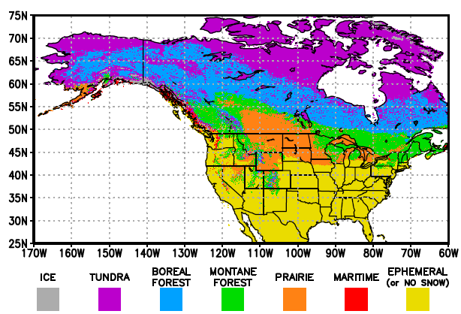
Regional Snowpack Characteristics
North America contains 7 snow classes
Heterogeneity is pronounced in the western states.
Empirical algorithms exist to estimate SWE using snow depth, snowpack classification type, and day-of year
Notes:
From tech manual:
“The range of seasonal snow characteristics has been catalogued and classified by Sturm et al (1995) <<updated in 2021>>. They divided seasonal snow covers in to six classes. They found it difficult to classify the snow cover of mountainous regions. Mountain snow covers have as their chief attribute a high degree of lateral or spatial variability. Wind turbulence over steep, complicated terrain and highly variable solar radiation distribution are the chief causes of this variability. So, the mountain snow class is used to flag regions of high snow variability. They found that these snow classes could be discriminated by a group of variables that they felt were relatively easy to measure. These variables are the winter average values of snow depth, air temperature, snow-ground interface temperature, and bulk density.”
Sturm, Matthew, and Glen E. Liston. 2021. “Revisiting the Global Seasonal Snow Classification: An Updated Dataset for Earth System Applications.” Journal of Hydrometeorology. American Meteorological Society. doi:10.1175/jhm-d-21-0070.1.
Sturm, Matthew, Brian Taras, Glen E. Liston, Chris Derksen, Tobias Jonas, and Jon Lea. 2010. “Estimating Snow Water Equivalent Using Snow Depth Data and Climate Classes.” Journal of Hydrometeorology. American Meteorological Society. doi:10.1175/2010jhm1202.1.

Slide 19
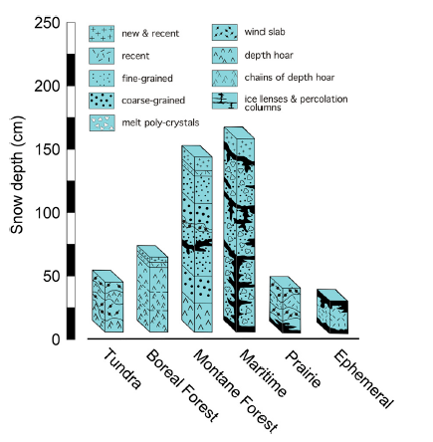
Regional Snowpack Characteristics
The 7 categorical snow classes have distinct stratigraphic signatures
Mixtures of grain size, presence of ice lenses, and other structural properties
Stratigraphic patterns represent snowpacks in middle- to late-winter
Notes:
You can look in HEC-HMS technical manual for how the different classes are defined
Sturm, Matthew, and Glen E. Liston. 2021. “Revisiting the Global Seasonal Snow Classification: An Updated Dataset for Earth System Applications.” Journal of Hydrometeorology. American Meteorological Society. doi:10.1175/jhm-d-21-0070.1.

Slide 20
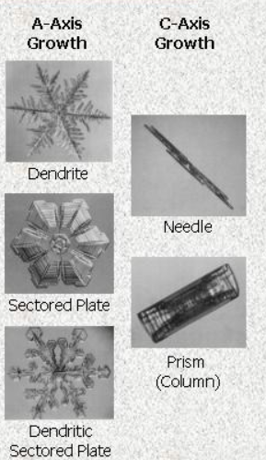
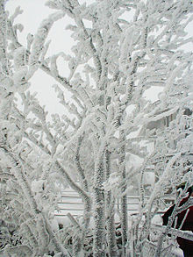
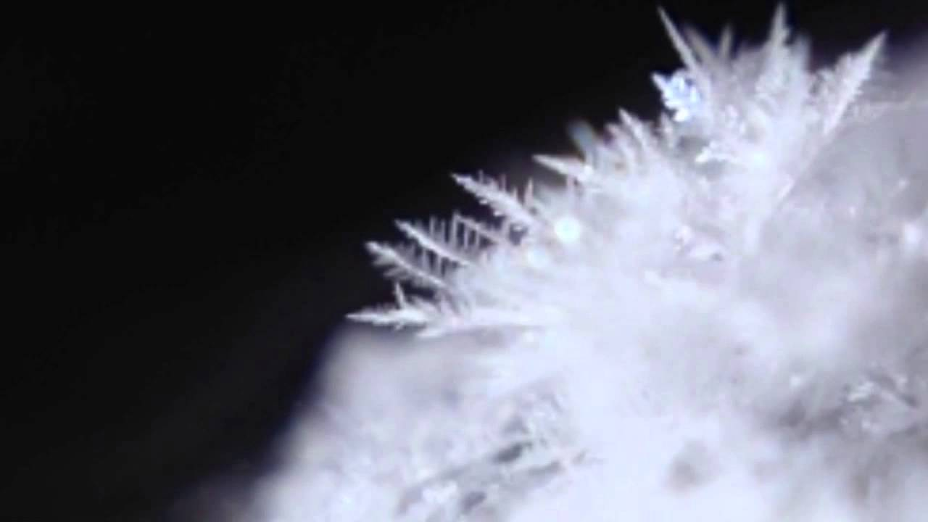
Snow Formation
For snow to form
Water Vapor + Nucleus + T<32ºF + Saturation
Rime Ice
Nucleation
Ice Crystal
Sublimation Growth
Ice Sublimation
Snow Crystal
Continued Growth
Sublimation
Riming
Aggregation
20
Notes:
Now, let’s zoom in and discuss snowpack characteristics from a micro perspective
First up, let’s talk about how snow actually forms
For rain to form need : (1) creation of saturated conditions in the atmosphere; (2) condensation of water vapor into liquid water; and (3) growth of small droplets by collision and coalescence until they become large enough to precipitate.
Snow differs from rain in a very important manner. Particles in the atmosphere must meet very specific requirements to act as ice nuclei. The reason for these exacting requirements is that it is very difficult to "make" water molecules line up correctly to form a crystalline, 3-dimensional shape.
The limiting ingredient to form snow in the atmosphere is often nucleating agents. That's why cloud seeding works.
Thus, for snow to form in the atmosphere, we need:
Water present in the vapor phase
RH => to 100%
Tair <= to 0 degree C
Nucleating agents.
If nuclei are not present, the atmosphere can become supersaturated
Nucleation can happen spontaneously at -40oC also -40oF from supercooled water droplets
Otherwise, need existing ice nuclei
The surface of the earth appears to be the primary source of ice nuclei in the atmosphere.
Silicate minerals such as clays
In Greenland, 85% of ice crystals had clay particle in their center,
Organic ice nuclei such as decomposing leaf matter
After nucleus formation, ice particles can grow in several ways
Grow directly from vapor phase (sublimation)
This can only produce small snowflakes
Large snowflakes must be grown by aggregation and riming
Aggregation = Snowflakes formed by the collosion and adhesion or sticking of ice and snow crystals.
Riming = Adhesion of a super-cooled water droplet to an ice particle or snow crystal.
*Rime ice forms when supercooled water liquid droplets freeze onto surfaces.

Slide 21
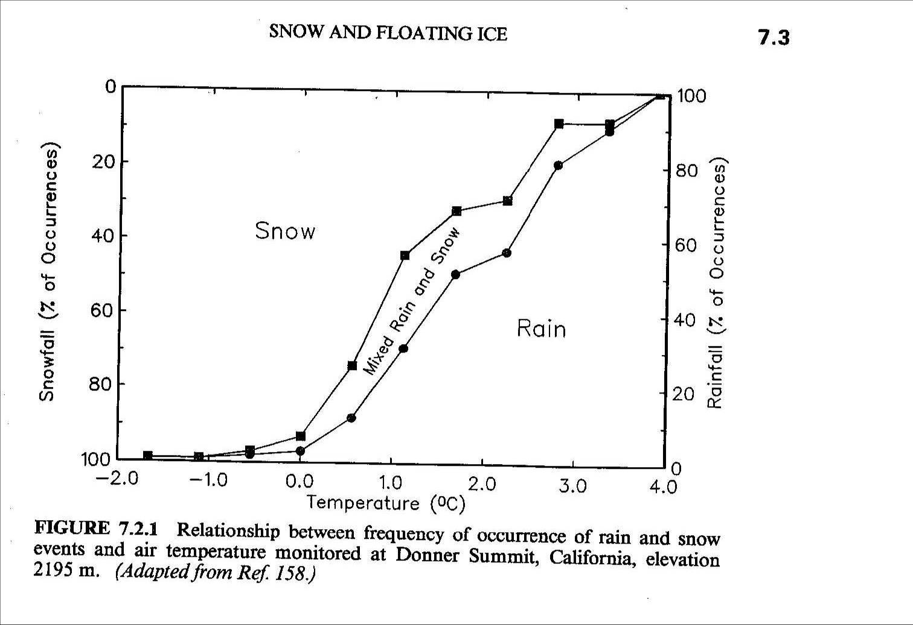
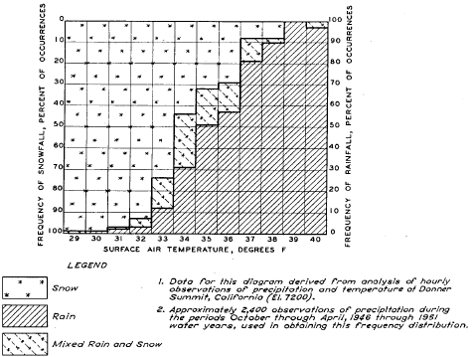
Snow Formation
21
Notes:
The type of precipitation that falls from the sky is heavily dependent upon the air temperature
Also, precipitation doesn’t always fall as purely liquid or solid
In can fall as a mixture (i.e. slush)
And, the precip phase that occurs at a given temperature isn’t fixed. It changes in both time and space.
The 1956 Snow Hydrology publication contained a bunch of awesome figures explaining this phenomena using data from the CSS laboratory at Donner Pass, as shown here

Slide 22
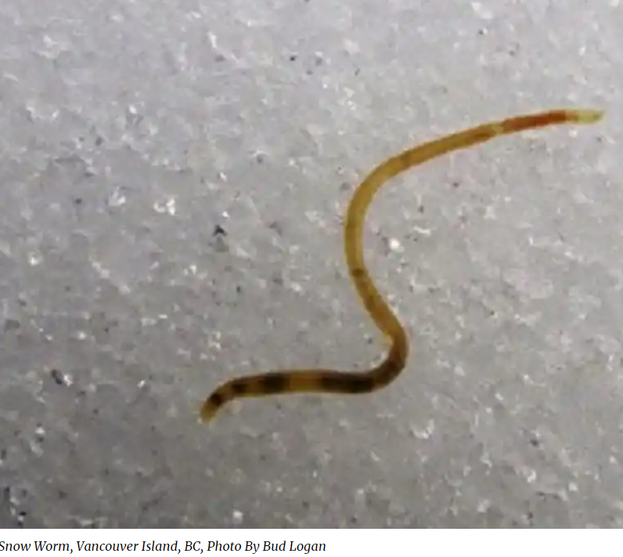
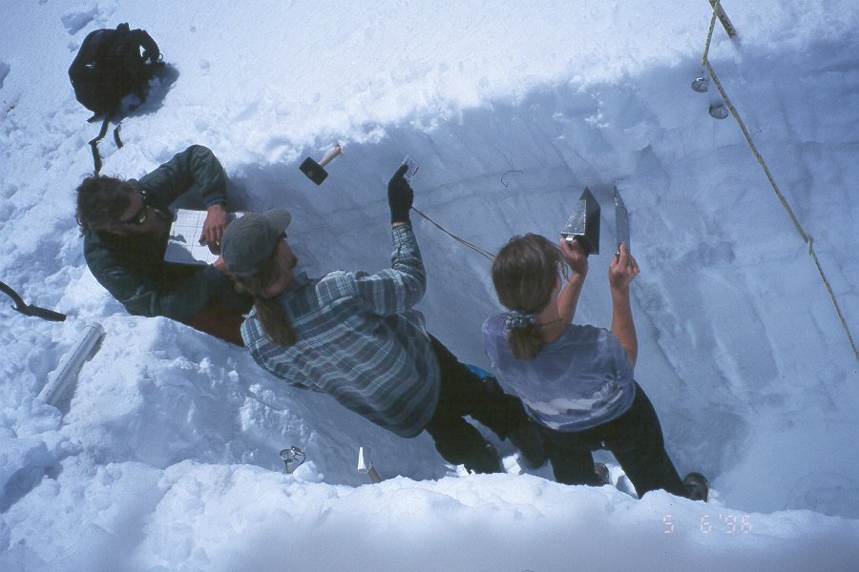
Snowpack
A snowpack is a porous medium
Ice + Air + Liquid Water + Water Vapor (and occasional snow worm)
Generally composed of layers of different types of snow
More or less homogeneous within one layer
Ice is in the form of crystals and grains that are usually bonded together
Forms a texture with some degree of strength
22
Notes:
The term snowpack is used when referring to the physical and mechanical properties of the snow on the ground.
“Snow on the ground is a complicated mixture of water in three phases: ice, liquid water, and water vapor as well as air.
Due to the intermittent nature of precipitation, the action of wind and the continuously ongoing metamorphism of snow, distinct layers of snow build up the snowpack.
However, in hydrologic applications, the snowpack is treated as a single layer and the properties of the snowpack must represent the conditions of the entire layer from the snow surface to the ground. This single layer representation is required by the practical limits of current hydrologic practice, and the currently available data on snow observed in the field. Generally, in practice, the distinct properties of individual layers of the snowpack are not known.
Once ice crystals are deposited on the ground, we refer to them as snow grains because of the changes that occur within the snowpack. Snow grains can become bonded to their neighbors, a process called sintering. These bonded snow grains act as an ice skeleton to provide structural strength to the snowpack. As temperature within a snowpack reaches 0ºC, the ice particles will begin to melt.”
The properties and characteristics of fallen snow change constantly as a function of energy fluxes, wind, moisture, water vapor, and pressure.
Furthermore, snow properties can vary widely over small distances, both vertically within a snowpack and horizontally over space.
Additionally, solutes and particulates within the snowpack can influence snow properties such as the albedo of snow.

Slide 23
Snowpack Characteristics
Hardness
Strength
Water Equivalent
Depth
Grain Shape
Temperature
Density
Grain Size
Impurities
Liquid Water Content
Albedo
23
Notes:
Here are numerous characteristics of snow
Note that many of these characteristics are dependent upon one another:
For example, albedo depends upon the depth of the snowpack, grain size, and impurities. However, grain size also depends upon the liquid water content and temperature of the snowpack. Changes in one change many other.
I will highlight a couple of these properties

Slide 24
Snowpack Characteristics
Snow Depth for
One Inch Water
Snow Type
Density (lb/ft³)
Snow Water Equivalent (SWE)
The depth of water if a snow cover is completely melted on a corresponding horizontal surface area
SWE = Snow Depth x Snow Density / Water Density
Water density is 62.4 lb/ft3
Wild Snow
0.6 to 1.9
98” to 33”
Ordinary new snow immediately
after falling in still air
3.1 to 4.1
20” to 15”
Settling Snow
4.4 to 5.6
14” to 11”
Average wind-toughened snow
17.5
3.5”
Hard wind slab
21.8
2.8”
New firn snow
25.0 to 34.3
2.5” to 1.8”
Advanced firn snow
34.3 to 40.6
1.8” to 1.5”
Thawing firn snow
37.5 to 43.7
1.6” to 1.4”
24
Notes:
The most important hydrologic parameter is the amount of liquid water stored as snow, the snow water equivalence (SWE). We can calculate SWE for some unit area as the product of snow density (rs) and depth (h), divided by the density of water.
You can also think about it as the depth of water that you would get if you completely melted snow contained on top of an area and spread it over that area
*water density is 62.4 lb/ft3
Here are some typical values of snow density for various types of snow
Firn (/fɪərn/; from Swiss German firn "last year's", cognate with before) is partially compacted névé, a type of snow that has been left over from past seasons and has been recrystallized into a substance denser than névé.
It is ice that is at an intermediate stage between snow and glacial ice.

Slide 25
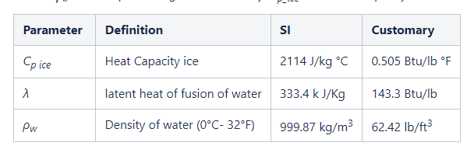


Snowpack Characteristics
ΔT is the temperature below 0ºC (32ºF)
D is the snow depth
ρ¯_{S} is the depth-averaged snow density
Cold Content
Heat required per unit area to raise temperature of snowpack to 32°F (0°C)
Expressed as a negative number equivalent to inches of frozen water that Hc_{heat} would melt
25
Notes:
From tech ref manual:
“The concept of “Cold Content” grew directly out of attempts to predict snowmelt using the Temperature Index approach. Snowmelt cannot occur unless the snowpack temperature is at 0°C (32°F). Cold content is the heat necessary to warm the snowpack up to 0°C (32°F) in terms of the amount of ice this heat would melt.”
Snow doesn’t just melt when the sun shines on it or when it momentarily rains. It persists through brief warm and/or rain periods.
The amount of energy that must be introduced to the snowpack to melt it is usually expressed as a negative energy content
“Cold Content” is a common term that is used to represent this negative energy. Cold content uses units of depth (e.g. mm or inches) of frozen water.
If the cold content is 0, the snowpack is ready to melt (any additional energy input will result in melt)

Slide 26
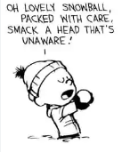
Snowpack Characteristics
Liquid Water Content
Wetness, Percentage by volume
Term
Remarks
Approximate Range
Dry
Usually T < 0ºC, but can occur at any temperature up to 0ºC. Little tendency for snow grains to stick together.
0%
Moist
T = 0ºC. The water is not visible even at 10x magnification. Has a distinct tendency to stick together.
<3%
Wet
T = 0ºC. The water can be seen at 10x magnification by its miniscus between grains, but cannot be pressed out by squeezing snow (pendular regime).
3-8%
Very Wet
T = 0ºC. The water can be pressed out by squeezing snow, but there is an appreciable amount of air (funicular regime).
8-15%
Slush
T = 0ºC. The snow is flooded with water and contains a relatively small amount of air.
>15%
26
Notes:
When a snowpack starts to melt (or in case of rain-on-snow event), it doesn’t immediately produce liquid water at the soil surface (LWASS) because snow is a porous media, as was previously mentioned
Typically, this value is somewhere between 3 and 8%, but it can vary depending upon the state of the snowpack
There is a limit to the amount of liquid water that a snowpack can hold, described by the percentage, LWC_{max%}, of the SWE.
Further liquid water added to the snowpack once the percentage of LWC in the snowpack has reached LWC_{max%} leads to the downward vertical movement of the liquid water through the snowpack.
Once the liquid water reaches the base of the snowpack it becomes snowmelt runoff. Another term for snowmelt runoff is Liquid Water at the Soil Surface (LWASS).
A “ripe” snowpack has C_{c} = 0; and the percentage of LWC in the snowpack is LWC_{max%}. Any heat added to a ripe snowpack will result in snowmelt runoff.
once the liquid water has reached the base of the snowpack and snowmelt runoff has commenced, further additions of liquid water move through the snowpack relatively rapidly.

Slide 27
Snowpack Evolution
Usually, there is a measurable variation in temperature between the top of the snowpack and the ground (i.e., temperature gradient)
Largely determined by the thickness of the snowpack and the mean snow surface temperature
If there isn’t a temperature gradient, the snowpack is termed isothermal
Diurnal temperature gradients
27
Notes:
Snowpacks evolve over time differently
For instance, deep, perennial snowpacks tend to experience notable temperature gradients in the upper portions
The deeper portions of the snowpack are isolated from energy inputs like shortwave radiation and air temperature
This results in the upper portions evolving differently than the deeper portions
Shallow, ephemeral snowpacks are oftentimes isothermal in that there isn’t a notable temperature gradient from top to bottom
Within deep snowpacks, temperature gradients are different during night and day cycles
During the day, energy is added to the snowpack from solar radiation
This leads to melting near the top
During the night, energy is released from the snowpack to the air and to the ground
Liquid water that is held within the snowpack is frozen
From tech ref manual:
The snowpack temperature is controlled by heat transfer through the snow surface to the atmosphere, heat transfer through the snowpack base to the ground below, and the temperature of the falling snow deposited in the snowpack. The trend of the snowpack temperature is to follow the air temperature as long as the air temperature is below 0°C (32°F). The actual vertical temperature profile through the snowpack will depend on the snowpack surface temperature, the base temperature, the snowpack depth, and the thermal conductivity of the snow in the pack.
In many cases, during the accumulation phase of the winter season, a difference in temperature exists between the top surface and the base of the snowpack. This temperature gradient may be large or small depending on the conditions. Small temperature gradients occur with deep snow and moderately cold temperatures. Large gradients tend to occur in shallow snowpacks with very cold air temperatures.
Large gradients can drive heat and water vapor from the warmer portions of the snowpack (generally the base) to the colder portions (generally the surface). This heat and mass flux can lead to rapid metamorphism, causing changes in the ice crystal size and shape.

Slide 28
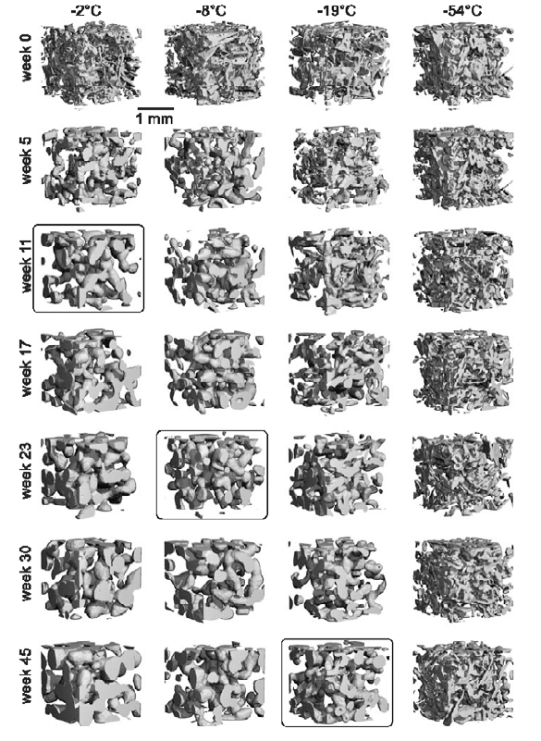
Snowpack Evolution
Changes in snow morphology take place as a function of temperature and pressure
Factors changed by metamorphism:
Density
Porosity
Reflectivity of radiant energy (albedo)
Strength
Thermal conductivity
Age of the snowpack affects water content to the greatest extent
28
Notes:
This figure shows how a snowpack changes over time
This change in ice crystal and grains throughout the season is called metamorphism
The two main mechanism for the increase in grain size are the tendency of individual ice crystals from their original unstable form with high surface-to-volume ratio towards their spherical equilibrium form and changes driven by temperature profile in the snowpack.
Note that as time goes on, the grains become larger (this increases density, reduces the surface reflection of sunlight (albedo). The decline in albedo increases the shortwave radiation (sunlight) that can be absorbed by the snowpack and can increase the rate of snowmelt.
The boxes indicate states that are similar in nature
Note that as temperature increases, the state is achieved sooner in time
The second process of snowpack metamorphism is driven by vertical temperature gradients in the snowpack. The temperature gradient creates a vapor gradient which effectively moves water molecules between ice crystals by vapor transport. A strong temperature gradient through the snowpack (>10°C m⁻¹) may result in the formation of new, relatively large, ice crystals within the snowpack termed depth hoar. This second form of metamorphism is common in the arctic but it can occur anywhere the difference between cold air temperatures and relatively warm ground temperatures are large and long lasting.

Slide 29
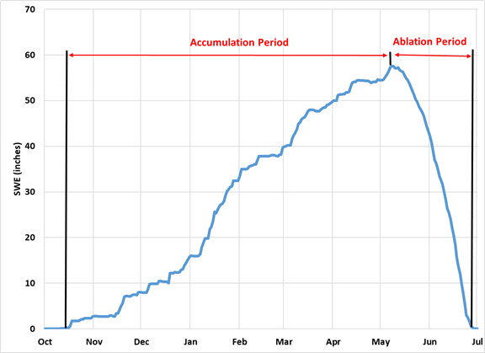
Seasonal Snow
Seasonal snow does not last more than one year
Accumulation period
Temperature gradients and sub-freezing temperatures
Followed by ablation / melting period
Uniform temperatures throughout the snowpack at 32°F (0°C) are most likely, especially during periods of continuous snowmelt.
Snow Water Equivalent (SWE) measured on Mount Alyeska in Alaska over the winter of 2000-01
Notes:
From tech manual:
Seasonal snow is snow that accumulates during one season and does not last for more than one year. The chart on this slide displays the Snow Water Equivalent (SWE) measured on Mount Alyeska in Alaska over the winter of 2000-01. Notice that the chart starts with a near monotonic increase in SWE up to the Annual Maximum SWE. This is the accumulation period. After the Annual Maximum SWE the ablation or melting period occurs. In many cases, the accumulation period is longer than the ablation period. In this case, the accumulation lasts for 7 months and the melt for 2 months. Other sites will vary in the timing and length of the accumulation and ablation periods. Some sites may have two or more accumulation periods and the SWE may drop to zero between the periods.
Temperature gradients and sub-freezing temperatures are more likely to exist in the snowpack during the accumulation period. Uniform temperatures throughout the snowpack at 32°F (0°C) are most likely to exist during the ablation period, especially during periods of continuous snowmelt.

Slide 30
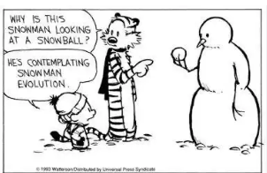
Snowpack Evolution

Slide 31
Snow Hydrology Goals
Differentiate between precipitation falling as rain, snow, or mixture
Represent snowpack evolution
Estimate heat transfer into/out of the snowpack
Calculate phase change (i.e., melt) and deliver liquid water to the soil surface
31

Slide 32
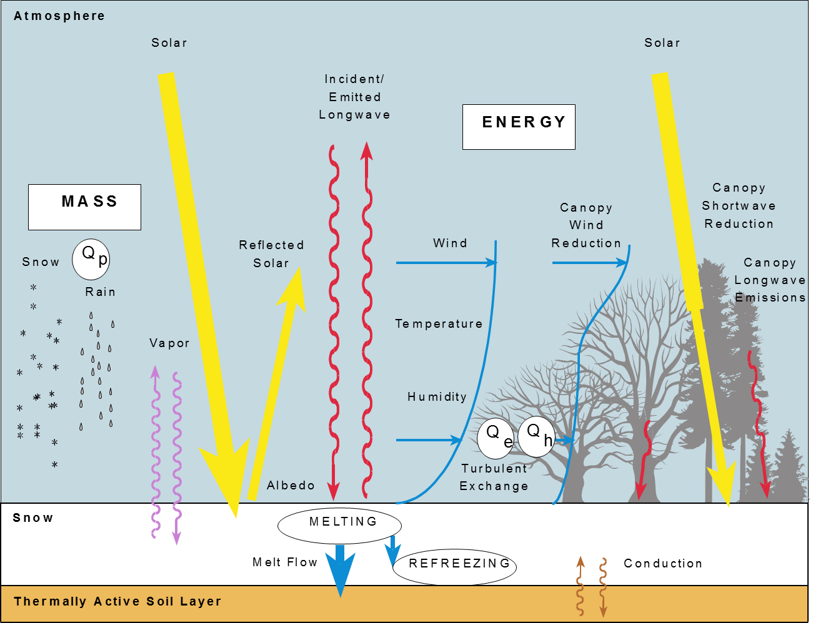
Snowpack Energy Inputs and Outputs
32
Notes:
Snow metamorphism and phase transfer is driven by gradients of temperature and vapor density within the snowpack
These are caused by transfers of heat (energy), liquid water, and water vapor to or from the snowpack. Mainly at the surface of the snowpack, but also between the snowpack and the ground.
Once snow temp is raised to 0 deg C, further energy input results in conversion of ice to liquid water.
Normally the entire snowpack temperature is raised to 0 deg C before much meltwater can leave the snowpack (called the cold content of the snowpack), but some water flow can occur through the snowpack even when snow temperatures are -3 or -4 deg C.
By examining and measuring energy fluxes at the snow surface, we can interpret and estimate metamorphism and melt.

Slide 33
Snowpack Energy Inputs and Outputs
All sources of energy input and output to a snowpack
Generally the largest contributors to snowmelt
Notes:
This equation represents all sources of energy inputs/outputs to a snowpack
In the next lecture we will go over the multiple snow modeling methods that represent various simplifications of this equation
It’s important to know what you’re simplifying so you can make an informed decision when choosing a modeling method
In general, the largest contributors to melting a snowpack are the radiative forcings (e.g. shortwave and longwave radiation).

Slide 34
Snowpack Energy Inputs and Outputs
(Turbulent fluxes)
Sensible and Latent Heat Flux
Driven by atmospheric turbulence near the snow surface
Sensible heat flux
Controlled by the difference between the snow surface temperature and air temperature, modified by wind and atmospheric stability
The larger the temperature gradient, the greater the sensible heat flux
Notes:
Convection or heat transfer is the transfer of energy where the substance (eg molecules) mix.
Sensible and latent heat transfer are discussed together because both are driven by turbulent transport in the air between the snow surface and the lower part of the atmosphere
sensible and latent heat transfer are often referred to as turbulent fluxes.
Sensible heat flux: in response to a temperature gradient.
Latent heat flux: through change of state among solid, liquid, and gas phases.
Sensible heat flux
Transfer of energy by conduction in response to a temperature gradient.
The larger the temperature gradient, the greater the sensible heat flux.
Energy transfer is always from the warmer object to the colder
If the air is warmer than the snow surface, snow pack will warm up until it reaches the equilibrium temperature of 0oC.
After that, any additional heat will go to melting the snow
However, in the absence of wind, molecular transfer of energy is comparatively slow.
With increasing wind velocity there is increasing convective mixing. Sensible heat flux occurs as much as 10,000 times faster than in the absence of wind.
With increasing shear stress, the greater the exchange of sensible heat.

Slide 35
Snowpack Energy Inputs and Outputs
(Turbulent fluxes)
Sensible and Latent Heat Flux
Driven by atmospheric turbulence near the snow surface
Latent heat flux
Controlled by the difference between the amount of water vapor in the snowpack and the amount of water vapor of the air, modified by wind and atmospheric stability
Sublimation absorbs heat energy from the snowpack
Condensation releases heat energy into the snowpack
Notes:
Latent heat flux
Latent heat transfer is due to the transfer of water vapor between the snowpack surface and the atmosphere.
Latent heat transfer always involves phases change between the water in the form of ice in the snowpack and the water in the form of vapor in the atmosphere.
The transfer of water molecules directly from snow to vapor occurs by sublimation. Sublimation absorbs heat energy from the snowpack and cools it off.
The transfer of water molecules directly from vapor to ice occurs by condensation (sometimes also referred to as deposition.) Condensation releases heat energy into the snowpack.
The latent heat flux will be into the snowpack generally only during periods of high relative humidity, for example rain on snow events, fog, and other periods when very moist air is present.
The direction of latent heat transfer is determined by the difference between the water vapor pressure of the air immediately above the snowpack and the water vapor pressure in the atmosphere above the snowpack.
The direction is from the higher vapor pressure layer to the lower vapor pressure layer.
The water vapor pressure of the air immediately above the snowpack is the saturated vapor pressure at the temperature of the snow surface.
Saturated vapor pressure is largely determined by air temperature and to a much less degree the atmospheric air pressure.
Saturated vapor pressure means that the water contained in the air is in equilibrium with the ice of the snowpack and is the maximum amount of water that can be contained in the air at that temperature and atmospheric pressure immediately above ice.
The vapor pressure of the atmosphere above the snowpack is determined by the relative humidity of the air and the air temperature.
The latent heat flux is from the air into the snowpack (condensation occurs) when e_a > e_sat(T_snow_surf) and vice versa
If air is supersaturated with water vapor with respect to the snow surface, energy may be transferred to the snowpack through condensation and latent heat exchange.
Conversely, if the atmosphere is drier than the snowpack, energy in the snowpack is used to sublimate water molecules from the snowpack, returning energy from the snowpack to the atmosphere.
Analogous to sweat evaporating from our body, returning energy from our bodies to the atmosphere and cooling our bodies.

Slide 36
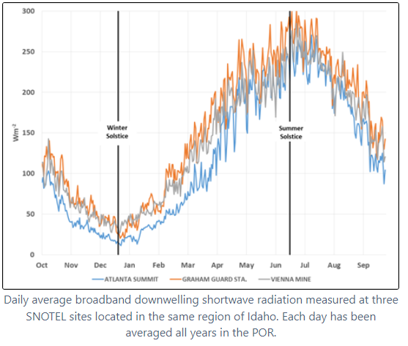
Snowpack Energy Inputs and Outputs
Net Shortwave Radiation
Radiation from the sun
The shortwave radiation absorbed at the snow surface as a fraction of the total downwelling shortwave radiation
That fraction is the snow albedo
Notes:
The portion of the top of the atmosphere shortwave radiation that actually reaches the surface of the earth depends on the conditions of the atmosphere, - primarily the presence of clouds. The earth’s atmosphere is not perfectly transparent to all the shortwave radiation even on a cloud free day when some radiation will be scattered, absorbed by gases and water vapor, and scattered by aerosol particles. These reductions in solar radiation on cloud-free days will tend to be relatively small unless the atmosphere is particularly turbid.
Clouds have a major impact on the sunlight reaching the earth. The impact will vary depending on the location of clouds relative to the position of the sun, the type of clouds, and the percentage of the sky covered by clouds.

Slide 37
Snow Albedo
Albedo is the ratio of the reflected shortwave radiation to the downwelling shortwave radiation reaching the surface
Short wave radiation reflects off surface of ice crystals and is absorbed in the interior of ice crystals
The greater the surface area per unit mass of snow – (S, specific surface area) the higher the albedo
Snow metamorphism – general coarsening – leads to larger crystals –less specific surface area- especially during melt periods – reduced albedo
Broadband albedo, α ,is important in hydrology
The albedo at specific wavelengths, α(l), is important in remote sensing of snow
37
Notes:
Albedo is the ratio of the reflected shortwave radiation to the downwelling shortwave radiation reaching the surface.
Albedo of snow varies wavelength by wavelength.
in snow hydrology, it is generally the broadband albedo that is of interest. The broadband albedo is found through a weighted integration of the albedo at each wavelength that comprises shortwave radiation.
The albedo is determined by the crystalline structure of the snowpack surface. Shortwave radiation tends to be reflected by the surface of ice crystals and absorbed in the interior of crystals
Newly fallen snow typically has large surface areas to volume ratios. As a result, the albedo of newly fallen snow is large, generally in the range of 0.85-0.95.
Snow metamorphism is the modification of the snow crystals and grains to less angular, more rounded forms with time. Metamorphism increases the size of the crystals which decreases the surface area and increases their volume. This causes the albedo to decline as the metamorphism progresses.
As long as the air temperature is less than 0°C (32°F), metamorphism proceeds slowly and the rate of decline of the albedo is relatively slow.
Each new snowfall ‘resets’ the albedo back to the newly fallen value and the metamorphism and albedo decline start over again.
However, when the air temperature is greater than 0°C (32°F) and active snowmelt is occurring, metamorphism occurs quickly and the rate of decline of the albedo is relatively rapid.
The albedo can decline to values of about 0.40 for well-aged snow. The albedo may drop to even lower values when the snowpack is shallow (snow depths of 0.5 m or less) allowing the ground surface beneath the snow to have an influence. Dust, soot, forest debris such as bark and twigs, and other deposited matter can also influence the snow surface albedo, and generally cause it to decline.

Slide 38
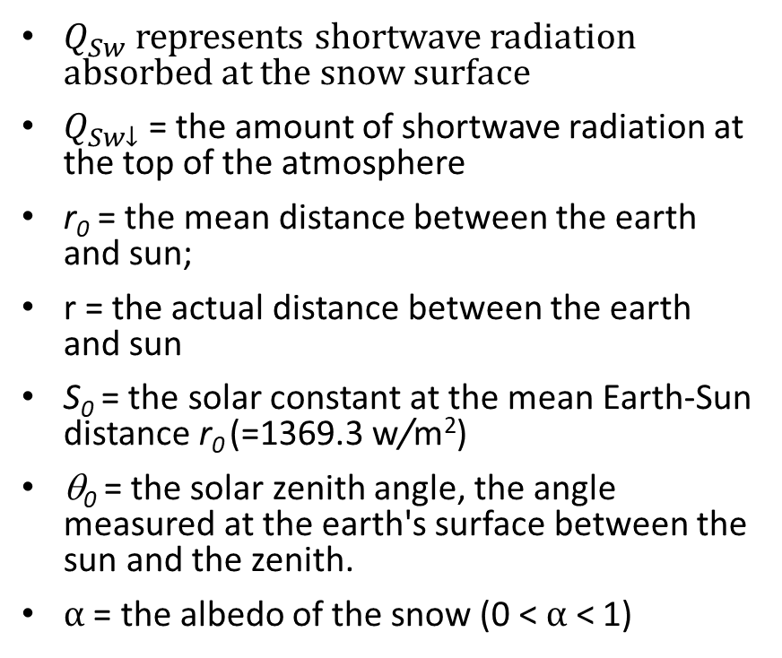

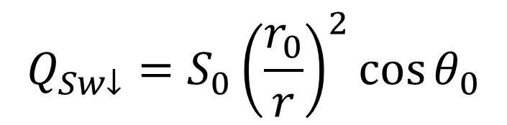
Downwelling Shortwave Radiation
$Q_{Sw}$ represents shortwave radiation absorbed at the snow surface
$Q_{Sw↓}$= the amount of shortwave radiation at the top of the atmosphere
r₀ = the mean distance between the earth and sun;
r = the actual distance between the earth and sun
S₀ = the solar constant at the mean Earth-Sun distance r₀ (=1369.3 w/m²)
θ₀ = the solar zenith angle, the angle measured at the earth's surface between the sun and the zenith.
$α$ = the albedo of the snow (0 < $α$ < 1)
$$Q_{Sw↓}=S_{0}{\left(\frac{r_{0}}{r}\right)}^{2}\cos{θ_{0}}$$
$$Q_{Sw}={(1−α)Q}_{Sw↓}$$
38
Notes:
From tech ref manual:
The shortwave solar radiation at the top of the earth's atmosphere is called extraterrestrial radiation. Extraterrestrial Radiation is a theoretical amount of solar radiation that would be available at the Earth's surface in the absence of the attenuation by the atmosphere. Variation in extraterrestrial radiation is caused by two sources, the first being the variation of radiation emitted by the sun and the second being the distance from the sun to the top of Earth's atmosphere. Earth is closest to the sun on January 3rd and farthest from the sun on July 4th. The figure below shows that extraterrestrial radiation varies between 1400 W/m2 and 1330 W/m2 based on the time of the year.
The portion of the top of the atmosphere shortwave radiation that actually reaches the surface of the earth depends on the conditions of the atmosphere, - primarily the presence of clouds. The earth’s atmosphere is not perfectly transparent to all the shortwave radiation even on a cloud free day when some radiation will be scattered, absorbed by gases and water vapor, and scattered by aerosol particles. These reductions in solar radiation on cloud-free days will tend to be relatively small unless the atmosphere is particularly turbid.
Clouds have a major impact on the sunlight reaching the earth. The impact will vary depending on the location of clouds relative to the position of the sun, the type of clouds, and the percentage of the sky covered by clouds.

Slide 39
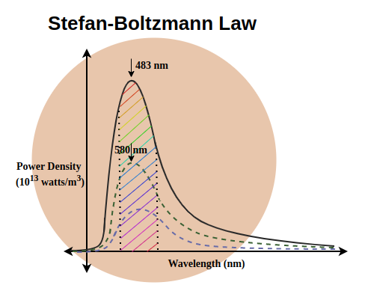
Snowpack Energy Inputs and Outputs
Net Longwave Radiation
Radiation from the earth and atmosphere
Calculated as the net of upwelling (outgoing) radiation that cools the snow, and downwelling (incoming) radiation that warms the snow
Notes:
Longwave radiation is radiation from the earth and atmospthere
Wavelength between 4 and 100 micrometers
The total longwave radiation emitted by a body per unit area can be calculated by integrating over all frequencies to arrive at the Stefan-Boltzmann Law
Longwave radiation is emitted by the snow surface according to the Stefan-Boltzmann Law. This is known as upwelling (or outgoing) radiation. The upwelling longwave radiation emitted by the snow surface is energy lost from the snow that cools the snow.
There is also downwelling (or incoming radiation) emitted from the atmosphere itself and by vegetation and structures in the vicinity. The downwelling radiation absorbed by the snow surface is energy gained by the snow that warms the snow.
The overall impact of longwave radiation is found by summing the downwelling and upwelling longwave radiation at the surface:
The longwave radiation emitted by the atmosphere that reaches the snow surface is also calculated by Stefan-Boltzmann law
And is a function of the emissivity of the atmosphere, which is affected by the vapor pressure, air temperature and cloud cover

Slide 40
Snowpack Energy Inputs and Outputs
Mass Transfer and Ground Heat Flux
Mass transfer of energy to the snowpack
Rain on snow, avalanche, etc.
Conductive exchange of sensible heat with ground
Generally, energy flux from soil to snowpack
Notes:
Heat can be transferred into the snowpack by precipitation. The heat transfer process is very different depending on the form of the precipitation, rain or snow.
Precipitation is assumed to arrive at the air temperature, and will change the snow temperature if it’s above or below it.
Rain on snow events can result in phase change of the liquid water to ice. Generally, freezing of rainfall in the snowpack can only happen if the snowpack temperature is less than the ice/water equilibrium temperature. Freezing of rainfall in the snowpack is a very effective means of raising the snowpack temperature due to the latent heat released by the liquid water when it freezes.

Slide 41
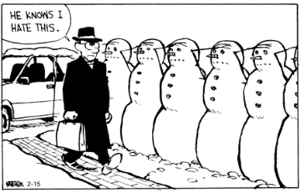
Snow Data Sources
41
Notes:
Now lets talk about the sources of snow related data.

Slide 42
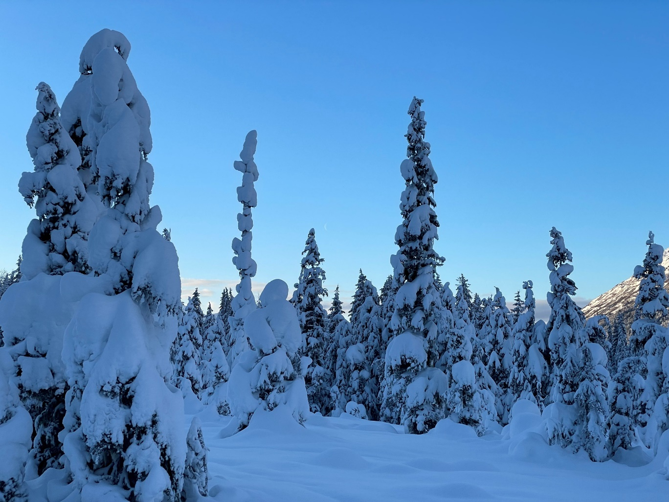
Snow Data Sources
Field Measurements
Remote Sensing
Data Assimilation
GIS
42
Notes:
Field Measurements
Snow courses, SNOTEL, NWS stations
Remote Sensing
Satellite and aerial
Data Assimilation
e.g. SNODAS, U of A
GIS Tools
Interpolation of snow measurements
Quantifying remote sensing data
Accounting for elevation and orographic effects

Slide 43
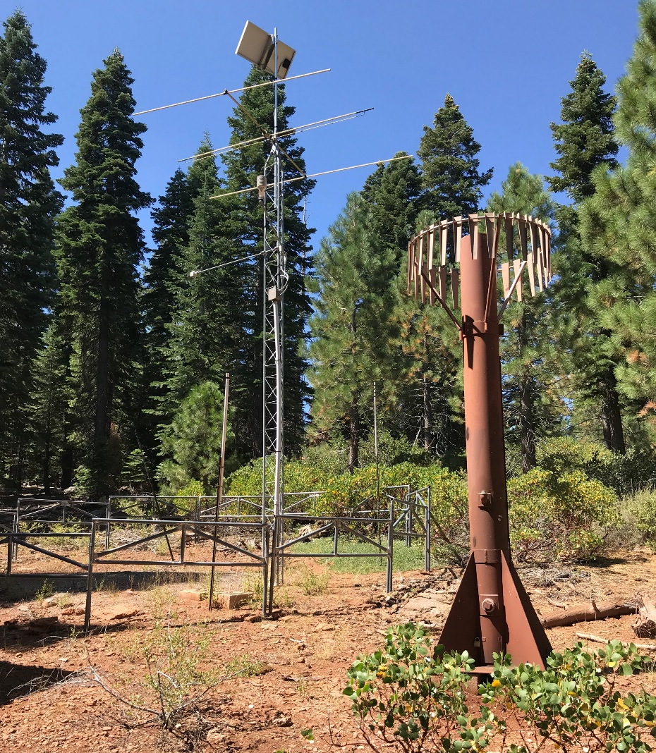
Ground Observations
These are point data!
Precipitation gages
Often inaccurate during snowfall due to wind
Snow Pillows
SNOTEL Sites (Western U.S.)
Snow Courses
Transects with snow depth and density
Snow Tubes
Measure volume and mass of snow cores
Snow Pits
Measure vertical profiles of SWE, and other snowpack variables.
CoCoRaHS
https://www.cocorahs.org/
43
Notes:
“The most important tool in snow hydrology is a shovel.”
gsk: these are all at a point level, which means that if the point is not reasonably representative of the larger area you’re hoping to model, the observed values provided may not help you in modeling much. High variation in elevation, aspect for slopes, etc. will make the point estimates less reliable of large areas.

Slide 44
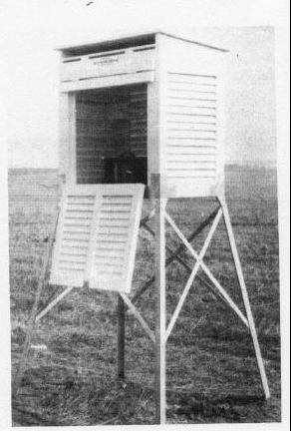
Field Measurements – NWS Meteorological Stations
Snow Depth
Snow Fall
Precipitation
Issue of under catch
44
Notes:
National Weather service meteorological stations include snow measurements
Such as snow depth, snow fall and precipitation
gsk: gauge undercatch is a huge problem for most precipitation gauges (even shielded gauges.)
Undercatch is high for solid precipitation under even moderate winds, and many of these sites are in wide-open high-fetch length areas prone to severe undercatch.
Undercatch = underreport the volume of snow, because it’s blown laterally across the orifice
Anecdotes of snow blowers blowing snow into gages, and kids using them as urinal at a school yard

Slide 45
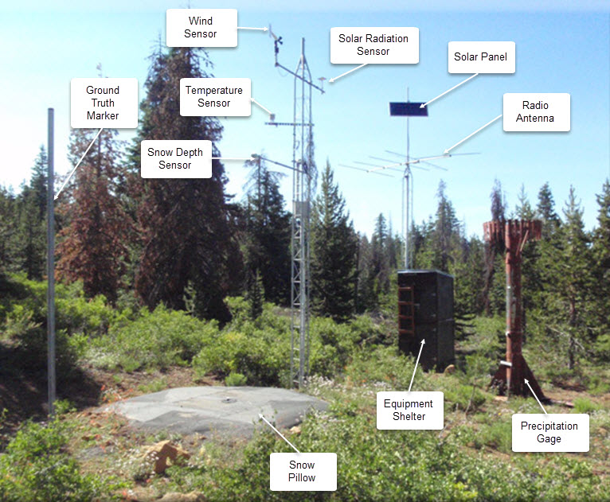
Field Measurements – SNOTEL
SWE
Temperature
Precipitation
Snow depth
Solar irradiance
Wind speed
Meteor burst telemetry
45
Notes:
The Natural Resources Conservation Service (NRCS) owns and maintains a network of snow observation sites, SNOw TELemetry (SNOTEL).
Each SNOTEL site is an automated, near real-time data collection station that collects hydroclimatic data including SWE, snow depth, precipitation, and temperature observations.
SNOTEL data collection began in 1978 at some stations and extends through the present.
Snow pillow measures the weight of snow as it’s piled on top of it and compresses the pillow
The NRCS also regularly conducts manual snow surveys throughout the mountainous regions of the western United States (http://www.wcc.nrcs.usda.gov/snow/).
gsk: I have pictures of a lot of these, and one of the most fun things about them is how tall the precipitation gauge can be. In areas where the snow depth can get very, very tall, the gauge has to be high enough not to be buried.
Uses “meteor-burst transmission” a request signal from one of the two SNOTEL master stations is bounced to remote sites not off a satellite but off the ionized trails of some of the billions of tiny meteors that enter the earth's atmosphere every day; the remote stations bounce back their most recent data in the same way.

Slide 46
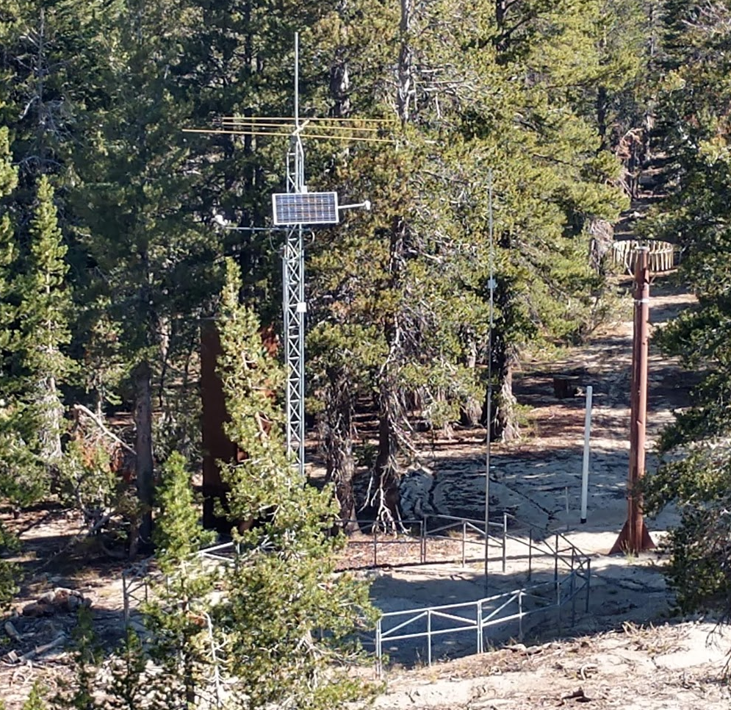
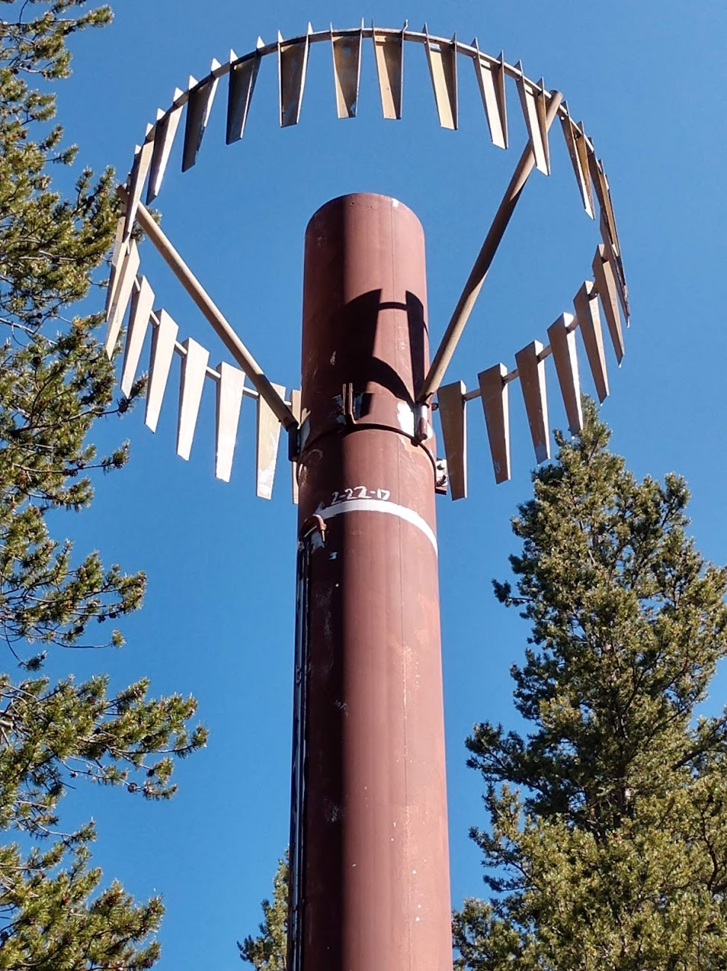

46
Notes:
gsk: pictures from the Mt Rose ski area snotel site taken in august 2018. It peaked at 232” snow depth on 2/22/17 (measured at 73.4” SWE, which wasn’t even the peak – it peaked at 93.6” on 4/21-23 but the depth subsided to about 200”). That precipitation station is at least 20’ tall. Snow can persist here routinely until July.

Slide 47

Field Measurements – SNOTEL
https://www.nrcs.usda.gov/wps/portal/wcc/home/
47

Slide 48


Field Measurements – SNOTEL
SNOTEL sites transmit data hourly
NRCS staff post process data
SWE
Cumulative precipitation
Min, max and daily temperature range
Snow depth
Emphasis on correcting daily data
Hourly data are very messy
SWE reported at 0.1-inch increments
Temperature reported at 0.1°C increments
https://directives.sc.egov.usda.gov/35529.wba

Slide 49

Field Measurements – Snow Courses
SWE = SWE in units of length
W_{snow} = weight of the snow alone
d_{Tube} = inner diameter of the snow tube
ρ_{w} = density of water
C_{s} = pre-calculated
49
Notes:
Snow courses measure snow depth and water content along a designated transect, typically around the first of each month during the winter season.
A snow course is a permanent site that represents snowpack conditions at a given elevation in a given area. ‘A particular snowpack may have several courses.
Generally, the courses are about 1,000 feet long and are situated in small meadows protected from the wind.
The federal snow course program began in 1934 to help with water supply forecasting.
gsk: snow courses taken at a regular interval along a pre-marked survey site using an aluminum tube driven into the snowpack

Slide 50
Other Sources of Field Measurements
Some Corps Districts – NAE, MVP, MRD
Other Federal agencies – USFS (research basins), USAF 14th WS
Some state agencies – west and northeast
Volunteer networks – CoCoRaHs, COOP, airports
Hit or miss – ski areas, hydropower companies, universities, etc.
Water Resources Operations:
The longer the period of record the more valuable the snow data
50
Notes:
Several districts within the United States Army Corps of Engineers (USACE) conduct regular snow surveys during the winter, typically at or near project sites. Surveys are generally done on a weekly or monthly basis and follow a standard procedure, similar to NRCS.
Volunteer snow survey programs have also been established in a limited number of locations. USACE districts provide SWE measurement equipment to volunteers, who collect SWE information and provide the data to USACE at various times throughout the snow season.
CoCoRaHS (click) Community Collaborative Rain, Hail & Snow Network – ‘grassroots volunteer network of backyard weather observers’
gsk: dubious reliability of ski area reports…

Slide 51
Snow Data Sources
Field Measurements
Remote Sensing
Data Assimilation
GIS
51
Notes:
Field Measurements
Snow courses, SNOTEL, NWS stations
Remote Sensing
Satellite and aerial
Data Assimilation
e.g. SNODAS, U of A
GIS Tools
Interpolation of snow measurements
Quantifying remote sensing data
Accounting for elevation and orographic effects

Slide 52
Snow Remote Sensing
Remote sensing types:
Passive – Instrument that measures how things reflect on surface
Active – Instrument has its own source of power/light
Research in snow remote sensing:
Terrestrial – Areas with complex topography
Marine – Areas without complex topography
Datasets:
Global
Coarse resolution, but long time series
Reconstructions
Highly accurate, but sparse
Data Assimilation
Combine multiple data streams
Landsat 16-day @ 30-meter, MODIS 1-day @ 500-meters
Satellite and Ground Observations
52
Notes:
The field of snow remote sensing encompasses many applications, objectives, and purposes
Remote sensing can be broadly split into active and passive applications.
Active remote sensing describes an instrument that has its own source of power/light.
Passive remote sensing describes an instrument that measures how solar radiation is reflected from the earth surface
Research in snow remote sensing can be broadly split into two groups: Terrestrial (areas with complex topography) and Marine (no-topography)
Remote Sensing dataset have different characteristics
Global datasets commonly have a course resolution (too coarse for water management decisions), but have extremely long time series)
Reconstructions – highly accurate data, but are not readily available
Data Assimilation – describes where multiple datasets are combined to increase the discriminatory power of models. Could develop relationships between satellites with different properties or combine remote and ground measurements.
Ground truthing with field measurements is important

Slide 53

Snow Remote Sensing
SD = Snow Depth
SCF = Snow covered fraction
53
Notes:
This is a table that summarized different remote sensing sensors which have been useful for snow applications.
Sensors vary based on type (active vs passive)
For passive sensors, the are divided based upon wavelength (optical → microwave)
Large variations in spatial/temporal resolutions, limitations (clouds, time-of-day, and others)
Not all sensors can measure all things. Fore example Optical sensors are useful for snow covered area and fractions, and abledo. Microwave sensors can directly measure SWE, but have limited applications) Wet/deep snow packs.
Accuracy varies but is being actively researched to for improvements.
Reference:
Largeron, Chloé, Marie Dumont, Samuel Morin, Aaron Boone, Matthieu Lafaysse, Sammy Metref, Emmanuel Cosme, Tobias Jonas, Adam Winstral, and Steven A. Margulis. 2020. “Toward Snow Cover Estimation in Mountainous Areas Using Modern Data Assimilation Methods: A Review.” Frontiers in Earth Science. Frontiers Media SA. doi:10.3389/feart.2020.00325.

Slide 54


Remote Sensing – Passive Microwave
Passive Microwave Detection of Snow
Microwave radiation from the soil and the snowpack is scattered by the snow grains
Polar Orbiting
Complete coverage of Earth twice per day – SSM/I July 1987
54
Notes:
gsk: ssm/i “special sensor microwave imager” 7-channel 4-frequency

Slide 55
Remote Sensing – Passive Microwave
SSM/I: August 1987 to present
AMSR-E: 2002 to present
Mean SWE in 25 km square pixel (625 km²)
Not affected by clouds, night
Problems with wet/thin snow covers-changing snow conditions
Forests – (vegetation) impact results
Relatively low accuracy but daily worldwide coverage north of 45 degrees
55
Notes:
gsk: amsr-e “advanced microwave scanning radiometer for EOS” is 12-channel 6-freq passive microwave radiometer

Slide 56

Remote Sensing – Snow Covered Area from Optical Sensors
Easy to recognize snow on the ground when skies are clear.
Clouds are a problem!
Distinguish clouds from snow
Clouds hide the ground
MODIS 09Dec2006
56

Slide 57

Using SCA to Estimate SWE
SCA estimates are important where:
No impact of elevation
During the ablation period
Snow exhibits spatial and temporal heterogeneity
Snow Distribution Great Plains - random tracks of episodic snowstorms with re-distribution by wind
57

Slide 58
Remote Sensing – LiDAR
17Jan14
26Dec13-17Jan14
Note ski cuts and craters
58
Notes:
Jeffrey S. Deemsª, Peter J. Gadomski^{b}, Dominic Vellone^{c}, Ryan Evanczyk^{c}, Adam L. LeWinter ^{b},
KarlW. Birkeland^{d}, David C. Finnegan^{b}
a National Snow and Ice Data Center, 449 UCB, University of Colorado, Boulder, CO 80309, USA
b US Army Corps of Engineers Cold Regions Research and Engineering Laboratory, 72 Lyme Rd., Hanover, NH 03755, USA
c Arapahoe Basin Ski Area, P.O. Box 5808, Dillon, CO 80435, USA
d USDA Forest Service National Avalanche Center, P.O. Box 130, Bozeman, MT 59771, USA
Mapping starting zone snow depth with a ground-based lidar to assist
avalanche control and forecasting
Cold Regions Science and Technology 120 (2015) 197–204

Slide 59


Remote Sensing – ASO
Airborne Snow Observatories (ASO)
https://www.airbornesnowobservatories.com/products
Snow depth, SWE, and albedo
~3m horizontal resolution
Increasing in popularity as more data becomes available
Expensive
59
Notes:
ASO = Airborne Snow Observatories
Data available for parts of California
Being actively used by USBR, USACE, and DWR
Each one is about ten miles long and is monitored by aircraft. The basic idea behind these very long snow courses is relatively simple. The earth's surface emits natural gamma radiation from trace elements of potassium, uranium, and thorium in the soil. That radiation is attenuated by the amount of water in the snow. An estimate of water content can be obtained along any of the established flight lines by comparing a background reading previously made over bare ground with a fresh reading made over the same piece of ground under snow.

Slide 60


Remote Sensing – ASO
60
Notes:
ASO = Airborne Snow Observatories
Data available for parts of California
Being actively used by USBR, USACE, and DWR

Slide 61
Snow Data Sources
Field Measurements
Remote Sensing
Data Assimilation
GIS
61
Notes:
Field Measurements
Snow courses, SNOTEL, NWS stations
Remote Sensing
Satellite and aerial
Data Assimilation
e.g. SNODAS, U of A
GIS Tools
Interpolation of snow measurements
Quantifying remote sensing data
Accounting for elevation and orographic effects

Slide 62

Data Assimilation – NOHRSC SNODAS
Energy balance snow model combined with multi-sensor snow observations
https://nsidc.org/data/g02158/versions/1
Hourly/Daily gridded snow products for conterminous U.S.
POR: October 2003 – Present
1 km2 resolution
62
Notes:
The National Oceanic and Atmospheric Administration’s (NOAA) National Operational Hydrologic Remote Sensing Center (NOHRSC) provides modeled snow data output from the Snow Data Assimilation System (SNODAS) model. SNODAS integrates modeled snow estimates with satellite, airborne and ground observations to create 1 kilometer-resolution gridded datasets of snow covered area, SWE, and other snow variables for the continental United States. These data are available daily from October 2003 through the present.
gsk: it is important to bear in mind that this is still a modeled product – think of it as a data assimilation product, where it tries to reconcile observations which happen at a point or averaged over an area by using a snow model
Energy balance snow model combined with multi-sensor snow observations
Hourly/Daily gridded snow products for conterminous U.S.
1 km2 resolution
POR: October 2003 – Present
http://www.nohrsc.noaa.gov/

Slide 63




Data Assimilation – NOHRSC SNODAS
SWE
Depth
Melt
Cold Content
63
Notes:
Daily Snow Water Equivalent map available on USACE CorpsMap System since 2009.
Example gridded output – 21 February 2004
Parameters Processed:
Snow Water Equivalent
Snow Depth
Snow Melt
Snowpack Average Temperature
Parameters Computed:
Cold Content (Function of Snowpack Temp and SWE)
Cold Content ATI (zero grid)
Liquid Water (zero grid)
Melt Rate ATI (zero grid)

Slide 64

Data Assimilation – NOHRSC SNODAS
Sources of uncertainty in data:
Forcing Data
Model errors
Gaps in available observation data
Spatial
Temporal
Data assimilation is a “black box”
Data included/excluded based on expert judgement
Moreau River Basin, SD – Discharge and average basin SNODAS SWE. Delays in model melt timing will affect model discharge results.
64
Notes:
Looks like the snow model got melt timing wrong on the fig

Slide 65

Data Assimilation – University of Arizona
PRISM-based snow model output combined with SNOTEL, etc observations
4 km x 4 km spatial resolution
1-day temporal resolution
SWE and snow depth
CONUS
POR: 1981 – current
https://climate.arizona.edu/snowview/
https://nsidc.org/data/nsidc-0719/versions/1 (published with DOI) https://climate.arizona.edu/data/UA_SWE/ (near-real time production)
65
Notes:
This data set was developed at the University of Arizona (UA) by assimilating in-situ snow measurements from the National Resources Conservation Service's SNOTEL network and the National Weather Service's COOP network with modeled, gridded temperature and precipitation data from PRISM. It provides daily 4 km SWE and snow depth (in millimeters) over the conterminous United States from 1981 to present (NSIDC).
The data is in NetCDF format and covers the entire CONUS. Should use clipping boundary to clip to project size.
U of A data has a longer historical record (1981 vs 2003). SNODAS has higher spatial resolution and hourly resolution available
but snow modeling is usually on a larger scale and fine temporal resolution is rarely crucial.

Slide 66
Snow Data Sources
Field Measurements
Remote Sensing
Data Assimilation
GIS
66
Notes:
Field Measurements
Snow courses, SNOTEL, NWS stations
Remote Sensing
Satellite and aerial
Data Assimilation
e.g. SNODAS, U of A
GIS Tools
Interpolation of snow measurements
Quantifying remote sensing data
Accounting for elevation and orographic effects

Slide 67


GIS – Estimating SWE Volume
SWE:
Interpolating point measurements accounting for orographic and elevation effects
SCA:
Satellite imagery (MODIS or AVHRR)
Volume = SWE x SCA
SSM/I SWE Map
AVHRR SCA Map
67

Slide 68

GIS – Estimating SWE Volume
Point estimates of SWE interpolated using inverse distance weighting
Biased by SSM/I SWE
Multiplied by AVHRR SCA
68

Slide 69

GIS – Spatial Interpolation
Interpolate point observations to a spatial grid
Interpolation methods vary in complexity
IDW – very basic, radius determines overall extent
Optimal interpolation – very complex, accounts for vertical and horizontal relationships of SWE and snow depth
Needed to initialize snow simulations prior to UofA or SNODAS data
Can bias-correct to adjust interpolated values for:
Elevation
Orographic Effects
69
Notes:
Fassnacht, S. R., K. A. Dressler, and R. C. Bales. 2003. “Snow Water Equivalent Interpolation for the Colorado River Basin from Snow Telemetry (SNOTEL) Data.” Water Resources Research. American Geophysical Union (AGU). doi:10.1029/2002wr001512.
Broxton, Patrick D., Nicholas Dawson, and Xubin Zeng. 2016. “Linking Snowfall and Snow Accumulation to Generate Spatial Maps of SWE and Snow Depth.” Earth and Space Science. American Geophysical Union (AGU). doi:10.1002/2016ea000174.

Slide 70
References
https://www.hec.usace.army.mil/confluence/display/HMSTRM/Snow+Accumulation+and+Melt – snow section of HEC-HMS Technical Reference Manual (also check out Meteorology section)
https://www.hec.usace.army.mil/confluence/display/HMSUM/.Snowmelt+v4.5 – snow section of HEC-HMS users manual
https://www.hec.usace.army.mil/confluence/display/HMSGUIDES/Modeling+Snowmelt - tutorials and guides
https://www.youtube.com/watch?v=TLCKDxQUhyY - HEC-HMS quarterly webinar on the topic of snow
http://snobear.colorado.edu/SnowHydro/geog4321_course13.html - University of Colorado Snow Hydrology course

Slide 71
Questions?
Check out our Confluence for tutorials, user’s manual, and webinars
https://www.hec.usace.army.mil/confluence/hmsdocs

