Slide 1
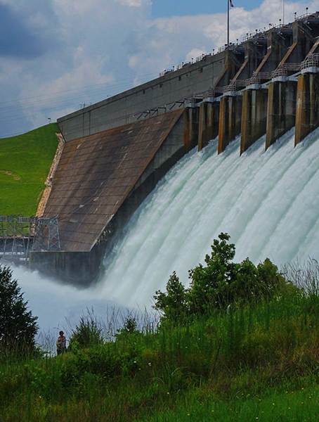
Model Optimization
Advanced HMS
June 2025
Presented by: Greg Karlovits

Slide 2
Purpose
Understand the role of the HEC-HMS Optimization Trial
Apply the Optimization Trial appropriately

Slide 3
Outline
Model optimization
Simplex search
Differential Evolution search
Optimization strategies
Upcoming enhancements

Slide 4
Model Optimization

Slide 5
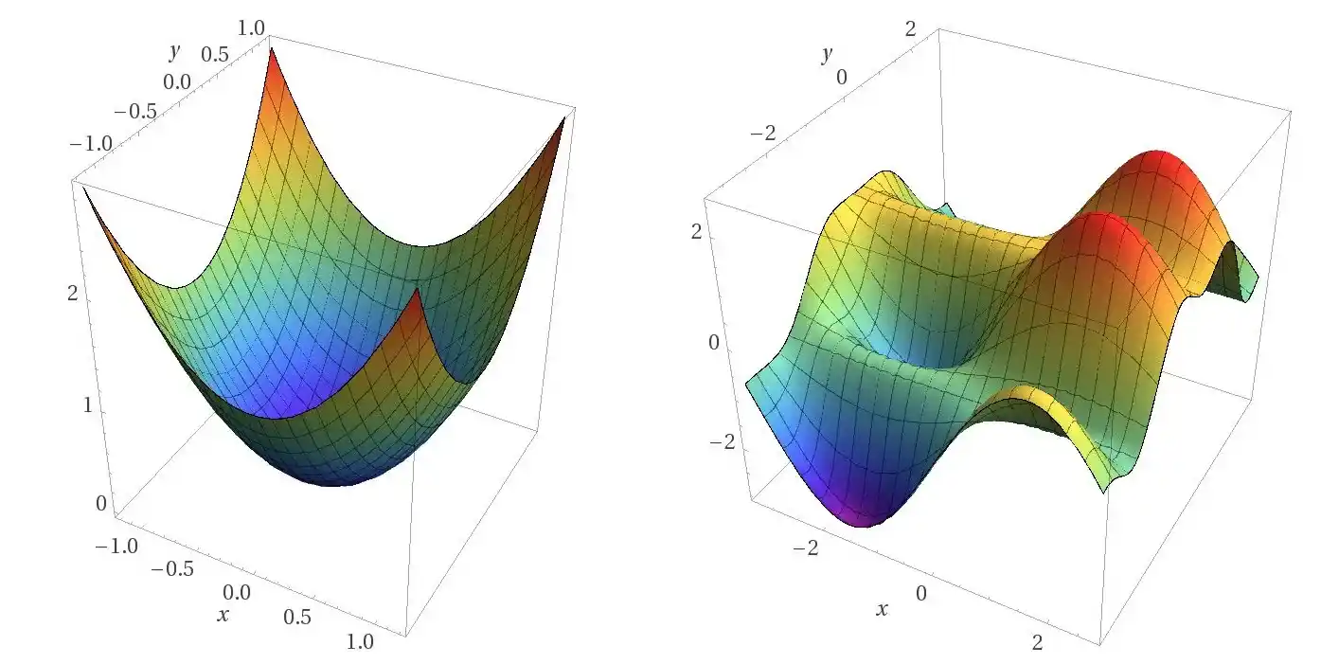
What is Optimization?
Numerical technique for finding extrema of a function
In a nutshell: vary a function’s parameters until you find a minimum or maximum
Notes:
Extrema: maximum or minimum
The hydrologic model is reduced to a function

Slide 6
What is Model Optimization?
Two different outcomes:
Best model fit
Maximum response
For hydrologic modeling, find the “best” parameter set
Goodness-of-fit measured using agreement with observed data
Maximize a response variable
Peak discharge, discharge volume, maximum stage or reservoir elevation, etc.
Notes:
This essentially turns the hydrologic model into a function – given a number of parameters with specific values, you get a single number to describe the model’s performance.
Model performance can have a couple of meanings.
One of them is in the “goodness of fit” context – how well do the modeled results agree with reality?
The other is for some kind of response – e.g. peak discharge, discharge volume, etc.

Slide 7
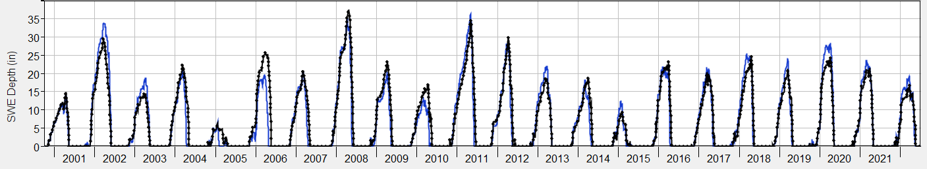
Objective Functions
Measure model performance in a single value

Slide 8
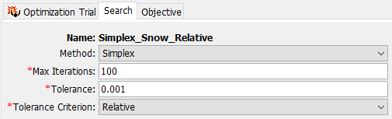
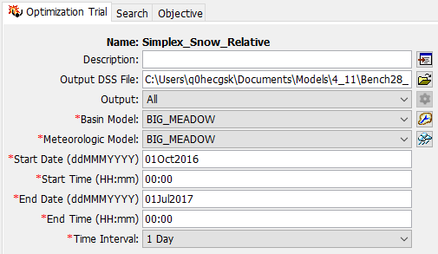
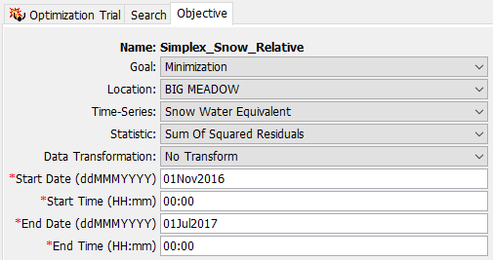
HEC-HMS Optimization Trial
Changes soon!
Notes:
The Optimization Trial Component Editor has 3 tabs:
The actual simulation setup, which is common to all simulation types (except simulation run)
The search, which controls the engine that drives evaluation of the parameter sets.
Objective, which tells the search how it’s doing.

Slide 9
Minimization Goal Objective Functions
Mean of absolute residuals
Mean of squared residuals
Peak-weighted RMSE
Peak-weighted variable power
Pct error in peak discharge
RMSE
Sum of absolute residuals
Sum of squared residuals
Time-weighted RMSE
Lower value means better goodness-of-fit
Notes:
These are available for discharge, a smaller set is available for SWE.
If an objective function has the word error or residual in it, we want to minimize it!
Some give more weight to the peaks because we don’t want to weight baseflow as heavily in continuous simulations and/or because we are more concerned with simulating floods.
I want to draw your attention to the peak-weighted variable power:
Sum of squared error but instead of the exponent always equal to 2, it varies between 1 (minimum observed) and 2 (maximum maximum)
Most severe penalty for missing the peaks

Slide 10

Maximization Goal Objective Functions
Goodness-of-Fit
Response
Coefficient of Determination (R²)
Index of Agreement
Normalized Nash-Sutcliffe
Modified Kling-Gupta Efficiency
Discharge volume
Peak discharge
Peak pool elevation (reservoir)
Total precipitation
Higher value means better goodness-of-fit
Notes:
Maximization goal has two functions in the optimization trial. One is to maximize objective functions which are defined to express a better goodness of fit with a larger value. The other is to maximize some kind of response variable (usually for design or risk analysis.)
Normalized Nash Sutcliffe has a range of 0 to 1 where 1 indicates perfect model performance. Nash Sutcliffe has a range of –inf to 1.

Slide 11
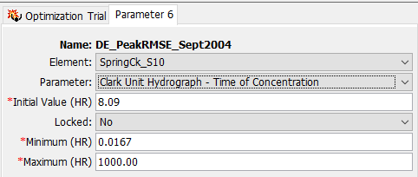
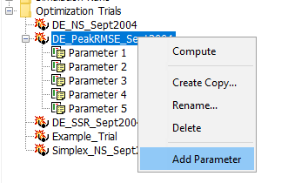
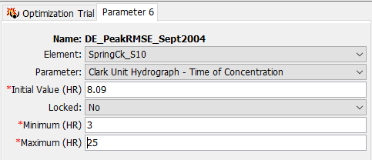
Optimization Parameters
Notes:
The Minimum and Maximum Parameter Values default to the allowable range within HMS.
This range is much larger than is physically realistic and will result in poor optimization results (i.e. the trial may find a local rather than global optimum or the trial will not reach convergence).
You want to narrow this range down based on your knowledge of the watershed, past calibration efforts, and engineering judgement.

Slide 12
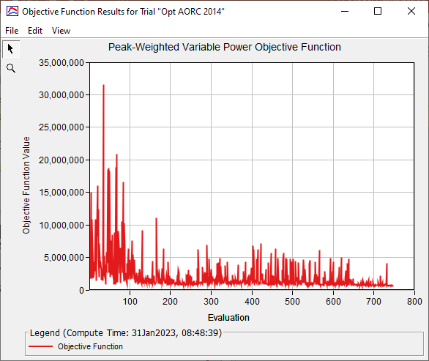
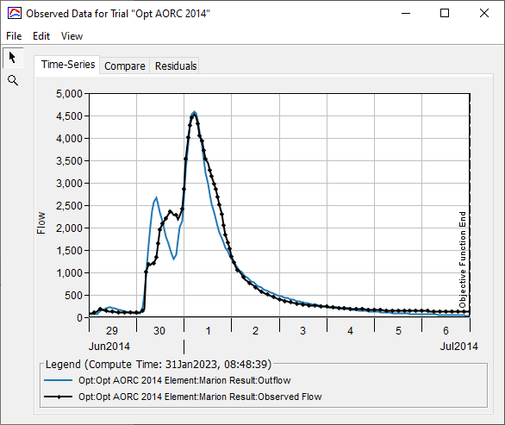
Results

Slide 13
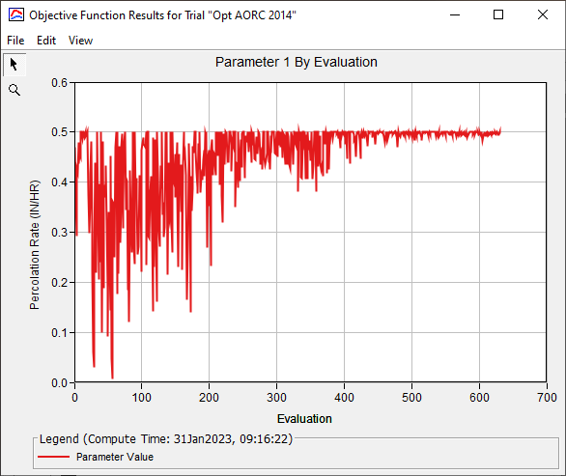
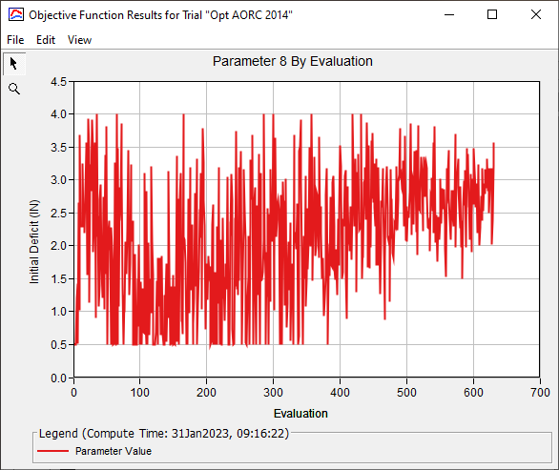
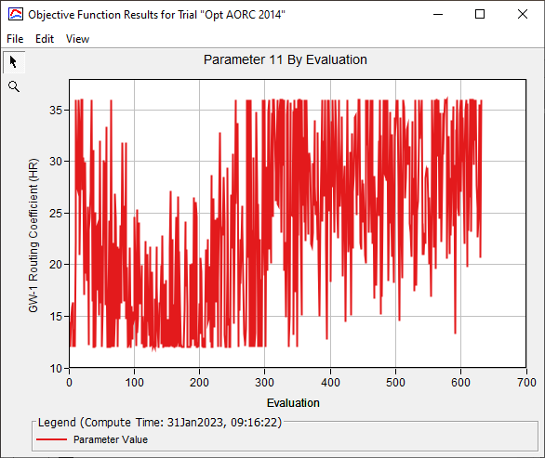
Results
Notes:
You should see the parameter values stabilize towards the end of the trial. If the value continues to vary substantially, you may need more a smaller tolerance or a higher value for Min Iterations (for Differential Evolution)

Slide 14
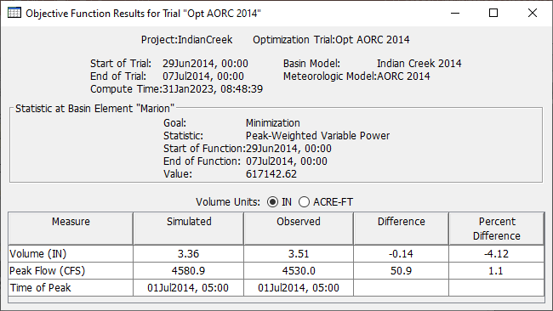
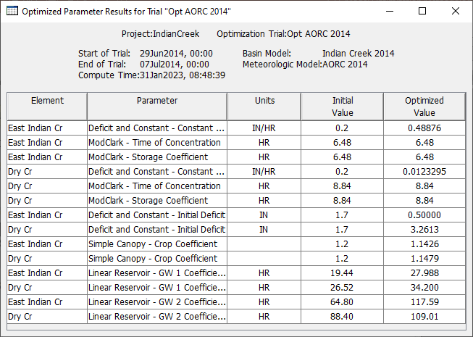
Results

Slide 15
When to use Optimization?
Probable maximum flood (PMF) modeling
What-if? scenario hypothetical modeling
Getting started on a calibration
Iteratively in a calibration exercise
Putting finishing touches on a calibration

Slide 16
Simplex Search
Notes:
Simplex search has been in HMS for a long time, but it has received tweaks and improvements to make its performance better.

Slide 17
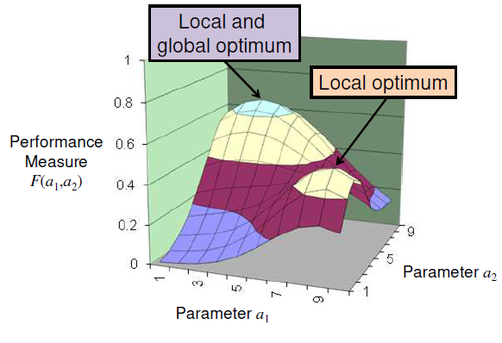
Nelder-Mead Simplex
Deterministic search method
Compares objective function across n+1 parameter sets
n is the number of input parameters
Sensitive to initial state
Very fast with a good initial guess
No bounds on parameters

Slide 18
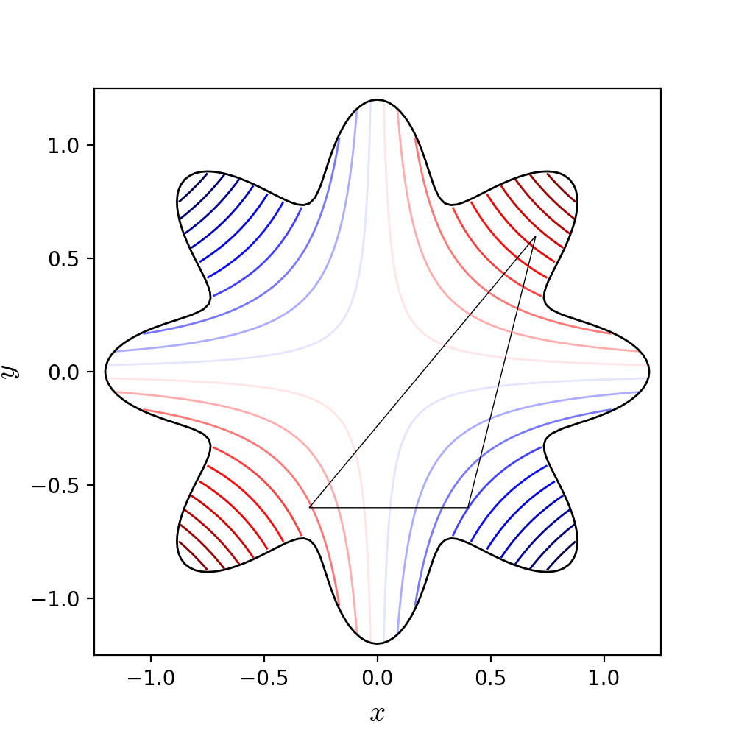
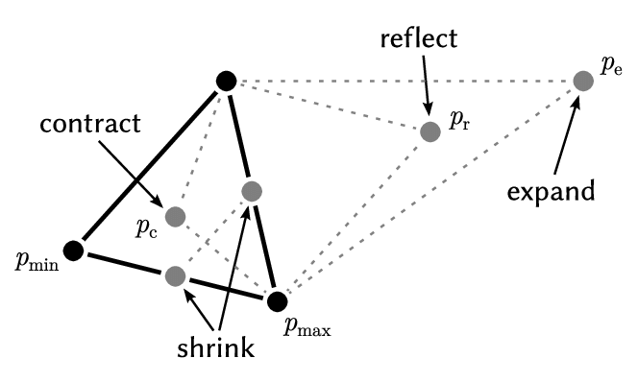
Nelder-Mead Simplex
Notes:
The lines in the figure on the right show contours of the objective function (lines of equal model performance)
Simplex has n+1 vertices, where is the number of parameters
Line segment for 1 parameter
Triangle for 2 parameters
Tetrahedron for 3 parameters
The method alters the simplex vertices so it approaches the optimum
The worst vertex is replaces with each iteration (reflection, expansion, contraction)

Slide 19
Search Termination/Convergence
When the difference of objective function value at all n+1 nodes of the simplex is within the tolerance, the search stops
The best node is reported
Lower tolerance means values have a smaller difference
Absolute tolerance: difference between largest and smallest
Relative tolerance: percent difference between largest and smallest

Slide 20
Differential Evolution Search
Notes:
Differential Evolution is the newer search method in HMS. It is considered a “global” search method, meaning it will span the entire range of all the parameters during the search, trying to find an optimum.

Slide 21
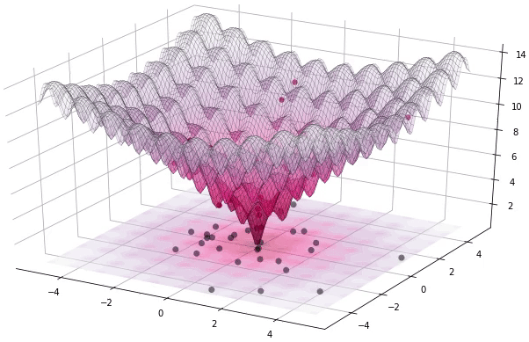
Differential Evolution
Stochastic search method
Compares objective function value across p parameter sets
p is user-selected population size
Insensitive to initial guess
Much slower than Simplex
Bounded search by nature
Notes:
A typical value for p is 30, although literature suggests 10n where n is the number of parameters.

Slide 22

Search Termination/Convergence
When the variability in the population’s objective function values gets sufficiently small, the search stops
$σ_{OF}$ < t (1 + $μ_{OF}$)
$σ_{OF}$ is standard deviation of objective function values
t is the tolerance
$μ_{OF}$ is mean of the objective function values
The best agent over the entire search history is reported
Lower tolerance means values have a smaller difference

Slide 23
Simplex vs. Differential Evolution
Good initial guess and small parameter ranges?
Simplex is always more performant
DE becomes favorable with less and less available information
More parameters
Wider ranges
More uncertain initial guess
Simplex is faster but has a more limited range it can search!
Notes:
We will talk later briefly about an advanced strategy to combine the two.

Slide 24
Simplex vs. Differential Evolution
Simplex
Differential Evolution
Deterministic search
Unbounded search
Tolerance: absolute or relative
Compute differences in OF between nodes
# evaluations per iteration = n + 1
Sensitive to initial value
Stochastic search
Bounded search
Tolerance: absolute
Variability in population’s OF value must be sufficiently small
# evaluations per iteration = n * Population Size
Insensitive to initial value

Slide 25
Optimization Strategies

Slide 26
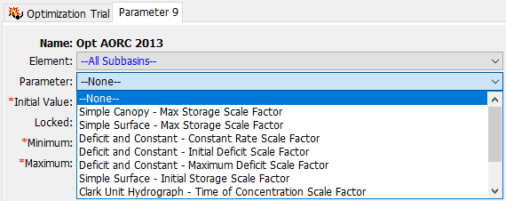
Scale Factors
Useful for multi-subbasin models
Preserves relative parameter magnitude across elements
Scales all elements of a type by a multiplier (1.0 = no change)

Slide 27
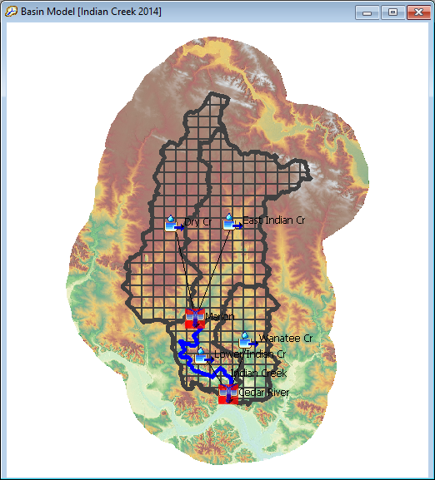
Scale Factors
SF = 1.2
Initial parameter estimates from soils data, regression, etc.
Want to avoid search moving parameters in opposite directions
R = 10.6 hr
R = 8.8 hr
R = 6.5 hr
R = 7.8 hr

Slide 28
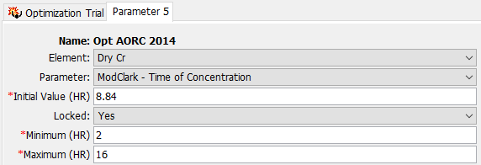
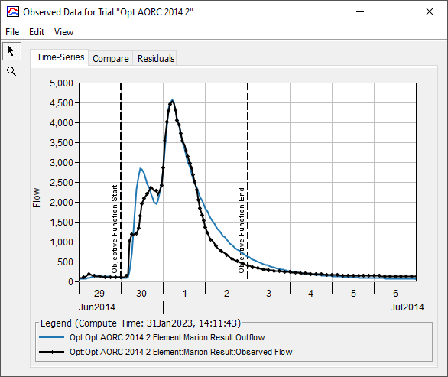
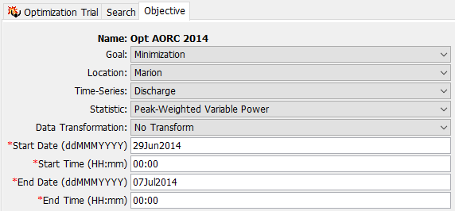
Additional Helpful Options
Parameter locking
Objective function time window

Slide 29
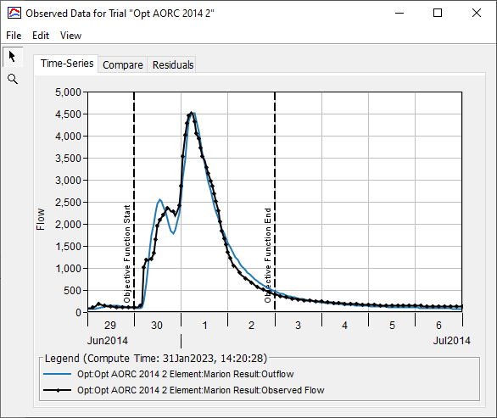
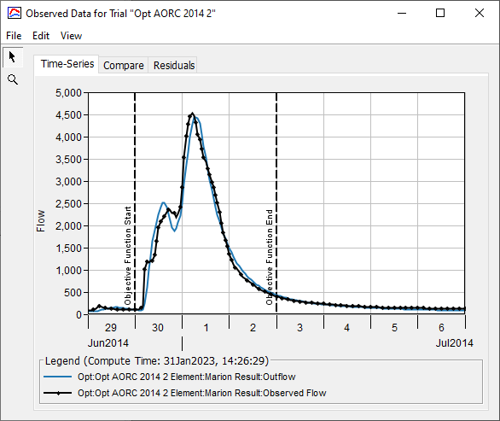

Objective Functions
PWRMSE
SSR
PWVP
Notes:
Same searcher (DE), tolerance (0.01), window, parameters, etc. Just varying the objective function. Each of these three describes the error in a slightly different way. The sum of square residuals (SSR) has no extra weighting that emphasizes the peak. Peak-weighted RMSE (PWRMSE) has a linear weight factor for flows close to the maximum. Peak-weighted variable power (PWVP) has the most emphasis on the peak but significantly de-emphasizes low flows.

Slide 30
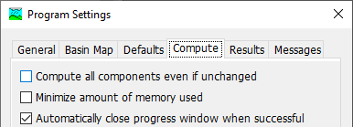
Continuing a Search
Run out of iterations before reaching tolerance?
Only change max iterations and run search
Reach tolerance before running out of iterations?
Only lower tolerance and run search
Turn this off!

Slide 31
Strategies
Correct usage is not “one and done”.
Plan several kinds of adjustments to your trial:
Initial parameter values
Parameter minimum and maximum values
Which parameters are included in the search
Objective function time window (if applicable)
Locking parameters in place
Reducing search tolerance as you iterate towards a solution

Slide 32
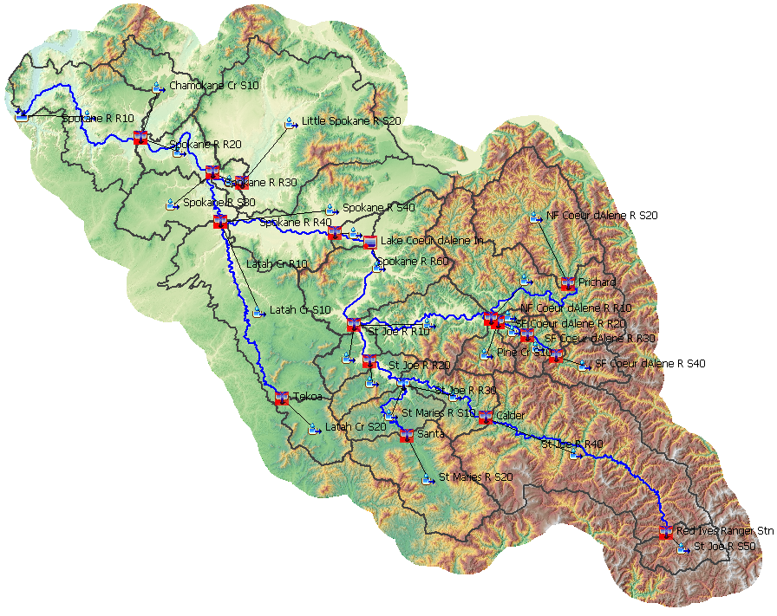
Strategies
Treat optimization like you would manual calibration
Move upstream to downstream
Be careful of offsetting parameters

Slide 33
Strategies
Start with a small set of sensitive parameters and a looser tolerance
Uncertainty Analysis to assess parameter sensitivity
Don't worry if first searches don't converge
Try to get them going in the right direction first
Pick a meaningful parameter range and initial guess
Ok to bump up against limits early

Slide 34
Strategies
Volume parameters can be locked early after volume looks ok
Pay attention to parameters that move towards their bounds
Avoid optimizing initial conditions

Slide 35
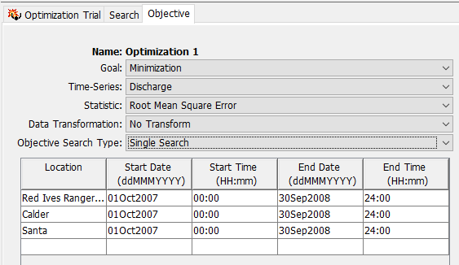
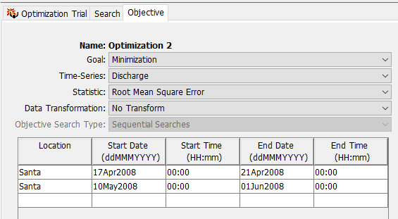
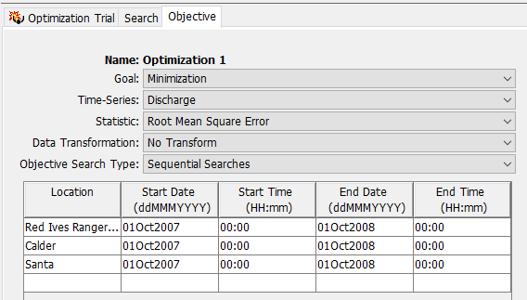
Upcoming Enhancements
Multi-location
Multi-time window

Slide 36
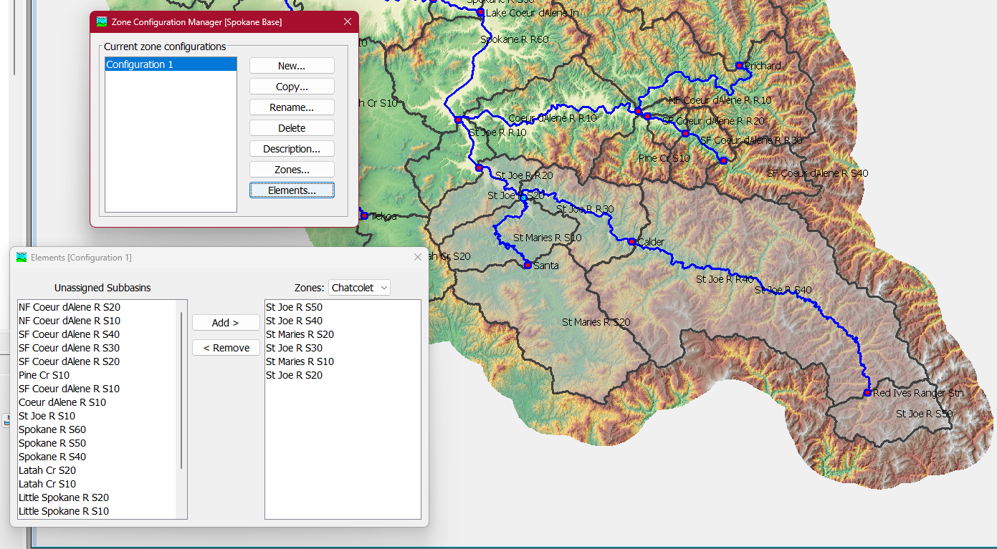
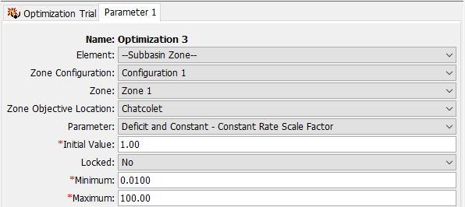
Upcoming Enhancements
Zonal scale factors

Slide 37
Questions?

Slide 38
Feeding a Simplex Search with DE
DE is great at initially narrowing the problem when you don’t have much information
However, DE is very slow to converge sometimes
Take advantage of positives of both DE and Simplex
Run a DE search to a very loose tolerance
Take best population member and narrowed parameter ranges from results file
Initialize a Simplex search with these settings

Slide 39
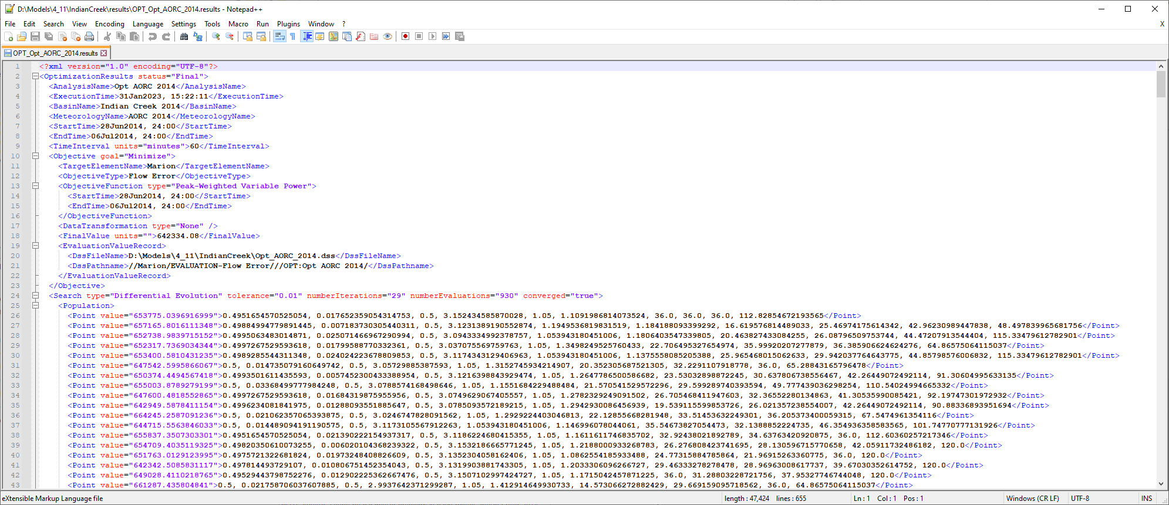
Results File

