Slide 1
Continuous Simulation
Advanced Applications of HEC-HMS
June 2025
Presented by: Daniel Black, P.H.

Slide 2
Overview
Learn about the differences between event and continuous simulation.
Learn about the Deficit and Constant loss rate method and how it is similar and differs from soil moisture accounting.
Learn about the structure of the Soil Moisture Accounting loss rate method.
Learn about the layered Green and Ampt loss method and how it represents infiltration in a physically based way.
Notes:
Event vs. Continuous Simulation:
We'll start by comparing event-based modeling, which focuses on single storm events, to continuous modeling, which simulates long-term watershed processes.
Understanding this difference is critical when selecting the right loss method and meteorologic model.
Soil Moisture Accounting Method:
This is one of the most commonly used continuous loss methods.
We'll explore its multi-layered structure, including soil, surface, and groundwater stores, and how it tracks water movement over time.
Deficit and Constant Method:
We'll examine how this simpler method compares to SMA.
It does not distinguish gravity and tension zones, and lumps soil and groundwater, but still allows continuous ET and infiltration.
Layered Green-Ampt Method:
This method provides a physically based approach to infiltration.
We'll look at how it models soil layers and field properties like suction, porosity, and conductivity, making it ideal for users with detailed soil data.

Slide 3
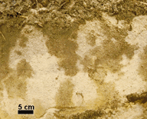
Soil Water Basics
Soil is a porous media with solids and voids, also called pores.
Voids may contain air or water.
Richard's Equation – Water moves through an unsaturated soil chiefly due to matric forces.
Darcy's Law – Water moves through a saturated soil chiefly due to hydrostatic forces.
Hydrophobic compounds in the soil particles may affect water movement.
In general, soil properties are highly heterogeneous.
Notes:
Porous Media Concept:
Soil consists of solid particles (minerals and organic matter) and voids (pores).
These pores may be filled with air, water, or a mixture of both, depending on saturation.
Water Movement Mechanisms:
In unsaturated soils, water is pulled by matric forces—capillary and adhesive effects described by Richard's Equation.
In saturated soils, water flow is driven by hydrostatic pressure, governed by Darcy’s Law.
Chemical Influence:
Hydrophobic compounds (e.g., waxes or certain organics) can repel water, affecting infiltration and retention.
Heterogeneity in Soils:
Soil properties (texture, structure, moisture content) can vary dramatically even within a small area—visible in the image as patches of wet and dry zones.
The blotchy patterns in the image show variable moisture retention and flow paths, demonstrating heterogeneous water movement through soil.

Slide 4

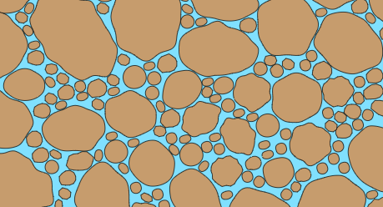
Continuous Versus Event
Event-based simulation
Continuous simulation
Precipitation
Precipitation
Meteorol. & canopy models
Interception
Evapotranspiration
Infiltration excess
Infiltration rate = constant rate
Deficit = 0
Percolation rate = infiltration rate
Infiltration
Infiltration
Loss model
Percolation
Percolation
Notes:
This slide contrasts event-based and continuous hydrologic simulations, highlighting how they handle infiltration and soil moisture processes differently.
Event-Based Simulation:
Simplified assumptions:
Only simulates a single storm or flood event.
Infiltration:
Happens at a constant rate until soil is saturated.
The soil moisture deficit is assumed to be zero at the start (i.e., soil is ready to infiltrate).
No evapotranspiration or interception modeled.
These processes are neglected because the time scale is short.
Excess precipitation:
Quickly becomes surface runoff once the infiltration capacity is exceeded.
Continuous Simulation:
Long-term water balance:
Simulates daily or hourly conditions over extended periods (months to years).
More complex modeling:
Includes interception, evapotranspiration, and dynamic soil moisture changes.
Deficit matters:
Infiltration depends on how much water the soil can still absorb (i.e., deficit ≠ 0).
Couples with meteorologic & canopy models
(e.g., rainfall, temperature, vegetation effects) to simulate water input/output more realistically.
Use event-based simulations for short-term design storms and continuous simulations for full water cycle assessments, including droughts, wet periods, and soil moisture evolution.

Slide 5
Available Loss Methods
Loss Method | Event | Continuous
Deficit and constant |  | Yes
Exponential | Yes
Green and Ampt | Yes
Gridded deficit and constant |  | Yes
Gridded Green and Ampt | Yes
Gridded SCS curve number | Yes
Gridded soil moisture accounting |  | Yes
Initial and constant | Yes
Layered Green and Ampt |  | Yes
Linear Deficit and Constant | Yes | Yes
SCS curve number | Yes
Smith Parlange | Yes
Soil moisture accounting |  | Yes
Notes:
Event-Based Only Methods:
These models assume short time scales and don’t track long-term soil moisture.
They're commonly used in design storms or calibration to specific rainfall events.
Continuous Only Methods:
These are designed to simulate ongoing changes in soil water content.
Suitable for long-term simulations involving ET, deficit tracking, and water balance.
Dual-Purpose Methods (Both Event & Continuous):
These are flexible options that can adapt to either simulation type.
They're particularly useful in semi-arid regions or operational forecasting.
Choose the loss method based on your simulation type and desired soil moisture complexity. Not all methods are compatible with continuous modeling.

Slide 6
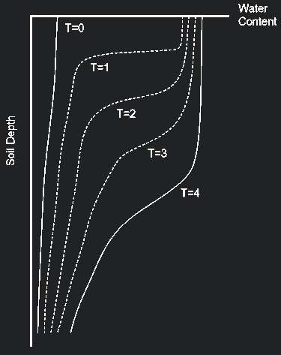
Soil Water Basics
The soil is unsaturated when precipitation starts.
If the rain rate is large enough, water ponds on the soil surface.
Hydrostatic force pushes the ponded water into the soil, while matric forces pull the water into the soil.
Water redistributes due to matric forces when ponding ceases.
Notes:
Initial State (T=0):
When rain begins, soil is typically unsaturated, especially near the surface.
The water content profile starts near dry.
Ponding and Infiltration:
If rainfall exceeds the infiltration rate, water ponds on the surface.
Two forces drive water into the soil:
Hydrostatic pressure from the ponded water.
Matric suction from the dry soil beneath.
Water Movement into Soil:
As infiltration begins, water content increases at the surface first, then moves deeper over time (T1 to T4).
The graph on the right shows water content vs. depth at multiple time steps, illustrating how infiltration front advances.
Redistribution After Rain Stops:
Once ponding ends, gravity no longer contributes, but water continues to move via matric forces.
Moisture redistributes downward and laterally, smoothing out the sharp gradients over time.
Visual Emphasis:
The widening curves at each time step show water penetrating deeper and more uniformly as time progresses.

Slide 7
Modeling requirements
The meteorologic model must be configured with precipitation and evapotranspiration. Add snowmelt in cold climates.
Subbasins must use a canopy method. The plant canopy is the mechanism for extracting water from the soil moisture state.
Subbasins must use a loss method that tracks soil moisture state, i.e. Soil Moisture Accounting, Deficit and Constant, or Layered Green and Ampt.
Notes:
Meteorologic Model Configuration:
Your meteorologic model must include both precipitation and evapotranspiration inputs.
These are essential for driving soil moisture changes.
In cold climates, don't forget to add a snowmelt method to account for frozen precipitation.
Canopy Method Requirement:
Each subbasin must use a canopy method.
The plant canopy is the only component that allows water to be withdrawn from the soil through evapotranspiration, simulating vegetation effects.
Loss Method Requirement:
Subbasins must also use a loss method that tracks soil moisture state over time.
Acceptable options include:
Soil Moisture Accounting
Deficit and Constant
Layered Green and Ampt
These methods are required to simulate long-term changes in infiltration, percolation, and water availability—especially in continuous simulations.

Slide 8
Deficit Constant
Precipitation
ET
Canopy Storage
Overflow
Overflow to Direct Runoff
ET
Surface Storage
Infiltration
ET
Soil Storage
Deep Percolation or Baseflow
Notes:
The Deficit and Constant method models soil moisture with three storage layers: Canopy, Surface, and Soil.
Canopy Storage:
First point of contact for precipitation.
Water is held temporarily by vegetation.
Losses occur via evapotranspiration (ET).
Once full, excess water overflows to surface storage.
Surface Storage:
Holds water temporarily at the ground surface.
Can lose water to ET, or pass it to the soil through infiltration.
If rainfall exceeds capacity, it overflows to direct runoff.
Soil Storage:
Represents the unsaturated soil zone.
Infiltrated water is stored here and can be lost via ET,
or move downward as deep percolation or baseflow.
The term “deficit” refers to how much storage is available before water can infiltrate.
Model Emphasis:
This structure allows the simulation of soil wetting, infiltration, runoff, and baseflow
over time—essential for continuous hydrologic modeling.
The constant infiltration rate is used once the soil is no longer deficit-limited.

Slide 9
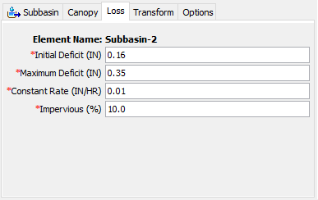
Deficit Constant
The meteorologic model should be configured with precipitation and evapotranspiration. Add snowmelt in cold climates.
Initial conditions:
  Initial deficit.
Parameters:
  Maximum deficit.
  Percolation rate.
  Percent impervious area.
Notes:
To use the Deficit and Constant method effectively, the meteorologic model must be configured with precipitation and evapotranspiration inputs.
In cold regions, also configure snowmelt as a water input.
Initial Conditions:
Set the initial deficit, representing how dry the soil is at the start of the simulation.
A higher value means more capacity to absorb water before runoff begins.
Key Parameters:
Maximum Deficit
This is the total soil moisture capacity that must be satisfied before infiltration becomes constant.
Percolation Rate (called “Constant Rate” in the UI)
The rate at which water leaves the soil zone to become baseflow or deep percolation.
Percent Impervious Area
Represents the portion of the subbasin that does not absorb water, directly contributing to runoff.
The screenshot on the right shows typical input fields in the HEC-HMS interface under the Loss tab for a subbasin.

Slide 10
Precipitation and Infiltration
Fill canopy interception. Precipitation that exceeds the canopy storage capacity will overflow and be added to the surface.
Infiltrate from surface depression. Infiltration is not limited by a maximum rate.
Precipitation
Meteorol. & canopy models
Evapotranspiration
Interception
Infiltration excess
Infiltration rate = constant rate
Deficit = 0
The current deficit is the amount of water that will infiltrate before surface runoff can begin.
Loss model
Infiltration
Notes:
Step 1 – Canopy Interception:
Precipitation is first intercepted by the plant canopy.
This simulates rainfall caught by leaves, branches, and vegetation.
Once the canopy storage is full, excess water overflows to the surface.
Step 2 – Surface Infiltration:
Water on the surface infiltrates into the soil from surface depressions.
In this model, there is no maximum infiltration rate while the soil still has a deficit.
Water fills the soil storage until the deficit is satisfied.
“Current deficit” is the amount of water the soil can still absorb before surface runoff begins.
Until that deficit is reduced to zero, all incoming water goes into infiltration, not runoff.
Diagram:
Shows vertical movement of precipitation through:
Canopy → Surface → Soil
Includes ET (evapotranspiration) from both canopy and soil layers.
Once the deficit = 0, any further rainfall may generate infiltration excess runoff.

Slide 11
Percolation and Evapotranspiration
Percolation only occurs when the soil is saturated. That is, the moisture deficit = 0 due to sufficient infiltration.
Percolated water can be split between contribution to linear reservoir baseflow, and aquifer recharge.
Evapotranspiration is computed by the plant canopy component.
Percolation stops as soon as evapotranspiration creates a moisture deficit in the soil.
Infiltration excess
Infiltration rate = constant rate
Deficit = 0
Percolation rate = infiltration rate
Infiltration
Loss model
Percolation
Notes:
When Percolation Occurs:
Percolation only begins once the soil is saturated—that is, when the moisture deficit = 0.
This means the soil has received enough water through infiltration to reach its maximum storage capacity.
Where Percolated Water Goes:
Water that percolates can:
Contribute to linear reservoir baseflow
Recharge deeper aquifers
These pathways are configured in the model depending on your groundwater setup.
Evapotranspiration (ET):
ET is computed by the canopy component, which extracts moisture from both canopy and soil storage.
It reduces the soil’s water content over time.
Dynamic Interaction:
As soon as ET reduces soil moisture, a deficit is reintroduced, and percolation stops.
This dynamic creates a feedback loop between soil water availability and ET loss.
Diagram:
Reinforces the concept that percolation occurs only when Deficit = 0.
Shows how ET and infiltration interact with soil moisture balance and deeper flow pathways.

Slide 12
Soil Moisture Accounting
Precipitation
ET
Canopy Storage
Overflow
Overflow to Direct Runoff
ET
Surface Storage
Infiltration
ET
Soil Storage
ET
Tension Storage
Percolation
Groundwater 1
Lateral to Baseflow
Percolation
Groundwater 2
Lateral to Baseflow
Deep Percolation
Notes:
The Soil Moisture Accounting (SMA) method models the complete water balance through multiple layers of storage, including canopy, surface, soil, and groundwater zones.
This approach supports continuous simulation by tracking water movement and storage dynamically.
Canopy Storage:
First to receive precipitation.
Evapotranspiration (ET) removes water directly from this layer.
Overflow moves to the surface.
Surface Storage:
Temporarily holds overflow from canopy.
Loses water via ET and infiltration into soil.
If full, overflows directly to runoff.
Soil Storage:
Receives infiltrated water.
Includes Tension Storage—a zone that holds water under suction and loses it via ET.
ET can occur from both general soil storage and tension zone.
Excess water percolates downward to groundwater.
Groundwater Layers (GW1 & GW2):
GW1: Shallower aquifer, can contribute lateral flow to baseflow.
GW2: Deeper storage with slower response; also contributes to baseflow.
Water can further percolate from GW2 to deep percolation if no further storage or discharge path exists.
Model Capabilities:
This method supports long-term simulations, allowing modeling of dry and wet periods, seasonal storage fluctuations, and full hydrologic cycling of water from rainfall to baseflow and deep recharge.

Slide 13
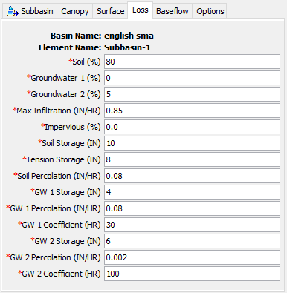
Soil Moisture Accounting
The meteorologic model should be configured with precipitation and evapotranspiration. Add snowmelt in cold climates.
Initial conditions:
  Percent soil storage.
  Percent groundwater storage.
Parameters:
  Soil storage and tension storage.
  Groundwater storage.
  Maximum infiltration rate.
  Maximum soil percolation.
  Maximum groundwater percolation.
  Groundwater storage coefficients.
  Percent impervious area.
Notes:
Like other continuous methods, the SMA method requires a meteorologic model configured with precipitation and evapotranspiration.
In cold climates, include snowmelt as an additional input source.
Initial Conditions:
Define the starting moisture levels in the model:
Percent soil storage – how full the soil layer is initially.
Percent groundwater storage – applies separately to GW1 and GW2.
Key Parameters:
Storage Values:
Soil storage, tension storage, and groundwater (GW1 and GW2) storage depths.
Infiltration and Percolation:
Max infiltration rate into soil.
Max percolation from soil to groundwater.
Max percolation from GW1 to GW2.
Groundwater Coefficients:
Control how quickly GW1 and GW2 release water to baseflow.
Higher values = faster release.
Impervious Area:
Affects direct runoff. Water falling on impervious surfaces bypasses infiltration.
Interface Preview:
The screenshot shows the Loss tab configuration for a subbasin using SMA.
All required input fields are marked in red and categorized by soil or groundwater interaction.

Slide 14
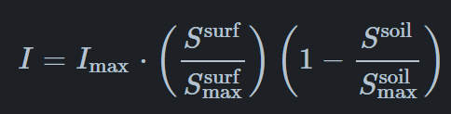
Precipitation and Infiltration
Fill canopy interception. Precipitation that exceeds the canopy storage capacity will overflow and be added to the surface.
Precipitation storage on the surface:
  Infiltrate to soil profile.
  Calculate the precipitation remaining in surface depression.
  Water exceeding surface storage becomes precipitation excess.
Soil storage:
  Add infiltration to the soil storage.
  Percolation occurs only when soil storage exceeds tension storage.
I_{max}: Maximum infiltration rate
S^{surf}/S^{surf} max: Relative surface storage fullness
1-(S^{soil}/S^{soil} max): Remaining soil storage capacity
Notes:
The Maximum Infiltration Rate sets the upper bound on infiltration from the surface storage into the soil. This is the upper bound on infiltration; the actual infiltration in a particular time interval is a linear function of the surface and soil storage, if a Surface Method is selected. Without a selected Surface Method, water will always infiltrate at the maximum rate.
Soil Storage represents the total storage available in the soil layer. It may be zero if you wish to eliminate soil calculations and pass infiltrated water directly to groundwater.
Tension Storage specifies the amount of water storage in the soil that does not drain under the effects of gravity. Percolation from the soil layer to the upper groundwater layer will occur whenever the current soil storage exceeds the tension storage. Water in tension storage is only removed by evapotranspiration. By definition, tension storage must be less that soil storage.
Canopy Interception:
As before, rainfall is first intercepted by the canopy.
If rainfall exceeds canopy capacity, the excess water is routed to the surface.
Surface Storage and Infiltration:
Water collects in surface depressions.
The amount that can infiltrate is calculated using the equation shown on the slide:
I_{max} -- Maximum infiltration rate
S^{surf}/S^{surf} max​: Relative surface storage fullness
1−S^{soil} / S^{soil}​: Remaining soil storage capacity
This equation reflects that infiltration is reduced when surface storage is low or soil is nearly full.
Any precipitation that exceeds surface storage capacity becomes surface runoff (precipitation excess).
Soil Storage Behavior:
Infiltrated water is added to soil storage.
Percolation only occurs once soil storage exceeds tension storage, allowing water to drain downward.
This formulation ensures infiltration is dynamically controlled by both surface depression and soil moisture state, providing a more realistic simulation of rainfall partitioning.

Slide 15
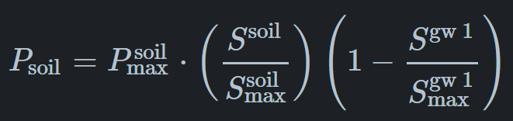
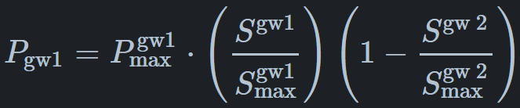
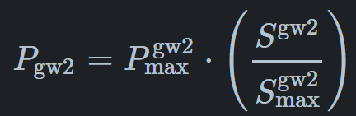
Percolation
Soil percolation only occurs when soil storage exceeds the tension zone storage.
Groundwater percolation occurs if there is storage.
Soil Percolation
GW1 to GW2 Percolation
GW2 to Deep Percolation
Notes:
The Soil Percolation sets the upper bound on percolation from the soil storage into the upper groundwater. The actual percolation rate is a linear function of the current storage in the soil and the current storage in the upper groundwater.
Groundwater 1 Storage represents the total storage in the upper groundwater layer. It may be zero if you wish to eliminate the upper groundwater layer and pass water percolated from the soil directly to the lower groundwater layer.
The Groundwater 1 Percolation Rate sets the upper bound on percolation from the upper groundwater into the lower groundwater. The actual percolation rate is a linear function of the current storage in the upper and lower groundwater layers.
The Groundwater 1 Coefficient is used as the time lag on a linear reservoir for transforming water in storage to become lateral outflow. The lateral outflow is available to become baseflow.
Soil Percolation Condition:
Percolation from soil only begins when soil storage exceeds the tension zone.
This ensures that gravitational flow (drainage) only occurs when soil is sufficiently saturated.
Groundwater Percolation Logic:
Water can percolate from GW1 to GW2, and then GW2 to deep percolation,
but only if there is available storage in the receiving layer.
Equations Overview:
1. Soil Percolation:
P_{soil} = P^{soil} max (S^{soil} / S^{soil} max) (1−(S^{gw1} / S^{gw1} max))
Percolation rate is scaled by how full the soil is and how much space is available in GW1.
2. GW1 to GW2 Percolation:
P_{gw1} = P^{gw1} max (S^{gw1} / S^{gw1} max) (1−(S^{gw2} / S^{gw2} max)
Similar logic applies – water moves downward if GW1 is full and GW2 has capacity.
3. GW2 to Deep Percolation:
P_{gw2} = P^{gw2} max⋅(S^{gw2} / S^{gw2} max) Final step toward aquifer recharge or model outflow, only dependent on GW2 fullness.
Percolation is not just a function of saturation above—it also depends on storage availability below.
This structure ensures realistic layer-to-layer water transfer based on physical constraints.

Slide 16
Evapotranspiration
Evapotranspiration removes water from the soil layer at the potential rate while the current storage exceeds the tension storage. During this phase, the soil water will also be percolating to groundwater.
Evapotranspiration from the soil layer while in the tension zone is controlled by the canopy’s tension reduction method.
Ratio of actual ET to potential ET
Notes:
If tension reduction is selected, the amount of evapotranspiration from the tension zone is a function of the storage. It represents the fact that water is increasingly difficult for plants to remove from the soil as the soil dries out.
ET Above Tension Storage:
When soil storage exceeds the tension zone, evapotranspiration occurs at the full potential ET rate.
This is the phase when both ET and percolation are active.
Water is lost upward to the atmosphere and downward to groundwater at the same time.
ET Within the Tension Zone:
Once soil moisture drops below the tension storage threshold, water is held more tightly by the soil.
ET becomes limited, and is no longer at the potential rate.
The rate is controlled by the canopy’s tension reduction function—a curve that adjusts ET based on relative moisture.
Chart Explanation:
The graph on the right shows the reduction function:
X-axis: Soil moisture as a fraction of tension storage
Y-axis: Ratio of actual ET to potential ET
ET decreases linearly with declining soil moisture until a critical point, after which it drops to zero or plateaus.
This dynamic ensures that plants extract less water during dry conditions, simulating realistic drought stress and water availability feedback.

Slide 17
Groundwater
Percolation into groundwater 1 is a function of current storage in the soil and groundwater 1.
Percolation from groundwater 1 into groundwater 2 depends on the storage in both layers.
Both groundwater layers convert a portion of water in storage to lateral outflow that connects to the linear reservoir baseflow.
  Add incoming percolation.
  Subtract outgoing percolation.
  Calculate portion of remaining storage that becomes lateral outflow.
  Transform lateral outflow to become baseflow.
Percolation out of groundwater 2 can be split between contribution to linear reservoir baseflow, and aquifer recharge.
Notes:
GW1 Percolation (Soil → GW1):
Water percolates from soil storage into Groundwater 1 (GW1) when soil is saturated.
The percolation amount depends on how full the soil and GW1 are.
If GW1 has limited storage, percolation is reduced.
GW1 → GW2 Percolation:
Once GW1 is full, excess water can percolate into Groundwater 2 (GW2).
This flow is also limited by available storage in GW2.
Lateral Outflow to Baseflow:
Both groundwater layers (GW1 and GW2) can contribute lateral outflow to the model’s linear reservoir baseflow.
This is calculated after:
Adding new percolation
Subtracting outgoing percolation
Determining how much remaining water can flow laterally
That lateral water is then transformed into baseflow, routed downstream.
GW2 Final Routing:
Water in GW2 has two pathways:
Lateral baseflow contribution
Deep percolation (aquifer recharge), which may leave the model domain
This two-layer groundwater structure supports realistic modeling of baseflow timing, groundwater storage dynamics, and aquifer recharge, especially over long simulations.

Slide 18
Layered Green and Ampt
Precipitation
ET
Canopy Storage
Overflow
Overflow to Direct Runoff
ET
Surface Storage
Infiltration
ET
Field Capacity
ET
Wilting Point
Seepage
ET
Field Capacity
ET
Wilting Point
Percolation to Deep Aquifer or Baseflow
Notes:
It may also be used in combination with a Surface Method that will hold water on the land surface. The water in surface storage infiltrates to the soil layer. The infiltration rate is determined by the capacity of the soil layer to accept water. When both a Canopy and Surface Method are used in combination with the Layered Green and Ampt Method, the system can be conceptualized as shown in the figure.
The Layered Green-Ampt method models infiltration using multiple soil layers, each with its own hydraulic properties.
This approach offers more detailed simulation of infiltration, especially in stratified soils.
Canopy and Surface Storage:
Precipitation first fills canopy storage, then surface storage if excess remains.
Water in the surface layer may evaporate or overflow to runoff.
Infiltration into the soil occurs once surface storage is available.
Soil Layers – Key Concepts:
Each soil layer has a wilting point and a field capacity:
Wilting Point: Lower limit where plants can no longer extract water.
Field Capacity: Maximum amount of water the soil can hold before it begins to drain.
ET removes water from both soil layers, and infiltration fills the top layer first.
Once the upper layer reaches field capacity, seepage begins into the second layer.
That layer then fills in a similar manner.
Deep Percolation or Baseflow:
When the bottom layer is full beyond field capacity, percolation occurs.
This can contribute to baseflow or deep aquifer recharge, depending on model setup.
This method enables simulation of infiltration through layered soils, accounting for non-uniform moisture distribution and more realistic plant-water interaction.

Slide 19
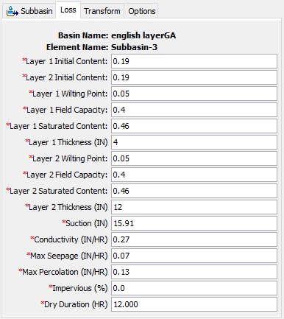
Layered Green and Ampt
The meteorologic model should be configured with precipitation and evapotranspiration. Add snowmelt in cold climates.
Initial Conditions:
  Layer 1 initial content.
  Layer 2 initial content.
Parameters:
  Saturated water content.
  Field capacity, wilting point.
  Layer thickness.
  Wetting front suction.
  Saturated hydraulic conductivity.
  Maximum seepage, percolation.
  Percent impervious area.
  Dry period duration (for reset).
Notes:
Meteorologic Model Reminder:
This loss method requires a meteorologic model configured with precipitation and evapotranspiration.
Add snowmelt input if modeling a cold-climate watershed.
Initial Conditions:
Set the starting soil moisture content for each layer:
Layer 1 Initial Content
Layer 2 Initial Content
These represent how wet the soil is at the start of the simulation.
Key Parameters to Configure:
Moisture Limits:
Saturated water content – maximum water-holding capacity
Field capacity – moisture held after drainage
Wilting point – lower limit for plant water availability
Layer Geometry:
Layer thickness – depth of each soil layer (in inches)
Infiltration Properties:
Wetting front suction – controls how quickly the wetting front advances
Saturated hydraulic conductivity – governs infiltration rate
Drainage Limits:
Maximum seepage – rate from layer 1 to layer 2
Maximum percolation – rate from layer 2 downward
Other Controls:
Impervious area – percent of subbasin that cannot infiltrate
Dry period duration – number of hours without rainfall needed to reset soil conditions
UI Snapshot:
The screenshot shows the Loss tab in the HEC-HMS interface for a subbasin using Layered Green-Ampt.
Fields are grouped logically by layer and process.
Be sure to use realistic soil property values for each layer—those strongly influence infiltration timing and runoff generation.

Slide 20

Precipitation and Infiltration
Fill canopy interception. Precipitation that exceeds the canopy storage capacity will overflow and be added to the surface.
Precipitation storage on the surface:
  Infiltrate to soil profile.
  Calculate the precipitation remaining in surface depression.
  Water exceeding surface storage becomes precipitation excess.
Layer 1:
  Add infiltration to the layer storage.
  Infiltration is limited to maximum seepage rate when saturated.
  Seepage occurs only when storage exceeds field capacity.
f = Infiltration
K = Saturated Hydraulic Conductivity
h_{f} = Wetting Front Suction Head
Θ_{SAT} = Saturated Water Content
Θ_{init} = Initial Water Content
F = Cumulative Infiltration
$$f=K_{SAT}\left(1+h_{f}\frac{θ_{SAT}^{1}−θ_{init}^{1}}{F}\right)$$
Notes:
Precipitation fills the canopy storage. Precipitation that exceeds the canopy storage will overflow onto the land surface. The precipitation is added to any water already in surface storage. The infiltration rate from the surface into Layer 1 is calculated with the Green and Ampt Equation so long as Layer 1 is below saturation. The infiltration rate changes to the current seepage rate when Layer 1 reaches saturation.
Step 1 – Canopy Interception:
Rainfall first fills canopy storage.
Once that fills, excess precipitation is passed to the surface storage layer.
Step 2 – Surface Storage:
Surface depression temporarily holds water.
Water from surface storage is available to infiltrate into the soil profile using the Green-Ampt equation.
Infiltration Equation:
f = Infiltration
K_{SAT} = Saturated Hydraulic Conductivity
h_{f} = Wetting Front Suction Head
Θ_{SAT} = Saturated Water Content
Θ_{init} = Initial Water Content
F = Cumulative Infiltration
This formulation shows how infiltration rate decreases over time as the soil wets up.
Step 3 – Behavior in Layer 1:
Infiltrated water is added to layer 1 storage.
If saturated, water can only move down at the maximum seepage rate.
Seepage to lower layers only occurs when storage exceeds field capacity.
Runoff Reminder:
If surface storage overflows (i.e., not infiltrated), the excess is routed to direct runoff.

Slide 21


Percolation and Evapotranspiration
Seepage only occurs if Layer 1 storage exceeds field capacity.
Percolation only occurs if Layer 2 storage exceeds field capacity.
Seepage is limited when Layer 2 is saturated.
Percolation can be split between contribution to linear reservoir baseflow, and aquifer recharge
Evapotranspiration is computed by the plant canopy component.
$$R_{SEEP}={Seep}_{MAX}\left(1−\frac{θ_{SAT}^{1}−θ^{1}}{θ_{SAT}^{1}−θ_{FC}^{1}}\right)$$
R_{SEEP} = Rate of Seepage
Seep_{max} = Maximum Seepage
R_{PERC} = Rate of Percolation
Perc_{max} = Maximum Percolation
Θ = Water Content
Θ_{SAT} = Saturated Water Content
Θ_{FC} = Field Capacity Water Content
$$R_{PERC}={Perc}_{MAX}\left(1−\frac{θ_{SAT}^{2}−θ^{2}}{θ_{SAT}^{2}−θ_{FC}^{2}}\right)$$
Notes:
The infiltration rate changes to the current seepage rate when Layer 1 reaches saturation. Infiltrated water is added to the storage in Layer 1. Seepage out of Layer 1 only occurs when the storage exceeds field capacity. Maximum seepage occurs when Layer 1 is at saturation and declines to zero at field capacity. The seepage rate changes to the percolation rate when Layer 2 is saturated. Seepage is added to the storage in Layer 2. Percolation out of Layer 2 only occurs when the storage exceeds field capacity. Maximum percolation occurs when Layer 2 is at saturation and declines to zero at field capacity.
R_{SEEP} = Rate of Seepage
Seep_{max} = Maximum Seepage
R_{PERC} = Rate of Percolation
Perc_{max} = Maximum Percolation
Θ = Water Content
Θ_{SAT} = Saturated Water Content
Θ_{FC} = Field Capacity Water Content
Seepage from Layer 1:
Seepage occurs only when storage in Layer 1 exceeds its field capacity.
The seepage rate is governed by the following equation:
RSEEP=SeepMAX(1−θSAT1−θ1θSAT1−θFC1)R_{\text{SEEP}} = \text{Seep}_{\text{MAX}} \left( 1 - \frac{\theta^1_{\text{SAT}} - \theta^1}{\theta^1_{\text{SAT}} - \theta^1_{\text{FC}}} \right)RSEEP​=SeepMAX​(1−θSAT1​−θFC1​θSAT1​−θ1​)
As the layer approaches saturation, the seepage rate approaches SeepMAX.
Percolation from Layer 2:
Percolation to baseflow or aquifer recharge begins when Layer 2 storage exceeds its field capacity:
RPERC=PercMAX(1−θSAT2−θ2θSAT2−θFC2)R_{\text{PERC}} = \text{Perc}_{\text{MAX}} \left( 1 - \frac{\theta^2_{\text{SAT}} - \theta^2}{\theta^2_{\text{SAT}} - \theta^2_{\text{FC}}} \right)RPERC​=PercMAX​(1−θSAT2​−θFC2​θSAT2​−θ2​)
Again, the closer the layer is to saturation, the higher the percolation rate—capped at PercMAX.
Constraints and Routing:
Seepage is restricted if Layer 2 is already saturated.
Percolation out of Layer 2 may be split between:
Contribution to linear reservoir baseflow
Deep aquifer recharge, depending on model setup.
Evapotranspiration Reminder:
ET from both layers is handled by the canopy model, which responds to soil moisture in both tension and full zones.
Key Concept:
The rate formulas ensure smooth transitions between dry and wet conditions while maintaining realistic water movement between layers.

Slide 22
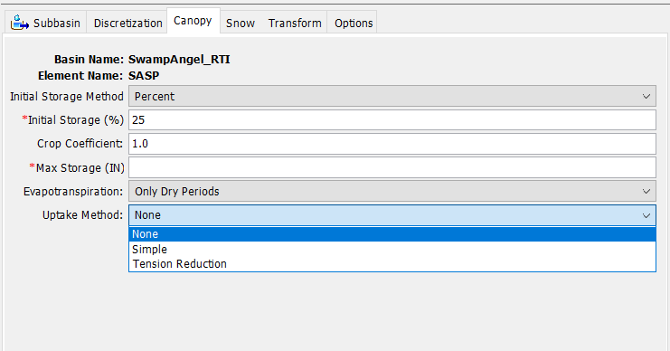
Plant Canopy
No ET from soil w/o Canopy Method (w/ Canopy Uptake Method)
Uptake method determines how water is extracted from the soil:
  Simple approach extracts at the potential evapotranspiration rate provided by the meteorologic model. It works with all three methods.
  Tension reduction reduces extraction as the soil becomes drier. It is traditionally applied with Soil Moisture Accounting but could be used with Layered Green and Ampt.
Notes:
Why a Canopy Method Is Required:
Without a canopy method, the model does not extract ET from soil storage.
The canopy acts as the interface between atmospheric demand and soil water supply.
Uptake Method Options – Determines How Soil ET Is Handled:
None:
No water is extracted from soil (ET effectively disabled).
Simple Method:
ET is applied at the full potential rate, regardless of how much water is available in the soil.
This works with any loss method:
Soil Moisture Accounting
Deficit and Constant
Layered Green-Ampt
Tension Reduction Method:
Reduces ET as the soil dries, based on the tension zone storage.
It’s more physically realistic.
Commonly used with Soil Moisture Accounting, but can also be applied to Layered Green-Ampt for drought-sensitive simulations.
UI Screenshot:
Highlights where to configure the Uptake Method in the Canopy tab of the subbasin element.
To simulate realistic ET behavior, especially under dry conditions, you should always use a canopy method and carefully select the uptake method that fits your modeling goals.

Slide 23
Surface Depression
The surface depression component captures precipitation or canopy overflow for eventual infiltration.
Allows for infiltration after the rain has stopped, thus increasing total potential infiltration.
Soil Moisture Accounting with no surface:
  Precipitation or canopy overflow infiltrates at the maximum infiltration rate when soil is unsaturated.
  Infiltration reduces to the maximum percolation rate when the soil is saturated.
  Precipitation exceeding the infiltration/percolation becomes excess precipitation.
Deficit and Constant with no surface is essentially unchanged except total infiltration is reduced.
Layered Green and Ampt with no surface will reset the initial water content quicker after the end of precipitation.
Notes:
What It Does:
The surface depression component captures rainfall or canopy overflow that does not immediately infiltrate.
This temporarily stored water is held for later infiltration, allowing more water to enter the soil after rainfall ends.
Why It Matters:
Including surface depression increases total potential infiltration, especially for short or intense storms.
Helps prevent early runoff and mimics the way ponded water slowly infiltrates in natural systems.
Behavior by Loss Method:
Soil Moisture Accounting (no surface component):
All precipitation or overflow attempts to infiltrate immediately.
Once the soil saturates, infiltration rate drops to maximum percolation rate.
Any excess becomes direct runoff, even if more infiltration could happen later.
Deficit and Constant (no surface):
The method is not heavily affected by the presence of surface depression,
but removing surface storage leads to a reduction in total infiltration.
Layered Green-Ampt (no surface):
If surface storage is not included, the model will reset water content more quickly,
meaning less infiltration occurs after rain events.
This could underestimate infiltration for short storms followed by dry periods.
Including a surface depression component allows models to retain water longer, making infiltration more realistic—especially important for continuous or semi-arid watershed modeling.

Slide 24
Gridded Loss Methods
A regular grid is overlaid on the subbasin to break it into grid cells.
Each grid cell receives a separate precipitation value.
The state variables in each grid cell evolve separately from surrounding grid cells.
"Gridded" loss methods have separate parameter values and initial conditions for each grid cell.
"Lumped" loss methods use the same properties at all cells.
Notes:
What Are Gridded Loss Methods?
These methods break a subbasin into a uniform grid—each cell is treated independently.
The image shows a watershed subdivided into grid cells overlaid on the basin boundary.
Key Feature – Spatial Variability:
Each grid cell receives its own precipitation input, which allows for spatially variable rainfall.
State variables—such as soil moisture, infiltration, or percolation—evolve independently within each cell.
This contrasts with lumped methods, where a single average state is assumed.
Gridded vs. Lumped:
Gridded Methods:
Each grid cell has its own parameter values and initial conditions (e.g., soil moisture, curve number, etc.).
Enables simulation of complex land cover, soil types, or rainfall patterns.
Lumped Methods:
Apply uniform parameters across the entire subbasin.
Simpler, but may underrepresent spatial variability in larger or heterogeneous basins.
Use Cases for Gridded Loss Methods:
Best suited for large subbasins or when using gridded precipitation inputs (e.g., radar, gridded gages).
Also useful when modeling heterogeneous land surfaces with variable infiltration capacity.

Slide 25
Method Differences
Deficit and Constant method lumps soil and groundwater together.
  A larger water store is available for evapotranspiration and so it may be overestimated.
Deficit and Constant method does not separate gravity and tension zones in the soil profile.
  Soil moisture is only removed by evapotranspiration.
Soil Moisture Accounting method uses a reduction function for evapotranspiration.
  Evapotranspiration is better modeled in soils that regularly dry out.
Layered Green and Ampt is more physically based.
  Parameter estimation is more parsimonious.
  Infiltration is more clearly linked to the soil moisture content.
Notes:
This slide summarizes the key conceptual differences among the three main continuous loss methods:
Deficit and Constant
Soil Moisture Accounting (SMA)
Layered Green-Ampt
Deficit and Constant Method:
Simplified model that lumps soil and groundwater together.
This can overestimate evapotranspiration because a larger storage volume is assumed available for extraction.
No separation between gravity and tension storage zones.
All water is removed from the same reservoir via ET—regardless of how tightly it's held in the soil.
Soil Moisture Accounting Method:
Includes explicit tension storage and uses a reduction function for evapotranspiration.
As the soil dries out, the model automatically reduces ET rates, simulating drought stress.
This method is well suited for dry climates or seasonally varying soil moisture.
Layered Green-Ampt:
The most physically based method.
Uses soil properties like field capacity, saturation, and wetting front suction.
Supports layer-specific infiltration, seepage, and percolation dynamics.
Parameter estimation is more parsimonious, especially when using soil survey data.
Each method has trade-offs between simplicity, realism, and parameter requirements.
Choose based on available data, model goals, and desired physical accuracy.

Slide 26
Review
Learned about the differences between event and continuous simulation.
Learned about the Deficit and Constant loss rate method and how it is similar and differs from soil moisture accounting.
Learned about the structure of the Soil Moisture Accounting loss rate method. Learned about the Layered Green and Ampt loss method and how it represents infiltration in a physically based way.
Technical Reference Manual is a great resource: Available Loss Methods - HEC-HMS Technical Reference Manual - HEC Confluence
Notes:
Event vs. Continuous Simulation:
We reviewed the conceptual differences between one-time event modeling and long-term continuous simulation.
Continuous simulation incorporates ET, canopy interception, and soil state evolution.
Soil Moisture Accounting Method:
Explored how this method tracks moisture across multiple stores and includes a reduction function for ET.
Highlighted how ET and percolation respond to soil moisture availability.
Deficit and Constant Method:
Learned that this method lumps soil and groundwater, making it simpler but potentially less realistic.
Discussed how it does not distinguish tension vs. gravity storage.
Layered Green-Ampt Method:
Introduced as a physically based infiltration model that uses soil properties like field capacity and suction.
Allows simulation of layered infiltration and moisture redistribution.
For further technical depth, the HEC-HMS Technical Reference Manual is a highly recommended resource.
It includes math, diagrams, and modeling tips for all available loss methods.

