Slide 1
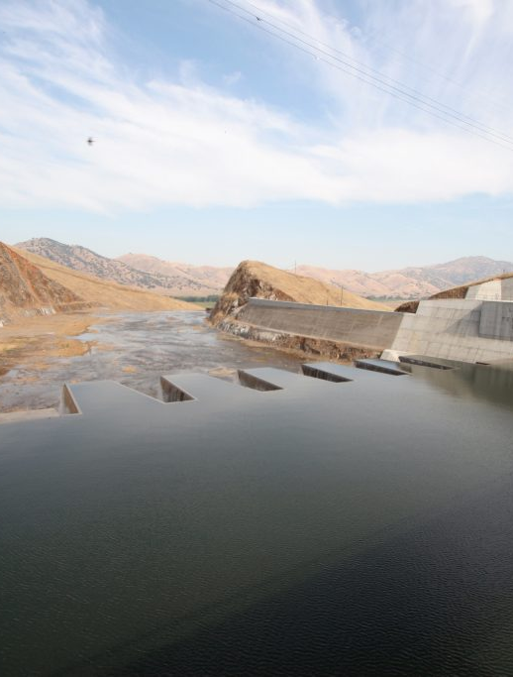
Model Calibration and Validation
Advanced Applications of HEC-HMS
June 2025
Presented by: Mike Bartles, P.E.

Slide 2
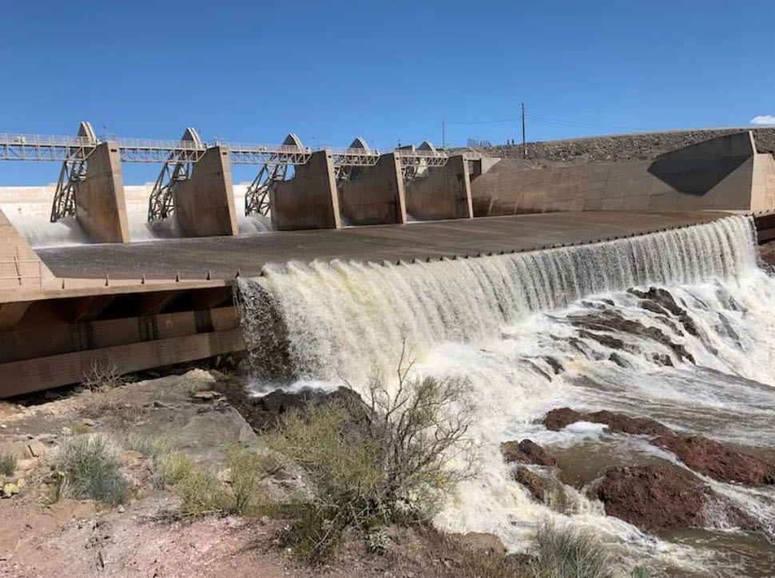
Objectives
Discuss modeling theory
Discuss model classifications
Calibration in the modeling process
Discuss event vs continuous simulation
Quantify model accuracy through performance metrics
Discuss model validation
Notes:
Model calibration and validation are essential steps in hydrologic modeling. This process involves comparing observed data from your watershed with the results generated by your model, and adjusting the model so that its outputs accurately reflect real-world conditions. The point of this is so we can feel confident in our model to make predictions. At the U.S. Army Corps of Engineers, we calibrate so we predict what the flood response might be for a 1% annual chance storm. We can have greater confidence in our model prediction if we know it's been calibrated vs a model that has not been calibrated.
The objective of the presentation:
We will discuss modeling theory
Go over different model classification.
Provide an overview on the calibration in the modeling process
Discuss event-based vs continuous calibration
Discuss the quantitative metrics HMS provides to assess model performance
Then go over model validation
Picture is Horseshoe Canyon Dam

Slide 3

Why do we model?
Notes:
A basic question that may seem obvious but is important to remember is why do we model? Why don’t we use measured flow or rainfall instead since those are real values?

Slide 4
Why do we model?
Modeling allows us to estimate the behavior of a system that is not otherwise captured in time or in space
Examples:
What will flow in a river be 3 days from now?
How will runoff response change if we build a project?
How much water will be in a reservoir 3 months from now?
How would damages change under different operations?
Notes:
Modeling allows us to estimate the behavior of our system that is not captured in time or space. Most of the time, we don’t have data at the locations we need it to make reasonable design choices. The next best way to get the information that we need is to create a model that can provide estimates for us. I’ve listed some examples of data that we can extract only from modeling:
What will the flow in the river be 3 days from now.
What is the runoff response to a project that was built
Predictions on reservoir storage within a given time period
What damages might occur if you change the reservoir operations
There are plenty of other examples but modeling provides us information that we cannot get simply by measuring.

Slide 5
What are we modeling?
Notes:
What are we modeling?

Slide 6
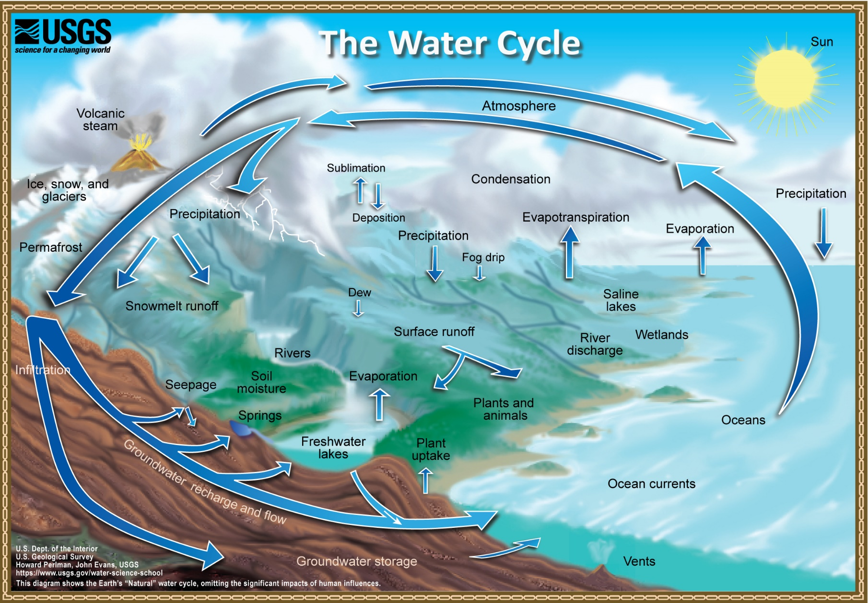
Watershed Processes
Notes:
In HEC-HMS we are essentially modeling the water cycle and tracking the rainfall once it falls from the sky.
Within USACE, we are typically most interested in surface water (but we also care about groundwater).

Slide 7
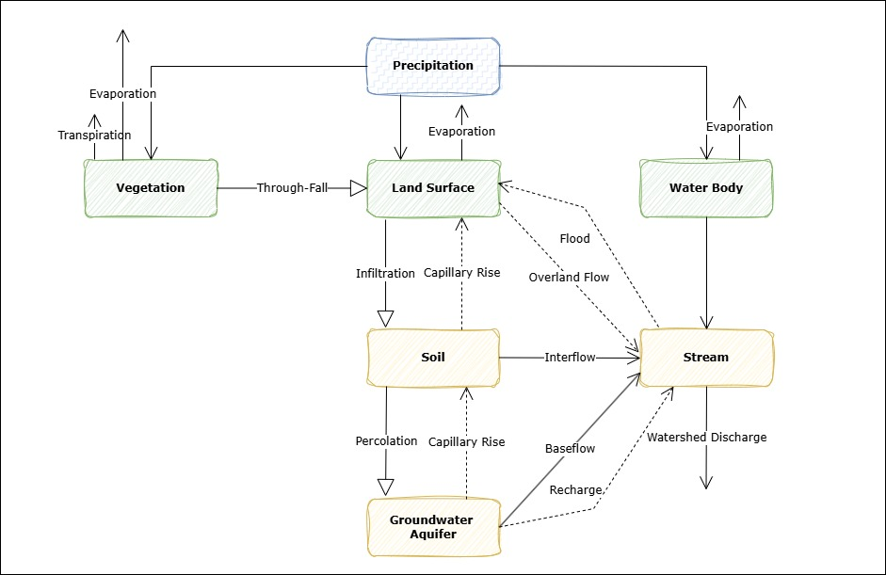
Watershed Processes
Notes:
Here is a diagram where we break down the water cycle into individual processes.
This diagram basically summarizes how HMS models the water cycle.
Starting from precipitation, the model tracks the volume of water as it falls on vegetation, land surface, or a water body element.
For each of these top level elements, the model continues to track where the water volume and its current phase state.
For example, with Vegetation, we can have a throughfall process which is when water falls through canopy onto the land surface, or we could have evaporation and transpiration occurring, changing the phase of the water from a liquid to a gas.
For each of these lines, we have a mathematical model to represent the process.

Slide 8
What is a mathematical model?

Slide 9
What is a mathematical model?
…a quantitative expression of a process or phenomenon one is observing, analyzing, or predicting (Overton and Meadows, 1976)
…simplified systems that are used to represent real-life systems and may be substitutes of the real systems for certain purposes. The models express formalized concepts of the real systems. (Diskin, 1970)
…a symbolic, usually mathematical representation of an idealized situation that has the important structural properties of the real system. A theoretical model includes a set of general laws or theoretical principles and a set of statements of empirical circumstances. An empirical model omits the general laws and is in reality a representation of the data. (Woolhiser and Brakensiek, 1982)
…idealized representations…They consist of mathematical relationships that state a theory or hypothesis. (Meta Systems, 1971)
Notes:
Here are some quotes from various research papers that describe mathematical models.
In simple terms, a mathematical model consists of an equation or a set of equations constructed to capture the key structural characteristics of a system.
In the context of hydrologic modeling, these equations are used to represent the movement and distribution of water within a watershed or river basin.
In the example with the process diagram, HMS has various equations it can select from to represent the evaporation and transpiration process.
By translating physical processes into mathematical terms, hydrologic models help us understand how water moves through the environment and enable us to predict runoff response.

Slide 10
Model Classifications

Slide 11
Model Classification
Mathematical models can be classified using several different criteria
Classifications focus on the way models are grouped or categorized
Helpful in deciding which of the models to use for various applications
Question: Is HEC-HMS a model or a program?
Notes:
When working with mathematical models, it’s important to recognize that they can be classified in several different ways.
These classifications are based on how models are grouped or categorized according to their characteristics.
These groupings include how the model represents physical processes (such as empirical, conceptual, or physically based models), how it handles spatial variability (like lumped, distributed, or semi-distributed models), and how it handles time scale (event-based versus continuous models).
Understanding these classifications is helpful because it guides us in selecting the most appropriate model for a specific problem or research question.
By identifying which category a model falls into, we can better match the model to our project goals, data availability, and the complexity of the system we are studying.

Slide 12
Model Classifications
Event or Continuous
Spatially Averaged (lumped) or Distributed
Empirical or Conceptual
Deterministic or Stochastic
Measured Parameter or Fitted Parameter
Notes:
These are the five classifications we will go into more detail.
There are more classifications out there but for hydrologic modeling within USACE, we tend to return to these classifications.

Slide 13
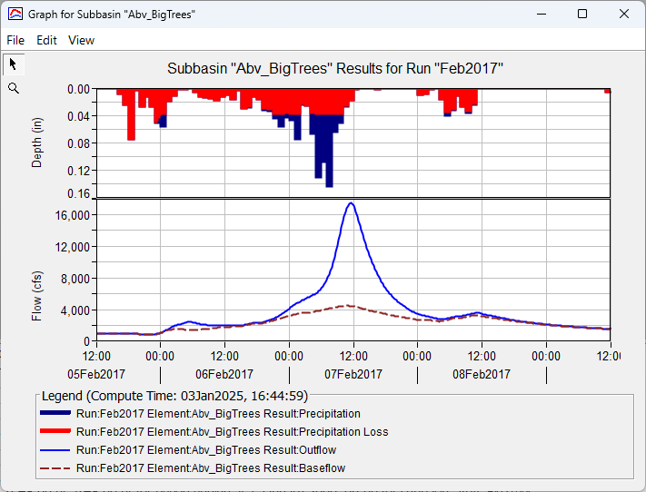
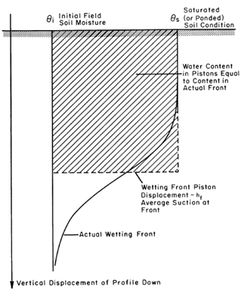
Classification: Event or Continuous
An event model simulates a single storm:
Does not include redistribution of the wetting front between storms and therefore does not account for drying of the soil through evaporation and transpiration (e.g., Green & Ampt)
Some baseflow models are classified as event because they compute baseflow based on direct runoff computed during a storm event (e.g., Recession)
Notes:
Let’s start by looking at the first classification: event-based versus continuous modeling. This basically comes down to the time scale you’re focusing on. Event-based models simulate a single storm and the resulting hydrograph from that storm. When deciding between event-based or continuous models, there are two key hydrologic processes to consider: loss and baseflow.
To the right, you’ll see an example of the Green and Ampt infiltration method. This method is designed as an event-based approach and does a good job representing how much water the soil can absorb during a single storm. However, it has some limitations. For instance, it assumes water only moves downward and doesn’t account for soil moisture drying out over time or lateral movement.
When it comes to baseflow, most event-based methods focus on fitting the recession part of the hydrograph rather than actually simulating the baseflow process itself. Event based modeling is often used for infrastructure design, such as reservoirs or stormwater systems.
This distinction applies primarily to models of infiltration, surface runoff, and baseflow. An event model simulates a single storm. The duration of the storm may range from a few hours to a few days. The key identifying feature is that the model is only capable of representing watershed response during and immediately after a storm. Event infiltration models do not include redistribution of the wetting front between storms and do not account for drying of the soil through evaporation and transpiration. Often but not always, event infiltration models use a function of cumulative loss to compute infiltration capacity. Some baseflow models are classified as event because they compute receding flow based on the peak flow rate computed during a storm event. These same methods must include a capability to reset between storms to begin the next recession; nevertheless they remain event models.

Slide 14
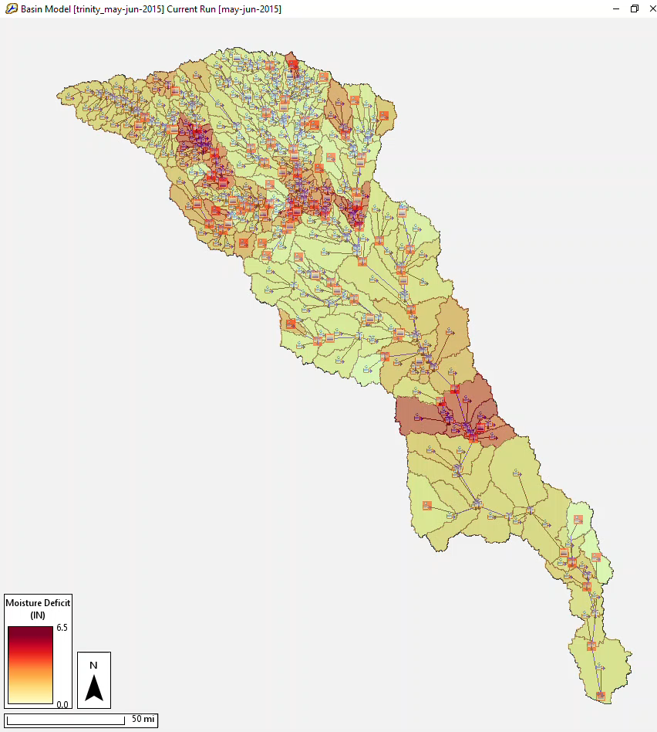
Event or Continuous
A continuous model simulates multiple events:
Infiltration models must consider the drying processes that occur in the soil between precipitation events
Baseflow methods are increasingly important because the vast majority of the hydrograph is defined by inter-storm flow characteristics
Question: Is HEC-HMS an event or continuous model?
Notes:
On the other hand, continuous models simulate rainfall and runoff over long periods—days, months, or even years.
This lets them capture changing soil moisture, groundwater recharge, baseflow, and how multiple storms interact over time.
Continuous models are often preferred for water balance studies, water quality studies, drought analysis, or watershed management because longer simulation time-period is necessary to obtain meaningful results.
Animation shows Trinity River; moisture deficit varies in both space and time during a single historic event simulation spanning ~45 days

Slide 15
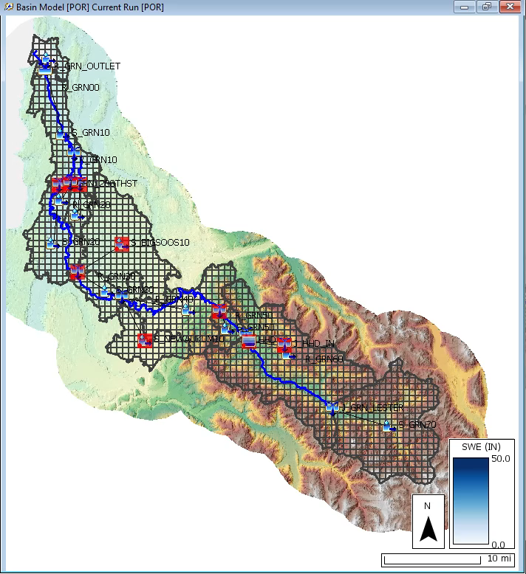
Classification: Spatially-Averaged or Distributed
Distributed model:
Spatial (geographic) variations of characteristics and processes are considered explicitly
Often distributed models represent the watershed as a set of grid cells
Spatially-averaged model (lumped):
Spatial variations are averaged or ignored
Notes:
Now let’s talk about another classification: spatially averaged models versus distributed models. This distinction is all about how models handle variations that occur across space.
Distributed models explicitly account for spatial differences within the watershed. Take rainfall, for example—it varies both in time and across different locations. Distributed models can represent this by dividing the watershed into smaller grid cells and performing calculations separately for each cell. This lets the model capture how rainfall and other processes differ from place to place.
On the other hand, spatially averaged models—sometimes called lumped models—simplify things by averaging conditions over larger areas like subbasins. For example, instead of using detailed grid-cell rainfall data, you might use an average rainfall depth across the entire subbasin or assign rainfall measured at a nearby gauge to represent the whole area.
In HEC-HMS, what we call distributed modeling is still fundamentally based on spatial averaging, but at a finer scale. Instead of averaging over an entire subbasin, the model averages over smaller units like grid cells.
Animation shows computed SWE accumulation and melt w/in Duwamish River watershed (~1 year from the POR simulation)

Slide 16
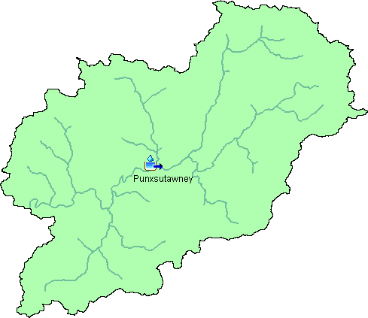
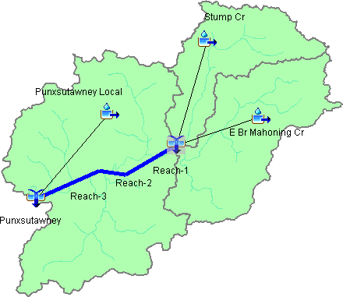

Spatially-Averaged or Distributed
Notes:
Here is an Illustration of how spatial averaging and distributed modeling is handled in HEC-HMS.
The first two watersheds are spatially-averaged model while the 3rd watershed is a distributed model.

Slide 17
Classification: Empirical or Conceptual
Conceptual model:
Built on knowledge of the physical processes that act on the input to produce the output
A control volume is established and equations for the conservation of mass and either momentum or energy are written for the control volume
Notes:
Conceptual models are developed based on an understanding of watershed hydrologic processes.
They typically use a control volume framework where water inputs, outputs, and storage changes are balanced using the principle of conservation of mass.
These models simplify complex processes by representing key storage components and flows through mathematical relationships, aiming to capture the essential behavior of infiltration, runoff generation, and baseflow without explicitly modeling all physical details.

Slide 18
Empirical or Conceptual
Empirical model:
Built upon observation of input and output, without necessarily seeking out the physical process
Sometimes called "black box" models because they convert input to output without any details of the actual physical process involved
Data is analyzed statistically and a mathematical relationship is sought between input and output
Can be very effective so long as they are applied under the same conditions for which they were originally developed
Example in HMS
Curve Number loss method
Notes:
Empirical models are based purely on observed relationships between inputs and outputs, without explicitly representing the underlying physical processes. Because they act like a "black box," they convert inputs into outputs without detailing how that transformation occurs. Typically, empirical models are developed by collecting field data that records inputs—such as rainfall or inflow—and the resulting outputs, like streamflow at a downstream point. Statistical analysis is then used to find mathematical relationships between these variables. Once established, these relationships can predict outputs for new input data.
While empirical models can be very effective and efficient, their accuracy depends on applying them within the same conditions under which they were developed. This would be a limitation to using empirical methods, while conceptual models can be applied more broadly. HEC-HMS includes both empirical and conceptual modeling options to address a range of hydrologic scenarios.

Slide 19
Classification: Deterministic or Stochastic
Deterministic:
Assumes that the input is exactly known
Assumes that the process described by the model is free from random variation
Stochastic:
Attempts to explicitly describe random variation
Includes the statistics of variation in both the input and processes
Notes:
Another classification is Deterministic vs Stochastic modeling: Deterministic models use fixed, best-estimate input values to produce a single simulation result. They assume that both the inputs and the hydrologic processes do not vary. While this simplifies modeling, it ignores the natural uncertainties present in real-world systems. For example, soil properties like porosity and hydraulic conductivity can vary within a small area and can be influenced based off compaction or vegetation. Despite these limitations, deterministic models are widely used because they are straightforward to implement and often provide useful approximations when the modeler has clearly stated his or her assumptions.
Stochastic models, on the other hand, explicitly account for uncertainty by representing inputs and processes as probability distributions rather than fixed values. Stochastic modeling generates a range of possible outcomes, giving a more comprehensive picture of potential hydrologic behavior under uncertainty. While it does provide a more robust result, it can be challenging to set up a stochastic model such as properly represent the probability distribution of parameters and it can take a long time to run the model.
In this course, you will gain experience with both deterministic and stochastic modeling approaches to understand their strengths and limitations.

Slide 20
Classification: Measured-Parameter or Fitted-Parameter
Measured-parameter:
Model parameters can be determined from system properties, either by direct measurement or by indirect methods that are based upon the measurements
Example: Green & Ampt loss parameters
Fitted-parameter:
Parameters cannot be physically measured
Parameters must be found by fitting the model with observed values of the input and the output
Example: Muskingum “X” parameter
Notes:
The last classification we will bring up is Measured-parameter vs Fitted Parameter.
Measured-parameter models use parameters that can be directly obtained from physical properties of the system. These parameters are determined either by direct or indirect methods based on measurements. This is going out into the field and measuring the parameter value that will be put into your model. For example, the Green and Ampt infiltration model includes parameters like hydraulic conductivity and wetting front suction, which can be measured in the field using soil instruments. Additionally, soil texture—often estimated by visual inspection—helps reliably estimate other infiltration parameters.
In contrast, fitted-parameter models rely on parameters that cannot be measured directly and must instead be calibrated by fitting the model to observed data. An example is the Muskingum routing model: while the parameter K can be approximated as the travel time through a river reach, the X parameter—which represents flow attenuation—is qualitative and must be estimated by comparing upstream inflow and downstream outflow hydrographs.
HEC-HMS includes both types of models, allowing flexibility depending on data availability and modeling goals.

Slide 21
Model Calibration

Slide 22
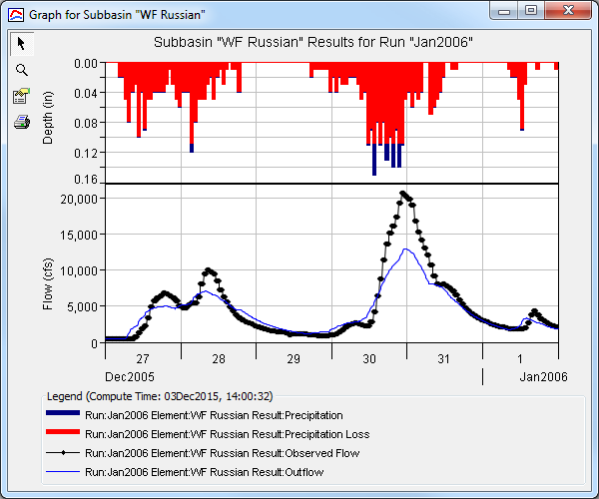
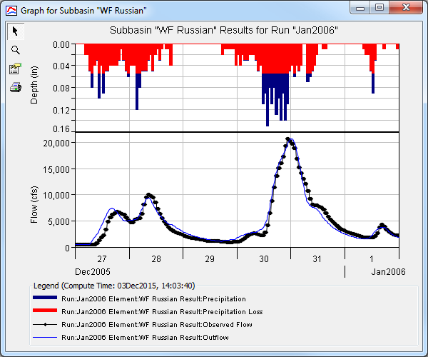
Calibration
“Calibration is the estimation and adjustment of model parameters and constants to improve the agreement between model output and a data set.” -Rykiel (1996)
Pre-calibration
Post-calibration
Notes:
This leads us to the concept of calibration. As defined by Rykiel, calibration is “the estimation and adjustment of model parameters and constants to improve the agreement between model output and a data set.” Since we are modeling complex hydrologic processes using simplified mathematical equations, it’s important to choose the right type of modeling—whether event-based or continuous, and whether using measured or fitted parameters. Because models rely on assumptions and simplifications, calibration helps adjust those assumptions to ensure that the model outputs realistically represent observed conditions.
If we use the example of flow, you are trying to match your simulated flow to your observed flow by adjusting your model parameters.

Slide 23
Calibration in the Modeling Process
Notes:
Here is a chart illustrating the calibration process and where it fits within hydrologic modeling. We will go through each step in detail. You start with collecting raw data—such as boundary conditions, discharge records, land use, and field observations—which will be incorporated into your model. Next, you select methods selection which you may have a number of different choices. Some hydrologic software’s make that choice for you. HMS allows you to choose from multiple different methods that is appropriate for your study area and data availability. Once you’ve selected your method, you will need to initialize model parameters based on your watershed and data information.
You can run then model and obtain initial modeling outputs and compare the simulated outputs against observed data. If the model performance is acceptable which is rarely the case for the first simulation, calibration is complete. If not, you adjust your model parameters; you can potentially also make adjustments to your raw data, boundary conditions, or even the selected methods if you discover limitations to the data or method. Calibration is therefore an iterative process that involves reviewing all these components to improve model accuracy.

Slide 24
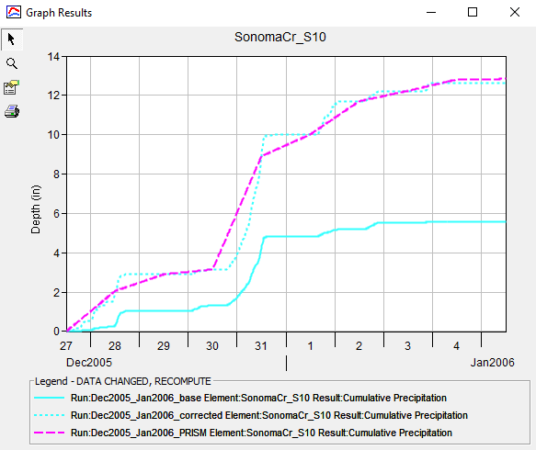
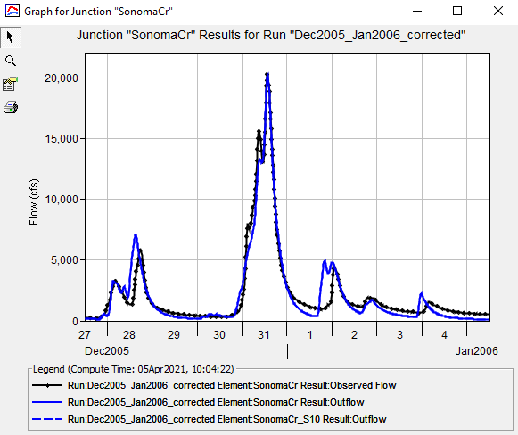
Calibration – Raw Data
Data sources should be the first consideration during calibration
Bad precipitation data is frequently the source of bad model performance
Question to ask yourself:
Is raw data the source of any discrepancies between simulation and observation?
Example: Adjusting parameters outside reasonable bounds to get matching results.
Consider:
Accuracy
Spatial and Temporal Extent
Spatial and Temporal Resolution
Notes:
The quality of raw data should be one of the first considerations during your model development and calibration process. Calibration can identify unreliable sources—such as gauges with consistently low precipitation readings—which may indicate instrument errors or regional anomalies. In such cases, replacing or supplementing data from nearby gauges might be considered.
A question to ask yourself while you are in the process of calibrating: Is raw data the source of any discrepancies between simulation and observation? A way to determine this is if you find yourself adjusting parameters outside reasonable bounds to get matching results. HMS has the ability to normalize gridded precipitation against another gridded dataset in case the precipitation volume is low or high.
Carefully consider both the spatial and temporal coverage of input data. Time-series data should align with the modeling period, and spatial datasets should correspond to the relevant timeframe and project scale. Data too far outside the study area could lead to misleading and inaccurate outputs.

Slide 25
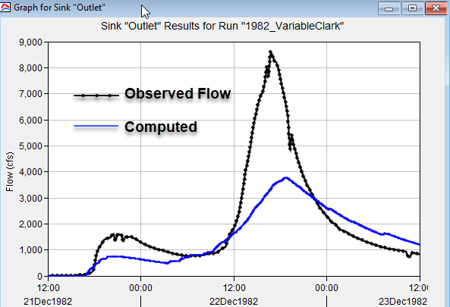
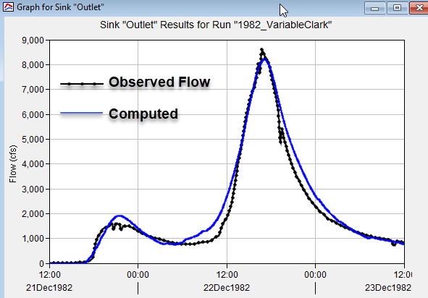
Calibration – Model Methods
While modeling methods are initially selected during model setup, calibration may reveal that alternate modeling methods perform better
Question to ask yourself:
Are the selected modeling methods properly modeling the system?
Example: Standard Clark vs Variable Clark Unit Hydrograph, Temperature Index vs RTI vs Energy Budget Snow
Consider:
Regional performance of modeling method
Physical basis of the modeling method
Notes:
Moving onto Modeling Methods, In HMS the modeler selects appropriate hydrologic methods for either the meteorological model or basin model. Examples of methods in the meteorological model are Gridded Precipitation or Specified Hyetograph and examples of methods in the basin model are Green & Ampt (loss), Clark UH (transform), linear reservoir baseflow (baseflow) and Muskingum (routing). While these choices are made early on, calibration may indicate that alternative methods yield better results.
It is important to consider that some methods perform better in specific regions or terrain types. Physically based methods, such as the Muskingum-Cunge method, generally rely more on measured data and fewer empirical coefficients allowing the method to be applied more broadly.
A question to ask yourself as you are selecting methods: Are the selected modeling methods properly modeling the system? For example, would you better capture the peak flow using the Standard Clark UH or switching over to the Variable Clark UH?

Slide 26
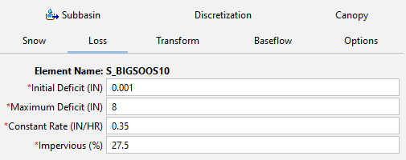
Calibration – Parameter Adjustment
Parameter adjustment is fine-tuning parameters to improve model output
Find parameter sets that do reasonably well across multiple events
Questions to ask yourself:
Which parameters can be adjusted?
How much can a parameter be adjusted?
Consider:
Physically reasonable range
Error bounds on parameter estimates
Sensitivity of parameters
Notes:
After selecting boundary conditions and modeling methods, you run the model and compare the simulated results against your observed data. In most cases, you will find that your simulated does not match your observe data well. The next step would be to review your parameters and fine-tuning them to improve output accuracy. Part of the process is identifying which parameters can be modified and most critical to your output and ensure that any adjustments remain physically realistic.
Key considerations during parameter adjustment include:
Physical Realism: Adjusted parameters should remain within plausible physical ranges to ensure the model remains scientifically credible and transferable.
Sensitivity: Focus on parameters to which the model outputs are most sensitive, as changes to these will have the greatest impact on improving performance.
Parameter Interactions: Be aware that parameters can interact, so changing one may affect others, requiring a balanced approach.
Objective Functions: Use quantitative metrics (e.g., Nash-Sutcliffe efficiency, RMSE) to objectively evaluate how well the model fits observed data during parameter tuning.
Effective parameter adjustment enhances model reliability and increases confidence in its predictive capabilities. It is often an iterative process requiring multiple runs and expert judgment to achieve a well-calibrated model.
When you have decided on sensitive parameters and appropriate ranges for that parameter, you can consider Optimization features in HMS to help with fine tuning your parameter values.

Slide 27
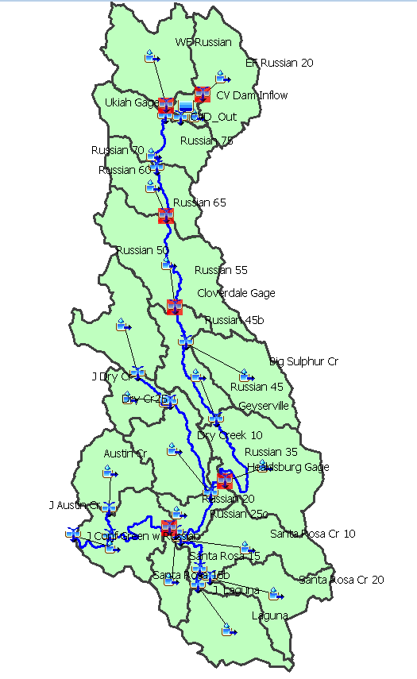
Calibration – Parameter Adjustment Guidelines
Work from upstream to downstream
Adjust one parameter at a time
Look for physical evidence to inform your parameter estimates and modifications
Perform a sensitivity analysis to determine the most impactful parameters
But beware of the tendency to adjust only parameters with higher individual impacts
Notes:
These are recommendations to follow when you are calibrating a hydrologic model:
Adjusting 1 parameter is a manual “replication” of the univariate search approach employed by the HMS optimization computations. If you adjust more than one at a time then it is difficult to determine the impact of each parameter separately.
When adjusting parameters to fit a frequency curve it is important that you don’t adjust parameters outside of their physically possible range.
Look for physical evidence to support or motivate parameter adjustments
Take care in adjusting loss rate parameters. Initially make changes to match volume. Losses during the first part of the event are indicative of antecedent conditions and can have a major impact on the computed peak.
Don’t just adjust parameters that have the greatest impact on the results. This could lead to unrealistic parameters
Manual calibration is useful since it helps you understand the impact of the parameters you are adjusting.

Slide 28
Event vs. Continuous - Calibration
Event calibration
Focus: peak, timing, volume for event, performance metrics
Continuous calibration
Focus: volume, runoff signatures such as flow-frequency, performance metrics
In both cases statistical metrics will be used to quantify performance
Notes:
Our next topic is on Event vs Continuous based Calibration. Other than knowing that event based and continuous based simulations are different in their time scale, the strategy for calibration is also different.
The focus of event calibration is to simulate the peak, timing, and volume of the event being modelled. The focus of continuous simulation calibration is to capture the behavior of the hydrologic system over time – this includes peak and volume but with less emphasis on single events. Runoff signatures are statistical hydrologic metrics used to described the behavior and response of your watershed area.
The modeler should evaluate performance metrics as a part of the continuous calibration process. We will describe the performance metrics HMS provides in a later slide.

Slide 29
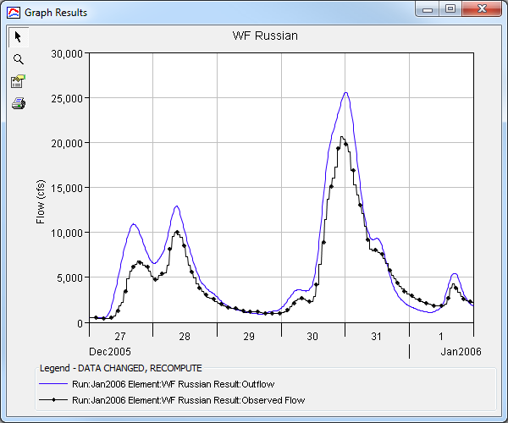
Calibration – Event Example
Notes:
Event-based calibration focuses on tuning model parameters using data from specific storm or runoff events. This approach targets short-term hydrologic responses, such as peak flows and runoff volumes, to ensure the model accurately represents watershed behavior during individual precipitation events.
Question for Students: What model parameters would you consider for this result?
There is clearly too much volume so we would focus on parameters that adjust for volume such as Initial loss, constant loss, baseflow fraction.

Slide 30
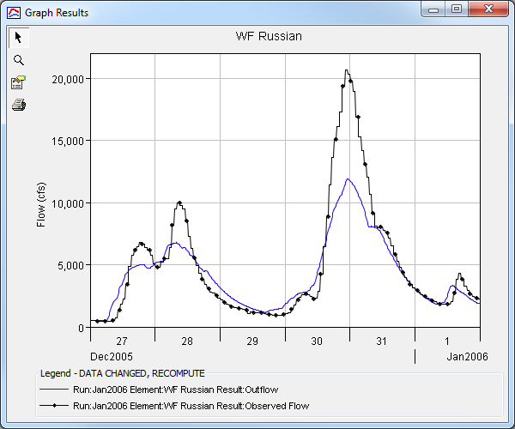
Calibration – Event Example
Notes:
Question to students: How would you adjust this output?
There is clearly too little volume especially in the second hydrograph. I would again focus on parameters that control volume.
Question to students: If you find that adjusting your parameters didn’t improve the output, what else could you consider adjusting?
The raw precipitation data might be off on volume, and you might consider adjusting the rainfall volume using the Normalizer tool in HMS.

Slide 31
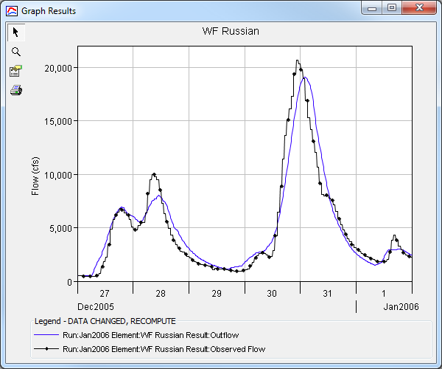
Calibration – Event Example
Notes:
Question to Students: What adjustments would you make to this output?
The timing is too late based on the observe peak value. I would focus on timing related parameters such as time of concentration (maybe storage coefficient to match the peak value).
Question to students: If you find yourself adjusting your timing parameters unreasonably, what other adjustments can you consider?
Maybe the raw data is in a different time zone that your simulation. Review your time zones to make sure its consistent. Maybe the temporal pattern is off and you need to switch to a different gage or gridded dataset.

Slide 32

Calibration – Event Example
Multiple Subbasin calibration
Group nearby or similar subbasins to contribute to a nearby flow gage
Adjust basin parameter by a factor to scale value higher or lower
Check simulated result against observe
Notes:
You often will have multiple subbasins within your study area, such as the example watershed you will work on in your workshop with the Russian River and you won’t have a gage at each subbasin outlet.
A simple technique to adjust your parameters are to group your subbasins that are nearby and have similar basin characteristics.
You then adjust the parameter based off a single factor which you can increase or decrease depending on your observed data.

Slide 33
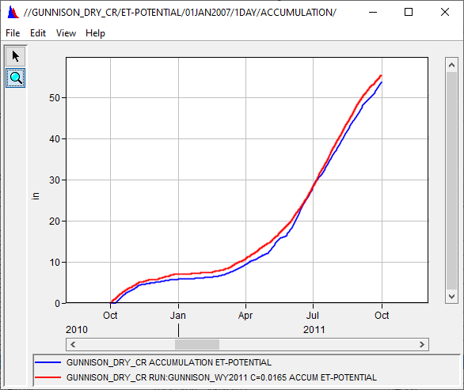
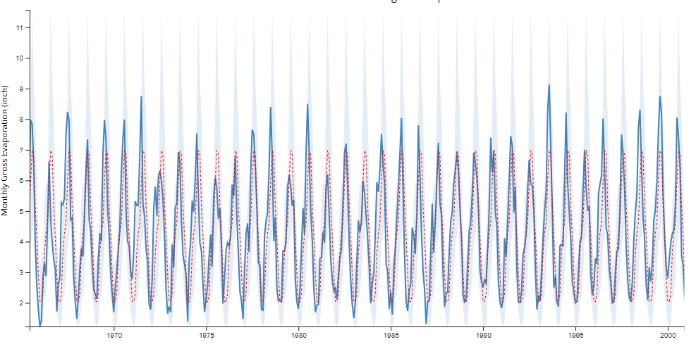
Calibration – Continuous Simulation Example
Evapotranspiration is important!
Point measurements
Pan estimates
Eddy covariance systems
Moderate Resolution Imaging Spectroradiometer (MODIS16) PET
Land Data Assimilation System (LDAS)
https://www.waterdatafortexas.org/lake-evaporation-rainfall
Notes:
Continuous simulation model. Our next presentation will go into ore detail on setting up a continuous simulation model. Continuous simulation calibration in hydrology modeling involves adjusting model parameters over a longer period than event modeling. There are additional processes and method considerations to replicate the flow than if you were to do an event-based simulation. The additional processes and their parameters are ET parameters, snowmelt parameters (if needed), and basin parameters. When calibrating continuous simulation models, there is a process order that should be consider. By calibrating out of order, you might find yourself in an iterative loop between ET, snow, and flow.
The first process to look at is ET. Evapotranspiration determines how much of the water evaporate or transpires due to heat and wind energy. You will have a presentation on evapotranspiration today this process in more detail. The amount of water volume that gets lost to ET can by large. Since ET is a meteorologic variable, we can calibrate the ET estimate independent of flow using the crop coefficient or the method specific ET parameter.
Even if you don’t calibrate your ET it would still be good to validate your ET estimates against another data source. Let's say you choose to use Monthly ET. These estimates are usually based on pan evaporation with some coefficient. You can still compare the monthly estimate to a computed estimate to see that your values are consistent.

Slide 34
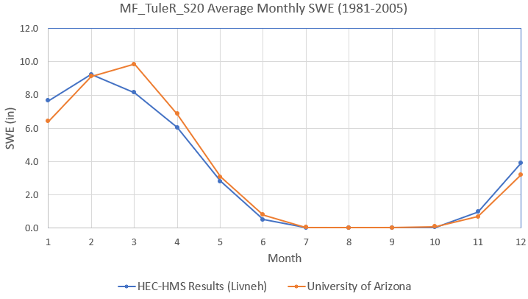

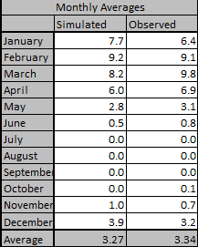
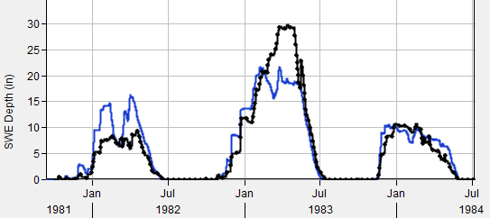
Calibration – Continuous Simulation Example
Notes:
Once you have ET calibrated, you move onto snow if it exists within your basin.
In snowmelt basins , your flow is highly dependent on your snow properties and you will not get reasonable flow outputs without considering how snow accumulates and melts.
The simulated SWE can be compared against an observed time series of SWE or another simulated time series of SWE, such as Snodas or UofA.
When looking at decade of simulations, you can perform a cyclic analysis and estimate monthly averages.
You can use this to check if your model is performing well on your volumes.

Slide 35
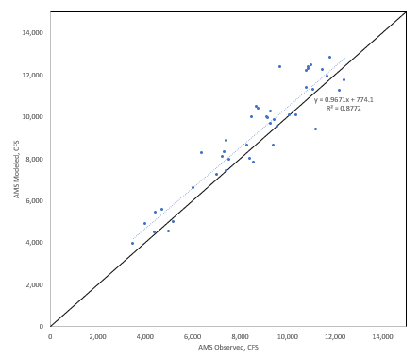
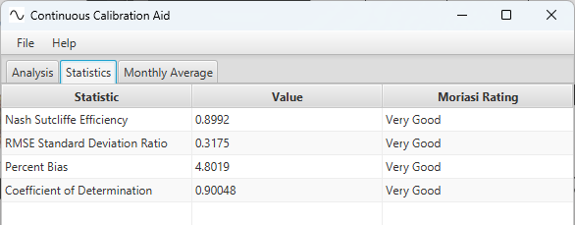
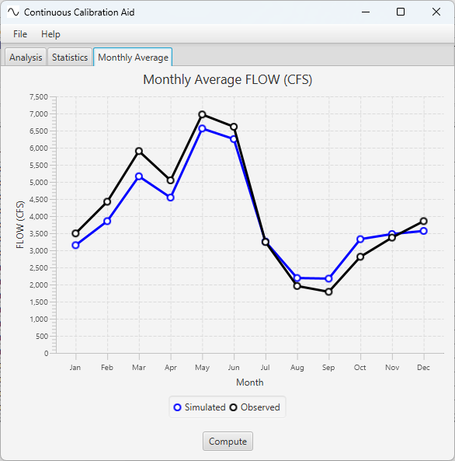
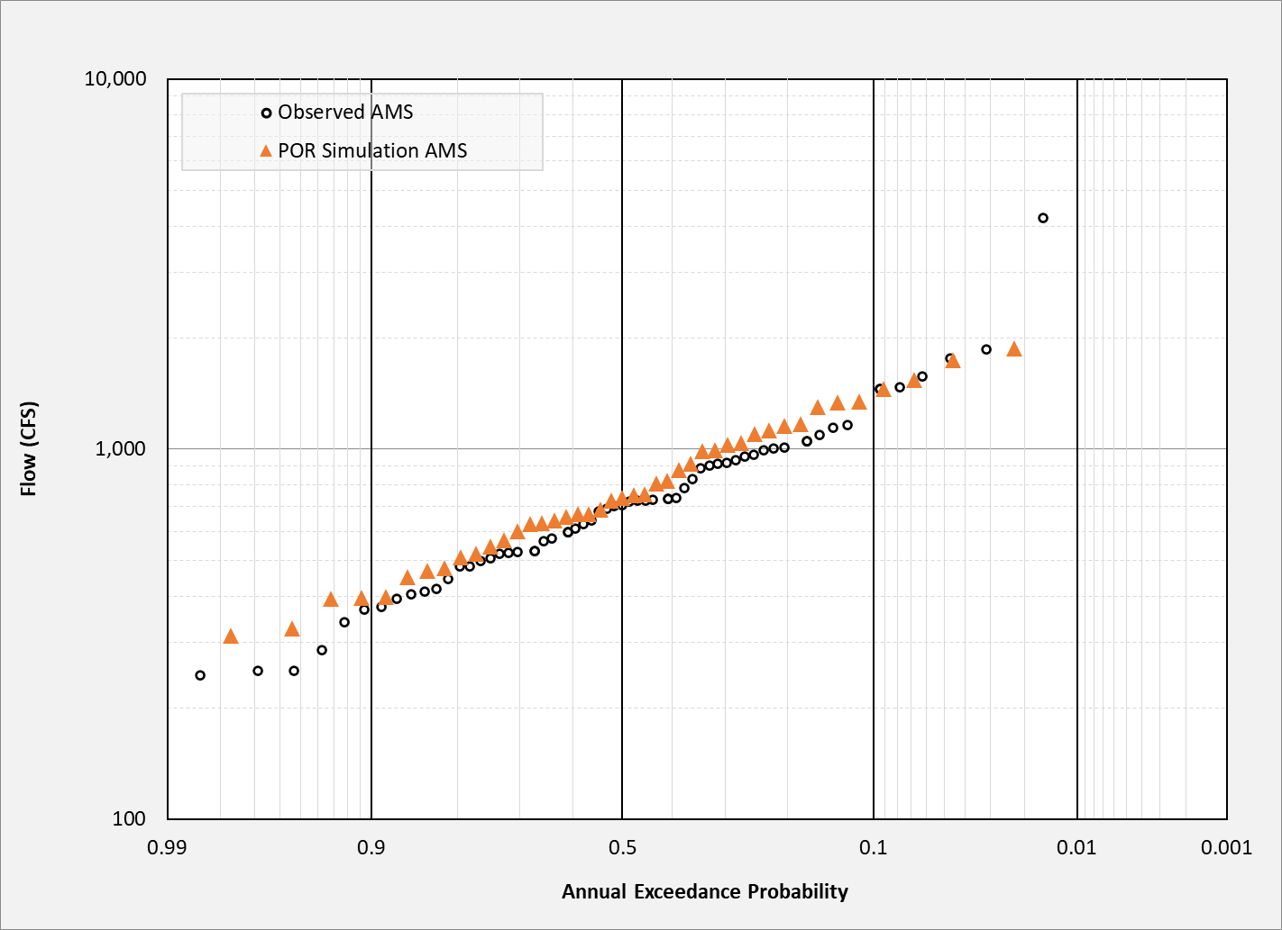
Calibration – Continuous Simulation Example
Notes:
After calibrating your evapotranspiration (ET) and snow parameters, proceed to calibrate the flow components by adjusting parameters related to losses, transformation processes, and baseflow.
Similar to snow calibration, this involves comparing simulated flows to observed time series data; however, when dealing with a long simulation period—such as 60 years—it may not be practical or necessary to calibrate every single year individually.
Instead, it is recommended to select one representative year for calibration, ideally one that reflects average watershed behavior rather than an extreme low- or high-flow event, to avoid biasing your parameter estimates.
Once calibrated for this selected year, you can then extend the simulation to cover the entire period.
Because long-term datasets contain vast amounts of data, fine-tuning parameters by inspecting each year individually is inefficient; instead, you can use "runoff signatures," which are statistical or hydrological metrics that characterize watershed flow behavior over time.
Examples of runoff signatures include monthly average flows, flow duration curves, or baseflow indices.
Comparing these signatures between observed and simulated data provides a practical way to evaluate and refine model performance across the entire period without focusing on every individual event.

Slide 36
Performance Metrics

Slide 37
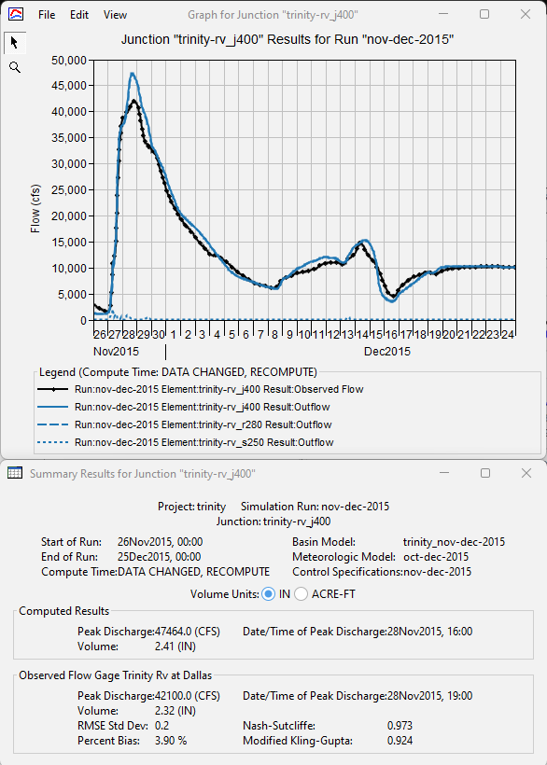
Evaluating Model Output
In general, the modeler should try to reproduce observed peaks, timing, and volume
Statistics used for model evaluation:
Coefficient of Determination (R²)
Nash-Sutcliffe Efficiency (NSE)
Root Mean Square Error (RSR)
Percent Bias (PBIAS)
Modified Kling-Gupta (MKGE)
Notes:
In general, the goal of calibration is for the model to accurately reproduce observed peak flows, timing, and volumes. Calibration aims to minimize the differences between simulated and observed values. While visual comparisons of simulation results are useful as an initial step, statistical methods provide objective measures to quantify how well the model matches observed data. These statistics not only help evaluate flow volumes but also condense overall model performance into a single value for easier comparison.
There are many statistical metrics available, some of which may be particularly relevant depending on your watershed characteristics; however, the basic statistics provided in HMS are a solid starting point. Although visual inspection is often the first step in calibration, effective calibration requires thorough quantification using these statistical analyses to ensure robust and reliable model performance.

Slide 38

Statistics - Coefficient of Determination (R²)
Measures the strength and direction of a linear relationship between simulated and observed values
Indicates the proportion of the variance in observed data that can be explained by the model
R² = 0, model cannot explain any of the variability in the measured data
R² = 1, model accounts for all of the variability in the measured data
0 < R² < 1, extent to which model reproduces observations
$$R^{2}={\left[\frac{Σ_{i=1}^{n}(Y_{i}^{obs}−{\overline{Y}}^{obs})(Y_{i}^{sim}−{\overline{Y}}^{sim})}{\sqrt{{Σ_{i=1}^{n}(Y_{i}^{obs}−{\overline{Y}}^{obs})}^{2}}\sqrt{{Σ_{i=1}^{n}(Y_{i}^{sim}−{\overline{Y}}^{sim})}^{2}}}\right]}^{2}$$
Notes:
The Coefficient of Determination (R²) measures the strength of the relationship between simulated and observed data by indicating the proportion of variance in the observed data explained by the model. While R² is useful for assessing overall fit, it can be overly sensitive to outliers and does not effectively capture differences in absolute or relative values between model predictions and observed measurements, limiting its ability to fully reflect prediction accuracy.
$Y_{i}^{obs}$ is the ith observation for the constituent being evaluated, $Y_{i}^{sim}$ is the ith simulated value for the constituent being evaluated, ${\overline{Y}}^{obs}$ is the mean of observed data for the constituent being evaluated, ${\overline{Y}}^{sim}$ is the mean of simulated data for the constituent being evaluated, and n is the total number of observations. It is the square of the Pearson correlation coefficient between the simulated and observed data.

Slide 39
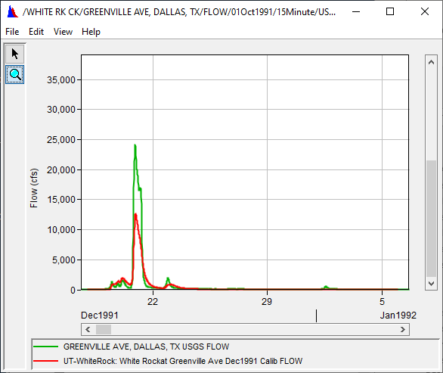
Statistics - Coefficient of Determination (R²)
Advantages
Widely used in hydrological modeling
Disadvantage
Overly sensitive to extreme values
Insensitive to additive and proportional differences
Notes:
R² is one of the most common statistical metrics because it provides a straightforward measure of how well the model explains the variability in observed data. Its familiarity makes it easy to communicate model performance to a broad audience, including stakeholders and decision-makers. As a value between 0 and 1, where values closer to 1 indicate better fit, R² offers an intuitive understanding of model explanatory power.
R² can be disproportionately influenced by a few extreme data points or outliers, which may artificially inflate or deflate the perceived model performance. This sensitivity can mislead modelers into overestimating accuracy when rare events dominate the metric. R² primarily measures correlation and variance explained but does not directly reflect differences in magnitude between simulated and observed values. This means that systematic biases, such as consistent over- or under-prediction (additive errors), or scaling errors (proportional differences), may not significantly affect R² even though they are important for assessing model accuracy.

Slide 40

Statistics - Nash-Sutcliffe Efficiency (NSE)
Indicates a correlation of computed values and agreement of the means
NSE=1, perfect model match computed to observed
NSE=0, computed values as precise as mean of observed data
NSE<0, mean of observations better predictor than the model
$$NSE=1−\left[\frac{{Σ_{i=1}^{n}(Y_{i}^{obs}−Y_{i}^{sim})}^{2}}{{Σ_{i=1}^{n}(Y_{i}^{obs}−{\overline{Y}}^{obs})}^{2}}\right]$$
Notes:
The Nash-Sutcliffe Efficiency (NSE) evaluates how well the simulated data predicts observed values by comparing the residual variance (the differences between observed and simulated values) to the variance of the observed data.
NSE values range from –∞ to 1.0, where a value of 1 indicates a perfect match between simulation and observation.
An NSE of 0 means the model performs no better than simply using the mean of the observed data as a predictor, and values less than or equal to zero indicate that the model predictions are worse than this simple benchmark, signaling poor performance.

Slide 41
Statistics - Nash-Sutcliffe Efficiency (NSE)
Advantages:
Good for use with continuous simulation and how well the model simulates trends
Robust, can be used for various output responses: flow, sediment, nutrients
Commonly used
Disadvantage:
Cannot identify model bias
Cannot identify differences in timing, magnitude, and shape of recession
Sensitive to extremes
Notes:
NSE reflects both the variance and bias in model predictions, providing a comprehensive measure of how closely simulations match observations across the entire dataset. NSE is widely used in hydrological modeling and is often considered a key benchmark metric for model evaluation due to its meaningful scale and interpretability.
Like R², NSE can be heavily influenced by outliers or extreme flow events, which may dominate the metric and obscure poor performance during low-flow or average conditions. NSE tends to be dominated by high flow periods because squared residuals weigh larger errors more heavily, making it less sensitive to model accuracy during low flow conditions that may be critical in certain applications.

Slide 42

Statistics - Root Mean Square Error (RSR)
Standardizes the root mean square error (RMSE) using the observation standard deviation
The optimal value of RSR is 0.0 which presents zero RMSE for perfect model simulation
Lower RSR values represent better model performance
$$RSR=\frac{RSME}{{STDEV}_{obs}}=\frac{\left[\sqrt{{Σ_{i=1}^{n}(Y_{i}^{obs}−Y_{i}^{sim})}^{2}}\right]}{\left[\sqrt{{Σ_{i=1}^{n}(Y_{i}^{obs}−{\overline{Y}}_{i}^{sim})}^{2}}\right]}$$
Notes:
Root Mean Square Error –Observed Standard Deviation Ratio (RSR).
The root mean square error (RMSE) is valuable because it indicates the error in the units of the constituent of interest, where the lower the RMSE the better the model performance.
The RMSE –Observed Standard Deviation Ratio (RSR) normalizes the root mean square error by using the standard deviation of the observations, incorporating the benefits of error index statistics so that the resulting statistic can be applied to various constituents.

Slide 43
Statistics - Root Mean Square Error (RSR)
Advantage
Incorporates error index statistics and includes scaling/normalization factor
Disadvantage
Gives more weight to large values due to squaring the difference between observed and simulated
Notes:
RMSE provides error magnitude in original units, offering intuitive insight into the size of prediction errors relative to the measured variable. By normalizing RMSE with the observed standard deviation, RSR creates a standardized performance metric that enables comparisons across different watersheds or variables with varying scales and units.
Like other squared-error metrics, RMSE and consequently RSR are sensitive to outliers and extreme events, which can disproportionately affect overall performance assessment. RSR summarizes total error but does not separate systematic bias (consistent over- or underestimation) from random errors, limiting detailed diagnostic insight into model behavior.

Slide 44

Statistics - Percent Bias (PBIAS)
Measures the average tendency of simulated values to be larger or smaller than observed values
The optimal value of PBIAS is 0.0
Positive values imply model underestimation bias
Negative values imply model overestimation bias
Some have separated PBIAS into Volume (V) and Peak (P)
$$PBIAS=\left[\frac{Σ_{i=1}^{n}(Y_{i}^{obs}−Y_{i}^{sim})×100}{Σ_{i=1}^{n}(Y_{i}^{obs})}\right]$$
Notes:
Percent Bias (PBIAS). Percent bias (PBIAS) measures the average tendency of the simulated data to be larger or smaller than the observed data. The optimal value for PBIAS is 0.0, with low absolute percent bias indicating accurate model simulation. Positive values mean the model underestimation bias when compared to the observed, whereas negative values indicate the model overestimation bias.
The negative positive sign can be confusing (positive is underestimation, negative is overestimation) but this is because Observation is first in the equation. If you switch it to simulated, then the signs get switched.

Slide 45
Statistics - Percent Bias (PBIAS)
Advantages
Useful for continuous simulations
Robust and commonly used
Identify average model bias of overprediction or underprediction
Disadvantages
Cannot be used to infer differences in timing, peak magnitude, and/or shape
Notes:
PBIAS directly shows whether a model tends to consistently over- or under-predict, providing straightforward insight into systematic errors. By identifying direction and magnitude of bias, PBIAS helps guide parameter adjustments during calibration to reduce persistent over- or underestimation.
PBIAS measures only systematic bias and does not reflect how well simulated values track observed variability or timing.

Slide 46


Modified Kling-Gupta Efficiency (MKGE)
Multi-objective alternative to mean squared error and Nash-Sutcliffe Efficiency (NSE)
Can be decomposed into three terms: (1) correlation r, (2) bias ratio β, and (3) variability ratio γ
The value of MKGE gives the lower limit of the three components (r, β, γ)
$$MKGE=1−\sqrt{{\left(r−1\right)}^{2}+{\left(β−1\right)}^{2}+{\left(γ−1\right)}^{2}}$$
$$β=\frac{{\overline{Y}}_{sim}}{{\overline{Y}}_{obs}}$$
$$γ=\frac{CV_{s}}{CV_{o}}$$
Notes:
The Modified Kling-Gupta Efficiency (MKGE) (Kling et al., 2012) was added as an Objective Function in the Optimization Trial and as a calibration statistic.
The Kling-Gupta Efficiency was first proposed by Gupta et al. (2009) as a multi-objective alternative to mean squared error and Nash-Sutcliffe Efficiency (NSE).
MKGE can be decomposed into three terms: (1) correlation coefficient r, (2) bias ratio β, and (3) variability ratio γ. The value of MKGE gives the lower limit of the three components (r, β, γ).
r = correlation coefficient between simulated and observed runoff (dimensionless)
β = bias ratio (dimensionless)
γ = variability ratio (dimensionless)
CV = coefficient of variation (dimensionless)

Slide 47
Modified Kling-Gupta Efficiency (MKGE)
Advantages
Three-in-one statistical metric
Disadvantages
Cannot be directly compared to NSE
Not as widely used as other statistical metrics
Notes:
Performance ranges for MKGE are not provided in HEC-HMS.
MKGE values greater than -0.41 indicate that the model's performance is better than the mean flow (similar to when NSE > 0)
NSE and MKGE values cannot be directly compared because the relationship depends in part on the coefficient of variation of the observed time series (Knoben et al., 2019).
Modelers should analyze the MKGE components (correlation coefficient, bias ratio, and variability ratio) to better understand the model error.

Slide 48
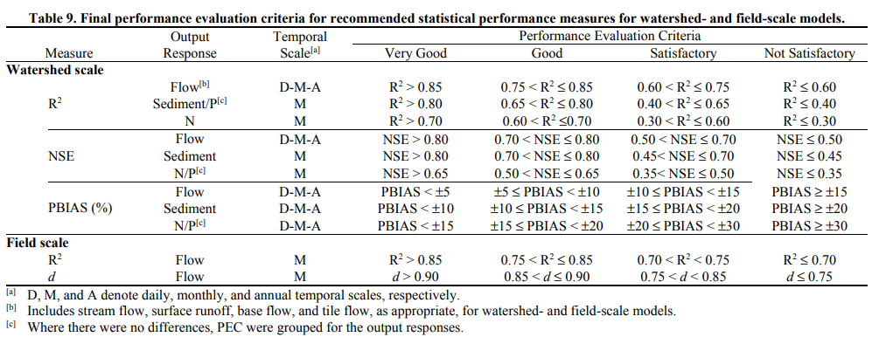
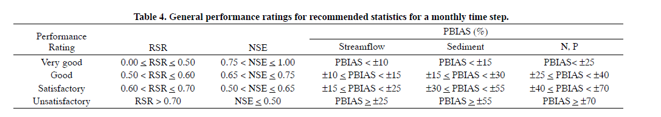
Statistics – Performance Ratings
Moriasi et al., 2015
Moriasi et al., 2007
Notes:
After calculating the relevant performance metrics, the model’s accuracy and reliability should be evaluated by assigning performance ratings for each metric.
Moriasi et al. (2007, 2015) provided guidelines based off his extensive literature review of calibrated models which is shown here.
These guidelines provide standardized thresholds that categorize model performance into qualitative ratings such as “satisfactory,” “good,” or “very good,”.
Note that these are derived for continuous flow data at daily and monthly time step at watershed scale. The acceptable values of the summary statistics will vary for your project, depending on the time step, uncertainty in observed data and boundary conditions and project scope.

Slide 49
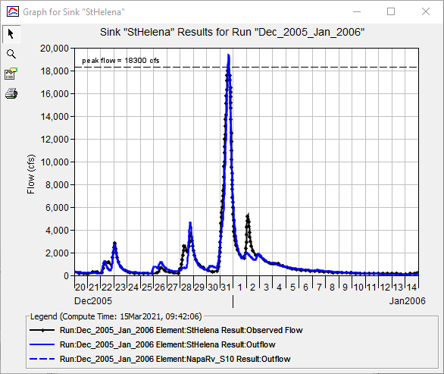
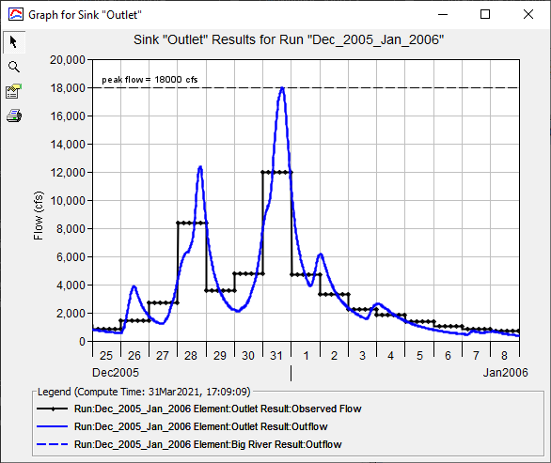
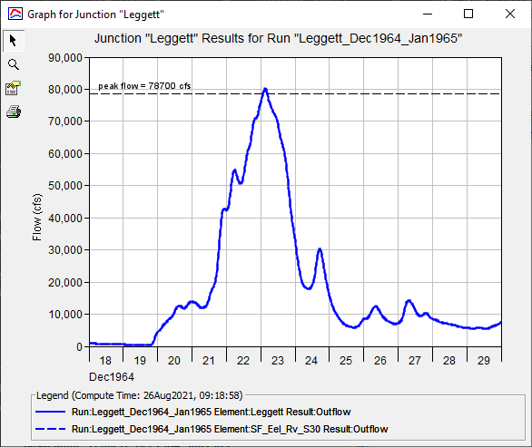
Statistics – Performance Ratings
Performance evaluation criteria can be adjusted based on:
Data availability
Quality and quantity of the data
Spatial and temporal scale of the data
Project scope and magnitude
Notes:
It is highly recommended that these performance ratings, along with the underlying metric values, be clearly documented and discussed in the study report. Presenting this information not only enhances transparency but also allows stakeholders to understand the strengths and limitations of the calibrated model, supports reproducibility, and provides context for decision-making based on model outputs.
Teams can decide for themselves what falls under very good or good. Model performance should be adjusted based on factors such as data availability, quality, and quantity. Limited or lower-quality data may require more flexible thresholds, while high-quality datasets support stricter standards. The spatial and temporal scale of the study also influences expectations, with larger scales often allowing for greater uncertainty. Additionally, the project’s scope and purpose dictate how rigorously performance metrics are applied—critical applications demand tighter accuracy, whereas preliminary studies may tolerate broader error margins. Morisai does recommend using his values for Satisfactory.

Slide 50
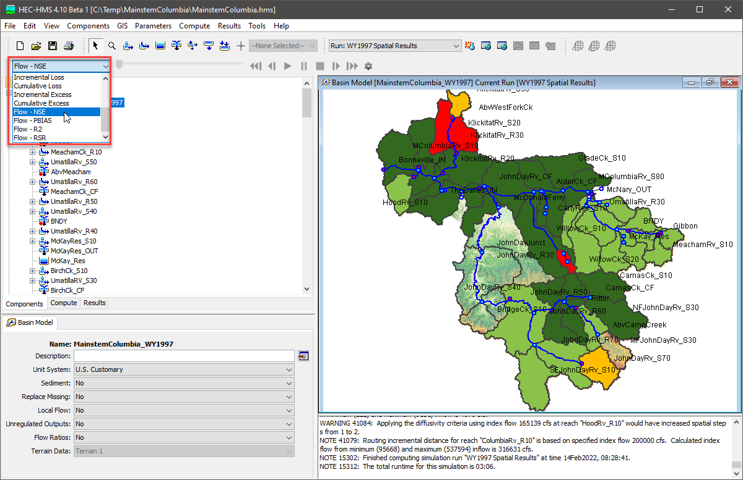
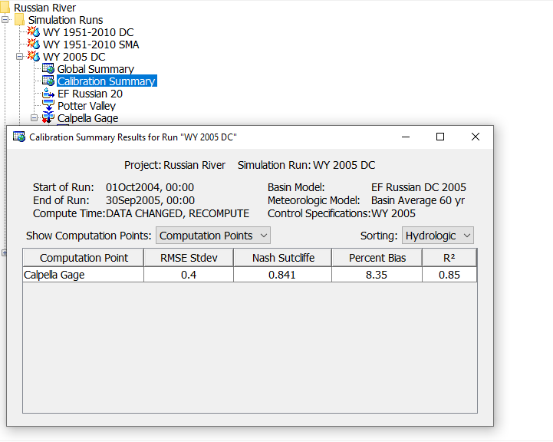
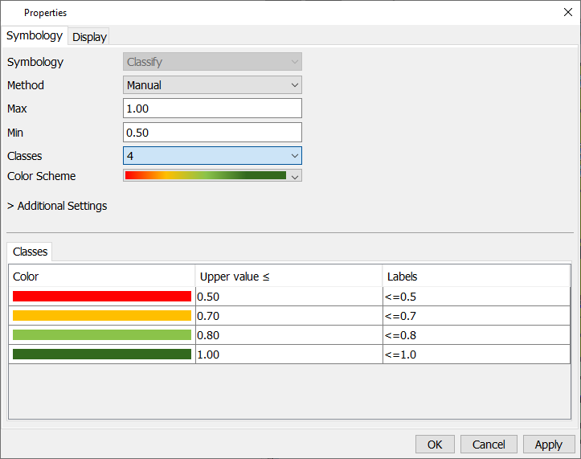
Statistics – Performance Ratings
Notes:
Some tools in HMS to support your calibration efforts.
You can now visualize metrics from the spatial results toolbar which can be done for SWE and flow.
You have the option to make changes to your performance metrics in the Properties menu.
The Results tab also has a Calibration Summary icon which shows your Performance Metrics at Computation Point locations.

Slide 51
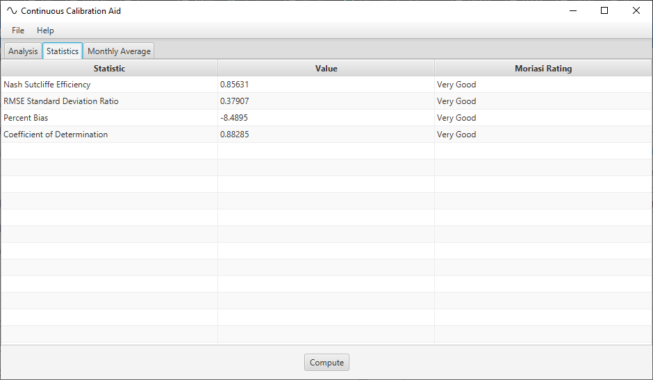
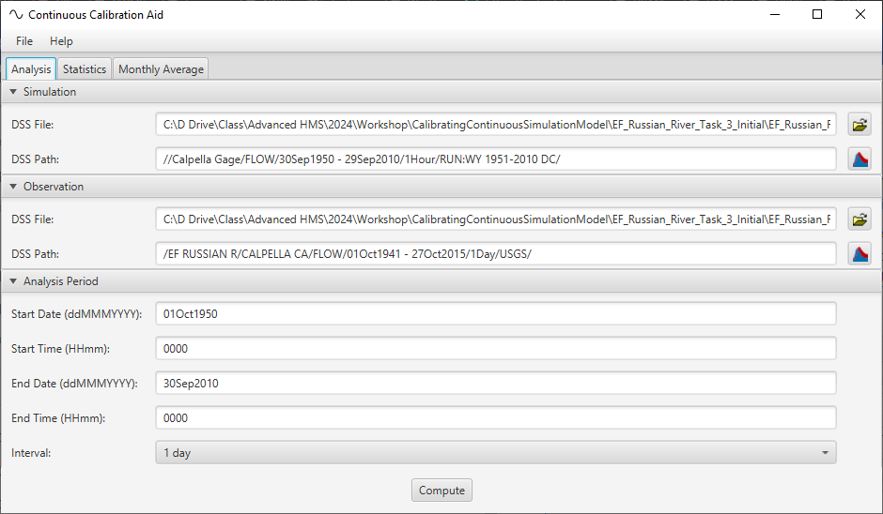
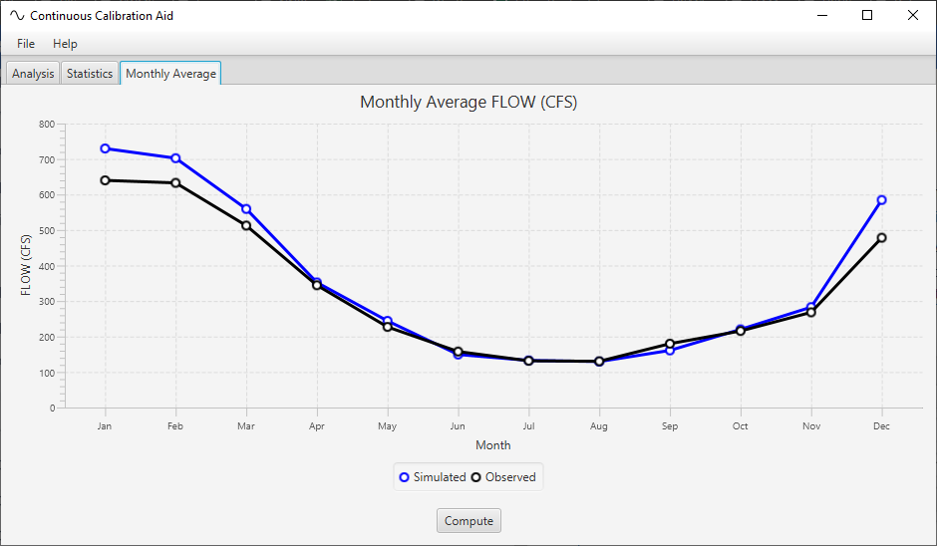
Calibration App
Notes:
There is also the Calibration App which you will be using for the Continuous Simulation workshop.
This tool is very useful for continuous simulation modeling.
This is a separate tool that you need to download but will help you compare your simulated time series and observe time series at different time intervals.
The tool will automatically convert your time series to your selected time interval and generate statistics based on consistent time increment.
There is also a cyclic plot that produces monthly averages if you are comparing a continuous simulation model.

Slide 52
Reporting Model Performance
Event modeling
Graphical comparison between simulated and observe time series
Peak magnitude and timing
Performance metrics
Continuous Modeling
Runoff signatures
Monthly volumes
% AEP
Graphs
Scatter plots (R^2 linear regression line)
Cumulative distributions
Flow duration curves
Performance metrics
Notes:
Event Modeling For event-based simulations, start by providing graphical comparisons of simulated versus observed time series to visually assess how well the model captures flow patterns. Key aspects to highlight include peak magnitude and timing, which are critical for understanding the model’s accuracy in representing storm events. Complement these visuals with quantitative performance metrics and corresponding performance ratings based on accepted standards to objectively evaluate model skill.
Continuous Modeling For continuous simulations, use runoff signatures to summarize model performance. Present monthly volume comparisons and relevant exceedance probabilities (e.g., % AEP) to capture seasonal and event frequency aspects. When looking at R^2, show a scatter plots of the outputs with 1:1 line and the linear regression lines to examine correlation. Include cumulative distribution plots and flow duration curves. As with event modeling, include performance metrics and performance ratings to quantify model accuracy.

Slide 53
Model Validation

Slide 54
Validation - Defined
“(Validation is) when a model that has been calibrated for one data set is evaluated against a different data set of the same variables, at the same site as used in the calibration (the classical ‘split-record test’).” –Bevan and Young (2003)
Calibration Events | Validation Events
Jan 2004 | Jan 1997
August 2017 | December 2010
December 2020
November 2024
Notes:
Validation is a critical step in hydrologic modeling used to assess a model’s predictive capability beyond the data it was calibrated on. As defined by Bevan and Young (2003), validation occurs “when a model that has been calibrated for one data set is evaluated against a different data set of the same variables, at the same site as used in the calibration”.
This process ensures that the model reliably simulates hydrologic behavior under independent conditions, providing confidence in its application for forecasting and decision-making. Effective validation helps identify model robustness and limitations, reinforcing the credibility of model results.

Slide 55
Validation in the Modeling Process
Notes:
Validation is performed after the model has been calibrated. If the validation is not accepted, go back to the calibration process to see if parameters, method selection, or raw data needs to be adjusted.

Slide 56
Validation
Validation events or period should be similar to that which was used for model calibration
Boundary conditions will change
Model parameters will remain unchanged from calibrated model
Initial conditions are event specific!
Define your performance criteria up front
If validation fails, go back to calibration and reconsider processes and parameterization
EM-1110-2-1417 suggests using at least two validation events
Notes:
Validation events should be of similar duration and exhibit hydrologic behavior comparable to the calibration period, such as matching wet or dry cycles, to ensure meaningful evaluation.
While boundary conditions during validation will naturally change, model parameters should remain fixed as determined during calibration—except for initial conditions, which are specific to each validation event.
It is important to define performance criteria upfront to objectively assess validation success.
If the model fails to meet these criteria, revisit the calibration step to reassess model processes and parameterization.
According to EM-1110-2-1417, using at least two distinct validation events was noted.

Slide 57
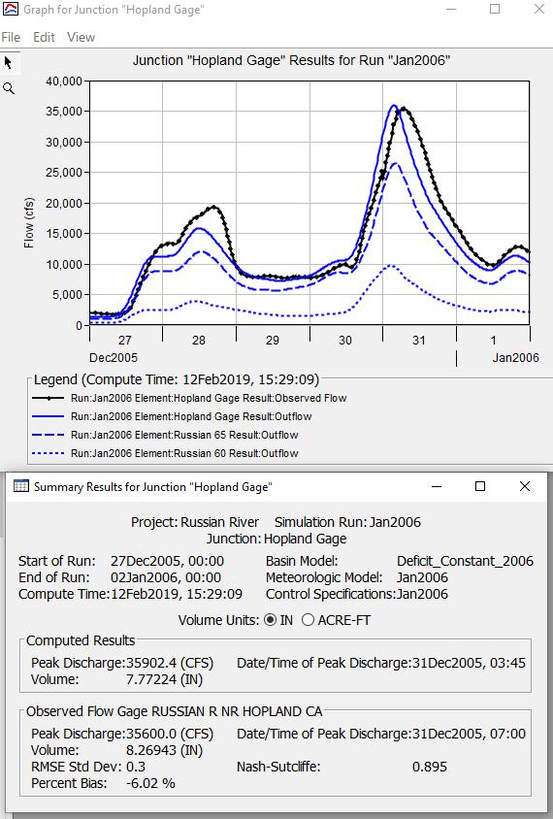
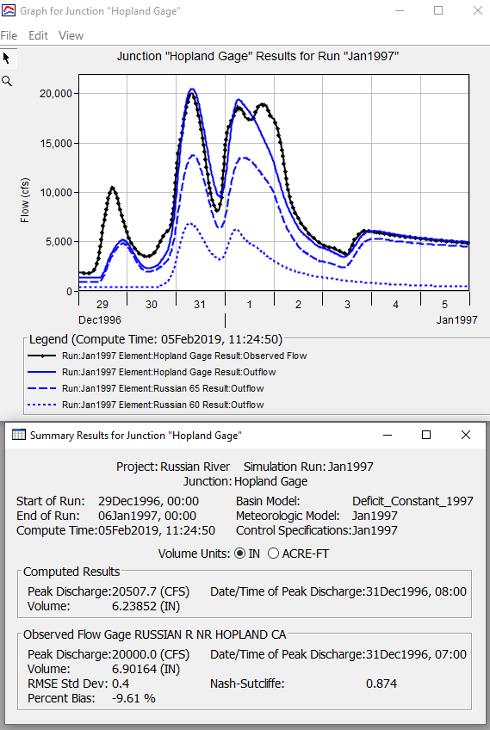
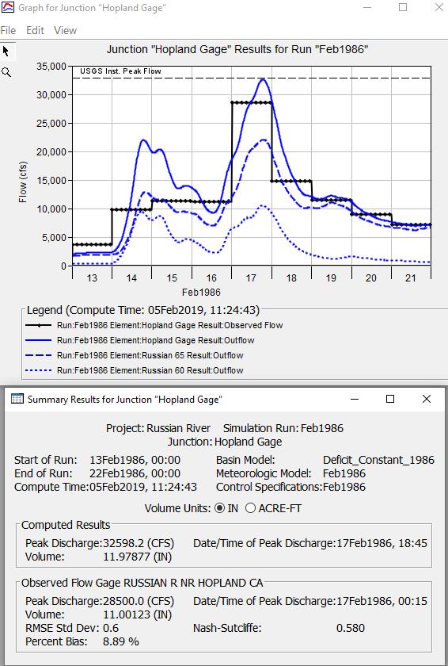
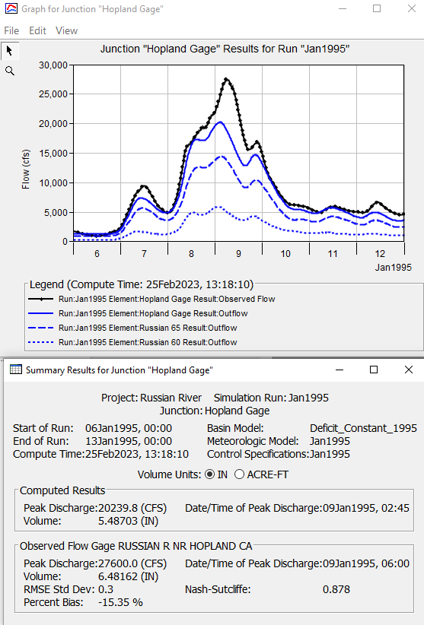
Calibration Events
Validation Event
Notes:
In your workshops, you will calibrate your model to 3 storm events. Then come up with a best estimate parameter set that you will use for your validation event.

Slide 58
Summary
Discussed modeling theory
Introduced the concept of model classification
Provided an overview of calibration in the modeling process
Compared event vs continuous simulation
Demonstrated how to quantify model performance using multiple statistical metrics
Provided recommendations for reporting calibration results
Discussed model validation

Slide 59
References
Moriasi, D. N., Gitau, M. W., Pai, N., & Daggupati, P. (2015). Hydrologic and Water Quality Models: Performance Measures and Evaluation Criteria. Transactions of the American Society of Agricultural and Biological Engineers, 58(6), 1763-1785.
Beven, K., and P. Young (2013), A guide to good practice in modeling semantics for authors and referees, Water Resour. Res., 49, 5092–5098, doi:10.1002/wrcr.20393.
Moriasi, D. N., J.G. Arnold, M.W. Van Liew, R.L. Bingner, R.D. Harmel, and T.L. Veith, Model evaluation guidelines for systematic quantification of accuracy in watershed simulations, Transactions of the ASABE 50 (3), 885-900, 2007
Rykiel, E.J., Jr. 1996. Testing ecological models: the meaning of validation. Ecological Modeling, 90:229-244.
Kling, H., Fuchs, M., and Paulin, M. (2012). "Runoff conditions in the upper Danube basin under an ensemble of climate change scenarios." Journal of Hydrology. 424–425, 264–277.

