Slide 1
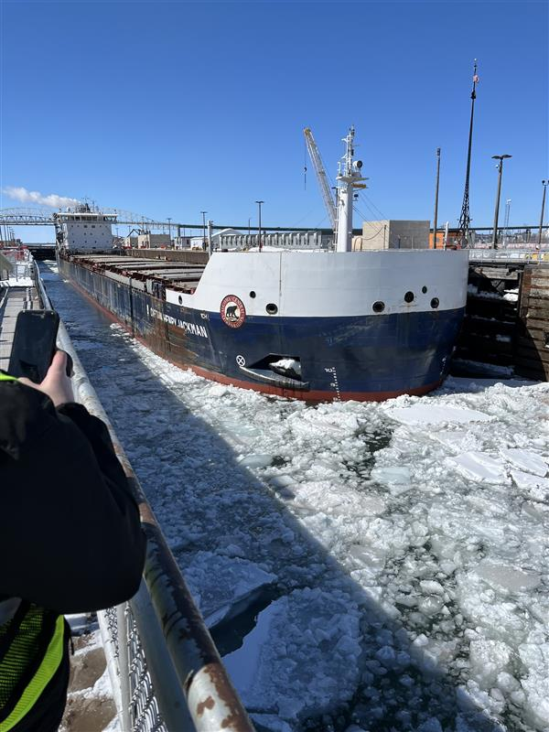
Snowmelt Modeling Methodologies
Advanced Applications of HEC-HMS
June 2025
Presented by: Mike Bartles, P.E.

Slide 2
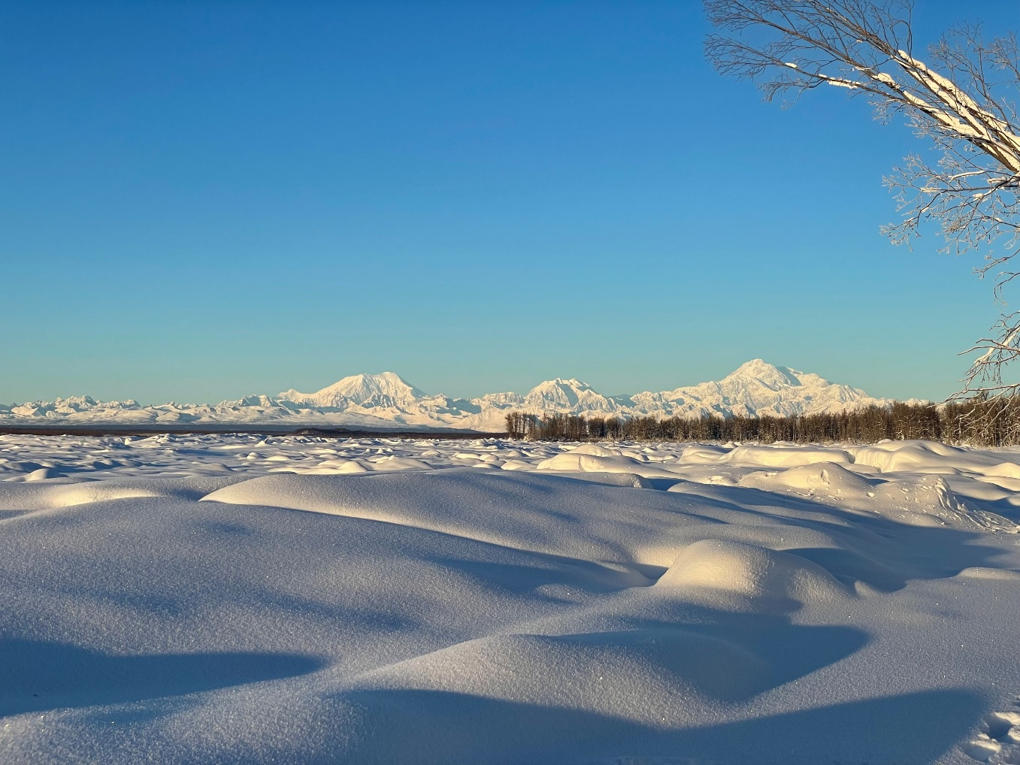
Overview
Review energy transfer in, out, and within a snowpack
Describe the available snowmelt modeling approaches within HEC-HMS
  Energy Budget
  Hybrid
  Temperature Index
Discuss snowmelt parameter sensitivity and calibration techniques
2
Notes:
Guess what spillway this is

Slide 3
Snowpack Energy Inputs/Output
In order to melt snow, energy is required.
This energy comes from radiation, wind, air temperature, rain, etc.
Typically snow melts in three phases:
  Warming: Frozen snow absorbs energy which causes the snowpack temperature to rise to 32 degrees F.
  Ripening: Snow absorbs energy which causes melt to occur where water fills the pores in the snowpack.
  Melt/Runoff: More energy absorbed into snow causes melt water to leave the snowpack.
All three phases must be represented in order to accurately estimate snowmelt and runoff.
3

Slide 4
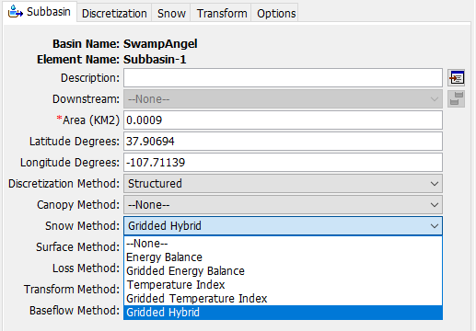
Available Snow Modeling Methods
Multiple modeling approaches are available to represent energy transfer:
  Temperature Index
    Use air temperature as a surrogate for the total heat transfer
    Banded and gridded implementations
  Radiation-derived TI (RTI)/Hybrid
    Account for some modes of heat transfer but not all
    Gridded implementation (no banded)
  Energy Budget
    Explicitly account for each mode of heat transfer
    Banded and gridded implementations
4
Notes:
In version 4.10, snow methods were migrated from the Meteorologic Model to the Basin Model.

Slide 5
Temperature Index Method
5

Slide 6
Temperature Index Method
Derived from the TI model within SSARR (USACE, 1987)
  Streamflow Synthesis and Reservoir Regulation (SSARR) was based upon TI method in Snow Hydrology (USACE, 1956)
Great flexibility in describing the melt rate
  Deep cold snowpack melting for months -> melt rate changes to account for snow metamorphism and seasonal change in meteorology
  Shallow, seasonal snowpack that melts in a few days -> constant melt rate
Though simple, it has been widely used with good results throughout the world
6
Notes:
USACE. (1987) SSARR Model, Streamflow Synthesis and Reservoir Regulation. User Manual. (Reprinted 1991) US Army Corps of Engineers, North Pacific Division, PO Box 2810, Portland, OR 97208-2870
USACE. (1956) Snow Hydrology. Summary Report Of The Snow Investigations. North Pacific Division, Corps of Engineers, U.S. Army, Portland, Oregon. 30 June 1956

Slide 7
Temperature Index Method
Uses a melt rate times the linear difference between the air temperature and base temperature to estimate melt:
  Melt = M_{f} (T_{a} – T_{base})
Dry melt rate, M_{f}, serves as an index of the total heat transfer at the snow surface
Can be influenced by wind speed, aspect, slope, vegetation, etc.
M_{f} can be a constant, a function of the accumulated thawing days, or a function of the day/time of year
7

Slide 8
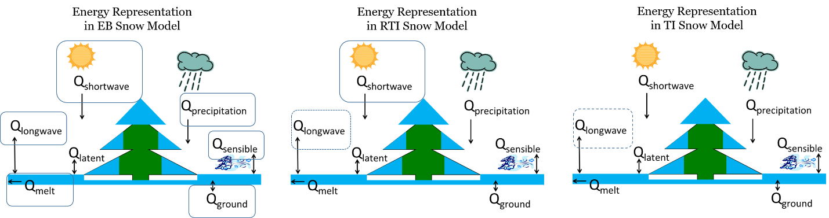
Temperature Index Method
8

Slide 9
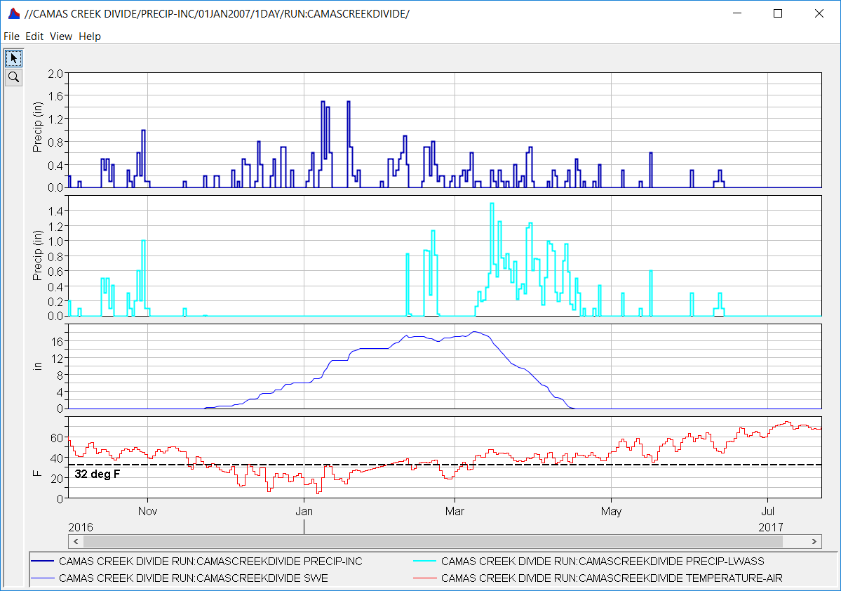
Temperature Index Method
Precipitation
LWASS
SWE
Temperature
9
Notes:
HMS calculates SWE and liquid water at the soil surface (LWASS)

Slide 10
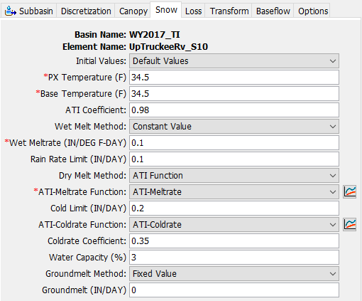
Temperature Index Parameters
PX Temperature
Base Temperature
ATI Coefficient
Wet Melt
  Constant, Pattern
Rain Rate Limit
Dry Melt
  Constant, Function, Pattern
Cold Limit
Coldrate Function
Coldrate Coefficient
Water Capacity
Groundmelt Method
Groundmelt
10

Slide 11
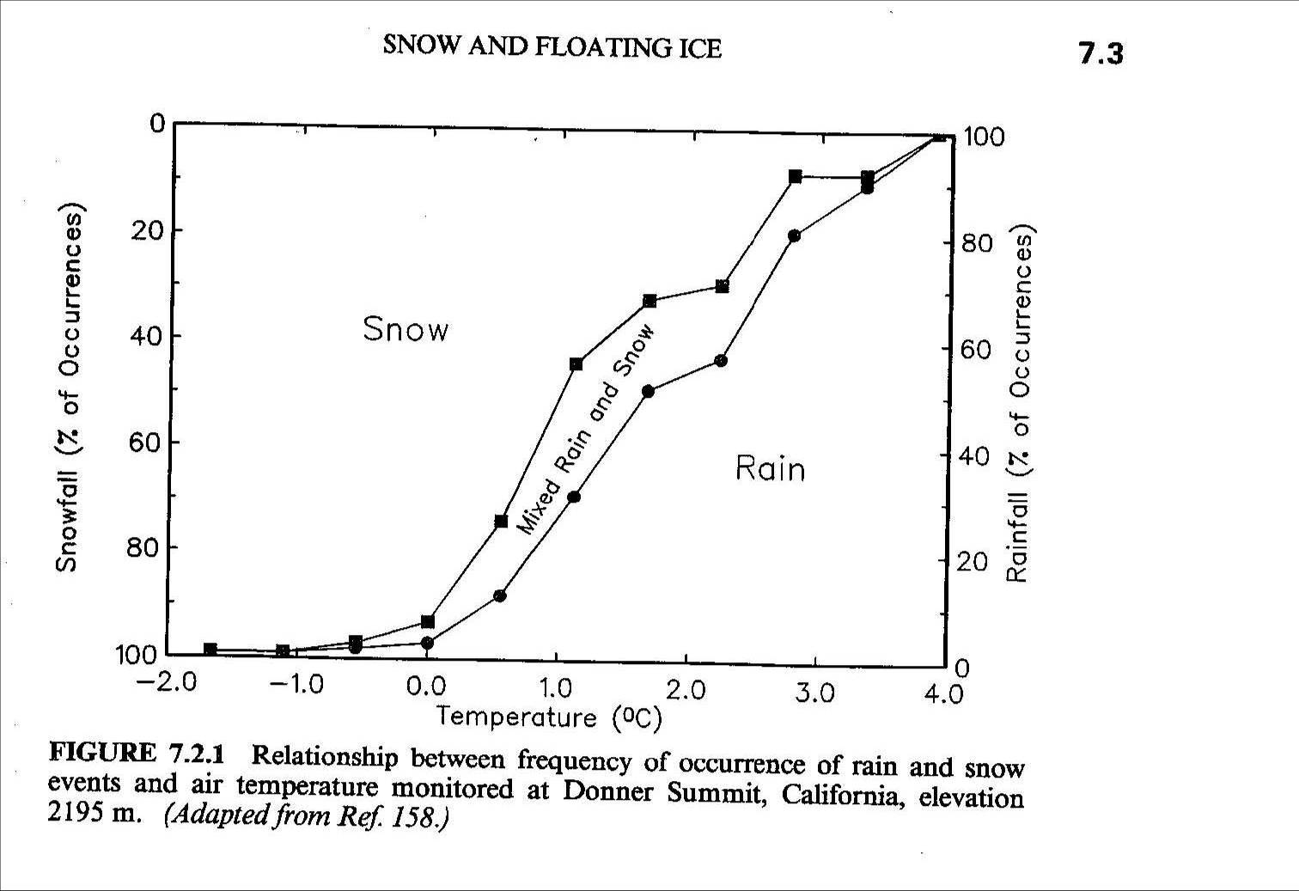
PX Temperature
The discrimination temperature between precipitation falling as rain or snow.
When the air temperature is less than the specified PX temperature, any precipitation is assumed to be snow.
When the air temperature is above the specified PX temperature, any precipitation is assumed to be rain.
This discrimination temperature is usually pretty close to freezing (32ºF-34ºF).
11

Slide 12
Base Temperature
The difference between the base temperature and the air temperature defines the temperature index used in calculating snowmelt.
The melt rate is multiplied by the difference between the air temperature and the base temperature to estimate the snowmelt amount.
If the air temperature is less than the base temperature, then the amount of melt is assumed to be zero.
The base temperature is usually pretty close to freezing (32ºF-34ºF).
Be careful using a base temperature > PX temperature.
12

Slide 13
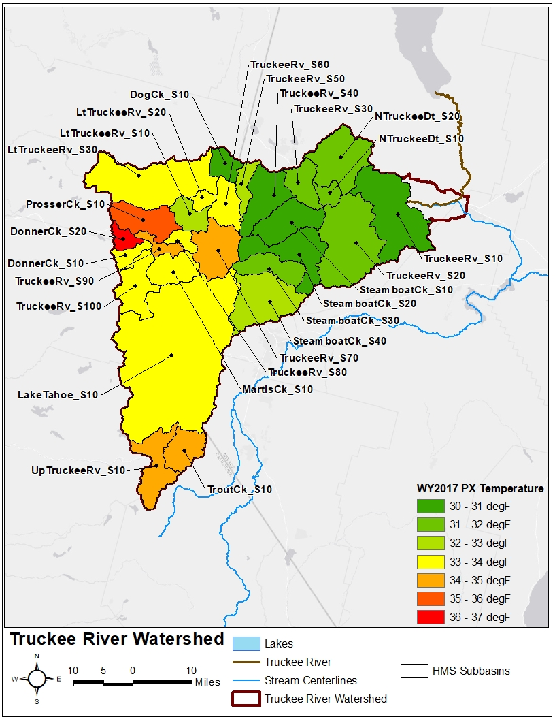
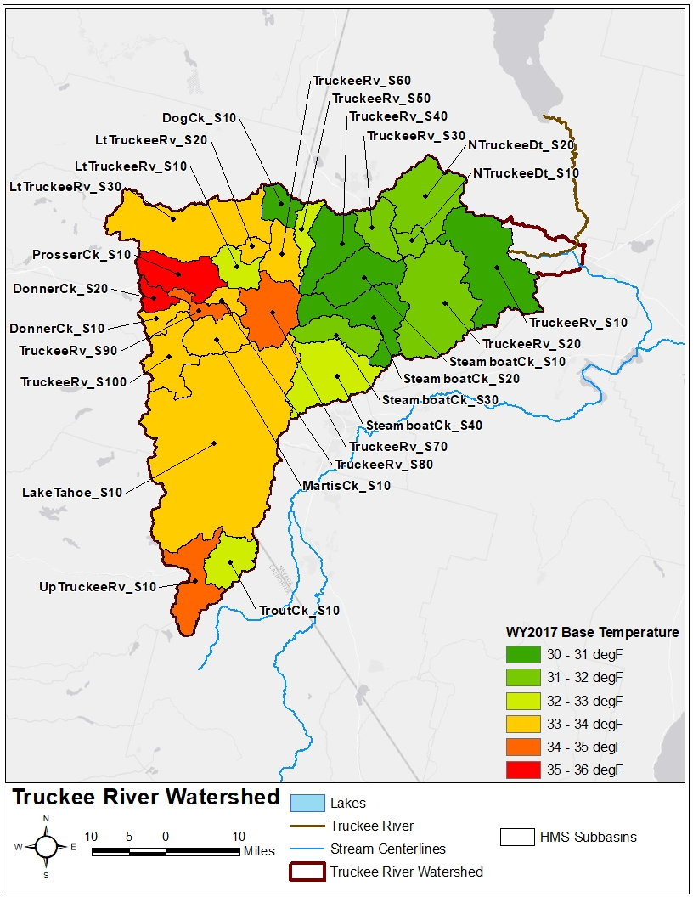
PX / Base Temperature
PX Temperature
Base Temperature
13
Notes:
On this slide, subbasin-specific PX and Base temperatures for water year 2017 are compared against one another
It’s evident that there are large differences in PX and Base temperature throughout the watershed

Slide 14
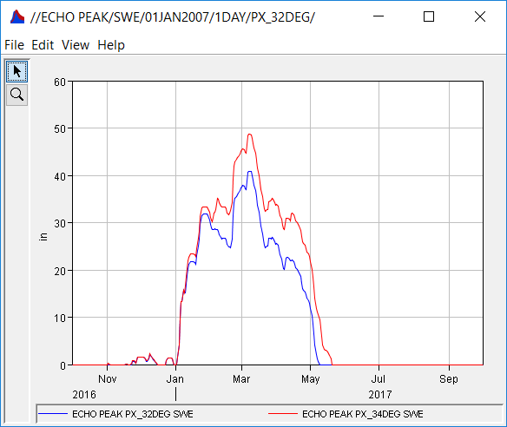
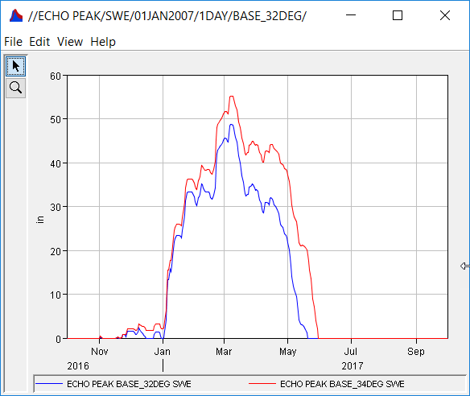
Temperature Index Parameters
PX = 32 deg F
PX = 34 deg F
Base = 32 deg F
Base = 34 deg F
14
Notes:
PX temperature discriminates between precipitation falling as rain vs. snow
Higher PX temperature means that there is a wider range of temperatures at which precipitation falls as snow which allows more snow to accumulate
Base temperature is the temperature above which snow melts
Lower base temperature means that there is a wider range of temperatures at which snow melts which reduces the snowpack

Slide 15
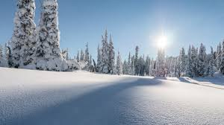
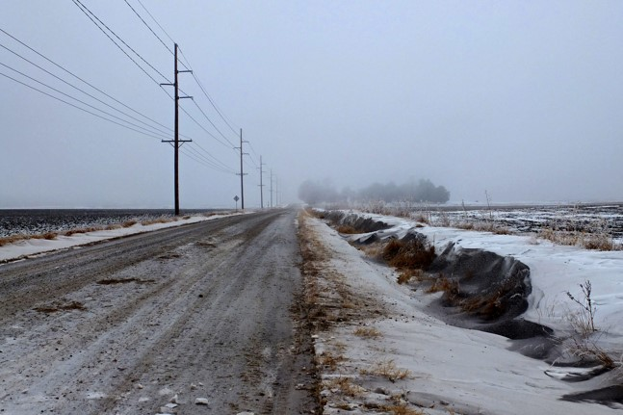
Dry Melt Rate
Constant, annual pattern, or function
A variable melt rate function recognizes that as the snowpack matures the heat transfer rates change AND/OR different components of heat transfer change in importance.
15

Slide 16
Dry Melt Rate
Constant
  Using a constant allows for this parameter to be included in optimization and uncertainty calculations.
ATI-Melt Rate Function
  The seasonal variation of melt rate is indexed by an antecedent temperature function.
  The initial melt ATI should be thought of as “the accumulated thawing degree days” at the start of the simulation.
  Using a function allows the melt rate to change as the snowpack matures and ages.
Annual Pattern
  An alternate method of entering the melt rates as a function of the day/time of year.
16

Slide 17
ATI-Melt Rate Function
ATI-Melt Rate: Melt rate values associated with ATI values in depth per degree-day.
Typical range of melt rate values is 0.015-0.2 in/ºF-day.
ATI-Melt Rate Coefficient for updating the antecedent temperature index. Set to 0.98 – 1.0
Automating the Development of ATI-Meltrate Functions
17

Slide 18
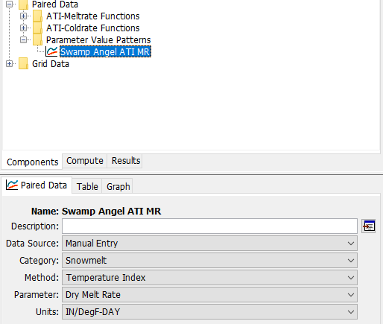
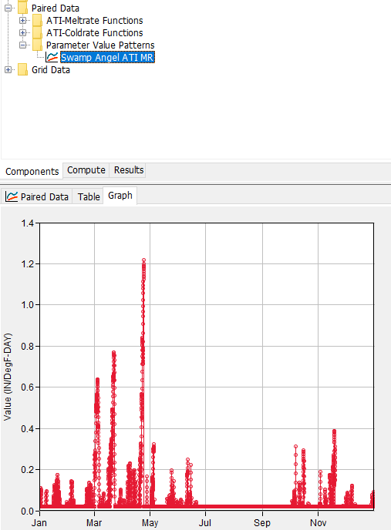
Annual Pattern
Entered as a Parameter Value Pattern:
  ddMMM, HH:mm vs. Melt Rate
Parameters can be estimated using techniques like these: Empirical Radiation Snow Model
  Giovando, et al. (2023)
18
Notes:
Giovando, et al. (2023): https://doi.org/10.1016/j.jhydrol.2023.129290

Slide 19
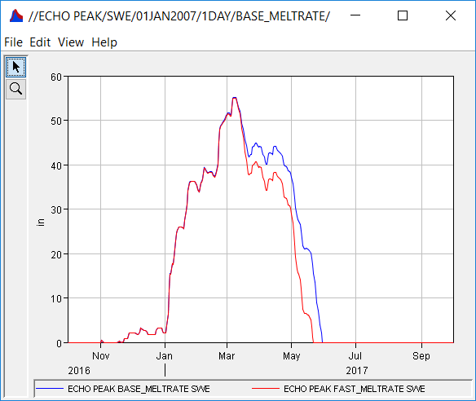
Dry Melt Rate
Slow Meltrate
Fast Meltrate
19
Notes:
PX temperature = 34 deg for both

Slide 20
Dry Melt Rate
Questions to ask yourself when setting dry melt rates:
How long does it take the snow to melt away at any one location?
  A few days – use a constant melt factor
    Melt rate is independent of ATI
    Typical of the eastern U.S.
  A month or more – use a variable melt factor
    Melt rate is dependent upon ATI or is a Function of Date/Time
    Typical of the western U.S.
20

Slide 21
Dry Melt Rate
Questions to ask yourself when setting dry melt rates:
How much SWE is typically on the ground?
  A few inches or less – use a constant melt factor
    Melt rate is independent of ATI
    Typical of the eastern U.S.
  10 inches or more – use a variable melt factor
    Melt rate is dependent upon ATI or is a Function of Date/Time
    Typical of the western U.S.
21

Slide 22
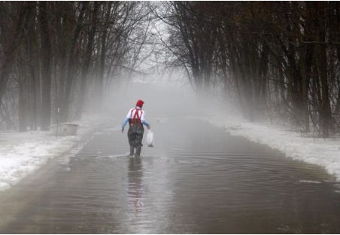
Wet Melt Rate
Greatest cause of snowmelt during rain-on-snow is from heat transfer to the snowpack during condensation of water vapor on the snowpack surface
Lesser cause of snowmelt during rain-on-snow is due to melting from warm rain by direct contact
Constant or annual pattern
22

Slide 23
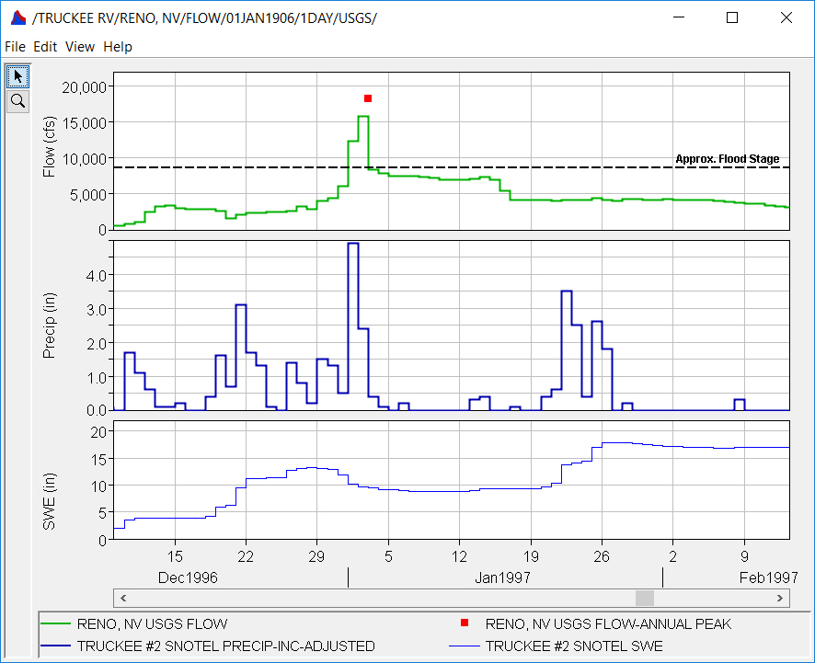
Wet Melt Rate
Wet Melt Rate
The wet melt rate should not be less than the dry melt rate
Usually, the wet melt rate is set to the higher end of the dry melt rate function, 0.05 - 0.2 in/ºF-day.
Rain Rate Limit
The discrimination rain rate in inches/day between dry melt and wet melt.
The wet melt rate is applied as the melt rate when it is raining at rates greater than the rain rate limit.
If the rain rate is less than the rain rate limit, the melt rate is computed as if there were no precipitation. (0.1 – 1 in/day)
23
Notes:
Third viewport is SWE. Notice the dip in SWE that corresponds with a ton of runoff and flooding.

Slide 24
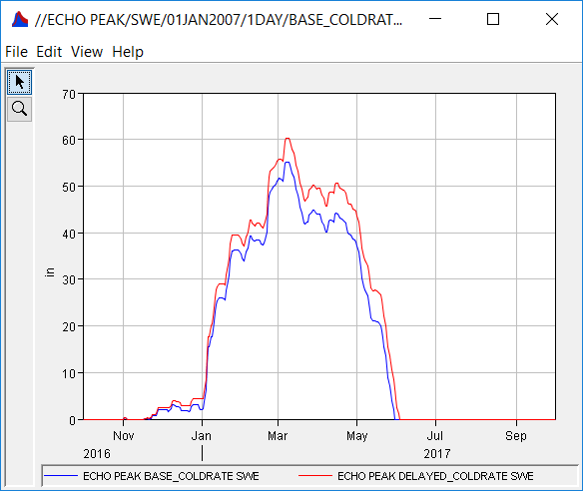
Cold Rate
ATI-Coldrate Function
Cold Content is the amount of energy required to bring the snowpack to 32 deg F (sensible heat).
Expressed as a depth of frozen water
The ATI for cold content is an index to the snow temperature near the surface.
It is calculated assuming an approximation to the transient heat flow equations.
Typically set as a constant function (i.e., coldrate doesn’t change with ATI).
Typical range of values is 0.01 - 0.05.
ATI-Coldrate Coefficient.
Coefficient for weighting previous values when updating the ATI-Coldrate.
Typical value 0.2-0.5.
Base Coldrate
Delayed Coldrate
24
Notes:
Base and PX temperature = 34 deg for both
Notice that each time the “Base Coldrate” curve melts, the “Delayed Coldrate” curve doesn’t. That’s because the “Delayed Coldrate” curve builds cold content at a greater rate and gets it through the short periods when temperatures are above the base temperature

Slide 25
Water Capacity
The maximum liquid water capacity specifies the amount of melted water that must accumulate in the snowpack before liquid water becomes available at the soil surface for infiltration or runoff
Typically, the maximum liquid water capacity is 3%-5% of the SWE
Liquid water can persist in the snow only if the snowpack temperature is at 32ºF (0ºC); at which point the cold content is zero
Water content is affected by age of snowpack to the largest extent
25

Slide 26
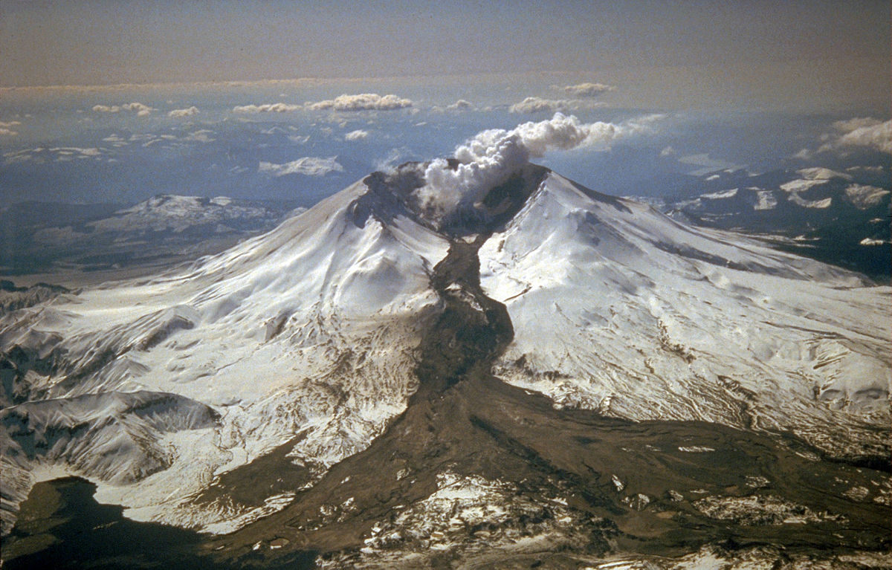
Groundmelt
Snow melt that occurs due to heat transfer from the ground beneath the snowpack.
Almost always set to zero, especially for relatively shallow, seasonal snow covers (SWE < 10 inches)
May not always be zero…
Mount St. Helens, 1982
26

Slide 27
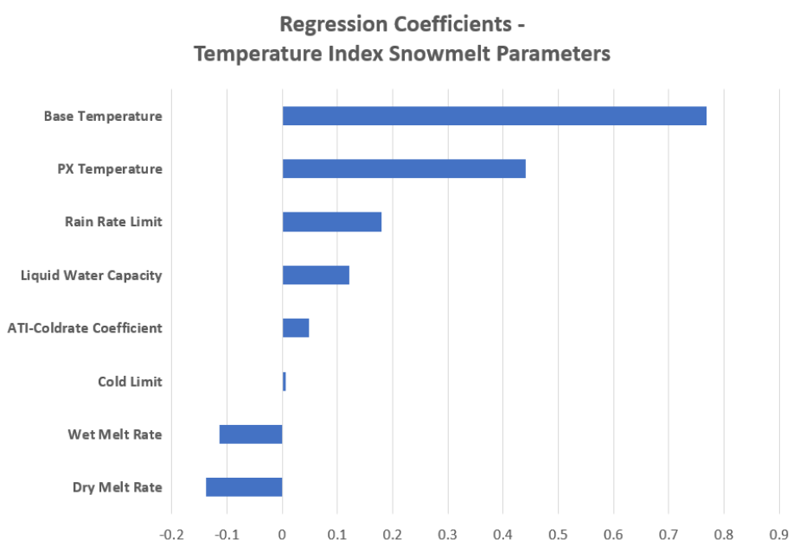
Temperature Index Method – Parameter Sensitivity
*with regards to peak SWE
27
Notes:
Use the Uncertainty Analysis and multiple linear regression to assess parameter sensitivity
In this case, we are examining how sensitive SWE is to the TI parameters
This tornado plot shows the magnitude of the regression coefficient
Higher absolute values indicate that SWE is more sensitive to that parameter and can help you decide which parameters to focus on during calibration
Positive regression coefficient means that increasing that parameter value increases SWE
Negative regression coefficient means that decreasing that parameter value increases SWE

Slide 28
Temperature Index Method
Advantages
"Mature" method that has been used successfully in thousands of studies throughout the U.S.
Easy to set up and use
Only requires precipitation and air temperature boundary conditions
More parsimonious than other methods
Disadvantages
May be too simple for some situations
Limited snowpack outputs compared to other methods
28
Notes:
Parsimony/parsimonious is relative to the user
In this instance, I’m comparing this snow method against the other snow methods within HEC-HMS (e.g., hybrid and energy balance)
Temperature index offers both lumped and gridded implementations

Slide 29
Hybrid / RTI Method
29

Slide 30
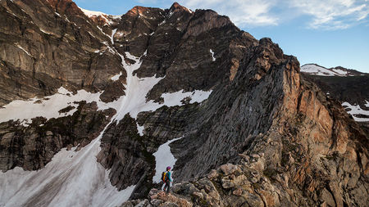
Hybrid / RTI Method
Derived from Follum, et al. (2015)
Instead of using air temperature, use a proxy that includes short and longwave radiation
Incorporates topographic, cloud cover, vegetation, and albedo affects
Requires additional meteorologic boundary conditions
Relatively new method
30

Slide 31
Hybrid / RTI Method
31
Notes:
Radiation is generally the largest contributor to melting the snowpack

Slide 32
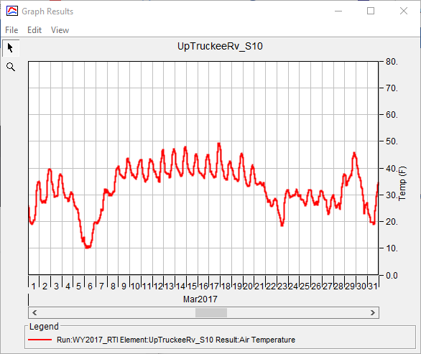
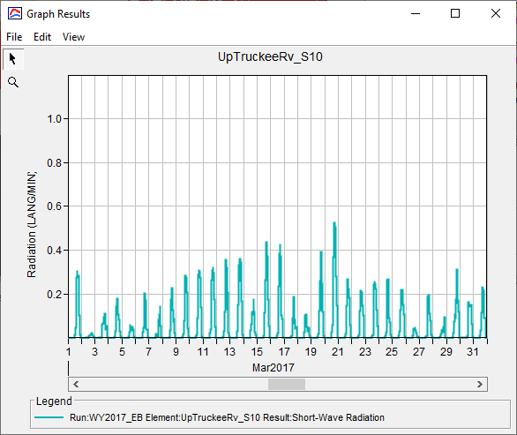
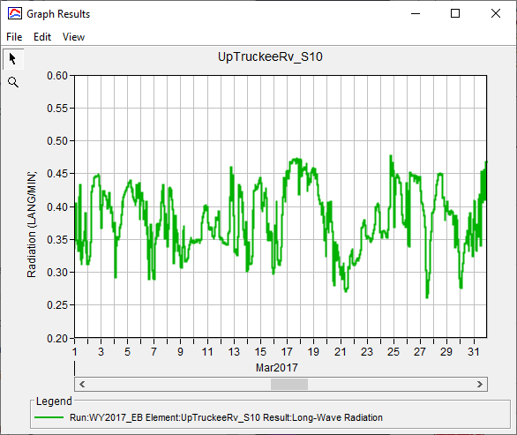
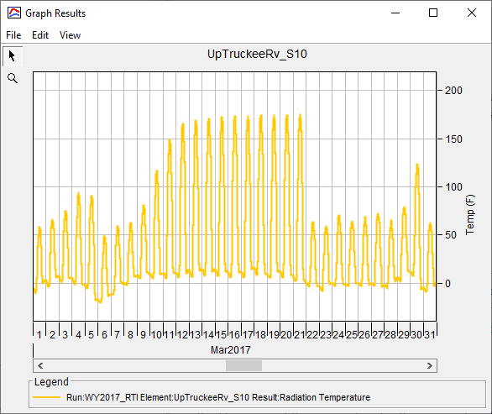

Hybrid / RTI Method
Air Temperature
Shortwave
Longwave
Radiation Temperature
32

Slide 33
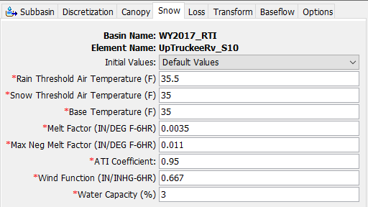
Hybrid / RTI Parameters
Rain Threshold Air Temperature
Snow Threshold Air Temperature
Base Temperature
Melt Factor
Max Negative Melt Factor
ATI Coefficient
Wind Function
Water Capacity
33

Slide 34
Rain and Snow Threshold Temperatures
Discrimination temperatures above/below which precipitation falls as rain or snow.
Rain temperature must be equal to or greater than snow temperature
If the two aren’t equal, precipitation goes to both liquid and snow
Rain (32ºF - 40ºF)
Snow (30ºF - 35ºF)
34

Slide 35
Melt Factor and Max Negative Melt Factor
Melt factor = Dry melt rate
  0.001 in / ºF-6hr – 0.01 in / ºF-6hr
Wet melt rate is calculated using relative humidity, saturation vapor pressure, and atmospheric pressure
  If 6 hr precip. accum. > 1.5 mm (0.06 in) && current precip. rate > 0.25 mm/hr (0.01 in/hr)
  These are not user-entered parameters. They are hard coded.
Max Negative Melt Factor (NMF)
  Used to update snowpack heat deficit
  Positive value despite its name
  0.001 in / ºF-6hr – 0.05 in / ºF-6hr
35
Notes:
Increasing the Max Negative Melt Factor increases the heat deficit and delays the initiation of snow melt
Decreasing the Max Negative Melt Factor decreases the heat deficit and causes snow melt to initiate sooner

Slide 36
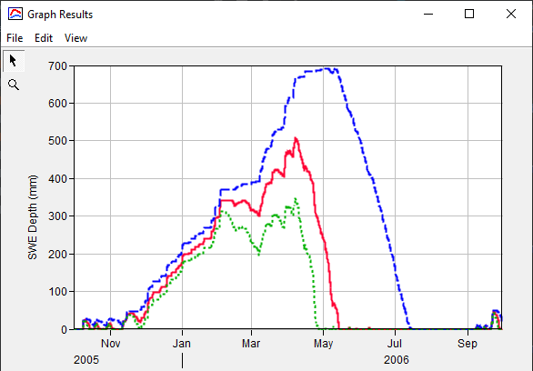
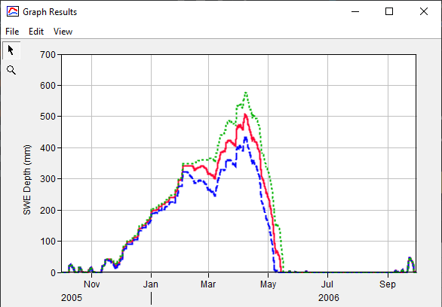
Melt Factor and Max Negative Melt Factor
MF = base
MF = -66%
MF = +66%
NMF = base
NMF = -66%
NMF = +66%
36
Notes:
Melt Factor
Decreasing Melt Factor results in less melt
Increasing Melt Factor results in more melt
Max Negative Melt Factor
Decreasing Max Negative Melt Factor results in more melt
Increasing Max Negative Melt Factor results in less melt

Slide 37
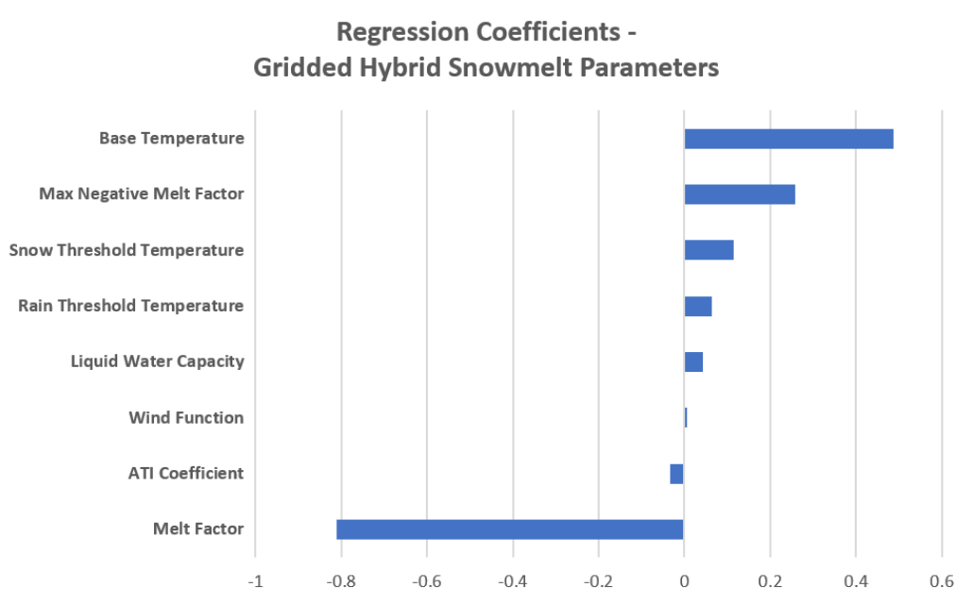
Hybrid / RTI Method – Parameter Sensitivity
*with regards to peak SWE
37
Notes:
Use the Uncertainty Analysis and multiple linear regression to assess parameter sensitivity
In this case, we are examining how sensitive SWE is to the Hybrid / RTI parameters
This tornado plot shows the magnitude of the regression coefficient
Higher absolute values indicate that SWE is more sensitive to that parameter and can help you decide which parameters to focus on during calibration
Positive regression coefficient means that increasing that parameter value increases SWE
Negative regression coefficient means that decreasing that parameter value increases SWE

Slide 38
Hybrid / RTI Method
Advantages
Incorporates factors such as short and longwave radiation into snowmelt equations
Can incorporate terrain slope, aspect, and shading
More snowpack outputs than TI method
Disadvantages
Requires additional meteorologic boundary conditions
Less mature than other methods
38

Slide 39
Energy Budget Method
39

Slide 40
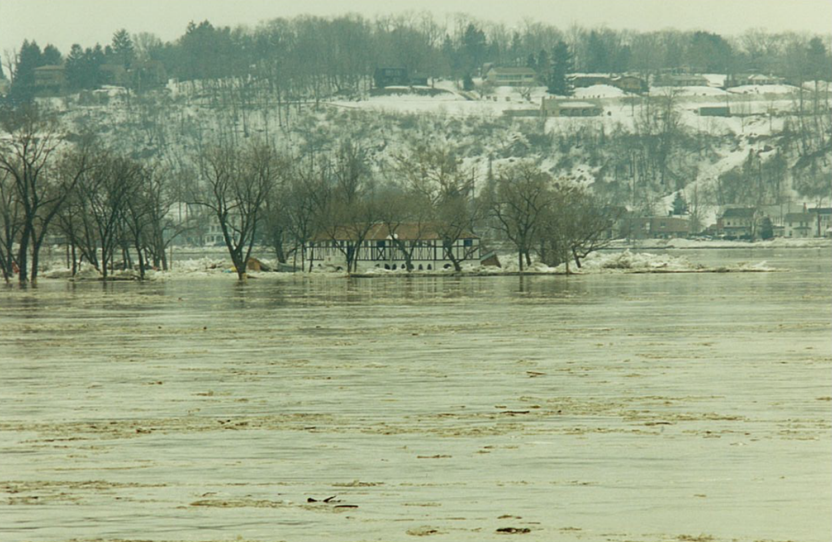
Energy Budget Method
Based upon University of Utah Energy Budget model
  Tarboton, et al. (1995)
Method balances energy stored within a single snow layer and upper part of the ground
Change in energy content affects snow water equivalent
Requires lots of additional meteorologic boundary conditions
Largely an academic method
40
Notes:
The Energy Budget method incorporates many more sources of energy that can potential melt (or grow) the snowpack
Image is of the Susquehanna River at Harrisburg, PA during the January 1996 flood
The January 1996 flood affected the Ohio River, Susquehanna River, Delaware River, and everything in between. Primary causes were large amounts of precipitation, high temperatures, large antecedent snow water equivalents, but also extremely high wind speeds. High wind speeds causes turbulent heat transfer. In essence, this allows for warm air to constantly be in contact with the snowpack. Normally, the air immediately above the snowpack is pretty cold. This drastically increases the rate at which the snowpack melts.
However, this method, especially when compared against the temperature index and RTI methods, requires a significant amount of additional boundary condition data.

Slide 41
Energy Budget Method
41
Notes:
Radiation is generally the largest contributor to melting the snowpack

Slide 42
Energy Budget Method
Requires iterative solver to balance mass/energy inputs and outputs, snowpack temperature, surface temperature, etc.
More computationally intensive than other snow methods
inner loop B computes surface temperature
B
A
outer loop A computes energy and mass flux for a time step
42

Slide 43


Energy Budget Method
Met Boundary Conditions
Compute State Change
Generate Outputs
Compute Energy and Mass Flux
A
Update Snowpack State
Compute Surface Temperature
Compute Melt Rate
B
Compute Surface Fluxes
43
Notes:
Use previous time step for initial SWE and snowpack energy content
Update each guess for SWE and energy content after each iteration
Iterate outer loop until guessed SWE and energy = computed SWE and energy (within tolerance):
deltaSwe > 0.025 mm
deltaEnergy > 2000 J
Max # iterations < 15
Iterate inner loop until surface temperature balances

Slide 44
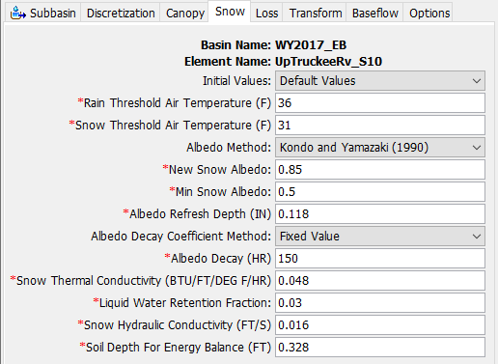
Energy Budget Parameters
Rain Threshold Air Temperature
Snow Threshold Air Temperature
New Snow Albedo
Min Snow Albedo
Albedo Refresh Depth
Albedo Decay
Snow Thermal Conductivity
Liquid Water Retention Fraction
Snow Hydraulic Conductivity
Soil Depth for Energy Balance
44

Slide 45
New Albedo, Min Albedo, and Albedo Refresh Depth
Albedo of fresh snow
  When new snow depth > albedo refresh depth
  0.6 – 0.95
Minimum albedo
  0.1 – 0.5
Depth at which albedo is reset
  0.02 inches – 0.2 inches
45
Notes:
Albedo is the reflectivity (0 to 1)
Albedo = reflected light/incident light
The maximum possible albedo value is 1.0 (all incident light is reflected)
But brand-new snow rarely has an albedo of 1.0

Slide 46
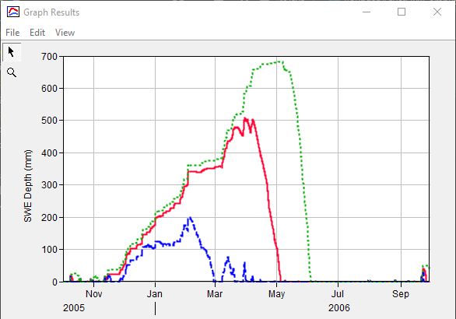
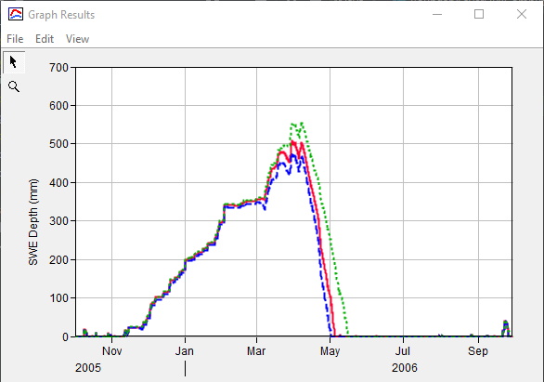
New Albedo and Min Albedo
New Albedo = base
New Albedo = -66%
New Albedo = +66%
Min Albedo = base
Min Albedo = -66%
Min Albedo = +150%
46
Notes:
New Albedo
Decreasing New Albedo means less incident light is reflected resulting in less accumulation/less SWE
Increasing New Albedo means more incident light is reflected allowing for more accumulation/more SWE
Min Albedo
Decreasing Min Albedo means less incident light is reflected resulting in less accumulation/faster melt out
Increasing Min Albedo means more incident light is reflected resulting in more accumulation/slower melt out

Slide 47
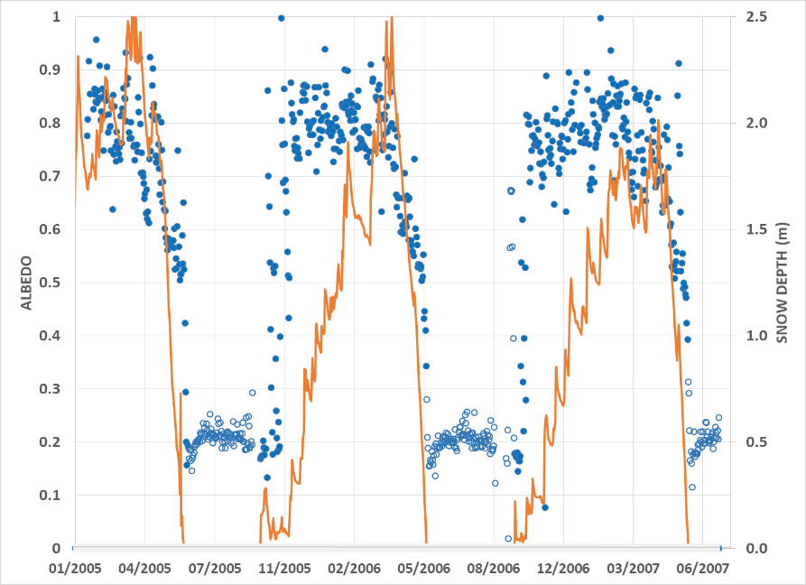
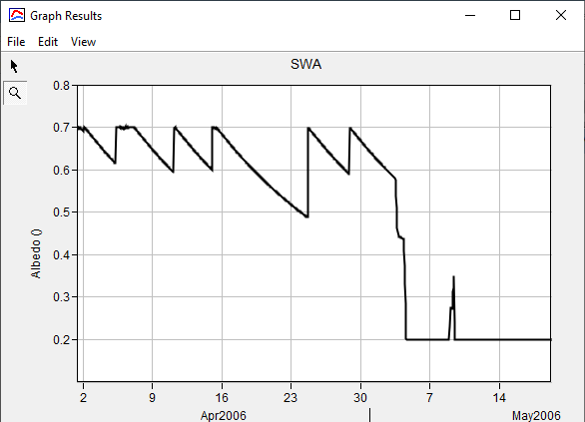
Albedo Decay Coefficient
Actual Observations
Describes how albedo decays from new snow albedo to min snow albedo
Constant or Annual Pattern
40 hrs – 600 hrs
Model Results
47
Notes:
Three winters of albedo measurements and snow depth observations in the Senator Beck basin in Colorado.
solid blue circles are the daily average snow albedo
open blue circles are the daily average albedo when the snow depth was reported as zero
orange line is the daily average snow depth.

Slide 48
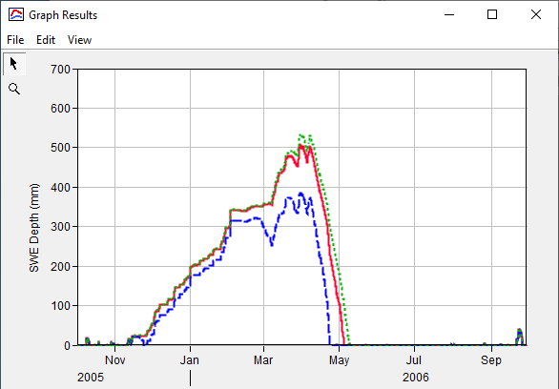
Albedo Decay Coefficient
Albedo Decay = base
Albedo Decay = -50%
Albedo Decay = +50%
48
Notes:
Albedo Decay Coefficient
Increasing albedo decay coefficient decreases the rate of snowmelt
Decreasing albedo decay coefficient increases rate of snowmelt

Slide 49

Snow Thermal Conductivity
Describes how efficiently heat is transferred within the snowpack
0.01 btu / ft / ºF / hr – 0.1 btu / ft / ºF / hr
Thermal Cond. = base
Thermal Cond. = -66%
Thermal Cond. = +66%
49
Notes:
Increasing snow thermal conductivity allows heat to be transferred more efficiently through the snowpack resulting in higher snow accumulations
Decreasing the snow thermal conductivity causes heat transfer to be less efficient which results in less accumulation and faster melt out

Slide 50
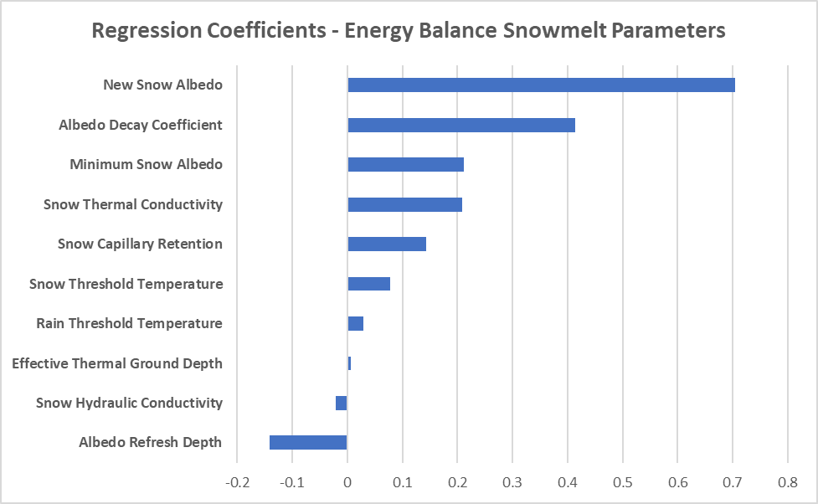
Energy Budget – Parameter Sensitivity
*with regards to peak SWE
50
Notes:
Use the Uncertainty Analysis and multiple linear regression to assess parameter sensitivity
In this case, we are examining how sensitive SWE is to 10 Energy Budget parameters
This tornado plot shows the magnitude of the regression coefficient
Higher absolute values indicate that SWE is more sensitive to that parameter and can help you decide which parameters to focus on during calibration
Positive regression coefficient means that increasing that parameter value increases SWE
Negative regression coefficient means that decreasing that parameter value increases SWE

Slide 51
Energy Budget Method
Advantages
Incorporates factors such as short and longwave radiation, sensible heat flux, sublimation, condensation, and wind into snowmelt equations
Can incorporate terrain slope, aspect, and shading
Lots of snowpack outputs available including SWE, snow density, snow depth, snowpack temperature, snowpack energy, albedo, etc.
Disadvantages
Requires lots of meteorologic boundary conditions
Computationally intensive
Solution isn’t guaranteed to converge
Much less parsimonious than other methods
51

Slide 52
Boundary Condition Requirements
Process | Temperature Index | Hybrid | Energy Budget
Precipitation | X | X | X
Temperature | X | X | X
Shortwave Radiation |  | X | X
Longwave Radiation |  | X | X
Wind Speed |  |  | X
Atmospheric Pressure |  | X | X
Relative Humidity |  | X | X
52

Slide 53
Snow Parameter Calibration, Optimization, and Uncertainty
53

Slide 54
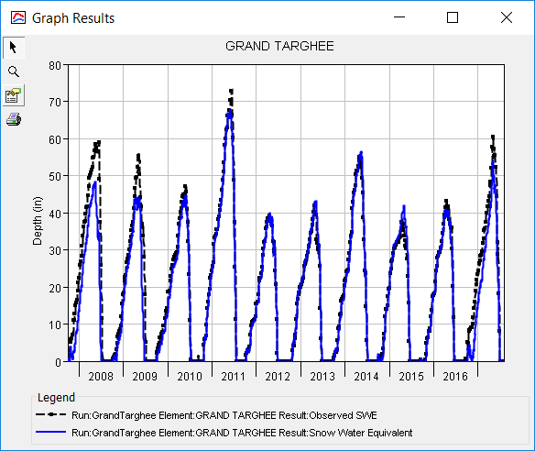
Calibration
Computed SWE
Observed SWE
Two approaches:
  Calibrate parameters for times with both accumulation and melt
  Calibrate parameters only during times of melt
The goal for both is to modify parameters to reduce the difference between the calculated and observed SWE
54

Slide 55
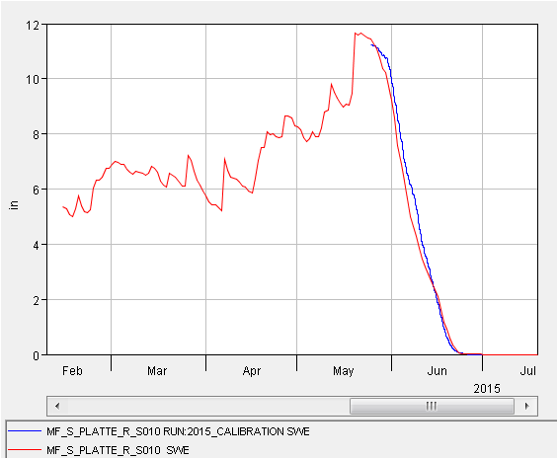
Calibration
Two approaches:
  Calibrate parameters for times with both accumulation and melt
  Calibrate parameters only during times of melt
The goal for both is to modify parameters to reduce the difference between the calculated and observed SWE
Computed SWE
Observed SWE
55

Slide 56
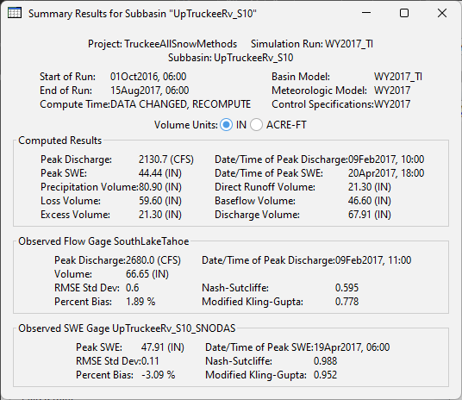
Calibration Metrics
Water Year | Peak SWE (in) |  |  | Peak SWE Date |  | SWE Meltout Date |  | NSE | RSR | PBIAS
 | Model | Obs. | Diff. | Model | Obs. | Model | Obs.
2008 | 48.9 | 59.0 | -10.1 | 13May | 12Jun | 30Jun | 14Jul | 0.68 | 0.53 | 29.6
2009 | 44.6 | 55.9 | -11.3 | 01May | 06May | 25Jun | 06Jul | 0.79 | 0.34 | 18.6
2010 | 45.2 | 47.0 | -1.8 | 25May | 29May | 11Jul | 11Jul | 0.99 | 0.12 | 6.5
2011 | 68.0 | 72.9 | -4.9 | 30May | 12Jun | 21Jul | 23Jul | 0.99 | 0.05 | 2.2
2012 | 40.4 | 39.6 | 0.8 | 19Apr | 19Apr | 25Jun | 24Jun | 1.00 | 0.03 | 0.9
2013 | 43.1 | 41.8 | 1.3 | 05May | 25Apr | 25Jun | 23Jun | 0.98 | 0.13 | 5.8
2014 | 56.6 | 55.6 | 1.0 | 12May | 27Apr | 05Jul | 04Jul | 0.99 | 0.05 | 1.4
2015 | 41.9 | 37.8 | 4.1 | 26Apr | 16Apr | 19Jun | 18Jun | 0.96 | 0.17 | 7.9
2016 | 41.0 | 43.0 | -2.0 | 18Apr | 14Apr | 19Jun | 20Jun | 0.99 | 0.08 | 1.7
2017 | 54.2 | 60.4 | -6.3 | 02May | 04May | 30Jun | 30Jun | 0.85 | 0.44 | 21.0
Overall | - | - | - | - | - | - | - | 0.91 | 0.18 | 6.1
Metrics to use:
  Rate of melt
  Peak SWE
  Date of Peak SWE
  Melt Out Date
  NSE
  RSR
  PBIAS
  MKGE
  Etc.
56

Slide 57
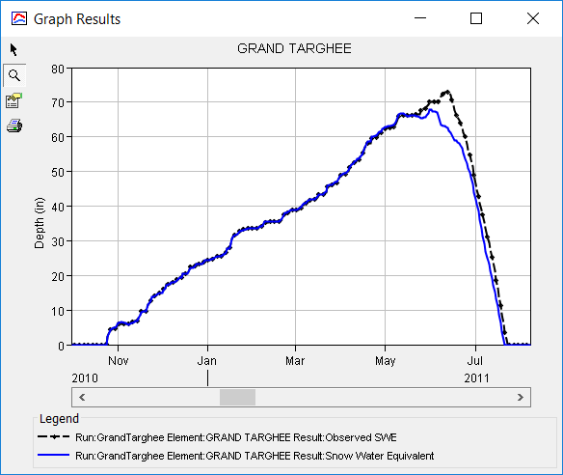
Calibration
Peak SWE
Melt Out
57

Slide 58
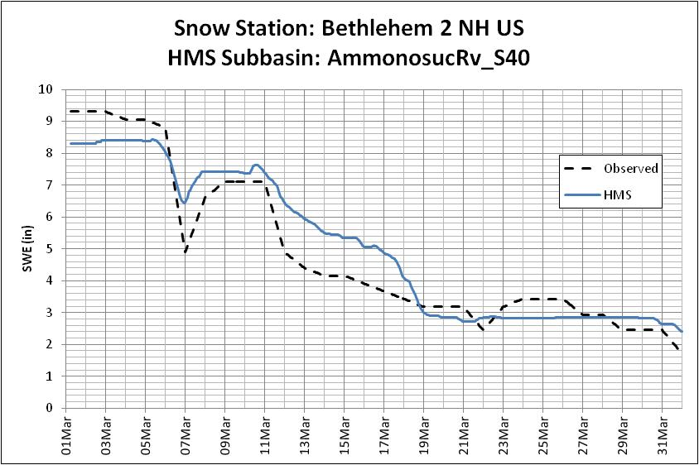
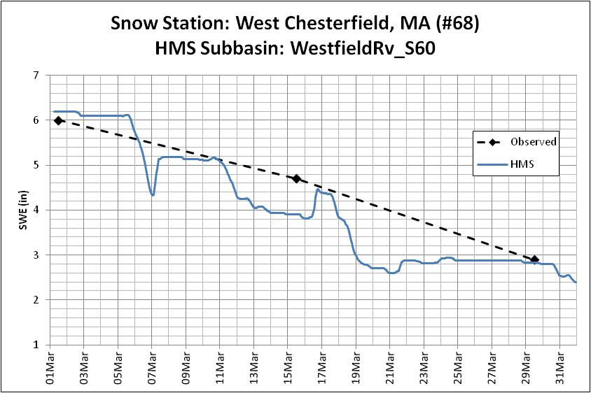
Calibration
USACE Snow Course
NCDC Hydromet Station
58
Notes:
SNOTEL is not the only source of point data for snow
SNOTEL stations (~900) are located at high elevations in the western 11 states
Left: National Climatic Data Center (NCDC, now part of National Centers for Environmental Information (NCEI) hydromet station
Right: USACE snow course station, often located near dams

Slide 59
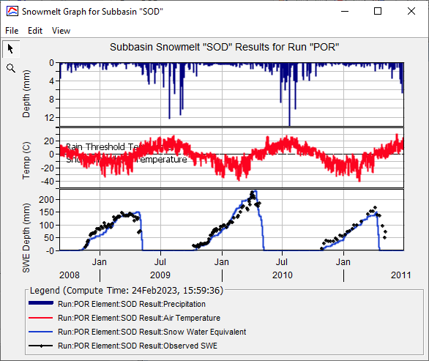
Snowmelt Graph
Precipitation
Air Temperature
SWE
59

Slide 60
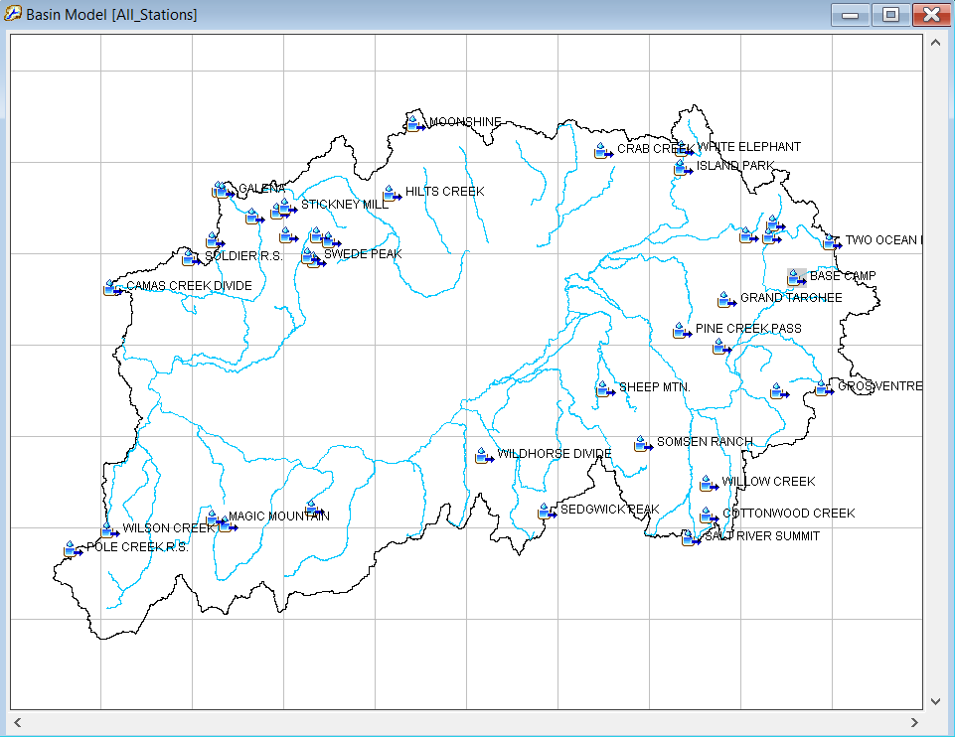
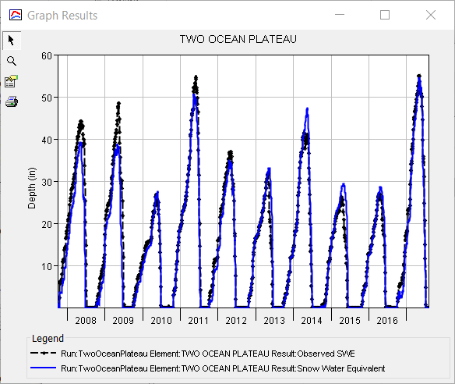
Calibration Strategies
If available, calibrate point SWE using multiple SNOTEL gages/snow sites in the watershed, each with its own set of observed data
Calibrate using multiple water years
Use a large time step (e.g., 1 day)
Very fast!
Point Calibration Workshop
60

Slide 61
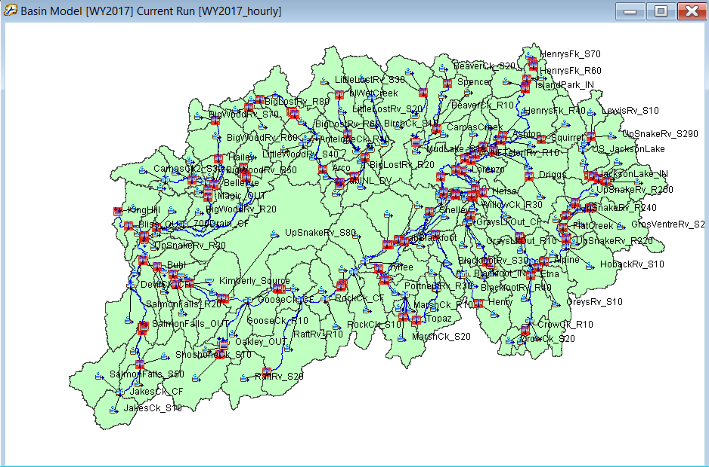
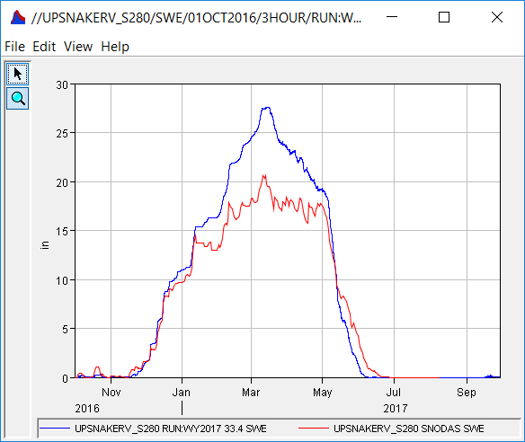
Calibration Strategies
Calibrate basin-average SWE against SNODAS or UofA data
Need to extract basin-average SWE
Calibrate using multiple events and/or water years
Use a smaller time step (e.g., 1 hr)
Can be slow
Gridded Snowmelt Workshop
HMS
SNODAS
61

Slide 62
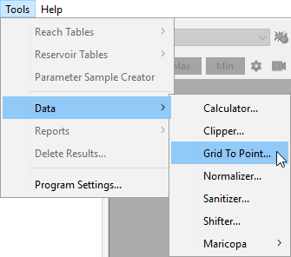
Grid-to-Point Tool
Extract subbasin-average time series from gridded data using the grid to point tool
Working with Gridded Data Workshop
62

Slide 63

Calibration Strategies
Calibrate runoff using snowmelt parameters
This is more important than any other calibration step!
Modify snowmelt, loss, transform, baseflow, etc. parameters, as necessary
Calibrate to a number of events and/or water years
Use a smaller time step (e.g., 1 hour)
Will be slow
63

Slide 64

Optimization
Can optimize parameters using both gridded and banded approaches
  Only constants are allowed
  No Annual Patterns or Functions
THIS IS NOT AUTO CALIBRATION!!!
Only use this feature after you’ve figured out reasonable parameter ranges
64

Slide 65


Optimization
65

Slide 66
Uncertainty
How much uncertainty in SWE, flow, volume, reservoir pool stage, etc. is due to snowmelt parameters?
Can use both gridded and banded approaches
  Only constants are allowed
  No Annual Patterns or Functions
66

Slide 67


Uncertainty
Uncertainty due *solely* to wet melt rate!
Martis Creek Dam
Pool Elevation
Flow at Reno, NV
67
Notes:
Results generated by randomly sampling a uniform distribution of wet meltrates ranging between 0.05 and 0.2 in/degF-day and applying uniformly throughout the modeling domain (i.e., wet meltrate is the same for each subbasin element)
Then, apply the precipitation and temperature sequences observed during the Jan 1997 flood event
Large amount of uncertainty due to just this single parameter!
This uncertainty needs to be incorporated within reservoir regulation manual and infrastructure design decisions!

Slide 68
Review
Reviewed energy transfer in, out, and within a snowpack.
Described the available snow modeling methods within HEC-HMS along with important model parameters.
Detailed how to calibrate snow method parameters.
Discussed optimization and uncertainty.
68

