Slide 1
Flood Frequency Analysis Using HEC-HMS
H&H For Dam Safety PROSPECT
March 2024
Melissa Mika, P.E.
Gregory Karlovits, P.E., PH, CFM
US Army Corps of Engineers
Hydrologic Engineering Center

Slide 2
Purpose
Introduce precipitation-frequency concepts and data products
See how precipitation-frequency data becomes a flow-frequency analysis

Slide 3
Outline
Purpose of modeling flood frequency in HEC-HMS
Introduction to precipitation-frequency
Precipitation-frequency data products
Modeling hypothetical storm events with HEC-HMS
Modeling flood frequency with HEC-HMS

Slide 4
Purpose

Slide 5
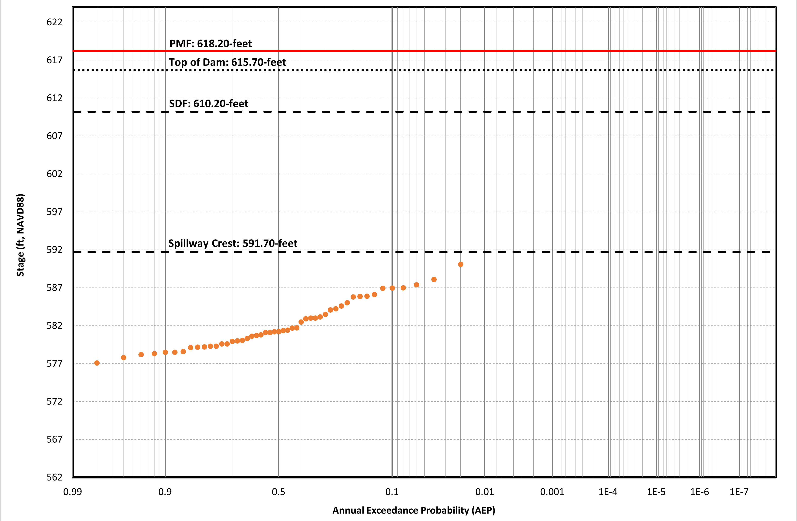
Flow-Frequency for Dam Safety Studies
Goal: Estimate the hydrologic hazard curve
?
Notes:
- One of the main goals of a hydrologic analysis for dam safety is to estimate the stage-frequency or hydrologic hazard curve
- How do we extrapolate beyond the period of record and estimate hydrologic hazards at rare frequencies?

Slide 6
Flow-Frequency for Dam Safety Studies
We are most interested in rare frequencies (<1/1,000)
Frequency analysis is used to extend beyond the period of record
Stage-frequency
We cannot fit an analytical curve to regulated data
Flow-frequency
Better, but we are still limited by the information content of a single gage record
Precipitation-frequency
Best, as we can more easily leverage regional data
Notes:
- As reservoir stage is regulated, we cannot fit an analytical distribution to the stage-frequency curve
- Therefore, we use simulation to extrapolate beyond the period of record and estimate hydrologic hazards at rare frequencies
- A flow-frequency curve is used as an input to the monte carlo simulation
- Flow-frequency curves can be fit to an analytical distribution and can extrapolate beyond the period of record
- However, we’re still limited by the information content of the gage, which is typically just systematic data but occasionally augmented by historical or even paleoflood data
- Precipitation-frequency allows us to leverage regional data more easily than flow-frequency since it is independent of a watershed response
- We must still ensure we are using homogeneous data; that is, gages that experience meteorology that is representative of the rainfall that might occur at the site of interest

Slide 7
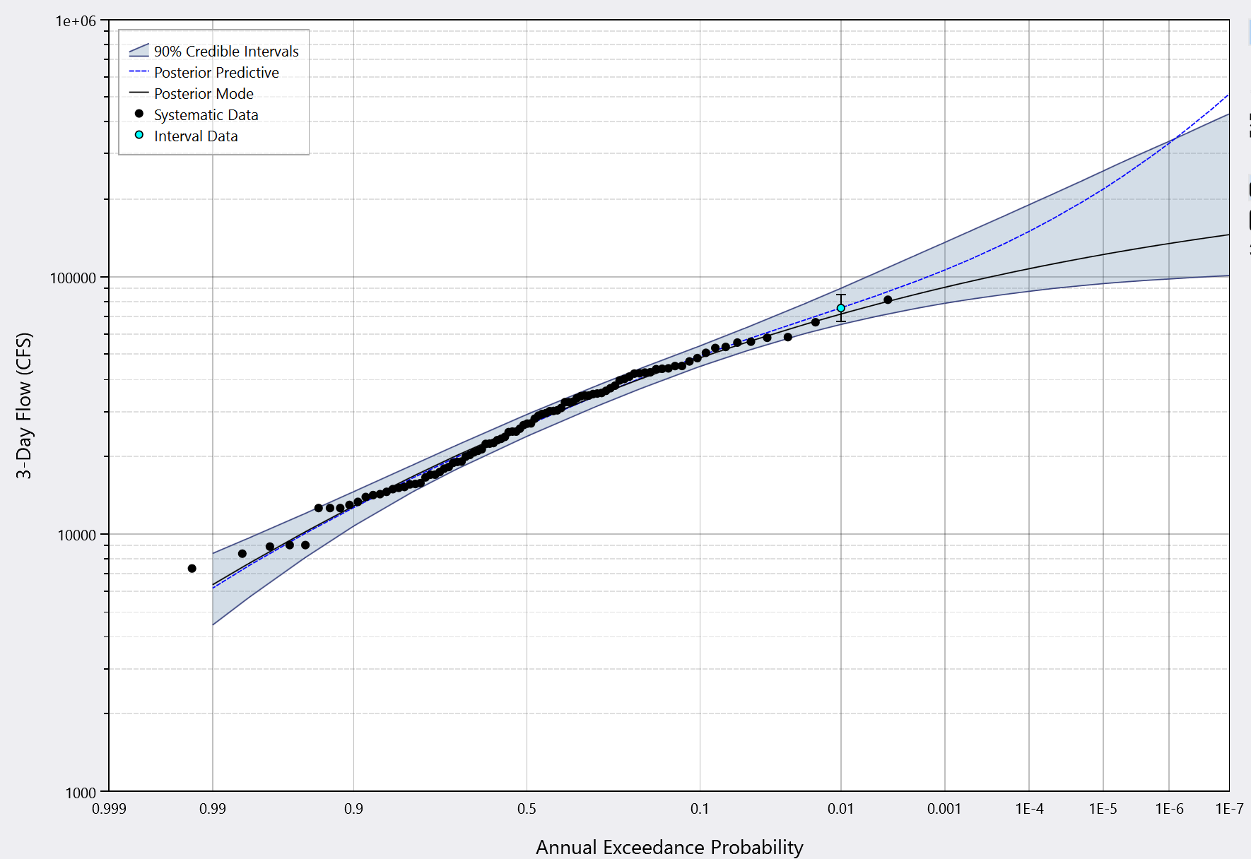
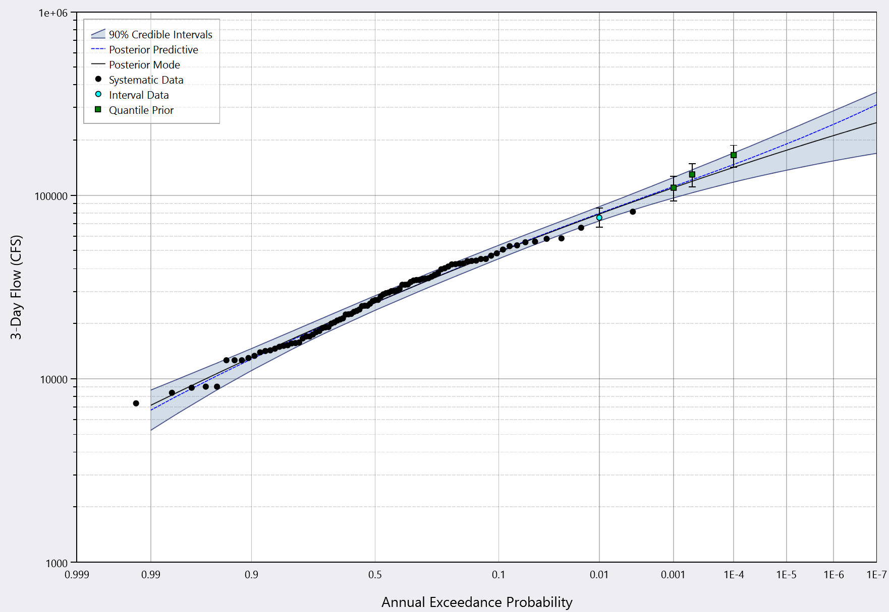
Precipitation-Frequency to Flow-Frequency Method
Instead of sampling inflows, sample precipitation
Compute runoff with a hydrologic model
Combine flow results with a flow-frequency analysis
Notes:
- To perform a precip-frequency to flow-frequency analysis:
- Sample precipitation from a precip-frequency curve
- Apply a temporal and spatial pattern and compute runoff
- This assumes an AEP-neutral approach
- The resulting flows can be blended with a B17C analysis using engineering judgment, or can be input as quantile priors to a flow-frequency analysis using Bayesian estimation techniques
- Alternatively, the AEP-neutral hydrographs can then be routed through a reservoir model to estimate stage

Slide 8
Precipitation-Frequency Concepts

Slide 9
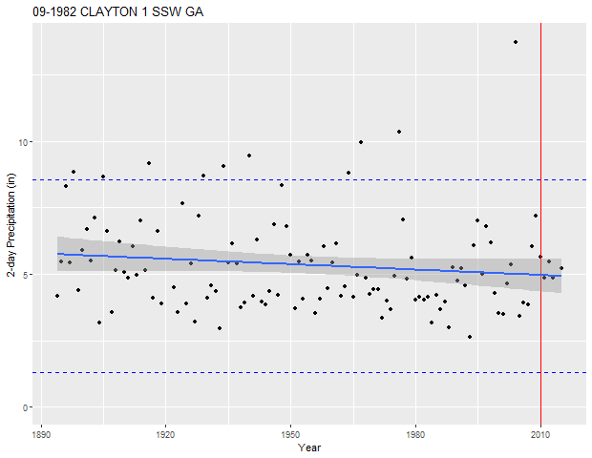
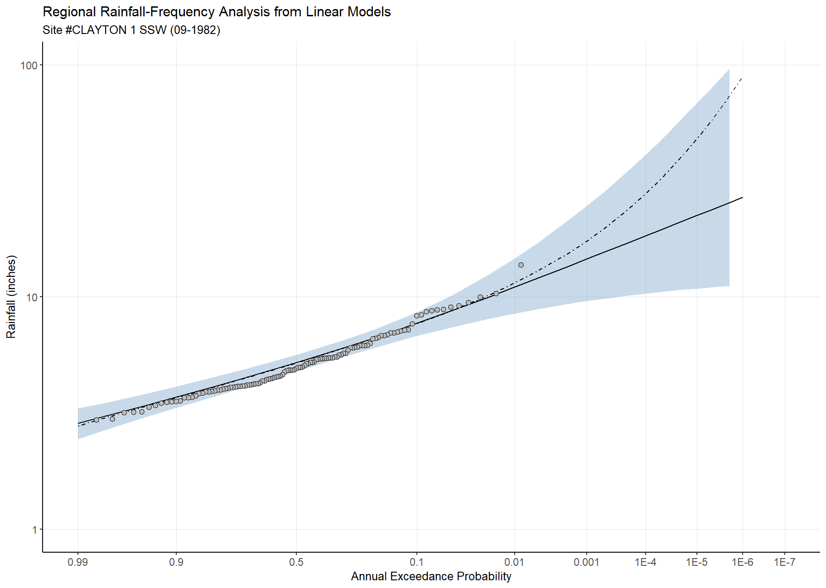
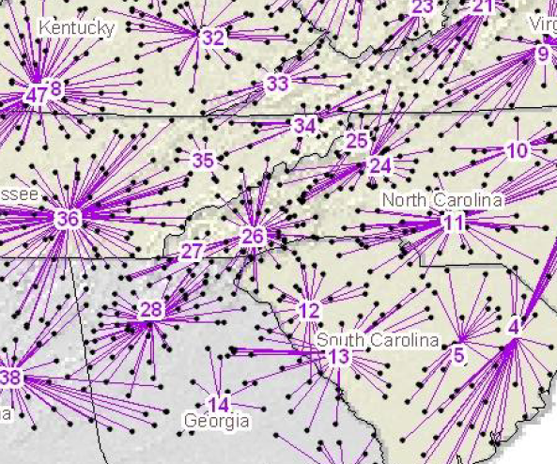
Regional Frequency Analysis
Goal: Trade “space for time”
Preserve homogeneous climatology by clustering multiple sites together
Single gage
Number of sites: 1
Number of annual maxima: 104
Effective record length: 104
Single region
Number of sites: 24
Number of annual maxima: 1,933
Effective record length: 1,170
Notes:
- The goal of regional frequency analysis is to trade “space for time”: increase the number of observations by grouping multiple homogeneous records together
- Handle the tradeoff: More storms of the same kind, but multiple stations can be dominated by the exact same events

Slide 10
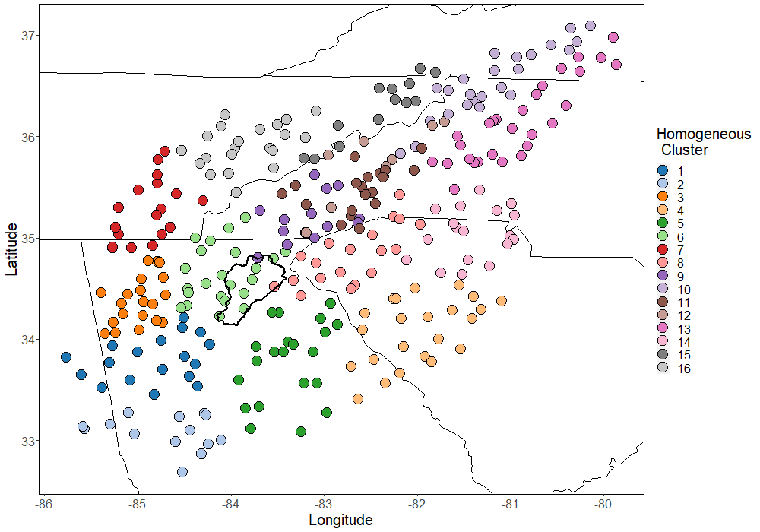
Regional Frequency Analysis
A common regionalization technique is the index-flood method where the variants are determined by:
Mean:
At-site
Standard deviation:
Regional average
Skew:
Regional average

Slide 11
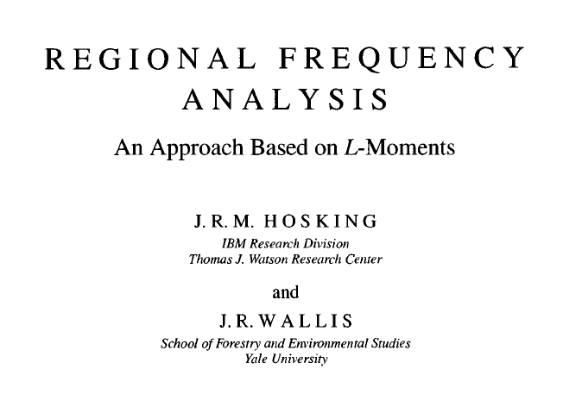
Regional Frequency Analysis
Basic process
1) Data collection
2) Regionalization
3) Distribution fitting
4) Spatial regression

Slide 12
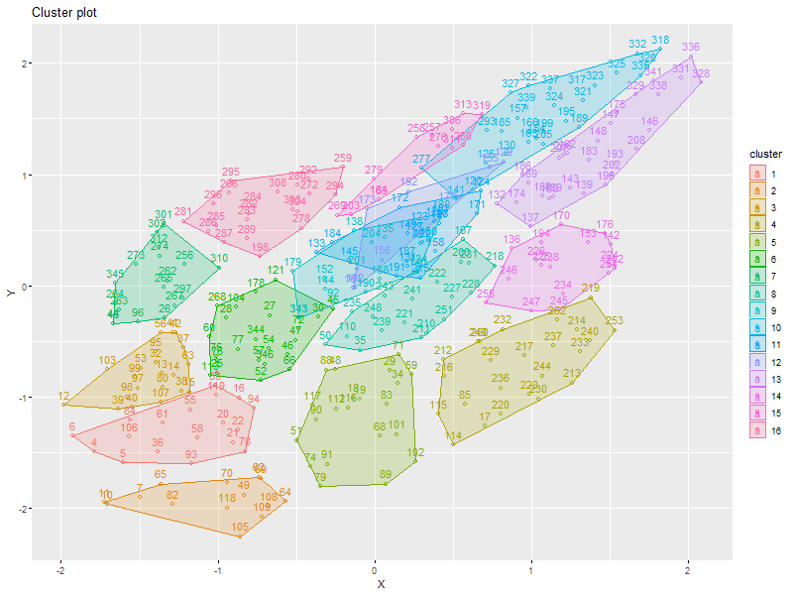
Regional Frequency Analysis –
Regionalization
Analyze annual maximum precipitation
Partition sites into meteorologically homogeneous regions

Slide 13
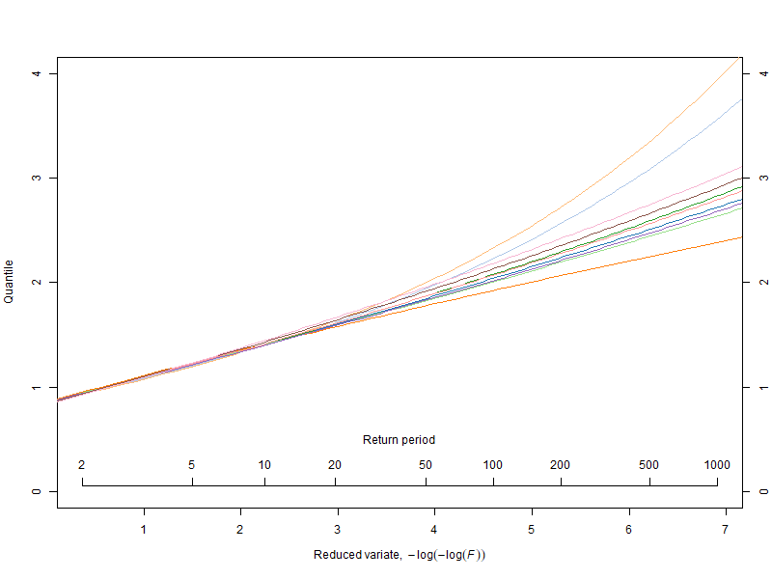
Regional Frequency Analysis – Distribution Fitting
At-site and regional average statistics are fit to an analytical distribution
Typical distributions
  Generalized Extreme Value (GEV)
  Generalized Logistic (GLO)
  Generalized Normal (GNO)
  Generalized Pareto (GPA)
  Pearson Type III (PE3)
Notes:
Determined based on the 3rd and 4th moments

Slide 14
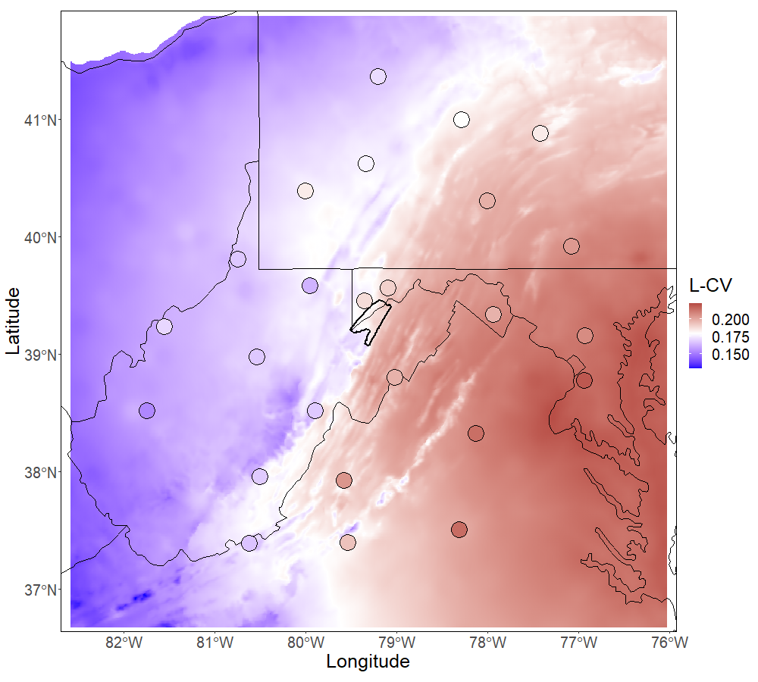
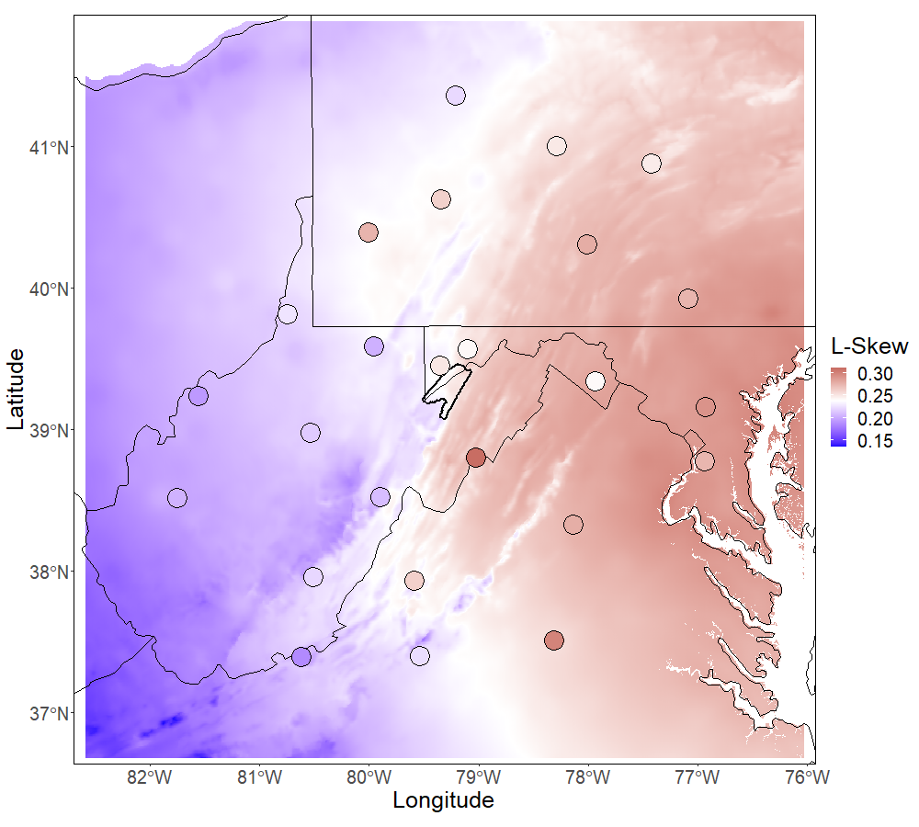
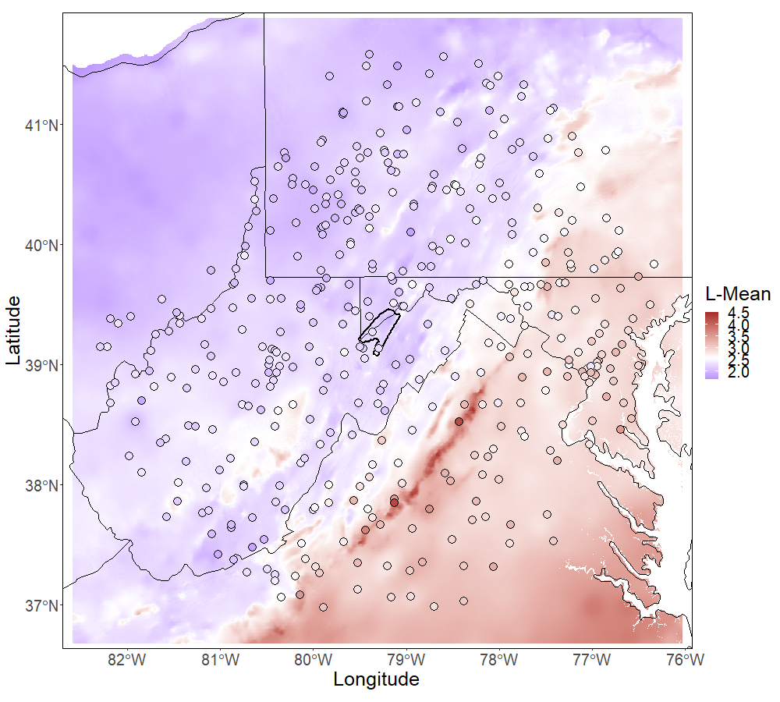
Regional Frequency Analysis –
Spatial Regression
Analyze regional trends in rainfall statistics
Predict rainfall statistics using physical characteristics

Slide 15
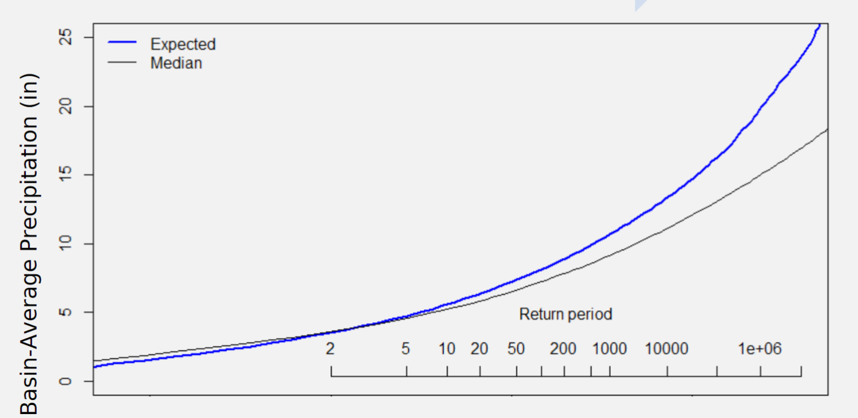
Precipitation-Frequency Curve
Choose Frequency
Take Basin-Average Point Precipitation
Apply ARF
Apply Spatial/Temporal Pattern
Rainfall-Runoff Model

Slide 16
Precipitation-Frequency Data Products

Slide 17
Precipitation-Frequency Data
For most applications: NOAA Atlas 14
Other cases: NOAA Atlas 2/TP-49, custom studies
Input data: isopluvial raster
  Represents a storm of a single duration and frequency occurring everywhere
  Not a storm pattern!

Slide 18
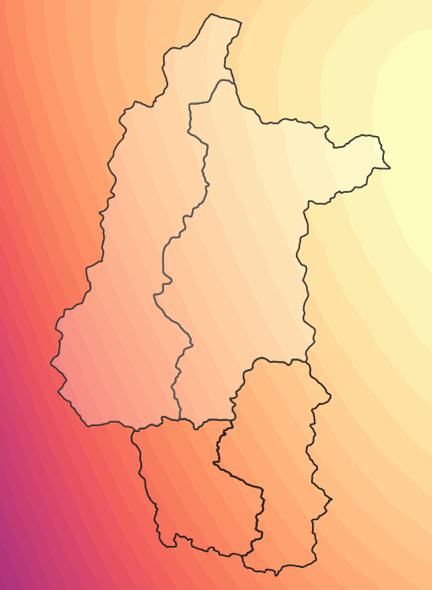
Precipitation Depth
Computed as a watershed-average above the computation point
Represents an average point precipitation – which must be areally reduced using an ARF
Average = 7.50 in
Computation Point

Slide 19
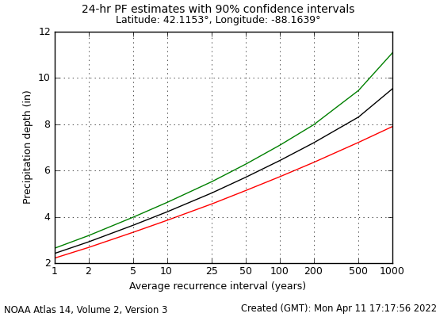
Precipitation-Frequency Curves
Notes:
Each pixel of the raster has a curve like this – to build the raster, go to the same average recurrence interval on the x-axis (for example 100 years) and then read off the value on the black curve.

Slide 20
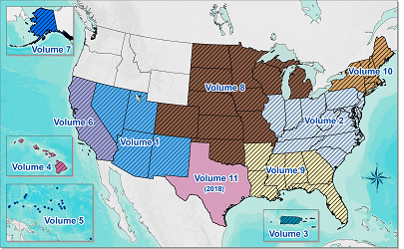
NOAA Atlas 14
Primary source of precipitation-frequency for most of the U.S.
Volume 1 (2004) to Volume 11 (2018)
Frequencies up to 1/1,000
☹️

Slide 21
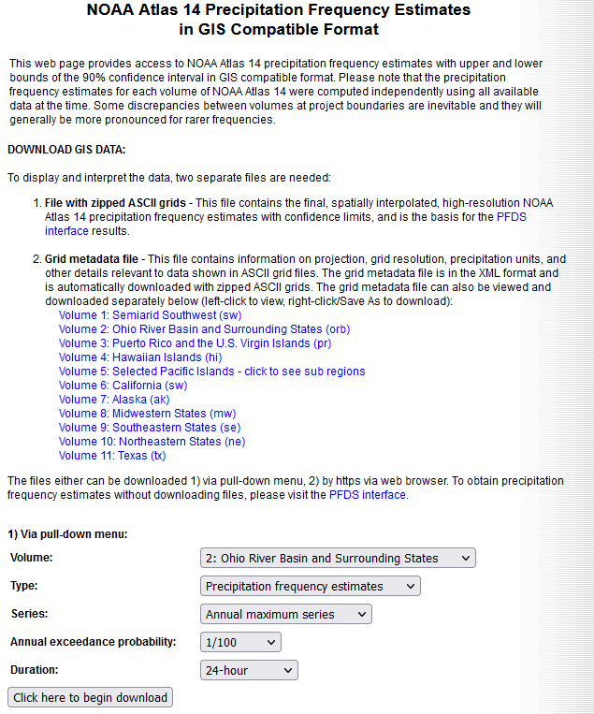
NOAA Atlas 14 – Getting Data
NOAA Precipitation Frequency Data Server (PFDS)
Rasters (.asc) for all volumes
Select AEP and Duration

Slide 22
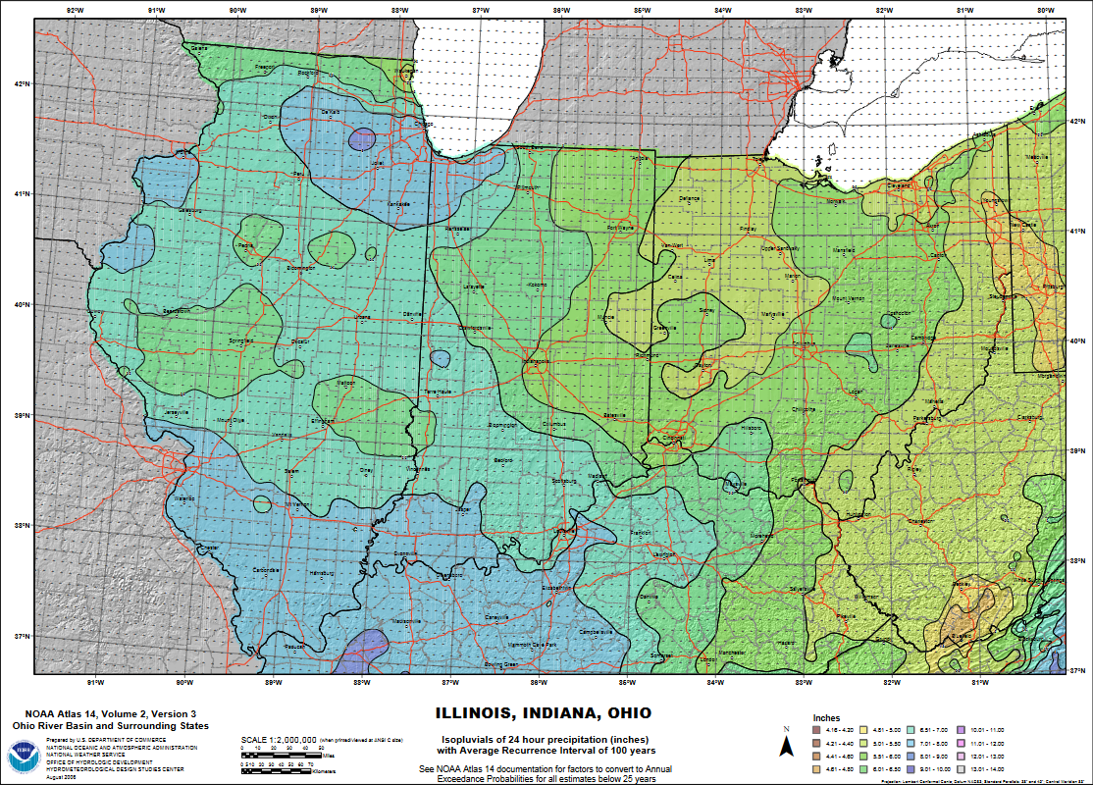
24-hour
1/100 AEP

Slide 23
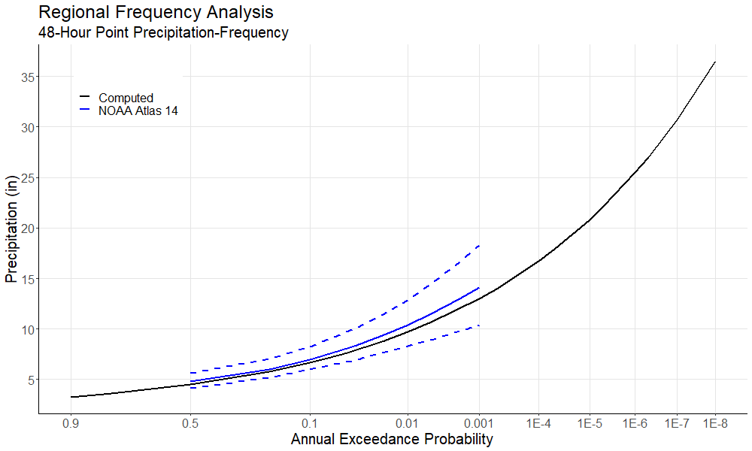
Custom Studies
Extend to much rarer frequencies than NOAA Atlas 14
Regional studies
Site-specific
  Typically at the IES-level
Notes:
Key difference: regional studies typically produce isopluvial rasters (similar to NA14), and site-specific typically produce basin-average frequency curves

Slide 24

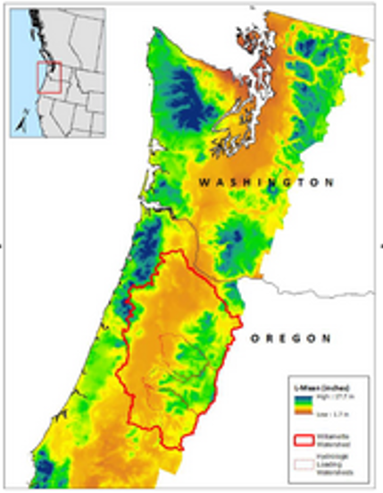
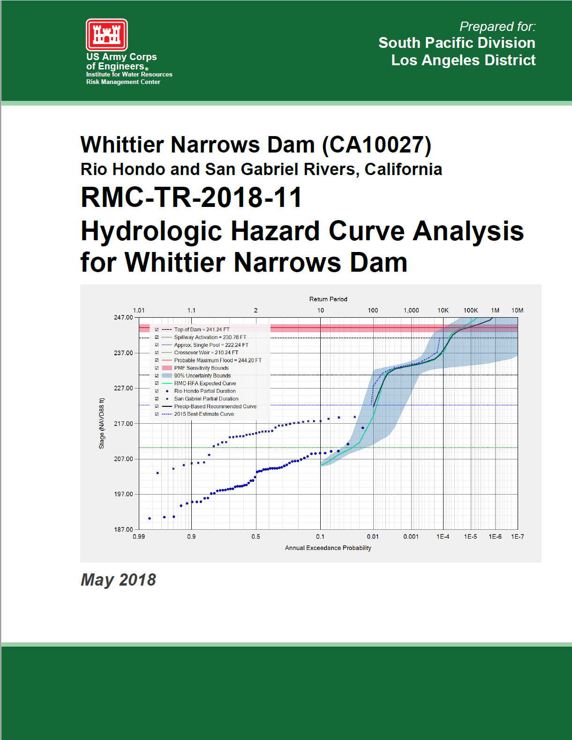
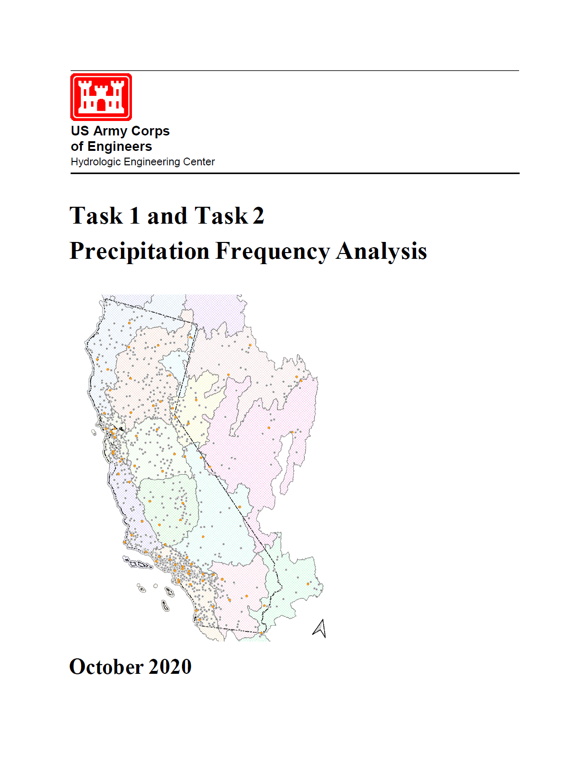
Custom Studies
Regional Studies
  Willamette Basin (2017)
  California DSOD (2020)
Site-Specific Studies
  Garrison/Ft. Peck (2016)
  Whittier Narrows (2018)
  Buford (in review)
  Kanopolis (in review)
  Jennings Randolph (in review)
Notes:
DSOD = Division of Safety of Dams
Also Tennessee Valley Authority (TVA)

Slide 25
Modeling Hypothetical Storm Events

Slide 26
Modeling Hypothetical Storm Events
Hydrologic considerations
  How does the watershed respond during a flood?
Meteorologic considerations
  What meteorologic characteristics create a flood?

Slide 27
Hydrologic Considerations
Model calibration
Initial conditions for flood frequency analysis
Non-linearity of hydrologic response
  Dependency of hydrologic parameters on amount of rainfall

Slide 28
Meteorologic Considerations
Storm duration
Storm spatial pattern
  Distribution of rainfall
  Area reduction
Storm temporal pattern
Unique for all storms, but we generalize

Slide 29
Watershed Response
Peak flow is sensitive to all the hypothetical storm settings
  Time pattern (most sensitive)
  Storm duration
  Area reduction
  Spatial pattern (least sensitive)

Slide 30
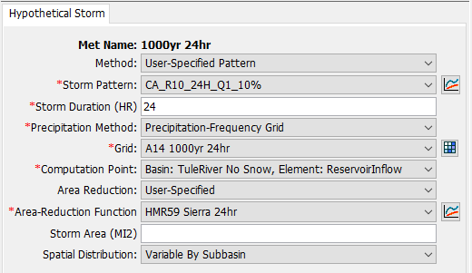
Hypothetical Storm in HEC-HMS
Precipitation-frequency grid for a given AEP
Temporal pattern
Storm duration
Area Reduction
Optional spatial distribution
Notes:
The precipitation method can either be a precipitation-frequency grid or a point depth. Most precip-frequency products should have grids, but if only a curve was developed, a basin-average POINT depth could be applied here. Areal reduction will be applied to both cases

Slide 31
Storm Duration
Total amount of time of rainfall
Time pattern depends on it
Chosen one of two ways:
  Watershed-based (close to time of concentration)
  Meteorologically-based

Slide 32
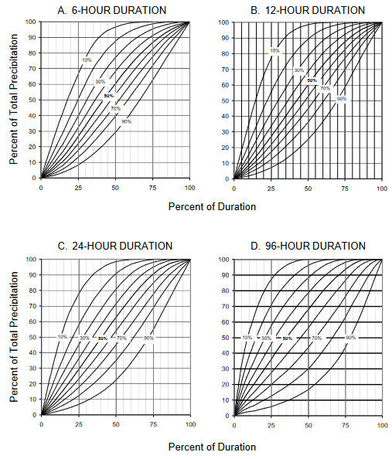
Time Patterns
Dependent on storm duration
Two sources:
  Observed storms
  Synthetic patterns
Input as a Paired Data curve
  Percentage curve
Notes:
Time pattern usually defines what the most severe increments of rainfall are – they are shown as percents of the total storm duration and total storm depth (cumulative curves)

Slide 33
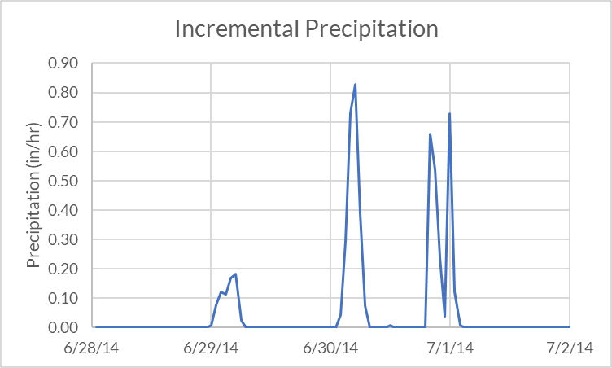
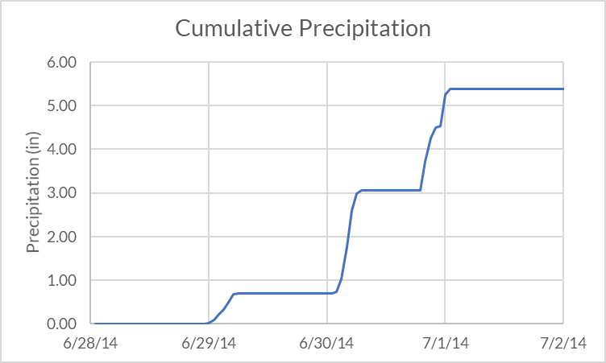
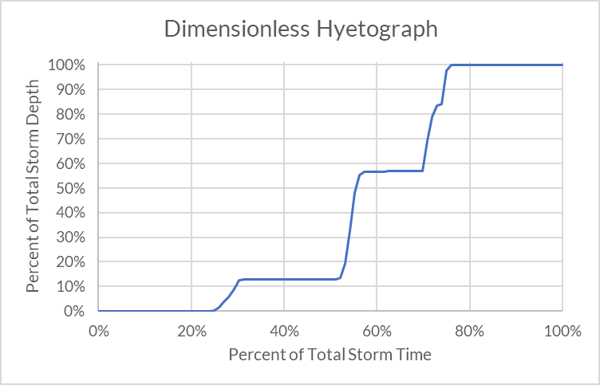
Time Pattern from Observed Storm
Dimensionless %-% cumulative pattern
% of total duration
% of total depth

Slide 34
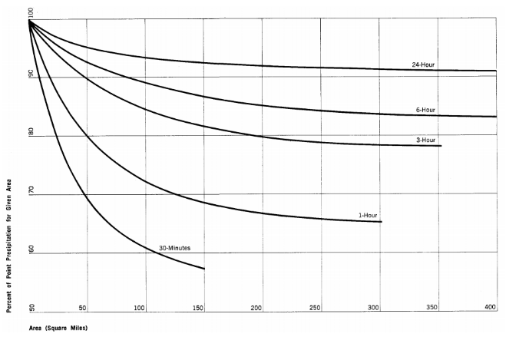

Area Reduction
Precipitation-frequency describes precipitation at a point
Compute area-average from point depths
Area-average reduced from point-average
24-hour
6-hour
3-hour
Percent of Point (%)
1-hour
30-min
Area (mi²)

Slide 35
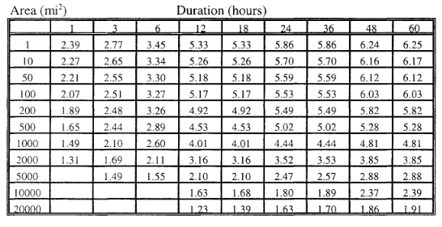
Depth-Area Reduction from Observed Events
Storm information summarized in depth-area-duration table

Slide 36
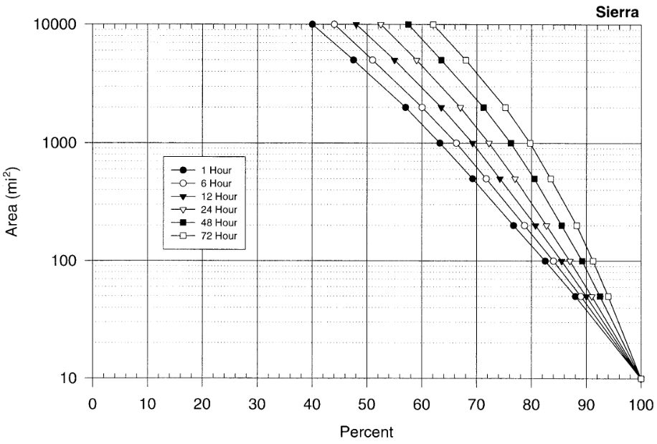
Example from HMR-59
< 10 mi² = 100%

Slide 37
Spatial Pattern
Spatially-uniform for all subbasins
  For small watersheds, usually an OK assumption
Variable by subbasin
  Specified depth for each subbasin

Slide 38
Modeling Flood Frequency with HEC-HMS

Slide 39
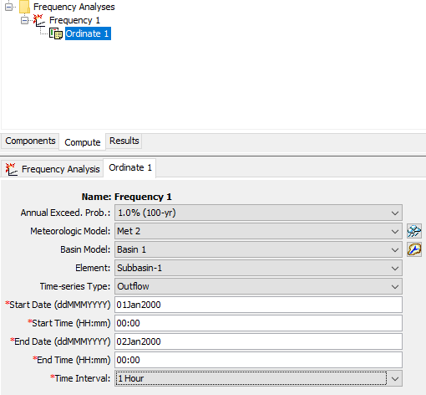
Frequency Analysis Compute
Each ordinate combines:
  AEP
  Meteorologic Model
  Basin Model
Extracts timeseries maximum
Plots as frequency curve
A14 Frequencies:
2-1,000yr
Notes:
Note: currently, the FA is limited to frequencies listed in A14. If you want to run other frequency events (say you have a custom product with other frequencies) you will need to run those as individual events in a Simulation Run and combine them later, as we will do in the workshop.

Slide 40
AEP Neutral Approach
Assumption:
  Precipitation frequency for a particular depth and duration equals the flood frequency
  i.e., 1/100 AEP rainfall causes 1/100 AEP flood
More advanced techniques are required to break free of this assumption
Notes:
The more advanced techniques are beyond the scope of this class but I’m happy to discuss them off-line.

Slide 41
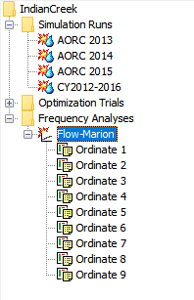
Frequency Analysis Compute
Collection of frequency ordinates (AEPs)
User specifies a basin model and met model combination that represents a specific AEP
  One met model per AEP
HEC-HMS runs each ordinate as a separate simulation
Collects the results
Creates a frequency curve plot

Slide 42
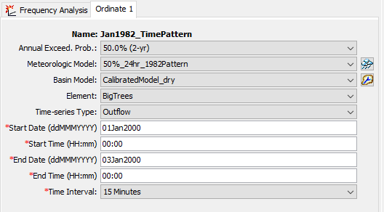
Frequency Analysis Ordinate
Notes:
Here is the interface again for a frequency analysis ordinate. Right now you can only choose AEPs from a list – these are the AEPs used in Atlas 14.
In the simplest of cases, your HMS project might contain one met model for each frequency ordinate, and one total basin model. However, in most situations you will need to create multiple basin models in order to capture initial conditions. To do this, first create a “master” basin model that has all the parameters set that you don’t plan to change. Then, make a number of copies of that master basin model and in the copies change only the parameters you intend to vary (for example initial deficit in a deficit and constant loss model.)

Slide 43
Frequency Analysis Ordinate
Meteorologic model defines the AEP
  Frequency from the precipitation-frequency data
Basin model captures appropriate hydrologic conditions for AEP
  Based on a calibrated model (if data available)
  Initial conditions
  Considerations for non-linearity
Time window
  Make sure window big enough to capture the peak

Slide 44
Basin Models
Calibrate model across range of events
Choose calibration parameter sets to represent range of conditions
  e.g. “dry”, “average”, “wet”
Create a basin model for each condition set
Decide which AEPs need which conditions

Slide 45
Meteorologic Models
The Frequency Analysis will use ANY meteorologic model!
You should probably use:
  Hypothetical storm
  Frequency storm
  Specified hyetograph (in specific instances)

Slide 46
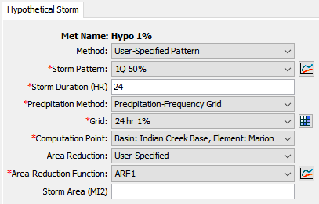
Hypothetical Storm
Paired Data: Percentage Curve
Grid Data: Precipitation-Frequency
Paired Data: Area-Reduction Func.
Notes:
Pro tip: leave the storm area blank to automatically compute it as the drainage area above the computation point!

Slide 47
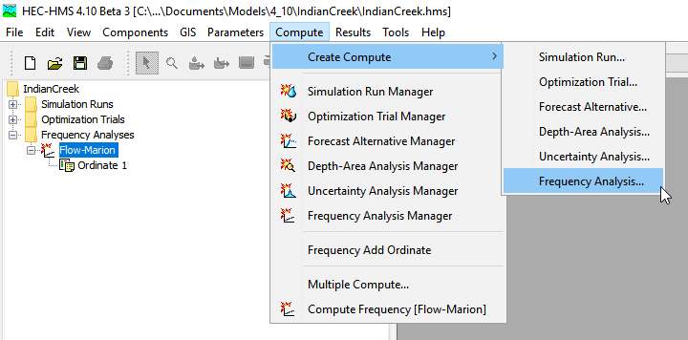
Create Frequency Analysis

Slide 48
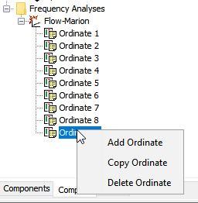
Add/Copy/Delete Ordinates
Right-click menu

Slide 49
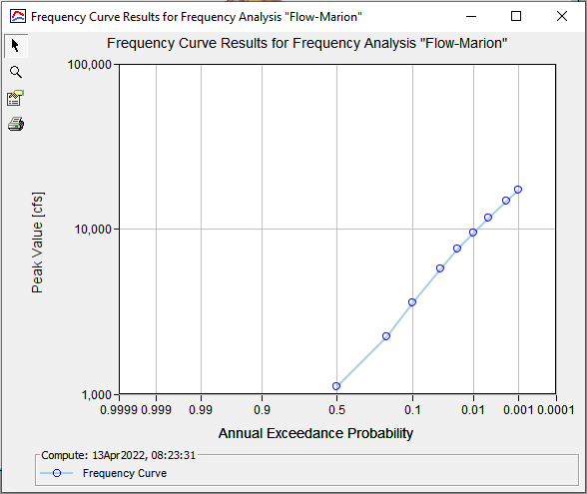
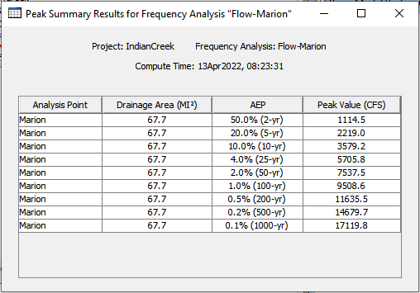
Frequency Analysis
Results

Slide 50
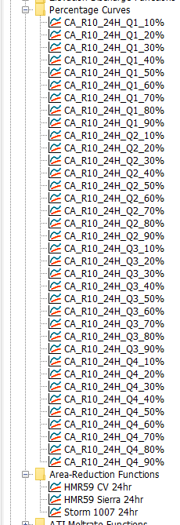
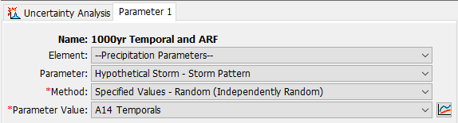
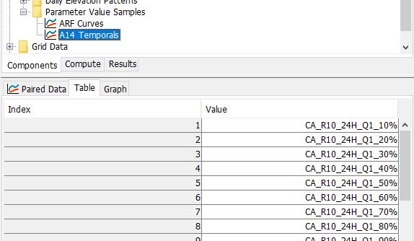
Uncertainty
Sample hypothetical storm parameters in Uncertainty Analysis
  Time patterns
  Area reduction functions
Notes:
Note: this has to be run for discrete events (i.e. one frequency at a time in separate UA)

Slide 51
Questions?

