Slide 1
Frequency and Hypothetical Storm Methodologies
Part I: Intro to Hypothetical Storms
Advanced HEC-HMS
June 2026
Slides courtesy of: Melissa Mika
Presented by: Josh Willis

Slide 2
Outline
What is a hypothetical storm?
Precipitation-frequency analysis products
Rainfall-runoff flow frequency tools in HEC-HMS
  Met models
    HEC-HMS Frequency Storm
    HEC-HMS Hypothetical Storm
  Compute types
    Depth-Area Analysis simulation
    Frequency Analysis simulation

Slide 3

An analogy…
Notes:
Image you are exploring and analyzing a small section of the Amazon Rain Forest…
Task: estimate the height of the tallest tree in the entire forest after exploring only a small section of it.
Task: what percentage of trees are greater than 100 ft tall?
Having only seen a small part of the forest, these are super challenging tasks.
Small section of forest ~ our historical storm record data that we have available to us
Guessing other heights of trees beyond what we observe ~ development of hypothetical storms

Slide 4
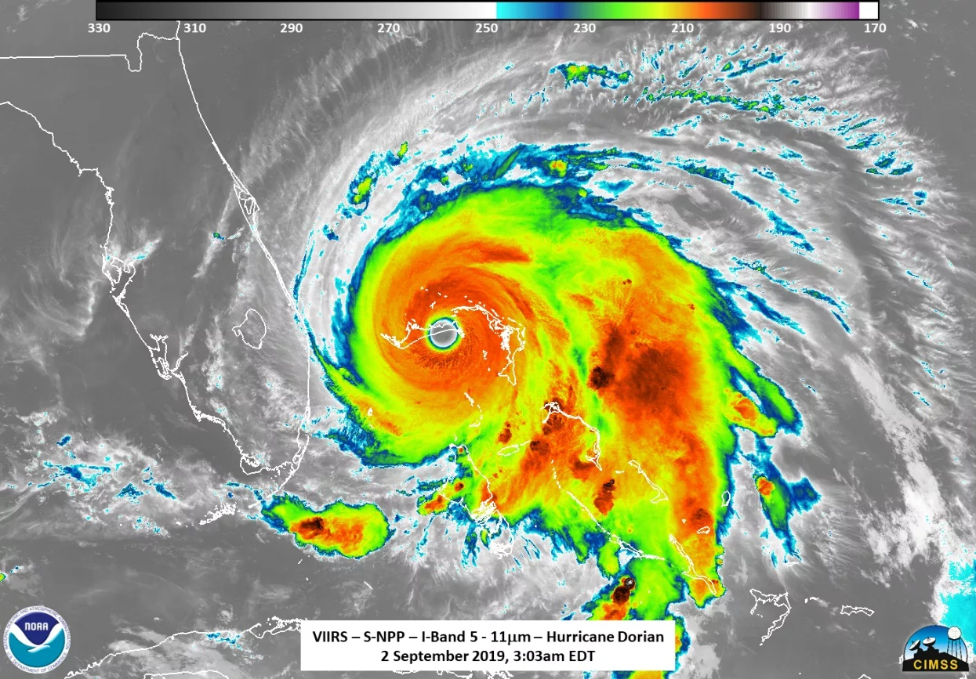
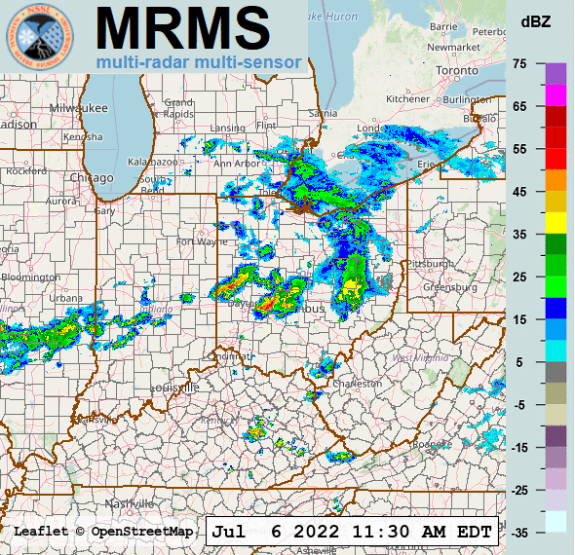
Real Precipitation
Notes:
These radar images represent real, observed historical storms. We use historical precipitation to model historical events or calibrate our models to observed data.
Up to now, we’ve studied storms that did happen. Today we turn to storms that have not happened in our record but could happen in the real world.
That means asking two uncomfortable questions:
How big can a storm physically get?
How surprised should we be when a very large one finally occurs?

Slide 5
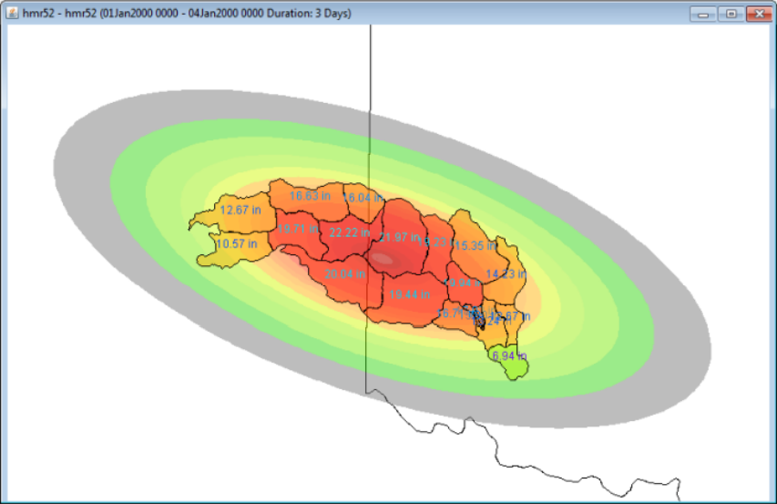
Hypothetical Storms
Idealized precipitation events used for design or risk analysis
Simplified versions of real storms with desirable properties
Hypothetical storms are used for design and risk analysis
Notes:
A hypothetical storm does not represent a real observed event, but rather an event that has idealized conditions. These typically represent a specific recurrence interval or annual exceedance probability (AEP) and are used for design or risk analysis.
Or, a hypothetical storm can also be a simplified version of a real storm where we have changed the properties of the storm, such as moving the location or orientation to maximize runoff.

Slide 6
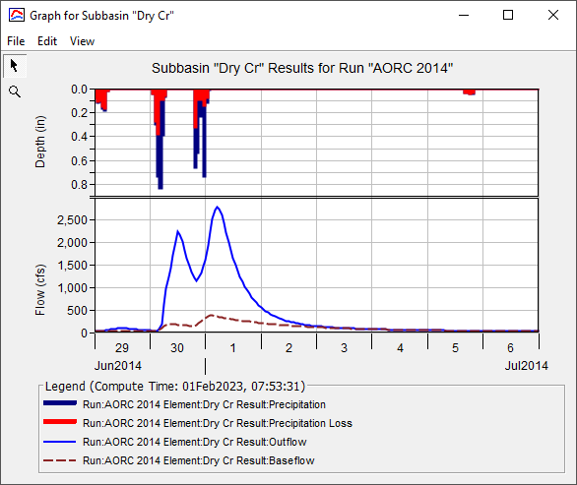
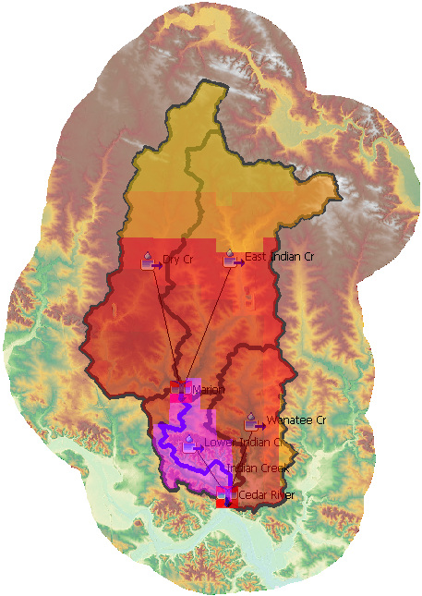
Simplifications
Storm duration
Temporal patterns
Spatial patterns
Notes:
The storms applied in hypothetical storm methods are simplifications of real storms, which are often chaotic in spatial and temporal pattern.
These are the properties of a storm which can be simplified: duration, temporal pattern, spatial pattern.

Slide 7
Design Properties
Hypothetical storms are created with design depth-duration information
Probable maximum precipitation (PMP)
  Location- and season-specific depth of precipitation
  Operational upper bound (historically)
Notes:
When creating a hypothetical storm used for design or risk analysis, certain depth and duration properties form the basis of the design storm. Such as 2.5 inches over 72 hours.
The PMP is an example of a hypothetical storm that’s often used for risk analysis and for developing a Probable Maximum Flood (PMF)
ER-1110-8-2
“It is the Corps of Engineers policy that dams designed, constructed, or operated by the Corps will not create a threat of loss of life or inordinate property damage.”
“Standard 1 applies to the design of dams capable of placing human life at risk or causing a catastrophe, should they fail. Dam height with appropriate freeboard, spillways, regulating outlets, and structural designs will be such that the dam will safely pass an IDF computed from probable maximum precipitation (PMP) occurring over the watershed above the dam site.”
New PMP publication (2024) by the National Academies: https://nap.nationalacademies.org/catalog/27460/modernizing-probable-maximum-precipitation-estimation

Slide 8
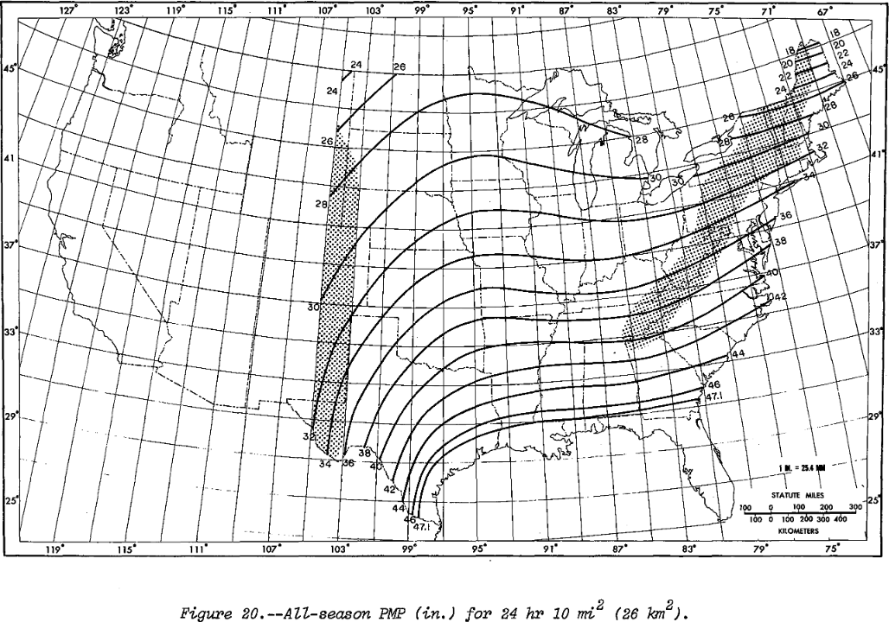
Probable Maximum Precipitation
Notes:
PMP depth estimates can be found in HMRs published by the NWS. The above index map from HMR 51 can be used to retrieve estimates of the all-season PMP for a storm duration of 24hours over an area of 10 square miles.

Slide 9
Probable Maximum Precipitation
Notes:
HMR 52 discusses how to develop a Probable Maximum Storm using the PMP depth estimates from HMR 51 (spatial distribution, temporal distribution, orientation, size).
For the eastern US, an idealized elliptical pattern was developed, as shown on this slide. The PMP depth decreases as the elliptical area increases. This pattern is overlaid on top of the watershed delineation to compute a subbasin average PMP. Tables in HMR 52 contain multipliers for each ellipse. These tables are broken up into 6-hour increments. The 6-hour increments are referred to based on intensity. The 1st 6-hour increment contains the most intense 6-hour precipitation depth. This increment contains the most spatial variability. No spatial variability is observed for the 4-12 6-hour increments.
Spatially, major storm isohyetal patterns were analyzed for statistics on pattern shape and a major-minor axis ratio of 2.5:1 was adopted.

Slide 10
Probable Maximum Precipitation
Notes:
HMR 52 discusses how to take the PMP depth estimates from HMR51 and develop a hypothetical storm.
Recommended guidance for distributing the PMP depths in time can be found in HMR 52. The guidance is based on examining 28 storms. HMR 52 recommends arranging individual 6-hr increments such that they decrease progressively to either side of the greatest 6-hr increment and placing the four greatest 6-hr increments at any position in the sequence except within the first 24-hr period of the storm sequence.
Following these guidelines, the goal is to develop a time pattern that maximizes runoff. It makes sense to place the more intense precipitation toward the end of the 72-hour event. You can maximum runoff by applying the most intense rainfall when the watershed is saturated. Additionally, historic storms in your area could be used as a source for developing the temporal pattern.

Slide 11
Design Properties
Need to take some design depth-duration information and make a storm out of it
Probable maximum precipitation (PMP)
  Location- and season-specific depth of precipitation
  Operational upper bound (historically)
Depth-duration-frequency
  Relationship between depth, duration, and probability
  for a location
Notes:
PMP hypothetical storms are covered in H&H for Dam Safety PROSPECT course. This lecture and workshop will focus on depth-duration-frequency hypothetical storms (that can be assigned an annual exceedance probably).

Slide 12

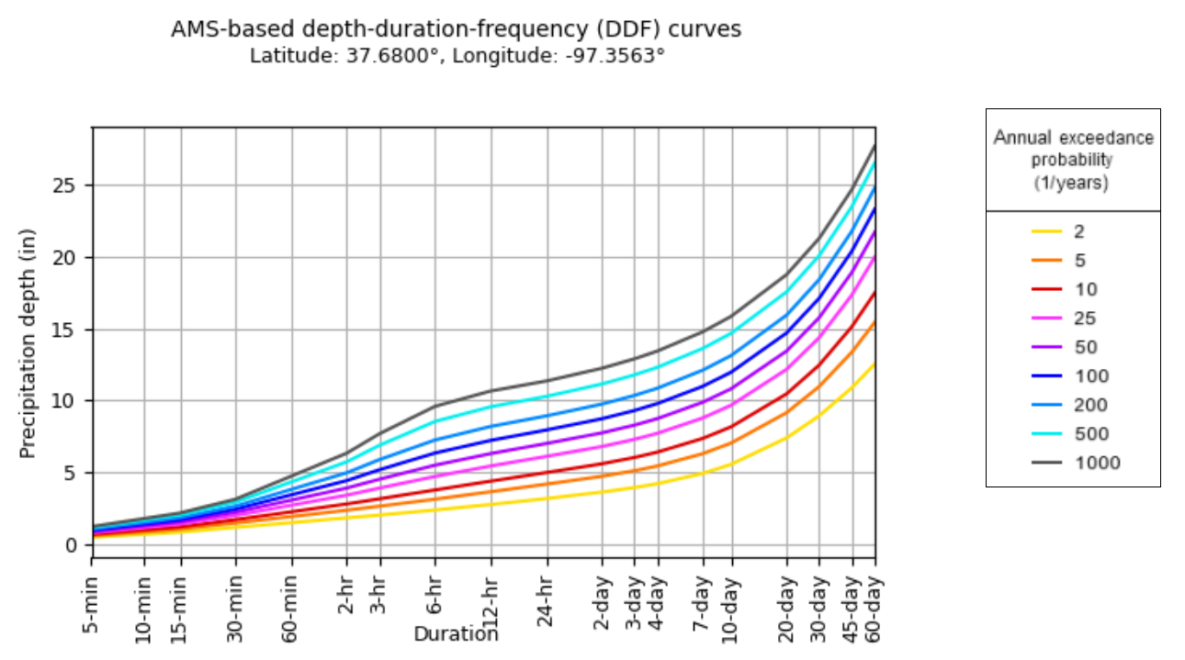
Depth-Duration-Frequency (DDF)
Depth- or intensity-duration-frequency curves are common design tools in engineering
Data for a point
Loses information about shorter durations
Notes:
Depth-duration-frequency (DDF) curves describe rainfall depth as a function of duration for given return periods. Similar curves are the intensity-duration-frequency (IDF).
These describe storm properties for a region across many frequencies. Storm properties for a single storm are often described by a depth-area-duration (DAD) table.

Slide 13
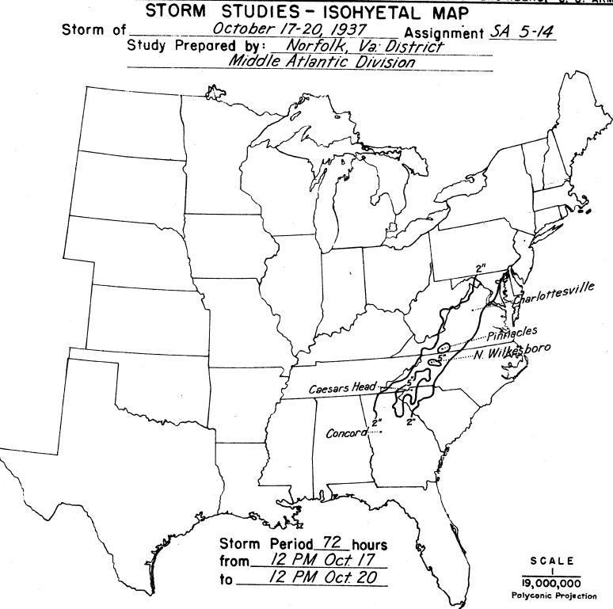
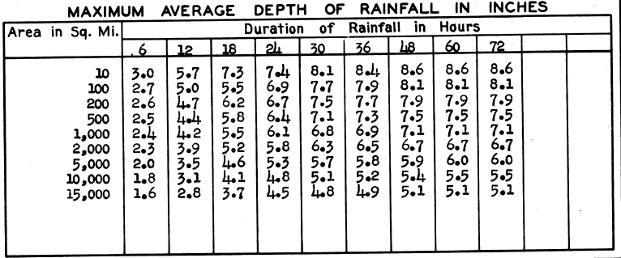
Not to be confused with…
Depth-Area-Duration (DAD)
Notes:
These graphics come from the “War Catalog” aka “Black book” historical document series compiled by USACE in collaboration with the U.S. Weather Bureau (now the National Weather Service).
Originally compiled in 1945 and updated via loose-leaf supplements through 1973, this thick, black-bound binder contains the forensic reconstructions of over 1,000 of the largest, most catastrophic historical storm events recorded across the continental United States.

Slide 14
Not to be confused with…
Depth-Area-Duration (DAD)
Depth-Duration-Frequency (DDF)
Depth-Area-Duration (DAD)
Represents properties of idealized frequency storms
Summarizes depths at various frequencies
Can be used in frequency analysis to simulate a specific frequency event
E.g., 3.1 inches over 24 hours for the 1/100 AEP event
Represents properties of a single observed storm
Summarizes depths at various storm areas
Can be used to develop depth-area reduction factor (DARF/ARF)
E.g., 3.1 inches over 24 hours over 50 square miles
Notes:
Depth-Duration-Frequency curves help us select a storm depth given a frequency (AEP) and duration.
Depth-Area-Duration tables allow us to summarize and simplify historical storms, which can be helpful when determining depth-area reduction factors.

Slide 15
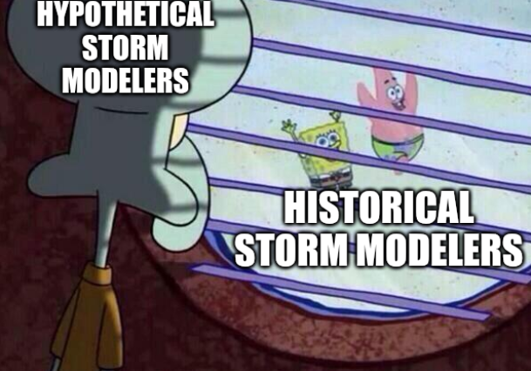
Summary
Historical storms represent real, observed storms
Hypothetical storms represent idealized and/or simplified storms
  Used for design and risk analysis
A hypothetical storm is defined by storm duration, depth, temporal distribution, and spatial distribution

Slide 16
Frequency and Hypothetical Storm Methodologies
Part II: Precipitation-Frequency Analysis Products
Advanced HEC-HMS
June 2026
Slides courtesy of: Melissa Mika
Presented by: Josh Willis

Slide 17
Recap: How we define a design storm
How we apply a hyetograph over an area
Duration
Area Reduction
Depth
Temporal Pattern
Spatial Pattern
How we define a hyetograph

Slide 18

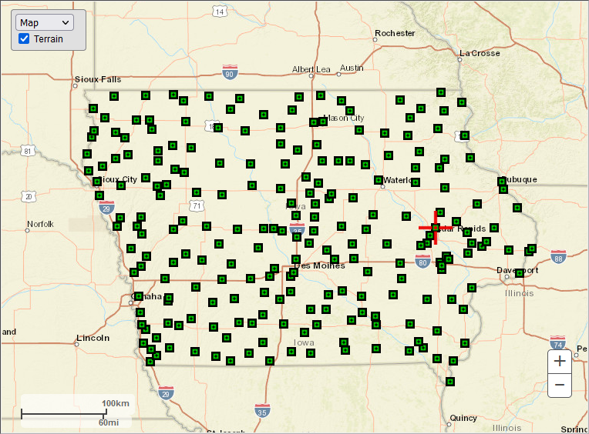
Point Data
Precipitation is measured at gages
Notes:
Precipitation data is typically measured as point data from gages

Slide 19
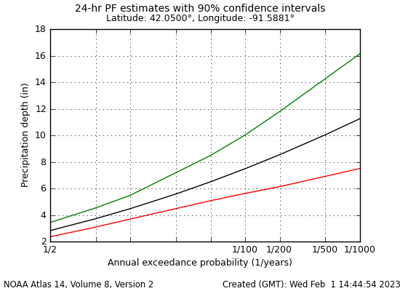
Precipitation-Frequency Analysis
(AMS)
Analysis of the maximum rainfall depth per year at a gage
Considers multiple durations of accumulation
  Dependent on gage recording interval
Develop a probability relationship for maximum depths
(6 hour, 24 hour, 72 hour…)
(precipitation-frequency curve)
At-Site
Regional
Notes:
We use the point data to perform precipitation-frequency analysis, much like flood frequency analysis. We can extract annual maximum series (AMS) or partial duration series (PDS) from the time series and fit a curve. This is typically done on multiple durations of accumulation. The limiting factor is often the recording interval of the gage, as most gages with a long period of record are recorded on 1-day intervals.
Precipitation-frequency analysis can be done using a single precipitation gage (at-site), or more commonly a regional frequency analysis is performed using many gages within a representative region.

Slide 20
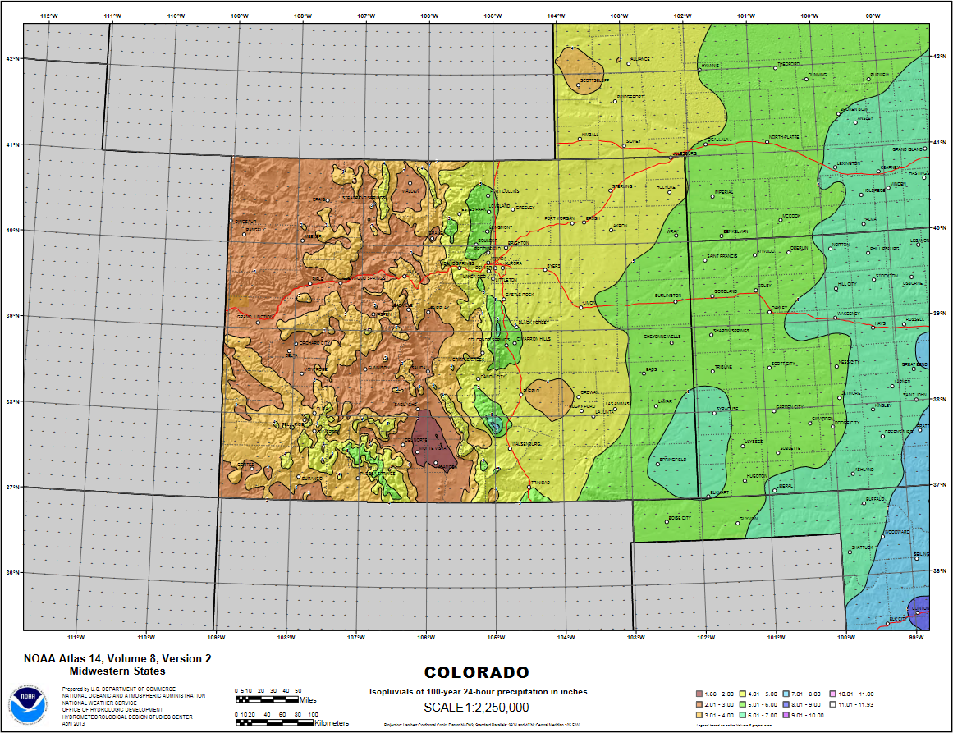


Precipitation-Frequency Grids
Depth for a duration and frequency as a map
NOT a storm pattern
Put a pin in the map and get depth anywhere

Slide 21
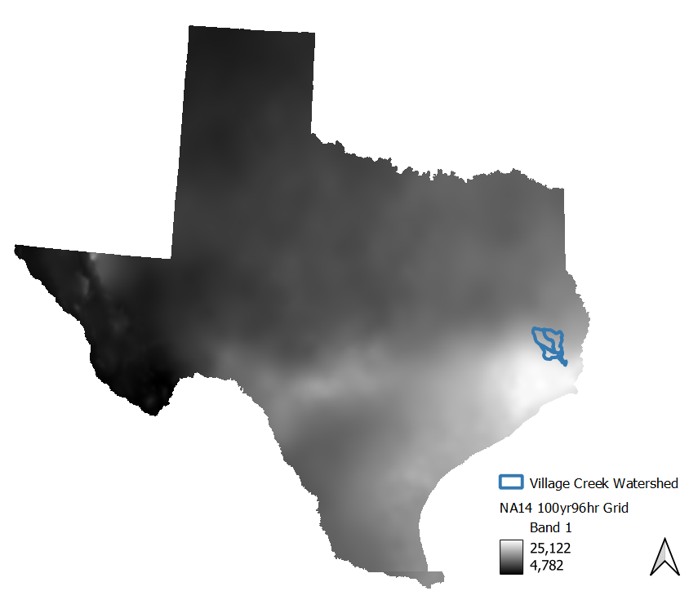
Precipitation-Frequency Grids
Depth for a duration and frequency as a map
NOT a storm pattern
Put a pin in the map and get depth anywhere

Slide 22
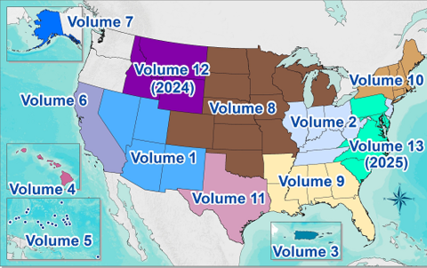
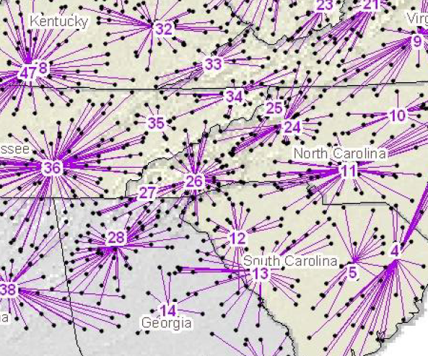
NOAA Atlas 14
NOAA Atlas 14 precipitation frequency estimates
Standard source of data for the US
Frequencies up to 1/1,000
Uses a regional approach:
  Improves sample sizes
  Allows estimation where there aren’t gages
Notes:
Volume 1 was developed as far back as 20 years ago (2004). NOAA Atlas 15, which will be a CONUS-wide approach, is actively under development.

Slide 23
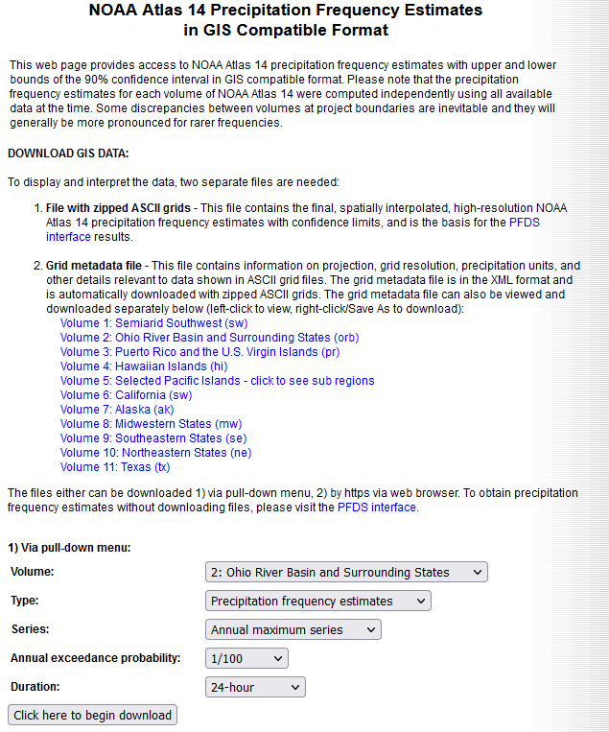
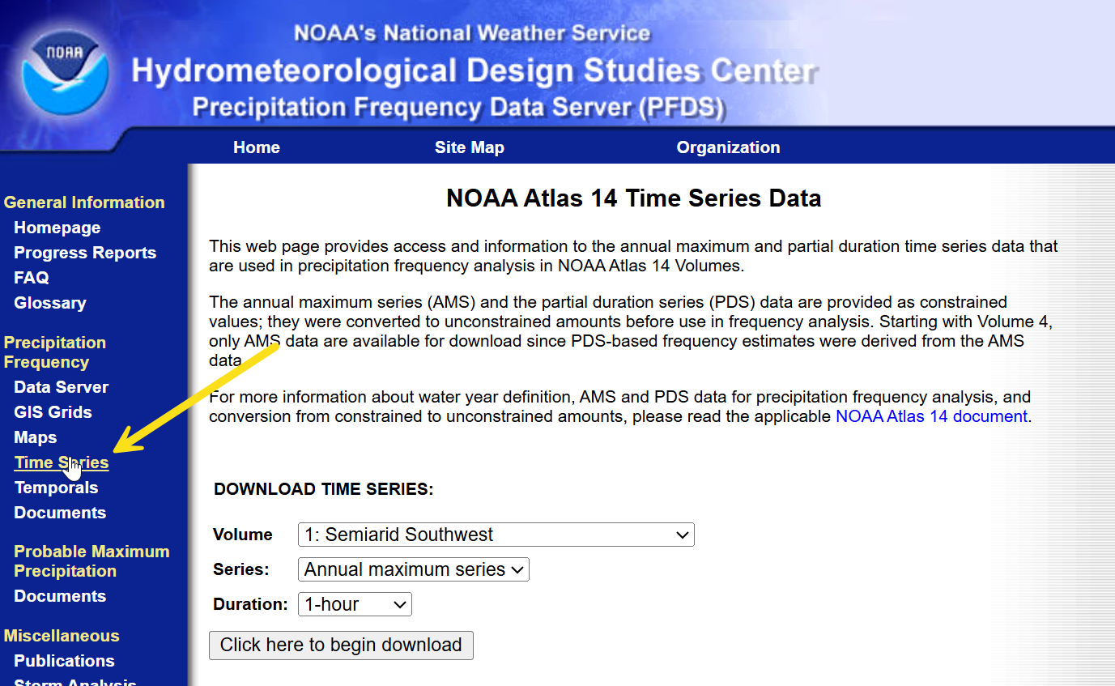
Getting NOAA Atlas 14 Data
NOAA Precipitation Frequency Data Server (PFDS)
Point estimates (selected by address or from a map)
Rasters (.asc) for all volumes (selected by AEP and Duration)
Time series (AMS and PDS)
  Underlying data used to
  develop each volume
Use this if there is little spatial variability
Use this if there is significant spatial variability

Slide 24
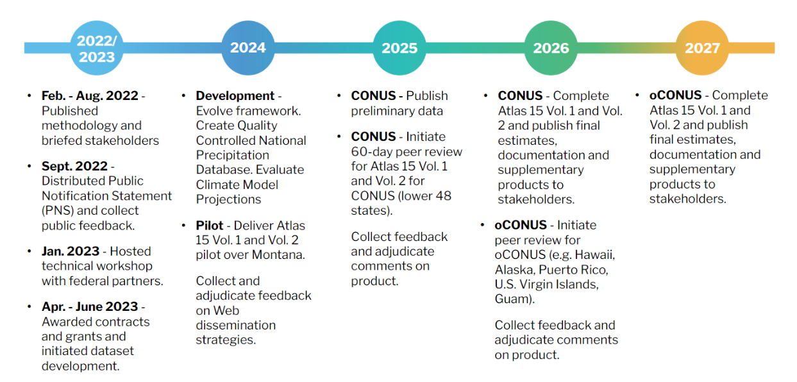
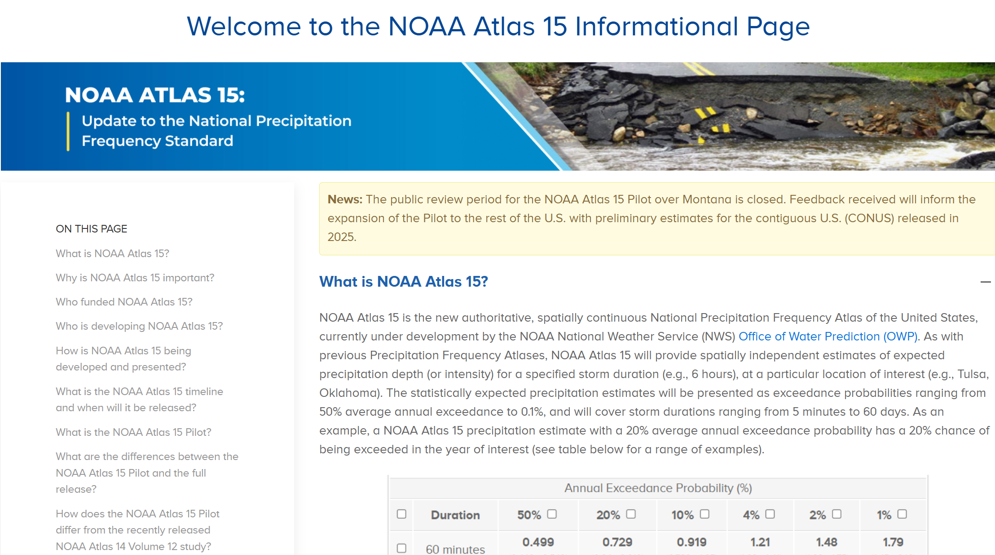
NOAA Atlas 15 – Coming Soon
https://water.noaa.gov/about/atlas15

Slide 25

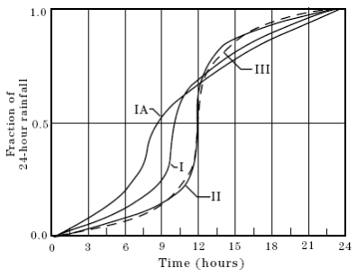
Temporal Patterns
How the rainfall is distributed in time
Goal: representative of realistic storms for the region
Can use synthetic patterns or historical patterns
Great opportunity for sensitivity analysis or uncertainty analysis!
SCS 24-hour rainfall distributions (Figure B-1, TR-55)

Slide 26

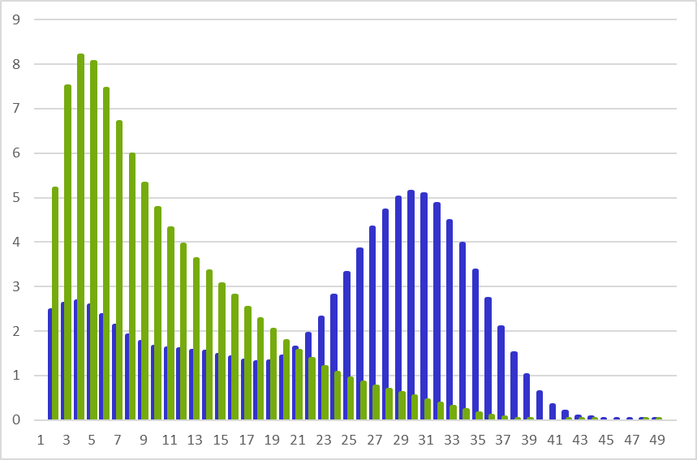
NOAA Atlas 14 Temporal Patterns
Probabilistic analysis of time patterns of heavy rainfall
4 durations: 6-, 12-, 24-, and 96-hour
Classified by “quartile” and “percentile”
Quartile = which quarter of storm has the most volume
Percentile = ranking of peakedness of storms in a quartile
Q1 Q2 Q3 Q4

Slide 27
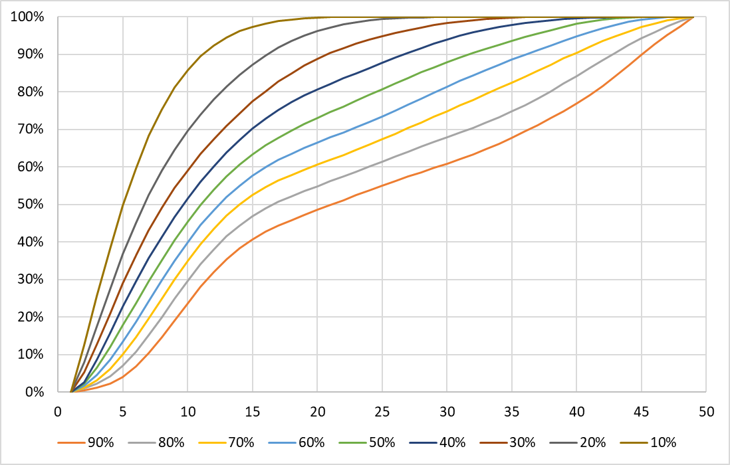
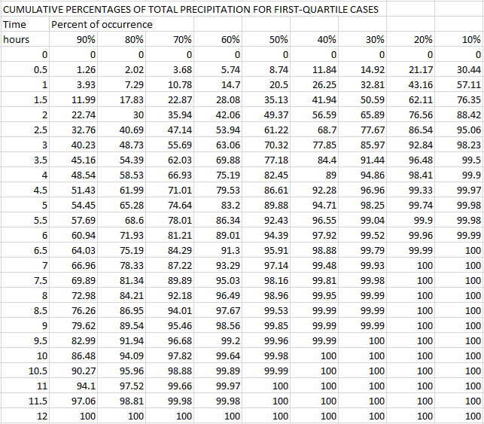
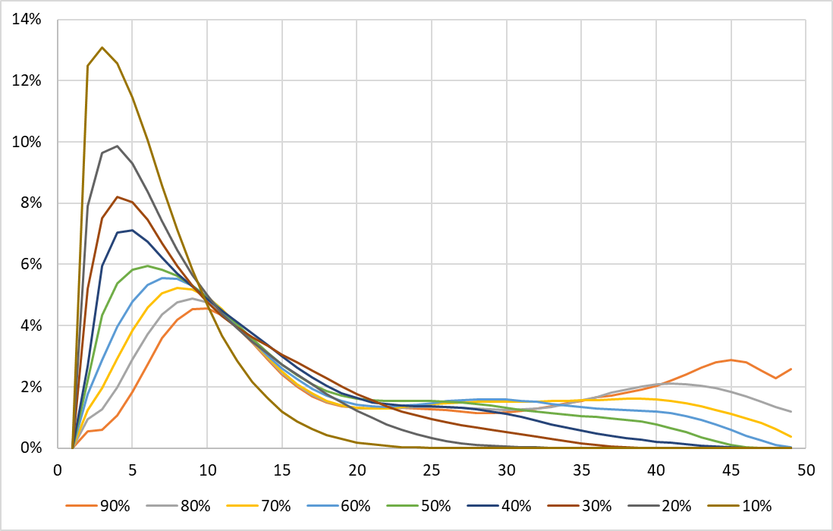
First Quartile
Cumulative
Incremental
Notes:
These are cumulative curves – cumulative time vs. cumulative percent of total precipitation.

Slide 28


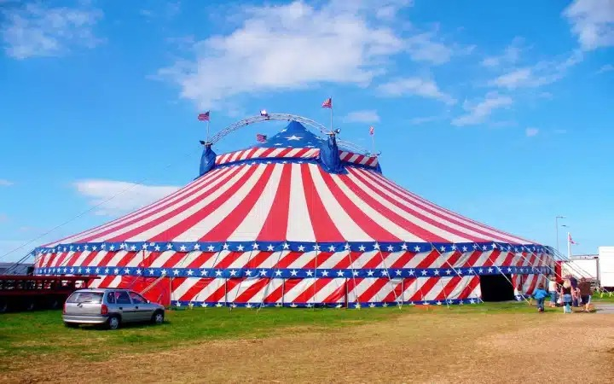
Area Reduction
Precipitation averaged over an area is less than point maximum
Effect more pronounced at shorter durations and larger watersheds
Simplification of spatial pattern
Notes:
Precipitation frequency depths, such as from depth-duration-frequency curves, represent a point depth. The point depth can be thought of as the storm center. A real storm has areas of highest intensity at the storm center, with intensities reducing radially from the center, much like a circus tent. We apply an area reduction factor as a simplification of the spatial pattern – it represents the average precipitation depth over a specified area when taking into account how the storm spatial pattern varies.

Slide 29
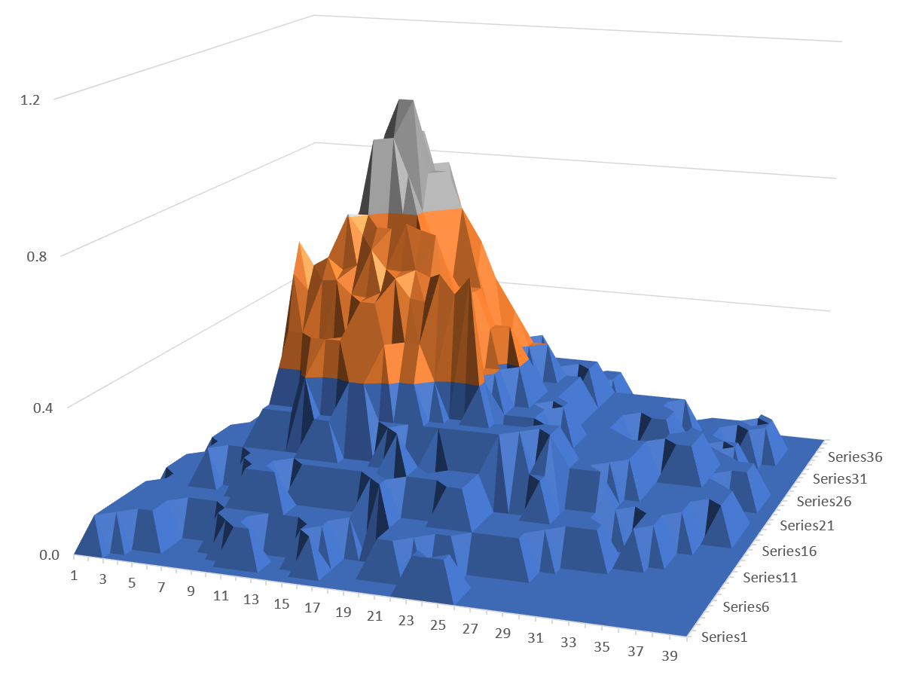
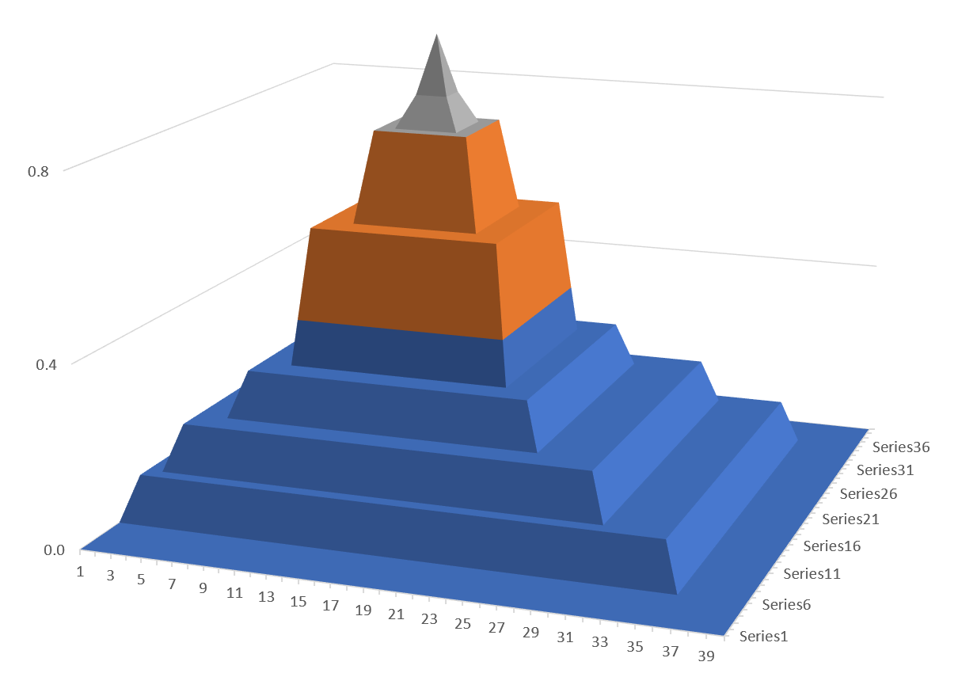
Area Reduction
10 mi² maximum:
100%
10 mi² maximum:
5 in
100 mi²
200 mi² average:
4.2/5 = 84%
200 mi² average:
4.2 in
Precipitation Depth (in)
Percent of Maximum
500 mi²
1,000 mi²
Notes:
To calculate area reduction factors from a real storm, we first take the storm maximum depth. Note, this is repeated for each duration of interest. We typically assign the 10 square mile depth as the “point maximum”, which is an appropriate assumption for the scale of storms that we are generally interested in. In this example, the point maximum is 5 inches over 24 hours. Next, calculate the precipitation depth averaged over various areas, such as 100 square miles, 200 square miles, 500 square miles, etc. Make sure to maximize the depths by centering the areas around the storm center. In this example, the average depth over 200 square miles was 4.2 inches.
Next, we standardize the depths into percent-of-maximum, which is the area reduction factor. The point maximum represents 100%. In our example, to calculate the area reduction factor for 200 square miles, we divide the 200 square mile depth (4.2 inches) by the point maximum depth (5 inches) to get an area reduction factor of 0.84 (84%). This process would be repeated for many areas and many durations to construct a depth-area-duration (DAD) table.

Slide 30
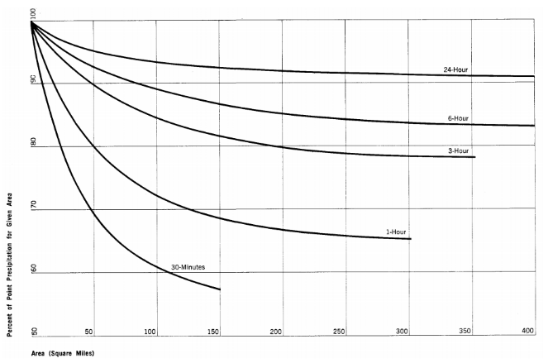
Area Reduction
Conservative assumptions:
Usually assumed that storm area = watershed area
Assumes the worst rainfall perfectly coincides with watershed
Tutorial:
Creating Depth-Area Reduction Curves from Gridded Precipitation Data
24-hour
6-hour
3-hour
Percent of Point (%)
1-hour
30-min
Area (mi²)
Notes:
The TP40 reduction curves were developed using only drainage areas of 400 square miles or less so the curves flat line and use similar reduction factors for storm area over 400 square miles. Logically, we know that as storm areas increase in size, the reduction factor should continue to decrease. Also, there is evidence that area-reduction varies across the country. For this reason, a User-Specified option exists in HEC-HMS where modelers can create and specify their own area-reduction curves specific to their area of interest.

Slide 31
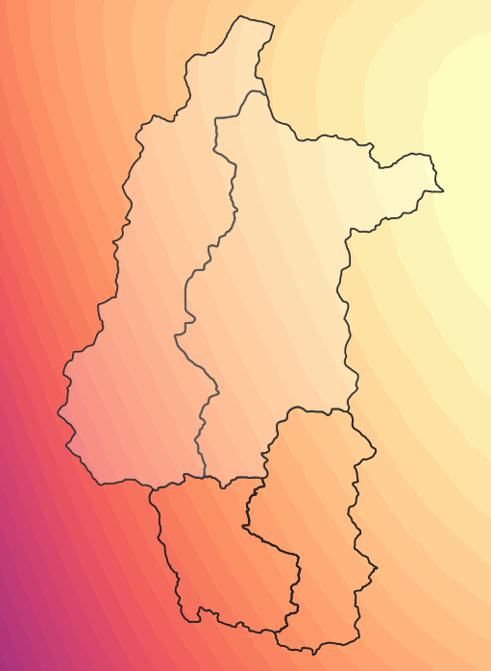
Area-Averaged Precipitation Frequency
Find the area-averaged point depth for duration/frequency
  GIS Zonal Statistics
  HEC-HMS
Apply an ARF for that area and duration
Average = 7.50 in
Computation Point

Slide 32
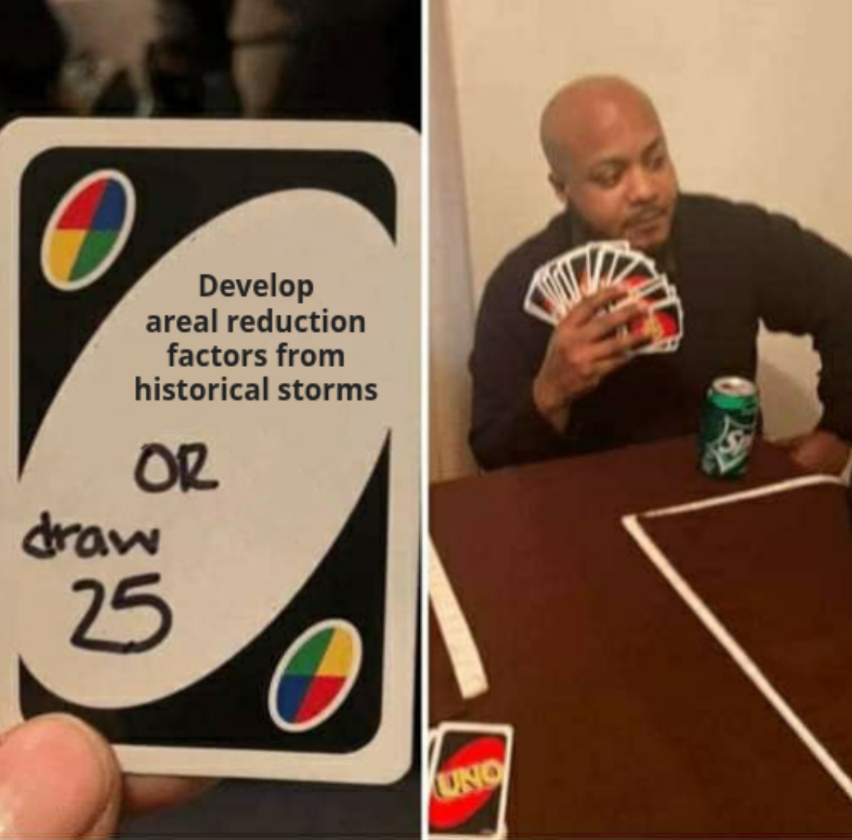
Summary
Precipitation-frequency analysis is used to define depth-duration-frequency curves
NOAA Atlas 14 is the standard precipitation-frequency product for most of the US
Temporal patterns can be synthetic (like NOAA Atlas 14) or historical
Area reduction factors are important for applying point precipitation frequency over a watershed area

Slide 33
Frequency and Hypothetical Storm Methodologies
Part III: Rainfall-runoff flow frequency tools in HEC-HMS
Advanced HEC-HMS
June 2026
Slides courtesy of: Melissa Mika
Presented by: Josh Willis

Slide 34
Motivation
Precipitation-Frequency Data
Rainfall-Runoff Model
Flow Frequency Curve
Notes:
Our motivation is to take precipitation frequency data, construct storm events to run in a rainfall-runoff model, in order to assess the magnitude and frequency of floods.
This workflow is used extensively in design, floodplain management, and risk analysis. It can be used in ungaged watersheds, but also in gaged watersheds to add information to a flow frequency curve.
Because it’s used so often, and used to make decisions, the HMS team has been improving these modeling tools so modelers can develop better models faster.

Slide 35
Flow-Frequency Modeling
Key assumption:
  Probability of rainfall equals probability of flow
  “AEP neutral”
Model flow with a combination of met and basin model
Basin characteristics should vary for different storm magnitudes
Goal is to better match our “AEP neutral” assumption
Notes:
The AEP neutral technique assumes you can calibrate the hydrologic model so that this is true.

Slide 36
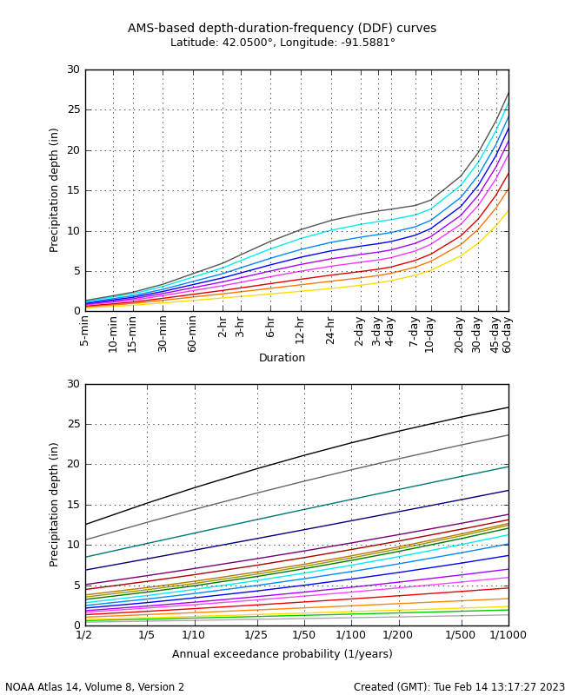
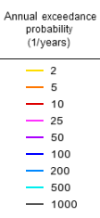
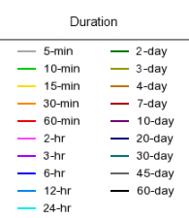
Data

Slide 37
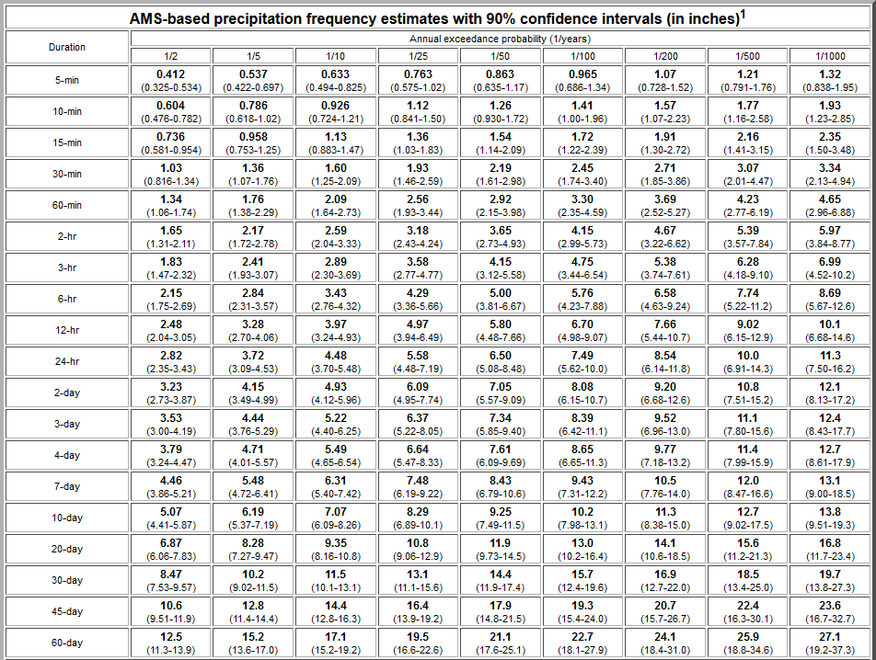
Data

Slide 38
Frequency and Hypothetical Storm Methodologies
Part IV: Storm Methods in HEC-HMS
Advanced HEC-HMS
June 2026
Slides courtesy of: Melissa Mika
Presented by: Josh Willis

Slide 39
Hypothetical Storm Methods in HMS
Design Storms
  HMR52 Storm
  Standard Project Storm
Frequency-Based Storms
  Frequency Storm
  Hypothetical Storm
Used for PMP
Legacy projects only
More traditional approach
More data-driven approach
These are all
Precipitation
Meteorologic Models
in HMS!

Slide 40
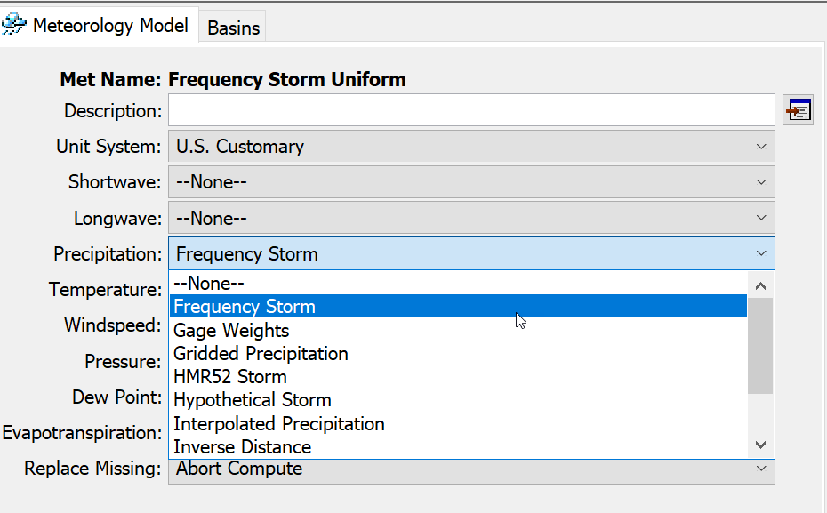
Frequency Storm Method

Slide 41
Frequency Storm Method
Not the same as the Frequency Analysis compute type!
Precipitation method in the meteorologic model
Creates a synthetic storm where all durations use the same frequency depth (“nested”)
  6-hour, 12-hour, 1-day, 2-day, etc. all have same frequency
No “critical” duration assumption
Assumes same frequency for all durations is reasonable

Slide 42
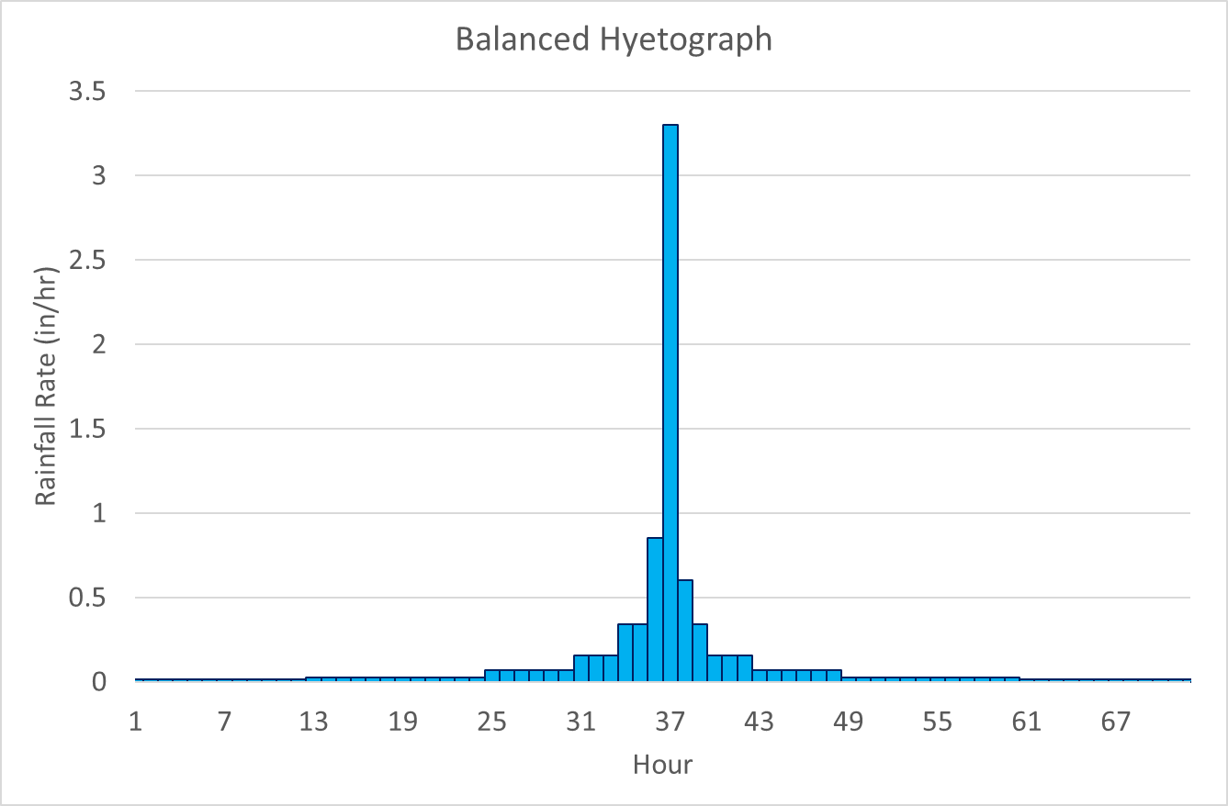
Intensity Duration
1-hour
2-hour
3-hour
6-hour
Storm Duration
12-hour
24-hour
48-hour
72-hour
Notes:
The Balanced Hyetograph technique is a very conservative approach. It assumes every duration has the same frequency of intensity, but this is not the case for real storms.
Hurricane Harvey was roughly a 4-day. If you look at the 96hr duration, it was a very rare event that we would expect to see less than once every 1000+ years. If you look at the most intense 1hr duration though, it roughly a 100-year event.

Slide 43
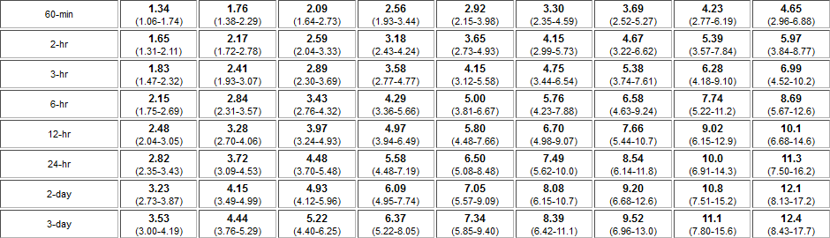
Frequency Storm Data
Intensity Duration
Storm Duration
Multiple durations and depths

Slide 44

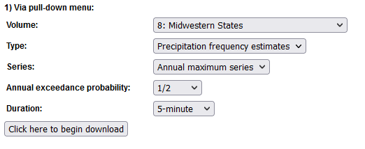
Frequency Storm Data

Slide 45
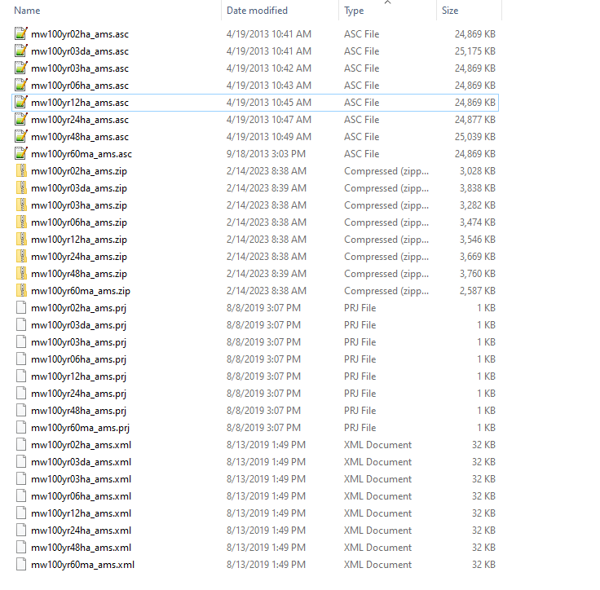
Data

Slide 46
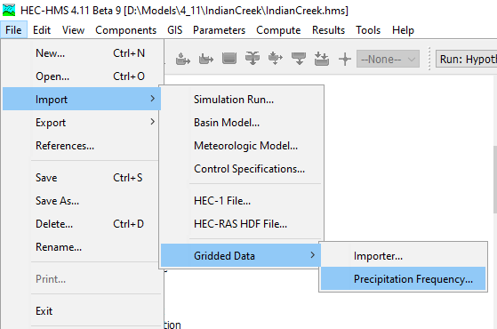
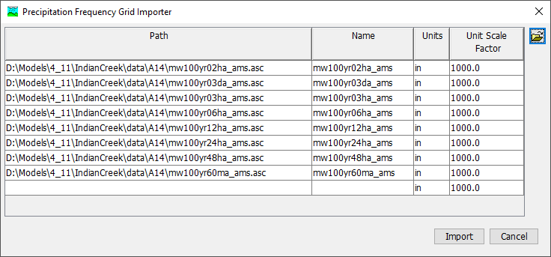
Importing Data

Slide 47
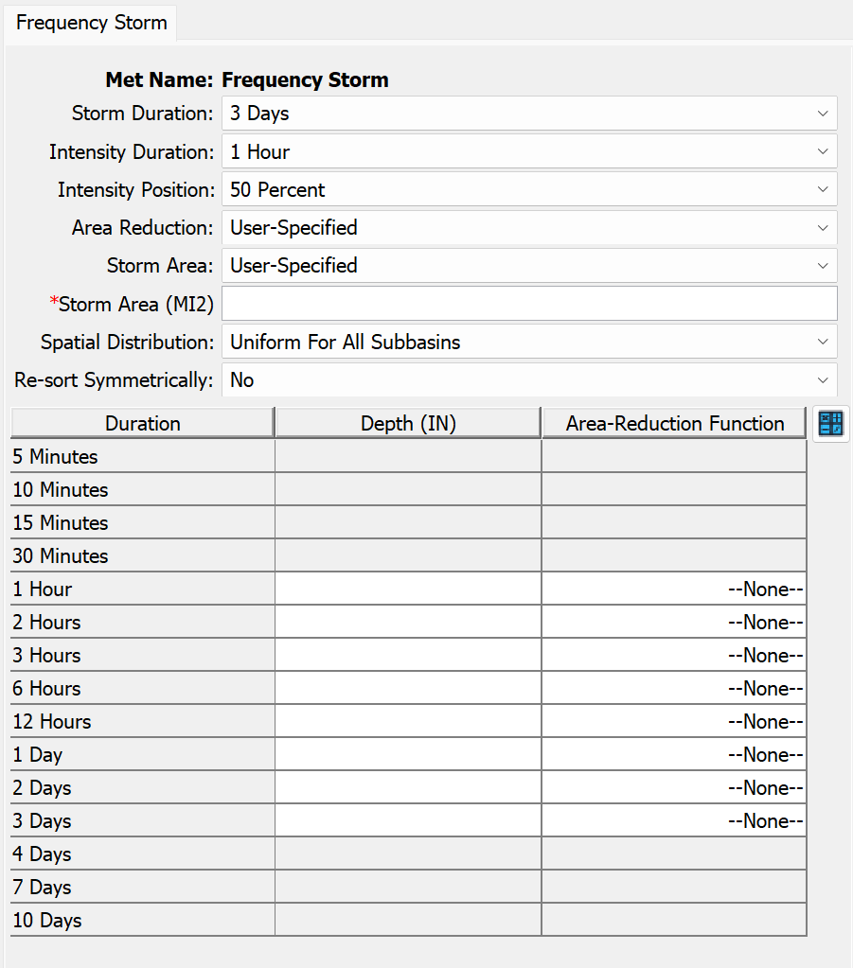
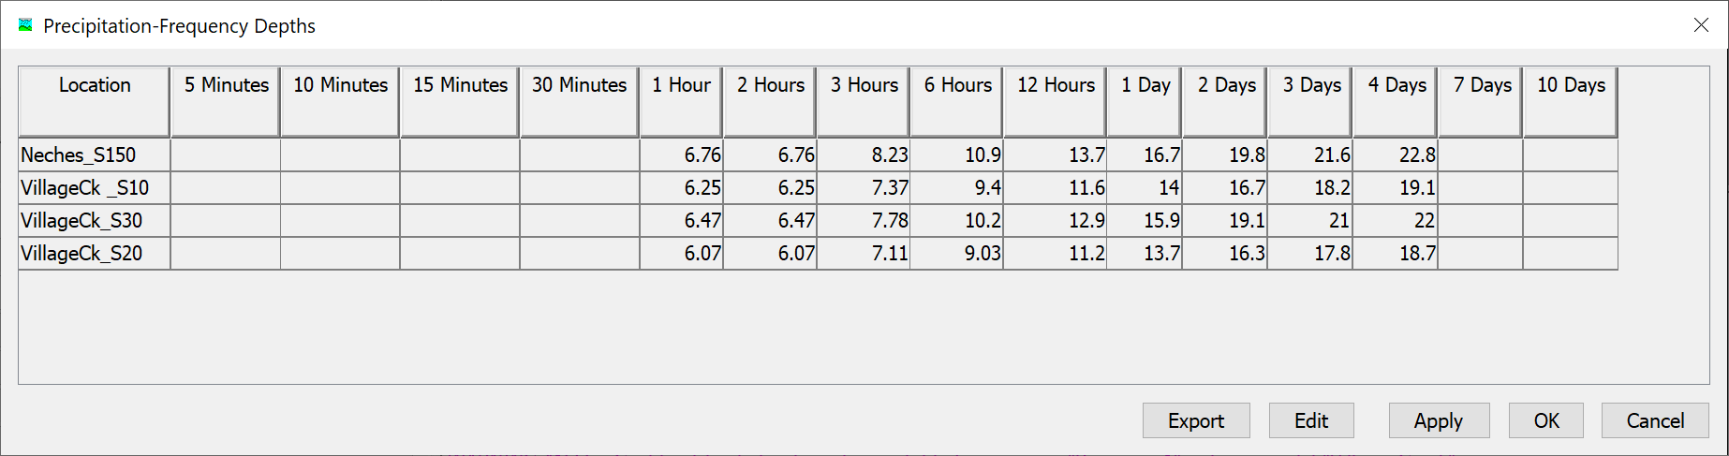
Frequency Storm
Calculator

Slide 48
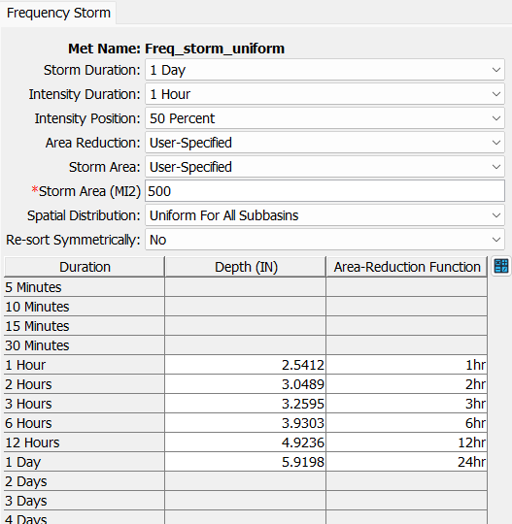
Frequency Storm Key Settings
Storm duration
  total duration
Intensity duration
  shortest increment
Intensity position
  peak timing
Area reduction
  point-to-area method
Storm area
  determines area reduction
Spatial distribution
  equal or by subbasin

Slide 49
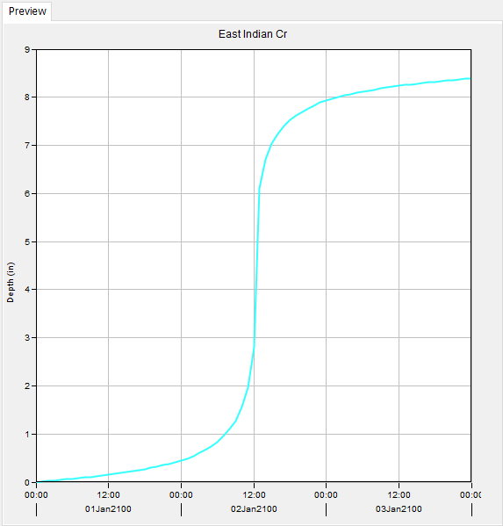
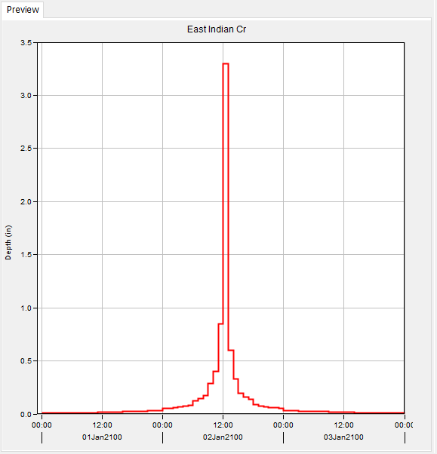
Synthetic Hyetograph

Slide 50
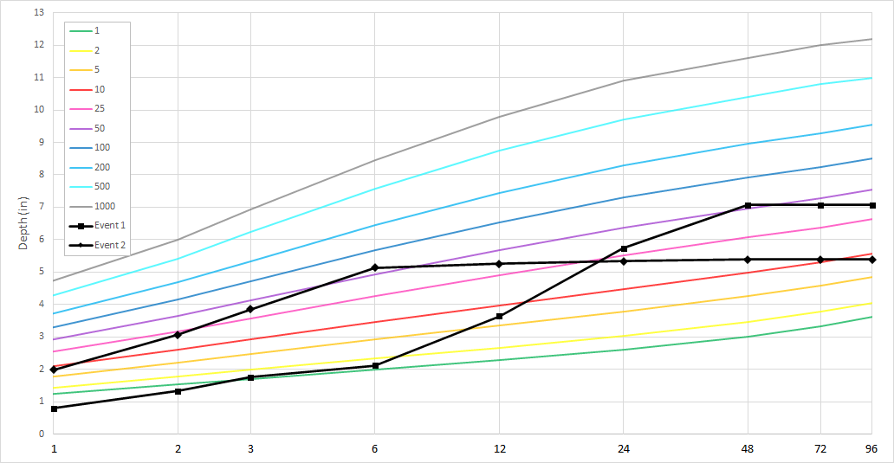
Limitations of Frequency Storm
Example: Cedar Rapids, IA
Aug 2009
Aug 2016
Notes:
The frequency storm method is very conservative. It assumes every duration has the same frequency of intensity, but this is not the case for real storms. See example for two storms in Cedar Rapids, IA

Slide 51
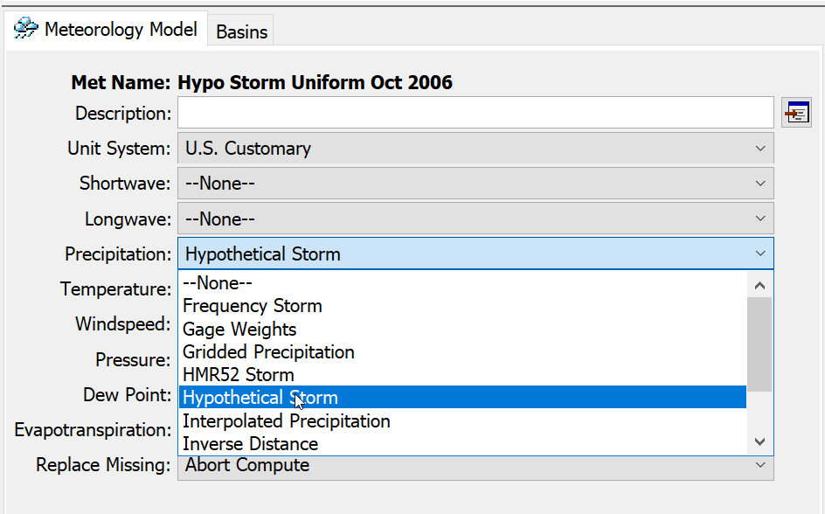
Hypothetical Storm Method

Slide 52
Hypothetical Storm Method
“DIY”
Precipitation method in the meteorologic model
3 sub-methods:
  Area-Dependent Pattern
  SCS Storm
  User-Specified Pattern
Creates a synthetic storm based on a single duration
Assumes you choose the right duration for AEP neutrality

Slide 53
Hypothetical Storm Data
One duration, one depth

Slide 54
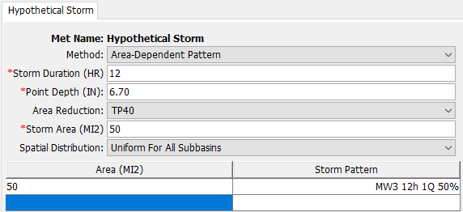
Area-Dependent Pattern
Meant to be used with the Depth-Area Analysis
Vary time pattern with storm area
Advanced method

Slide 55

SCS Storm
Notes:
Puerto Rico should probably be in Type 3, for the record.

Slide 56


SCS Storm
Very simple design storm approach
Always 24-hour storms
Notes:
The spatial distribution of the rainfall can either be uniform for all of them (specified by this point depth) or if you use Variable by Subbasin, you can set it individually for each subbasin as in the image below.

Slide 57

User-Specified Pattern
Average = 7.50 in
User-defined hyetograph
Ability to read PF grids
Depth-Area Analysis magic
  Computes precipitation above each comp. pt.
  Gets drainage area
  Computes area reduction
Computation Point

Slide 58


Temporal Patterns
Percentage curve paired data
Atlas 14 has data
Percent of total depth
Percent of time
Notes:
I copy the right column from the A14 temporals CSV file and paste it into the table. Then I set the first to 0.000 and 100.0000 and use the interpolation function to fill in the left column.
Note that values can repeat in the right column – in older versions of HMS they had to be strictly increasing. Now they just have to be non-decreasing.

Slide 59



Synthetic Hyetograph
Volume matches area-reduced subbasin amount
Midwest Region 3
2nd Quartile, 50%

Slide 60

Summary
The Frequency Storm met model is an older approach but still widely used today
  Assumes same frequency for all durations is reasonable; this is a very conservative assumption
The Hypothetical Storm met model method is the most flexible
  More data-driven approach
The most important assumption is that of “AEP Neutrality”
  Storm frequency = flow frequency
More advanced stochastic methods allow us to break free of those assumption constraints…SST is the future!
  SST Tutorial & Guide

Slide 61

Tools in HEC-HMS
One frequency
Many locations
Depth-Area Analysis Compute
  Compute flows for same frequency at multiple locations
  Allows storm area to vary
Frequency Analysis Compute
  Compute multiple frequency flows for a location
  Summarize and plot results
Many frequencies
One location

Slide 62


Depth-Area Analysis
Uses hypothetical storm precipitation in the met model
Iterates over analysis points
Updates met model with storm area
Notes:
Overrides the computation point setting in the met model. For each analysis point computes the drainage area upstream and plugs it into the met model if it has that setting.

Slide 63



Simulation Notes
Analysis point: Marion
Analysis point: Cedar River
67.7 mi²
93.3 mi²

Slide 64


Results
Peak flow summary results for each analysis point
Element results for each analysis point

Slide 65
Tools in HEC-HMS
Depth-Area Analysis Compute
  Compute flows for same frequency at multiple locations
  Allows storm area to vary
Frequency Analysis Compute
  Compute multiple frequency flows for a location
  Summarize and plot results

Slide 66

Frequency Analysis
Define frequency ordinates for a location
Combination of met model and basin model for each

Slide 67


Results

Slide 68

Summary
Flow-frequency curves can be quickly generated in HEC-HMS using:
  Depth-Area Analysis: one frequency, many locations
  Frequency Analysis: many frequencies, one location
You can get the same results by creating individual simulation runs – these analyses just save time and effort

Slide 69
Stochastic Storm Transposition
Notes:
We covered the background of SST and how to do basic SST simulation in HMS in an earlier lecture – this is just a note about the direction we’re headed with respect to SST.

Slide 70


Overview of SST Method
Data-driven method for watershed precipitation frequency
Based on a “catalog” of severe storms
Simulated by random selection of storms and their position
1 real storm…
…out of a whole catalog of storms

Slide 71

Overview of SST Method
Non-parametric space-for-time substitution
Resample severe storm events from a catalog
Preserve properties of real storms
Develop watershed-average precipitation-frequency
Transpose multiple storms per year
  Use a data-driven approach to reduce assumptions
Wright, Smith, and Baeck (2013)

Slide 72

Transposing Storms
Δx ~ uniform
Δy ~ uniform
observed
transposed

Slide 73

SST Precipitation-Frequency
For some large number of years of storms:
Sample number of storms for the year
For each storm:
  Select one from the catalog
  Transpose it uniformly within the domain
  Compute area-average precipitation over watershed
Plot annual maximum storm totals as a frequency curve
Notes:
SST can be used to generate watershed-averaged precipitation frequency curves by selecting storms at random from the catalog, transposing them at random inside the transposition domain, and computing the watershed-averaged precipitation from each transposition. Each simulation year contains multiple transpositions, and an empirical annual maximum distribution is extracted from the largest transposition of each year. The number of storms per year can vary, usually sampled from a Poisson distribution with a mean rate equal to the mean rate of storms per year in the storm catalog. Storms are altered by transposition only, and the fields are not rotated or scaled in any way.
The structure of the simulation has more years than the rarest desired return interval. For example, if an estimate for the 1/1,000 AEP event is desired, the simulation will have more than 1,000 years of transpositions.

Slide 74


HMS Uncertainty Analysis Tools
Hypothetical storm uncertainty parameters:
  Point depth
  Temporal pattern
  Area-reduction function
SST uncertainty parameters:
  X coordinate
  Y coordinate
  Precipitation grid
Use this to evaluate uncertainty/sensitivity due to storm assumptions
Use this to sample storm grid and/or storm location

Slide 75
Closing thoughts…
Mother nature has never read our design standards…
  …and that is why engineers and scientists study hypothetical storms.
  We must continually learn from mother nature and improve our design standards / frequency estimates accordingly.
Hypothetical storm modeling is challenging, but…
  …our observed data points increase with every given year.
  …our tools are getting better.

Slide 76

Questions?
Check out our Confluence for tutorials, user’s manual, and webinars
https://www.hec.usace.army.mil/confluence/hmsdocs

