Slide 1

Model Optimization
Advanced HEC-HMS
June 2026
Presented by: Josh Willis

Slide 2
A quote
“With great power comes great responsibility.”
  ~ Lord Melbourne, Winston Churchill, Teddy Roosevelt, Franklin Roosevelt, and…

Slide 3


Spiderman!!!

Slide 4
Big Takeaways…
The Optimization Trial compute type is powerful, if used responsibly with good engineering judgement.
Goals
  Understand what the Optimization Trial can do
  Apply the Optimization Trial appropriately

Slide 5
Outline
Model optimization
  General
  HEC-HMS
Optimization Trial setup
Optimization Trial strategies
-----
New enhancements in v4.14
Demo
  Forecast Optimization

Slide 6
Model Optimization
General Background

Slide 7
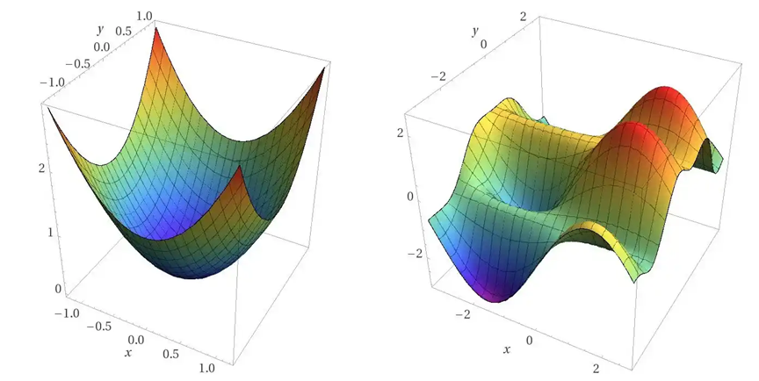
Model Optimization
Optimization – a numerical technique for finding extrema of a function
Involves varying a function’s parameters iteratively until you find a minimum or maximum

Slide 8
Model Optimization
In the context of hydrologic modeling…
  The hydrologic model gets turned into a function
  For each compute iteration…
    Hydrologic parameters are given specific values
      Example: Tc = 5h, R = 6h, Constant Loss Rate = 0.25 in/hr
    Model is computed
    Model results are recorded as a single number that describes the model’s performance
    Repeat
  After many iterations...
    A specific parameter set is found that leads to the best model performance
Adjust parameter values
Assess model performance
Compute model

Slide 9
Model Optimization
Model performance can have a couple of meanings
In HEC-HMS, there are two categories of objective functions
  Goodness-of-Fit
    How well do the modeled results compare with observed data?
  Maximize a response
    Peak discharge, inflow volume, reservoir pool elevation, etc.
    What parameter set leads to the highest peak discharge at an element?

Slide 10
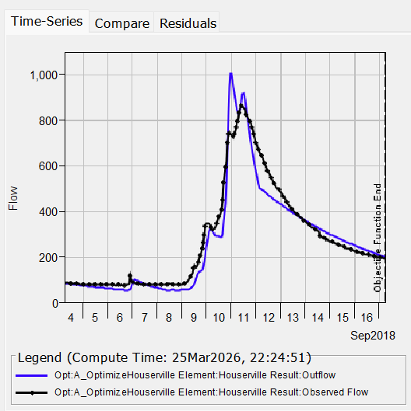
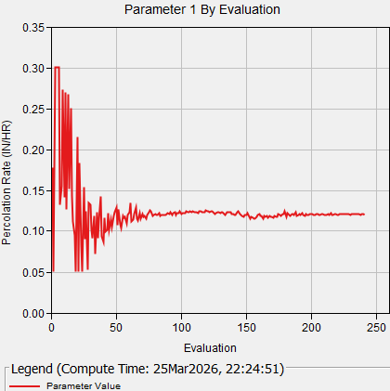
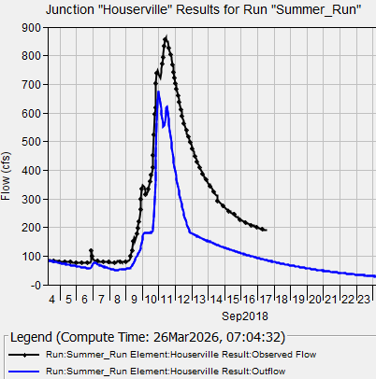
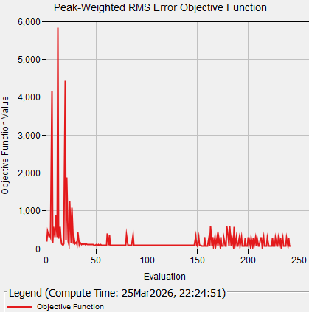
Model Optimization
Adjust parameter values
Assess model performance
Compute model
Goodness-of-Fit Example
  What parameter value set best matches observed flow data at the Houserville element?

Slide 11
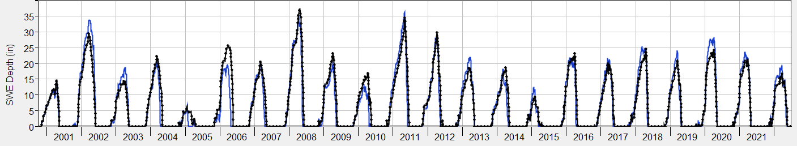
Model Optimization
Goodness-of-fit category
  Goal is to match observed data
  Measure model performance in a single value
    i.e. RMSE

Slide 12
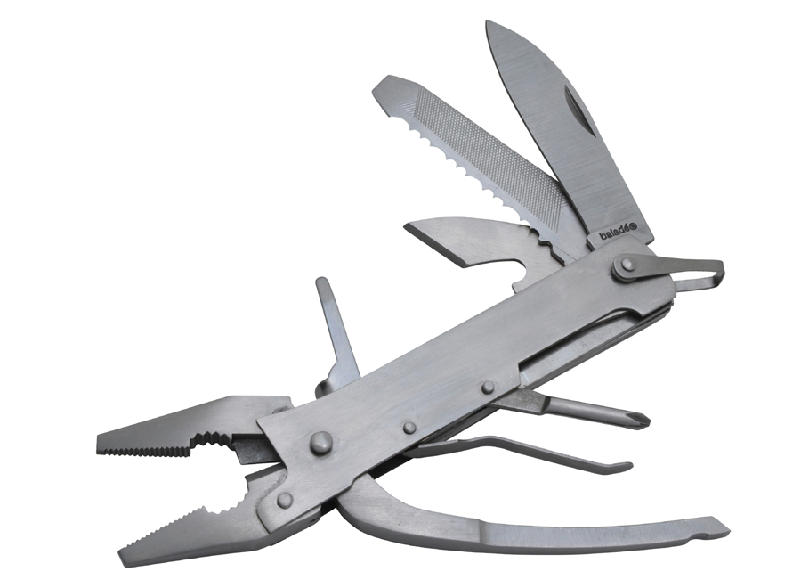
Model Optimization
The Optimization Trial in HEC-HMS has many use-cases
  Calibration
    Single-event
    Continuous simulation
    Multi-location and Multi-window (v4.14)
    Forecast specific optimization (v4.14)
  Maximization
    Flood Maximization
      What basin parameter set leads to the highest peak discharge?
    HMR52 Storm Optimization
      What storm configuration (location, orientation) maximizes reservoir elevation?
    Gridded Precipitation Optimization
      For historical near-miss storms, what might have happened if the storm location changed slightly?
Check out our new Rapid Digest documentation for more!
  https://www.hec.usace.army.mil/confluence/hmsdocs/hmsrd/optimization-analysis-342565456.html

Slide 13
Optimization Trial setup
Inputs

Slide 14
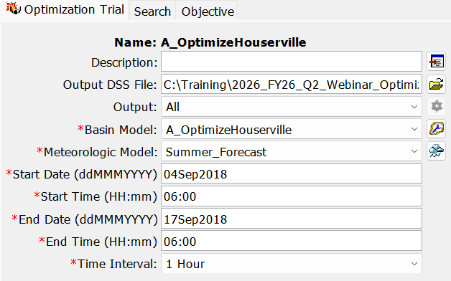
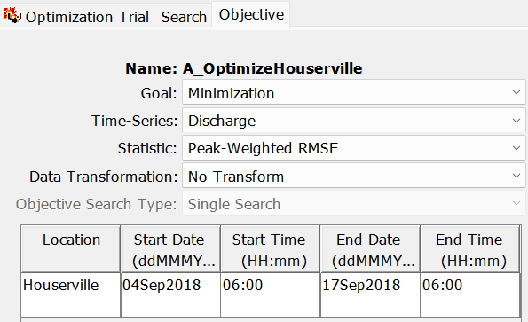
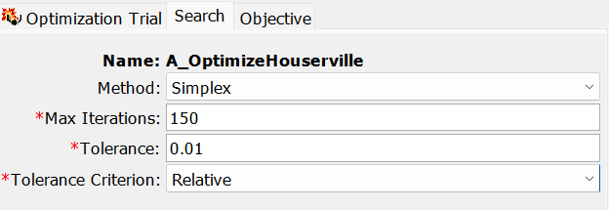
Optimization Trial setup
Notes:
Setting up an Optimization Trial requires more information than a regular Simulation Run.
The Optimization Trial Component Editor has 3 tabs:
The actual simulation setup, which is common to all simulation types (except simulation run which uses a Control Spec)
The search, which controls the engine that drives evaluation of the parameter sets
Objective, which tells the search how it’s doing.
But wait, don’t forget Parameter tabs (hidden right-click option to add)

Slide 15
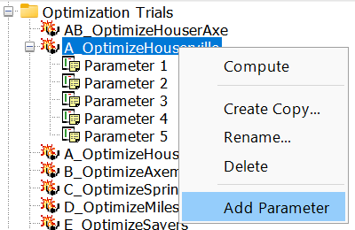
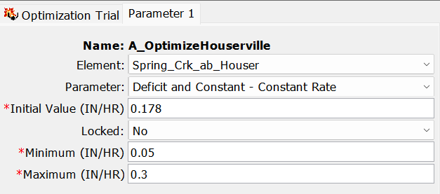
Optimization Trial setup
Notes:
The Optimization Trial needs one last input…parameters
Right-click option to “Add Parameter” from Optimization Trial node
Only the added parameters will be varied and assessed for model performance during the optimization routine
Best parameter sets are ultimately what we are after…
What parameter set values lead to best model performance compared to observed data?
What parameter set values lead to peak reservoir elevation?

Slide 16
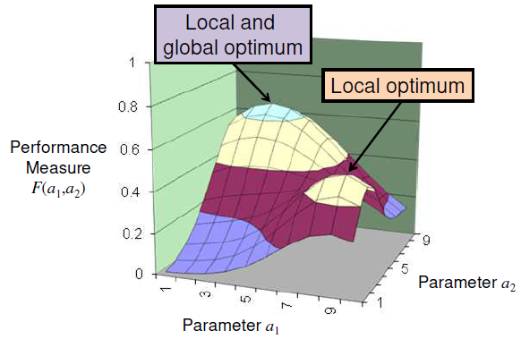
Search
Nelder-Mead Simplex
  Deterministic search method
  Compares objective function values across n+1 parameter sets
    n is the number of input parameters
  Sensitive to initial state
  Very fast with a good initial guess
  No bounds on parameters
Notes:
A simplex is a geometric figure with n + 1 vertices in n dimensions

Slide 17
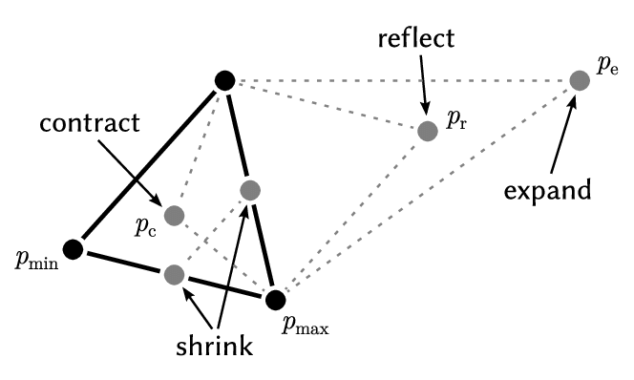
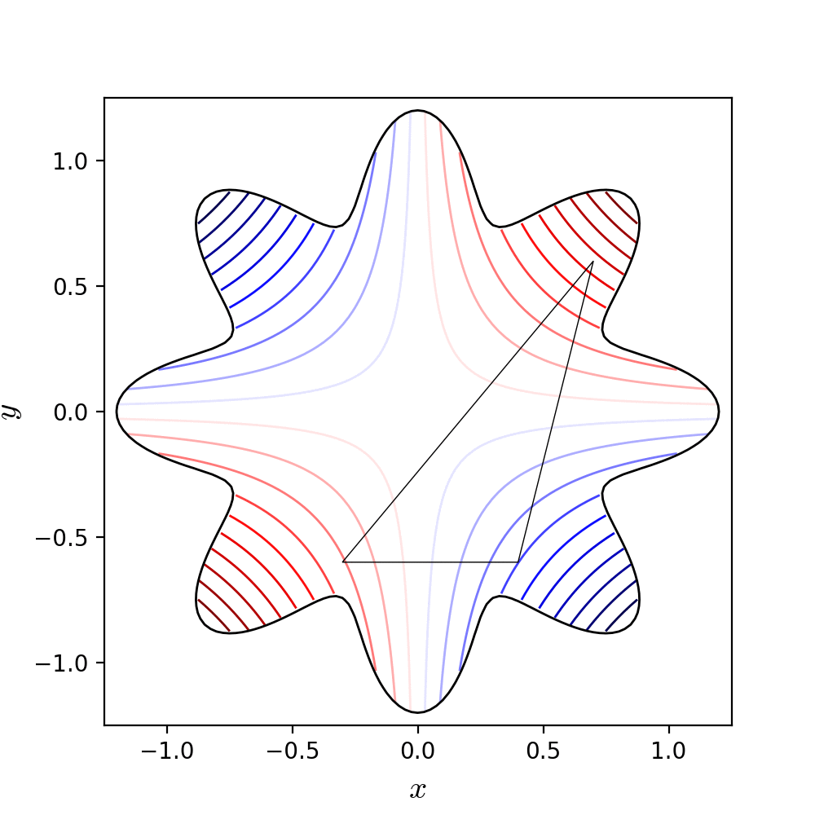
Search
Notes:
The lines in the figure on the right show contours of the objective function (lines of equal model performance)
Simplex has n+1 vertices, where is “n” the number of parameters
Line segment for 1 parameter
Triangle for 2 parameters
Tetrahedron for 3 parameters
The method alters the simplex vertices so it approaches the optimum
The worst vertex is replaced with each iteration (reflection, expansion, contraction)
The simplex (triangle) repeatedly:
Identifies the worst point.
Reflects away from it.
Expands if things improve.
Contracts if things worsen.
Shrinks if stuck. Then repeats these steps…
The triangle effectively "crawls downhill (or uphill)" toward an optimum.

Slide 18
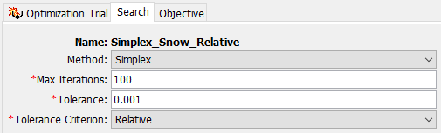
Search Termination/Convergence
When the difference of objective function value at all n+1 nodes of the simplex is less than the tolerance, the search stops
The best node is reported
Lower tolerance means values have a smaller difference
  Absolute tolerance: difference between largest and smallest
  Relative tolerance: percent difference between largest and smallest

Slide 19

Search Termination/Convergence
Vertex | Tc | R | NNSE
A | 10.1 | 4.0 | 0.943
B | 10.3 | 4.1 | 0.948
C | 10.2 | 3.9 | 0.946
Example
  Compute the relative difference between the best and worst objective value
    $\frac{\left|0.948−0.943\right|}{0.948}=0.0053$
  Would the search terminate (converge) if the relative tolerance was set to 0.01?
  Would the search terminate (converge) if the relative tolerance was set to 0.001?

Slide 20
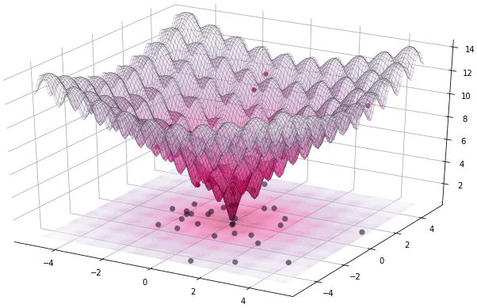
Search
Differential Evolution
  Stochastic search method
  Compares objective function value across p parameter sets
    p is user-selected population size
  Insensitive to initial guess
  Much slower than Simplex
  Bounded search by nature
Notes:
A typical value for p is 30, although literature suggests 10*n where n is the number of parameters.
During the first iteration, given a p value of 30, HMS is computed 30 times with randomly different parameter sets. 30 different objective function evaluations occur.
During the second iteration, each of the 30 different parameter sets are mutated. If a mutated parameter set performs better than the original, it survives. If not, DEATH, and the original remains (elitism)!
This process is repeated in subsequent iterations, and the population gradually migrates toward the best region.

Slide 21

Search Termination/Convergence
When the variability in the population’s objective function values gets sufficiently small, the search stops
  $σ_{OF}$ < t (1 + $μ_{OF}$)
    $σ_{OF}$ is standard deviation of objective function values
    t is the tolerance
    $μ_{OF}$ is mean of the objective function values
The best agent over the entire search history is reported
Lower tolerance means values have a smaller difference

Slide 22
Search
Simplex
Differential Evolution
Deterministic search
Unbounded search
Tolerance: absolute or relative
  Compute differences in OF between nodes
# evaluations (computes) per iteration = 1
Sensitive to initial value
Stochastic search
Bounded search
Tolerance: absolute
  Variability in population’s OF value must be sufficiently small
# evaluations (computes) per iteration = Population Size
Insensitive to initial value

Slide 23
Objective
Objective Functions
  Determines how model performance is measured

Slide 24
Minimization Goal Objective Functions
Mean of absolute residuals
Mean of squared residuals
Peak-weighted RMSE
Peak-weighted variable power
Pct error in peak discharge
RMSE
Sum of absolute residuals
Sum of squared residuals
Time-weighted RMSE
Lower value means better goodness-of-fit
Notes:
These are available for discharge, a smaller set is available for SWE.
If an objective function has the word error or residual in it, we want to minimize it!
Some give more weight to the peaks because we don’t want to weight baseflow as heavily in continuous simulations and/or because we are more concerned with simulating floods.
I want to draw your attention to the peak-weighted variable power:
Sum of squared error but instead of the exponent always equal to 2, it varies between 1 (minimum observed) and 2 (maximum maximum)
Most severe penalty for missing the peaks

Slide 25

Maximization Goal Objective Functions
Goodness-of-Fit
Response
Coefficient of Determination (R²)
Index of Agreement
Normalized Nash-Sutcliffe
Modified Kling-Gupta Efficiency
Discharge volume
Peak discharge
Peak pool elevation (reservoir)
Total precipitation
Higher value means better goodness-of-fit
Notes:
Maximization goal has two functions in the optimization trial. One is to maximize objective functions which are defined to express a better goodness of fit with a larger value. The other is to maximize some kind of response variable (usually for design or risk analysis.)
Normalized Nash Sutcliffe has a range of 0 to 1 where 1 indicates perfect model performance. Nash Sutcliffe has a range of –inf to 1.

Slide 26
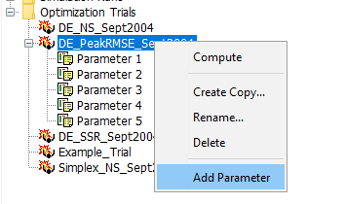
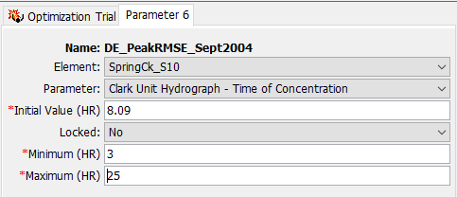
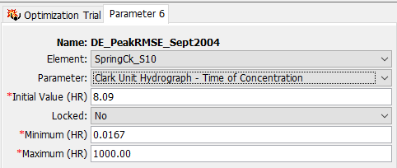
Parameter
Notes:
The Minimum and Maximum Parameter Values default to the allowable range within HMS.
This range is much larger than is physically realistic and will result in poor optimization results (i.e. the trial may find a local rather than global optimum or the trial will not reach convergence).
You want to narrow this range down based on your knowledge of the watershed, past calibration efforts, and engineering judgement.

Slide 27
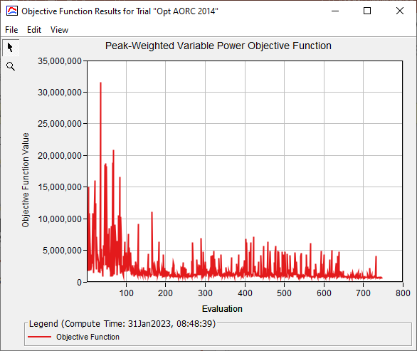
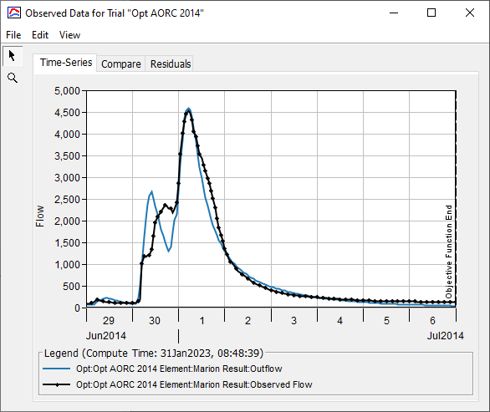
Optimization Trial results

Slide 28
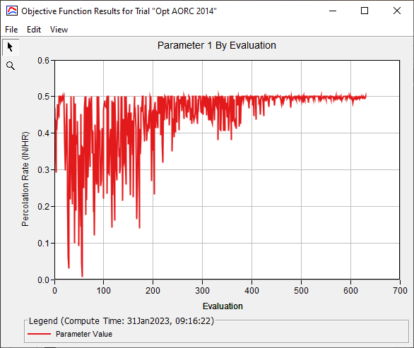
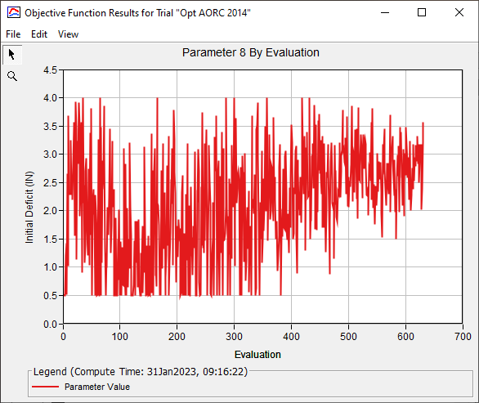
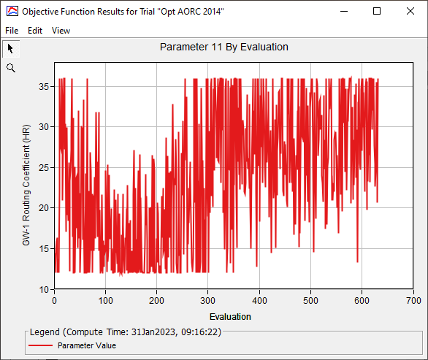
Optimization Trial results
Notes:
You should see the parameter values stabilize towards the end of the trial. If the value continues to vary substantially, you may need a smaller tolerance or a higher value for Min Iterations (for Differential Evolution)

Slide 29
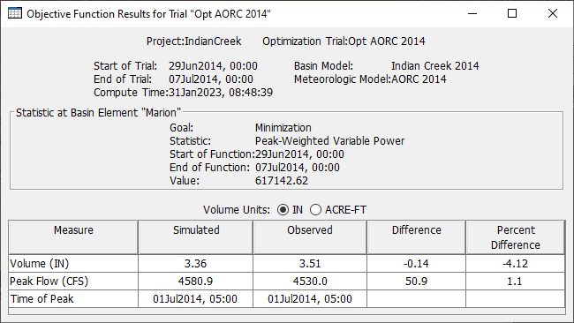
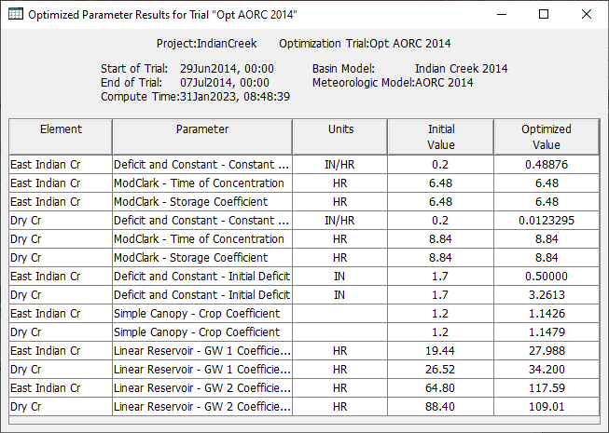
Optimization Trial results

Slide 30
Optimization Trial strategies
How to apply the Optimization Trial effectively
Notes:
We’ve discussed the inputs of the Optimization Trial
Optimization tab
Search tab
Objective tab
Parameter tabs
Now let’s talk about strategies and best practices…this is where hydrologic engineering judgement comes into play.

Slide 31
Optimization Trial strategies
Choose an appropriate search method
  Simplex
    Faster, but sensitive to the initial guess
    Better for well-studied systems where you have a good initial guess of parameters and their ranges
  Differential Evolution
    Slower, but insensitive to the initial guess
    Better when there is a lot of parameter uncertainty

Slide 32
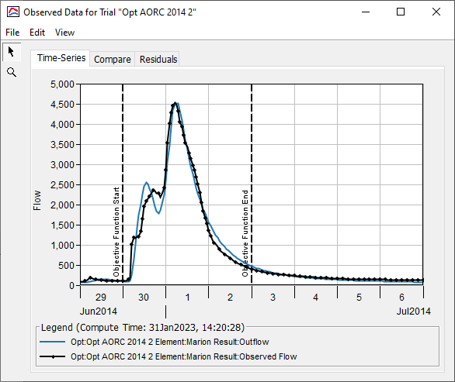
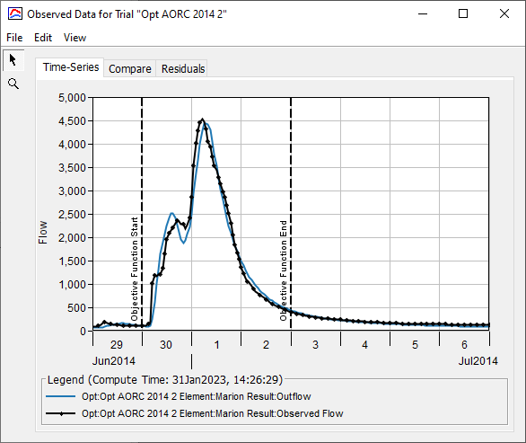
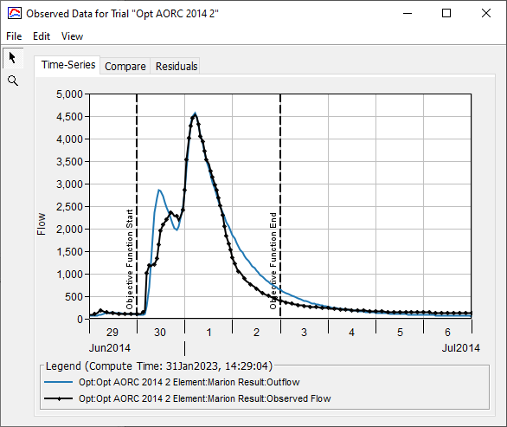
Optimization Trial strategies
Objective Functions (Goodness-of-Fit)
  Choose an objective function that meets your modeling goals
    Sum of squared residuals
    RMSE
    Peak-weighted RMSE
    Peak-weighted variable power
PWRMSE
SSR
PWVP
Notes:
For goodness-of-fit, choose an objective function that best meets the objectives of your study or use case.
Same searcher (DE), tolerance (0.01), window, parameters, etc. Just varying the objective function. Each of these three describes the error in a slightly different way. The sum of square residuals (SSR) has no extra weighting that emphasizes the peak. Peak-weighted RMSE (PWRMSE) has a linear weight factor for flows close to the maximum. Peak-weighted variable power (PWVP) has the most emphasis on the peak but significantly de-emphasizes low flows.

Slide 33
Optimization Trial strategies
Parameters
  This is where hydrologic expertise is critical
  Tips
    Try to limit the parameters to those that matter the most
      ~3 to 6 parameters
    Assign Minimum and Maximum values that are meaningful
      The tighter the bounds, the better
Optimization algorithms have no notion of hydrology. An optimization routine might give you combinations of parameter values that agree well with observed data but individually are non-sensical.

Slide 34
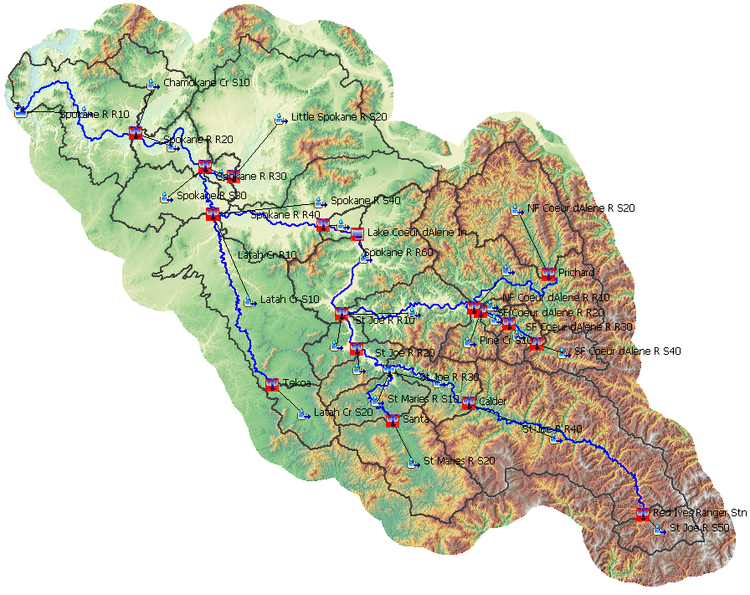
Optimization Trial strategies
Treat optimization like you would manual calibration
Move upstream to downstream
Be careful of offsetting parameters

Slide 35
Optimization Trial strategies
Tweaks are almost always necessary, not “one and done”
Start with a small set of sensitive parameters and a looser tolerance
  Uncertainty Analysis to assess parameter sensitivity
Don't worry if first searches don't converge
  Try to get them going in the right direction first
Pick a meaningful parameter range and initial guess
  Ok to bump up against limits early

Slide 36
Optimization Trial strategies
Typical adjustments include…
  Search tab
    Tolerance
      Start higher (0.1) end lower (0.01)
    Max Iterations
      Start lower (20) end higher (50+)
  Parameter tab
    Lock initial parameters in place
    Add/remove parameters
    Adjust initial guess
    Adjust min / max bounds

Slide 37
Optimization Trial strategies
Notes:
You should see the parameter values stabilize towards the end of the trial. If the value continues to vary substantially, you may need a smaller tolerance or a higher value for Min Iterations (for Differential Evolution)

Slide 38
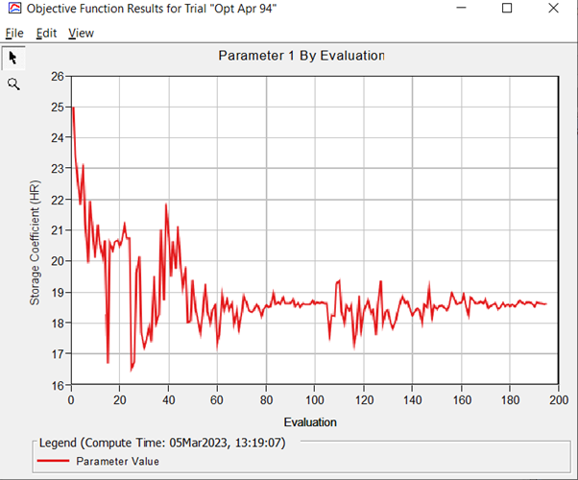
Optimization Trial strategies
Notes:
You should see the parameter values stabilize towards the end of the trial. If the value continues to vary substantially, you may need a smaller tolerance or a higher value for Min Iterations (for Differential Evolution)

Slide 39
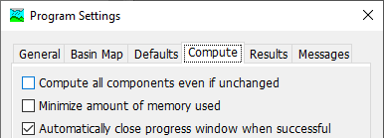
Optimization Trial strategies
Search Continuation Features…
  Run out of iterations before reaching tolerance?
    Only increase max iterations and re-compute (don’t force-compute)
  Reach tolerance before running out of iterations?
    Only lower tolerance and re-compute

Slide 40
New Enhancements
Available in v4.14

Slide 41
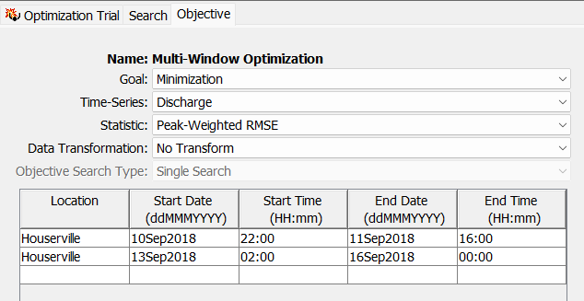
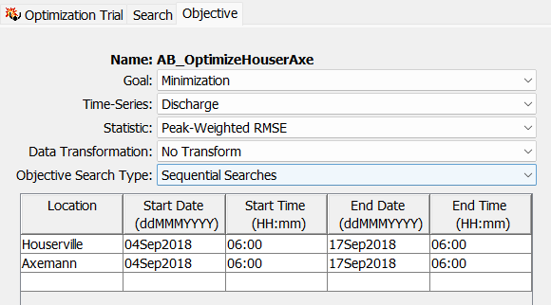
New Enhancements
Tutorial and Guide
Multi-Location
  Single Search
  Sequential Search
Multi-Window
Forecast Optimization
  Zonal Scale-factors

Slide 42
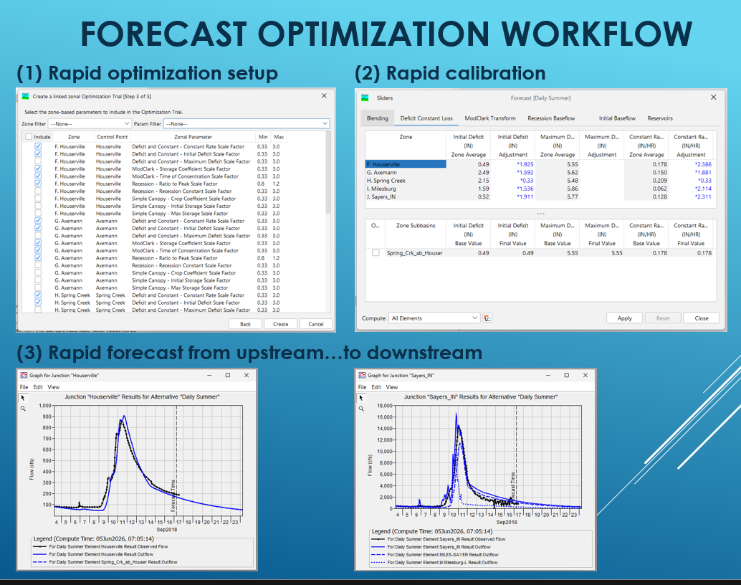

Slide 43
Demo
Forecast Optimization (v4.14)

Slide 44
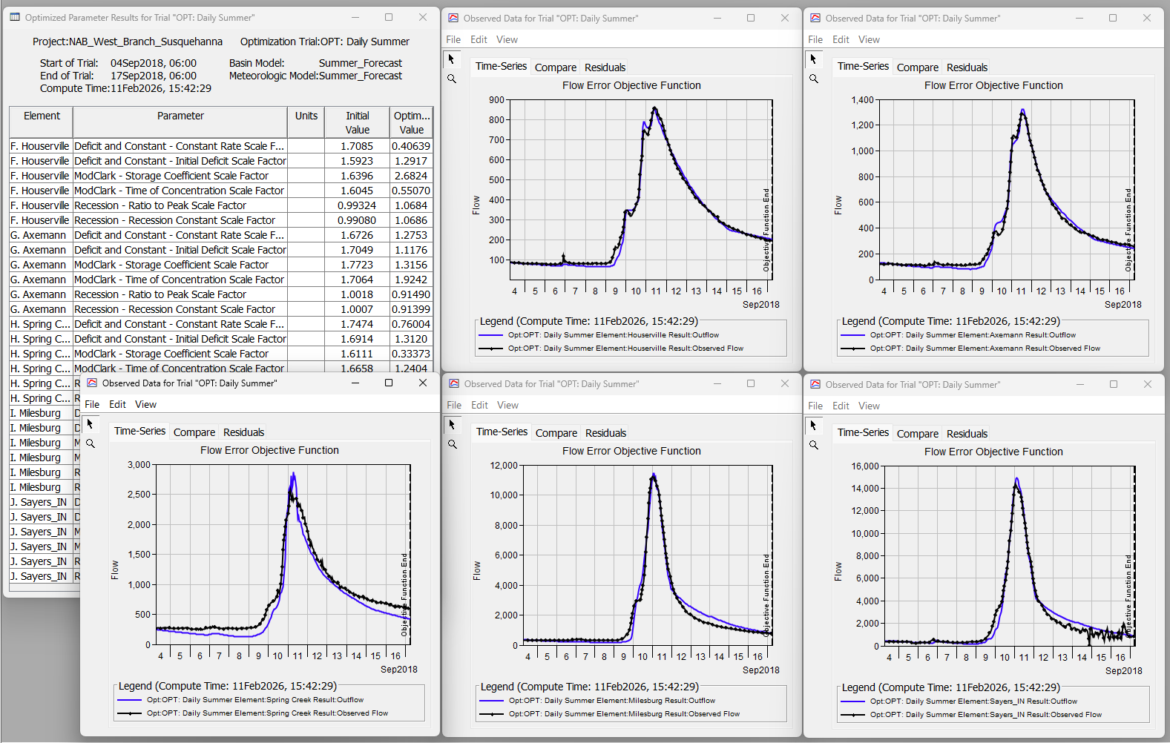
Demo
Forecast Optimization
  Compute Forecast
    Look at Results
  Set up linked forecast optimization
    Compute Optimization Forecast Sequence
    Look at Results

Slide 45
Closing statement
“With great power comes great responsibility.”
  ~ Lord Melbourne, Winston Churchill, Teddy Roosevelt, Franklin Roosevelt, and Spiderman
The Optimization Trial compute type is powerful
  Versatile tool
    Calibration, Real-time forecasting, PMF studies, Emergency planning (what-if scenarios)…
  Saves time (and $)
The Optimization Trial should be used responsibly
  Choose appropriate search methods, objective functions, and parameters
  Use an iterative approach as you fine-tune the Trial and reach convergence

Slide 46
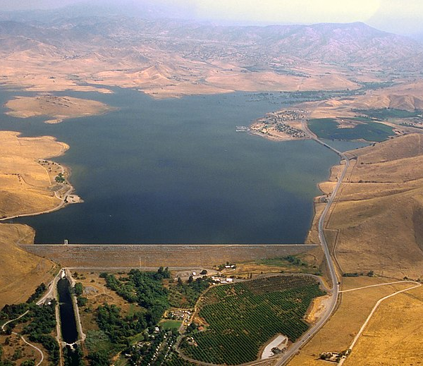
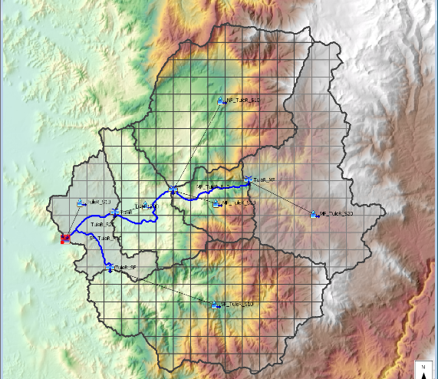
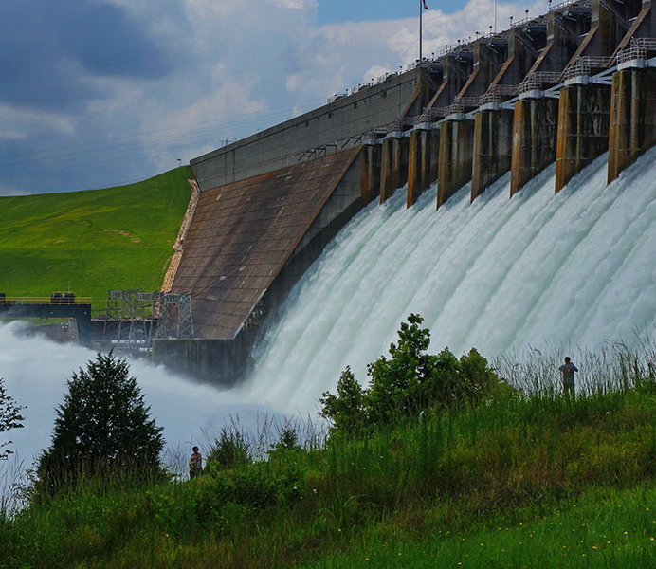
Questions?
Check out our Confluence for tutorials, user’s manual, and webinars
https://www.hec.usace.army.mil/confluence/hmsdocs

