Slide 1

Ensemble Analysis Simulation in HEC-HMS
Advanced Applications in HMS
June 2025
Presented by: David Ho, P.H.
Notes:
The ensemble analysis simulation is the newest compute type in HEC-HMS. It was implemented in HMSv4.11. This presentation will provide a general overview of the ensemble analysis and its application within HEC-HMS.

Slide 2
Objectives
Intro to Ensemble Analysis and Ensemble Forecasting Systems
Performing an Ensemble Analysis in HEC-HMS
  Selecting ensemble members
  Aggregating ensemble member results
Examples of Ensemble Analysis Configurations
Weighting Ensembles
Ensemble Analysis Demos in HEC-HMS
  Creating an Ensemble Analysis Compute
  Applying the Ensemble Compute to Flood Forecasting
  Applying the Ensemble Compute to Downscaled Climate Model Datasets
Notes:
We’ll begin by talking about what an ensemble analysis (or model) is and how it can be applied in HEC-HMS
Then we’ll talk the advantages of performing an ensemble analysis and how to actually set one up
Next I’ll provide a few different examples of applying the ensemble analysis in HEC-HMS in different ways to achieve different goals
Lastly, I’ll talk about some future enhancements that are planned for the ensemble analysis, and then we will jump into some live demos

Slide 3


Notes:
The ox-weighing story
The story comes from Francis Galton, a British scientist and an article he published in Nature in 1907 titled "Vox Populi" ("the voice of the people").
What happened
In 1906, Galton attended a regional livestock fair in Plymouth, England. At the fair there was a weight-judging competition: a fat ox was on display, and for a small entry fee, anyone could buy a ticket and write down their guess for what the ox would weigh after it had been slaughtered and dressed (i.e., its butchered weight). The closest guesses won prizes.
About 800 people entered. They were a real mix — some were butchers and farmers who knew livestock well, but many were ordinary fairgoers with no special expertise, essentially guessing.
What Galton did
Galton was actually a bit of a skeptic about the judgment of ordinary people (he had rather dim views of the "average voter"), and he expected the crowd's guesses to be wildly off. He collected the 787 legible tickets and analyzed them statistically.
He took the middle value (the median) of all the guesses — his idea being that this represented the collective "vote" of the crowd.
The surprising result
The crowd's collective estimate (the median): 1,197 pounds
The ox's actual dressed weight: 1,198 pounds

Slide 4
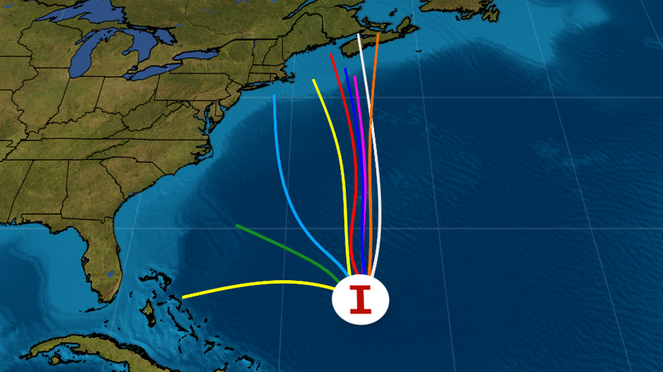
Why Perform An Ensemble Analysis?
One of the key aims of the ensemble analysis approach is to reduce uncertainty in the modelled predictions
Combining the predictions of multiple, independent models can produce a more accurate prediction overall
Image courtesy of The Weather Channel; https://weather.com/science/weather-explainers/news/2024-08-20-hurricane-spaghetti-models-track-like-pros
Notes:
So why is it important to perform an ensemble analysis? The main reason is that it can help to reduce the uncertainty in the modelled predictions.
There are many different research papers and studies that seem to show that an ensemble model (made up of multiple member models) usually outperforms a single model
Combining the predictions of multiple, independent models (and we’ll talk about what independent means specifically a few slides from now) can produce a more accurate prediction overall
Let’s talk about the image on this slide…
Let’s pretend for a second that we live in Charleston, SC
Based on the current projected paths for a tropical storm, how confident can we be that we can avoid evacuating further inland?
If we look at a single model result that I have circled, it appears that the hurricane is predicted to veer towards us
But we know that there are many different factors that determine the paths that hurricanes ultimately take, so how sure can we be?
If we look at additional models to see if they can shed some additional light or consensus
It now appears that most of the models agree that the storm will make landfall much further to the north
Although we can’t be sure that the tropical storm will not cross through Charleston, looking at different models (each with their own set of assumptions) certainly helped to reduce the uncertainty on where it will likely land

Slide 5
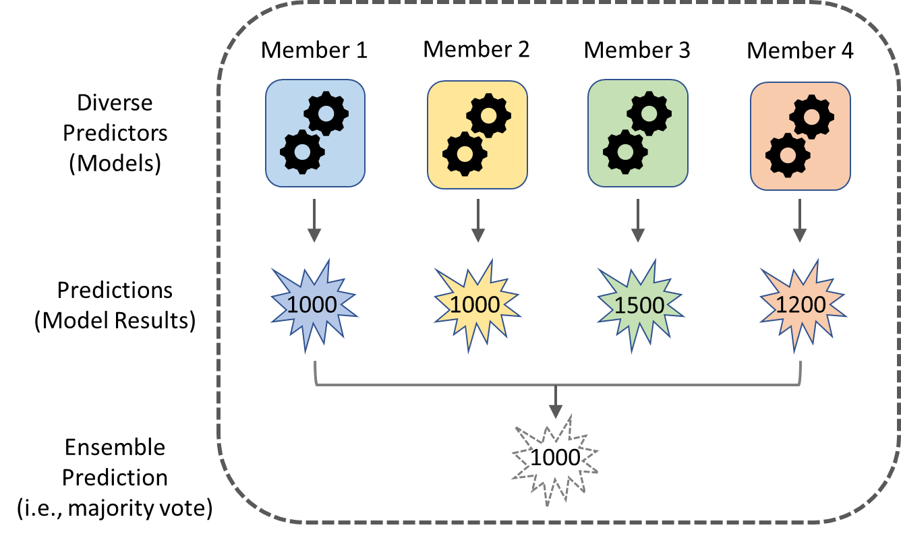
What is an Ensemble Analysis?
An ensemble model is a collection of multiple, diverse models that are created to predict an outcome
An ensemble model is a way to pool predictions from several base models
  These other base models are often called “ensemble members”
Notes:
Ensembles can consist of different variables that we have uncertainty over: precipitation, temperature, discharge, etc.
When I think of the word “ensemble”, I think of a collection of members or parts, each of which are unique but also related
An ensemble model is a collection of multiple, diverse models that are created to predict an outcome
Ensemble learning methods are often used in the fields of machine learning and statistics
In the illustration on this slide, the ensemble model is made up of everything within the dotted rectangle
This ensemble is made up of 4 members (or base models)
Although different, each base model is designed to accurately predict the same end goal
In this example, ensemble member 1 and member 2 each predicted an outcome of 1000, member 3 1500, and member 4 1200
There are different ways to aggregate each of the member predictions (results) into an ensemble prediction (result)
In this example, majority vote was used, and the ensemble result is 1000 since it was most frequently predicted by the member models

Slide 6
Ensemble Forecasting Systems
Statistics-Based Streamflow Prediction – no weather observations, using historical flow only
Ensemble Streamflow Prediction – historical climate as plausible representations of future
Numerical Weather Prediction-Based Systems – weather forecasts from climate models
Troin, M., Arsenault, R., Wood, A. W., Brissette, F., & Martel, J.-L. (2021).
Notes:
The most prevalent use case for ensembles has been for

Slide 7
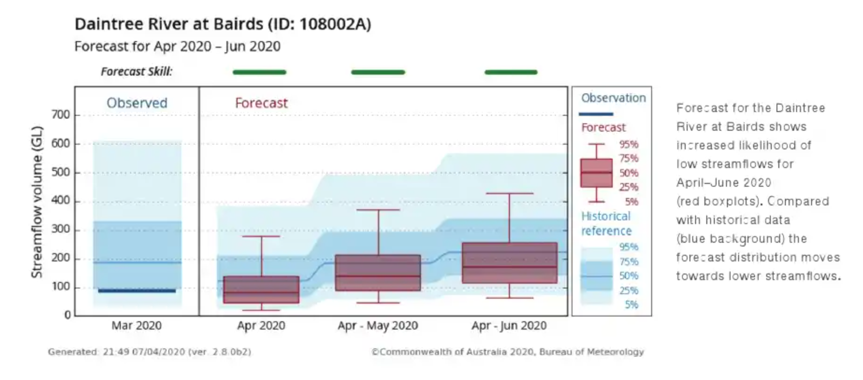
Statistics-Based Streamflow Prediction
Consists solely of observed streamflow data
  No quantitative precipitation forecast systems available
  Statistical streamflow data-drive models
  Mostly used for long range forecasts (> 16 days)
Notes:
Statistics Based Stream flow prediction is a method that uses streamflow and other data to estimate their uncertainty. This does not use any rainfall forecast and mainly statistic driven. It can use rainfall data to make the prediction but doesn’t run a forecast weather model.

Slide 8
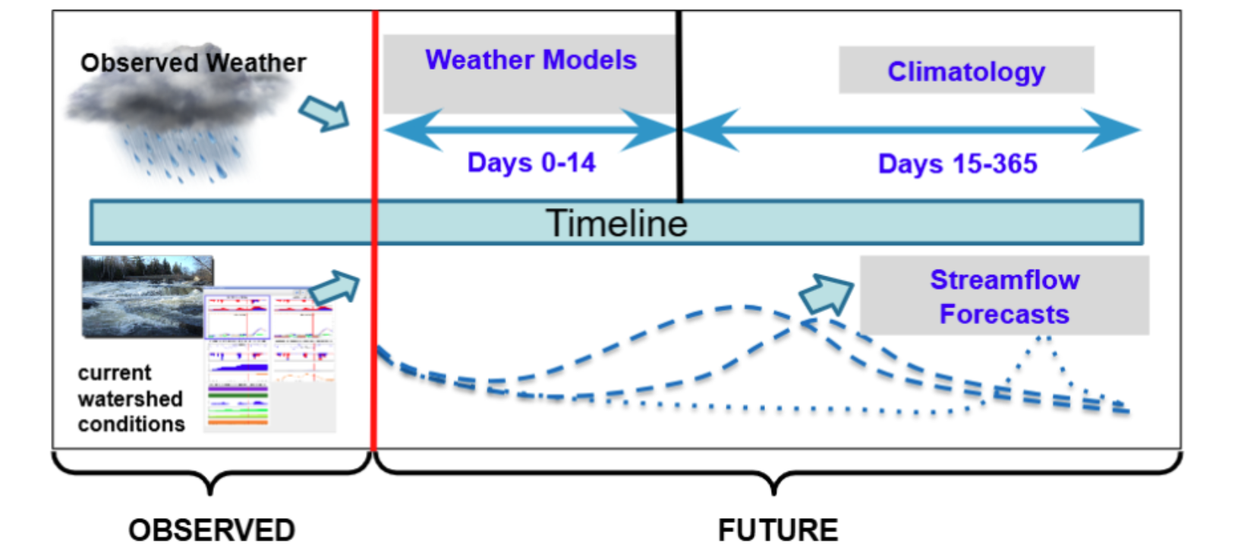
Ensemble Streamflow Prediction
Consists of Historical/Reanalysis precipitation
  Combined with hydrologic models
  State variables initialized for the time of forecast
  Mostly used for short (1 to 3 days) and long range (>16 days)
Notes:
The HEFS dataset created by the RFC uses this method for the long-range forecasts which dumps historic rainfall to generate forecasts out to 365.

Slide 9
Numerical Weather Prediction Based Systems
Consists of rainfall forecast based on numerical weather (NWP) prediction models
  NWP models with hydrologic models
  Heavily used in medium ranged (4 to 15 day) forecasts
  Can be complex systems, (NWP models) * (Hydrologic models), and potentially not practical for forecasting
    “Multi-model ensembles” or Super ESP
Notes:
HEFS ensembles short and medium duration are created using numerical weather forecasts. The MEFP process: You have different weather forecasts such as NBM, GEFS, HRRR, etc that the meteorologist uses and makes adjustments. It comes up with a singe deterministic forecast. Then uses historic forecast/observed statistics to come up with the ensembles. Currently it has 45 ensemble values and adds more ensembles for each year.

Slide 10
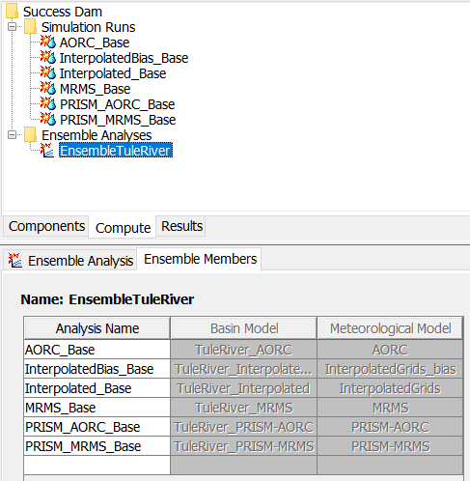
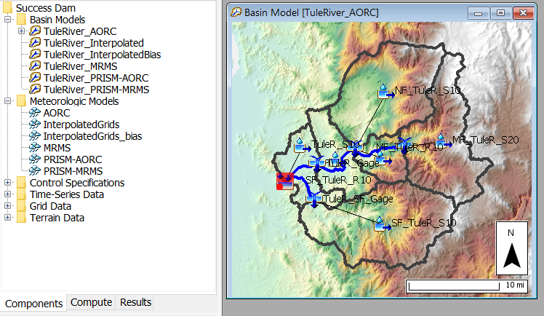
Application within HEC-HMS
The ensemble analysis compute in HEC-HMS is a useful tool for combining multiple simulation runs / forecast alternatives
This compute type can be applied to analyze different configurations of…
  Boundary conditions
    Forecast models
    Climate model projections
  Basin models
    Antecedent conditions
    Parameterizations
    Structures
    Modeling methods
Notes:
Let’s talk about ensemble analyses specifically as the apply to HEC-HMS
This is, again, the newest compute type in the HEC-HMS software, and it is extremely useful for combining multiple runs
There are two types of runs that can currently be added to an ensemble analysis: traditional simulation runs and forecast alternatives
The ensemble analysis can be used to analyze different configurations of two central components: boundary conditions and basin models
For boundary conditions, an example of an ensemble analysis application might be to analyze the effect that different precipitation or temperature data sources can have on the computed rainfall runoff for a subbasin
It could also be used to analyze the uncertainty in different weather forecasts and in different climate model projections
In HMS, basin models represent the physical processes of the watershed
To measure uncertainty in antecedent conditions, different basin models could be set up with differing amounts of initial baseflow, initial losses, and even different starting reservoir elevations
To measure the impacts of structures, an “as-is” basin model configuration could be set up and then other basin model configurations could be added to represent the addition or removal of structures such as reservoirs or diversions
HEC-HMS is a unique and powerful hydrologic modeling software in that it allows the users to choose the individual methods that they would like to use for key operations such as transform, baseflow, losses, etc.
A particularly insightful application of the ensemble analysis that I am excited about is using ensembles to analyze the uncertainty introduced from choosing different modeling methods
i.e. set up one basin model with muskingum routing reaches, another with muskingum-cunge, and a third with mod-puls and then analyze their impacts on the timing and peak of outflow hydrographs

Slide 11
Selecting Ensemble Members
How do I select Ensemble Model Members?
  Each member should be performant
    It should be designed and equipped to accurately model the intended outcome/goal of the ensemble analysis
    I.e., if the study goal is to model the 100-year event, do not include models that were only designed/calibrated to predict relatively common, low-flow events
  Each member should be independent
    It is desirable to use a suite of models that are constructed in different ways and that make different assumptions
    Independent models lead to less correlated prediction errors
    I.e., for hydrologic modeling…
      an ensemble model might include member models that each use different boundary condition datasets
      an ensemble model might include member models that each have different HEC-HMS basin model configurations and parameter sets, including initial conditions
Notes:
When performing an ensemble analysis, there are two main steps to perform
1) the selection of ensemble members
2) the aggregation of individual ensemble member results
Let’s talk about things to consider when selecting which ensemble members to include in an ensemble analysis

Slide 12
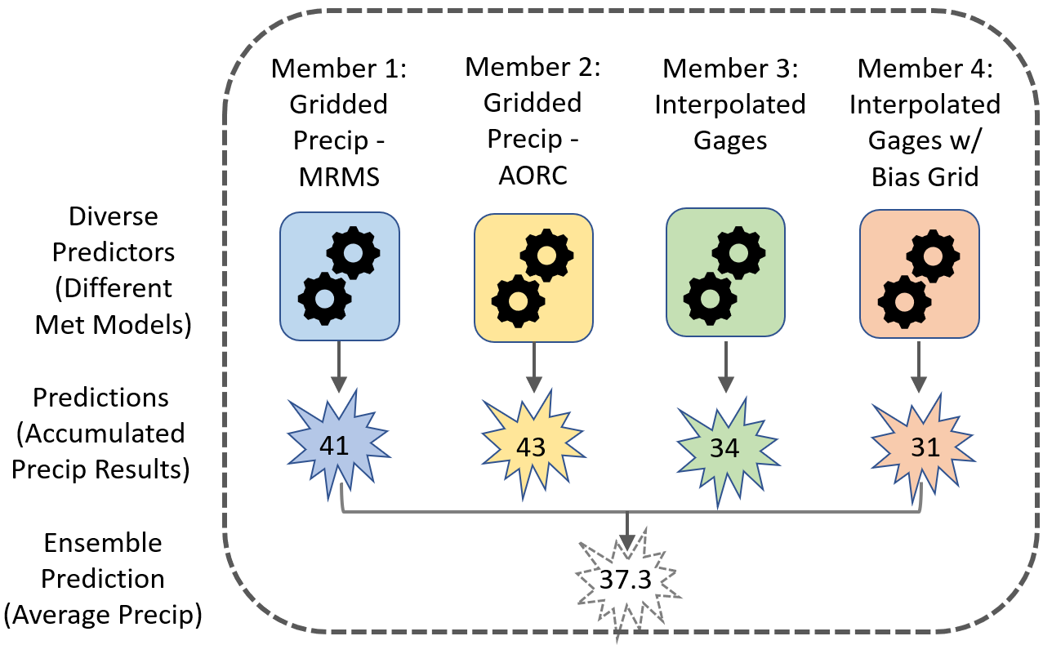
HEC-HMS Ensemble Analysis Example 1
Modeling Objective: capture uncertainty in historic rainfall data sources
Ensemble Configuration: setup simulation runs that use different meteorologic models

Slide 13
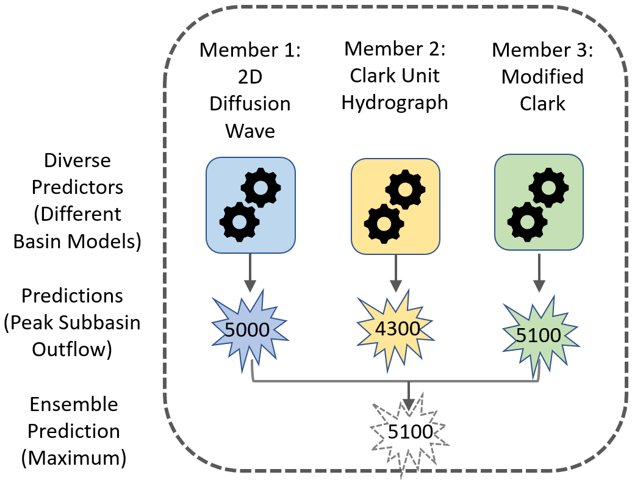
HEC-HMS Ensemble Analysis Example 2
Modeling Objective: capture model uncertainty in different transform methods with respect to subbasin outflow
Ensemble Configuration: setup simulation runs that use different basin models (with different transform methods)

Slide 14
Transform | Loss | Baseflow | Snowmelt
Clark | Deficit & Constant | Bounded Recession | Temperature Index
Kinematic Wave | Exponential | Constant Monthly | Gridded Temperature Index
ModClark | Green & Ampt | Linear Reserovir | Gridded Hybrid
SCS Unit Hydrograph | Gridded Deficit & Constant | Nonlinear Boussinesq | Gridded Energy Budget
Snyder | Gridded Green & Ampt | Recession | Energy Budget
S-Graph | Gridded SCS Curve Number
Diffusion Wave | Gridded Soil Moisture Accounting
 | Initial & Constant
 | Layered Green & Ampt
 | Linear Deficit & Constant
 | SCS Curve Number
 | Smith & Parlange
 | Soil Moisture Accounting
Notes:
Here is a sample of the various modeling methods offered in hms. If you are uncertain on the type of modeling method to use, you can choose to use some or all these methods to reflect your structure uncertainty.

Slide 15
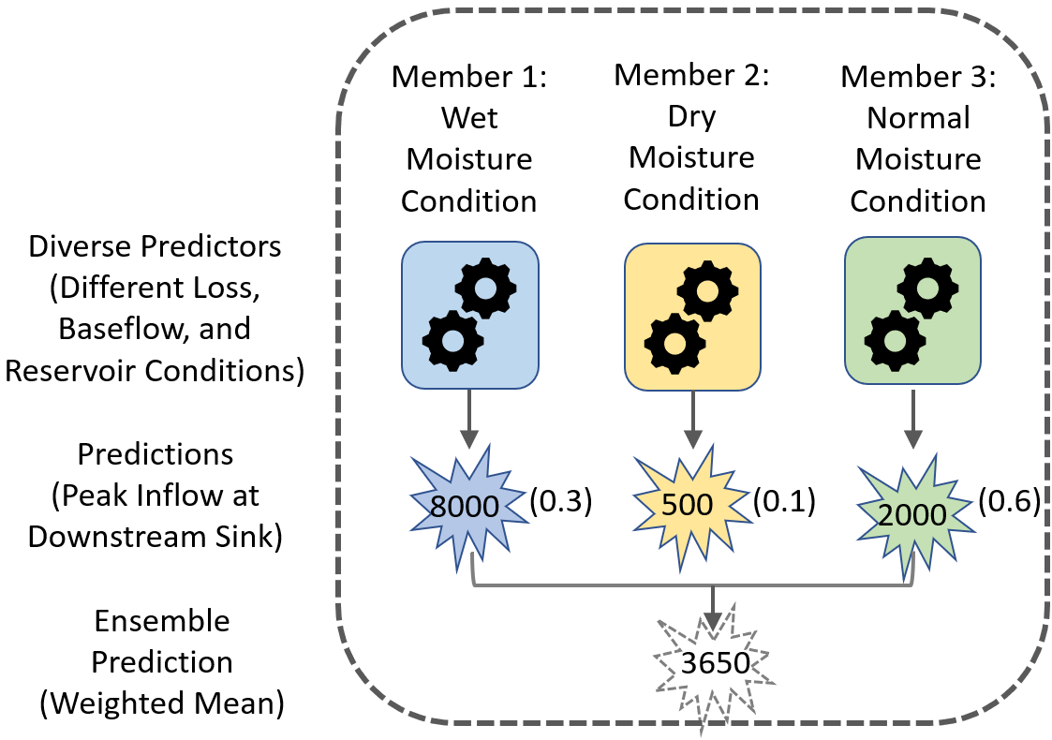
HEC-HMS Ensemble Analysis Example 3
Modeling Objective: capture model uncertainty in different initial antecedent moisture conditions
Ensemble Configuration: setup simulation runs that use basin models with different baseflow and loss parameters and different starting reservoir elevations

Slide 16
Aggregating Ensemble Member Results
Current Prediction Aggregation Options in HEC-HMS
  Mean, + and – 1 Standard Deviation, Maximum, and Minimum
Future Prediction Aggregation Options in HEC-HMS
  Weighting Schemes
    User assigned weights
    Computed weights
  Bias Correction Options
    Adjusted mean/variance to correct bias with observed data
      Assume a normal distribution for each set of data
      Link observed and simulated data by percentile
    Quantile mapping
      Assume an empirical CDF for each set of data
      Link observed and simulated data by percentile
      paired data of cdfs is generated
    Linear model
      Assume pairwise relationship between simulated and observed is related linearly
Notes:
Again, the current aggregation capabilities in HEC-HMS include mean, plus and minus one standard deviations, maximum, and the minimum
There are plans to add more aggregation options though in the very near future

Slide 17
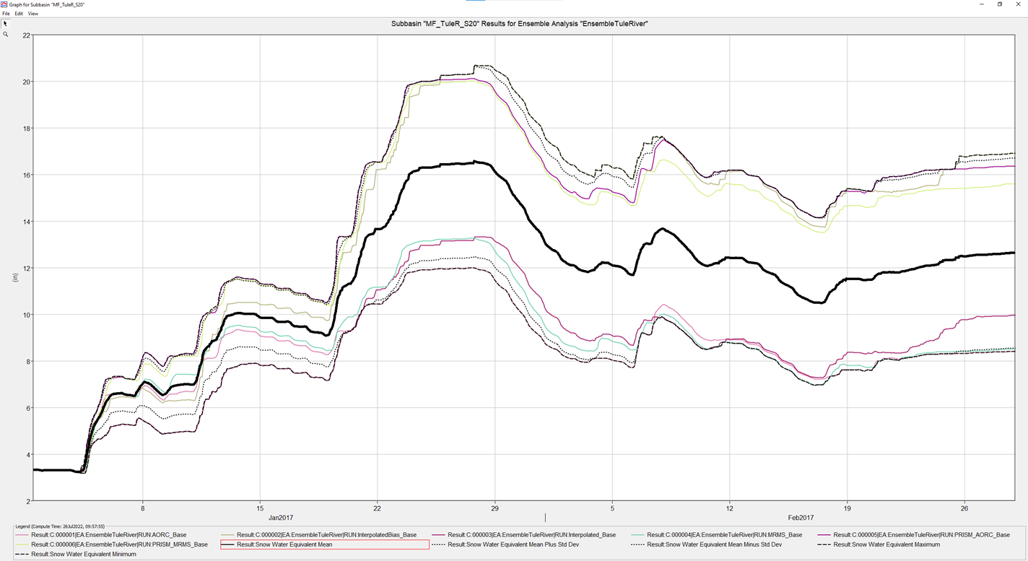
Aggregating Ensemble Member Results
Current Prediction Aggregation Options in HEC-HMS
  Mean,
  +1 and -1 Standard Deviation
  Maximum
  Minimum
Notes:
Current capabilities for aggregation is Mean, the + / - the standard deviation, the maximum, and the minimum. These aggregation is at each time step of the ensemble, so we are computing the mean value at time step 1, then time step 2 etc.
We also have in HMS the Ensemble Viewer. This is another tool to visualize the ensembles. The metrics computed in the forecast processor that Evan had discussed can be easily visualized with this tool
Here is an example of the current aggregation method available built into HMS.
This figure shows a plot generated in HEC-HMS after computing an ensemble analysis
In this example, each ensemble member used a different boundary condition data source (precipitation) to model the same event period
The colored lines represent SWE computations for each ensemble member (there were 6 in this example)
The black, dotted lines represent different aggregations of the ensemble member results
The highlighted black line (in bold) represents the mean SWE result of all the ensemble member runs
The other dotted black lines represent other types of aggregations (minimum, maximum, and + and – one standard deviation

Slide 18
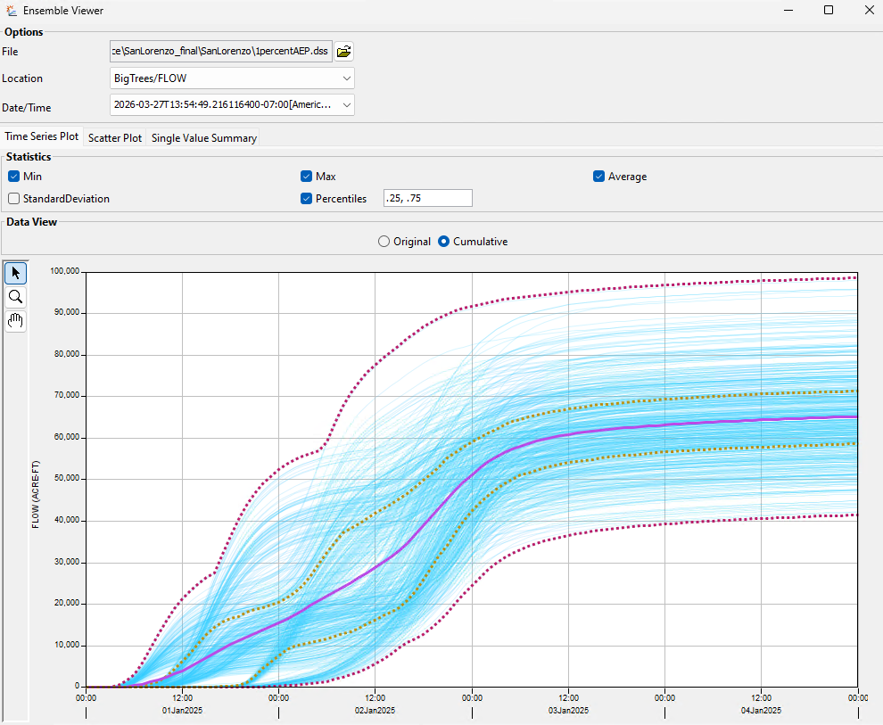
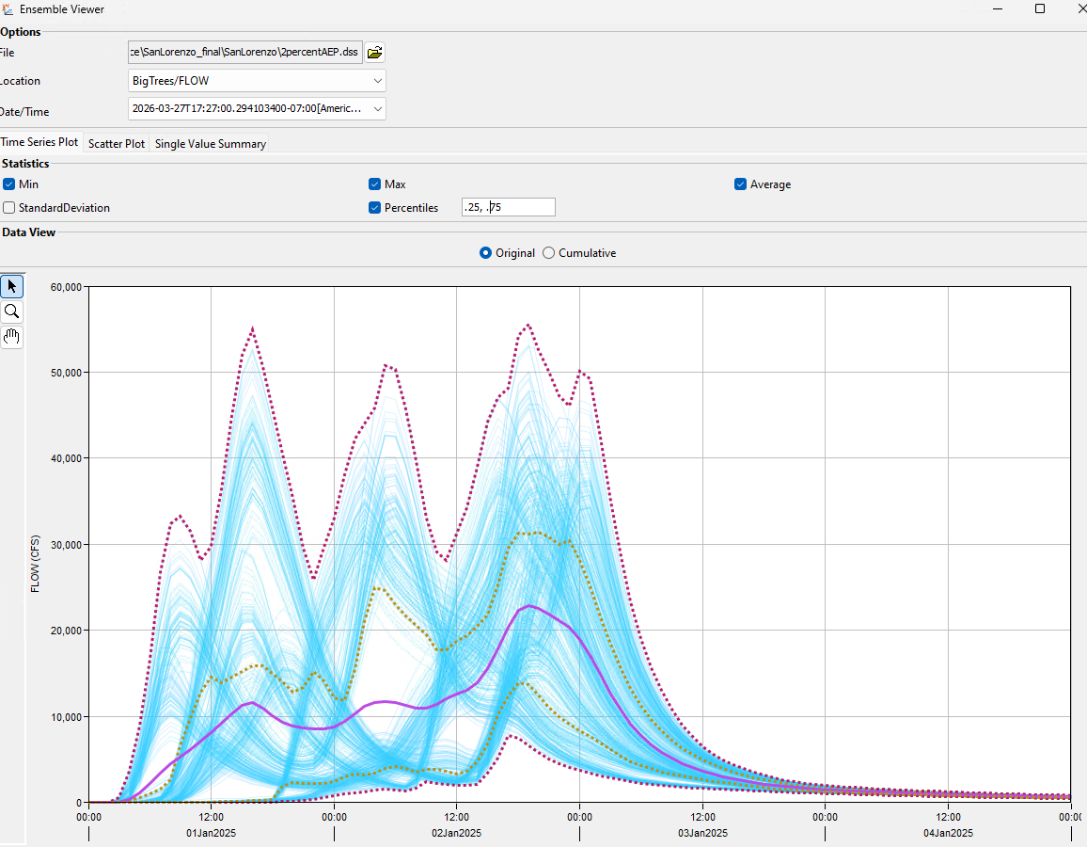
Ensemble Viewer – Time Series View
Notes:
A separate tool in HMS, RTS and WAT is the ensemble viewer. The design behind the viewer is to easily see the ensembles and compute various metrics assuming each ensemble is equally weighted. There are three different types of computes available. The first is the Time Series view. This is similar to the aggregation methods I just mentioned in HMS (with mean, min, max) but you could also include percentiles. So I have the 25% and 75% showing along with the min, max, and average. You can also view the data as a cumulative time series.

Slide 19
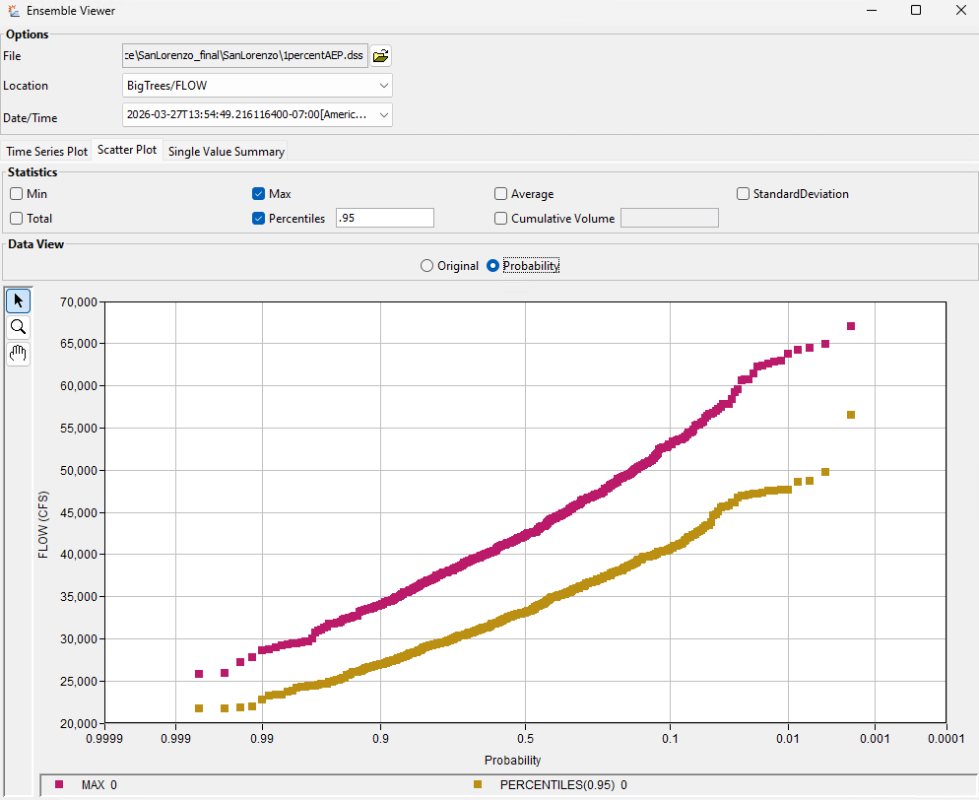
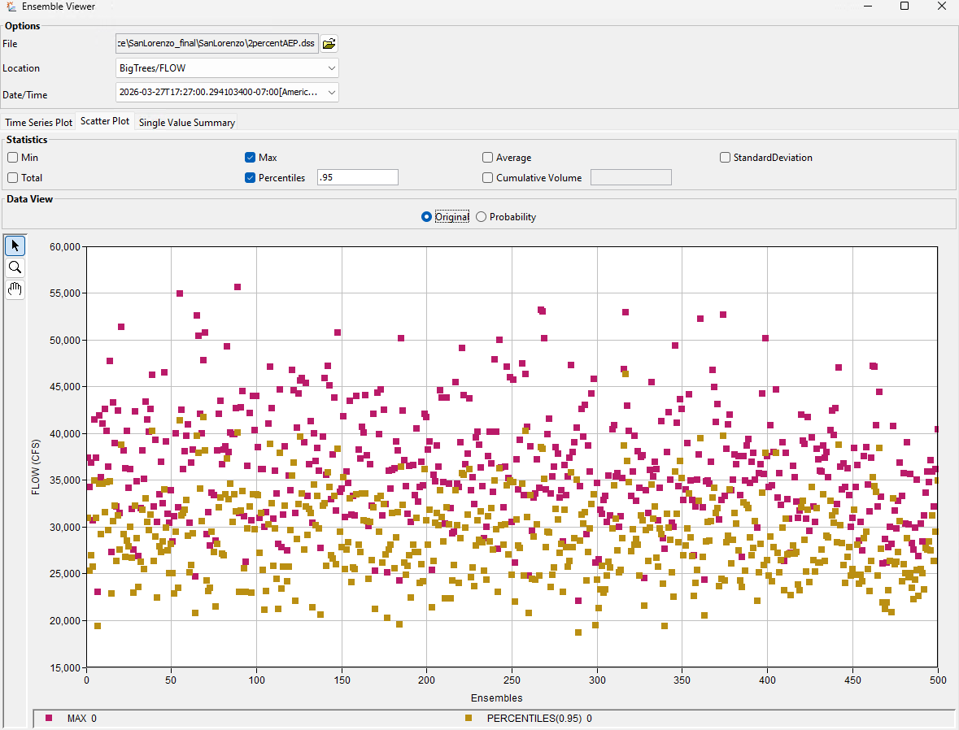
Ensemble Viewer - Scatter Plot View
Notes:
The second view is the Scatter Plot. This is computing the statistics for each ensemble member. So ensemble member 1, find the max value, then plot. Then for ensemble member 2, find the max value, then plot. That is what is showing to the graph on the right. On the left, we could rearrange the data and plot the data on a probability axis. This is a simple Weibull plotting position that ranks then plots the values. This is another way to see your ensemble outputs by ranking and assigning probabilities. This is not a flow frequency curve in the traditional sense so you cannot use this to find the 100 year flow. We are not looking at Annual Exceedance Probability. We can borrow the concepts from a flow probability to see the number of ensembles that exceed a given flow value. So 10% of the time, we see flow exceeding 52,000 cfs while 1% of the time we see flow exceeding 64,000 cfs. We can look at the ensemble data from different metrics.

Slide 20
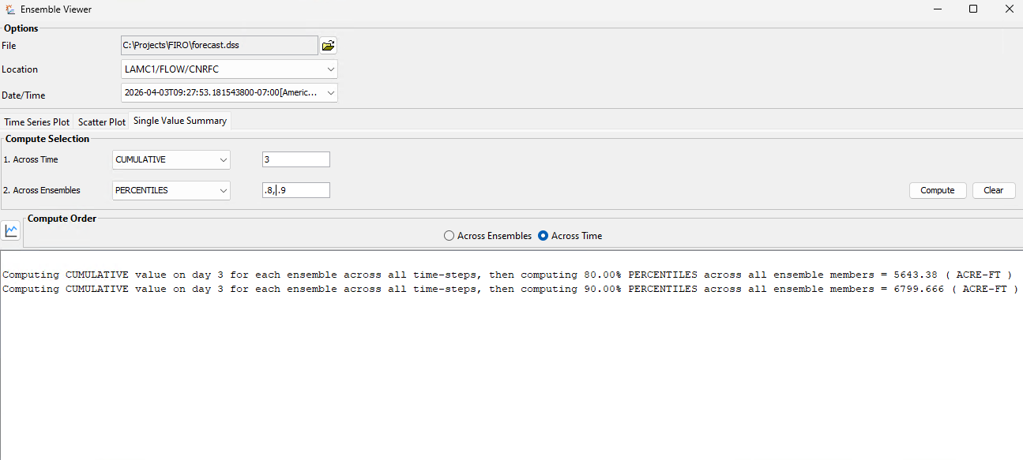
Ensemble Viewer – Single Value Summary
Notes:
Our last tab is the Single Value Summary. This compute condenses the ensembles into a single metric value by computing the metric in two directions.

Slide 21
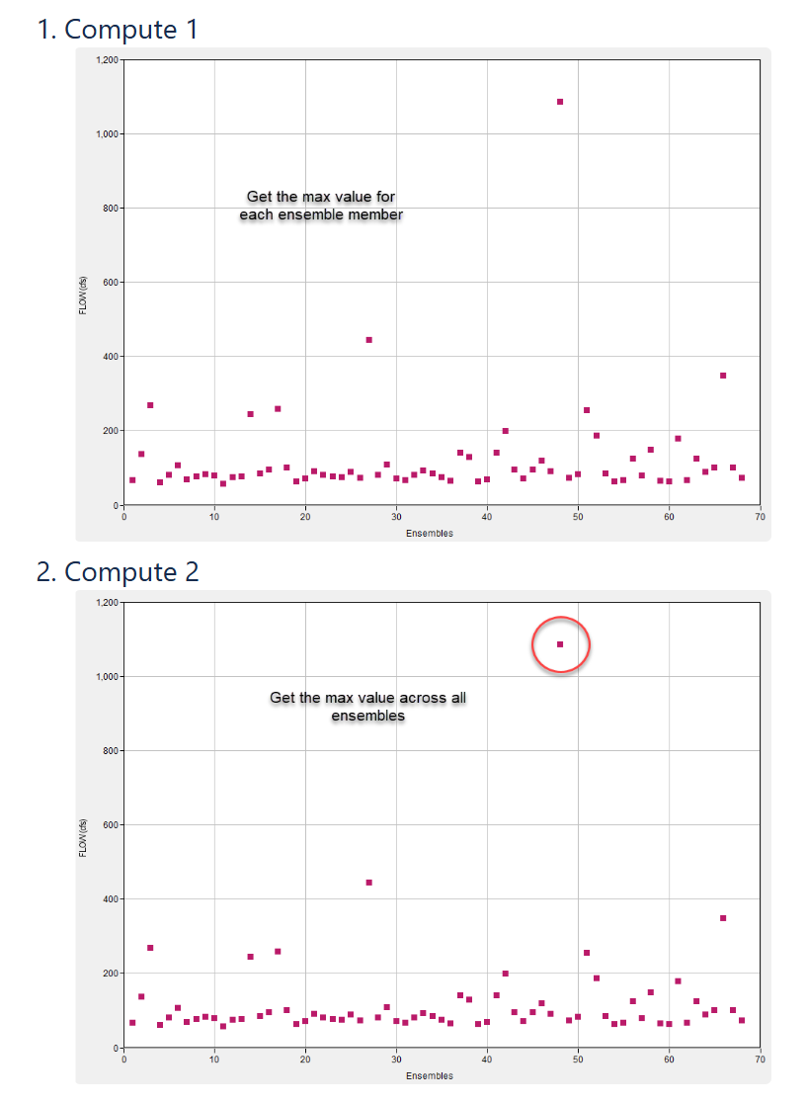
Across Time
Notes:
The Single Value Summary you can choose the direction you want to compute from. You can start with first computing across time to get a condensed ensemble metric, or you can first compute across ensembles to get a condensed metric.
For example, you can find the max value for each ensemble member (so across time what is the max value for each member), then amongst the max ensembles find the largest value. This would be a maximum of the maximums. Or you can compute the average of the maximum values.

Slide 22
Aggregating Ensemble Member Results
Future Prediction Aggregation Options in HEC-HMS
  Weighting Schemes
    User assigned weights
    Computed weights
Notes:
Our team is investigating other ways to aggregate the ensembles through weighting each ensemble separately. There are two ways we plan on handling this: first is simply allow users to specify weights. The second is computing weights based off calibration metrics using a cross correlation analysis.

Slide 23
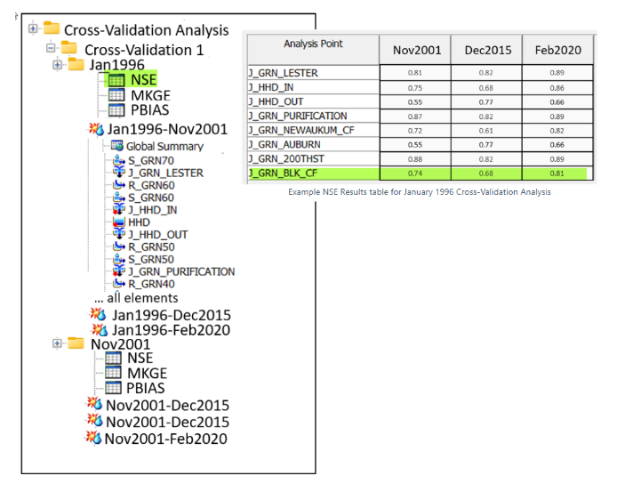
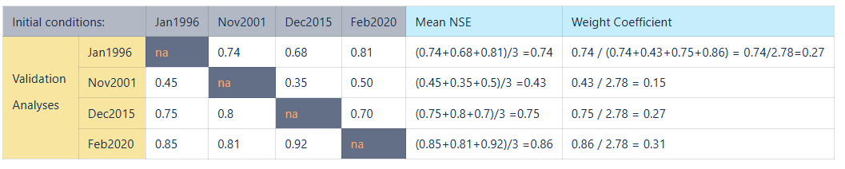
Weighting Scheme
Initial Design for Applying Ensemble Weights (still in design)
  Cross Validation Analysis
    Calibrate and compute Statistical Metrics (i.e., NSE, MKGE) for each member
    Weight each member
Notes:
This is the initial design for how you might assign computed weights to individual ensembles. The current design is to perform a cross validation analysis on calibration simulations. If you have 4 calibrated basins, you run the historic storms on each basin and get a statistical metric such as NSE or KGE. Then come up with a weight for basin model. So the Jan1996 basin would have a weight of 0.27 applied to any hydrograph that outputs from this basin model.
This is still in design so we welcome any feedback or ideas on improving this feature.

Slide 24
Ensemble Analysis Tradeoffs
Creating and running multiple models to improve prediction accuracy is good in theory, but at what cost?
  Deciding on number of basin models and meteorologic models and their combinations
  Basin model setup and calibration
  Deciding on aggregation technique
  Time and money
Notes:
What are some of the tradeoffs to using the Ensemble Analysis in HMS. At this time, it does take time to build the ensemble analysis model, especially if you’re including basin model uncertainty. You need to make a decisions on how many basin model models or met models to use. Then you need to set up the basin model and calibrate the basin model. Once you have model set up completed there’s the choice of aggregation. How do you decide on a representative ensemble. We give users all of these different options, however, these are also decisions user need to make. You come across the paradox of choice which can lead to decision fatigue. There is also the challenge of model spin up time. Most applications of ensembles are for forecasts such as real time flood operations or post wildfire analysis which require quick turn-arounds. There is an upfront cost to setting up an ensemble model. These are challenges we are aware of and investigating to make the process easier and as we have more use cases, we can improve on the pain points.
We have briefly discussed some of the advantages of ensemble modeling, now let’s look at some of the tradeoffs
Time and Money do need to be considered when weighing the benefits of an ensemble analysis
Unfortunately, most USACE studies/forecasts need to be performed quickly and typically have very little flexibility in analyzing the uncertainty of using different boundary condition data and/or different basin model configurations or parameterizations
For this reason, the principle of Occam’s razor (also sometimes referred to as the law of parsimony) typically governs our choices as H&H modelers
The modeling methods that are simple, with parameters that are few in number and simple to calibrate, that still produce generally acceptable results are the ones that are often chosen
“When faced with two equally good models, choose the simpler one.”
My argument to this quote would be ‘do we for sure know that one model, or assumption, is equally as good as another without some initial investigation first’?
While creating the multiple boundary conditions and/or basin model configurations needed to perform an ensemble analysis in HEC-HMS does take time, I think there are cases where it is absolutely warranted and where you as a modeler can gain a significant amount of additional insight and confidence for only a nominal amount of extra burden

Slide 25
References
Troin, M., Arsenault, R., Wood, A. W., Brissette, F., & Martel, J.-L. (2021). Generating ensemble streamflow forecasts: A review of methods and approaches over the past 40 years. Water Resources Research, 57, e2020WR028392. https://doi.org/10.1029/2020WR028392

Slide 26

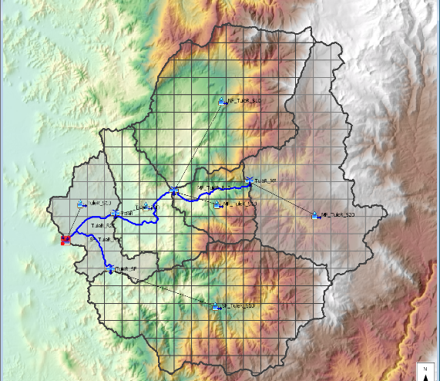

Questions?
Check out our Confluence for tutorials, user’s manual, and webinars
https://www.hec.usace.army.mil/confluence/hmsdocs
Notes:
Example Questions Slide with HEC logo

Slide 27
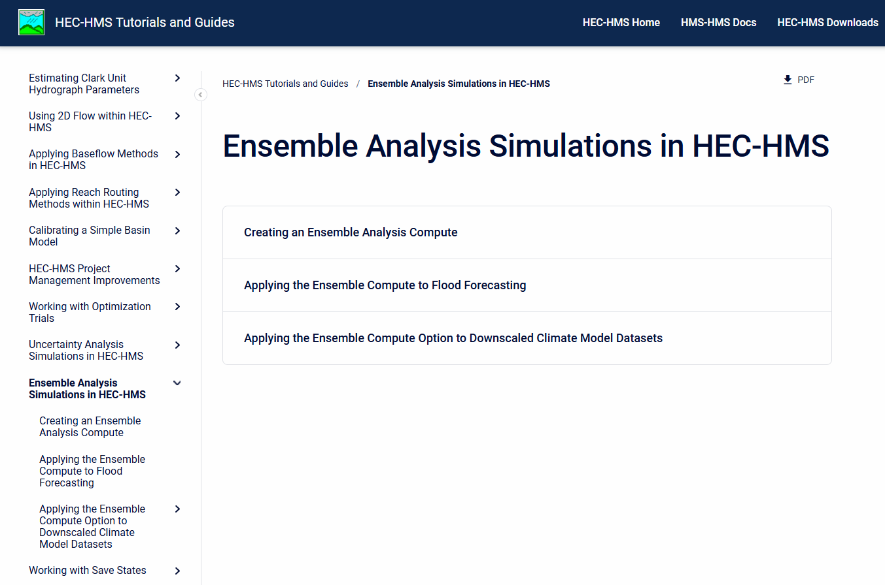
Ensemble Analysis Demos
Ensemble Viewer Users Guide - HEC-WAT Plugin Documentation - HEC Confluence (army.mil)
Notes:
Here is the tutorial and guide page on our website
There are several guides specifically geared towards ensemble analyses
I will now be doing a live demo and will walk you through the “Applying the Ensemble Compute to Flood Forecasting” tutorial and guide
You may watch me perform the demo, or you may download the tutorial and follow along with me on your own computer if you prefer

